Slide 1
Affordable Housing Units (Case study Gaza Strip)
Name Husam Qissi
Mojahed Mostafa
Rajai Awwad
Sae’d Allosh
Supervised by: Eng. Rema Nassar

Slide 2
Outline
Overview
Containers House
Steel House
Timber House
Thermal Insulation
Conclusion
Recommendations

Slide 3
Overview
What was graduation project 1 about ?
What have we done in graduation project 2 ?

Slide 4
Video

Slide 5
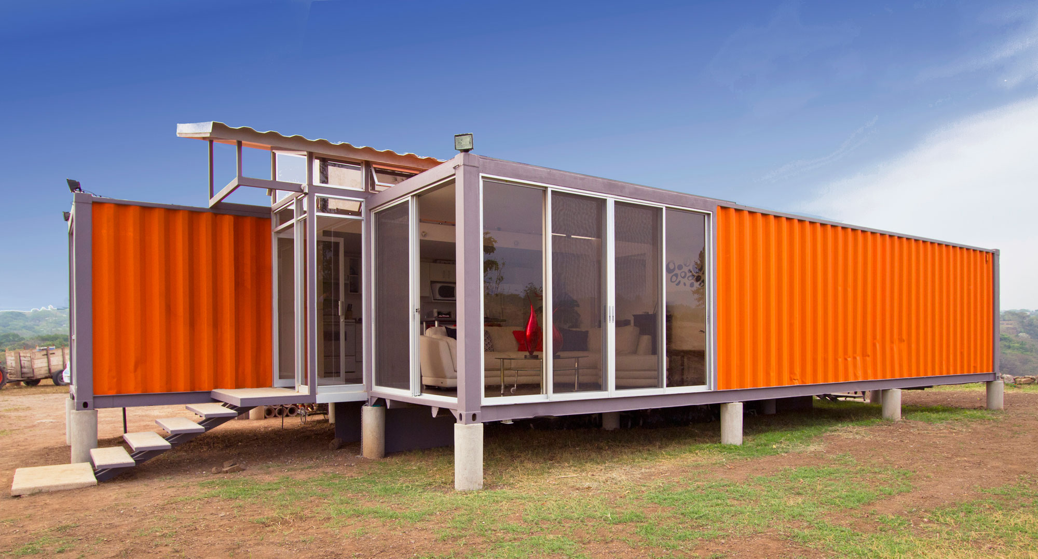
Container House

Slide 6

What is Intermodal Container ?

Slide 7

Why to use ?

Slide 8

1-Affordability

Slide 9



2-Short Time

Slide 10
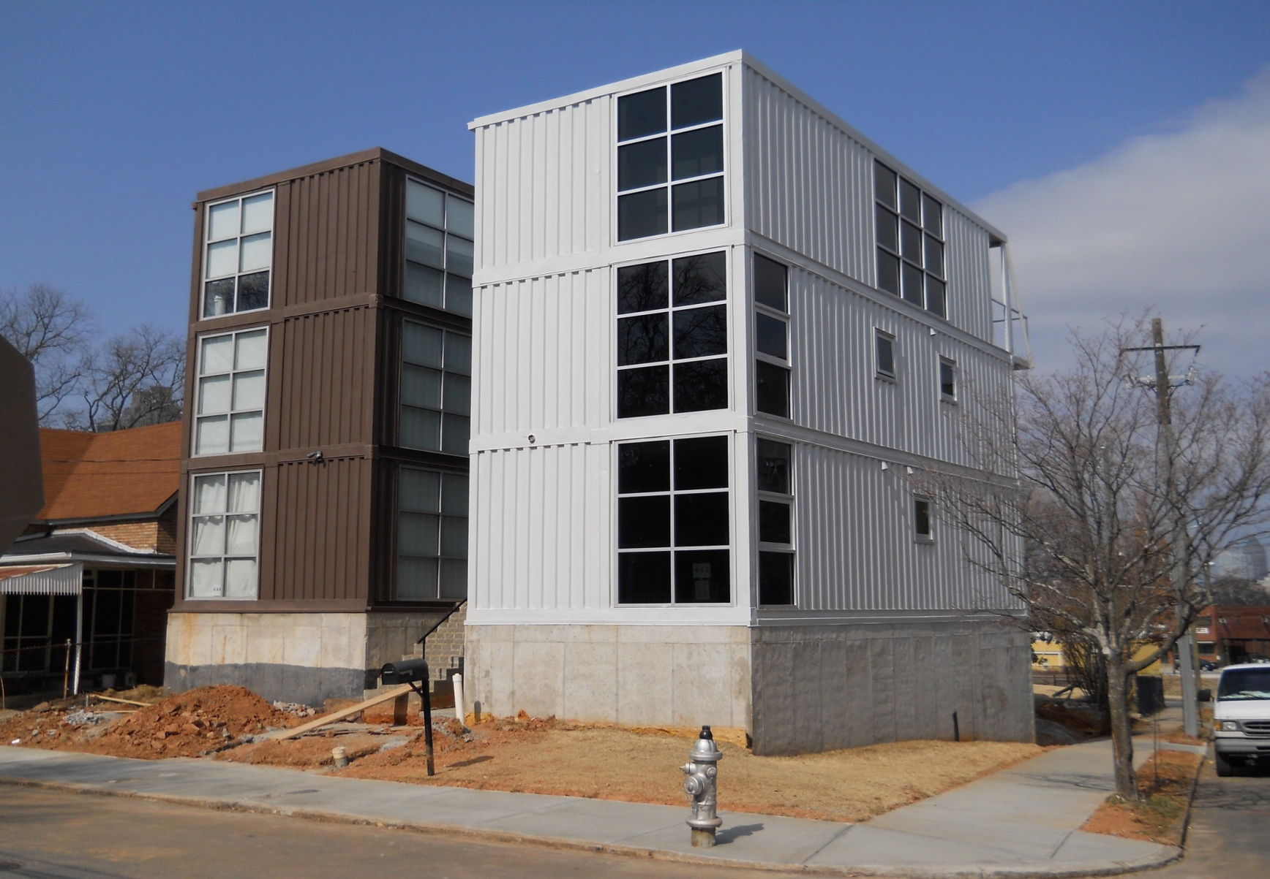
3- Design and Strength

Slide 11
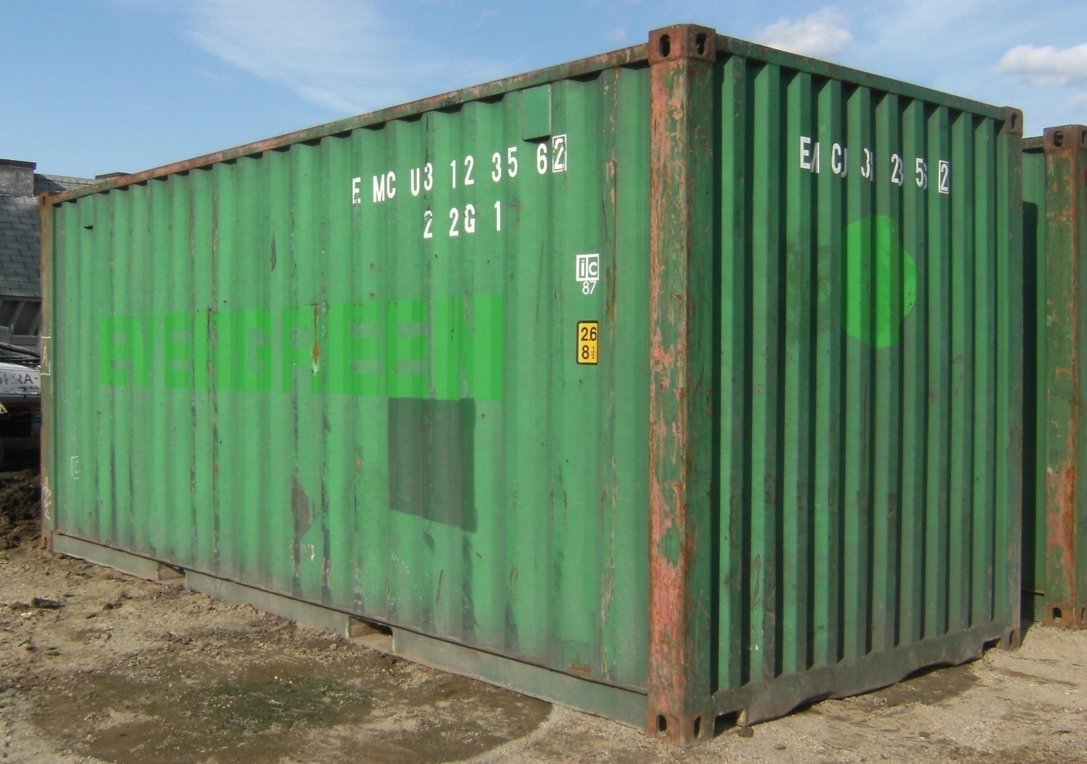
4-Green

Slide 12
Architectural Design

Slide 13
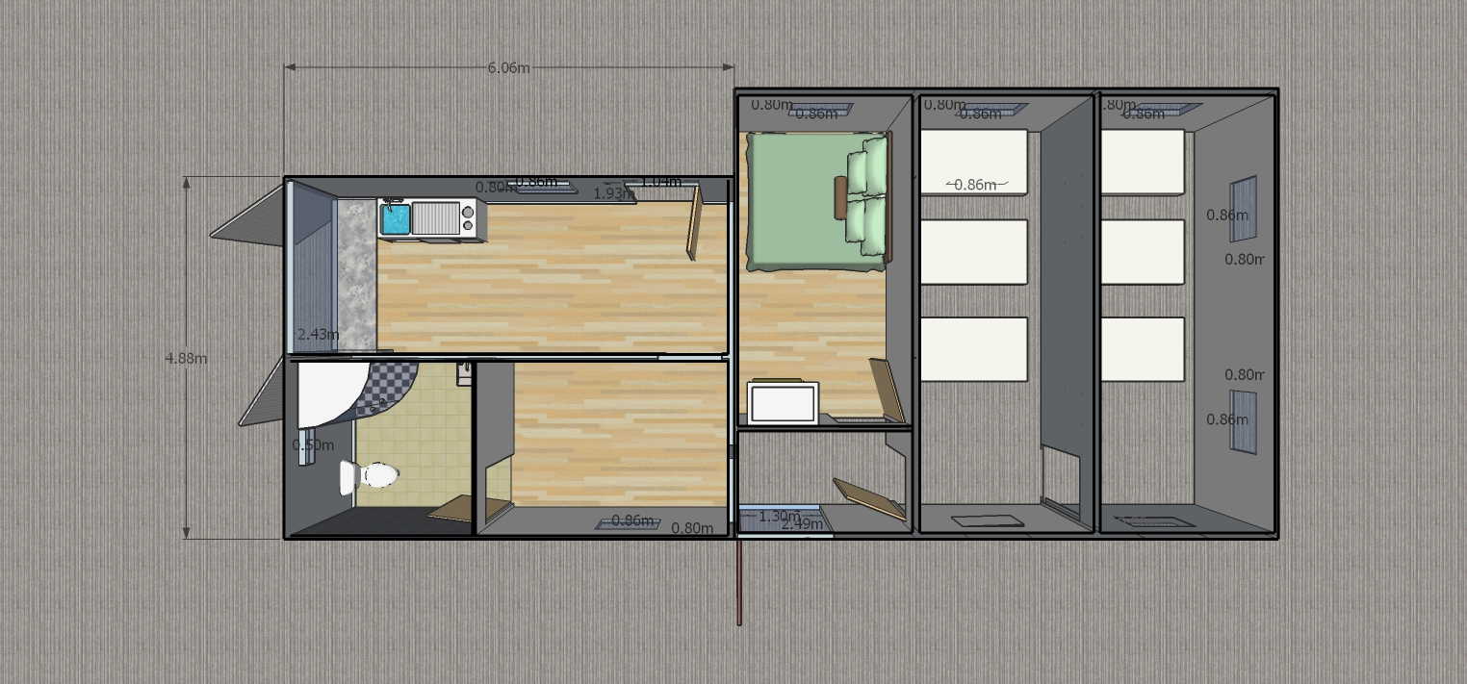
Top View
Five 20 foot containers
Area of the unit = 80m2

Slide 14
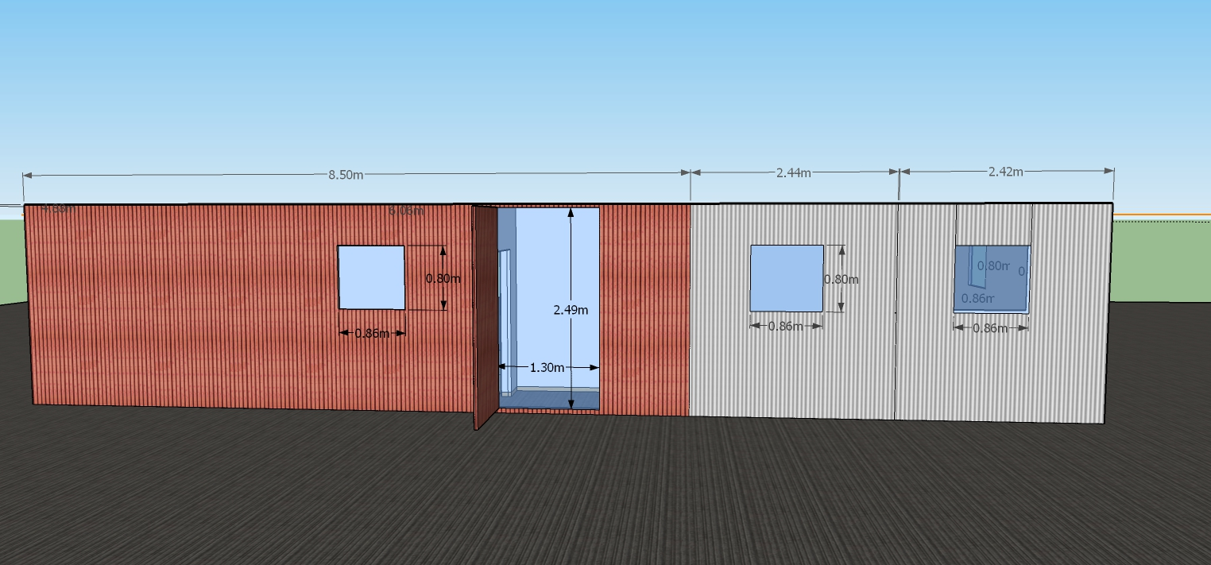
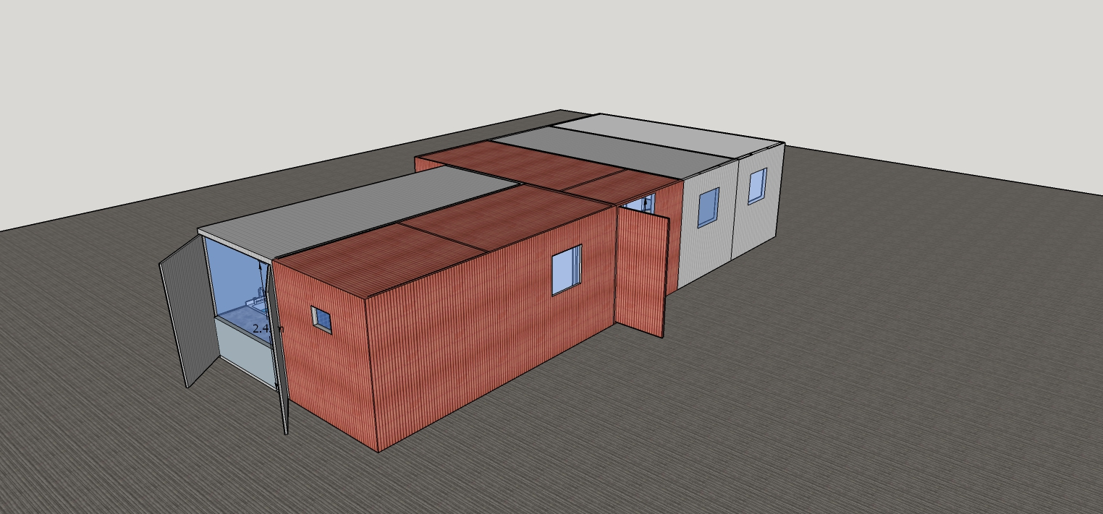
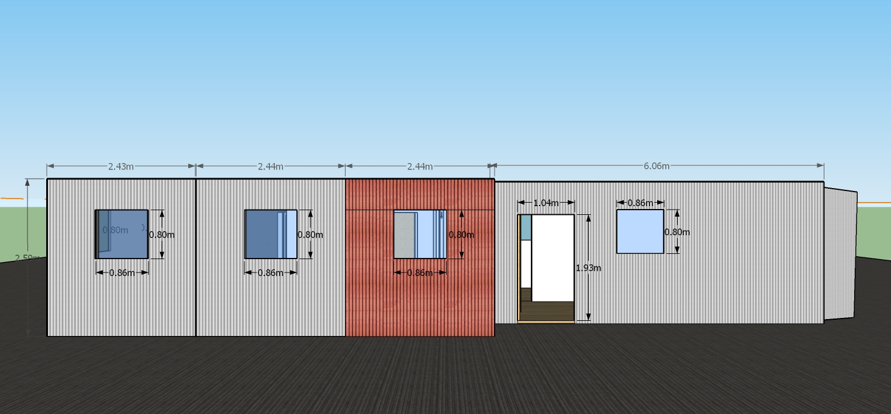

Slide 15
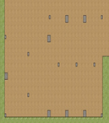
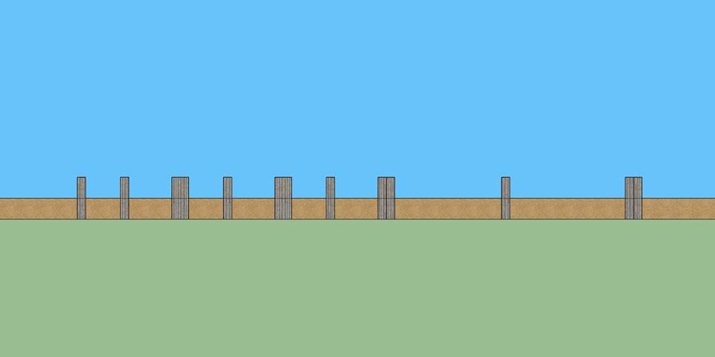
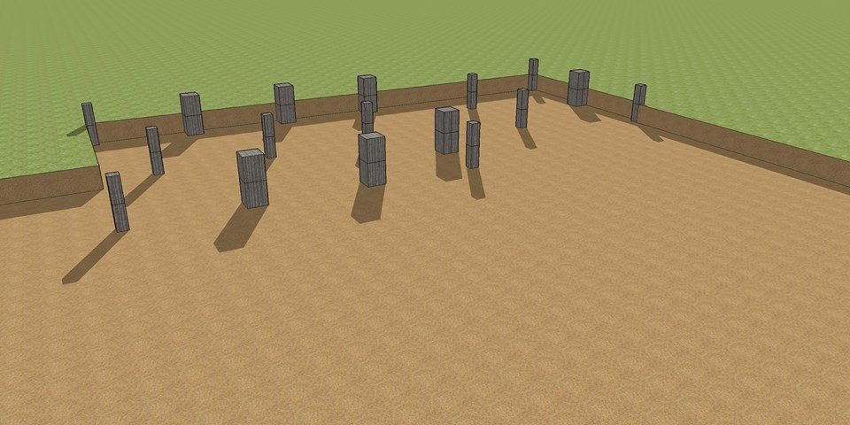
Structural Design
Footings layout
0.2*0.2m, 0.4*0.4m

Slide 16
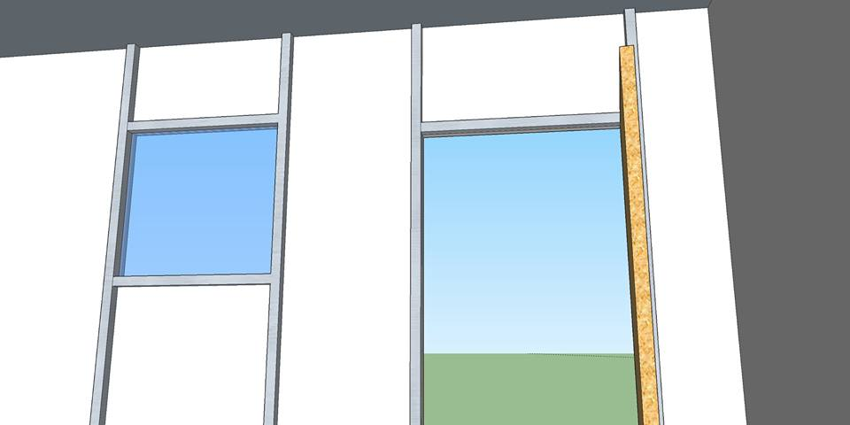
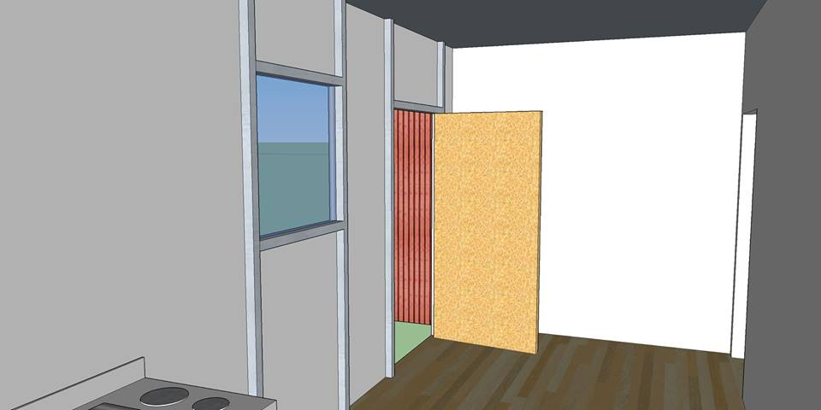
Supporting System

Slide 17
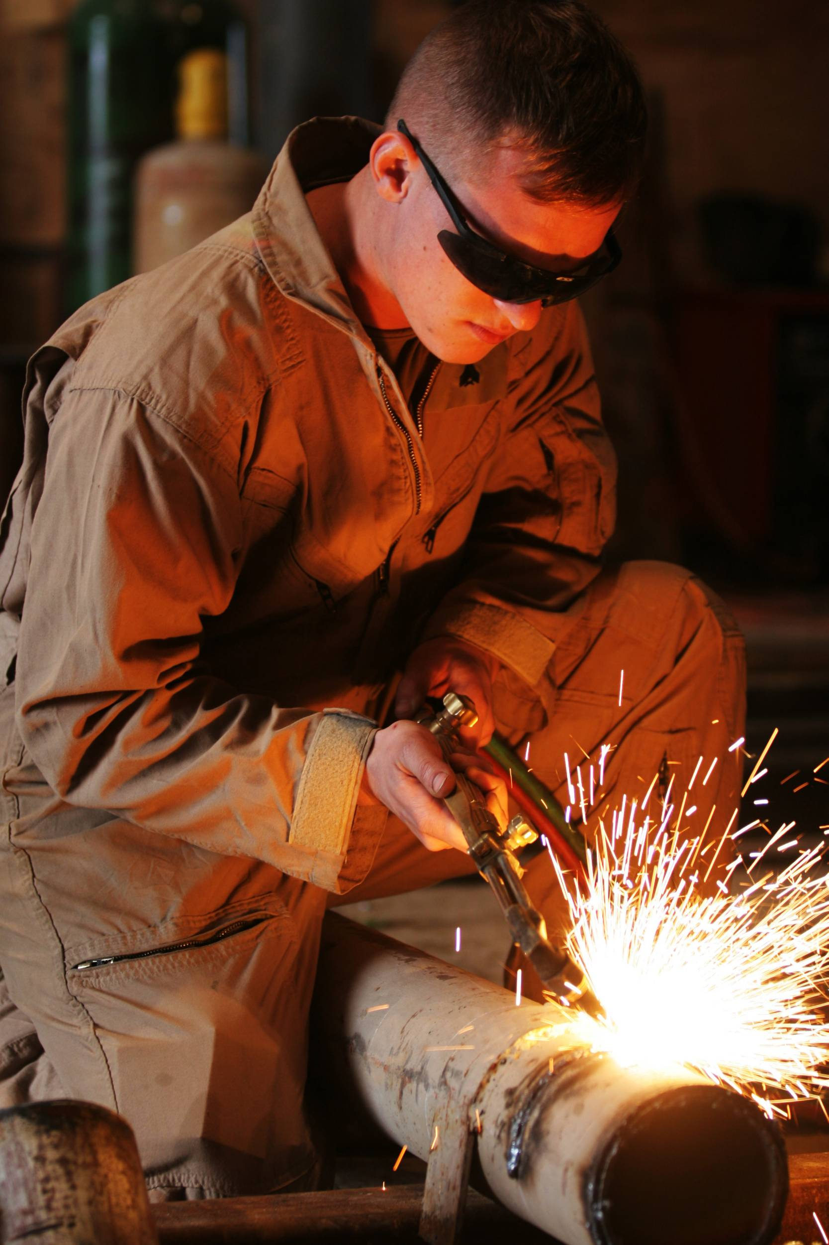
Modification Process

Slide 18
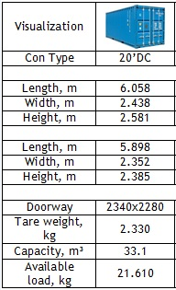
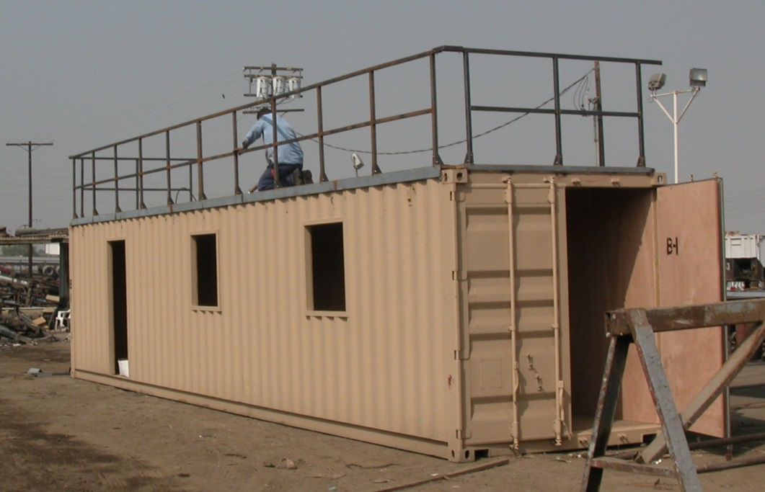
Does the process of cutting panels have a limit ?

Slide 19
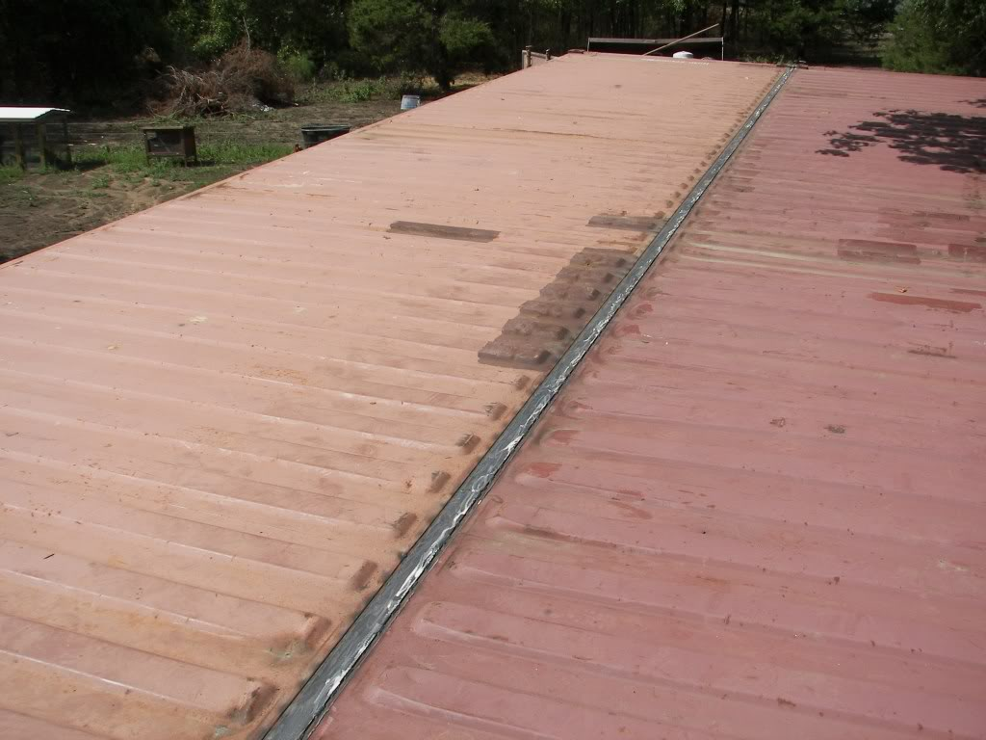
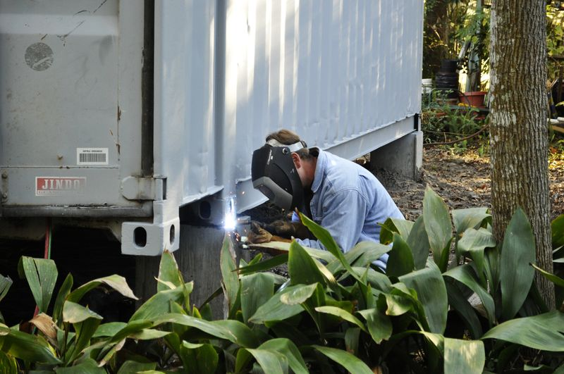
Welding

Slide 20
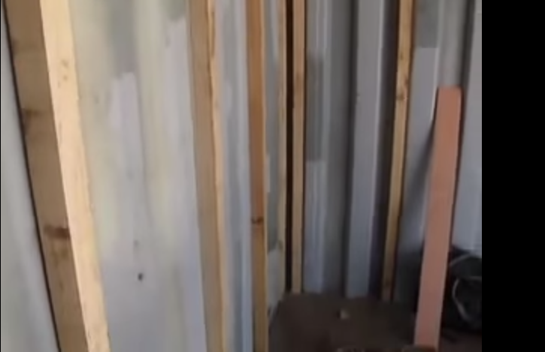
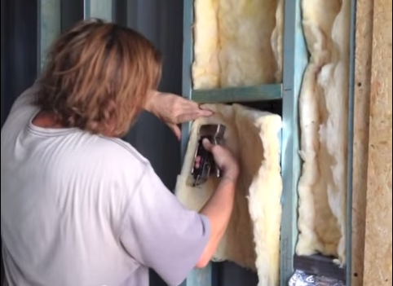
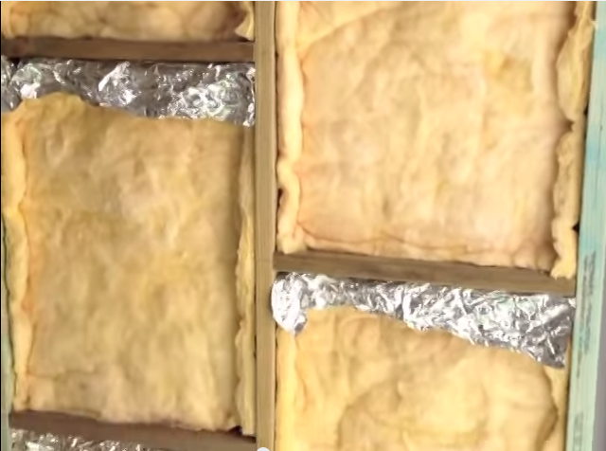
Thermal Insulation

Slide 21
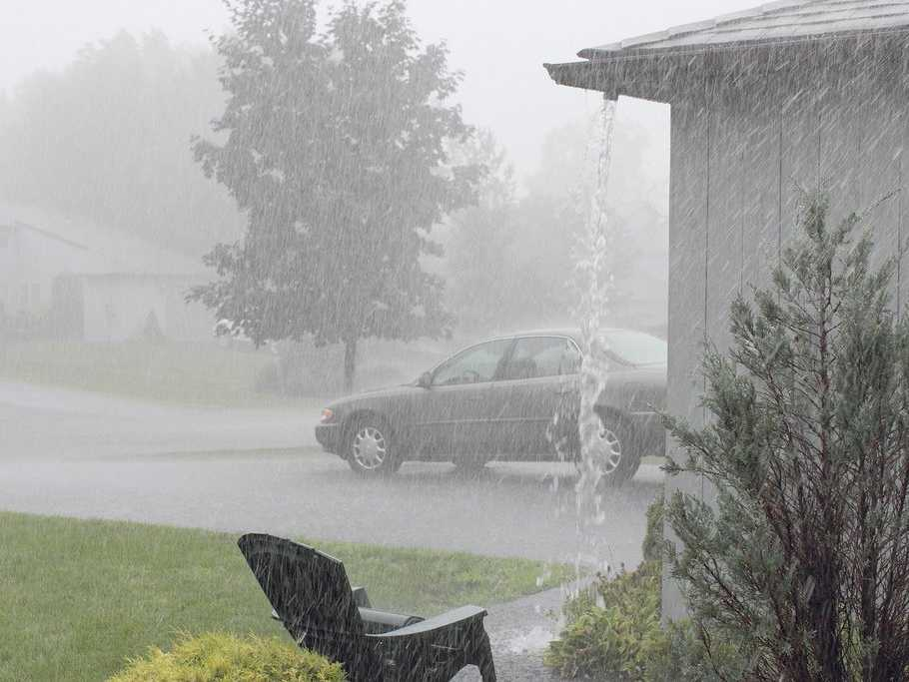

Rain Noise!

Slide 22
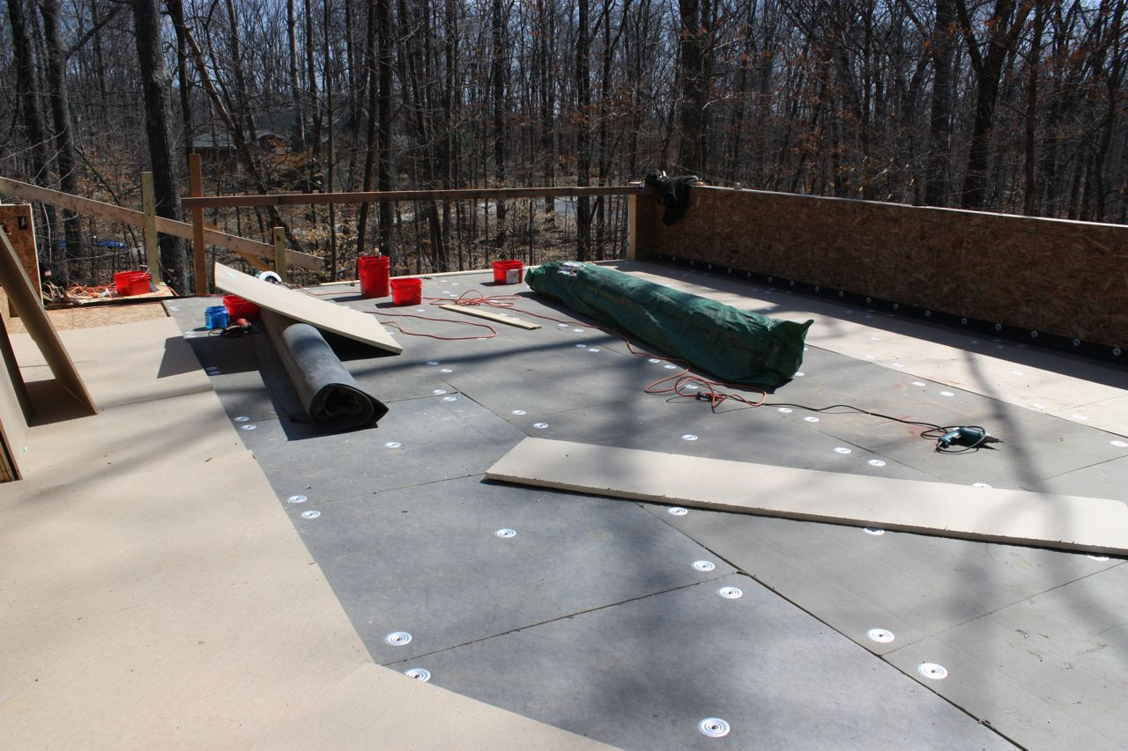
Rubber Beds

Slide 23
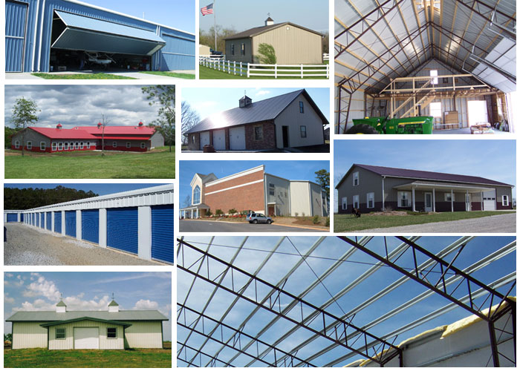
Steel House

Slide 24
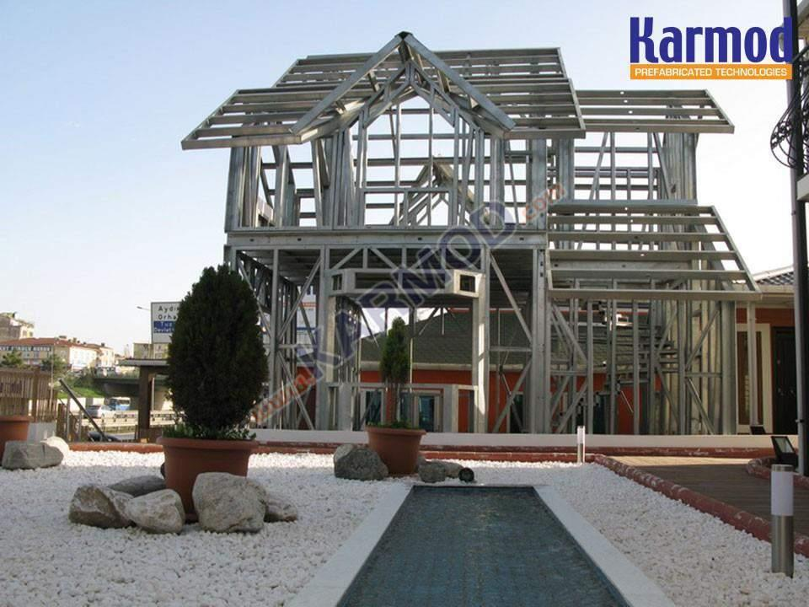
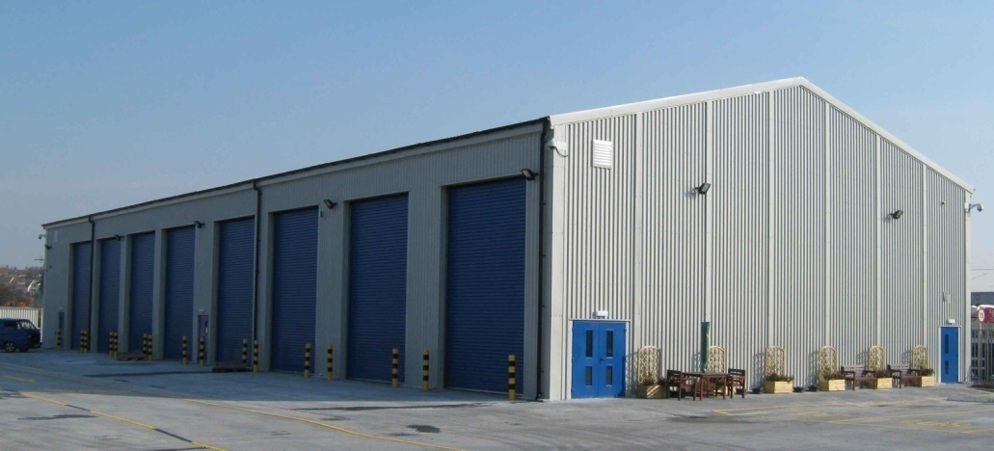

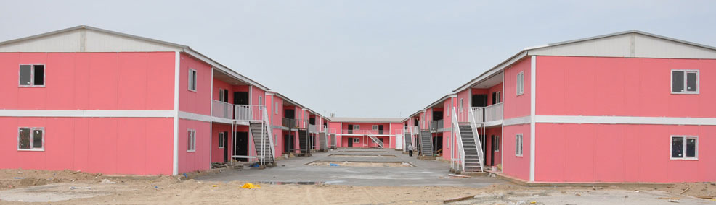
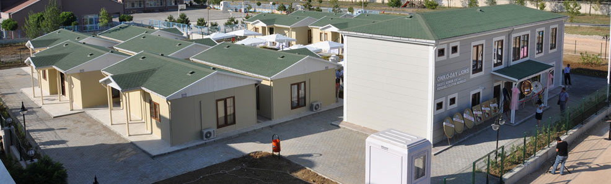
Why steel ?

Slide 25

Time :it has a great ability to minimize the construction implementation time .
Strength : Steel has a high strength/weight ratio Thus, the dead weight of steel structures is relatively small and gives more resistance to earthquakes
Construction Time

Slide 26
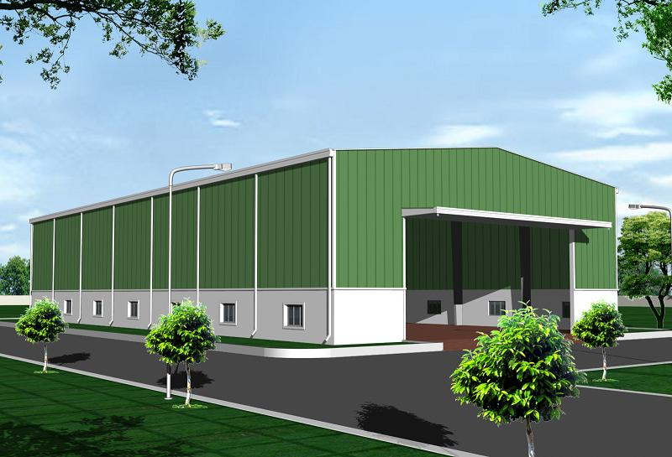
Strength/weight

Slide 27
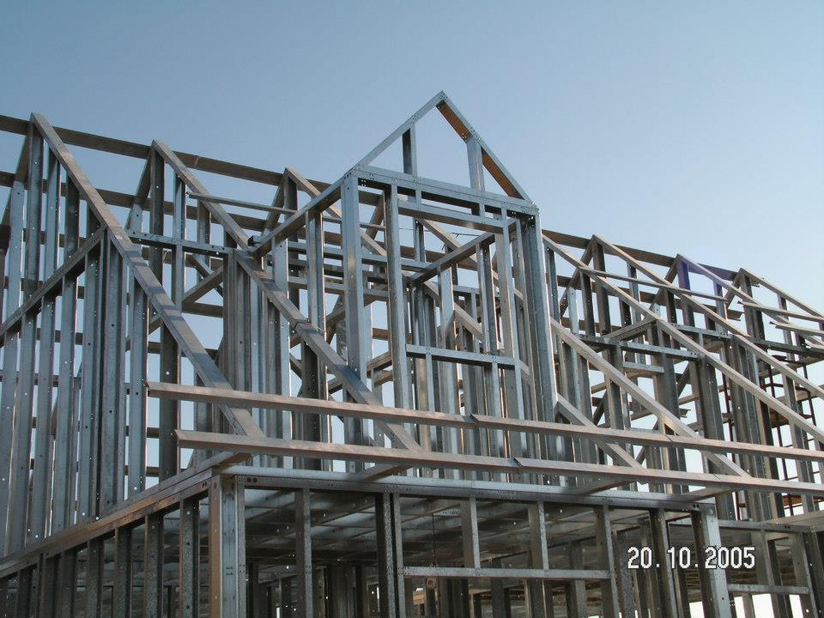
Reusable

Slide 28

Water Resistant

Slide 29

Fire

Slide 30
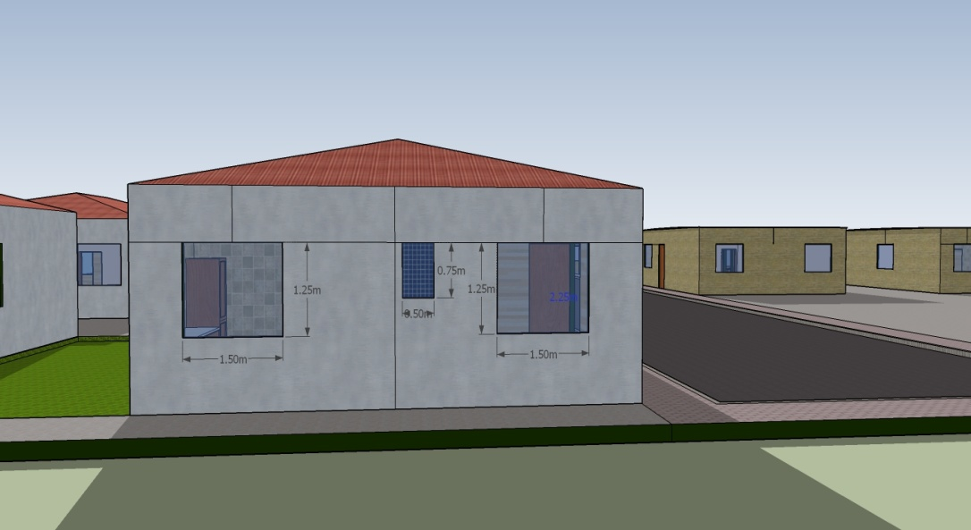
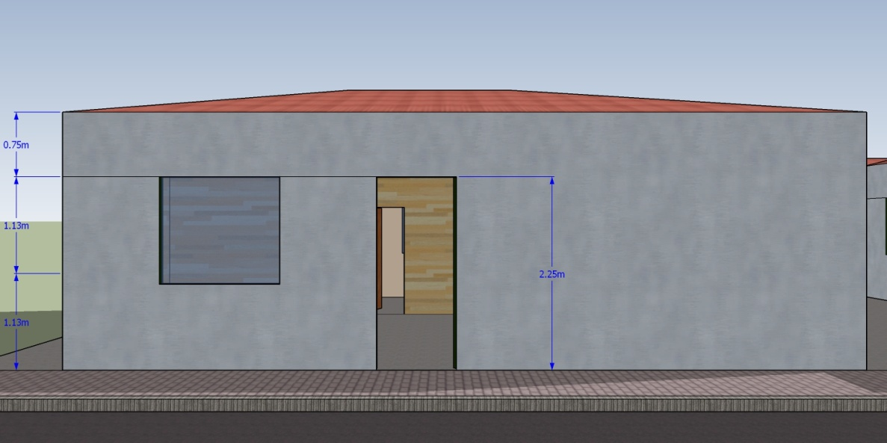
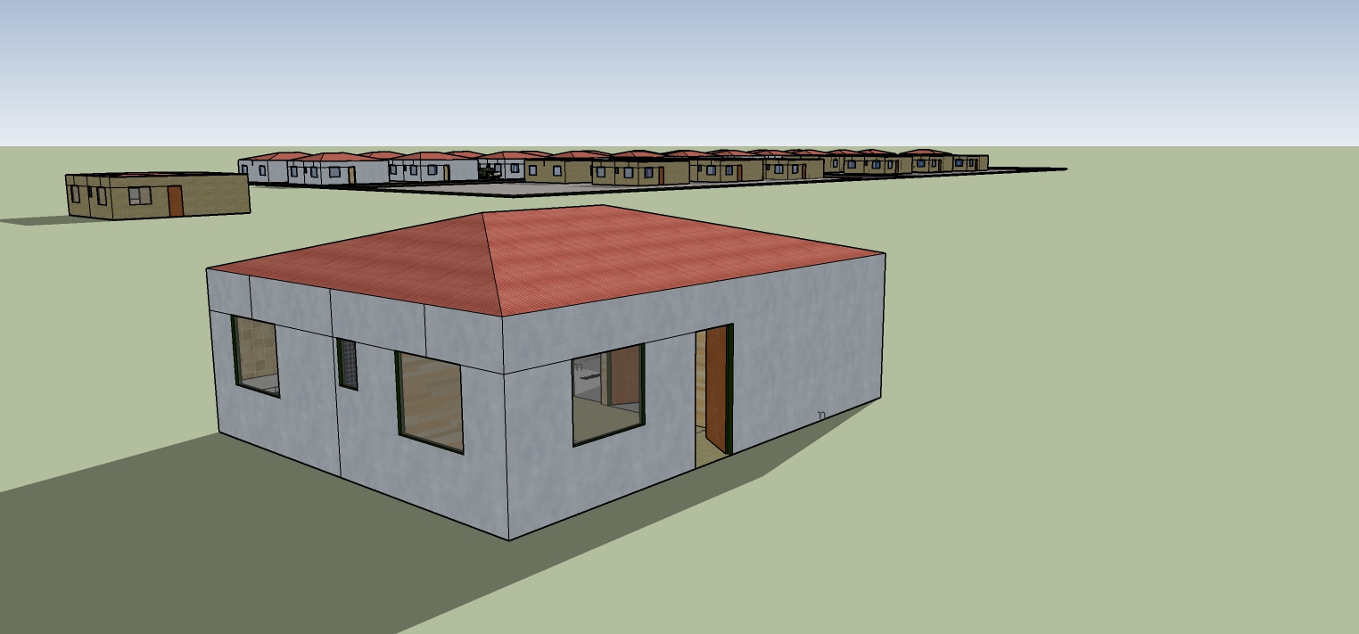
Architectural Design

Slide 31
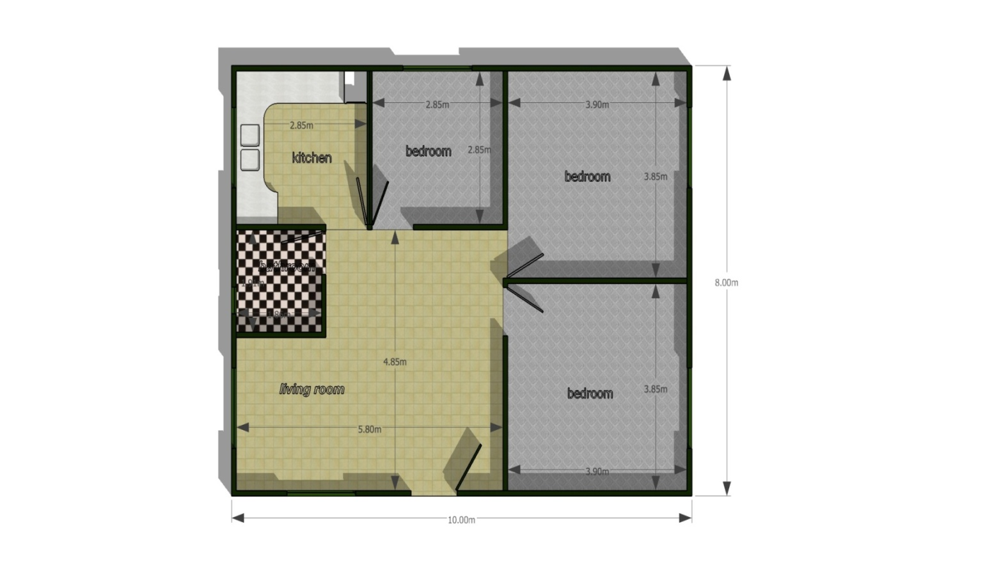
Architectural design

Slide 32
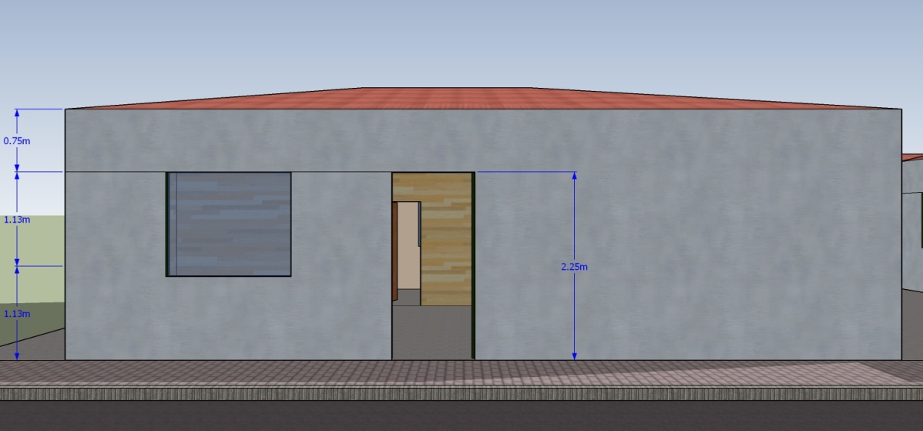
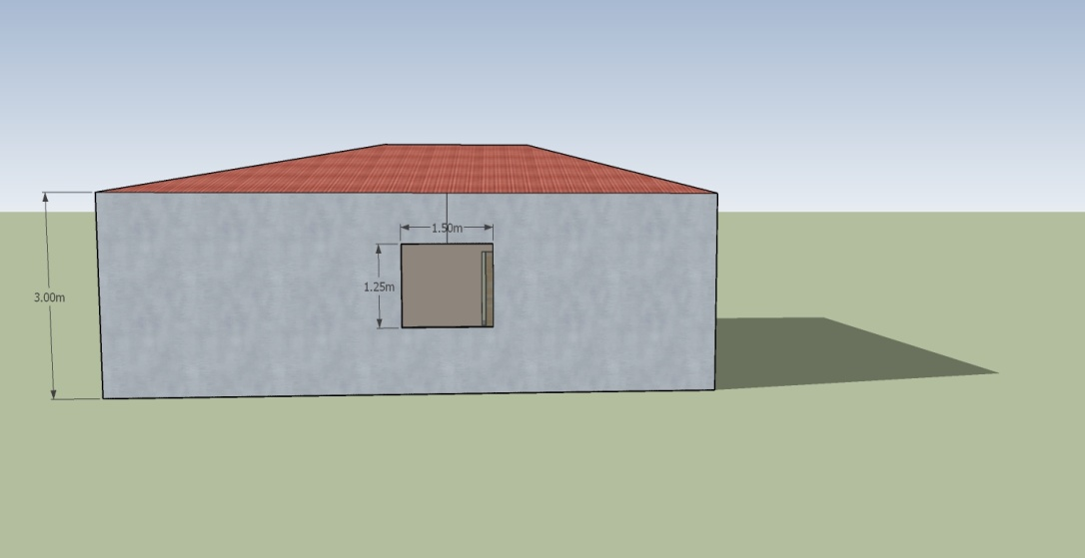

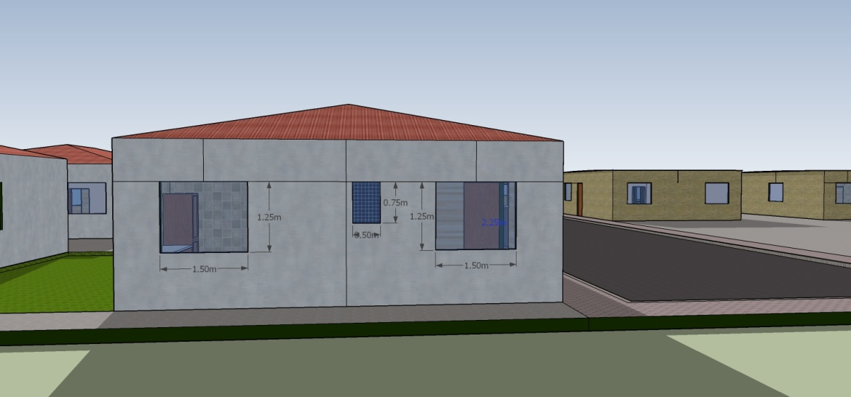
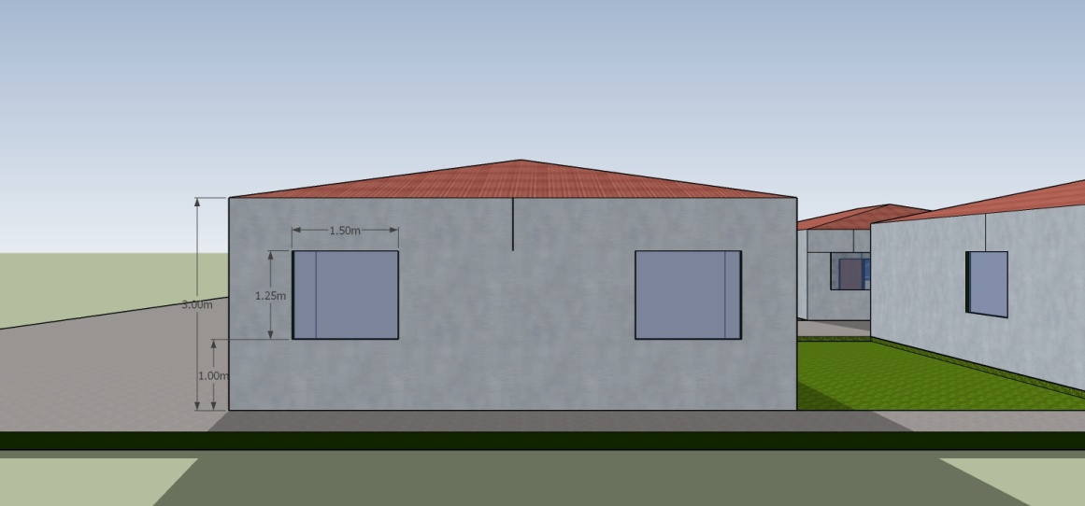

Slide 33
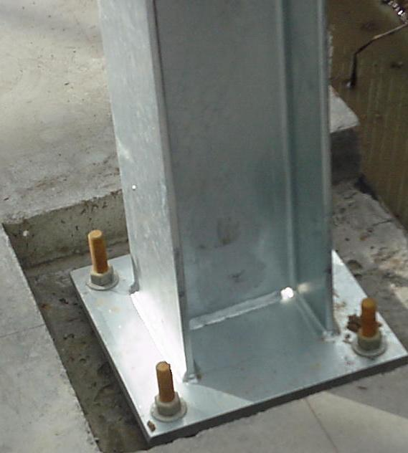
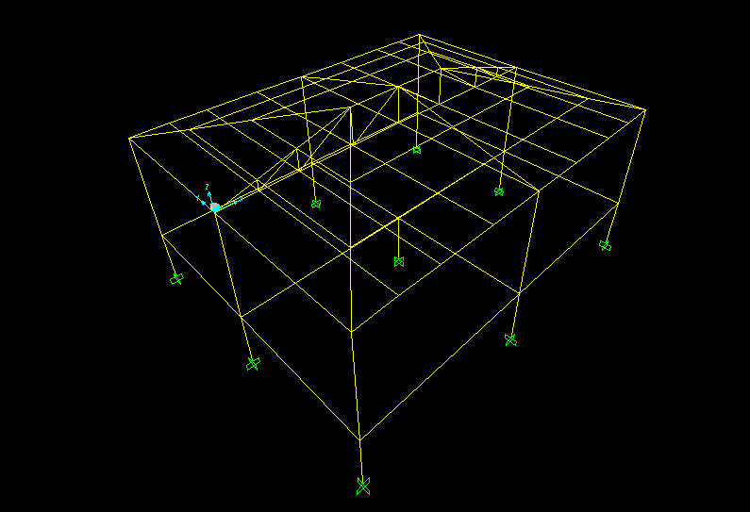
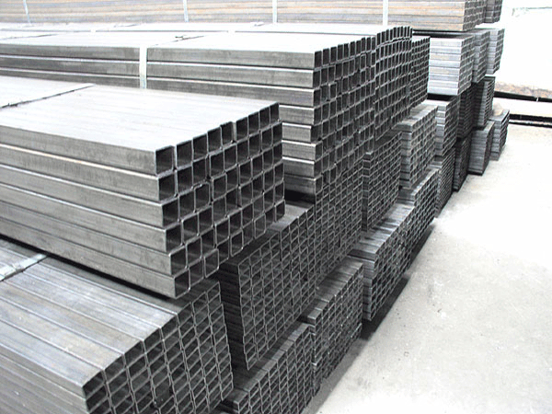
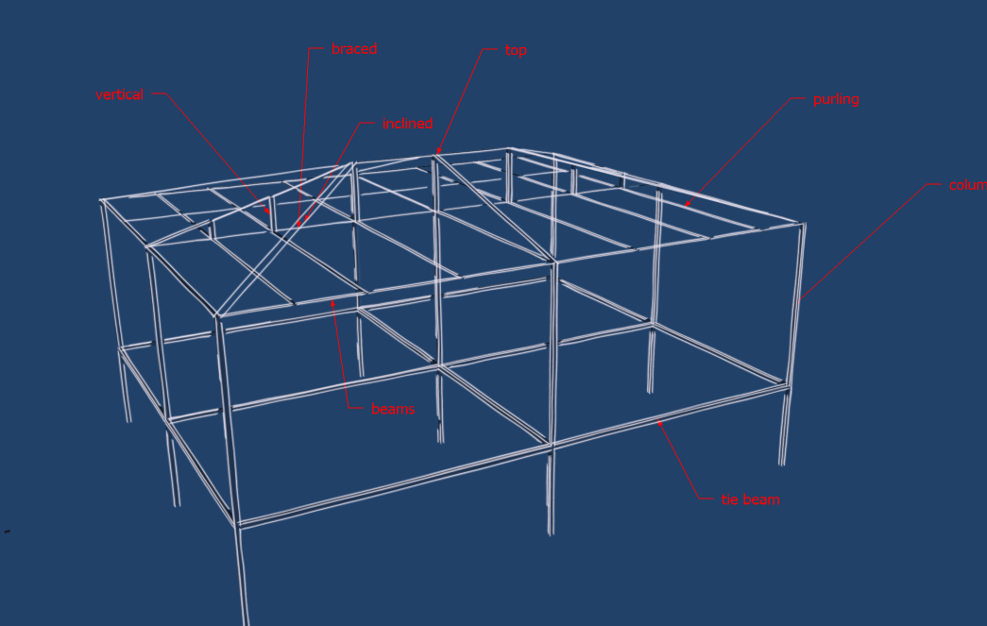
Structural Design

Slide 34
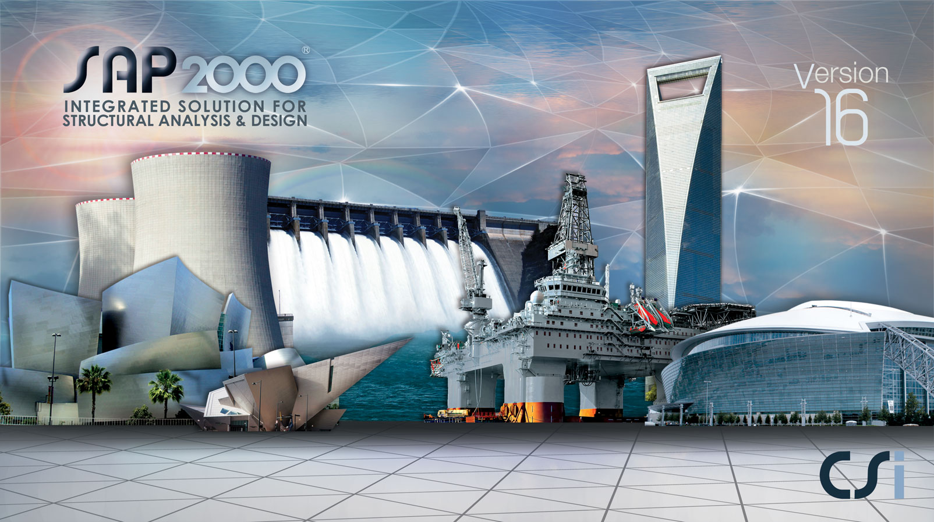
Methodology

Slide 35
SAP Model
This figure shows the model of the house used in sap 2000

Slide 36
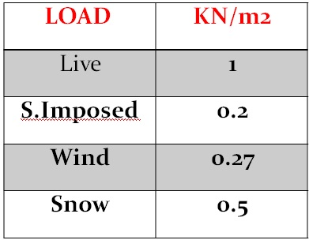
Load Calculation

Slide 37
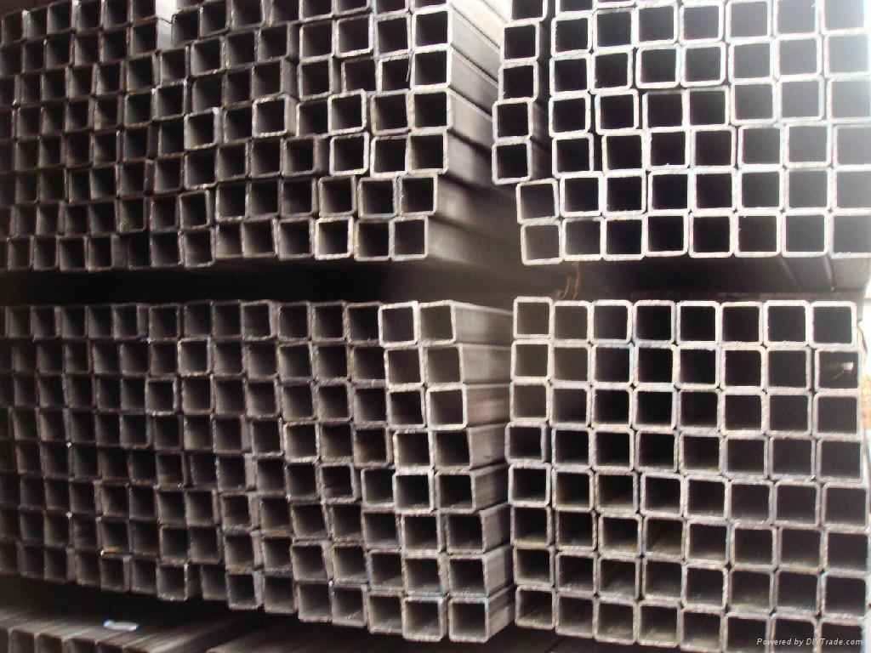
A36 Steel
Hollow Section

Slide 38
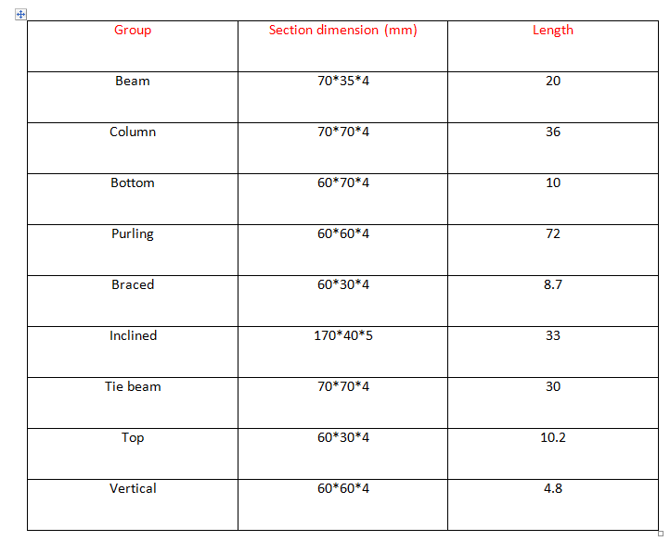

Slide 39
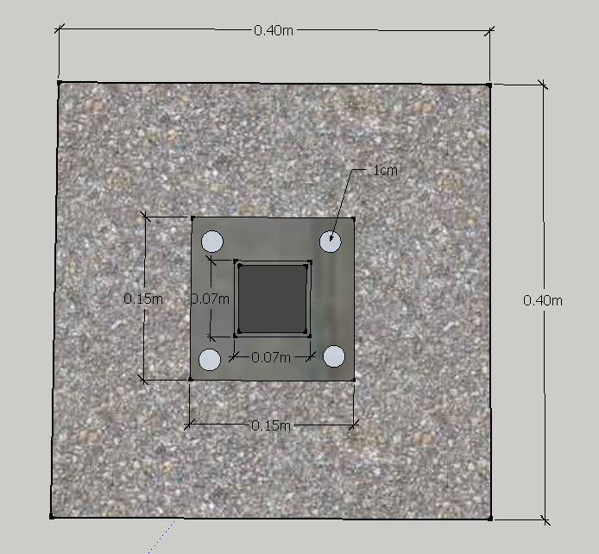
Footing design

Slide 40
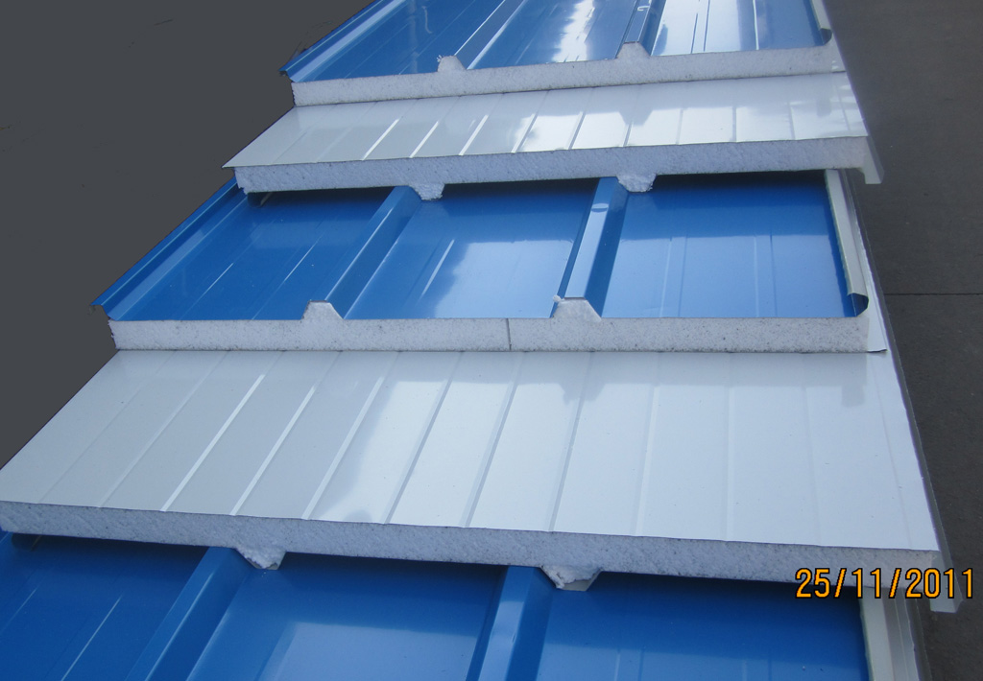
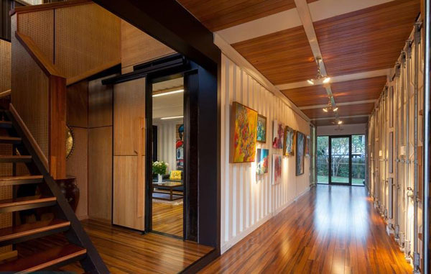
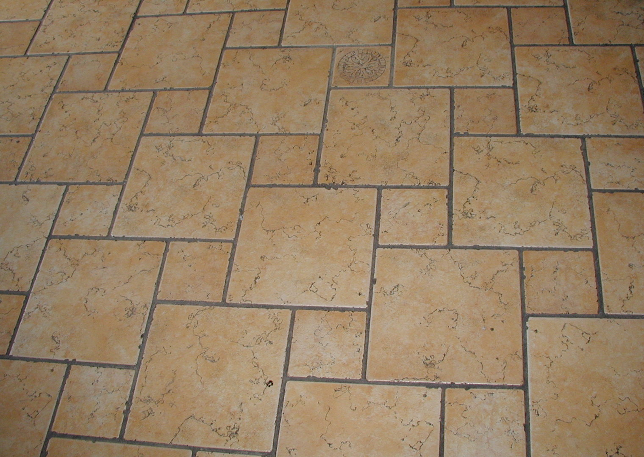
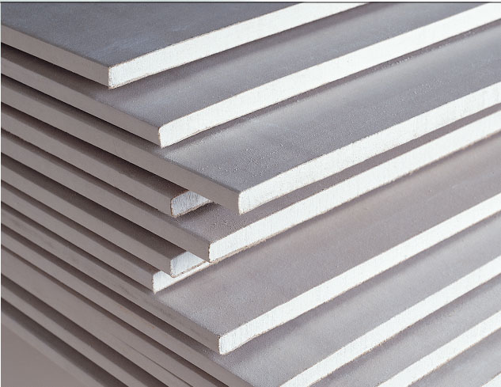
Technical Specification

Slide 41


Slide 42


External Panel and Roof
Sandwich Panel

Slide 43


Slide 44

Suggested types

Slide 45

Timber House

Slide 46

Introduction
Timber houses are not common in Arab world

Slide 47

Advantages
Timber house is considered as energy efficient
Economically efficient because the way of construction
High strength of timber as construction material

Slide 48

Disadvantages
Need to maintain timber house in short time relatively
Might be attacked by biological agents and non biological agents

Slide 49

Architectural Design
Area of each unit 80 m²

Slide 50

Structural Design

Slide 51

Structural Design

Slide 52
Structural Design
Footing
  Blending from concrete was used as footing with thickness of 20 cm.

Slide 53
Technical Specifications
External panel
Internal panel
Tiles
Roof cover
Doors & windows

Slide 54
External Panel
  Swedish wood for external side of the panel
  Glass wool insulation is used for external panel
  Thin wood will be used for intern

Slide 55
Roof Cover
Sandwich steel panel was used as roof cover.

Slide 56

Internal Panel
Gypsum board was used for internal partitions.

Slide 57

Tiles
Tiles (بلاط بلدي) was used.

Slide 58

Doors & windows
Internal doors and windows were from aluminum material.

Slide 59
Thermal Insulation

Slide 60

Ways of Heat Transfer
Conduction

Slide 61

Ways of Heat Transfer
Convection

Slide 62

Ways of Heat Transfer
Radiation

Slide 63
Thermal Insulation
Definition: The reduction of heat thermal energy transfer between objects of different temperature which are in direct contact or in range of radiation effect.

Slide 64
Thermal Insulation Types
Glass wool
Rock wool
Polyurethane Sprayed Foam
Cotton Batts
Gypsum Boards

Slide 65
Steel House Insulation
The steel house is made of sandwich steel material which is already insulated with Sprayed foam

Slide 66
Timber and Containers house insulation
Glass wool is used for insulating the external panels of the timber and containers house

Slide 67

Installation of glass wool

Slide 68
Results

Slide 69

Conclusion

Slide 70
Recommendations

Slide 71
Recommendations
The labor and materials costs were taken based on construction of one unit from Tulkarm and Nablus cities.
Building multi units of any of the alternatives will drop the cost per unit.
Building thousands of units requires manufacturing plants near the location of building.

Slide 72
Recommendations
The distribution of the residential blocks and units should not constrain the rebuilding process.
ruins of the destroyed houses should be used.
A water tank for each unit should water supply.

Slide 73
Recommendations
If the construction time period is the most critical factor a steel house and container house are recommended. If the initial capital cost is the most critical factor then the steel house is recommended.
Design review should be made.

