Slide 1

An-Najah National University
Faculty of Engineering
Civil Engineering Department
“Structural Analysis and Design of Faculty of Law”

Slide 2
Graduation Project Report I
Analysis and Design of Faculty of Law

Slide 3
Prepared By:
Ali Darawshah
Shahd Suleiman Samara
Taimaa Waleed Abd AL - Razeq

Slide 4
Under supervision:
Dr.Mohammad Samaaneh

Slide 5
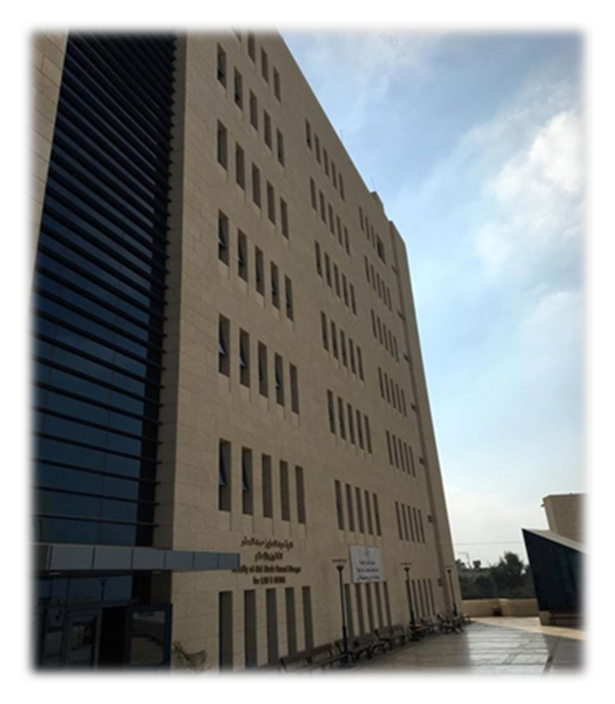
Outline
1 Introduction
2.
Review of 3D modeling
3.
Seismic Design
4.
Final Design and details
5
Conclusion

Slide 6
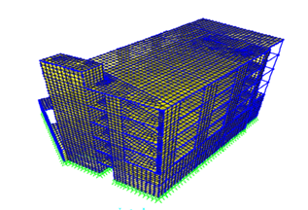
Introduction

Slide 7
Faculty of Law
This project is concerning with faculty of law which is
constructed in 2015.
This building is a reinforced concrete structure that consists of two building blocks, the first block consists of basement floor, and the second part consists of seven floors with total area of (5089.28 ) m².

Slide 8

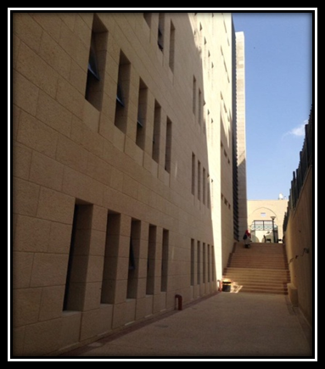

Slide 9
Architectural Description
Architectural plan for basement floor

Slide 10
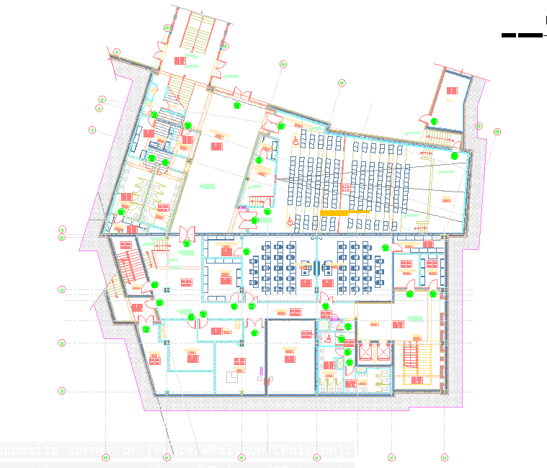

Slide 11
Structural description
In the building consists of two blocks. The first block designed as two way U-boot system and the second designed as one way solid slab.
The materials used in this project are Concrete with f ̀c= 28Mpa and steel with F_{y} = 420Mpa.
Soil properties:
The bearing capacity of the soil in the region is estimated to be 2.80Kg/cm³ .

Slide 12
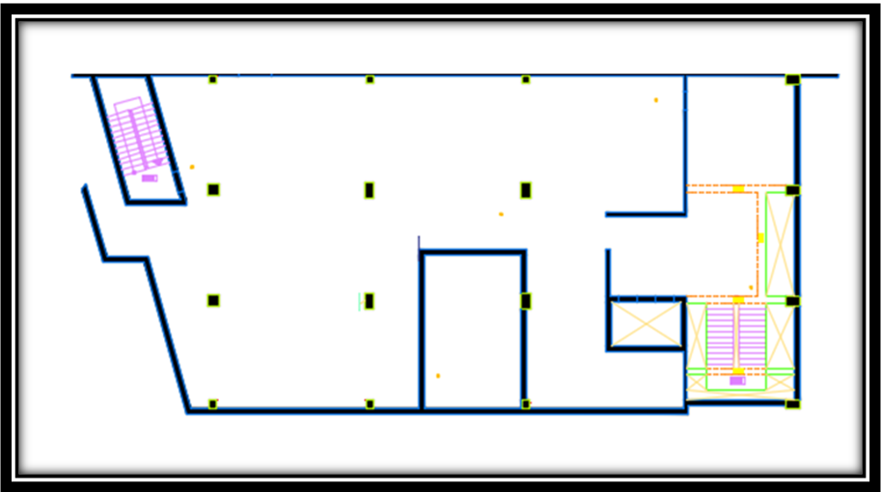
Block One

Slide 13
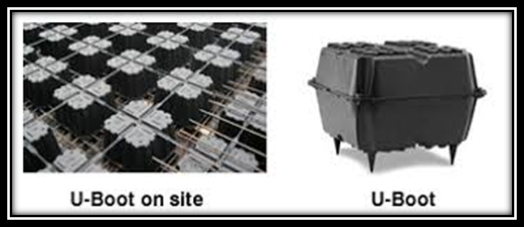
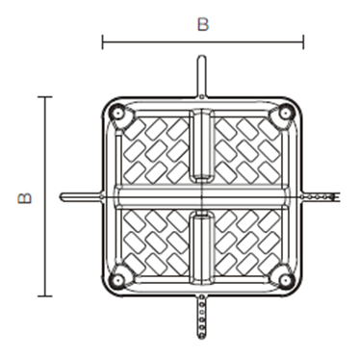
U-boot slab for the first block :

Slide 14
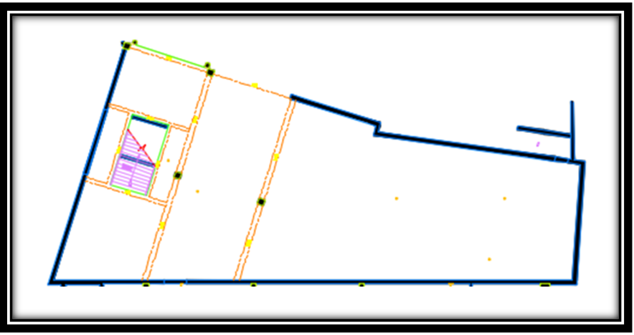
Block Two

Slide 15
The Codes Used in This Project
The Codes used in this project are the following :
1
  IBC2015 (International Building Code).

Slide 16
Load Types
Live Load.
Superimposed load.
5kN/ m²
4.59kN/ m²
Dead Load.
Tiles
Seismic Load.
Mortar & Filling
Plaster
Partitions

Slide 17
Loads:
During the design process of this project different types of loads were considered to get the critical design results, loads are divided into two categories, gravity and lateral.
Dead load
Deal load refers to loads that relatively don’t change over time

Slide 18
Superimposed load.
S.I = plastering +filler +tiles +mortar +partitions weight.
Where, Partitions weight (block, wood, gypsum…) ≈1kN/ m²
Super imposed dead loads (S.I.D)
= (0.12*16) + (0.03*23) + (0.03*25) + (0.01*23) + 1 =4.59kN/ m²

Slide 19
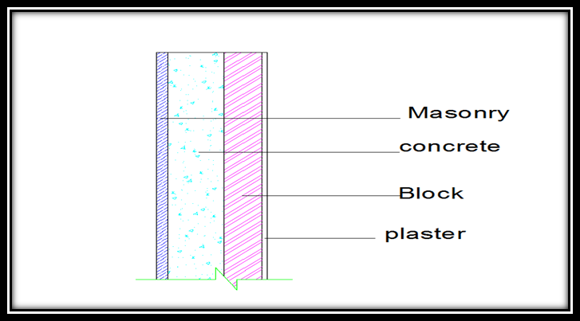
Wall cross section

Slide 20

Wall weight:
Wall weight = (0.03*27) + (0.15*25) + (0.1*12) + (0.015*23)
=6.105 * 4 = 24.42 kN/ m²
For Wall weight of the Roof = 6.105* 3.2 = 19.536 kN/ m²

Slide 21
Snow Load.
Snow load is the downward force on a building's roof by the weight of accumulated snow and ice.
Ɣ for snow = 3 kN/m³
We consider the thickness of snow = 0.5 m
Ws= 3*.5= 1.5 KN

Slide 22
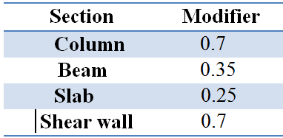
Modifiers and Loads Combinations

Slide 23
EARTHQUAKE LOADS
The magnitude earthquake load depends up the mass of the structure, the stiffness of the structural system and the acceleration of the surface of the earth. It can be seen that the application of these two types of loads is very different.

Slide 24
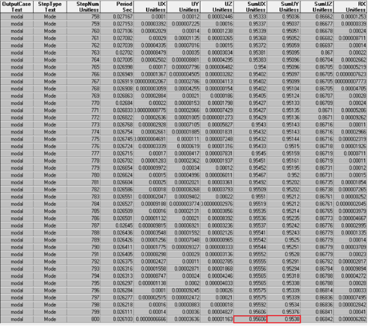
Modal participation ratios.

Slide 25
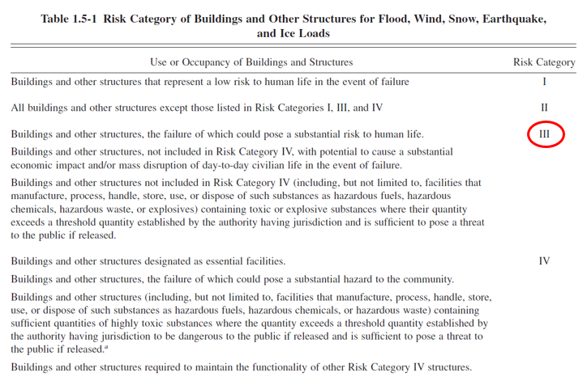
Seismic Design Parameters
Risk Category

Slide 26
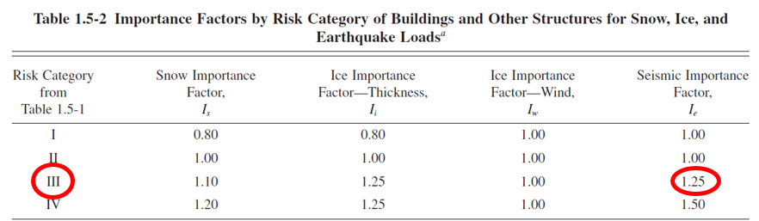
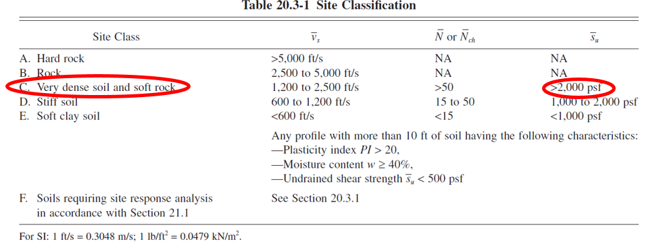
Seismic Design Parameters
Importance Factor, I
Site Class (B)

Slide 27
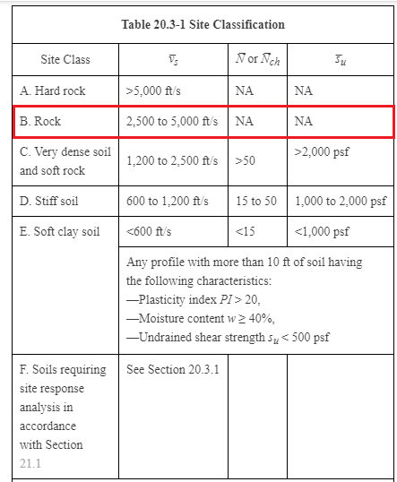
Seismic Design Parameters
Site Class (B)

Slide 28
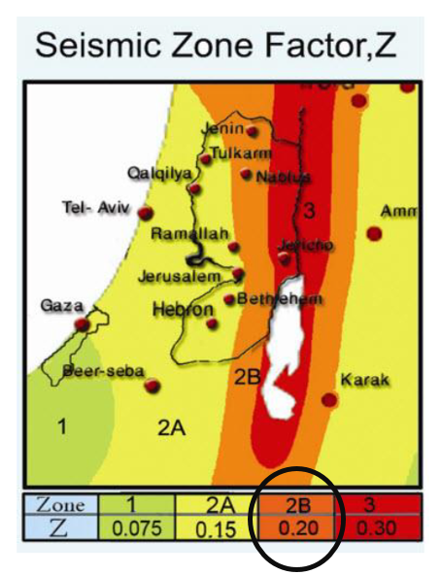
Seismic Design Parameters
Seismic Zone Factor, Z
Seismic Zone for Nablus is 2B
Factor (Z) = 0.20
S_{S} = 2.5 x Z = 2.5 x 0.2 = 0.5
Z = 0.20
S₁ = 1.25 x Z = 1.25 x 0.2 = 0.25

Slide 29
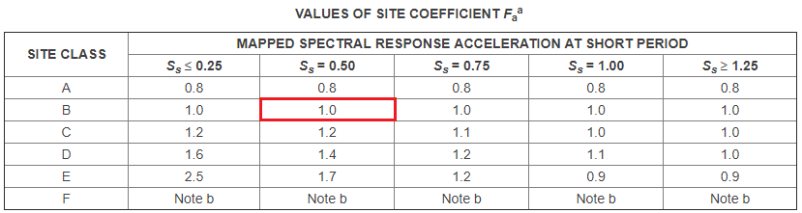
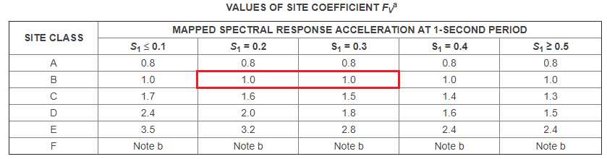
Seismic Design Parameters
Site Coefficients, F_{a ,} F_{v}

Slide 30
Response Accelerations S_{M1} & S_{MS}
S_{MS} = F_{a}·S_{S}
S_{M1} = F_{v}·S₁
S_{MS} = 1×0.5 = 0.5
S_{M1} = 1×0.25 = 0.25
Based on 10% chance of exceedance in 50 years
𝑆𝐷𝑠 = 2/3 𝑆𝑀𝑠
𝑆𝐷1 = 2/3 𝑆𝑀1
Five percent damped design spectral response acceleration at short period,
𝑆𝐷𝑠 = 2/3 𝑆𝑀𝑠 IBC 2012 (16-39)
𝑆𝐷𝑠 =2/3∗ (0.5) = 0.333
Five percent damped design spectral response acceleration at a 1- second period,
𝑆𝐷1 = 2/3 𝑆𝑀1 IBC 2012(16-40)
𝑆𝐷1 = 2/3∗ (0.25) = 0.167
Seismic Design Parameters

Slide 31
Seismic Design Parameters
Spectral response acceleration parameters. S_{DS} , S_{D1}
F_{a}=1
S_{MS} = 0.5
S_{DS}= 0.333
S_{S}=0.5
F_{v}=1
S_{M1} = 0.25
S_{D1}= 0.167
S₁=0.25

Slide 32
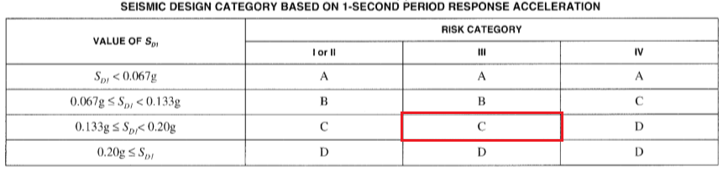
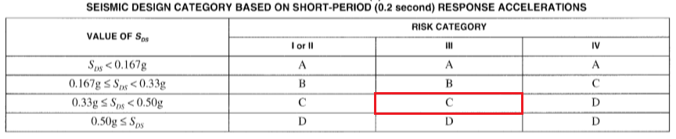
Seismic Design Parameters
Seismic Design Category (C)
Seismic design category is determined based on:
- Risk category
- Values of S_{DS} and S_{D1.}

Slide 33
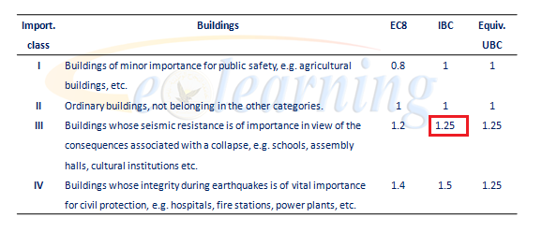
Importance Factor (I):
Since there is no specified occupancy for schools, the importance factor is taken as 1.25

Slide 34
Structural System Type
Structural System is Bearing Wall System of Intermediate Moment Frames and Shear Walls
Response Modification Coefficient (R) = 4.0
Overstrength Factor (Ωo) = 2.5
Cd = 4

Slide 35
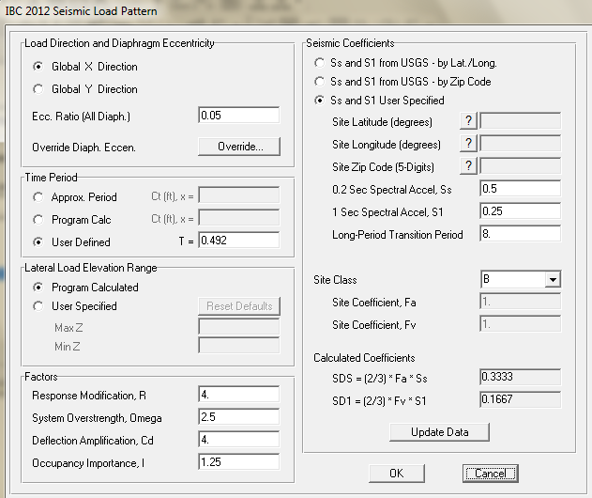
Definition of Seismic load patterns in X direction according to IBC code

Slide 36
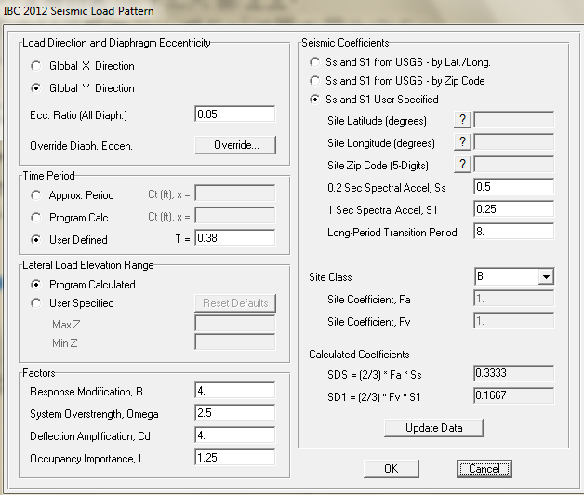
Definition of Seismic load patterns in y direction according to IBC code

Slide 37
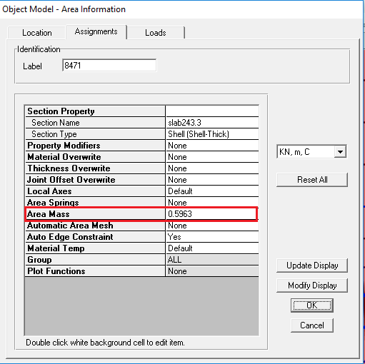
Area Mass:
Area mass for each slab of the structure is equal to SD + 0.25L / 9.81
Area mass = 4.6 + 0.25×5 / 9.81 = 0.596

Slide 38
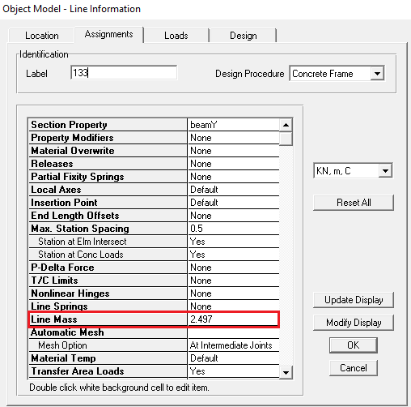
Line Mass:
Line mass = 24.45 / 9.81 = 2.49

Slide 39
Load Combinations
Combination
1.4D
1.2D+1.6L
2D+1.3L+2SD
1D+1SD+0.25L
D+L+SD
1.4D+1.4SD
1.2D+1.6L+1.2SD+0.5S
1.2D+1L+1.2SD+1.6S
1.2D+1L+1.2SD+0.2S+1EQx
1.2D+1L+1.2SD+0.2S-1EQx
1.2D+1L+1.2SD+0.2S+1EQy
1.2D+1L+1.2SD+0.2S-1EQy
0.9D+0.9SD+1EQx
0.9D+0.9SD-1EQx
0.9D+0.9SD+1EQy
0.9D+0.9SD-1EQy
1.2D+1L+1.2SD+0.2S+1ResponseX
1.2D+1L+1.2SD+0.2S+1ResponseY
0.9D+0.9SD+1ResponseX
0.9D+0.9SD+1ResponseY

Slide 40
CH2 :
Preliminary Design

Slide 41
Two Way Solid Slab (Hand calculations):
For Solid Slab:
Assume α<2
h=Ln (0.8+Fy/1400)/ (36+9B) >=90 mm
B= (long clear span/shorter clear span)
B= (8.5)/ (5.6) =1.5178
h=8.5(0.8+420/1400)/ (36+9*1.5178) =0.188m
.
For Solid Slab:
h= 200 mm.

Slide 42
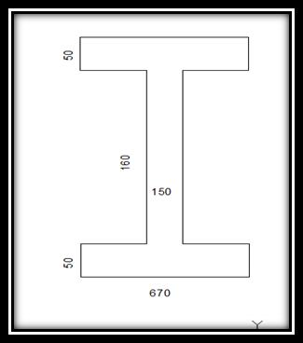
U-boot Slab:
thickness of the Web = 150mm
H of U-boot = 160mm
h=50 mm
Area of U-Boot section = 91000 mm²

Slide 43
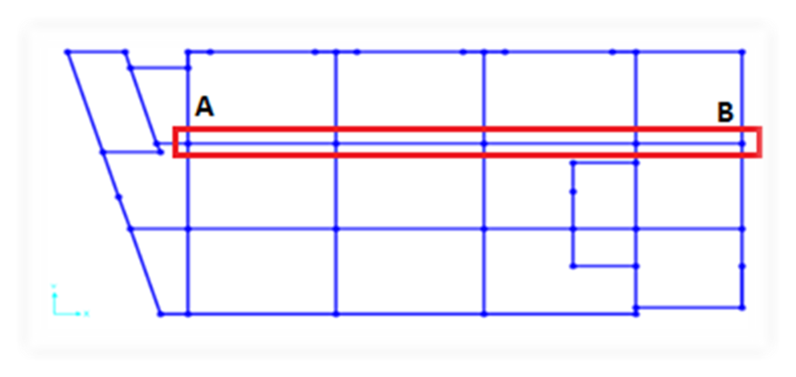
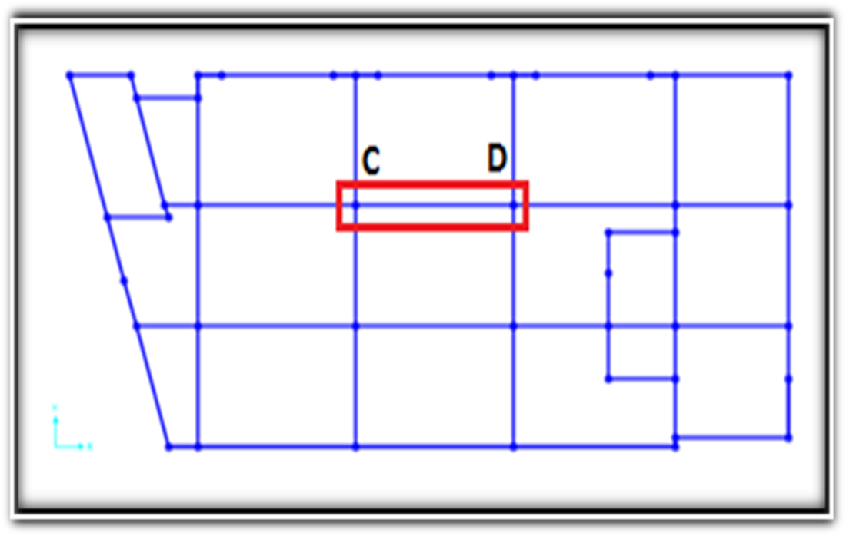

Slide 44
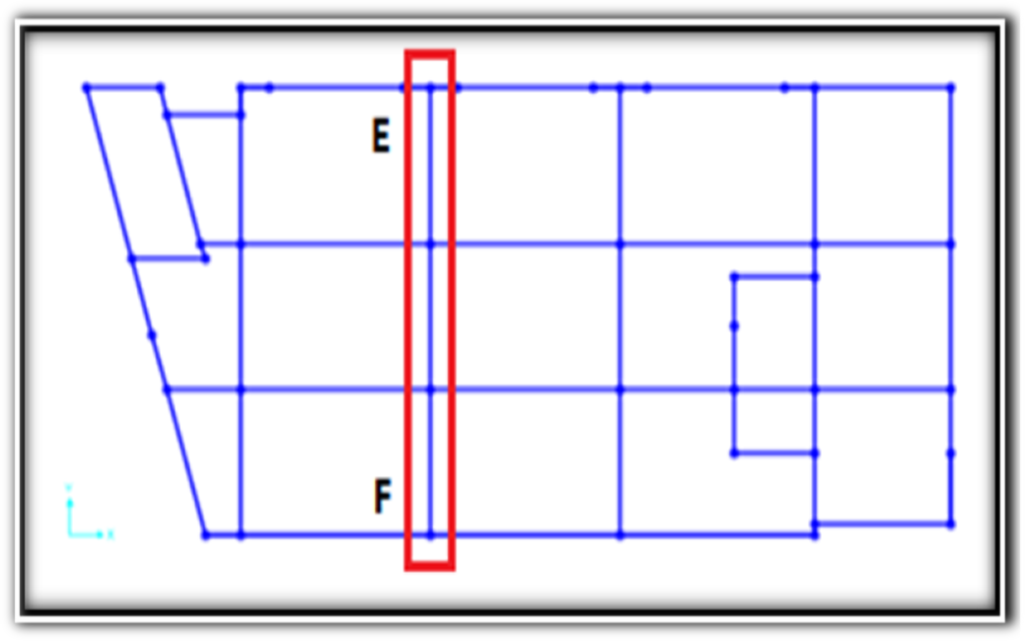
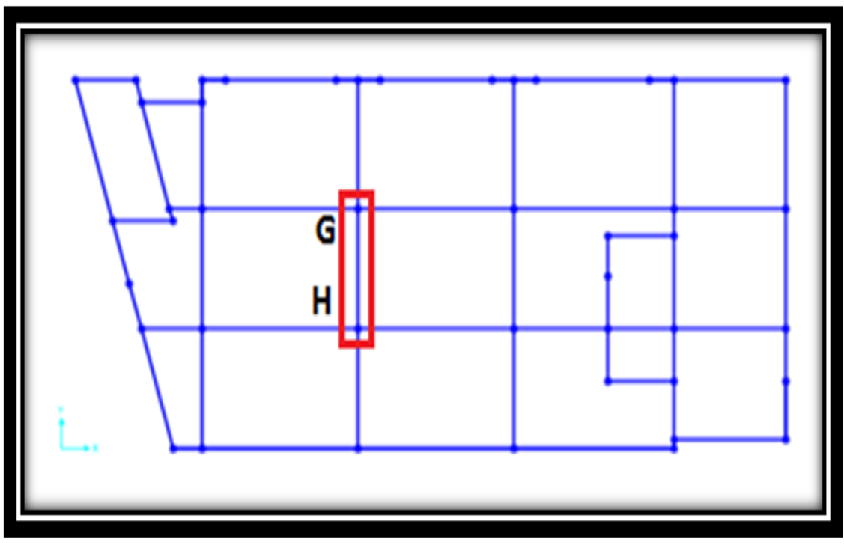

Slide 45
Dead Load per rip = 3.4KN
Wu = 17.6 KN/m
Wu per rib = 11.792 KN/rib
Check for shear of U-boot slab:
Vu-x = 6KN
Vu-y = 12.8KN
Block Number one
Ø Vc = 106.4KN
Vu < Ø Vc OK

Slide 46
Block Number Two
h = 150mm
Slab own weight = 3.75KN
Ultimate load on the slab:
Wu = 18.02 KN/

Slide 47
Check slab for shear
Vu = 33.157 KN
ØVc = 85.987 KN
➔Thickness is adequate.
No need for shear reinforcement.

Slide 48
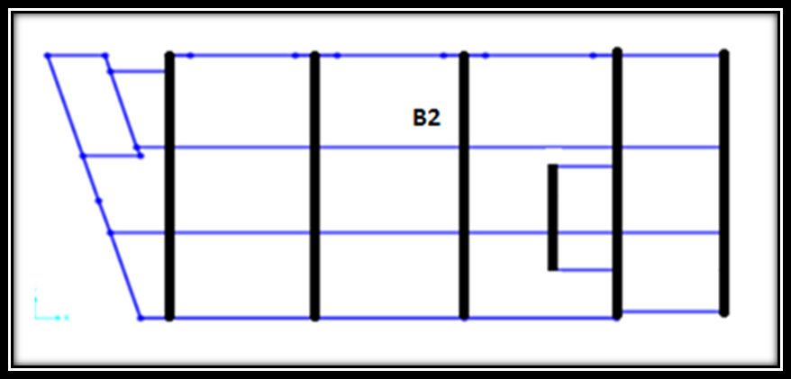
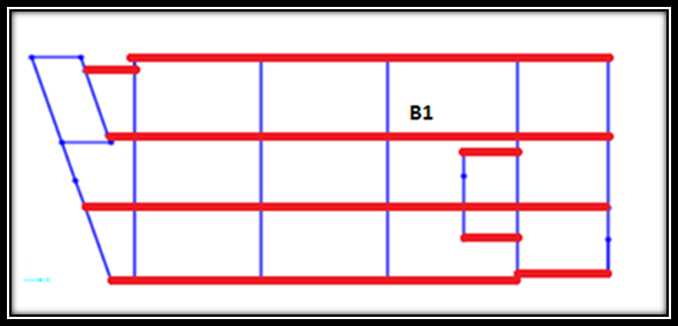
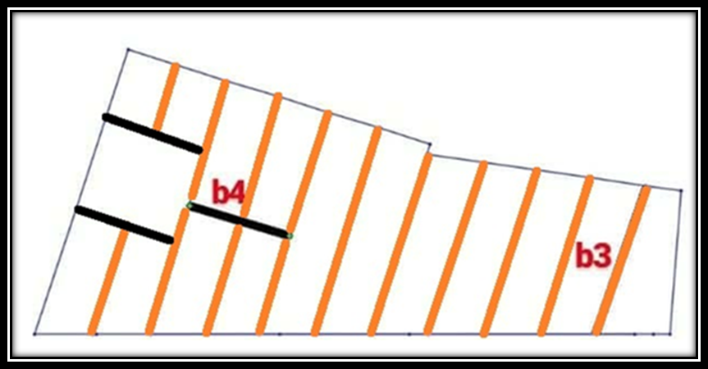

Slide 49
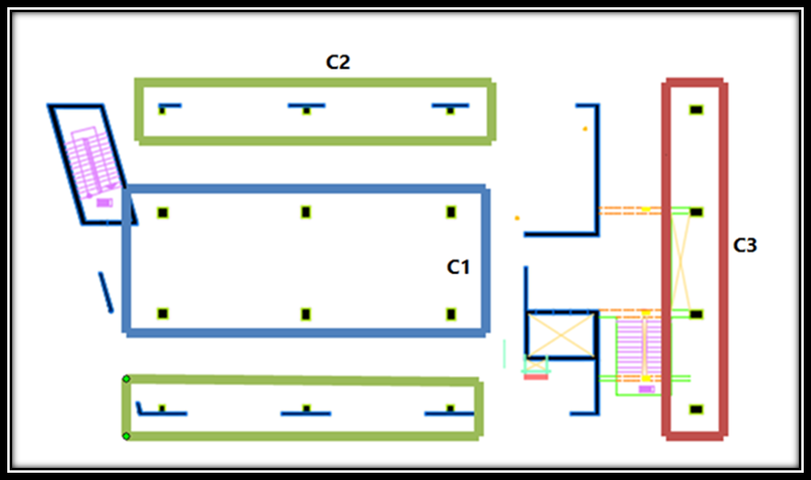
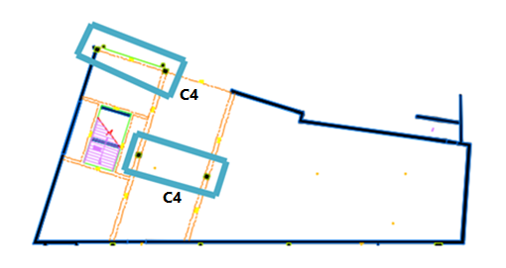

Slide 50
Dimensions of the beam
Beam number | Depth(mm) | Width(mm) | Section Type
B1 | 750 | 350 | Rectangular section
B2 | 500 | 350 | Rectangular section
B3 | 650 | 600 | Rectangular section
B4 | 400 | 350 | Rectangular section
Column number |  |  | Depth(mm) | Width(mm) | Section Type
C1 |  | 350 |  | 900 | Rectangular section
C2 |  | 350 |  | 550 | Rectangular section
C3 | 300 |  |  | 400 | Rectangular section
C4 | 600 |  |  | 300 | Rectangular section

Slide 51
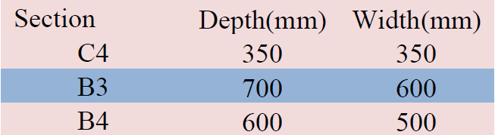
After Design for the model:
We notice that we have a failure in the column (C4) and three beams (B3 , B4 ) in block2. So, the dimensions of the sections were enlarged.

Slide 52
Model Checks
Compatibility
Equilibrium
Stress - Strain
Base Shear
Irregularities
Stability
Period
Checks

Slide 53
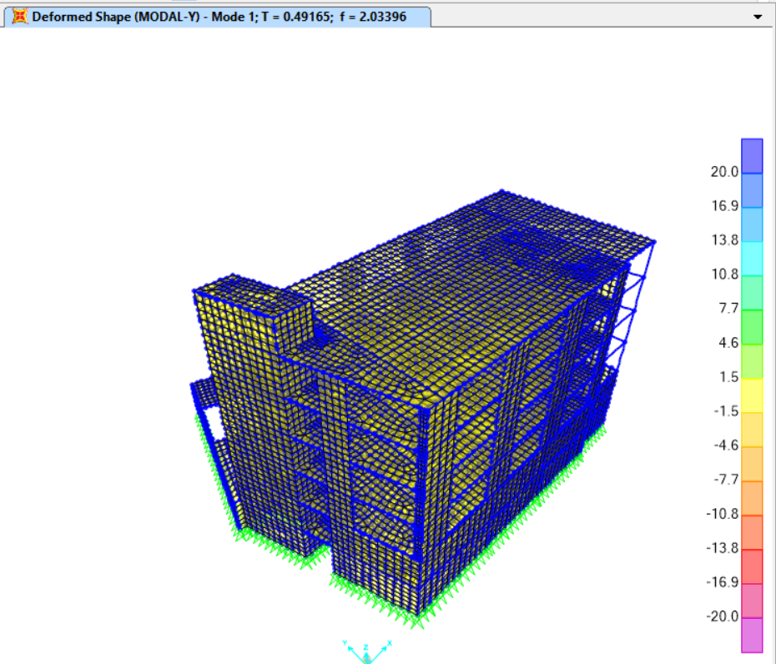
1- Compatibility Checks:
To ensure that model will behave as one static unit.

Slide 54
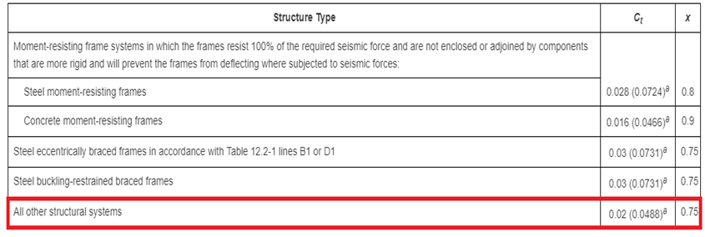


Values of approximate period parameters Ct and X
Ct = 0.0488
X= 0.75
Ta = 0.58 second

Slide 55
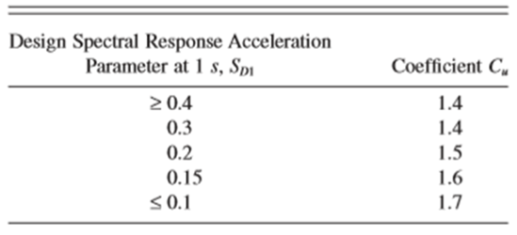
Period from SAP < Cu × Ta
Where Cu is a coefficient for upper limit on calculated period = 1.4

Slide 56
The period in X direction from SAP ( Tx) = 0.492 second < 1.4× 0.58 =0.812

Slide 57
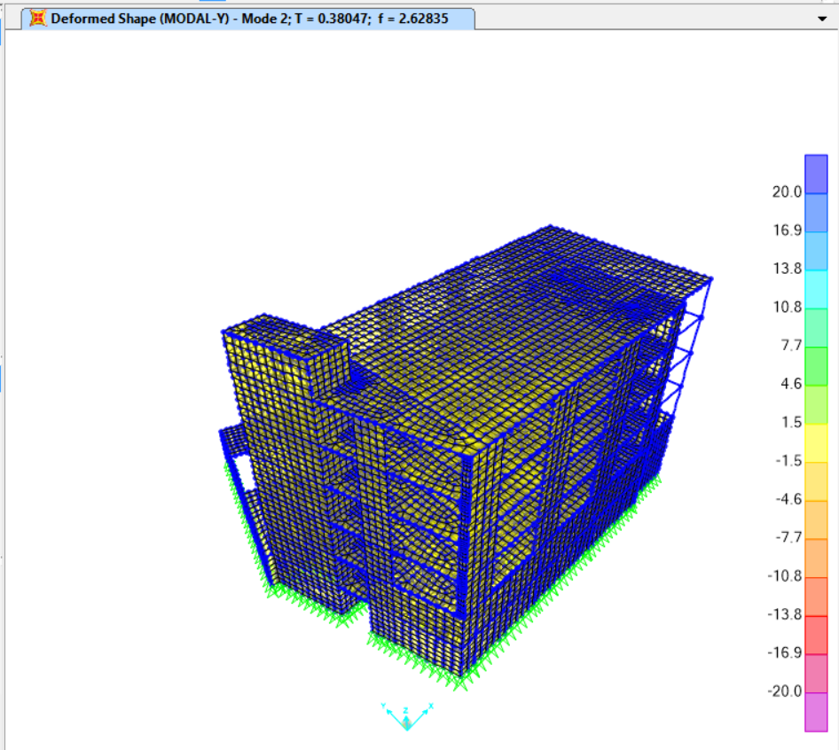
The period in y direction from SAP ( Ty) = 0.38 second< 1.4× 0.58 =0.812

Slide 58
Check for irregularities:
1a - Torsional Irregularity
1b - Extreme Torsional Irregularity
2 - Re-entrant Corners
3 - Diaphragm Discontinuity
4 - Out-of-plane Offsets
5 - Nonparallel Systems
Plan Structural Irregularities

Slide 59
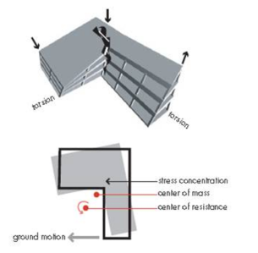
Torsional irregularity exists if ( dmax/ davg >1.2 )
Extreme Torsional Irregularity exists if ( dmax / davg >1.4 )
Torsional irregularity
Extreme Torsional Irregularity

Slide 60
In X- direction :
Dmax = 25.84mm
davg = 24.31mm
25.84/24.31 = 1.06 < 1.2
No Torsional irregularity
In Y- direction
Dmax = 15.01mm
davg = 13.65mm
15.01/13.65 = 1.09 < 1.2
No Torsional irregularity
Floor | Drift δ (mm)
4 | 15.01
3 | 14.81
2 | 14.75
1 | 13.65
Gf | 12.51
B1 | 11.187
Floor | Drift δ (mm)
4 | 25.840
3 | 25.20
2 | 24.66
1 | 23.95
Gf | 23.25
B1 | 22.96

Slide 61
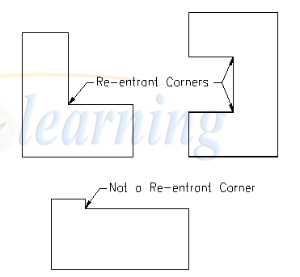
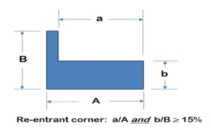
Type 2: Re-entrant Corners
No Re-entrant Corners in our structure

Slide 62
Diaphragms with abrupt discontinuities or variations in stiffness, including those having cutout or open areas greater than 50% of the gross enclosed diaphragm area, or changes in effective diaphragm stiffness of more than 50% from one story to the next.
Type 3: Diaphragm Discontinuities
NO Diaphragm Discontinuities in our structure

Slide 63

Type 4: Out-of-Plane Offsets
No Out-of-Plane Offsets in our structure

Slide 64
The vertical lateral force-resisting elements are not parallel to or symmetric about the major orthogonal axes of the lateral force resisting system.
Type 5: Nonparallel Systems
Our system is not nonparallel

Slide 65
1a - Stiffness Irregularity -Soft Story
1b - Stiffness Irregularity - Extreme Soft Story
2 - Weight (Mass) Irregularity
3 - Vertical Geometry Irregularity
4 - In-plane Discontinuity in Vertical Lateral Force Resisting Elements
5a - Discontinuity in Lateral Strength- Weak Story irregularity
5b - Discontinuity in Lateral Strength- Extreme Weak Story irregularity
Vertical Irregularities
No vertical irregularities

Slide 66
2-Equilibrium Checks:
To insure that model is satisfied the Newton law for statics and equilibrium objects.
Hand calculation:
Live load=5*4036.5 = 20182.5 KN
SD = 4.6 * 4036.5 = 18567.9KN
Load Type | Hand result (KN) | SAP result (KN) | Differences % | % of error acceptable or not
Dead |  | 36675.992
SD | 18567.9 | 18541.713 | 0.141 | Acceptable
Live | 20182.5 | 20154.036 | 0.141 | Acceptable

Slide 67
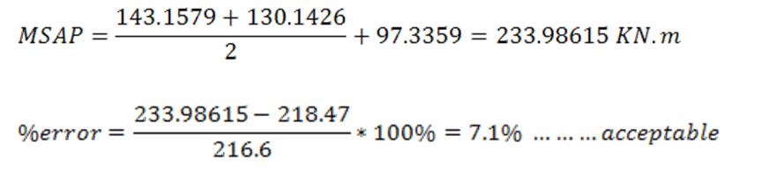
3- Stress strain Checks
To insure that the loads will be distributed in an expected way in both slabs and beams.
For Block One:
For interior span CD in X-direction:
Frame moment from live load:

Slide 68

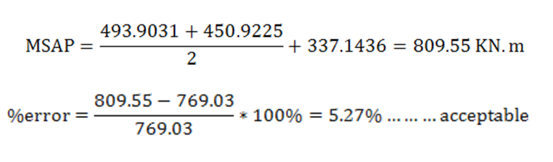
Frame moment from Load combination:

Slide 69
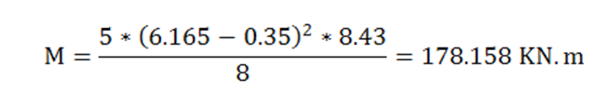
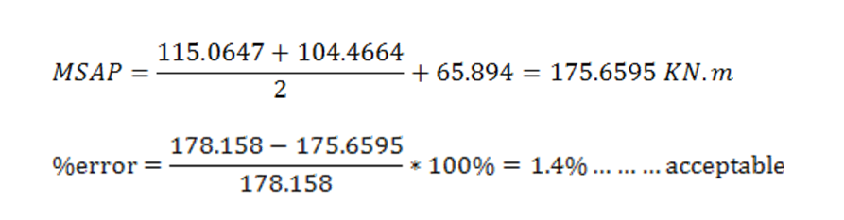
For interior span(GH) in Y-direction:
Frame moment from live load:

Slide 70
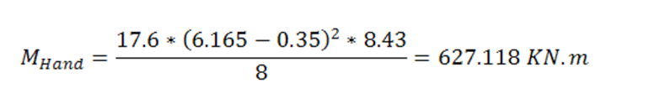
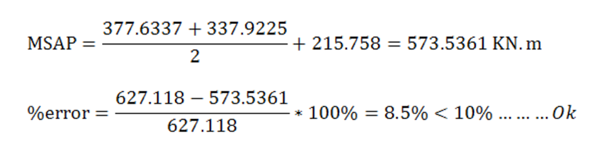
Frame moment from Load combination:

Slide 71
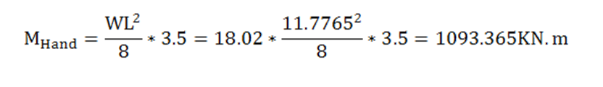

For Block two:

Slide 72

4- Deflection Checks:
For Block One:

Slide 73


Slide 74
For Block Two

Slide 75

5- Wide Beam Shear Check:
For Block One:

Slide 76

For Block Two

Slide 77
Base shear
We use two methods of design
1.Equivalent lateral force analysis
2.Modal response spectrum analysis

Slide 78



Base reaction
Vx = Vy
W = 74109.519 KN
V= 0.1044×74109.519 = 7737KN

Slide 79
Vmax = 0.103× 74109.519 = 7633.28KN
Vmin = 0.0184 × 74109.519 = 1363.6 KN
As the calculated base shear V is larger than the maximum calculated base shear Vmax , then the base shear for the design will be taken equal to Vmax = 7633.28 KN

Slide 80


Base Shear from SAP
Vx & Vy from SAP
% of error = 1.11 % …. Acceptable

Slide 81

Response spectrum

Slide 82

Response Spectrum function

Slide 83

Base reaction in X & Y direction from SAP
% of error between the two methods is acceptable

Slide 84
Reinforcement of structural elements

Slide 85
1.slab design

Slide 86


slab design for moment and tension force
Mu =60.5KN.m,

Slide 87
For block 1
Steel in X-direction
For each room from (p1 to p17)
Mu (Bottom) Max on any of each room for all floor ( near to)= 20KN.m
use Asmin= 775.5 mm2/m
Mu (Top) Max on any of each room ( near to)= 44KN.m
Use Asmin= 0.0033*1000*235 =775.5 mm2/1m
Max axial tension force from SAP2000 at this rooms = F11=198 KN .
But Tu = 0.9*As*Fy
As (top + bottom)=523.8mm/1m
As top = As bottom = 261.9mm2
Total Top steel in slab =1037.4= (7Ø14 mm/1m) = 1 Ø14mm/16.5cm.
Total Bottom steel in slab =1037.4= (7Ø14mm/1m) = 1 Ø14 mm/16.5cm.

Slide 88

Steel of block1

Slide 89

For block two
Mu =9KN.m

Slide 90

Steel of block2

Slide 91

Detailing of slabs
Block 1

Slide 92

Block 2

Slide 93
2.Beam design

Slide 94

Beam design

Slide 95


Slide 96

Detailing of beams

Slide 97

مقاطع عرضية في الجسور

Slide 98


Slide 99
3.Column design

Slide 100

Distribution of columns for block1

Slide 101

Distribution of columns for block2

Slide 102


Slide 103

Detailing of Columns

Slide 104


Slide 105
4.Footing design

Slide 106

Distribution of footing for block1

Slide 107

Distribution of footing for block2

Slide 108

Reinforcement for all footings

Slide 109

Detailing of footings:

Slide 110


Slide 111
5.Shear Wall design

Slide 112

Distribution of shear walls

Slide 113

Detailing of shear wall

Slide 114
6.Design of stairs

Slide 115

Distribution of shear and moment of stairs

Slide 116
Dimension of stairs:
Thickness of the flight:
h = L / 10 = 1.60/10 = 160 mm
Use h=160mm.
Loads:
The total loads on stairs are:
1) The own weight of stairs = 0.16∗25 𝑘𝑁/𝑚³. =4 𝑘𝑁/𝑚².
2) The live load is assumed = 5 KN/m².
3) The SD =3 KN/m²
Material | Thickness(cm) | Unit weight(𝑘𝑁/𝑚³) | Load (𝑘𝑁/𝑚²)
Plastering | 0.5 | 23 | 0.115
Filling | 5 | 23 | 1.15
Marble | 3 | 27 | 0.81
Sand | 5 | 18 | 0.9
Sum of the SD Loads |  |  | 2.975

Slide 117
Check for deflection based on the long term deflection:
Max immediate deflection due to service load from SAP ( Δ )= 0.37 mm.
Deflection limitation:- Δ 𝐿,𝑎𝑙𝑙𝑎𝑤𝑎𝑏𝑙𝑒( 𝐿𝑜𝑛𝑔 𝑡𝑒𝑟𝑚)≤ 𝑙/240
= 1600 / 240= 6.66 𝑚𝑚
The long term deflection is smaller than the allowable deflection
(0.37 < 6.66) →OK

Slide 118
Check for shear
𝑑=160−30=130𝑚𝑚.
∅ 𝑉𝑐 = 0.75×(1/6)×√𝑓𝑐` 𝑏×𝑑
=0.75×(1/6)×√28×1000×130/1000 = 86 𝑘𝑁 /𝑚
∅ 𝑉𝑐= 86 𝑘𝑁
all reading smaller than 86 KN.
Then no need for shear reinforcement.

Slide 119

Design for flexural:
In flight:
For the middle max M22 (positive) = 11.3 KN.m, bottom steel
ρ= 0.85 * (28/240) * 1 -
ρ = 0.0018
So the 𝐴𝑠=0.0018 ×130×1000= 234 𝑚𝑚².
𝐴𝑠𝑚𝑖𝑛= 0.0018×160×1000=288 𝑚𝑚².
𝐴𝑠 < 𝐴𝑠𝑚𝑖𝑛 → use As min
use (4∅10/ 1m).

Slide 120

Detailing for stair

Slide 121
Conclusion
As a result of this project, we found out that U-Boot slab with drop beam system was the best system for this structure.
We learned many things from this project:
* Knowledge about SAP2000 program.
* Knowledge about U-Boot system.

Slide 122




