Slide 1
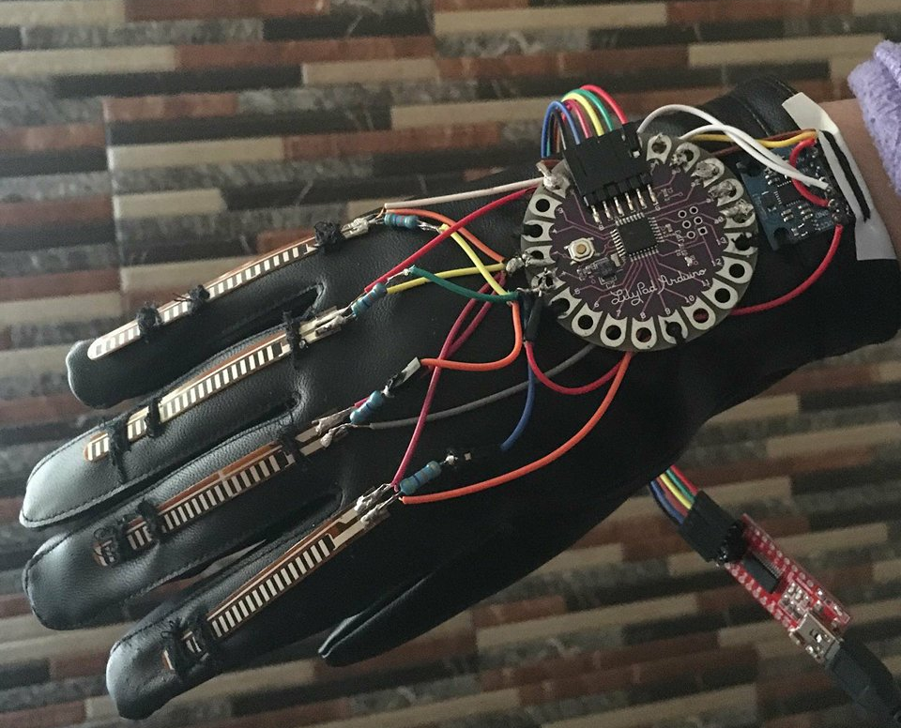
Piano Glove
Students: ataa Munther Husni Refai
Leena khaled haj yousef
Supervisors:
Dr. Raed Al-Qadi.
Dr. Samer Arandi.
Notes:
NOTE:
To change the image on this slide, select the picture and delete it. Then click the Pictures icon in the placeholder to insert your own image.

Slide 2
Outline
1. Introduction
2. Problem
3. Objectives
4. Scope of work
5. Constraints
6. Future work
7. Demo

Slide 3
Problem
The need of a tool or instrument for performers to control certain aspects of performance, creating easier real-time experimentation was the motivation to come up with the idea of piano glove , that help beginners learn music faster easier and with more fun.

Slide 4
Objectives
1. Body motion sensing performance.
2. Using gesture to control music/MIDI output (interact with computer through physical object).
3. Create customizable glove , that can be turned to any musical instrument needed : drums , Acoustic piano...etc.

Slide 5
Scope of work
We built the project based on Lilypad Arduino, a sewable Arduino microcontroller designed for building soft interactive textiles, and utilized diverse programmable electronic sensors. With 4 flex sensors sewn onto the fingers and accelerometer, the glove can play piano when the fingers are bended and when the wrist is rotated to the left and right.

Slide 6
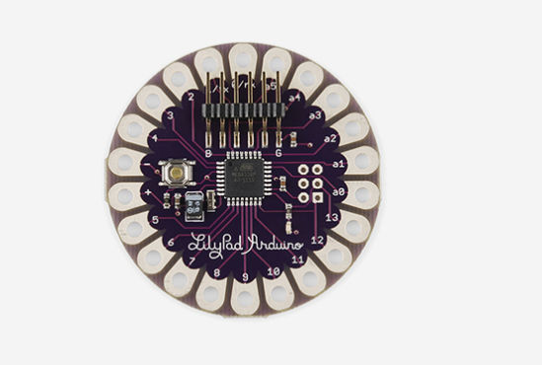
Scope of work
LilyPad Arduino board:
The LilyPad Arduino is designed for e-textiles and wearables projects. It can be sewn to fabric and similarly mounted power supplies, sensors and actuators with conductive thread.

Slide 7
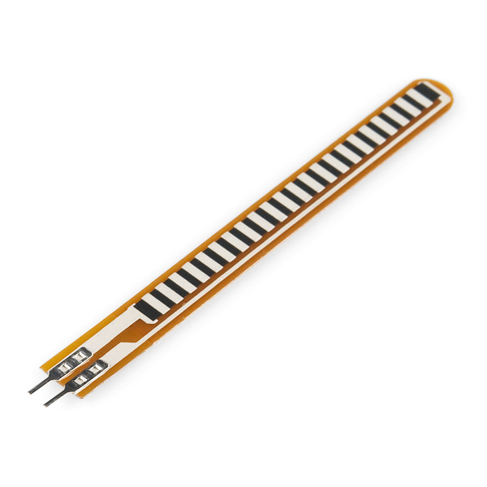
Scope of work
Flex Sensors:
This flex sensor is a variable resistor ,the resistance of the flex sensor increase as the body of the component bends.
In our project we used 4 flex sensors to implement 4 of piano notes, a specific note is released when corresponding flex is bended.

Slide 8
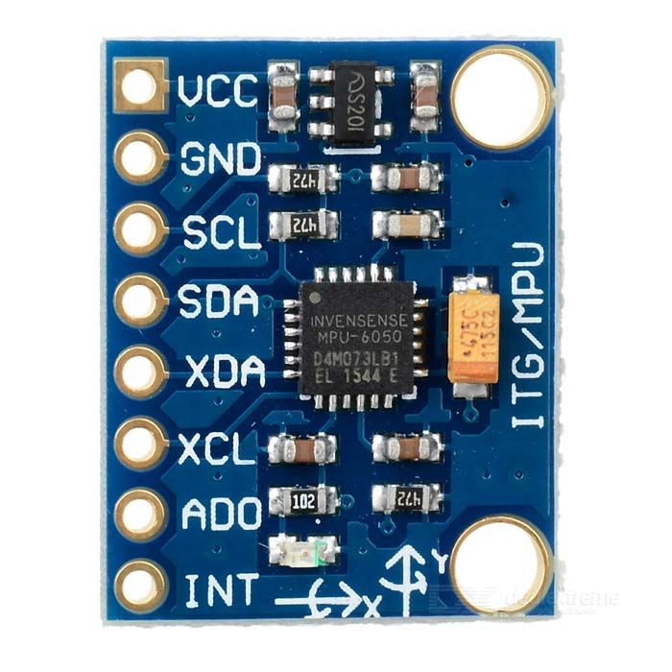
Scope of work
MPU6050 Sensor:

Slide 9
Scope of work

Slide 10
Constraints
The hand movement restriction. With the USB cable connecting to the Lilypad Arduino at an awkward angle, we discovered the user was highly aware of the limited wrist movement and faces difficulty in utilizing the accelerometer sensor naturally
Dealing with conductive threads within a tiny space. when started building the circuit on glove, we tried sewing with conductive threads to connect sensors and the Arduino Lilypad. Soon we realized the conductive thread is similar to exposed wire then we replaced the conductive threads with thin wires..

Slide 11
Future Work
If we had the chance to pursue this project further, we will eventually need to replace the wires with thicker ones and to re-orient the Lilypad placement on the glove. A looser and bigger glove will be more ideal to fit in different users’ hand without too tight to drag. If possible, I think building another controller glove to pair up with the existing one will help to create a more enrich music controlling experience with two hands, wearing gloves at the same time, cooperating to perform.

Slide 12
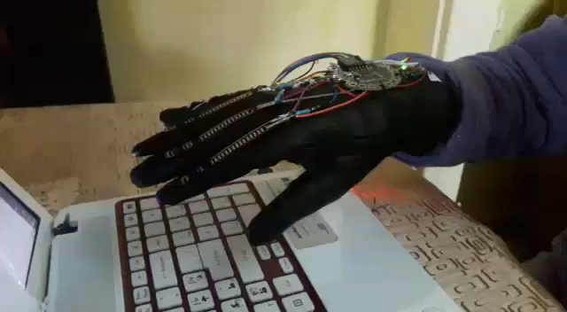
Demo

