Slide 1


An-Najah National University Faculty of Engineering and Information Technology Building Engineering Department Graduation project (2) Redesign for Sameer Shanaa Mall in Nablus Prepared By: Raghidah Fateh Maria Shtaya Dalal Nazzal Under the Supervisor of: Eng. Nirmeen Al-Barq 2022-2023

Slide 2

Introduction
Architectural Aspects
Environmental Aspects
Electro-Mechanical Aspects
Structural Aspects
Quantity surveying and cost estimate

Slide 3

Site analysis
Plans before and after

Slide 4


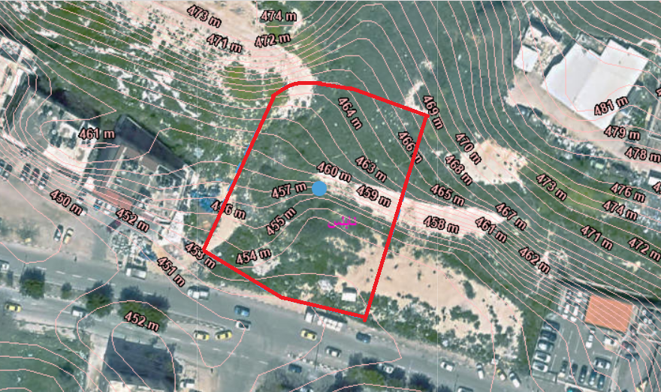
INTRODUCTION
Location:
Located in ”Haifa Street” in Nablus
on latitude 32.231155 and 35.245252
Land area = 2690 SM
Building total area = 9000 SM
Distributed on 7 floors

Slide 5
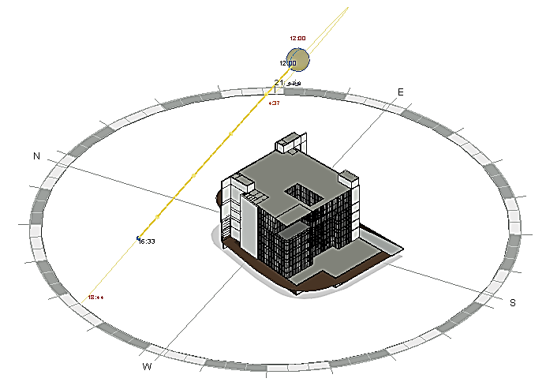
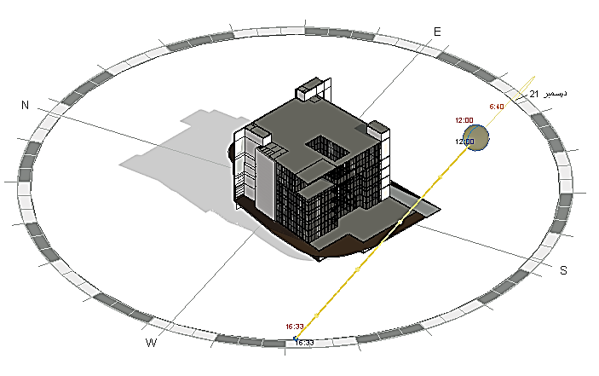
SITE ANALYSIS
Sun path

Slide 6
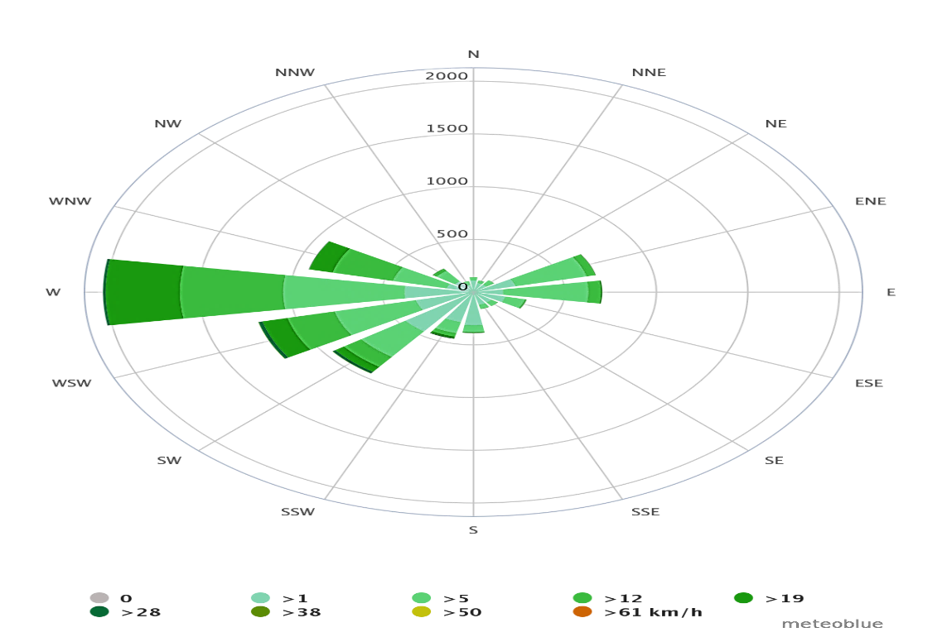
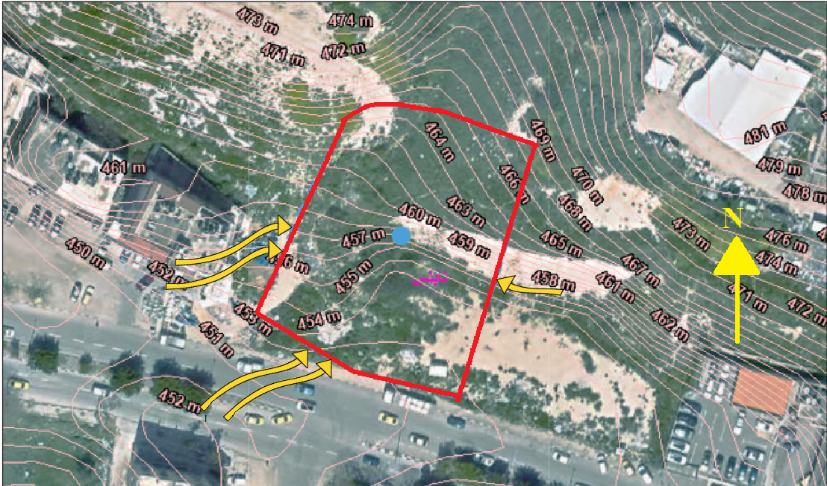
SITE ANALYSIS
Wind analysis

Slide 7
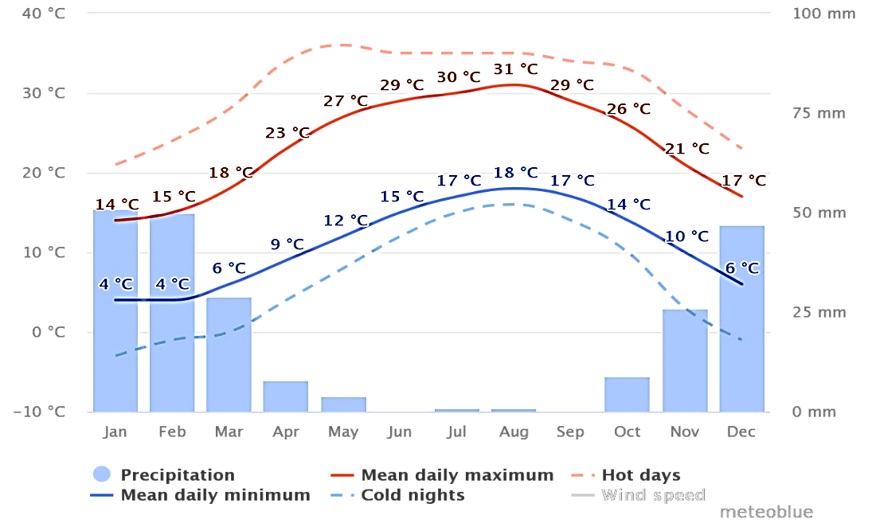
SITE ANALYSIS
Temperature analysis

Slide 8
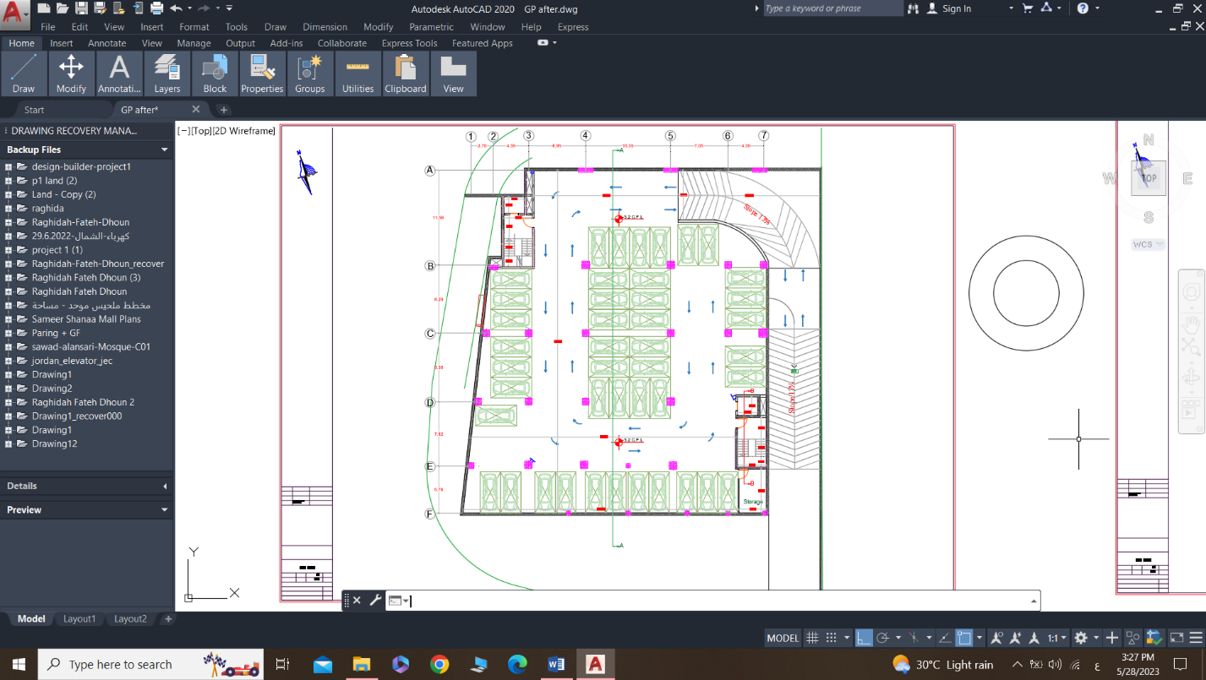
Plans before and after
Second Basement floor:

Slide 9
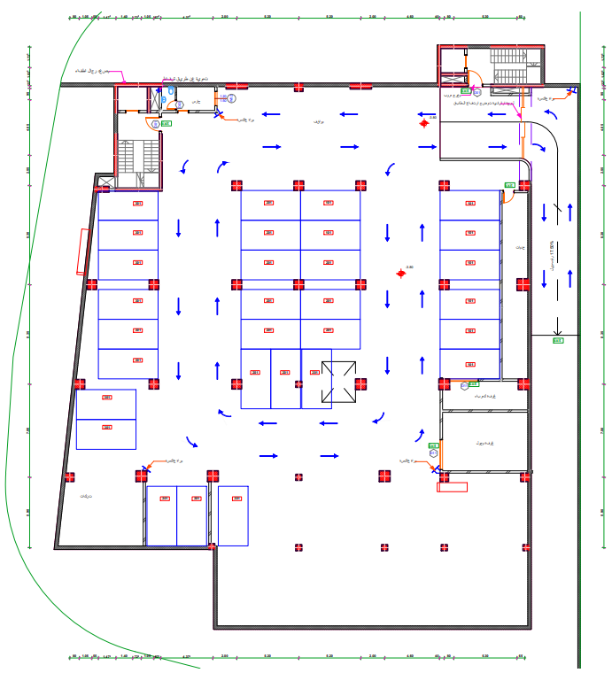
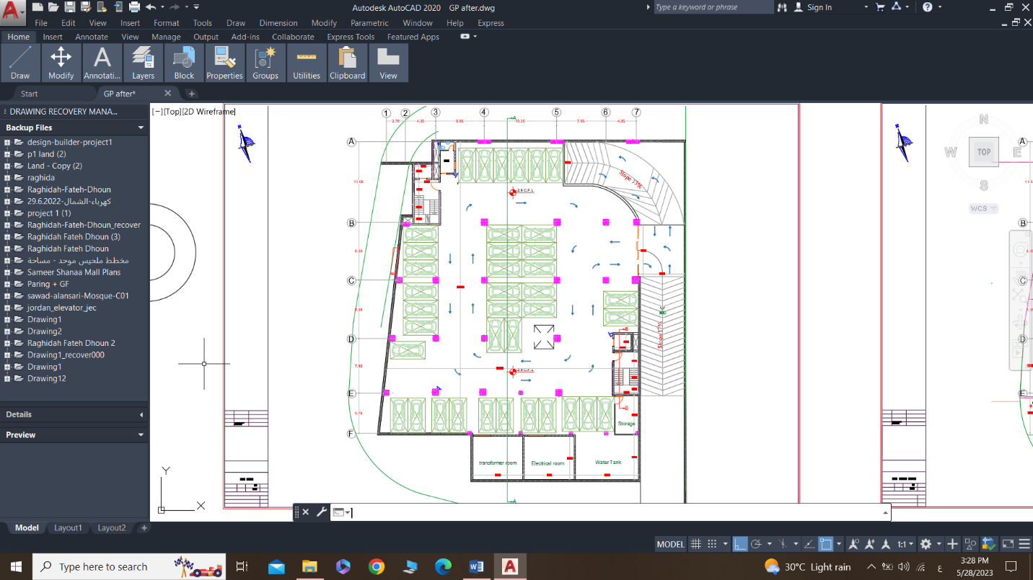
Plans before and after
First Basement floor:
Before
After

Slide 10
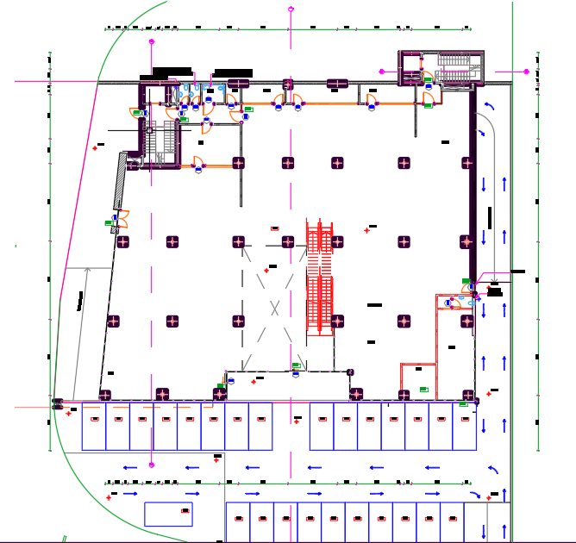
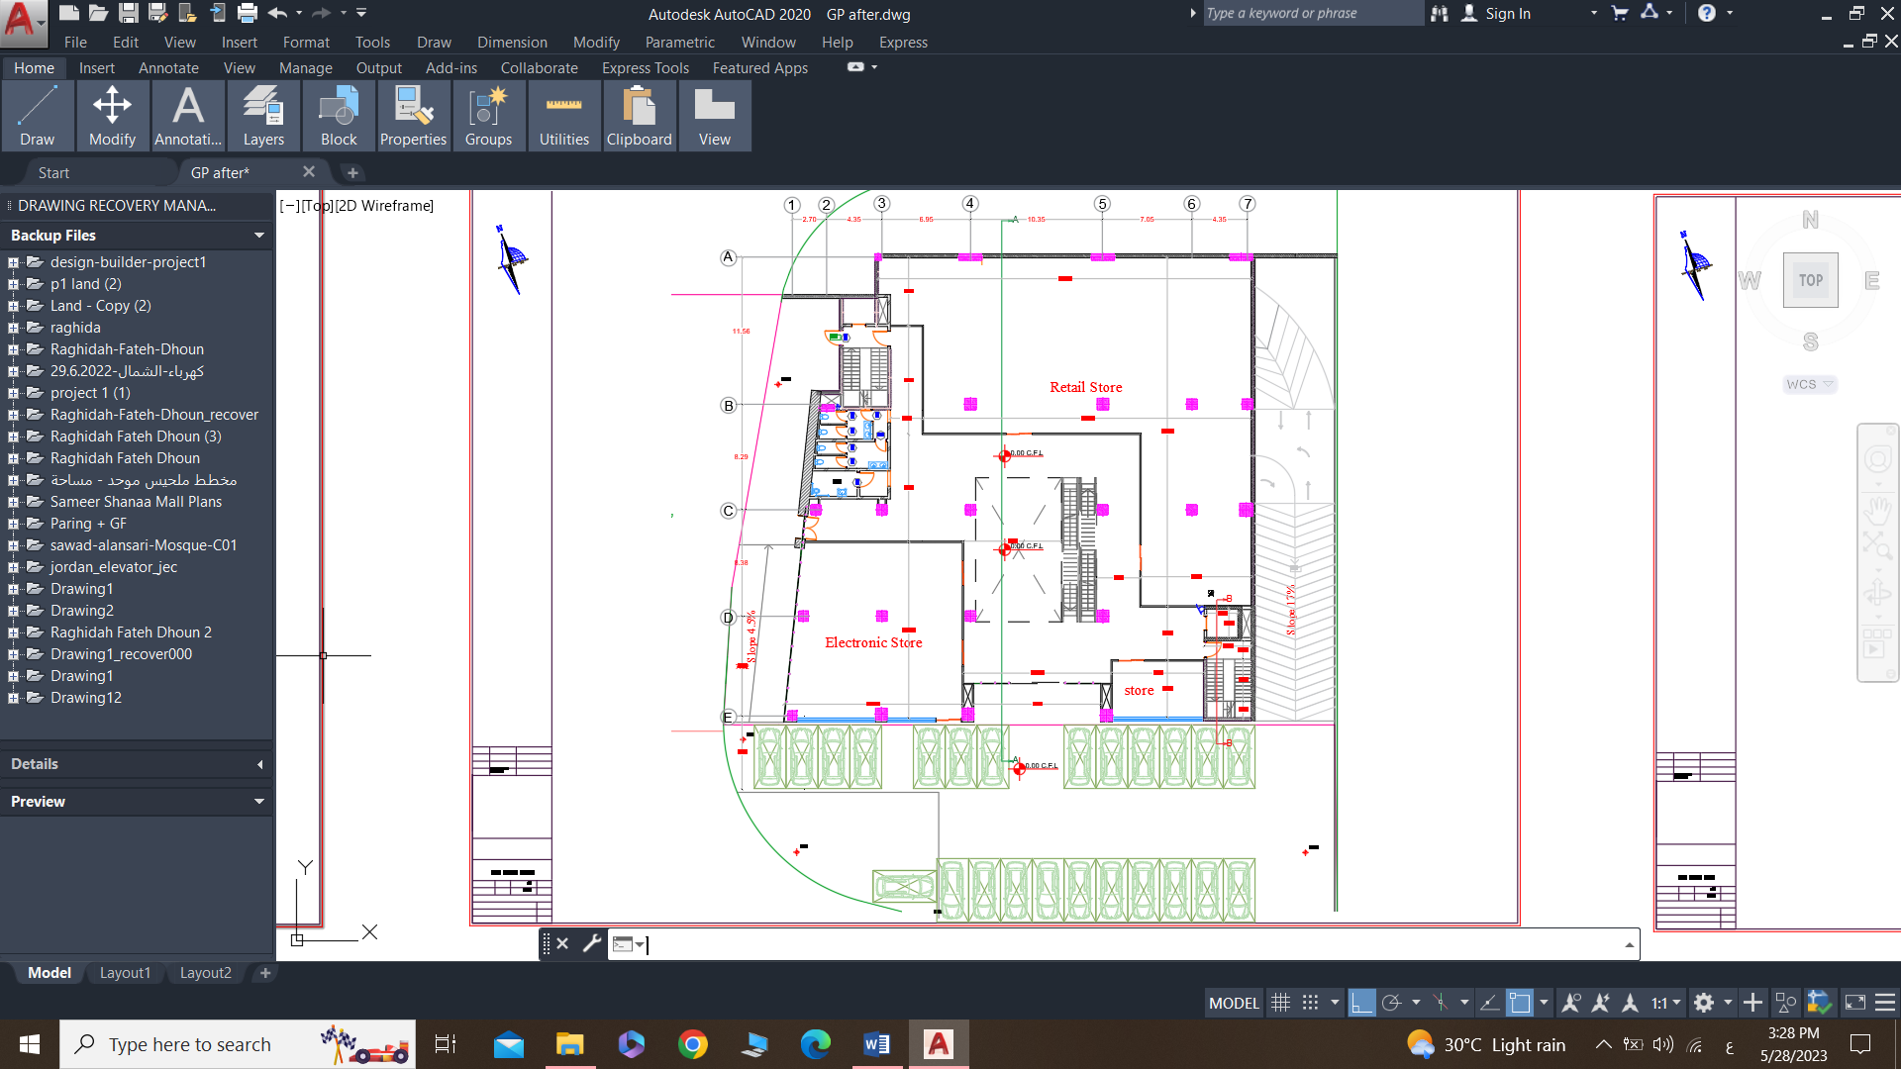
Plans before and after
Ground floor:
Before
After

Slide 11
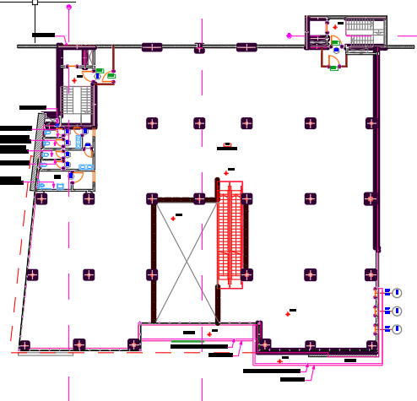
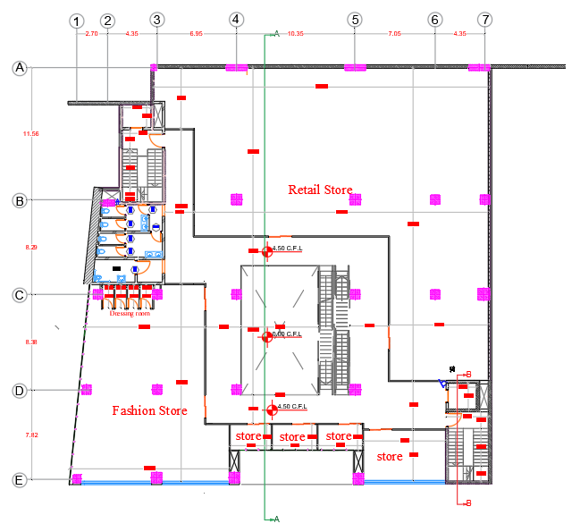
Plans before and after
First floor:
Before
After

Slide 12
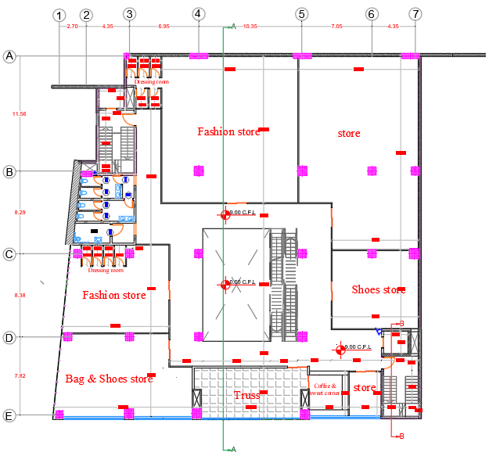
Plans before and after
Second floor:
Before
After

Slide 13
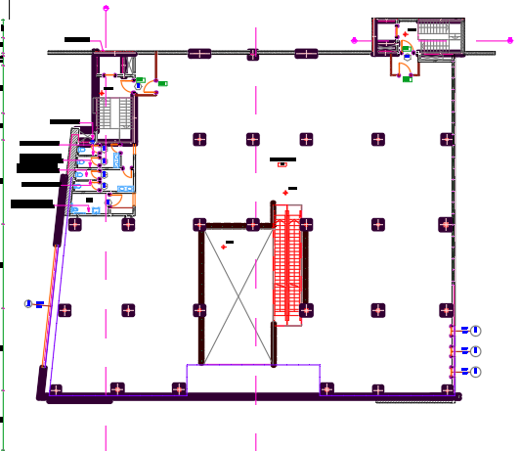
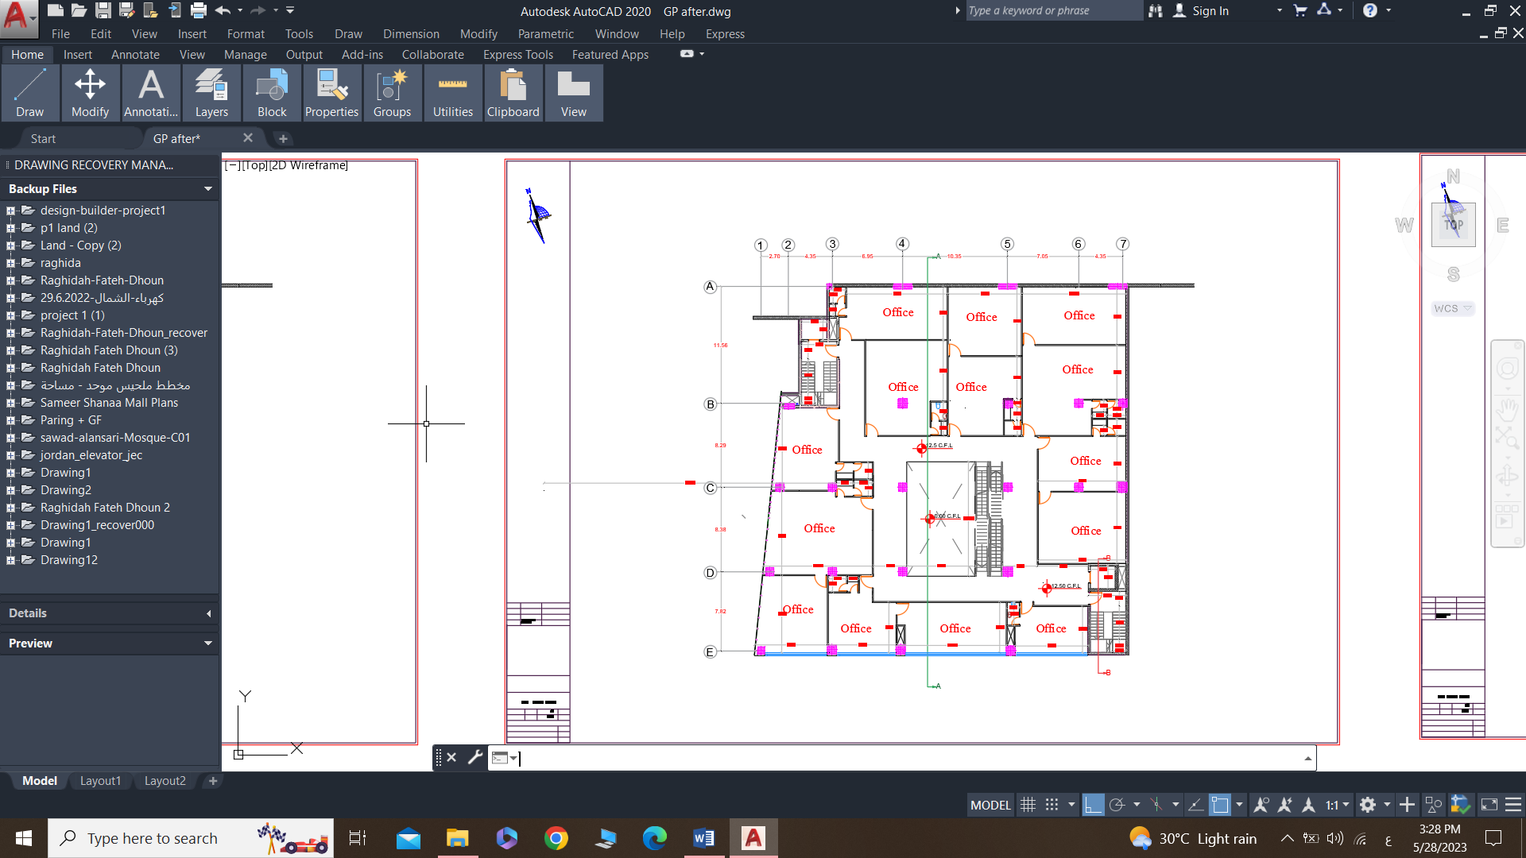
Plans before and after
Third floor:
Before
After

Slide 14
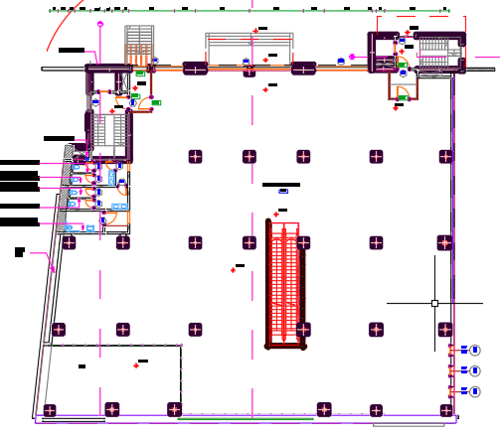
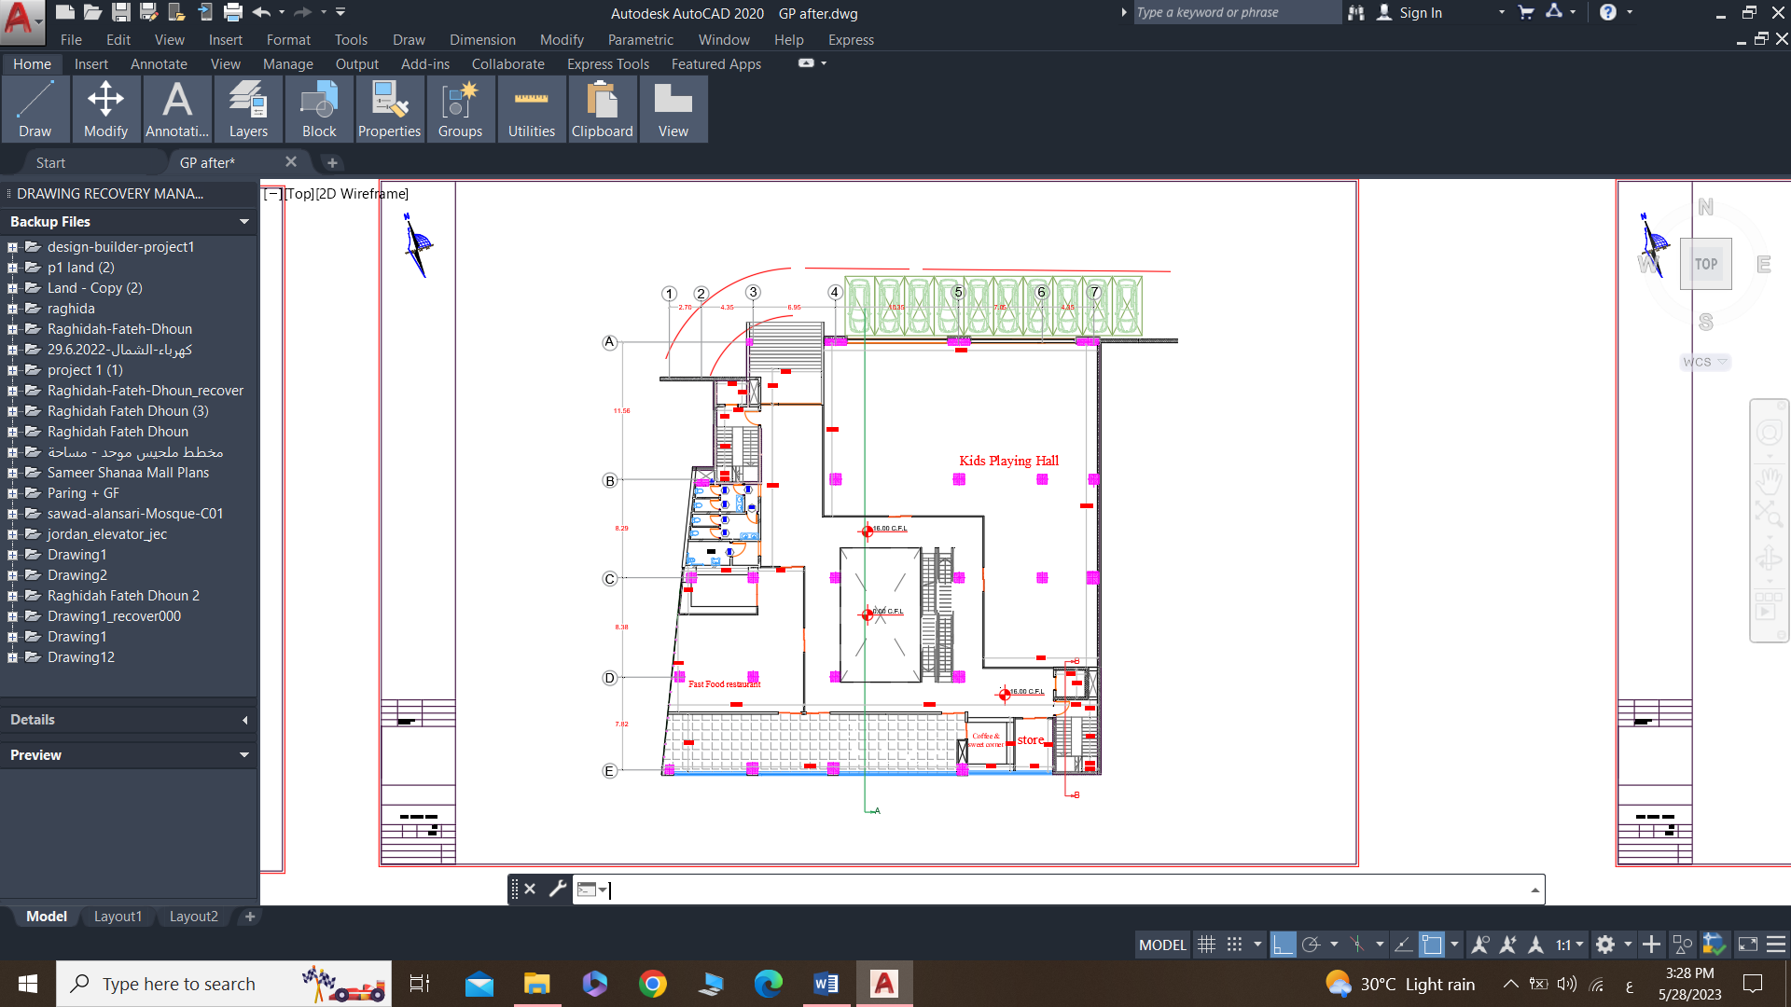
Plans before and after
Forth floor:
Before
After

Slide 15

Design builder data
Daylight factor analysis
Shading analysis

Slide 16
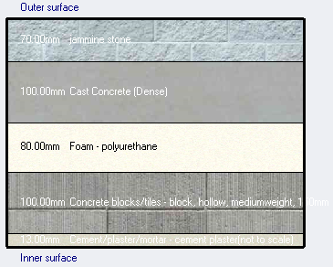
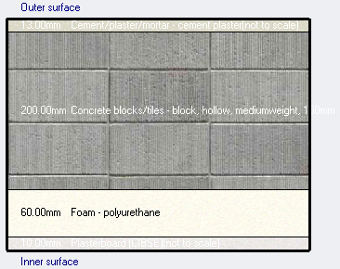
Design builder data
External wall
Internal wall
U-value = 0.303 w\m².k
U-value = 0.356 w\m².k

Slide 17
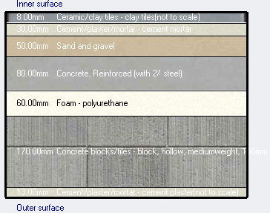
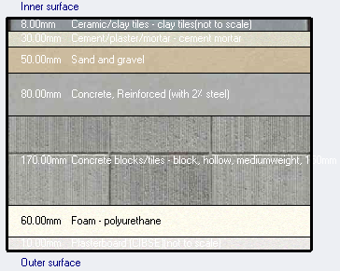
Design builder data
External floor
Internal floor
U-value = 0.371 w\m².k
U-value = 0.365 w\m².k

Slide 18
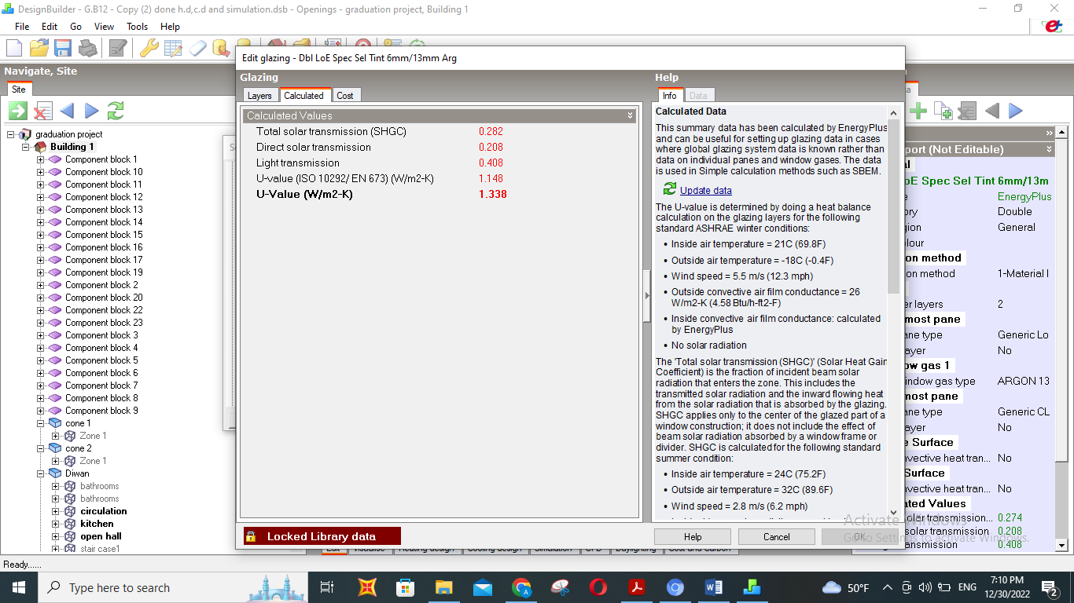
Design builder data
Glazing
U-value = 1.338 w\m².k

Slide 19
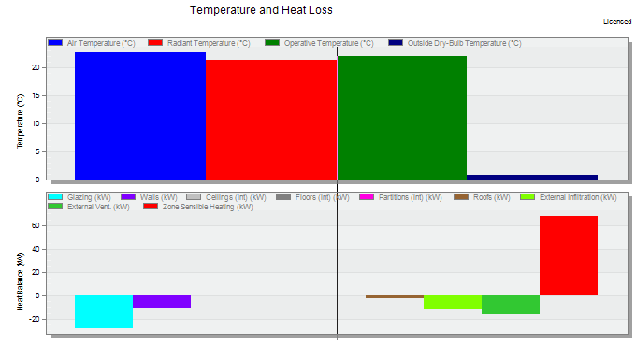
Design builder data
Heating load
Total heating load = 68.21 KW

Slide 20
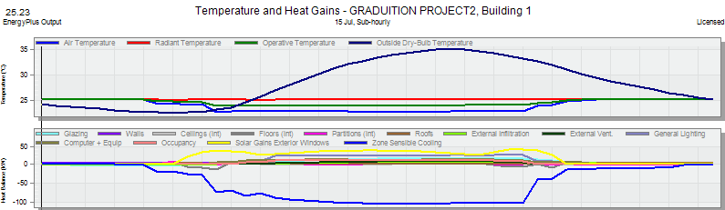
Design builder data
Cooling load
Total cooling load = 147.64 KW

Slide 21
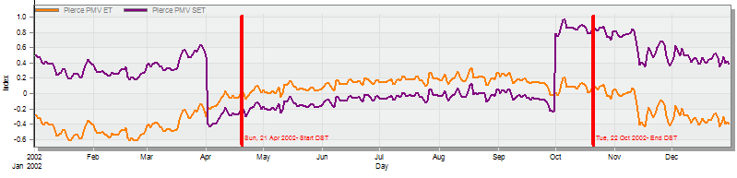
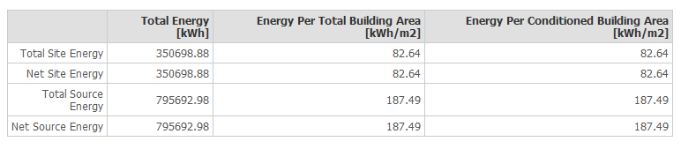
Design builder data
Thermal comfort
PMV Index value
The site and source of energy

Slide 22
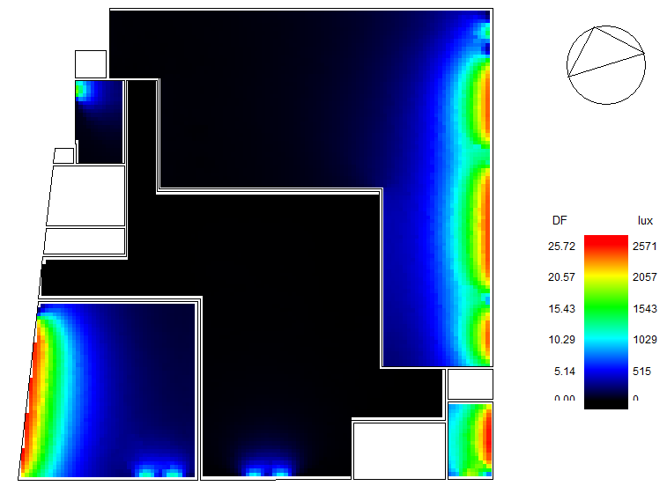
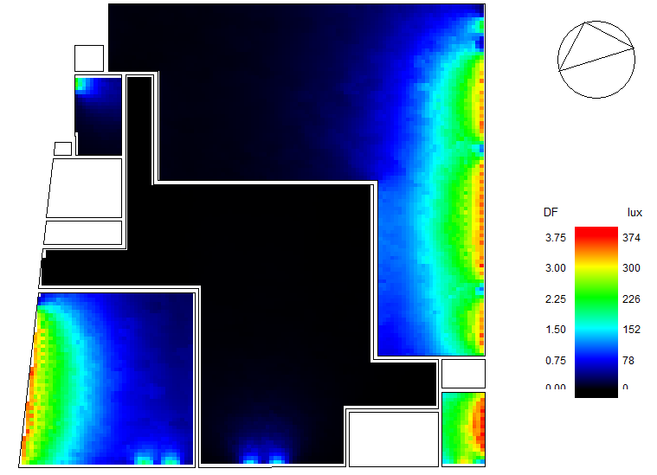
Daylight factor analysis
For the ground floor:
After
Before

Slide 23
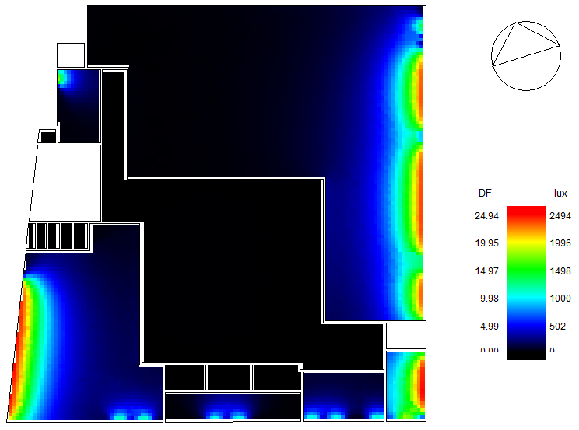
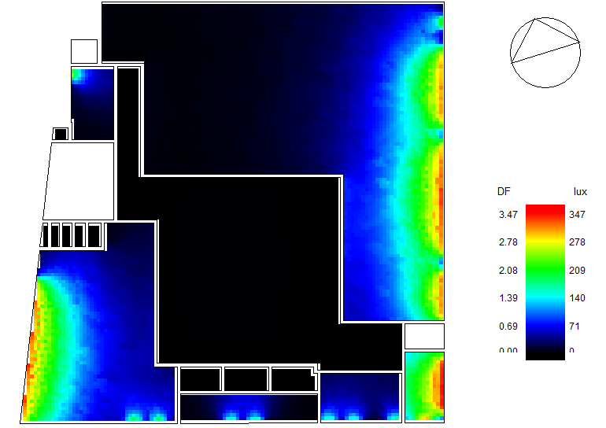
Daylight factor analysis
For the first floor:
After
Before

Slide 24
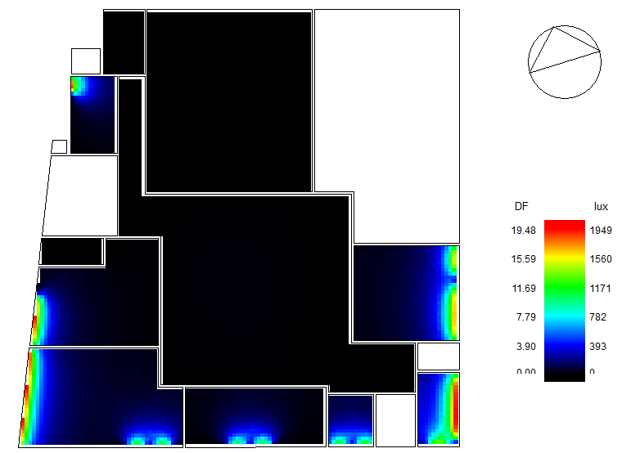
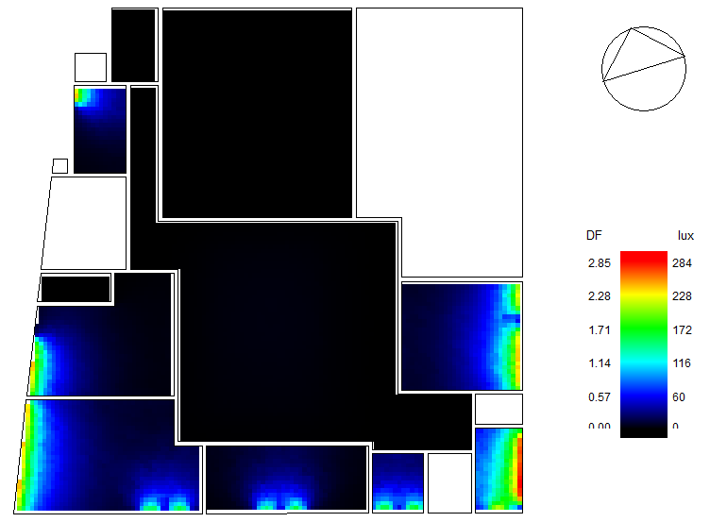
Daylight factor analysis
For the second floor:
After
Before

Slide 25
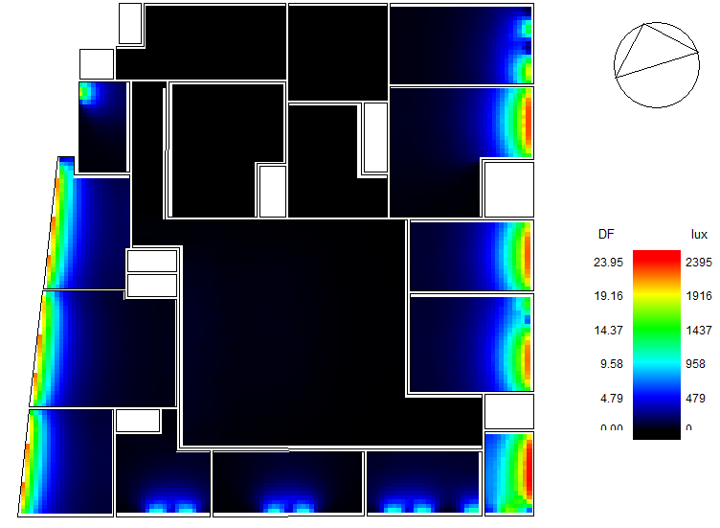
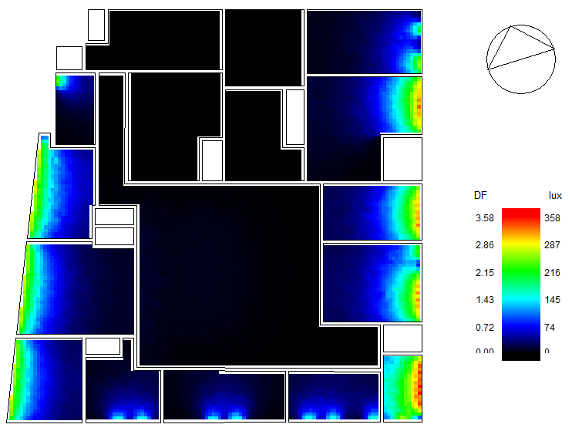
Daylight factor analysis
For the third floor:
After
Before

Slide 26
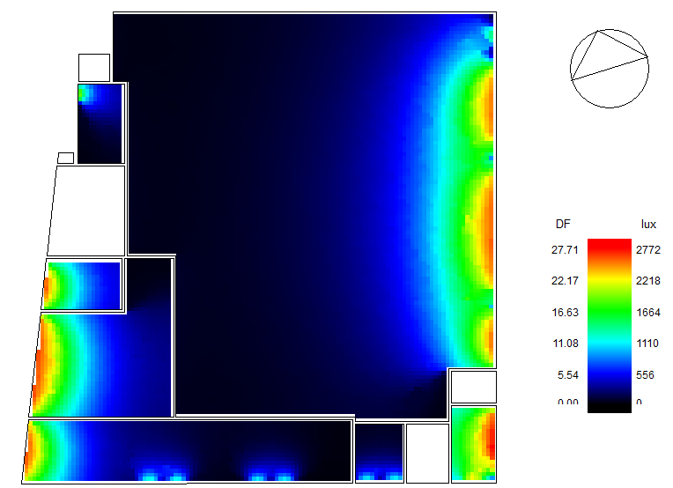
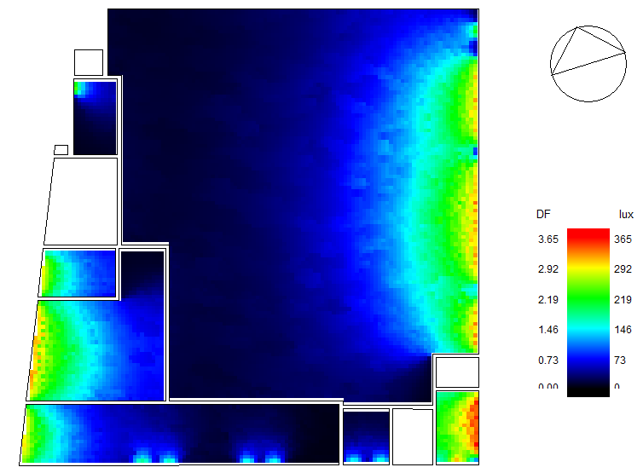
Daylight factor analysis
For the forth floor:
After
Before

Slide 27
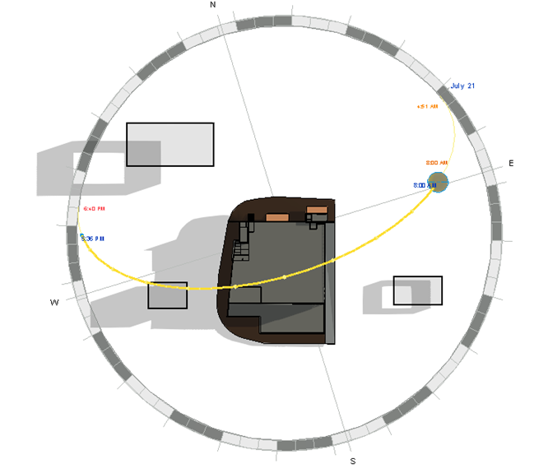
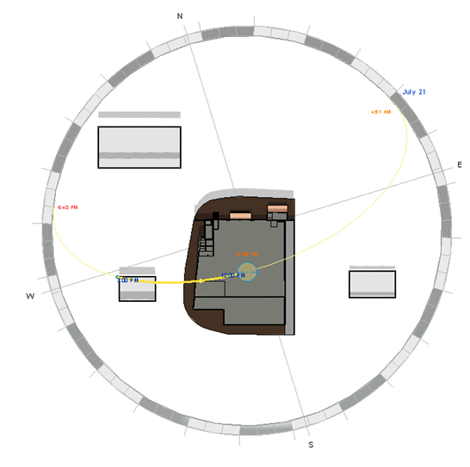
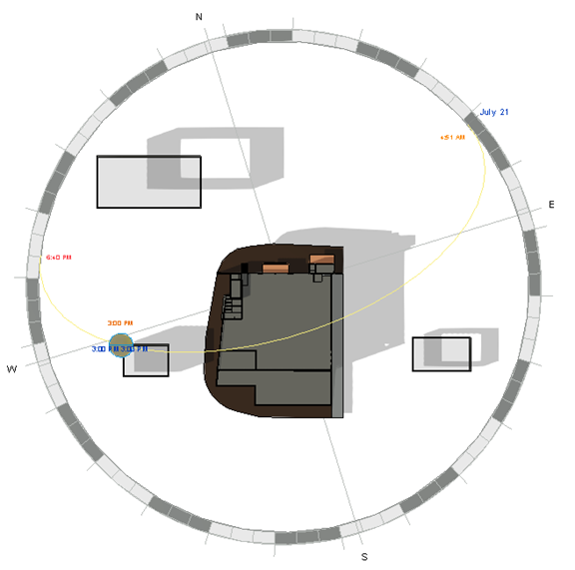
Shadowing and Overshadowing
Summer (21/July)
at 8:00 a.m.
at 12:00 p.m.
at 3:00 p.m.

Slide 28
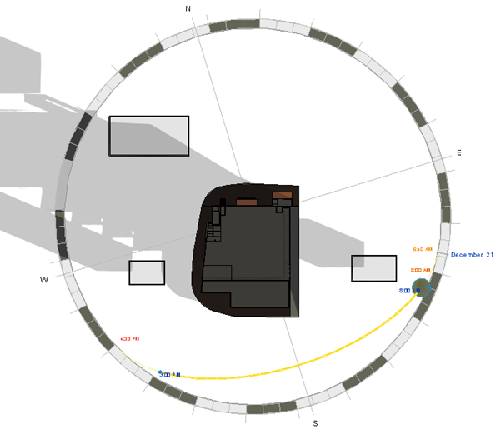
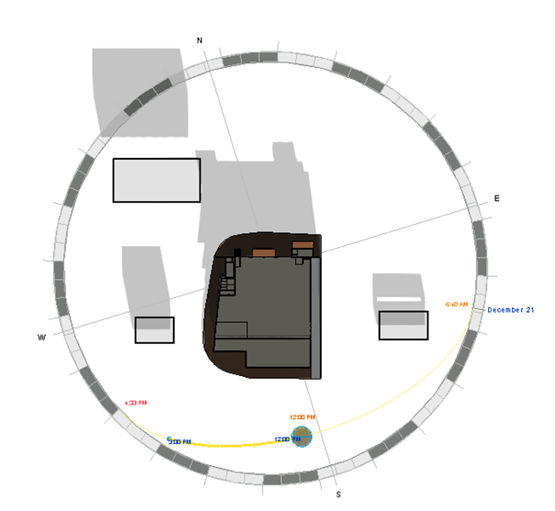
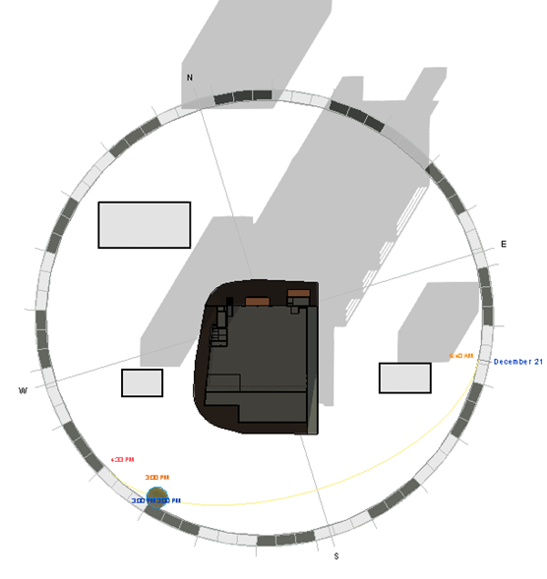
Shadowing and Overshadowing
Winter (21/Dec.)
at 8:00 a.m.
at 12:00 p.m.
at 3:00 p.m.

Slide 29


Slide 30
Materials
The parameters for seismic analysis
Concrete with compressive strength of 28 MPa (B350) and 32 MPa(B400)
Steel rebar with yielding strength of 420 MPa
Steel with minimum yield stress of 248.1 MPa.
1
Mass source: 100% for dead laods and SID , 25% for live laods.
2
Seismic zone : The faculty is located in Nablus city Therefore, the seismic zone is 2B and the Z value is equal to 0.20.
3
Soil profile: The soil type is rock so the soil profile is SB .
4
5
6
Force Reduction Factor R = 5.5 (Building Frame System - shear wall)
Importance Factor I = 1.25
Acceleration-Dependent Seismic Coefficient Ca = 0.2
7
Velocity-Dependent Seismic Coefficient Cv = 0.2
8
Response spectrum scale factor = $\frac{I×g}{R}$ = $\frac{1.25 ∗9810}{5.5}$ = 2230
Response spectrum scale factor = (𝑰×𝒈)/𝑹 = (𝟏.𝟐𝟓 ∗𝟗𝟖𝟏𝟎)/(𝟓.𝟓) = 2230
Codes
Loads
ACI 318-14
Seismic design UBC 97
ASCE for load design
AISC360-10 for steel analysis,
Live load = 5KN/m²
SID = 4KN/m²

Slide 31
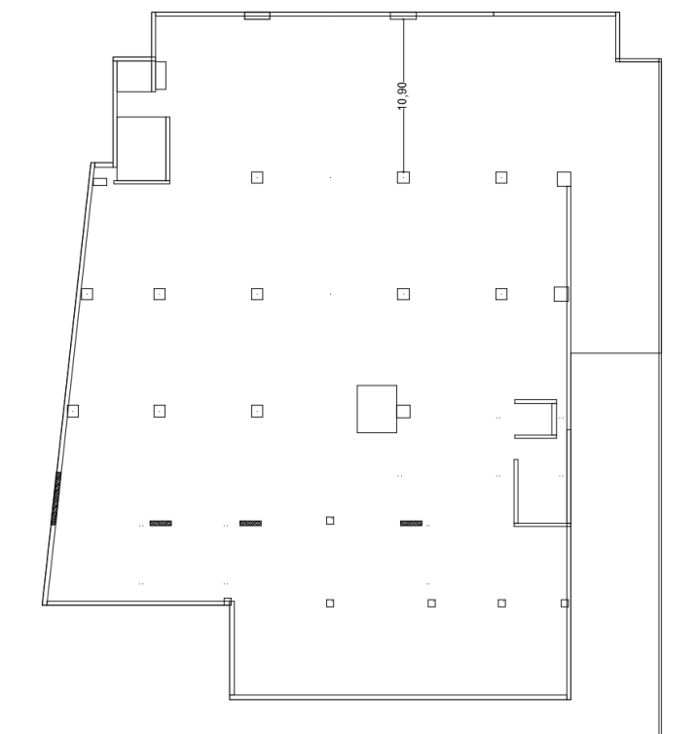
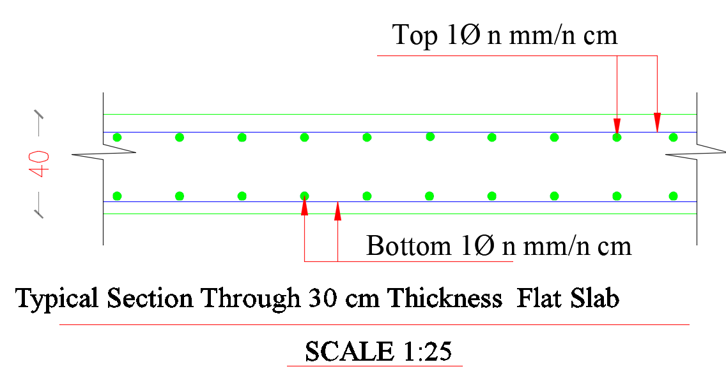
Slabs
The largest span for Flat slab

Slide 32
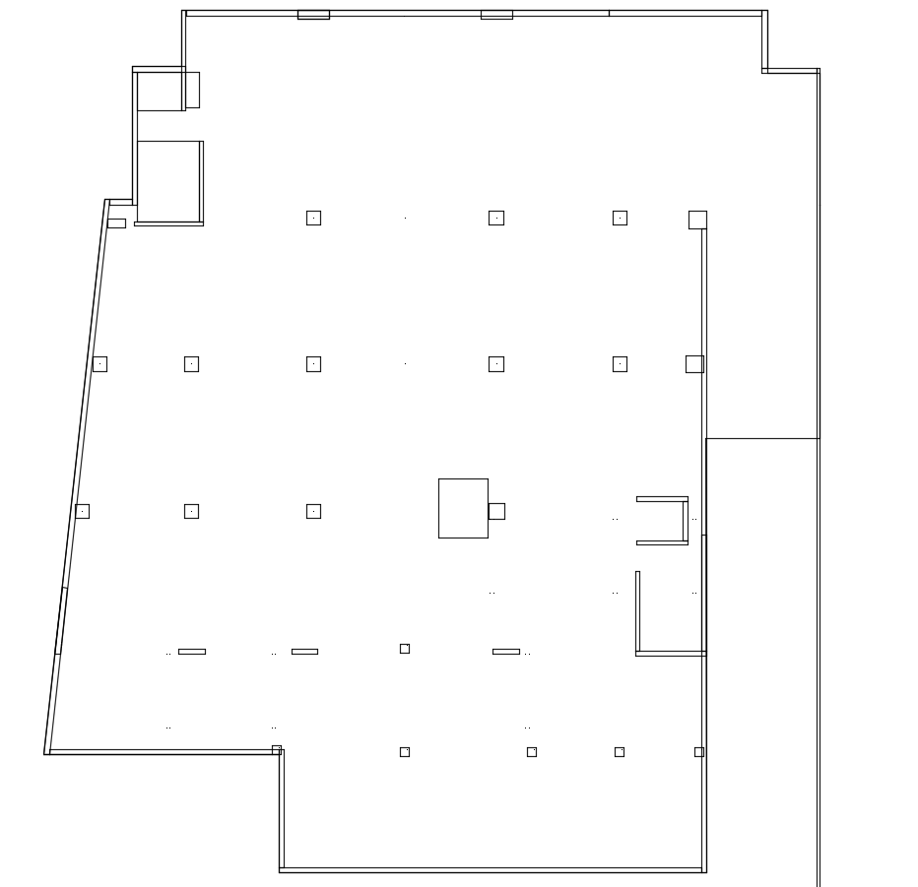
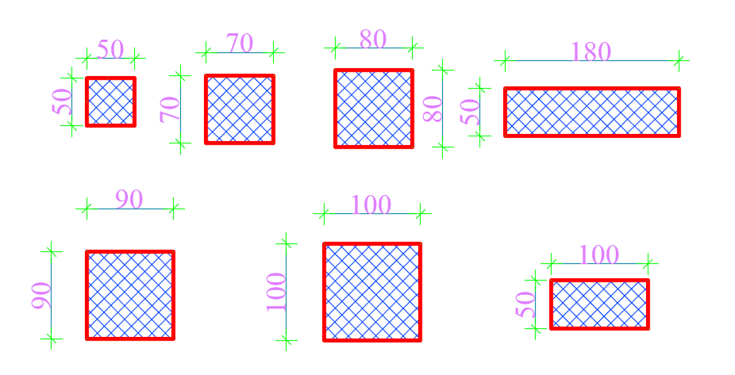
Columns
The distribution of columns and shear walls

Slide 33
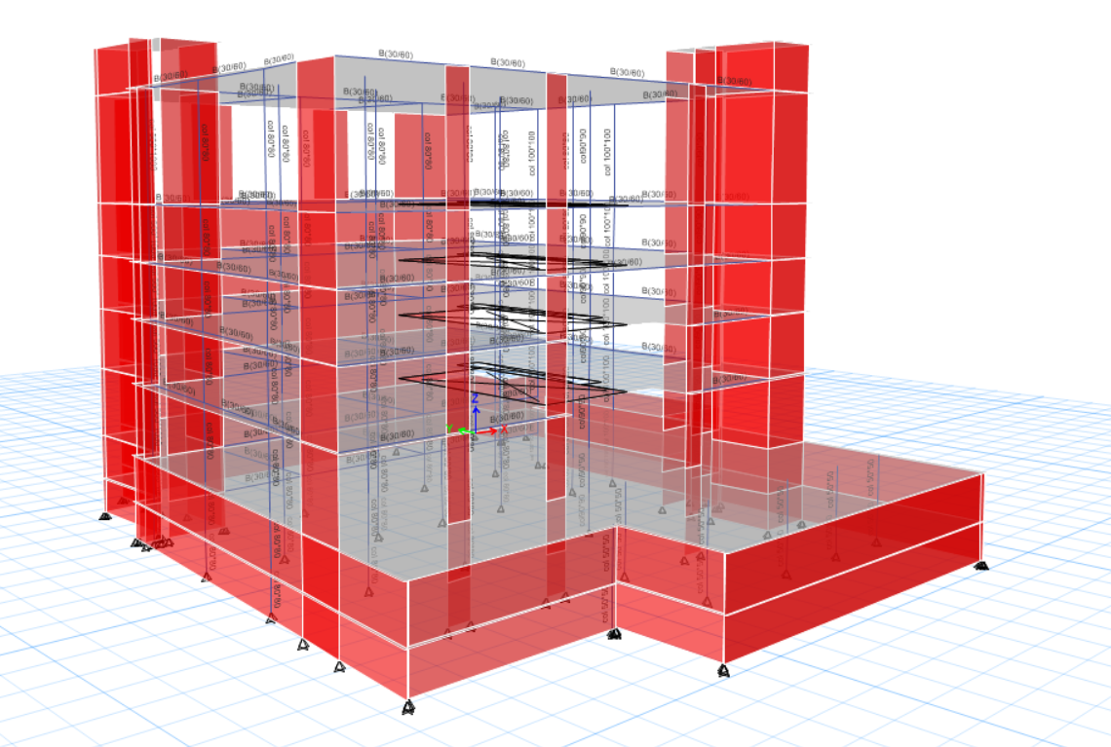
ETABS model

Slide 34
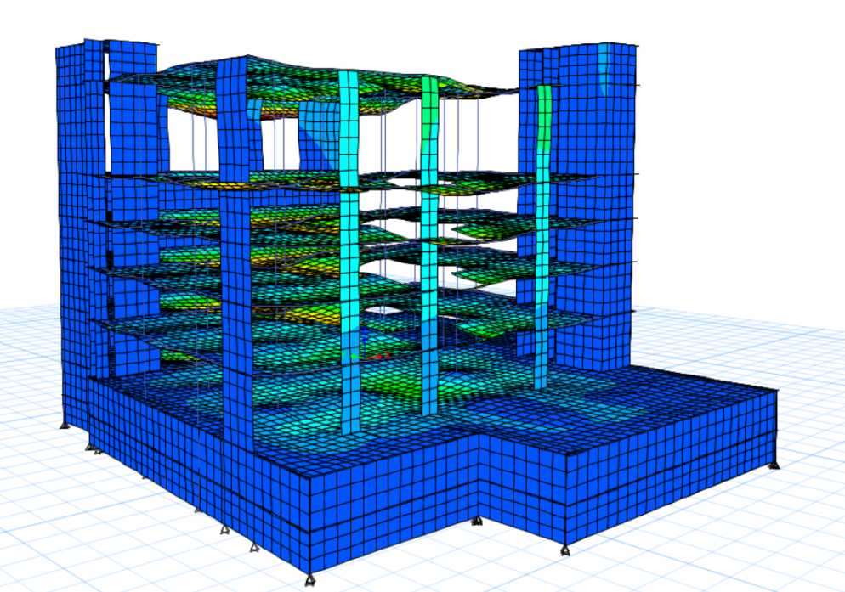
Compatibility check
To ensure the calculations is done correctly some

Slide 35

Equilibrium
Base reaction from ETABS
The error from manual calculations less than 5% for Dead and live loads reaction from ETABS

Slide 36
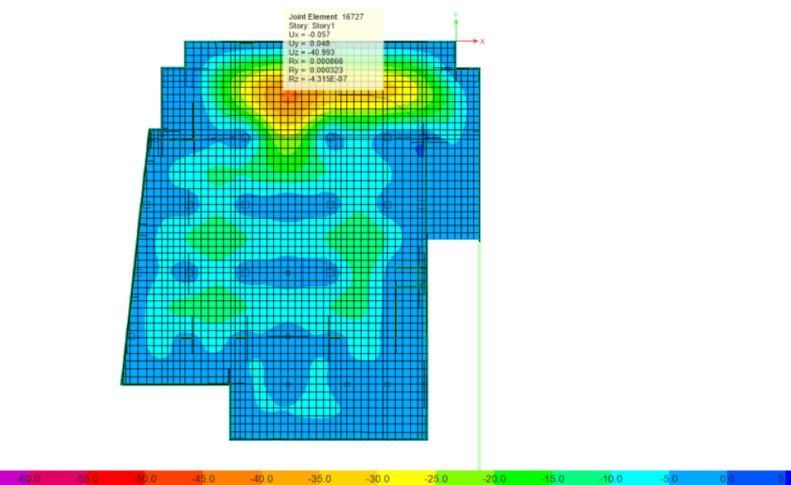
Deflection check
The deflection from ETABS in the first floor

Slide 37


Check internal forces

Slide 38

Seismic analysis
Mass source: 100% for dead loads and SID , 25% for live loads.
Velocity-Dependent Seismic Coefficient Cv = 0.2
Response spectrum scale factor = $\frac{I×g}{R}$ = $\frac{1.25 ∗9810}{5.5}$ = 2230
Response spectrum scale factor = (𝑰×𝒈)/𝑹 = (𝟏.𝟐𝟓 ∗𝟗𝟖𝟏𝟎)/(𝟓.𝟓) = 2230
Seismic zone : The faculty is located in Nablus city Therefore, the seismic zone is 2B and the Z value is equal to 0.20.
Soil profile: The soil type is rock so the soil profile is SB .
Force Reduction Factor R = 5.5 (Building Frame System - shear wall)
Importance Factor I = 1.25
Acceleration-Dependent Seismic Coefficient Ca = 0.2

Slide 39


Seismic analysis

Slide 40
Seismic analysis
Seismic checks:
Period Check
Time period from ETABS <= 1.4
Tmethod _{A} = 1.4 ×0.685 =1.00 sec.
Time period from mode 1 (Tx) = 1.28 sec > 1.00 sec, the check is ok if the drift check is ok.
Time period from mode 2 (Ty) = 1.00 sec < 1.00 sec, the check is ok.

Slide 41
Modal Mass Participating Ratios Check
Summation of the mass participation ratio > 0.90, so the check is ok.

Slide 42
Base shear check
Building weight from ETABS
Base shear values from ETABS

Slide 43
Drift check
All drifts in floors < limit, so the check is ok

Slide 44


Shear check
Wide beam shear check
$∅Vc>Vu$, so the solid slab does not need for shear reinforcement
Punishing shear check

Slide 45


Design of structural elements
Slabs
The top reinforcement in the slabs in the X-direction for second floor
The slab reinforcement for the second floor

Slide 46

Columns
The rebar percentage for columns from ETABS
The distribution of the columns

Slide 47

The detailing for columns

Slide 48


Beams
The design result from ETABS for Basement slab beams

Slide 49


Basement wall design
From ETABS the vertical will be used ₂$∅12/15$ cm and for horizantal rebar will be used ₂$∅12/15$ cm

Slide 50


Stair design

Slide 51


Footing checks and design
For this building soil type is rock so Q _{all} will be 300 KN/m^{2 .}
Mat foundation will be used

Slide 52


Punishing check in safe
Soil bearing capacity check in safe

Slide 53

Mat foundation detailed

Slide 54

Artificial lighting design
H

Slide 55



Artificial lighting design
Office

Slide 56




Artificial lighting design
Fast food restaurant
Shoes store
Retail store
Parking

Slide 57
Fire Fighting System
Type of spaces | Used fire suppression system | Fire detector system
Kids playing hall | Fire extinguisher(class A),Water sprinkler | Smoke detector
Restaurant and café shop | Fire extinguisher (class C) ,Water sprinkler | Heat detector
offices | Fire extinguisher (class A) ,Water sprinkler | Smoke detector
retail store | Fire extinguisher(class A),Water sprinkler | Smoke detector
Corridor | Water sprinkler , Hose station, Fire extinguisher (class A) | Smoke detector
Parking | Water sprinklers, Fire extinguisher (class A) | Heat detector
Electrical room. | CO₂ sprinkler, fire extinguisher (class C) | Smoke detector
Transformer room | CO₂ sprinkler, fire extinguisher (class C) | Smoke detector

Slide 58
Acoustical Consideration
Space | RT60 | SPL (dB) | NR (dB) | Noise level (dB)
Restaurants | 0.7 - 1.2 | 40-55 | 45 | 40- 50
Commercial function (stores) | 1-1.7 | 45-50 | 45 | 40-50
Open Offices | 0.8 - 1.3 | 45 | 40 | 40
Kids playing hall | 1-1.5 | 45 | 45 | 40-50

Slide 59

Acoustical Design
Restaurant, stores and kids playing hall floor

Slide 60

Acoustical Design
Office ceiling

Slide 61

Acoustical Design
Walls
Office adjacent to office/toilet

Slide 62

Acoustical Design
Walls
Office adjacent to lobby

Slide 63

Power design
The total power load per day =156.674 KW.
Total current= 456.84 A.
Total current for the circuit breaker= 525.366 A.
Cable size=2@120mm².

Slide 64

Sample design of water supply

Slide 65

Sample design of Drainage system

Slide 66


Slide 67
Cost estimation:
Shopping mall floor | Floor area (m²) | Unit cost ($/m²) | Floor cost ($)
Basement 1 | 1640 | 1550 | 2542000
Basement 2 | 1474 | 1550 | 2284700
Ground floor | 1245 | 1550 | 1929750
First floor | 1245 | 1550 | 1929750
Second floor | 1245 | 1550 | 1929750
Third floor | 1245 | 1550 | 1929750
Fourth floor | 1245 | 1550 | 1929750
Total shopping mall cost ≈5,475,500$

Slide 68


