Slide 1

Graduation Project II
Design of Tubas Main Street
Bashar Hanoun, Noor Akhras & Aws Ammar
Dr. Amjad Issa

Slide 2
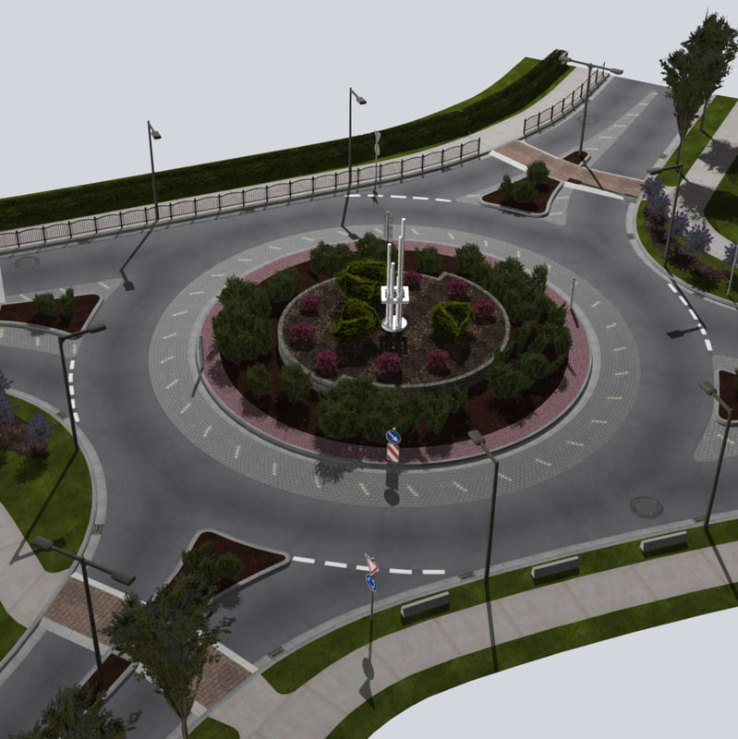
Design of Tubas Main Street
Prepared by:
Bashar Hanoun
Noor Akhras
Aws Ammar
Under Supervision of:
Dr. Amjad Issa

Slide 3
DESIGN OF TUBAS MAIN STREET
BASHAR HANOUN, NOOR AKHRAS & AWS AMMAR

Slide 4
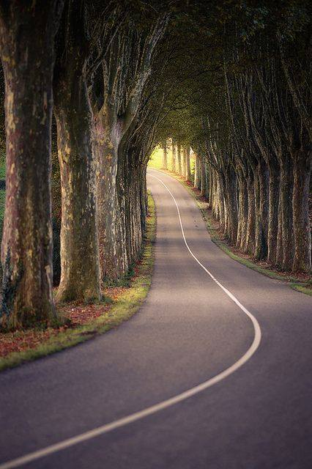

1
General Background
2
Objectives
3
Project Entrance
4
Methodology & Design Criteria

Slide 5
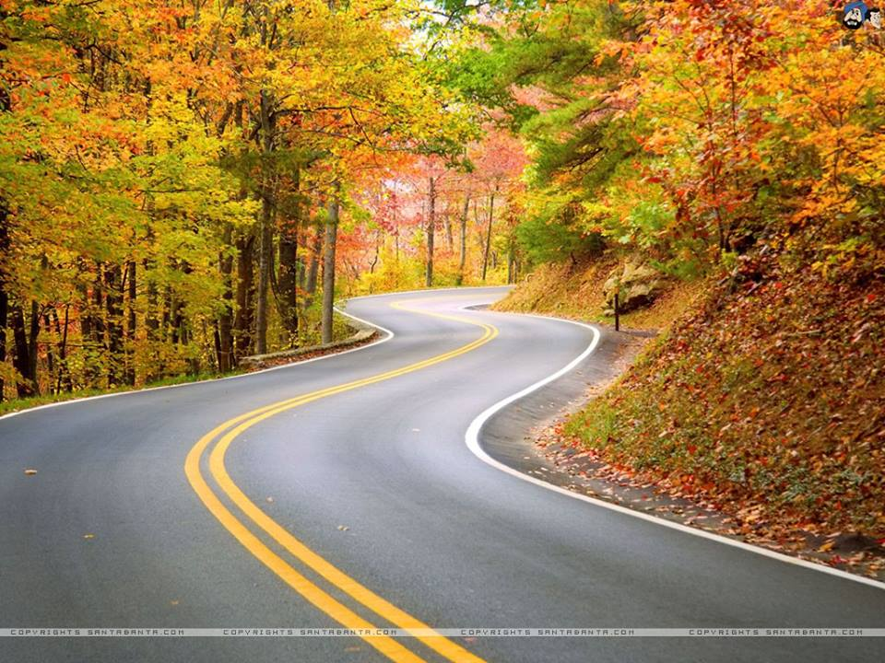
5
Geometric Design
6
Pavement Design
7
BOQ & Cost Estimations
8
Conclusions & Recommendations

Slide 6
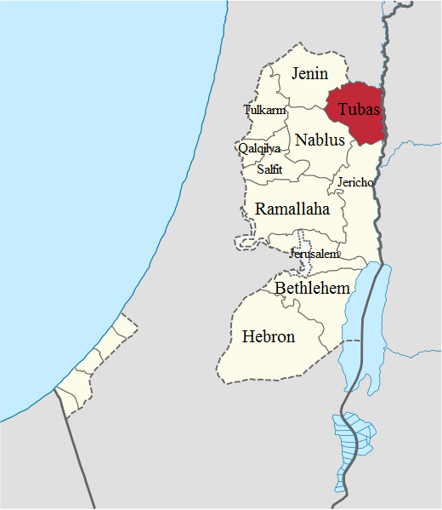

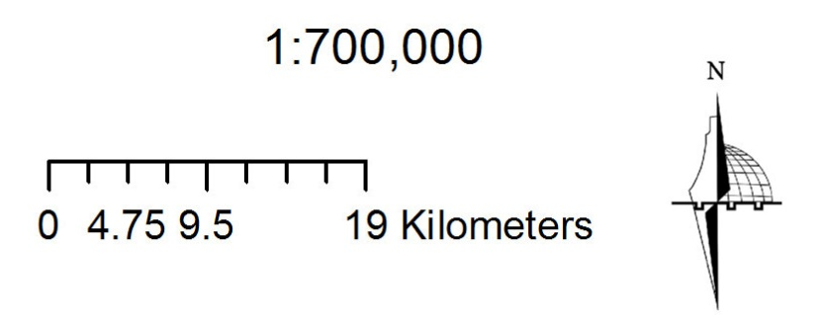
Tubas city is one of the most important Palestinian cities because it’s connects Jenin city with Nablus city in addition to the Jordan Valley.

Slide 7
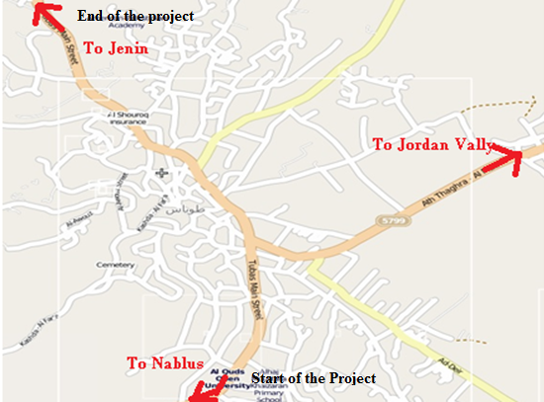
Map of Tubas City and the location of Tubas Main Street

Slide 8
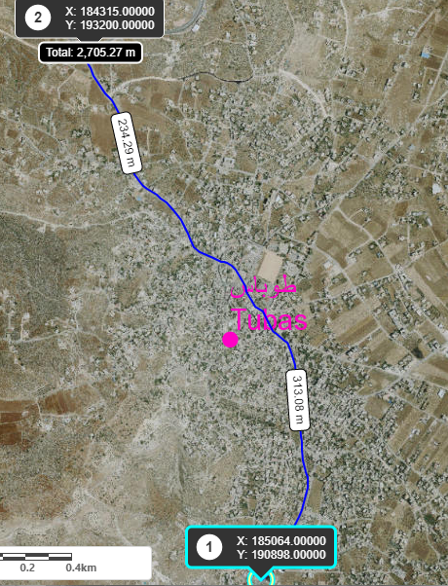
Aerial Photos for the Entrance and Exit of the road.

Slide 9
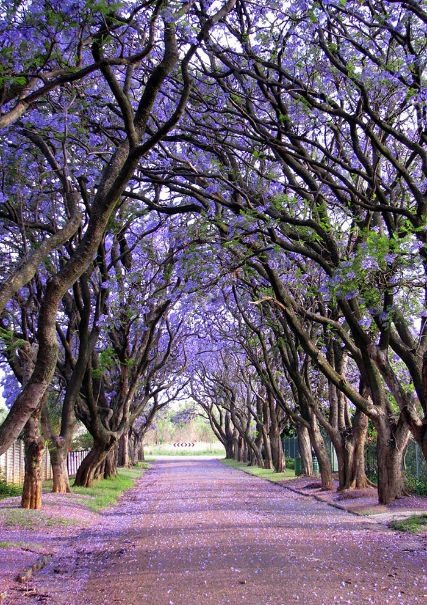

1
Evaluate Existing Road
2
Analyze Existing Road
3
Re-Design Geometric of existing Road
4
Quantities & Costs Estimated

Slide 10
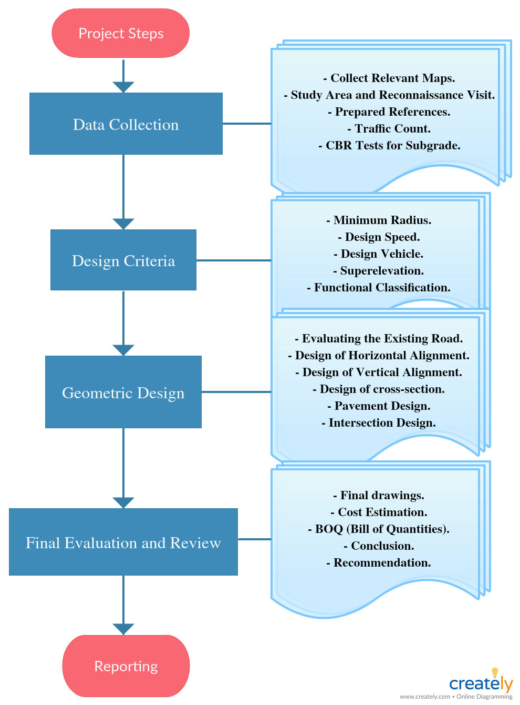
Methodology

Slide 11
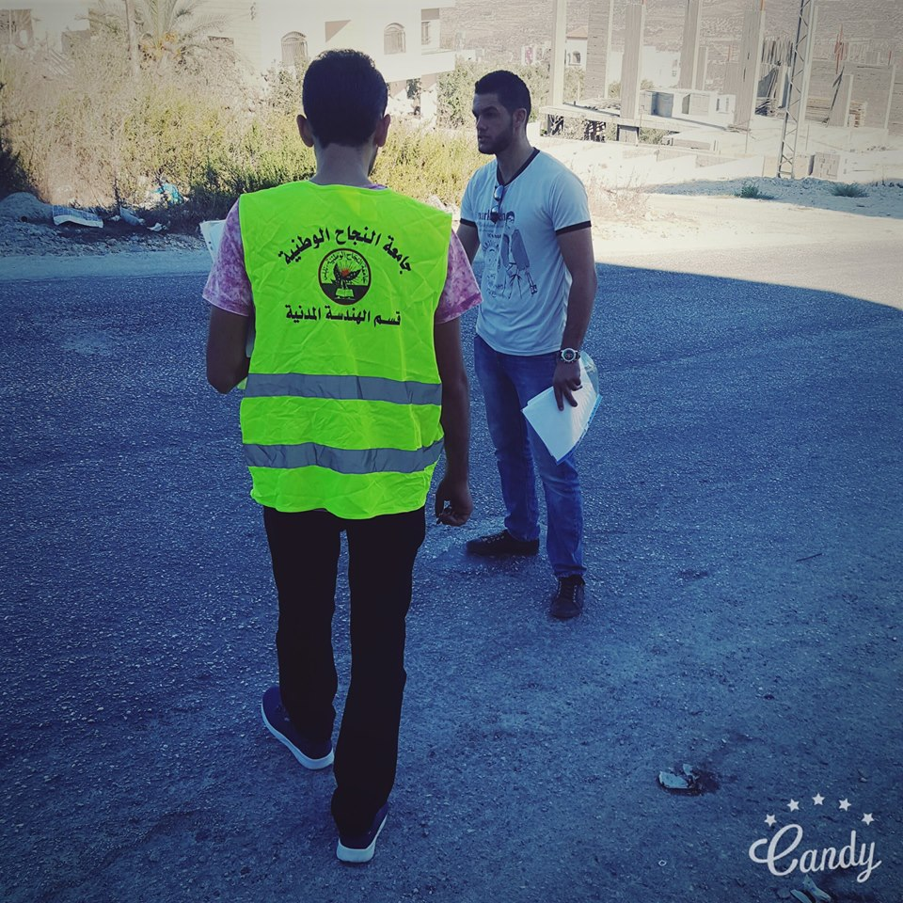
Site Investigation
Road Inventory studies and data collection

Slide 12
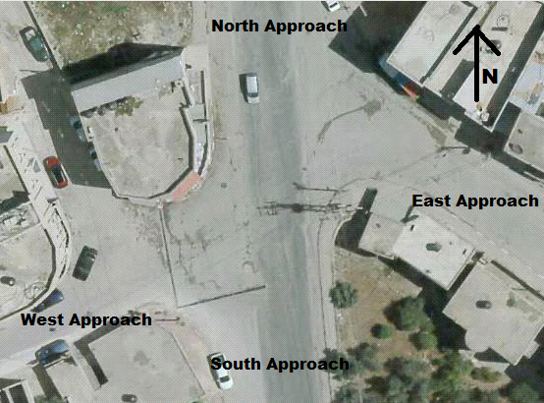
Al-Shaheed Intersection
16 meter , two way
10 meter , two way
8 meter , two way
20 meter , two way

Slide 13
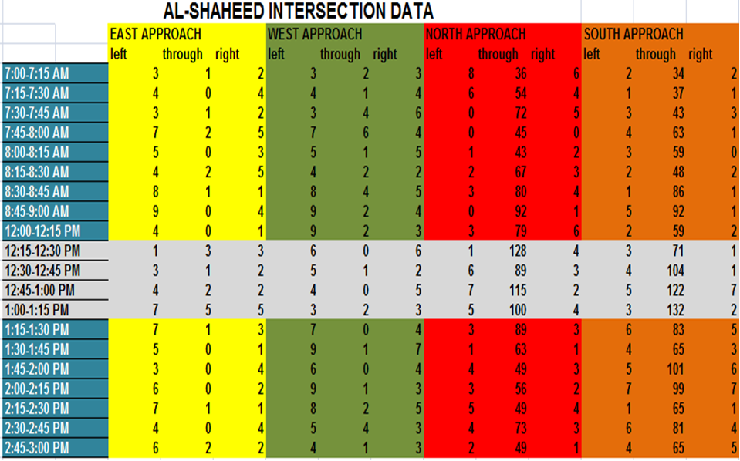
Data Collection

Slide 14
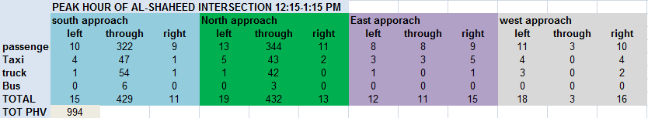
Peak Hour Classification

Slide 15
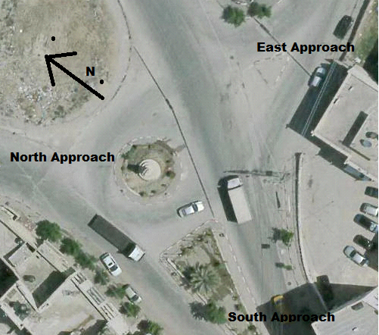
Tubas Roundabout Intersection
12 meter , one way
14 meter , one way
20 meter , two way

Slide 16
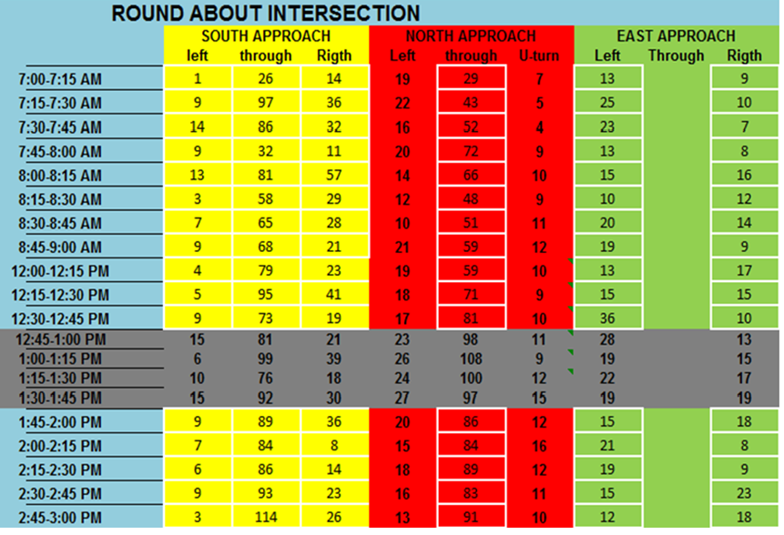
Data Collection

Slide 17
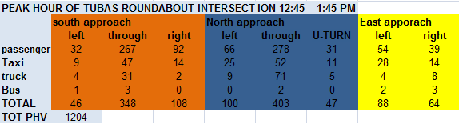
Peak Hour Classification

Slide 18
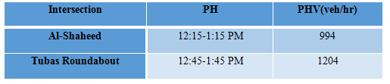
Data Analysis
PH and PHV calculation

Slide 19
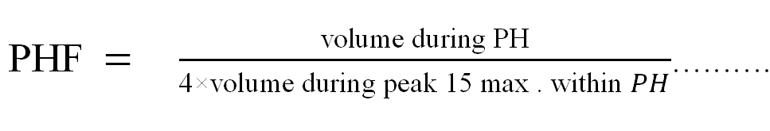
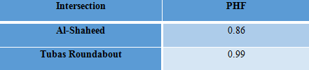
Overall PHF value for each Intersections

Slide 20
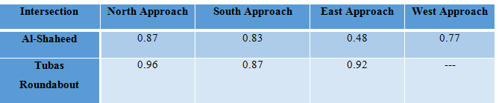
PHF value per approach for both Intersections

Slide 21
PH, PHV and PHF calculation after 20 years
Intersection | PH | PHV(veh/hr)
Al-Shaheed | 12:15-1:15 PM | 1792
Tubas Roundabout | 12:45-1:45 PM | 2171
Intersection | PHF
Al-Shaheed | 0.86
Tubas Roundabout | 0.99

Slide 22
Warrants and Level of service
Warrant 1, Eight-Hour Vehicular Volume.( Not applicable ).
Warrant 2, Four-Hour Vehicular Volume.
Warrant 3, Peak Hour Delay/Volumes.
Warrant 4, Pedestrian Volume. ( Not applicable ).
Warrant 5, School Crossing. ( Not applicable ).
Warrant 6, Coordinated Signal System. ( Not applicable ).
Warrant 7, Crash Experience. ( Not applicable ).
Warrant 8, Roadway Network. ( Not applicable ).

Slide 23
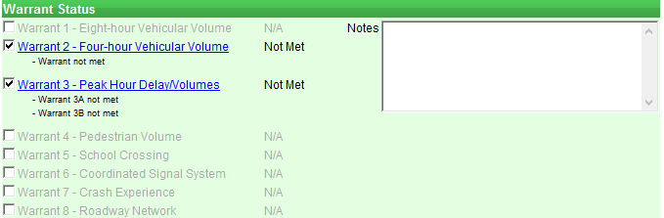
The result of warrants in Al-Shaheed intersection

Slide 24
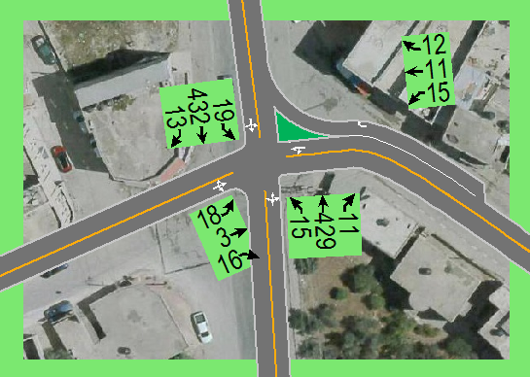
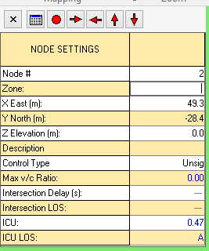
The Result of LOS of Al-Shaheed intersection

Slide 25
The result of warrants in Al-Shaheed intersection after 20 years

Slide 26
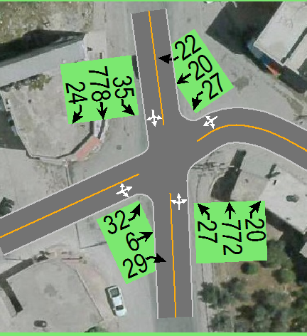
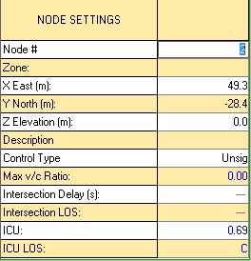
The Result of LOS of Al-Shaheed intersection after 20 years

Slide 27
The result of warrants in Tubas Roundabout intersection

Slide 28
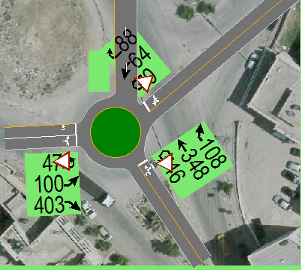
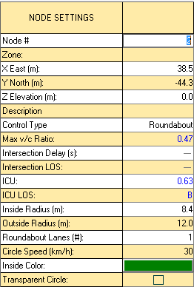
The result of LOS of Tubas Roundabout intersection

Slide 29
The result of warrants in Tubas Roundabout intersection after 20 years

Slide 30
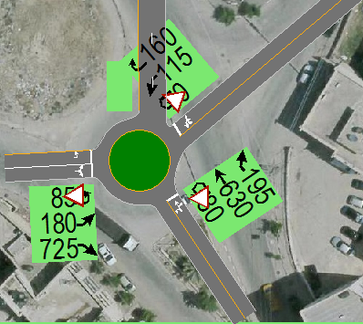
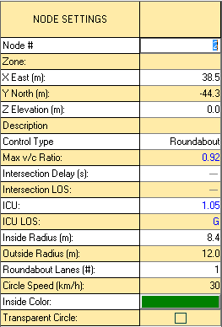
The result of LOS of Tubas Roundabout intersection after 20 years

Slide 31
The result of warrants in New Tubas Roundabout intersection

Slide 32
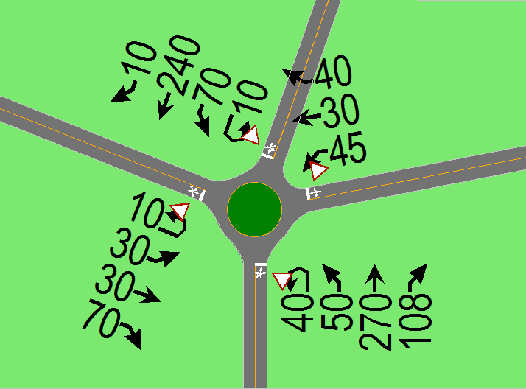
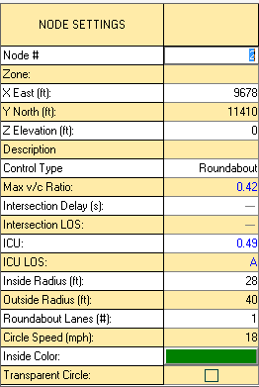
The result of LOS of New Tubas Roundabout intersection

Slide 33
The result of warrants in New Tubas Roundabout intersection after 20 years

Slide 34
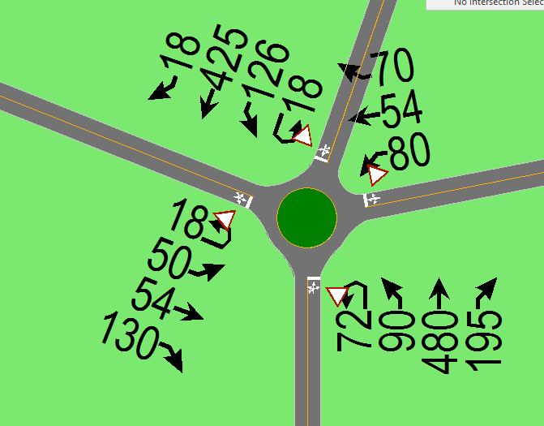
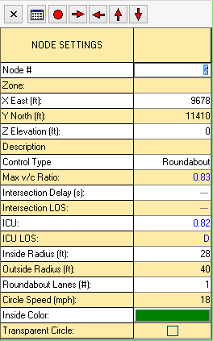
The result of LOS of New Tubas Roundabout intersection after 20 years

Slide 35
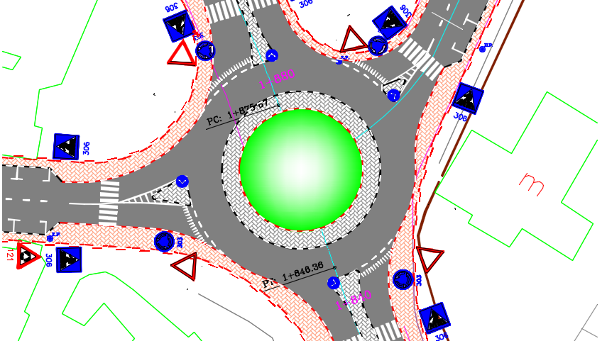
The New Tubas Roundabout intersection

Slide 36
The New Design of New Tubas Roundabout

Slide 37


Station | Design Speed (Km/hr) | Superelevation | Minimum Radius (m)
(0+000 – 0+370) | 50 | NON | 116
(0+370 – 2+800) | 70 | 6 % | 184
(2+800 – 8+200) | 50 | NON | 116
(8+200 – 9+120) | 40 | NON | 70
(9+120 – 9+396) | 50 | NON | 116

Slide 38

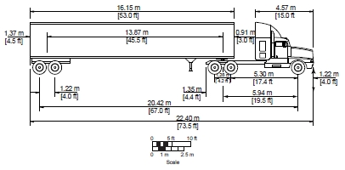
WB-20
Height = 4.1 m
Width = 2.6 m
Length = 22.4 m

Slide 39

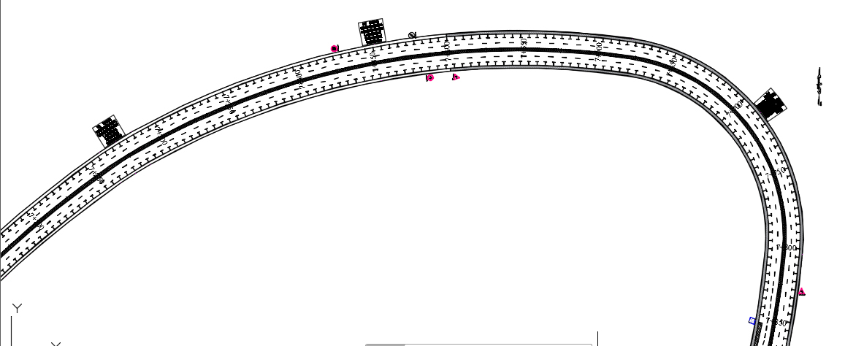
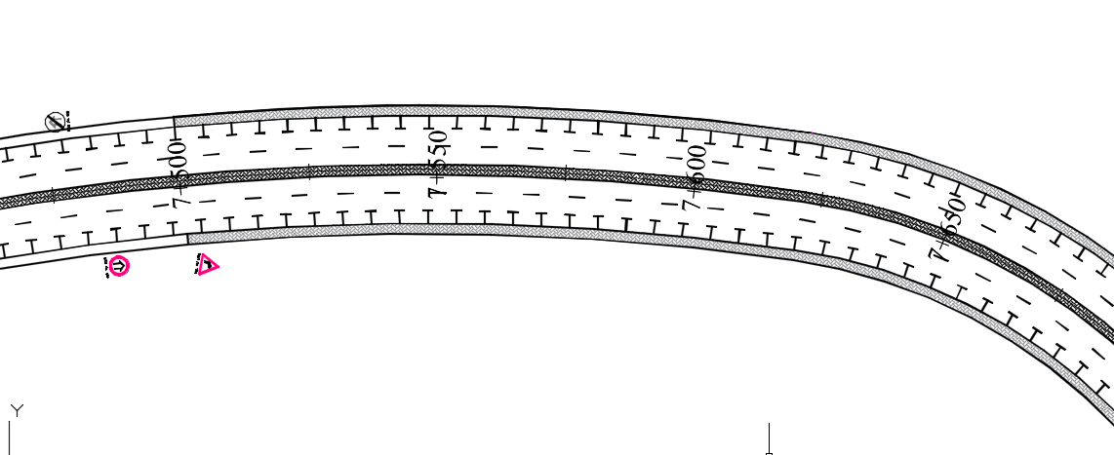
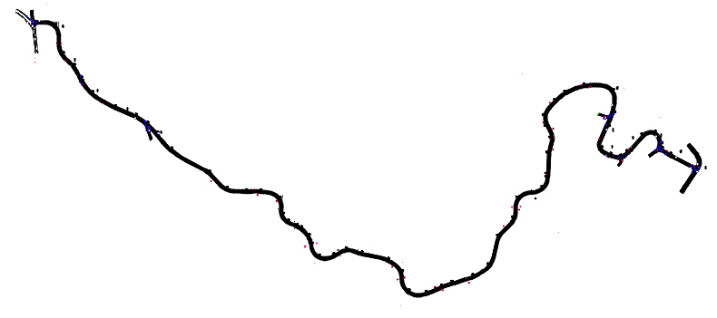
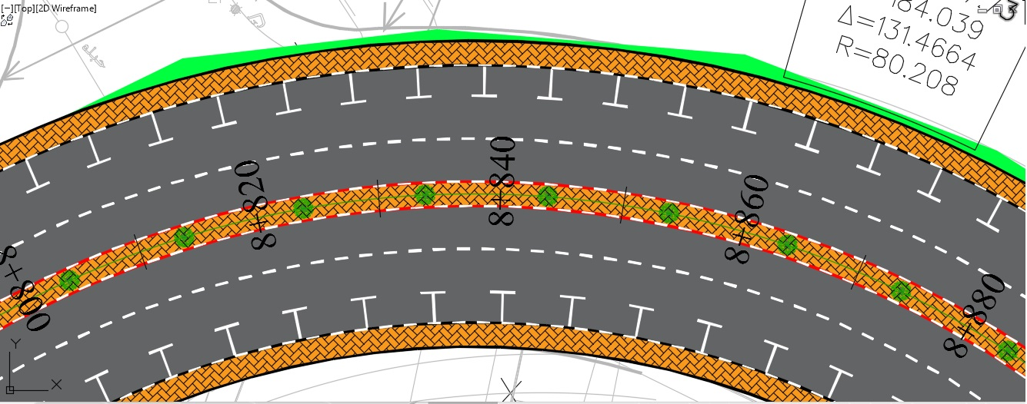
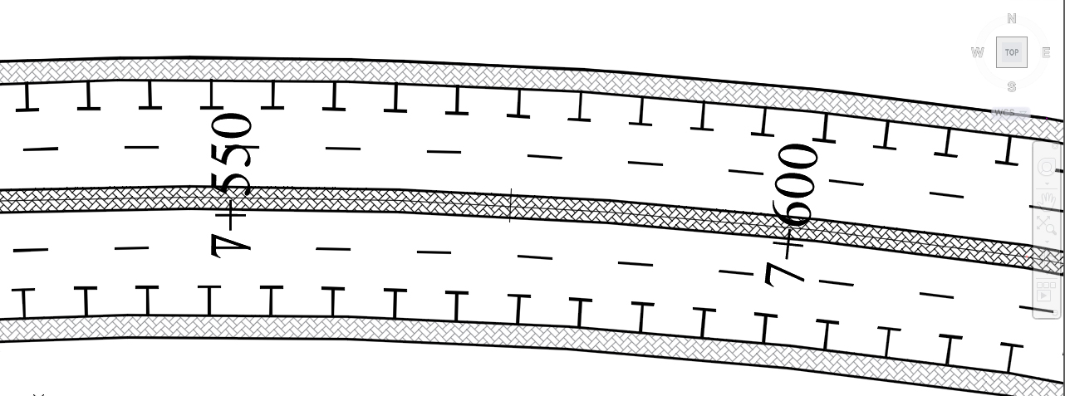
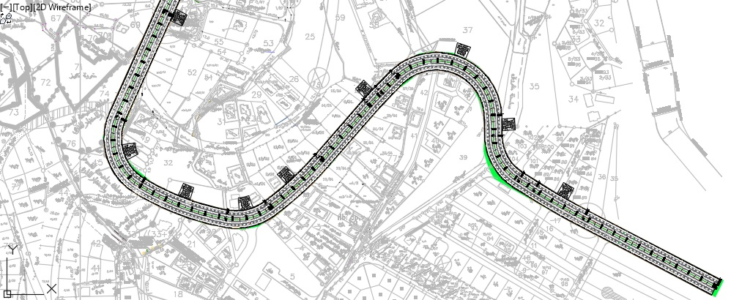
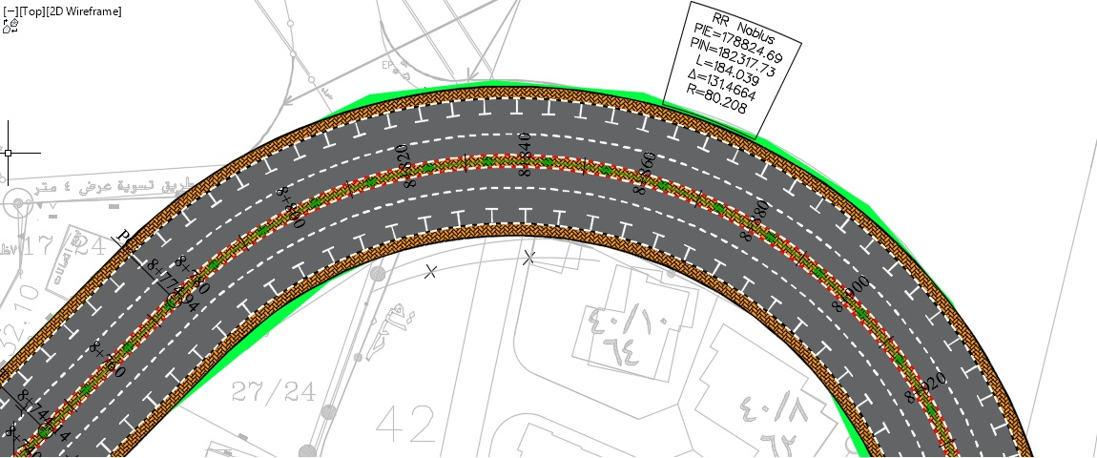
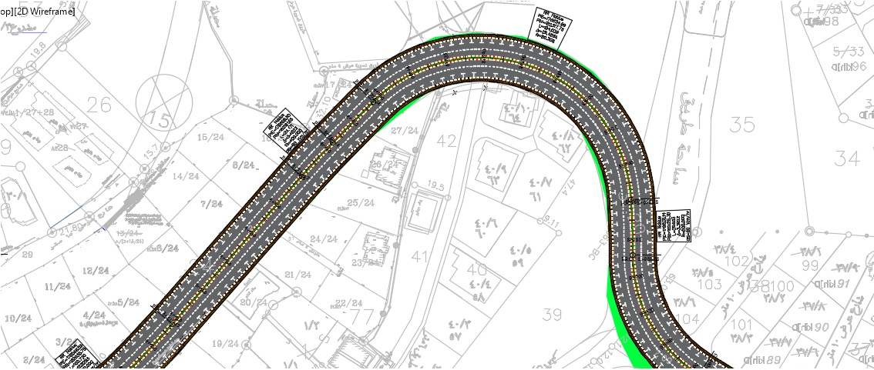

Slide 40
Type of the Curve | Number
Simple curves | 26
Compound curves | 12
Reversed curves | 6

Slide 41

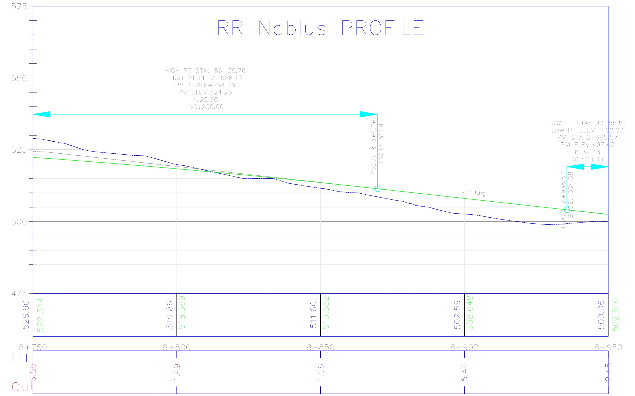

Slide 42
Max. Grade ➔ 13 %
Note : All segments match the max grade except the following.
Station | Grade
(0+020 – 1+095) | 15.12 %
(7+075 – 7+615) | 13.97 %

Slide 43
Type of Curve | Minimum K | Number
Crest Curve | SSD for V = 70 ➔ k = 17 for V = 50 ➔ k = 7 for V = 40 ➔ k = 4 | 9
Sag Curve | HSD For V = 70 ➔ k= 23 for V = 50 ➔ k = 13 for V = 40 ➔ k = 9 | 9

Slide 44

We have two typical cross section scenarios:
Type of the Cross Section | Station
With Sidewalk ( Typical 1 ) | (0+000 – 1+500)
 | (7+500 – 9+396)
With Shoulder ( Typical 2 ) | (1+500 – 7+500)

Slide 45
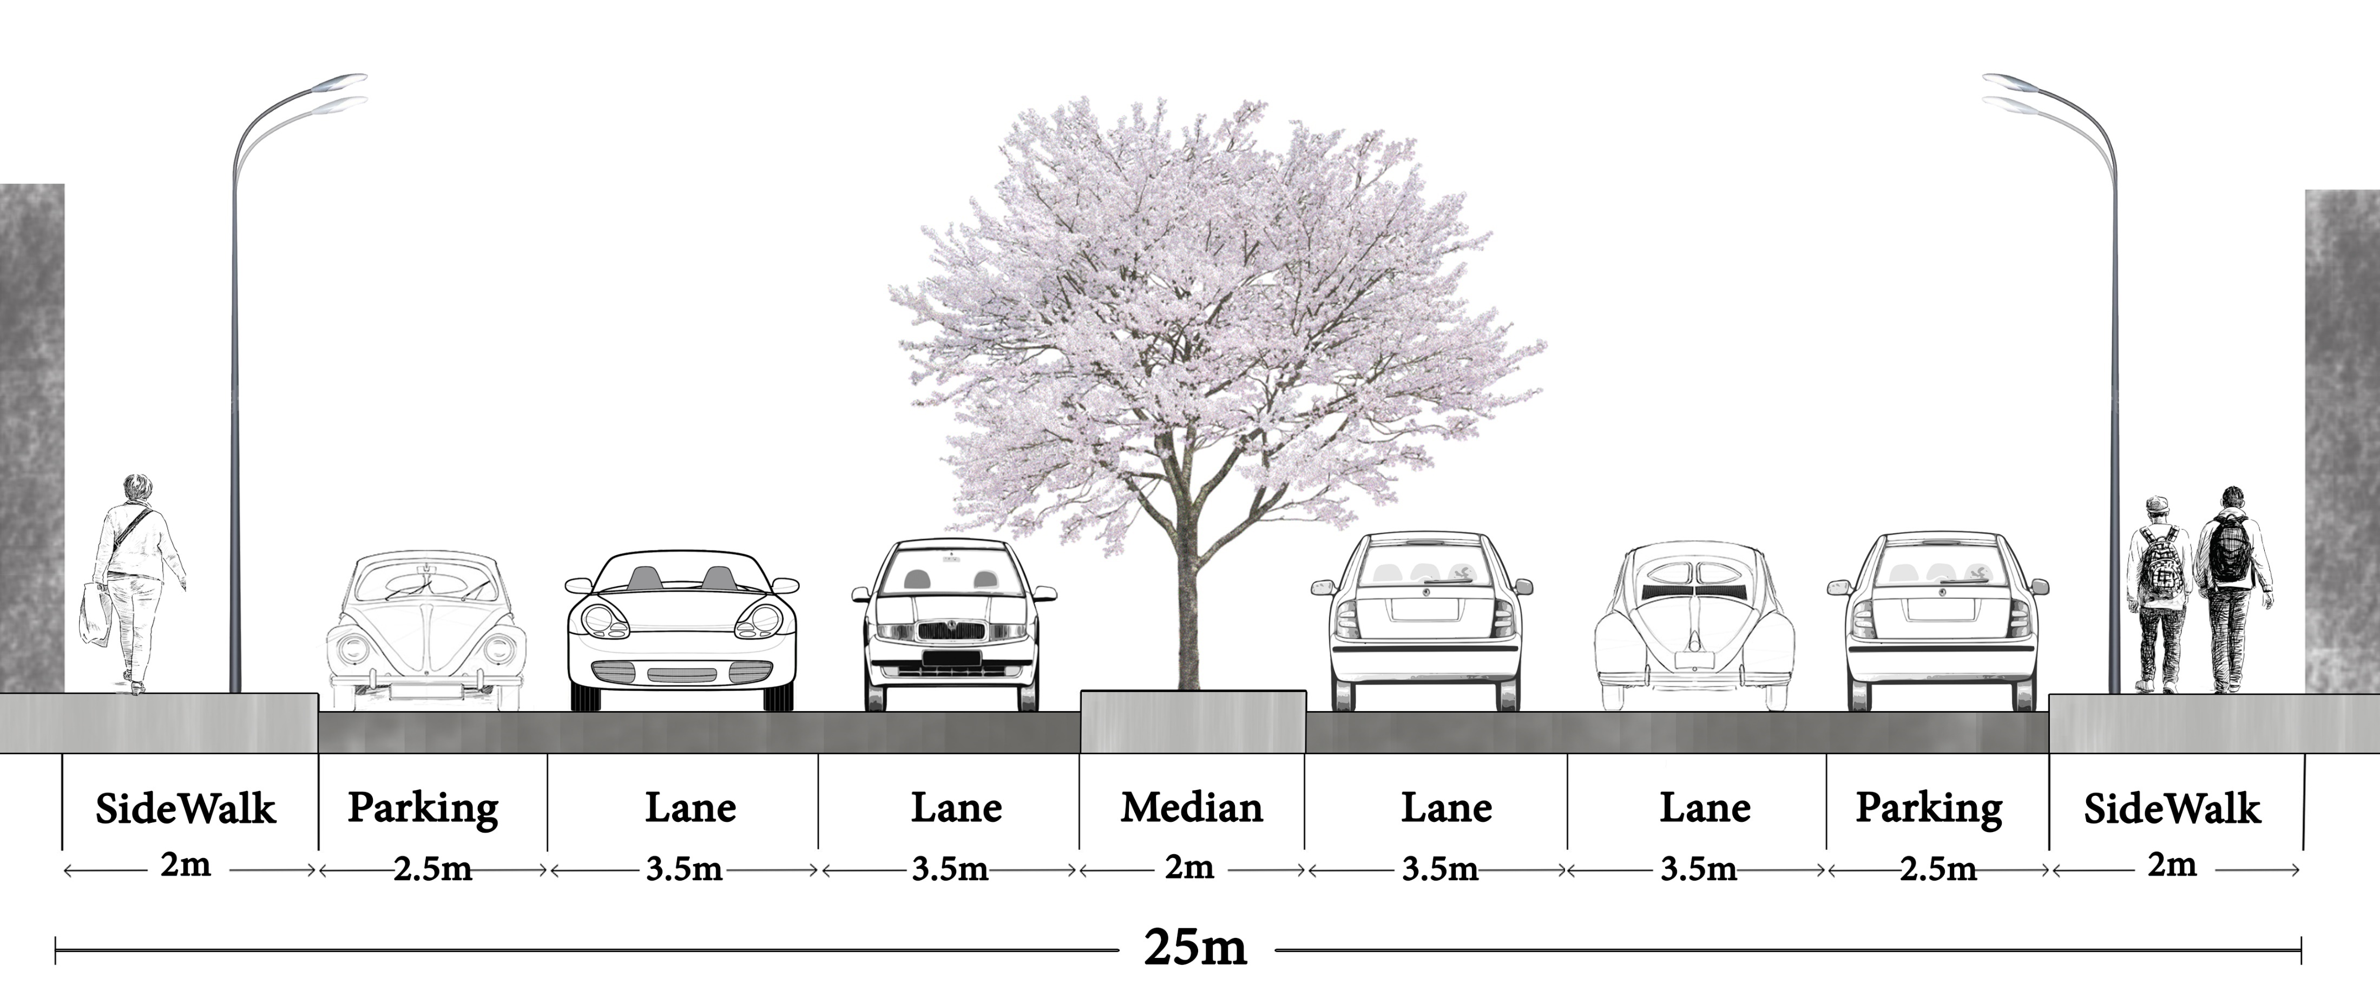
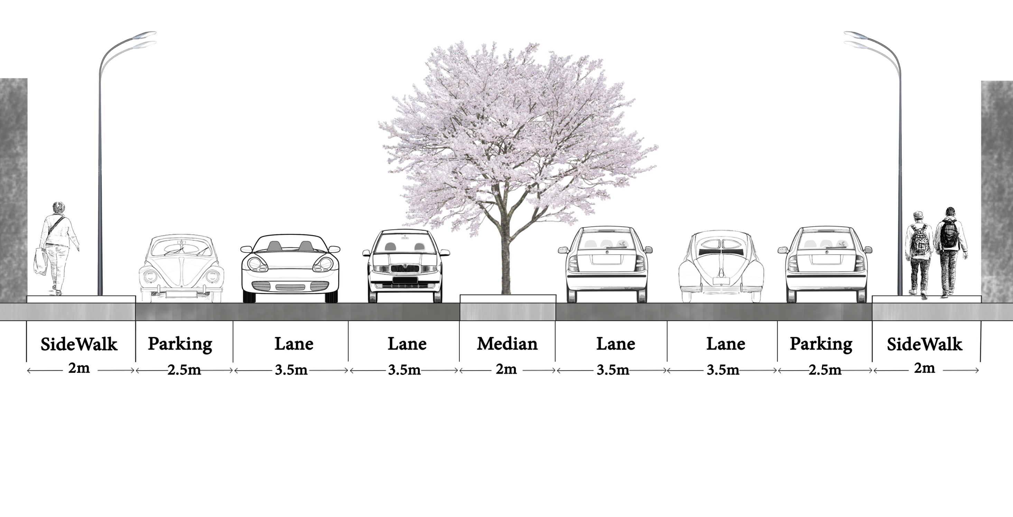
Typical Cross Section 1 ( with Sidewalk )

Slide 46
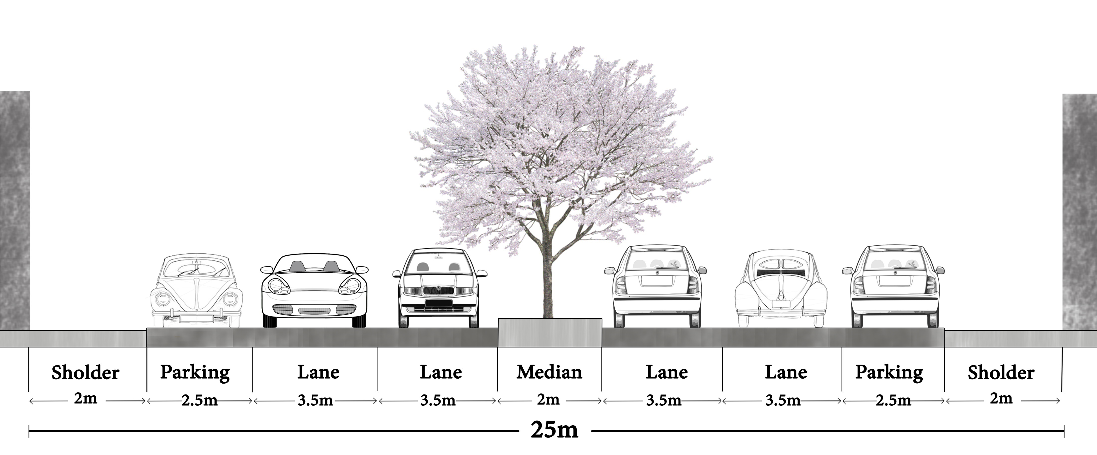
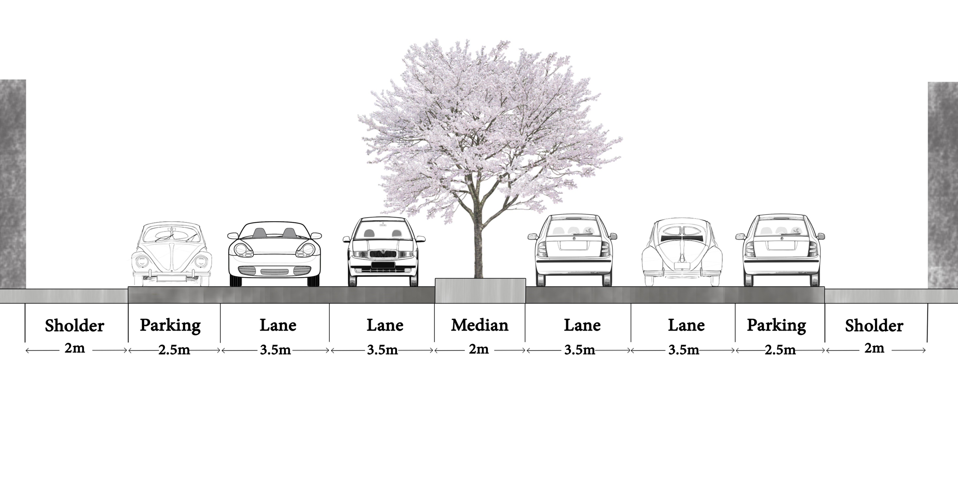
Typical Cross Section 2 ( with Shoulders )

Slide 47

Current ADT(Faisal Street)➔ 31080 veh/day
Percentage (NRR) = 23 % ➔ Take 25 %
25 %
Estimation ADT(NRR)➔ 7770 veh/day
Design ESAL (20 years)➔ 2.9 Millions

Slide 48
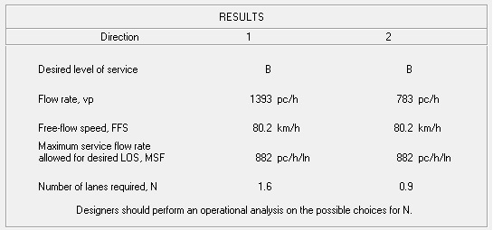
HCS software check:
Travel lanes number (N = 2) ➔ Satisfied

Slide 49

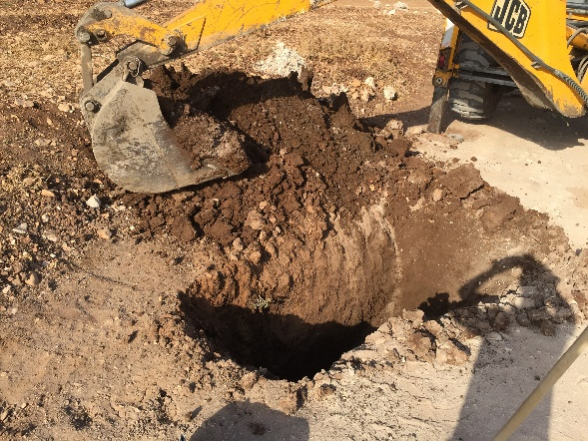



CBR Test

Slide 50
Sample | CBR Value | Stations Represented
Sample 1 (0+850) | 27.4 % | (0+000 – 7+500)
Sample 2 (7+600) | 3.8 % | (7+500 – 9+396)

Slide 51

0+000 – 7+500
7+500 – 9+396

Slide 52

INT.1
U-Turn
INT.3
INT.2
INT.4
INT.5
INT.6

Slide 53

INT.1

Slide 54

U - Turn

Slide 55

INT.2

Slide 56

INT.3

Slide 57

INT.4

Slide 58

INT.5

Slide 59

INT.6

Slide 60

Vehicle Tracking Check

Slide 61

Items | Estimation Cost (Million)
Cut & Fill | 4.79
Base Coarse | 1.41
Sub Base | 0.1
Pavement | 4.28
Marking | 0.22
Paving | 1.04
Signing & Cuties | 0.07
Walls & Guard Rail | 1.2
TOTAL PROJECT COST | 13.1 M

Slide 62
Conclusion
1
Decreasing Congestion and
Providing Accessibility
2
The Proposed Route not match
AASHTO Classification
3
The design match AASHTO around 90%
4
In high fill segments, we need
layers of Rock Block
5
The Current Solutions aimed at reduction the Traffic Jam

Slide 63

It is recommended to consider the other alternative modified route for the entrance of the road in order to work 4-legs intersection.
Nablus Municipality is encouraged to attain the needed funds to construct the whole Ring Road.
Redesign intersections after street operating.
Reorganizing the area around the Road especially at the End .

Slide 64
Complete all parts of the project surround Nablus-City.
Select the projects that are in the priory and short list according to the strategic plan.
Design a proper drainage system in order to avoid acceptable future problems in the road layers.
Design the thickness of the concrete walls.

Slide 65


Prevent the placing of grafts in the street area.
November
2017
February
2017

Slide 66


Check Current House Levels And Stabilize Street Levels.

Slide 67


