Slide 1
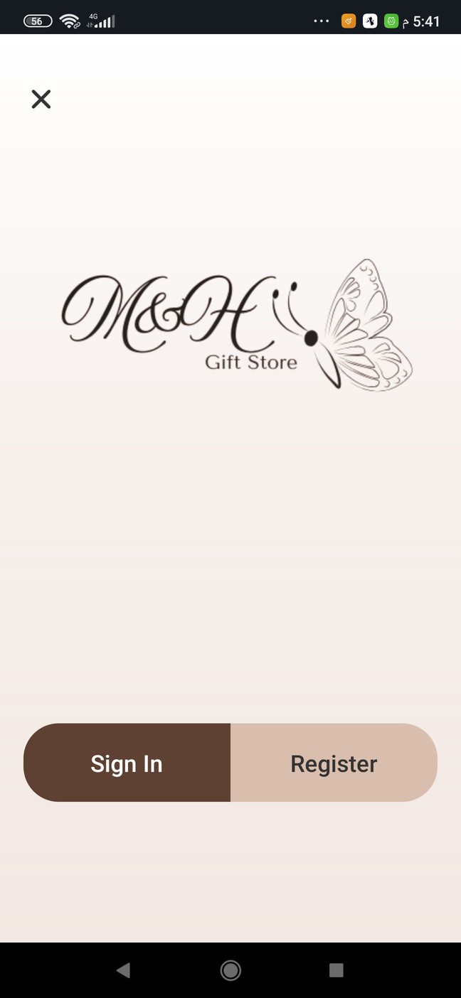
M&H Gift Store
Mobile Application
With
image recognition
Explore Now
  Aya Qazoor
  Mona Hindia
  Batool Khanfar
Supervised by :
  Dr. Ruba Awayes

Slide 2





The problem :
Difficulty reaching customers in dispersed locations
02
04
Difficulty building customer loyalty and trust
Difficulty for customers to easily find products suitable for their skin type
Poor order organization and inventory management
01
03

Slide 3





The Solution :
The app allows browsing and purchasing products from anywhere.
02
Implement a rewards and reviews system within the app
04
The app automates orders and inventory, reducing errors and showing availability.
The image recognition and personalized product recommendations.
01
03

Slide 4
Challenges
Learning a new programming language (React Native) from scratch
02
Linking the app with Firebase database
04
Loading all products at once may affect performance.
Implementing the image recognition feature
01
03

Slide 5








Tools Used :
Expo Go
Figma
Firebase
React Native
Imagur
Cursor Ai
Githup
Teachable Machine

Slide 6

The Logo :

Slide 7
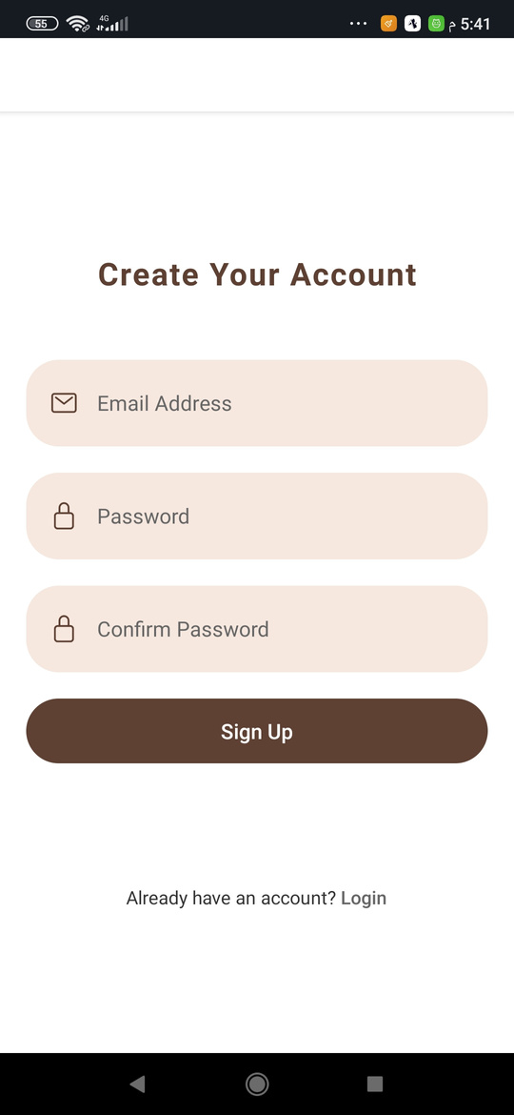
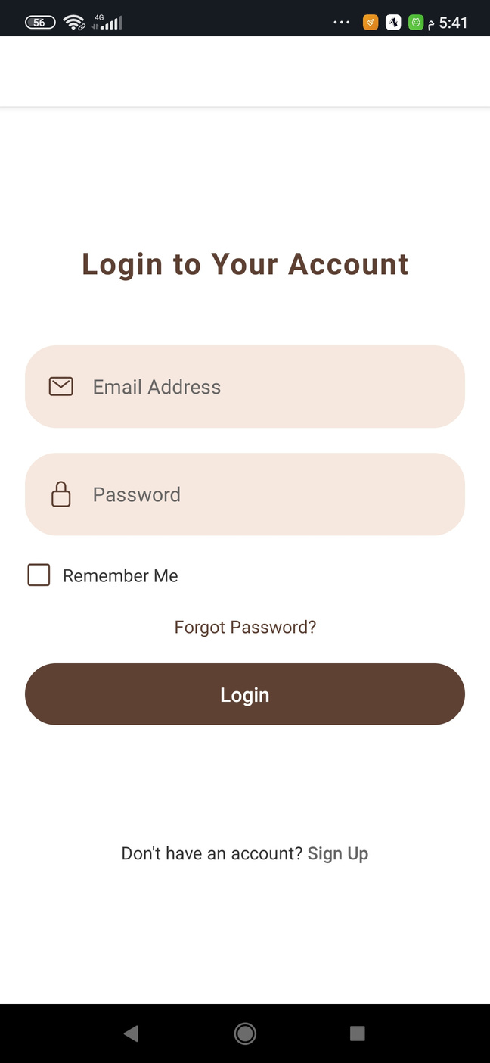
The Sign in &
Sign Up

Slide 8
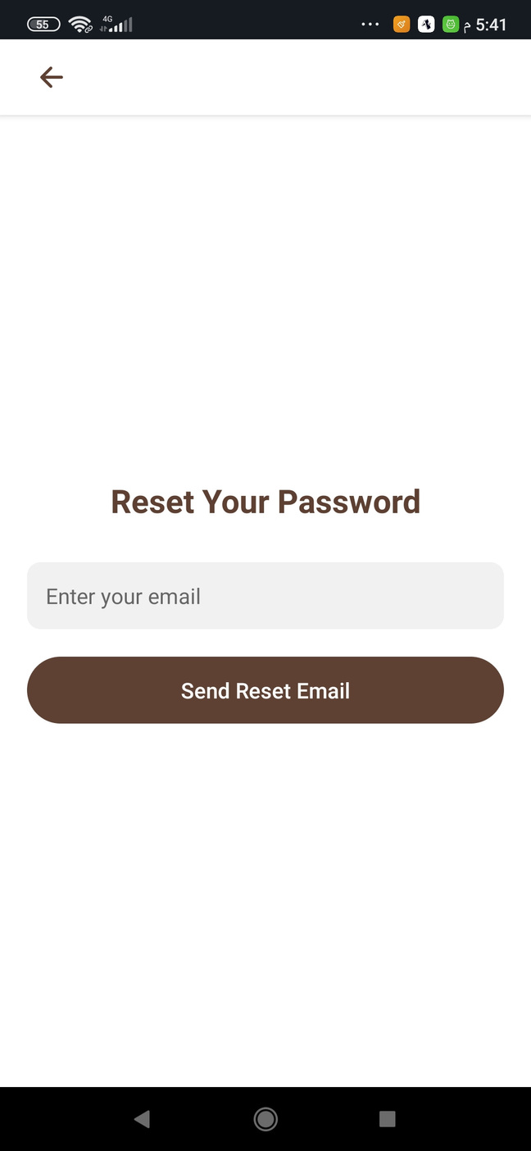
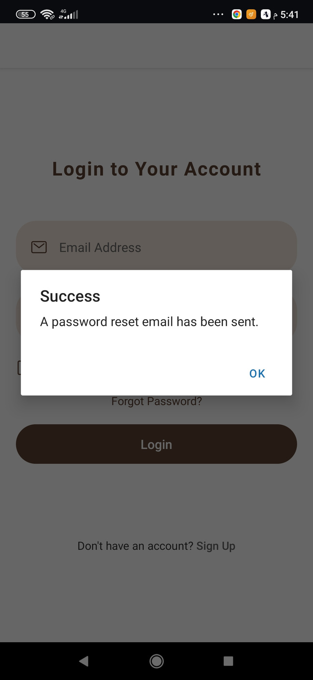
Reset Your Password Using Firebase

Slide 9
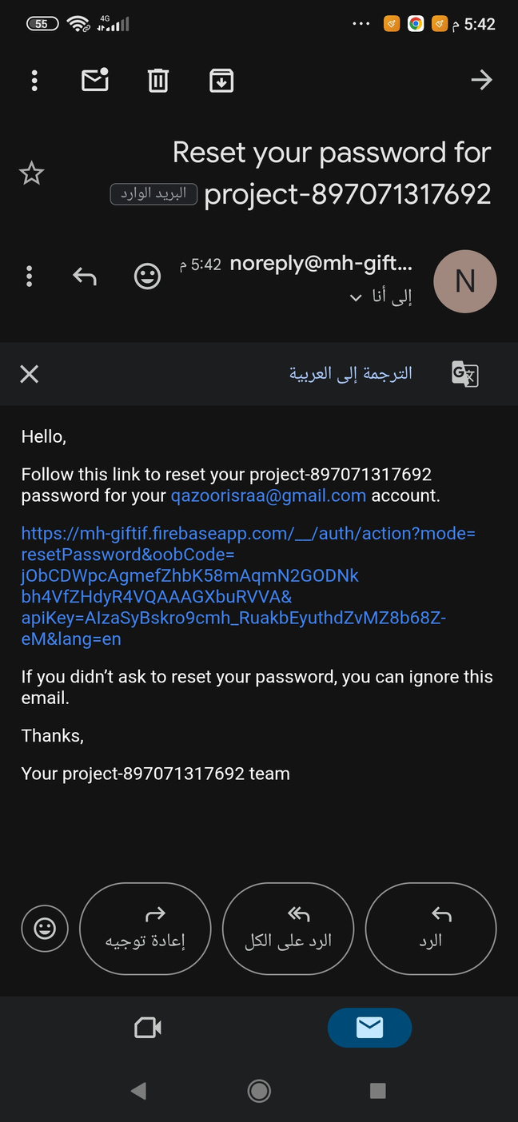
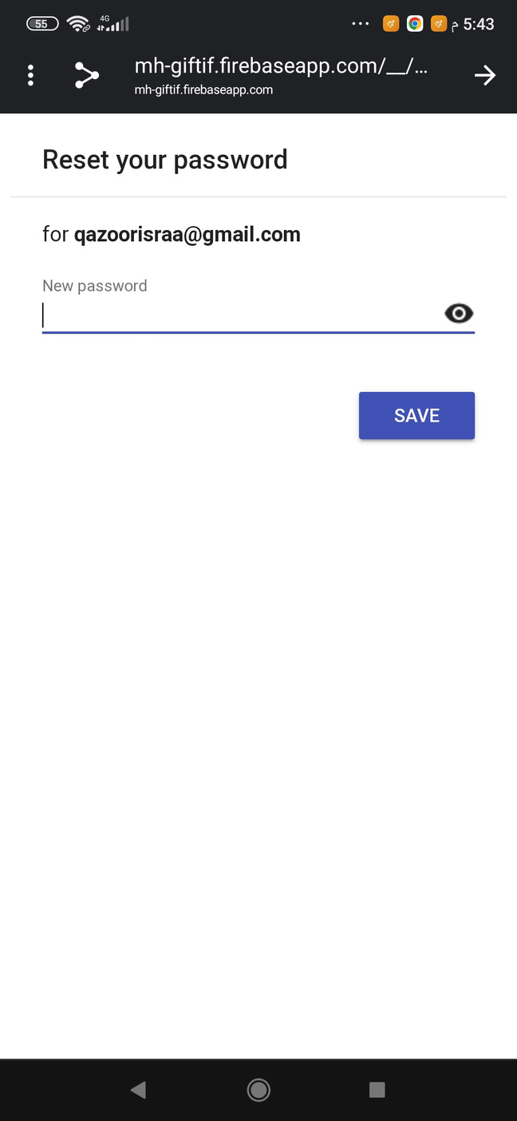
Reset Your Password Using Firebase

Slide 10


We have two roles in the application:
User
Admin

Slide 11
The user :

Slide 12
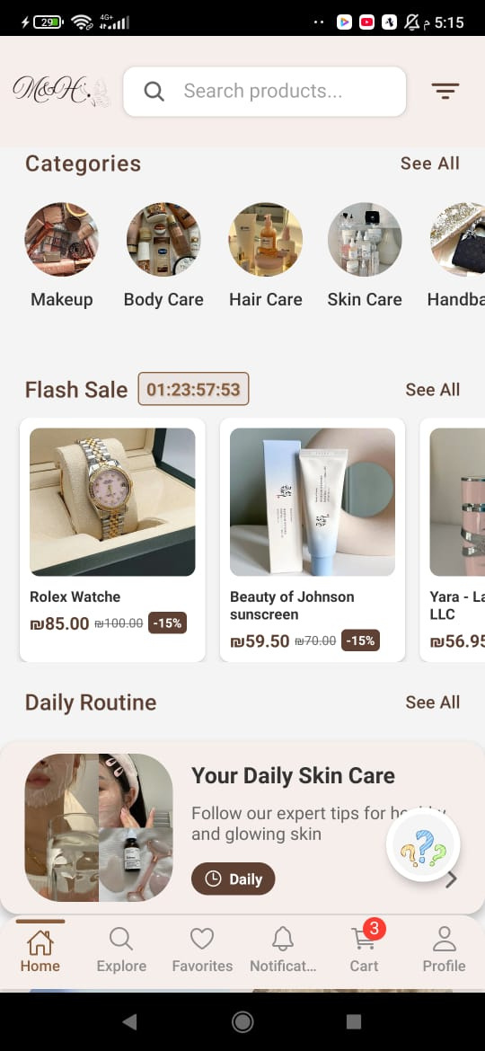

Home Page
Categories
Flash Sale
Daily Routine
FAQ

Slide 13
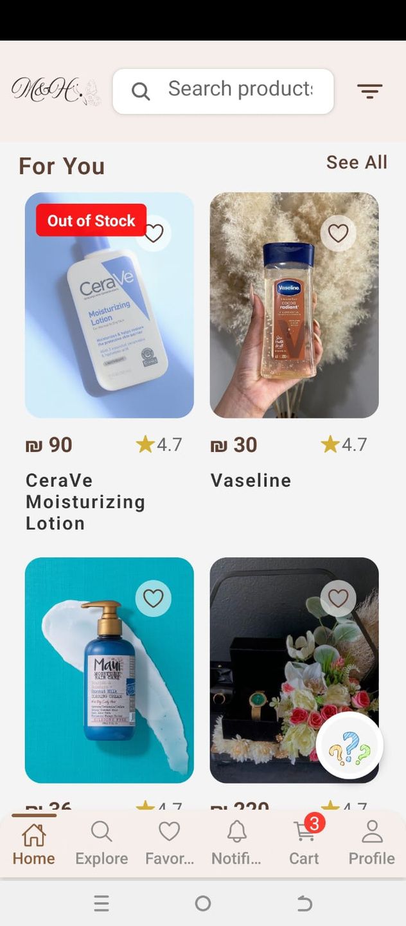
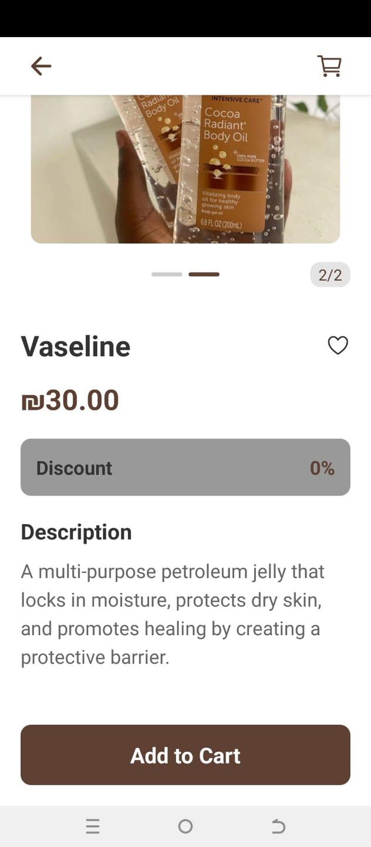
Suggestion Product:
Description

Slide 14
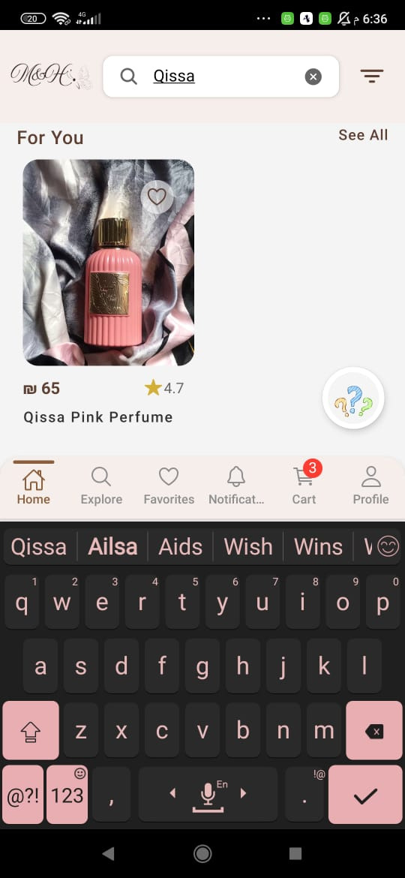
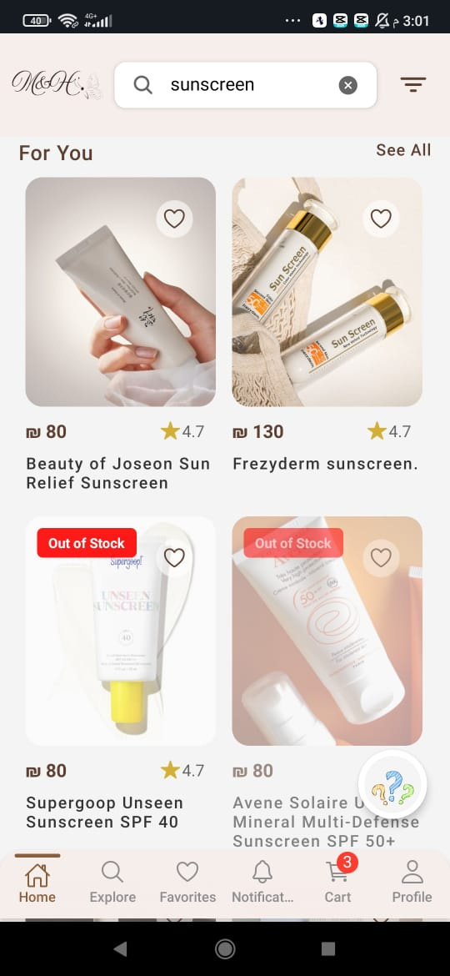
Search Functionality
Out of Stock Product

Slide 15
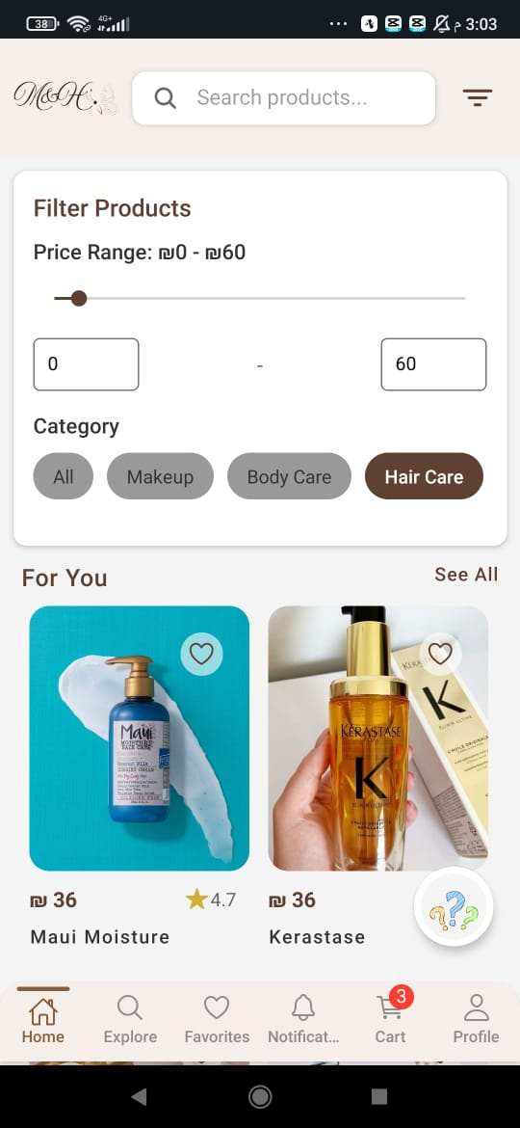
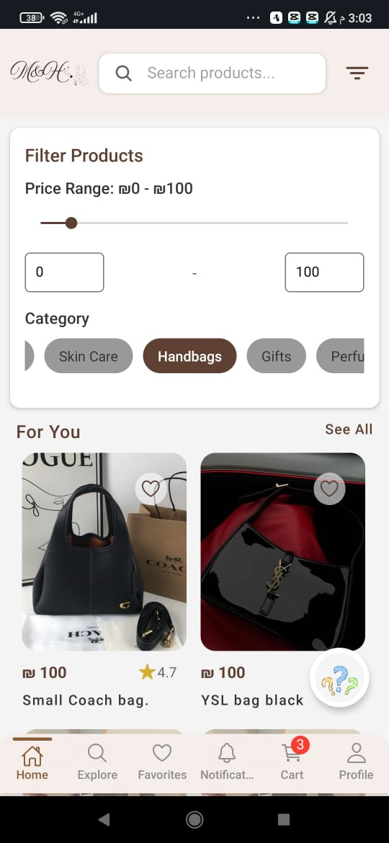

Filter Functionality
Filter Price
Filter Category

Slide 16
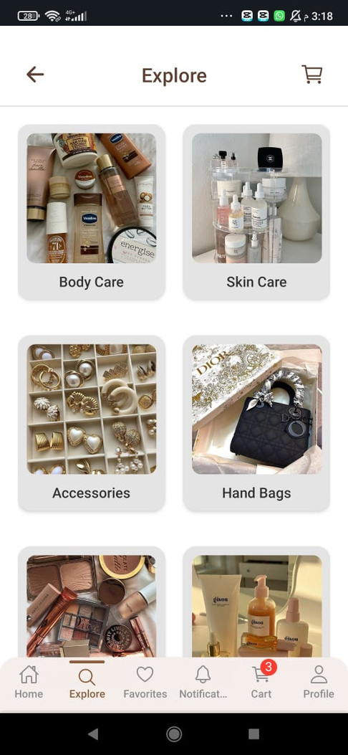
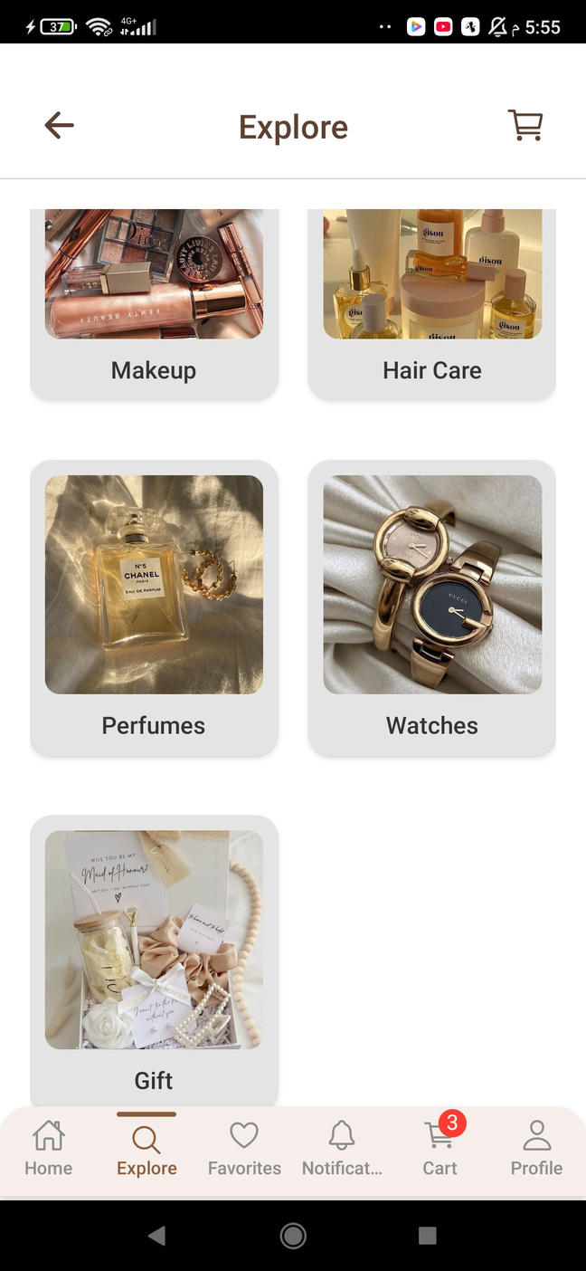
Categories

Slide 17
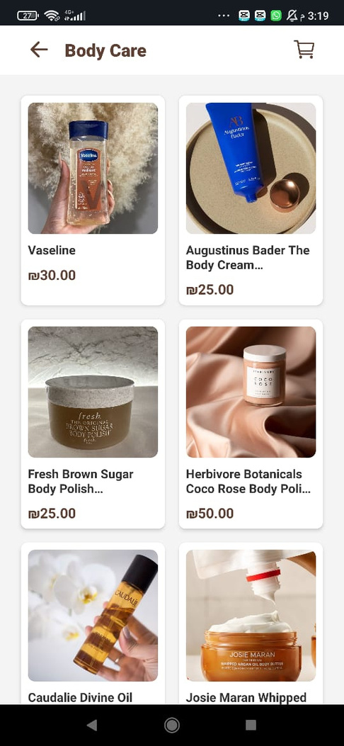
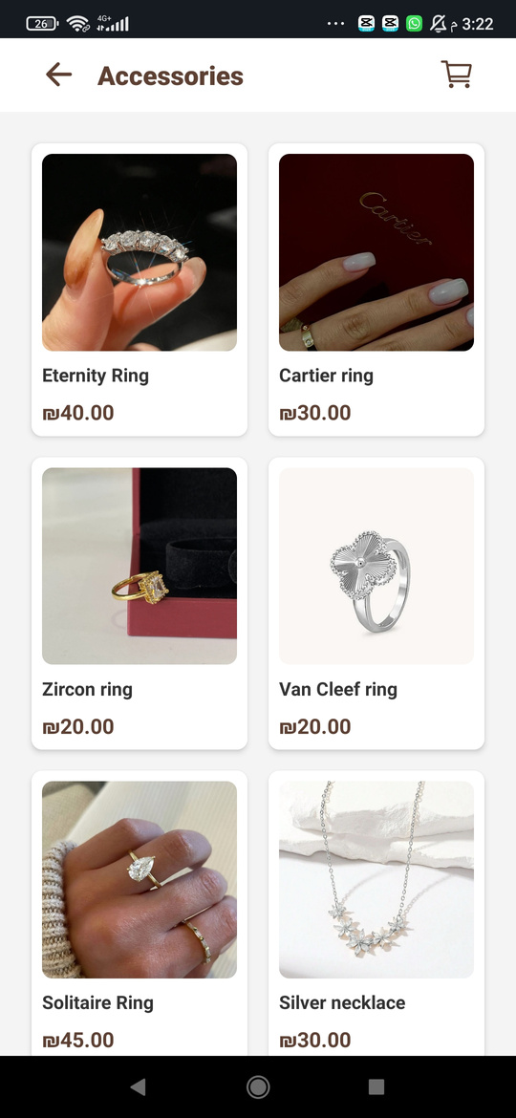
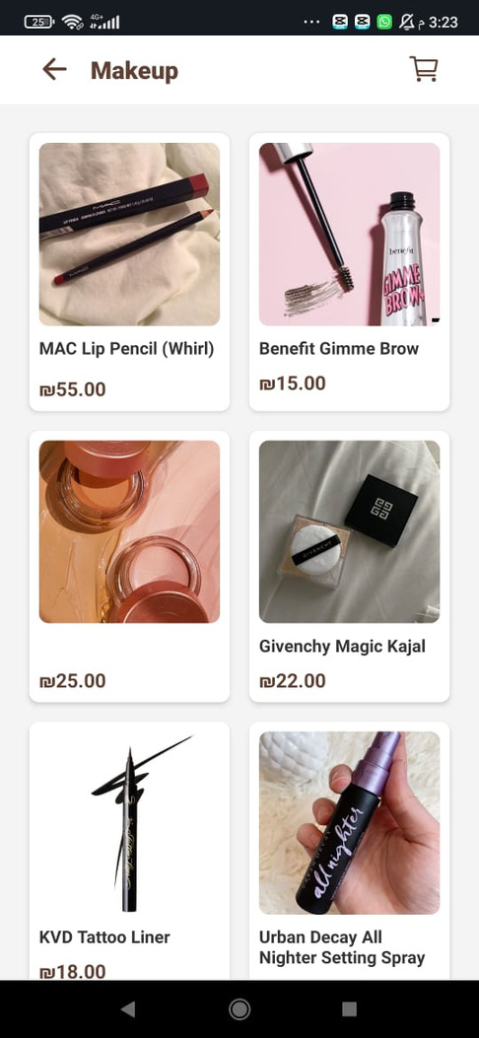
Body Care , Skin Care and Accessories

Slide 18
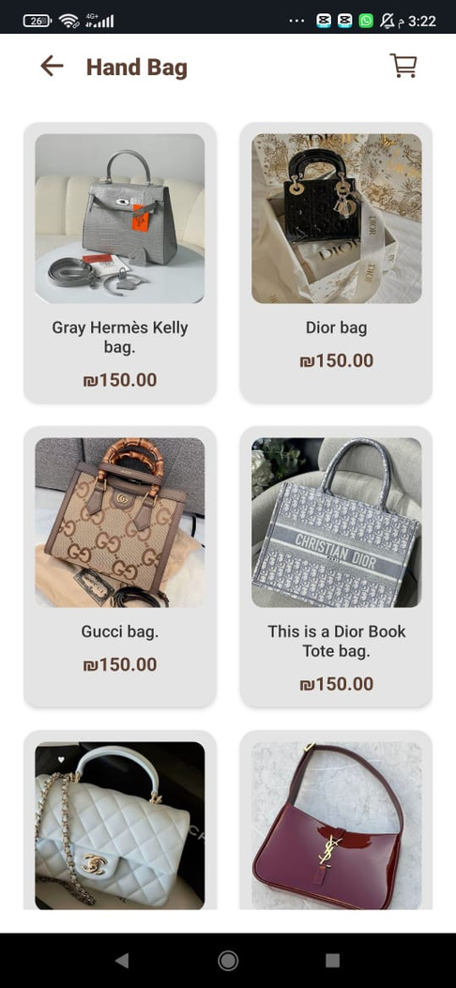
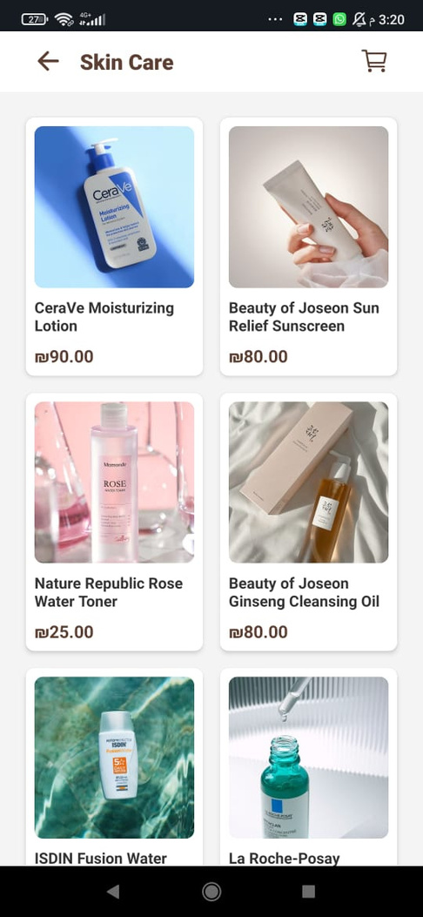
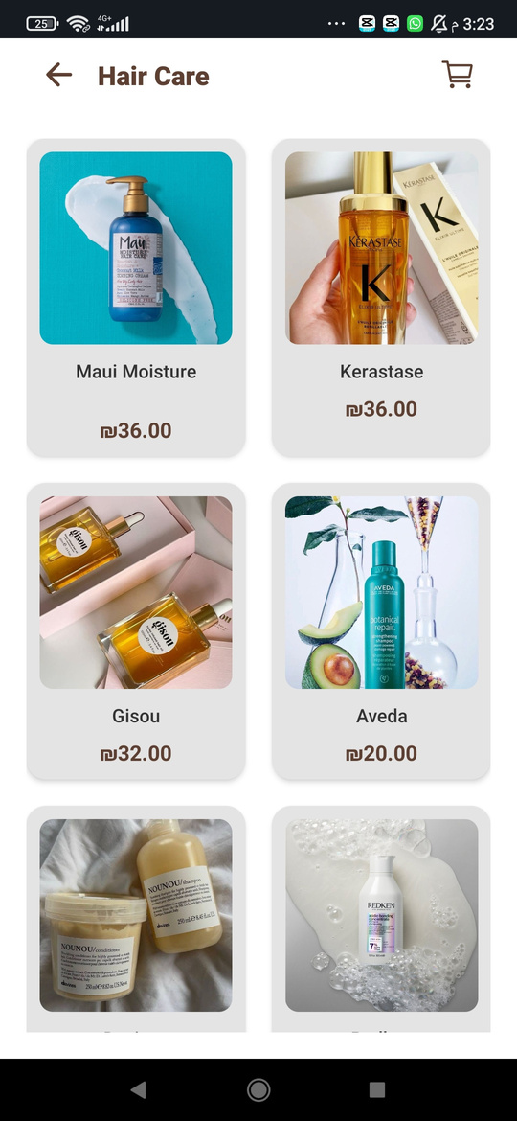
Body Care , Hair Care and Accessories

Slide 19
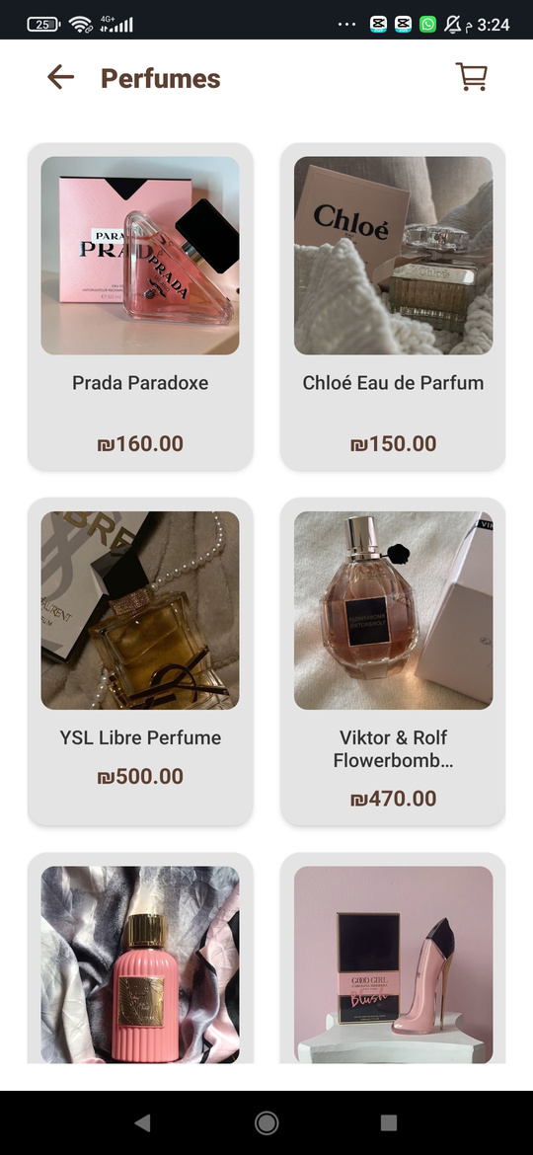
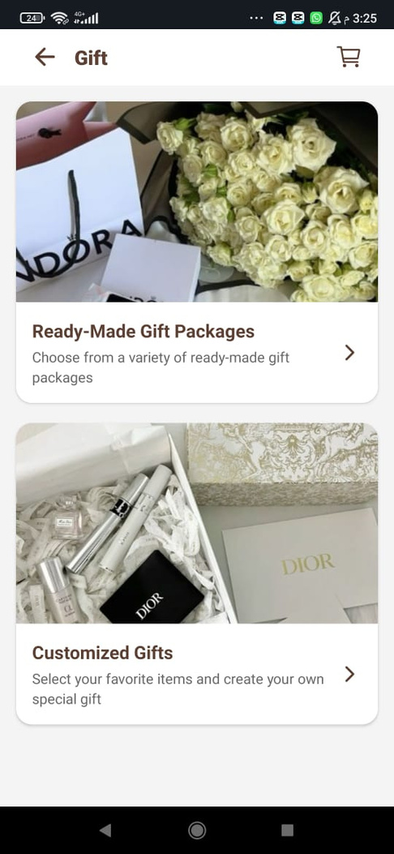
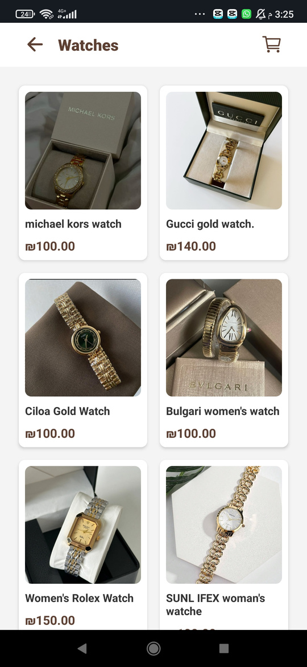
Perfume , Watches and Gifts

Slide 20

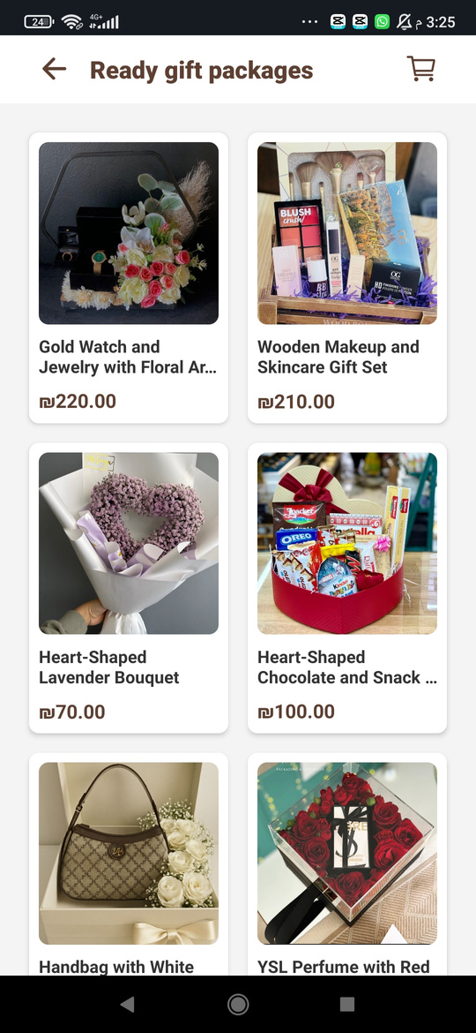
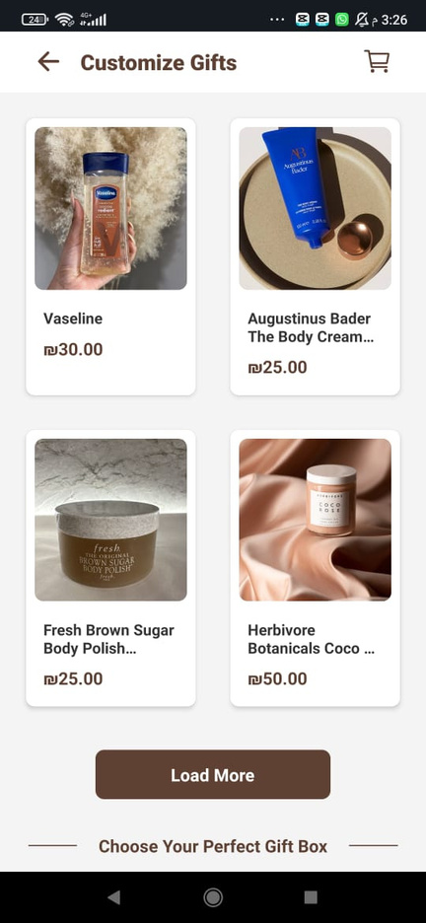
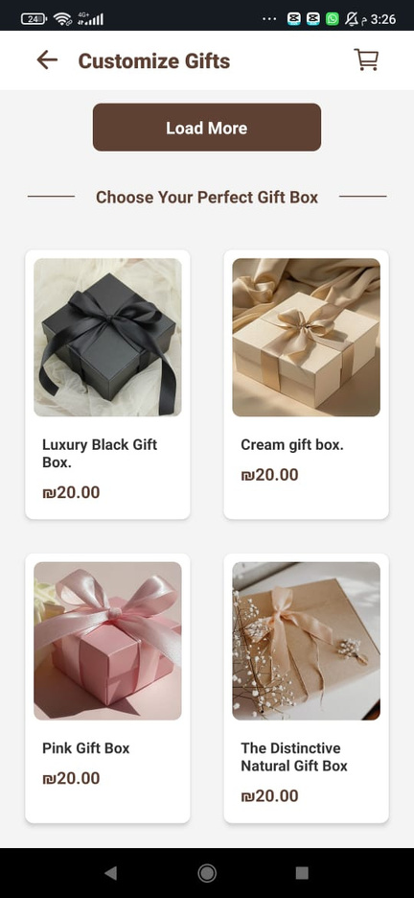
Gifts Category

Slide 21
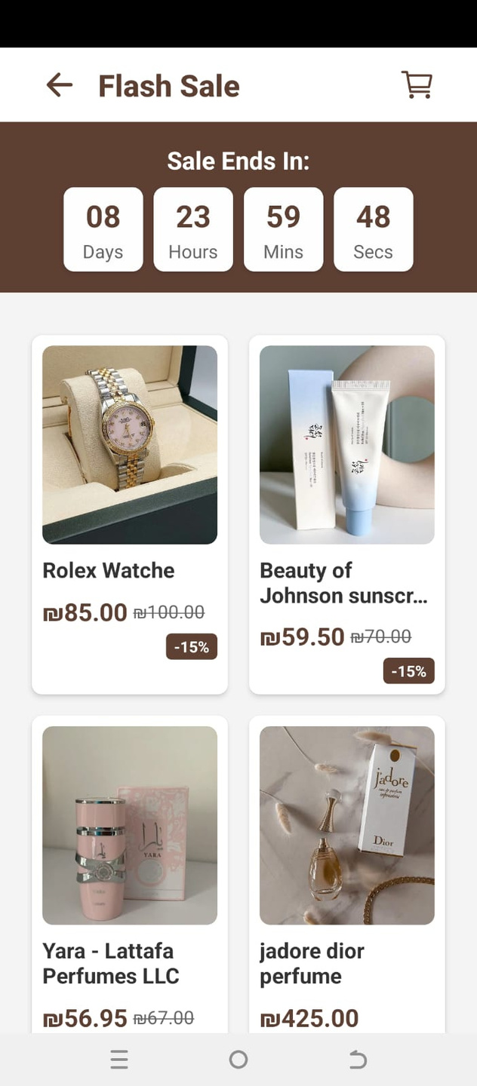
Flash Sale
Timer
Discount percentage

Slide 22
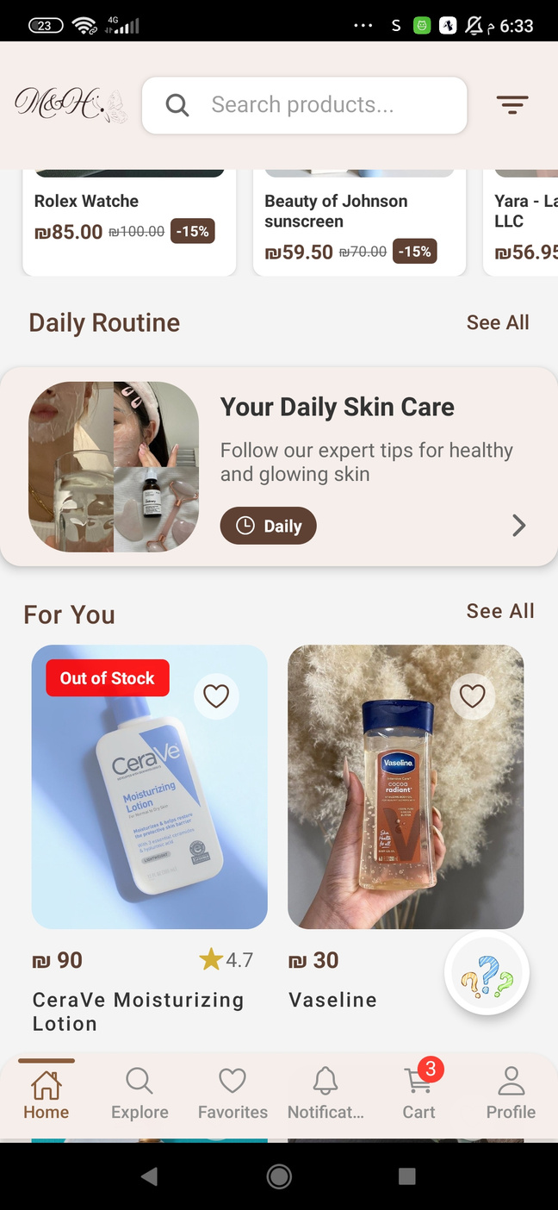
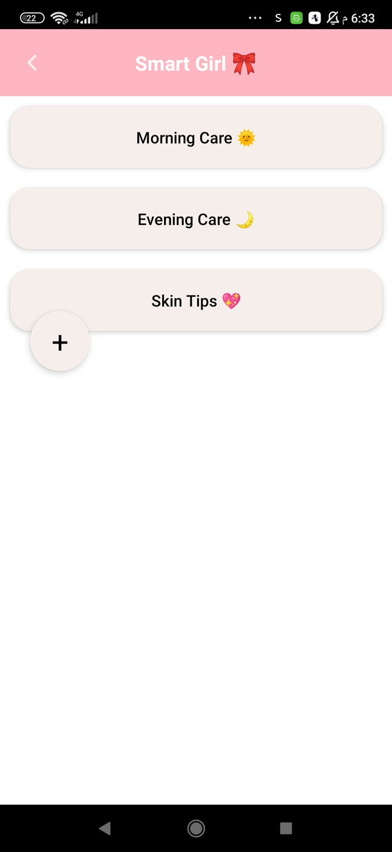
Your Daily Skin Care Routine
Click Here

Slide 23
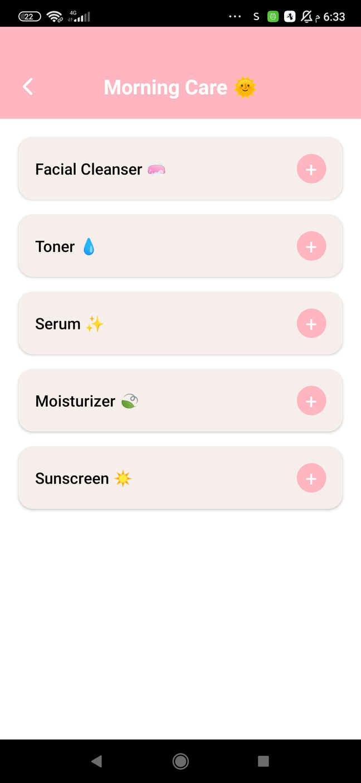
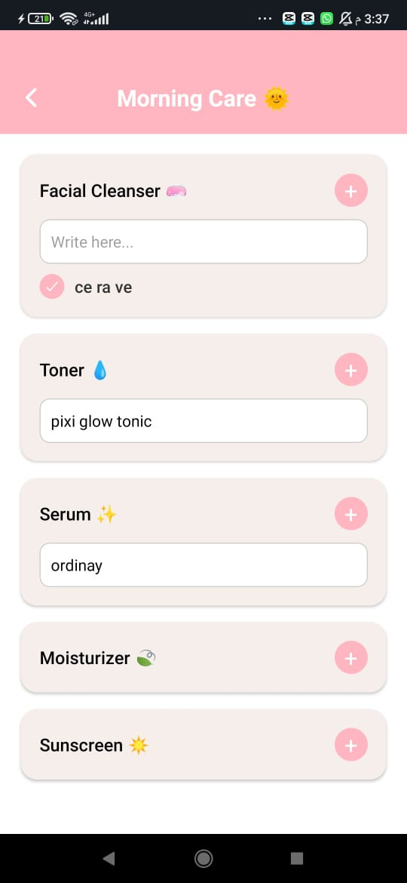
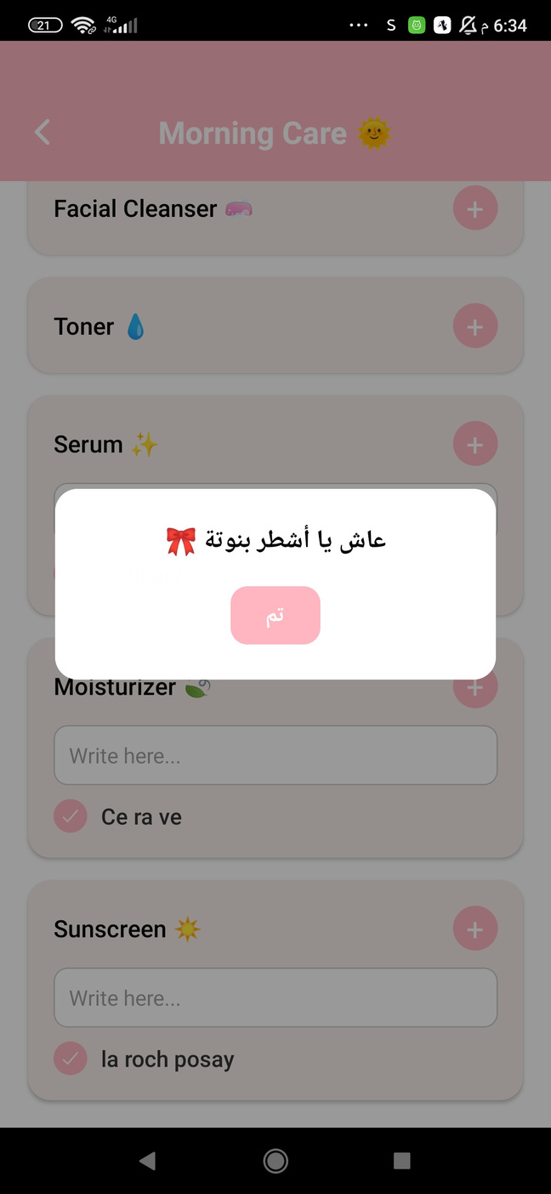
Click Here
Morning Skin Care Routine

Slide 24
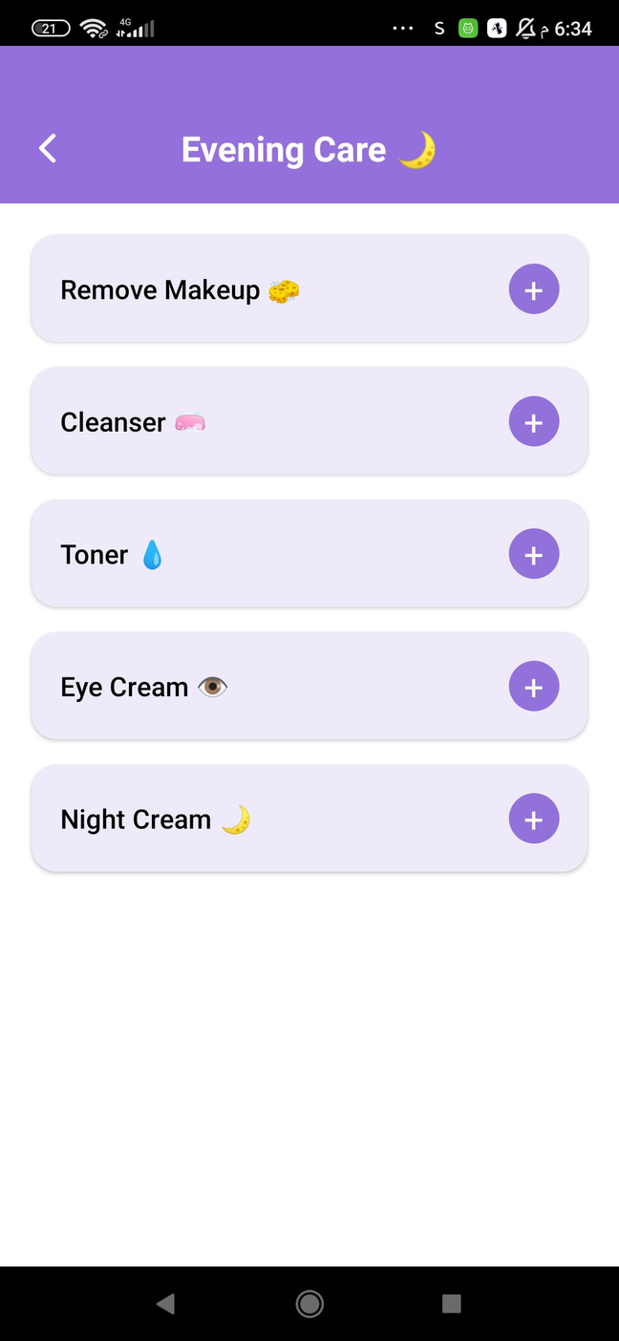
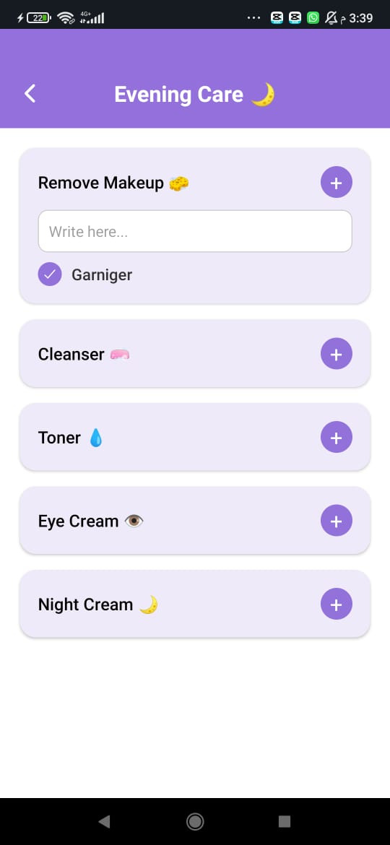
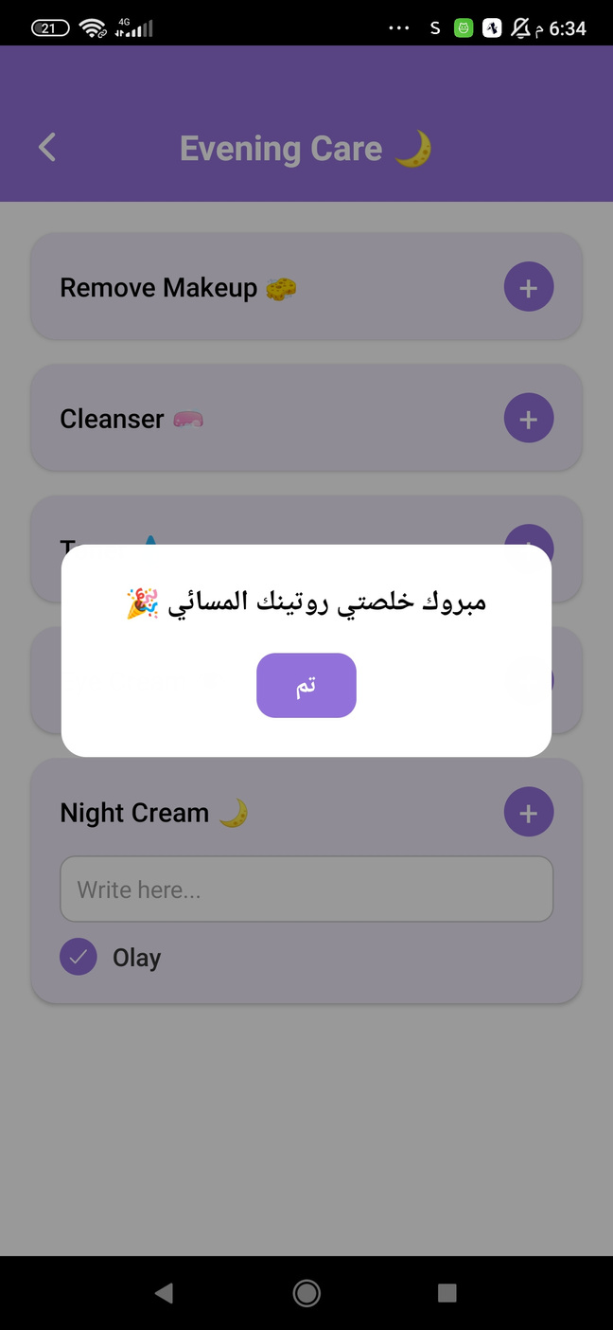
Evening Skin Care Routine

Slide 25
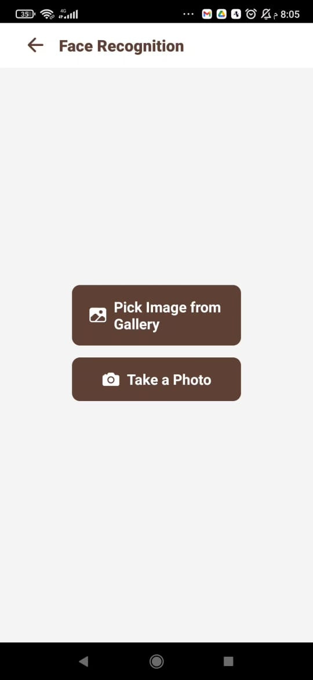
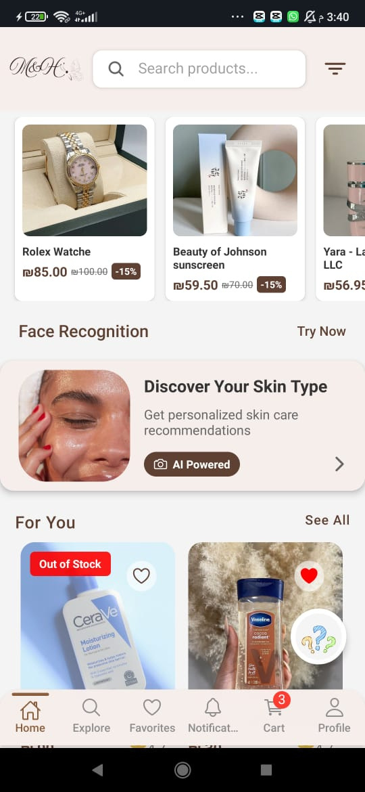
Click here to pick from gallery
Click here to take instant photo
Click here to discover your skin type
Image Recognition

Slide 26
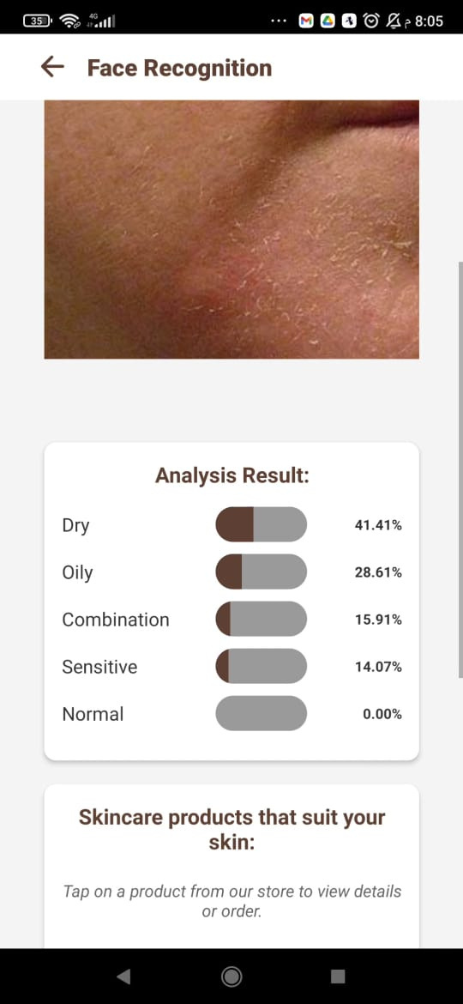
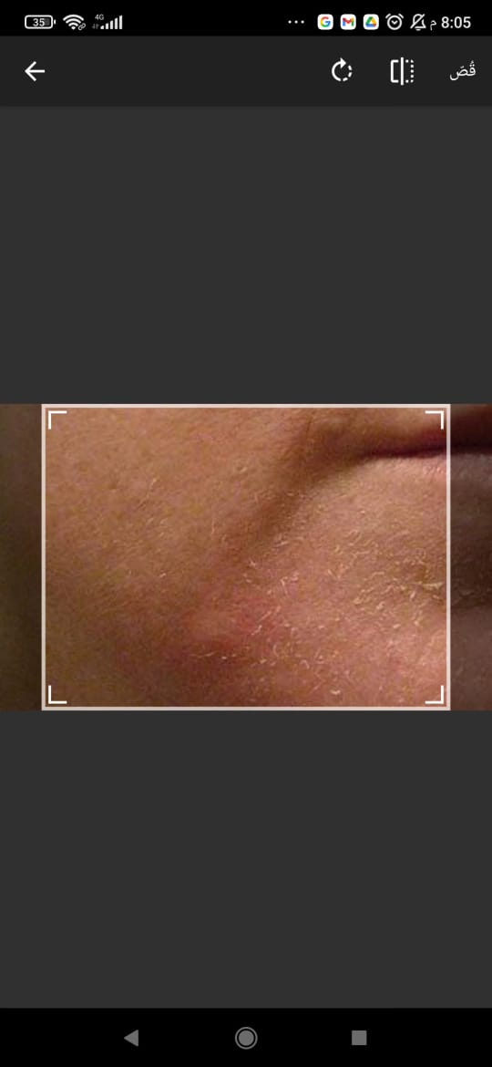
Here you can see your skin type

Slide 27
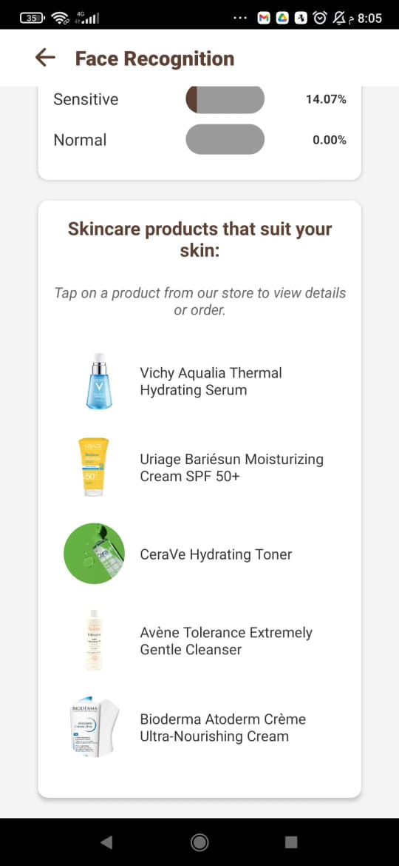
This is the best skin care routine based on your skin type
Recommendation

Slide 28
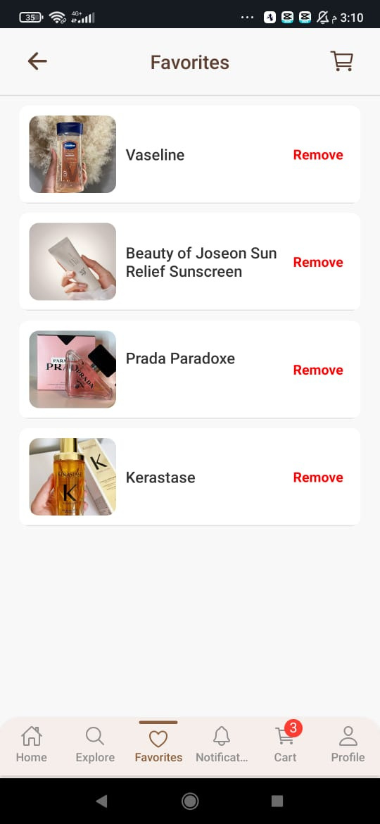
Favorites

Slide 29
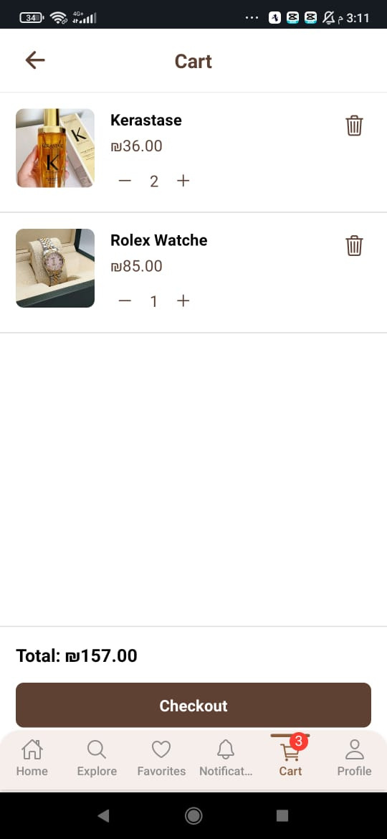
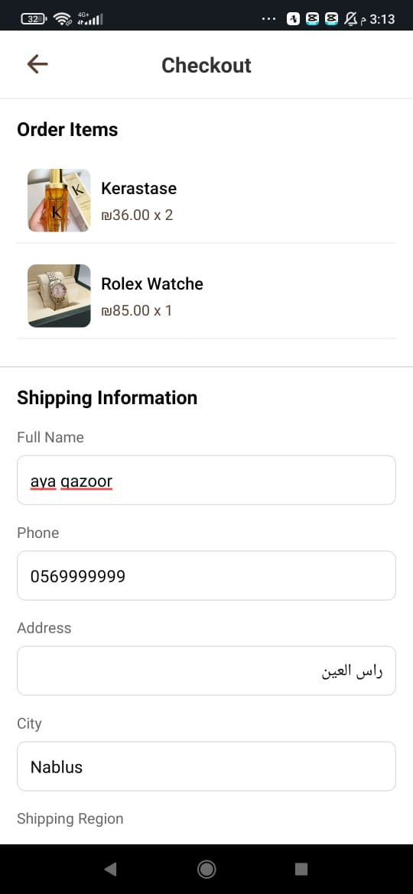
Cart & Check out

Slide 30
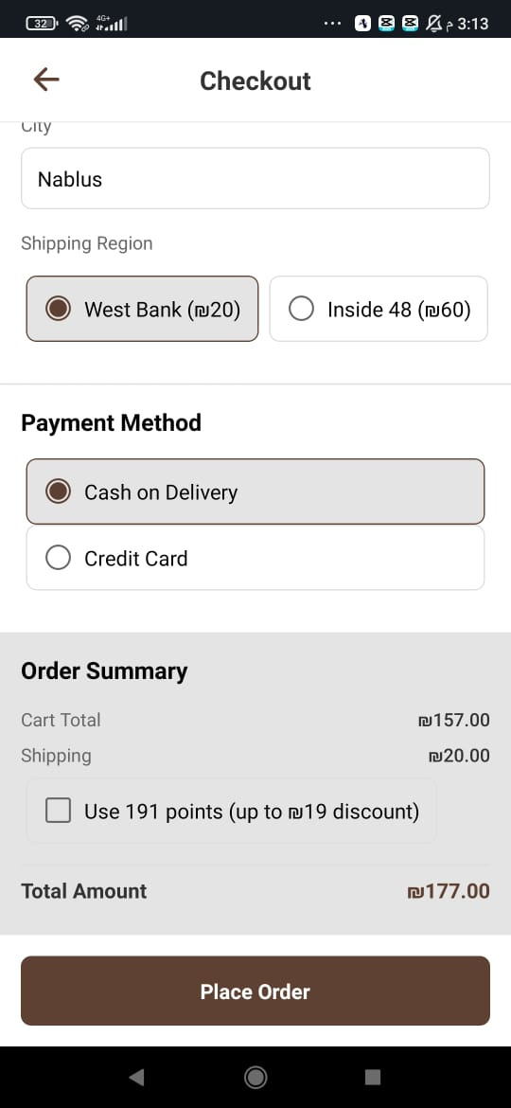
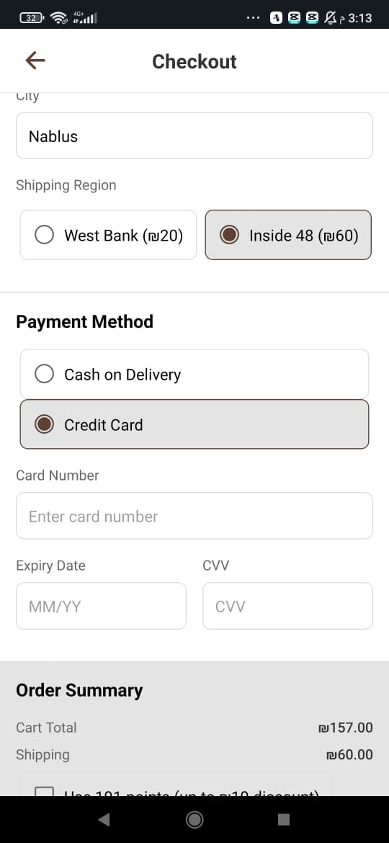
Shipping Region

Slide 31
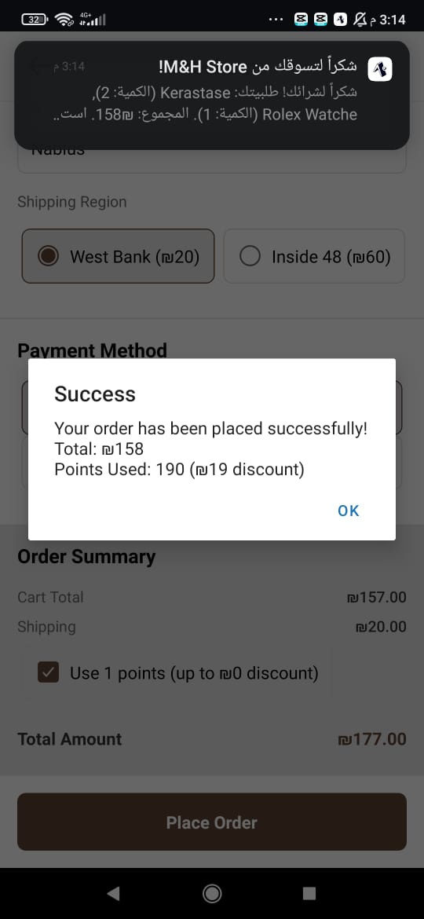
Order Confirmation Notification

Slide 32
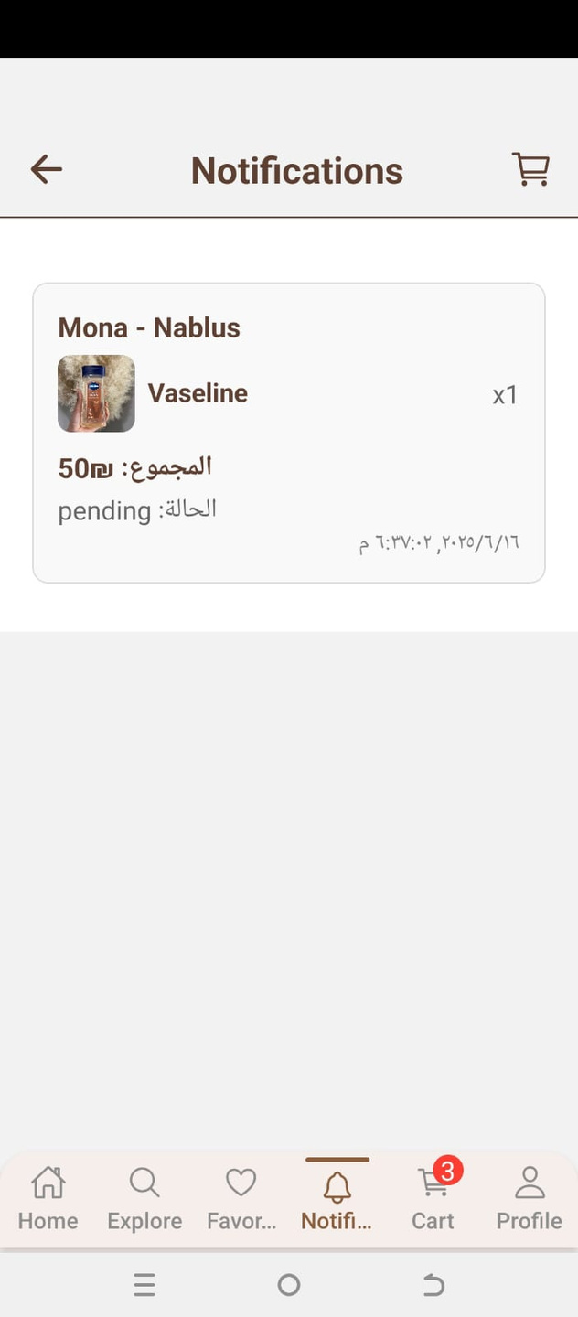
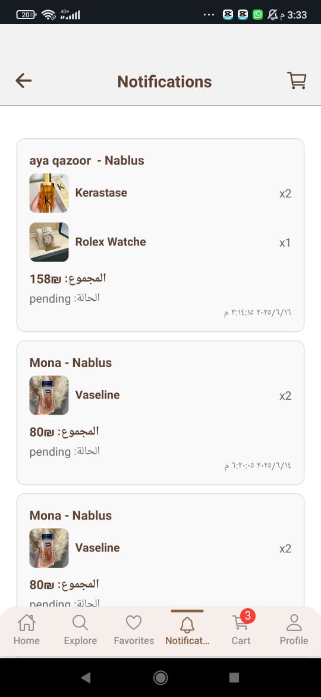
User Notification
Admin Notification

Slide 33

User Profile

Slide 34


Change Photo , password and name

Slide 35

My Oders (user) :

Slide 36


Loyalty Program
We let the user use the loyalty points to get discounts on the checkout and some available rewards

Slide 37

Our Policies

Slide 38


FAQs

Slide 39
The admin role :

Slide 40

Admin Panel
If you are admin you will see this

Slide 41






Admin Panel Includes this
Products Management
Orders Management
Statistics
KPIs
Reports

Slide 42
Adding a new product
Click here to add a new product

Slide 43


From here you can add a new product to the store

Slide 44
Manage the existing products
Click here to manage the products

Slide 45

Filter , Delete and Edit a product
From here you can filter the products based on category
From here you can delete any product from the store

Slide 46

Edit a product
Click here

Slide 47

Click here to confirm the payment
Click here to confirm the order
Orders Management

Slide 48

Statistics
This is the number of daily orders
This is the total number of products in the store
This is the total revenues after confirming the payment
This is the number of user who have an account

Slide 49

KPIs
Daily Sales
Conversion rate
Top Products Sold

Slide 50

Print

Slide 51

Report
Product we should Reorder
Date filtering
revenue

Slide 52



Thank you!
Mona Hindia
Aya Qazoor
Batool Khanfar

