Slide 1

Foundation Design for a multi-story residential Building Considering Seismic Loads
By
Mezar Saleh Idily - 11541274
Monther Moamar Rawajbeh - 11819790
Mohammad Jalal Sultan - 11821414
Under supervision of: Dr. Isam Jardaneh

Slide 2
: Introduction
The aim of this project is figure out the most appropriate foundation type for Multistory Building Which consist of 7 floors located at city center of Nablus. The main challenge in this project is to consider seismic loads according to expected earthquake. The foundation system under consideration are isolated, mat or piles. We will show you some information about the types of foundations and soil conditions to be built upon, so that we can choose the appropriate type after studying the conditions.

Slide 3
Foundation design includes a site inspection program to create the most appropriate type of foundation for a given structure that is affected by many factors such as:
    1- Soil bearing capacity onsite.
    2-The geological condition of the soil at the site.
    3-Depth of foundation for adjacent buildings.
    4-The load of the structure to be designed.
    5-Other factors related to the expected stability of the site's soil.

Slide 4
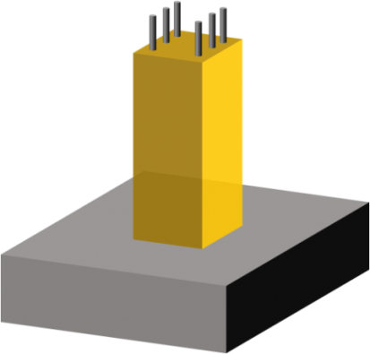
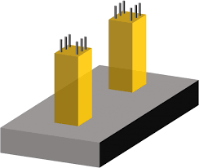
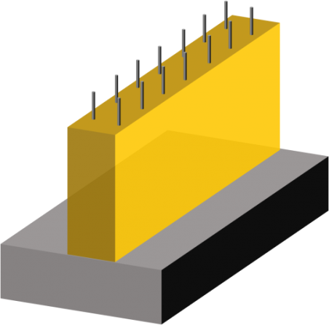
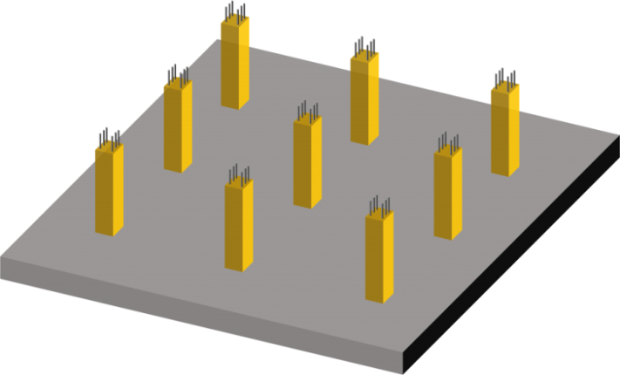
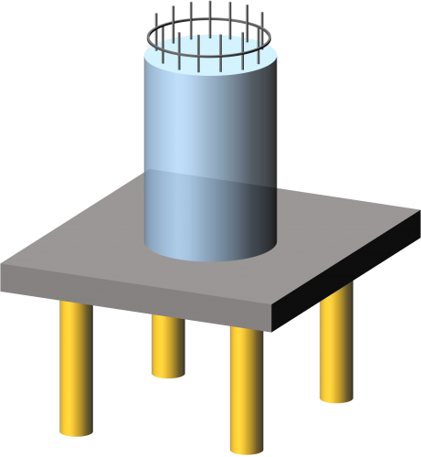
Shallow Foundation
Isolated footing
Combined footing
Wall footing
Mat Foundation
2. Deep Foundation
Pile Foundation

Slide 5
Soil Investigation
Purpose of the study:
First of all, identifying the proper type of foundations required wither its shallow or deep. Second, to make recommendations related to bearing capacity of the tested soil.
Procedure:
Two boreholes. One borehole was dug to depth of 13 m. while the second of (9m). these
Site description:
The site from geotechnical point of view consists dark brownish silty clay of high plasticity. This type of soil has high swelling potential. Care should be done to take care of swelling of this soil. This type of soil slide when having cuts greater than 2m, Safety precautions should be taken in this case.
Soil parameter:
Geotechnical parameter:
1- Unit weight γ=17.3Kn/m³
2-compression index (C_{c}) = 0.26
3-swelling index (C_{s}) =C_{c}/5 = 0.052
4-initial void ratio (e) = 0.67
5-precompression pressure (σ_{c}) =110kn/m²

Slide 6
Soil Investigation
Bearing Capacity
The bearing capacity of the soil at the site was 140 kN/m²
the soil was improved by adding two layers of )120cm) thickness,
the first was (80cm) of compacted rockfill,
and the second was (40cm) of compacted basecourse,
then the bearing capacity of the soil at the site became 200 kN/m²

Slide 7
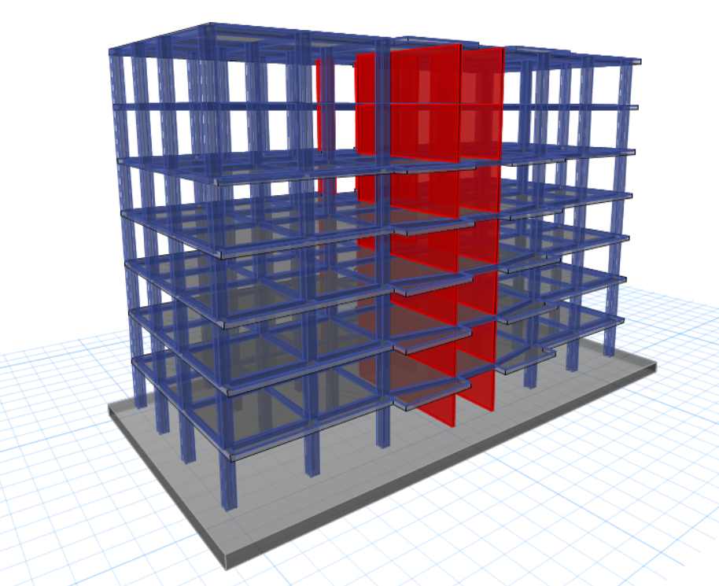
Modeling (ETABS)

Slide 8
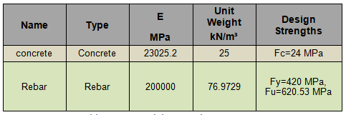

Material Properties
Soil Properties

Slide 9
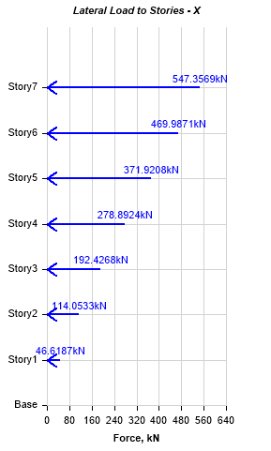
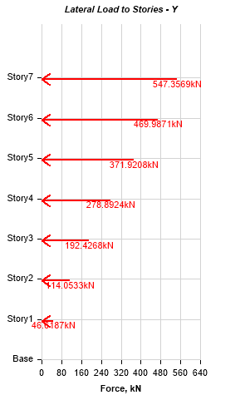
Loads
Gravity loads :
2 Live load = 2 KN/m
Superimposed dead load = 4 KN/m2
Perimeter wall weight = 20 KN/m
lateral loads :

Slide 10
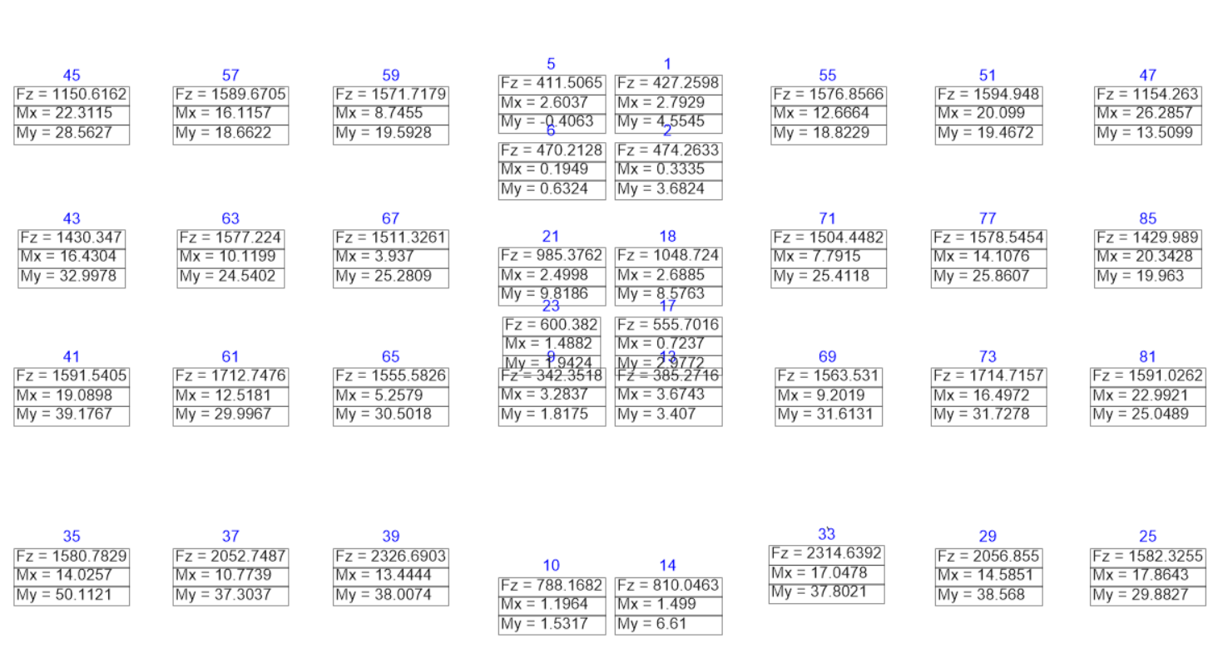
Columns and walls loads from envelope service load combination

Slide 11
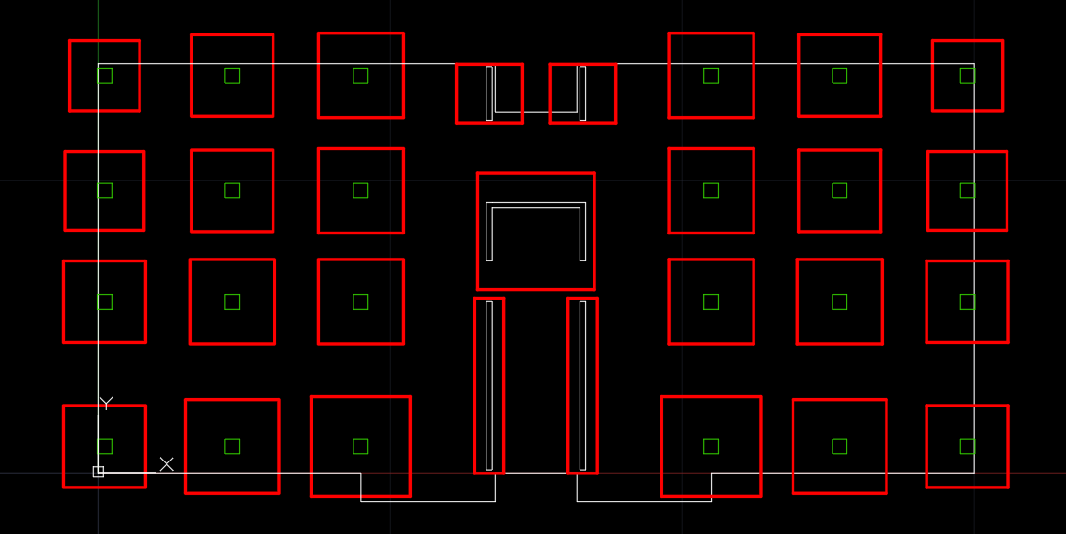
Design
Try single footing :
Area of footing = Service load / Allowable bearing capacity
Total area of footings / Total area of building = 56%
We need to use mat foundation.

Slide 12
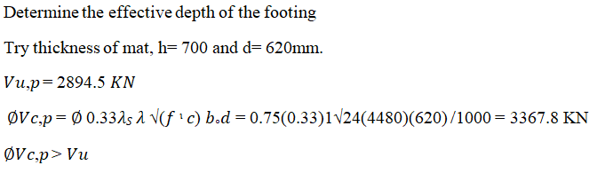
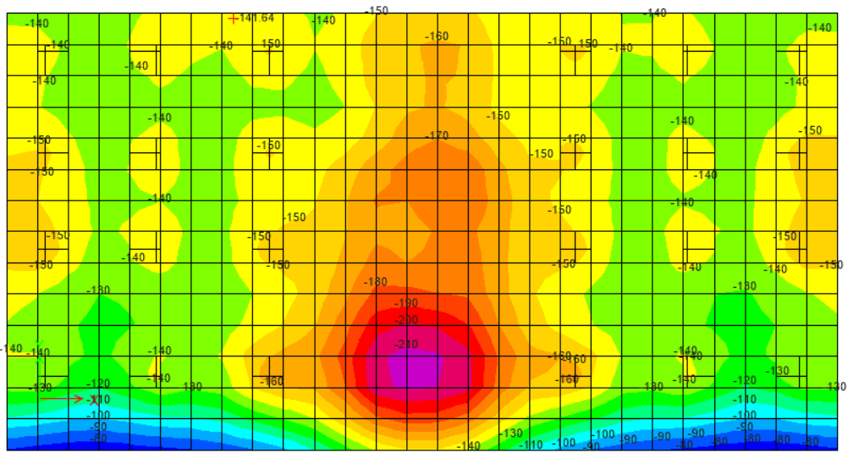
Mat foundation (using ETABS)
WE USE a (32.55*17.1) m² ➔ Area = 556.6 m²
Soil pressure :
Soil pressure is acceptable

Slide 13
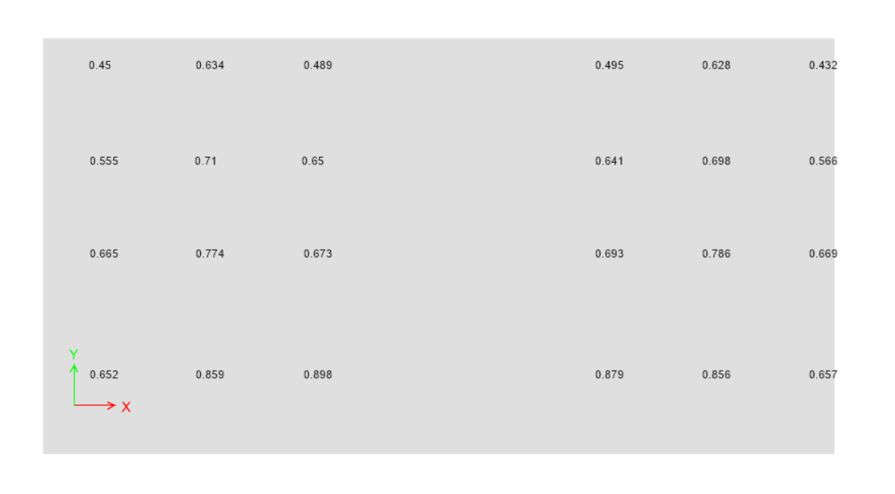
Check punching shear:
Demand/Capacity values:
Demand/Capacity<1
Punching shear Check is ok

Slide 14
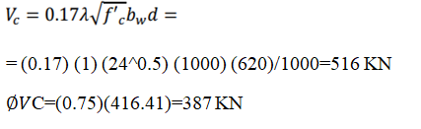
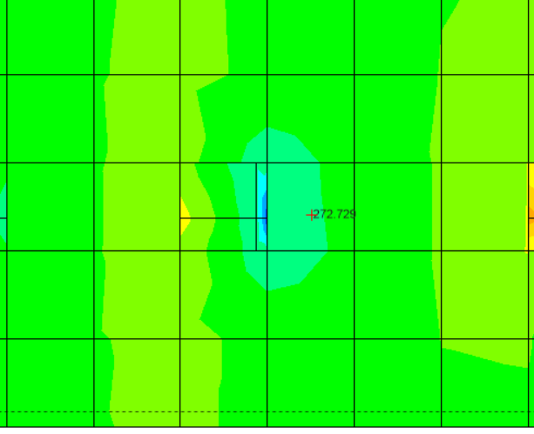
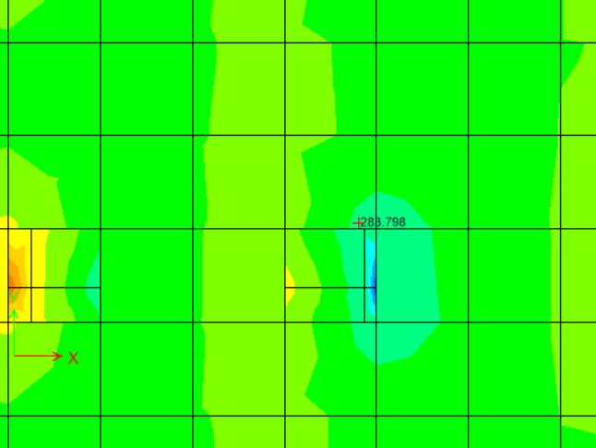


Check shears capacity:

Slide 15
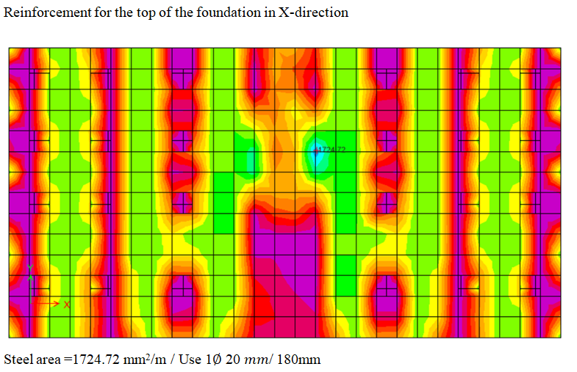
Reinforcement for the foundation :

Slide 16
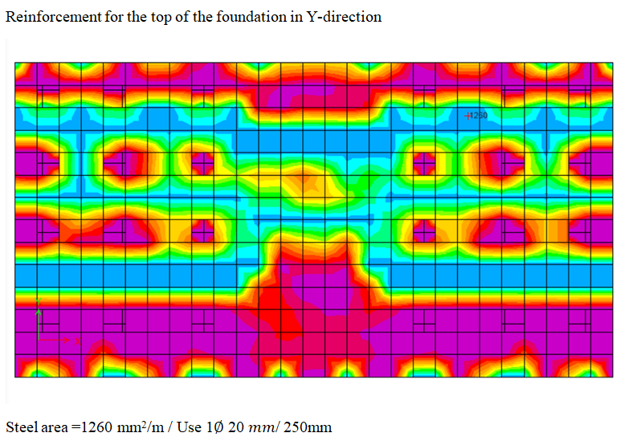

Slide 17
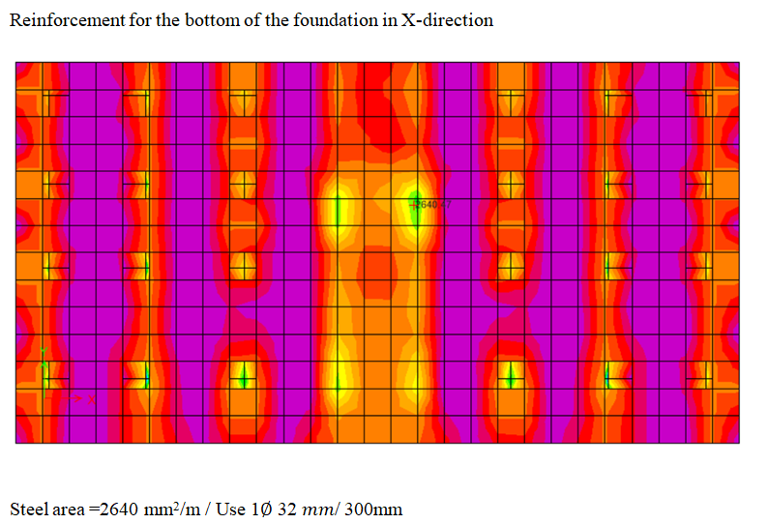

Slide 18
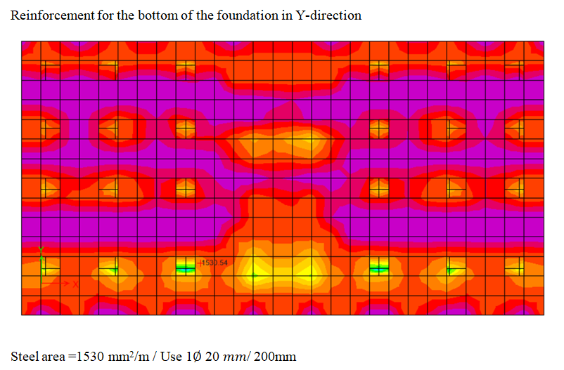

Slide 19
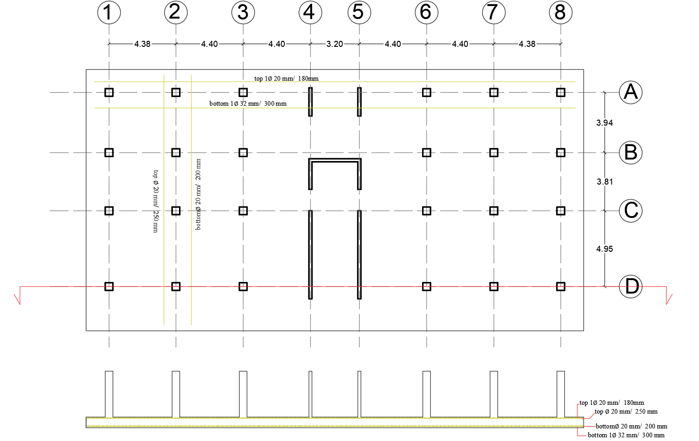

Slide 20
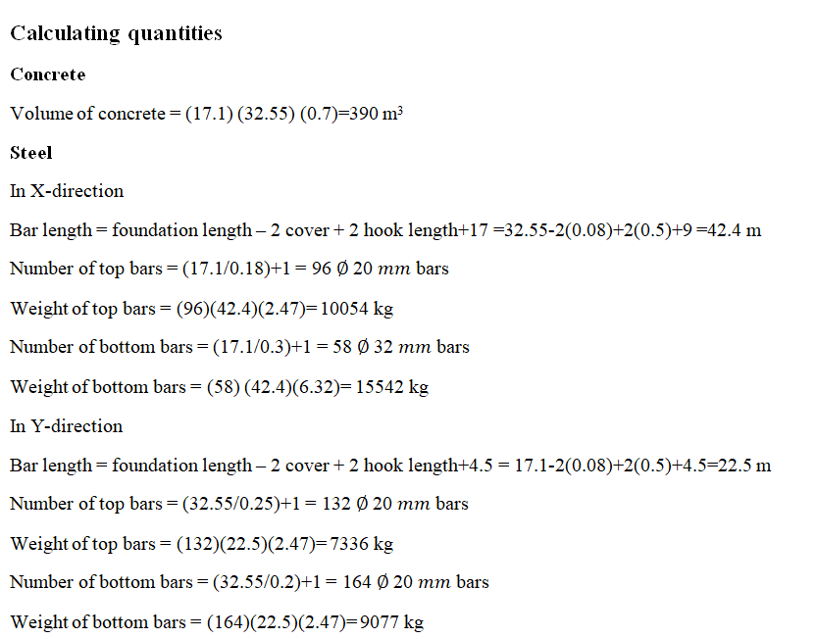

Slide 21
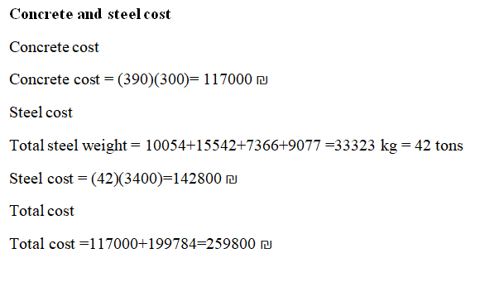

Slide 22
Recommendations
It was not suitable to use single footing because the area of ​​the footing cover more than 50% of the total area of the structural (the ratio was 56%), and if combined foundation is used it will covers all the footing.
Therefore, in this case, it is preferable to use a hollow mat foundation, but the stress was high in all areas, so non-hollow mat foundation was designed.
Pile foundations were not used because they are more expensive.
Seismic design is considered, so the cost was higher.

