Slide 1

Electrical engineering department
Clever solar battery charger
Prepared by:
*Amani Abu Obaia
*Afrah Abd El-Dayem
Supervised by:
Prof. Marwan Mahmood

Slide 2
Introduction
Since the beginning of the oil crises, which remarkably influenced power development programs all over the world, massive technological and research efforts are being concentrated in the field of renewable energy resources. In the solar sector for electricity generation, greater attention is being given to photovoltaic conversion.

Slide 3
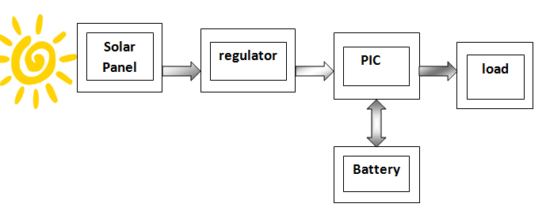
The block diagram:
S2
S1
VB ≤ 10.5 V → S1=1 S2=0 VB ≥ 14.4 V → S1=0 S2=1
S1=1 S2=1→12.7 ≤ VB ≤13

Slide 4
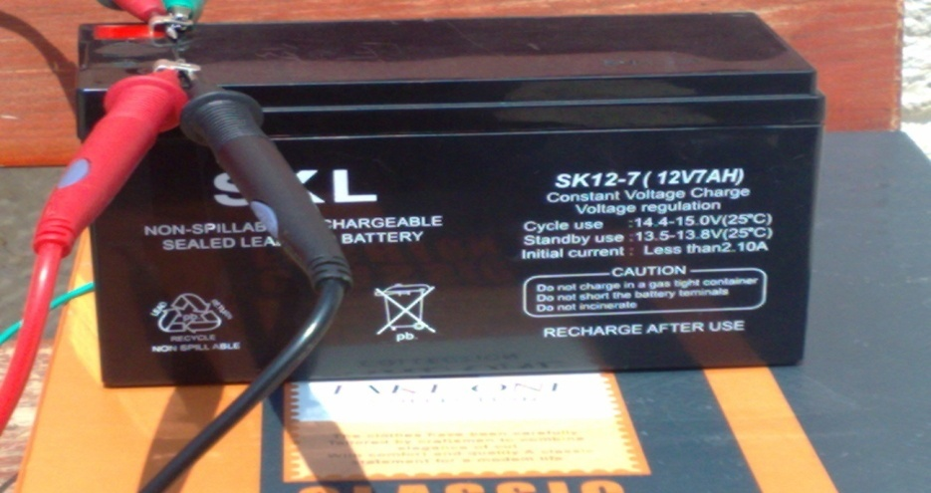
The objectives:
We mean to design a PV powered system which enable the consumer to charge up the 12 V lead-acid batteries and to supply any low DC load.
This project has advantages for the environment by using the solar power energy
Also we need to develop ourselves in the electrical fields specially in power , electronics and control using PIC microcontroller.

Slide 5


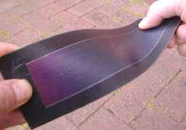
Photovoltaic cells
In our design, the solar panels will function as a power supply to our circuit. It will convert the sun radiation to voltage and current.
types of photovoltaic cells :
1-mono-crystal silicon.
2-Polycrystal silicon .
3-Amorphous silicon .

Slide 6

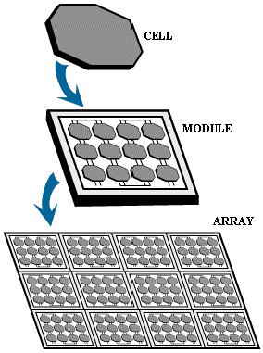
The number of cells:
The output voltage of a module depends on the number of cells connected in series.
The module we used was 25 cell connected in series which has an open circuit voltage equal to 19.4 Volt and maximum short circuit current equal to 0.4 Amp.

Slide 7
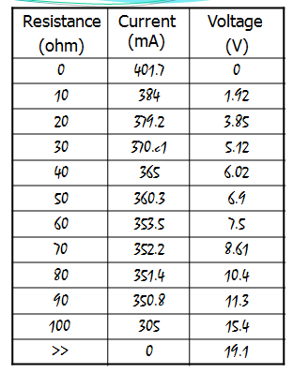
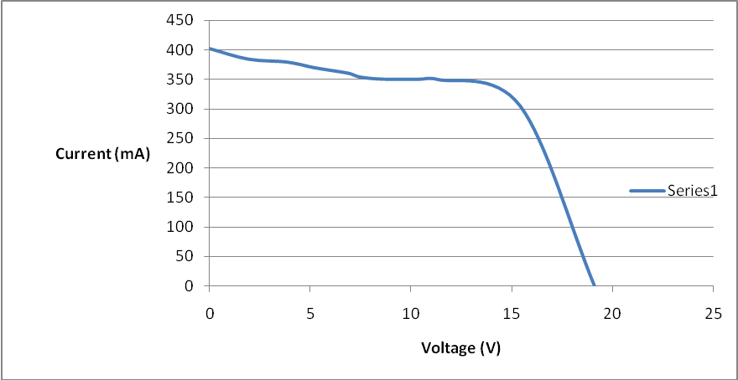
Test we make to find IV –characteristics of a solar cell
We use a solar cell and connect it with a variable resistance then we change R and take the readings of V AND I. as the following:

Slide 8
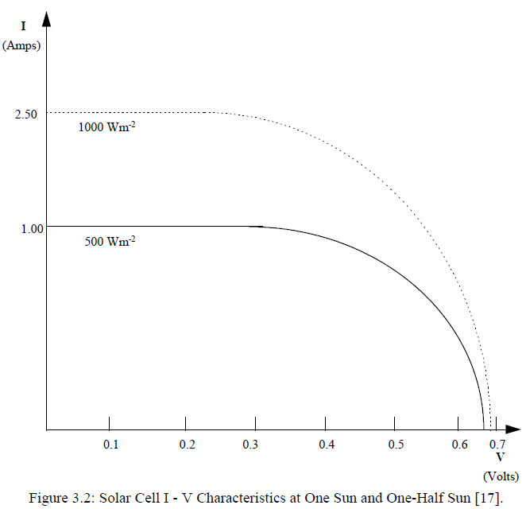
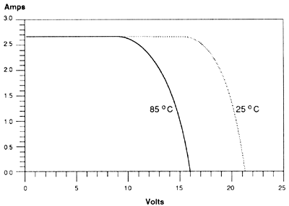
The effects of G & T on the I-V characteristics
A Typical Current-Voltage Curve for a Module at (1000)W/m^2
&
(500)W/m^2
A typical current-voltage curve for a module at different temperatures

Slide 9
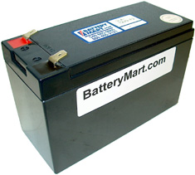
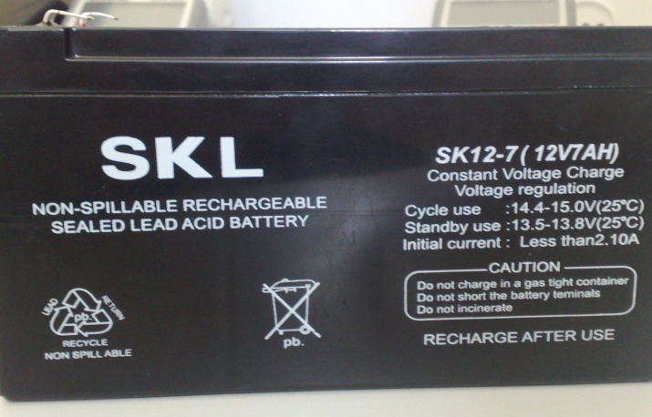
Lead Acid Battery:
We are going to work on six-cell lead-acid batteries.
Voltage/cell 1.75-2.4 V.
Battery charge.
Battery efficiency.
Minimum Voltage.

Slide 10
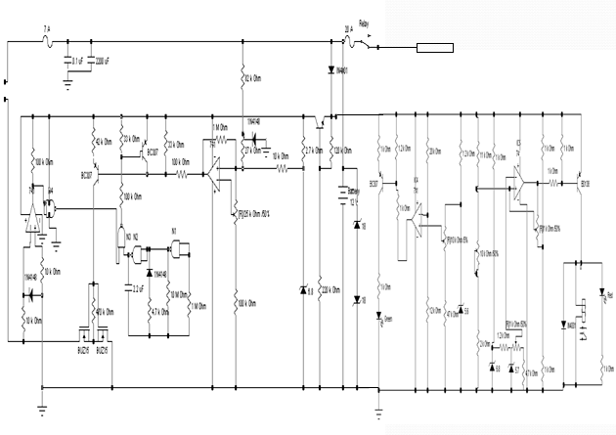
The circuit diagram

Slide 11
Procedure of work:
When the voltage is lower than 14.4V the comparator (IC3) allows a high negative output signal to switch on the PNP transistor (Q1), so a current will flaw from the emitter to the collector which in turn switches on the BUZ15 transistors. This means that the battery is directly connected to the solar generator.
the battery voltage increase until it reaches the 14.4 V value. At this voltage, the transistor (Q1) will be switched off, thus no current will flow between the emitter and the collector of this transistor, and as a result the solar generator will be disconnected from the battery

Slide 12
since the two MOSFET transistors will be switched off. When the battery voltage reaches 14.4V, the green light emitting diode (LED1) will switch on to give an indication that the battery has been fully charged.
N1 and N2 from the NAND gates are utilized as pulse oscillators for the purpose of testing. They send a short voltage pulse with a wavelength of 15 mm every 14 seconds (1:933 from the normal operating period).
In this short period, transistor Q2 will be switched on, and a current will flow from the emitter to the collector of Q2, so, the voltage difference between the base of Q1 and the main voltage source (+S) will be zero, which means that Q1 and the two MOSFET transistors will be switched off.

Slide 13
then the comparator (IC2) compares the battery voltage with the open-circuit voltage of the solar generator.
If the voltage of the solar generator is higher than the voltage of the battery, the output voltage of the comparator will be applied to (N4), (N3) and the base of (Q2).
As a result the current flow from the emitter to the collector of (Q2) will be interrupted. This means that the charging process will continue.
The main objective of using the pulse generator is to control the voltage of both the solar generator and the battery continuously.

Slide 14
In our circuit there is two MOSFET transistors were utilized instead of one for the following tasks:
  To make the prevention of the battery discharging via the solar generator as strong as possible.
  The temperature of the two transistors, due to the voltage drop across them, is divided equally between them.
  Increasing the reliability of the controller since one transistor can perform the task of the other in case of its failure.
  This arrangement protects the controller from failure whether it is connected to the solar generator first or to battery.

Slide 15
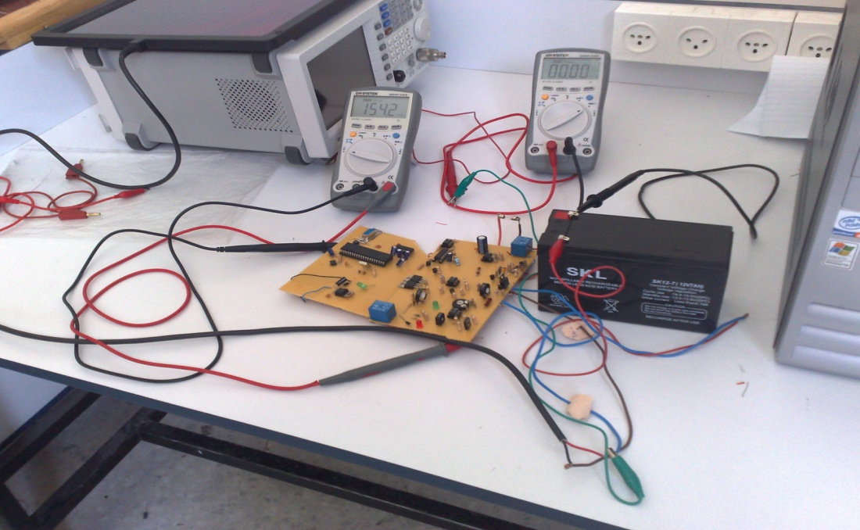
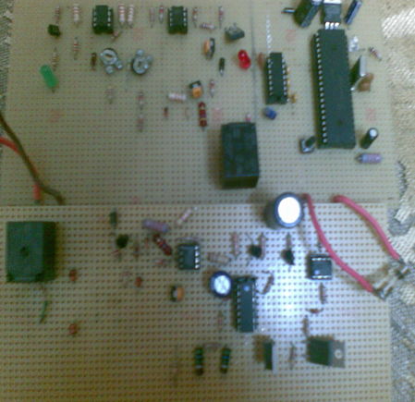
The results :

Slide 16
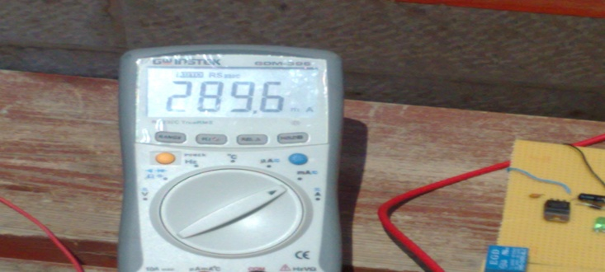
Results & calculations :
The Fill Factor & Efficiency
* The Fill Factor
( FF= (Vmp*Imp)/ (Is.c*Vo.c
= (15*0.350)/ (19.4* 0.386) = 70%
* The efficiency:
η = P.opt/ A.G
=5.25/ 0.3*0.3*950 =6.1%

Slide 17
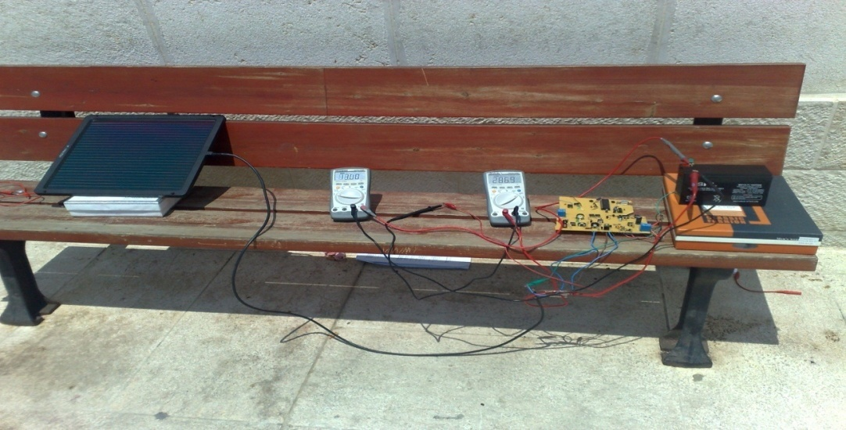
The Results :
Ibatt (mA) | Vbatt (V) | Ipv (mA) | Vpv (V)
323 | 12.6 | 328 | 17.1
296 | 12.9 | 302 | 14.9
289.6 | 13.01 | 298 | 14.1
270 | 13.27 | 275 | 13.46

Slide 18
Features of The solar battery charger:
Protects battery against overcharging.
Protect the battery against deep discharging.
the system can also be used to power smaller load appliance with varying operating voltages ranging from 3-12V.
The power consumption of this unit is very small.
The unit is protected against battery reverse polarity via a diode (D4).

Slide 19
problems we have faced:
The output voltage was about 15 volts, and when we added the PIC we noticed that its input is 5 volts maximum so we solve this problem by using a voltage regulator.
The radiation from sun was different from day to another. So we tried to get the best angel and the best time to make our tests.
It was too difficult to find BUZ100L in the market.

Slide 20


