Slide 1
An-Najah National University
Faculty of Engineering and Information Technology
Department Of Mechanical Engineering
Graduation project II
Cement replacement for concrete mixture containing 4% pyrolysis carbon black
Prepared by :
-Mohammad As’ad
-Ali Barahme
-Afnan Hmeadan
Supervisor:
Dr. Osayd Abdul Fattah

Slide 2


Table of contents
1
Introduction
2
Objectives
Brief background about concrete and the usage of it and the benefits of carbon black to the mixture.
The goal of the project and the ways to achieve it.
3
Materials
4
Methodology
What is used in this project and why we used it.
The ways of research and trails to conclude the project results
5
Results
6
Conclusion

Slide 3
1. Introduction
Concrete is a popular construction material made from water, gravel, and cement. However, it often faces issues like voids that lead to water absorption, corrosion, and weakened structural integrity.
A potential solution is adding carbon black powder, which can fill these voids due to its tiny particle size, increasing concrete density, strength, and resistance to environmental damage. Carbon black is made from burning waste tires, which also addresses environmental pollution issues. Additionally, using Polychlorinated Biphenyls (PCBs) in concrete can nearly double its strength while reducing costs by allowing the use of more sand and gravel without increasing cement content. This approach maintains the concrete’s properties while making it more economical.

Slide 4
2. Objectives
This project aims to reduce the amount of cement to be added to concrete containing 4% PCB, hoping for achieving the mechanical properties of ordinary concrete.
As well as studying the effect of this reduction on mechanical properties over time, and how the cost changes with changes in cement proportions in the concrete mix

Slide 5
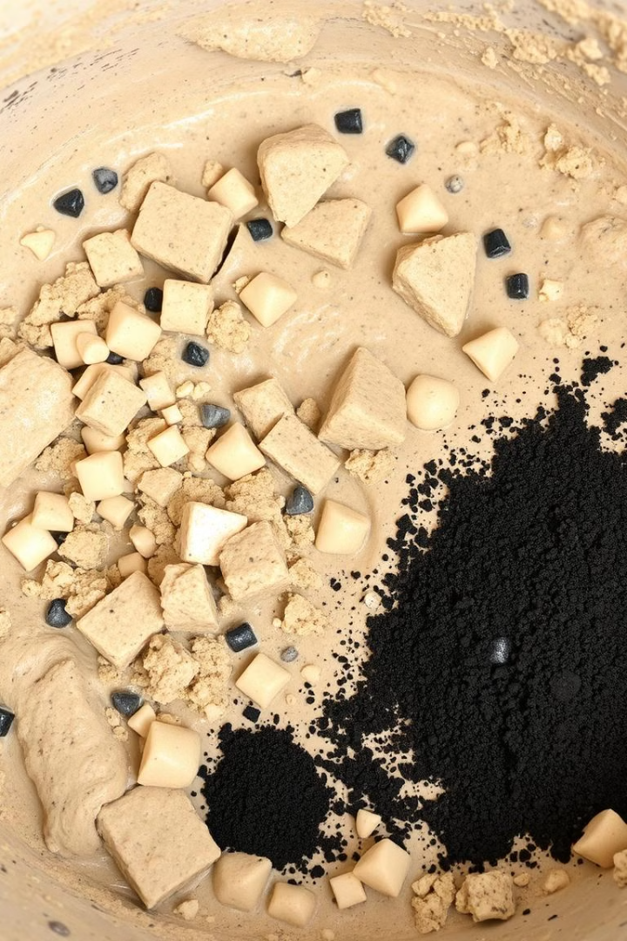
3. Material
The type of concrete most used in the West Bank and Palestine used in this study B300 (52.5 N/mm2) .
The materials added per 1kg of cement
1
Water Content
(w\c = 0.50)
2
Aggregate
around 18-25 mm (2.6 kilogram), type two has a diameter around 7-17 mm (1.2 kilogram) and type three has a diameter around 1-6 mm (1.28 kilogram)
3
Sand
2.57 kilograms.
4
pyrolysis carbon black
A percentage of 4% of the cement content.
5
Enhancements.
super G7 10g and super C30 4g.

Slide 6




4. Methodology
Four mechanical tests were applied :
Compression Strength Test
Friction Test
Water Absorption Test
Slump Test

Slide 7
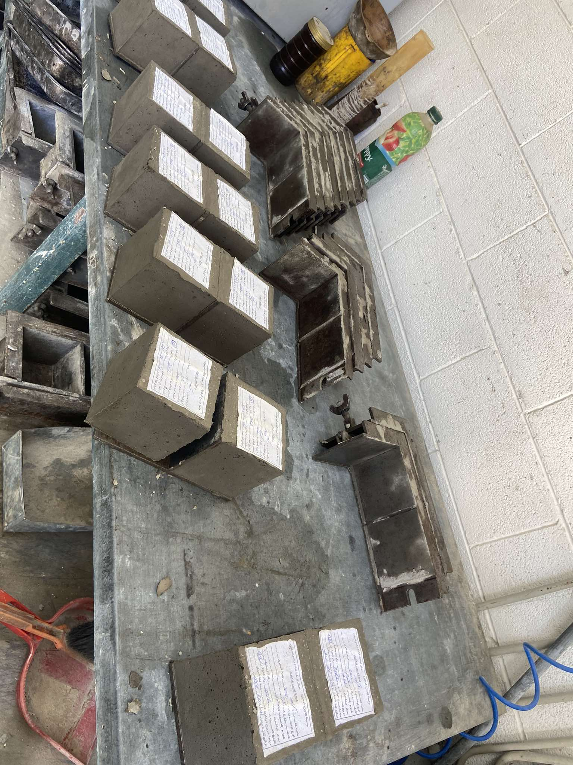
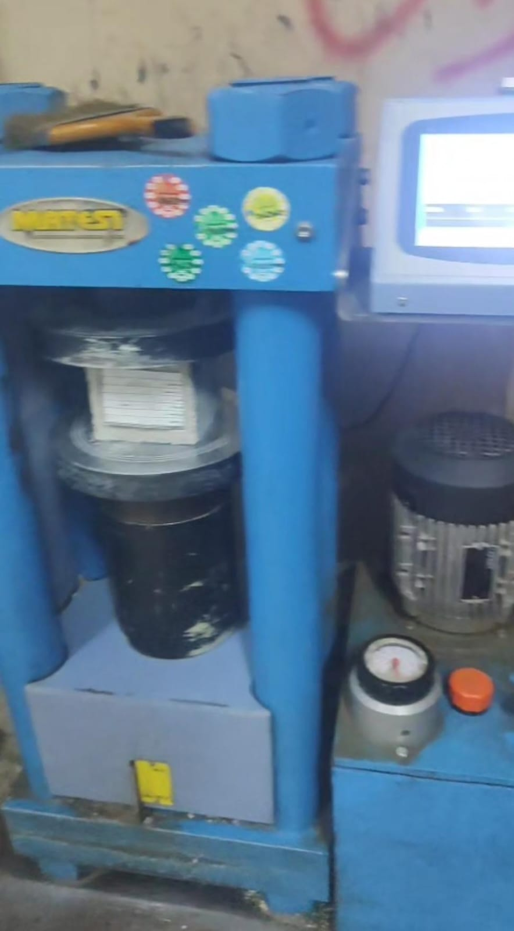
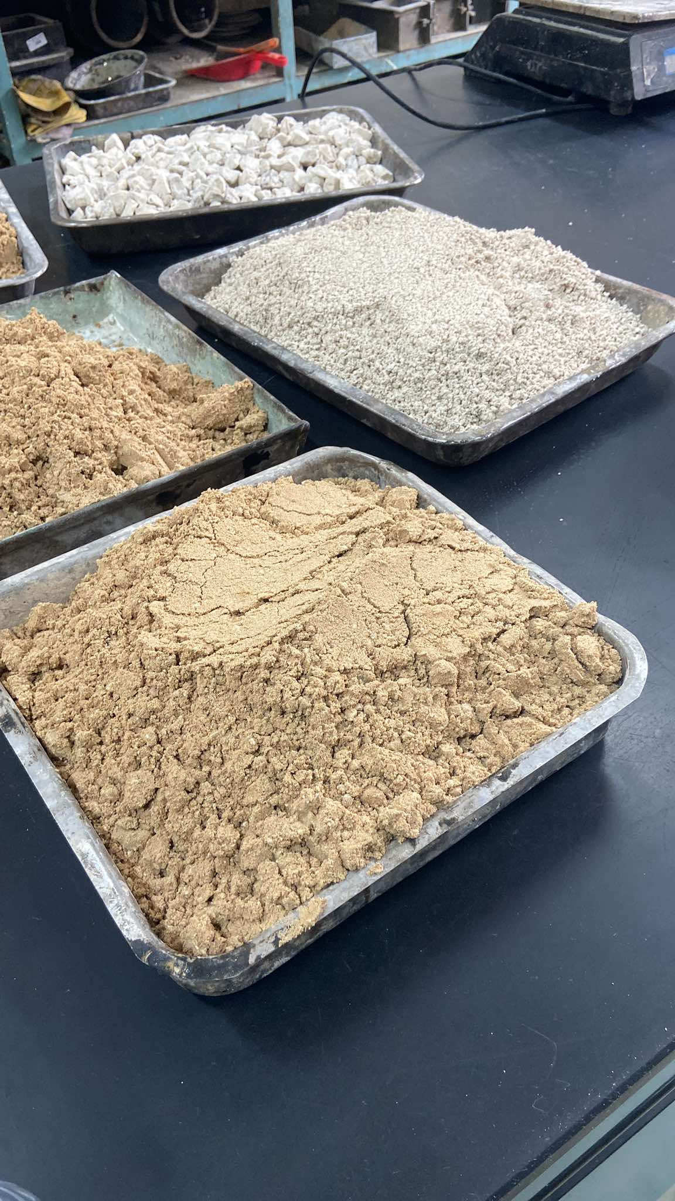
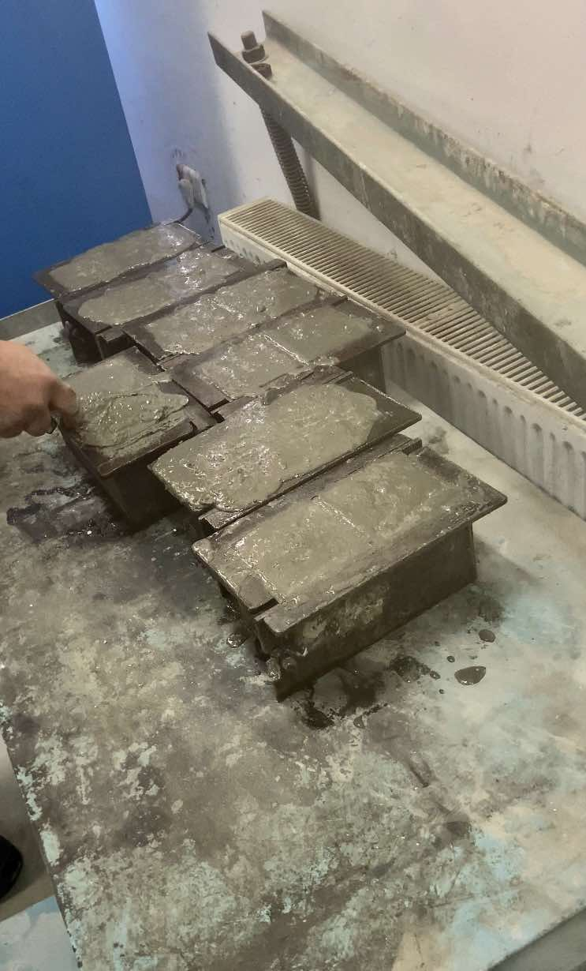
Compression Test:
The sample cubes are prepared and then allowed to settle for 7 and 28 days before we use the compression stress device, centering them within it.

Slide 8
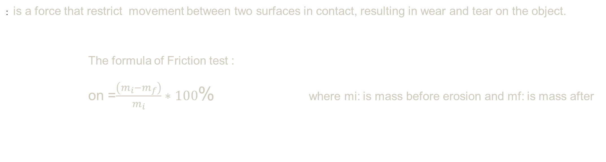
Friction Test
: is a force that restrict movement between two surfaces in contact, resulting in wear and tear on the object.
The formula of Friction test :
on =$\frac{\left(m_{i}−m_{f}\right)}{m_{i}}∗100$% where mi: is mass before erosion and mf: is mass after

Slide 9
Water Absorption Test
The testing procedure involves drying the sample to a constant weight, weighing it, immersing it in water for a specified period of time, and then weighing it again.
This Accomplished by :
Drying of the concrete : Until the concrete is completely dried, the samples are placed in a dry oven at 110 C after , and a digital scale was used to weigh the concrete after continuous drying
Wetting of concrete : After complete drying of the samples, the concrete cubes are immersed in water for 48 hours, then removed and the surface is dried after weighing and wetting

Slide 10
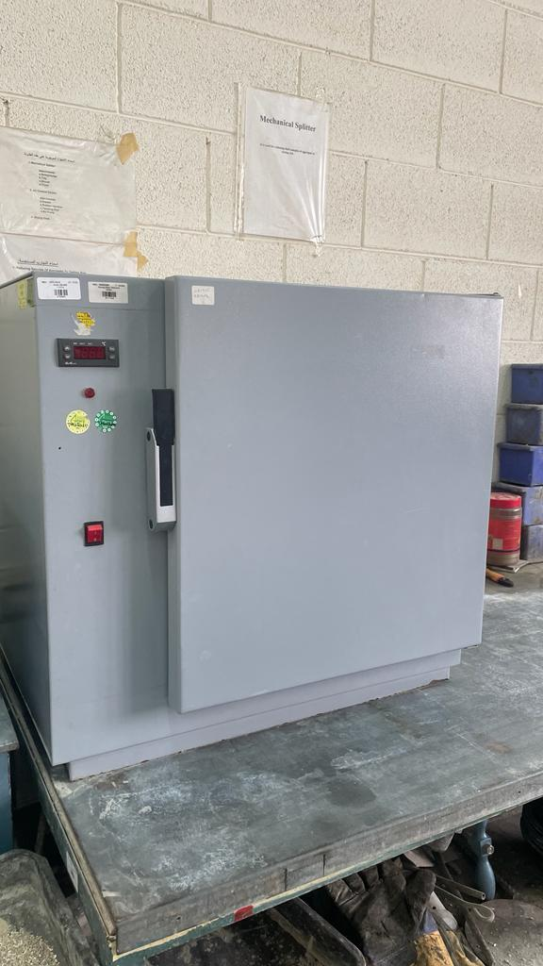
Water Absorption Test
The formula of water absorption test :
Absorption test=(Wet−Dry)/Dry∗100%
Drying oven
For drying concrete cubes at 110℃

Slide 11
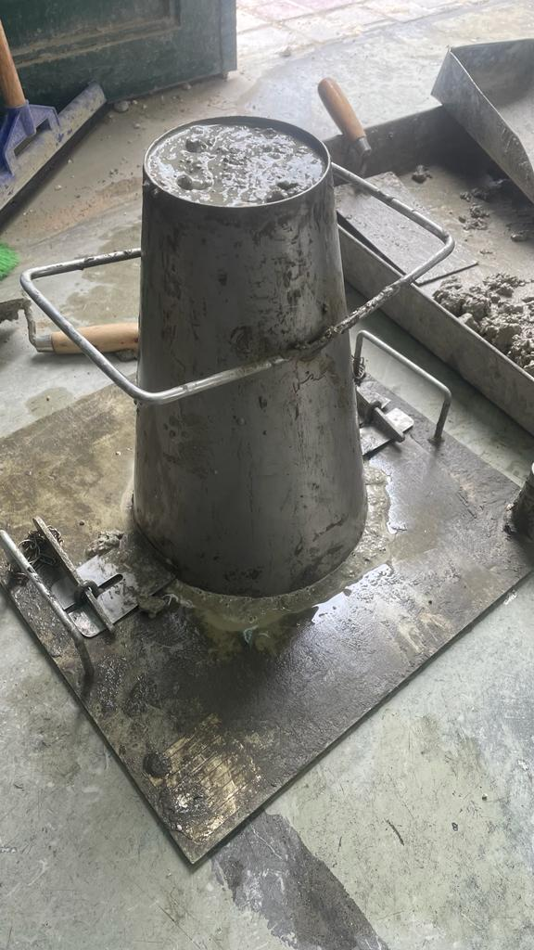
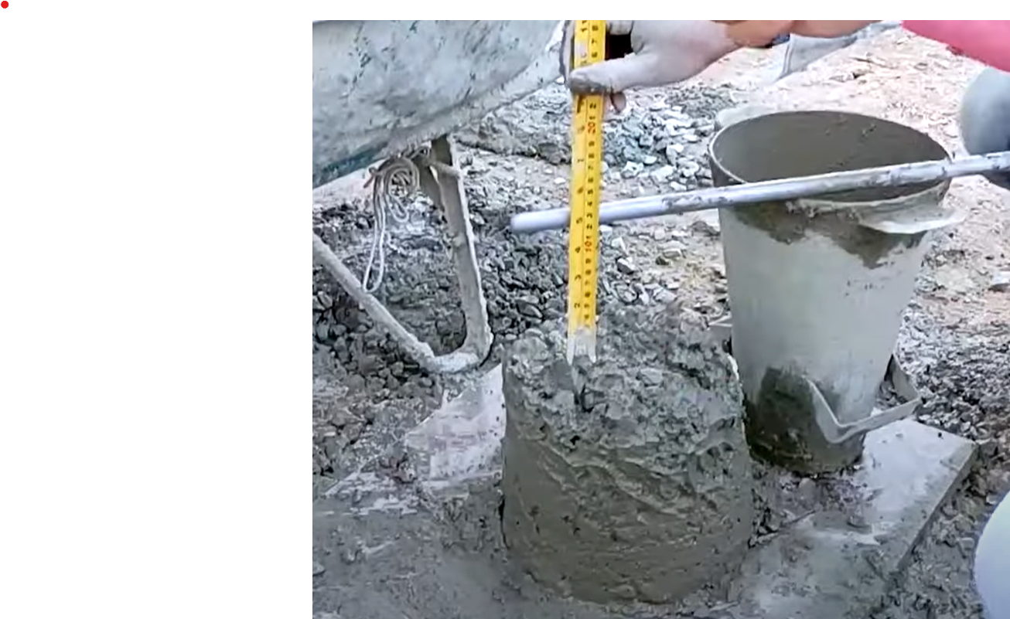
Slump test or cone slump test
used to determine the workability or cohesion of concrete mixture prepared in the laboratory or construction site during the progress of work.
The decrease in the height of the center of fallen concrete is called slump.
Slump is measured by placing the cone directly next to the sloped concrete and the heating rod is placed over the cone so that it must also come over the area of the sloped concrete.
The measurement is made via a ruler (cm).
Cone tool used for Slump test

Slide 12
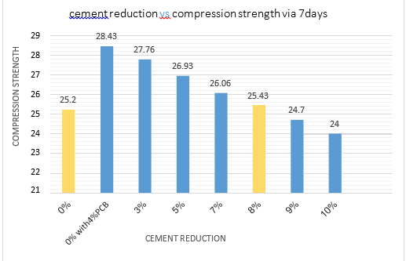
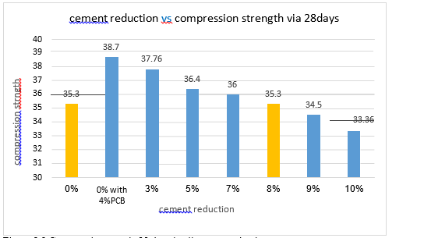
5. Results
Compression Test
That adding PCB to concrete specimen increased the strength.
It found out that adding 4% of PCB to concrete specimen increased the compression strength at the maximum rate.

Slide 13
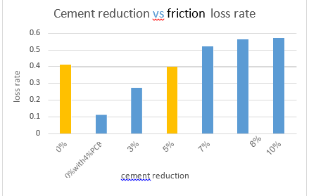
Friction Test
In this table, as the cement content was reduced, the friction loss in the specimens increased. This increase is attributed to the concrete becoming more brittle with less cement, which negatively impacts the surface of the specimens. Consequently, this brittleness weakens the specimens and decreases their resistance to frictional loads.

Slide 14
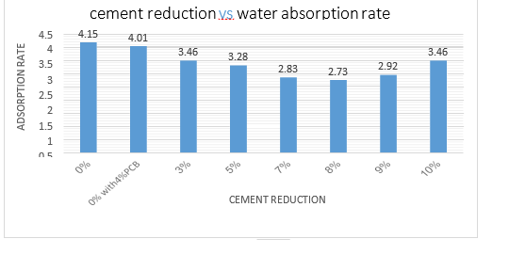
Water Absorption Test
It was observed that as the cement content decreased, the rate of water absorption also decreased. This trend continued until the cement content was reduced by 9% and 10%.
reducing the cement content by 9% and 10% led to lower compressive strength. Because water adsorption of concrete made it tend to be a little bit wet and that's absolutely decreased the compressive strength

Slide 15
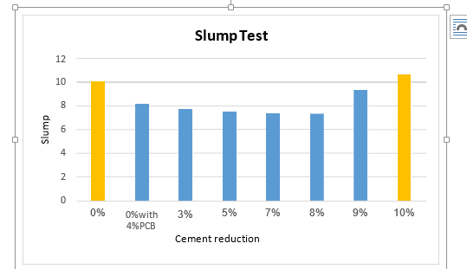
Slump test or cone slump test
the slump test results show that at a cement reduction of 7% and 8%, workability decreased

Slide 16
6. Conclusion
At an 8% cement replacement with Polychlorinated Biphenyls (PCBs), the concrete's compressive strength was similar to the reference sample (0% PCB, no cement reduction), achieving 25.43 MPa after 7 days and 35.3 MPa after 28 days. However, with 9% and 10% cement replacement, the strength dropped to approximately 24.7 MPa and 24 MPa, respectively, after 7 days.
Regarding water absorption, the 8% cement replacement resulted in a 2.73% absorption rate, a 65.7% reduction compared to the reference sample's 4.15%. In terms of friction, the 8% replacement sample had a friction rate of 0.56%, compared to 0.41% for the reference sample. The slump test showed that as cement replacement increased, the slump also increased, from 7.3 cm at 8% replacement to 10.6 cm at 10% replacement.
Overall, using 4% PCB allows for an 8% reduction in cement usage while maintaining similar concrete quality and performance, saving 20 kg of cement per 250 kg batch.

Slide 17
Thank You

