Slide 1




GRAD PROJECT I
“PATHY”
HALA KAWNI - NASSER AKER
DR. ALADDIN MASRI
Start Slide

Slide 2
Project Objectives:
  Design and implement a multifunctional robot dog
  Enable safe navigation and obstacle avoidance
  Support perception and monitoring
  Provide human–robot interaction

Slide 3
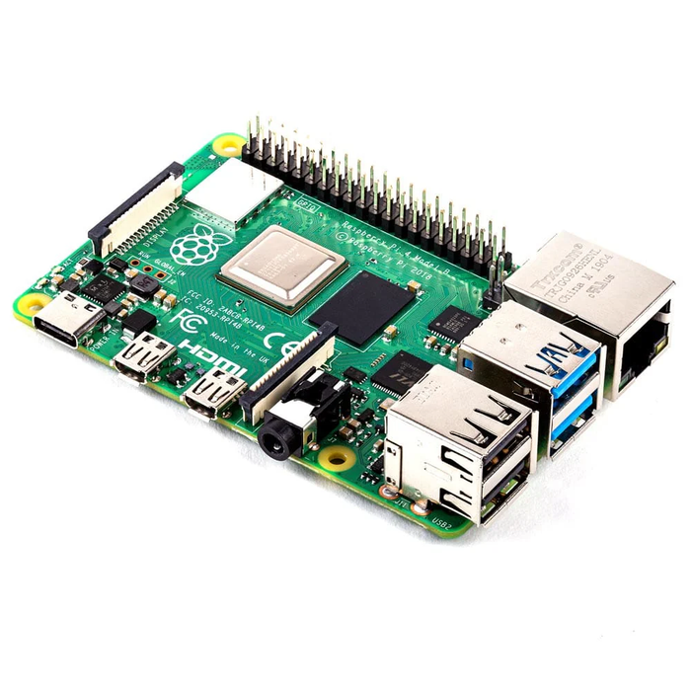
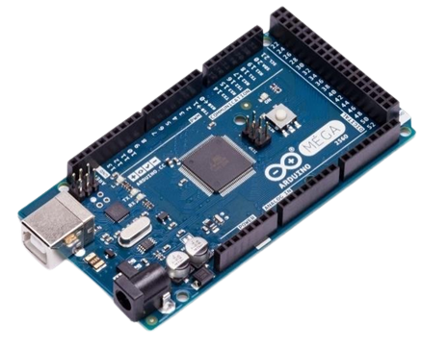
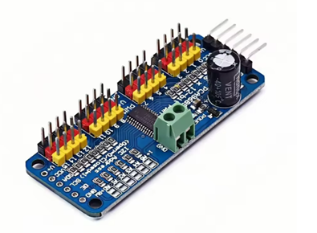
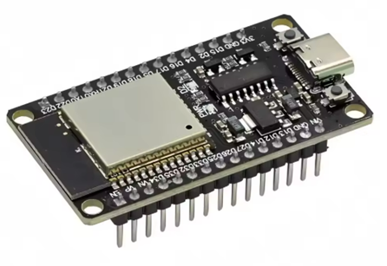
Hardware Components
  Raspberry Pi 4 Model B (2GB RAM)
  Arduino Mega
  ESP32 Microcontroller
  Servo Control Board (PCA9685)

Slide 4
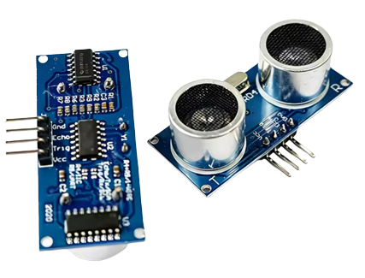
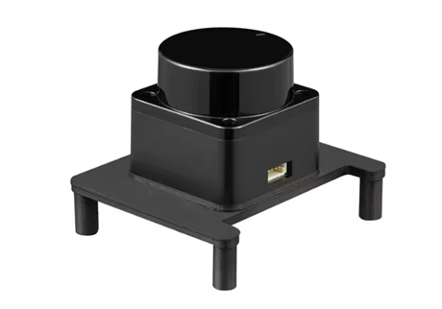
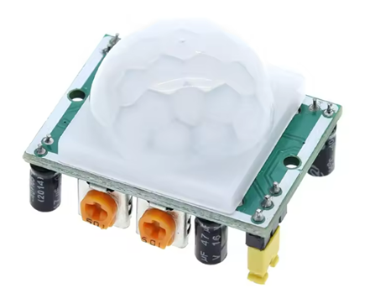
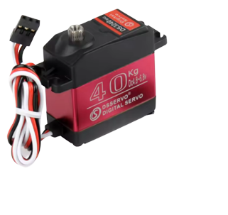
Hardware Components
  LiDAR Sensor (LD06)
  Ultrasonic Sensors
  Servo Motors (270° – 40 kg torque)
  PIR Sensors

Slide 5
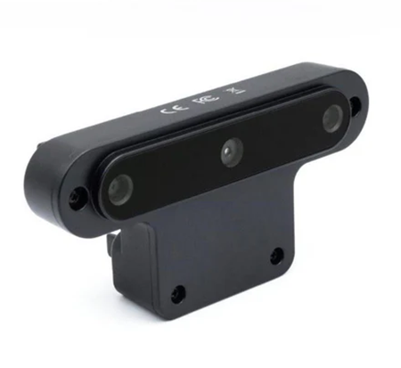
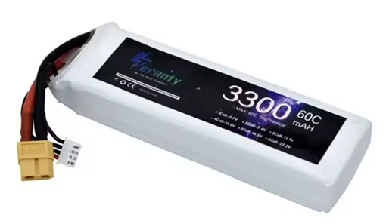
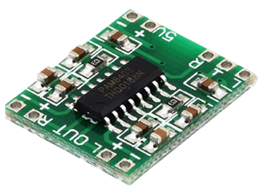
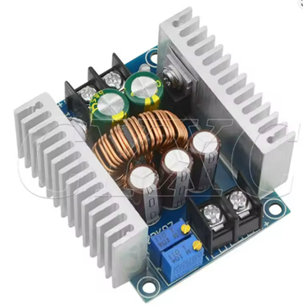
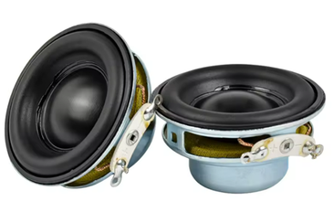
Hardware Components
  Luxonis AI Camera
  lipo battery
  Audio System (Speaker )
  Buck Converter

Slide 6
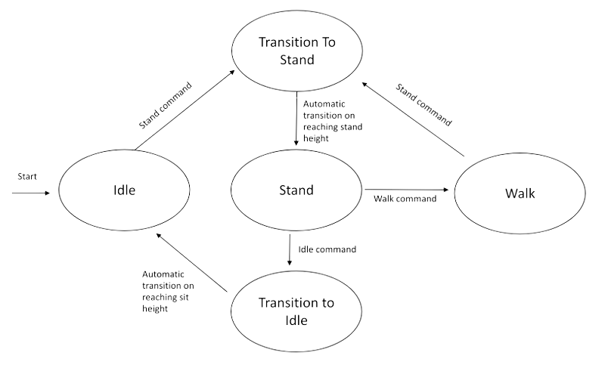
Movement
  can be represented with 5 states.

Slide 7
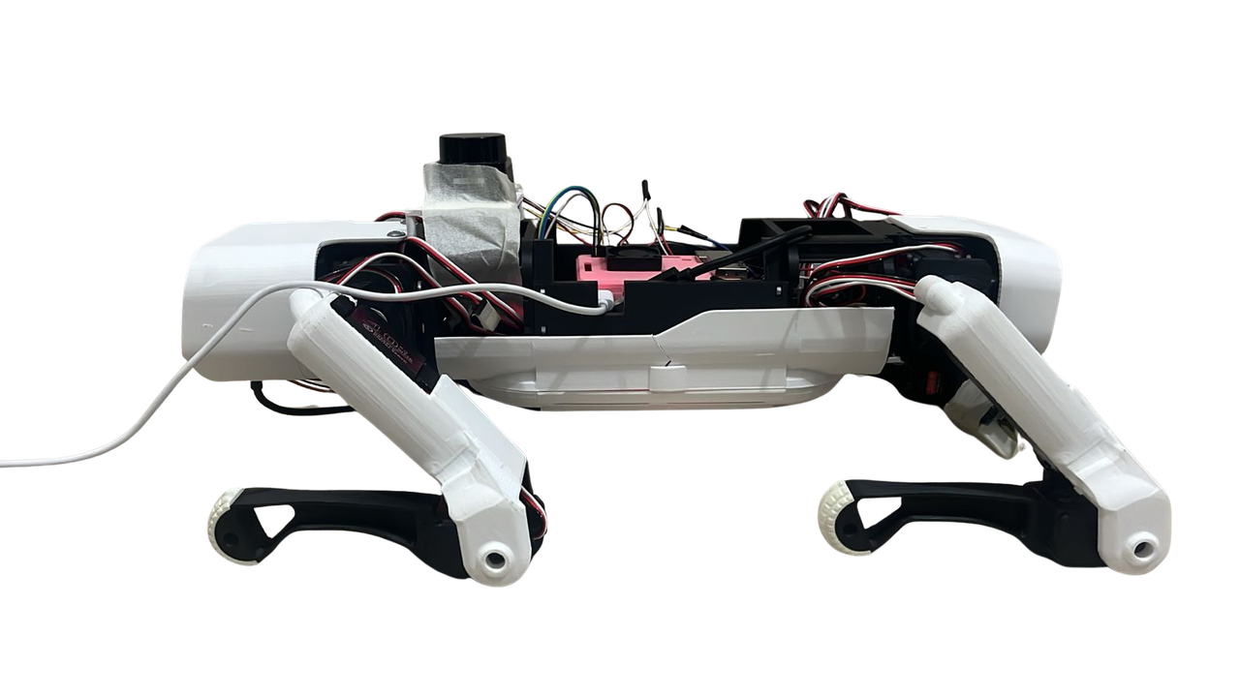
1. Idle State
  This is the initial state when the robot starts.
  The robot is in a sitting or resting position.
  No leg movement occurs except for maintaining balance.
  From Idle, the robot waits for a stand command.

Slide 8
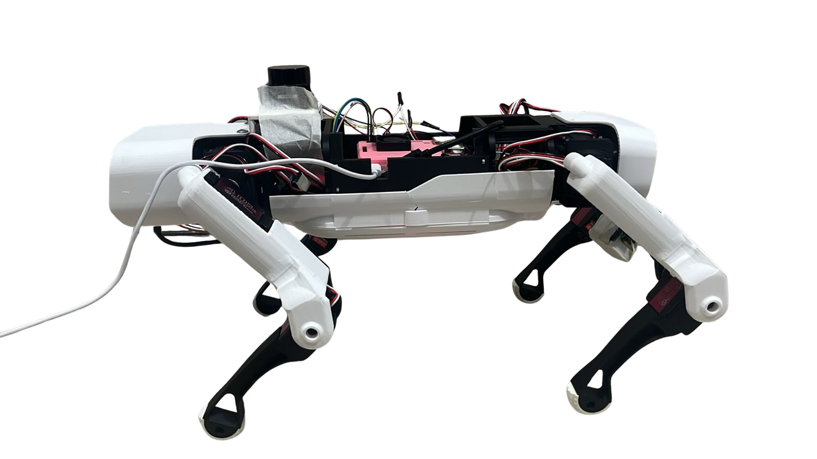
  3. Stand State
  The robot is fully upright and balanced.
  In this state, the robot is ready to move but remains stationary.
  Two commands are possible:
  Walk command → transitions to Walk state
  Idle command → transitions to sitting down

Slide 9
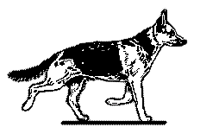
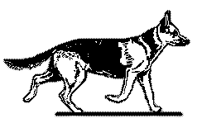
4. Walk State
  The robot performs a walking gait using coordinated leg movements.
  Continuous balance and posture control are maintained.
  If a stand command is issued, the robot stops walking and returns to the Stand state safely.

Slide 10
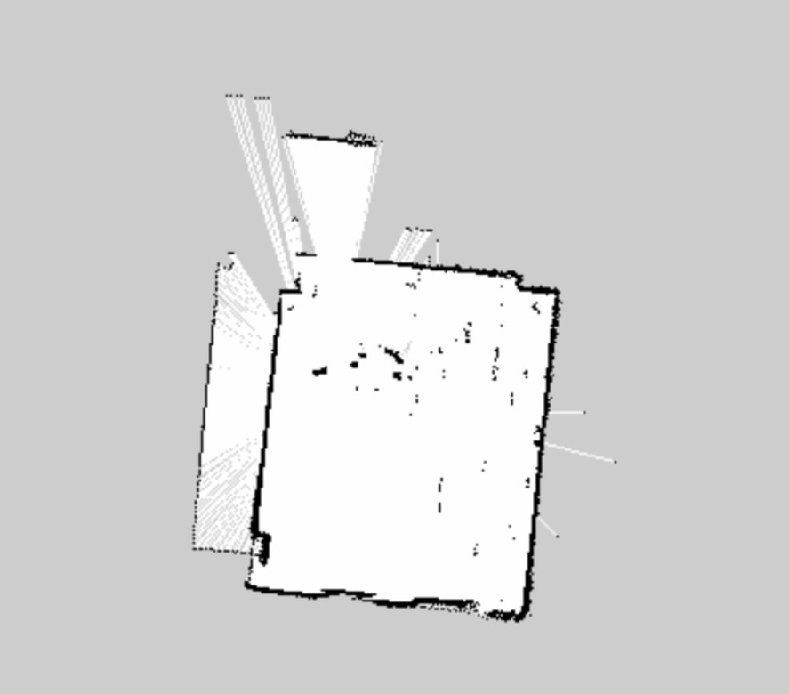
Features :
  Mapping
  Mapping was performed using LiDAR-based obstacle detection
  The robot was moved using a manual controller
  LiDAR data was collected during movement
  Detected obstacles were stored to create a basic environment map

Slide 11
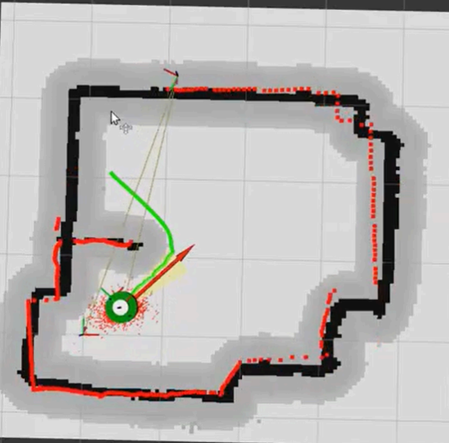
  localization & path finding
  Localization was based on the robot’s position relative to detected obstacles
  The generated map was used to identify free and occupied areas
  Path finding selected safe directions to avoid obstacles
  The robot adjusted its movement when obstacles were detected
  Dijkstra was used to find the shortest and safest path to the target

Slide 12
  Alarm mode
  Camera system used for real-time object detection
  YOLO model detects objects in front of the robot
  Ultrasonic sensor measures distance to obstacles
  Sensor data is processed together to improve awareness
  Audio feedback is generated when obstacles are detected

Slide 13
  Gard Mode
  Motion detection in multiple directions using PIR sensors
  Sensor data processed in real-time for environment awareness
  Audio alerts notify users when motion is detected
  Alerts are timed to avoid repetitive notifications

Slide 14
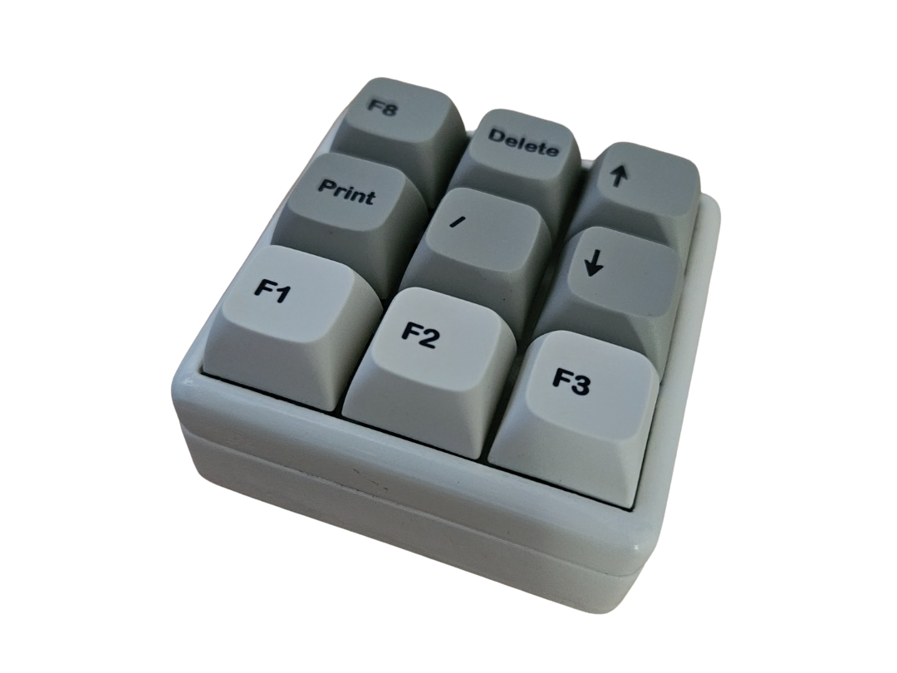
  ESP controller
  ESP32-based wireless controller enables manual robot control
  Commands include forward, backward, left, right, and stop
  Allows safe testing, and guided exploration
  Can be used to assist in mapping and real-time navigation

Slide 15
Constraints
  Power Management
  Component Availability
  Mechanical Design
  Calibration

Slide 16
Future work
  Enhance walking performance for smoother, more natural motion
  Develop smarter interaction and feedback with the user
  Add voice command functionality for hands-free control
  Expand outdoor navigation and robust autonomous capabilities

Slide 17
THANK YOU
ANY QUESTIONS?
End Slide

