Slide 1
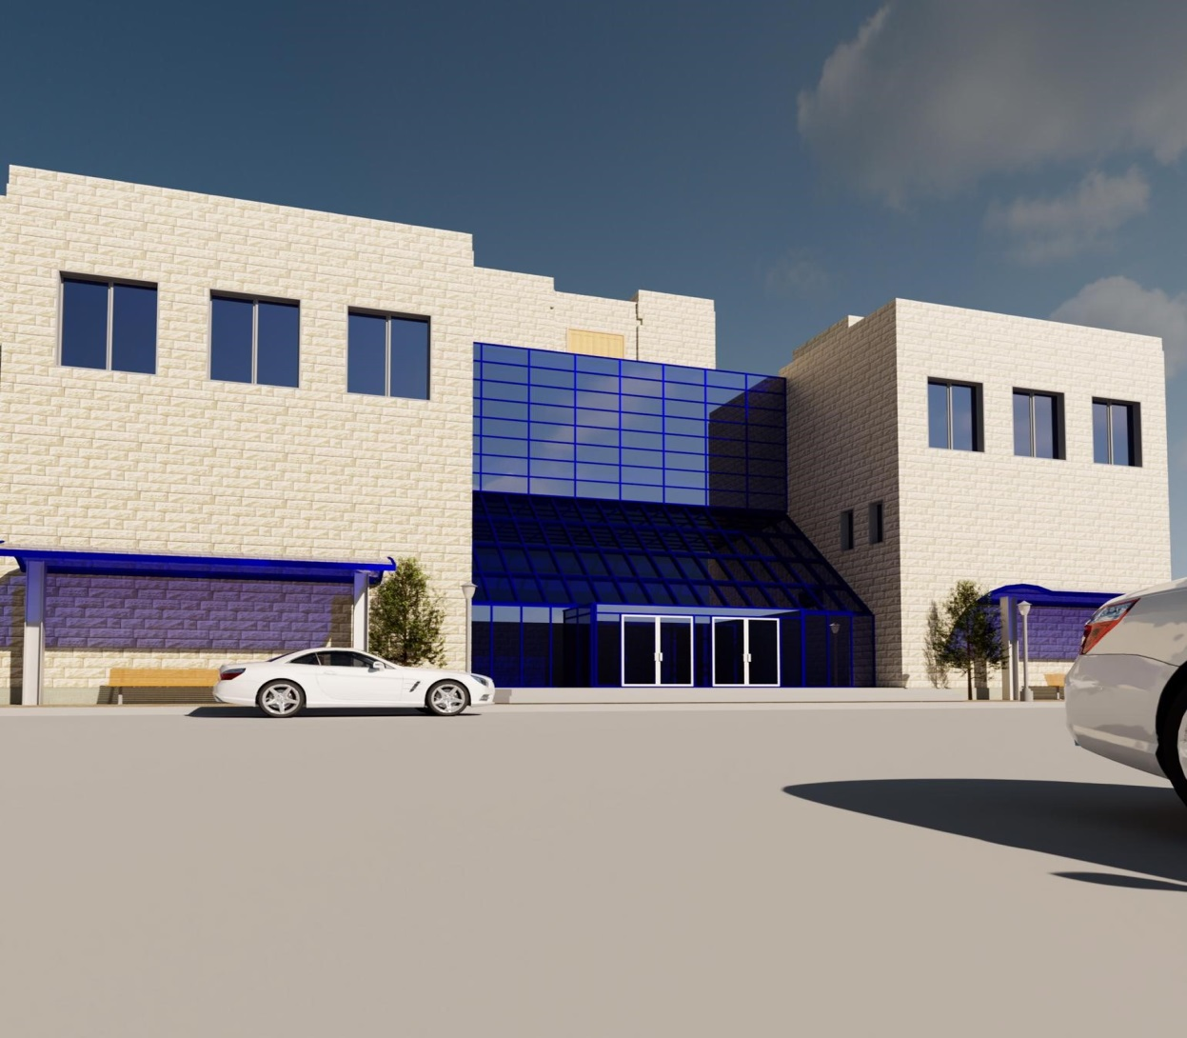
Quantity Surveying and Time Management for Faculty of Medicine-An-Najah National University
Prepared By:Ahmed Al-massri
Batool Sawafta
Lamya Hanani
Tariq Abatli
Supervied by:Eng. Reema Nassar

Slide 2

Outline
Management Functions.
Project Constraints.
Project Delivery Systems.
Construction Contracts.
Methodology.
Quantity survey.
Rivet 3D modeling.
Time And Cost Management
using Primavera software.
Hand calculation.
Results And Conclusions.
Bill of Quantity.

Slide 3
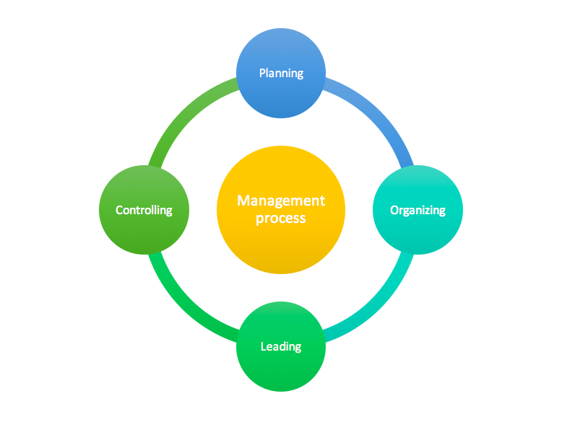
Management Functions:

Slide 4

Project Constraints
Time
Cost
Quality

Slide 5
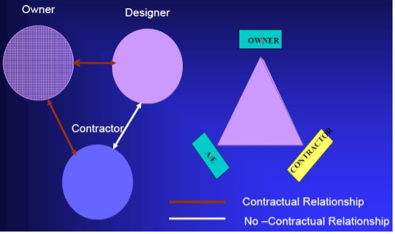
Project Key Participant

Slide 6
Project Delivery Systems
Traditional (Design-Bid-Build)
Design-Build (Turnkey)
Self-performance (Owner Builder)
Build Operate Transfer (BOT)

Slide 7
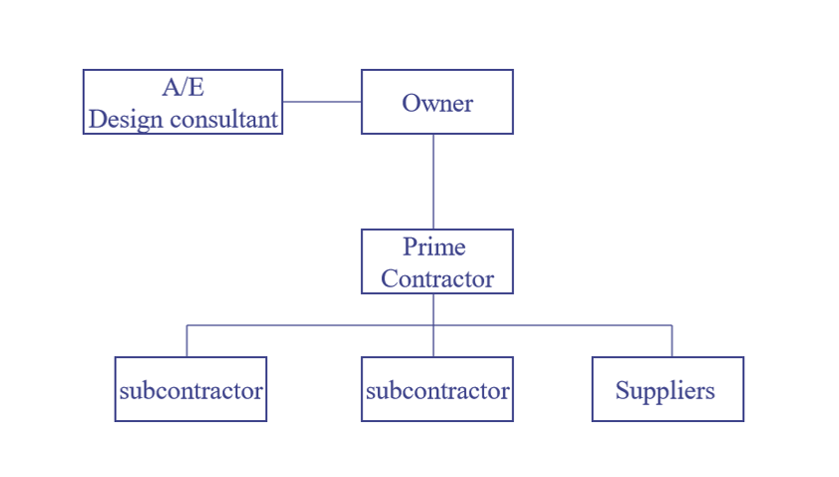
Traditional (Design-Bid-Build)

Slide 8
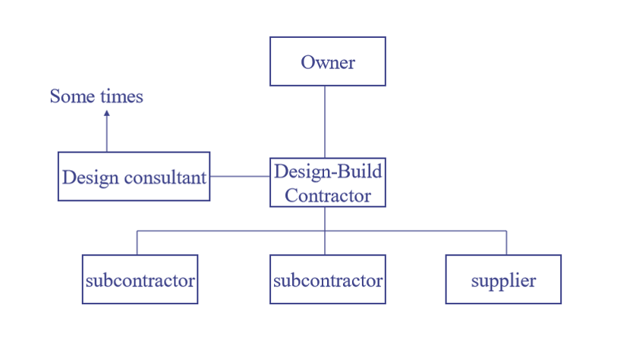
Design-Build (Turnkey)

Slide 9
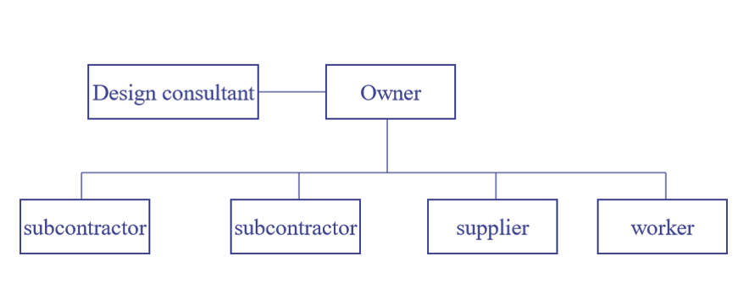
Self-Performance

Slide 10
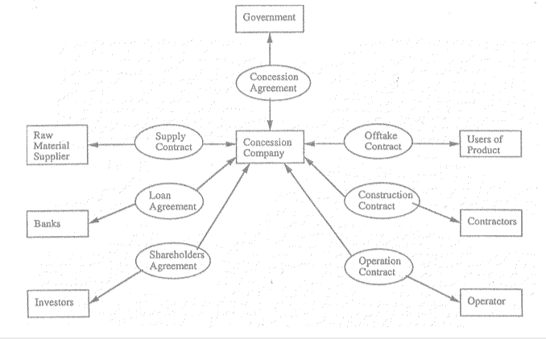
Build Operate Transfer (BOT)

Slide 11
Construction Contracts
lump sum contracts or single fixed cost (عقد المبلغ المقطوع).
Unit price contract (عقد وحدة الأسعار).
Negotiated Cost plus fee contracts (عقد التفاوض).
Guaranteed maximum price (GMP)(عقد التكلفة مع ضمان حد أعلى للتكلفة).

Slide 12
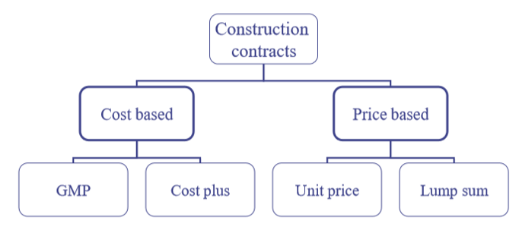

Slide 13
Methodology
This project is about quantity survey and cost estimate for a project of constructing.Faculty of medicine
The methodology of this project will be:
Studying the construction documents of the project.
Making a quantity survey using Revit program.
Estimating the time schedule for the project using Primavera.

Slide 14
Quantity survey
The estimated quantities of materials required on a project.
It is determined by a professional surveyor or engineer
Net in place quantity & material quantity.

Slide 15

Quantity Survey.
Data required for the preparation of an estimate or survey .
Drawings.
General and special conditions .
Rates and Specifications .

Slide 16
Units of measure
The five basic categories of units used in estimating are:
Number
Length
Area
Volume
Weight

Slide 17
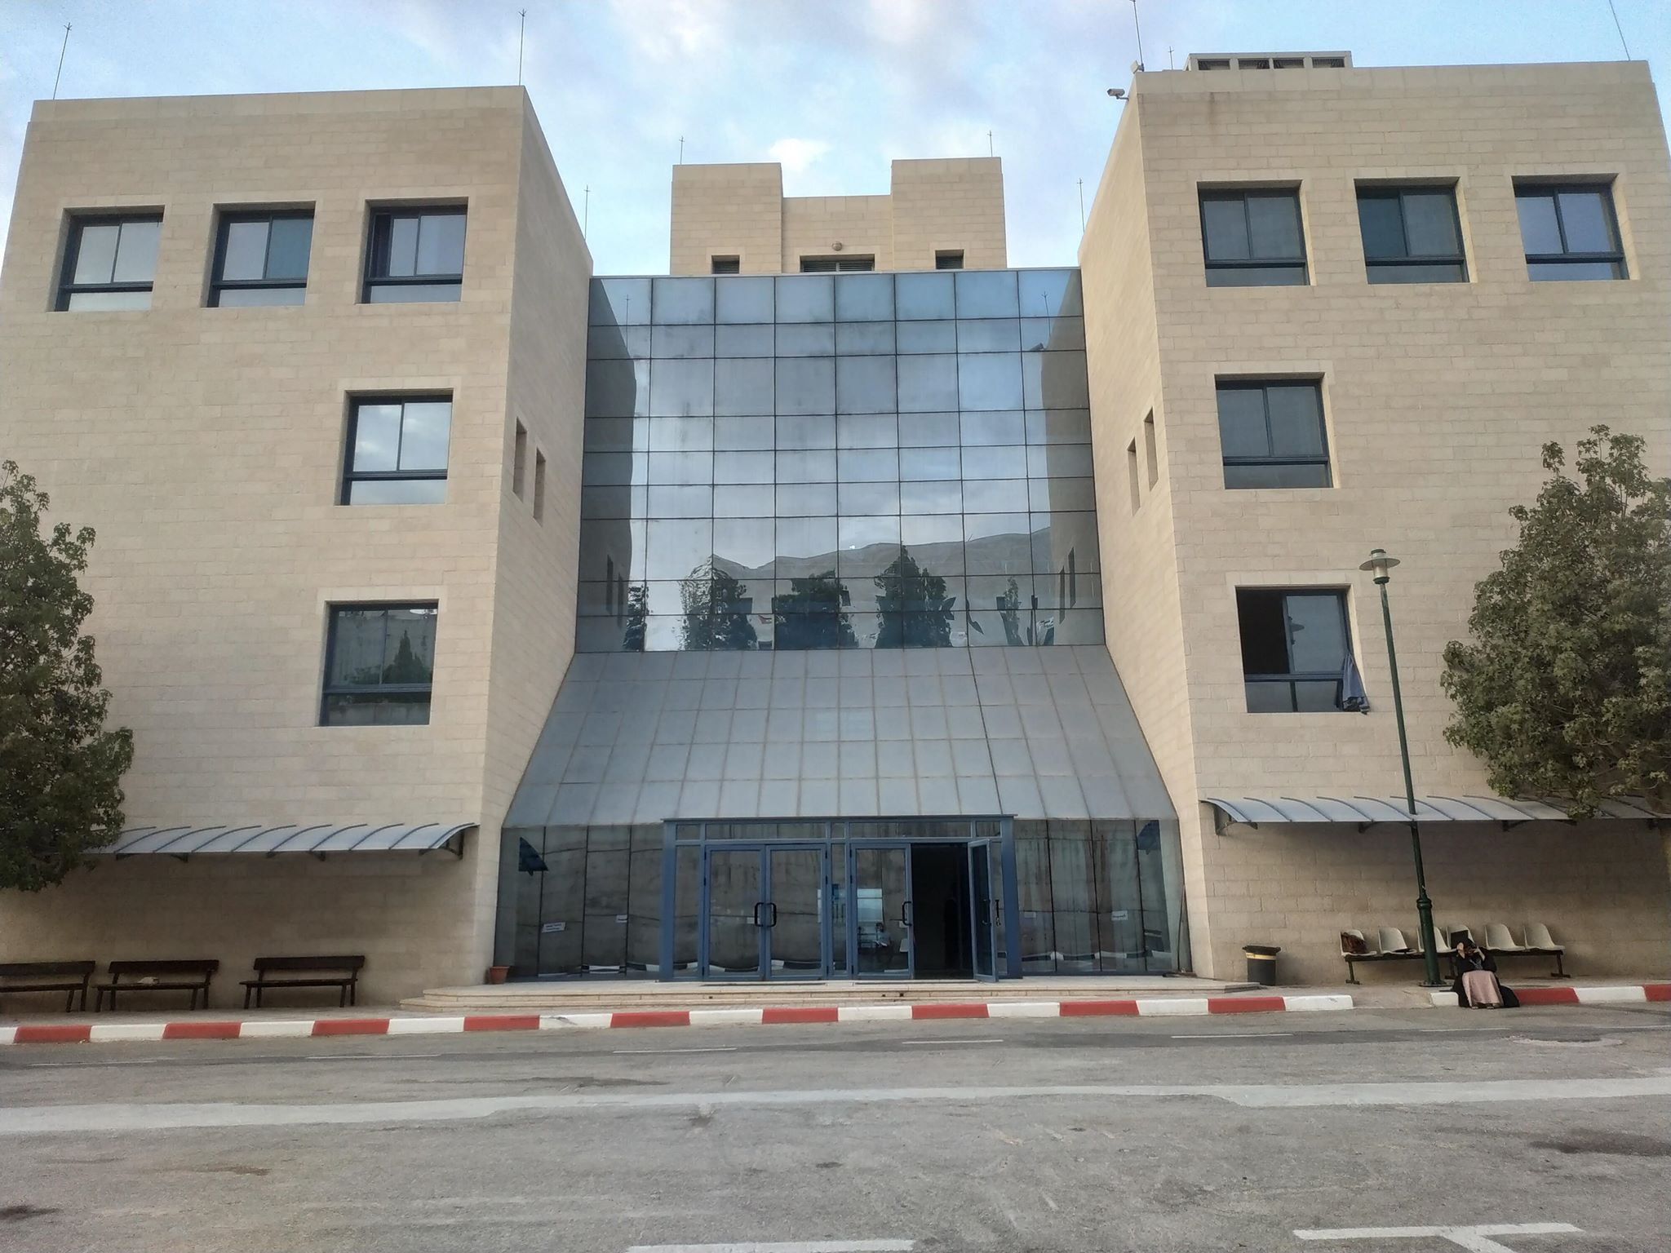
About Project
Nablus (NNU)
6 Floors
6708m²

Slide 18

,

Slide 19
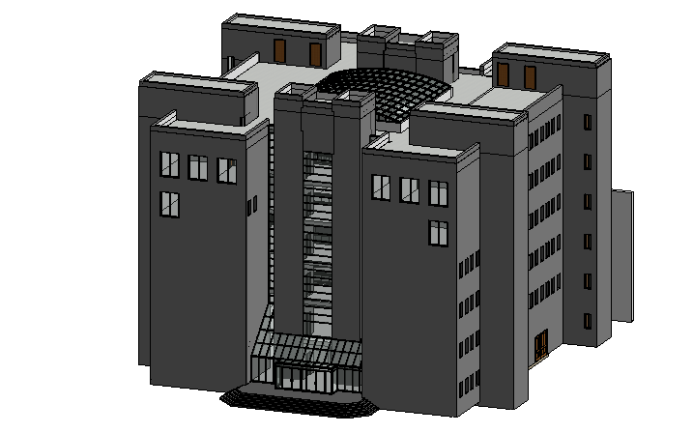
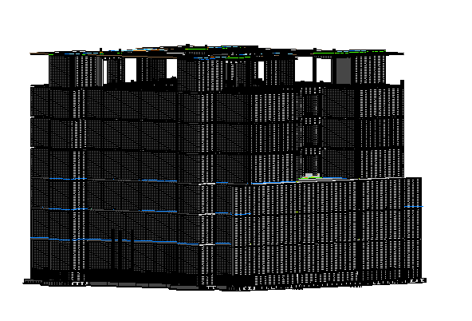
Architectural Structural

Slide 20
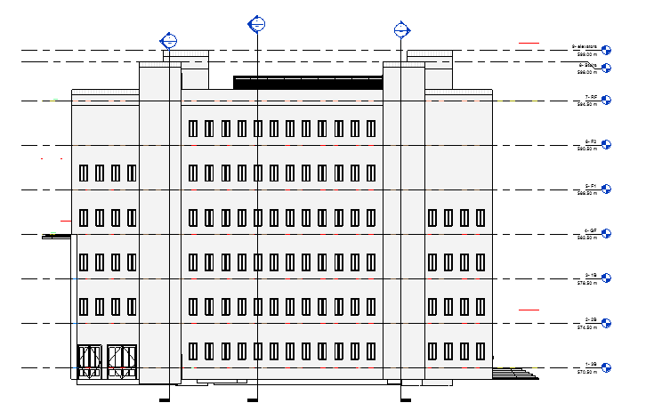
Levels

Slide 21
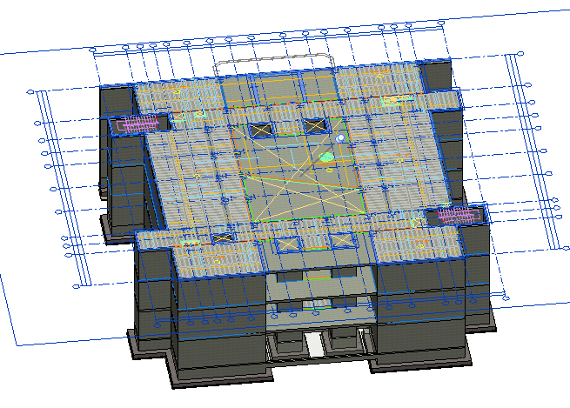
Link CAD

Slide 22
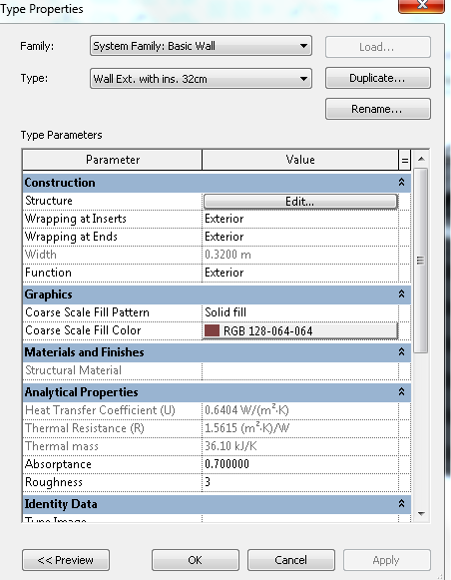
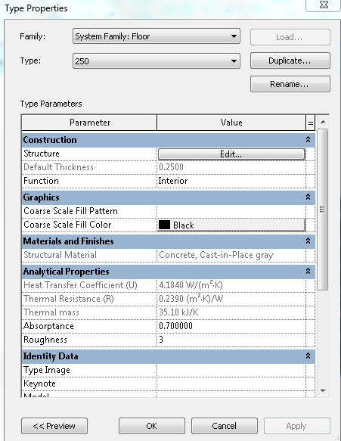
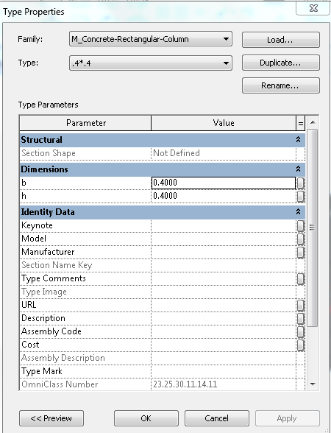
Sections Definition for the Structural Elements

Slide 23
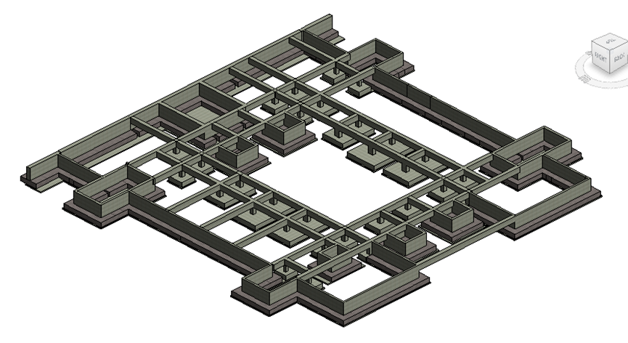
Foundation and tie beams

Slide 24
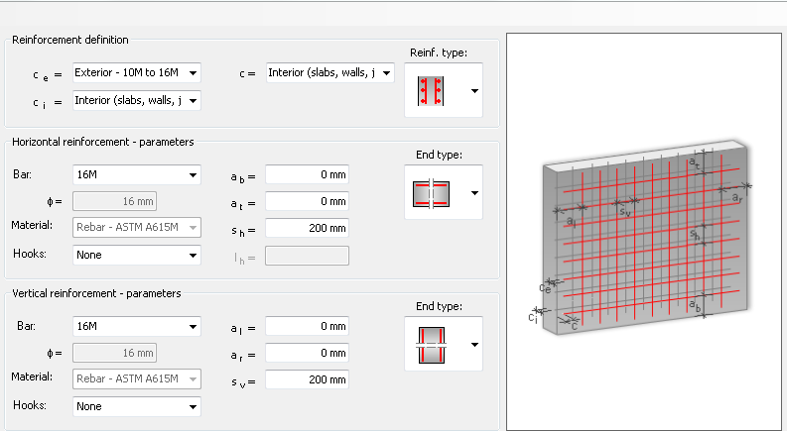
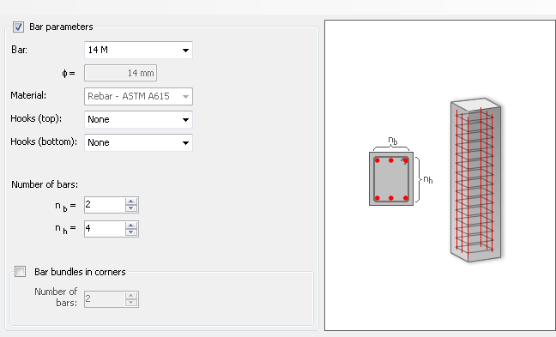
  Reinforcing Draw Using Revit

Slide 25
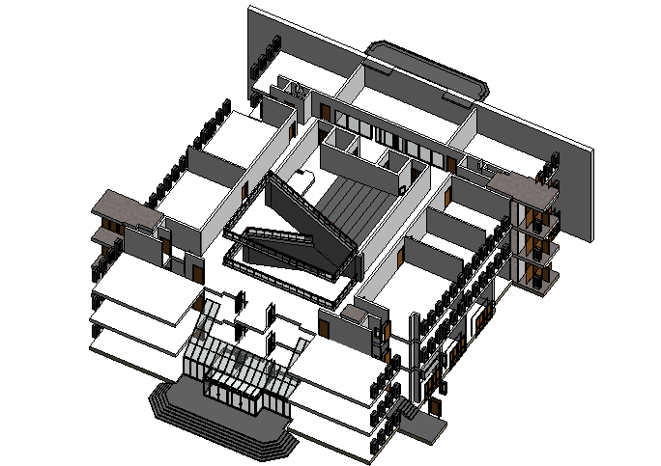
Internal Partition

Slide 26
The Final result
Architectural Structural

Slide 27
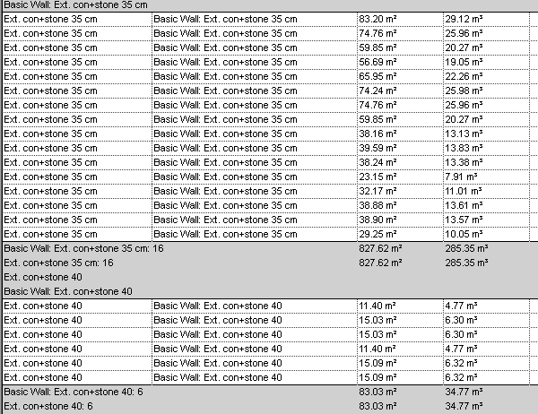
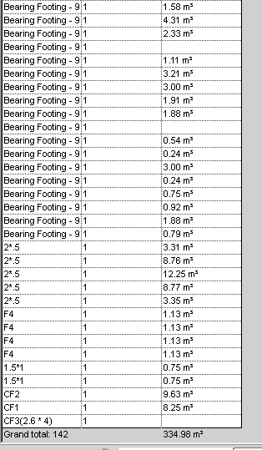
Tables from Revit

Slide 28
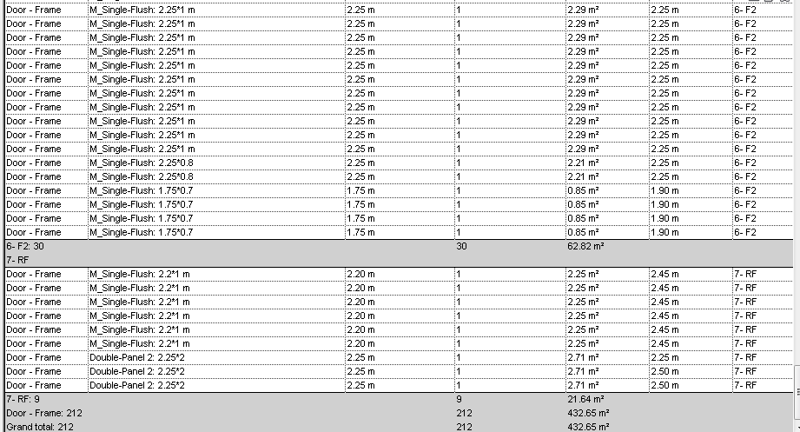

Slide 29
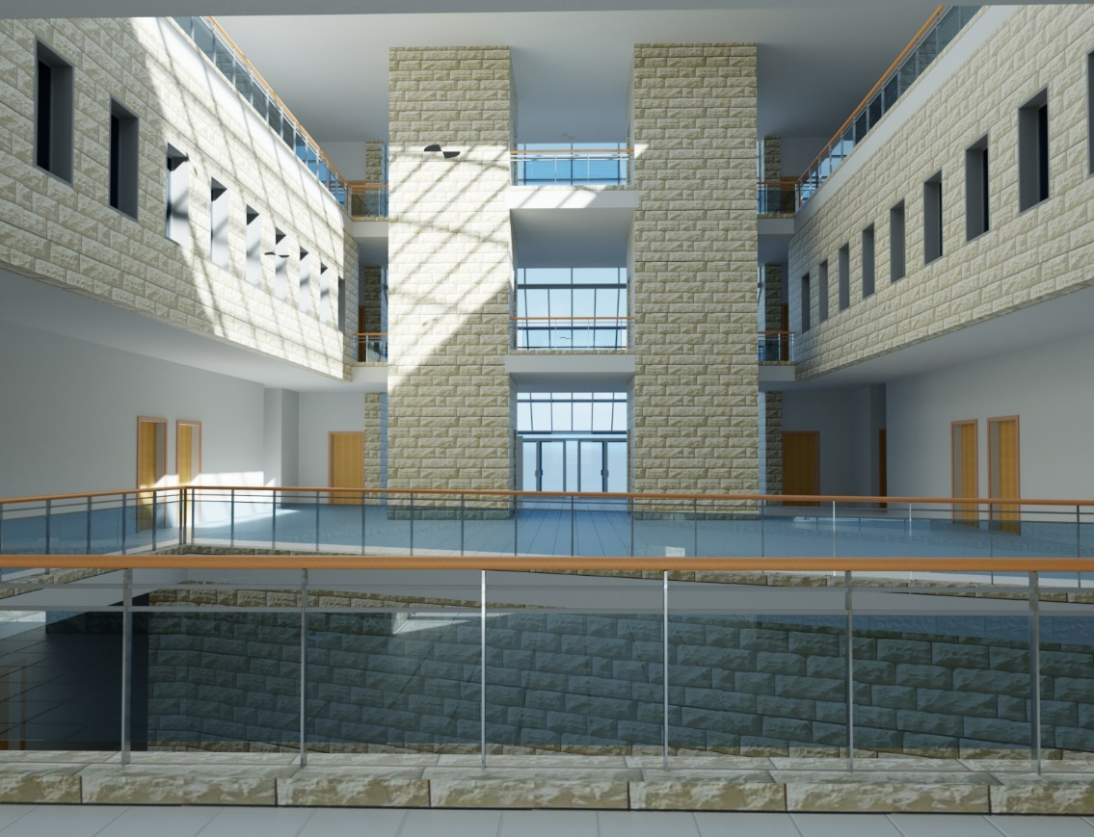
Render

Slide 30
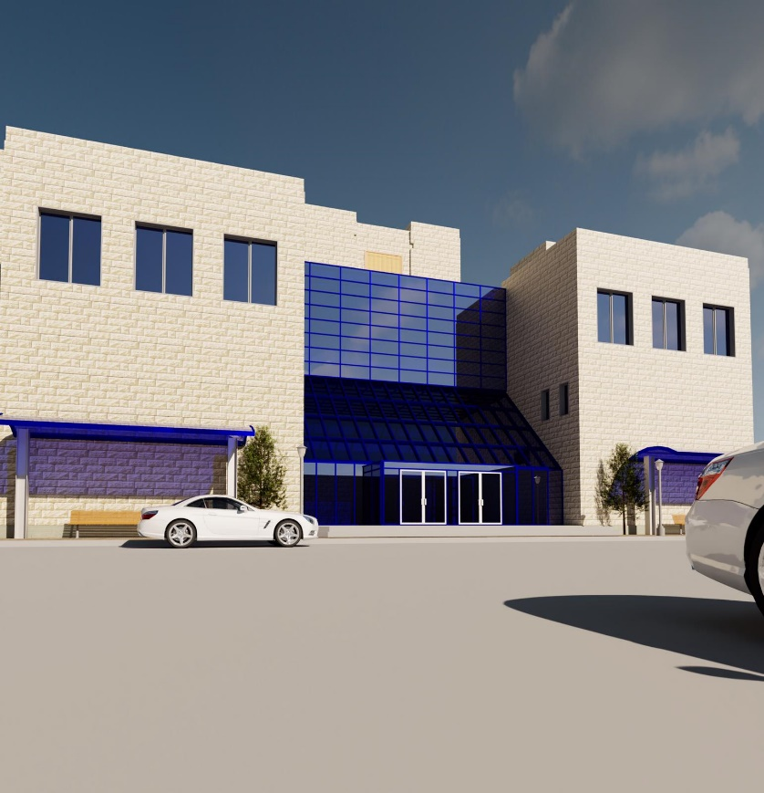
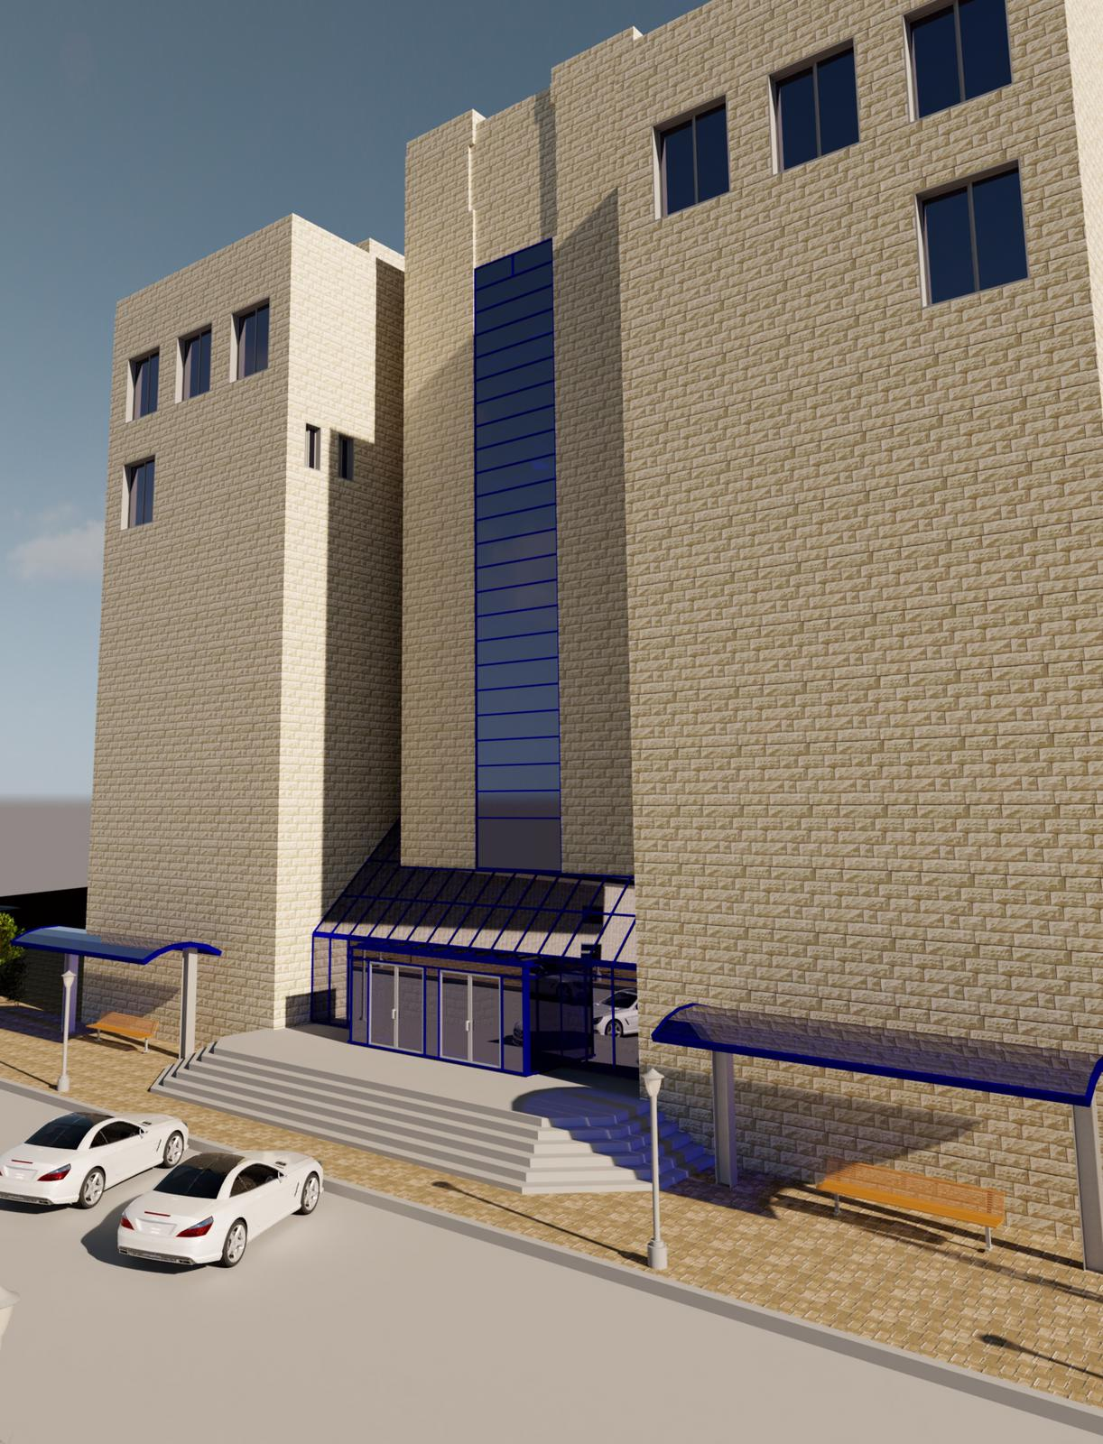

Slide 31
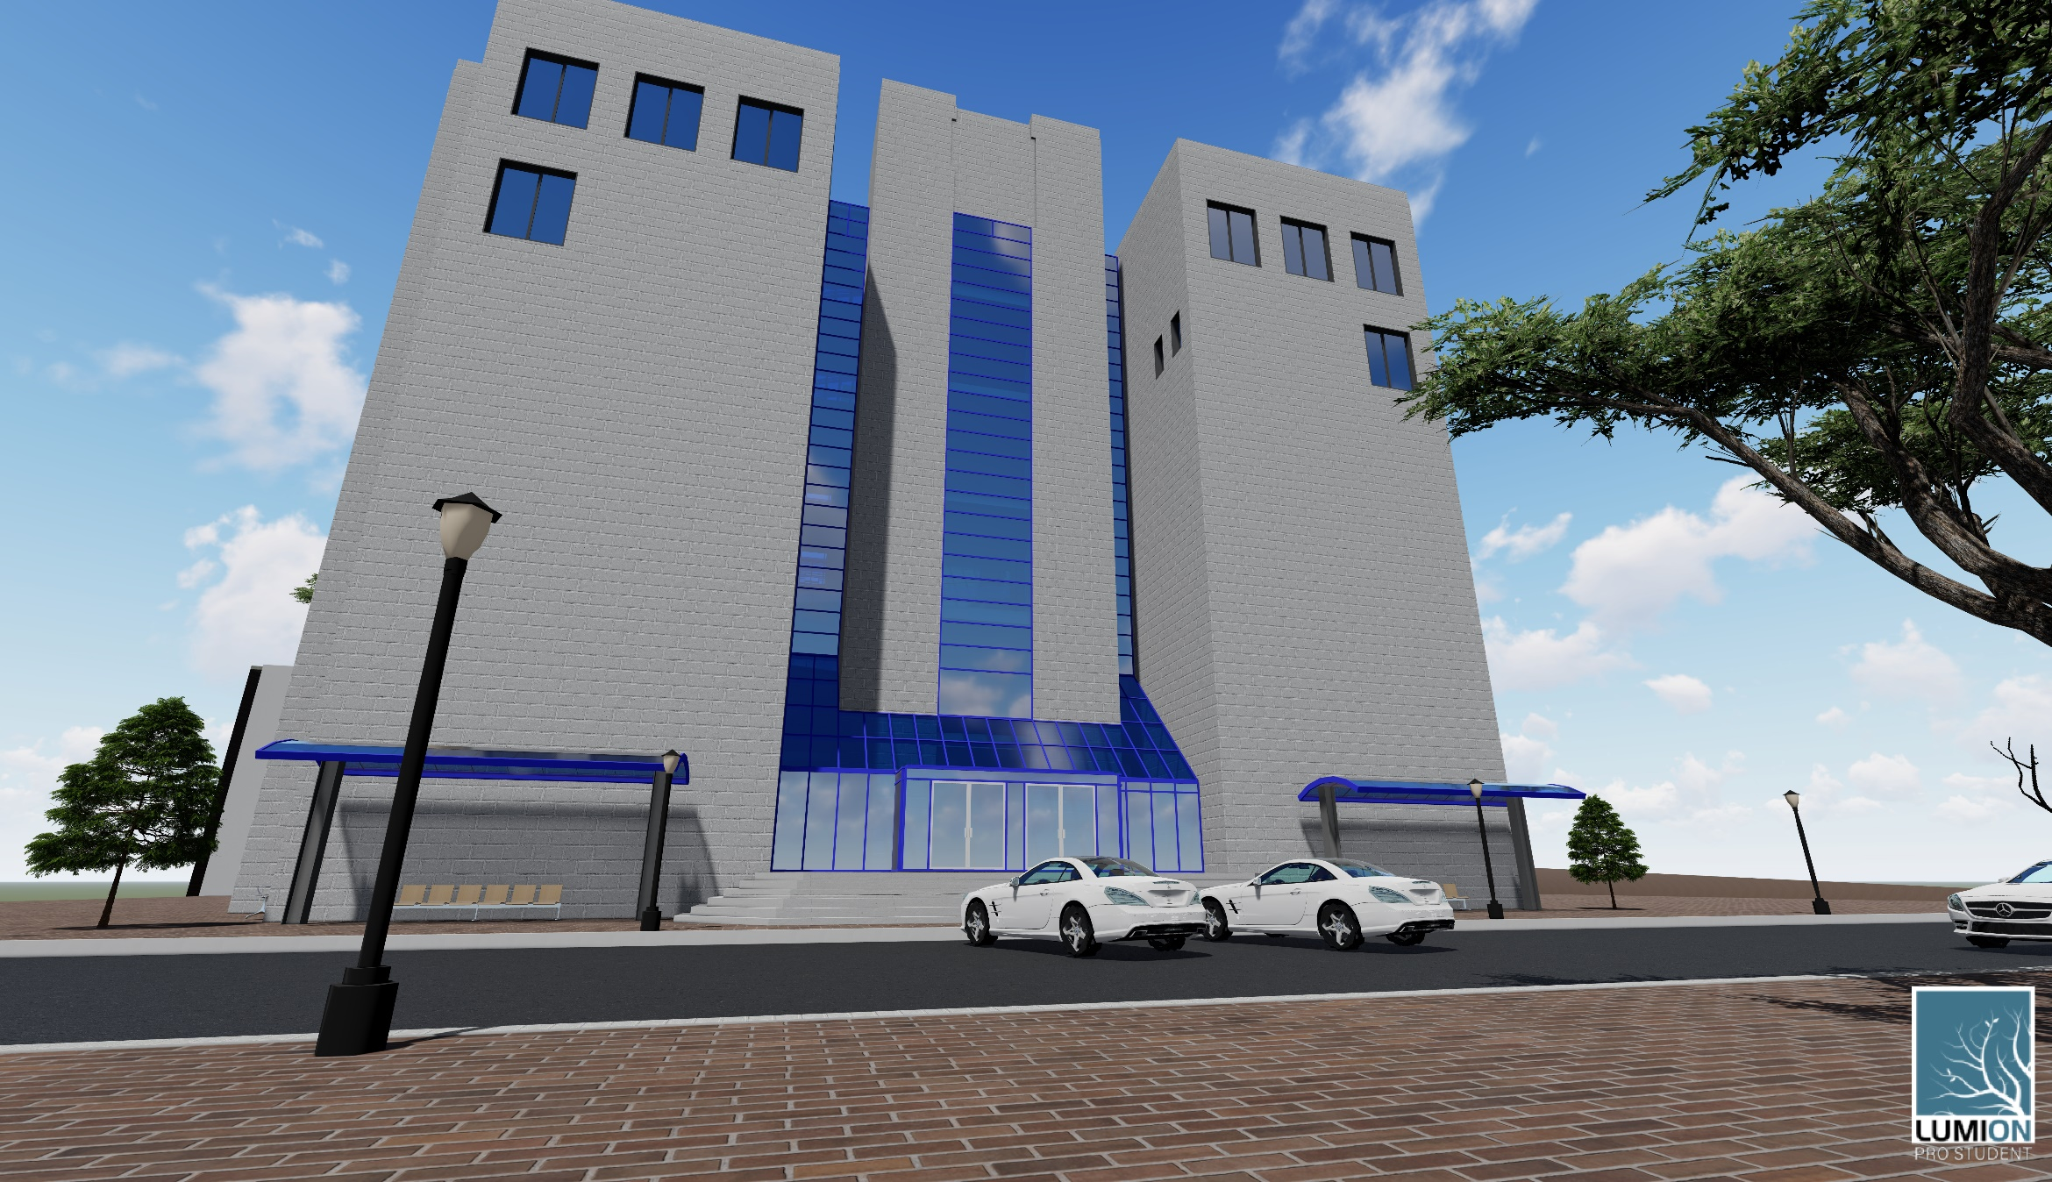
lumion

Slide 32
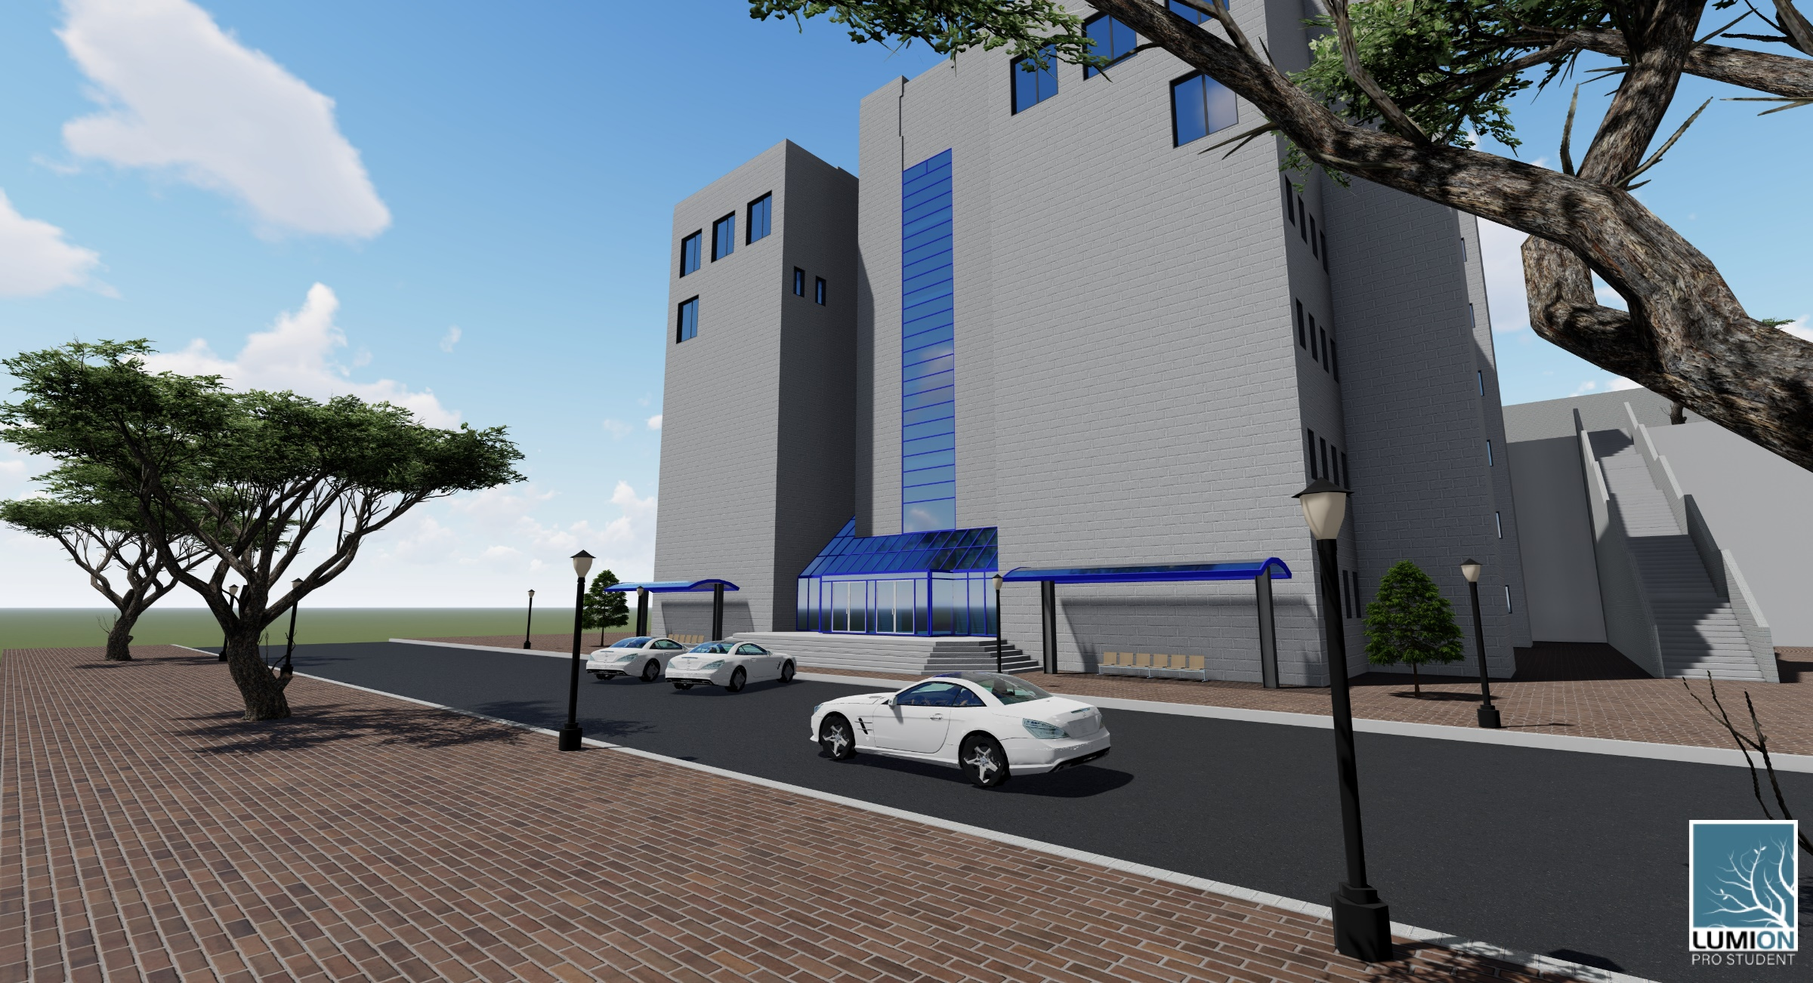

Slide 33

Primavera software

Slide 34
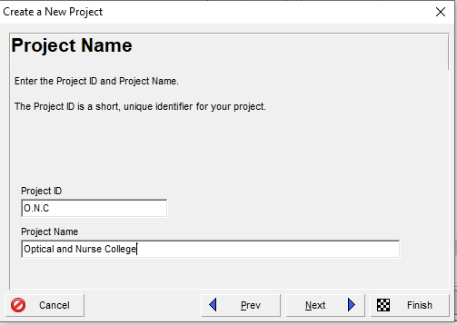
Project definition

Slide 35
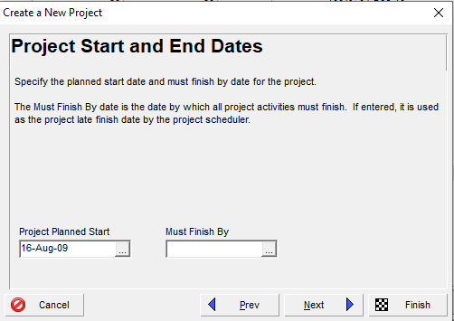

Slide 36
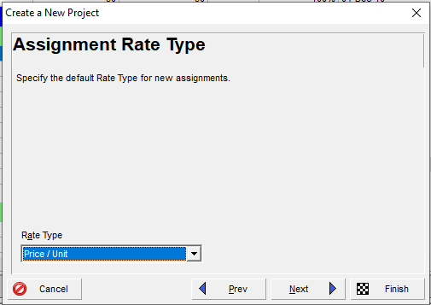

Slide 37
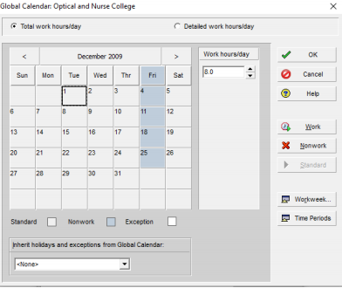
Calendar Definition

Slide 38
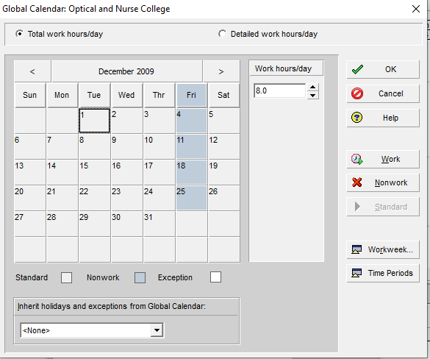
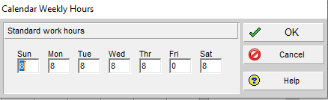

Slide 39
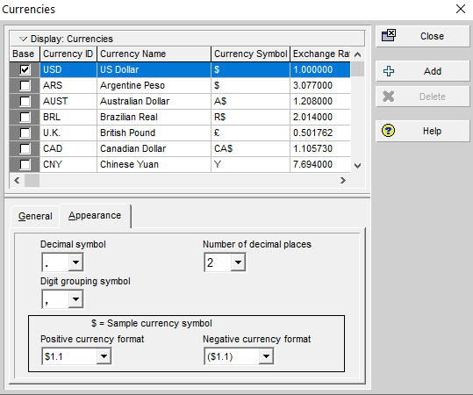
Currency Definition

Slide 40
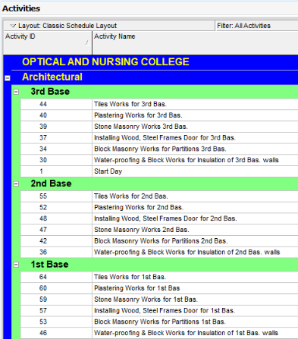
Activates Definition

Slide 41
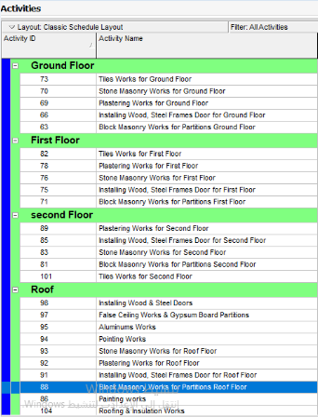

Slide 42
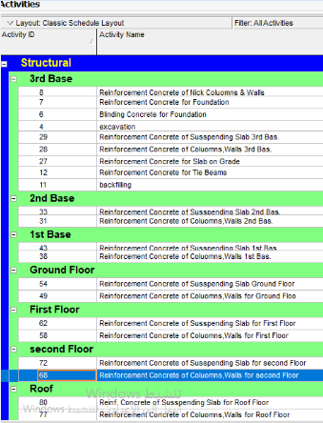

Slide 43
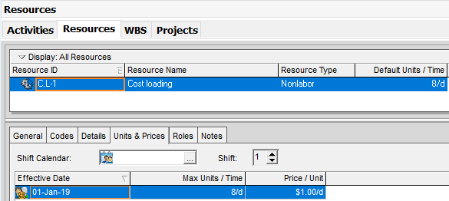
Resources definition
Definition

Slide 44
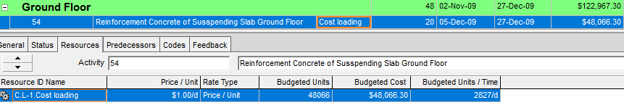

Slide 45

Total Direct Cost and Working Days

Slide 46
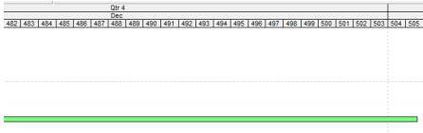
Calender Days

Slide 47
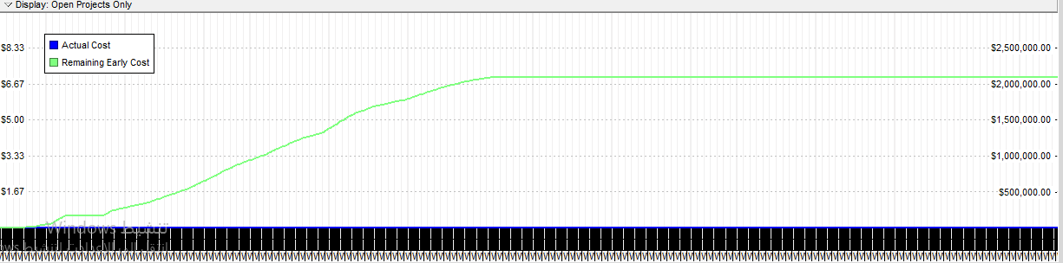
S Curve

Slide 48
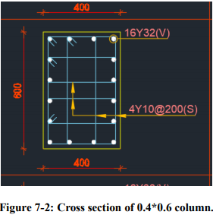
Hand Calculations

Slide 49
Concrete volume= length * width* high
= 0.4*0.6*3.7
=0.88m³.
In Revit the quantity of concrete equal 0.89m³, the percent of error 1.1% less than5%

Slide 50
Weight of the bars = (Diameter²/162) (bar length) (# of bars)
Net Weight of the bars and stirrups=581 kg
In Revit the quantity of reinforcement equal 589 kg, the percent of error 1.5% less than 5%.

Slide 51
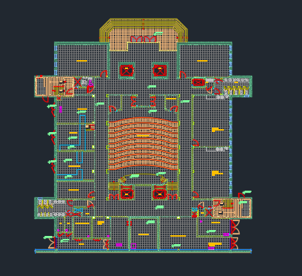
Top view of B3

Slide 52
Total area of tiles =1054.306 m²
In Revit the area of tiles equal 1059.58 m² , the percent of error 0.5% less than 5%.

Slide 53
Results & Conclusions
The important results of our project :
Bill of Quantity
Total price of the project
Total duration of the project

Slide 54
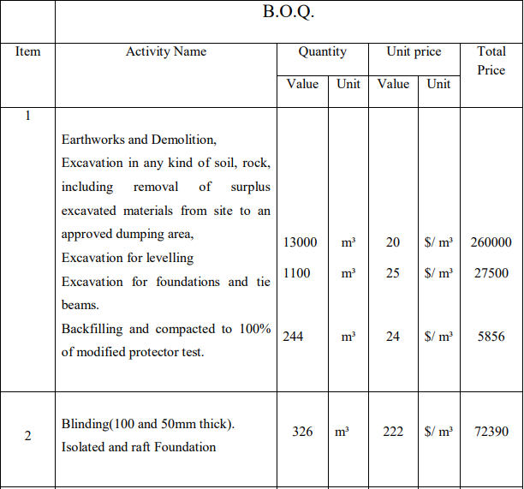
Bill of Quantity

Slide 55
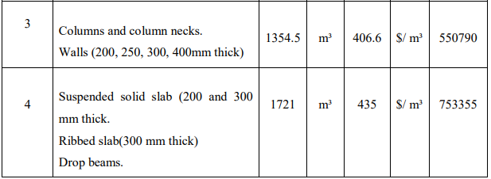
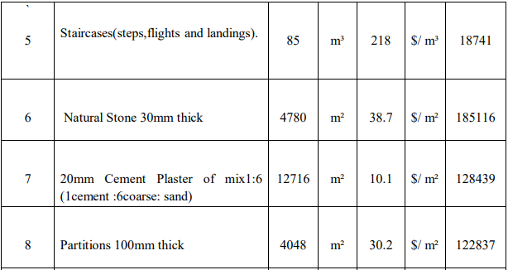

Slide 56
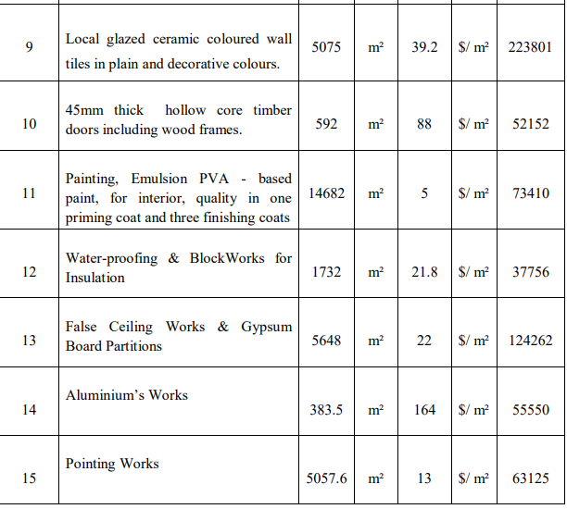

Slide 57
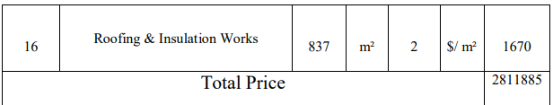
Mobilization= 0.02*2756750= 55135 $
Total Price=2811885 $

Slide 58
Columns Shear Walls Cost and price.
Columns and Shear Walls cost = budgeted material cost+ labor cost= 395443$.
Indirect cost= waste material cost+ job and operating overhead cost.
Waste of materials= .05*(384619.8) = 19231$.
Total cost= 395443+19231=414674$.

Slide 59
Job overhead = 414674*0.1= 41467 $. 414674+41467=456141 $.
Operating overhead=456141*0.05=22807$. 456141+22807=478948 $.
Profit =478948*0.15=71842 $. 478948+71842=550790 $.
Unit price for the columns and walls= Price/total volume. =550790/1354.5= 406.6$/ m

Slide 60
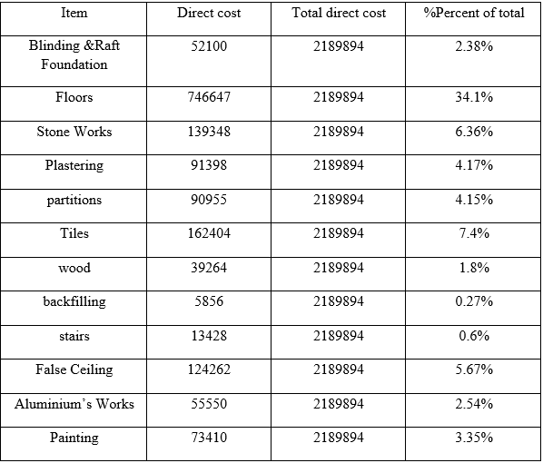
Percentage of direct cost of some activities to total direct

Slide 61
Results
The total project cost is 2189894 $.
The total project price is 2811885$
The project planning start at 16 August 2009, and the latest finish date 2nd of JAN 2011.
The duration for the project is 505 calendar days and 433 working day

Slide 62


