Slide 1
Comfort amelioration forthe Faculty of Fine Arts
Prepared by:
Hamza Hamide
Motaz Hamarheh
Haytham sbitany
Supervisor:
Eng.Wala Omar

Slide 2
Outline
Architectural Design
Environmental Design
Mechanical Design
Electrical Design
Quantity Surveying & conclusions
Structural Design

Slide 3
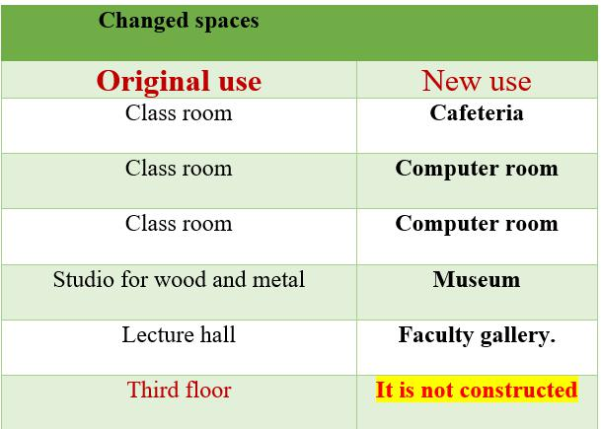
Architectural Design
Notes:
Before starting the comparison between the old and new design its important to mintion our stratigy of design that basicly depend on how achive the optimum functionalty of building , as you can see here some main added space to new design .

Slide 4
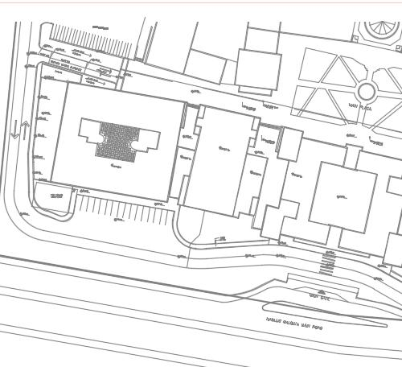
Architectural Design
Site Plan
Original
Design
Notes:
Starting with a comparison within the old site and the new site plan , that show clearly the location of the structure in an-najah new campus near to the main entrances , as you can see in the photo here .

Slide 5
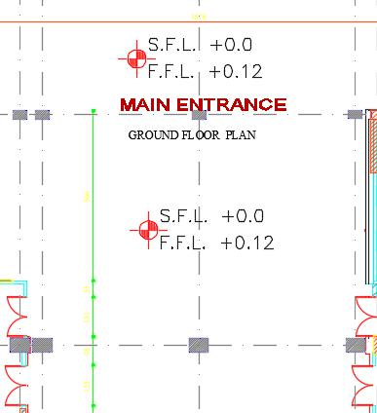
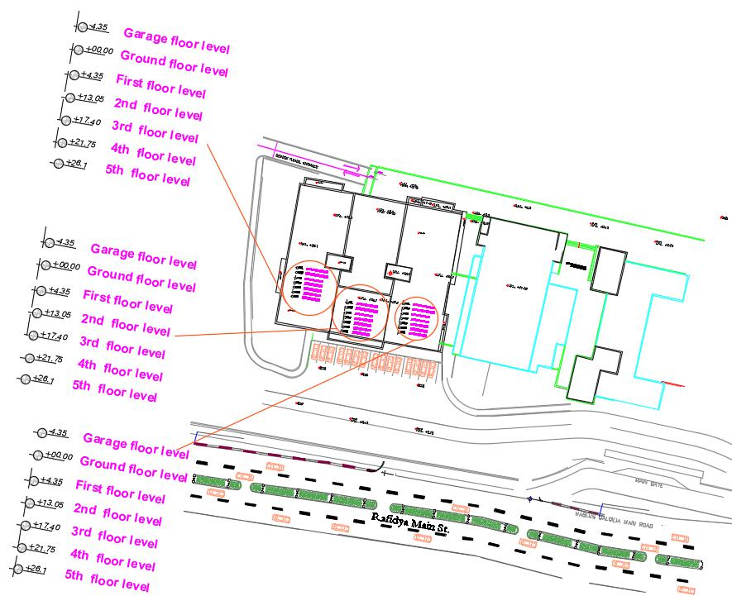
Architectural Design
Our
Design

Slide 6
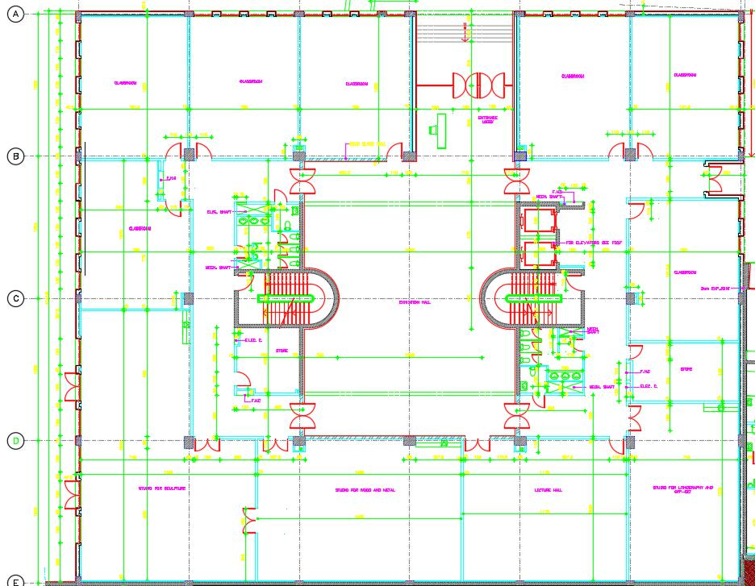
Architectural Design
Ground Floor
Original
Design

Slide 7
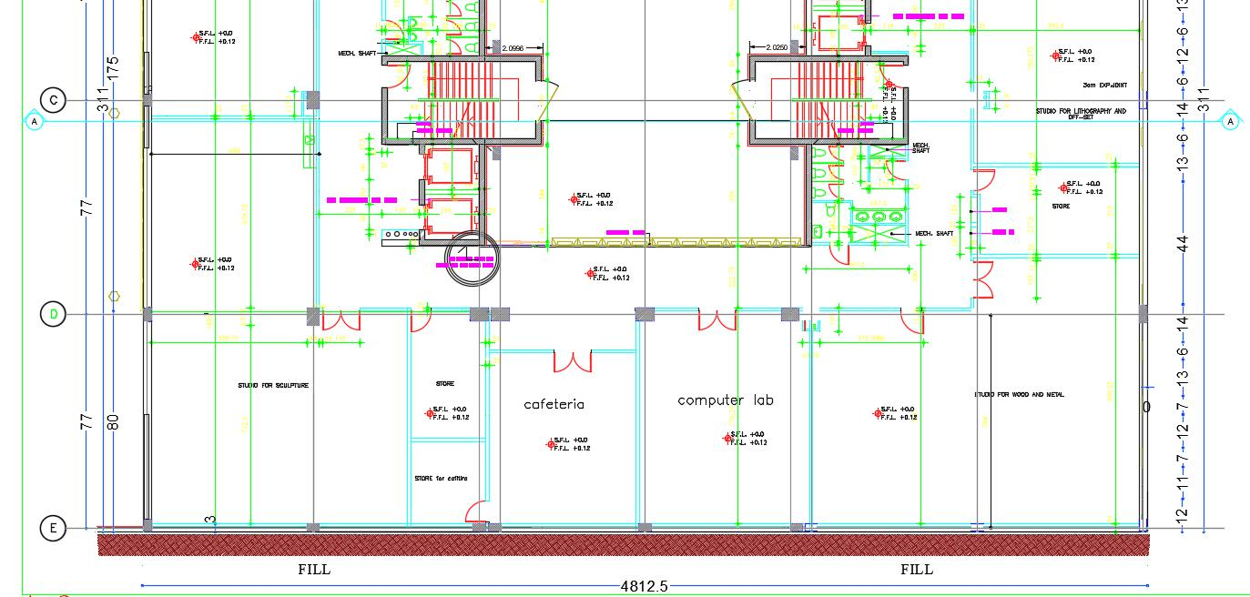
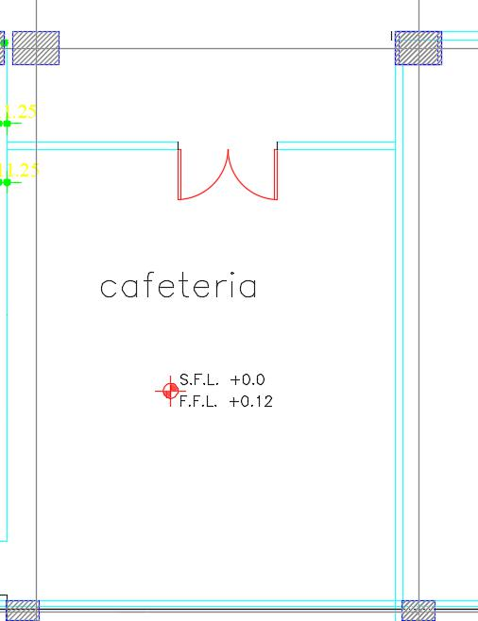
Architectural Design
Our
Design

Slide 8
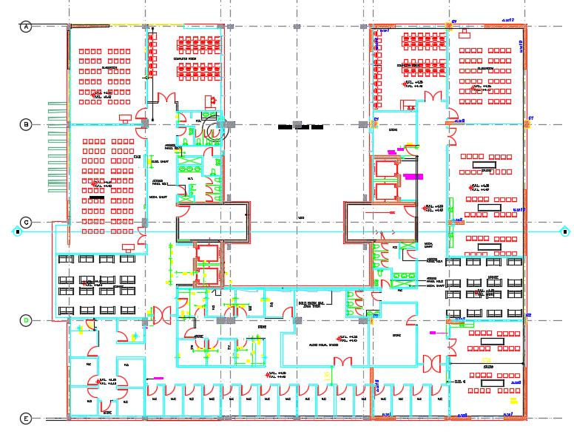
Architectural Design
First Floor
Our
Design

Slide 9
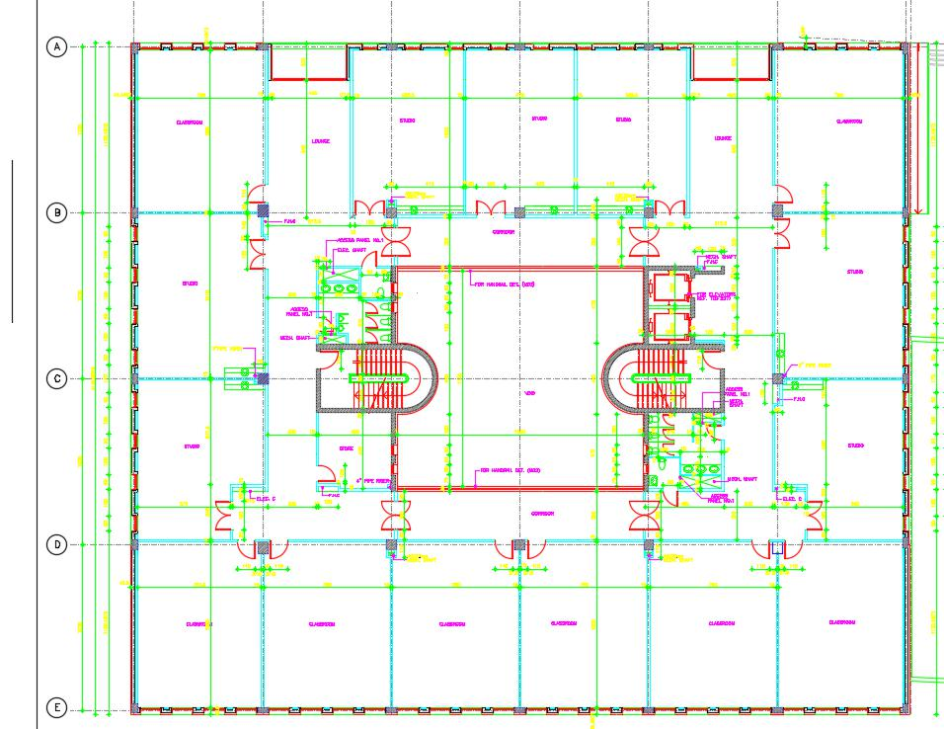
Architectural Design
Second Floor
original
Design

Slide 10
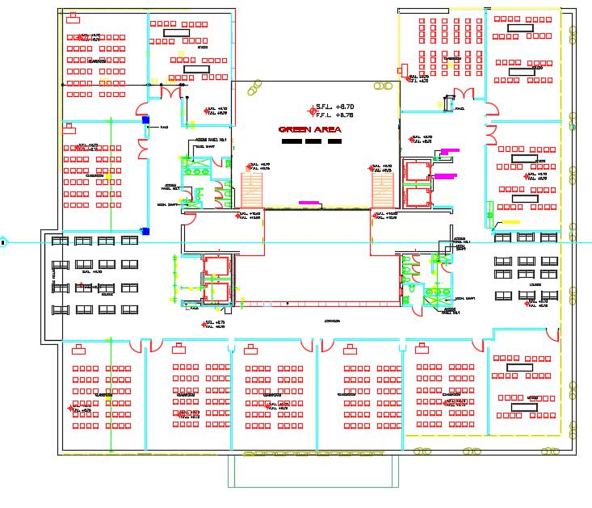
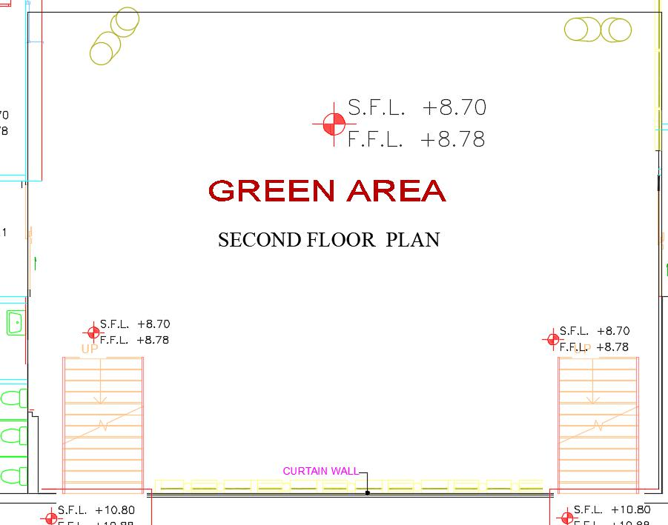
Architectural Design
Second Floor
Our
Design
Notes:
The new design of second floor staes green area for students

Slide 11
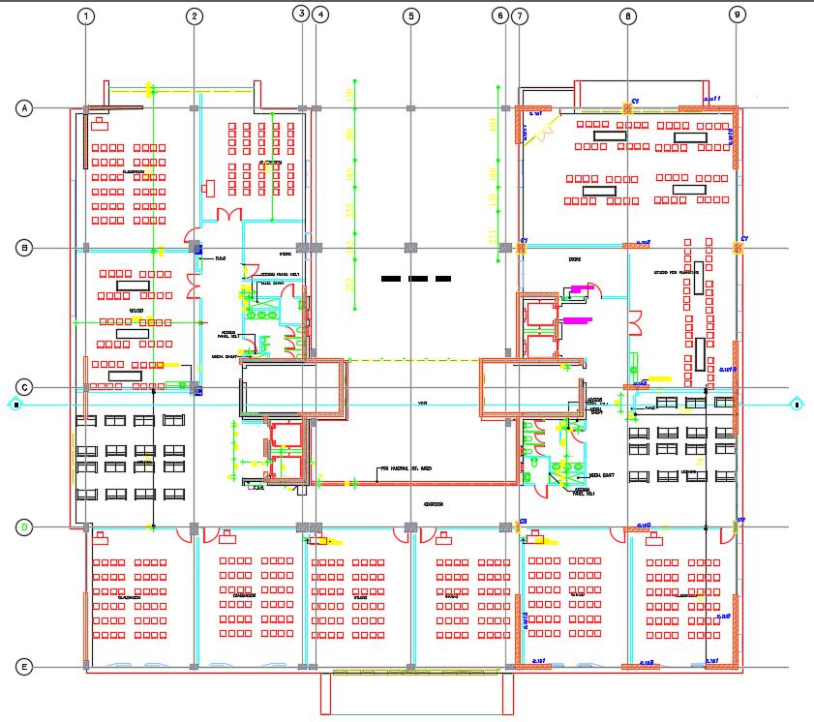
Architectural Design
Third Floor
Our
Design

Slide 12
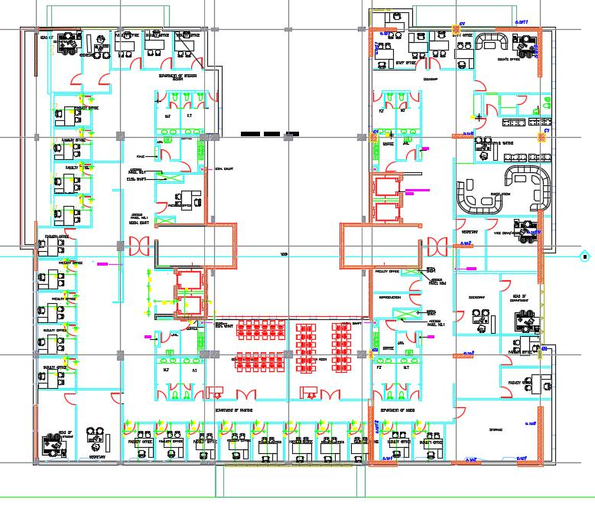
Architectural Design
Fourth Floor
Our
Design

Slide 13
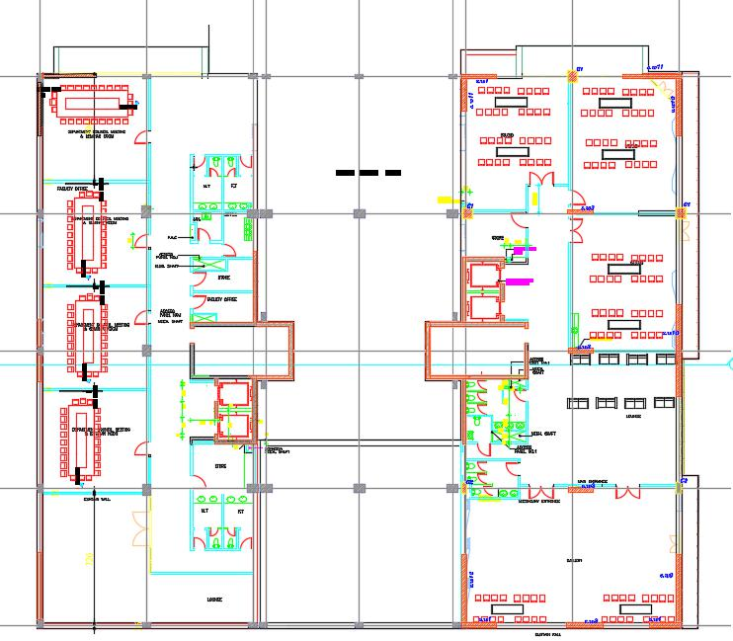
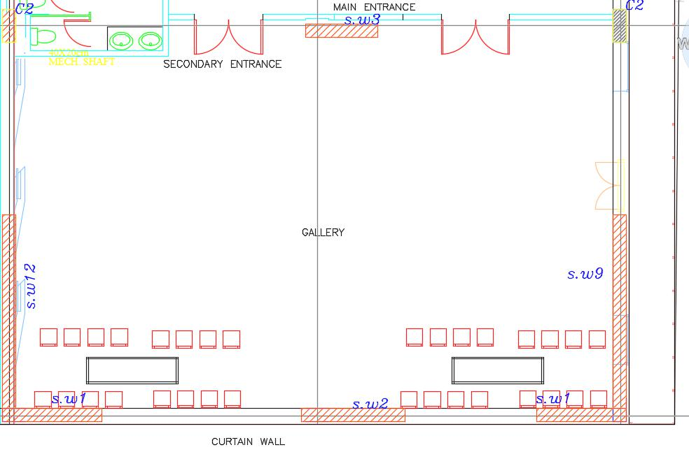
Architectural Design
Fifth Floor
Our
Design
Notes:
The new design of fifth floor contain a faculity gallery with 300 m sq

Slide 14
Architectural Design
Elevations

Slide 15
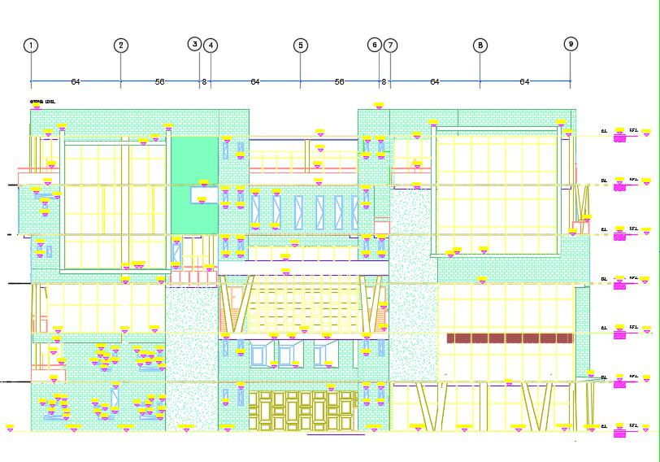
Architectural Design
North Elevation

Slide 16
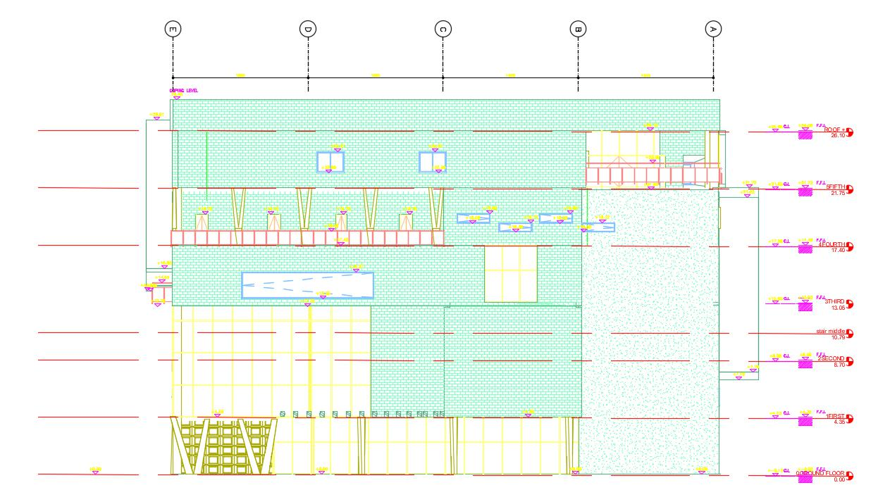
Architectural Design
West Elevation

Slide 17
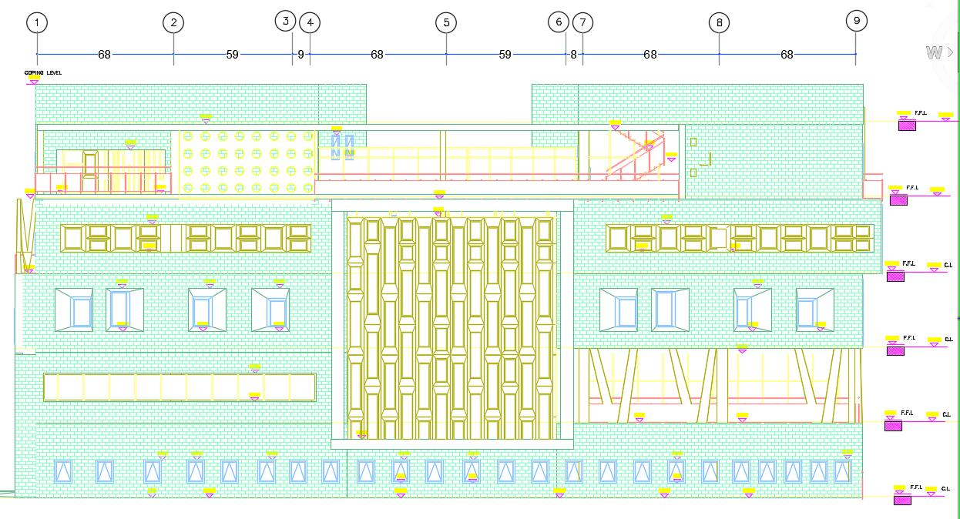
Architectural Design
South Elevation

Slide 18
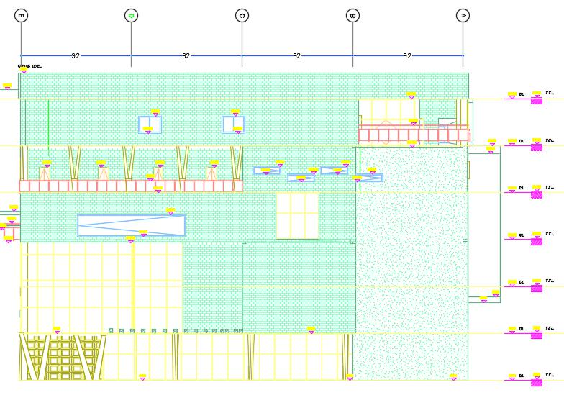
Architectural Design
East Elevation

Slide 19
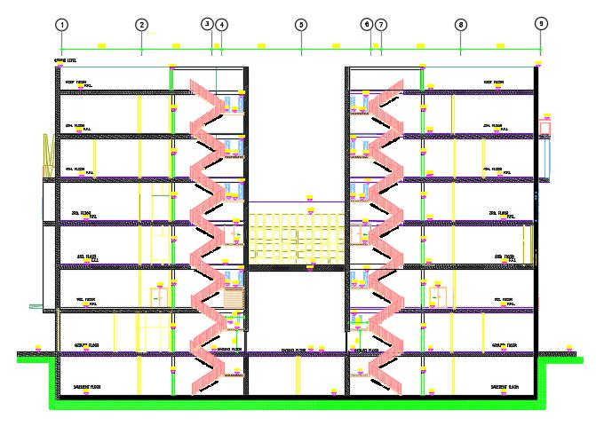
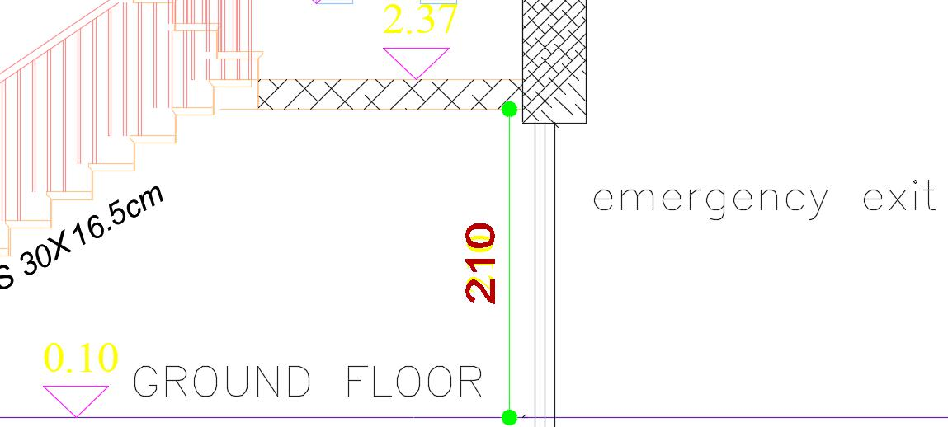
Architectural Design
Section
Section
A-A

Slide 20
Architectural Design
3D Models

Slide 21
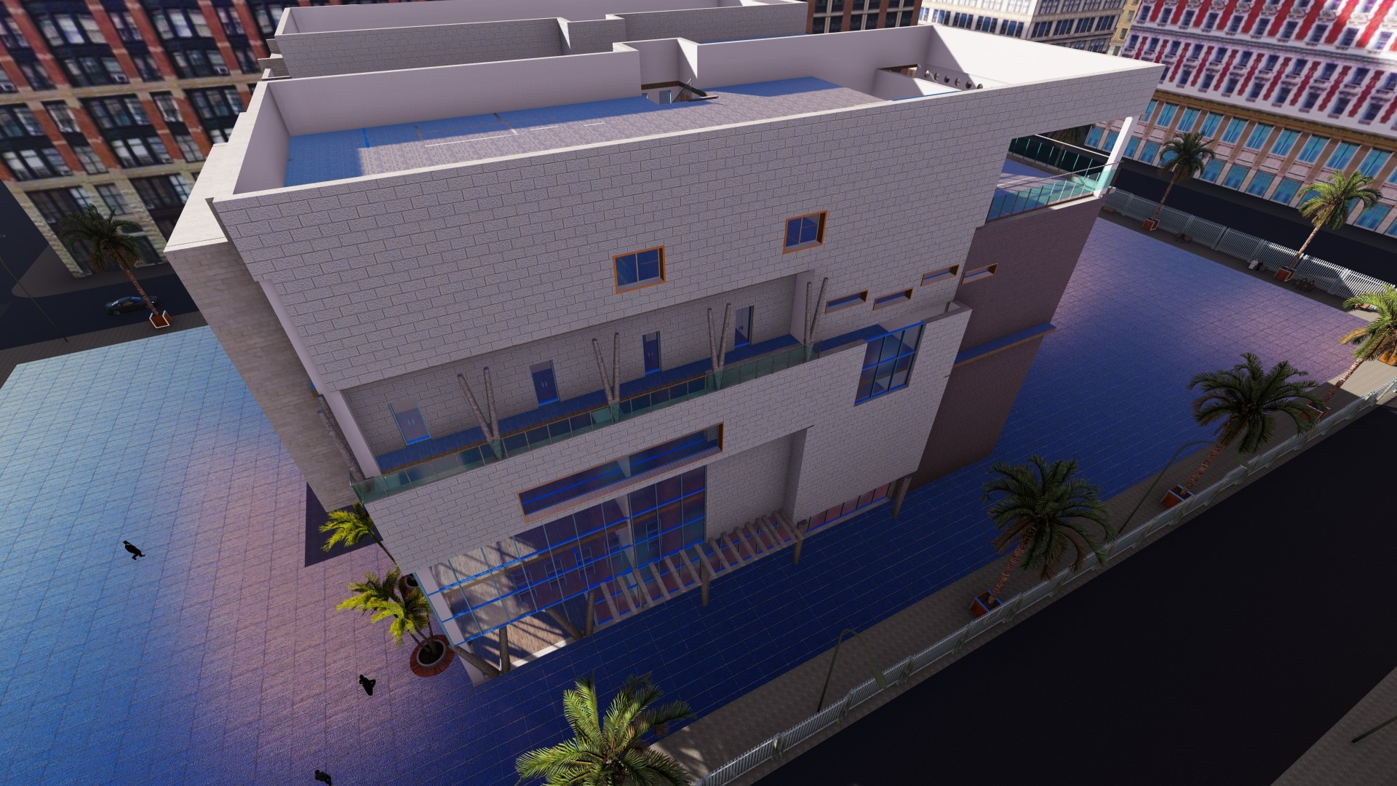
Architectural Design
3D model

Slide 22
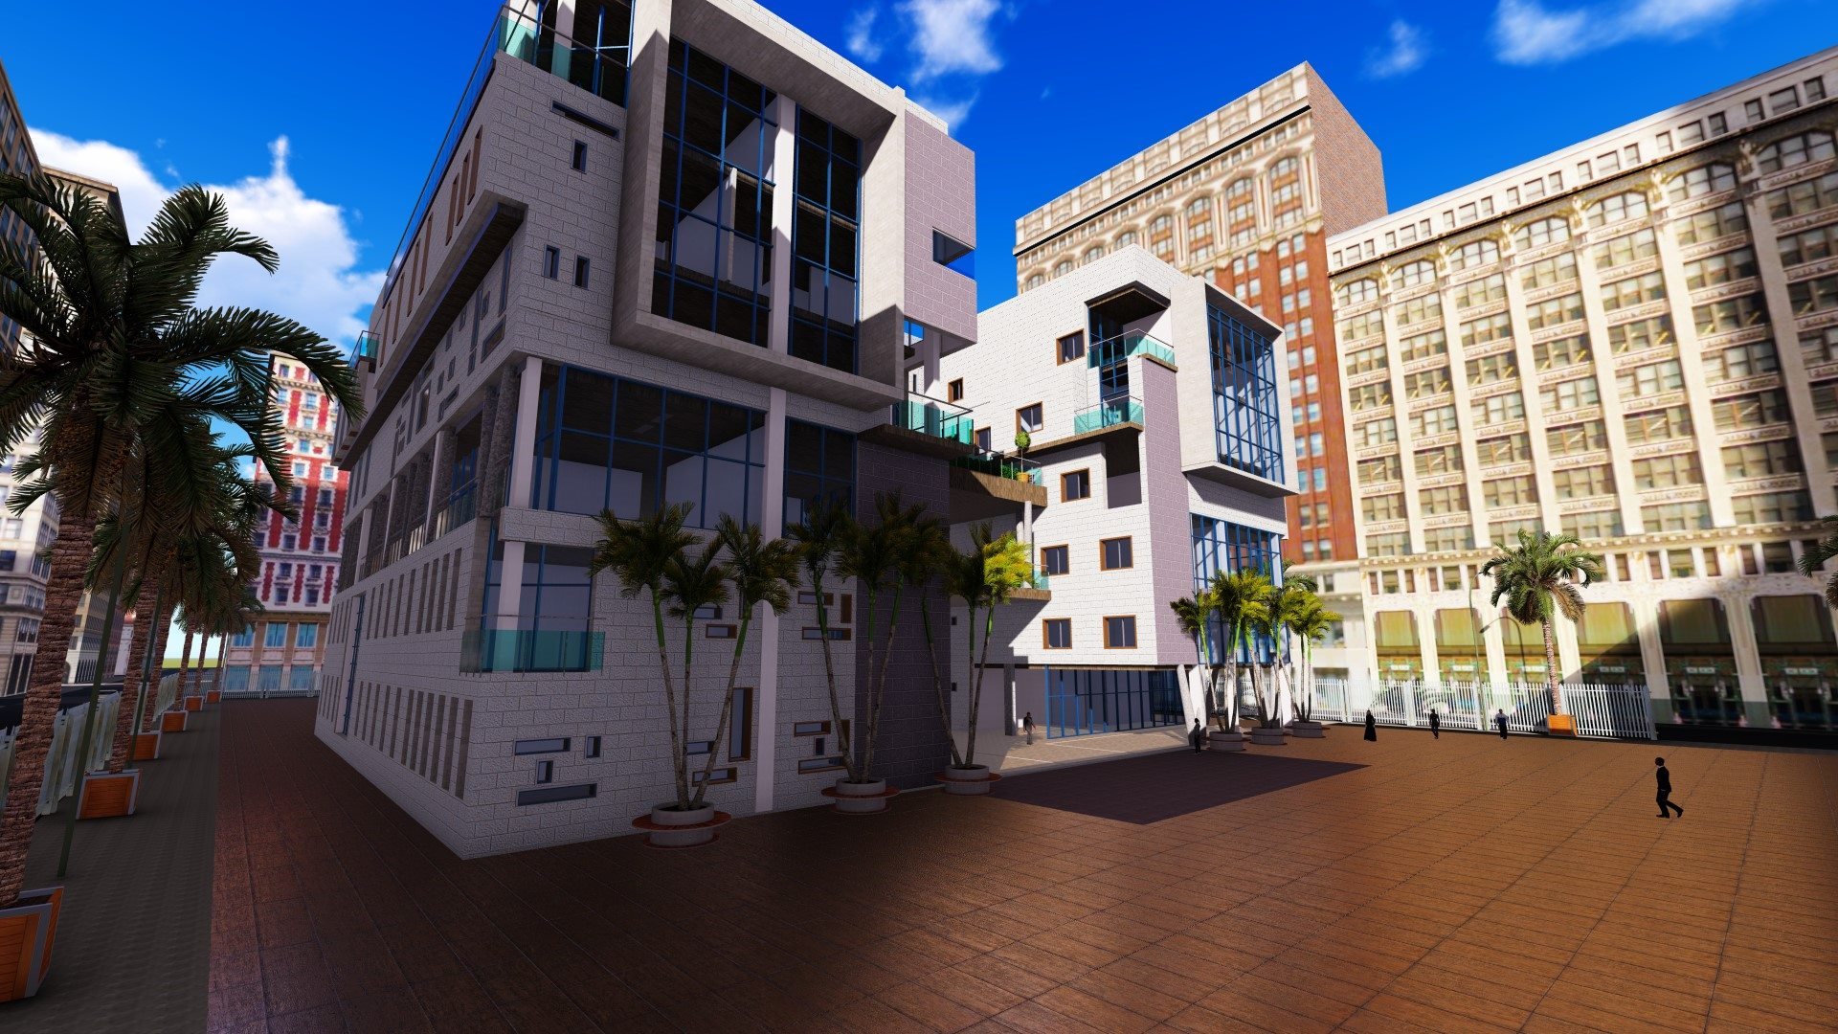
Architectural Design
3D model

Slide 23
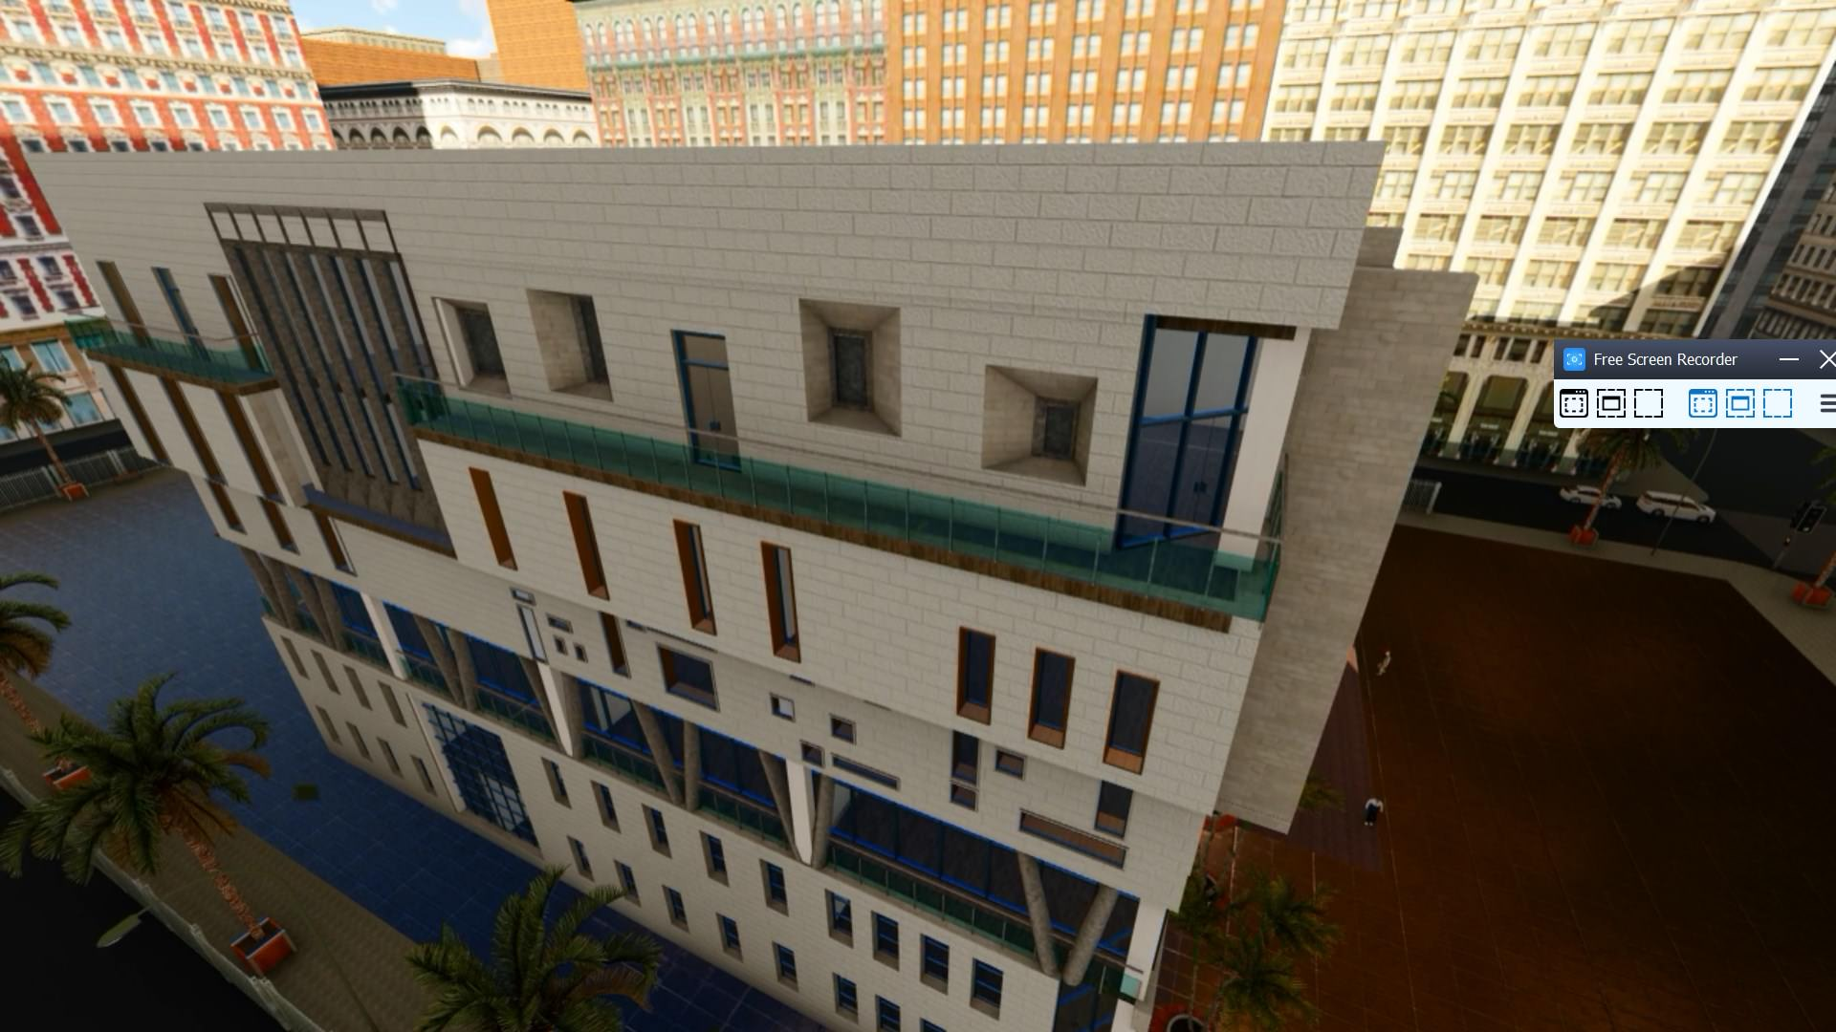
Architectural Design
3D model

Slide 24
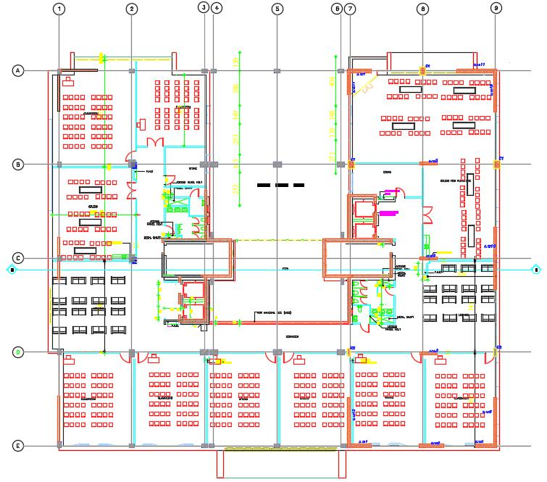
Architectural Design
Egress Routs in G.F

Slide 25
Structural Design

Slide 26
Structural Design
Codes
(ACI 318) for RC Structures Design
(UBC 97) for Earthquake Loads
(ASCE 7 2010) for loads computations
(ACI 350.3-06) for Water Tanks Loads

Slide 27
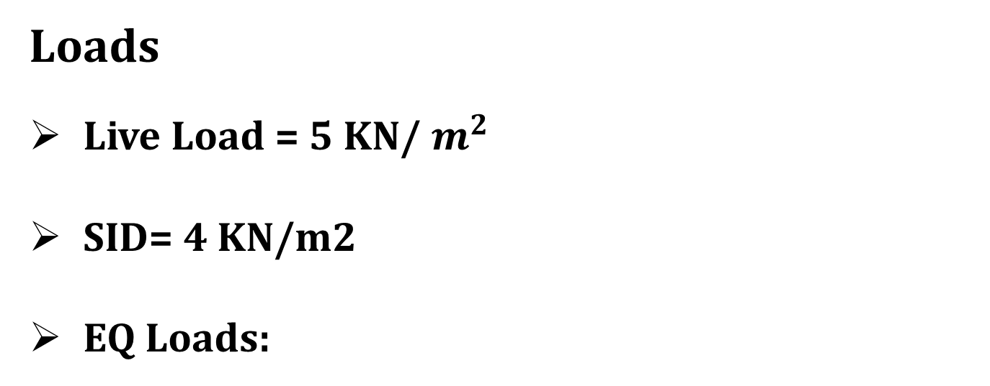
Structural Design
Loads
Live Load = 5 KN/ $m^{2}$
SID= 4 KN/m2
EQ Loads:
I= 1 Cv=0.2
R= 5.5 Ca=0.2
Z= 0.2 (2B) Ct= 0.563
Notes:
These loads parameters were used in the programming the model of etabs

Slide 28
Structural Design
Material
Concrete B350 for all structural elemants.
Concrete B150 for all blinding at footing level.
Notes:
Moving to the material two kind of concret were used

Slide 29
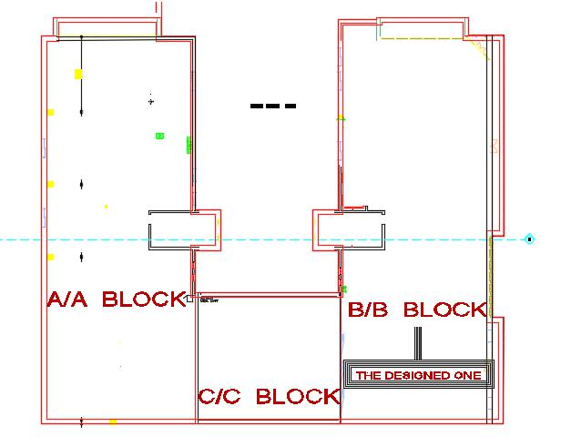
Structural Design
Blocks of the Building
Notes:
This slide shows the different block in the project

Slide 30
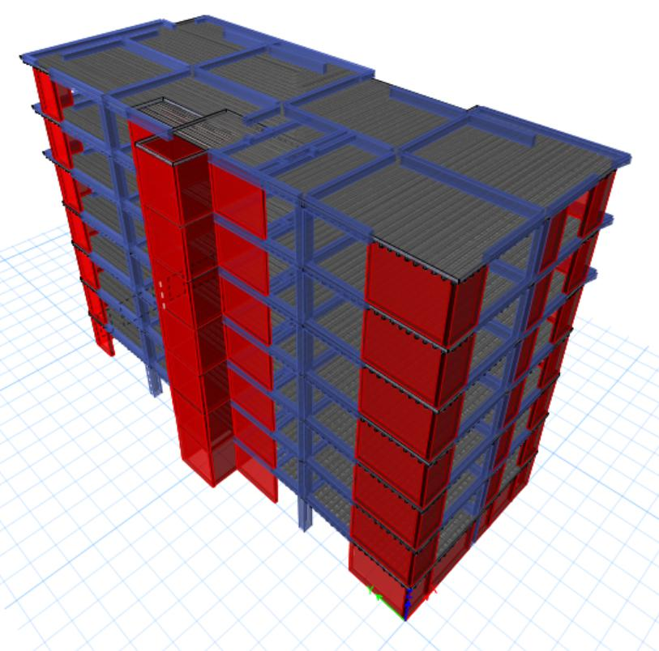
Structural Design
Block B/B of the Building
Notes:
As you can here Block B/B were choosed to be designed

Slide 31
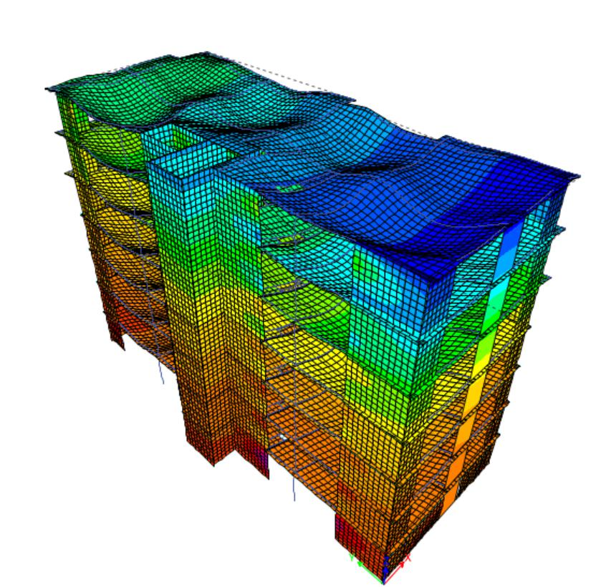
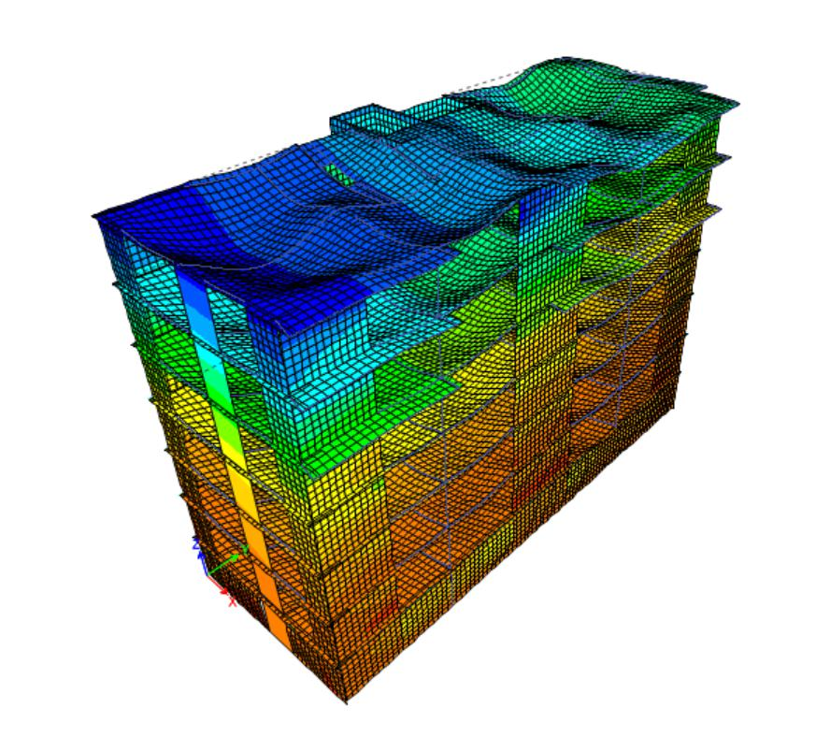
Structural Design
Compatibility Check
Notes:
Starting with the well done compatability check as you can see here

Slide 32
Structural Design
Load | Manual calculations (KN) | Calculations from SAP (KN) | Difference (%)
Dead load | 55575.68 | 58770 | 2.7
Live load | 23350 | 22902 | 0.24
Superimposed dead load | 31700 | 32186 | 0.016
Equilibrium Check
Internal Forces Check
Element | Hand calculations | Calculations from SAP | Difference (%)
Slab 1 | 365 KN.m | 344 KN.m | 5.70
Beam 6 | 1021 KN.m | 910 KN.m | 9.97
Column 5 | 4460 KN | 4555 KN | 1.23
Notes:
Continue The rest of checks that illustrated here

Slide 33
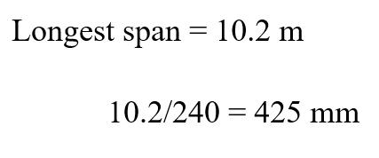
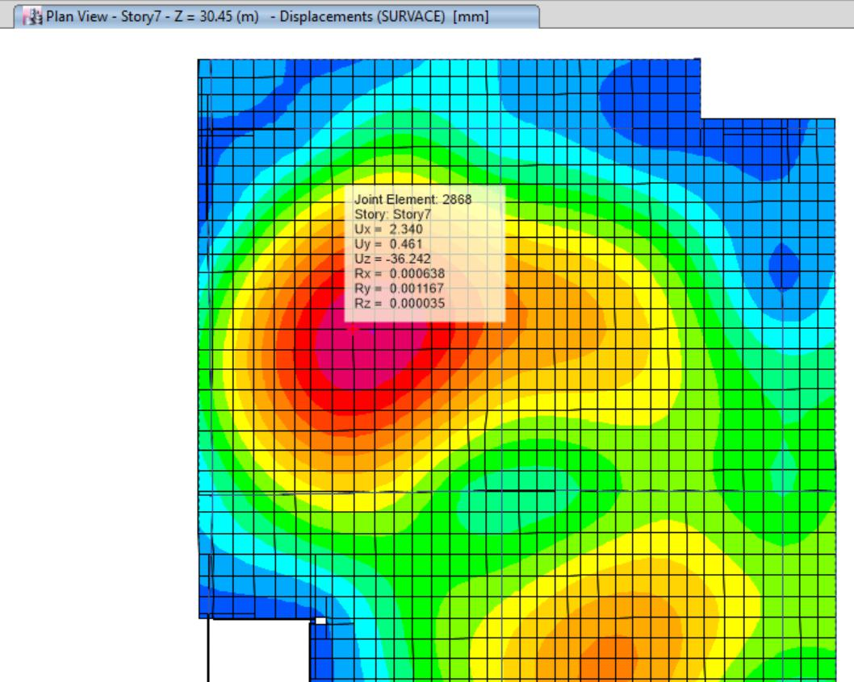
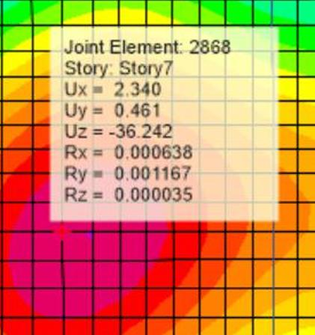
Structural Design
Deflection
Notes:
Finaly ending with the deflection check

Slide 34
Structural Design
Fine Art Faculty
Two-way ribbed slab
Two way solid slab
Slabs
Beams
Columns
Footing
Stair case
Notes:
This diagram here shows the relations between the structural elemats as usual

Slide 35
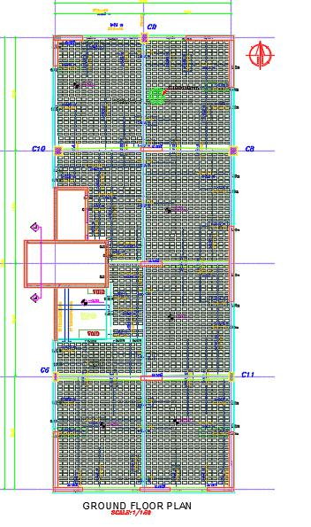
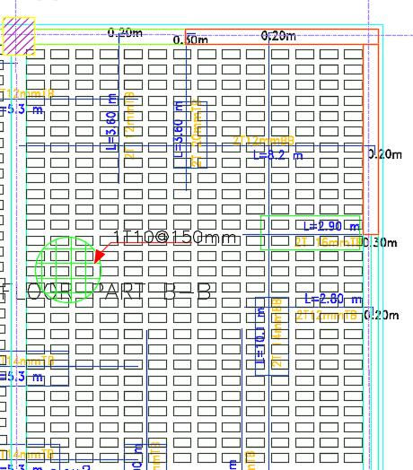
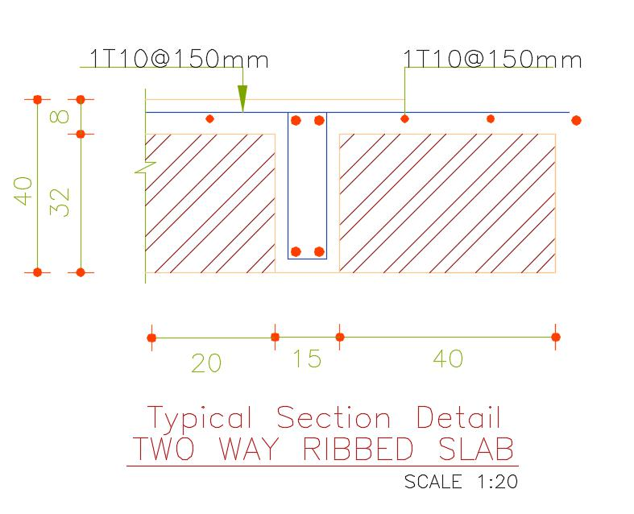
Structural Design
Slab:
Two-Way Ribbed Slab with dropped beams
Notes:
Two kinde of slabs were used the first one is

Slide 36
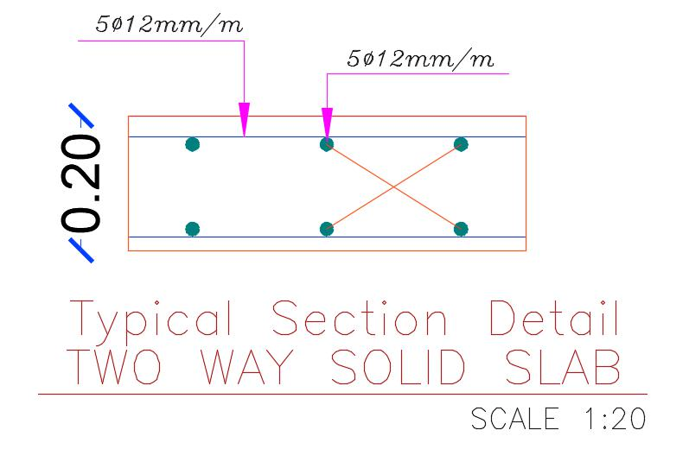
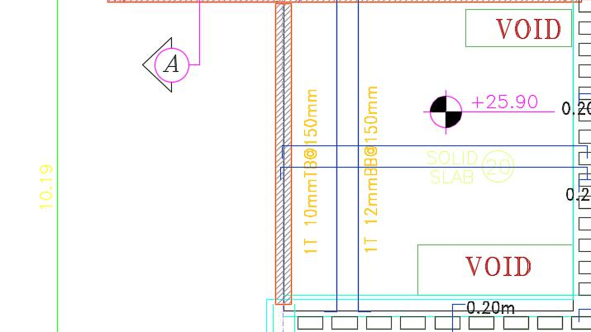
Structural Design
Slab:
Two-Way SOLID Slab

Slide 37
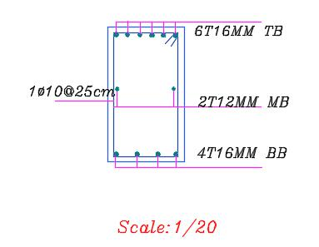
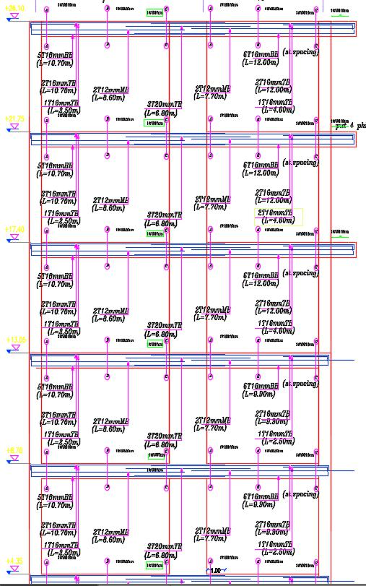
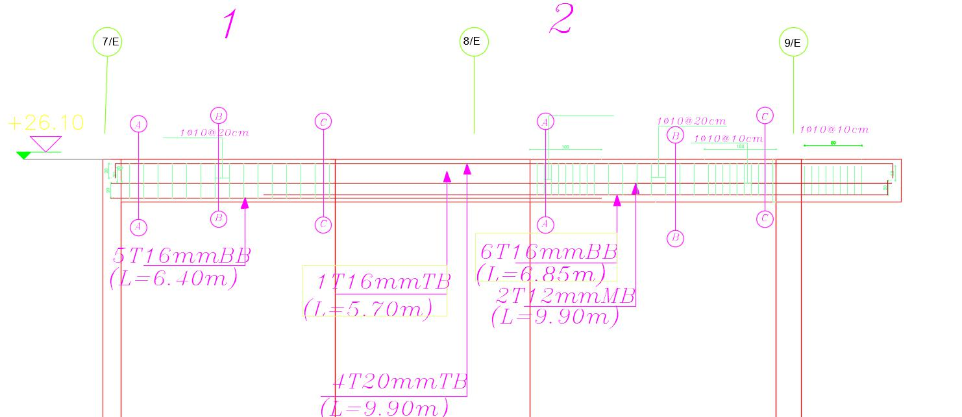
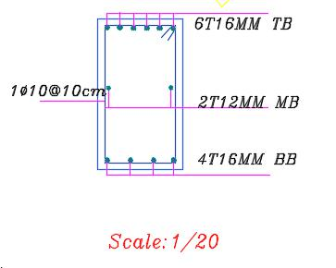
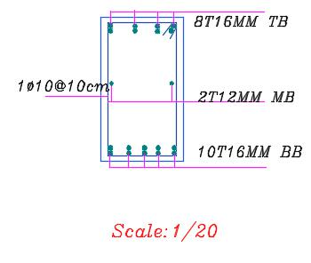
Structural Design
Beam Design (fram5)
Section 1-1
Section 2-2
FRAM DESIGN
Section 3-3
Notes:
Moving to the beam design
All of beams were designed in a complete farams

Slide 38
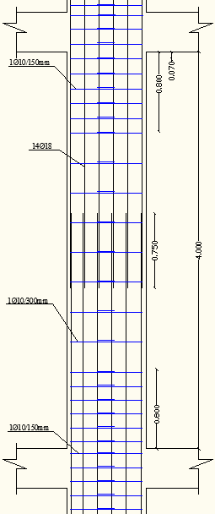
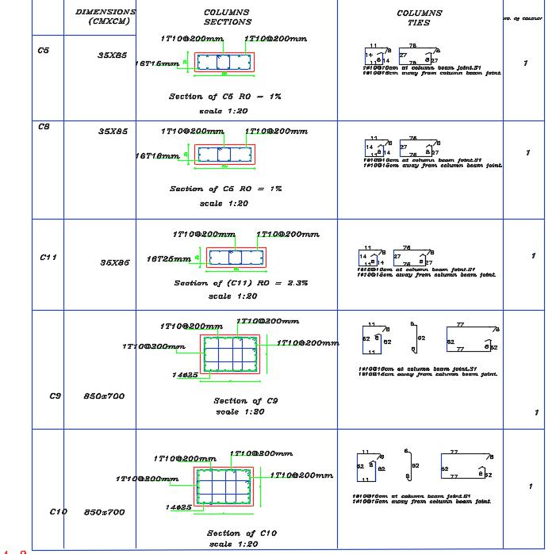
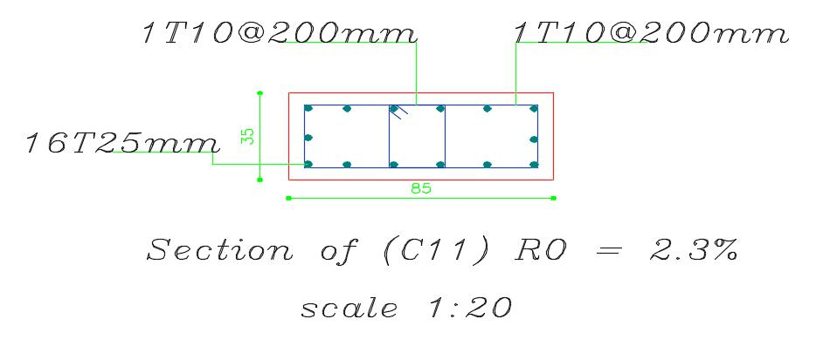
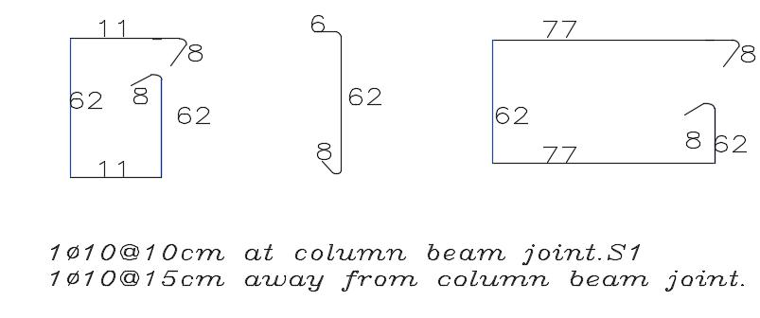
Column Design
Structural Design
Notes:
This slide shows the sizmic column design

Slide 39
Structural Design
Footing Design
Wall footing
Isolated footing

Slide 40
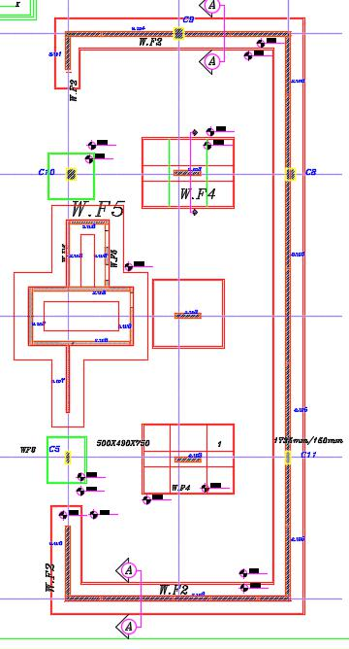
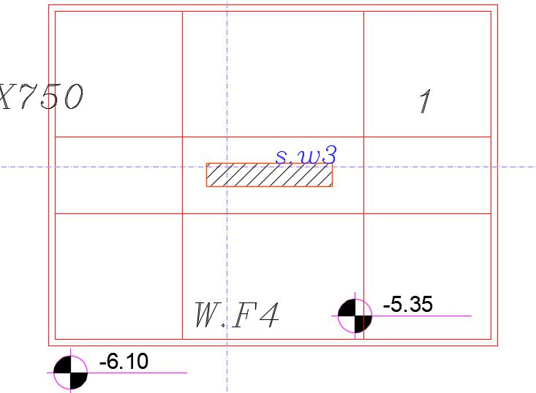
Structural Design
Footing Design
Strip Shear wall Footing

Slide 41
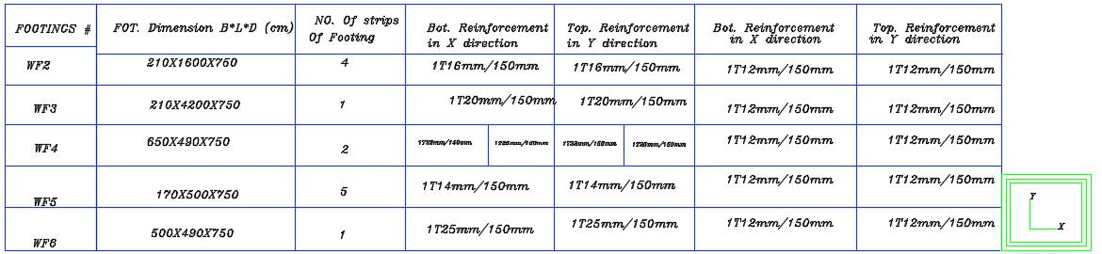


Structural Design
Continuous wall footing Design

Slide 42



Structural Design
Isolated Footing Design

Slide 43




Structural Design
Shear Wall Design

Slide 44


Structural Design
Stair
Notes:
Ending up with the stair reinforcement

Slide 45
Environmental Design

Slide 46

Internal Ceiling
U= 0.34
External Roof
U=0.31
Certain Wall
U= 2.2
External wall
U=0.47
Double Glass
U = 1.7
Ground Floor
U= 1.58
Notes:
It should be noted here that the values of insulation were very poor in the old design, and the problems which it caused

Slide 47

ACOUSTICAL DESIGN
RT60 in the Music Room

Slide 48


Slide 49

RT60 in the Class Room.

Slide 50


Slide 51

Sound Transmission Class (STC)
Classroom external wall

Slide 52

Sound Transmission Class (STC)
Classroom internal wall

Slide 53

IMPACT INSULATION CLASS (IIC)

Slide 54

Shading
              Winter

Slide 55

Shading
Summer

Slide 56


Daylight Analysis
Ground Floor
Notes:
Two sample were used to display the daylight distribution and the daylight factor in the faculty, which are the ground floor and the third floor

Slide 57


Third Floor

Slide 58

Thermal Loads
Total cooling load is 554.1 KW

Slide 59


Total Heating load is 397 KW

Slide 60


Thermal Comfort
The recommended acceptable PMV range for thermal comfort from ASHRAE 55 is between -0.5 and +0.5 for an interior space.
Notes:
In our case, this rate has been achieved most of the year

Slide 61
Mechanical Design

Slide 62
Mechanical
Drainage system.
Water supply system.
Elevators.
Fire fighting system.
HVAC system.

Slide 63
Plumbing Fixtures
Used plumbing fixtures in the project are:
Water closets.
Lavatories (also called bathroom sinks).

Slide 64
Drainage system :
The main pipes are U.P.V.C with 4’’size and P.V.C 2’’ size for internal connection and 6’’ U.P.V.C for outdoor pipes.
All pipes (2’’,4’’ and 6’’ pipes) have slope equal to 1% to let the waste water flow by gravity.
The manholes are connected with the vertical, the last manhole is connected to the main sewer , The pipe’s size between the manholes is 6’’ to ensure good flow rate.
Type | Type
 | Black Water |  |  | Grey Water
 | Diameter | Slope | Type | Diameter | Slope | Type
Stack | 4'' | 0%(90°) | PVC | 4'' | 0%(90°) | PVC
Sewer | 4'' | 1% | PVC | 2'' | 1% | PVC
Drainage | _ | _ | _ | 4'' | 1% | PVC
Manhole Sewer | 6'' | 1% | PVC | _ | _ | _
Vent | 4'' | 0%(90°) | PVC | 4'' | 0%(90°) | PVC

Slide 65




Slide 66


Water supply system :
The system is designed based on flush tank and public used for all fixture unit.
The cold water are supplied to the fixture unit(Lavatories) from the roof fresh tanks and the fixture unit (WCs) from the roof grey water tank.
There is a tank with 10m3 for recycle the water from lavatories and reusing it for flush tank (WCs) in each block in the basement floor ; to reduce water consumption.
The hot water supplied from the electrical water heater that fixed in each bath room .

Slide 67



Total fixture units : 249 fixture unit in each block.
Total cold water consumption per month is 66 m3 and the same for hot water.
Total grey water consumption per month is 154 m3.
The cold water tanks supplied from a basement tank with capacity 80 m3, 30m3 for fresh water and the rest saving for fire fighting system .

Slide 68

Elevators:
the best option is 3 elevators with 2500Ib / 350fpm , but we will use 4 elevators to achieve the uniformity in the faculty because we have two zone, in each zone two elevators .

Slide 69

Fire fighting system:
Notes:
this figure shows the fire fighting systems that designed as we see here fire hose station and the distribution of dedicators , audio visual alarm and fire exist sign

Slide 70

Emergency Exits in The Building
Notes:
This slide shows the emergency exits in the building this is for up floor and this is for ground floor

Slide 71
HVAC system:
Based on the "Design Builder“ results of the total cooling capacity and the total heating capacity we designed based on the largest value which is cooling load capacity.
Then we used three outdoor unit with capacity 140 kw for each one outdoor unit to achieve the needed cooling capacity .
Notes:
The Hvac system that used is vrf outdoor unit then

Slide 72

HVAC system:
Notes:
The hvac system that designed in the faculty is vrf system and this figure shows the distribution of diffuser in the ground floor as an example

Slide 73
Electrical Design

Slide 74



Artificial lighting
Studio for lithography and offset.
Notes:
Artificial lighting ……… Dialux evo were used for these calculations …….. We have 2 rooms samples starting with …………… and we have got a 545lux Illuminance and uniformity of 0.68 and the Max UGR = 16.4 and its all in its acceptable ranges.

Slide 75




Classroom:
Notes:
A classroom room have 391 lux illuminance and uniformity of 0.65 and max UGR 17.9 so all values acceptable.

Slide 76

Lighting distribution in GF

Slide 77


Main boards

Slide 78
Cost
Estimation

Slide 79
Price(NIS) | Quintity | Unit | Work
1249851 | 3571,002 | m3 | Concrete works
550000 | 189,655 | Ton | Steel works
1322300 | 13223 | m2 | Form work
64427 | 1171,4 | m3 | Excavation work
326260 | 14830 | m2 | Plastering works
266940 | 14830 | m2 | Paint works
562800 | 8400 | m2 | Tile works
258090 | 8541 | NO. | Windows & doors
420000 | 1200 | m2 | Curtain wall
238000 | 6800 | m2 | False celling
634492,8 | 12040 | m2 | Block works
59040 |  |  | Staircase
1720035 |  |  | MECHANICAL
71947,29 |  |  | Electrical
7744182 | Total project cost (NIS)
922 | Total unit cost (NIS/m2)

Slide 80
Mechanical Design

Slide 81
Mechanical
Drainage system.
Water supply system.
Elevators.
Fire fighting system.
HVAC system.

Slide 82
Plumbing Fixtures
Used plumbing fixtures in the project are:
Water closets.
Lavatories (also called bathroom sinks).

Slide 83
Drainage system :
The main pipes are U.P.V.C with 4’’size and P.V.C 2’’ size for internal connection and 6’’ U.P.V.C for outdoor pipes.
All pipes (2’’,4’’ and 6’’ pipes) have slope equal to 1% to let the waste water flow by gravity.
The manholes are connected with the vertical, the last manhole is connected to the main sewer , The pipe’s size between the manholes is 6’’ to ensure good flow rate.
Type | Type
 | Black Water |  |  | Grey Water
 | Diameter | Slope | Type | Diameter | Slope | Type
Stack | 4'' | 0%(90°) | PVC | 4'' | 0%(90°) | PVC
Sewer | 4'' | 1% | PVC | 2'' | 1% | PVC
Drainage | _ | _ | _ | 4'' | 1% | PVC
Manhole Sewer | 6'' | 1% | PVC | _ | _ | _
Vent | 4'' | 0%(90°) | PVC | 4'' | 0%(90°) | PVC

Slide 85
Water supply system :
The system is designed based on flush tank and public used for all fixture unit.
The cold water are supplied to the fixture unit(Lavatories) from the roof fresh tanks and the fixture unit (WCs) from the roof grey water tank.
There is a tank with 10m3 for recycle the water from lavatories and reusing it for flush tank (WCs) in each block in the basement floor ; to reduce water consumption.
The hot water supplied from the electrical water heater that fixed in each bath room .

Slide 86
Total fixture units : 249 fixture unit in each block.
Total cold water consumption per month is 66 m3 and the same for hot water.
Total grey water consumption per month is 154 m3.
The cold water tanks supplied from a basement tank with capacity 80 m3, 30m3 for fresh water and the rest saving for fire fighting system .

Slide 87
Elevators:
the best option is 3 elevators with 2500Ib / 350fpm , but we will use 4 elevators to achieve the uniformity in the faculty because we have two zone, in each zone two elevators .

Slide 88
Fire fighting system:
Notes:
this figure shows the fire fighting systems that designed as we see here fire hose station and the distribution of dedicators , audio visual alarm and fire exist sign

Slide 89
Emergency Exits in The Building
Notes:
This slide shows the emergency exits in the building this is for up floor and this is for ground floor

Slide 90
HVAC system:
Based on the "Design Builder“ results of the total cooling capacity and the total heating capacity we designed based on the largest value which is cooling load capacity.
Then we used three outdoor unit with capacity 140 kw for each one outdoor unit to achieve the needed cooling capacity .
Notes:
The Hvac system that used is vrf outdoor unit then

Slide 91
HVAC system:
Notes:
The hvac system that designed in the faculty is vrf system and this figure shows the distribution of diffuser in the ground floor as an example

Slide 92
Electrical Design

Slide 93

Artificial lighting
Studio for lithography and offset.
Notes:
Artificial lighting ……… Dialux evo were used for these calculations …….. We have 2 rooms samples starting with …………… and we have got a 545lux Illuminance and uniformity of 0.68 and the Max UGR = 16.4 and its all in its acceptable ranges.

Slide 94

Classroom:
Notes:
A classroom room have 391 lux illuminance and uniformity of 0.65 and max UGR 17.9 so all values acceptable.

Slide 95
Lighting distribution in GF

Slide 96
Main boards

Slide 97
Conclusion
The new redesign solved the arrangement of the spaces according to standards and create new spaces that has not been found in the previous design such as; cafeteria and gallery..etc
The heat transfer coefficient for the walls and ceilings improved. Also, the northern façade has been utilized to improve the daylight in the building, so, the natural lighting has been solved in contrast previous design .
The tie beams have not been found in the previous design and after the redesign the tie beams are placed.

Slide 98
The structural system converted from one way ribbed slab without secondary beams into two way ribbed slabs with secondary beams .
The HVAC system used in the building was sufficient enough to overcome the previous cooling problems .
The storm water collected in a tank and utilized for irrigation and both the grey water and the fresh water was separated .
The number of elevators changed to fit the number of people in the faculty.

Slide 99


