Slide 1

An-Najah National University
Faculty of Engineering & Information Technology
Department of Building Engineering
Graduation Project (2)
Assessment and Redesign of Solitaire restaurant
Students:
Ahmad Ismail , Ayham Ebayeh , Aysar Abu Jaish , Yahya Qadous
Supervisor :Dr. Hasan Mather

Slide 2
Outline :
Introduction
Project Description.
Architectural Analysis and Re-design
Environmental Analysis and Evaluation
Structural Analysis
Cost estimation
Results and Recommendation

Slide 3
Introduction:
In this project an evaluation and a redesign for the architectural, structural, mechanical and environmental systems was made for solitaire restaurant.
Project problem:
The city of Nablus is a destination for many tourists , a noticeable increase in the number of restaurants has been observe. Thus, this study explored Solitaire restaurant to see if the restaurant meets the required specifications.

Slide 4
Objectives:
Evaluation and redesign the architectural, structural , mechanical and environmental systems that achieves the comfort for users , taking the architectural aspects in consideration.
Methodology:
Then there was a data collection about the restaurant and the international standards.
A comparison with international standards will be done, restructuring and development of the building from the inside, to better organize the spaces, to ensure a smooth flow of work and the comfort of visitors.
4

Slide 5
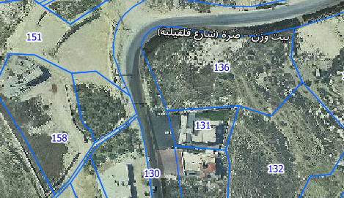
Description of the project :
Location :
The project locates in Beit Wazan village in north west of Nablus city on the land with an area of 1131 m²

Slide 6
Description of the project :
Site and land boundary
The total area of the site equals 1131 m²

Slide 7
Architectural analysis and redesign
Architectural analysis
This study conducted the site relationship with streets , garage and restaurant it self and study the functional spaces in the building by this analysis to reach results that help us to modify these spaces according to standards.

Slide 8
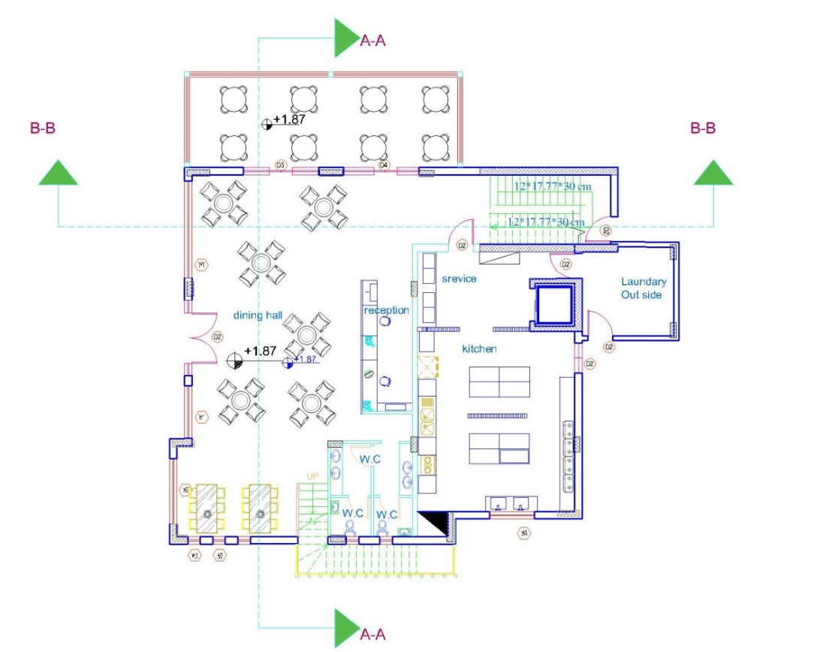
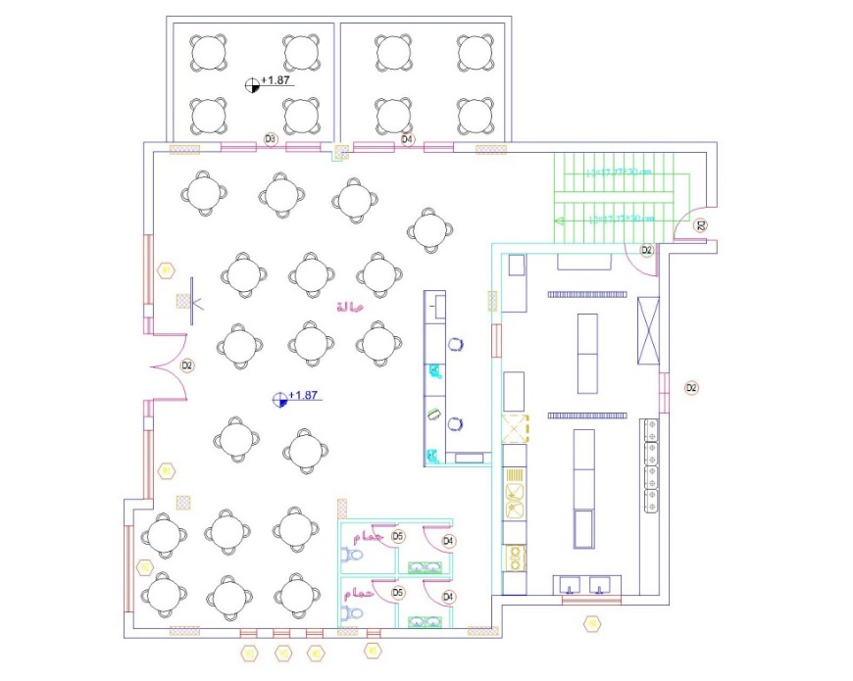
Architectural analysis and redesign
Ground floor plan:
Before
After

Slide 9
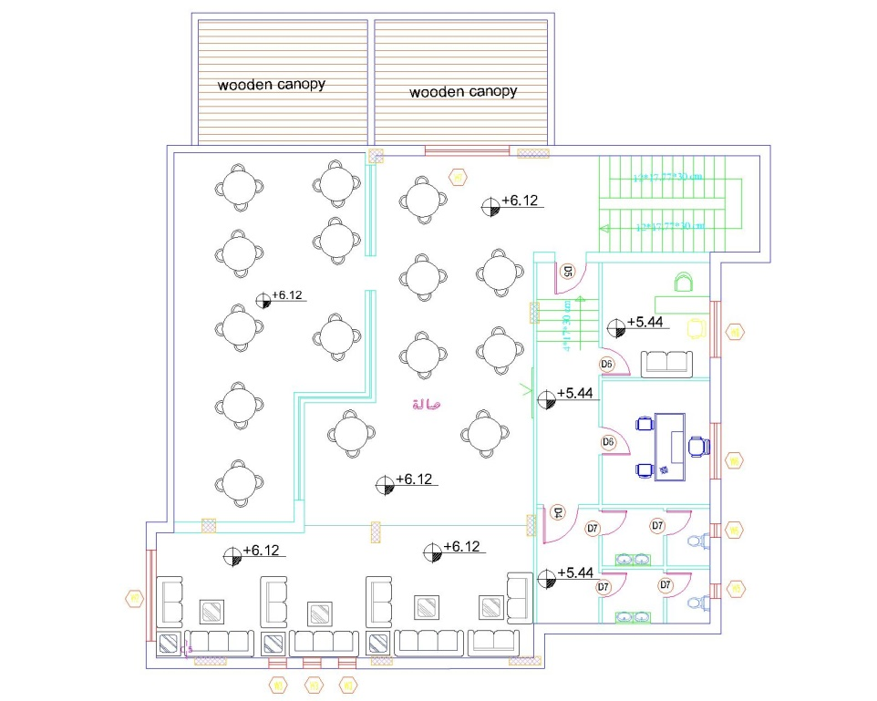
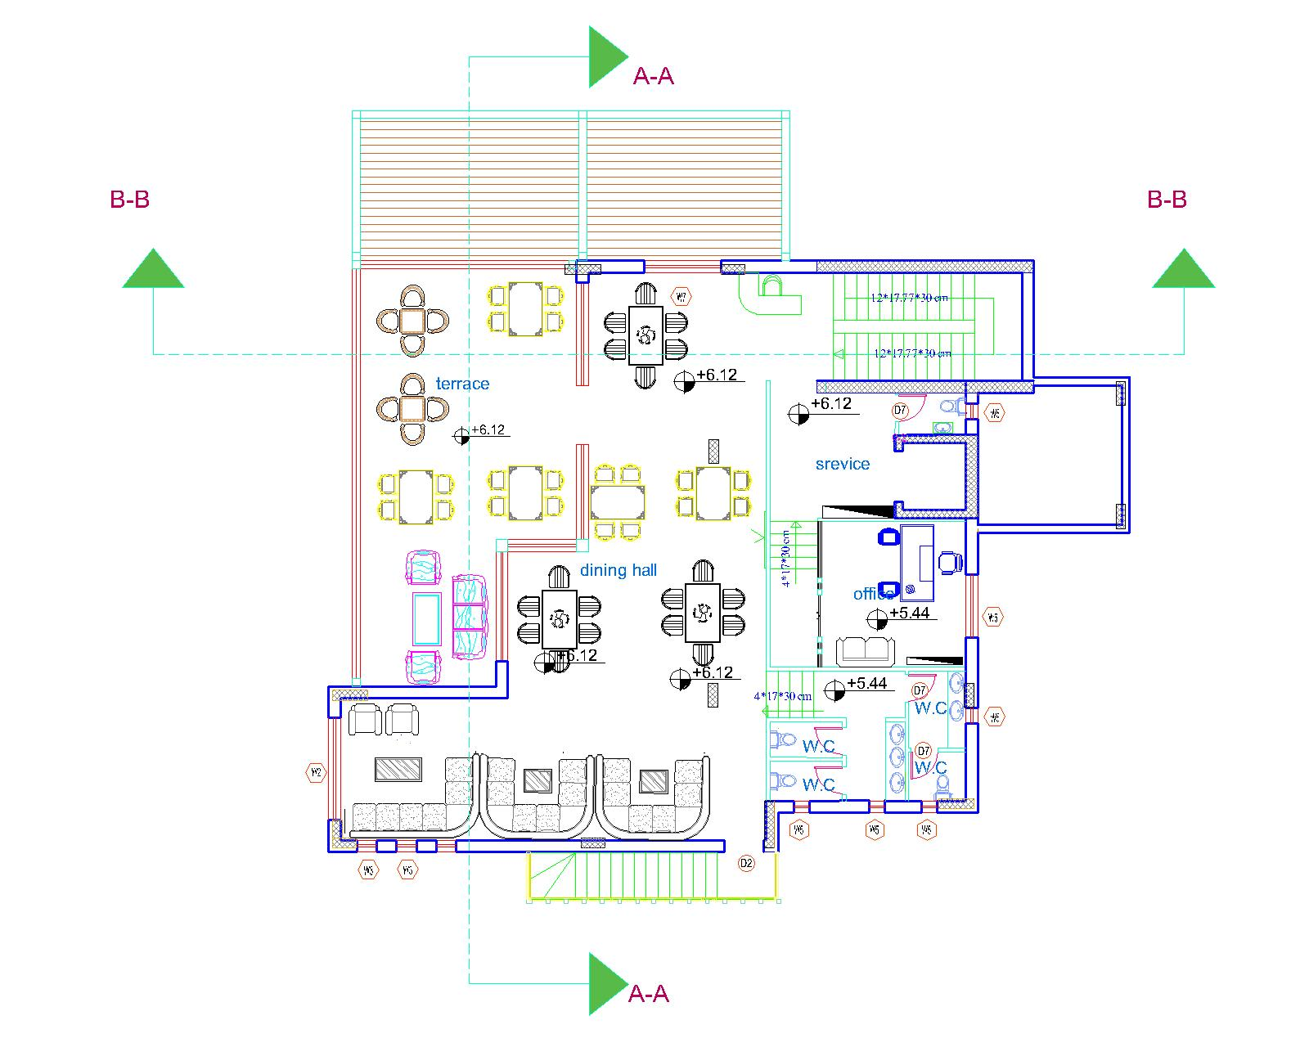
Architectural analysis and redesign
First floor plan:
Before
After

Slide 10
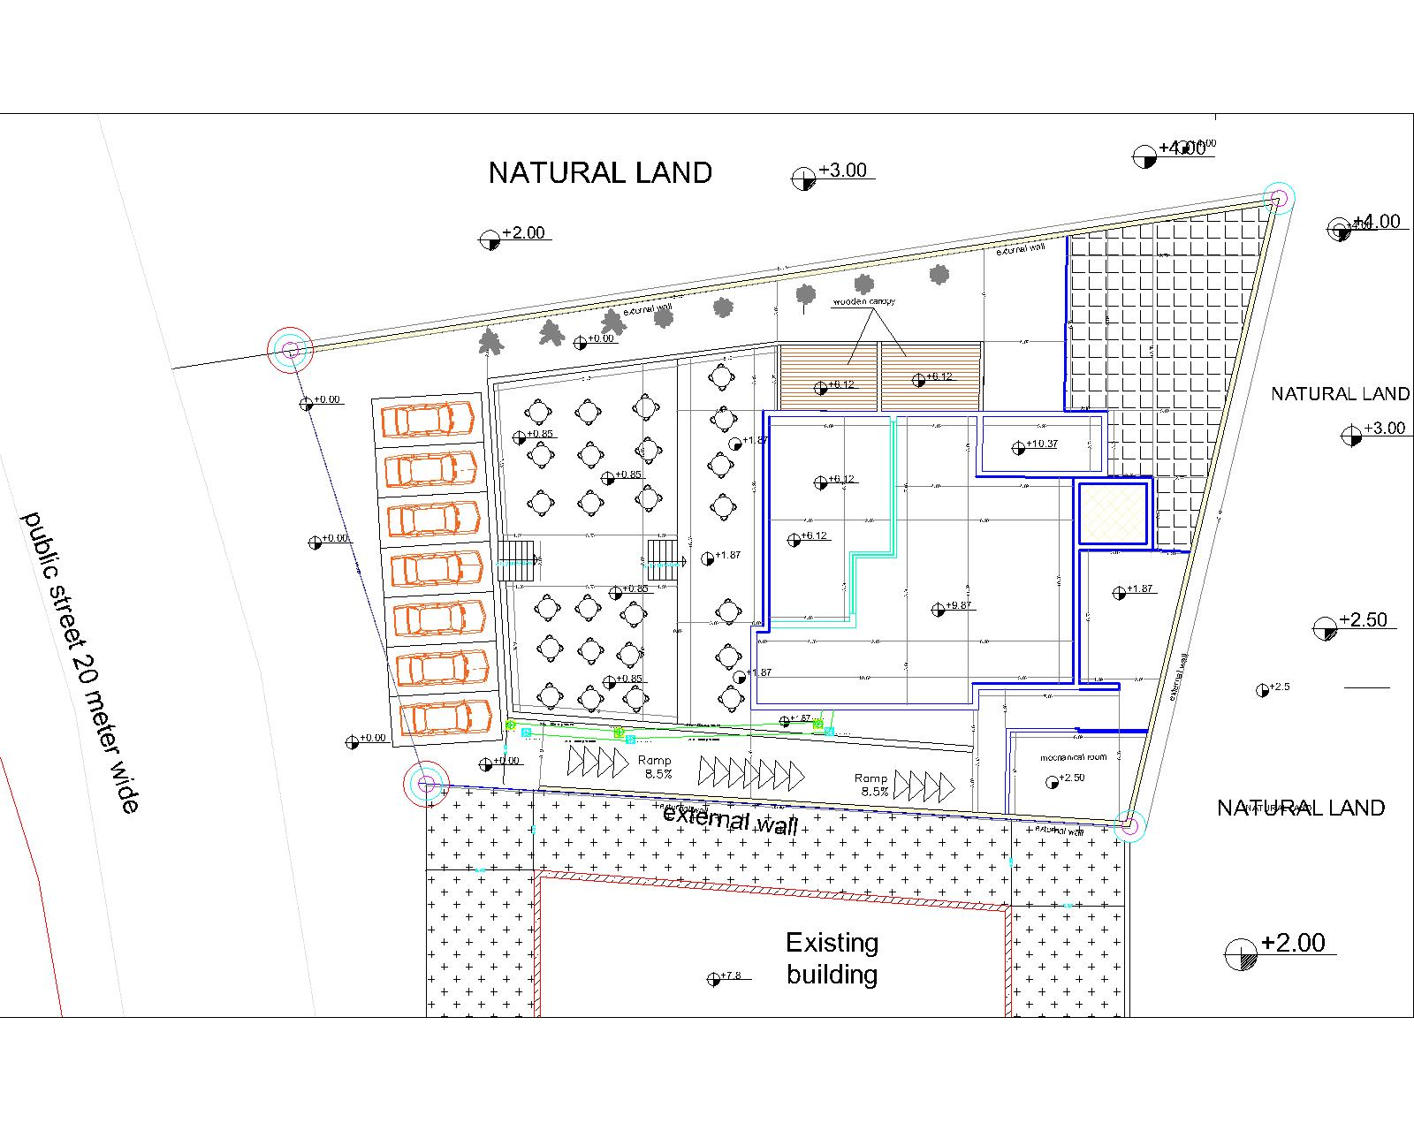
Architectural analysis and redesign
Site before redesign

Slide 11
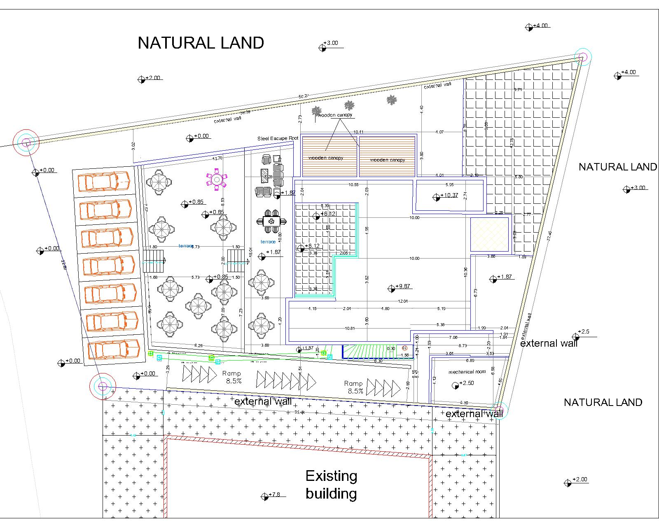
Architectural analysis and redesign
Site after redesign

Slide 12
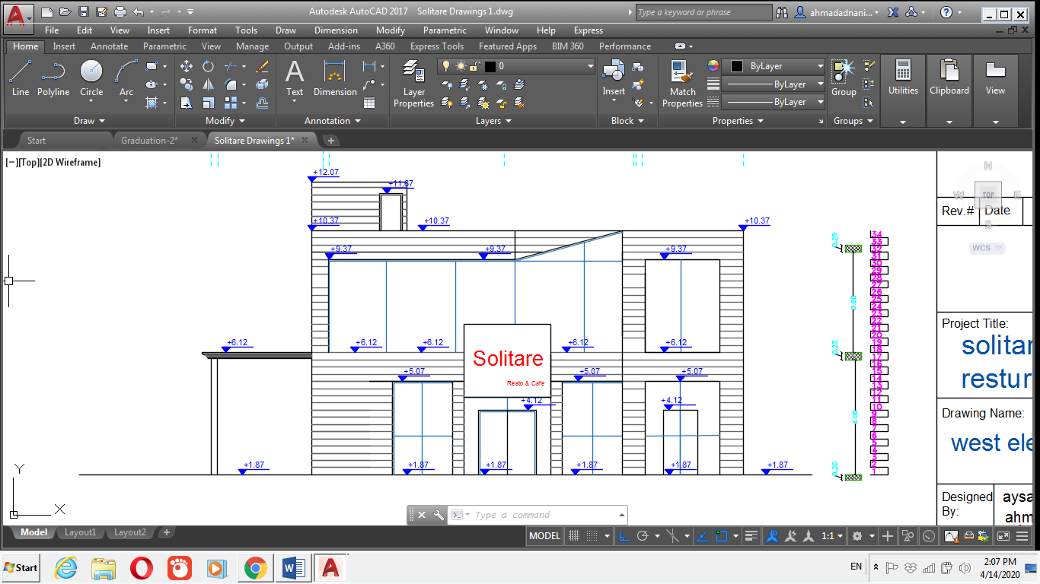
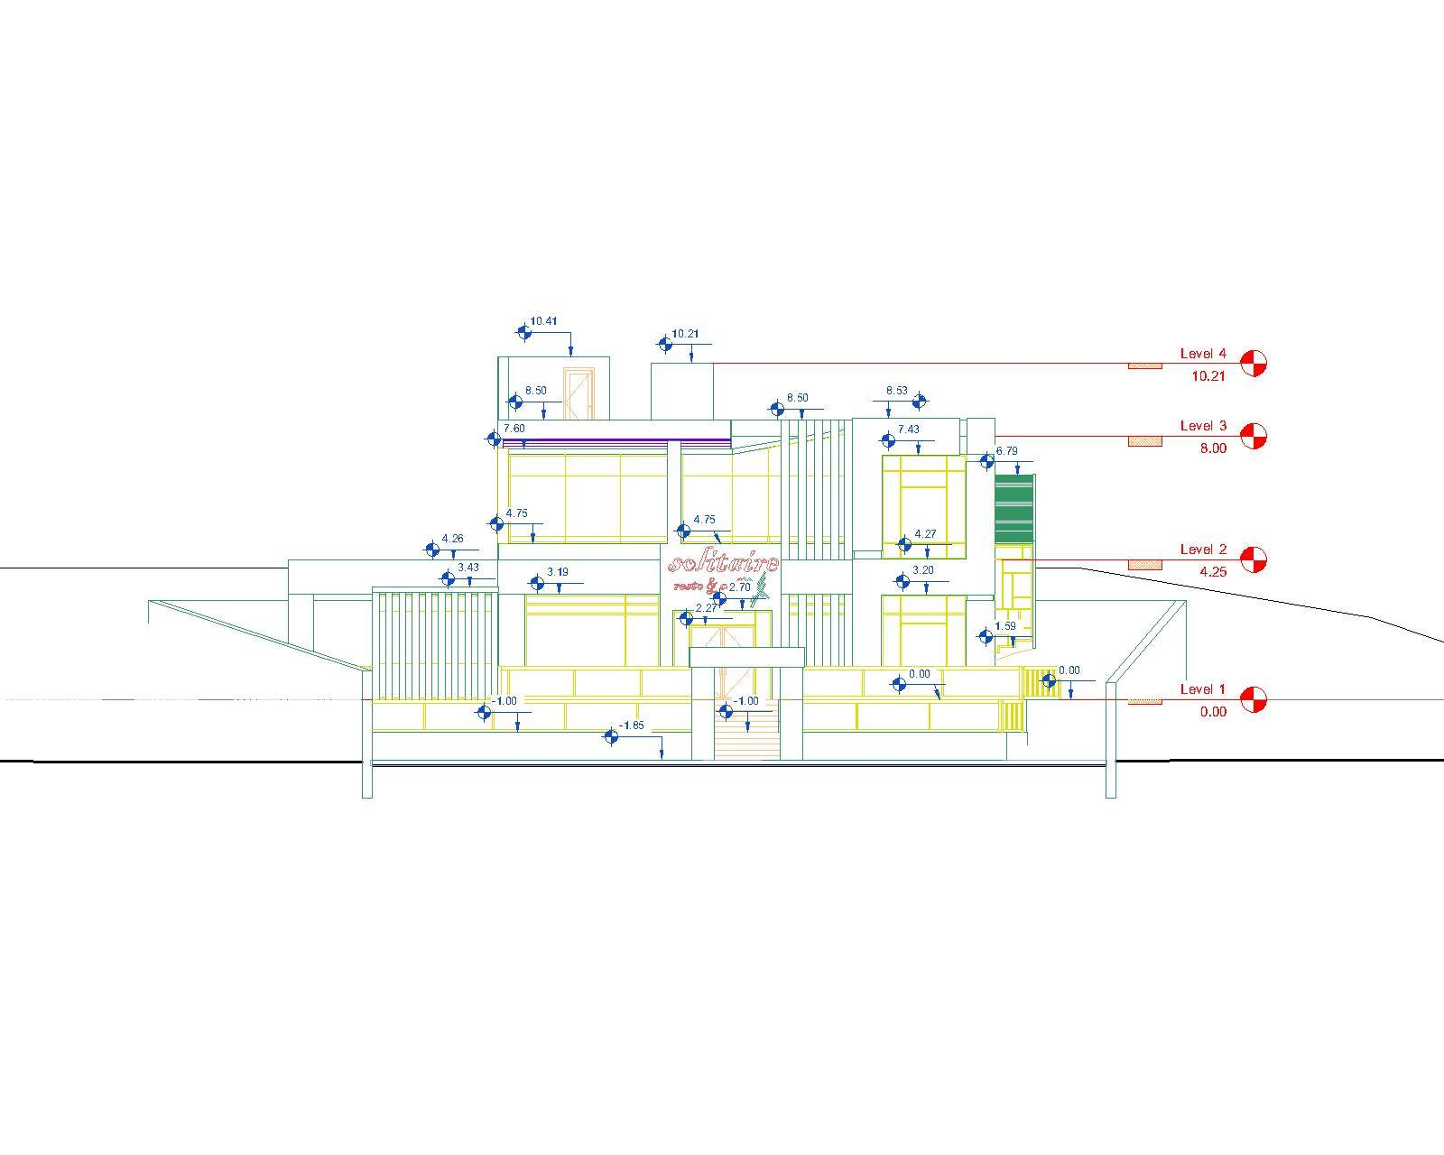
Architectural analysis and redesign
West elevation before redesign
West elevation after redesign

Slide 13
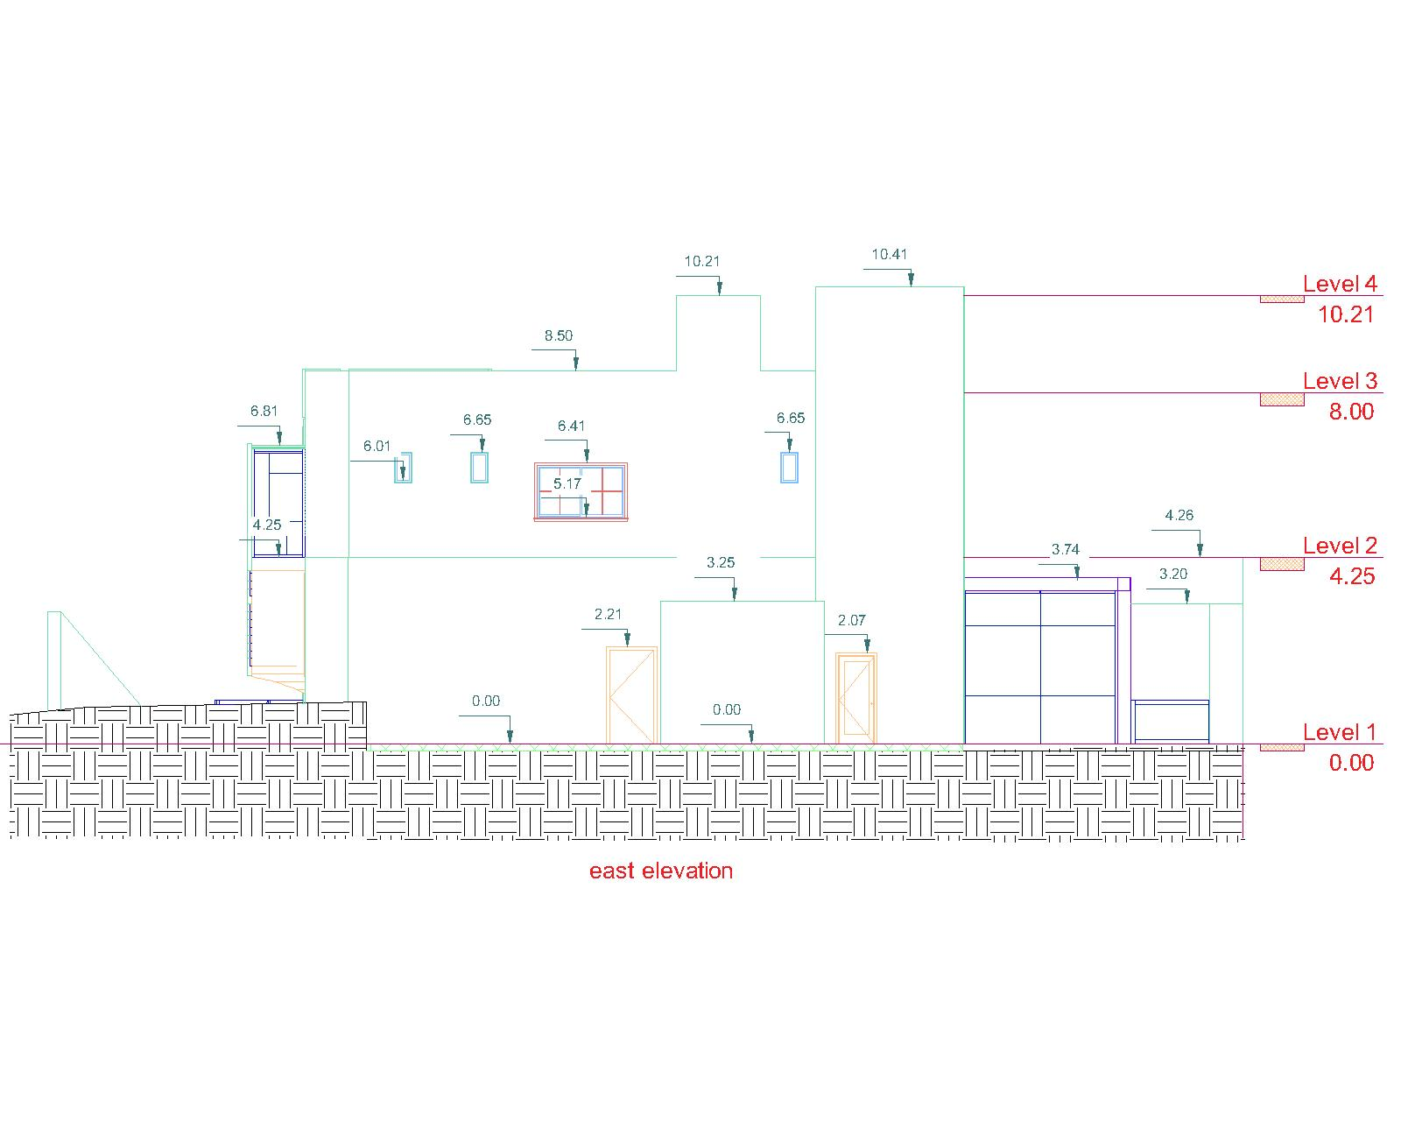
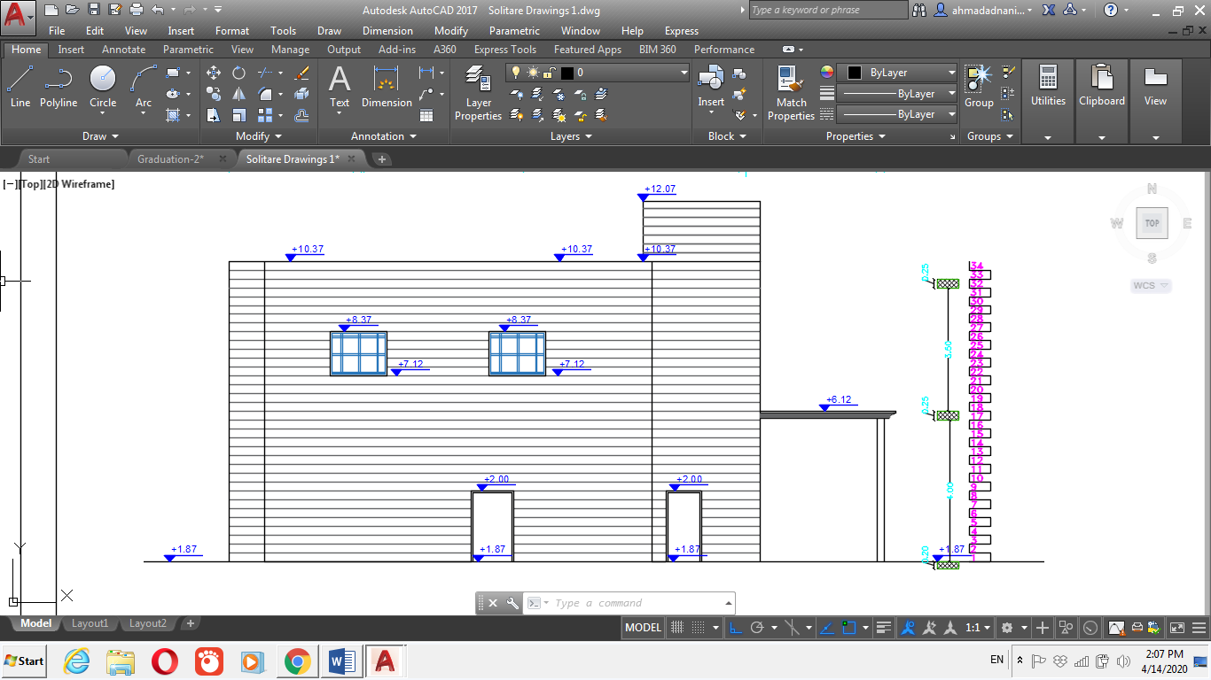
Architectural analysis and redesign
East elevation before redesign
East elevation after redesign

Slide 14
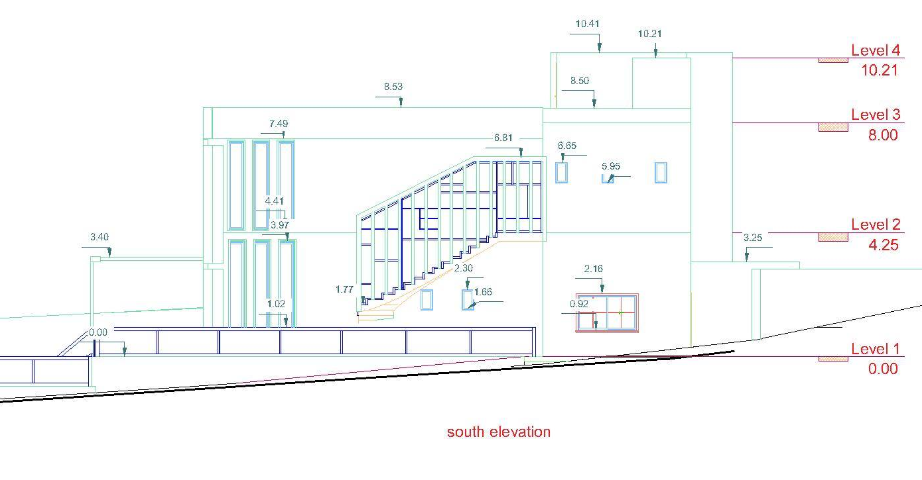
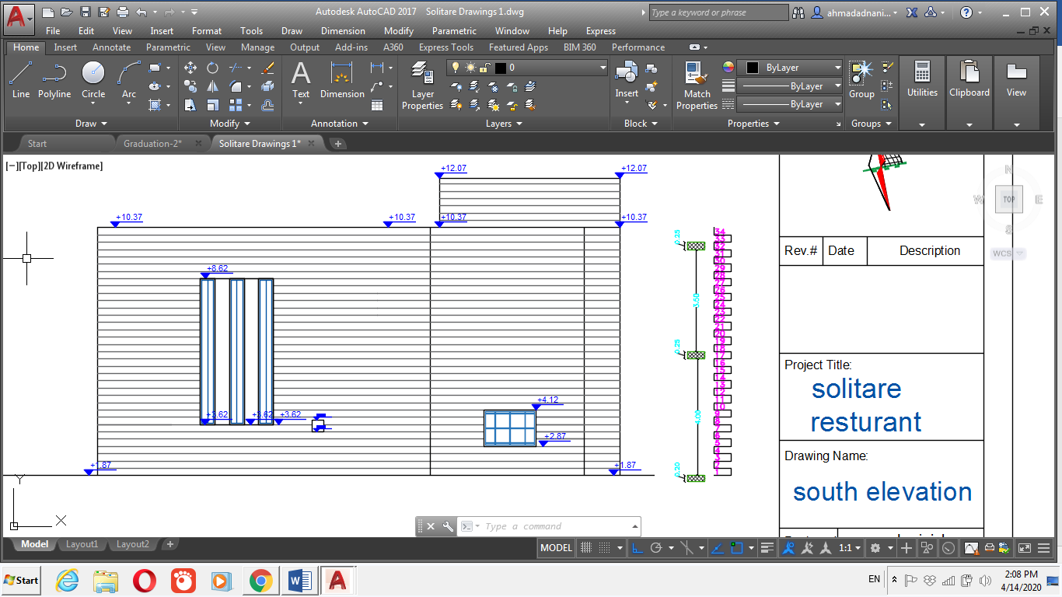
Architectural analysis and redesign
south elevation before redesign
south elevation after redesign
14

Slide 15
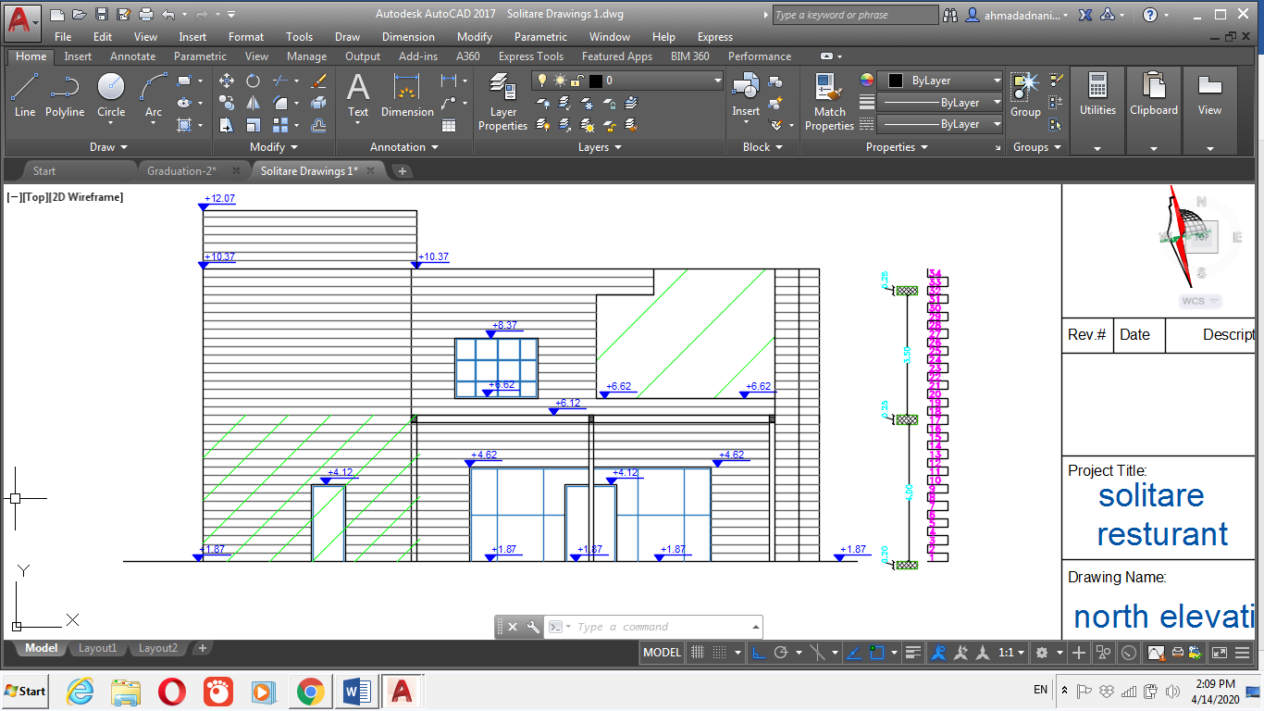
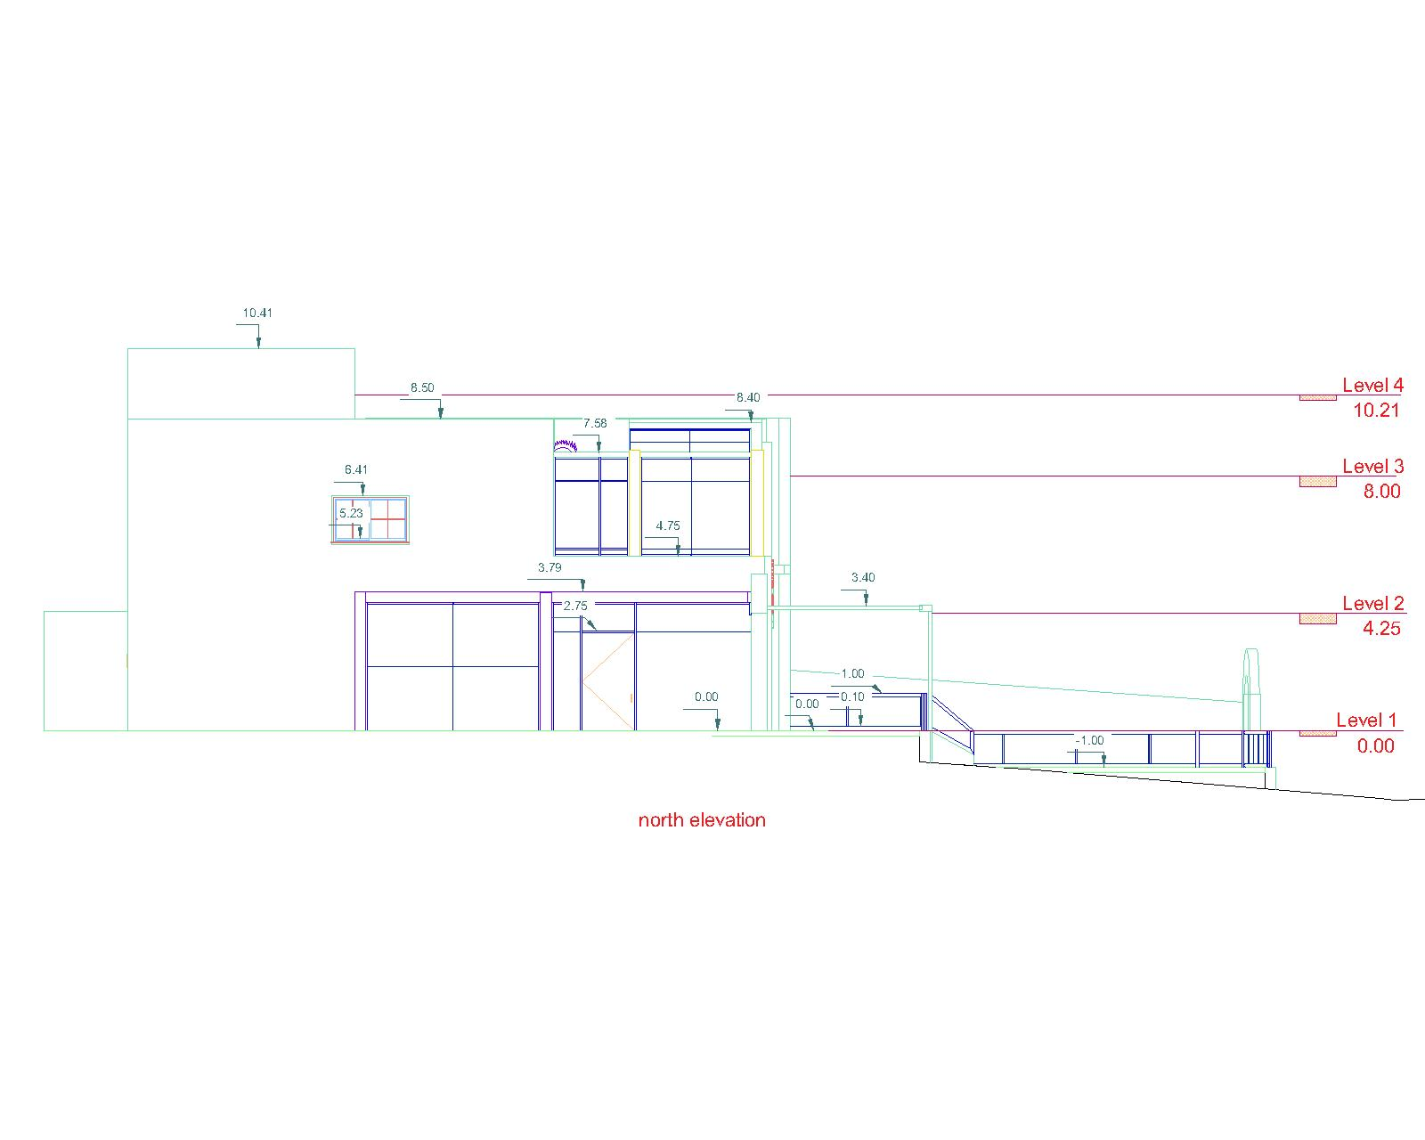
Architectural analysis and redesign
north elevation before redesign
north elevation after redesign
15

Slide 16
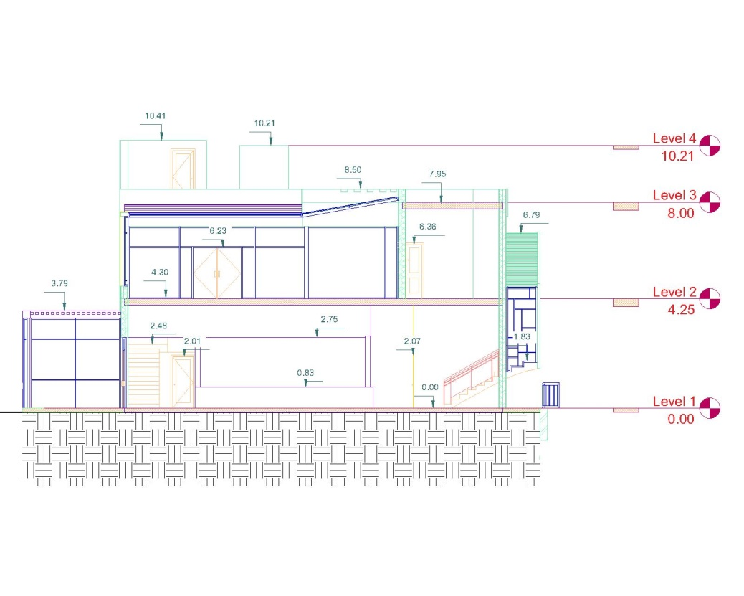
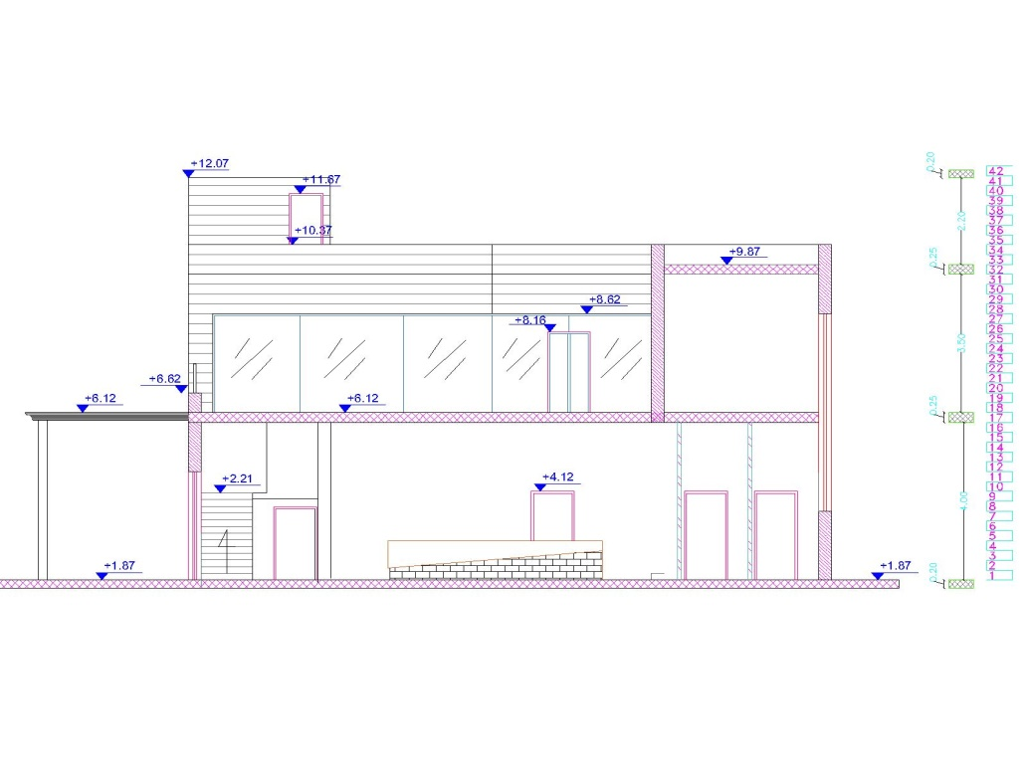
Architectural analysis and redesign
Section A-A before redesign
Section A-A after redesign
16

Slide 17
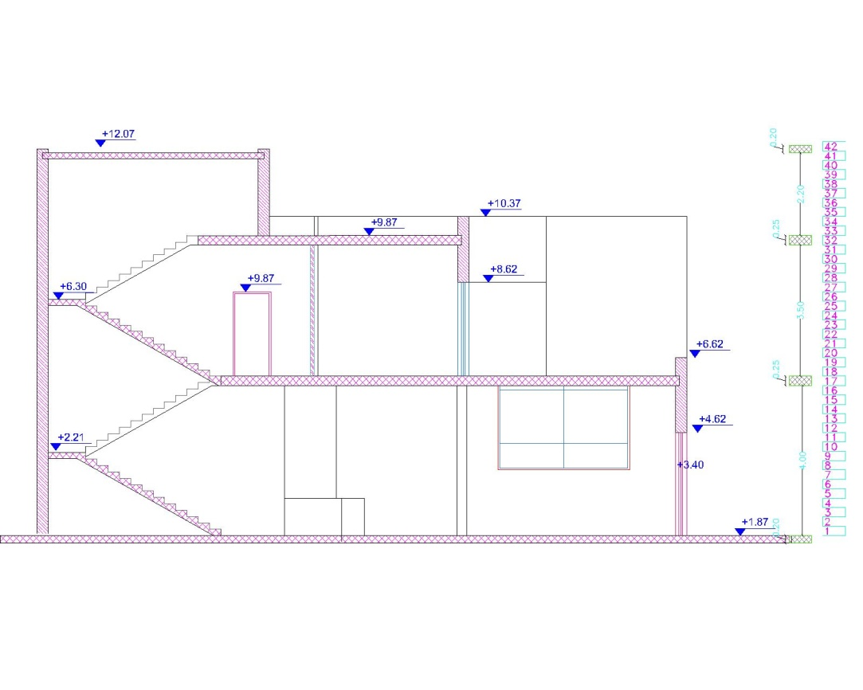
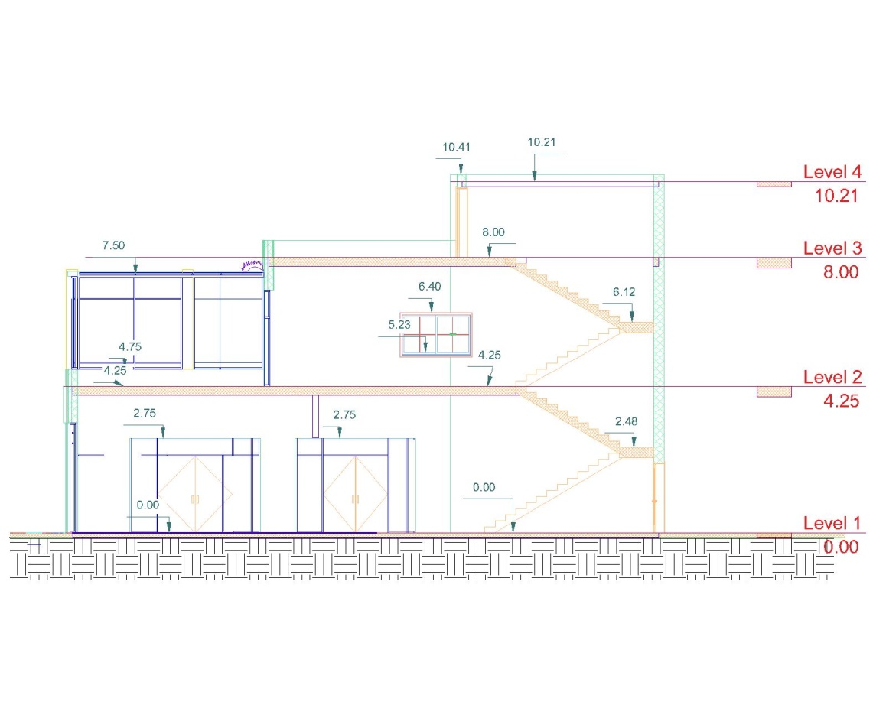
Architectural analysis and redesign
Section B-B before redesign
Section B-B after redesign
17

Slide 18
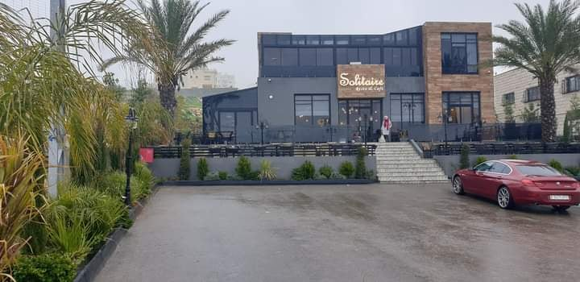
Description of the project :
Existing building

Slide 19
3D photo for solitaire restaurant after redesign
19

Slide 20
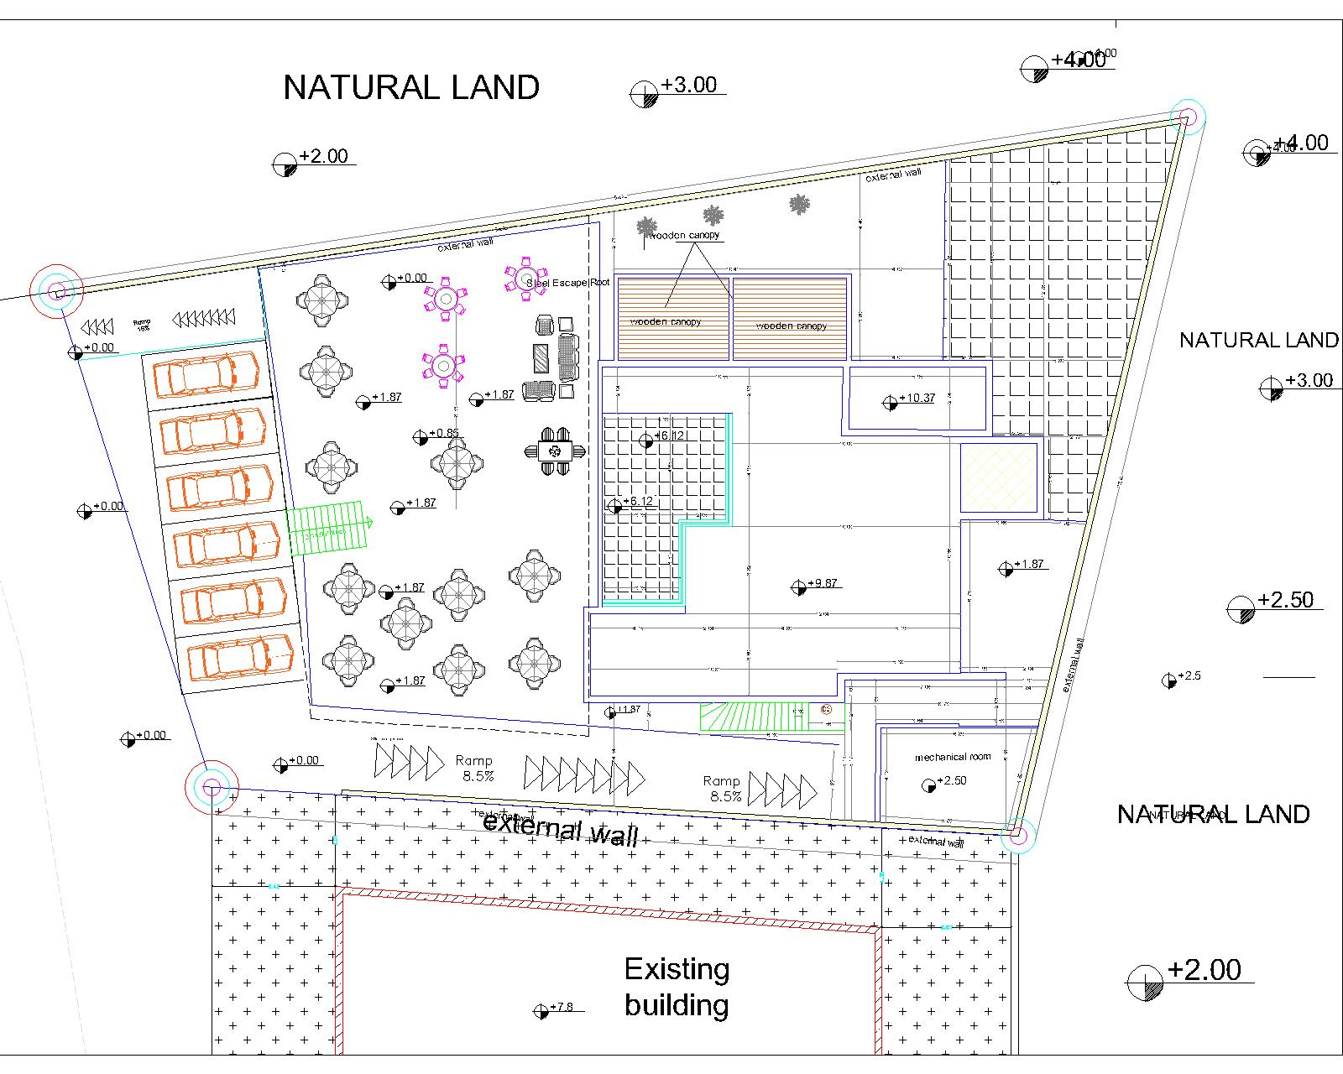
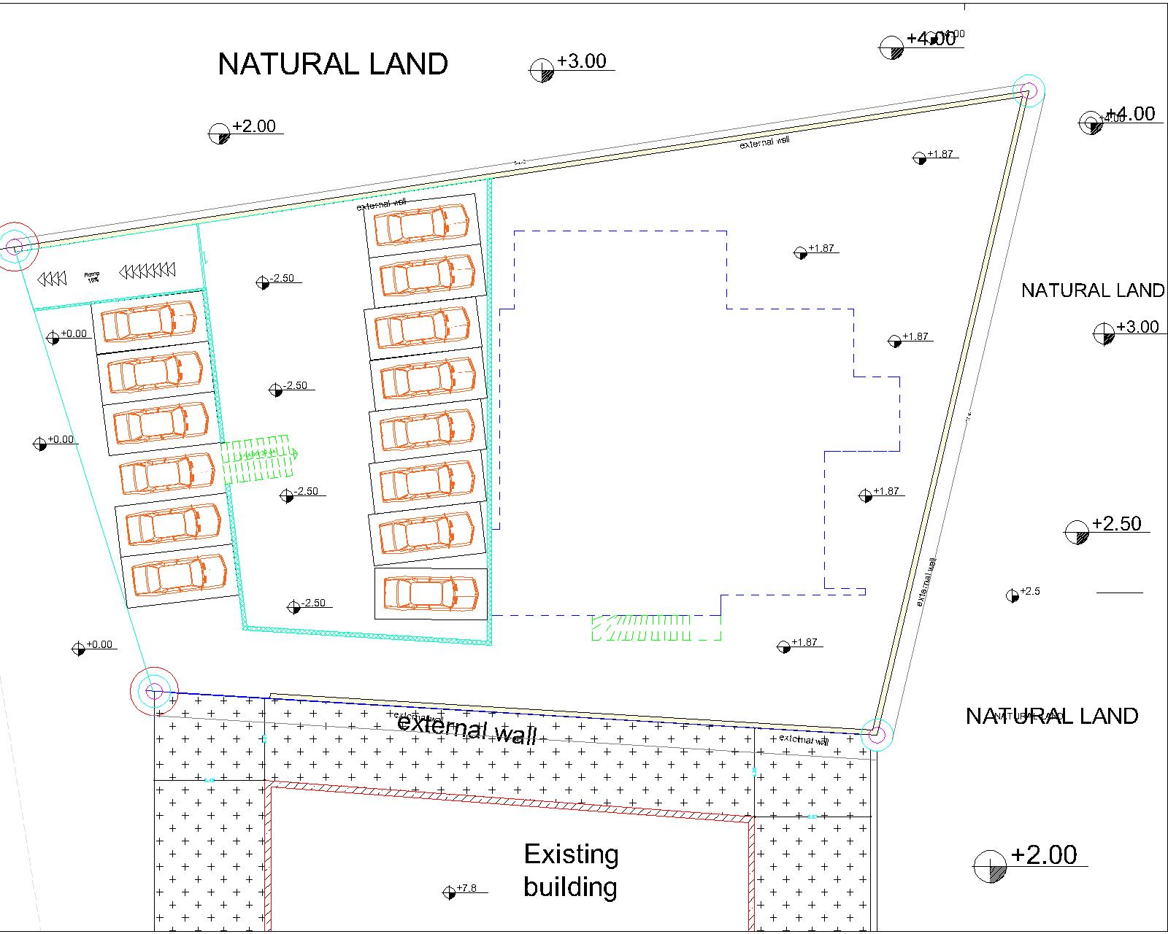
Parking suggestion 1
20

Slide 21
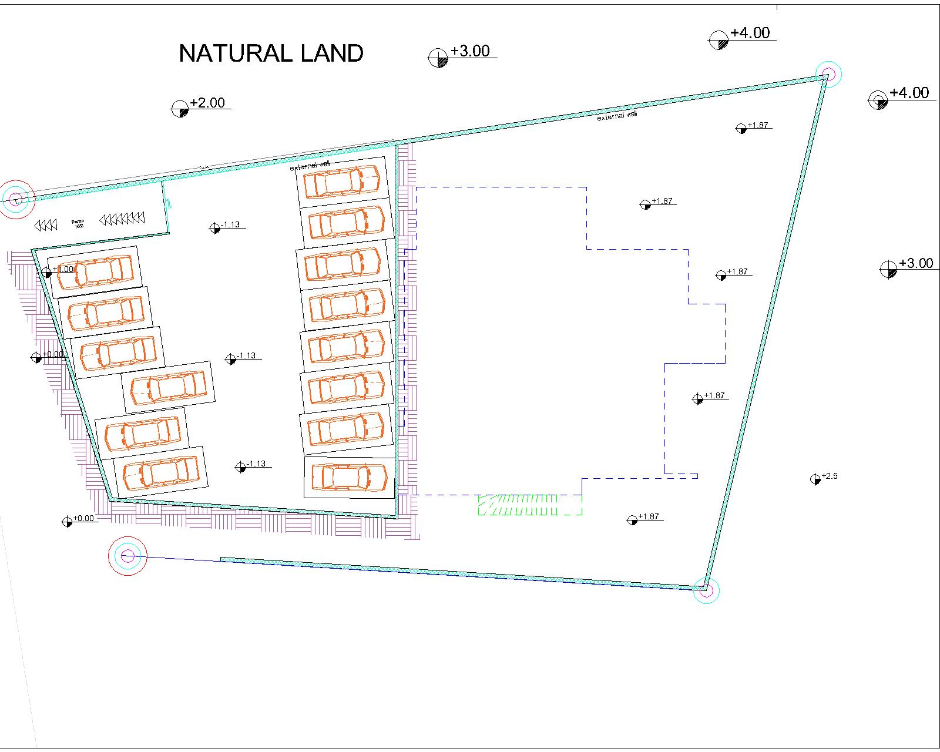
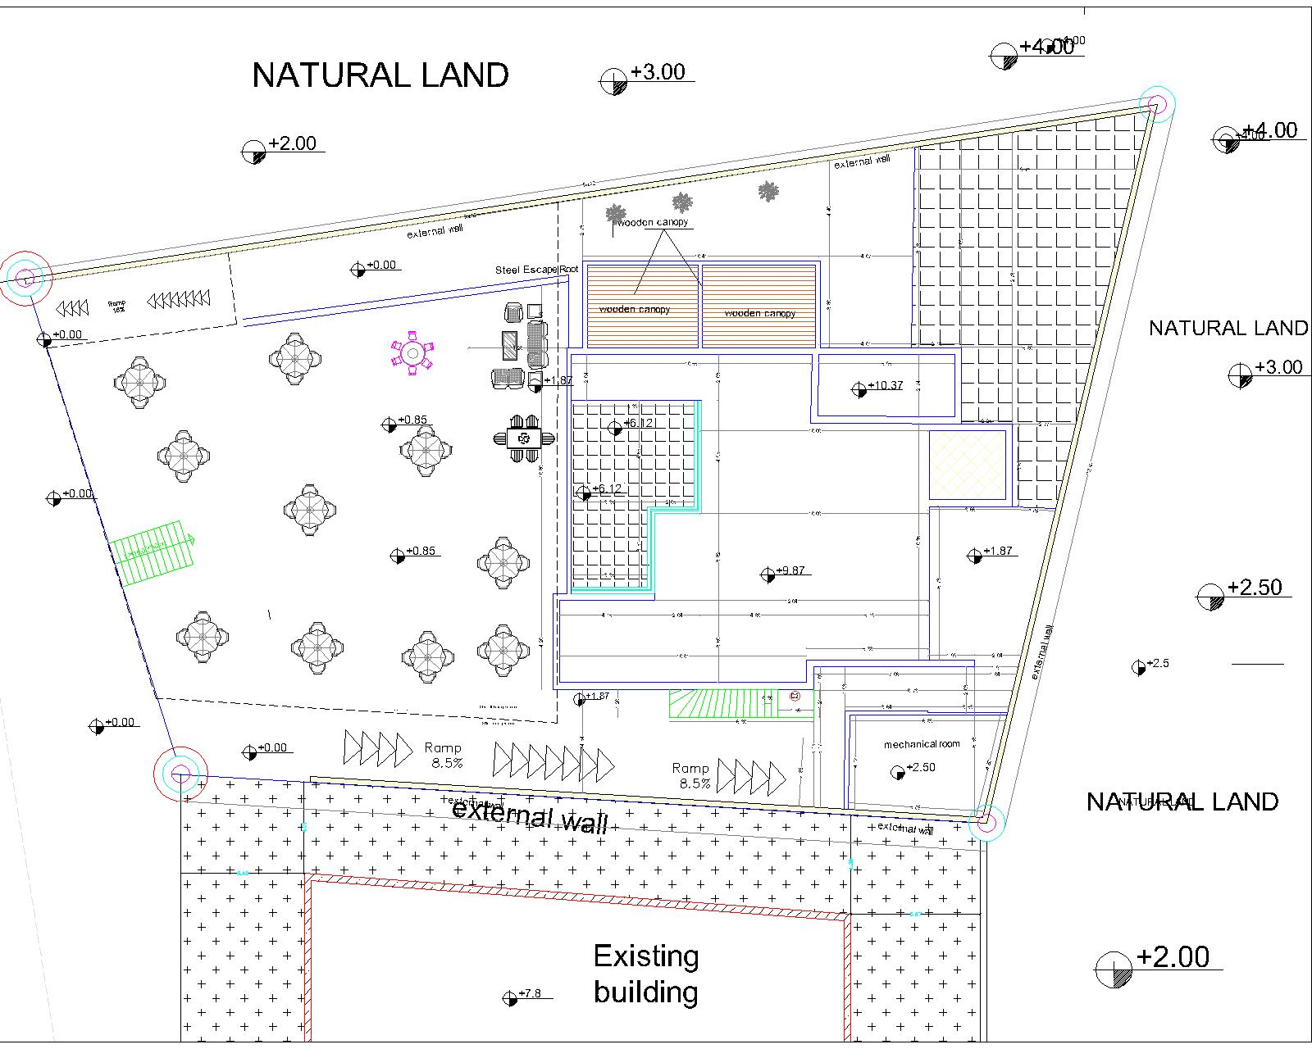
Parking suggestion 2
21

Slide 22
Structural analysis
General information
Design code :
American Concrete Institute ACI 318
.
American Society of Civil Engineers (ASCE) 7-98.
Materials :
Concrete.
f´c = 24 Mpa.
specific weight of Reinforced concrete (Ɣ) = 25 KN/m³
specific weight of block (Ɣ) = 12 KN/m³
Yielding strength of steel (Fy = 420 Mpa)

Slide 23
Structural analysis
General information
General information
Loads
Live Load= 3 KN/m²
Live Load of barking = 5 kn/m²
Superimposed dead load = 4 KN/m² (assumed)
Weight of Masonry wall = 21 KN/m (assumed)

Slide 24
Structural analysis
Structural element used
- Slab:
Solid slab with 15cm thickness for the restaurant floor.
One way and two way ribbed slab with thickness of 32 cm.
One way ribbed slab with thickness of 25 cm for the outside laundry.
- Columns:
The columns are dimensional (0.25* 0.6), (0.25* 1) m
- Shear walls:
Thickness 30 cm for walls.

Slide 25
Structural analysis
Structural element used
- Main beams:
The main beams dimensions are assumed to be 0.6m depth and 0.6m width .
-Secondary beams :
The secondary beams dimensions are assumed to be 0.32m depth and 0.4m width .

Slide 26
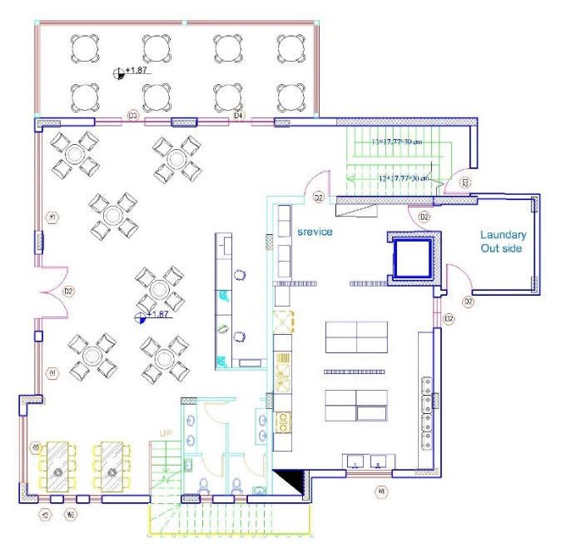
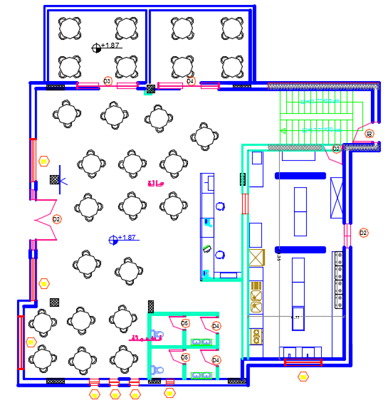
The structural layout after redesign The structural layout before redesign
26

Slide 27
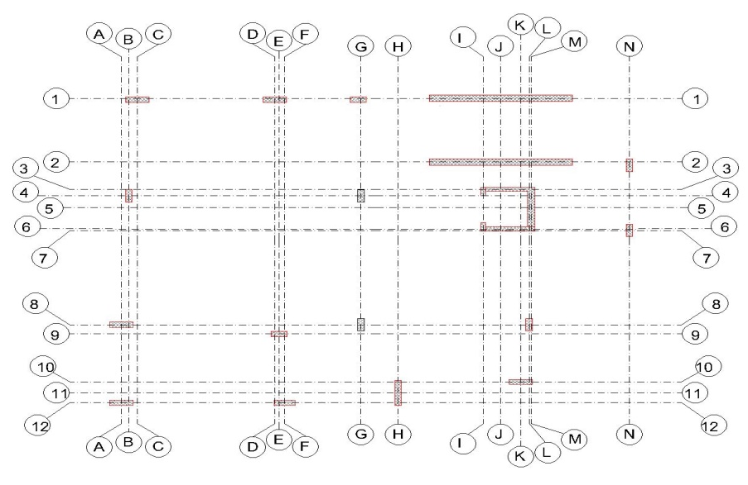
Structural analysis
Structural layout for the building after redesign
The building is one structural blocks.
Columns center lines after redesign

Slide 28
Beam Layout
second floor
first floor
28

Slide 29
Structural analysis
Structural ETABS model
Figure :3D model for the first part

Slide 30
Structural analysis
ETABS checks
All checks will be done to make sure that the work was done properly according to ACI which is deflection, compatibility, equilibrium and internal forces check

Slide 31
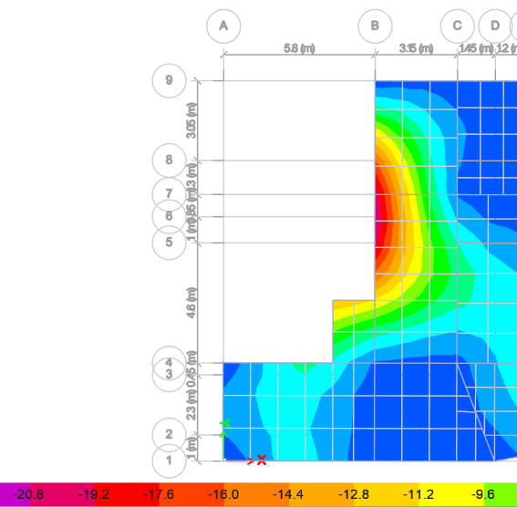

Deflection check:
Critical span length =10.80m
Deflection limit (Δ) = $\frac{10.80}{240}$ = 0.045m
From ETAB Deflection = Uz = 0.021m
The deflection in slab does not exceed the limit.
31

Slide 32
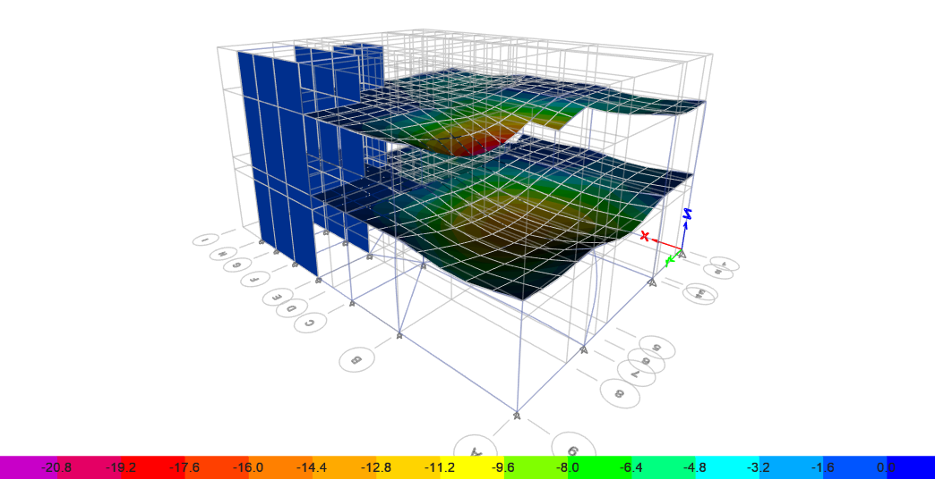
Compatibility check
Compatibility check was done on ETAB, all element are moving together.

Slide 33
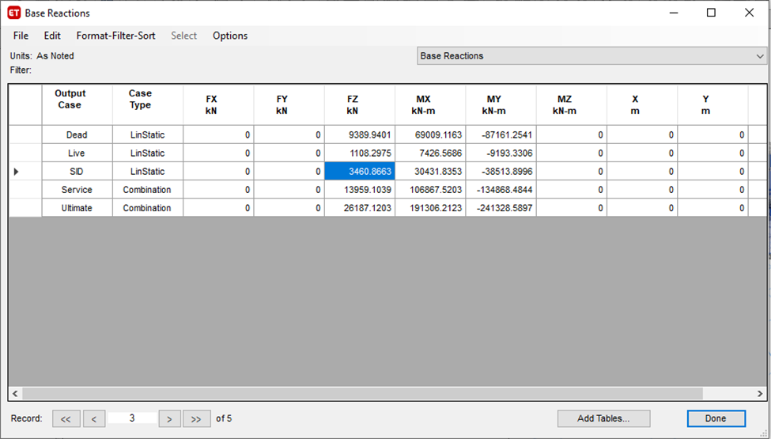
Equilibrium check
Table :Equilibrium check for the first part
a) For Live Load:
From ETAB LL= 1108.2 KN.
Manual:
LL =657.75 KN “ first story
LL=455.16 KN “ second story
LL total=1112.91KN
%Error =0.42 % < 5 % it’s OK

Slide 34
Equilibrium check
Table :Equilibrium check
Loads | ETABS (KN) | Parts | Manual | % Error
Live | 1108.2 | Slabs | 1112.91 | 0.42%
SID | 3460.86 | Slabs | 3605.83 | 4.1%
 |  | Slabs | 3834.92
 |  | Columns | 450
Dead | 9389.94 | Walls | 1324.75 | 0.5%
 |  | External walls | 2870
 |  | Beams | 864
Total (KN) |  |  | 9343.67

Slide 35
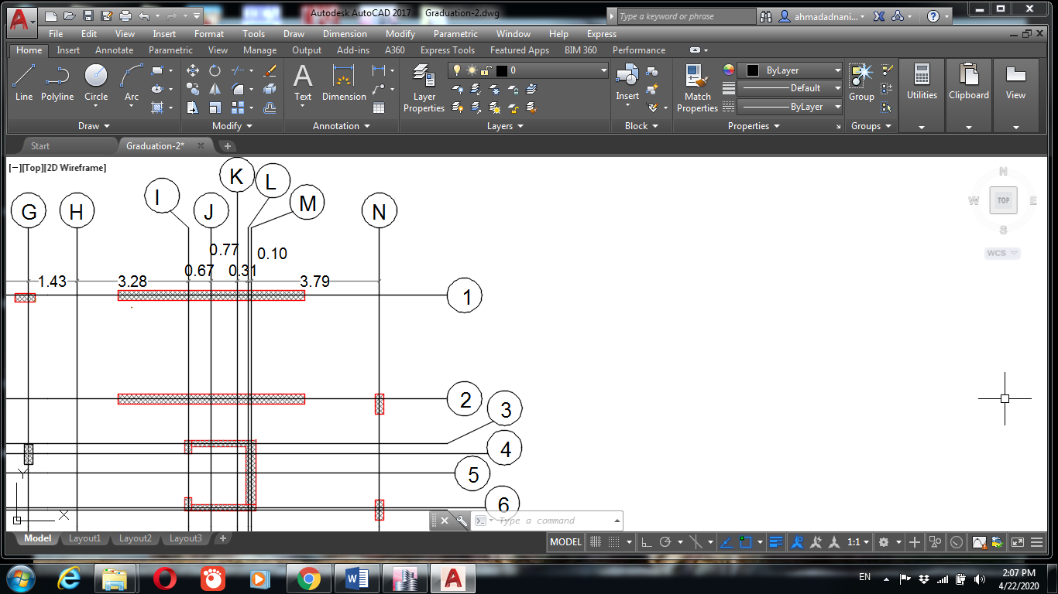
Internal forces check
Column 1:
From ETAB ultimate axial force = 99.13 KN.
Column weight =16.875 KN.
Slab weight = 23.7 KN.
Wall weight = 60.48 KN.
Total manual = 101.05 KN.
% error = 1.9% < 5% … Ok

Slide 36
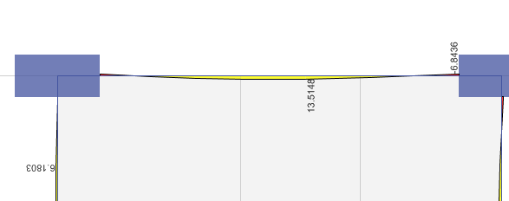
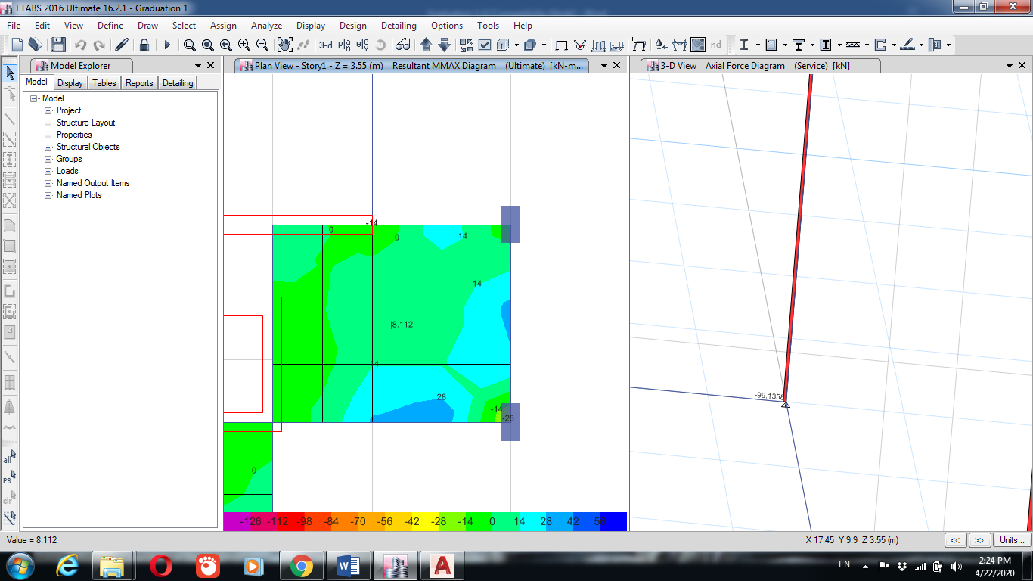
Beam:
Moment from ETAB = 13.51 KN.m.
Manual = WL2*Ln^2/16 = 12.6 KN.m
%error = 4.1% < 5% … Ok.
Slab:
Moment from ETAB = 8.12 KN.m.
Manual = WL^2/8 = 8.4 KN.m.
%error = 3.4 % < 5%… Ok.

Slide 37
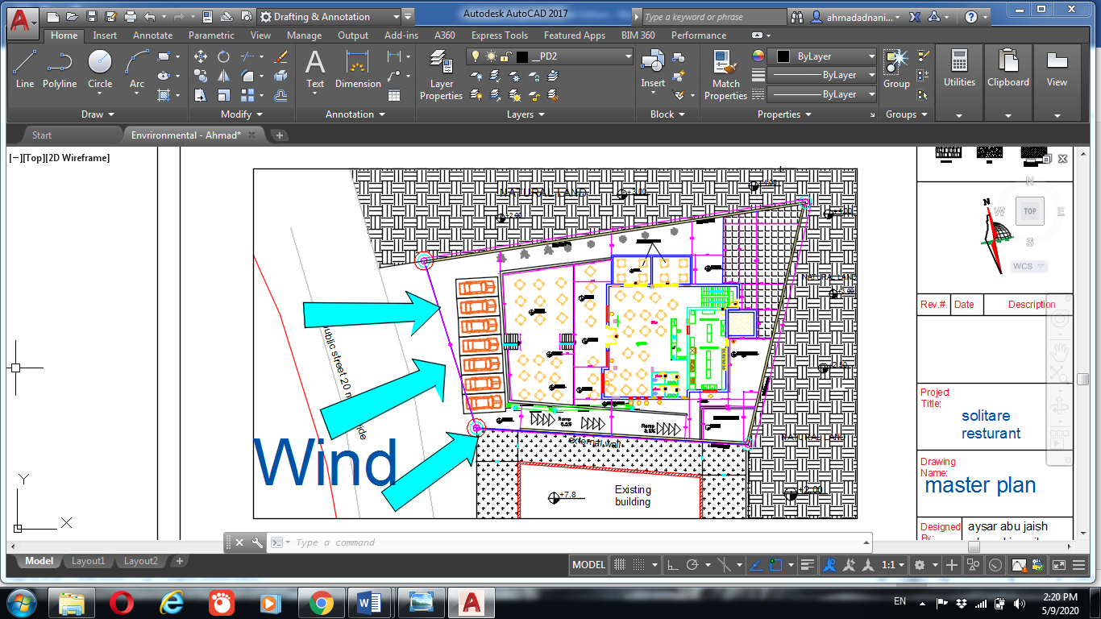
Environmental analysis and evaluation
Site analysis
Wind direction : the general direction in our country is from the north-west direction.
The noise: mainly from the street and the neighbor buildings.
The orientation of building the restaurant titles northward by an angle of 25 degrees.

Slide 38
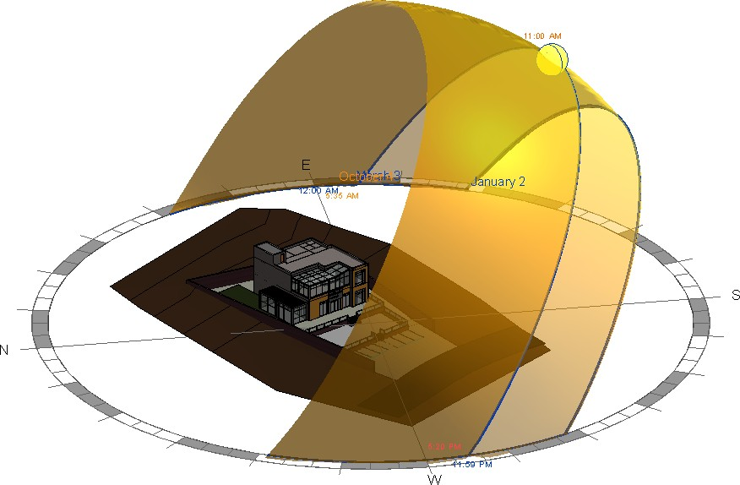
Environmental analysis and evaluation
Site analysis
Sun path the sun moves from east to west passing through the south. Therefor, the south west facad will be the one which exposed the most sun heat.

Slide 39
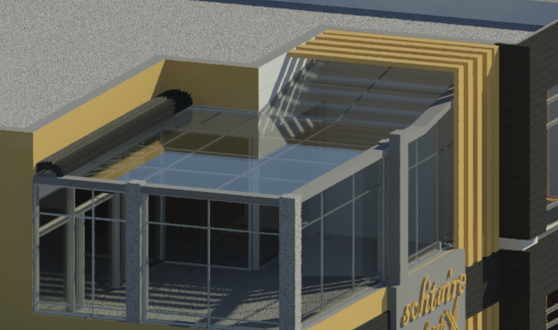
Environmental analysis and evaluation
Shading system
According to the sun path a treatment for the south west elevation was done with horizontal and vertical louvers. And a moving shading system was made as a treatment for the roof of the terrace.

Slide 40
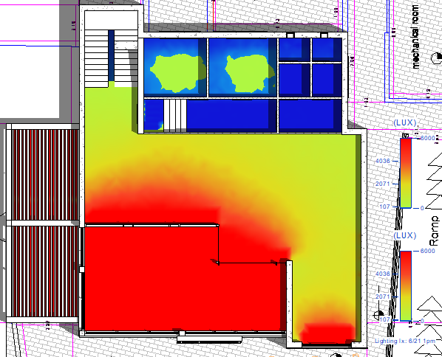
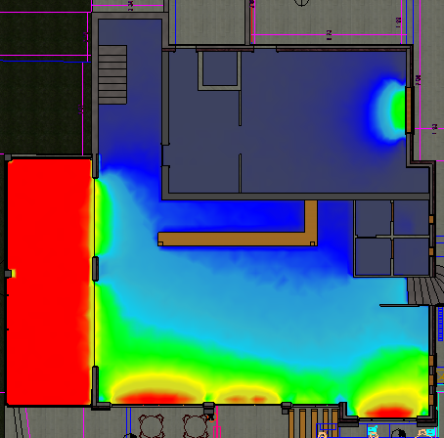
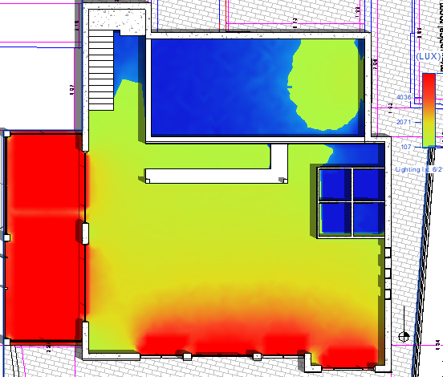
Environmental analysis and evaluation
The illuminance in the ground floor
After Modification
Before Modification

Slide 41
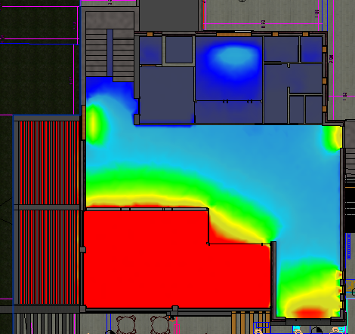
The illuminance in the first floor
After Modification
Before Modification

Slide 42
Environmental analysis and evaluation
Solar radiation on the elevation
The solar radiation has three main components diffuses ,direct and reflected components the main solar radiation effect on the building is direct solar radiotin on the building elevation by using Revit to find the value of solar radiation on elevation , this value and its affect was taken into consideration in the HVAC system in the second part of the project.

Slide 43
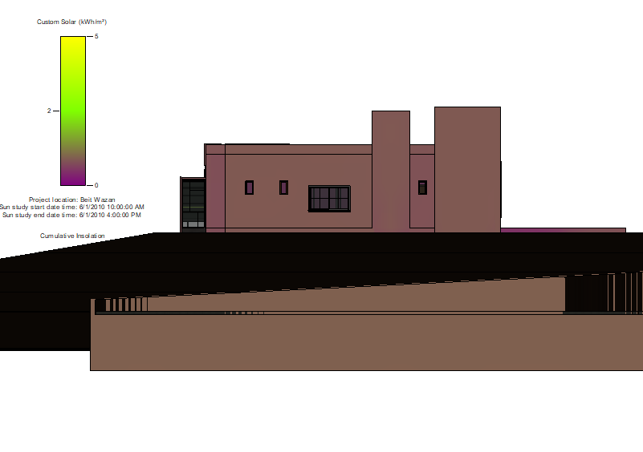
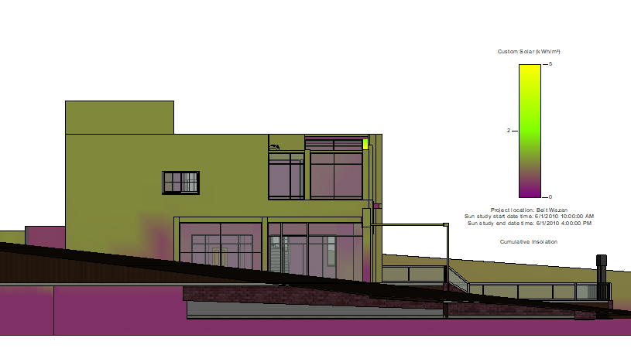
Environmental analysis and evaluated
Solar radiation on the elevation
East elevation
North elevation

Slide 44
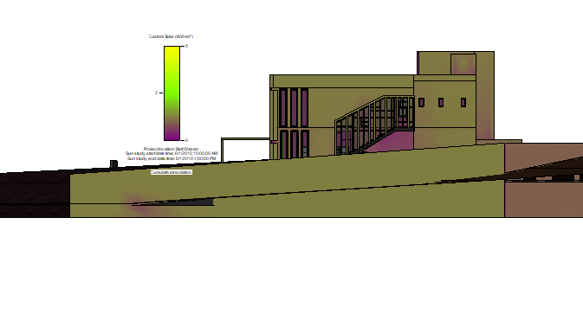
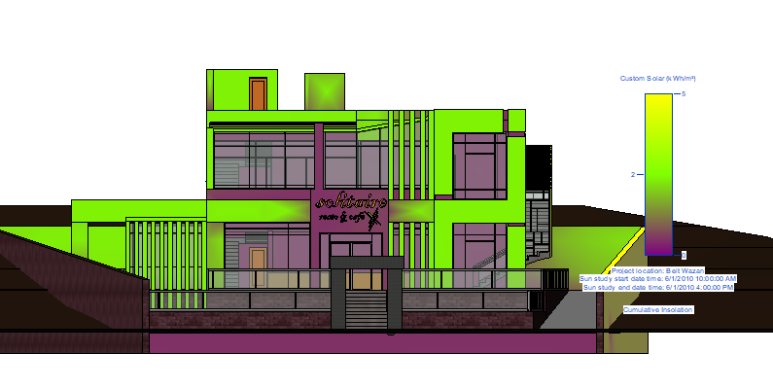
Environmental analysis and evaluated
Solar radiation on the elevation
South elevation
West elevation

Slide 45
Cost estimation:
In this stage of the project will follow the parametric modeling for cost estimation.
The cost per square meter of such a project is estimated at 600 dollars/m².
Total cost of the restaurant is around = 600*394.52 = 236800 $.
The cost per square meter of the Garage is estimated to be a bout = 300 dollars/m².
Total cost of Garage is around= 274*300 = 82200 $.
Total cost for the Restaurant and the Garage is around = 319000 $.

Slide 46
Results
1) A shortage of car parking lots.
2) There is a different between shop drawings and as built drawings.
3) The absence of an emergency exit in the event of a fire inside the restaurant.
4) There is no service elevator inside the restaurant.
5) The outside terrace need a suitable shading system.

Slide 47
Thank You

