Slide 1

Vibration Table Design For The Palestinian Construction Products Company
Prepared By:
Samir Lahlabat Rana Hindia
Ibrahim Aqel Talal Shakhshir
Supervisor:
Dr. Nidal Farhat

Slide 2
Agenda
Introduction
Vibration Concepts
Vibration Analysis
Design Analysis
Final Shape of Vibration Table

Slide 3
The Palestinian Construction Products Company
The Palestinian Construction Products Company PCP was established in 1994 with high aims to supply the local market with reliable construction products which are needed for the infrastructure projects in the west bank and Gaza. PCP is currently producing concrete pipes for sewerage and drainage networks , precast concrete manholes , and hollow concrete blocks.

Slide 4
The Goal of Our Project
The goal of this project is to design a Vibration Table for The Palestinian Construction Products Company that will meet the necessary requirements that they desire by eliminating the disadvantages that is associated with the current vibrating Table (cracks in the vibrations table , increasing the intensity of the electric current causing the motors to turn off and some cracks in the vibrating table frames).

Slide 5
Vibration Table
The Vibration Table is a machine that is used mainly in Construction Companies to :
To remove air and water trapped within the concrete
Removal of these voids improves the outside surface of the molded concrete
Allows the use of a lower water to cement ratio, to get a much stronger finished product

Slide 6
The Preliminary Design
The preliminary design of the Vibration Table will consist of the following components :
Table top (Plate)
Compression springs
Main frame

Slide 7
The Preliminary Design Cont.
Inner frame (for further support when the load is applied)
Bolts
External vibrator

Slide 8
Vibration Table Specifications
Dimensions For Table Top :
Length :2 m
Width :2 m
Thickness : 2 cm
Estimated weight :
640 kg ( including the external vibrator )

Slide 9
Vibration Table Specifications Cont.
Table Top and frames material :
Cast Iron Alloy

Slide 10
Vibration Table Specifications Cont.
Cost : The Estimated costs for the Vibration Table main components :
Total cost : 30000 NIS
External vibrator :12000 NIS
Twenty springs : 10000 NIS

Slide 11
Intended Design Goals
Being able to vibrate about 3000 kg of concrete.
Maintain the amplitude of vibration that is equal to ( 0.5-2 )mm .
Must operate within the frequency range of (3000 RPM)
Durable: must last without major repair for 2-5 years .
Must be easily built and repaired using parts available from nearby department store and tools that are readily accessible.

Slide 12
Vibration Concepts

Slide 13
Vibration Mechanisms
Concrete Vibration
Usually, concrete requires a very high frequency of vibration in order to remove air bubbles, mix the aggregate and provide a smooth, clean finish

Slide 14
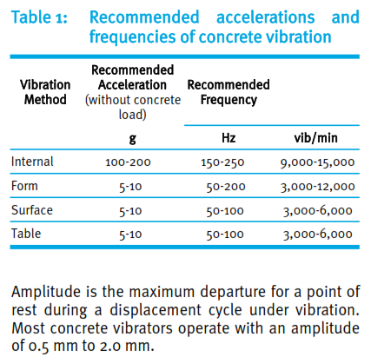
Vibration Mechanisms cont…

Slide 15
Vibration Mechanisms cont..
The cycle of vibrations travel through the concrete, transferring their energy to the particles in the mix.
The most important parameters in the process of concrete vibration are :
Centrifugal force
Amplitude
Frequency
Acceleration

Slide 16
Types of Vibration Isolators
Common types of isolators we can be used such as:
rubber isolators , springs .

Slide 17
Source of Vibration
External Vibrator
The vibration is often generated by an external vibrator with an unbalanced eccentric mass on its driveshaft.

Slide 18
Vibration Analysis

Slide 19
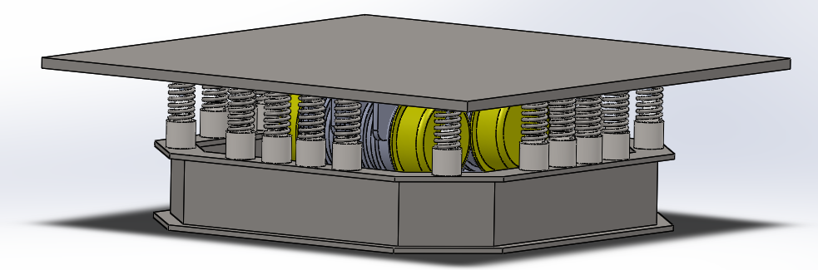
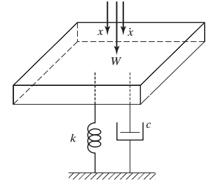
Vibration analysis
F(t)
The equation of motion :
Which : m : total mass
c : damper constant
k : total stiffness of spring
f(t)=F0 cos(wt)
The complete solution , x(t) :

Slide 20
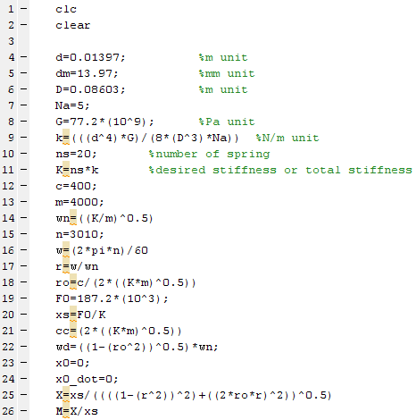
Vibration analysis cont..
Complete vibration analysis by MATLAB program :

Slide 21
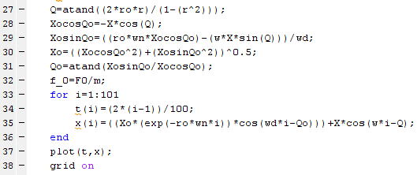
Vibration analysis cont..

Slide 22
Vibration analysis cont..
  The final results of MATLAB program are as follows :
K = 1.154 *10^5 N/m
Ktot = 2.3*10^6 N/m
Wn = 24 rad /sec
W = 315.2 rad/sec
r = 13.119
Ro ( ) = 0.0021
Xs = 0.0811 m
cc = 1.922*10^5 N.sec ⁄m
X = 0.955 m
M = 0.0058

Slide 23
Vibration analysis cont..
As in the results of MATLAB program analysis , the natural frequency is very less than forcing frequency . If the forcing frequency is less than the natural frequency, the amplitude decreases to a much smaller value . Also , A resonance occur , when the driving frequency of oscillations is approximately equal to the natural frequency of the object .

Slide 24
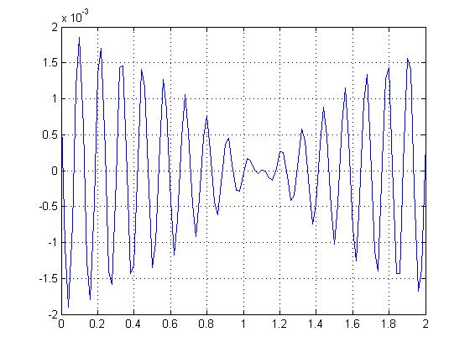
The final analysis of vibration table
Simulation of the Plot of tabletop displacement over time . The plot shows the beat frequency apparent with minimal damping ( without damper c=0.000001 )

Slide 25
The final analysis of vibration table cont..
In this situation the beat frequency emerges, which is a secondary vibration frequency. This beat frequency is undesirable because the amplitude of vibration varies with time in a periodic manner.

Slide 26
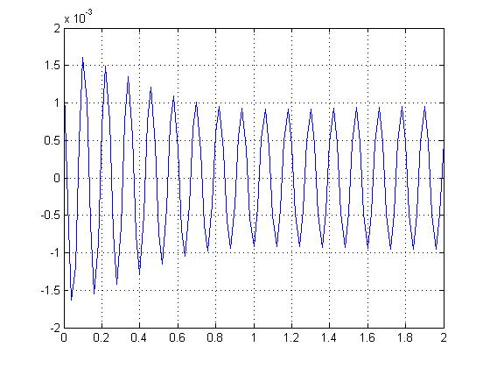
The final analysis of vibration table cont..
Simulation Plot of tabletop displacement over time. The plot shows the suppressed beat frequency apparent when moderate damping is used with c = 400 (N.sec)⁄m

Slide 27
The final analysis of vibration table cont..
Finally, the simulation above assumes that the motions of the springs are restricted to the vertical axis , and that all springs vibrate synchronously

Slide 28
Damper dashpot
A dashpot is a mechanical device , which resists motion via viscous friction. The resulting force is proportional to the velocity, but acts in the opposite direction, to slow the motion and to absorb energy.

Slide 29

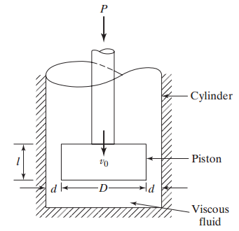
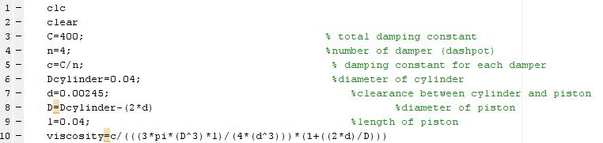
Damper dashpot cont..
Calculation of the damping constant (c) , to determine the viscosity to select a suitable fluid :

Slide 30
Damper dashpot cont..
From above We found that :
D = 0.0351
= 0.3166 Pa.s
From previous calculation the suitable of fluid use in damper is motor oil SAE 40 ,whish have a viscosity equal to 0.319 Pa.s

Slide 31
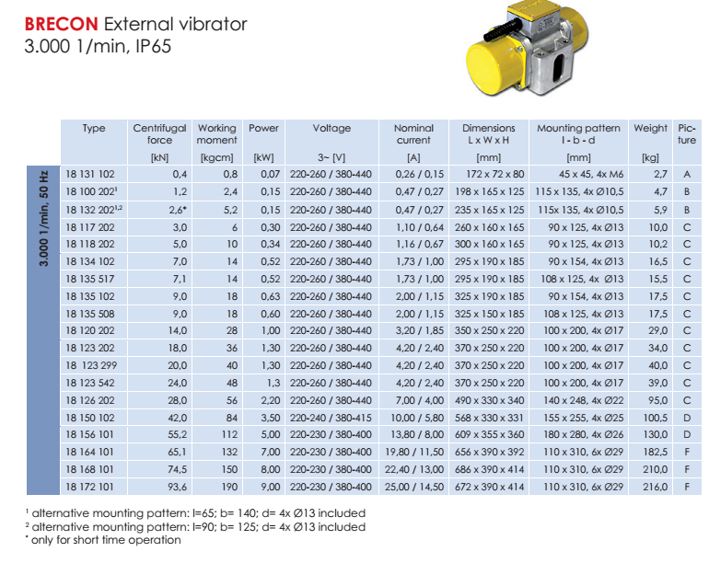
External vibrator

Slide 32
External vibrator cont..
Most concrete vibrators operate with an amplitude of 0.5 mm to 2 mm
The centrifugal force is equal to 93.6 KN . It came from Catalog BRECON External vibrator its amplitude 0.955 mm , the frequency is 3000vib/ min .
The vibration is determined by the magnitude of the generated centrifugal force and the mass of the vibrating equipment.

Slide 33
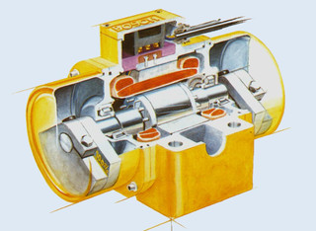
External vibrator cont..
The external vibrator is a three-phase asynchronous motor, So-called eccentric weights (discs) are fixed eccentrically at the ends of the rotor shaft . At rotating, centrifugal forces are generated.

Slide 34
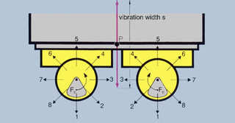
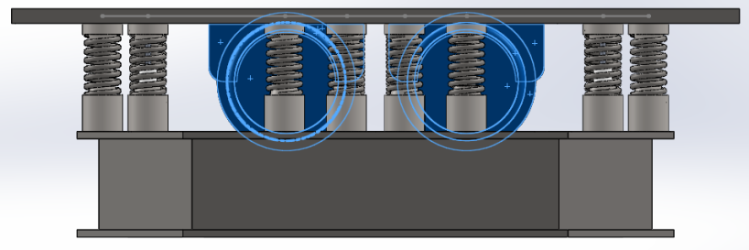
External vibrator cont..
Two equal, counter rotating external vibrators are attached parallel to each other.
Due to synchronization, the opposite forces cancel out each other and aligned forces add up. This creates linear vibration.

Slide 35
Vibration isolation systems
The concept of Vibration isolation :
Consider a vibrating table , bolted to a rigid floor. The force transmitted to the floor is equal to the force generated in the table . The transmitted force can be decrease d by adding a spring and damping elements

Slide 36

Vibration isolation systems cont..
Transmissibility : the ratio of transmitted force to the input force .
The effectiveness of the isolator is :
% Isolation=(1-T)×100=99.4 %
For minimum transmissibility (maximum isolation), the excitation frequency should be as high above the natural frequency as possible .

Slide 37
Design Analysis

Slide 38
Design analysis
Arigid Tabletop.
Compression Springs
Base Table Design
Welding
Bolt Design

Slide 39
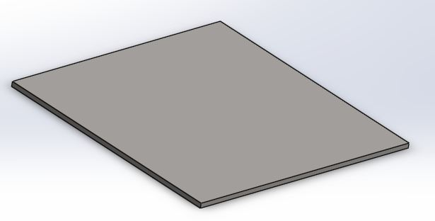
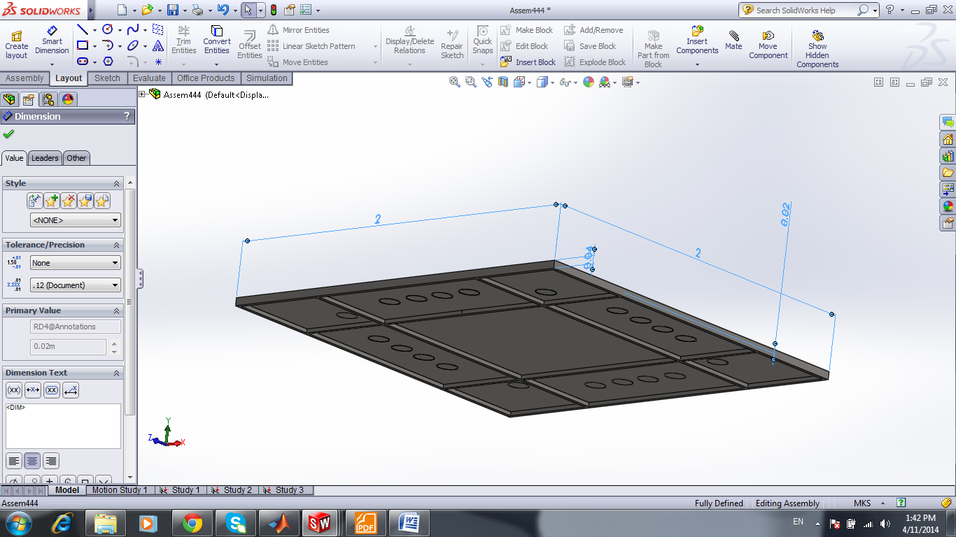
Table Top Analysis
tabletop above view
tabletop below view

Slide 40
Table Top Analysis cont..
The tabletop has a square shape to carry the mold of concrete which is weight about 3000 kg. And has a length of 2m and a width of 2 and a thickness of 2 cm , . It is built of a material that has a very strong installation property, such as Cast Iron Alloy .
. Looking at the bottom of the tabletop there are four bars to increase the strength of the tabletop. These bars have a thickness of 2 cm which distributed symmetrically.

Slide 41
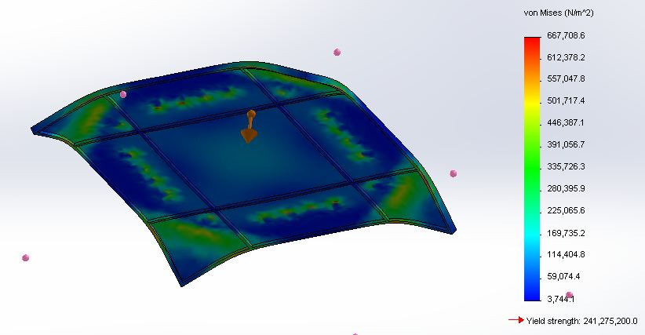
Table top analysis cont..
tabletop simulation stress by Solidworks

Slide 42
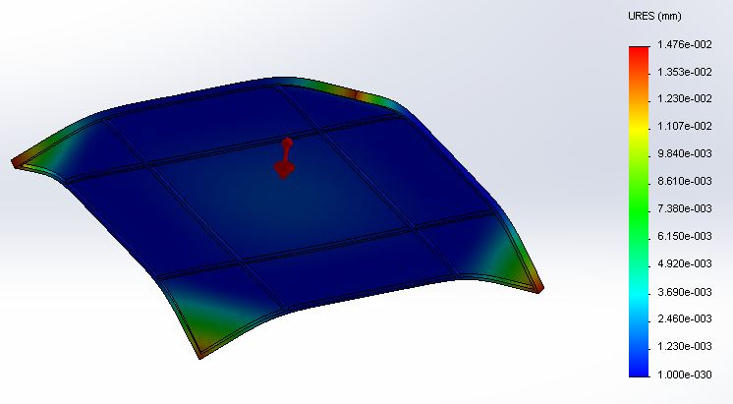
Table top analysis cont..
the maximum displacement appeared in angles of tabletop ,It is too small to see with the eye .

Slide 43
Compression Springs Design
The number of springs is twenty to reduce the applied force to small amount.
By Solidworks program each spring have a compression force not exceeded to solid force (Fs) . So the average compression force in the all spring is equal 2000 N

Slide 44
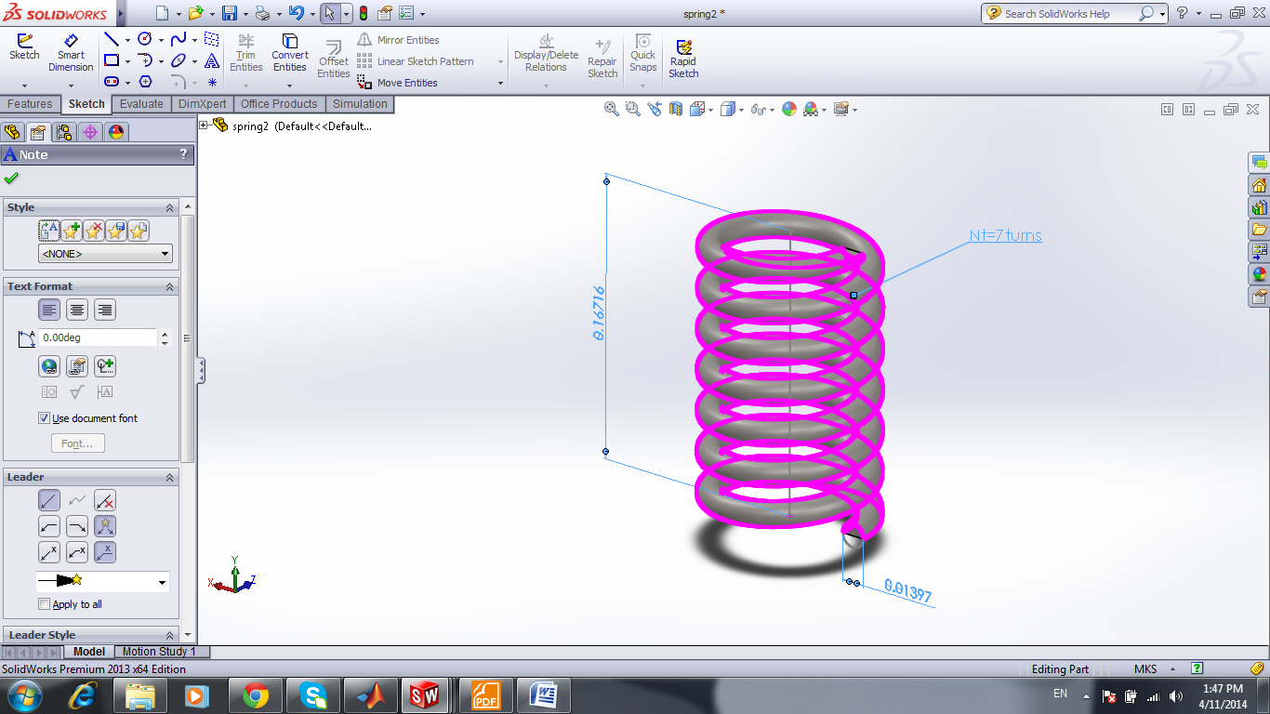
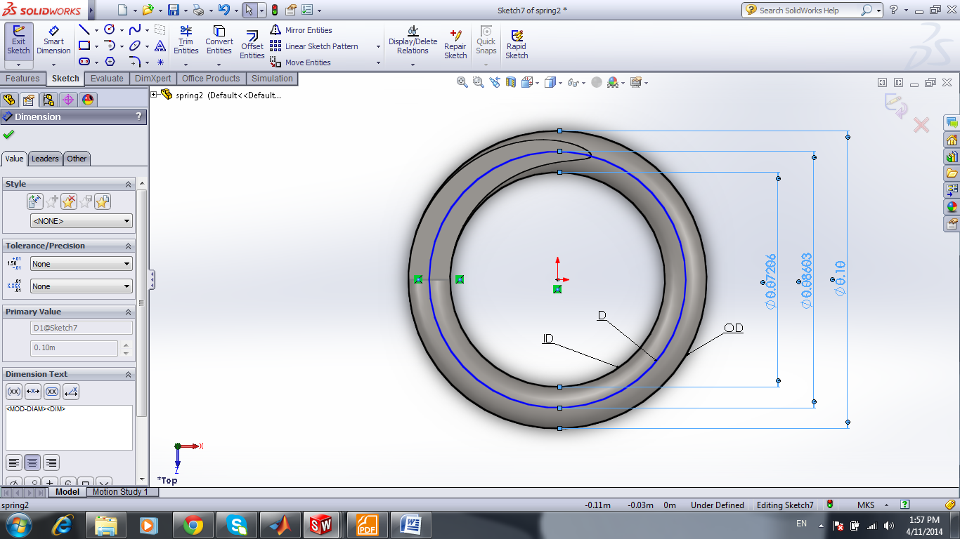
Compression Springs Design cont ..
OD | 0.10 m
D | 0.08603 m
ID | 0.07206 m
d | 0.01397 m
Na | 5 turns
Nt | Na+2 = 7 turns

Slide 45
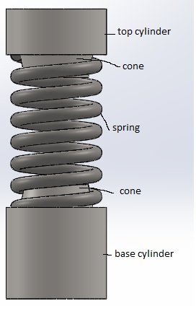
Compression Springs Design cont ..
We must choose material be suitable for shock resistance and to avoid any failure in the vibrations system , the most suitable material is Chrome-Vanadium

Slide 46




Compression Springs Design cont..

Slide 47


Compression Springs Design cont..
The calculation in the solid state of spring :

Slide 48


Compression Springs Design cont..
The calculation in the free state of spring :
So the spring was in stability by ( Lo < Loc) .
The factor of safety of spring is :

Slide 49
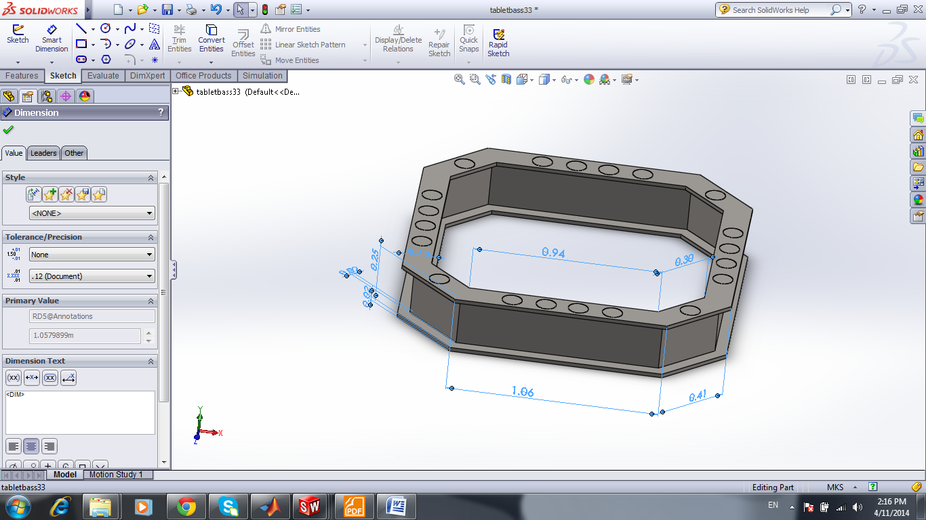
Table Base Design
The base of the table should be strong enough to carry this heavy weight Also The weight of the base must be heavy to fix the table to the ground when the shaking is started. The material of the table is Cast Alloy Steel this material gives strength in design . The base is 419.52 kg .

Slide 50
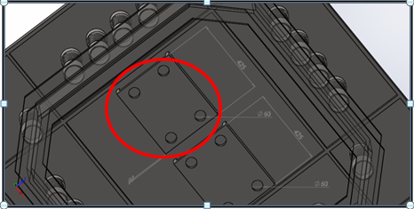
Welding analysis
The part that connects the vibrator with the tabletop

Slide 51
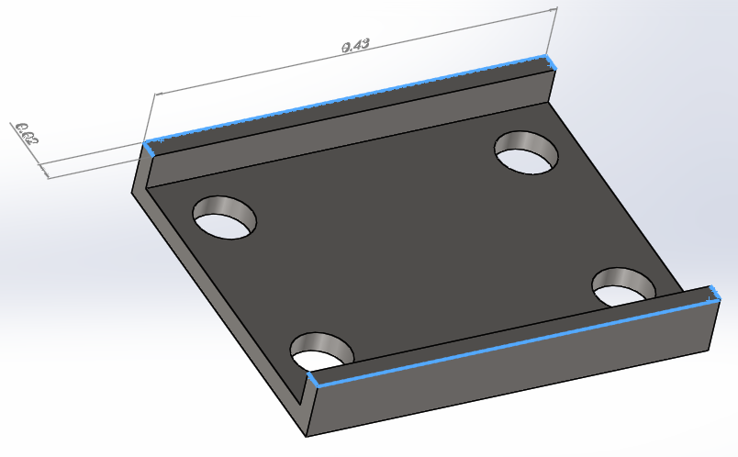
Welding analysis
the place of the part with dimension b= 0.02 m and d=0.430 m )

Slide 52
Welding analysis
We Assume that
the throat area of the weld :

Slide 53

Welding analysis
The average normal stress is :
The allowable tensile stress :

Slide 54
Bolt Design Analysis
Specification standard for M64*6 ISO8.8
Nominal major diameter 64mm
Tensile stress area At 2680mm^2
Preload force 1206kN
Mimimum proof strength600 Mpa
Mimimum tensile strength 830Mpa
Length of bolt 6cm
Endurance limit fully corrected 129 Mpa
Maximum and mimimum force 23.3 and -23.3 respectively

Slide 55
Bolt Design Analysis
fatique calculation for M64 *6* ISO Glass 8.8
For steel bolt the endurance limit life N is about 10^6 to 10^7 cycles
Fatique strength :
Where:
N is the cycles to failure
The constant a ,b are defined at 10^6
Fatique strength fraction ( f)varies 0.89
a= 685.3
b=- 0.25kpsi

Slide 56
Bolt Design Analysis
Sf =21.6 kpsi
When stress in compression and the failure occurs at Se ,the number of cycles to failure is
N = (Se/a)^1/b = 1 *10^6 ( infinte life )
stiffness constant of the joint :

Slide 57
Bolt Design Analysis
Mimimum stress
Ϭi = 450Mpa
where Fi is the maximum preload force obtained when tight abolt before external force is applied .
The alternating component of the bolt stress is :
Ϭa = 7.24 Mpa
the mean stress Ϭm = Ϭa +Ϭi = 450 Mpa

Slide 58
Bolt Design Analysis
by Goodman Method the stress component of fatigue failure
Sa =51.1Mpa
The factor of safety guarding against fatigue is given by :
Sa / Ϭa = 7 SO NO Fatigue accrue .
Yielding safety factor = Sp / Ϭm+Ϭa = 1.3 no yeilding .

Slide 59
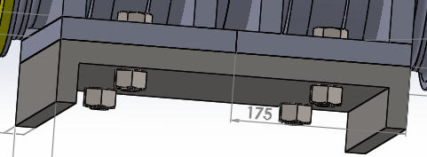
Bolt Design Analysis
Table fixed with ground

Slide 60
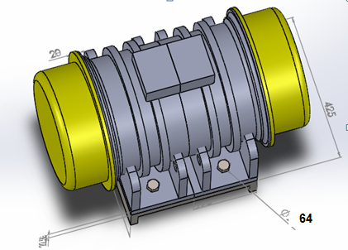
Bolt Design Analysis
Connection between external vibrator and table top by bolts

Slide 61
Final shape of vibration table

Slide 62
Final shape of vibration table
Final shape of vibration table

Slide 63
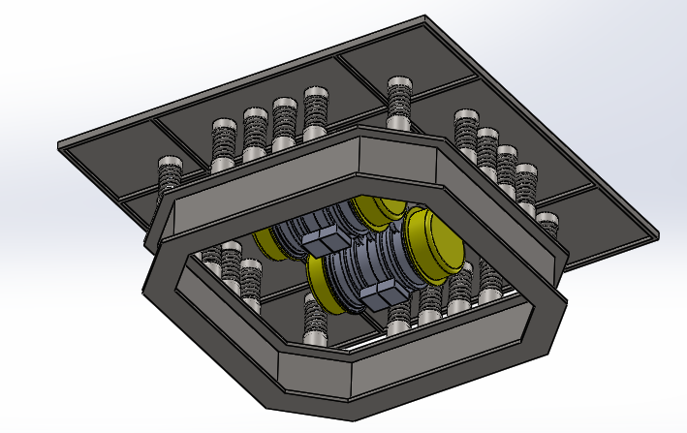
Final shape of vibration table
Bottom view of vibration table

Slide 64
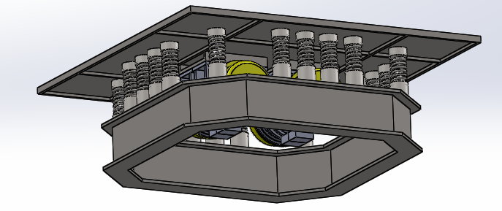
Final shape of vibration table
Side view of vibration table

Slide 65
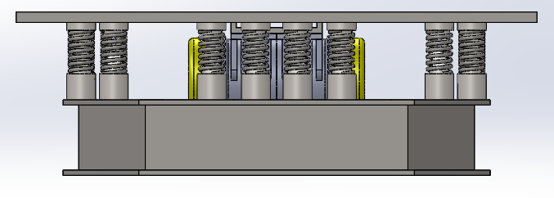
Final shape of vibration table

Slide 66
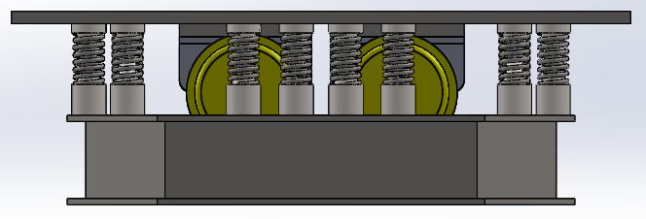
Final shape of vibration table

Slide 67
Conclusion

Slide 68
Conclusion
In our project we cover almost every aspect that is related to the vibration table , from obtaining and calculating the essential vibration parameters (natural frequency of the system, the desired amplitude transmissibility , stiffness of springs ,vibration isolation , and aspect that is related to the design analysis that we need in this vibration table, from the table top analysis ,the table base design ,the compression springs design ,to the bolts design , weld design and the final shape of our vibration table .

Slide 69
Conclusion cont …
Overall , the vibration and design analysis in our project are used to improve the performance of the Vibration Table that had been used in The Palestinian Construction Products Company by having a fully new design for almost every aspect and part in the vibration table .Several methods have been used in this report like :ordinary calculations and analysis using our vibration and mechanical design textbooks, using the Computer software's like Matlab and Solidworks for the simulation and further calculations.

Slide 70


