Slide 1



AutoMentor
Driving School Simulator
Done By:
Omar Haji
Mohammed Hantouli
Supervisor:
Dr. Suhad M. Daraghmeh
An-Najah National University
Department of Computer Science

Slide 2
AutoMentor
Outline
What is AutoMentor? & Objectives.
Problem Statement.
Problem Statement Solution.
Main technologies and tools were used.
Rewind Mechanism.
Multi Agent AI System.
DEMO video.
How could AutoMentor be improved?
An-Najah National University
Department of Computer Science

Slide 3
AutoMentor
What is AutoMentor?
AutoMentor is a comprehensive driving school simulator designed to provide a realistic and educational experience for learners. It features a detailed virtual city where players can practice driving rules, interact with AI cars and NPCs and receive real-time feedback on their performance.
The primary objectives of AutoMentor are to enhance driving skills, ensure adherence to traffic laws and offer a motivating environment that encourages continuous improvement through positive motivations.
An-Najah National University
Department of Computer Science

Slide 4
AutoMentor
Problem Statement:
Many new drivers struggle to practice and internalize driving rules
in a safe and controlled environment.
Traditional driving lessons can be costly.
An-Najah National University
Department of Computer Science

Slide 5
AutoMentor
Solution:
Safe Simulation Environment: AutoMentor offers a realistic virtual city
where learners can practice driving without real-world risks providing
a safe space to make and correct mistakes.
Cost-Effective Learning: By simulating driving lessons, AutoMentor reduces
the need for expensive in-person sessions, making quality driving
education more accessible.
An-Najah National University
Department of Computer Science

Slide 6
AutoMentor
Utilized technologies
Unity Game Engine: For building the simulator city for more realistic experience.
C# Scripting: For implementing the actions in the city like AI cars, NPCs and rules in the city.
Other Used Tools: Blender, Unity Asset Store.
An-Najah National University
Department of Computer Science

Slide 7
AutoMentor
Rewind Mechanism
When the user do any violation against the traffic rules, a rewind mechanism starts execution, by popping the stored data before the violation occurred.
An-Najah National University
Department of Computer Science

Slide 8
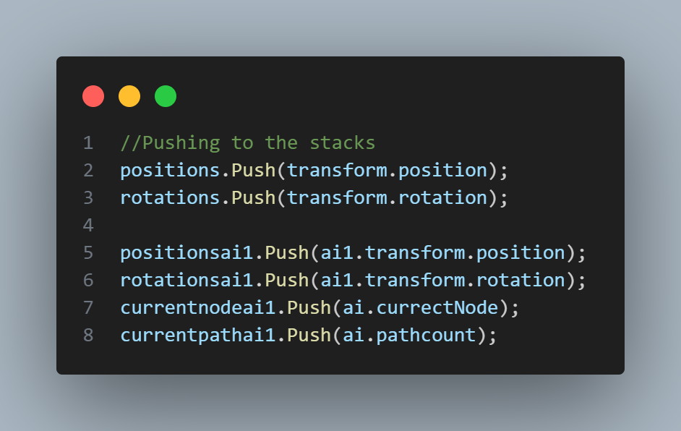
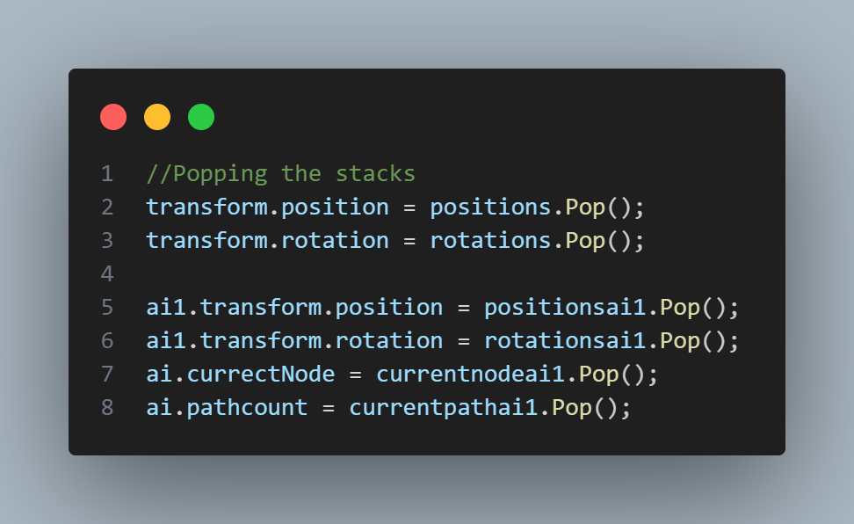
AutoMentor
Rewind mechanism code snippet:
An-Najah National University
Department of Computer Science

Slide 9
AutoMentor
Multi Agent AI System
A multi agent system consists of multiple decision-making agents which interact in a shared environment to achieve common or conflicting goals.
An-Najah National University
Department of Computer Science

Slide 10
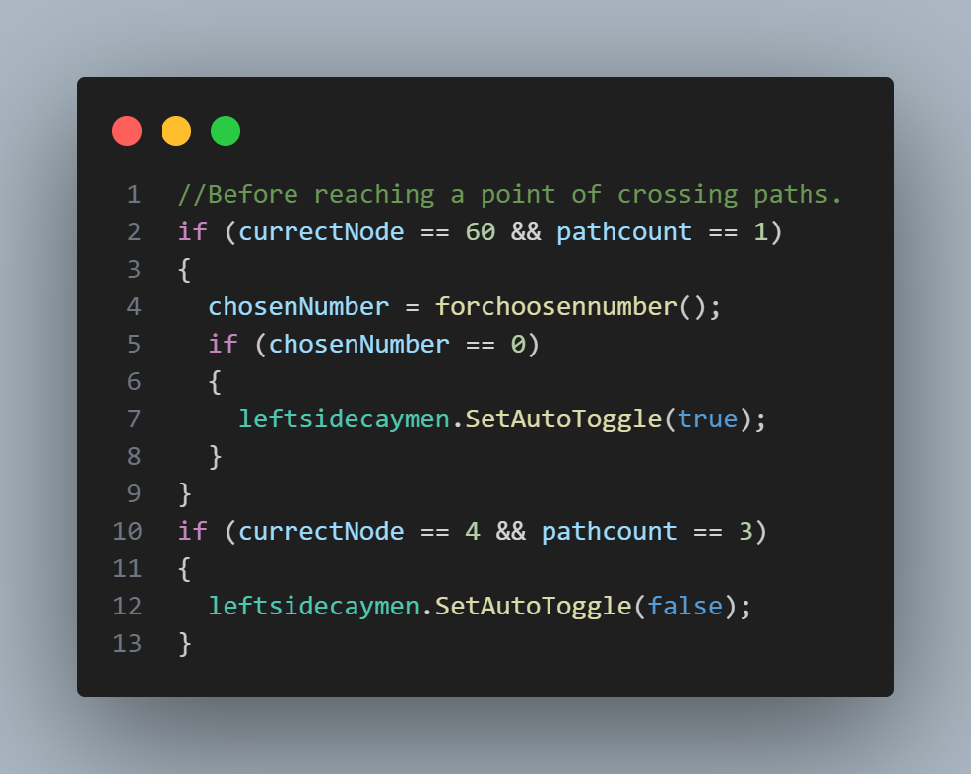
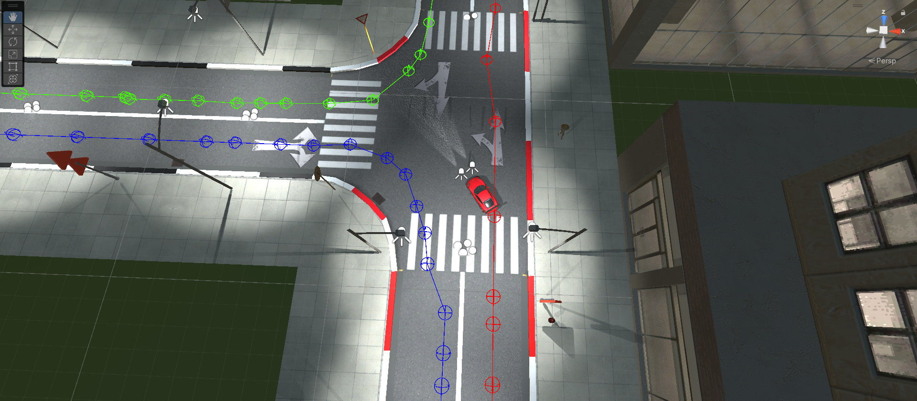
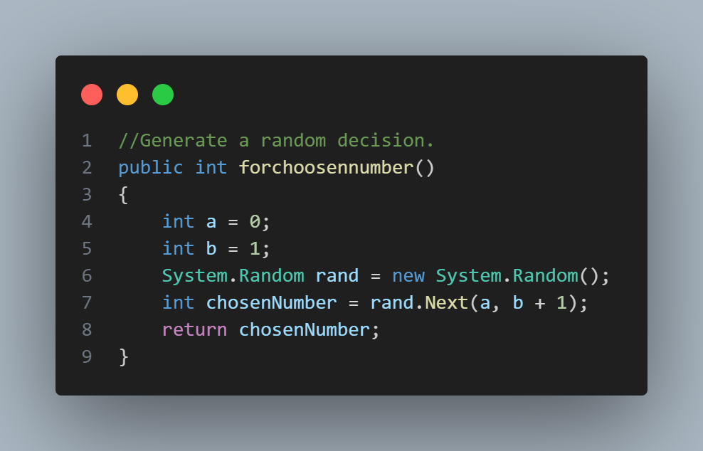
AutoMentor
AI Cars Path Decision Making
AI cars path decision making code snippet:
An-Najah National University
Department of Computer Science

Slide 11
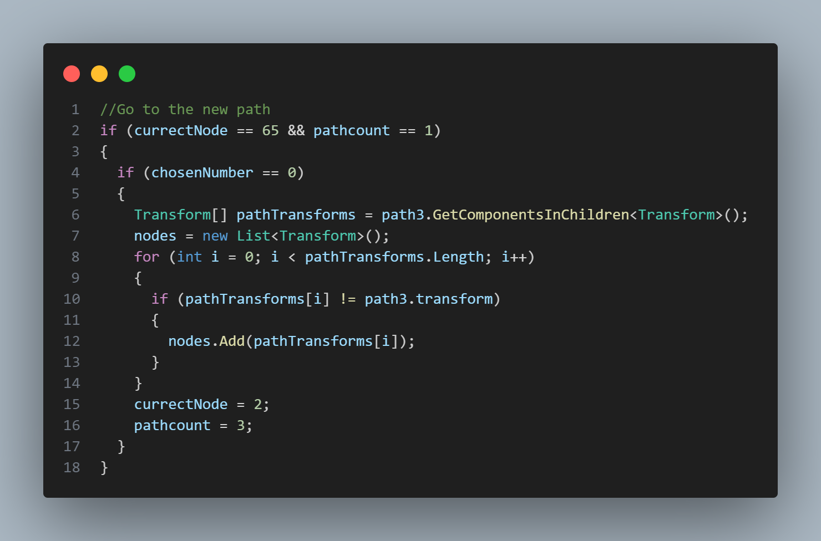
AutoMentor
AI Cars Path Decision Making
AI cars path decision making code snippet:
An-Najah National University
Department of Computer Science

Slide 12
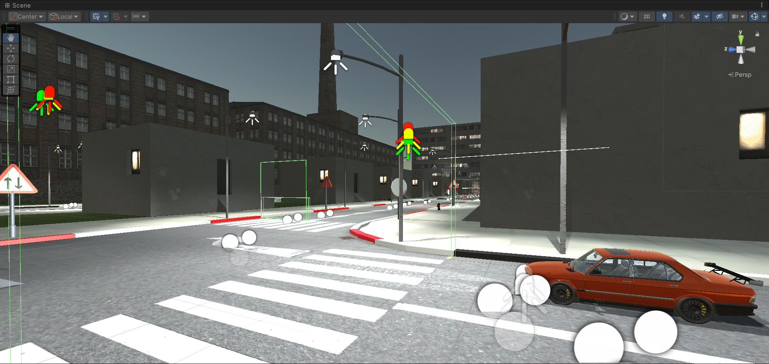
AutoMentor
An example for AI cars following traffic rules:
AI Car Sensor detects the traffic light game object
An-Najah National University
Department of Computer Science

Slide 13
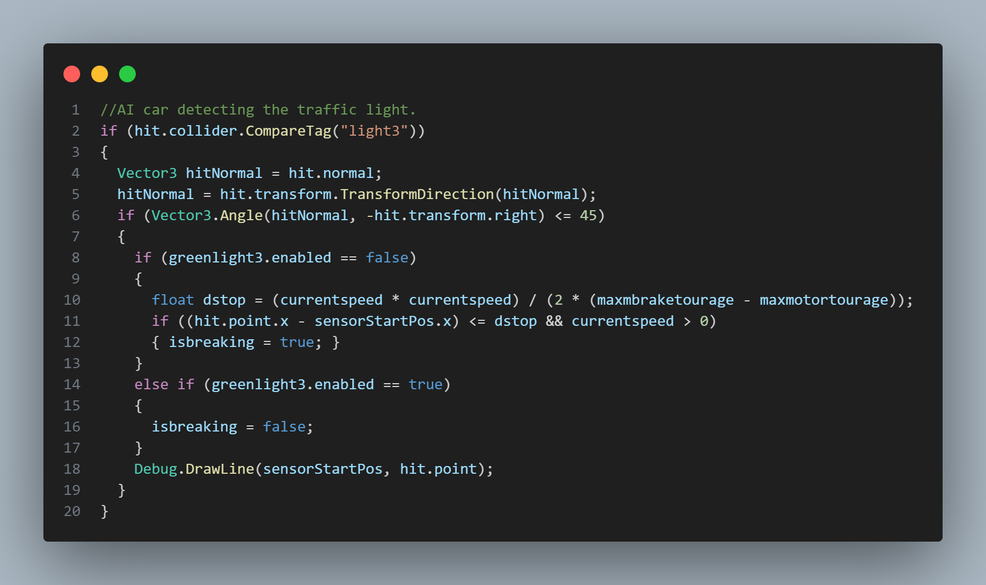
AutoMentor
Traffic light decision making code snippet:
An-Najah National University
Department of Computer Science

Slide 14
AutoMentor
Go to the DEMO video
An-Najah National University
Department of Computer Science

Slide 15
AutoMentor
Software Evolution
Enhanced AI Capabilities.
Virtual Reality (VR) Integration.
Expanded Scenario Library.
Enhanced User Interface.
An-Najah National University
Department of Computer Science

Slide 16

Any Questions?

