Slide 1

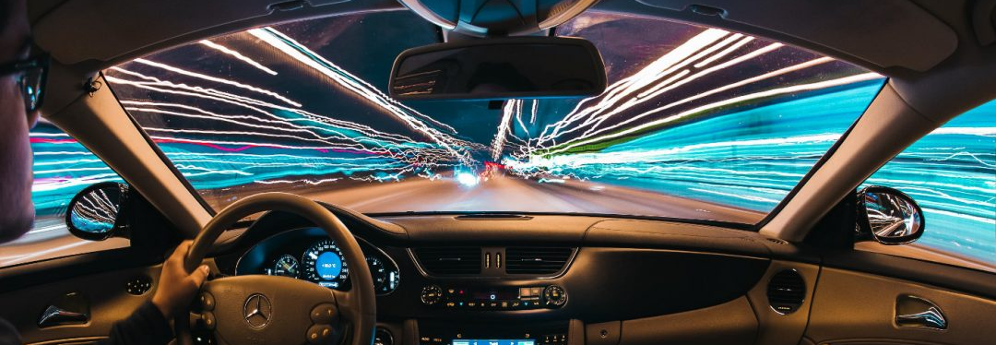

Safe Driving
Prepared by: Nour Abu-Hijleh && Raya Mahamdeh
Teacher supervisor: Dr. Aladdin Masri

Slide 2
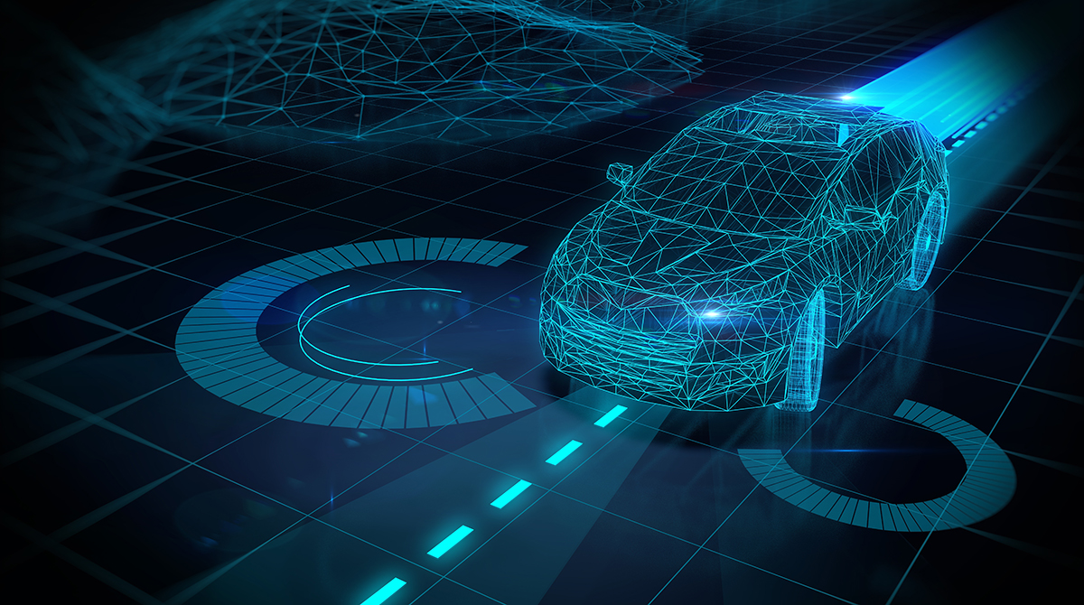
Overview:
Introduction.
Literature Review.
Methodology.
Discussion & Results.
Conclusion & Future Work.

Slide 3

Introduction:
Car Accidents : 9th leading cause of death globally.
What is Drowsy Driving ?
328000 annually !
Thus SAFE DRIVING Project.
Notes:
Assotiasion for safe international road travel
AAA foundation
3 times more to be in crash if he is fatigued : national safety council
خطر عليه وعلي حوليه

Slide 4
Literature Review:
Full Self-Driving Cars (Autonomous Driver) & semi-autonomous.
Different driving features.
Notes:
Assotiasion for safe international road travel
AAA foundation
3 times more to be in crash if he is fatigued : national safety council

Slide 5
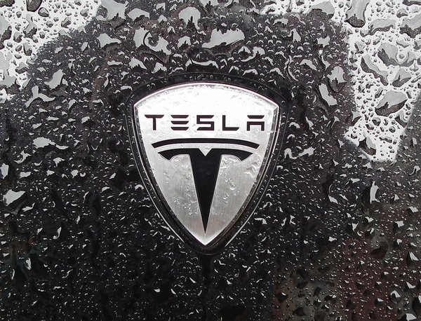
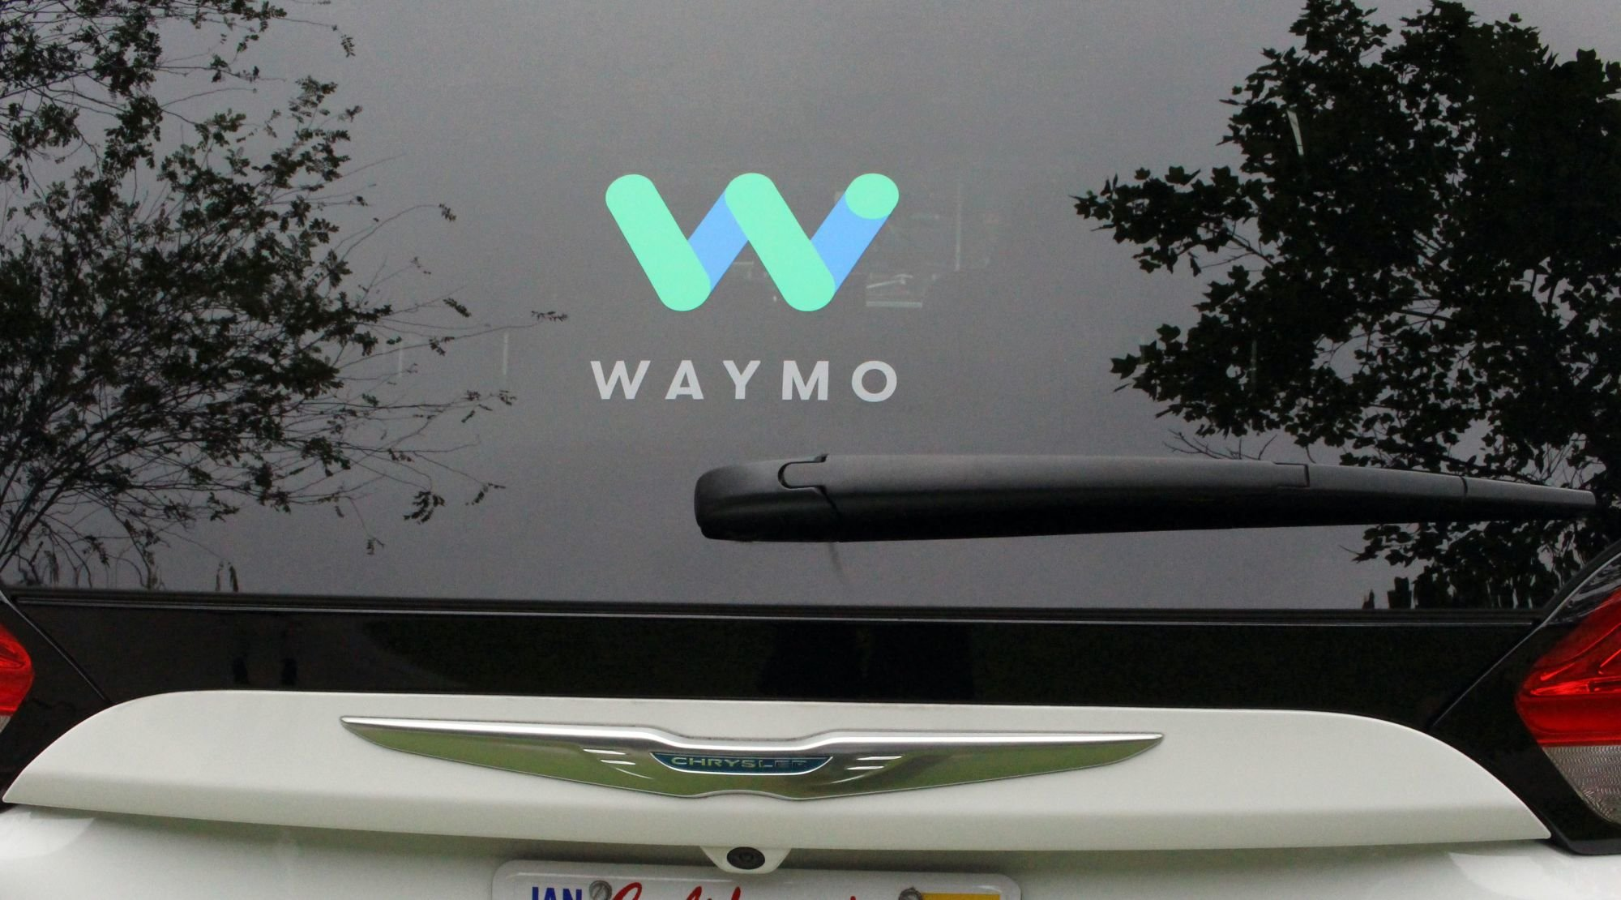
Full Self-Driving Cars (Autonomous Driver)
Tesla , Waymo … even Mercedes and many others !
But when ? And why not now ?

Slide 6
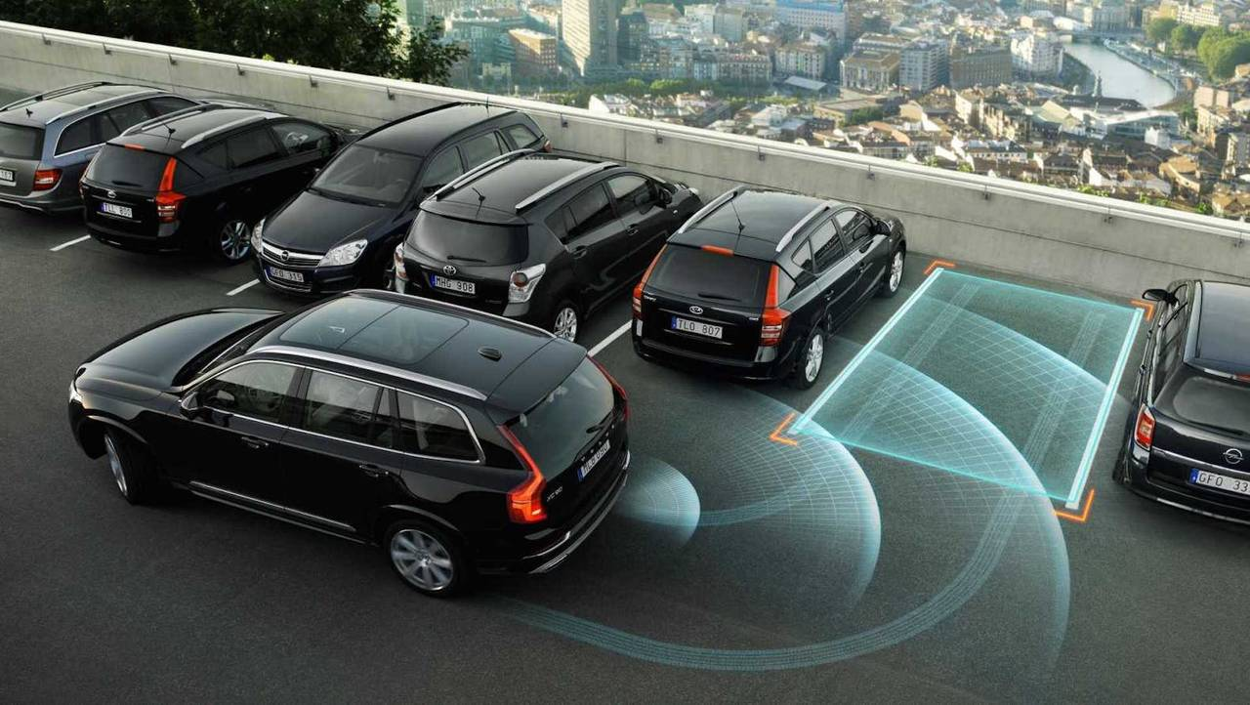
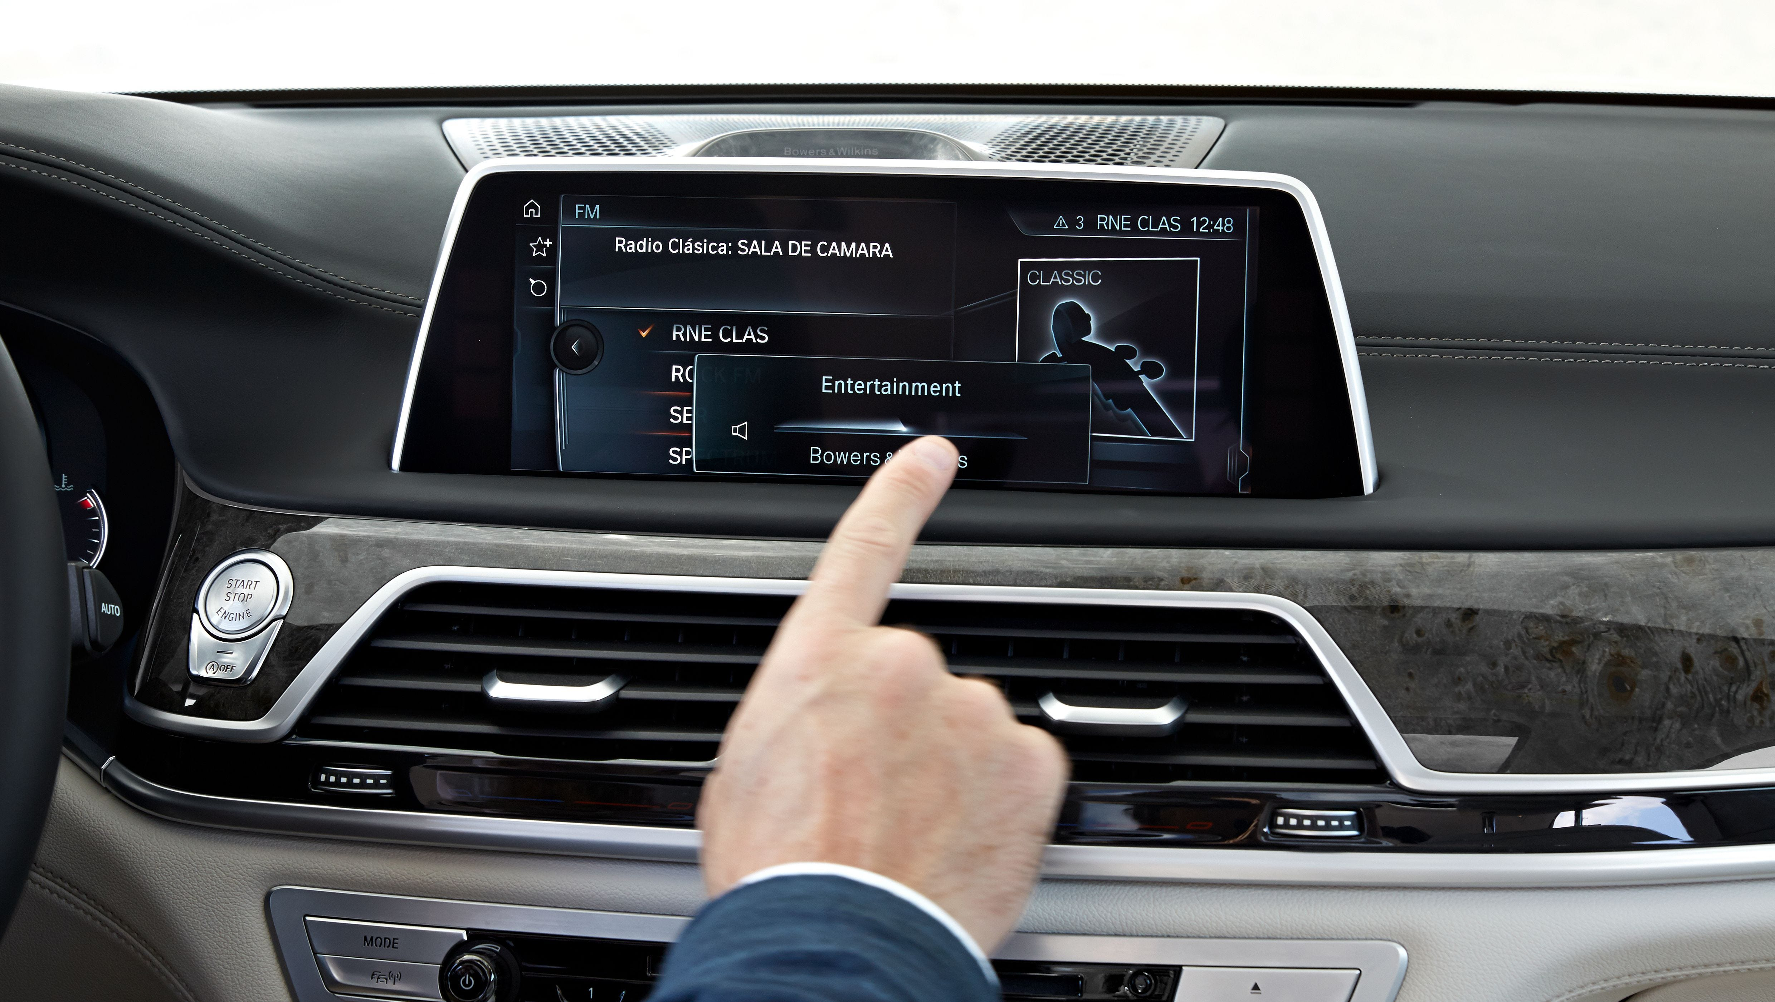
Different driving features
Auto parking cars
Audio controlled by hand motion

Slide 7
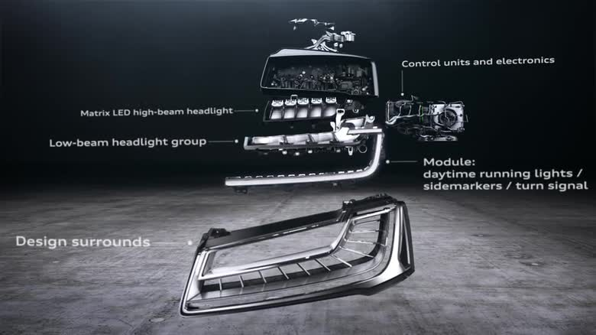
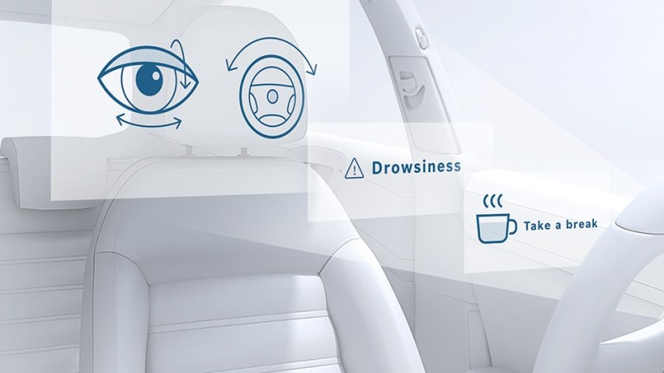
Different driving features
Led Matrix-Lighting Technology
Drowsiness alert cars

Slide 8
To detect Drowsy driving ?
Steering pattern monitoring
Driver eye/face monitoring
Vehicle position in lane monitoring
Physiological measurement
Notes:
Combine 3
Human health with future(image processing)/.. Sensors
Not fsd so trust and athics solved
Must important less accidents
Other that what was implemented

Slide 9
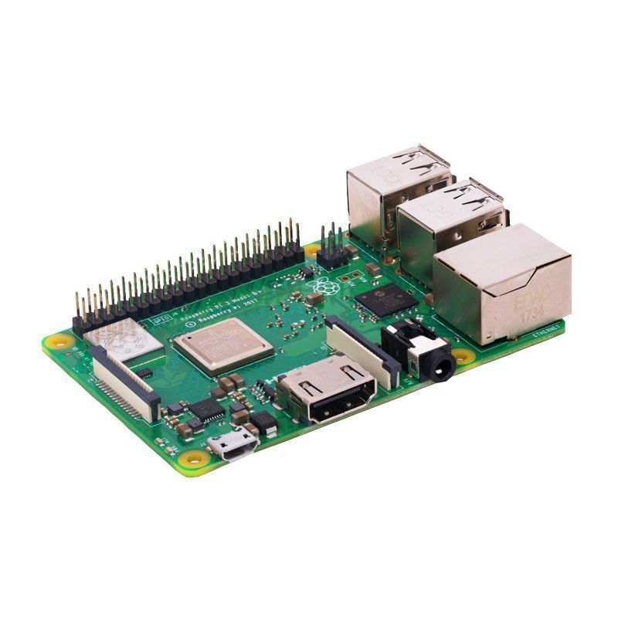
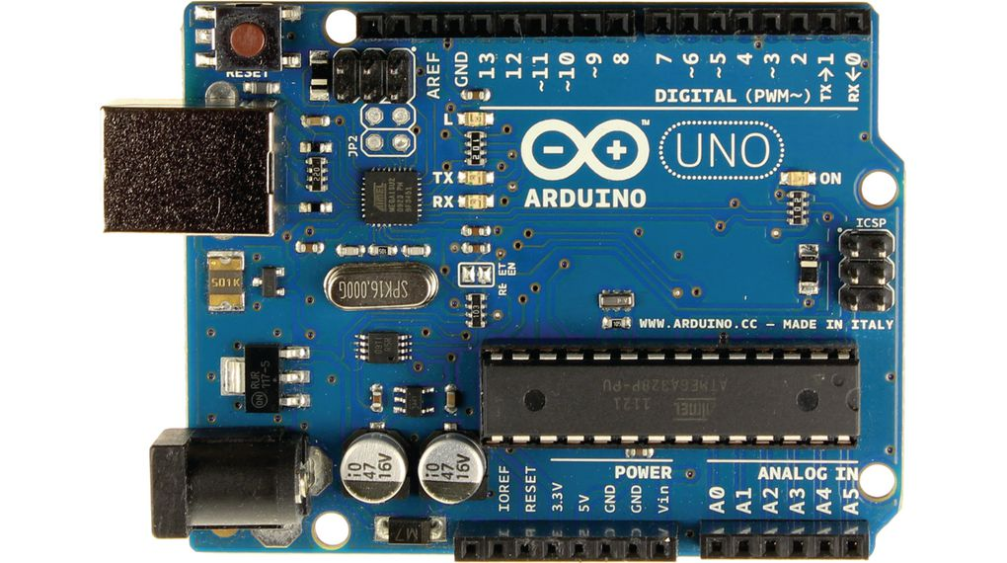
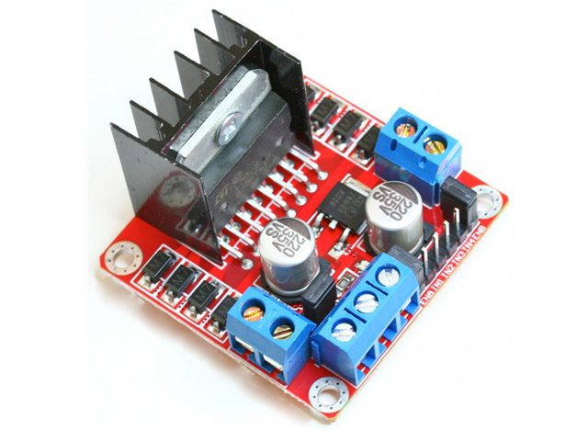
Methodology:

Slide 10
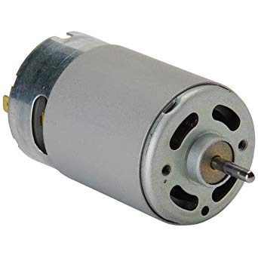
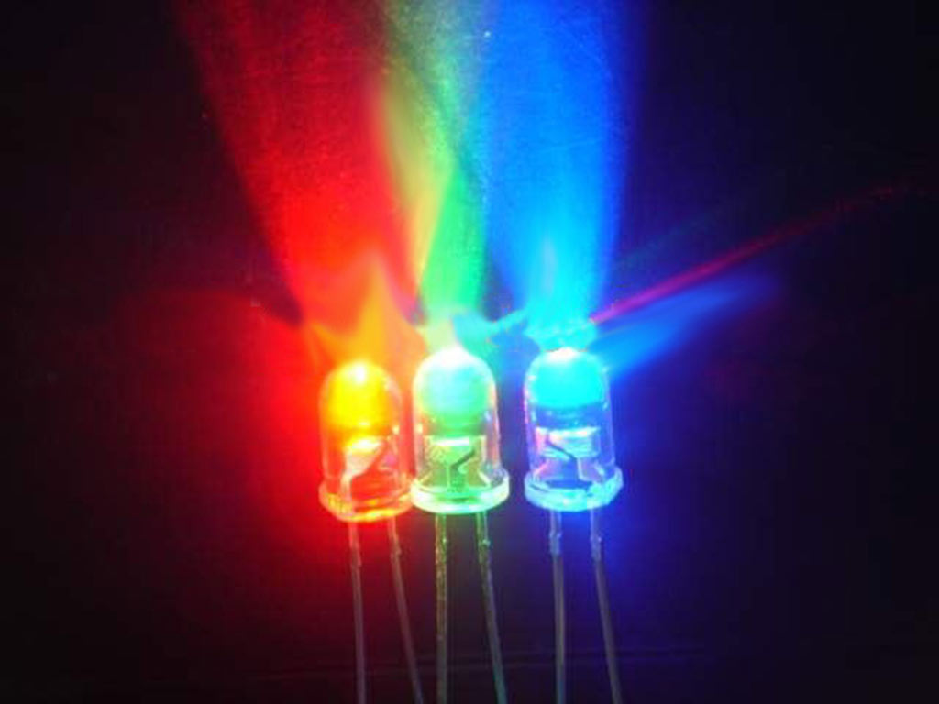
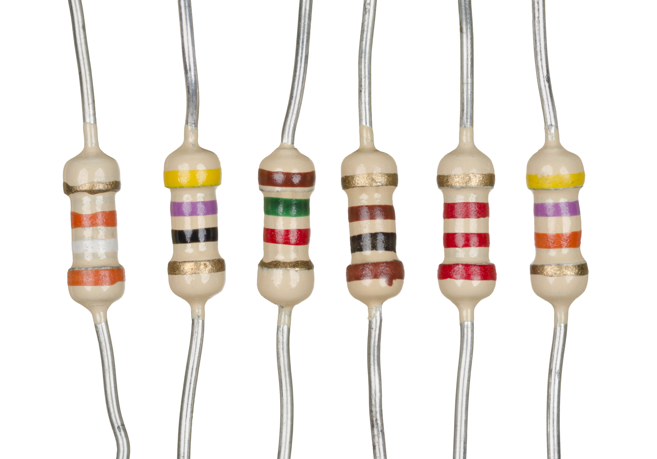
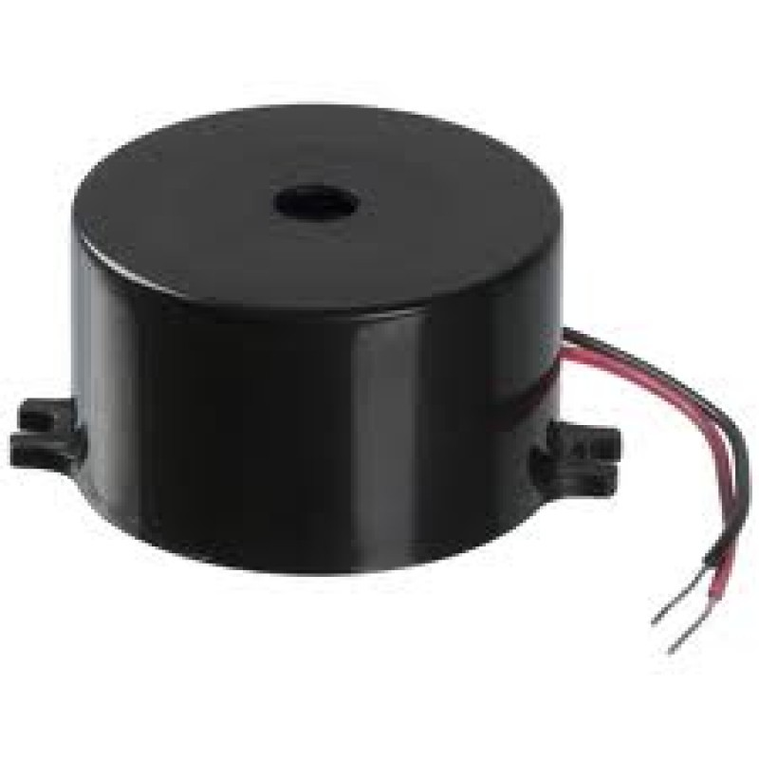
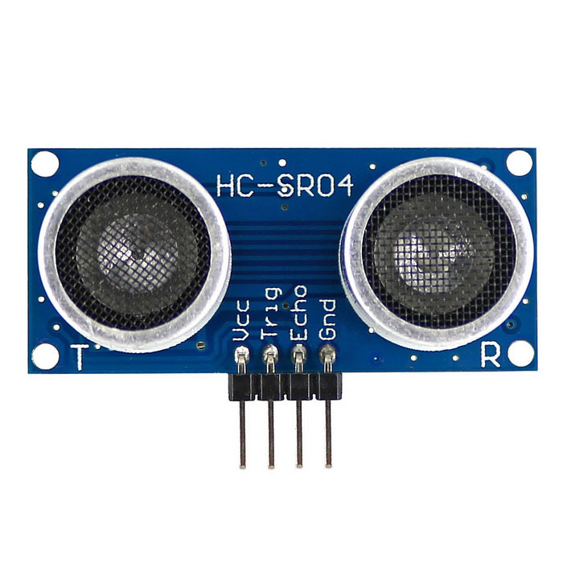
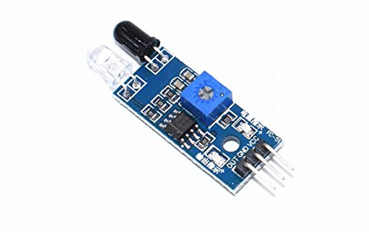
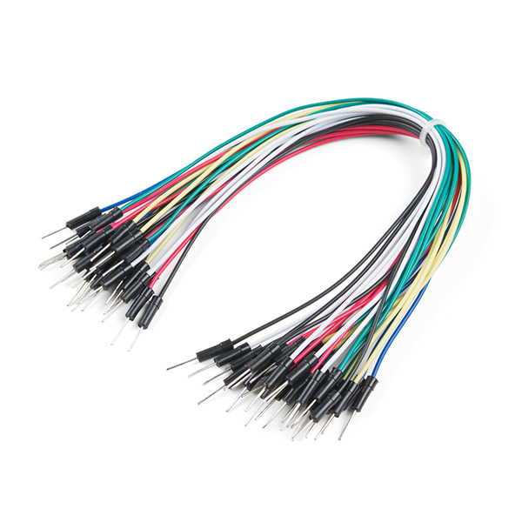

Slide 11
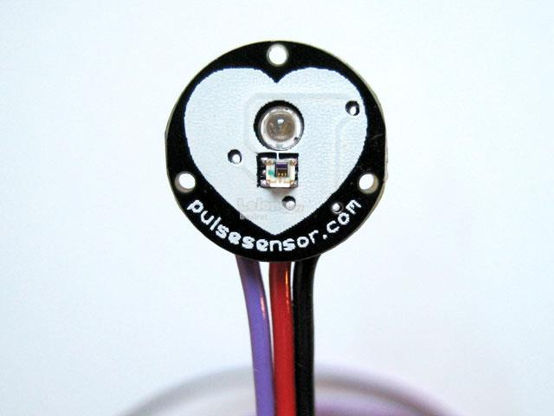
Steering pattern monitoring + Physiological measurement

Slide 12


Driver eye/face monitoring

Slide 13
Discussion & Results:

Slide 14
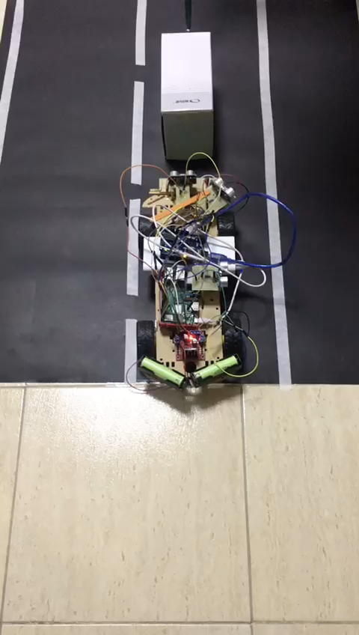
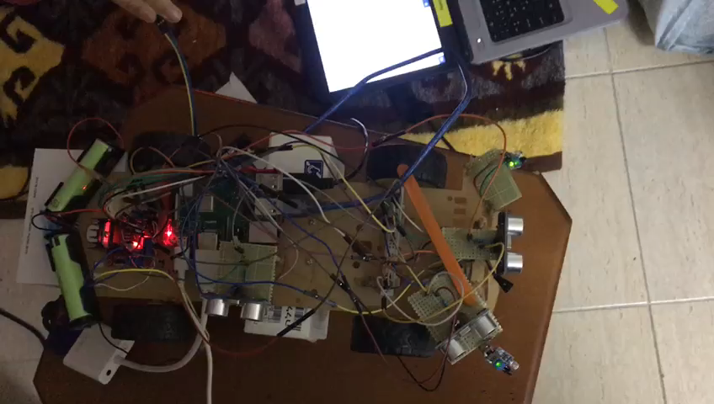
Forward Collision Avoidances

Slide 15
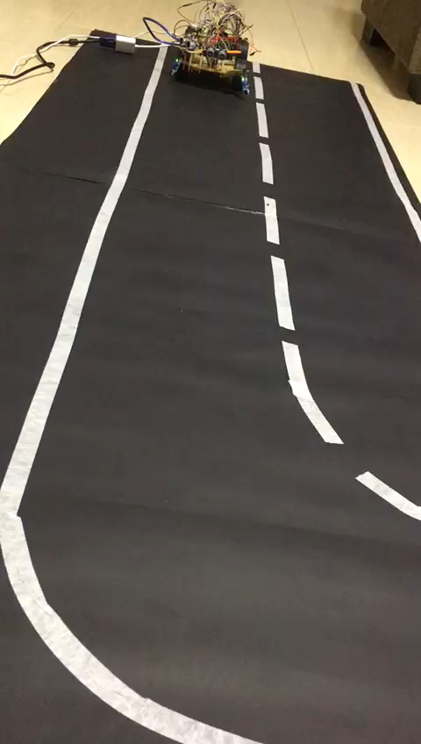
Stay In Lane

Slide 16
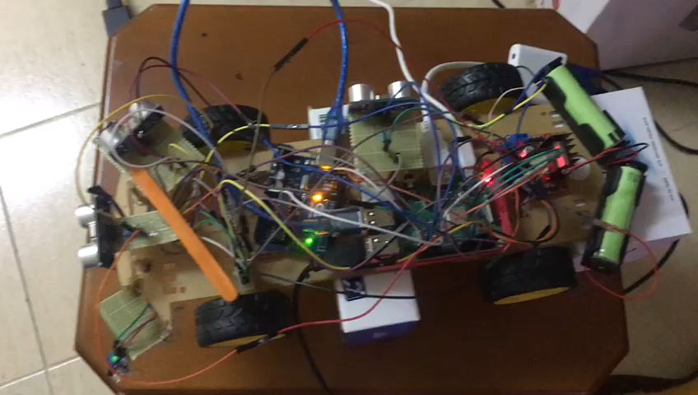
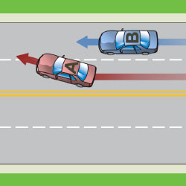
Parking

Slide 17
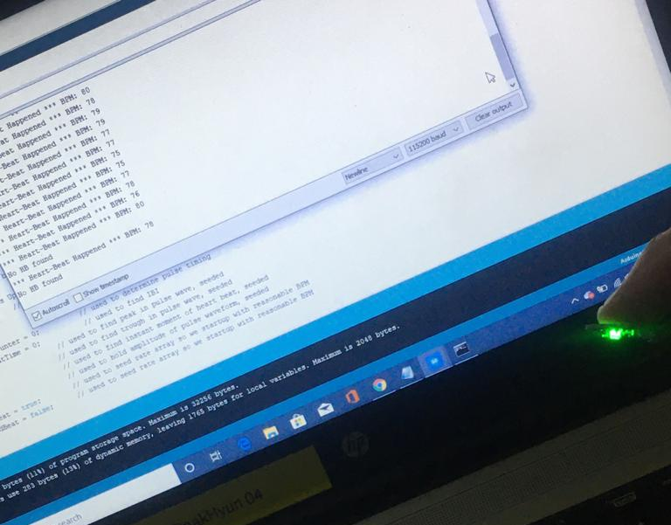
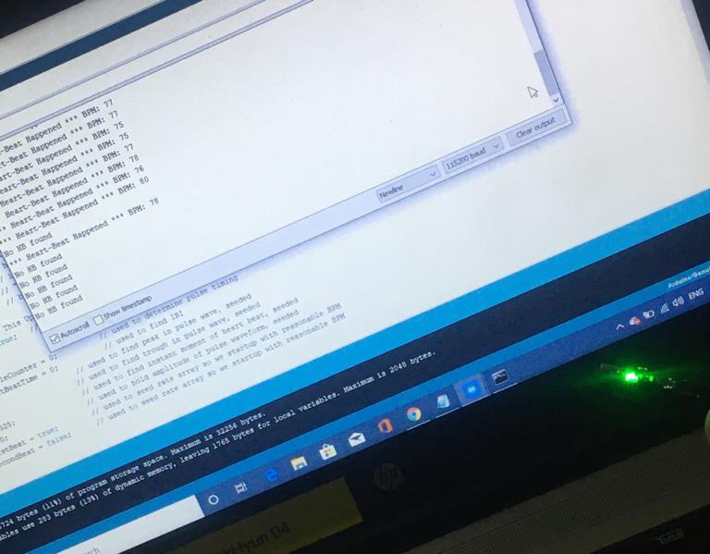
Heartbeat Detection

Slide 18
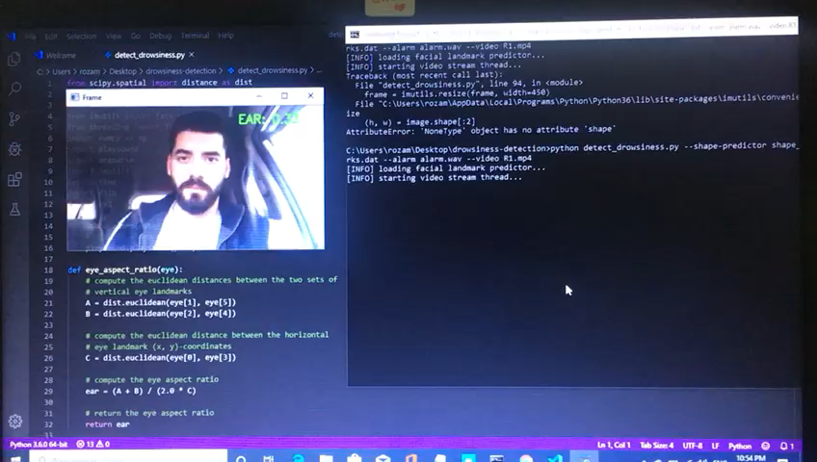
Eye/Face Detection

Slide 19
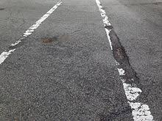
Bad Streets :

Slide 20
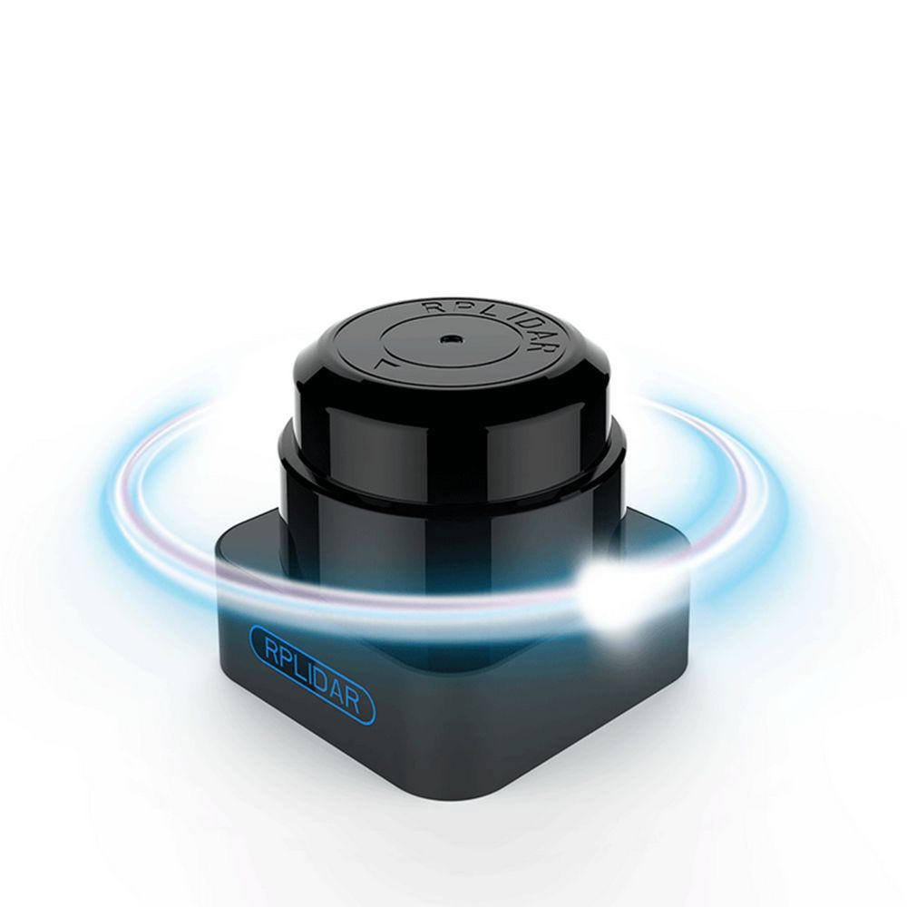
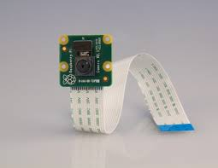
LiDAR & Image Processing
Notes:
Accuracy + range

Slide 21
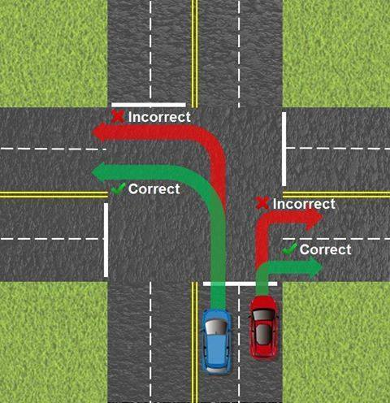
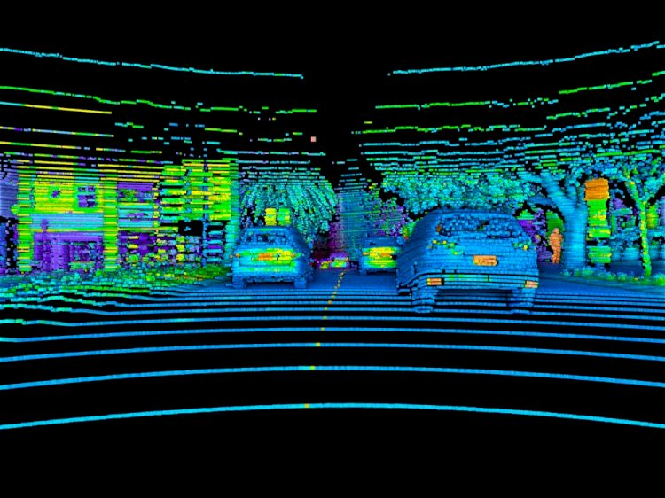
LiDAR & Image Processing

Slide 22
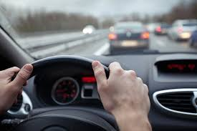
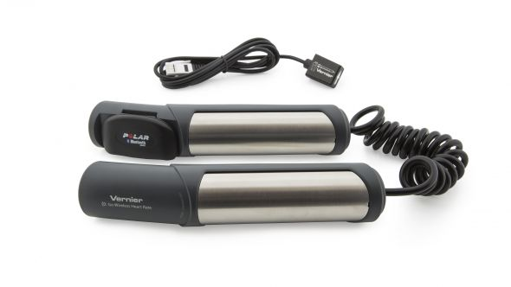
Heartbeat through steering wheel:

Slide 23
Conclusion & Future Work

Slide 24
Drowsy Driver Detection
&
Forward Collision Avoidances
Appropriate Action Taken
Less Car Accidents

Slide 25
Better sensors > Better accuracy > and More features:
Intersections and Traffic lights handling.
Better detection of the number of lanes.
Using eye/face Detection for more than blinking detection.
Adding GPS to locate the car and SOS.
… and many other different features

Slide 26
Thank You

