Slide 1
Smart wheelchair
Isra daraghmeh

Slide 2
Contents
ABOUT project .
Features.
Future work.

Slide 3
overview
The importance of this project lies in providing a wheelchair for the blind
or people with mobility disabilities, as most of the people of these groups
face difficulties in movement , and this wheelchair facilitates their
mobility and the practice of their lives in a more natural way.
A person can move by means of a chair on flat surfaces by issuing voice
commands to go forward, backward, right and left, The chair emits a
warning sound if it gets close to a wall, solid object or edge , and It
sends notifications to the phone in the event of any fall or injury to a
person.

Slide 4
Continue
Using an embedded system, this project presents the creation of a smart, powered, voice-controlled wheelchair.
Toot sound
Send SMS message to the another person with its location

Slide 5
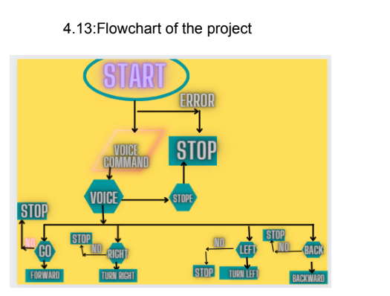

Slide 6
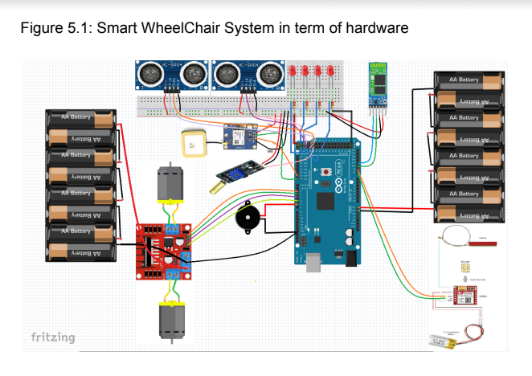

Slide 7
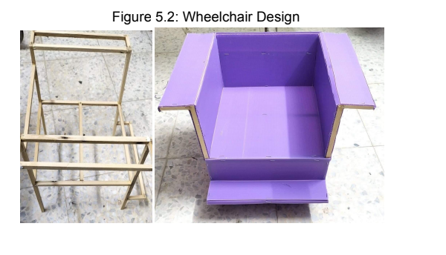

Slide 8
Future work:
Use better design for the chair .

Slide 9
Thanks for your Time.

