Slide 1
General board for full automatic washing machines

Slide 2
A simple definition of our project
Design general board for full automatic washing machines that is capable of dealing with most of the types found in the Palestinian market

Slide 3
Project Idea
The idea behind our project, that many machines are produced once and sold in our market without technical support, so the alternative solution of the customer if any fault occurs in the board of washing machine is to buy a new board from the global market which is cost and need a lot of time to get it in Palestine that is not acceptable, here starts the problem of the local market.

Slide 4
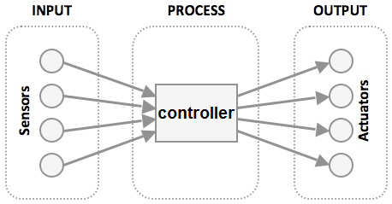
How can we make it general ??
First we should figure out all components in the washing machines and know the algorithm and the flow chart of its process
Design drive circuit that fit most of types of actuator .
Choose a microcontroller capable of handling most of actuators and sensors.
Make some code modification to suit the sensor data

Slide 5
The electrical components in the washing machine

Slide 6
Actuators in washing machines

Slide 7
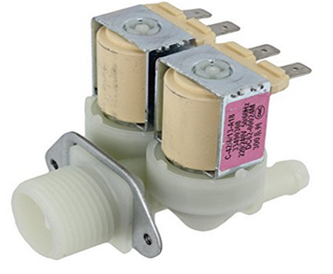
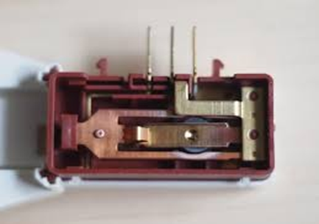
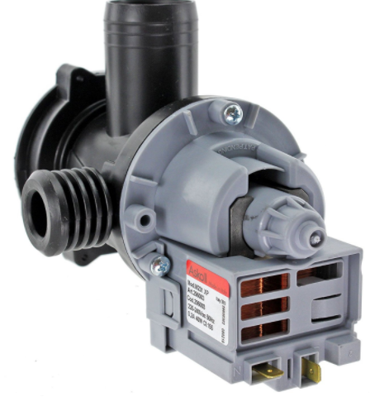
- Water inlet valve
- Door lock
- Drain pump

Slide 8
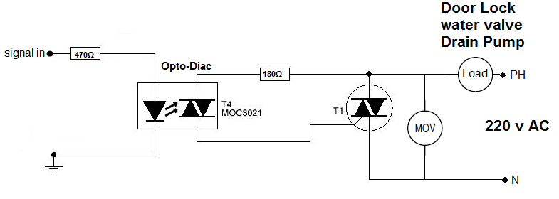
TRIAC was used for switching these loads at zero firing angle
Opto-Diac for isolation and make firing point more even in both +ve ,-ve AC
- MOV for protecting TRIAC circuit from any high instant voltages that generated from switching on and off inductive loads and also reduce noise waves .

Slide 9
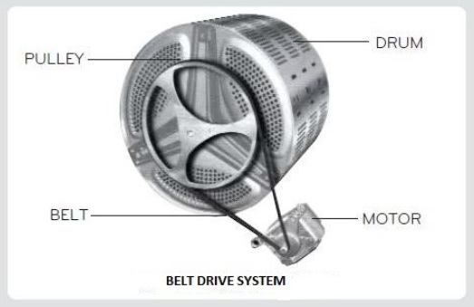
Motor
The board is designed for washing machines that contain universal motor

Slide 10
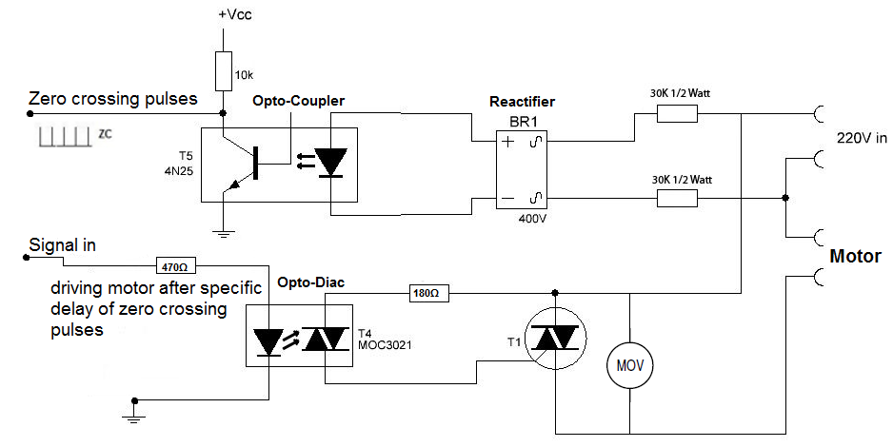
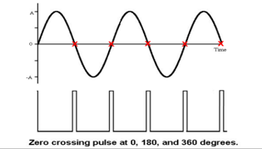
Speed of the universal motor
By zero crossing detector CCT

Slide 11
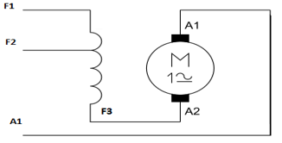
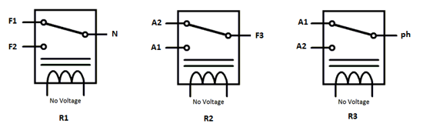
The direction of rotation in the universal motor
Reverse the direction of rotation in the
universal motor depends on reversing
the current in the rotor only .

Slide 12
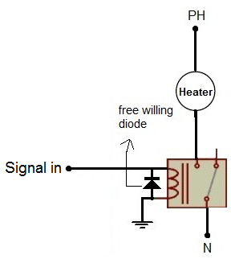
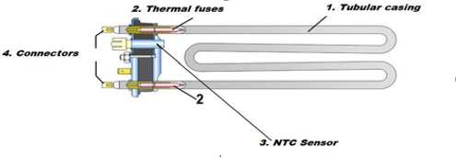
Heater

Slide 13
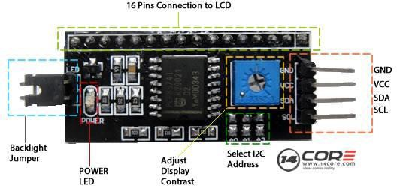
display
A liquid crystal display, or LCD with I2C module was used as a display pf this project.
Need 2 pins in the controller for serial data and serial clock and 2 pins for power.

Slide 14
Inputs in washing machines

Slide 15
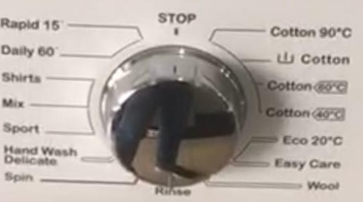
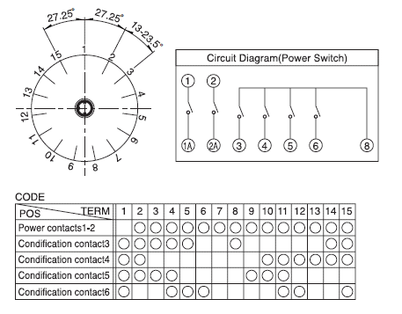
Power switch ( selector ) :
It is just a selector to select at what program (washing type ) the washing machine will work “eg: cotton , sport wear , …. etc”

Slide 16
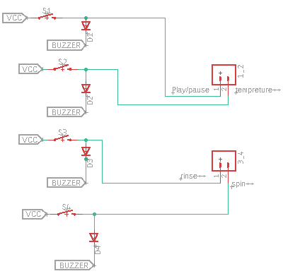
Push buttons
4 push buttons were considered as inputs in this project:
Play/pause.
Temperature adjustment.
Rinse adjustment.
Spin speed adjustment.

Slide 17
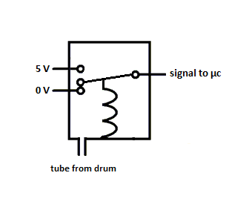
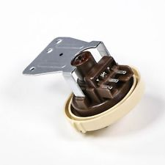
Pressure sensor
The pressure sensor is a device that detects the level of water that required to the clothes that will be washed

Slide 18
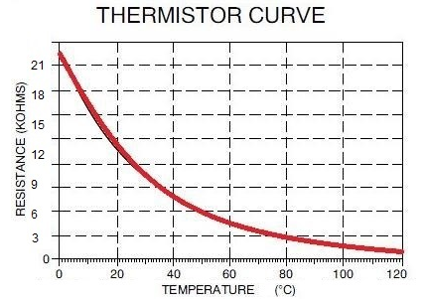
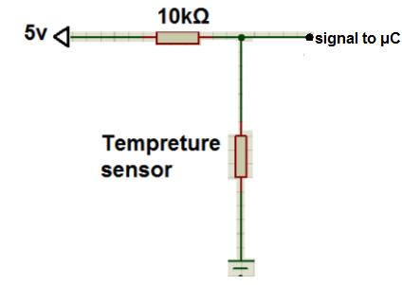

thermistor
The thermistor (temperature sensor) acts as a feedback unit to the controller to obtain the temperature that is reached by the heater

Slide 19
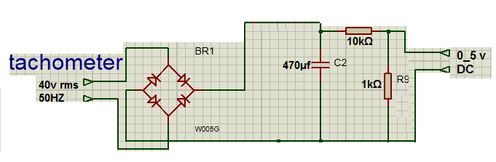
tachometer
The speed of the motor will be measured and sent to the controller as a feedback by the AC tachometer

Slide 20
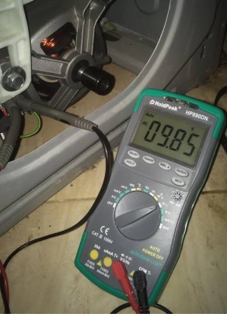
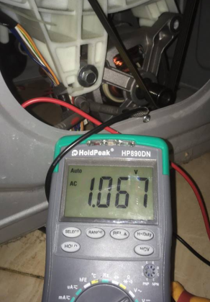
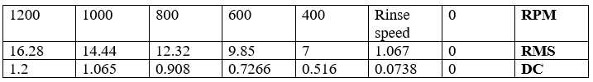

Slide 21
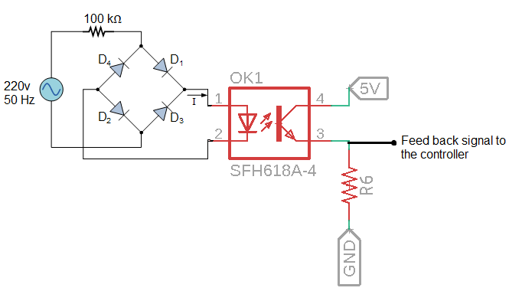
Feed back pin of the door lock

Slide 22
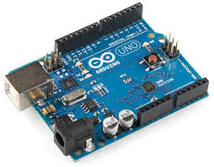
The Type of the controller
We found that using Arduino is more cheaper and easier for controlling and still effective controller for this process .
We chose Arduino UNO.
UNO contains 18 I/O pins.
23 I/O pins are needed.

Slide 23
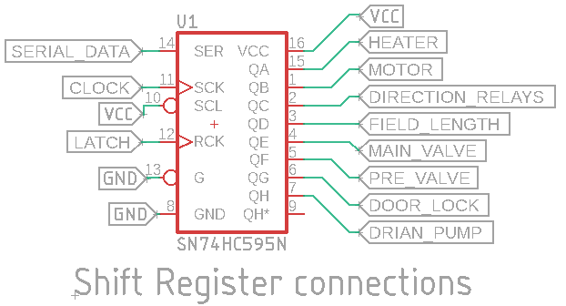
Expanding I/O pins of the controller
we used 8-bit Shift Register for expanding output pins of UNo

Slide 24

Designing all schematics and generating them to board files

Slide 25
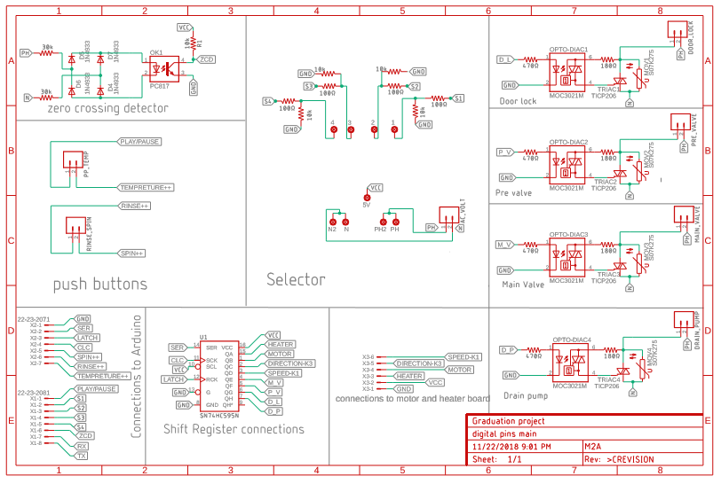
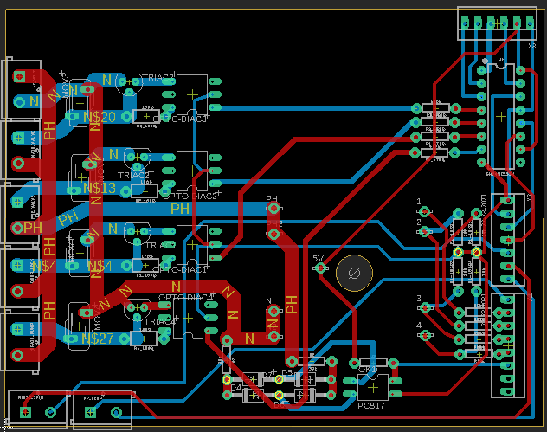
For board connected to digital pins

Slide 26
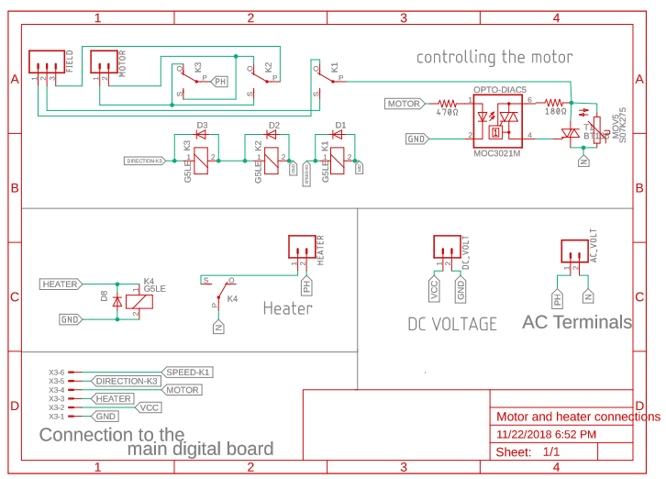
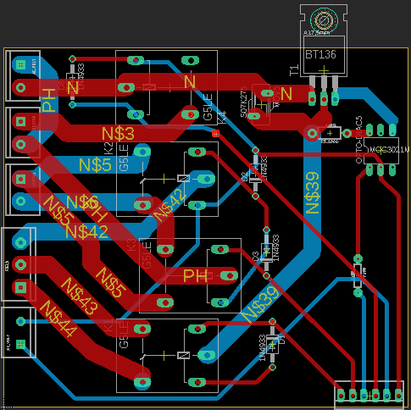
For second board connected to digital pins

Slide 27
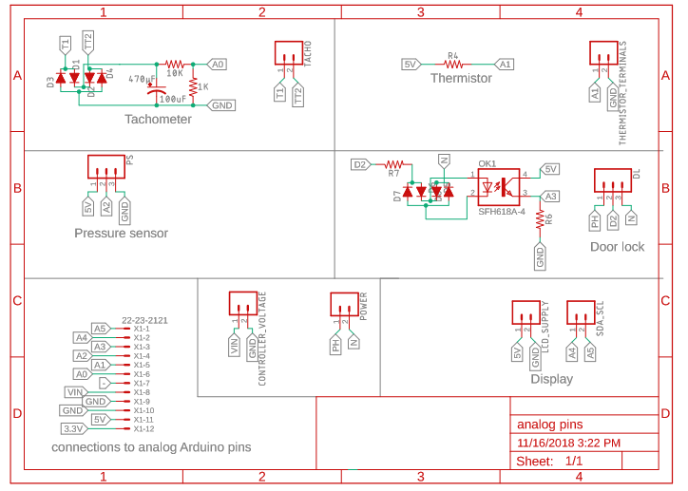
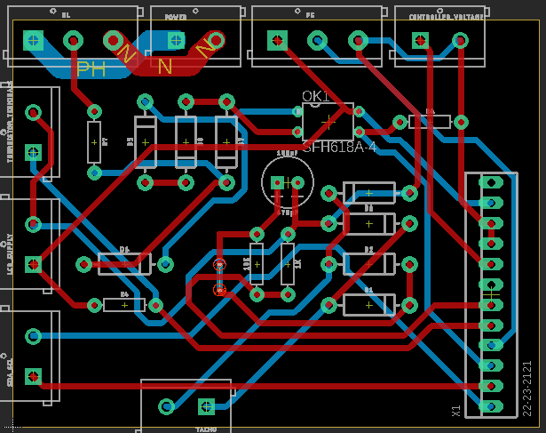
For board connected to analog pins

Slide 28
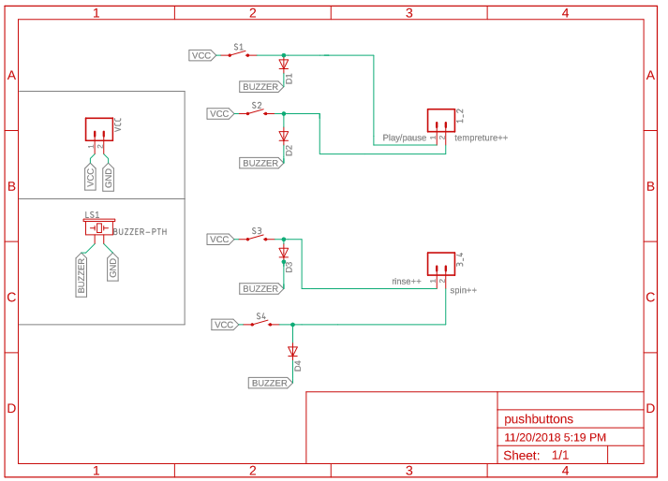
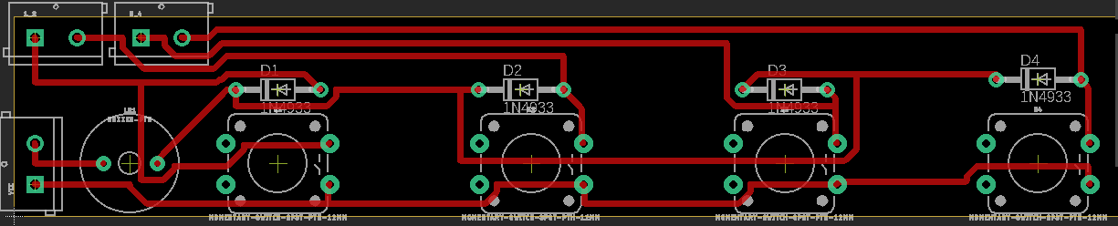
For push buttons board

Slide 29
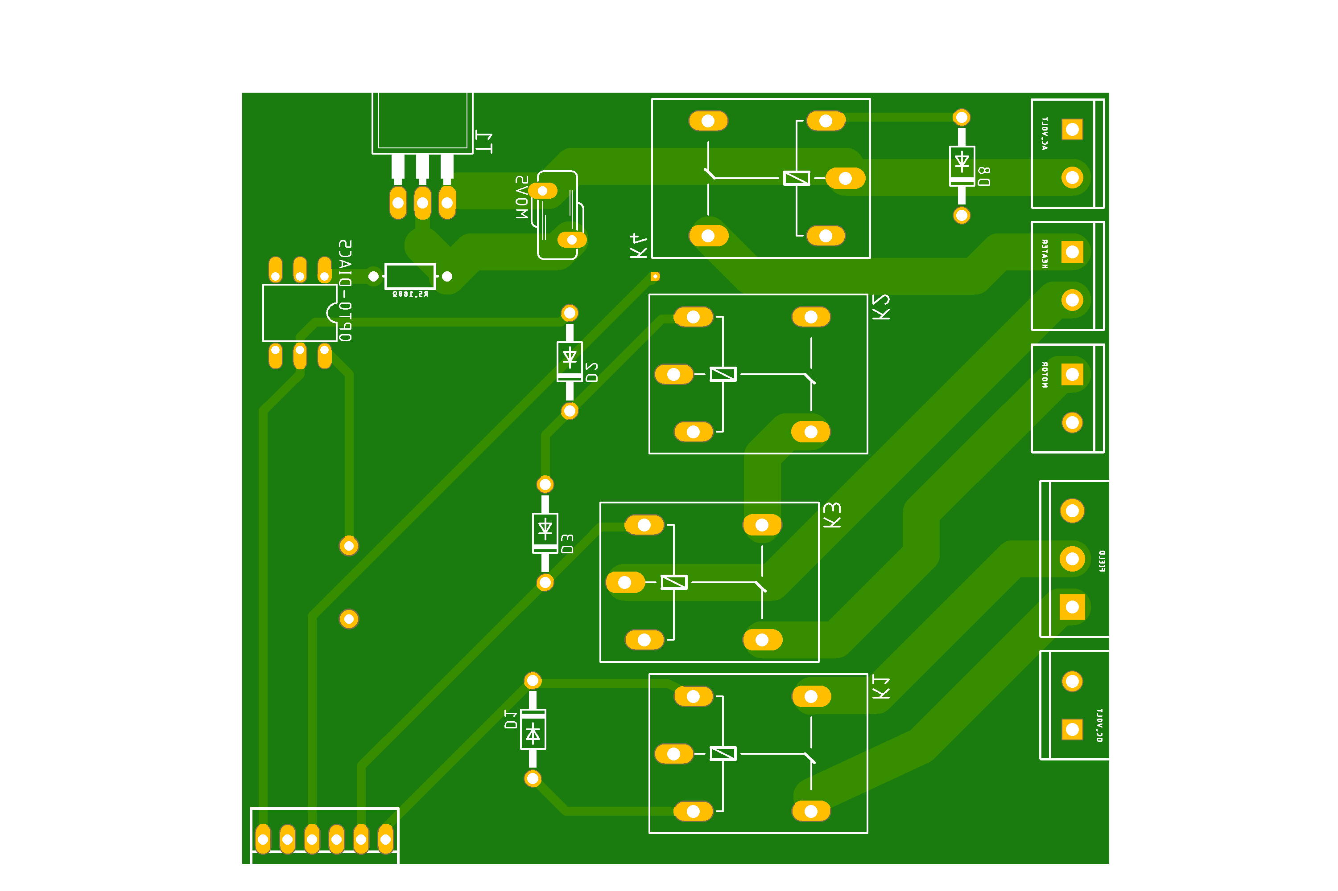
Transform to real boards

Slide 30
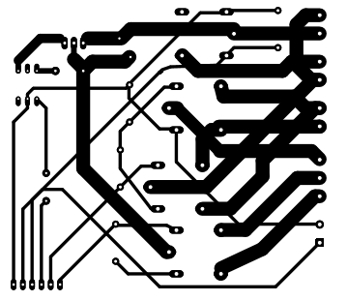
Print CCT’s onto photo paper

Slide 31
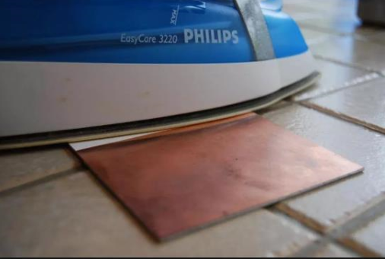
Put the photo paper on copper board under iron

Slide 32
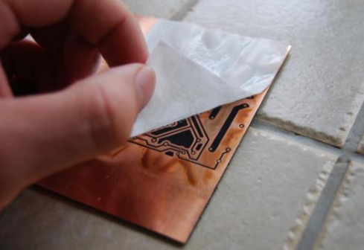
Removing photo paper

Slide 33
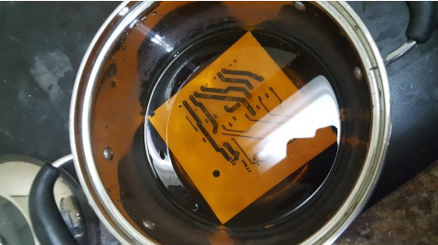
Putting this copper board under ferric chloride acid

Slide 34
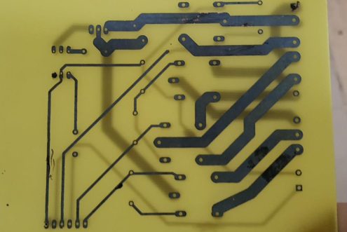
Taking the board and drying it from the acid

Slide 35
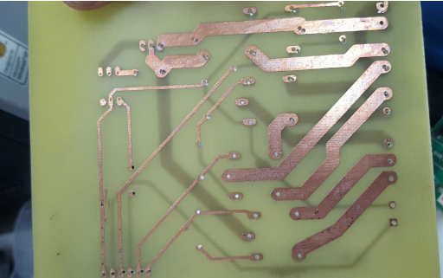
Erasing the protection ink by sharp fiber

Slide 36
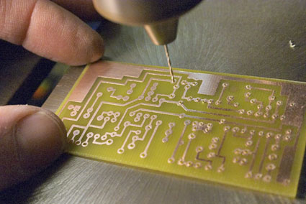
Puncture all pads and vias by a drill and weld all components

Slide 37
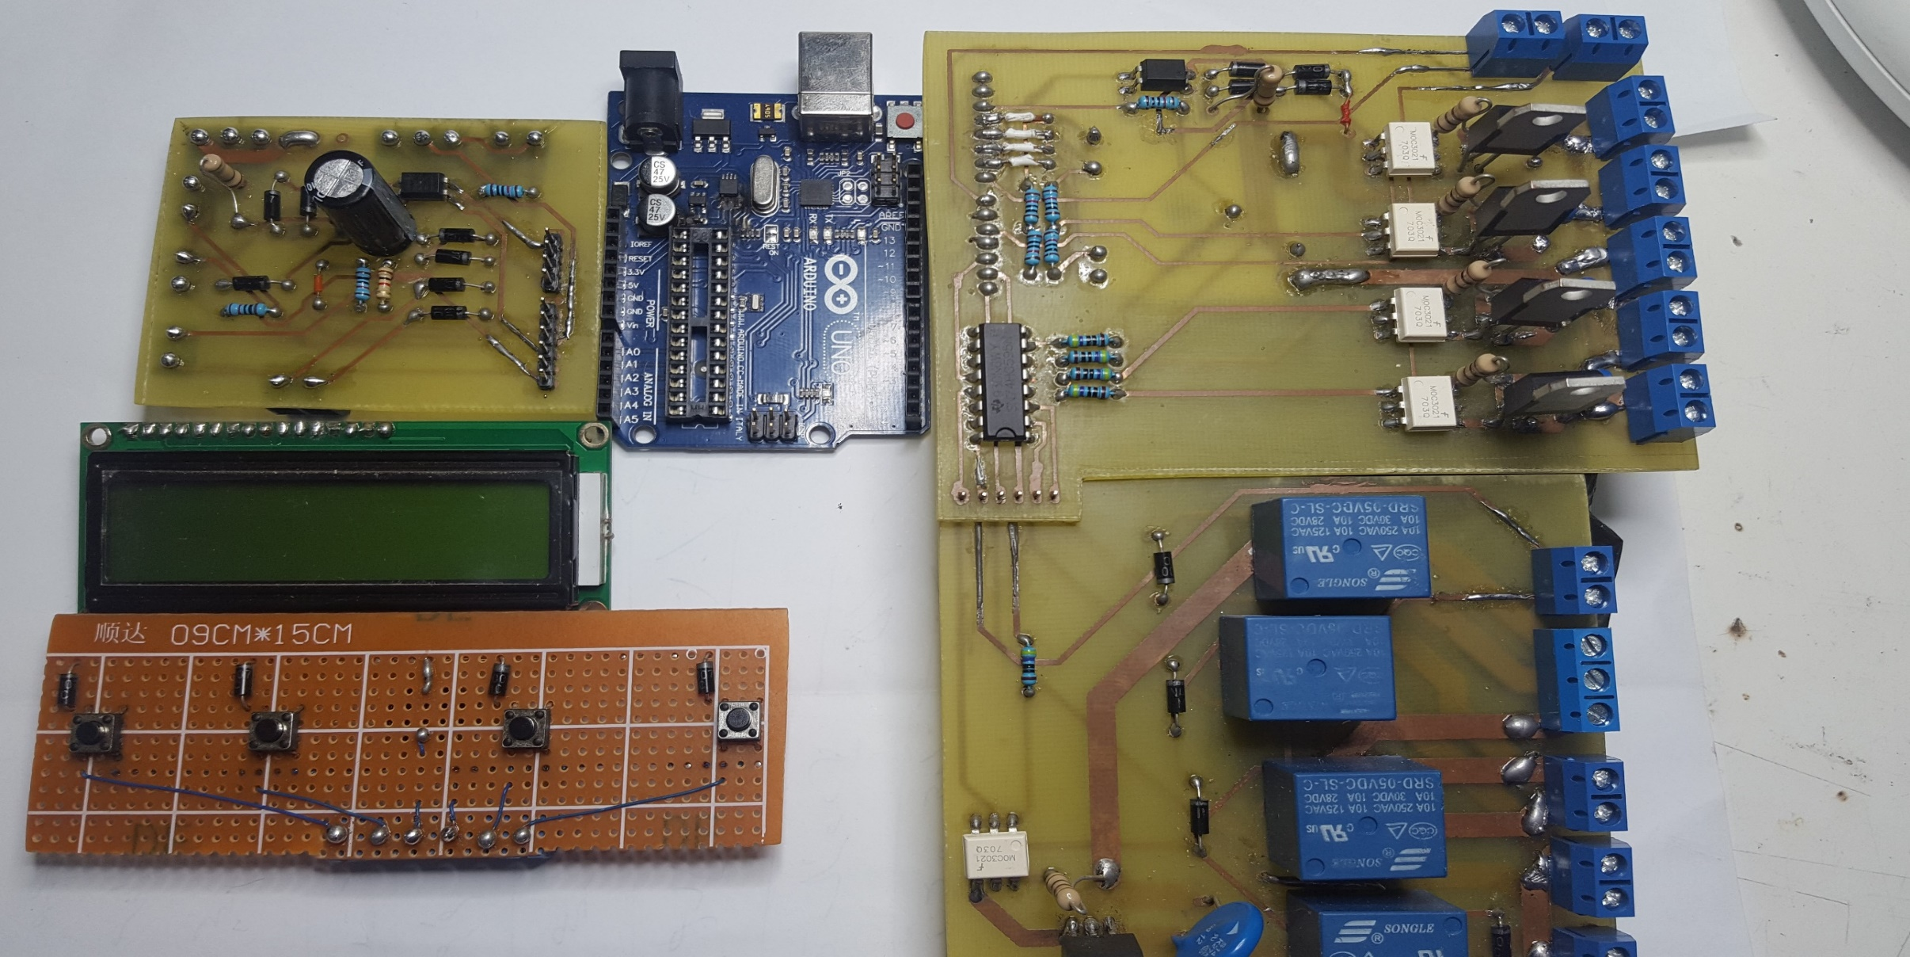
The final results

Slide 38
Programming general algorithm

Slide 39
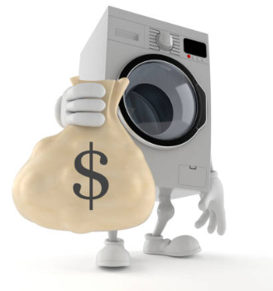
Economical study
The whole project costed 35$ and it will suit most of washing machines.
The average price of the manufactured boards sold
in the market = 90 $ and it suits specific brands only.
Which means that it is economically feasible
and money-saving

Slide 40
Thank you

