Slide 1

Validation of Model Metrics as
Indicators on Model Quality
Notes:
Mention admin and head of department

Slide 2
Abstract
This work was implemented in Daimler AG, Research and Development. Department of Electric/Electronic Software Structure. This research aims to fulfill the requirements of An-Najah National University’s Department of Electrical Engineering’s “Graduation Project”.
This work was performed under the supervision of Dr. Jammal Kharoushe (An-Najah National University) and Pascal Montag (Daimler AG RD\ESS).
2

Slide 3
Agenda
Introduction
Experimental Work
Interpretation
Summary
Future Improvement
3

Slide 4
Objective
4
Utilize and extend Scheible‘s thesis.
Find the most influential metrics on model quality
Use expert opinions and bug data as quality indicators

Slide 5
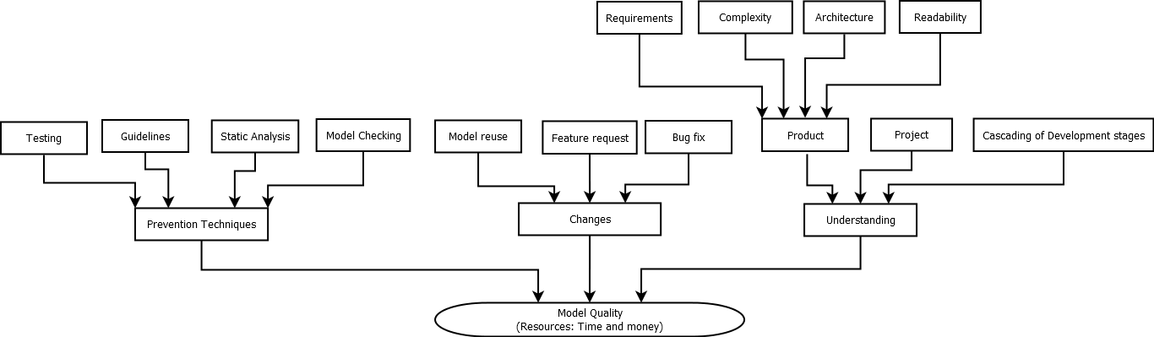
Assumptions
5

Slide 6
Methodology
6
Metrics validated by correlations with experts and bug rate ranking.
The correlation is measured using spearman’s rank coefficient.
Notes:
The model metrics are validated by correlating them experts opinion and failure reports.
Each metric used to rank the targeted models. Then, the metric rankings were correlated with rankings from experts and failure reports.
The correlation is measured using spearman’s rank coefficient.

Slide 7
Agenda
Introduction
Experimental Work
Interpretation
Summary
Future Improvement
7

Slide 8
MBE merics, and MBE tool
8
MBE tool provides 84 metrics
Quality rating depends on models in reference database
Aggregation includes non-measured metrics .
Notes:
The metrics which were used are the metrics defined in Jan Scheible Phd thesis ‘Automatisierte qualitaewtsbewertung am beispiel von matlab simulink-modellen in der automobil-domaene’.(84 metrics)
Also, we used the MBE tool to measure the metrics.
The tool is comprehensive and the wide range of metrics covering almost all aspects of the model.
The measurement database content effects the quality rating.

Slide 9
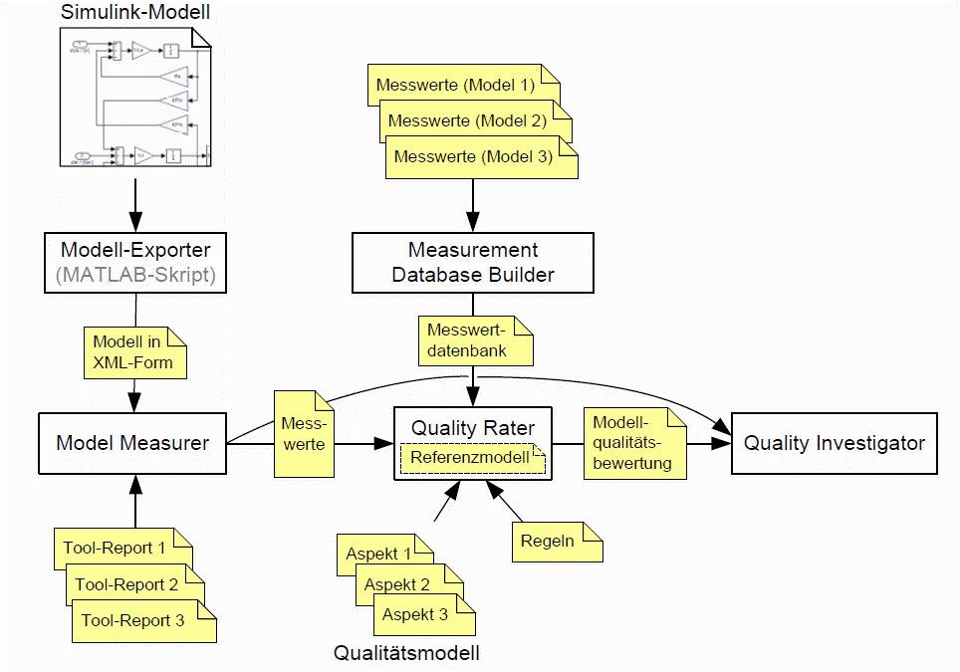
MBE tool Prototype structure

Slide 10
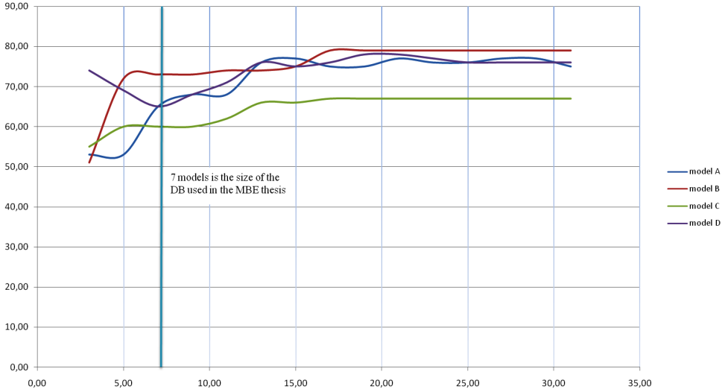
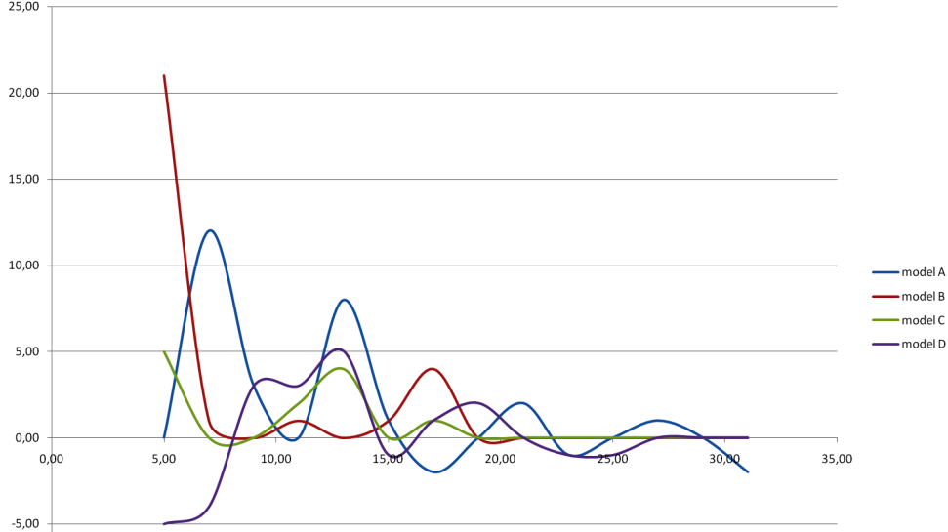
Reference measurement database size
Rating change over the change of DB size
Rating is more stable when the DB size is more than 10 models

Slide 11
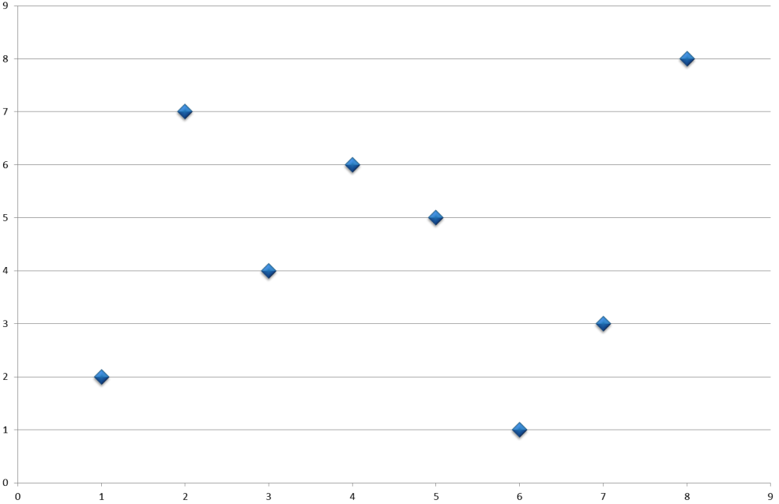
Validation of Experts ranking and Failure reports
Both entities correlation with each other 0,67

Slide 12
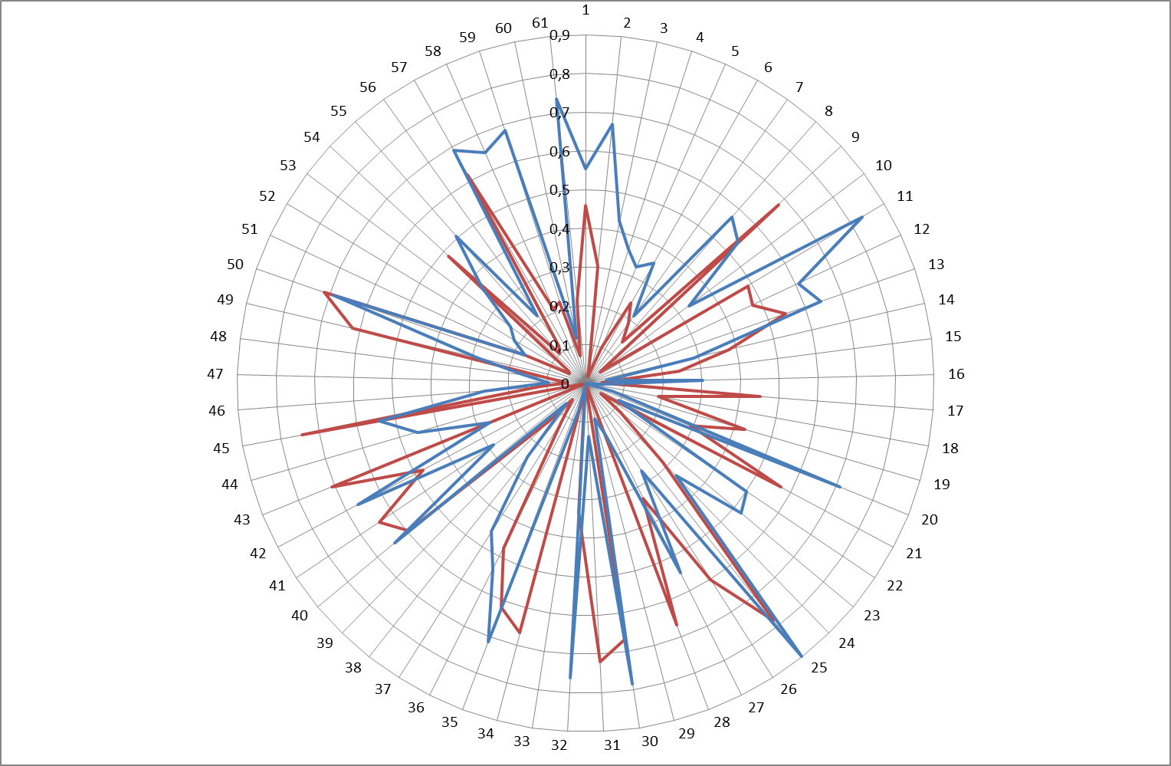
Metrics vs. Experts Metrics vs. Failure reports

Slide 13
Research Data
FailureScore = (Occurrence) * (Priority) * (Severity)
13
Bug data: EP/EK-Dante (EP/EK: one of Repositories used in ECU design. Dante: Platform for bug records from after sale)
Experts opinion: Scheible’s thesis.
Notes:
Failure mode and effects analysis

Slide 15
Agenda
Introduction
Experimental Work
Interpretation
Summary
Future Improvement
15

Slide 16
Calculations and findings
Strong positive correlation (Implies lower is better) |  | Strong negative correlation (Implies higher is better)
#signal routing subsystems | 0,73 | #magic constant uses | -0,84
øindependent paths | 0,70 | #terminator blocks | -0,67
#data store memory without write access | 0,66 | øsignal length | -0,65
depth of subsystem hierarchy | 0,64 | #unused results | -0,62
#testable subsystems with implicit inport data types | 0,51 | #data store memory | -0,61
#internal states | 0,50 | #data store write | -0,60
#used libraries | 0,49 | #used dd variables | -0,57
#used block types | 0,46 | #subsystem annotations | -0,55
øsubsystem child count | 0,45 | #data store read | -0,54
#magic constant values | 0,43 | #arithmetic subsystems | -0,51
16
Correlating the metrics with failure reports and experts ranking, the following list was created:

Slide 17
Agenda
Introduction
Experimental Work
Interpretation
Summary
Future Improvement
17

Slide 18
Summary
18
Improvements have been found for the model rater
Quality data has been verified (high reliability)
Some metrics are more important than others
  Determined a priority list of metrics
  Some unexpected findings

Slide 19
Agenda
Introduction
Experimental Work
Interpretation
Summary
Future Improvement
19

Slide 20
Suggestions and Future Improvments
20
Improve reliability of the data
  Resource Expansion
  More models and different projects
Rating the model quality based on correlated metrics

