Slide 1

Graduation Project II
Structural analysis and design for
Burj Al-Jame’a - Jenin
By:
1. Mohammad Abbadi
2. Nafe’ Alyat
3.Omar Abd El-Jawad
Under supervision of:
Dr. Munther Diab
December 2018

Slide 2



Outline
1 Project description.
2 Seismic Design Parameters.
3 Check for Structural Irregularities.
4 Structural System Type.
5 Preliminary Evaluation.
.
7 Three Dimensional Structural Analysis.
8 ETABS Model Checks.
.
9 Design Structural Elements
.

Slide 3

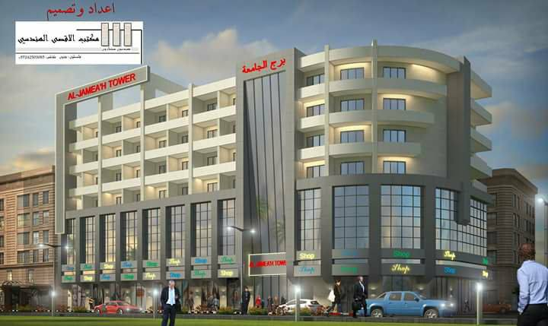
Project Description
A commercial building located in Jenin, Palestine.

Slide 4
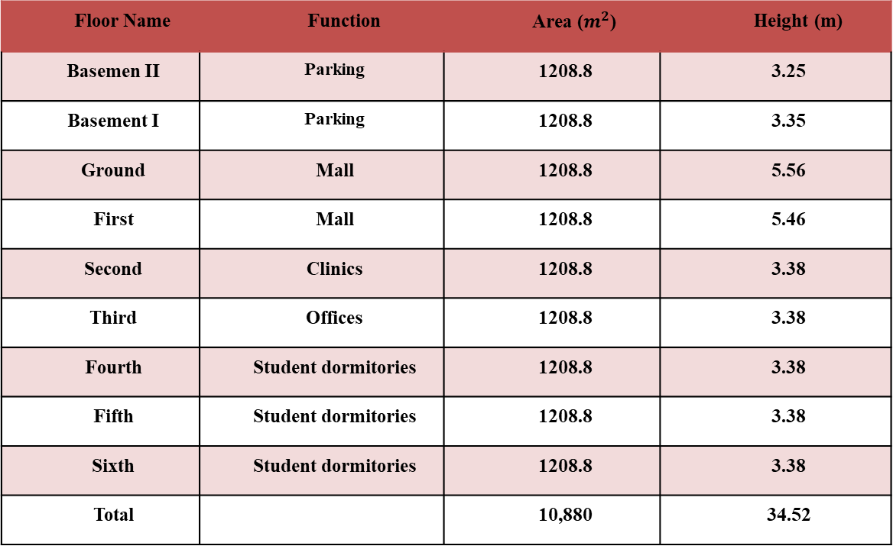
Project Description
The soil in the site has a bearing capacity of about 3.5 kg/ cm²
Floor Name | Function | Area ($m^{2}$) | Height (m)
Basemen ІІ | Parking | 1208.8 | 3.25
Basement І | Parking | 1208.8 | 3.35
Ground | Mall | 1208.8 | 5.56
First | Mall | 1208.8 | 5.46
Second | Clinics | 1208.8 | 3.38
Third | Offices | 1208.8 | 3.38
Fourth | Student dormitories | 1208.8 | 3.38
Fifth | Student dormitories | 1208.8 | 3.38
Sixth | Student dormitories | 1208.8 | 3.38
Total |  | 10,880 | 34.52

Slide 5
Materials
Structural
Non Structural
Tile (𝛾 = 25kN/𝑚³ )
Block (𝛾 =12 kN/𝑚³ )
Reinforcement
steel
Filler
(𝛾 =16 kN/𝑚³ )
Concrete
Plaster
(𝛾 = 23 kN/𝑚³ )
Concrete Mortar
(𝛾 = 23kN/𝑚³ )
.
Stone (𝛾 = 27 kN/𝑚³ )

Slide 6
Materials
Element | Value
Columns | 28 MPa
Shear walls | 28 MPa
Beams | 24 MPa
Footings | 24 MPa
Slabs | 24 MPa
Stairs | 24 MPa

Slide 7
The Codes Used in This Project
The Codes used in this project are the following :
1
  ACI 318-14 (American Concrete Institute).
2
  UBC 97 (Uniform Building Code).

Slide 8
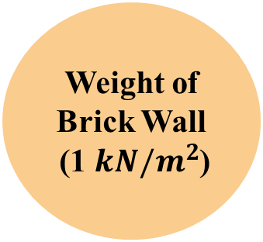

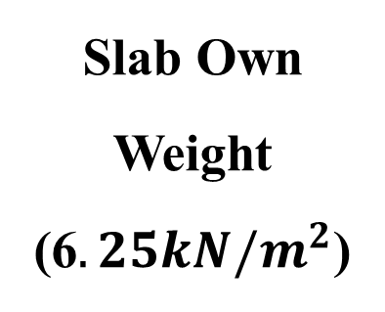




Gravity loads
Live Load
Weight of Brick Wall
(1 $kN/m^{2}$)
Slab Own Weight
(6$.25kN/m^{2}$)
Super Impose Dead Load
Parking (2.5 $kN/m^{2}$)
Mall (3.5 $kN/m^{2}$)
(4 $kN/m^{2}$)
Clinics & Offices
(3 $kN/m^{2}$)
Student dormitories
(2 $kN/m^{2}$)

Slide 9


Slide 10



Seismic Design Parameters
R= 5.5
Ω = 2.8
Seismic Design Parameters
𝑪𝒂 = 0.24
&
𝑪𝒗 = 0.32
Importance Factor,
I = 1.0
Soil Profile Type ($S_{c}$)
Seismic Zone Factor,
Z = 0.2

Slide 11
Seismic Analysis Methods
1) Equivalent lateral force analysis
2) Modal response spectrum analysis
3) History analysis

Slide 12
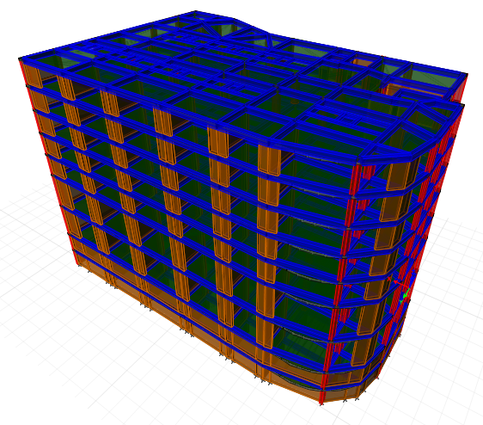

Check for Structural Irregularities

Slide 13
Horizontal Irregularities
Vertical Irregularities
1a – Torsional Irregularities
1b – Extreme Torsional Irregularities
2 – Re-entrant Corners
3 – Diaphragm Discontinuity
4 – Out-of-plane Offsets
5 – Nonparallel Systems
1a – Stiffness Irregularity -Soft Story
1b – Stiffness Irregularity - Extreme Soft Story
2 – Weight (Mass) Irregularity
3 – Vertical Geometry Irregularity
4 – In-plane Discontinuity in Vertical Lateral Force Resisting Elements
5a – Discontinuity in Lateral Strength- Weak Story irregularity
5b - Discontinuity in Lateral Strength- Extreme Weak Story irregularity

Slide 14
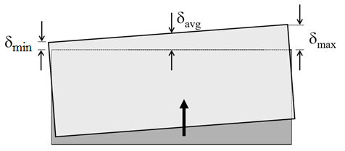
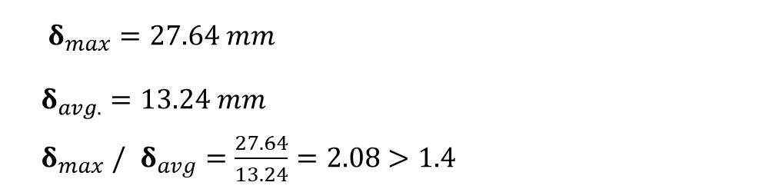
Horizontal Irregularities
1a. Torsional Irregularity
1b. Extreme Torsional Irregularity
Story | Drift δ (mm)
Sixth | 27.64
Fifth | 24.54
Fourth | 21.03
Third | 17.38
Second | 13.68
First | 10.02
Ground | 4.21
B1 | 0.51
B2 | 0.19
Avg. | 13.24
$δ_{max}=27.64 mm$
$$δ_{avg.}=13.24 mm$$
$δ_{max} /$ $δ_{avg}=\frac{27.64}{13.24}=2.08>1.4$
In x-direction :

Slide 15
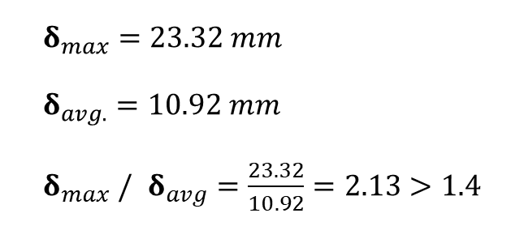
Horizontal Irregularities
1a. Torsional Irregularity
1b. Extreme Torsional Irregularity
Story | Drift δ (mm)
Sixth | 23.32
Fifth | 20.07
Fourth | 16.91
Third | 13.76
Second | 10.68
First | 8.07
Ground | 3.86
B1 | 1.20
B2 | 0.38
Avg. | 10.92
$$δ_{max}=23.32 mm$$
$$δ_{avg.}=10.92 mm$$
$δ_{max} /$ $δ_{avg}=\frac{23.32}{10.92}=2.13>1.4$
In y-direction :
Note: Extreme Torsional Irregularity exists.

Slide 16
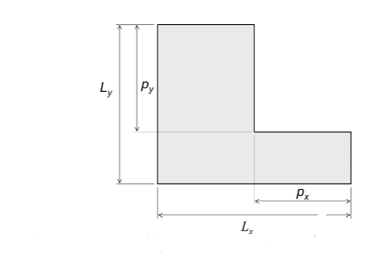
Horizontal Irregularities
2.Reentrant Corner Irregularity
Irregularity exist If: $P_{x}>\%15L_{x}$ & ${ P}_{y}>\%15L_{y}$

Slide 17
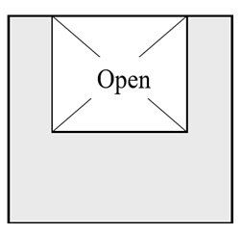
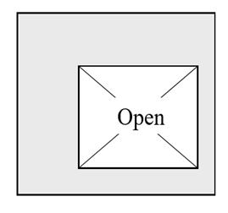
Horizontal Irregularities
3. Diaphragm Discontinuity Irregularity
Occurs if: X*Y > %50 A*B
y
B
x
A

Slide 18
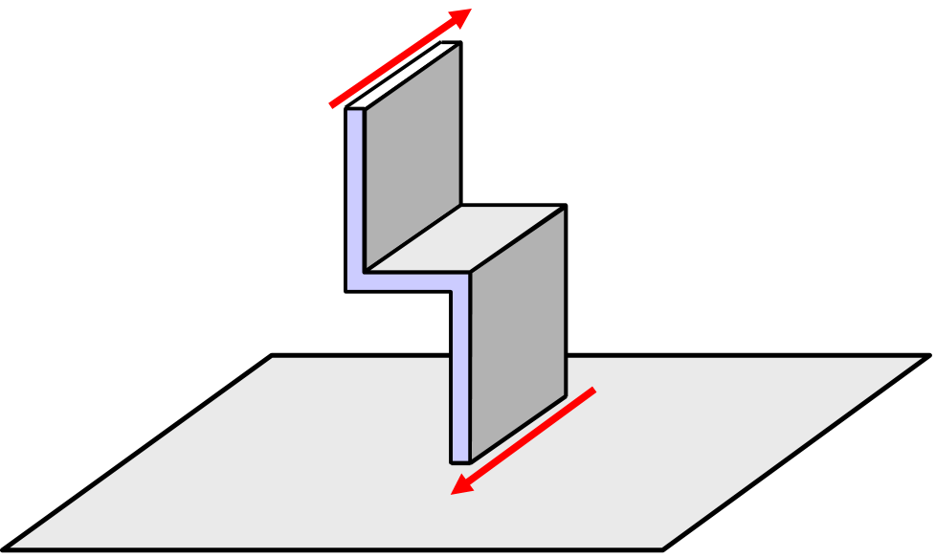
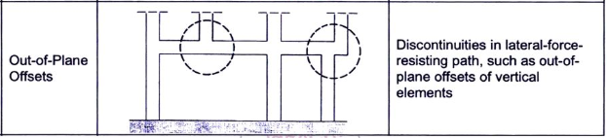
Horizontal Irregularities
4. Out-of-Plane Offset Irregularity.

Slide 19
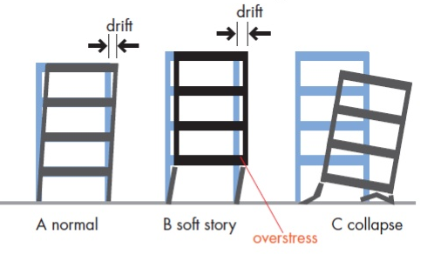
Vertical Irregularities
1a. Stiffness-Soft Story Irregularity
1b. Stiffness-Extreme Soft Story Irregularity

Slide 20

Vertical Irregularities
In x-direction :
Story | Load Case | Stiffness X kN/m
Sixth | EQXS | 933556.672
Fifth | EQXS | 1544241.98
Fourth | EQXS | 1948428.417
Third | EQXS | 2283244.209
Second | EQXS | 2605530.936
First | EQXS | 1879245.597
Ground | EQXS | 3211747.547
B1 | EQXS | 26667333.629
B2 | EQXS | 52425746.181
Fifth floor is soft story, $K_{5}<0.70 K_{6}$

Slide 21
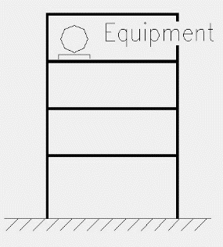
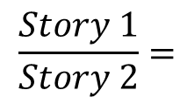

Vertical Irregularities
2. Weight (Mass) Irregularity
Mass irregularity shall be considered to exist where the effective mass of any story is more than 150% of the effective mass of an adjacent story.
Story | Weight kN
Sixth | 15159.1
Fifth | 15108.2
Fourth | 15108.2
Third | 15108.2
Second | 15108.2
First | 17562.9
Ground | 17597.1
B1 | 17652.1
B2 | 17459.3
$$\frac{Story 1}{Story 2}=$$
$$\frac{17562.9}{15108.2} ∗100 \%=116\% < 150\%$$
Note: No mass irregularity.

Slide 22
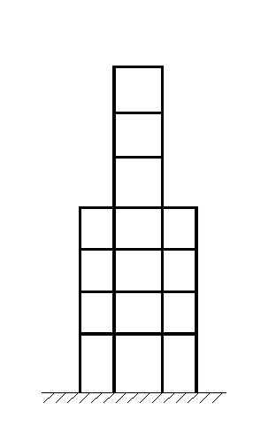
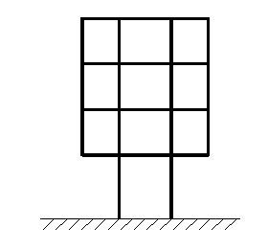
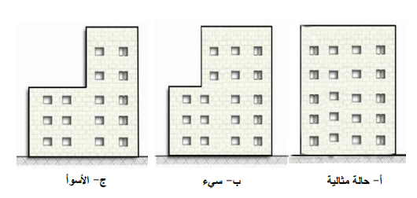
Vertical Irregularities
3. Vertical Geometric Irregularity

Slide 23

All of the above shows that the building is irregular. So, It is preferred to analyze the building dynamically using Response Spectrum method, that is suitable for all cases whether the building is regular or not .

Slide 24
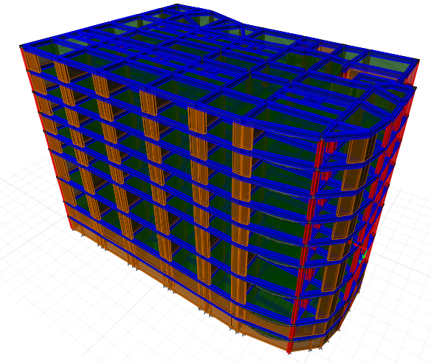

Preliminary Evaluation

Slide 25

Slab
Selected slab system:
The selected system is two – way solid slab.

Slide 26
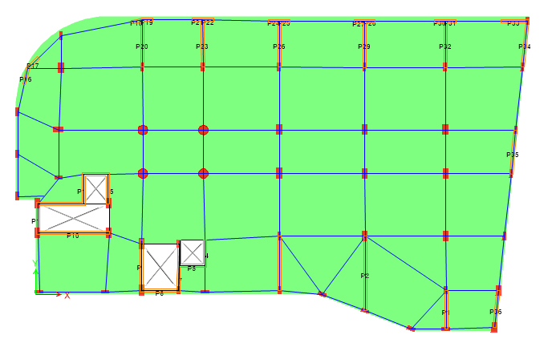
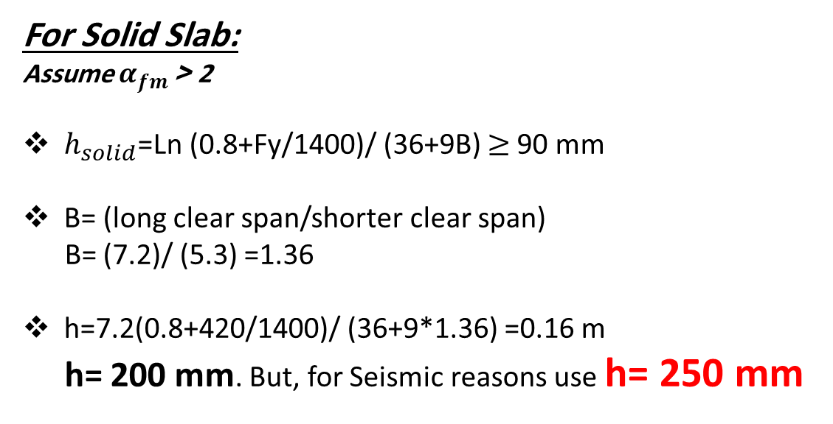
Slab
Slab thickness calculated based on the critical span
For Solid Slab:
Assume $α_{fm}$< 2
$h_{solid}$=Ln (0.8+Fy/1400)/ (36+9B) $≥$90 mm
B= (long clear span/shorter clear span)
B= (7.2)/ (5.3) =1.36
h=7.2(0.8+420/1400)/ (36+9*1.36) =0.16 m
h= 200 mm. But, for Seismic reasons use h= 250 mm

Slide 27
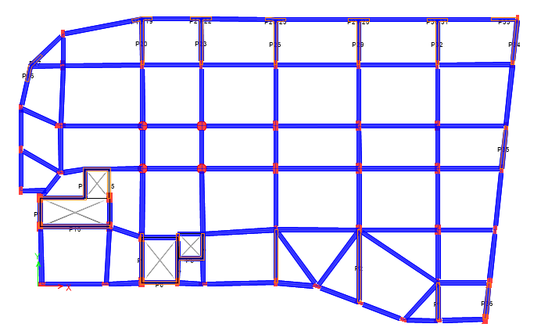
Beams
1
Beams distribution
For all floors, the Beam distribution is shown:

Slide 28
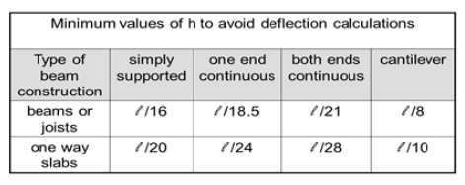
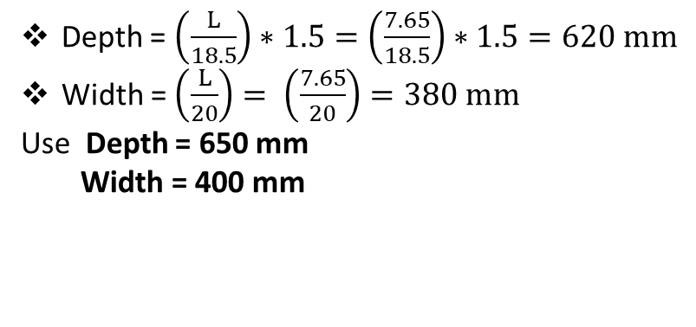
Beams
2
Beams dimensions
In X & Y direction the critical beam is one end continuous
Depth = $\left(\frac{L}{18.5}\right)∗1.5=\left(\frac{7.65}{18.5}\right)∗1.5=620 mm$
Width = $\left(\frac{L}{20}\right)= \left(\frac{7.65}{20}\right)=380 mm$
Use Depth = 650 mm
Width = 400 mm

Slide 29
Beams
2
Beams dimensions
Opening Beams
We use the secondary beams in order to reduce the slab deflection near openings,
so we suppose dimensions to be:
Depth = 250 mm
Width = 300 mm

Slide 30
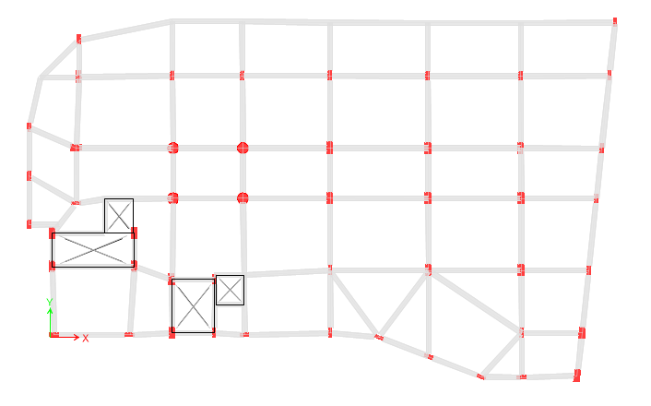
Columns
1
Columns distribution
For all floors, the distribution is shown:

Slide 31
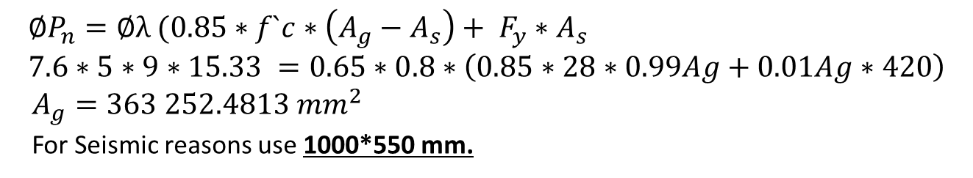
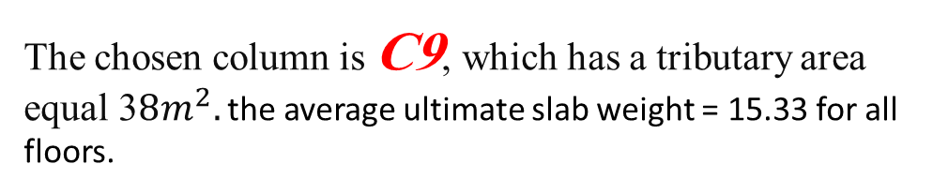
2
Dimension of column
Columns
The chosen column is C9, which has a tributary area equal 3$8m^{2}.$ the average ultimate slab weight = 15.33 for all floors.
$$∅P_{n}=∅λ (0.85∗f`c∗\left(A_{g}−A_{s}\right)+ F_{y}∗A_{s } \\ 7.6∗5∗9∗15.33 =0.65∗0.8∗\left(0.85∗28∗0.99Ag+0.01Ag∗420\right)$$
$A_{g}=363 252.4813 {mm}^{2}$
For Seismic reasons use 1000*550 mm.
For circular columns in we supposed diameter = 900 mm – will be rechecked in design phase. Also, some columns shall be minimized, especially the edge ones.

Slide 32
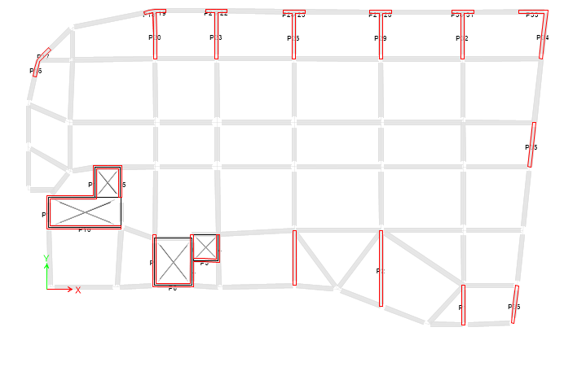
Shear Walls
Shear wall distribution
For all floors the distribution was:

Slide 33
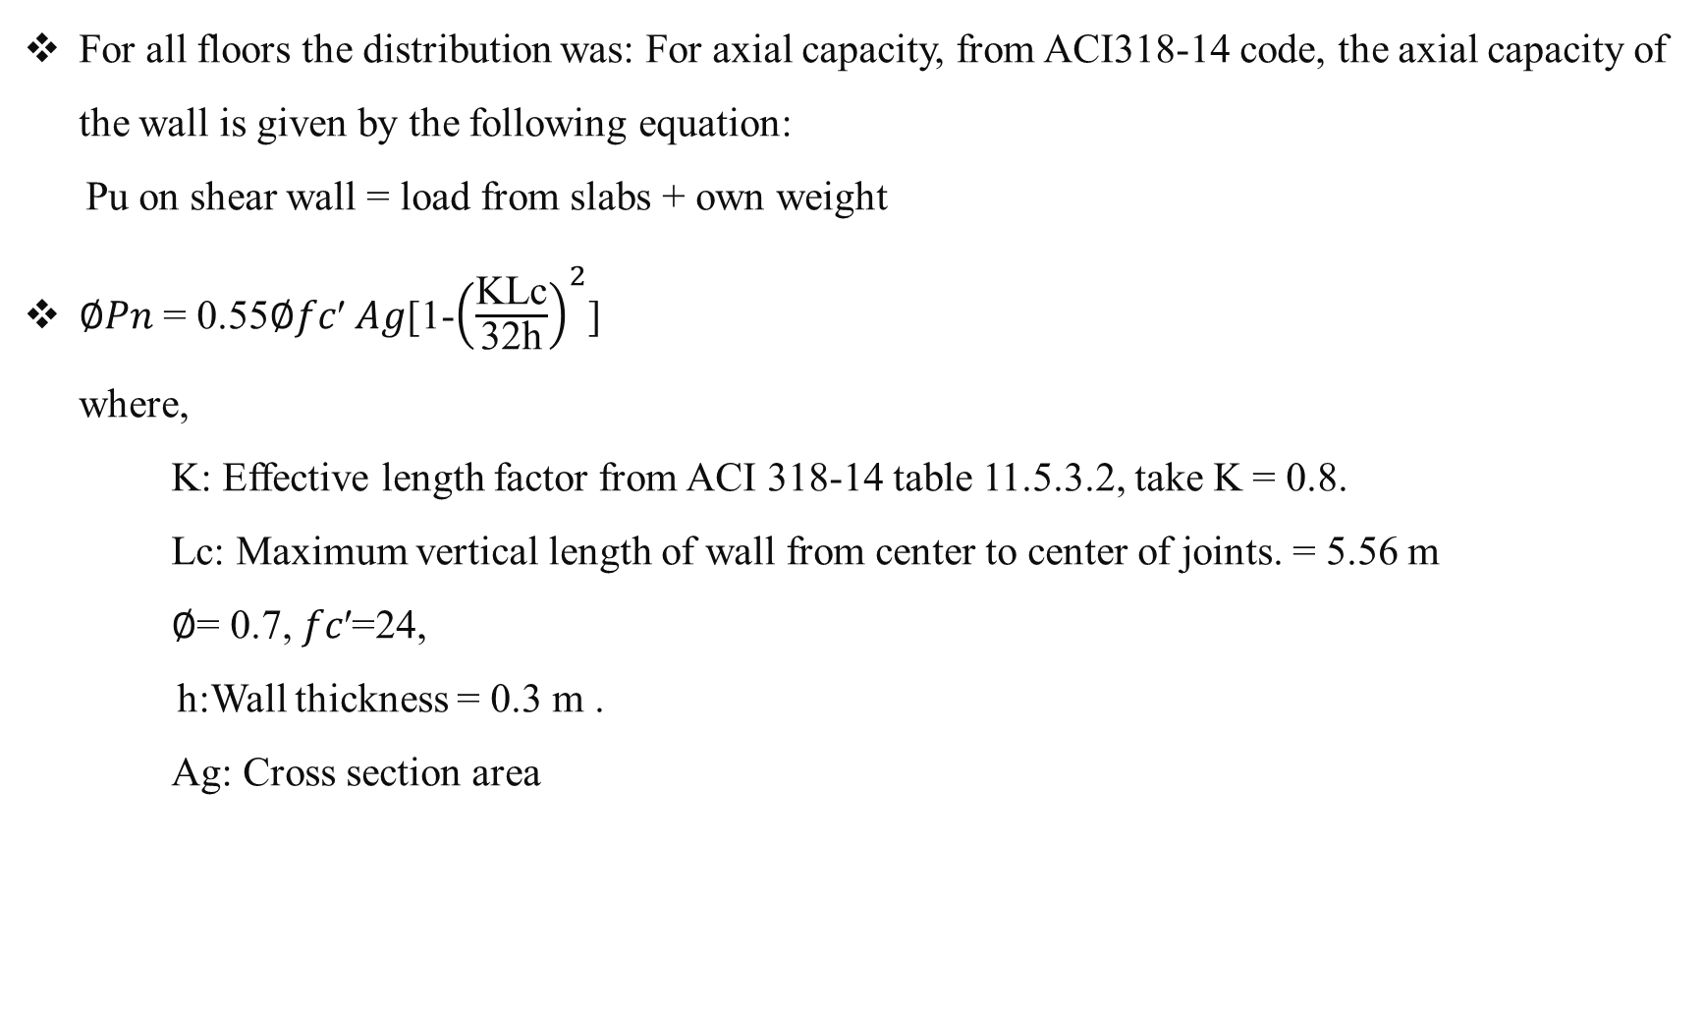
Shear wall checks
Shear Walls
For all floors the distribution was: For axial capacity, from ACI318-14 code, the axial capacity of the wall is given by the following equation:
Pu on shear wall = load from slabs + own weight
∅𝑃𝑛 = 0.55∅𝑓𝑐′ 𝐴𝑔[1-${\left(\frac{\text{KLc}}{\text{32}\text{h}}\right)}^{2}$]
where,
K: Effective length factor from ACI 318-14 table 11.5.3.2, take K = 0.8.
Lc: Maximum vertical length of wall from center to center of joints. = 5.56 m
∅= 0.7, 𝑓𝑐′=24,
h:Wall thickness = 0.3 m .
Ag: Cross section area

Slide 34
Shear wall checks
Shear Walls
If Pu < ∅𝑃𝑛 , Shear Wall dimension will be adopted.

Slide 35
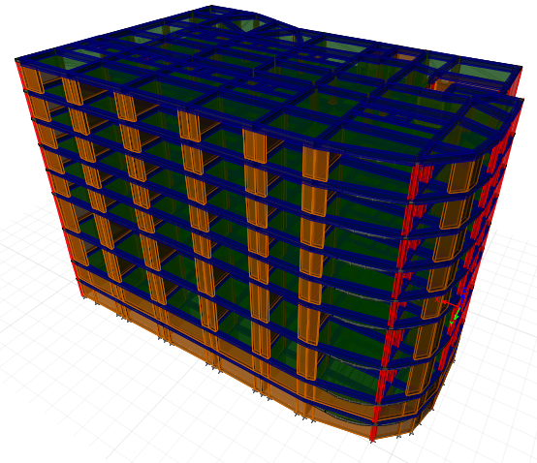
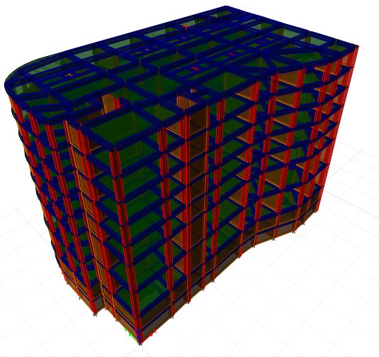
Three Dimensional Structural Analysis

Slide 36
ETABS Model Checks
Drawing structural model
Structural system type
Compatibility
Mass participation ratio
External equilibrium
Base shear by ELM
Checks
Internal equilibrium
Base shear by Response Spectrum
Slab deflection
Slab shear
Fundamental period
Drift

Slide 37
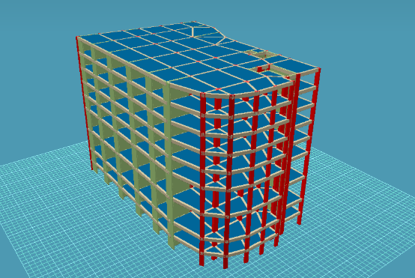
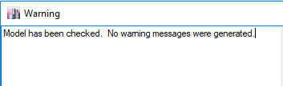
ETABS Model Checks
Drawing structural model
1

Slide 38
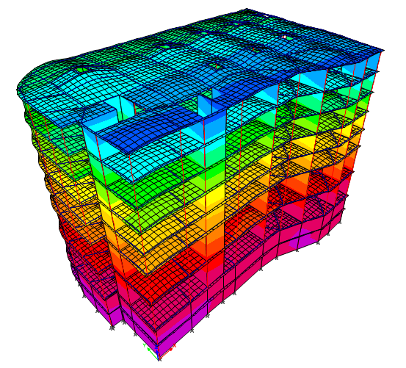
ETABS Model Checks
2
Compatibility
All structural members are moving as one unit.

Slide 39
ETABS Model Checks
3
External Equilibrium
All loads on the structure and reactions are approximately the same.
Load type | Manual results (kN) | ETABS results (kN) | Difference %
Dead | 141792 | 145864 | 2.79 %
Live | 30042.2 | 30067.7 | 0.08 %

Slide 40
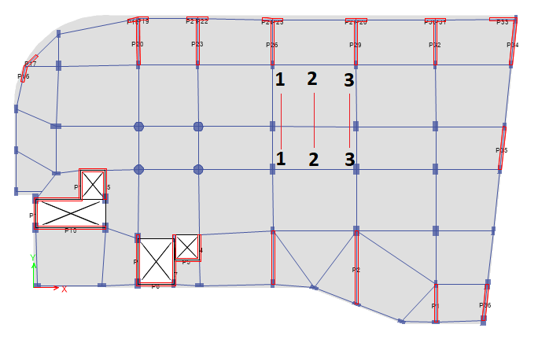
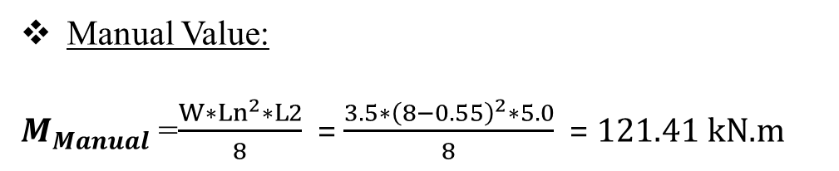
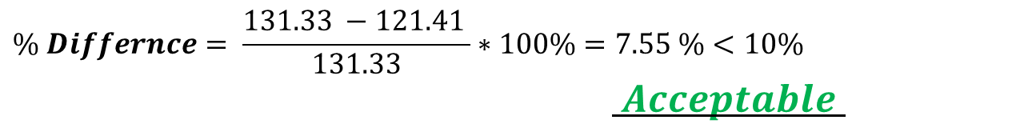
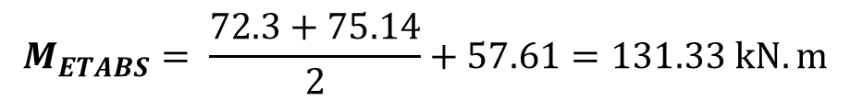
ETABS Model Checks
4
Internal Equilibrium ( for frame )
Make a check on Ground floor slab for Live load ($W_{live}$ = 3.5 kN/$m^{2})$
Manual Value:
$M_{Manual}$ =$\frac{W∗{Ln}^{2}∗L2}{8}$= $\frac{3.5∗{\left(8−0.55\right)}^{2}∗5.0}{8}$ = 121.41 kN.m
ETABS Value:
$$M_{ETABS}= \frac{72.3+75.14}{2}+57.61=131.33 kN.m$$
$$\% Differnce= \frac{131.33 −121.41 }{131.33}∗100\%=7.55 \%<10\%$$
$Acceptable$

Slide 41
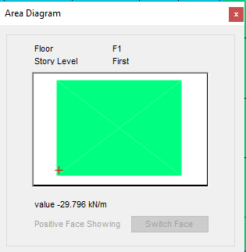

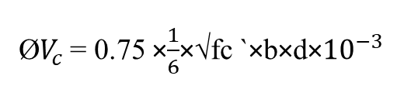

ETABS Model Checks
5.a
Slab shear (V13)
Ø$V_{c}$= 0.75 ×$\frac{1}{6}$×√fc `×b×d×${10}^{−3}$
Ø$V_{c}$ = 0.75× $\frac{1}{6}$ ×√ 24× 1000× 220×${10}^{−3}$
= 134.72 kN/m
V13 = 29.796 kN/m
Ø$V_{c}$= 134 kN/m >${ V}_{13}$ = 29.796 kN/m

Slide 42
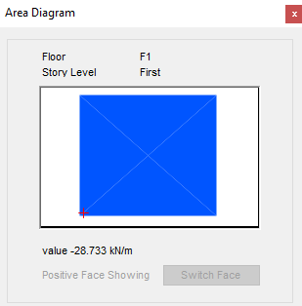

ETABS Model Checks
5.a
Slab shear (V23)
Ø$V_{c}$= 0.75 ×$\frac{1}{6}$×√fc `×b×d×${10}^{−3}$
Ø$V_{c}$ = 0.75× $\frac{1}{6}$ ×√ 24× 1000× 220×${10}^{−3}$
= 134.72 kN/m
V13 = 28.733 kN/m
Ø$V_{c}$= 134 kN/m >${ V}_{13}$ = 28.733 kN/m
➔ Slab thickness is adequate.

Slide 43

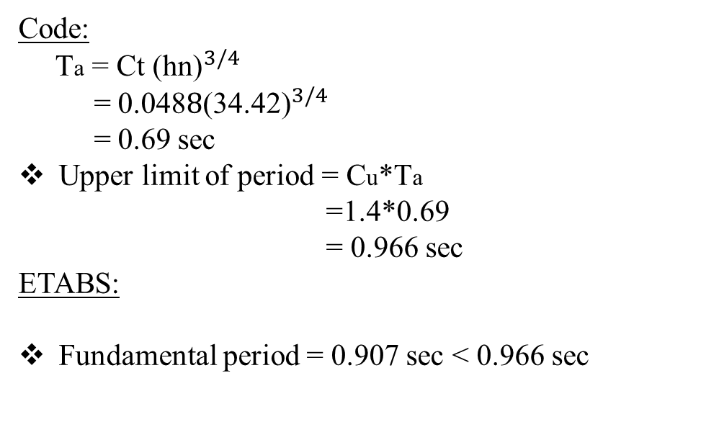
ETABS Model Checks
6
Fundamental period
Code:
Ta = Ct ${\text{(}\text{hn}\text{)}}^{3/4}$
= 0.048$8{\text{(}\text{34.42}\text{)}}^{3/4}$
= 0.69 sec
Upper limit of period = Cu*Ta
=1.4*0.69
= 0.966 sec
ETABS:
Fundamental period = 0.907 sec < 0.966 sec
$$So, Period is acceptable$$

Slide 44
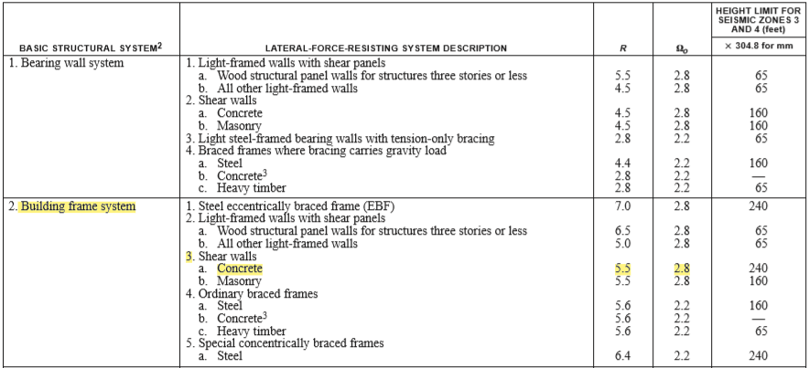
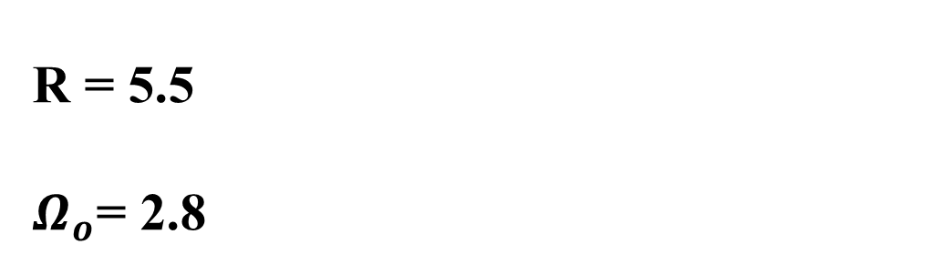
ETABS Model Checks
7
Structural system type
Building Frame System (concrete shear walls).
R = 5.5
$Ω_{o}$= 2.8

Slide 45
ETABS Model Checks
8
Mass participation ratio
Number of modes taken to develop design spectra must have at least 90% of the participation mass of the structures for each principle direction as reported in both UBC 97 and IBC codes. In this project, the first nine modes - using Ritz Modal Case Sub Type - participate in more than 90% of the mass for both directions.
TABLE: Modal Participating Mass Ratios
Case | Mode | Period, sec | UX | UY | Sum UX | Sum UY | Sum RZ
Modal | 1 | 0.907 | 0.5581 | 0.0328 | 0.5581 | 0.0328 | 0.0378
Modal | 2 | 0.765 | 0.0356 | 0.6005 | 0.5937 | 0.6333 | 0.0378
Modal | 3 | 0.663 | 0.0395 | 0.003 | 0.6332 | 0.6363 | 0.6103
Modal | 4 | 0.222 | 0.1057 | 0.0011 | 0.7389 | 0.6374 | 0.6157
Modal | 5 | 0.163 | 0.0001 | 0.14 | 0.739 | 0.7774 | 0.6298
Modal | 6 | 0.14 | 0.015 | 0.0296 | 0.7541 | 0.807 | 0.7282
Modal | 7 | 0.113 | 0.0383 | 0.0036 | 0.7923 | 0.8106 | 0.7371
Modal | 8 | 0.064 | 0.1593 | 0.0208 | 0.9516 | 0.8314 | 0.7376
Modal | 9 | 0.061 | 0.023 | 0.1357 | 0.9746 | 0.9671 | 0.7385

Slide 46
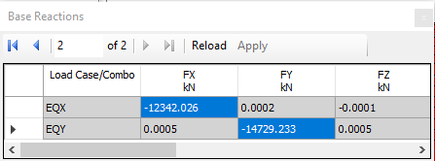

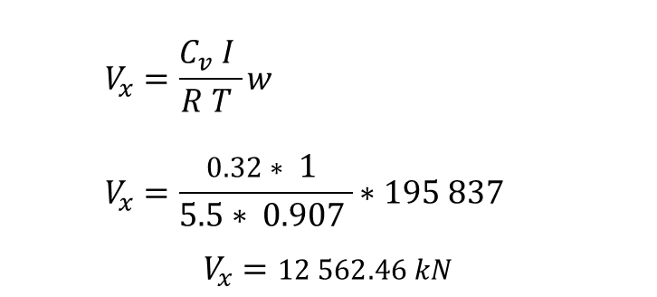
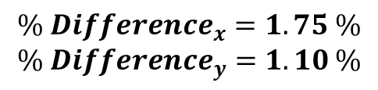
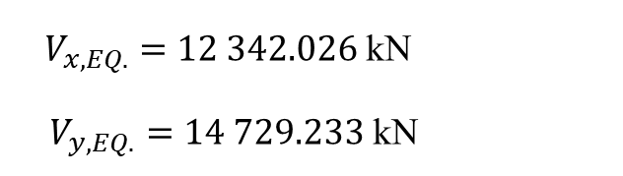
ETABS Model Checks
9
Base Shear by Eq. Static Method
Manual
ETABS
$V_{x,EQ.}=12 342.026$ kN
$V_{y,EQ.}=14 729.233$ kN
$$V_{x}=\frac{C_{v} I }{R T }w \\ V_{x}=\frac{0.32∗ 1 }{5.5∗ 0.907 }∗195 837$$
$$V_{x}=12 562.46 kN$$
$$V_{y}=\frac{C_{v} I }{R T }w \\ V_{y}=\frac{0.32∗ 1 }{5.5∗ 0.765 }∗195 837$$
$$V_{y}=14 894.31 kN$$
$${\% Difference}_{x}=1.75 \% \\ {\% Difference}_{y}=1.10 \%$$
So, It is Acceptable

Slide 47

ETABS Model Checks
9
Base shear by Response Spectrum
Input data of Response Spectrum

Slide 48


ETABS Model Checks
9
Base shear by Response Spectrum
Results of current dynamic analysis
Results of modified dynamic analysis

Slide 49

ETABS Model Checks
10
Slab deflection
Check was Implemented on the critical panel in Ground Floor.
Δ Allowable = L/240 =9.62/240 = 0.040m = 40mm
Deflection from ETABS = 22.40 mm
Deflection from ETABS < allowable deflection
Acceptable

Slide 50

Design of Structural Elements

Slide 51

Structural Design
Slabs
Beams
Shear walls
Design
columns
Footings
Stairs

Slide 52


Slabs
Slabs Design
1
Check slab thickness for Shear
Shear capacity for the slab.
Ø$V_{c}$= 0.75 ×$\frac{1}{6}$×√fc `×b×d×${10}^{−3}$
= 0.75× $\frac{1}{6}$ ×√ 24× 1000× 220×${10}^{−3}$
= 134.72 kN
Vu = 29.796 kN
Ø$V_{c}$= 134 kN >$V_{23}$ = 29.796 kN
➔ Slab thickness is acceptable.

Slide 53



Slabs
In x-direction :M11
$M_{u}$ < 29.50 ➔ use ${As}_{min}$
As =0.0018× 1000×220 = 726${mm}^{2}$
Use 1ø14/20 cm, Bottom in x direction.

Slide 54



Slabs
In y-direction :M22
$M_{u}$ < 29.50 ➔ use ${As}_{min}$
As =0.0018× 1000×220 = 726${mm}^{2}$
Use 1ø14/20 cm, Bottom in y direction.
shrinkage steel:
As (shrinkage) = 0.0018x1000x250 = 450mm2
4Ø12/m
But, use = 1Ø12/20 cm (in both directions)
.

Slide 55

Steel Detailing In Slab
Slabs

Slide 56

Columns
Columns distribution

Slide 57

Columns
Slenderness check
Code ACI318-14 permits to neglect the slenderness in braced columns if :
$\frac{KLu}{r}$ ≤ 34 – 12 $\frac{M1}{M2}$
≤ 40
Where:
K: the effective length factor.
L_{u}: the unsupported height.
r: the radius of gyration which equals to $\sqrt{\frac{I}{A}}$ , where I is the moment of inertia and A is the area of the section.
M₁: Smaller factored end moment on column.
M₂: larger factored end moment on column.

Slide 58



Columns
Slenderness check
Check slenderness on column C5 in two direction
Assume k=1
Lu = 5.46m
r = 0.3h = 0.3*1 = 0..30m
$\frac{KLu}{r}$ = $\frac{1∗5.46}{0.30}$ = 18.20
18.20 ≤ 34 – 12* $\frac{−42.66}{150.43}$ = 37.40
≤ 40
Neglect slenderness.

Slide 59

Columns
Reinforcement percentages
All values are permitted as ACI318-14.

Slide 60




Columns
ACI requirements of columns

Slide 61


Columns
Summery of columns

Slide 62

Columns
Summery of columns

Slide 63

Detailing of column group C-1

Slide 64


Beams
1
Beams Design
Design of beam for flexure:
Left moment value ➔ M=308.31 kN.m
Mid. Moment value ➔ M= 172.90 kN.m
Right moment value ➔ M= 377.57 kN.m
For the mid of span M+ = 172.90 kN.m
➔(use 5Ø16)
For the right and left side of span is
maximum value of M- = 377.57 kN.m
➔(use 7Ø20)

Slide 65


Beams
1
Beams Design
Design of beam for shear force:
Left shear value ➔ V=234.77 kN
Right shear value ➔ V=241.84 kN
Shear Rebar Ratio (Av/S):
Concrete shear Capacity is found using :
ØVc =0.75* $\frac{1}{6}$*$\sqrt{fc }$ b*d = $\frac{1}{6}$*$\sqrt{24}$*400*590/1000
=144.525 kN
Vu =234.77 kN
Vu > ØVc we need stirupps
Use $S$ =150 mm ➔ 6Ø10/m
At distance 2h from support: Vu =163 kN
S = d/2 = 300 mm➔ 3Ø10/m.

Slide 66

2
Beams Detailing

Slide 67

Shear Wall
1
Shear wall design

Slide 68

Shear Wall
For vertical and horizontal reinforcement:
Internal forces in shear wall:
Vu = 2867 kN
Mu = 20424 kN
Pn = 8665 kN
vertical : ➔ AS= Use 1Ø16/200mm
horizontal : ➔ AS= Use 1Ø14/200mm

Slide 69

Shear Wall
Shear Wall Detailing:

Slide 70


Design of footing
Mat Footing
Single
Footing
Combined Footing
Wall
Footing
Piles

Slide 71



Footing
Mat Footing was selected
Allowable bearing pressure is small q all =350kN /$m^{2}$.
Area of single footings and wall footings in the base is more than half ground floor area.
Required area of footing =$\frac{Pservice}{q all}$
Required area of footing = $\frac{218387.7}{350}$ = 624 $m^{2}$
Area of basement = 1210 $m^{2}$
Percentage between required area of footing and area of basement equals 0.515, which is greater than 0.50.

Slide 72

Design of footing

Slide 73
Design of footing
Checks for mat footing
Checks for thickness of 1.1 meter
Compatibility:
➔ A𝒄𝒄𝒆𝒑𝒕𝒂𝒃𝒍𝒆
Deflection :
Δallowable= 𝑞𝑎𝑙𝑙𝑜𝑤𝑎𝑏𝑙𝑒/k
= 350/(350*100)= 0.01 m = 10 mm
Δallowable=10 > Δmax=9.4 mm
➔ A𝒄𝒄𝒆𝒑𝒕𝒂𝒃𝒍𝒆
Punching Shear:
The ratio of punching shear = (Vu/ΦVcp) < 1
➔ A𝒄𝒄𝒆𝒑𝒕𝒂𝒃𝒍𝒆

Slide 74


Design of footing
Punching shear check
Interior column
ФVcp $≤ Ф∗0.17(1+\frac{2}{β})\sqrt{f`c}∗bo∗d$
$≤ Ф∗0.083(2+\frac{d∗αs}{bo})\sqrt{f`c}∗bo∗d$
$≤ Ф∗0.333∗\sqrt{f`c}∗bo∗d$
ФVcp = 6598 kN
Vup <<< ФVcp
➔ A𝒄𝒄𝒆𝒑𝒕𝒂𝒃𝒍𝒆

Slide 75

Mat Foundation Reinforcement:
Design of footing
$A_{S}=ρ∗b∗h$
= 0.0018 * 1000* 1100 = 1980 ${mm}^{2}$
$a=\frac{A_{s}∗F_{y}}{0.85∗F_{c}∗b}$
= (1980 *420) / (0.85 * 24 * 1000) = 40.764
$M_{n}=A_{s}∗F_{y}∗(d−\frac{a}{2})$
= 1980 * 420 * ( 1040 – 20.38) * ${10}^{−6}$= 847.91 KN.m
ΦMn = 0.9 * 847.91 = 763.12 KN.m

Slide 76


Design of footing
Design mat footing (M11)
Design mat footing (M22)

Slide 77
Design of footing
Mat Foundation Reinforcement:
Then As = As, min =1980 mm2 ➔φ20/15 cm
but we will take it φ25/15cm to achieve the value for
area under column and shear walls.
For both X & Y Directions.

Slide 78

Detailing in mat Footing

Slide 79


Design of stairs
$θ=\tan^{−1}{\frac{1.7}{3}}=29.5°$acceptable
$L=\sqrt{{1.7}^{2}+ 3^{2} }= 3.45 m$
Thickness of the flight according to ACI code :
$t=\frac{L}{24}=\frac{3.45}{24}=0.14 m$
in our project we use it 0.17 m ➔ 17 cm
Load Calculations :
For flight ➔ Wu = $18.528 kN/m$
For Landing ➔ Wu= $20.486 kN/m$

Slide 80

Design of stairs
Check shear
ØVc =0.75* $\frac{1}{6}$*$\sqrt{fc }$ b*d
= $\frac{1}{6}$*$\sqrt{24}$*1000*150/1000 =122.47 KN
$V_{u}=63.6 kN$
ØVc > $V_{u}$
So we don’t need shear reinforcement
Steel design :
For flight : ➔ for $positive$ moment ➔ AS= 2053.6 ${mm}^{2}/m$ ➔ 1Φ16\10 cm
➔for $positive moment$➔ AS= 1026.8 ${mm}^{2}/m$ ➔ 1Φ16\20 cm
For flight : ➔ ( top & bot ) ➔ As = 759 ${mm}^{2}/m$ ➔ 1Φ14\20 cm
Shrinkage steel: ➔ As= 306 ${mm}^{2}/m$ ➔1Φ10\25cm

Slide 81

Design of stairs
Longitudinal section

Slide 82

Thank you

Slide 83


