Slide 1
Exploring mineral deposits in Palestine for potential
use in manufacturing refractory ceramics
Group member:
Hiba Ramadan
Yasmina Sameer

Slide 2

Outlines
Introduction:
Refractory definition.
Refractory properties.
problem statement.
Methodology:
Materials.
Sample Preparation.
Tests.
Results:
Results of the first project.
Results of tests.
Conclusion.

Slide 3
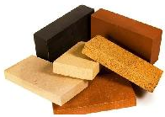
Introduction :
A refractory is any material that has an unusually high melting point and that maintains its structural properties at very high temperatures.

Slide 4
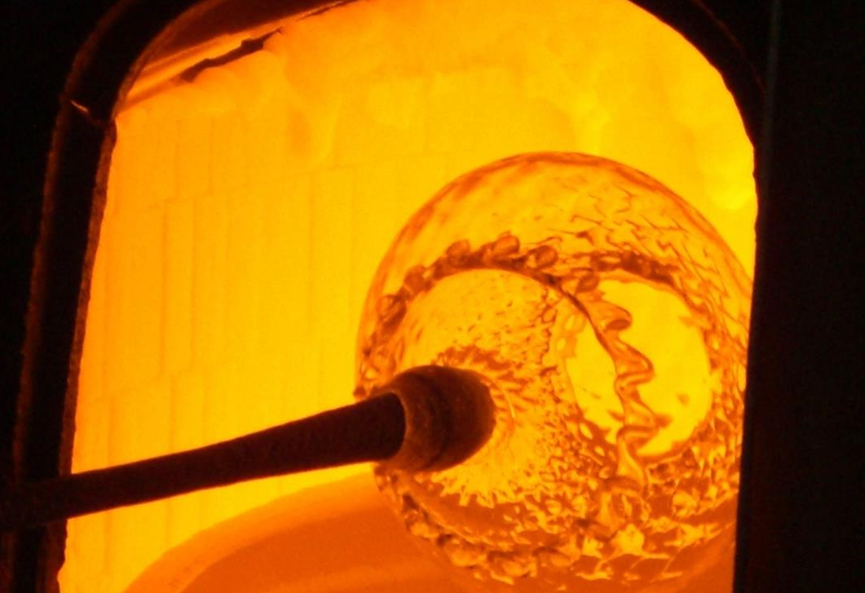
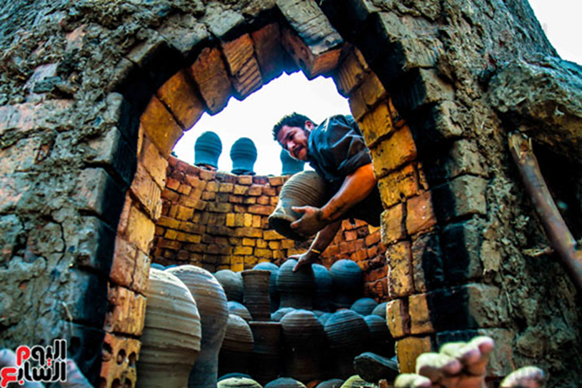
Refractories are employed in great quantities in:
glassmaking
ceramic industries

Slide 5
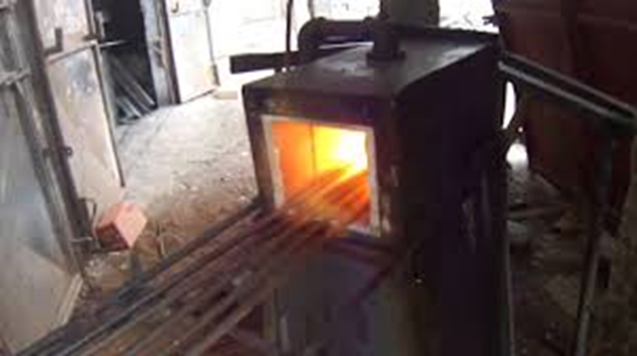
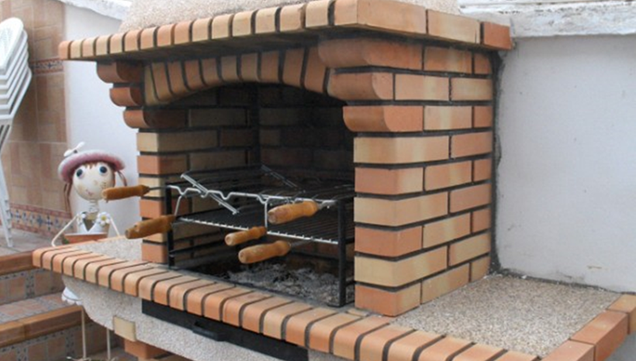
metallurgy
kilns

Slide 6

Refractory properties:
High melting point.
High mechanical strength at high temperature under load, high thermal shock resistance, low thermal shrinkage, low porosity and permeability.
Resistance to chemical attack.

Slide 7

problem statement:
In Palestine, the manufacture of the firebricks is not available. Therefore, the Palestinian market relies on imported products from abroad.

Slide 8

Thus, it aims to overcome many of the difficulties facing a particular category of projects that need furnaces reaching very high temperatures.

Slide 9
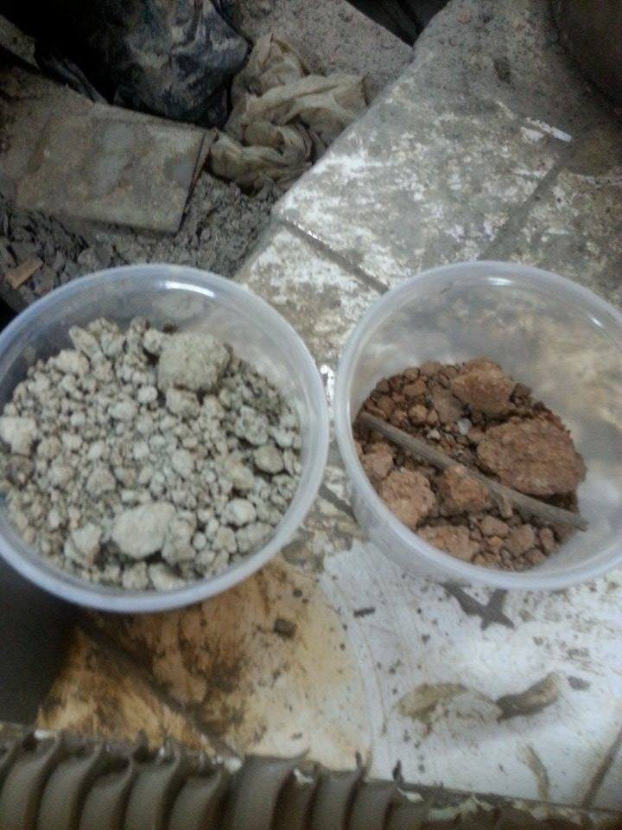
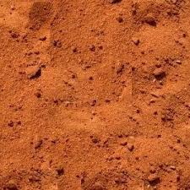
Materials:
First group materials:
Clay from Jaba, Jenin:
The material used consists in two types of clay: one of them is called zamhare and the other is a red clayey soil.
Sand:
we used sand to improve water absorption of clay.

Slide 10
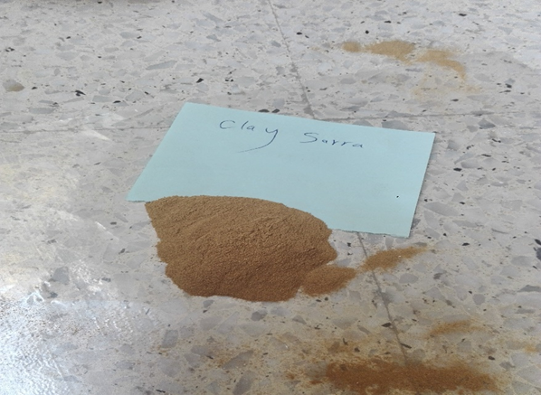
Second group materials:
Clay from Sarra:
This clay from Sarra, Nablus was used as binder to join the silica and calcium carbonate together.

Slide 11
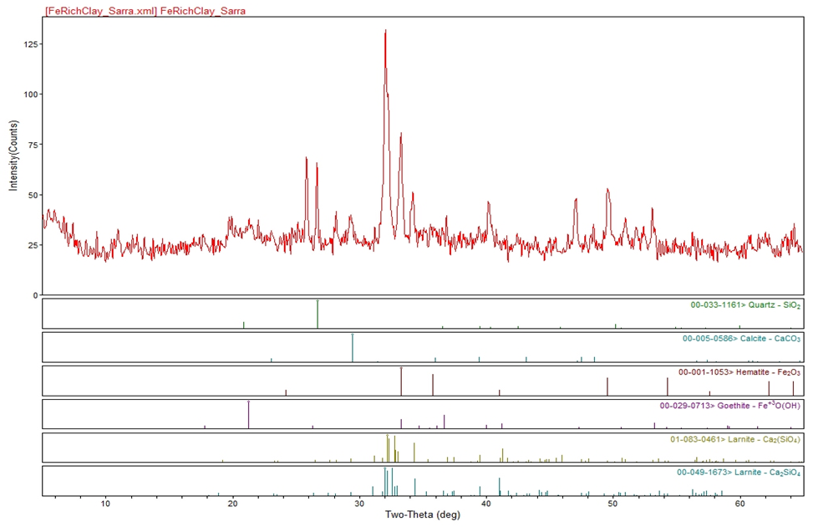
XRD characterization:

Slide 12

XRD pattern, shows major phases of Sarra clay are hydroxyapatite (Ca5(PO4)3(OH)), Quartz (SiO2) calcite (CaCO3), Hematite Fe2O3

Slide 13
Particle-Induced X-ray Emission spectrometry (PIXE):

Slide 14
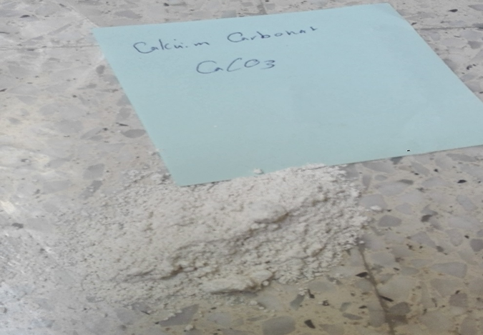
Limestone:
This project has been working on limestone resulting from stone cutting factories.
Limestone is predominately calcium carbonate, with minor amounts of magnesium carbonate, silica, clay, iron oxide, or carbonaceous material

Slide 15
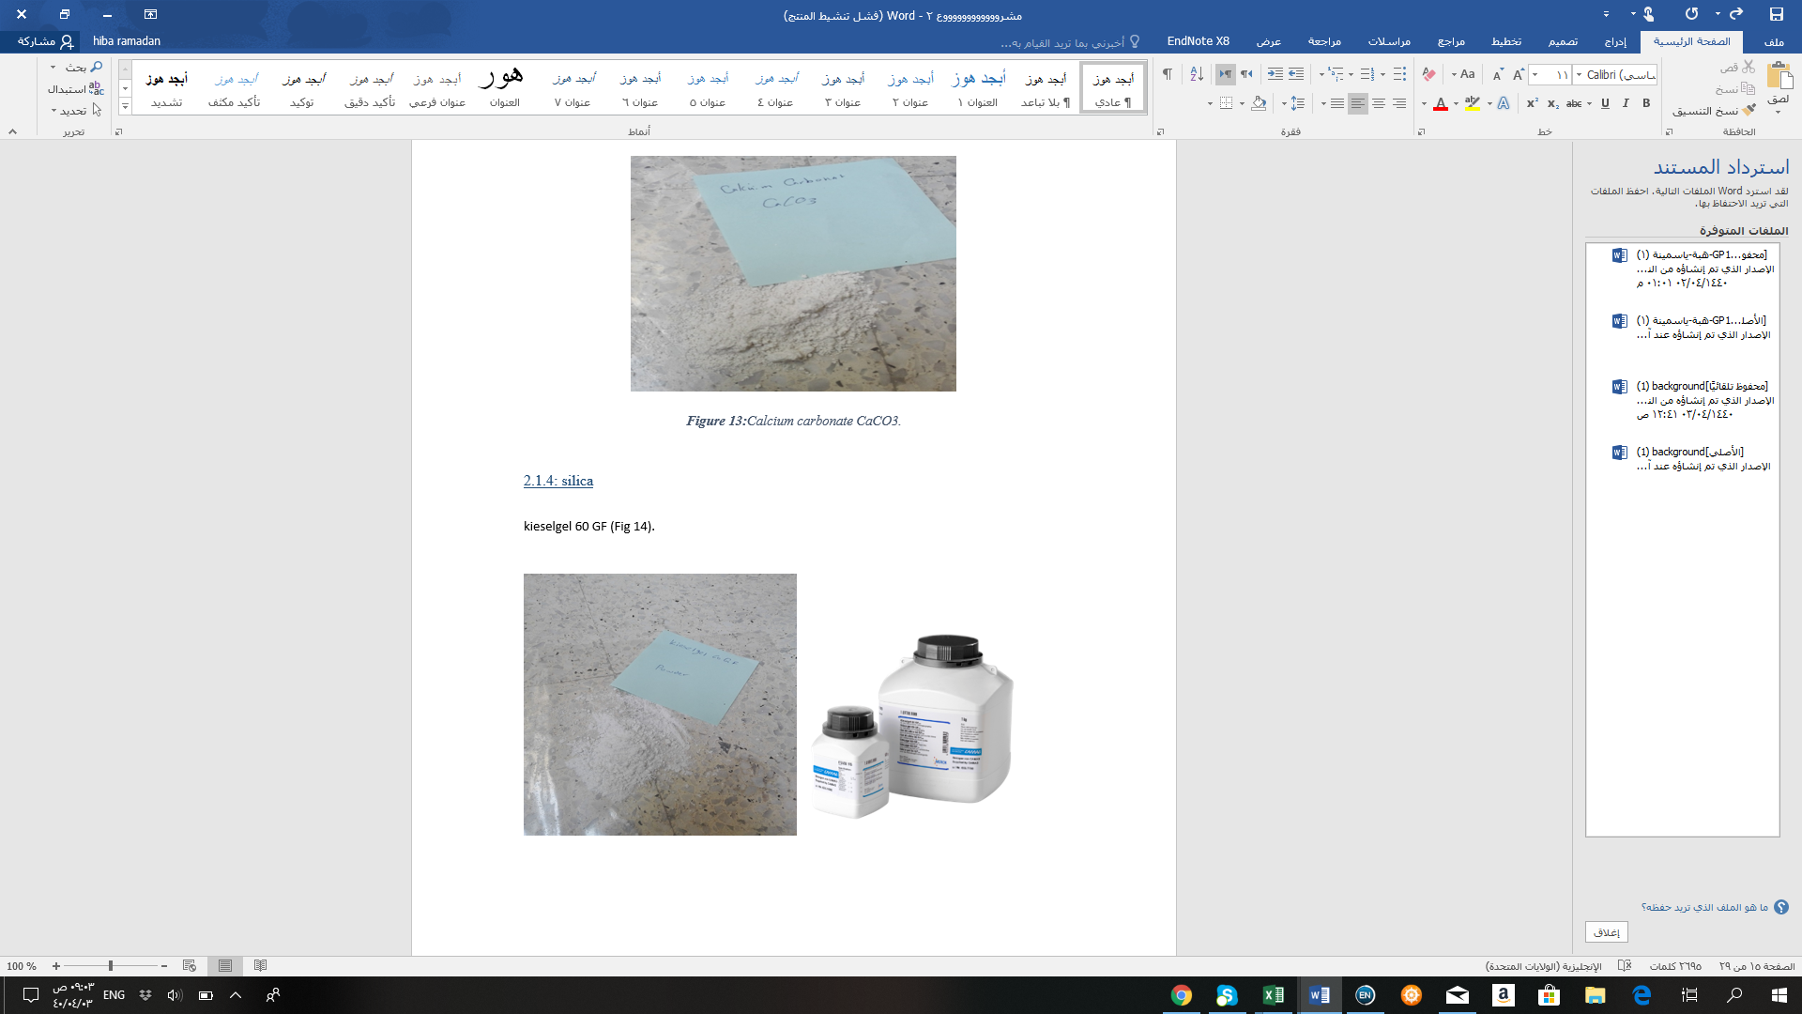
Silica:
Silica Kieselgel 60 GF, It is synthesis fine white powder made of silicon dioxide (SiO2) , Calcium sulfate (CaSO4), and water of Silicit acid (H4 SiO4) , zinc salt (1:2).

Slide 16

Preparation of samples for testing:
The first stage: Mixing
Work has been done on two groups:
Group I: The clay from Jaba was mixed with sand, (1:3) sand to clay ratio.
Group II: Calcium carbonate was mixed with silica (1:1) CaCO3 to SiO2), and 10% clay from Sarra was added.

Slide 17
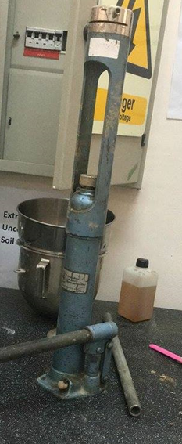
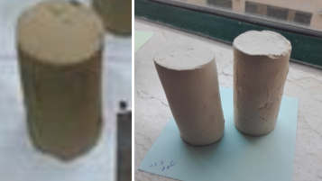
The second stage: Molding

Slide 18
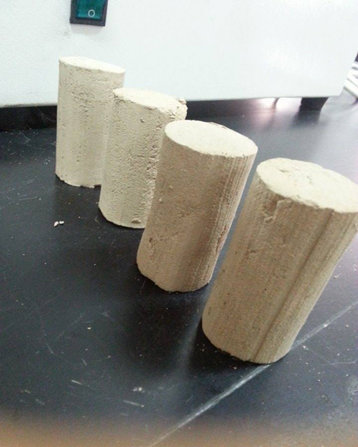
The third stage: Drying samples

Slide 19
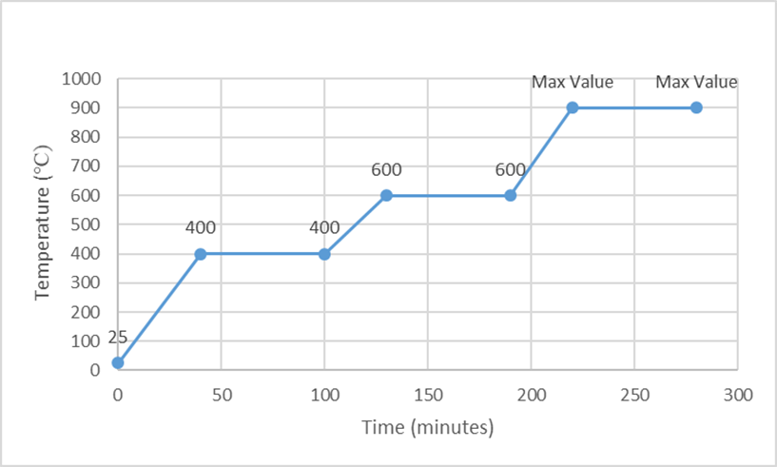
Final stage: Firing

Slide 20
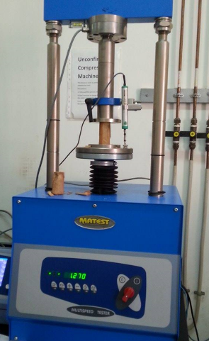
Tests:
Compression test

Slide 21
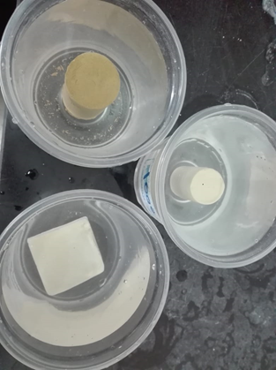
Absorption test

Slide 22
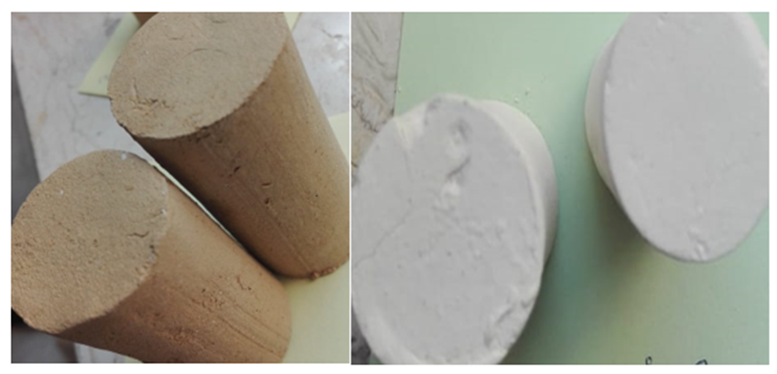
Color

Slide 23

Results

Slide 24
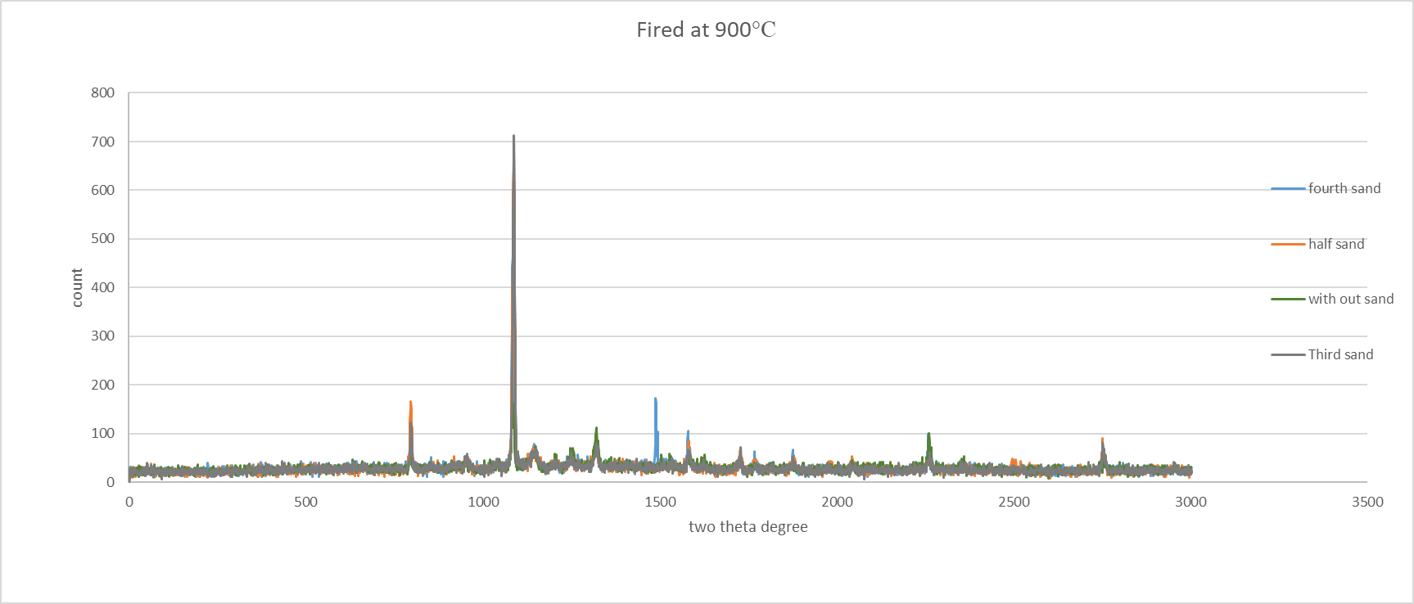
Results of the first project:
XRD Analysis of clay and sand groups :

Slide 25
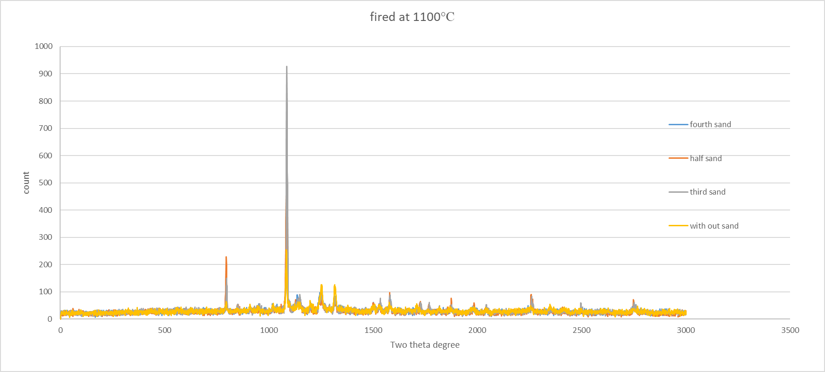
XRD Analysis of clay and sand groups at 1100 C:

Slide 26
From XRF analysis it found that the major components are:
Silica (SiO2)
Lime (CaO)
Alumina(Al2O3)
Hematite(Fe2O3)
Magnesia)MgO)
With different quantity in each group

Slide 27

Clay sand group results:

Slide 28
Compression Result:

Slide 29
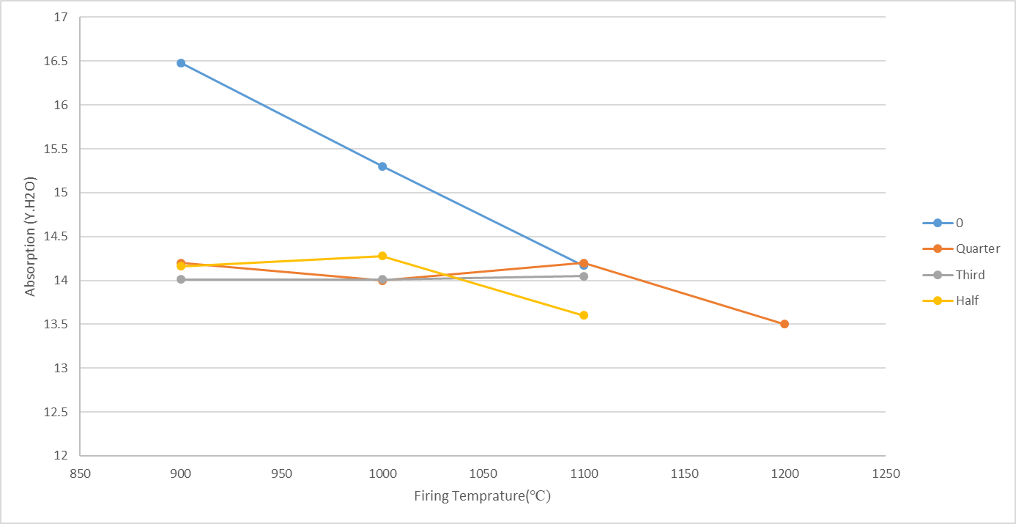
Absorption test result :

Slide 30
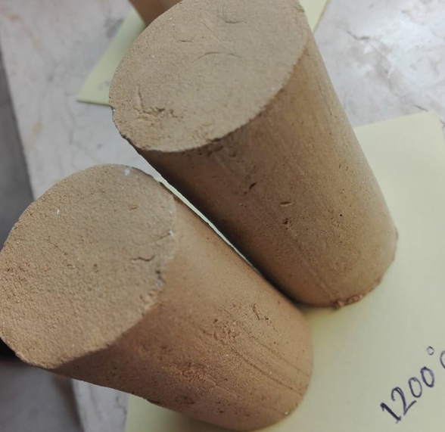
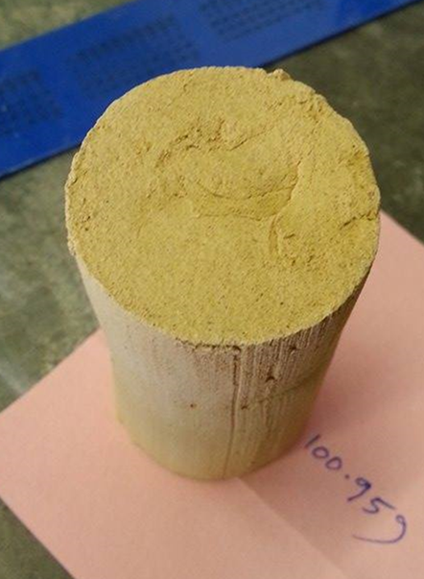
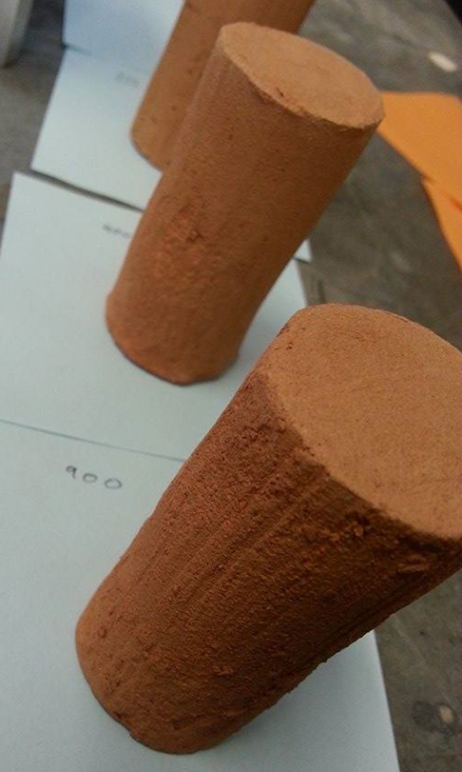
Color:
Color of samples fired at 1100℃.
Color of samples fired at 1200℃.
Color of samples fired at 900℃.

Slide 31

Calcium carbonate with silica groups results:

Slide 32
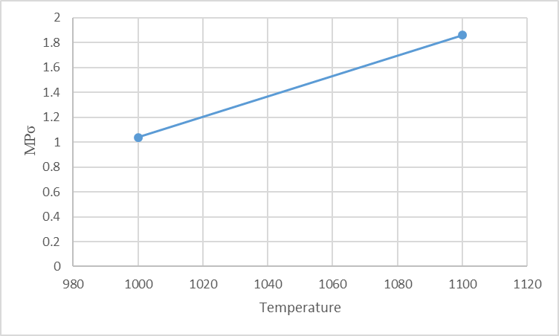
Compression Result:

Slide 33
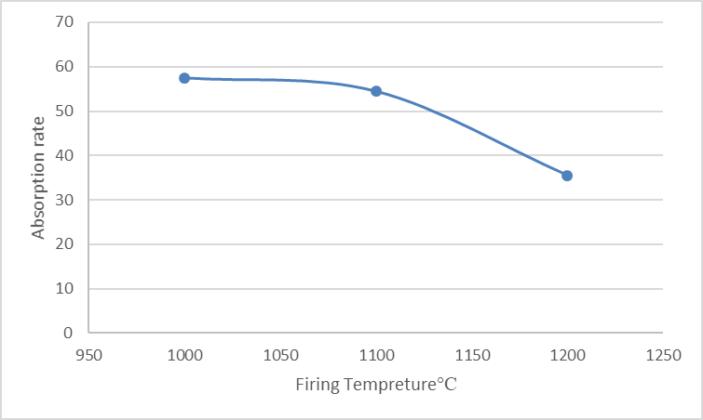
Absorption test result :

Slide 34
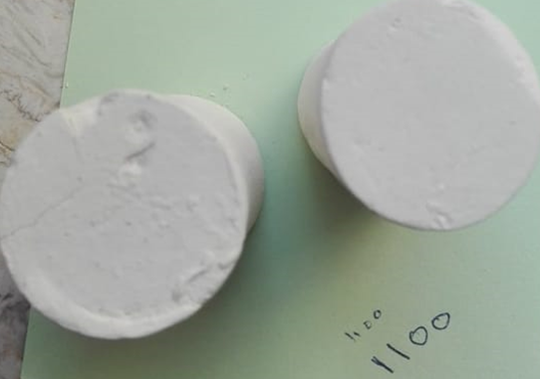
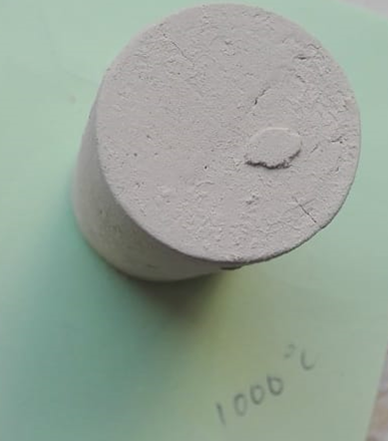
Color:
Color of samples fired at 1000℃.
Color of samples fired at 1100℃.

Slide 35
Conclusion:
The project has been working on the production of firebricks from the resources available in Palestine.
As part of the exploitation of Palestinian resources, working on investment in local markets, and work on low-cost domestic production as compared to the imported product. The material used is clay, from the Jaba area in Jenin and limestone from stun cutting factories in Jamaen.
After making the product and doing the necessary tests, from the results we got so far, it we believe that calcium silicate product can appear temperature above 1200C and we can improve it by add impurities

Slide 36


Slide 37

Have a nice Day

