Slide 1

Design of Kindergarten
Prepared By :
Adel Abdul-al
Shatha Abdul-Fattah
Yazan Ibraheem
Supervisor:
Eng. Ala’a Shaheen

Slide 2
Outline
Site location
Architectural Design
Environmental Design
Structural Design
Mechanical Design
Safety Design
Electrical Design
BOQ

Slide 3
Site Information
The site is located at Qaffen village in Tulkarm,
Street. slight slope which equals 2%( from west to east).
The land has an area of 3595m^{2.}

Slide 4
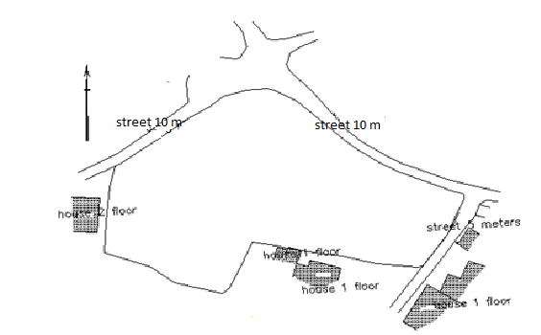
Site Information

Slide 5
Architectural Design
Outline:
Site plan
Circulation and entrances
Elevations
Sections

Slide 6
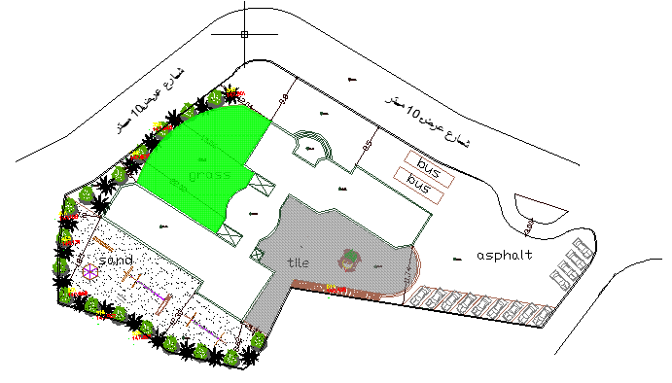
Site plan
Circulation &entrance
Area total=3595 m²

Slide 7
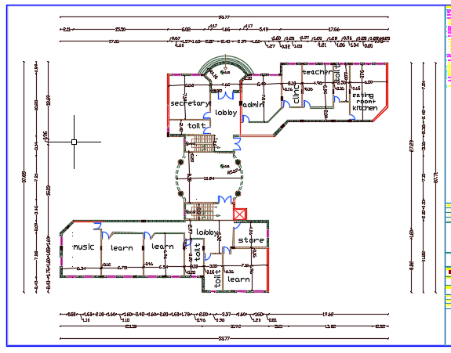
Ground Floor
Area=837m²

Slide 8
Ground Floor Areas
Space | Area
Eating room and kitchen | 52 m2
Teachers room | 34.5 m2
clinic | 22 m2
Administration | 46 m2
Secretary | 47 m2
Toilet | 15 m2
Entrance | 21.6 m2

Slide 9
lobby | 34 m2
Staircase | 20 m2
Class room 1 | 48 m2
Class room 2 | 47 m2
Class room 3 | 46 m2
Music room | 53 m2
Store | 22 m2
Toilet for class room | 18 m2
Note: all areas were taken according to Newfort reference

Slide 10
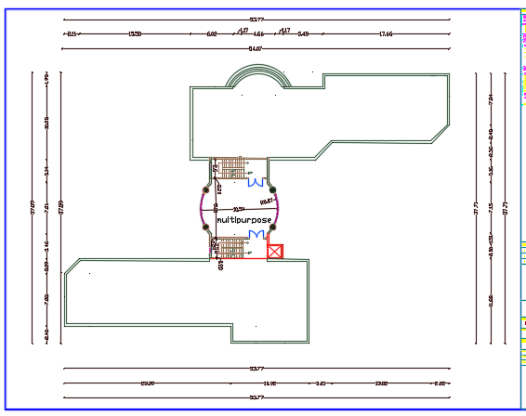
First Floor
Area=13m²

Slide 11
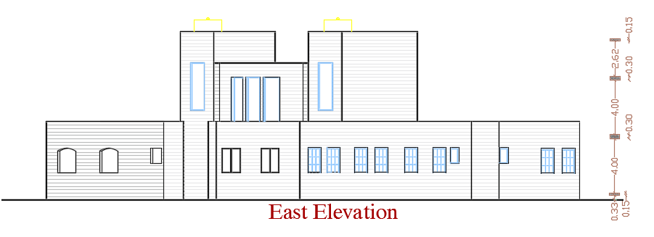
East Elevation

Slide 12
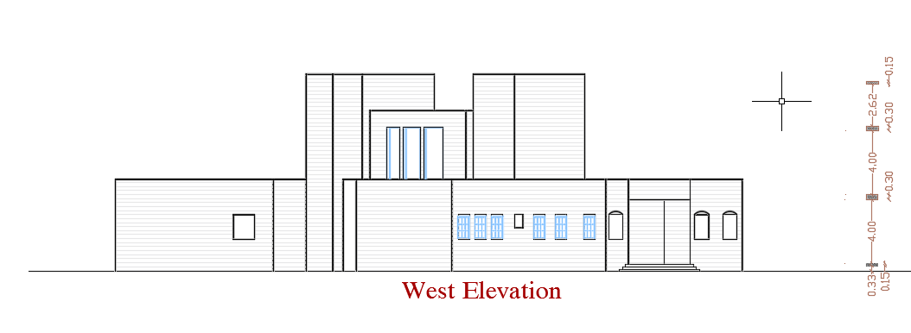
West Elevation

Slide 13
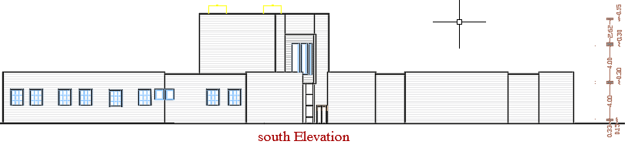
South Elevation

Slide 14
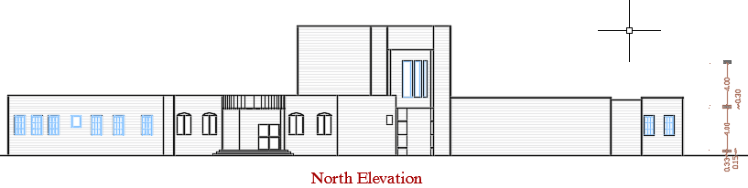
North Elevation

Slide 15
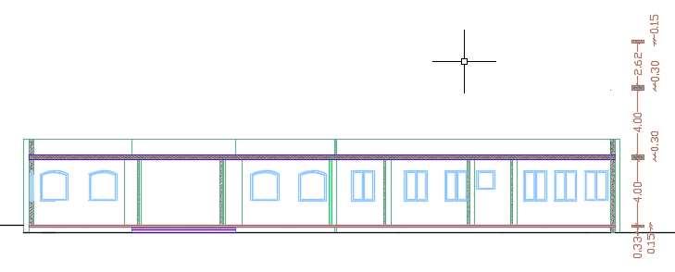
section A-A

Slide 16
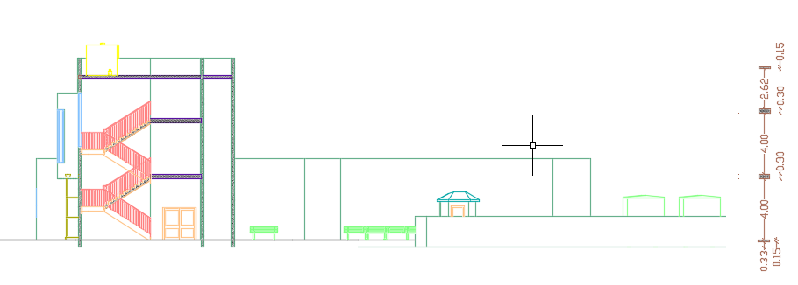
section B-B

Slide 17
Environmental Design
Outline :
Shading Design
Daylight factor
Thermal analysis
Acoustical design

Slide 18
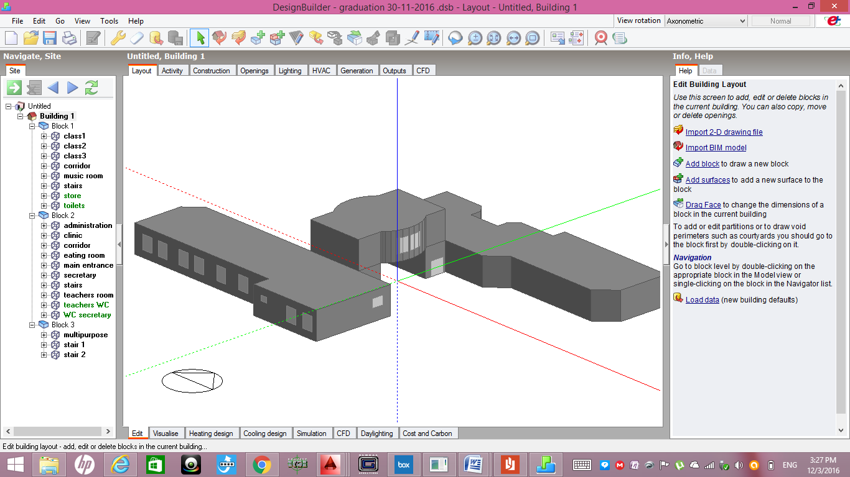
Design builder model

Slide 19
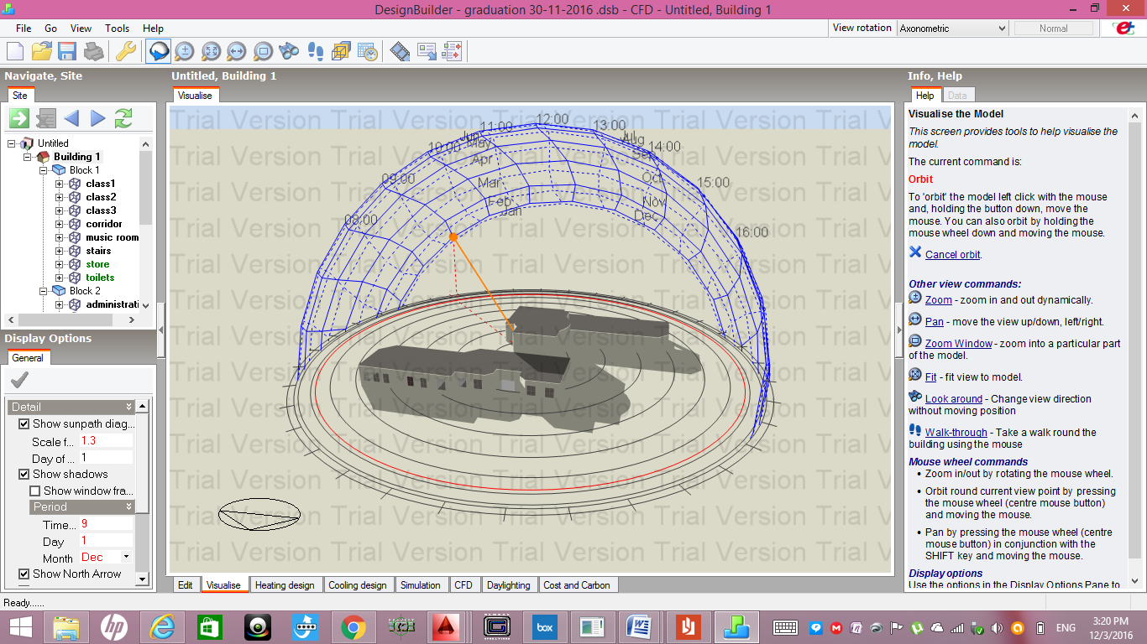
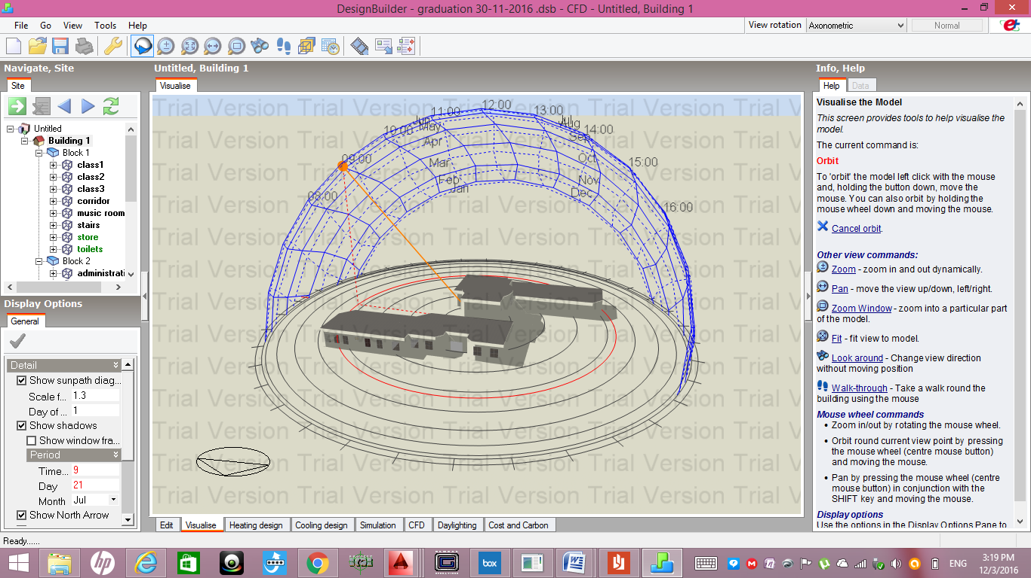
Shading Design
Dec 1st at 9:00 am
July 21st at 9:00 am

Slide 20
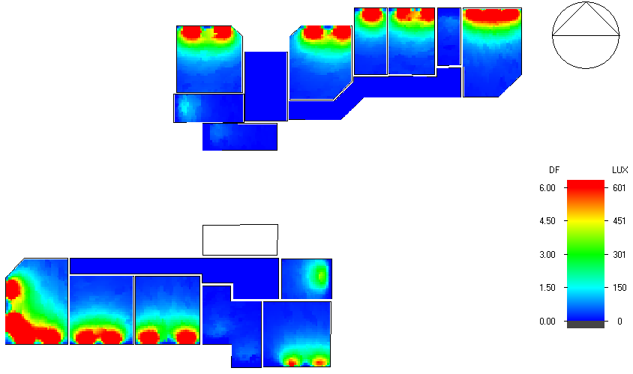
Daylight factor

Slide 21
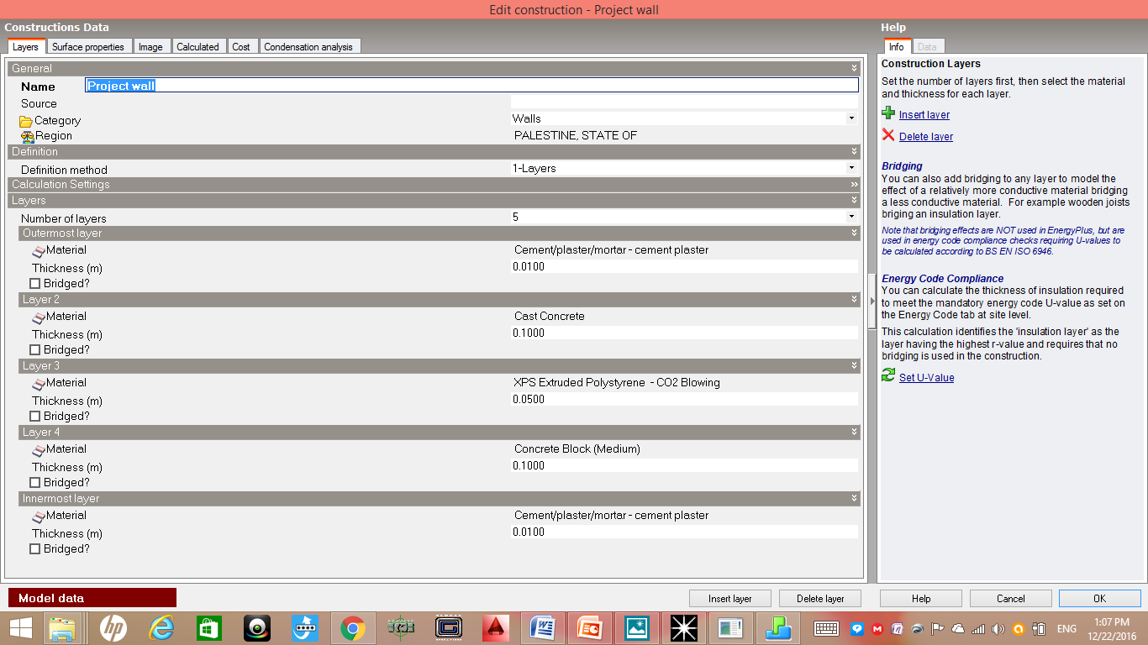
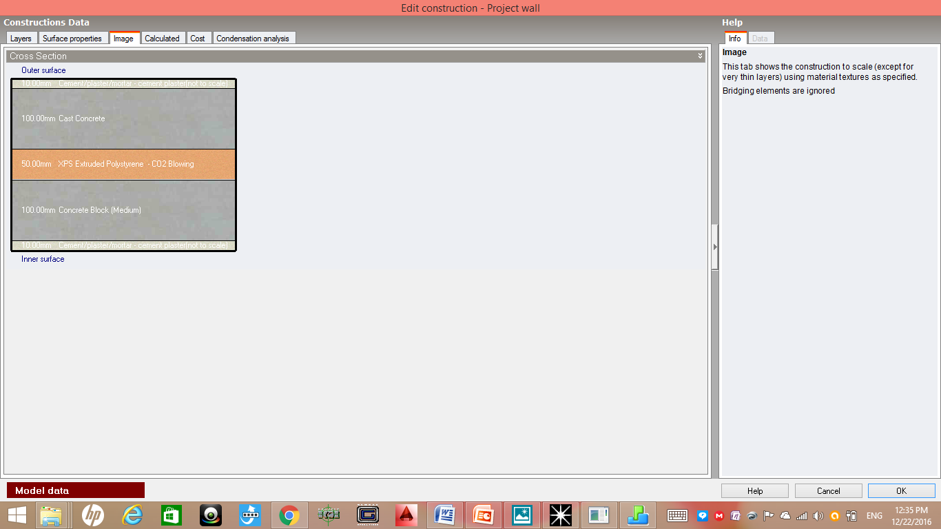
Materials :
1-External Walls

Slide 22
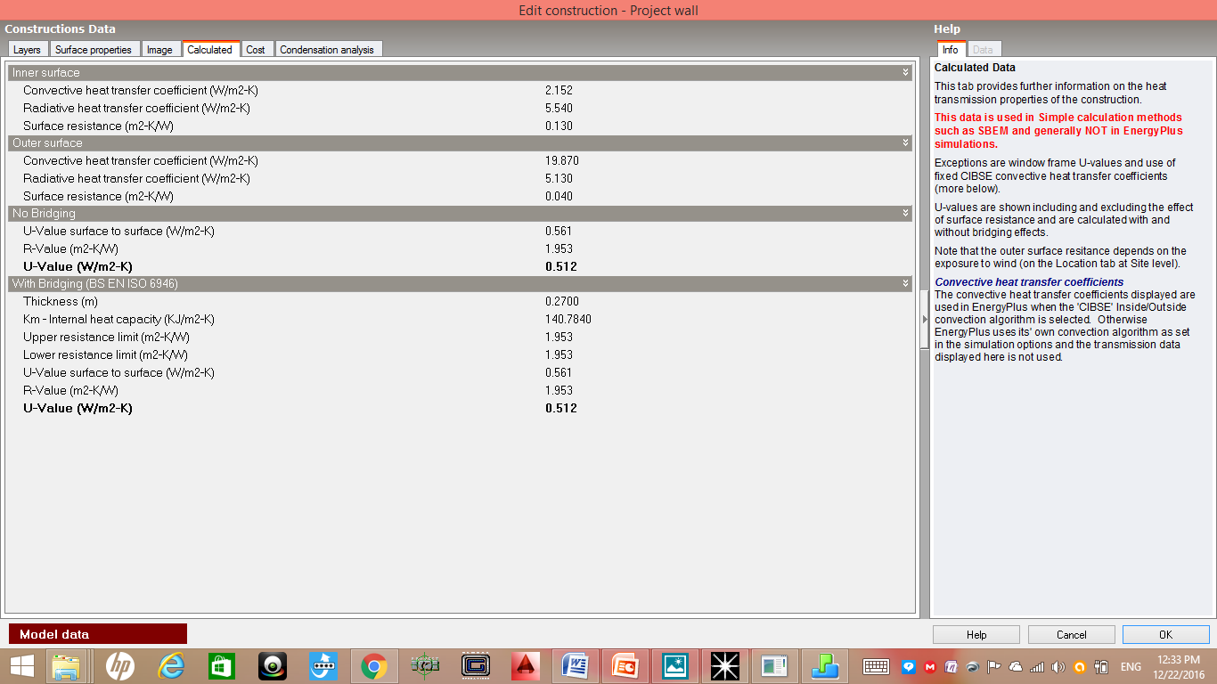
External Wall Properties
U-Value=0.512 W/m2.K

Slide 23

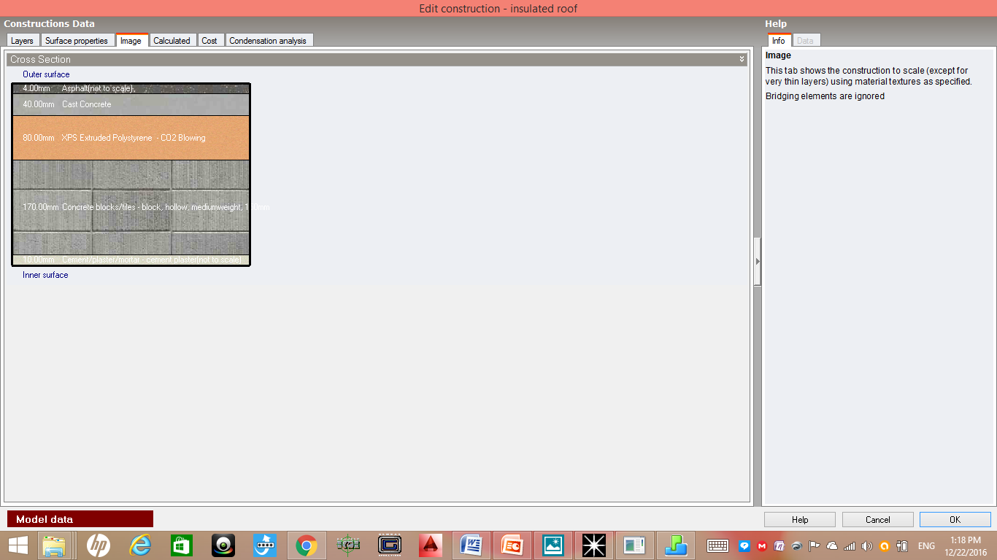
2- Flat Roof

Slide 24

Flat roof properties
U-Value=0.354 W/m2.K

Slide 25
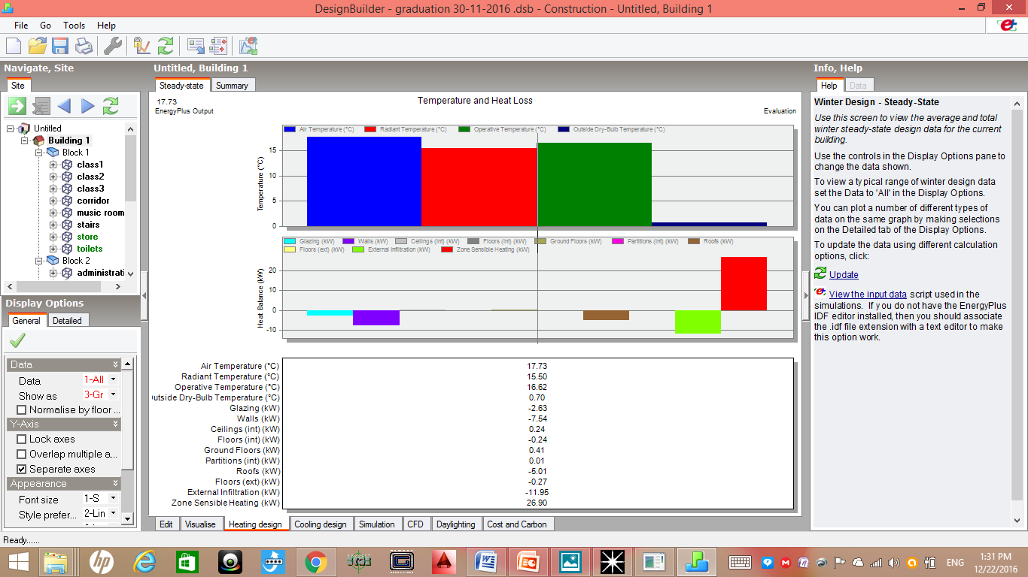
Heating loads in kindergarten

Slide 26
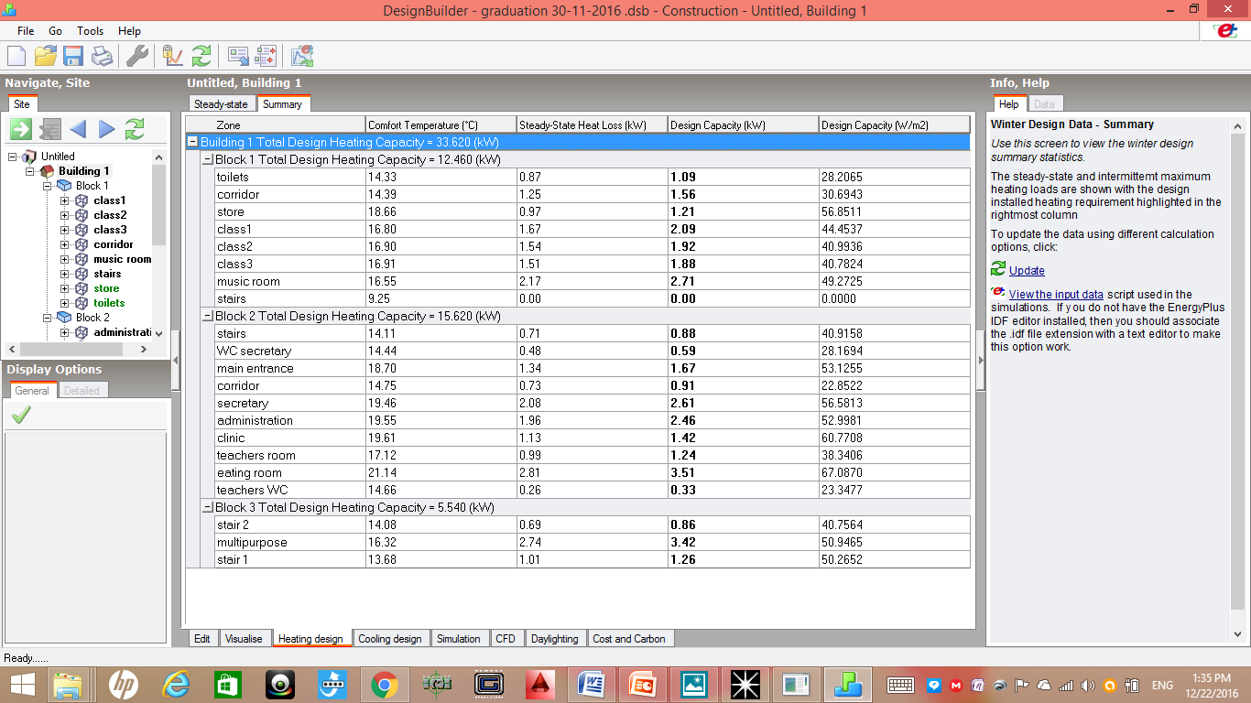
Heating loads in kindergarten
Total heating capacity =33.62 KW

Slide 27
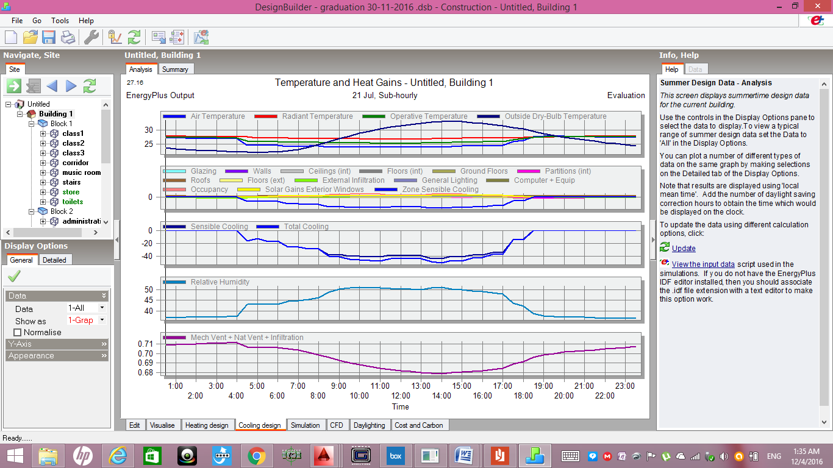
Heating loads in kindergarten

Slide 28
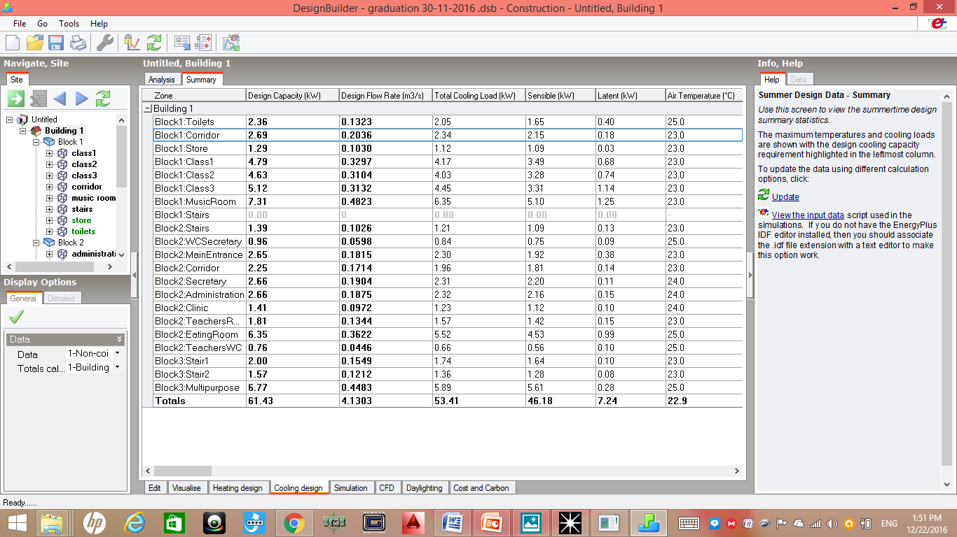
Cooling loads in kindergarten
Total cooling capacity=61.43 KW

Slide 29
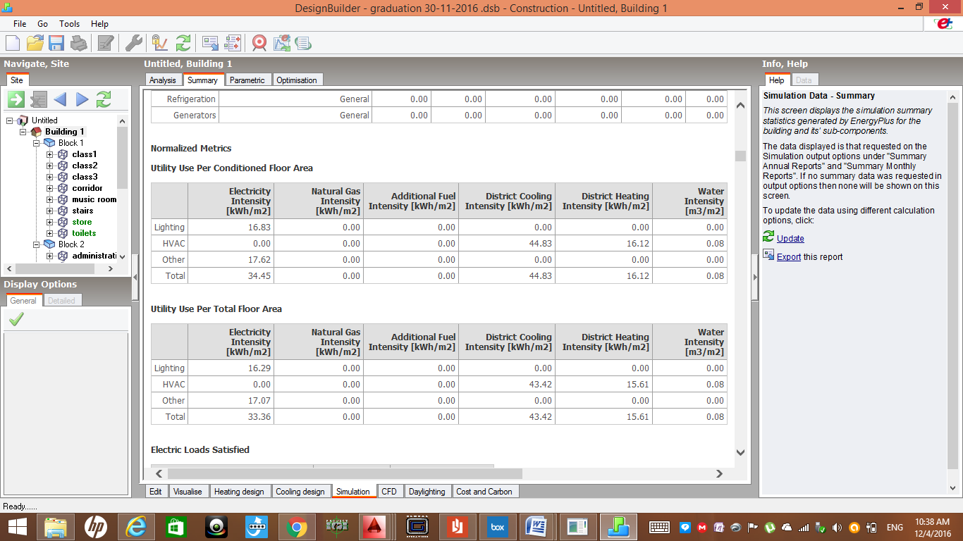
Simulation results
The use of lighting =16.83 KWh/m2
The use of cooling=44.83 KWh/m2
The use of heating=16.12 KWh/m2

Slide 30
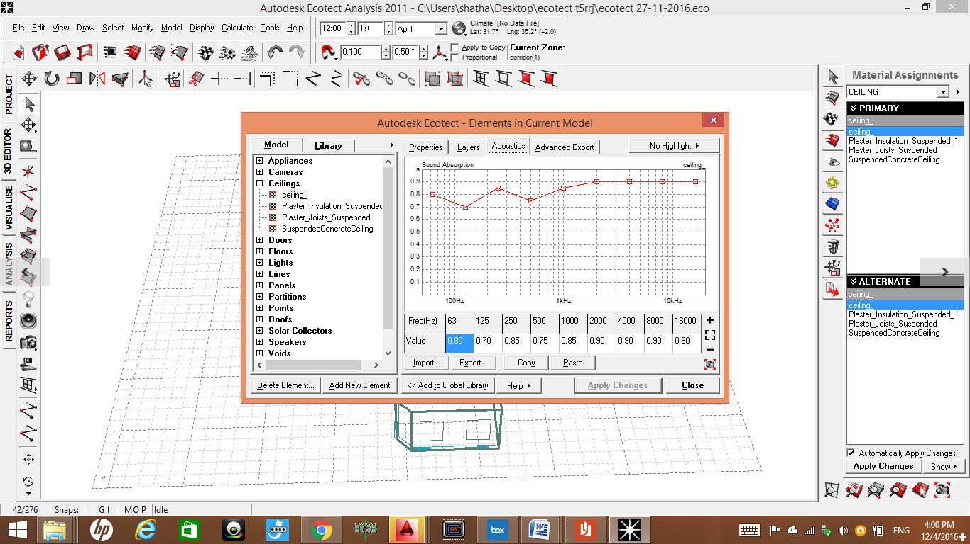
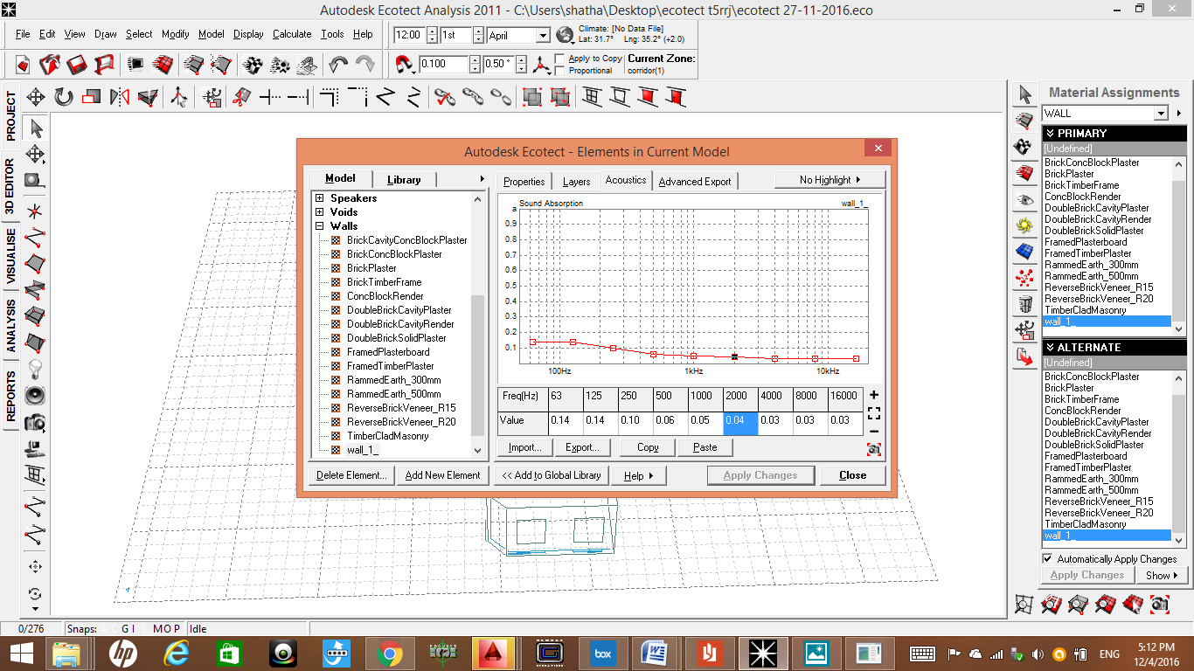
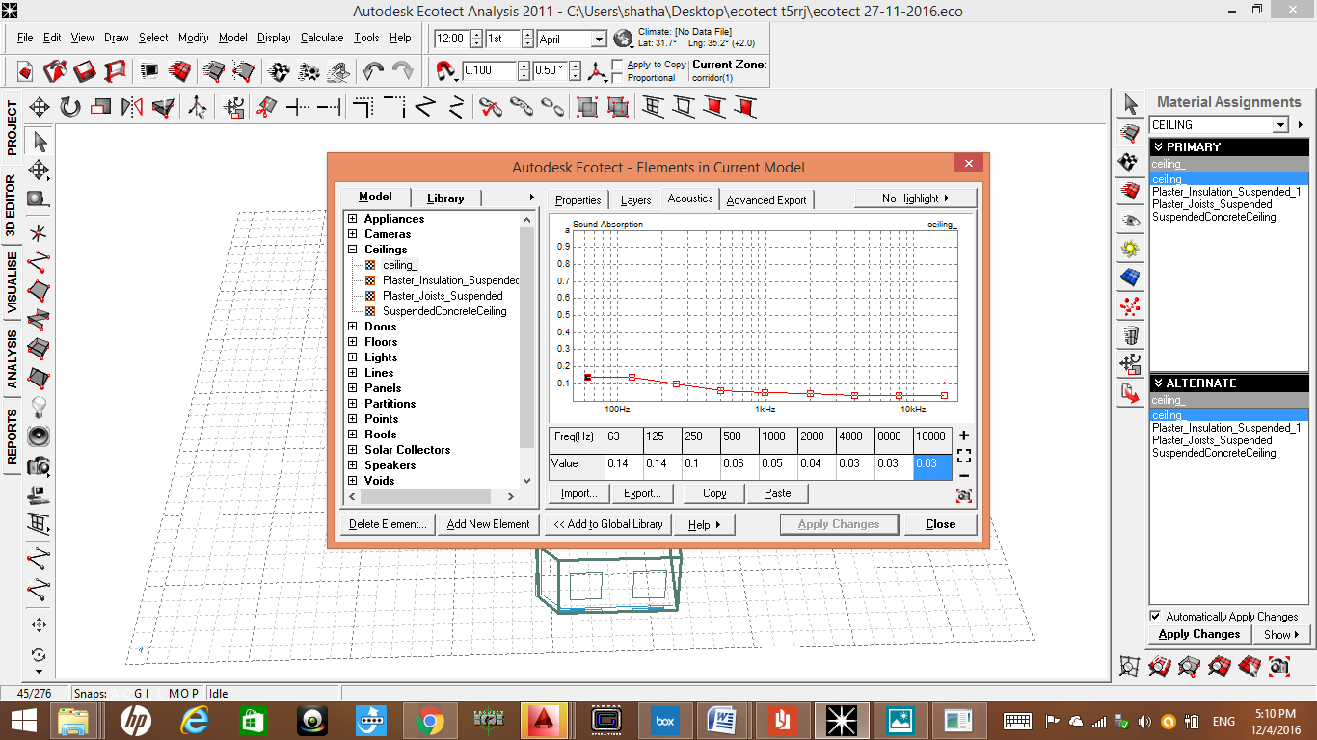
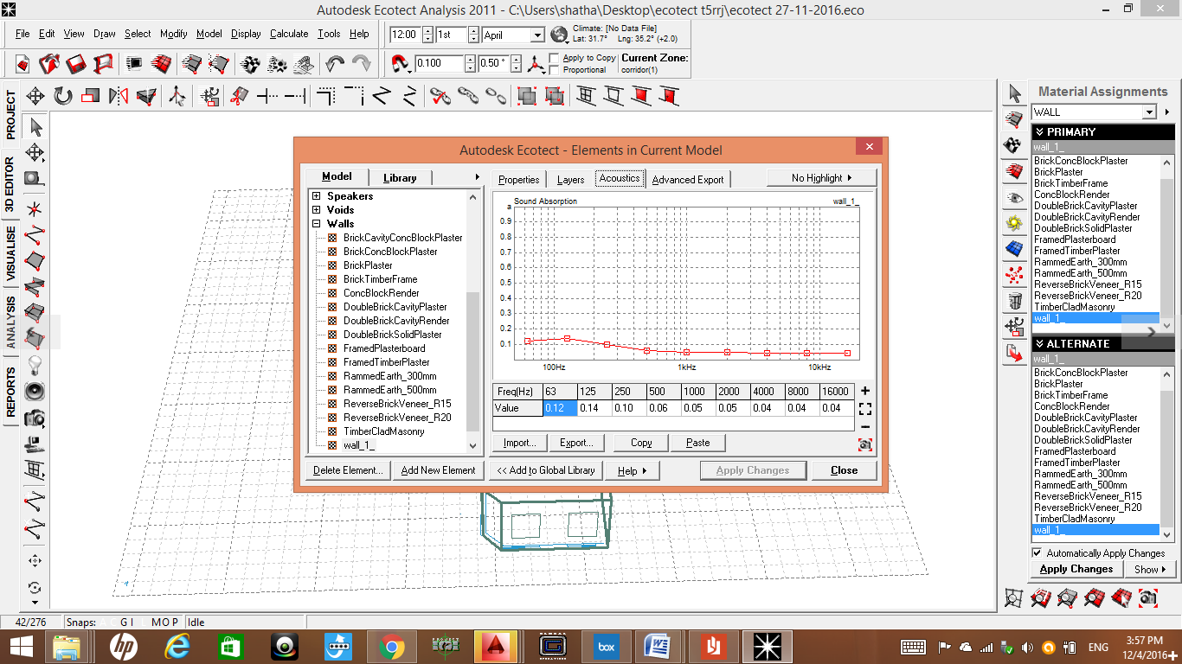
Absorption coefficient values
Absorption coefficient for ceiling before treatment .
Absorption coefficient for walls before treatment .
Absorption coefficient for ceiling after treatment .
Absorption coefficient for walls after treatment .

Slide 31
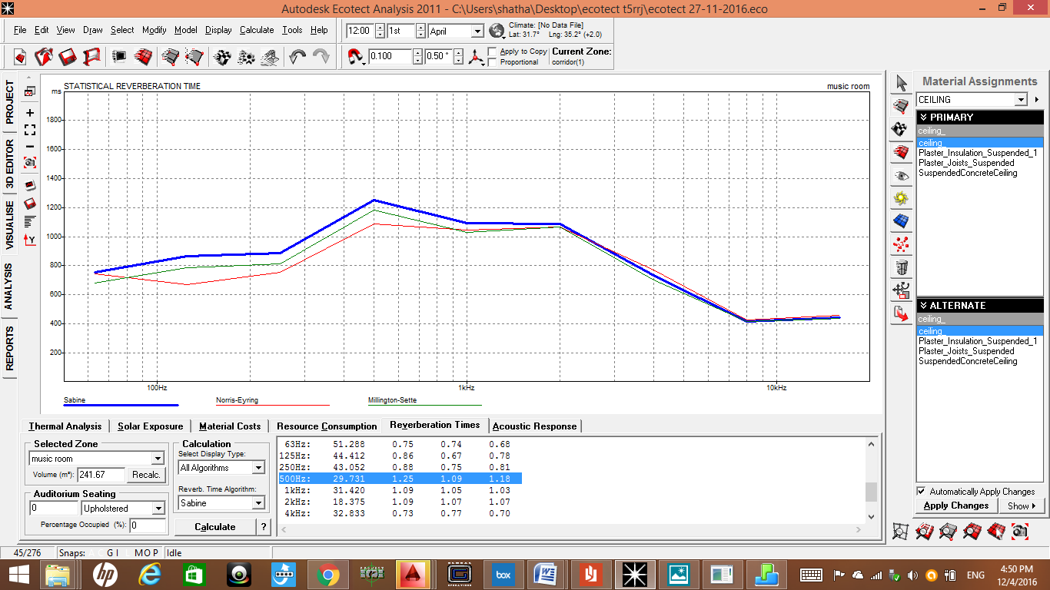
Reverberation time:
1-Music Room
RT60 range for music room is from 1.2-1.4 seconds .
RT60 for music room = 1.25 seconds at 500HZ .

Slide 32
Reverberation time
2-Secretary room
RT60 range for secretary rooms
From (0.6-0.9) seconds .
RT60 for secretary room = 0.75 seconds at 500HZ .
Volume: 212.220 m³ |  |  | Surface Area: 224.141 m²
Occupancy: 0 (0 x 0%)
Most Suitable: Sabine (Uniformly distributed) |  |  | Selected: Sabine (Uniformly distributed)
Frequency | Total Absorption | Sabine RT(60) | NOR-ER RT(60) | MIL-SE RT(60)
63Hz | 52.822 | 0.64 | 0.65 | 0.56
125Hz | 45.688 | 0.74 | 0.59 | 0.66
250Hz | 42.811 | 0.78 | 0.69 | 0.71
500Hz | 44.480 | 0.75 | 0.73 | 0.68
1kHz | 35.447 | 0.88 | 0.90 | 0.82
2kHz | 35.107 | 0.79 | 0.85 | 0.74
4kHz | 39.209 | 0.63 | 0.70 | 0.59
8kHz | 21.886 | 0.40 | 0.41 | 0.39
16kHz | 15.414 | 0.31 | 0.31 | 0.31

Slide 33
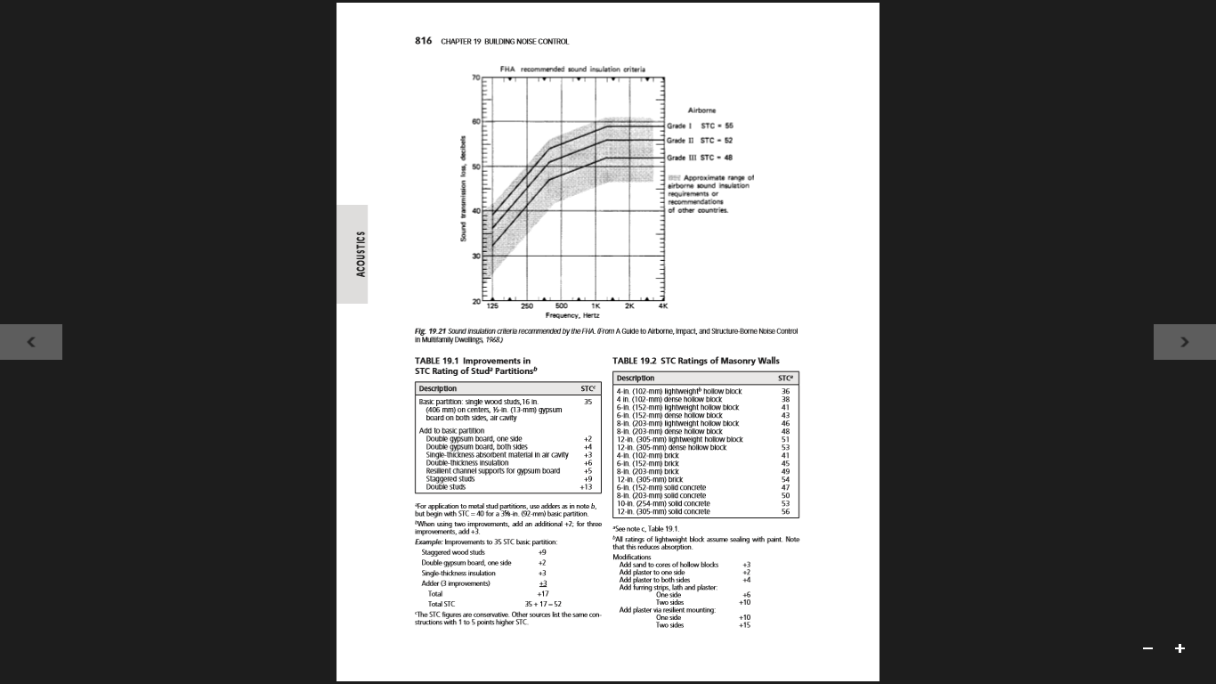
STC Values:
STC | Before treatment | After treatment
wall | 46 dB | 50 dB
partition | 35 dB | 50 dB
Studs(+9dB) and double thick insulation(+6dB) is the treatment for partitions.
Plaster to both sides (+4dB) as treatment for walls.

Slide 34
Structural Analysis
Outlines :
Design Codes
Design Data
Stuctural Elements
ETABS Results
Detailings

Slide 35
Design codes
The American Concrete Institute code (ACI 318-11).
The seismic design according to UBC-97.
The analysis and design were done using SAP2000, and ETABS 2015 programs.

Slide 36
Design Data
Concrete compressive strength
f`c = 24 MPa
Yielding strength of steel
fy = 420 Mpa
Bearing capacity of soil
3kg/cm2

Slide 37
Structural system
Concrete structure:
One way ribbed slab
thickness of 30 cm

Slide 38
Structural elements
Concrete structure
Beams
Columns
Slabs
Stairs
Footings
Shear walls

Slide 39
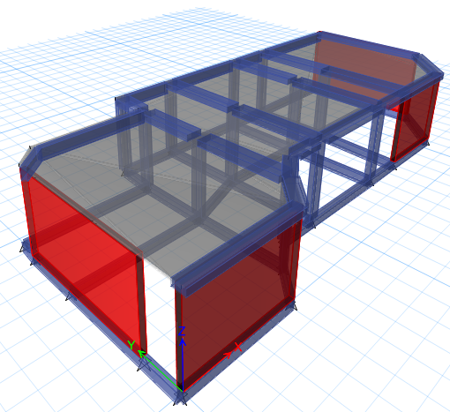
3D Structural Modeling
For Block1

Slide 40
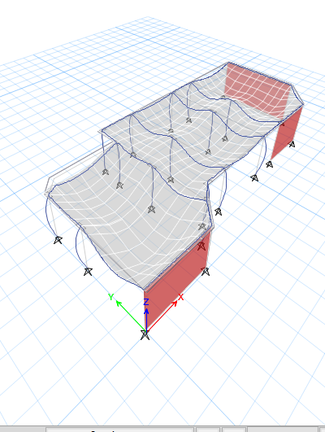
Compatibility check

Slide 41
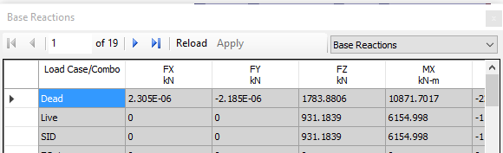
Equilibrium Check
Load | Manual calculations | ETABS results | %Error
Live | 915.2 | 931.2 | 1.7%
Dead | 1805.9 | 1783.9 | 1.2%
SID | 915.2 kN | 931.2 | 1.7%

Slide 42
Stress-Strain Check
Element | Ultimate force from ETABS | Ultimate force calculated manually | % Error
Column | 389.85 kN | 364 kN | 6.6%
Beam | 154 kN.m | 151.02 kN.m | 2%
Slab | 52.8 kNm/m | 55.7 kN.m/m | 7%

Slide 43
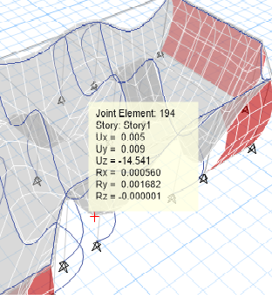
Deflection Check
Max. allowable check = L/240 = 9.11/24= 37mm>max. deflection in the structure = 14

Slide 44
Seismic Design(Response spectrum)
Important factors that we should know:
I(importance factor) = 1.25
R = 5.5
Ca (seismic coefficient) = 0.20
Cv (seismic coefficient) = 0.20
T (period) = 0.074 sec.
Z = 0.2
Soil profile Sb

Slide 45
Period Check
T manual= 0.048*(4)¾=0.138 sec.
T from ETABS = 0.074 sec.
T from ETABS should be less than 1.3Tmanual.
The period is OK.

Slide 46
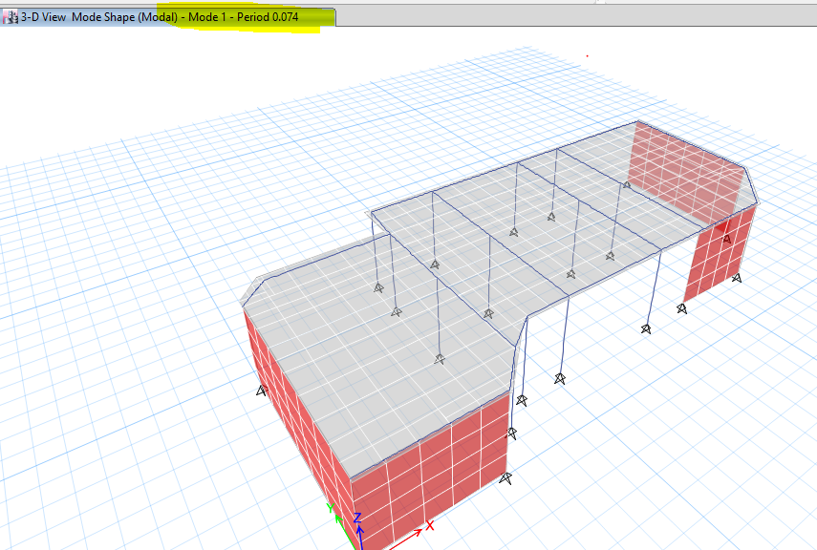

Slide 47
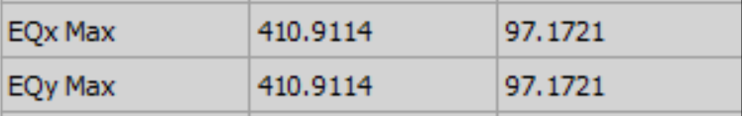
Base shear (V) from ETABS :
EQx and EQy = Vmax.

Slide 48
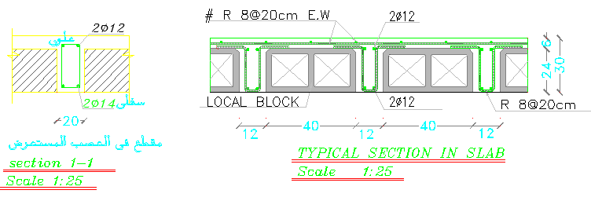
Cross and longitudinal section in slab:

Slide 49
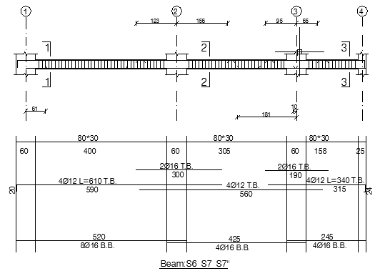
Beam detailing

Slide 50
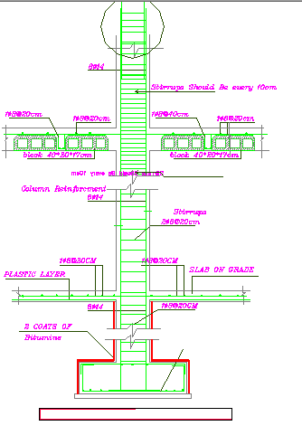
Column detailing

Slide 51
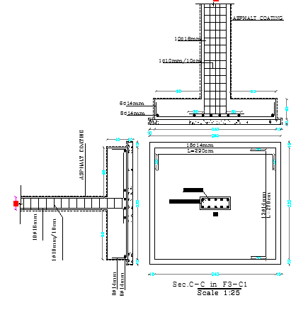
Footing detailing:

Slide 52
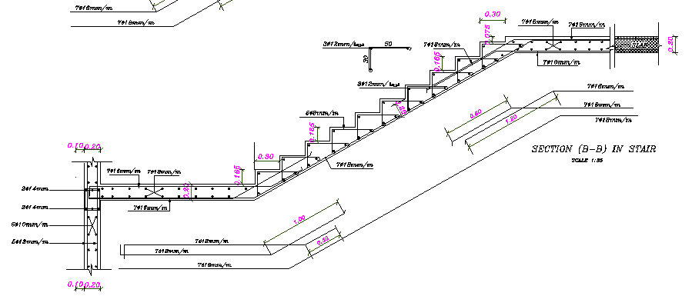
Stair Reinforcement:

Slide 53
Mechanical Design
Outlines:
Water supply system
Drainage system
HVAC

Slide 54
Water consumption
Total building of water demand = 1400 L / day
(according to municipality of Tulkarm )
Average water consumption / child/day in KG = 15L/child/day

Slide 55
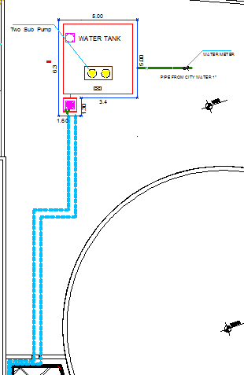
a water tank of 2m3

Slide 56
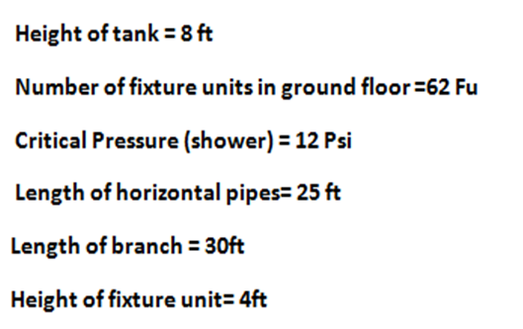
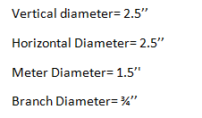

Slide 57
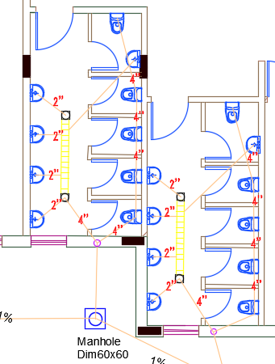
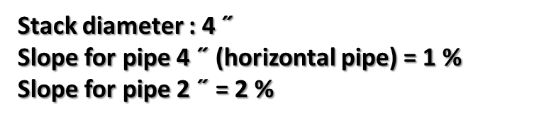
Drainage system for Ground Floor
This KG have 142 dFu

Slide 58
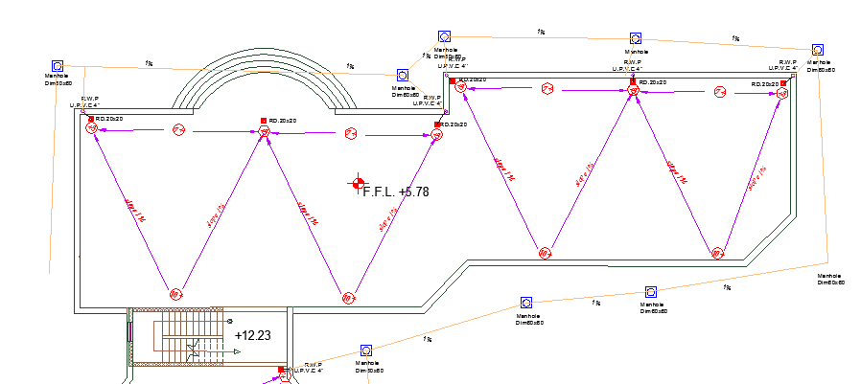
Roof and Storm water Drainage

Slide 59
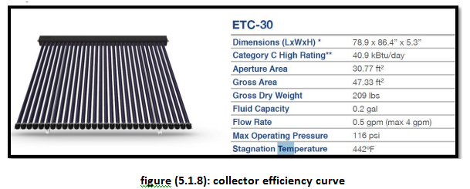
Domestic hot water:

Slide 60
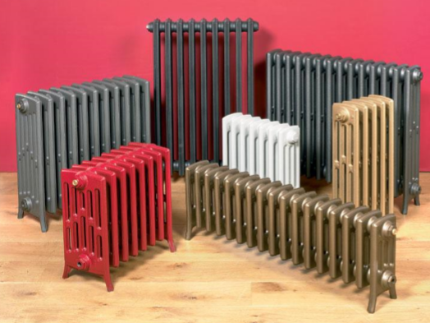
HVAC Design
The used HVAC system is Radiators system:

Slide 61
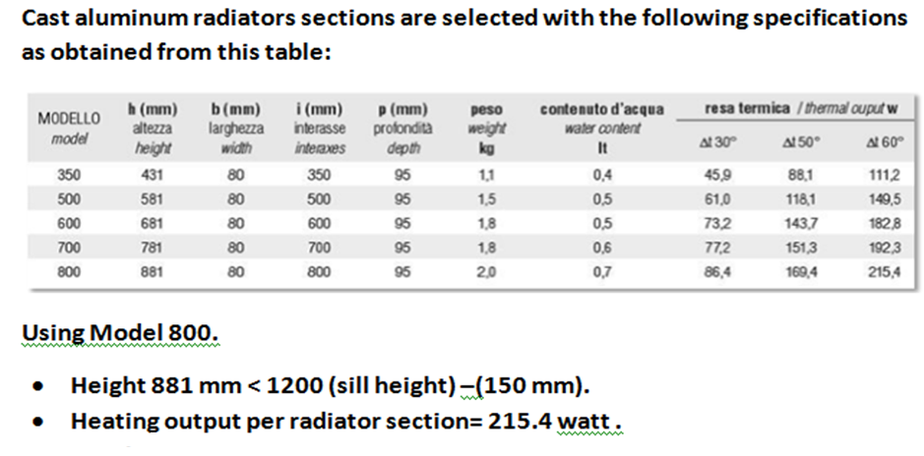

Slide 62
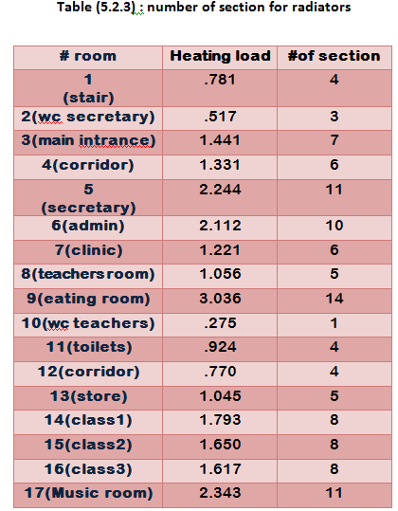
Number of sections of radiators

Slide 63
Annual Fuel Consumption:
Mf = 24𝑄∗𝐷𝐷 (𝑇𝑖−𝑇𝑜)∗𝐶𝑉* (𝐶𝑑/ ɳ)
=24∗70∗3600∗1126.6 18∗39000* (0.75/ 0.8 ) =9100kg/season
The volume of diesel fuel tank: Vf = 9100/850 = 10.70 m3

Slide 64
Expansion Tank.
According to the Boiler Capacity, the minimum Tank Volume shall be not less than 250Liter.

Slide 65
Boiler Chimney.
Boiler uses diesel as fuel.
Combustion Efficiency for diesel (ɳ)= 80%.
Calorific Value of diesel (C.V) = 39000 kJ/kg.
ṁ g = mass flow rate of flue gases leaving chimney.
ṁ f =mass flow rate of fuel.
Velocity (v) = 3-5 m/s . Use 5 m/s.
Fuel gases density (ρg)=1.1 kg/m3.

Slide 66
Then the chimney diameter of the boiler is: Dc = 0.1188m (118.8 mm)
∴The chimney diameter is 240mm.

Slide 67

Pipe sizing:

Slide 68


Slide 69
Safety Design
outline
Fire Fighting System
Safety signs

Slide 70


Safety/Fire Fighting System

Slide 71


Fire Fighting System
Hose and extinguishers cabinet
Fire alarm device

Slide 72


Safety signs
Emergency exit signs.
Don’t use the elevator in case of fire

Slide 73
Electrical Design
Socket distribution
Lighting distribution
Dialux

Slide 74

Distribution of Sockets

Slide 75

Lighting Distribution

Slide 76


Type of lighting units/Dialux 4.12
Class room 1
Class room 1
PLAT LED luminair
Uo=0.595

Slide 77


Type of lighting units/Dialux 4.12
Teachers room
Uo=0.535
Type: OSRAM luminair

Slide 78


Artificial Lighting from Dialux 4.12 Program
Class room rendering
Teachers room rendering

Slide 79
BOQ
Total cost of project= 321623.8 $
Total building area= 953 m2
Price of 1 m2 =337.49 $

Slide 80
Thanks for your listening

