Slide 1
Chalet Reservation Website
Baker Shaheen
Mohammad Sayeh

Slide 2
Introduction
In Palestine, people often spend their time, especially during summer holidays, visiting chalets as they are one of the few entertainment options available in the country. As we know, entertainment choices are very limited in Palestine. Recently, there has been a noticeable increase in people's interest in this type of leisure activity, particularly with the widespread use of social media. This has led to a growing demand for chalets in recent times. A 2023 study indicates that the number of chalets has reached hundreds and continues to grow

Slide 3
Project Overview
A web platform for chalet reservations
Users can browse, book, and pay online
Ensures security, convenience, and efficiency

Slide 4
Technologies Used
React (Frontend: Fast, interactive UI)
Spring Boot (Backend: Secure, scalable API)
Stripe (Payments: Secure transactions)
PostgreSQL (Database: Reliable, scalable storage)

Slide 5
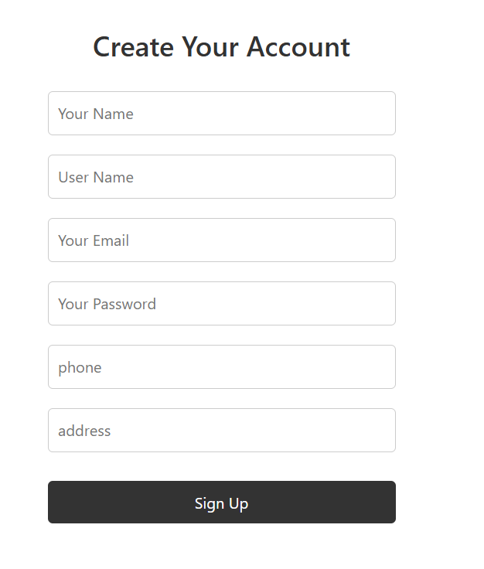
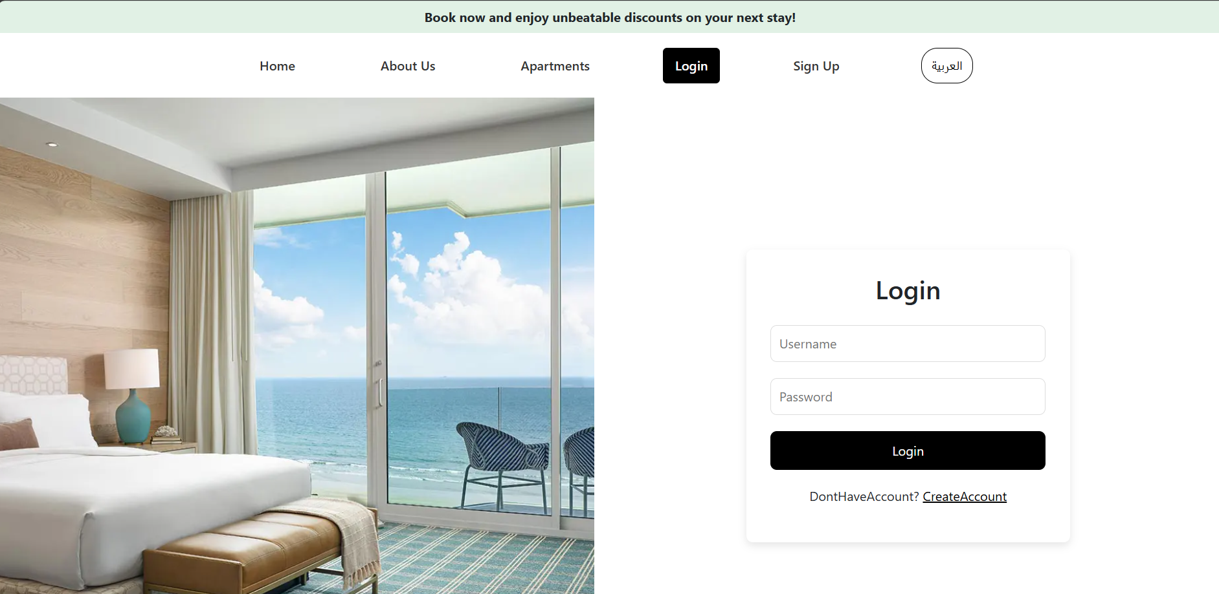
Key Features
User Authentication (Login & Sign up)

Slide 6
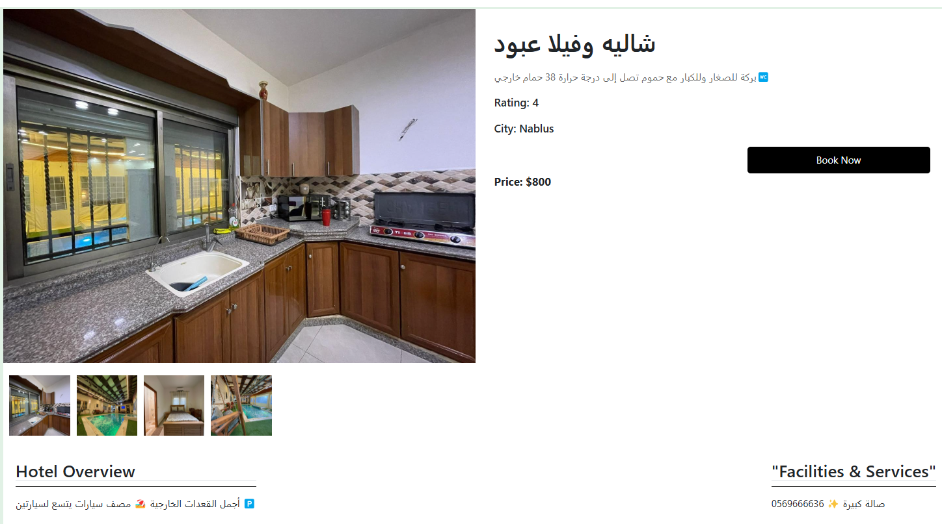
Key Features
Chalet Browsing (Images, details, availability

Slide 7
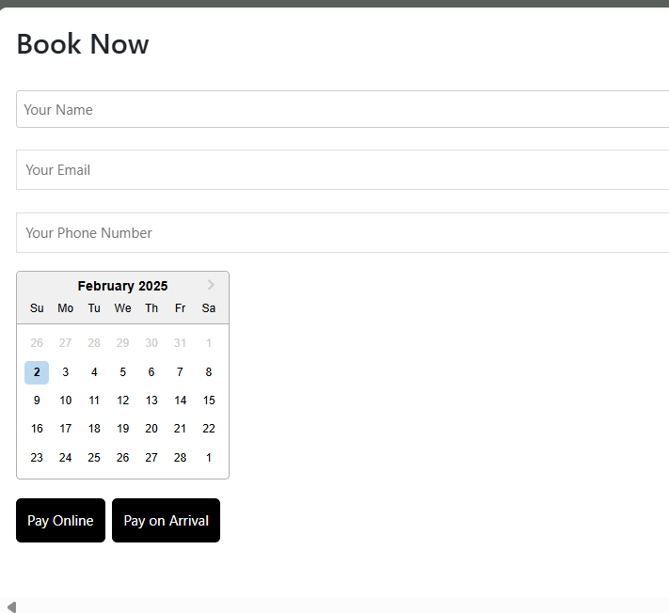
Key Features
Online Reservation (Book based on available dates)

Slide 8
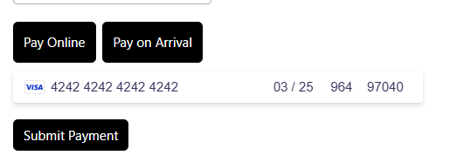
Key Features
Secure Payments (Stripe integration)

Slide 9
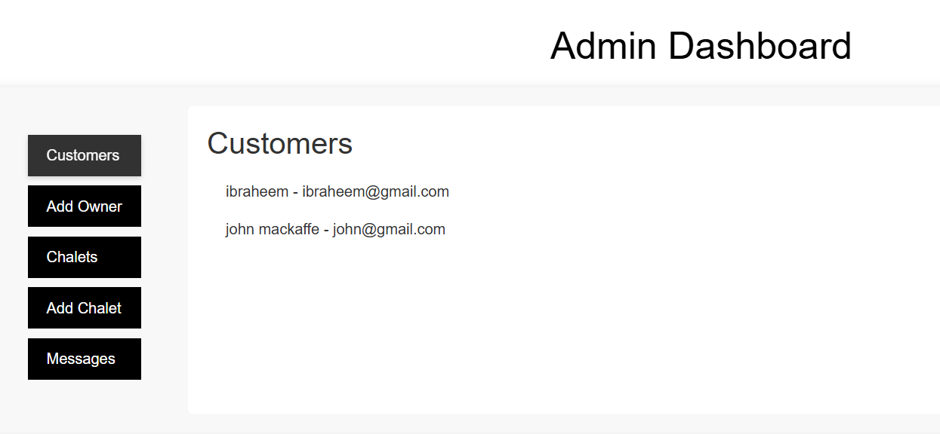
Key Features
Admin Panel (Manage bookings, users, payments)

Slide 10
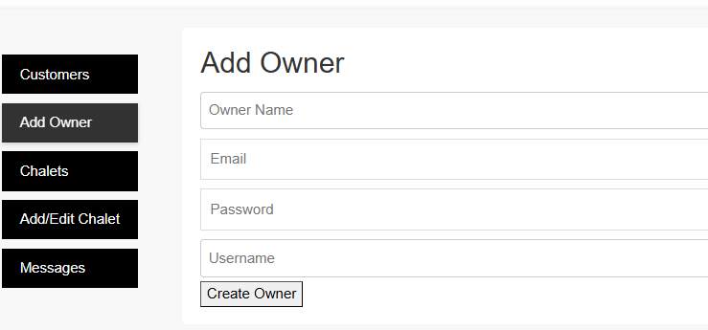
Key Features
Admin Panel (Manage bookings, users, payments)

Slide 11
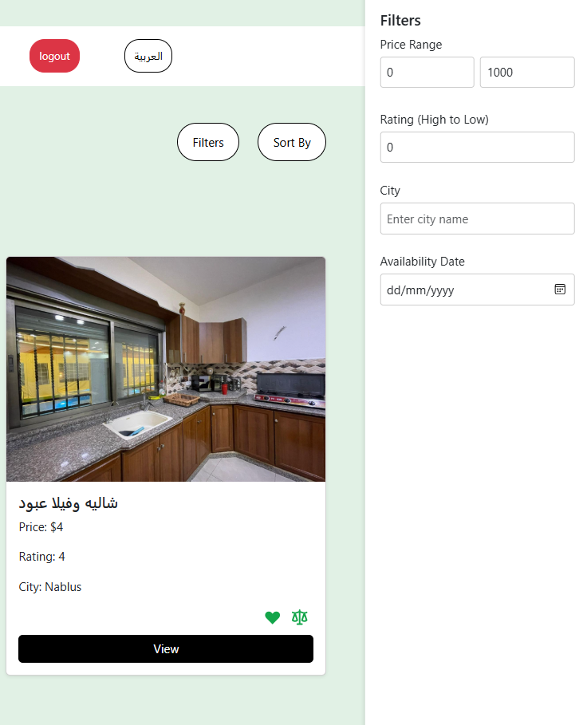
Key Features
Search Chalet (Filter, sort)

Slide 12
Benefits & Conclusion
Automates and simplifies chalet booking
Secure and reliable payment processing
Saves time for users and chalet owners
Scalable and efficient system

Slide 13
Future Work
Add Location GPS.
Add recommendation system.
Add dynamic pricing and seasonable discounts.
Add advanced search filters

