Slide 1
An-Najah National University
Faculty of Engineering
Graduation Project Report 2
(Noise pollution in Nablus city)
By
Mohammad Hani Qasem - 11642737
Malik Ahmad Obaid – 11612102
Mohammad Ramadan Naji-11642315
Under supervision of: Dr. AbdelhaleemKhader

Slide 2
INTRODUCTION
General background:
A noise measurement plan has been developed in the city center of Nablus, and implementation has begun in the Al-Shuhada Square near the commercial complex, to determine noise levels and sources, and making use of monitoring results to reduce noise levels, improve the quality of the surrounding environment,
This project aims to alleviate the pressure to reduce the noise levels in the square and the surrounding streets, thus achieving a positive impact on the health of citizens.

Slide 3
  The objective of studying:
1- The study aims to identify and define the forms of physical pollution resulting from human activity.
2- The concept of noise pollution in detail (its causes, types, effects, and prevention). An assessment of the level of noise to which the citizen is exposed.
3- And the search for the best ways and means to reduce noise pollution.

Slide 4
  Significance of the projects :
Noise is one of the environmental pollutants affecting human
health, as the European Environment Organization stated that 451 million people are regularly exposed to noise. The negative effects of noise are not limited to, hearing loss or part of it, but also to reach the stage of causing fatal diseases.
And by causing permanent disabilities in some cases, including heart attack.

Slide 5
  Approach
In order achieve this project, the following steps will be applied:
Conducting literary research and studies related to the study of noise pollution and its application to the study area.
Visit the website to take measurements.
Summarize the main results obtained

Slide 6
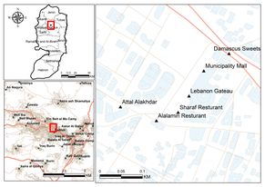
  Study area:
Shuhada Square of Nablus City(Study area)

Slide 7
METHODOLOGY

Slide 8
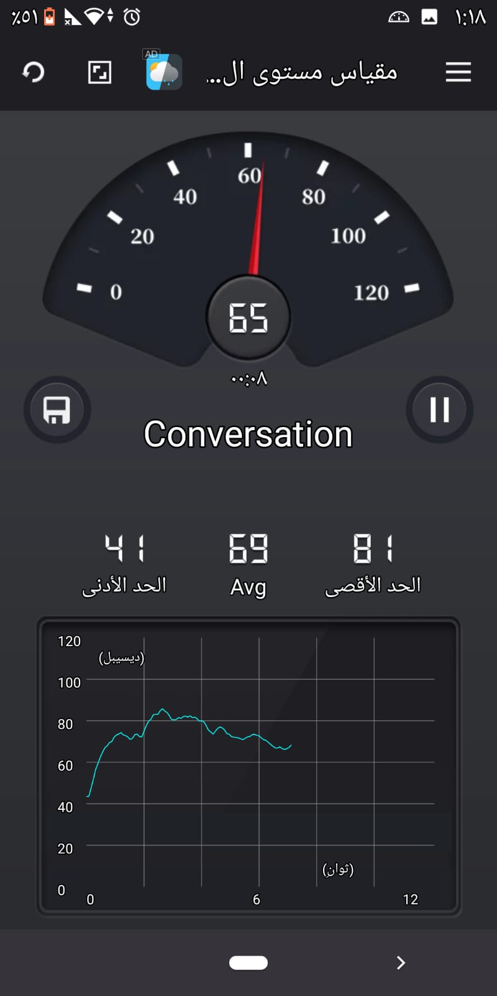
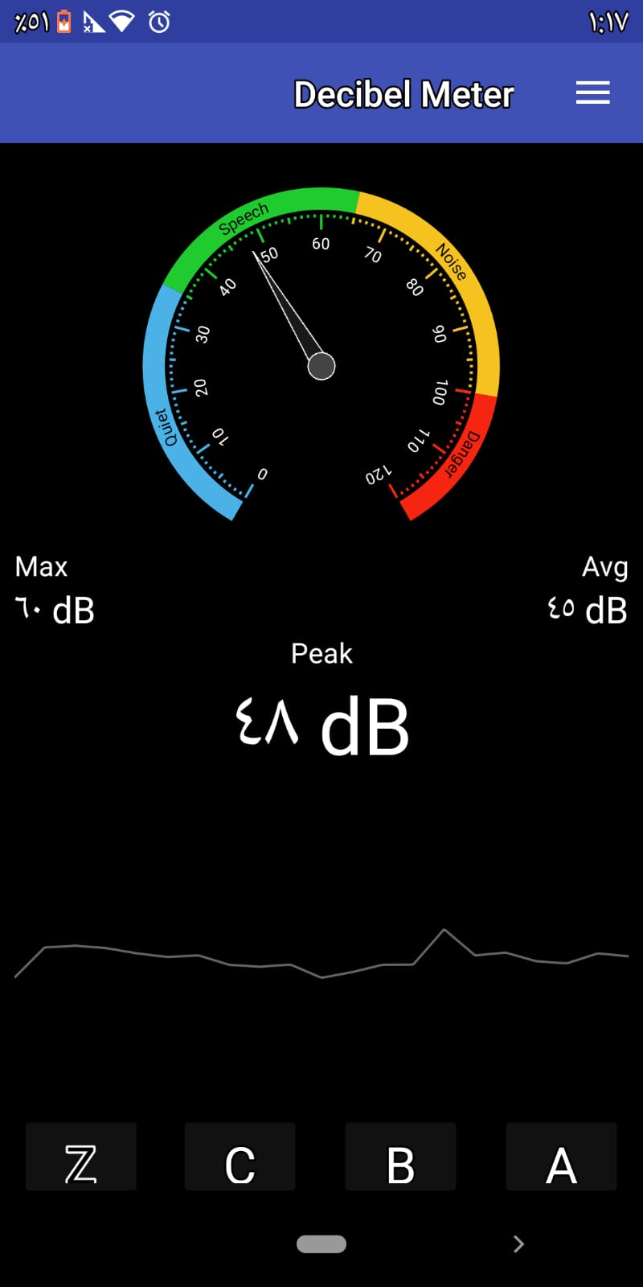
Measuring devices
The decibel meter was used to measure the sound level due to the lack of sound meters and it is a mobile application and is used to detect noise levels

Slide 9
Intensity in decibels |  | Noise type | Safety level
0-10 | Audible |  | Very safe
10-30 | very calm |  | Relatively secure
30-50 | Quiet |  | safety
50-70 | Medium in height |  | A little secure
70-100 | Very high |  | Dangerous
100-130 | Troublesome |  | Relatively dangerous
200 | Very troublesome |  | Very dangerous
Sound intensity and safety level(WEO).

Slide 10
Criteria :
To measure the noise in the selected regions, according to the (ISO World) standards, the following conditions must be applied:
The height of the phone from the ground (120 cm).
The distance of the phone from the noise source is within (7m).
A sound level measurement period is (15 minutes) for each measurement test

Slide 11
Project constraints:
The project has many limitations and problems, and here are some of them:
1. Unavailability of a noise meter and dependence on the application of decibel measurement, which may affect the accuracy of the measurement.
2. Not taking measurements on weekends, due to closures and unavailability of transportation.
3. Noise is measured for all hours due to the Corona pandemic, which limits its movement and continuous shutdown

Slide 12
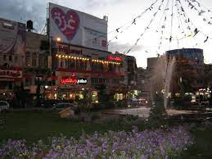
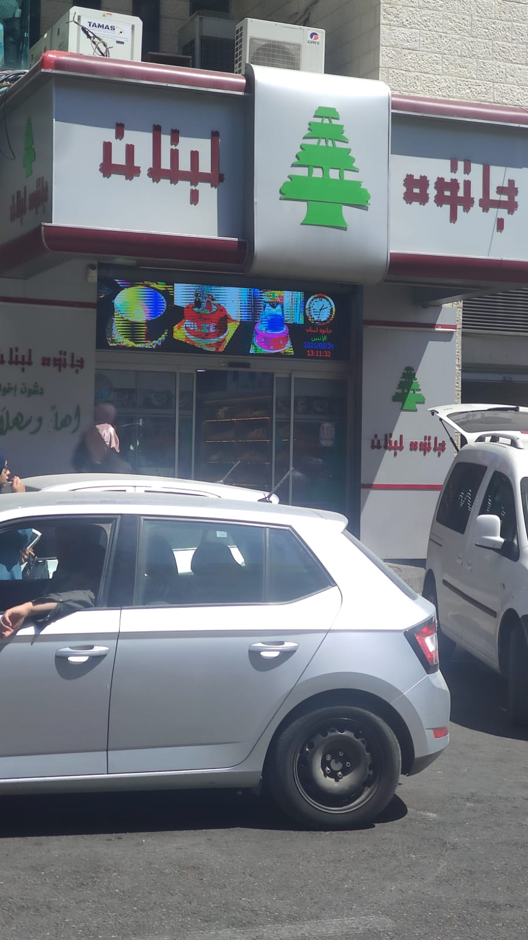
Noise levels were monitored in Nablus city square in seven locations:
حلويات دمشق Demashg sweets
واحة العطشان(Waha al-atshan)
جاتوه لبنانJatoh Lebanon

Slide 13
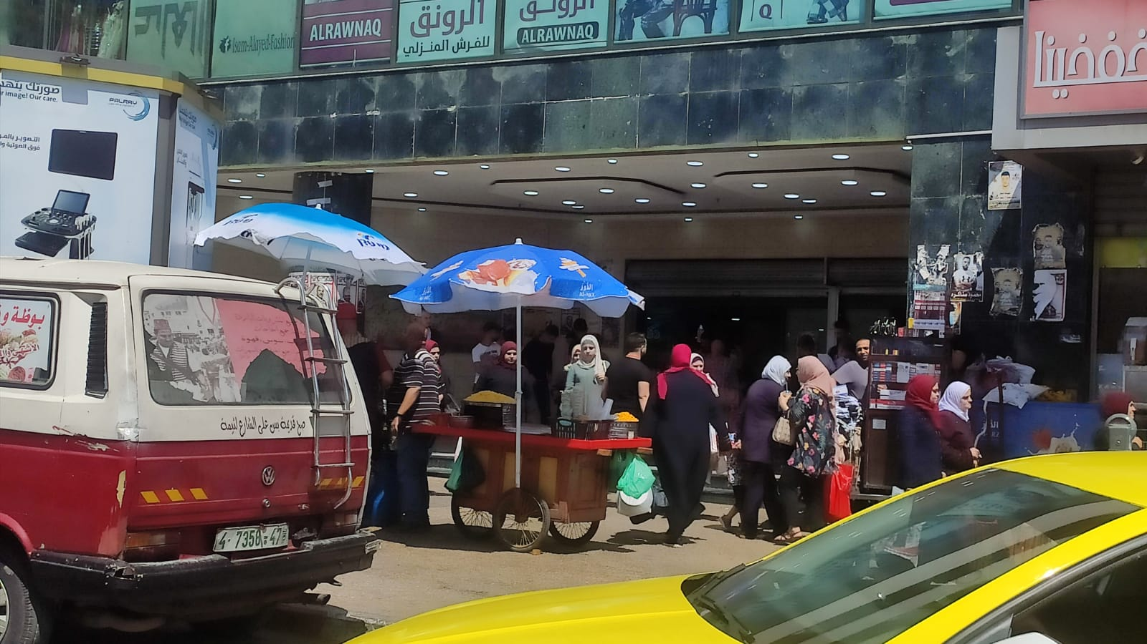
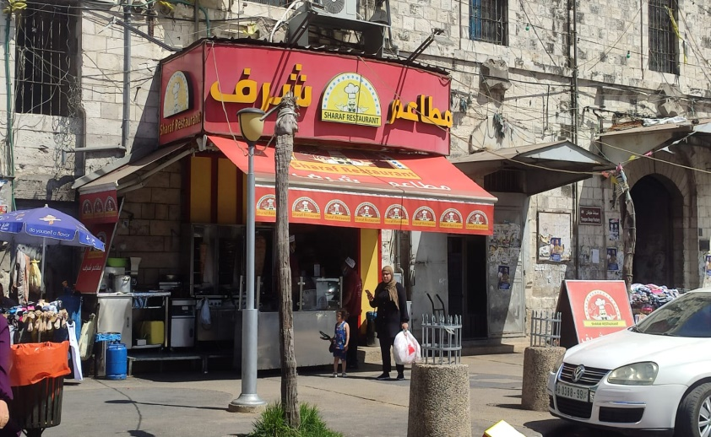
المجمع التجاري(MOJAM'A AL-TEJARI)
مطعم شرف(Sharaf restaurant

Slide 14
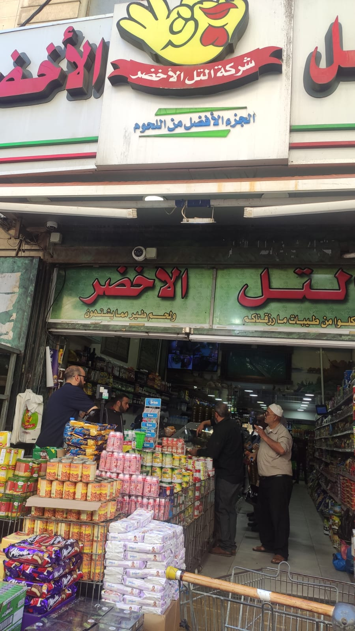
مطعم العلمين(Alalmain restaurant)
التل الاخضرAtal-alaghder)

Slide 15
Collected Data :
Regions | Max.level ofnoise(dB) | Min. levelof noise(dB) | Averagevalue | Allowablevalue(dB)
MOJAM'A AL-TEJARI | 72 | 56 | 64 | 110
Sharaf restaurant | 76 | 65 | 70.5
Jatoh Lebanon | 70 | 63 | 66.5
Demashg sweet | 84 | 73 | 78.5
al-almain restaurant | 82 | 78 | 80
Waha al-atshan | 80 | 54 | 67
Atal-alaghder | 79 | 63 | 71
Locations,maximumandminimumlevels,dates,andtheallowablenoiselimitaccording to

Slide 16
هل تعلم ما هو مفهوم التلوث الضوضائي؟
٣- غير مؤكد |  |  |  |  | ٢- لا |  |  |  |  | ١- نعم
كيف تقيم التلوث الضوضائي الذي يزعجك يوميا؟
٣- ضعيف |  |  |  |  | ٢- متوسط |  |  |  |  | ١- كبيرا
ما هو اكثر وقت تواجه فيه الضوضاء في اليوم
٣- مساءا |  |  |  |  | ٢- ظهرا |  |  |  |  | ١- صباحا
هل كنت يوما مصدرا لضوضاء؟
٣- لا اتذكر |  |  |  |  | ٢- لا |  |  |  |  | ١- نعم
هل يعتبر الاشخاص من المصادر الرئيسية للضوضاء في منطقة الدوار؟
٣-احيانا |  |  |  | ٢- لا |  |  |  |  | ١- نعم
هل تعتبر المركبات من المصادر الرئيسية للضوضاء في منطقة الدوار؟
٣- احيانا |  |  |  | ٢- لا |  |  |  |  | ١- نعم
هل تعتبر الصيانة واعمال البناء من المصادر الرئيسية للضوضاء في منطقة الدوار؟
٣- احيانا |  |  | ٢- لا |  |  |  |  | ١- نعم
هل هناك مصادر اخرى لضوضاء في هذه المنطقة من جهة نظرك؟
هل انت مع وجود قوانين تقلل من الضوضاء.
٣- احيانا |  |  | ٢- لا |  |  |  |  | ١- نعم
هل يؤثر عليك الضوضاء نفسيا؟
٣- احيانا |  | ٢- لا |  |  |  |  |  |  |  |  | ١- نعم
هل يئثر الضوضاء على سمعك؟
٣- احيانا |  |  | ٢- لا |  |  |  |  | ١- نعم
كم عدد الساعات التي تقضيها بالسوق يوميا ؟
ما هي اكثر الايام في الاسبوع ازعاجا؟
الجمعة | الخميس | الاربعاء |  |  |  | الثلاثاء | الاثنين |  |  |  | الاحد | السبت
من جهة نظرك ما هي الاقتراحات والحلول الممكنة لمعالجة الضوضاء قي منطقتك؟

Slide 17
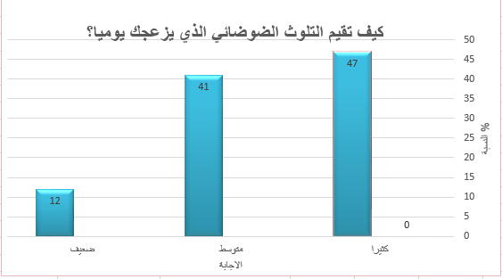
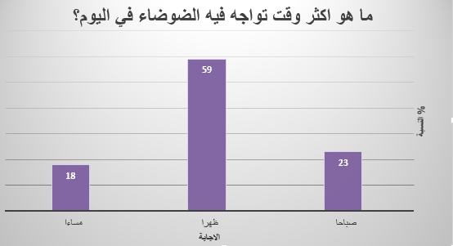

Slide 18
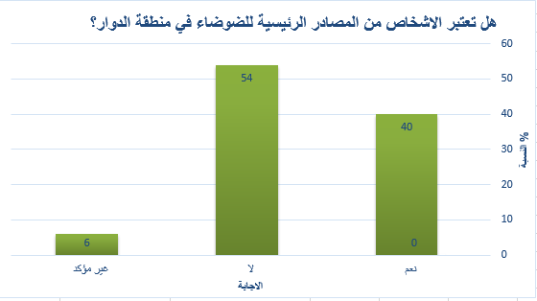
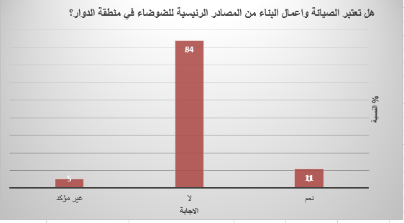

Slide 19
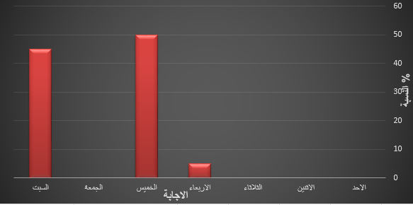
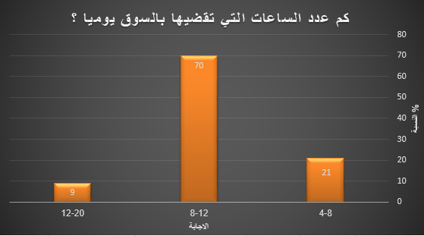

Slide 20
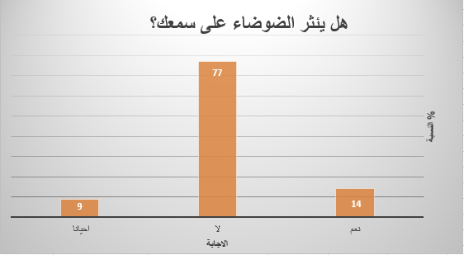
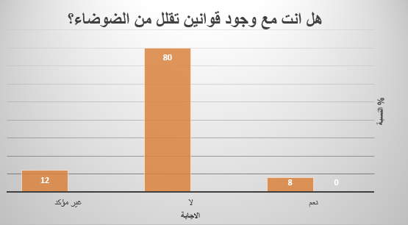

Slide 21
Discussion:
The main conclusions that can be drawn from this research are the noise generated by different sources such as: shops, vendors, people and traffic.
Therefore, noise is a specific occupational hazard in many places. One of the most common occupational diseases is “noise-induced hearing impairment”

Slide 22
CONCLUSION
From the results obtained from the measurement, it was noticed that the high noise values in the commercial complex were recorded between (72 dB) to (56 dB) with an average of (64 dB), while the permissible limit for WHO was (110 dB). Because of the noise from shops and ATMs. As for the Sharaf restaurant, it is between (76 dB) to (65 dB) with an average of (70.5 dB), and this is due to the presence of customers and a parking lot for cars and traffic.

Slide 23
After collecting a questionnaire, the data were entered into an appropriate computer program
(Access to Microsoft).To classify the data, then they were extracted in the form of percentages where three main sources of noise in the streets and shops were identified. These sources are : Vehicle noise (60%), Market noise (30%) and People noise (10%).
Through the questionnaire, the negative effects caused by the noise resulting from the sound of the vehicles were examined and the proposals to treat them, as the questionnaire indicated that 60% of the questionnaire found that the sound of the vehicles is the most disturbing, and also it was found that the noon period
(4-12) is the most disturbing time.

Slide 24
It was found through the questionnaire:
1) High traffic density with no flow of traffic.
2) Not allocating a place for pedestrians to cross and not adhering to places in some places.
3) The spread of street vendors, which impedes traffic.

Slide 25
  Recommendations :
Environmental awareness of citizens about the harmful effects of noise, in coordination with the Youth Center.
And the media. Establishing laws that determine the level of noise at the permissible level, especially in commercial markets.

Slide 26
REFERENCES:
Foreign references:
https://www.iso.org/home.html
https://www.who.int/ar/
Enda Murphy and Eoin A. King. (2014). Environmental Noise Pollution.
Agarwal. (1995). Noise Pollution
Haines, & Brown. (2000). Noise and Health in urban Environment.
L.L. Stevens, Niessen, & Steels. (2009). Noise Tube: Measuring and mapping noise pollution with the mobile phone.
Peterson, A. P. (1980). Handbook of Noise Measurement.
Arabic references:
جهاز شئون البيئة. (2016). رصد مستويات الضوضاء بميدان الجيزة .
حسين البحراني (2009) دراسة حقلية عن أهم مصادر التلوث الضوضائي في الأحياء السكنية لمدينتي النجف والكوفة

