Slide 1

Graduation Project (2)
Integrated design for Al-Qaser Hostel
Group Names
Obaydah M Shtaiwi
Nour J Habaybeh
Ruba M Sarris
Shtaiwi
Habaybeh
Sarris
Supervisor : Dr Ahmed AL-Haj Saleh
T E A M
1
Building Engineering

Slide 2
Outline
Introduction
Project information summary
Site plan
Architectural design
Structural design
mechanical design
Quantity surveying
2

Slide 3
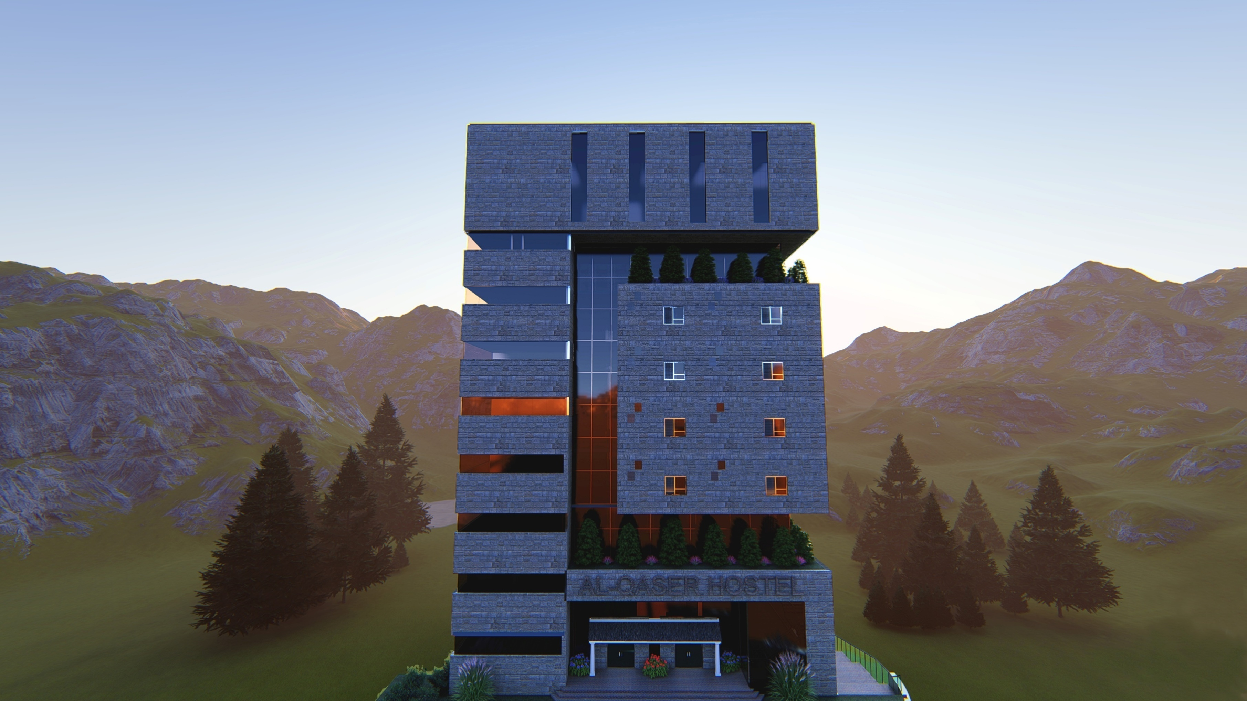
Shtaiwi
Sarris
Habaybeh
Introduction
01
T E A M
3

Slide 4

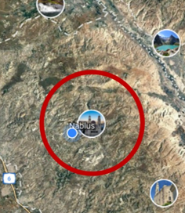
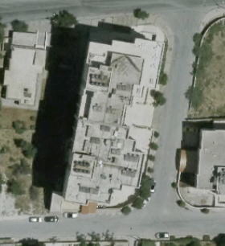
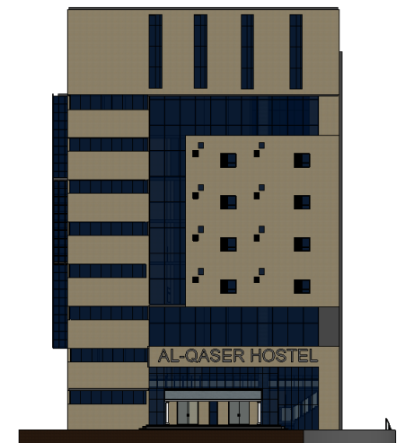
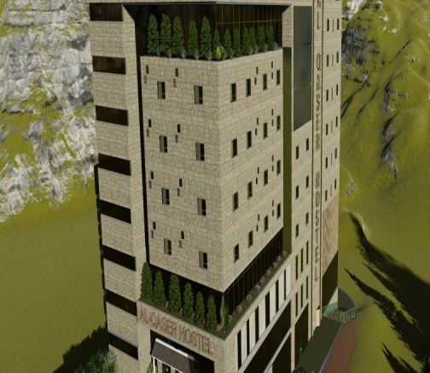
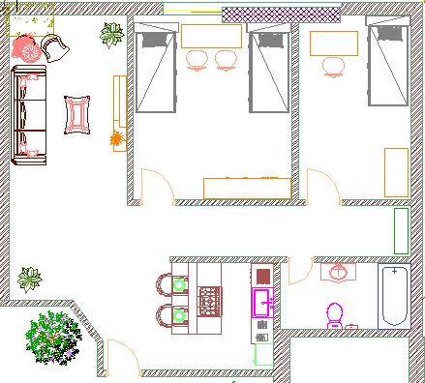
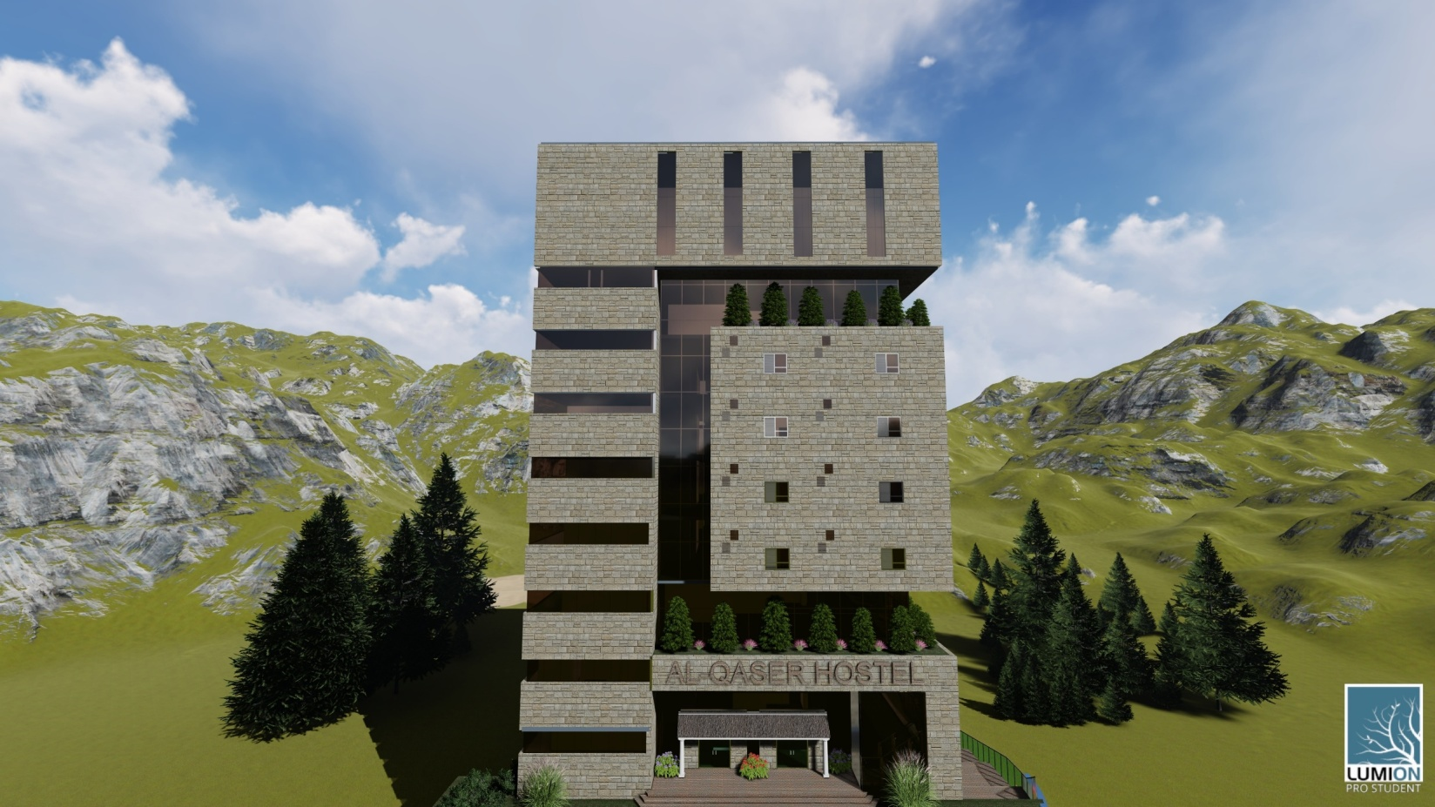

Project information summary
02
Shtaiwi
Sarris
Habaybeh
T E A M
location
1
land Area
2
3
Floor number
4
Bed room #
5
Building height
13 Floor
150 bed
Palestine
NABLUS
53 m
1900 m²
Overview
Th building has an a semi uniform shape
4
Exterior shot for the building

Slide 5
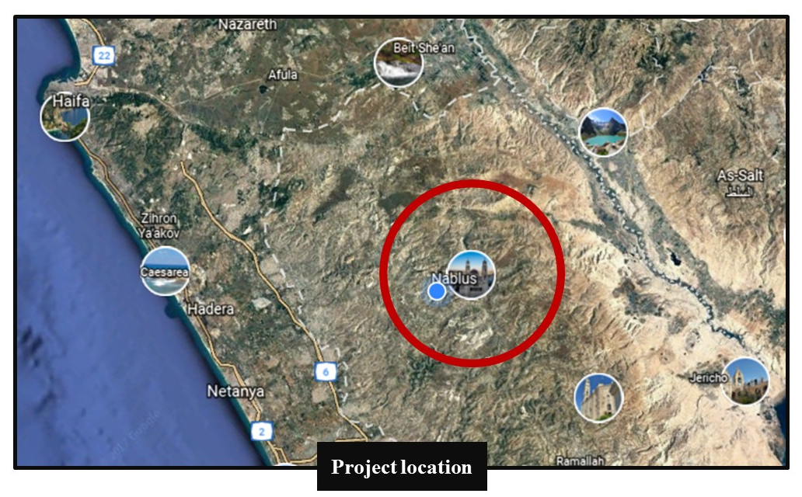

General Layout study (location)
03
Shtaiwi
Sarris
Habaybeh
T E A M
5

Slide 6
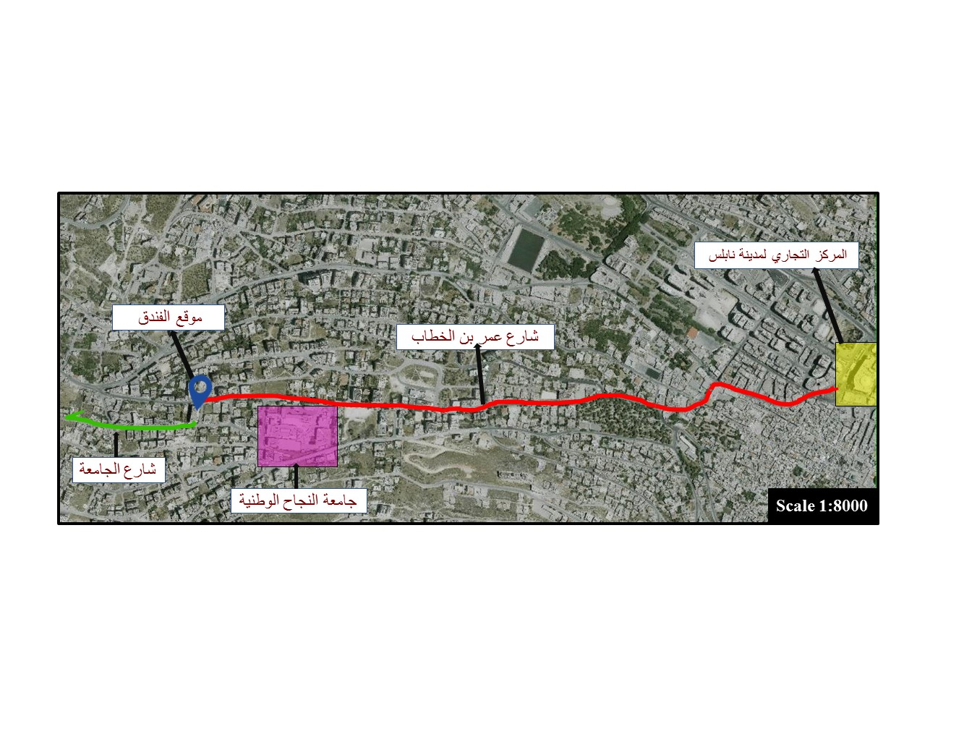
General Layout study (location)
03
Shtaiwi
Sarris
Habaybeh
T E A M
موقع المشروع
6

Slide 7
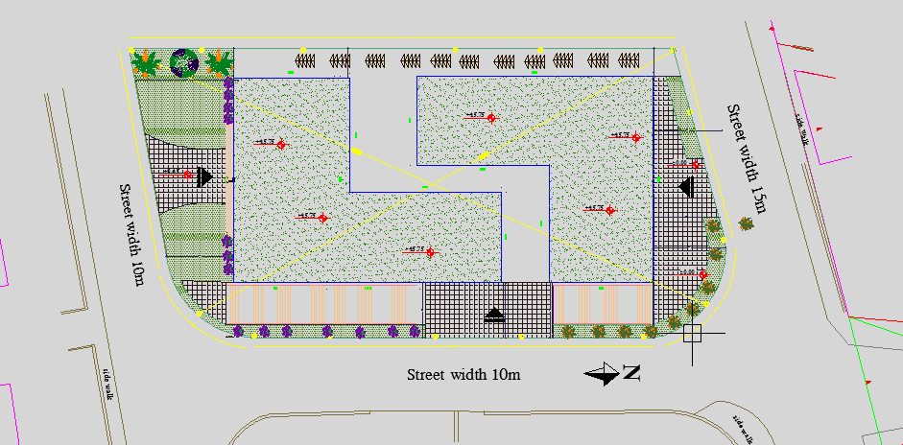
Site plan
03
Shtaiwi
Sarris
Habaybeh
T E A M
Site plan Show the three entrance for the building, main entrance from the university street , restaurant entrance , entrance from Omar ben el Khattab street .
7

Slide 8
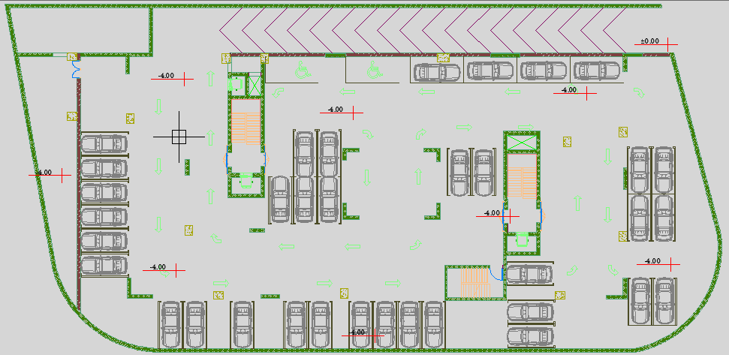
Basement 1 floor
03
Shtaiwi
Sarris
Habaybeh
T E A M
Car parking with capacity of 37 car
8

Slide 9
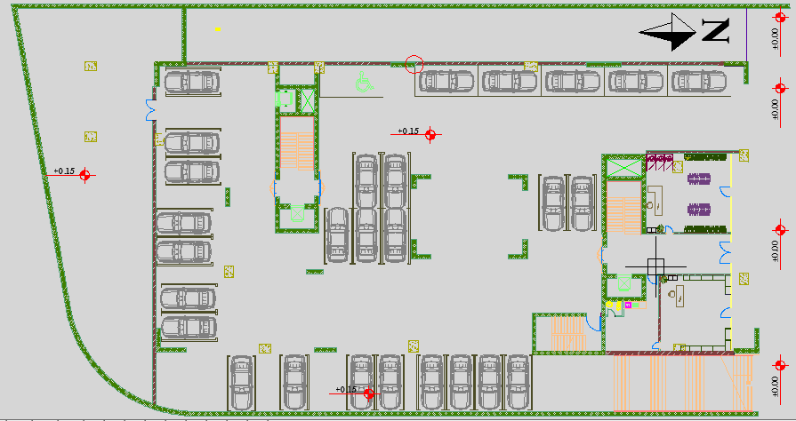
Basement 2 floor
)
03
Shtaiwi
Sarris
Habaybeh
T E A M
Car parking with capacity of 28 car , and commercial shop
9

Slide 10
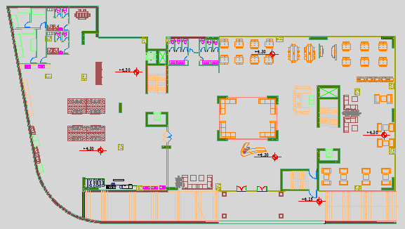
Restaurants floor plan
03
Shtaiwi
Sarris
Habaybeh
T E A M
Restaurant with area of 400 m2 , about 150 seat, main kitchen with 400 m2
10

Slide 11
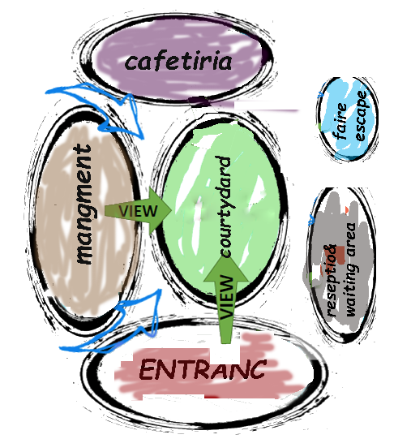
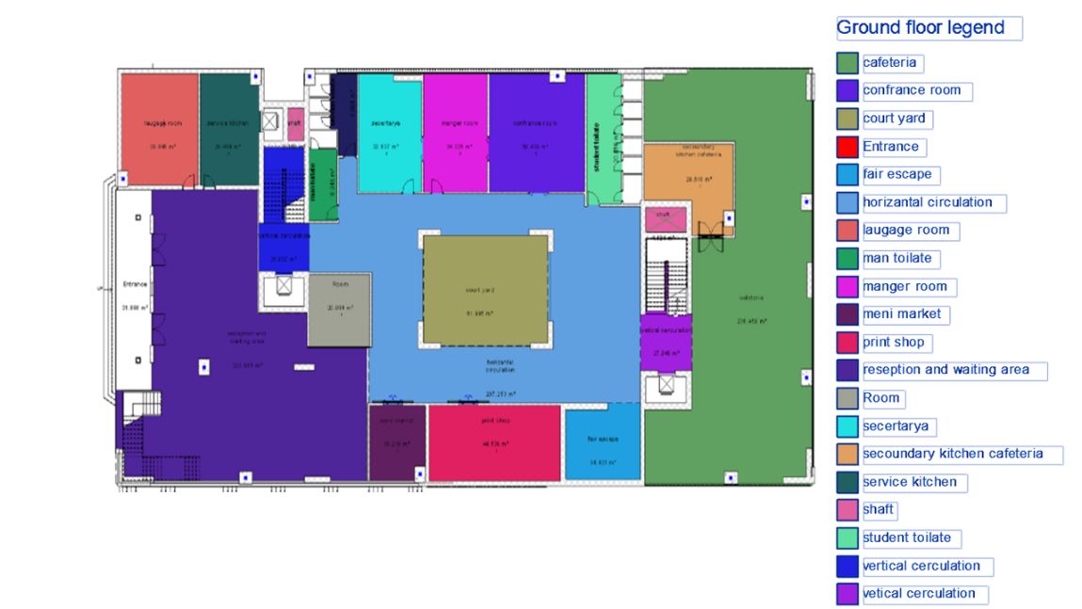
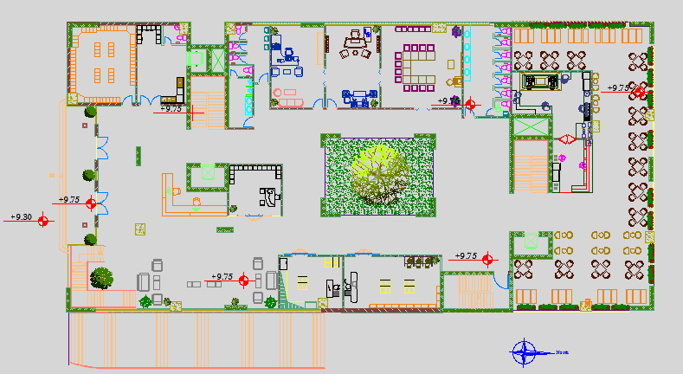
Ground floor plan
Shtaiwi
Sarris
Habaybeh
T E A M
-Luggage room
-Service
-Reception and
waiting area
-Management
-Cafeteria
-Print shop
-Mini market
11

Slide 12
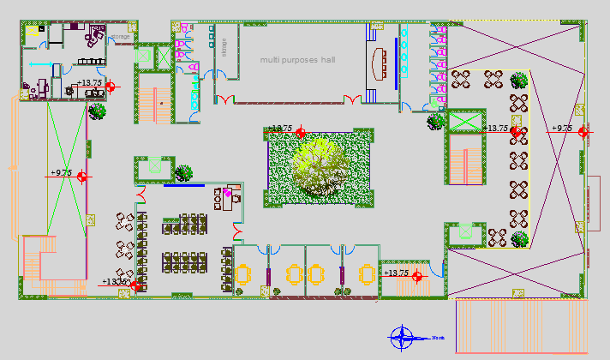
First floor plan
04
Shtaiwi
Sarris
Habaybeh
T E A M
-computer room , study room , multipurpose hall , clinic
12

Slide 13
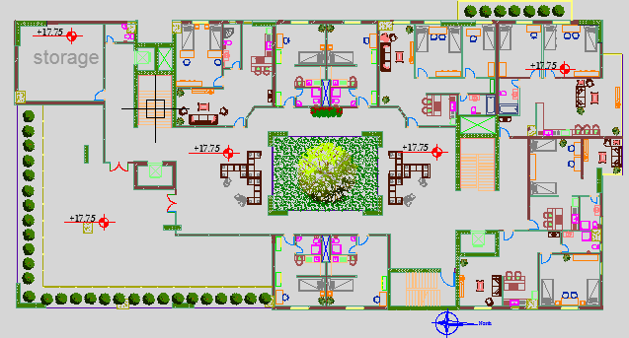
Second and third floor plan
04
Shtaiwi
Sarris
Habaybeh
T E A M
-storage ,worker room , playing and seating area , bed room (single ,double ,triple)
13
13

Slide 14
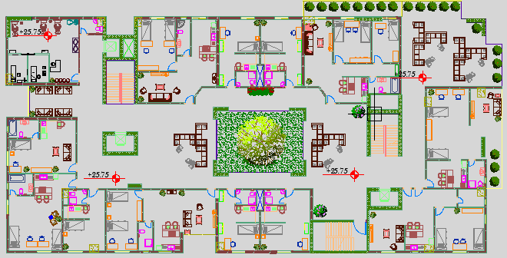
Forth floor plan
04
Shtaiwi
Sarris
Habaybeh
T E A M
-beauty salon , external and eternal seating area , bed room (single ,double ,triple)
14
14

Slide 15
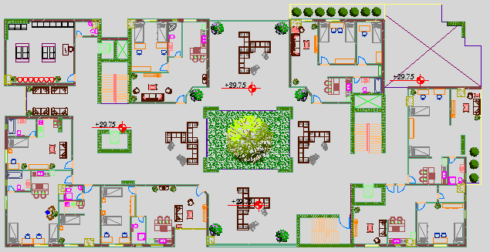
Fifth floor plan
04
Shtaiwi
Sarris
Habaybeh
T E A M
-laundry , seating area , bed room (single ,double ,triple),double volume .
15
15

Slide 16
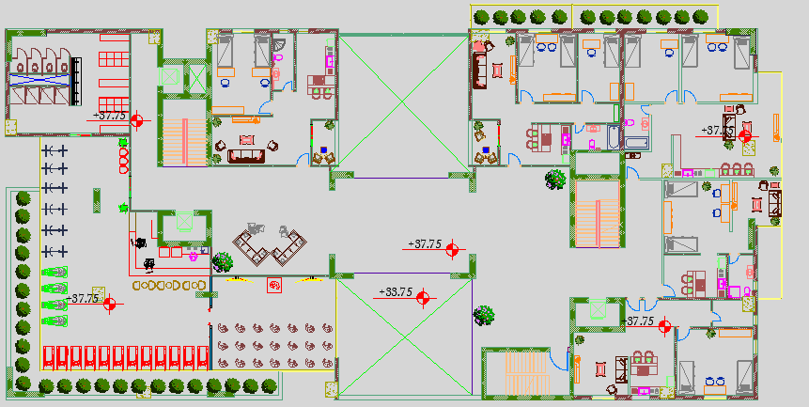
Sixth and seventh floor plan
04
Shtaiwi
Sarris
Habaybeh
T E A M
-GYM , shower room , bed room (single ,double ,triple)
16
16

Slide 17
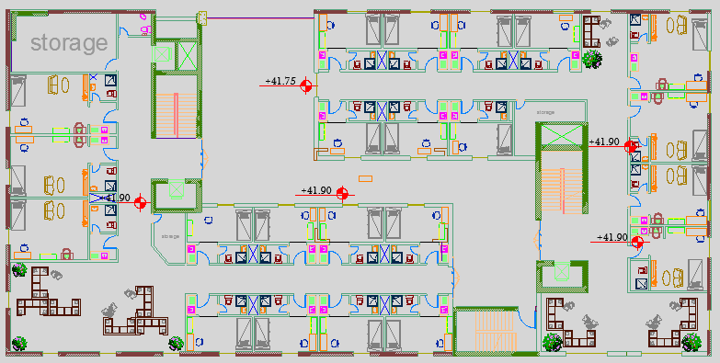
Eighth and ninth floor plan
04
Shtaiwi
Sarris
Habaybeh
T E A M
-single bed room , external and internal seating area .
17
17

Slide 18
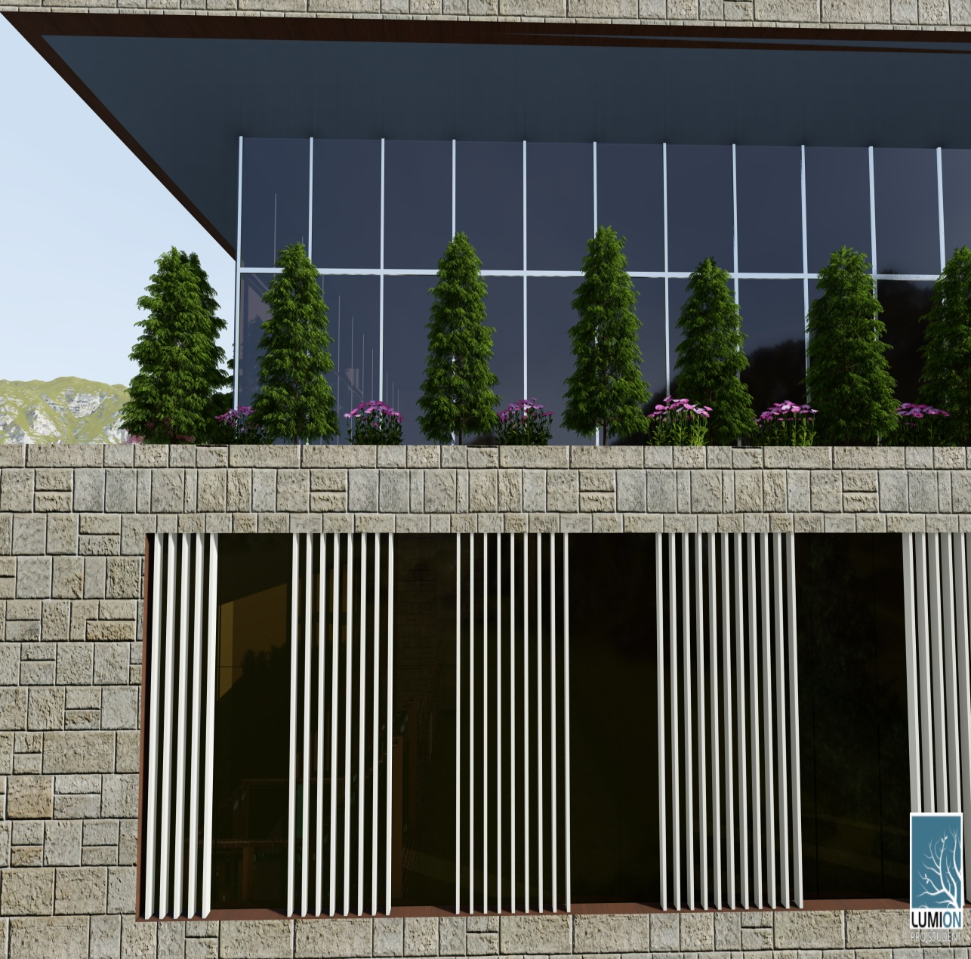
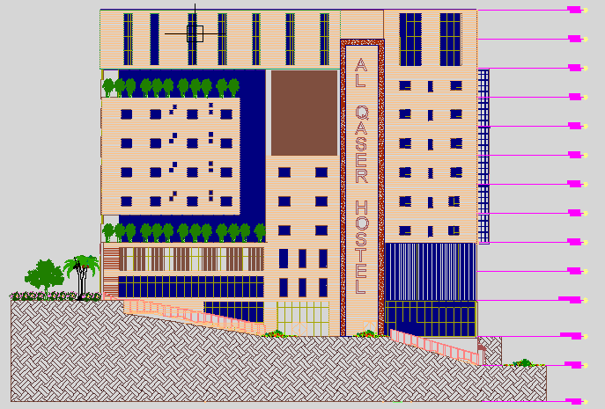
East elevation
04
Shtaiwi
Sarris
Habaybeh
T E A M
-to improve shading for Curtin wall we used vertical louver , and trees
18
18

Slide 19
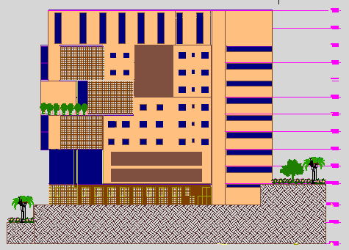

West elevation
04
Shtaiwi
Sarris
Habaybeh
T E A M
19
19

Slide 20
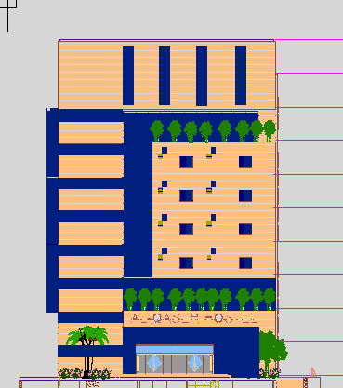
South elevation
04
Shtaiwi
Sarris
Habaybeh
T E A M
20

Slide 21
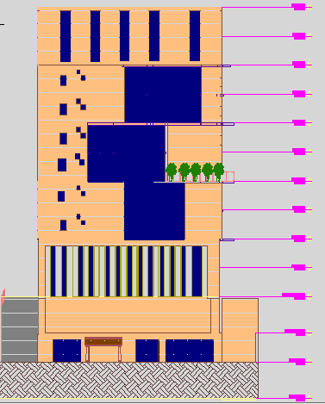
North elevation
04
Shtaiwi
Sarris
Habaybeh
T E A M
21

Slide 22
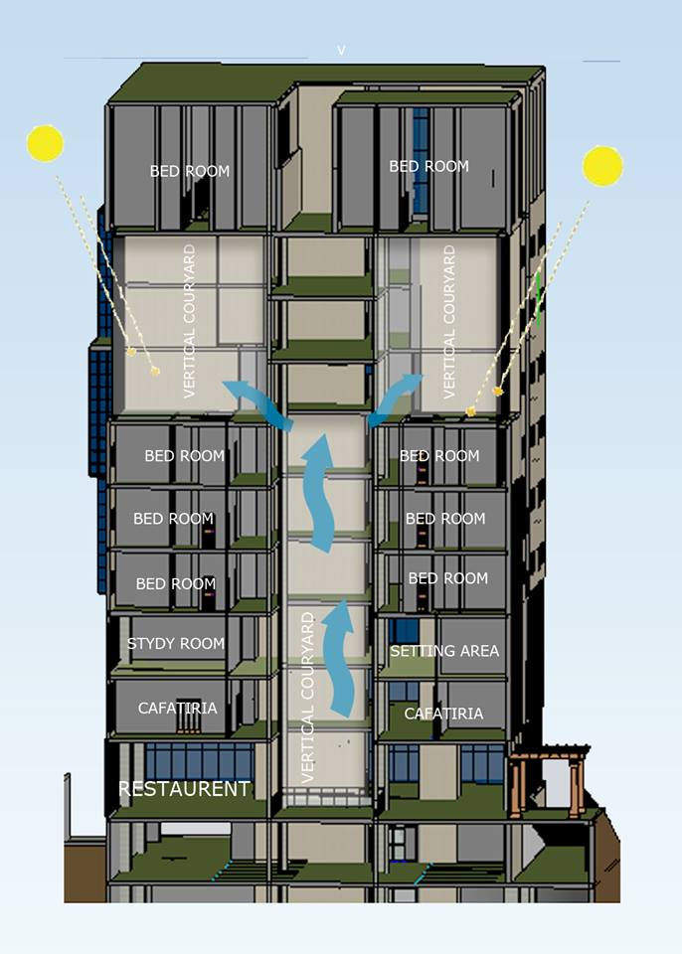
Section A-A
04
Shtaiwi
Sarris
Habaybeh
T E A M
22

Slide 23
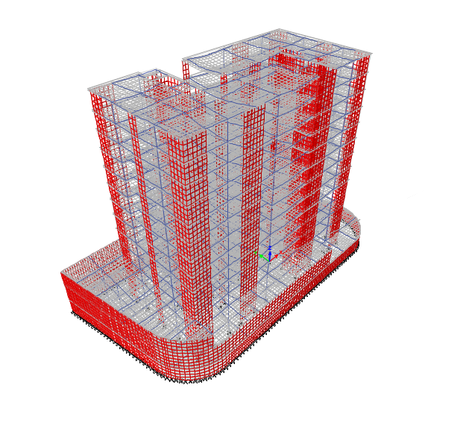
Structural design
04
Shtaiwi
SarHabaybehris
T E A M
23
The hostel has 13 floor which made completely from reinforced concrete.

Slide 24
Structural design
04
Shtaiwi
SarHabaybehris
T E A M
Codes and Standards:
ACI -318-14 for reinforced concrete structural design.
UBC-97 Code for earthquake design.
IBC Code for live load
The structural system designed by using ETABS , Safe ,sap and hand calculations .
24

Slide 25
Structural design
04
Shtaiwi
SarHabaybehris
T E A M
Design data:
Concrete compressive strength for all elements , f’_{c}=28 MPa.
Steel yielding strength f_{y}=420 MPa.
Bearing capacity for soil = 300 kN/m²
Unit weight for reinforced concrete =25 kN/m³
25

Slide 26
Structural design
04
Shtaiwi
SarHabaybehris
T E A M
Applied load
Load type
Live load | 4 kN/m² For all floor
Superimposed dead load | 4.5 kN/m²
26

Slide 27

Structural design
04
Shtaiwi
SarHabaybehris
T E A M
Seismic Design data :
structure located Nablus.
The seismic zone factor. Z=0.2.
The soil profile is type Sc.
The acceleration seismic coefficient Ca=0.24
The velocity seismic coefficient Cv=0.32.
The Seismic importance factor is 1.
The structural design type is intermediate,
R=5.5
27

Slide 28
Structural design
04
Shtaiwi
SarHabaybehris
T E A M
Verification of the structural model
Compatibility check
28

Slide 29
Structural design
04
Shtaiwi
SarHabaybehris
T E A M
Equilibrium check
TABLE: Base Reactions FZ (Kn)
Load Case/Combo | Etabs result | Hand calculation | < 5%
Dead | 256401.37 | 256754.85 kn | 0.13%
Live | 65682.83 | 64609.2 kn | 1.63%
SID | 113871.5 | 112644.31kn | 1.07%
29

Slide 30
Structural design
04
Shtaiwi
SarHabaybehris
T E A M
Internal force check
TABLE: check from live load
 | Manual | By Etabs | Error <10%
Column | 1555.3 | 1525 | 1.98%
Beam | 386.5 | 370.5 | 4.31%
Slab strip | 14.21 | 15.45 | 1.07%
30

Slide 31
Structural design
04
Shtaiwi
SarHabaybehris
T E A M
Seismic Design check
1.Deflection check
32.5mm<39mm
2.Period check
Manual = 1.34 sec
By Etabs = 1.32 sec ………. 1.32<1.34 ok
3. Drift check
14.2 mm <80 mm ok
4. Modal participation ratio check
Sum x , sum y >> 90 %
5. base shear check
-Base shear values = 17350.85in x-direction, which is greater than the manually calculated 16786.3 kn
-Base shear =17928.26y-direction, which is greater than the manually calculated 16786.3 kn
Sum UX | Sum UY
0.9993 | 0.9389
0.9217 | 0.9995
31

Slide 32
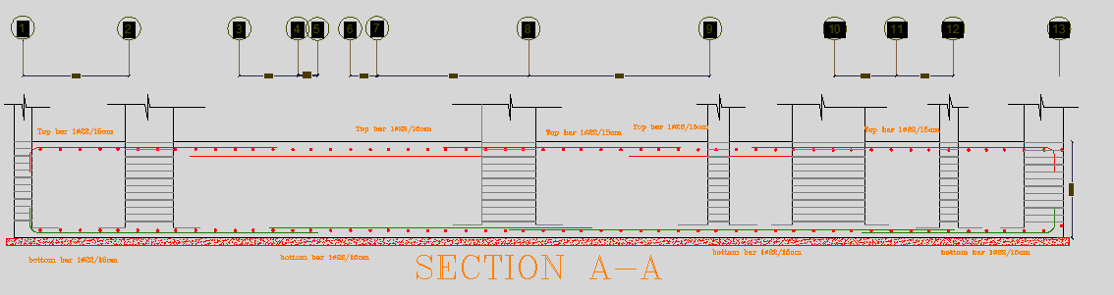
Structural design
04
Shtaiwi
SarHabaybehris
T E A M
Mat foundation reinforcement
Mu = 14612 , b=12500 , d=1200mm
ρ =0.002189 > ρmin
Use As=0.002189*12500*1200 =32849 mm2 → (1Ø22/15 cm) bottom
As min= 0.0018*12500*1300 → 29250 mm2 → (1Ø22/15 cm) Top and bottom
32

Slide 33
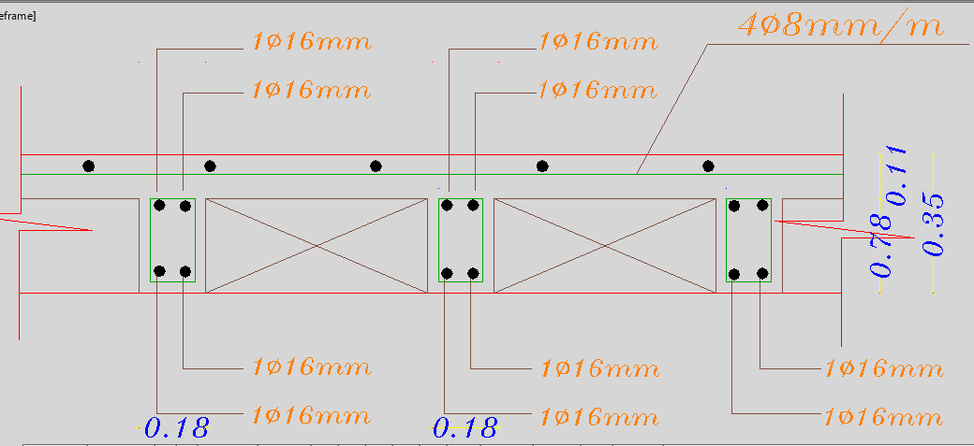
Structural design
04
Shtaiwi
SarHabaybehris
T E A M
Slab Reinforcement(two way ripped slab )
33

Slide 34
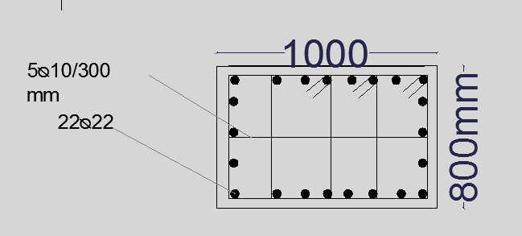
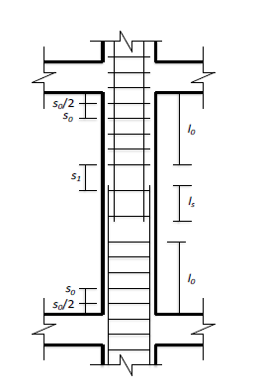
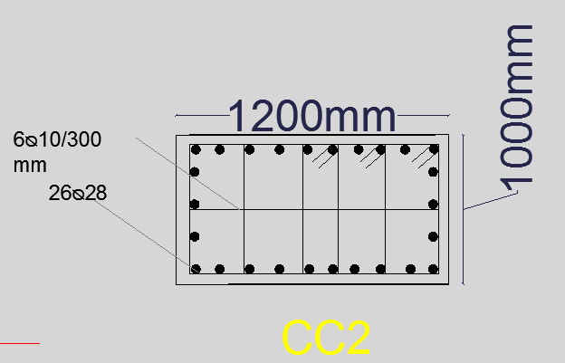
Structural design
04
Shtaiwi
SarHabaybehris
T E A M
Column reinforcement (intermediate frame )
So= 200mm
S1= 300mm
Is=1300mm
34

Slide 35
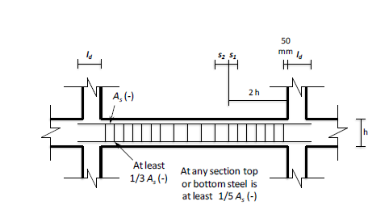
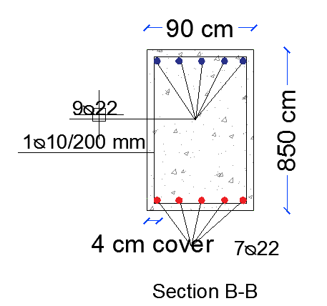
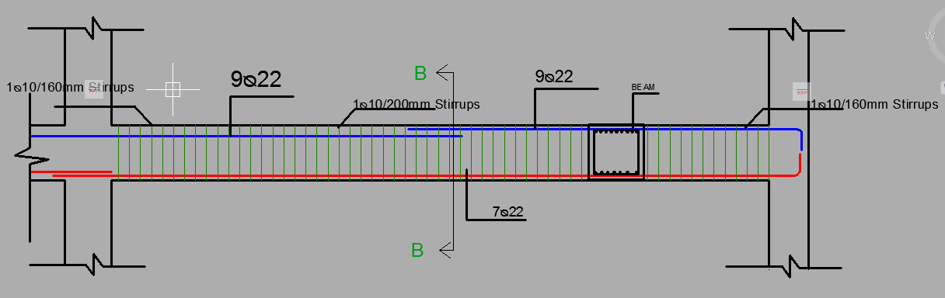
Structural design
04
Shtaiwi
SarHabaybehris
T E A M
Beam reinforcement (intermediate frame )
35

Slide 36
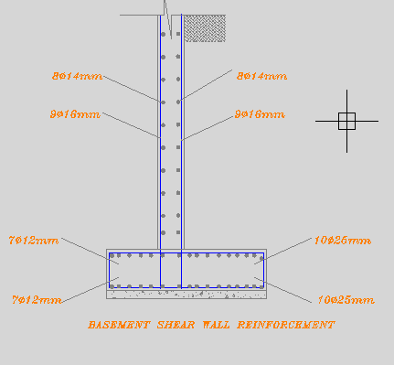
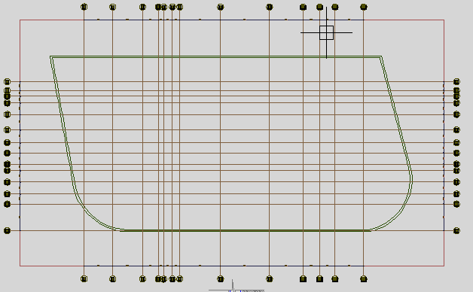
Structural design
04
Shtaiwi
SarHabaybehris
T E A M
Basement Shear wall reinforcement
36

Slide 37
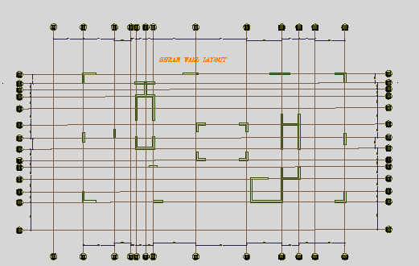
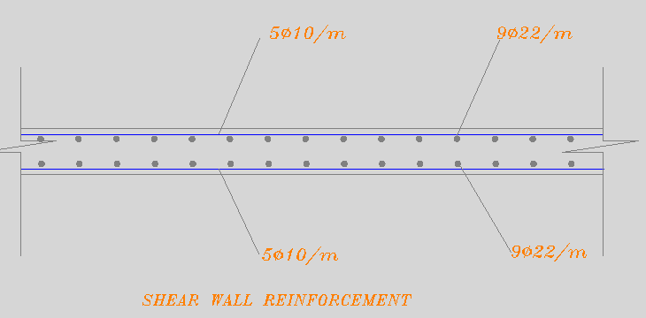
Structural design
04
Shtaiwi
SarHabaybehris
T E A M
Shear wall reinforcement
37

Slide 38
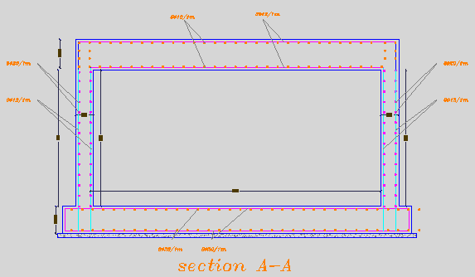
Structural design
04
Shtaiwi
SarHabaybehris
T E A M
Water tank reinforcement
38

Slide 39
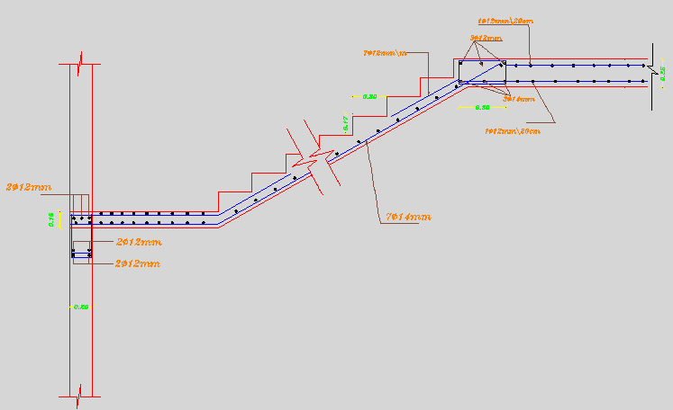
Structural design
04
Shtaiwi
SarHabaybehris
T E A M
Stairs reinforcement
39

Slide 40
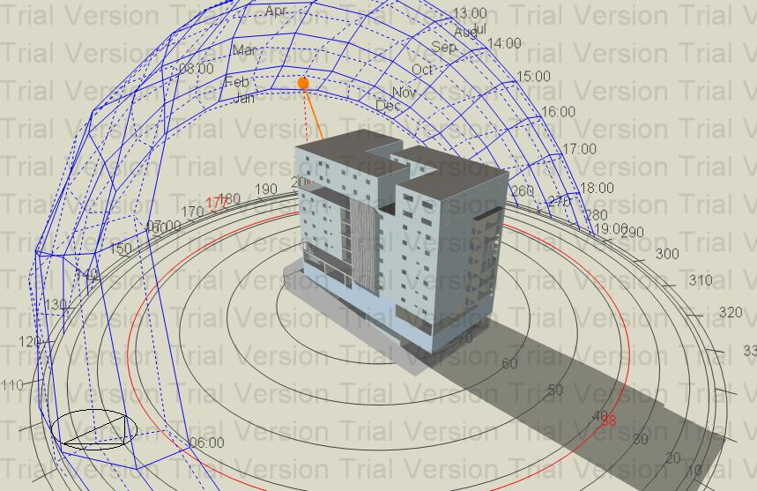
electromechanical design
05
Shtaiwi
SarHabaybehris
T E A M
Figure : building shadow on 21 January at 12:00 pm.
40

Slide 41
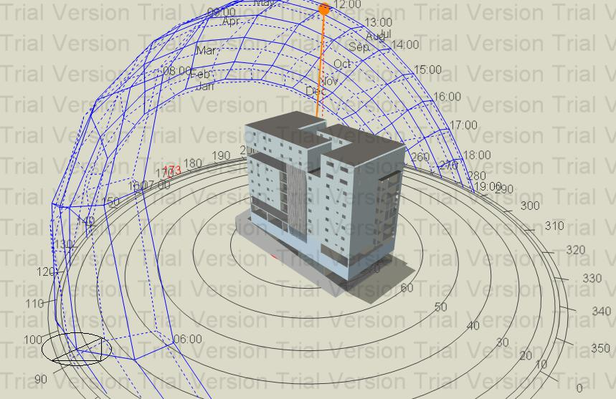
electromechanical design
05
Shtaiwi
SarHabaybehris
T E A M
Figure: building shadow on 21 July at 12:00 pm.
41

Slide 42
electromechanical design
05
Shtaiwi
SarHabaybehris
T E A M
Material used.
Thermal design.
42

Slide 43
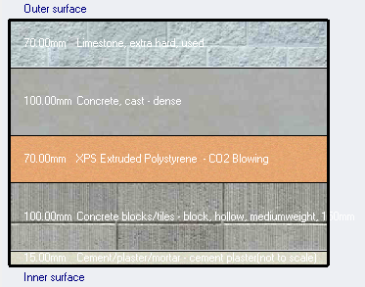

Environmental Design.
electromechanical design
05
Shtaiwi
SarHabaybehris
T E A M
Materials.
External wall layers.
(7) cm jamaine lime stone.
(10) cm cast concrete.
(7) cm XPS Extruded polys.
(10)cm concrete hollow block.
(1.5) cm cement plaster.
U-value= 0.4 W/ $m^{2}.k$
43

Slide 44
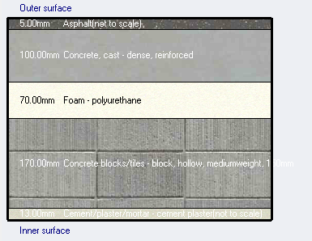
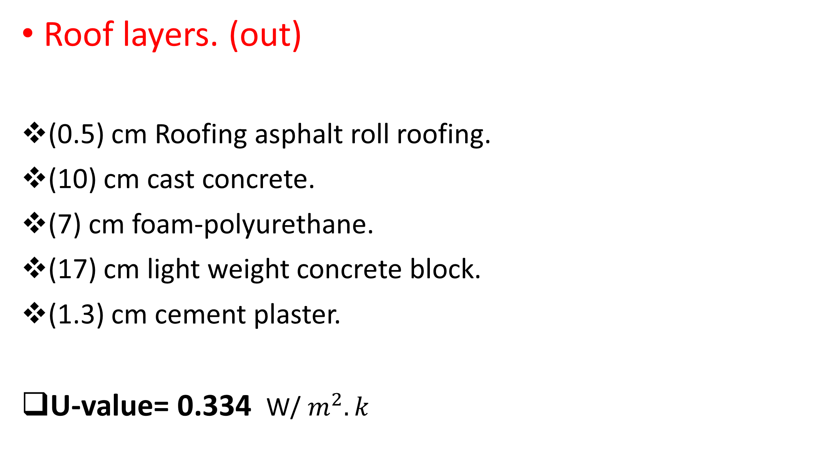
Environmental Design.
electromechanical design
05
Shtaiwi
SarHabaybehris
T E A M
Roof layers. (out)
(0.5) cm Roofing asphalt roll roofing.
(10) cm cast concrete.
(7) cm foam-polyurethane.
(17) cm light weight concrete block.
(1.3) cm cement plaster.
U-value= 0.334 W/ $m^{2}.k$
45

Slide 45
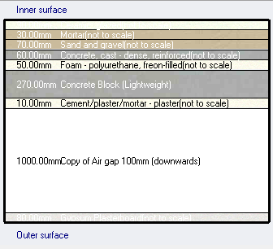

Environmental Design.
electromechanical design
05
Shtaiwi
SarHabaybehris
T E A M
Internal floors layers.
(3) cm ceramic tile.
(3) cm mortar.
(7) cm sand and gravel.
(6) cm light weight concrete.
(5) cm foam-polyether.
(27) cm concrete block.
(1) cm cements plaster.
(100) cm Air Gap.
(8) cm Gypsum plaster.
U-value= 0.251 W/ $m^{2}.k$
46

Slide 46
Environmental Design.
electromechanical design
05
Shtaiwi
SarHabaybehris
T E A M
Glass Prosperities.
Double Glass with Aluminum window frame with thermal break containing the following layer:
Generic clear 6mm.
ARGON 13 mm.
Generic clear 6mm.
47

Slide 47
Environmental Design.
electromechanical design
05
Shtaiwi
SarHabaybehris
T E A M
Heating and cooling loads.
Site energy
Heating design capacity. | 302 KW
Cooling design capacity. | 343 KW
Total site energy. | 249.66 KWh/m2
48

Slide 48


Environmental Design.
electromechanical design
05
Shtaiwi
SarHabaybehris
T E A M
Simulation.
heating and cooling load analysis and PMV index.
49

Slide 49

electromechanical design
05
Shtaiwi
SarHabaybehris
T E A M
Acoustic Design
Reverberation Time(RT60):
We used ECOTECT Analysis Program in the calculation and testing of the reverberation time.
figure for Restaurant. .
50

Slide 50
electromechanical design
05
Shtaiwi
SarHabaybehris
T E A M
Reverberation time
Note : RT60 range for restaurant is (0.8 – 1.2), does achieve the requirements .
FREQ | RT(60)
63 HZ | 1.08
125HZ | .95
250 HZ | .86
500 HZ | .91
1 KHZ | .99
2 KHZ | 1.13
51

Slide 51
electromechanical design
05
Shtaiwi
SarHabaybehris
T E A M
Reverberation time
For Meeting room:
RT60 value ranges from( 0.6-1.20) , this room achieves requirements
FREQ | RT(60)
250 HZ | 0.62
500HZ | 0.63
1 kHZ | 0.65
2 kHZ | 0.68
4 KHZ | 0.63
52

Slide 52

Acoustic Design
electromechanical design
05
Shtaiwi
SarHabaybehris
T E A M
The STC for partition must =52 dB Improvement in STC by using block with thick.= 14cm & a density of 2000 kg/m3.
53

Slide 53

electromechanical design
05
Shtaiwi
SarHabaybehris
T E A M
IIC value for floor and ceiling:
The IIC for ceiling must >50 dB, so the value is acceptable.
54

Slide 54
Loud Speakers
electromechanical design
05
Shtaiwi
SarHabaybehris
T E A M
ATLAS BT720-4-T47 :
(380 mm H x 450 mm diameter) :Enclosure outer dimensions 130° Nominal coverage angle :
55

Slide 55
Mechanical design
electromechanical design
05
Shtaiwi
SarHabaybehris
T E A M
1-H-VAC System
2- Water Supply System
3-Drainage System
56

Slide 56
Mechanical design.
electromechanical design
05
Shtaiwi
SarHabaybehris
T E A M
HVAC systems.
Systems used are :
(VRF) SYSTEM.
Main components of centralized system are :
Chiller (for cooling and heating).
Outdoor unit.
FCU.
Ducts.
Diffusers.
57

Slide 57
Mechanical design.
electromechanical design
05
Shtaiwi
SarHabaybehris
T E A M
Centralized system.
Cooling load = 916 KW .
Selected chiller is CUW280DSY with cooling capacity 945kw.
58

Slide 58


Mechanical design.
electromechanical design
05
Shtaiwi
SarHabaybehris
T E A M
Centralized system.
Outdoor unit.
Selected outdoor unit is 1404FTB-E.
Diffusers.
59

Slide 59

Mechanical design.
electromechanical design
05
Shtaiwi
SarHabaybehris
T E A M
Ducts and diffusers arrangement in 8th floor.
60

Slide 60

Mechanical design.
electromechanical design
05
Shtaiwi
SarHabaybehris
T E A M
Outdoor unit.
the cooling capacity for each one is 118kw
Specifications of selected outdoor unit.
61

Slide 61

Mechanical design.
electromechanical design
05
Shtaiwi
SarHabaybehris
T E A M
Water supply design
For the left part:
Vertical →2.5
Horizontal →1.5
Branch →1
For the right part:
Vertical →2.5
Horizontal →1
Branch →3/4
62

Slide 62

electromechanical design
05
Shtaiwi
SarHabaybehris
T E A M
Water distribution System in GF
63

Slide 63
electromechanical design
05
Shtaiwi
SarHabaybehris
T E A M
Domestic hot water
We need almost 25 m3 for DHW
we used boiler system to heat water
Equipment Hot | water required
Clothes washing machine | 1520 L/ standard size machine
Tub bathing | (40L/person)
lavatory | 15 L/day
Dishwashing | 60L/day
64

Slide 64


Mechanical design
Shtaiwi
SarHabaybehris
T E A M
Drainage system
Diameter | DFu | Fixture
4" | 4 | W.C
2" | 1 | Lavatory
2" | 2 | Kitchen sink
2" | 2 | Shower
65

Slide 65
Electrical design
Shtaiwi
SarHabaybehris
T E A M
Electric lighting Analysis
Circuit breaker and Socket.
66

Slide 66

Electrical design
Shtaiwi
SarHabaybehris
T E A M
Electric lighting Analysis
Recommended illumination.
67

Slide 67



Electrical design
Shtaiwi
SarHabaybehris
T E A M
Artificial lighting
Bed room selected luminaires
68
For most spaces selected luminaires

Slide 68

Electrical design
Shtaiwi
SarHabaybehris
T E A M
Artificial lighting
Double bedroom
E(lux) | U | UGR
279 | .81 | 17<19
69

Slide 69


Electrical design
Shtaiwi
SarHabaybehris
T E A M
Artificial lighting
Clinic
Training room
E(lux) | U | UGR
579 | .87 | 12.7<19
E(lux) | U | UGR
309 | .74 | 18<22
70

Slide 70

Electrical design
Shtaiwi
SarHabaybehris
T E A M
Lighting arrangement.
71

Slide 71

Electrical design
Shtaiwi
SarHabaybehris
T E A M
Socket arrangement
72

Slide 72

Electrical design
Shtaiwi
SarHabaybehris
T E A M
Lighting arrangement.
Circuit breaker branches.
Main distribution board.
73

Slide 73

Electrical design
Shtaiwi
SarHabaybehris
T E A M
Second distribution board.
74

Slide 74

Safety requirement
Shtaiwi
SarHabaybehris
T E A M
Fire fighting system
75

Slide 75

Safety requirement
Shtaiwi
SarHabaybehris
T E A M
Emergency exit
The egress rout in eight floor.
78

Slide 76
Quantity surveying
Shtaiwi
Sarris
Habaybeh
T E A M
 | Total Cost ($) | Unit cost ($/m²)
Earth work | 1187480 | 1793
Structural works | 10599100 | 1059
Architectural works | 8366211 | 8365
Mechanical works | 603436.5 | 61
Electrical works | 113334 | 120
Total Cost | 20869561 | 1504
79

Slide 77

Shtaiwi
Sarris
Habaybeh
T E A M

