Slide 1



رُطباً جنياً

Slide 2
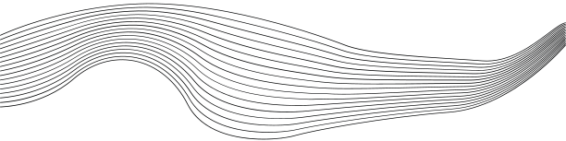
CONTENT
01
INTRODUCTION
02
OUR TEAM
03
OUR IDEA
04
MAIN COMPONENTS
05
FEATURES
06
FUTURE WORK
07
CONSTRAINTS

Slide 3

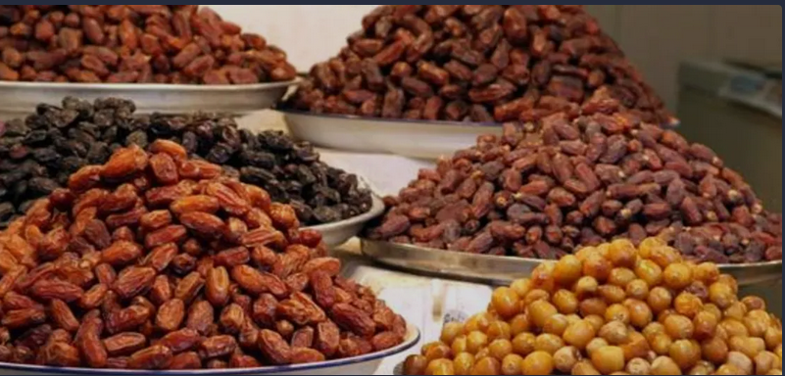

INTRODUCTION
Dates are classified in the market according to many criteria, and the sorting process is not accurate using the human eye, it is okay, we are here to help solve this problem

Slide 4


OUR TEAM
Batool Shilleh
Manar Mohamed

Slide 5

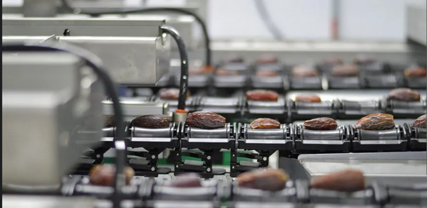
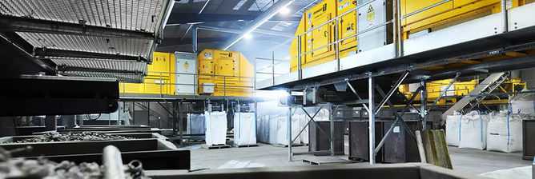
OUR IDEA
Quick overview
  Our project sorts dates into three main categories (first, second, and third), which are the categories spread in the market in general, depending on the weight of the date grain.
Where did the idea come from?
  A post appeared on Facebook looking for a date sorting machine
  Research shows that the source for most of this machine sleep is Italy
  This is an expensive type of machine

Slide 6

01
02
03
04
CAMERA
BALANCE
SENSORS
AIR JACKS
The user will have three different rings for each category. The date belongs to which category is determined by the scale
To determine if it is a date or not using machine learning
The sensor belonging to a specific category will be checked only
It pushes the dates off the track when activated

Slide 7


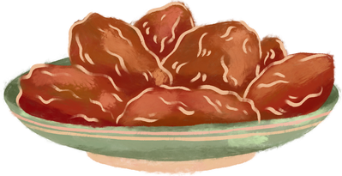

FEATURES
Determine whether it is a date or not using camera and machine learning
Classification of dates according to weight into three categories
Submit a report as reviewed by the owner

Slide 8

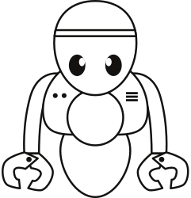


FUTURE WORK
additional criteria
automation
Versatility
Classification of dates using grain moisture, size and type
Adding mechanical parts and controlling them so that the system becomes fully automated without any human intervention
Making the system adjustable by the user to recognize other types of fruits

Slide 9


Constraints
3
1
2
Image Processing Challenges
Occupation
Cost

Slide 10


THANK
YOU

