Slide 1

An-Najah National University
Faculty of Engineering and Information Technology
Civil Engineering Department
Graduation Project II
Structural Design and Analysis of
Rawabi Commercial Building
Prepared by:
Mahmoud Badran
Mohammad Sabbah
Khalid Tahayneh
Osaid Sholi .
Under supervision of:
Dr . Munther Diab .

Slide 2
Outline :
Introduction.
Architectural Drawing.
Lateral loads
Preliminary Structural Design.
Three Dimensional Structural Analysis and verification .
Design and Reinforcement for slab and columns
Design and Reinforcement for Beams and shear walls
Design and Reinforcement for footings.
Design and Reinforcement for Stairs .

Slide 3
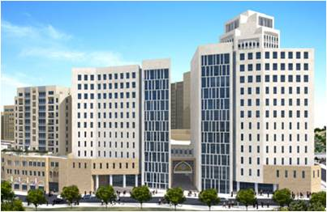
Introduction :

Slide 4
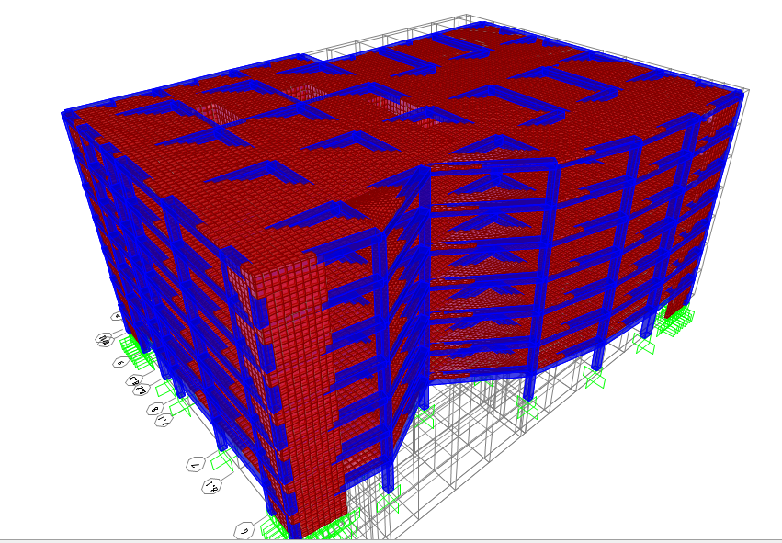

Slide 5
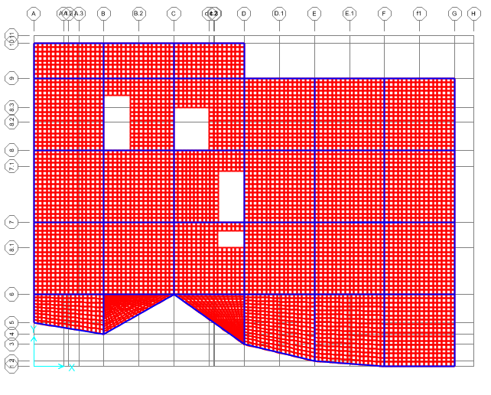

Slide 6
Project Description
The project is structural analysis and design of Rawabi commercial building .
The building is Six floors of reinforced concrete.
Contains one Block
The Area of building around 1530 m2 .
We added two halls in the last floors .
The area of hall is around 400 m2 .
Function | Height(m) | Area(m2) | Floors
Retail, resturant hall and dinning room | 3.5 | 1530 | First Floor
Offices , corridors , shops and ballrooms | 3.5 | 1530 | 2nd – 6th
Two Wedding hall | 3.5 | 2 X 400 | The Roof

Slide 7
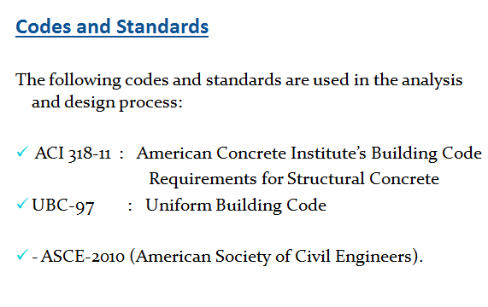
Analysis and Design Principles
the design will be accomplished according to ACI-318-11 code, while the analysis part will be performed using the structural analysis program “SAP2000” .
The footings are considered as fixed supports .

Slide 8
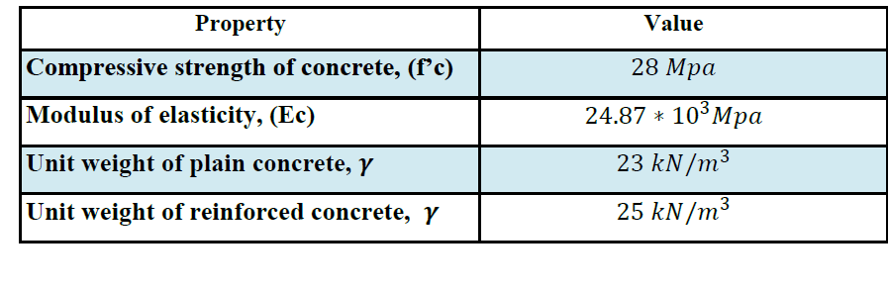
Structural Materials
Concrete:
The concrete type for all structural Element is B350
  Steel:
The steel used in all reinforcements is ASTM A955 Grade 60, and this type has a tensile strength of 620 MPa, yield strength of 420 MPa, and modulus of elasticity of 200 GPa.

Slide 9
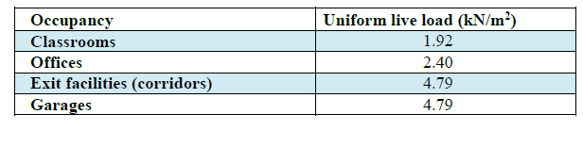
  Loads
Gravity loads:
  Live load: according to UBC97 , the following uniform live loads are used
In this project, The live load of 5 kN/m² will be used for first slabs , and 4 kN/m² for another slabs .
  Dead load:
  The super imposed dead load on slabs = 3.7 kN/m2.

Slide 10
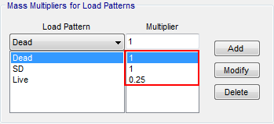
Masses:
  The mass source used to calculate the seismic weight of the building.

Slide 11
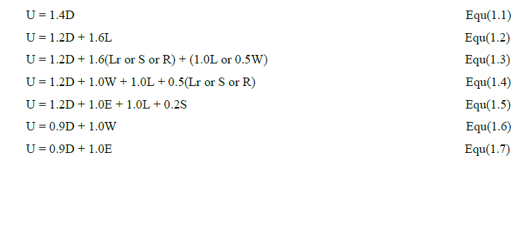
Load combinations

Slide 12
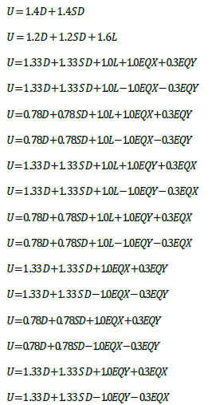
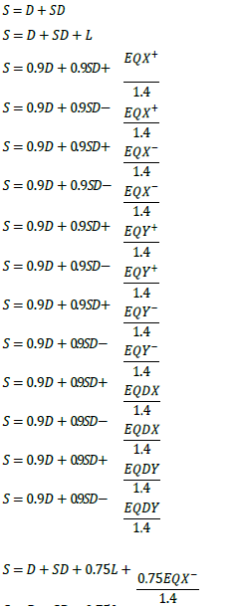
Load combinations:

Slide 13
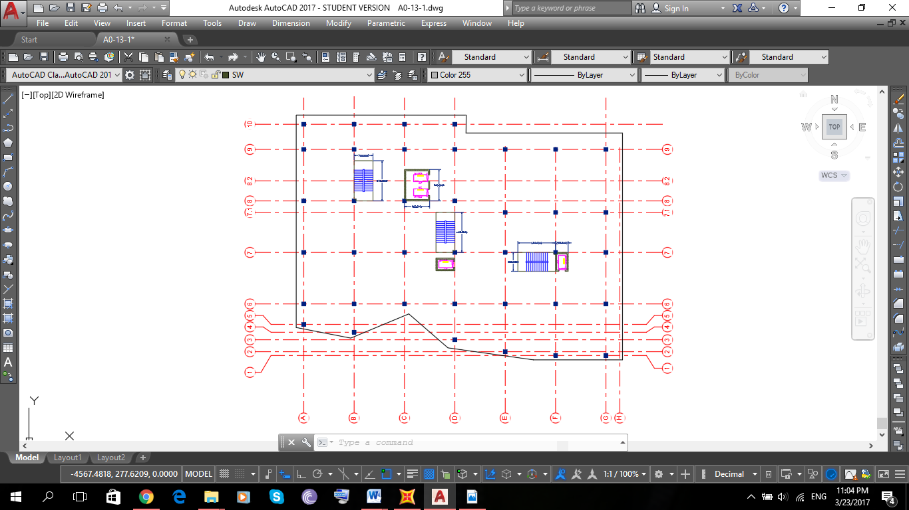
Architectural Drawings Block

Slide 14
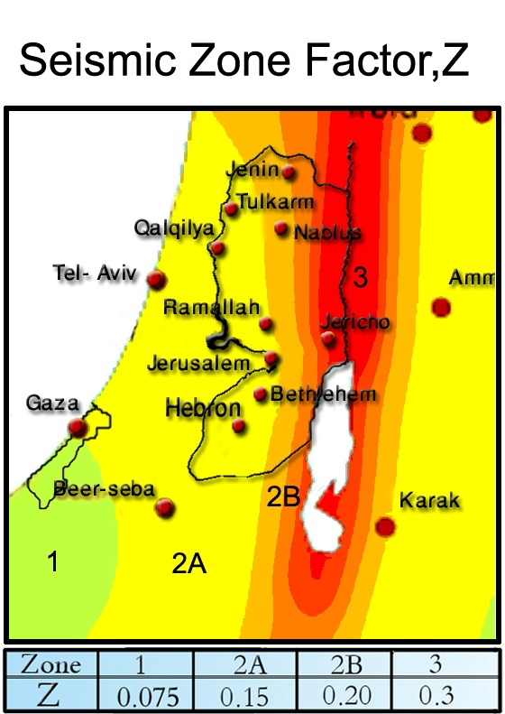
2) Lateral loads:
For Rawabi city near Ramallah :
Seismic Zone is , 2A
Seismic Zone factor , Z=0.15
Seismic coefficient , Ca = 0.15
Seismic coefficient , Cv= 0.15
Importance factor , I = 1.25
Numerical Coefficient , R= 5.5

Slide 15


Seismic loads UBC
Structural period :
According to section 1630.2.2 in UBC 97 :
Base Shear :
According to section 1630.2.1 in UBC 97 :
➔V = 9756.37 KN

Slide 16

UBC Base shear values
There's 3 values for base shear According to UBC 97 Code :
Value from equivalent static in (X and Y )
Value from Response spectrum (X and Y) ,
Value from Time History (Avg Value) , same scale factor .
EQy | EQx | Base shear (KN)
10455.16 KN | 11282.914 KN | Equivalent static
10958.99 KN | 11685.973 KN | Response spectrum
Avg = 13357 KN |  | Time History

Slide 17
Seismic loads IBC
S1 = 1.25 ∗ Z = 1.25 ∗ 0.15= 0.1875 - structural period :
Ss = 2.5∗Z =2.5∗0.15 =0.375
𝑆𝑀𝑠 = 0.375
𝑆𝑀1 = 0.1875
𝑆𝐷1 =𝑆𝑀1
𝑆𝐷1= 0.1875
𝑆𝐷s =𝑆Ms
𝑆𝐷s= 0.375
Occupancy category of structure is III
Therefore, the seismic design category is C.

Slide 18

I = 1.25
R = 5.5
ELF will be used in this structure.
𝑉 = 𝐶𝑠 ∗ 𝑊
𝐶𝑠 =
Cs =0.086
The value of Cs computed not exceed the
following:-
Cs = = 0.079≤0 .086→ Cs =0 .079
→ 𝑉 = 0 .079∗153682= 12140KN

Slide 19
Comparing between Base shear values according to codes :
Value of Base shear (KN) | Code
9800 KN | UBC
12140 KN | IBC

Slide 20
Comparing between Base shear values according to codes :
Value of Base shear (KN) | Code
9800 KN | UBC
12140 KN | IBC

Slide 21
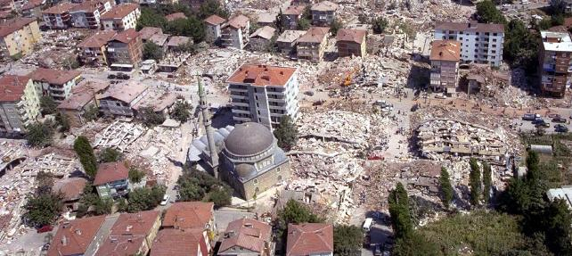
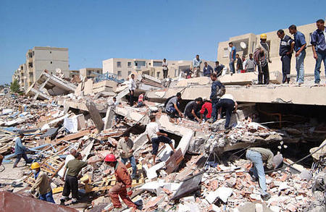

Slide 22
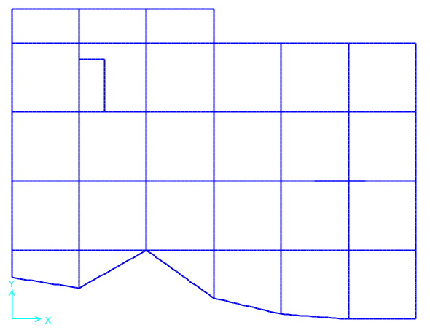
Design of slab :

Slide 23
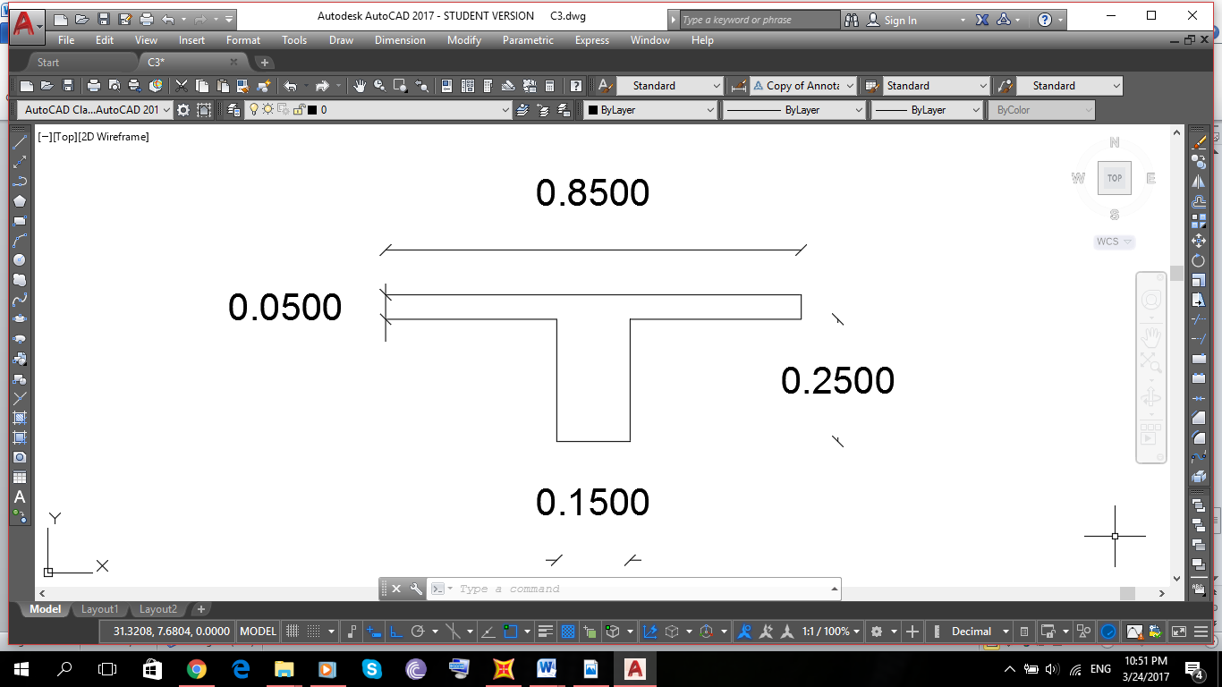
Waffle Slab :
The slab system is two way waffle system .
The slab thickness is 30 cm .

Slide 24
Slab Load :
G-f slab :
Slab own Weight = 0.3 m * 25 KN/m3 = 7.5 KN/m2 So ,,
Wu1 = 1.4 (OW+ SD) = 1.4(7.5+3.7) = 15.68 KN/m2
Wu2 = 1.2 (OW+SD) + 1.6 Live = 1.2(7.5+3.7)+ 1.6 (5) =21.44 KN/m2
From above take Wu slab1 = 21.44 KN/m2
1 st-6th slab :
Slab own Weight = 0.3 m * 25 KN/m3 = 7.5 KN/m2 So ,,
Wu1 = 1.4 (OW+ SD) = 1.4(7.5+3.7) = 15.68 KN/m2
Wu2 = 1.2 (OW+SD) + 1.6 Live = 1.2(7.5+3.7)+ 1.6 (4) =19.84 KN/m2
From above take Wu slab1 = 19.84 KN/m2 .

Slide 25

Design of slab :
For Bending Moment by taking a section cut in Frame at x-direction and y- direction
:
➔Use→ 2Ø10
In Top (Flange) = 0.0018*1000*50 =
➔Use→ 1Ø8/100 mm

Slide 26

Check for shear:
By handle :
øVc = =(0.75)()(150)(270)/1000= 161 KN/rib
from SAP :-.
22.3 KN/rib
ø𝑉𝑐 ≫ 𝑉𝑢 ∴ ➔𝑂. 𝐾
No need for shear reinforcement, thickness is adequate.

Slide 27
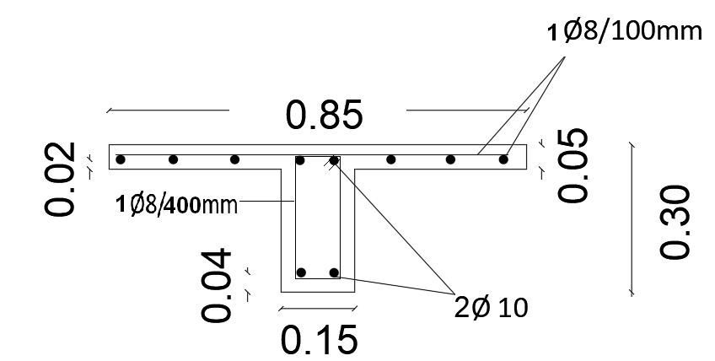
Slab cross – section :

Slide 28
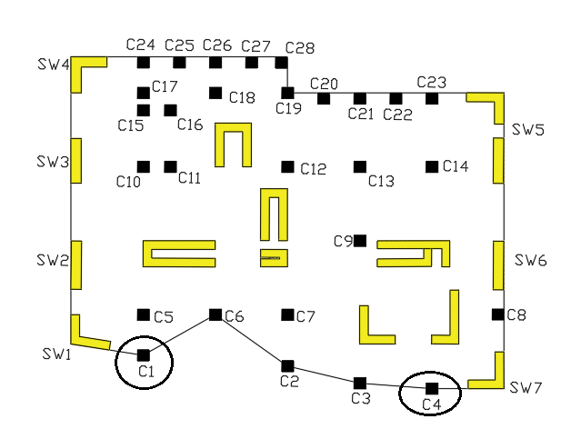
Design for Columns

Slide 29
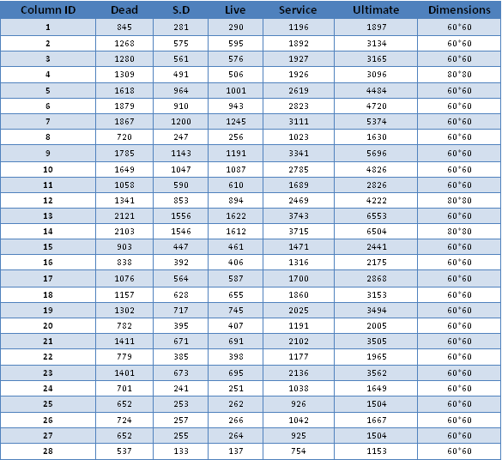
Dimension of columns :

Slide 30
The pure compressive strength that the column can carry is given by this equation:
For C1 (600*600), assuming no steel, the pure compression force is:
) + = 4455.4 KN
For C2 (800*800), assuming no steel, the pure compression force is:

Slide 31
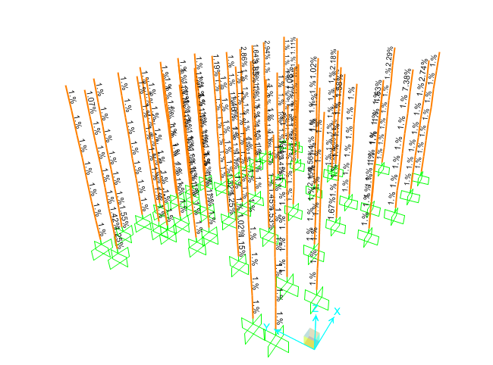
Design of column

Slide 32
For SAP program design result, the rebar percentage for most of columns in all floors is 1% but two of them has rebar percentage around 2% and it is Ok .
As a result, using a rebar percentage equal 1% for all columns is suitable and very safe.
Therefore, for 600mm-square column : .
As = ρ*Ag = 0.01*= 3600 →(16ɸ18)
Assuming 50 mm cover
Spacing between Longitudinal bar = = 125mm ≤150mm ➔OK .
And, for 800mm-square column :
As = ρ*Ag = 0.01*= 6400 →(20ɸ20)
Spacing between Longitudinal bar = = 140 mm ≤ 150mm ➔OK .

Slide 33



The capacity of column to resist the shear strength is given by:

Slide 34
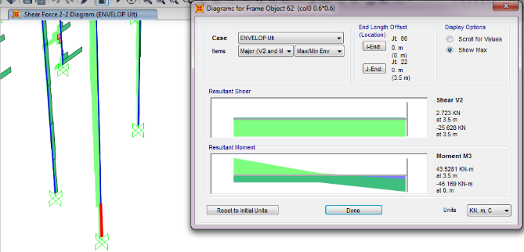
Vu= 26 KN . ➔Vu << . ➔ Okay
➔All Columns have Vu less than it is kind so (use ACI318-11 for maximum spacing permitted between hoops).

Slide 35
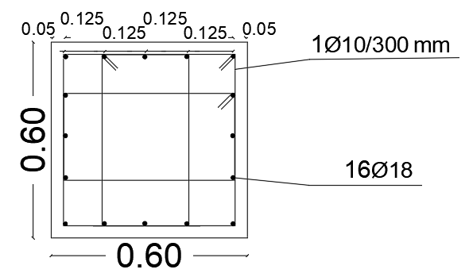
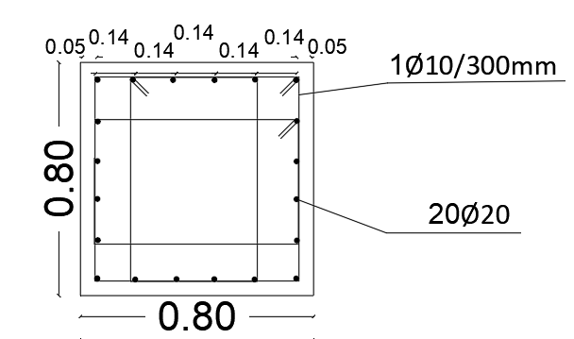
600mm-square:-
800mm-square:-

Slide 36
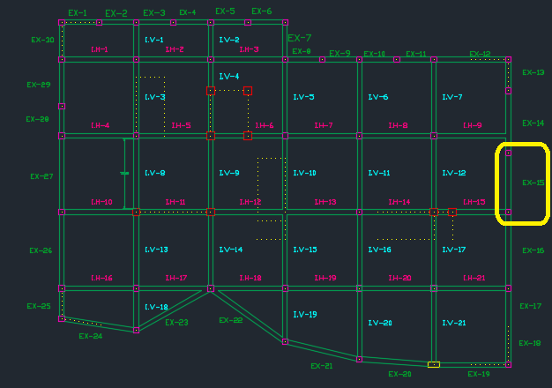
Design of Beams :

Slide 37
Design of Beams :
Dimensions :
Group of Beam | Beam Name
B2 , B3 , B5 , B7 , B6 , B24 , , B29 B34 , B35 , B36,B30, B31 , B32, B33 B48, B49, B56 | B-1 (55 * 50 )
B1 , B8 , B9 , B10 , B11 , B12 , B13 , B14 , B15 , B17 B18, B19, B21, B22B42, B44, B54, B50B23 , B37 , B38 , B39, B41 | B-2 (60*80)

Slide 38
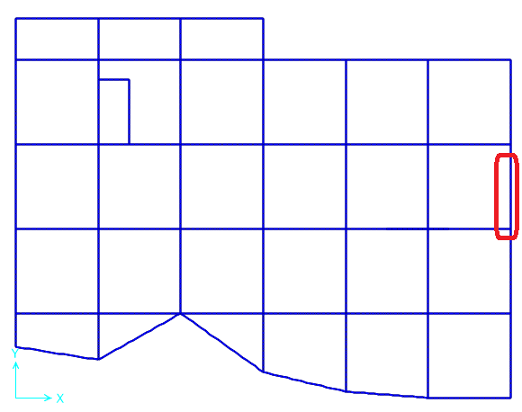
Sample calculation :
Take Ex-15 as an example :

Slide 39
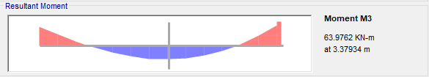
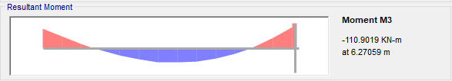
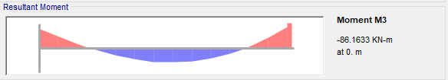
By taking the moment force from SAP :

Slide 40
Design For Bending Moment:
Max Positive moment :
Mu,max = 64 KN.m
Fc' = 28 MPa Fy = 420 MPa
Ø bars = 18 mm Ø stirrups = 12 mm
b (mm) = 550 h (mm) = 500
ρ = 0.00159
As = 0.00159 X 550 X 440 = 384 mm²
As min = 0.0033 X 550 X 500 = 915.75 mm²
As used = 915.75 mm² ➔ (4 Ø 18) .
And the same calculation for Max Negative moment .

Slide 41
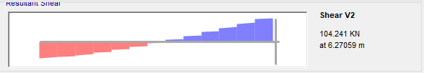
Design For Shear:
According to ACI code :
Ø Vc = 213.5 which is bigger than Vu ➔ so the check is okay .
so we have a minimum reinforcement for shear As shown in beam detailing .

Slide 42
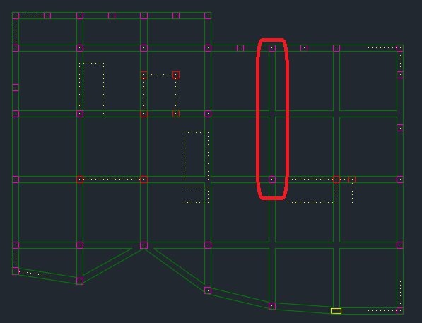
Design of girder in the last floor :
Length = 16.4 m , Depth = 60 cm , Width = 80 cm

Slide 43
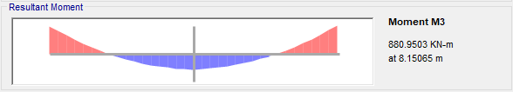
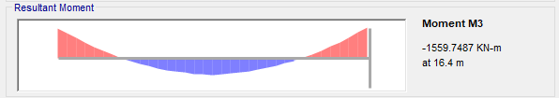
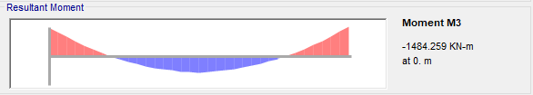
By taking the moment force from SAP :

Slide 44
Design For Bending Moment:
Max Positive moment :
Mu,max =880KN.m
Fc' = 28 MPa Fy = 420 MPa
Ø bars = 32 mm Ø stirrups = 12 mm
b (mm) = 800 h (mm) = 600
d = 600 – 60 = 540 mm
ρ = 0.01
As = 0.01 X 800 X 540 = 4300 mm²
As min = 0.00333 X 800 X 600 = 1600 mm²
As max = 0.0181 X 800 X 540 = 7819 mm²
A used = 4300 mm^{2 ➔} Reinforcement = (9Ø25)

Slide 45
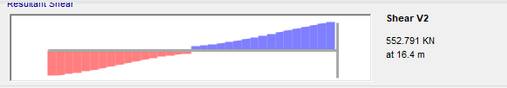
Design For Shear:
So , ➔Vc = 381kN,
➔Vu = 552kN
➔Vs = 355kN .
So use 1∅12 / 150mm

Slide 46
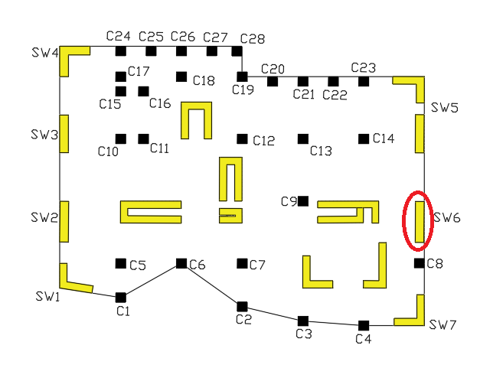
Design of shear wall :
Figure 6.14 below shows the location of SW6 to be checked :

Slide 47

Shear wall dimensions :
Length = 5.45 m , thickness = 0.25 m , height = 24.5 m
Find the load on shear wall by section cut :
So , Pu = 868 KN
Mu = 280 KN.m
Vu = 111 KN .

Slide 48



Shear wall checks :
Thickness check :
Designing the horizontal steel using Eq.6.14-to- Eq.6.15 :
Vc > , therefore, use the minimum horizontal steel according to ACI318-11 .

Slide 49


➔As horizontal = 0.0025 b h = 0.0025 (1000)(250) = 615 mm2
➔ Then, for each face of wall = 313 mm2 ➔ 3Ø12/1m ➔1Ø12/300 mm
Designing the longitudinal steel using Eq.5.13, , as follow
Assume cover = 40 mm ,
➔ 7Ø20/1m for each side ➔ 1Ø20/150 mm for each side .

Slide 50
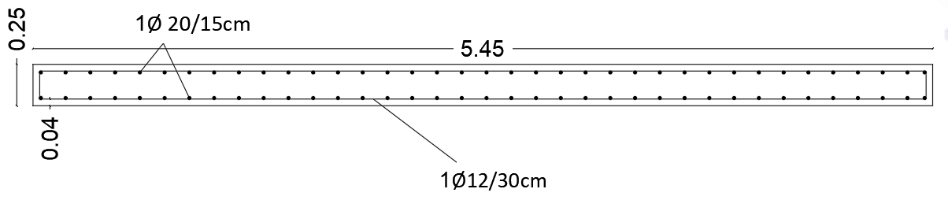

Slide 51
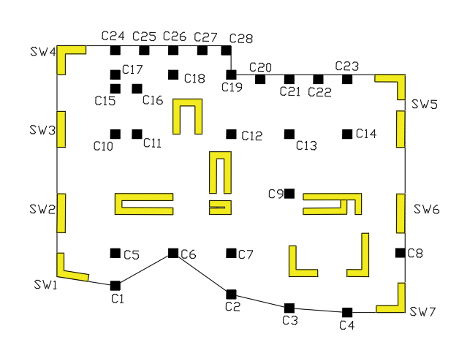
Design of footing :

Slide 52
Design C13 as single footing :
Q all = 350 KN/m2 ,,, P service =3744 KN ,,, P ultimate =6554 KN
The results :
Area footing = 3.3 *3.3
Q ult = 600 KN\m2
Thickness =85 cm
Solve for ρ ➔ ρ= 0.0023
As = 0.0023* 1000* 800 = 1845 mm^2
As min = 0.0018 *1000* 850 = 1530 mm^2
As > As min ➔ so As = 1845 mm^2 ➔ 6 Ø 20 / m
Shrinkage steel ➔ 5 Ø 20 / m .

Slide 53
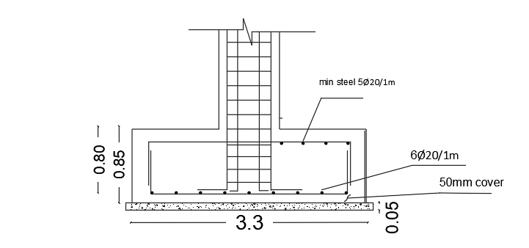

Slide 54
Design of wall footing :
Take S.W6 as an example for design :
Pult =868 KN ,,, Pser = 545 KN ,
The results :
Area footing = 1.60 *5.45
Q ult = 600 KN\m2
Thickness =35cm
Solve for ρ ➔ ρ= ρ = 0.00376
A_{s} = 0.00367*1000*300 = 1129 mm²/m ➔ 5Ø18 / m
A_{s}, min = 0.0018*1000*350 =630 mm²/m ➔3Ø18 / m
Total shrinkage steel = 1.60*1*630= 1008 mm²
Shrinkage steel ➔ 4 Ø 18 / m .

Slide 55
Total Area Footing :
Area Footing = Area for Single Footing + Area For Wall Footing
Area For single Footing = Area Group1 * No. + Area G2 * No. + Area G3 * No.
Area For Wall Footing = Area Group1 * No. + Area G2 * No. + Area G3 * No.
➔Approx Area for Single Footing = 44.89 +67.27 + 88.36 = 210 m2
➔Approx Area for Wall Footing = 19.2 +36 + 27.6 = 83 m2 .
So ,,,
The Total Area for footing = 210 + 83 = 300 m2 .
Building Area = 1530 m2
➔75% (1530) = 1150 m2
The Area footing is smaller than 75% from Building area ,,, our Selection is Right .

Slide 56
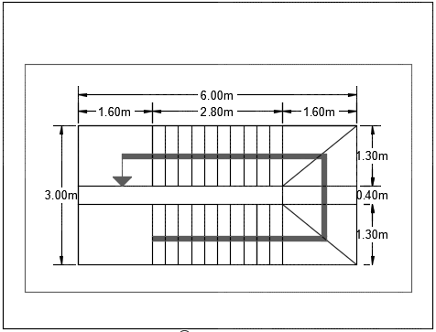
Design of stairs :
Dimension of stairs:
The thickness of stair slab is assumed based on ACI deflection table, and checked it with shear constraints.

Slide 57

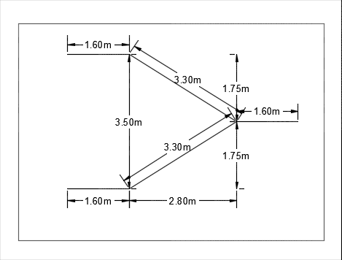
Thickness of the flight :
We take h =20cm , to minimize the deflection .

Slide 58
Load on stairs :
The total loads on stairs are:
The own weight of stairs = 0.2 ∗ 25 = 5 KN/m²
The live load is assumed = 5 KN/m2.
The SD is summarized in table that shown the value of SD load =3 KN/m2
Checks :
Deflection =
Note : the long term deflection is became approximately 8.73 mm that is smaller than the allowable deflection➔ OK .

Slide 59

Check shear :
Vu = 64 KN
Since ΦVC >Vu ➔ 112.5 >64 KN ➔ There's No Need For Shear Reinforcement .
Design for flexural:
For the middle M22 (positive) = 27KN.m, bottom steel in Flight :
➔4ϕ14 /m .
OR ,, Use (1∅12/20 cm) for all longitudinal steel ( main steel ) .

Slide 60
For the middle M22 (positive) = 8KN.m, bottom steel in Landing
Use minimum steel ➔ As min = 0.0018 *1000*200 = 360 mm2 ➔4∅12/1m .➔ 1∅12/25cm OR 1∅10/20cm .
Design for Transverse steel with stairs using (M11):
As we said we defined the stairs as one way solid slab so the transverse moment is so small =18 kN.m, so we used:
As min= 0.0018 × 200 × 1000 = 360 mm² in both face ➔ 1∅10/20cm in each layer .

Slide 61
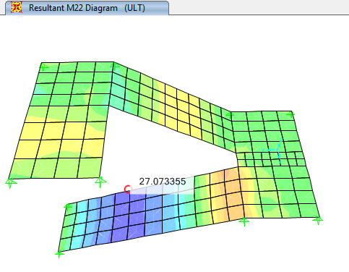
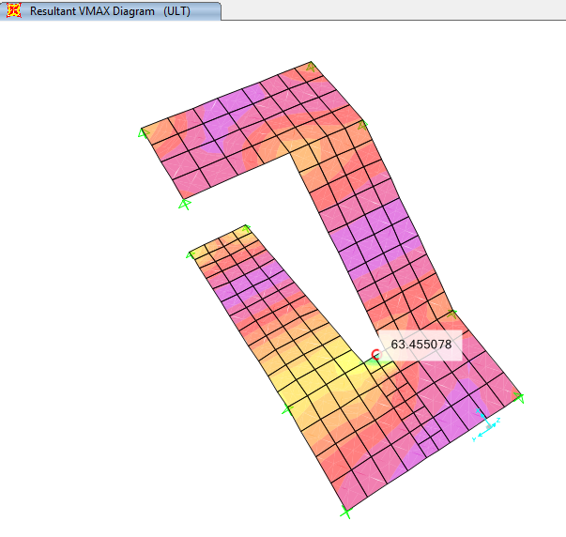

Slide 62




