Slide 1

Software Graduation Project
Hope Application
Prepared by:
Shaima Yamien, Lina Bobali
Supervised by:
Dr. Aladdin Masri

Slide 2
Outline
About Hope
Applications and Website
Features
Standards/Codes
Earlier Course Work
Nonfunctional Requirements
Constraints
Conclusion
Future Work

Slide 3
About Hope
Hope is an application, whose main mission is to help children with autism integrate them into society.
As well as help parents to know the development of their children as well as their knowledge of the existence of any events or courses for parents of autistic children.

Slide 4
About Hope
In addition to the website that helps center and teachers to control both applications And managing matters for children and their families

Slide 5
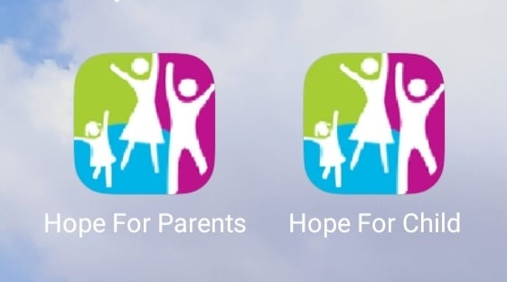
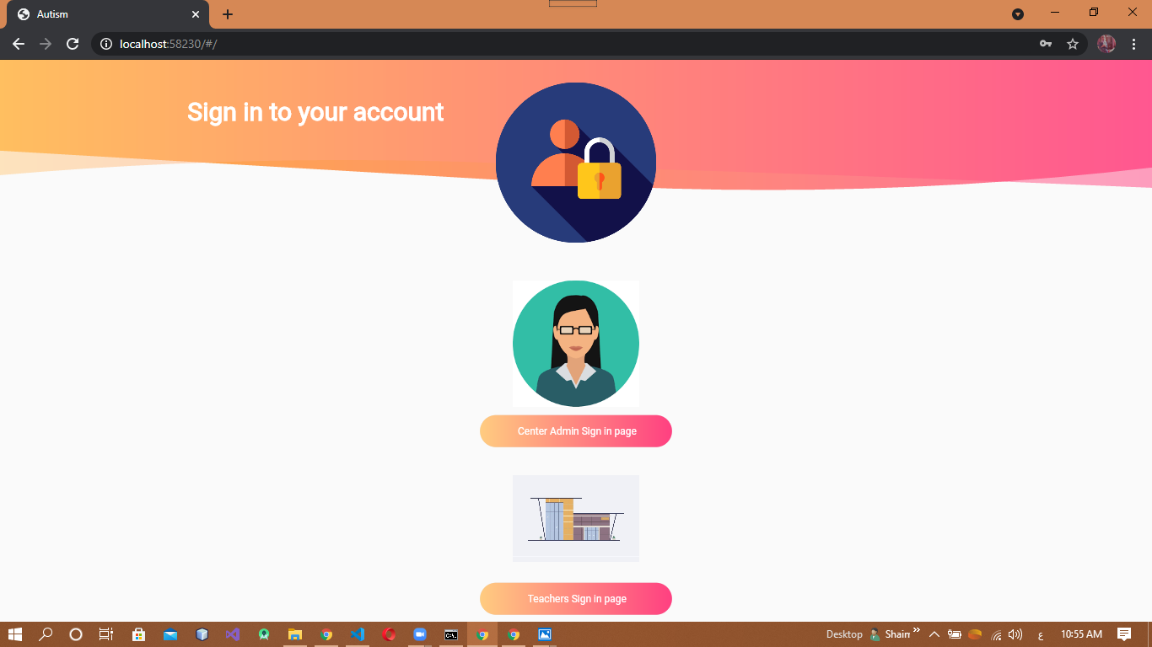
Applications and Website

Slide 6
Features
Hope for Children
SignIn, SignUp
View Information
Display colors, animals and foods
Play games and challenges
Upload images and score

Slide 7
Features
Hope for Parents
View child progress
Ask questions
View questions and answers
View events
Change theme of application

Slide 8
Features
Hope for Teachers
SignIn
Show, update and delete children information
Update children progress
Show questions and answers
Answer questions
Show and add events

Slide 9
Features
Hope for Center
SignIn
Show, update and delete children information
Show child progress
Show, add, update and delete teachers information
Show questions and answers
Answer questions
Show and add events

Slide 10
Standards/Codes
For programming Hope application, we used:
Flutter platform (Front end)
MySQL and php (Back end)
Notes:
We choose it because we can use it in many applications from one base code with small changes in every system. and also it is high performance

Slide 11
Earlier Course Work
web programming
Database
Software Engineering
Java and c++

Slide 12
Nonfunctional Requirements
Performance and scalability.
Portability and compatibility.
Availability, maintainability.
Security.
Usability.

Slide 13
Constraints
Covid-19 Constraint
Knowledge Constraint

Slide 14
Conclusion
To conclude everything, we achieved our goal of our project, we created Hope application for autistic children in Palestine and another one for their parents, that help them to communicate with teachers in centers that their children belong to them. In addition to created the website for teachers and center to use it in controlling everything in the applications.

Slide 15
Future Work
Add more games and challenges.
Allow multiple centers to create an admin accounts and control children and teachers.
Add notifications system for Hope application for parent.
Add Arabic and English language for all apps and website.

Slide 16
The End
Thank You!

