Slide 1
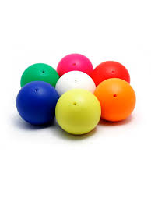
Ball Collecting Robot
Prepared By : wala’ Hamad
Khayrieh Homran
Supervisor : Dr.Raed alqadi

Slide 2
OUTLINE
What is Ball collector robot?
Overview
Motivation
Components
Methodology
Constrains
Demo

Slide 3
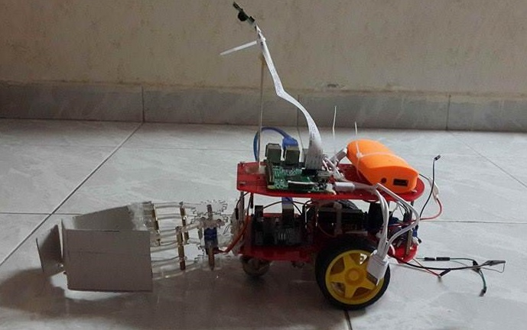
What is Ball collector robot?
Ball collector robot is a vehicle that analyze its surrounding area then detect balls and collect them to specific point known with predefined sign.

Slide 4
Overview
The project consists of two main parts:
Image processing using Raspberry Pi 2 board and Raspberry Pi camera module.
Controlling robotic car movement and sensors operation using Arduino Uno microcontroller.

Slide 5
Motivation
In many sports that use balls, it is very important to collect balls to specific point.
Golf practice and Tennis playing fields

Slide 6
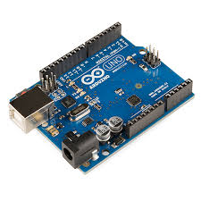
Arduino Uno Microcontroller

Slide 7
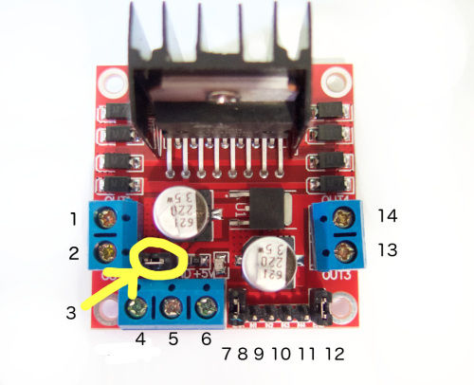
H-bridge module

Slide 8
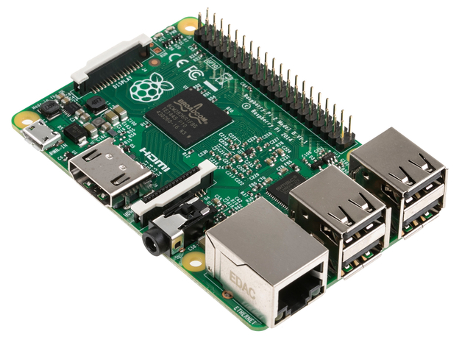
Raspberry Pi 2 Module B

Slide 9
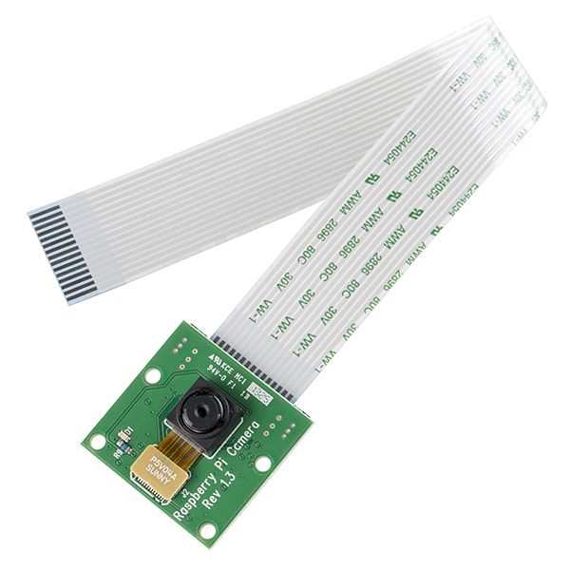
Raspberry Pi Camera Module

Slide 10
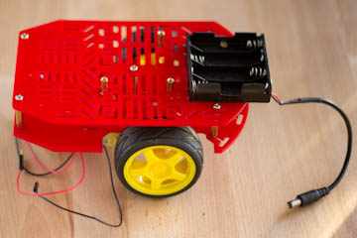
Two wheels robotic car

Slide 11
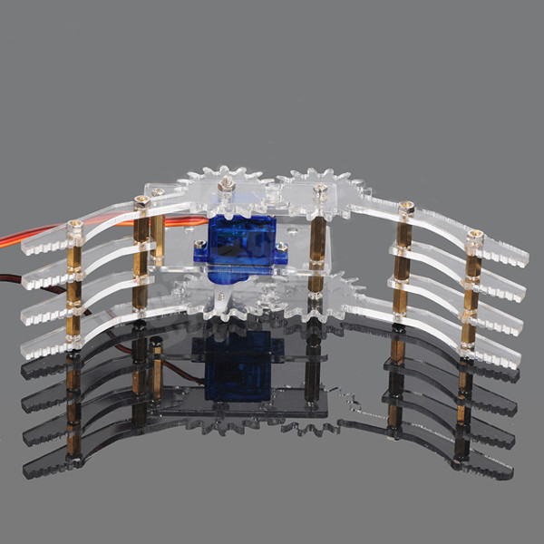
Servo gripper

Slide 12
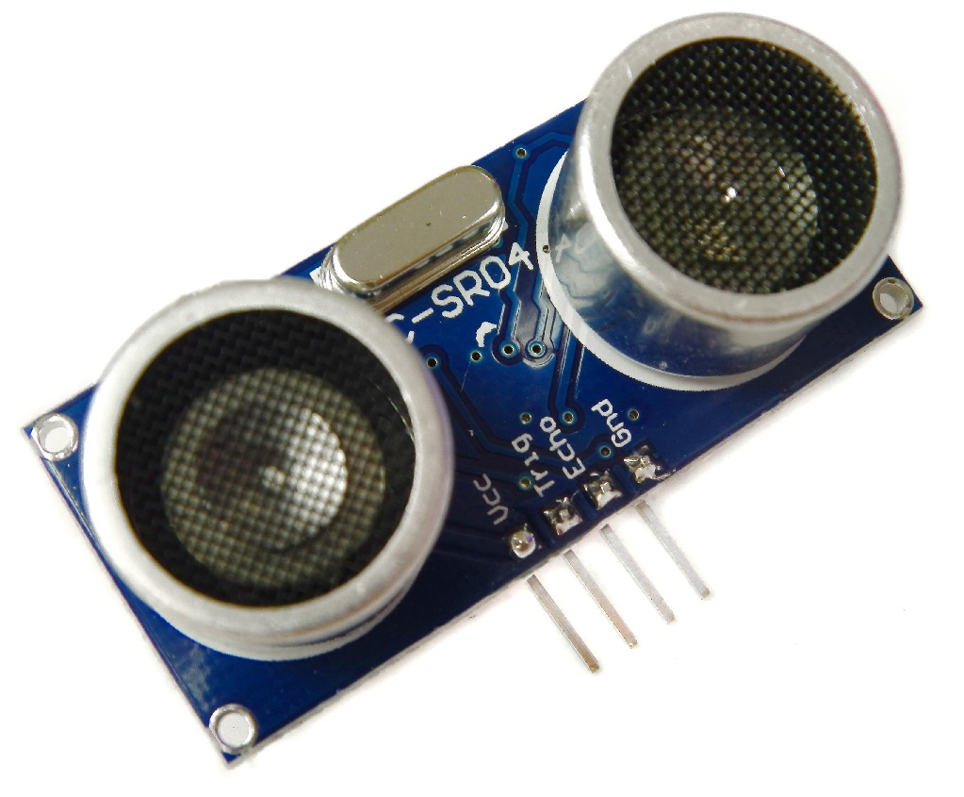
Ultrasonic Sensor

Slide 13
Methodology
Project main parts:
Ball detection using Image Processing.
Destination point detection using Image Processing.
Car movement using Arduino.

Slide 14
Ball Detection
We use Raspberry Pi 2 kit and camera module.
Use Open CV python library for Image Processing .
Ball Detection based on color and shape.

Slide 15
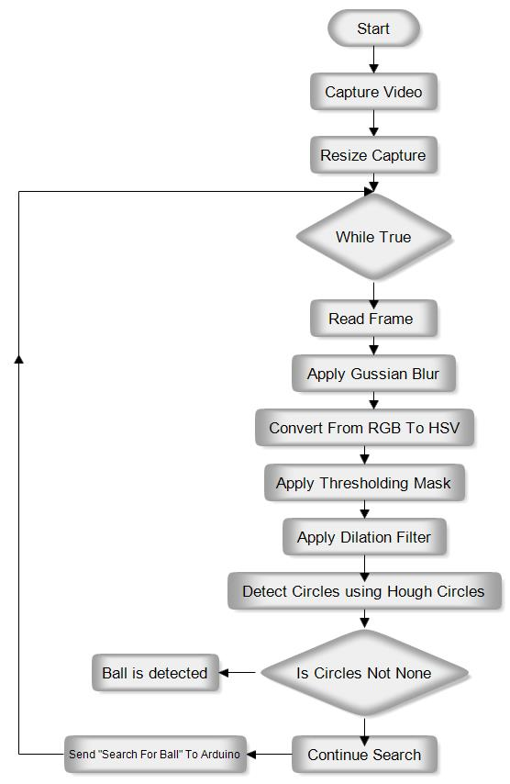
Flow Chart

Slide 16
Release Point Detection
Release ball at hole.
Detect hole using small black rectangle at one hole corner.
Detect black rectangle using Image Processing .
Direct car to hole location

Slide 17
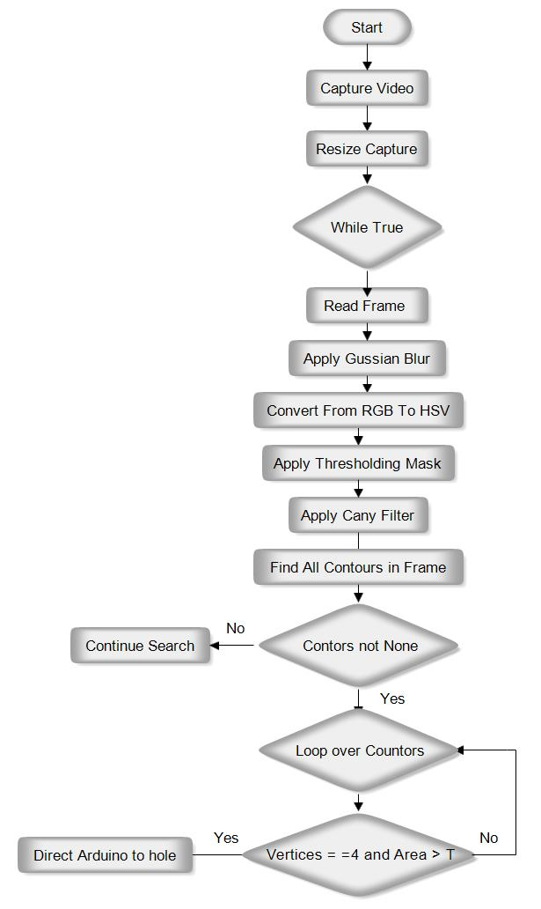
Flow Chart

Slide 18
Robotic Car Movement
Control car movement using:
Commands that received from Raspberry Pi
Ultrasonic Sensor Readings.

Slide 19
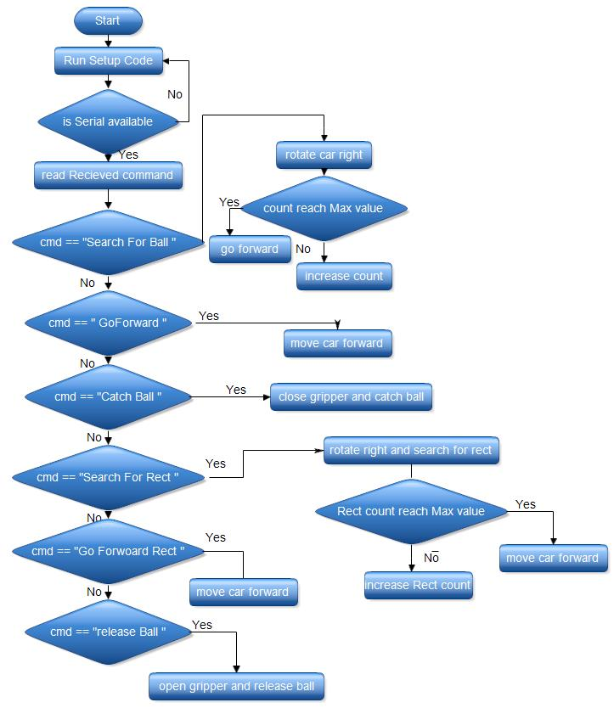
Flow Chart

Slide 20
Constraints
Unstable Robotic car movement.
Solution:
Try multiples cars and use most stable one.

Slide 21


Constraints
Raspberry Pi power supply.
Solution:
Try group of 9V batteries connected in parallel.
Use power bank.

Slide 22
Constraints
Raspberry Pi 2 Module and camera module compatibility.
Unreliable operation of Raspberry Pi 2 Module.

Slide 23
Future Work
Implement more reliable and accurate Image Processing Algorithm.
Try to make catching, releasing ball operations more accurate .

Slide 24
Demo

Slide 25
Thank You

