Slide 1

Current Status of Stone-Cutting Waste Management in Palestine

Slide 2




Team Members
Saad Jodallah
Rahaf Ghozzi
Abdelraheem khateeb
Bara’a Abu Baker

Slide 3

01
02
03
Table of Contents
Introduction
Problem Statment
o
Objectives
Research Gap
05
Methodology
06
Data analysis
07
Conclusion and Recommendation

Slide 4
Introduction
1

Slide 5
Stone & Marble Industry
01
One of 50
largest and most powerful marketplaces worldwide.
02
10%
annual increase in global stone and marble sales.
03
600 Million m2
the annual consumption of stone.
04
$28 Billion
Value of sales.

Slide 6

Palestinian Stone
12th
4.5%
Largest stockholder of construction stones
Of Palestinian GDP
Of world production
Employees
4%
20,000

Slide 7
Market share for stone and marble industry
10%
20%
70%
10% of the total production exporting to global market.
20% of the total production go to domestic market.
70% of the total production go to Israel occupying market.

Slide 8
Distribution of quarries and stone factories

Slide 9
Stone Waste
15%-85%
Of Total material extracted is lost.
1.24 million tons
Of solid and liquid waste (slurry/sludge) will be generated annually in Palestine.

Slide 10
Stone Waste Types
Small Stones and Rocks
Quarrying
Cracked Stones
Main types
Fabricating
Little Broken Stone Pieces
Stone Waste
Stone Powder
Equipment
Wastewater Sludge
Other types
Rubbish
Spent Petroleum Products

Slide 11
Problem Statement
2

Slide 12
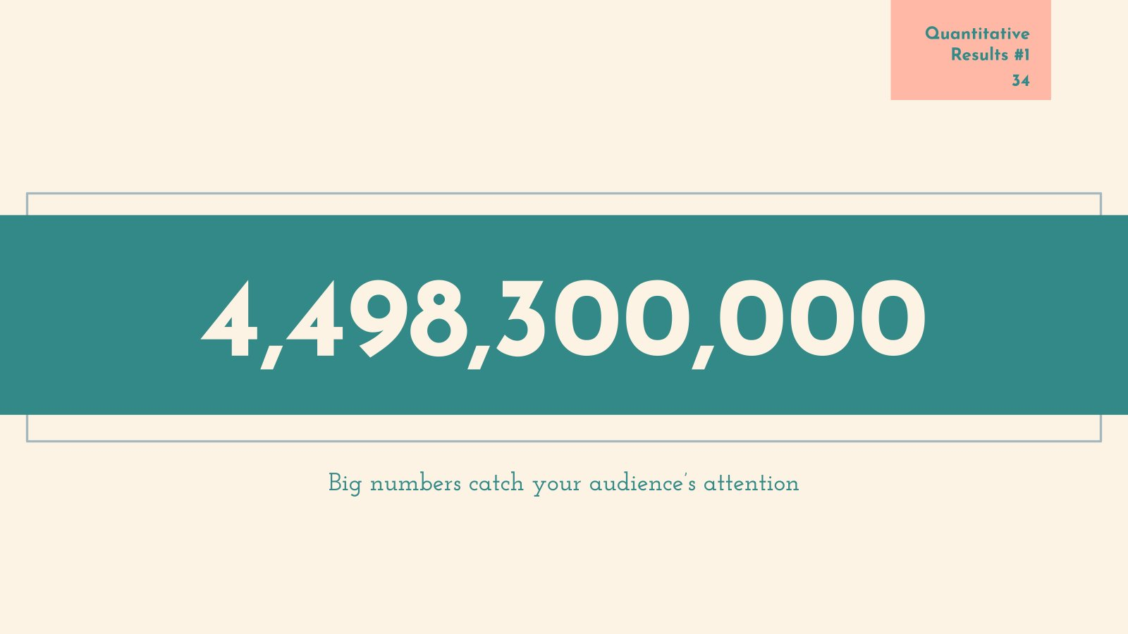
The stone industries in Palestine produce a large amount of waste and a small percentage of it is exploited.

Slide 13
Objectives
3

Slide 14
Objective of
The project
Assess the current approaches of waste management in stone-cutting industries in Palestine
Provides the best practices to deal with waste

Slide 15
Research Gap
4

Slide 16

All of previous studies conducted:
1- for specific areas in Palestine .
2- for specific type of waste.

Slide 17
Methodology
5

Slide 18
Conduct a Sufficient Relevant Literature Review
Analyzing data
Draw Conclusions & Recommendations
Study Tool
Step 1
Step 2
Step 3
Step 4
Step 5
Step 6
Step 7
Step 8
Collect Data
Document all results in a report (the project report)
State the study questions, and Formulate proper Hypotheses
Test the hypothesis

Slide 19
Study Tool
Tools
Sample Size
Questionaries
Interviews
Software analysis
Calculated by Herbert Arken formula
Designing questionnaires to collect appropriate data for this study
Communicating with specialists and officials in this field
Make proper analysis using SPSS, Minitab and excel

Slide 20
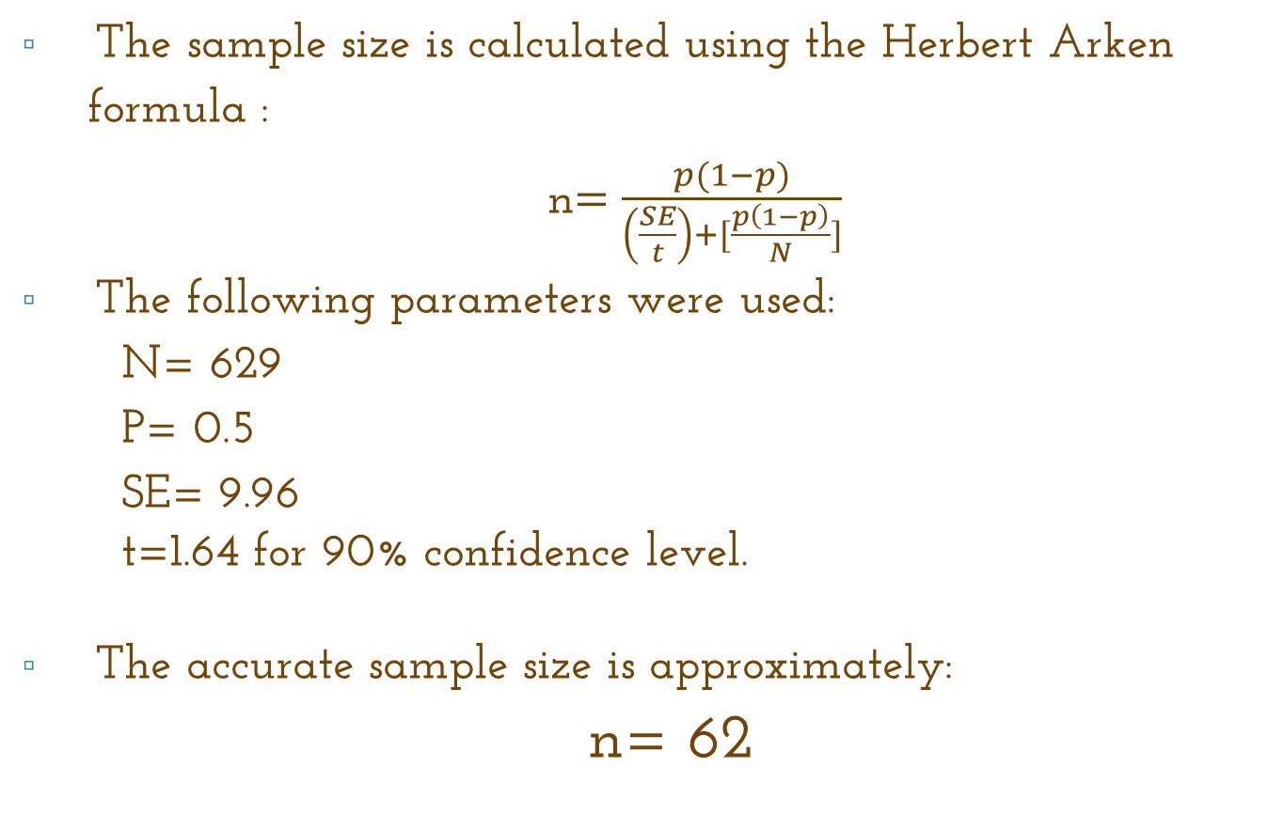
Sample Size
The sample size is calculated using the Herbert Arken formula :
n$=\frac{p(1−p)}{\left(\frac{SE}{t}\right)+[\frac{p\left(1−p\right)}{N}]}$
The following parameters were used:
N= 629
P= 0.5
SE= 9.96
t=1.64 for 90% confidence level.
The accurate sample size is approximately:
n= 62

Slide 21
Data analysis
6

Slide 22
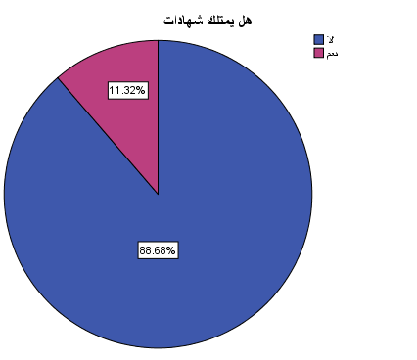
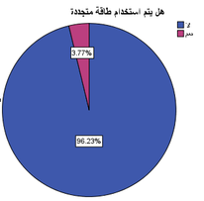

Slide 23
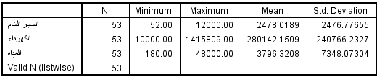
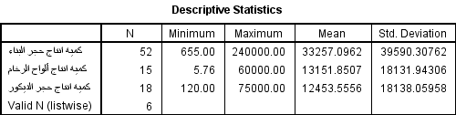
Objective of
The project
production input resources
production quantity

Slide 24
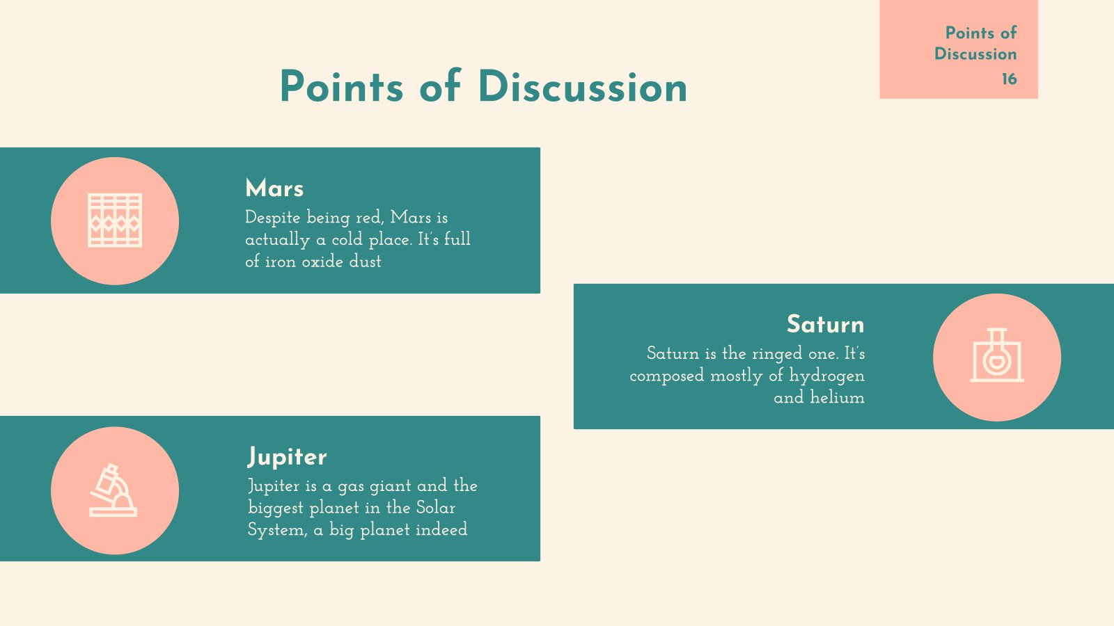
52%
Yield percentage
The percentage of waste from raw material
26%
87%
The percentage of liquid waste compared to water input

Slide 25
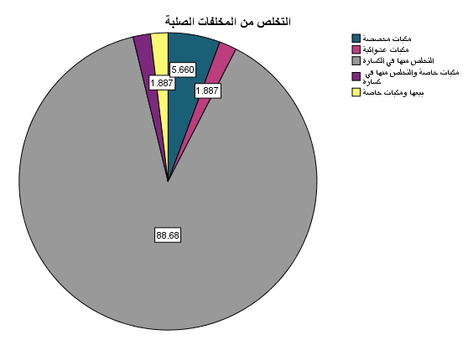
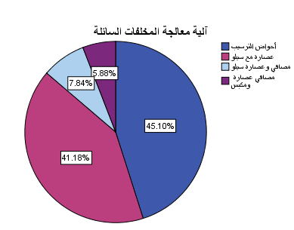

Slide 26
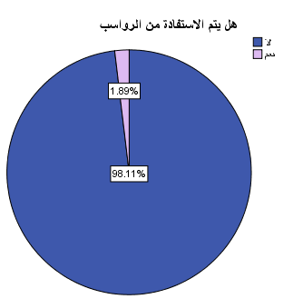
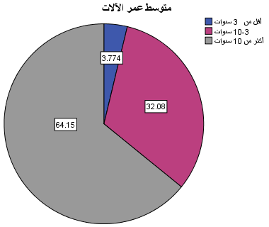

Slide 27
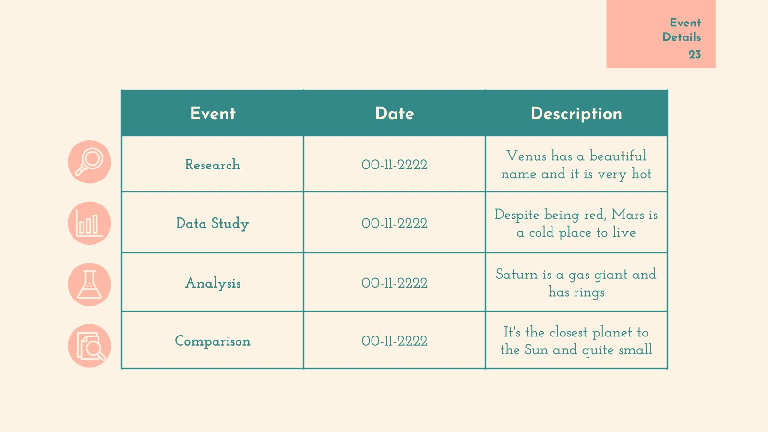
Management issues | Mean score | Level of agreement
Matters related to growth and creativity in the enterprise. | 2.009434 | Agree
Matters related to the company’s internal operations. | 2.289308 | Agree
Customer matters. | 2.386792 | Agree
Financial matters. | 2.215094 | Agree
Agreement to implement a waste management system with a small additional cost? | 1.603774 | Strongly Agree

Slide 28
NO. | Hypothesis | Status of acceptance or rejection
1 | There are no statistically significant differences between the age of the machines in the factory and the percentage of produced solid waste. | Reject.
2 | There are no statistically significant differences between water consumption in the factory and the presence of the silo. | Accept.
3 | There are no statistically significant differences between the ratio of the number of automatic machines to the total number of machines in the factory and the percentage of solid waste produced. | Accept.
4 | There are no statistically significant differences between matters related to the financial aspect and the presence of a silo in the factory. | Accept.

Slide 29
Conclusion & Recommendation
7

Slide 30
Conclusion:
Even though the stone sector is an important and ancient sector, it was concluded that most of factories don’t have certifications such as ISO 9000 and ISO 14000. Also, most of factories don’t care to renew the machines, as most of the machine’s age was more than 10 years. In addition, the largest proportion of factories dispose the solid waste in crushers, and treat the liquid waste by purification plant and silo. While factories who don’t treat the liquid waste, most of them get rid of the liquid waste in random landfill. For sludge, most of factories don’t use it, and dispose it in dedicated landfill. It’s important also to mention that the largest proportion of factories always take the size of the vehicle into account with the quantity transported, but most of them never care about choosing a proper time for transportation.

Slide 31
Recommendation
All of the factories that we visited don’t have any waste management model, because of that we recommend every factory manager to have one
The stone industry depends mainly on electricity, and due to the high price of kilowatt-hours, which increases the burden on factory owners, we recommend the use of renewable energy.
The amount of stone waste depends on several factors, the most effective factor is the quality of raw stone. So, attention should be paid to this factor and to choose a raw stone without any cracks
As we mention, most of the machine’s age was more than 10 years. These machines have high running cost (electricity consumption and maintenance cost). So, machines should be renewed to decrease the waste and increase profitability.

Slide 32
Filler for construction.
Landscaping and ornamental applications.
Materials used in the construction of roadbeds.
Solid waste
Development of residential driveways.
Gabion fill for retaining walls.

Slide 33
Agricultural applications.
Cement production.
Porcelain manufacturing
Sludge
Ceramics manufacturing, particularly floor and roof tiles.
building material and wall painting.

Slide 34
Challenges
Finding the locate of stone factories on the West Bank.
01
There is also difficulty in communicating with the Stone and Marble Association.
02
03
Large number of stone and marble factories in the West Bank.
visiting 53 factories was a burden in terms of effort and cost.
04
many factories refused to fill the questionnaire
05

Slide 35
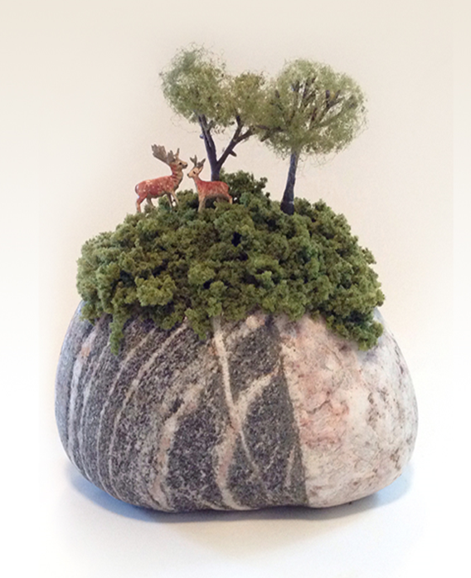
Thank you
Do you have any question?
Do you have any question?

