Slide 1





CraftHub

Slide 2


Our Team
Linda Abu Khalil
Lubna Bsharat
Supervisor
Dr. Amjad Abu Hassan

Slide 3

Introduction
Motivation
Technologies
Types of users
Future work

Slide 4

Introduction
With the development and advancement of technology, craftsmen and handicrafts owners have
resorted to displaying their work on social media pages for the purpose of selling, but the main
obstacle they face is reaching the target group interested in purchasing these products.

Slide 5

Motivation
The main objective of this project is to design an application that connects craftsmen and people
interested in these products instead of creating a general page on social media sites, which often
fails to reach the target groups.

Slide 6





Technologies
Flutter
PostgreSQL
Django
Firebase

Slide 7

Types of users
Admin
Artist
User

Slide 8
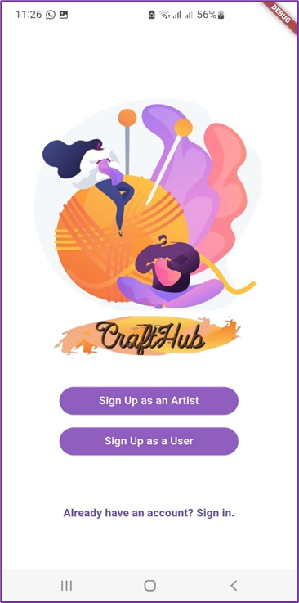

Welcome page

Slide 9
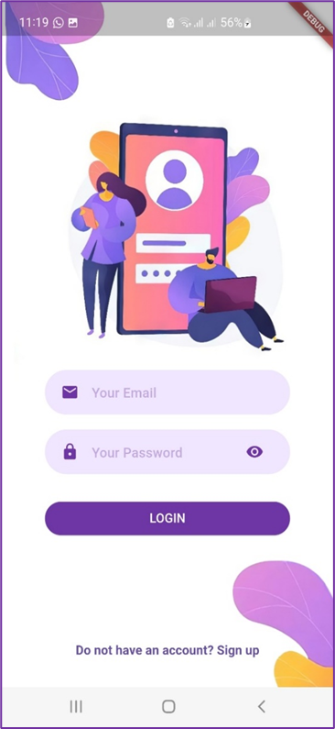
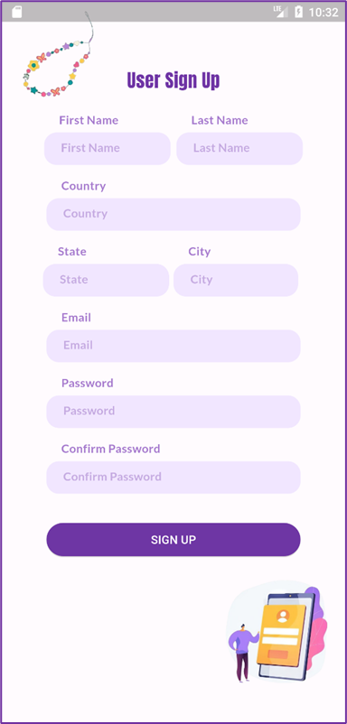
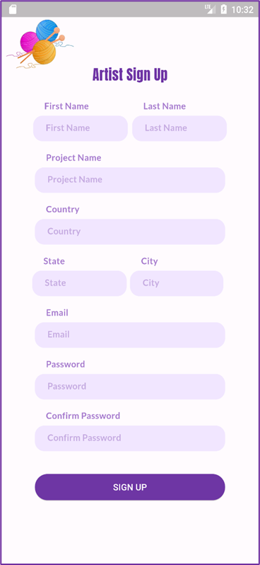
Sign Up options

Slide 10
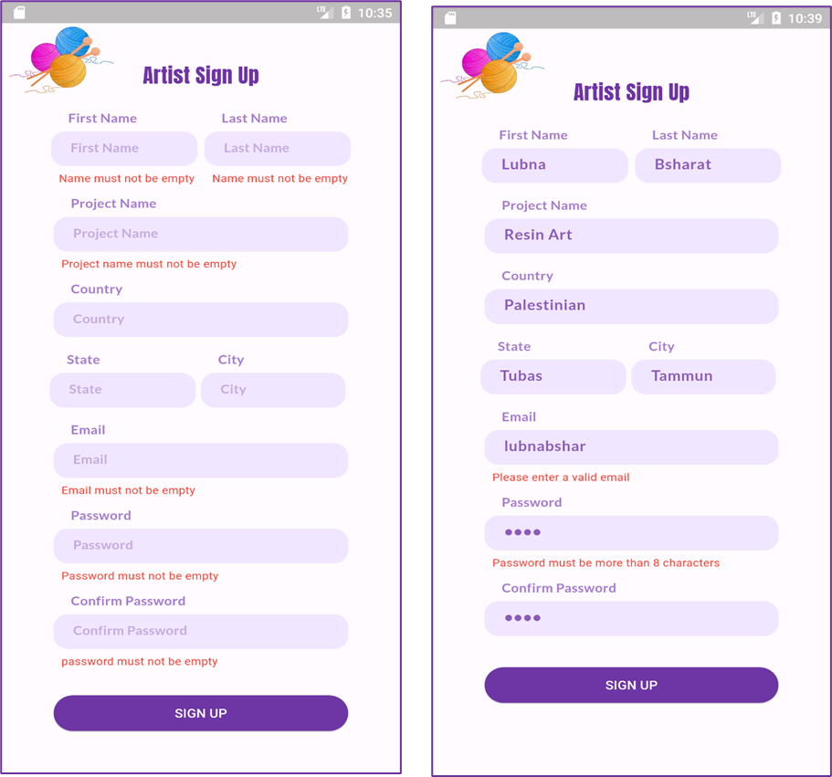
Validation

Slide 11
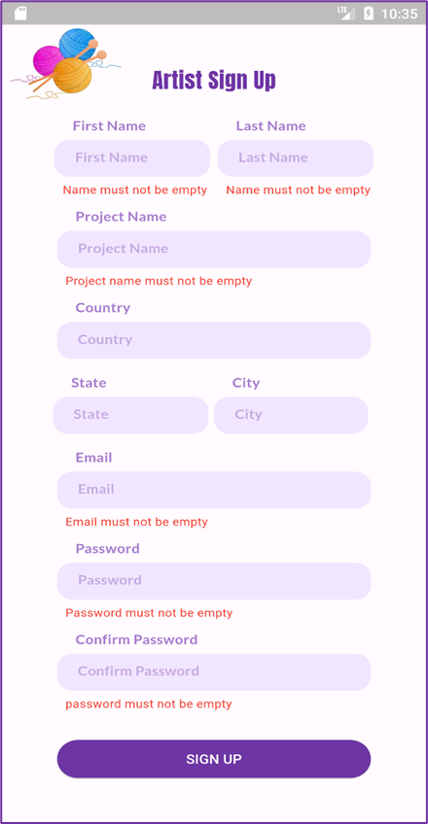
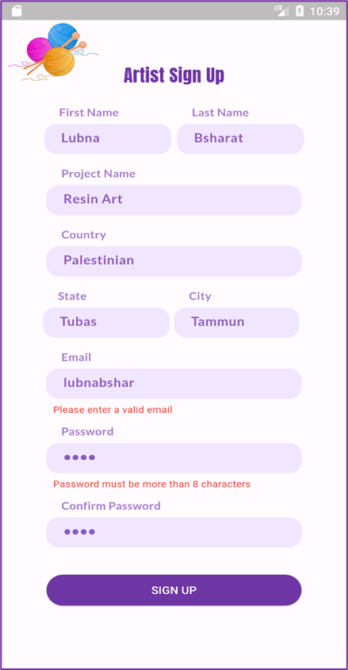
Validation
EMPTY FIELDS
Email pattern and password long

Slide 12
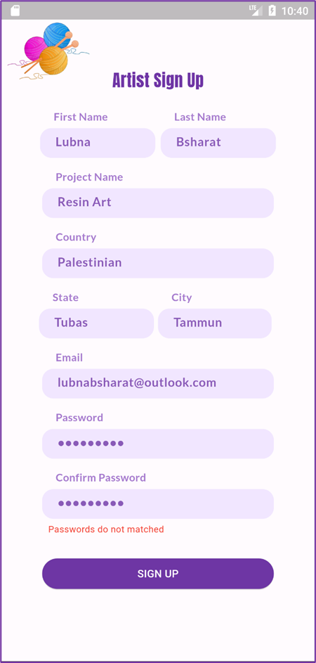
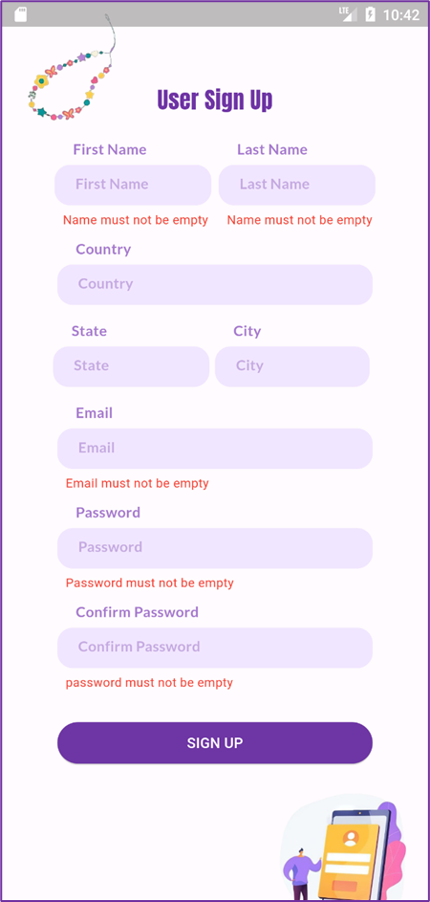
Validation
Passwords Match
empty fields

Slide 13
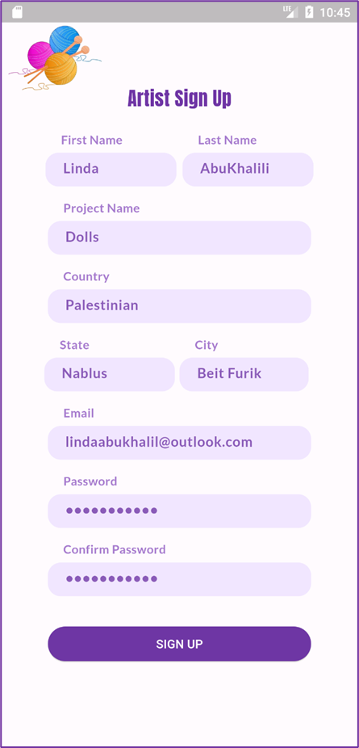

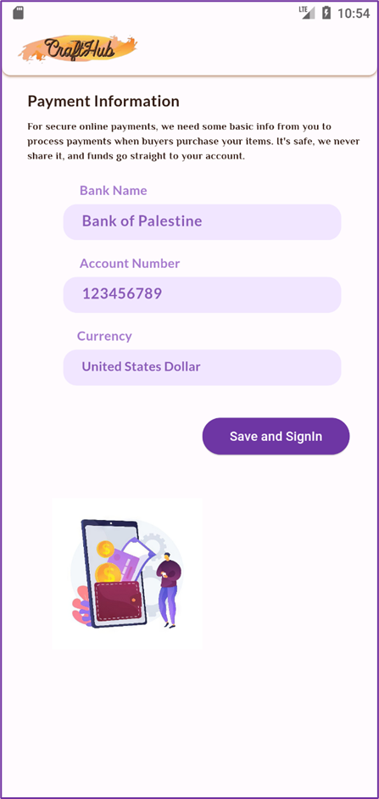
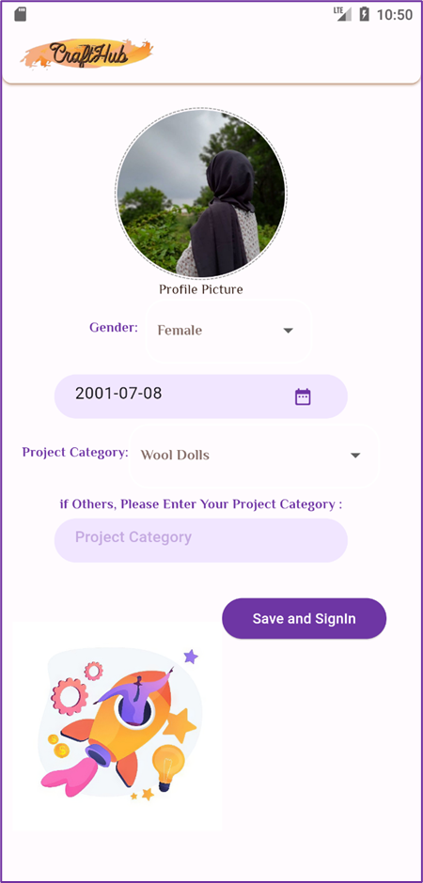
Artist Sign up Process

Slide 14
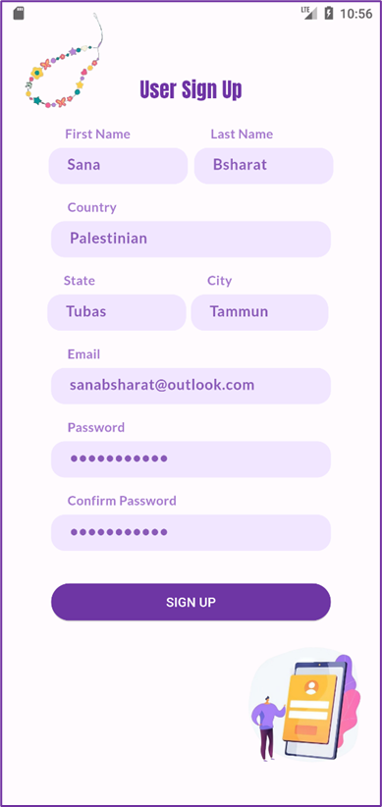
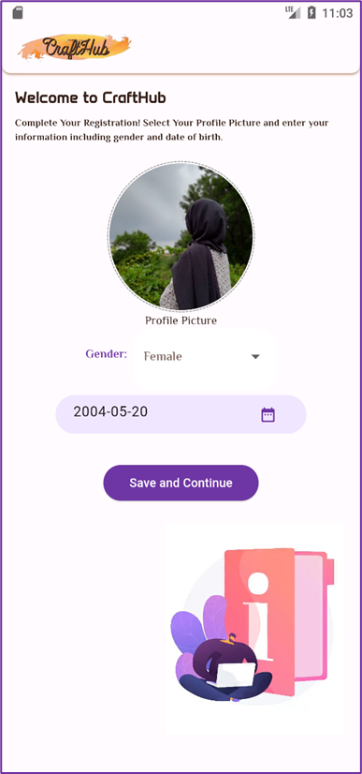
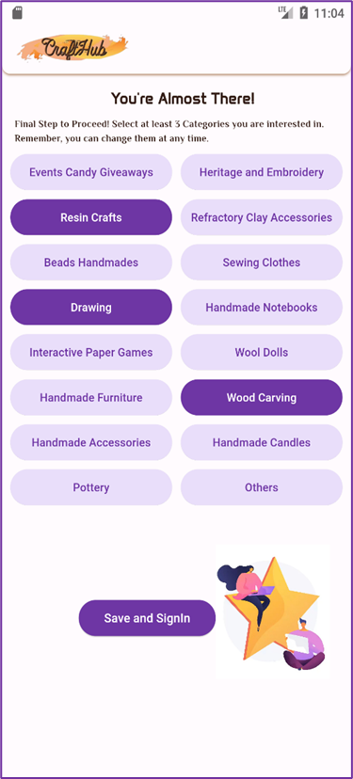
User Sign up Process

Slide 15
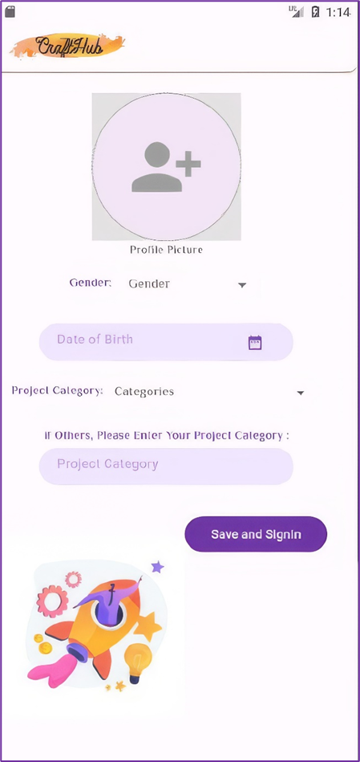
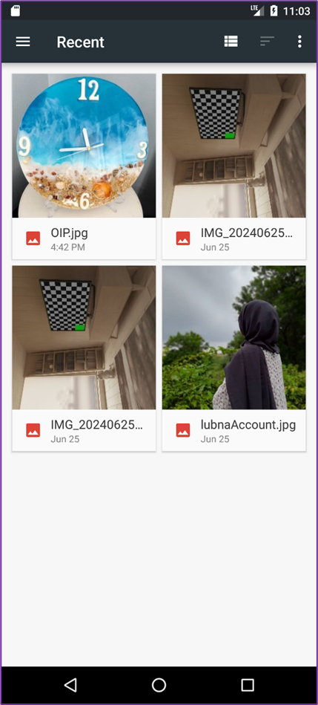
Special Widgets in the Sign-up Process

Slide 16
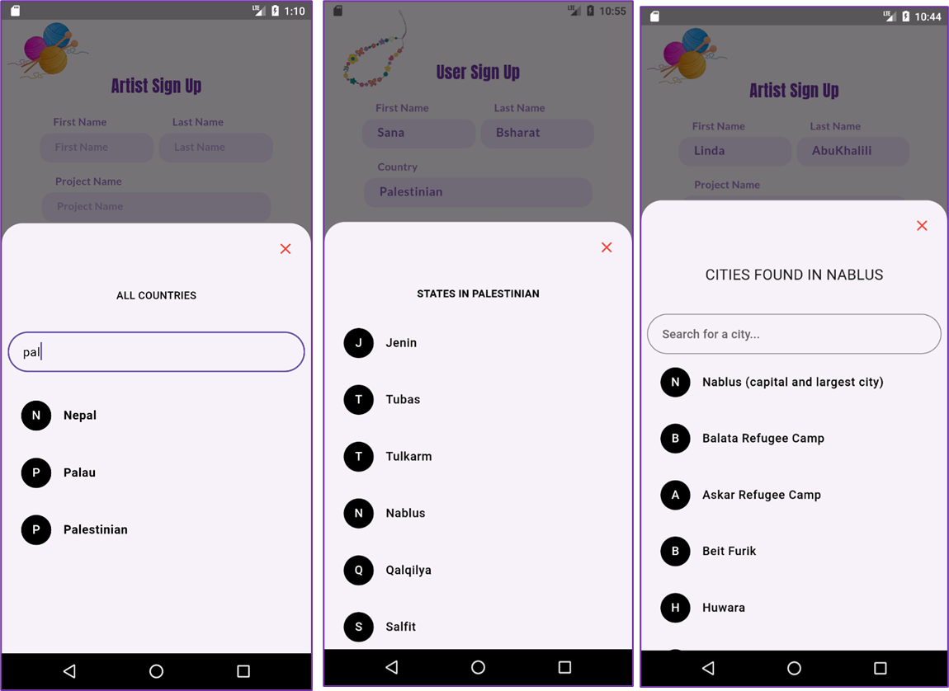
Special Widgets in the Sign-up Process

Slide 17
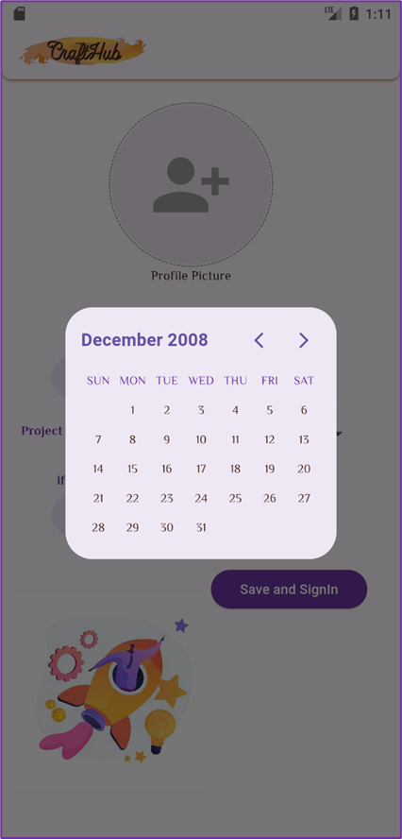
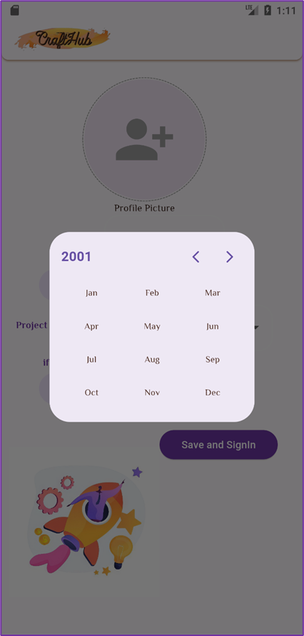
Special Widgets in the Sign-up Process

Slide 18
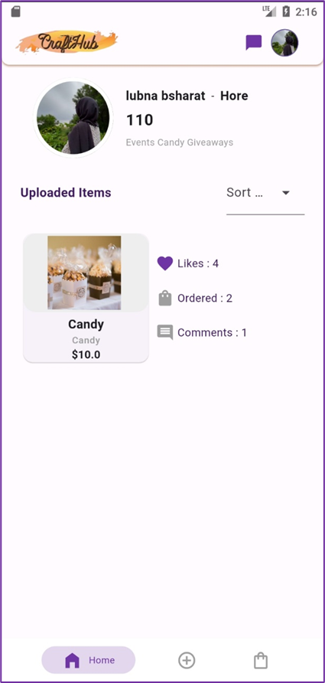
Artist Home Page

Slide 19
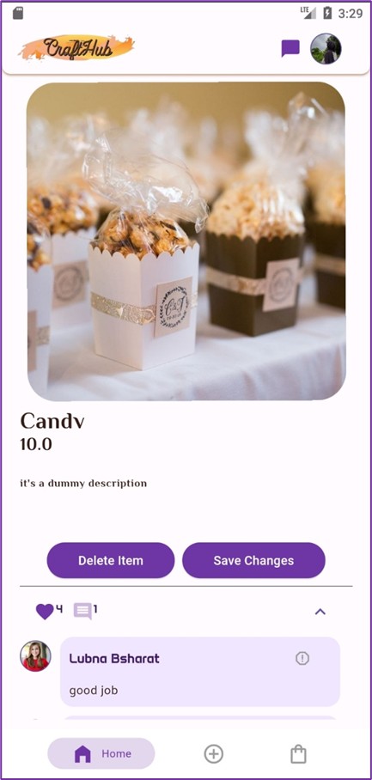
Artist’s Item Details Page

Slide 20
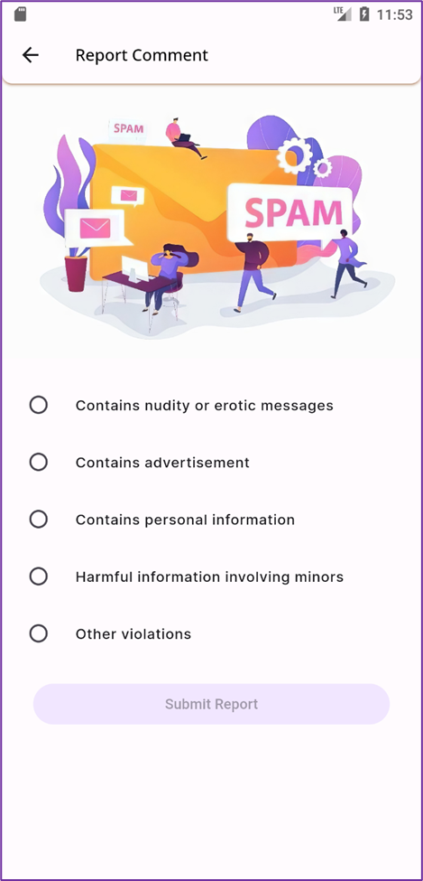
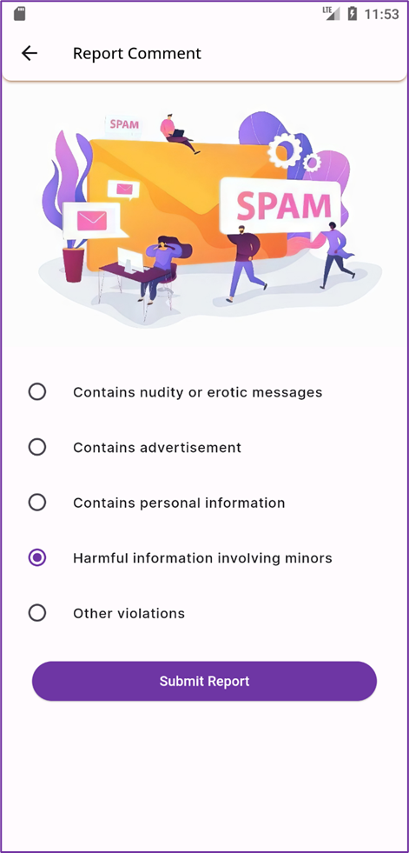
Comment Report Page

Slide 21
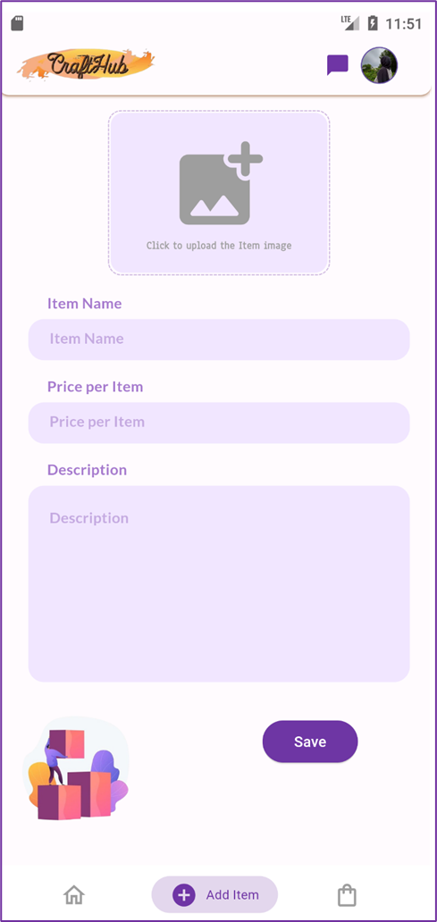
Add a New Item

Slide 22
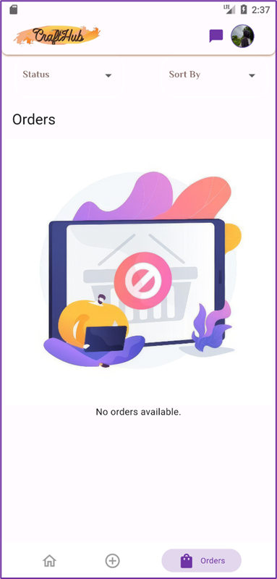
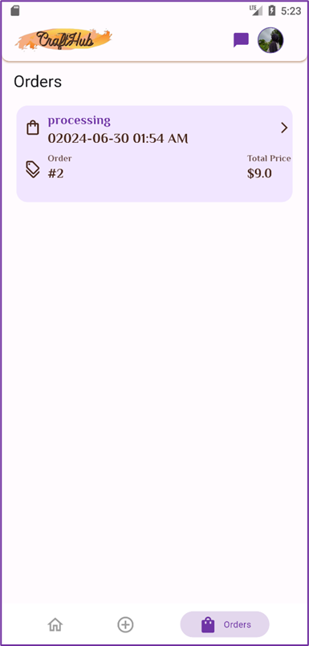
Orders Page

Slide 23
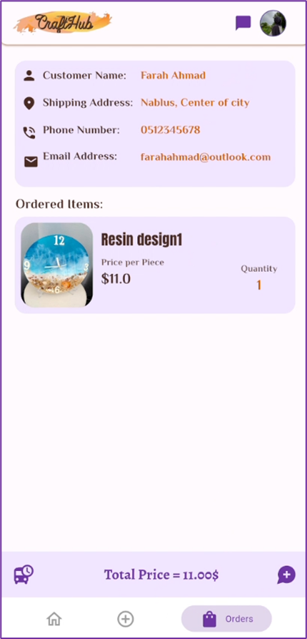
Order’s Details Page

Slide 24
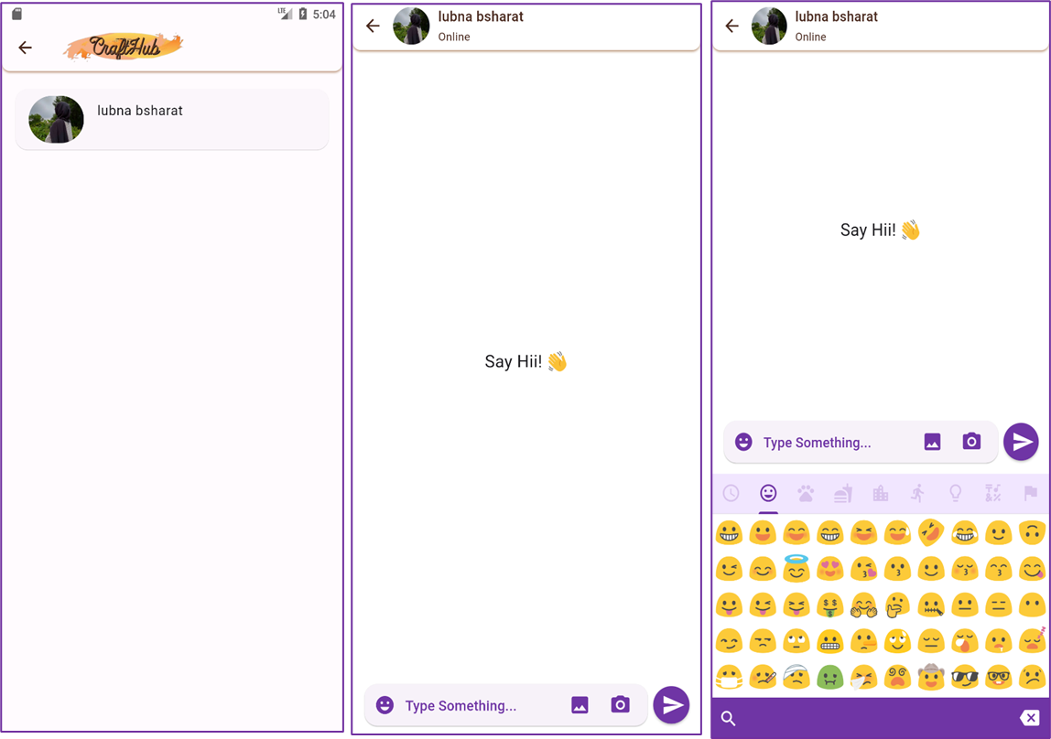
Chat Home Page

Slide 25
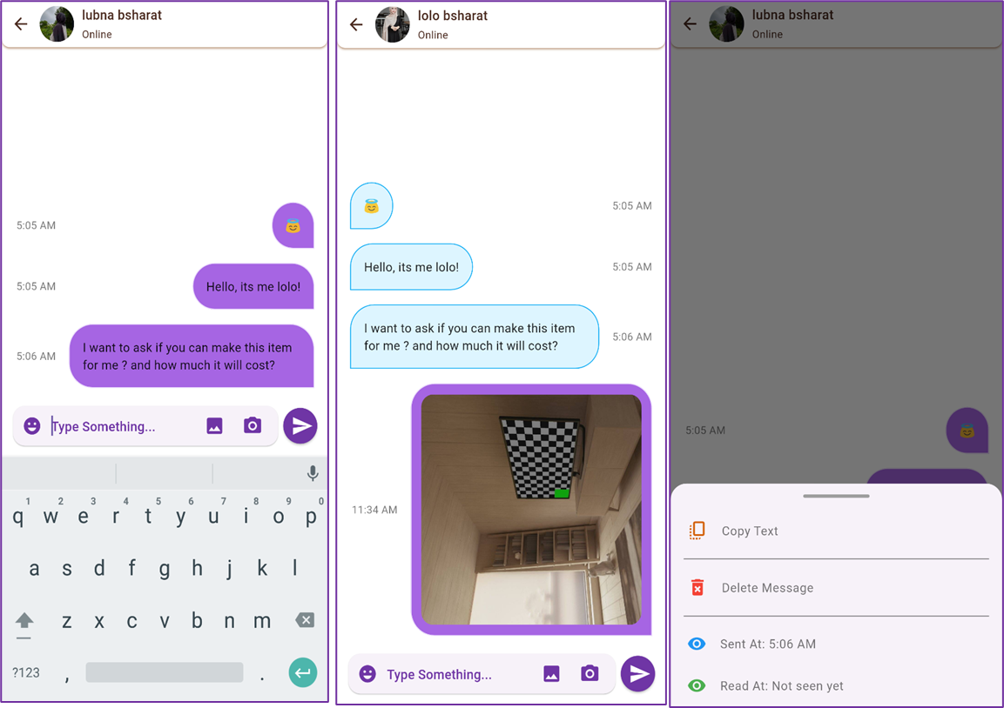
Chat Home Page

Slide 26
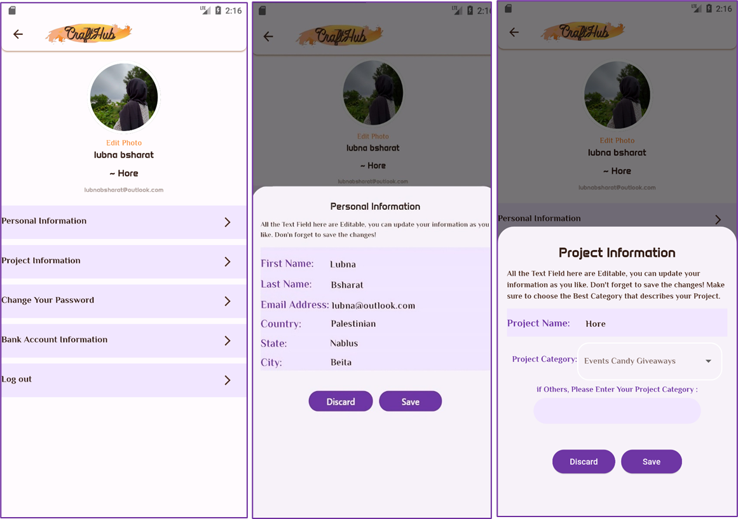
Artist Account Page

Slide 27
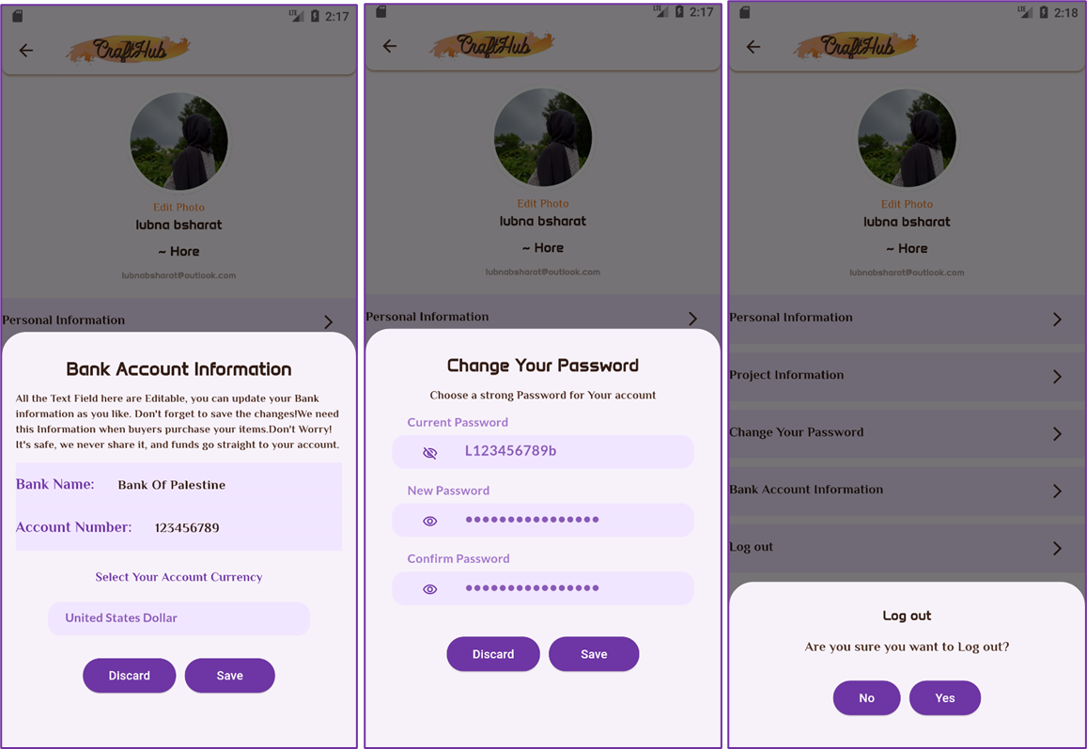
Bank information section

Slide 28
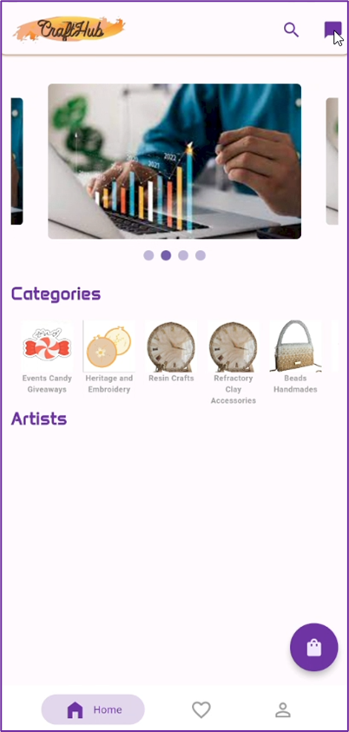
User Home Page

Slide 29
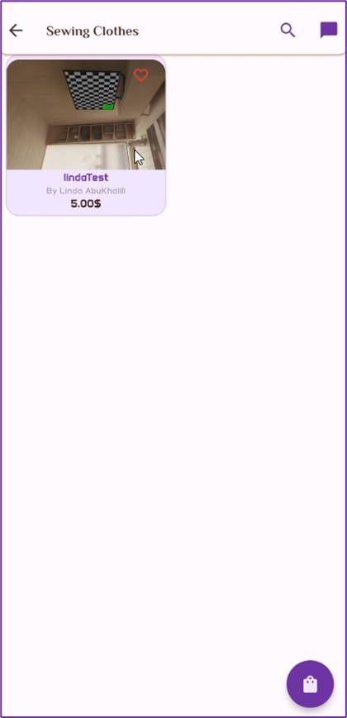
Category Items page

Slide 30
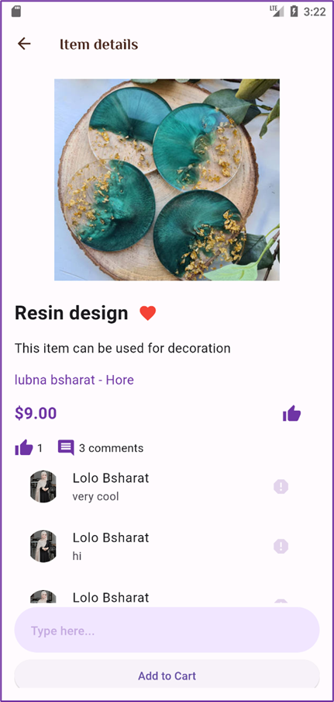
Item’s details page

Slide 31
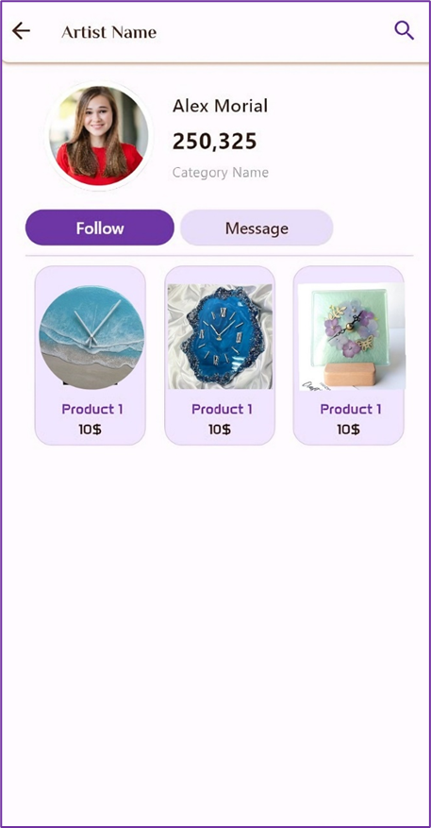
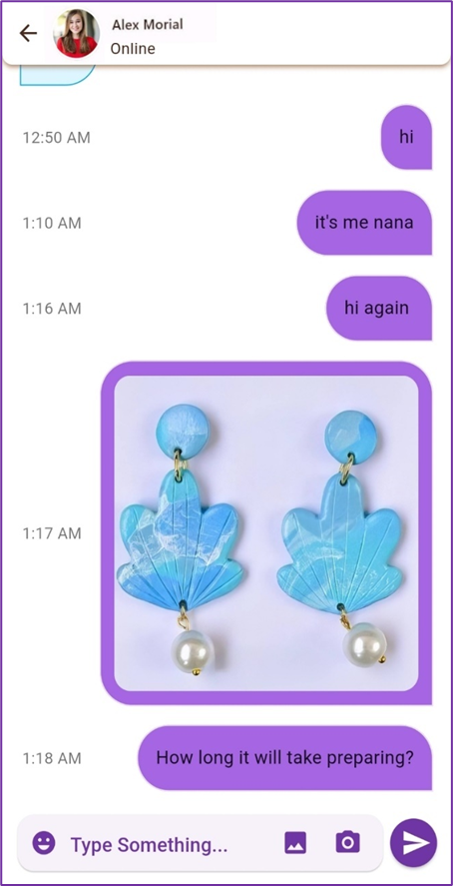
Item’s Artist profile page

Slide 32
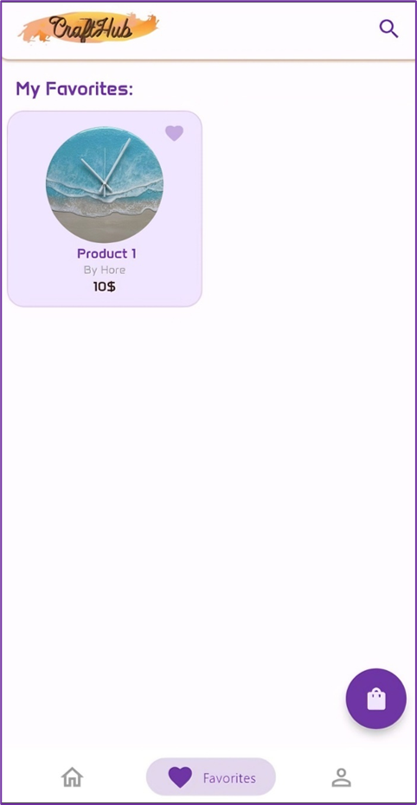
Favorites Page

Slide 33
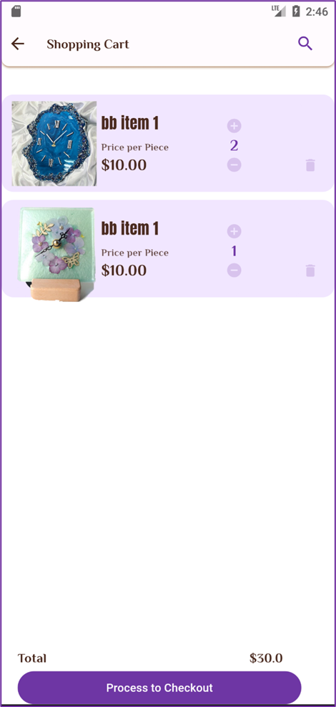
Cart Page

Slide 34
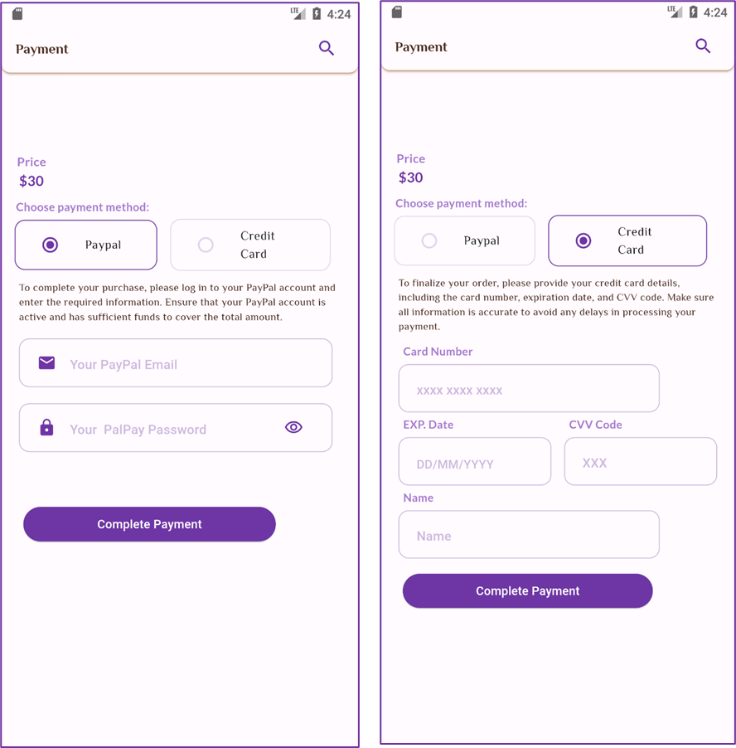
Payment page

Slide 35
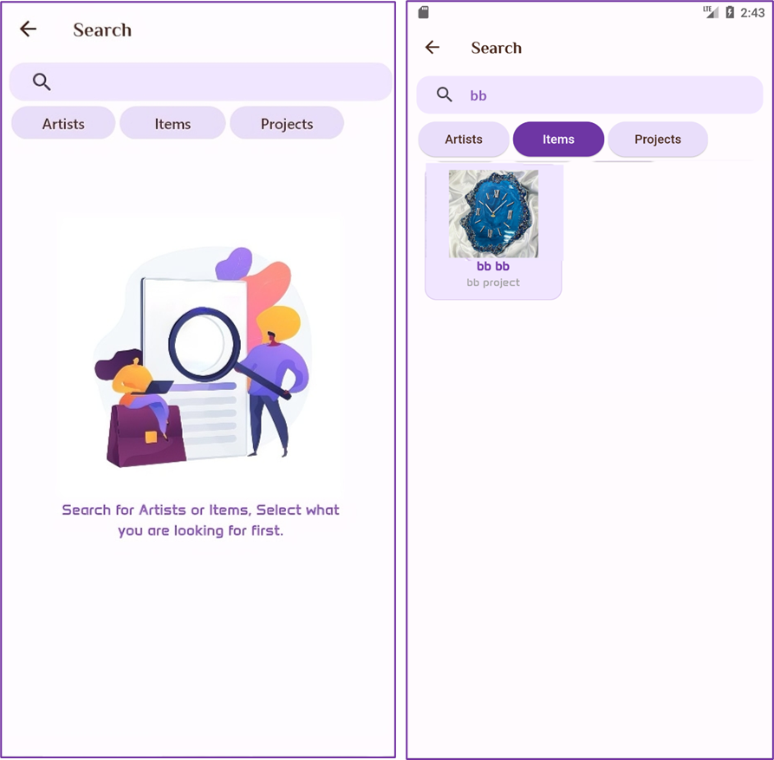
Search Page

Slide 36
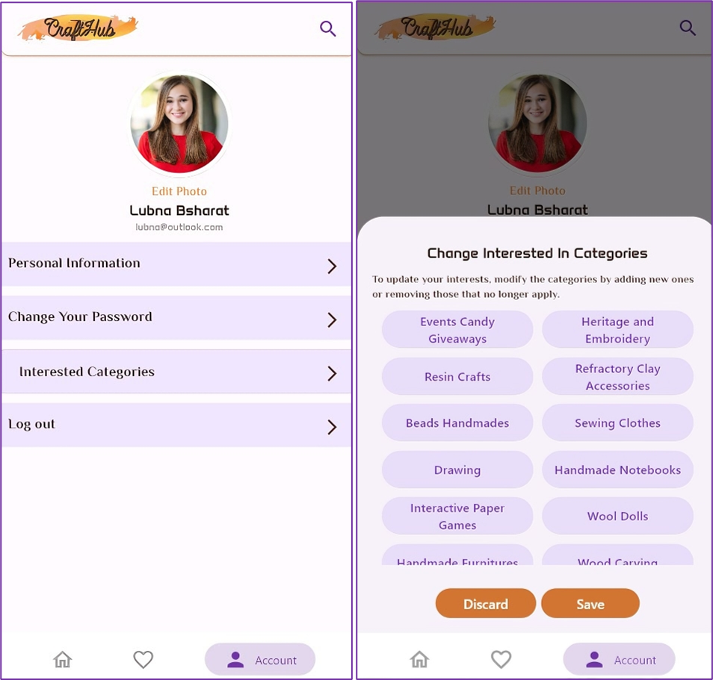
User’s Account Page

Slide 37
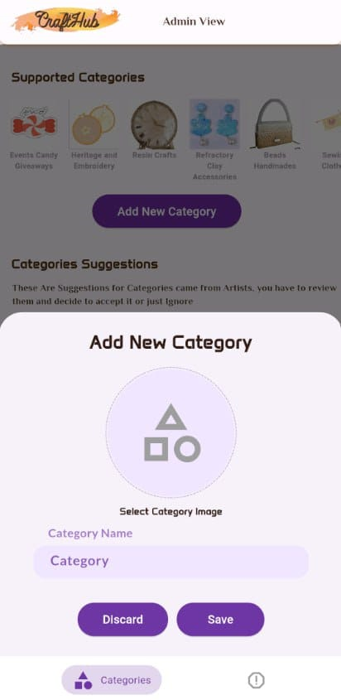
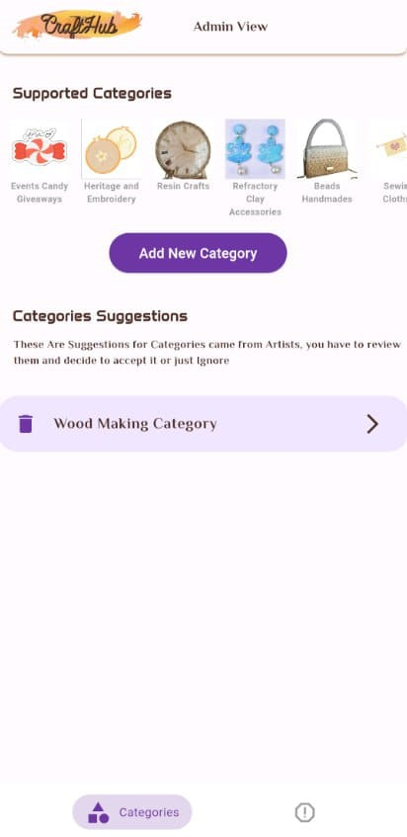
Admins Categories page

Slide 38
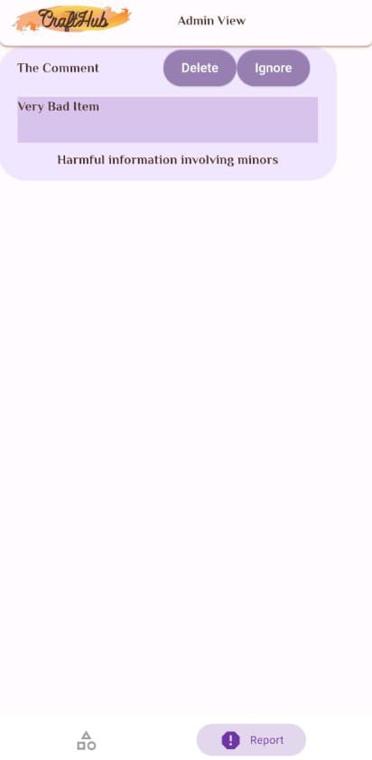
Admins Reports page

Slide 39

Web pages
Welcome Page

Slide 40
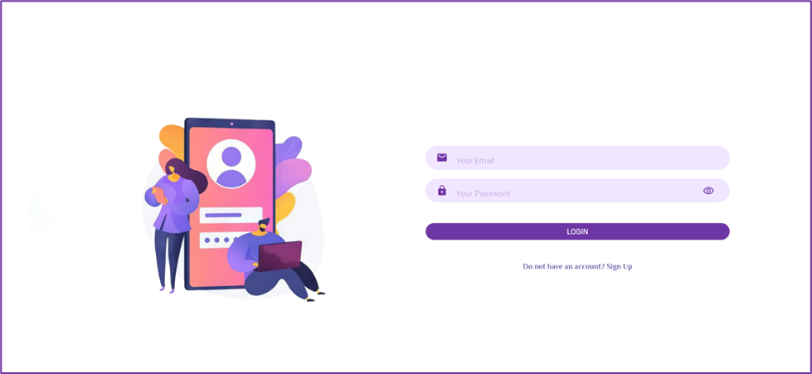
Sign In Page

Slide 41
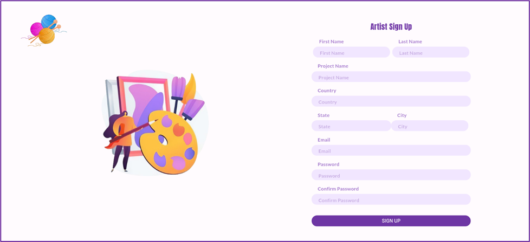
Artist Sign Up Page

Slide 42

Artist Transition at Sign Up Page

Slide 43
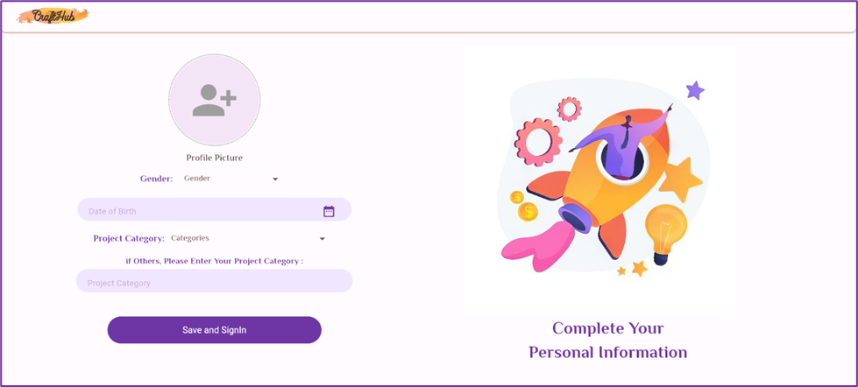
Artist Personal Info Completion

Slide 44
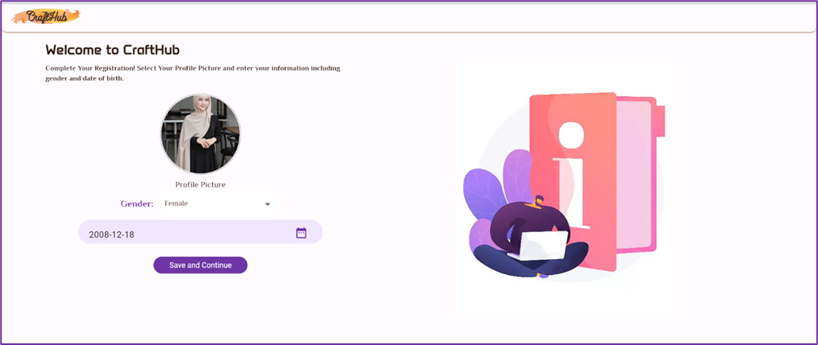
Artist Bank Info Completion

Slide 45
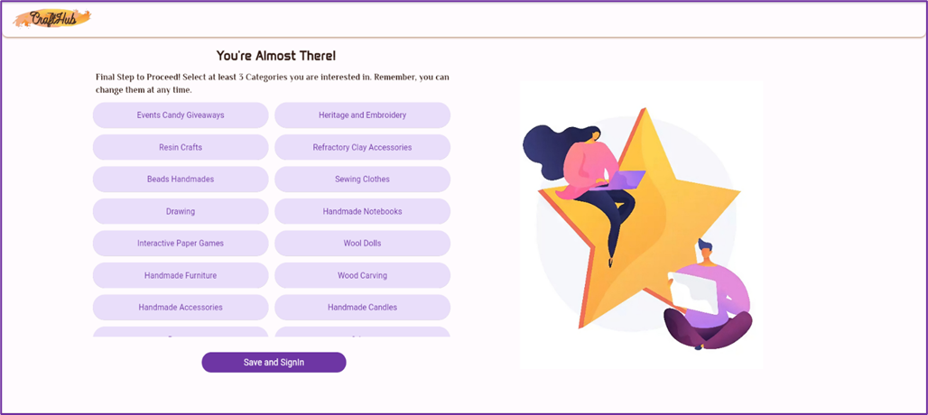
User Interested in Categories Selection

Slide 46

User Web Home Page

Slide 47

User Web Favorites Page

Slide 48

User Web Account Page

Slide 49

Shopping Cart at Web

Slide 50

Web Search Page

Slide 51

Web Search Page with Result

Slide 52

Item’s Details Page at Web

Slide 53

Artist Profile from User View

Slide 54

Chats Home Screen

Slide 55

Artist’s Web Home Page

Slide 56

Artist's Add New Item Page

Slide 57

Artist's Web Orders Page

Slide 58

Artist's Web Order’s Details Page

Slide 59

Orders Page with no orders available

Slide 60

Item’s Details Page for Artist

Slide 61

Artist's Web Account Page

Slide 62

Admin categories Page

Slide 63

Admin categories Page

Slide 64

Admin reports Page

Slide 65

Artis payment info completion

Slide 66

Future work

Slide 67

Project Demo

Slide 68
Thanks
for
listening

