Slide 1


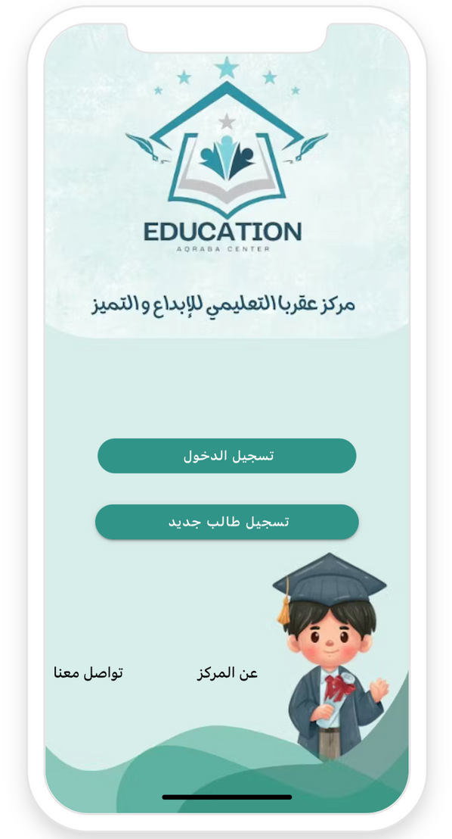



Mobile Application-Aqraba Educational Center
shahd Abu shehab
Mahmoud shehab

Slide 2
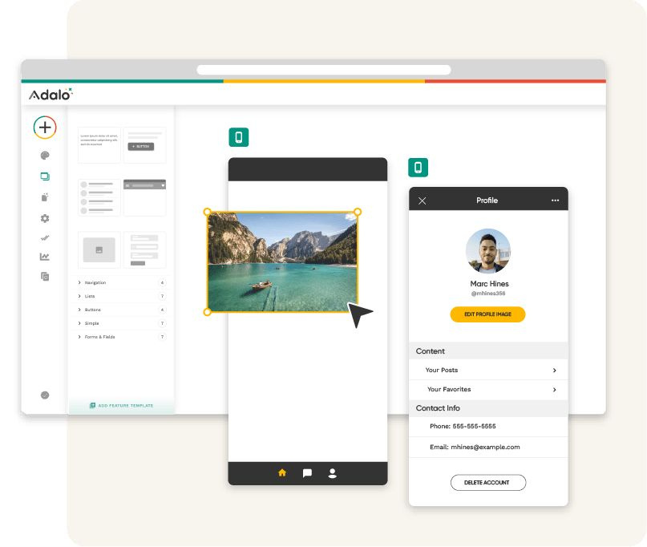

Introduction
  This project aims to digitize and simplify student management and communication at the Aqraba Educational Center for Creativity and Excellence. Using the Adalo platform, we developed an integrated mobile app that allows students to register for courses, view materials, check schedules and prices, and receive updates and announcements from the center — all in a user-friendly and efficient way.

Slide 3
Problem
The center faces organizational and communication issues due to outdated, paper-based processes.
Operational Challenges:
• The center still relies on traditional paper-based student registration, leading to data loss and delays.
• There’s no centralized system to clearly display course details, fees, and schedules.
Communication Barriers:
• Students aren’t always informed of updates or deadlines effectively.
• No digital interface is available for students or parents to easily connect with the center.

Slide 4



solution
A custom mobile app was developed using Adalo to overcome the center’s management and communication challenges.
Digital Management:
• Students can register for available courses quickly and easily through the app.
• All course content, schedules, and fees are clearly displayed in one place.
Improved Communication:
• The app allows the center to send instant announcements and updates.
• A simple interface ensures easy access for students and parents to stay connected.

Slide 5
Tools & Technologies Used
📱 App Development Platform:
• Adalo: A no-code platform that allows visual and intuitive mobile app development. We used it to build the full application — screens, database, and all internal logic.
🧰 Design & Support Tools:
• Canva: Used to professionally design the app’s user interface (UI Design). Also used to create this presentation.
Presentation by Jacqueline Thompson

Slide 6
Key Features of the Application
Course Information Display:
Announcement System:
Class
Schedules:
User-Friendly Interface:
Displays details of each course, including the name, number of sessions, price, and schedule.
Enables the administration to send announcements or notifications directly to students within the app.
Provides a timetable for each course, helping students manage their time effectively.
The user interface is designed to be clear and intuitive, suitable for all age groups.
Presentation by Jacqueline Thompson

Slide 7
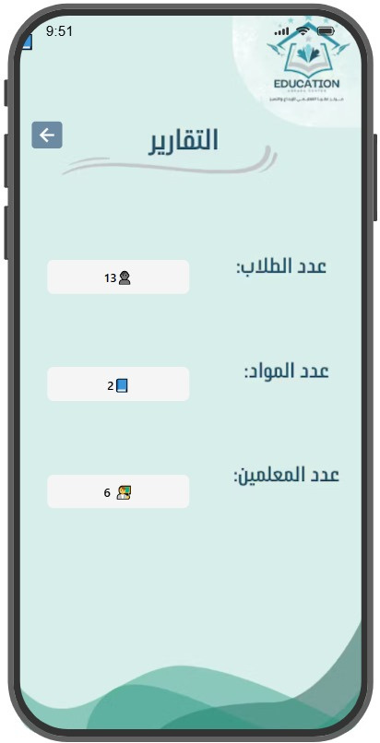
Statistics
The Reports page in the app displays key statistics that help the supervisor monitor the center’s overall performance easily and efficiently.
Available Reports:
• 👨‍🎓 Number of Registered Students
• 📚 Number of Courses
• 👨‍🏫 Number of Teachers
Technologies Used:
We used the Count feature in Adalo to dynamically display real-time numbers within the app.

Slide 8

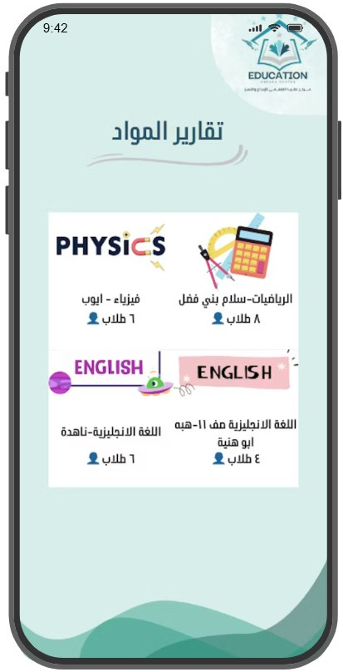
Reports
The Reports page displays real-time statistics showing the number of students enrolled in each course.
This helps the administration track course demand, monitor participation levels, and make informed decisions effectively.

Slide 9
Future Plan
💳
📋
🔔
Online Payment Integration:
Enables students to pay course fees directly through the app using credit cards or e-wallets.
Electronic Attendance System:
Automatically tracks student attendance in each course, with ready-made reports.
Push Notifications:
Sends instant alerts to students’ phones, such as: “Today’s class reminder” or “New announcement added.”

Slide 10
Future Plan(cont....)
🖥️
🌍
:Web Dashboard for Management
A dedicated web version for admins to access data and reports easily via desktop.
:Multilingual Support
Allows users to switch between Arabic and English based on preference.

Slide 11

Thank
You

