Slide 1
Remote Controller
Prepared by:
I’tidal Rashdan
Yasmeen Amer
Submitted To:
Dr. Luai Malhis
Dr. Raed AL-Qadi
Dr. Hanal Abu-Zanet

Slide 2
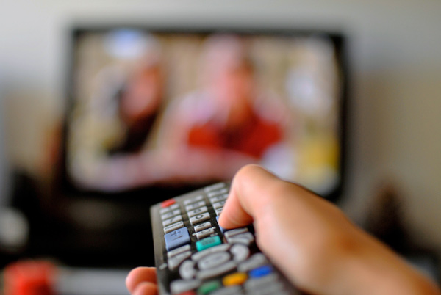
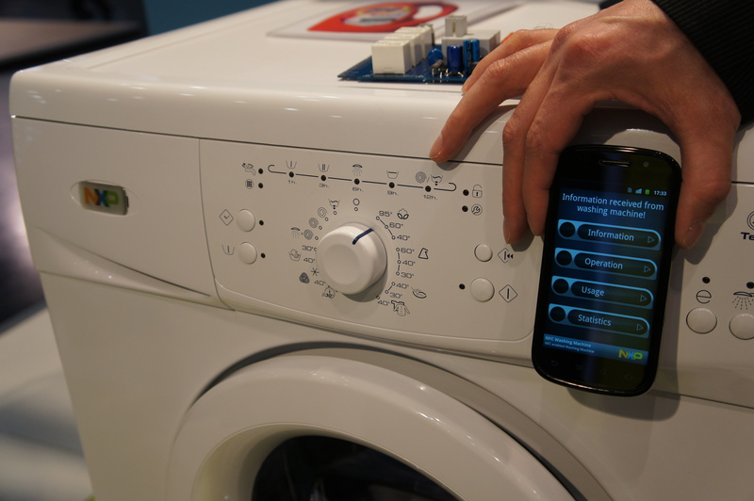

A Remote For PC

Slide 3
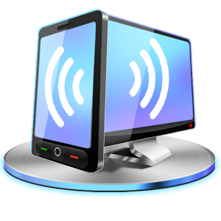
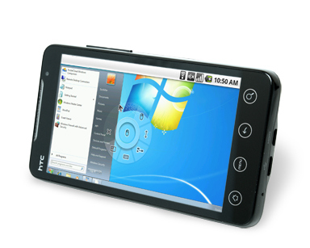
Main Objective

Slide 4


Application Components
Client (mobile): which was programmed using Android.
Server (PC): which was programmed using C#.

Slide 5
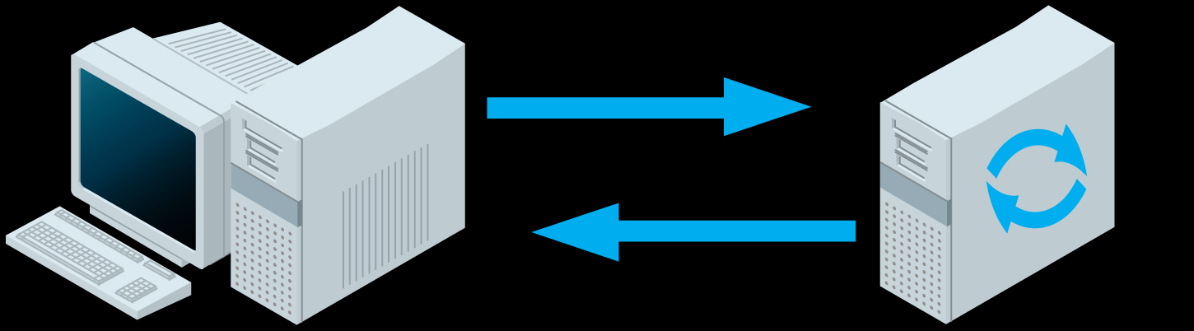
Main method: WebSockets
WebSockets are the ideal basis for bidirectional high-speed data exchange in real time.

Slide 6
Windows API
WIN32 library was used to simulate:
Keyboard Events.
Mouse Events.

Slide 7
NAudio
NAudio is an open source audio API for .NET written in C# by Mark Heath.
This library was used to play sound received from the client via speakers.

Slide 8
Main features
Showing screenshots of desktop on mobile screen constantly.
Being able to control mouse position according to touch position.
Typing on desktop applications remotely.
Sending files from phone to PC.
Streaming Audio from phone to PC.

Slide 9
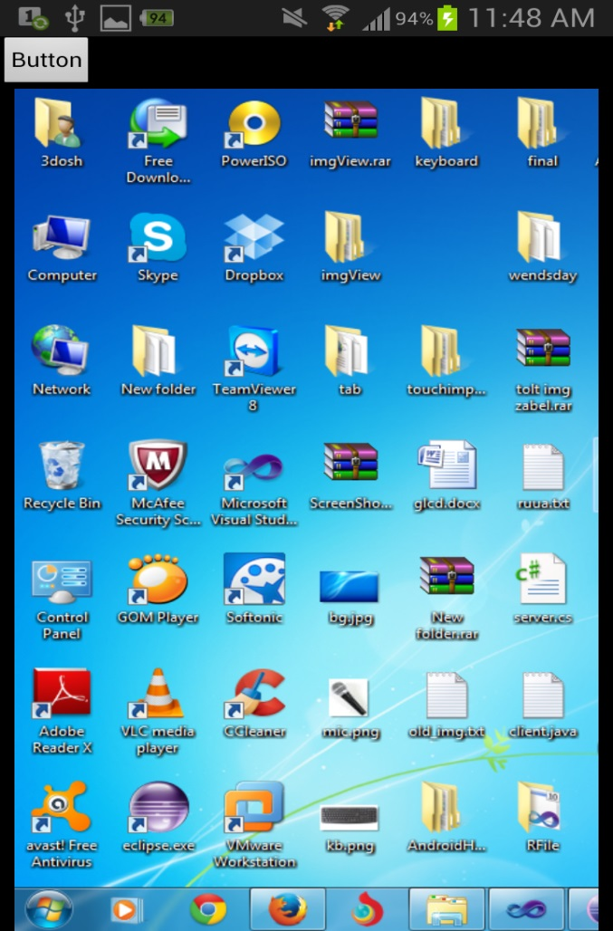
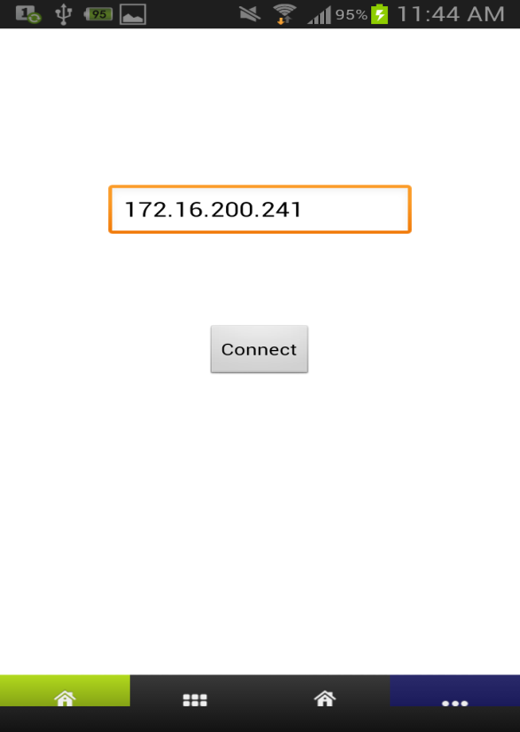
Screenshot of Desktop

Slide 10
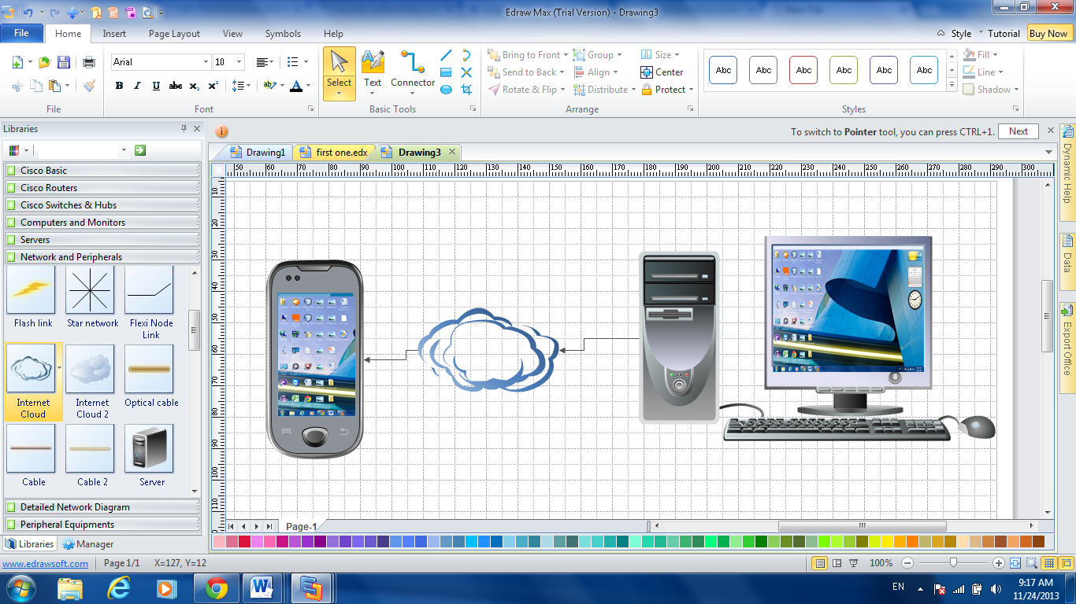
The server should constantly take screenshots of the screen divide it to three blocks send the first block and then depending on the cursor position send the other blocks.

Slide 11
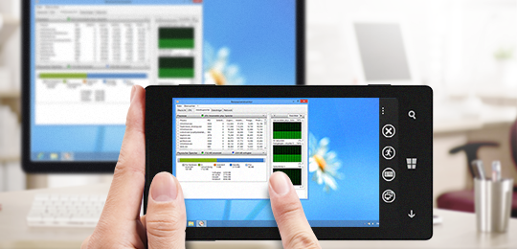
Controlling Mouse

Slide 12
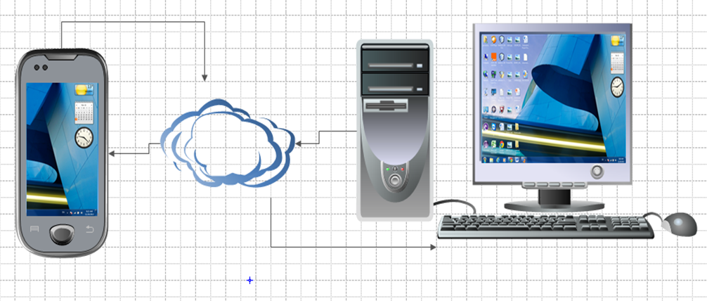
Depending on the finger's touch position on the screen the coordinates will be sent and then scaled according to the computer’s screen.

Slide 13
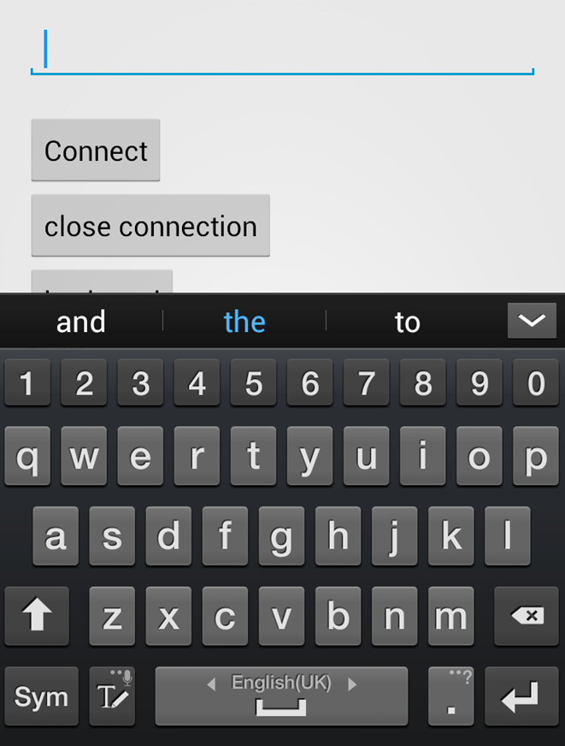
Keyboard
All smart phones have virtual keyboard.

Slide 14
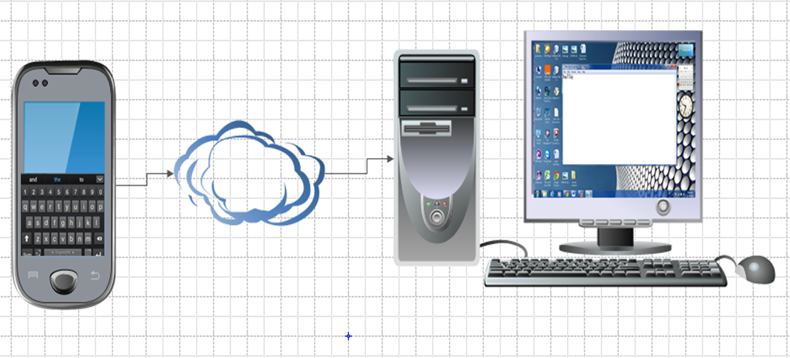
The letters will be sent and pressed as soon as the keys are pressed.

Slide 15
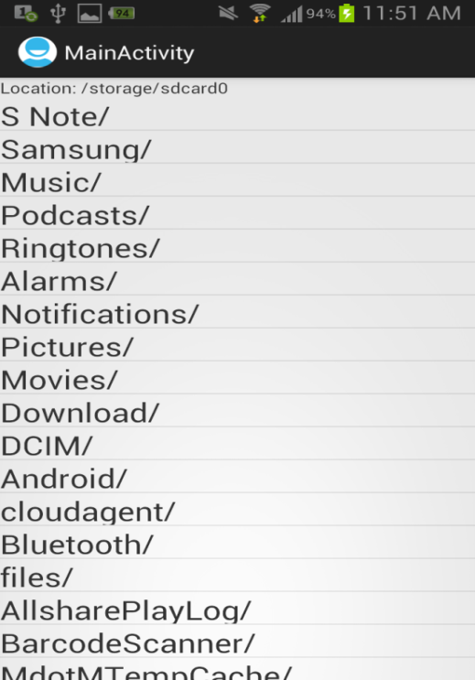
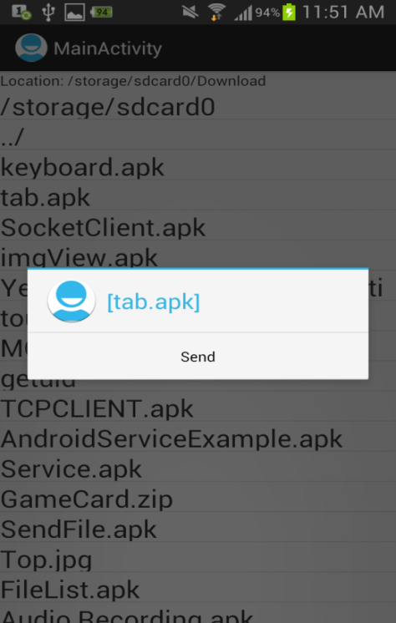
Sending Files

Slide 16
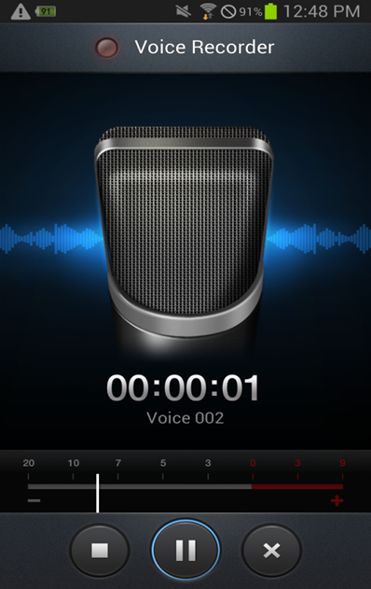
Audio Streaming

Slide 17
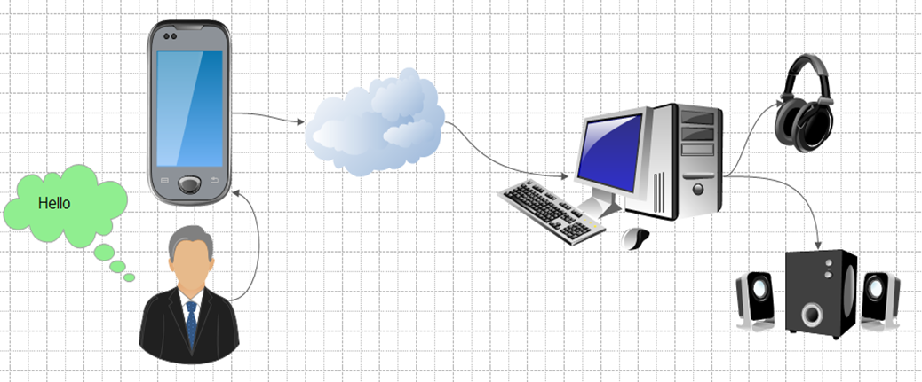
The client captures sound from MIC and sends it through socket to the server were it will be played via speakers.

Slide 18
Problems
Internet permission to the manifest file was needed to allow connection between client and server.
Changing the strict mode thread policy to permit all to allow sending and receiving between client and server.

Slide 19
Being able to display a small part of the screen on the phone only.
It was resolved using asynchronous sending and receiving method on the server side.

Slide 20
Future work
Being able to connect multiple clients to the same server.
Two way audio streaming between both client and server.

