Slide 1
FurniFlow
Amro Jomaa & Yazan Saleh
  Department of Computer Engineering,
  JUN 2026
Supervisor: Dr. Luai Malhis
  An-Najah National University, Faculty of Engineering

Slide 2
Contents
1|Project Overview
2|System Features
3|Technical Architecture
4|User Management
5|Implementation Details
6|Future Development
7|Conclusion

Slide 3
1|Project Overview

Slide 4

Project Idea
FurniFlow is a web and mobile furniture e-commerce and retail operations platform. It connects customers, sellers, warehouse teams, operations managers, drivers, cashiers, support teams, and administrators through one FastAPI/PostgreSQL backend.

Slide 5





Main Project Objectives
Unify Furniture Commerce Operations
Support online shopping, POS sales, catalog management, warehouse fulfillment, delivery, and support in one platform.
Improve Product Discovery
Provide Google Gemini shopping assistance and hybrid recommendations based on behavior and catalog similarity.
Enable End-to-End Delivery Tracking
Track orders from checkout through seller preparation, warehouse packing, driver assignment, pickup, delivery, and proof photos.
Order Visibility
Provide clear order, installment, warehouse, and delivery statuses for all authorized roles.
Support Customer Feedback
Allow ratings, reviews, reported comments, feedback collection, and sentiment analysis.

Slide 6
2|System Features

Slide 7





Key Functional Features
Multi-Role Management:Customer, seller, warehouse staff, warehouse manager, operations manager, driver, cashier, support agent, support manager, and admin with RBAC.
AI Shopping Assistant:Google Gemini product assistance with intent detection and offline catalog fallback.
Furniture Catalog:searsh of products, category filters, search, discounts, images, stock, ratings, cart, and wishlist.
Order Lifecycle Management:Checkout, Stripe Payment Intents, installments, promotions, POS sales, support tickets, and analytics.
Delivery Tracking:Seller preparation, warehouse verification/packing, manager approval, driver GPS tracking, proof photos, and delivery chat.

Slide 8
Problems Solved & Solutions Provided
Problem: Retail operations are split between catalog, checkout, warehouse, delivery, POS, and support tools.
Solution: A unified role-based FurniFlow platform with shared FastAPI APIs and PostgreSQL data.
Problem: Customers cannot clearly follow fulfillment and delivery progress.
Solution: Order status timelines,live driver location
Problem: Product discovery and support are repetitive and manual.
Solution: Gemini shopping assistant, hybrid recommendations, support tickets, WebSocket chat, reviews, and sentiment analysis.

Slide 9
3|Technical Architecture

Slide 10
Technical Architecture
Web Frontend
Backend API
Database
-React/CSS
-JavaScript
-Python
-FastAPI
-PostgreSQL
-SQLAlchemy ORM
AI / ML Services
TextBlob
-Sentiment Analysis
-Google Gemini
-Recommendation Engine

Slide 11



Client
(web,mobile)
Layered Client-Server Architecture
React web and Expo React Native mobile clients.
Clients communicate with a centralized FastAPI backend.
Backend uses SQLAlchemy with PostgreSQL.
Authentication is handled using JWT.
Payments use Stripe Payment Intents.
Real-time chat uses WebSocket.
Images are stored locally.
Includes Gemini AI assistance.
Includes recommendation services.
Backend
->
Database
(PostgreSQL)
->

Slide 12
4|User Management

Slide 13
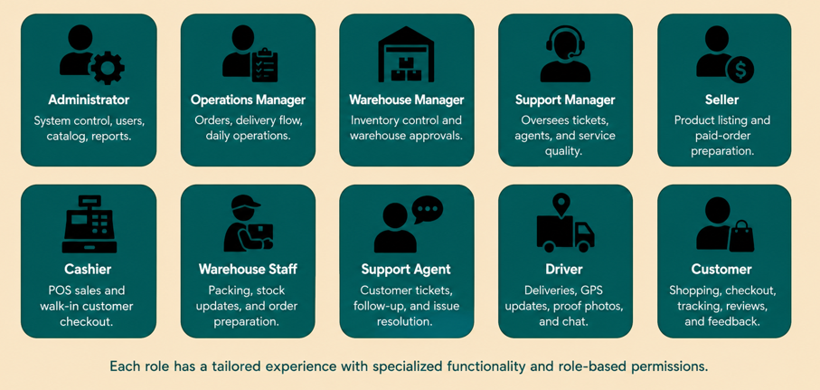




System User Roles Overview
Customer:
Shopping, checkout, installments, tracking, tickets, reviews, feedback, and recommendations.
Driver:
Delivery jobs, GPS updates, proof photos, chat, issues, and earnings.
Administrator:
System oversight, users, catalog, orders, deliveries, installments, comments, feedback, promotions, and POS analytics.
Seller:
Product and paid-order preparation workflows.
Each role has a tailored experience with specialized functionality and role-based permissions.

Slide 14
5|Implementation Details

Slide 15


AI Features
AI Shopping Assistant:
Uses Google Gemini for natural-language product discovery, product suggestions, follow-up context, and multilingual shopping conversations.
Hybrid Recommendation Engine:
Stores user interaction events and combines behavioral signals, co-purchase analysis, batch cache, and cold-start fallbacks.

Slide 16


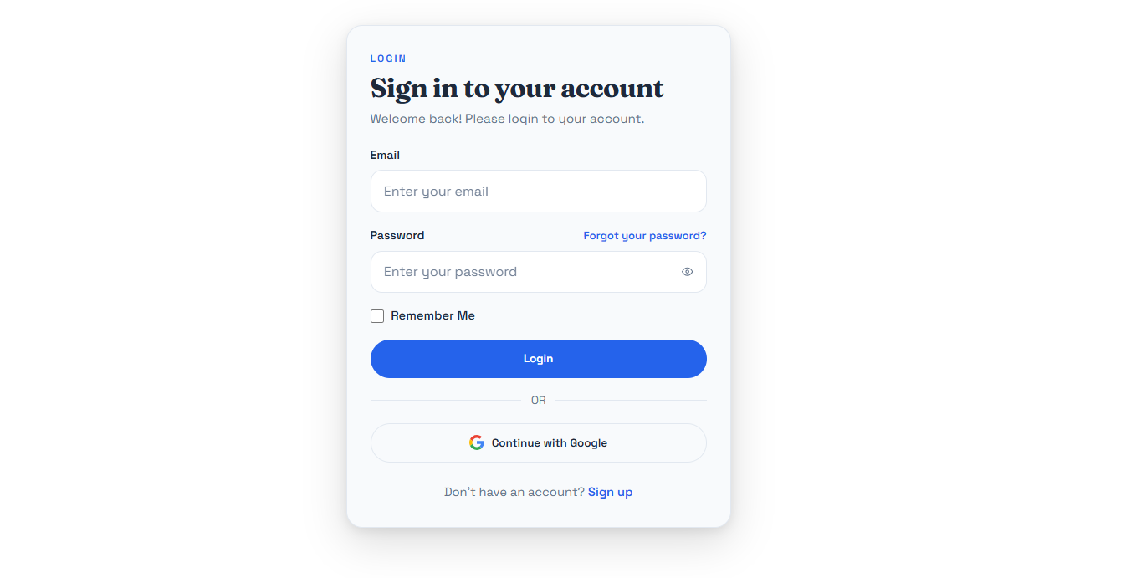
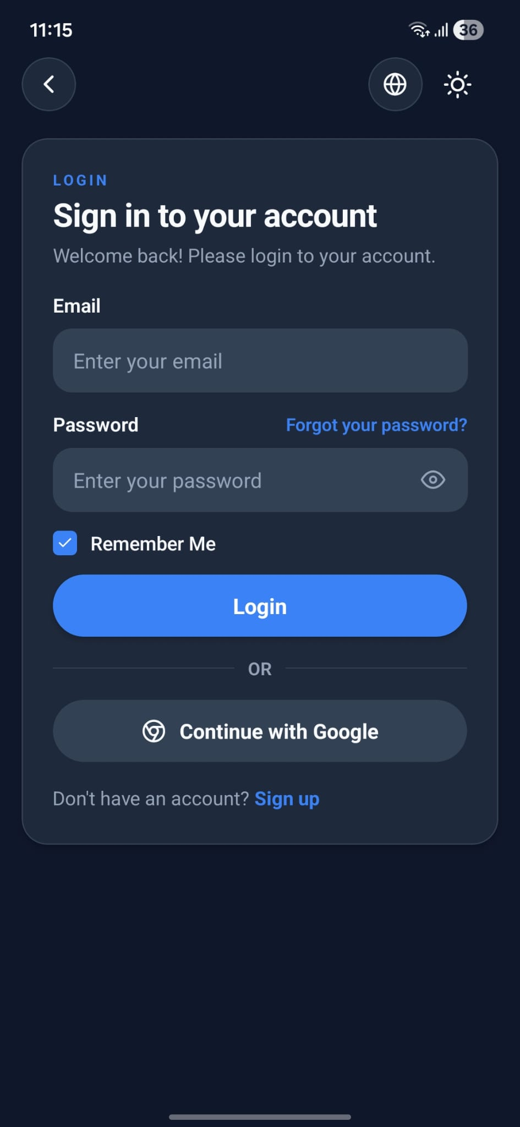
Authentication - Login

Slide 17
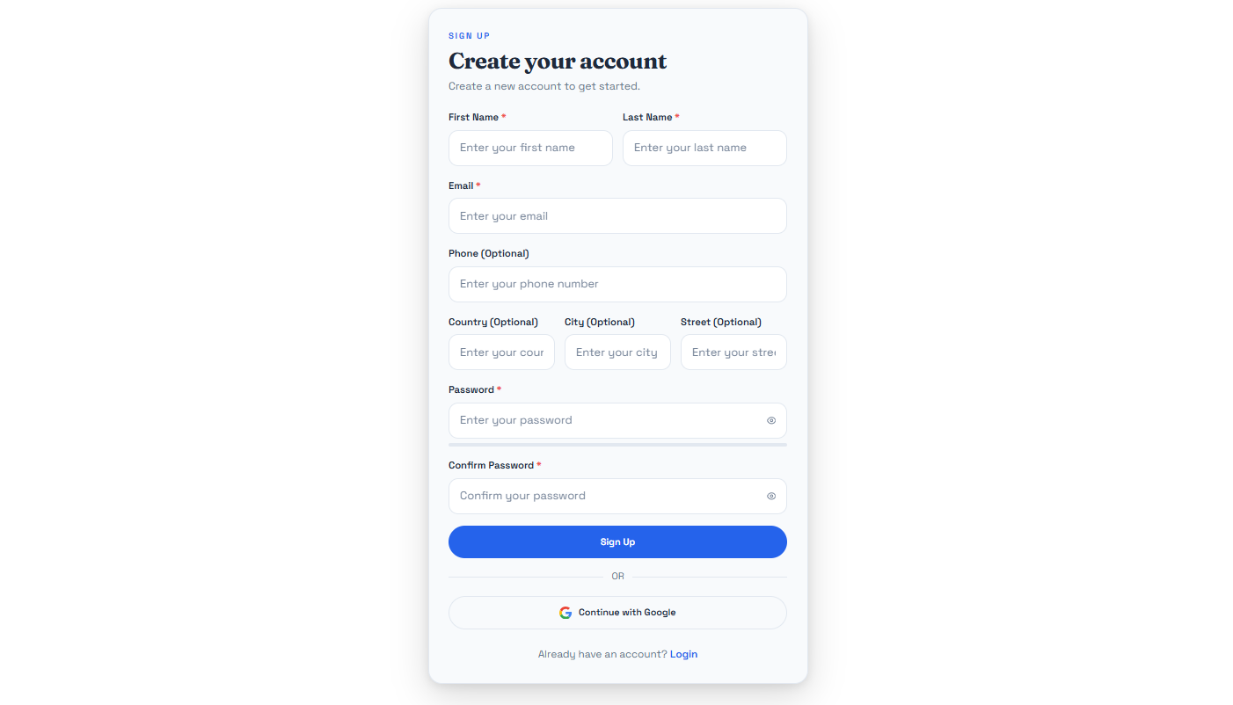
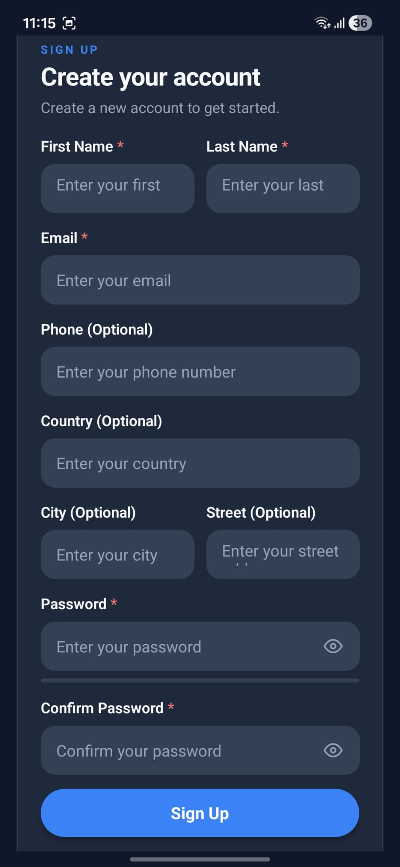
Authentication - Signup

Slide 18
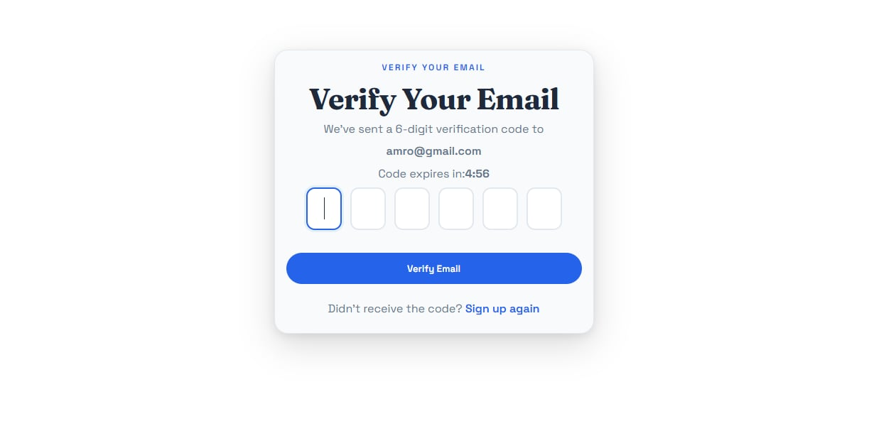
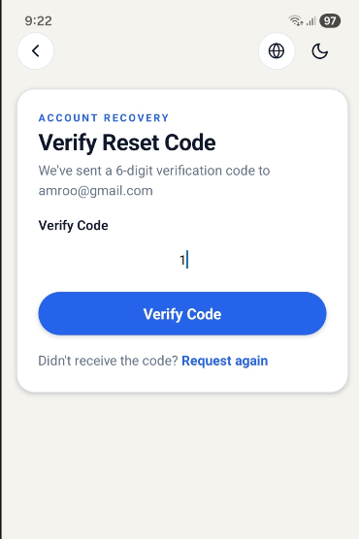
Email Verification & Password Reset

Slide 19
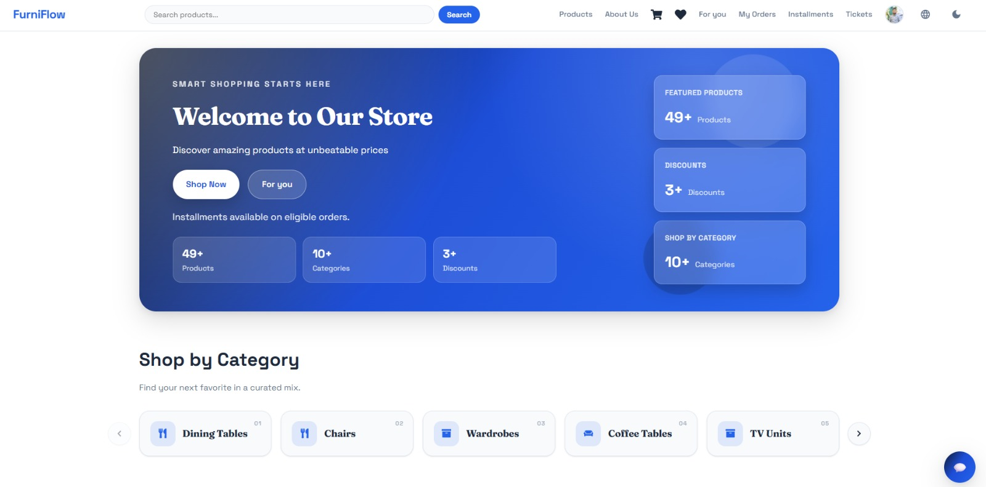
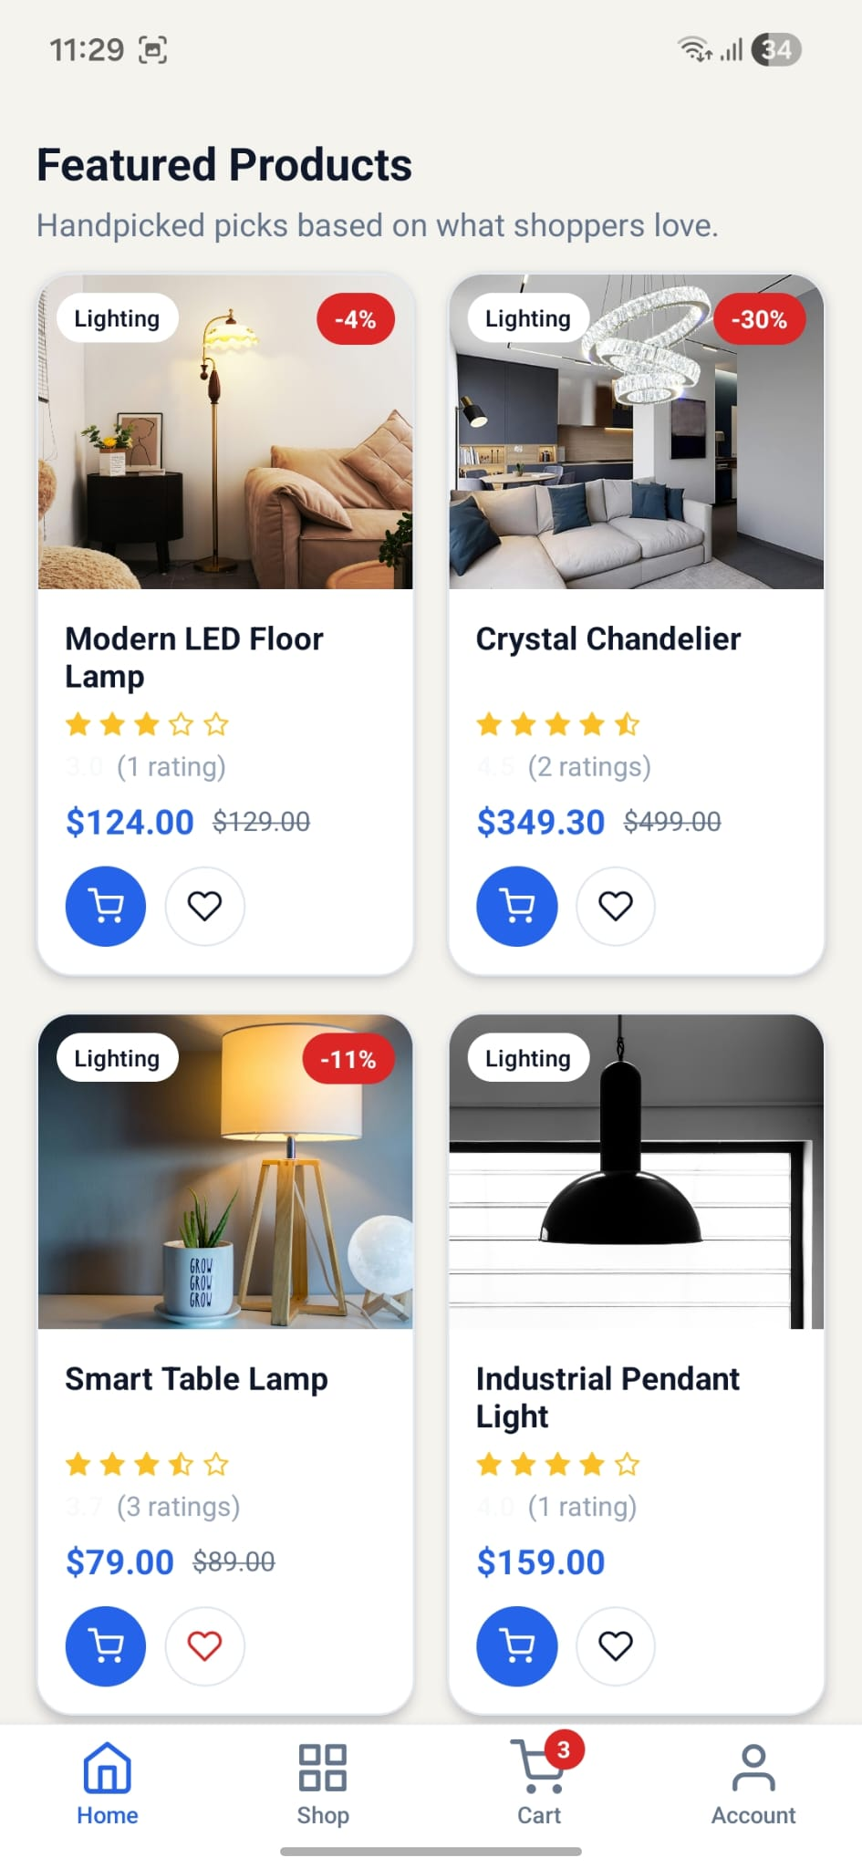
Customer Home

Slide 20
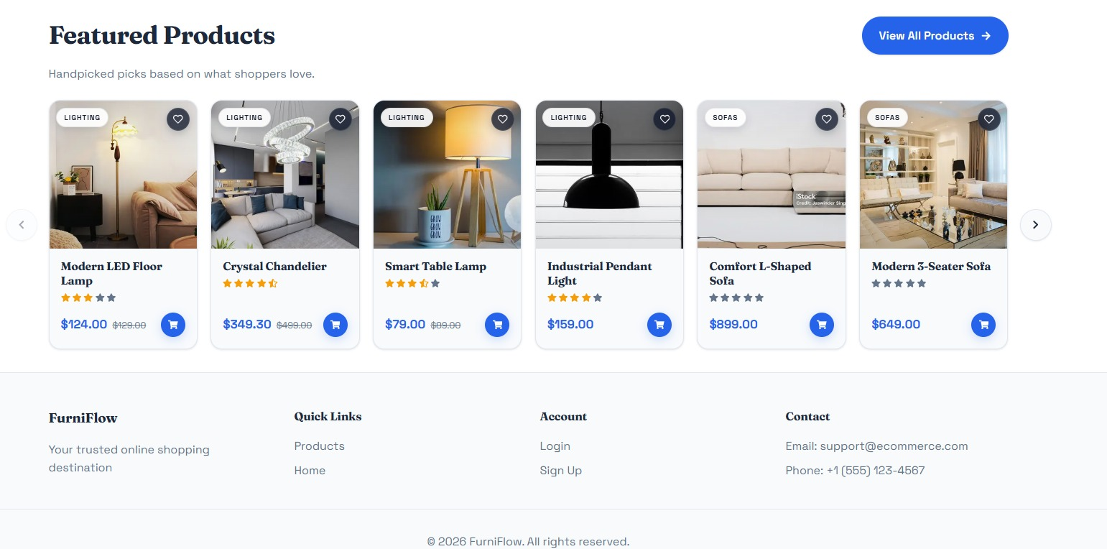
Product Catalog

Slide 21
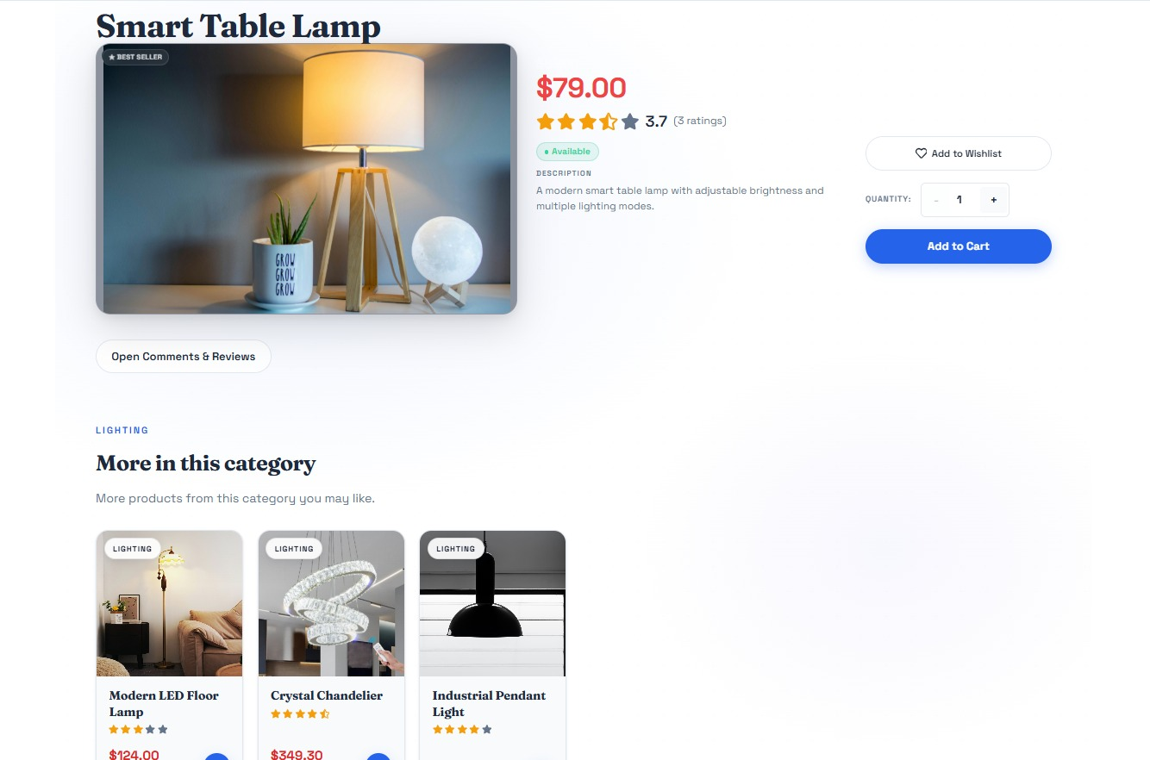
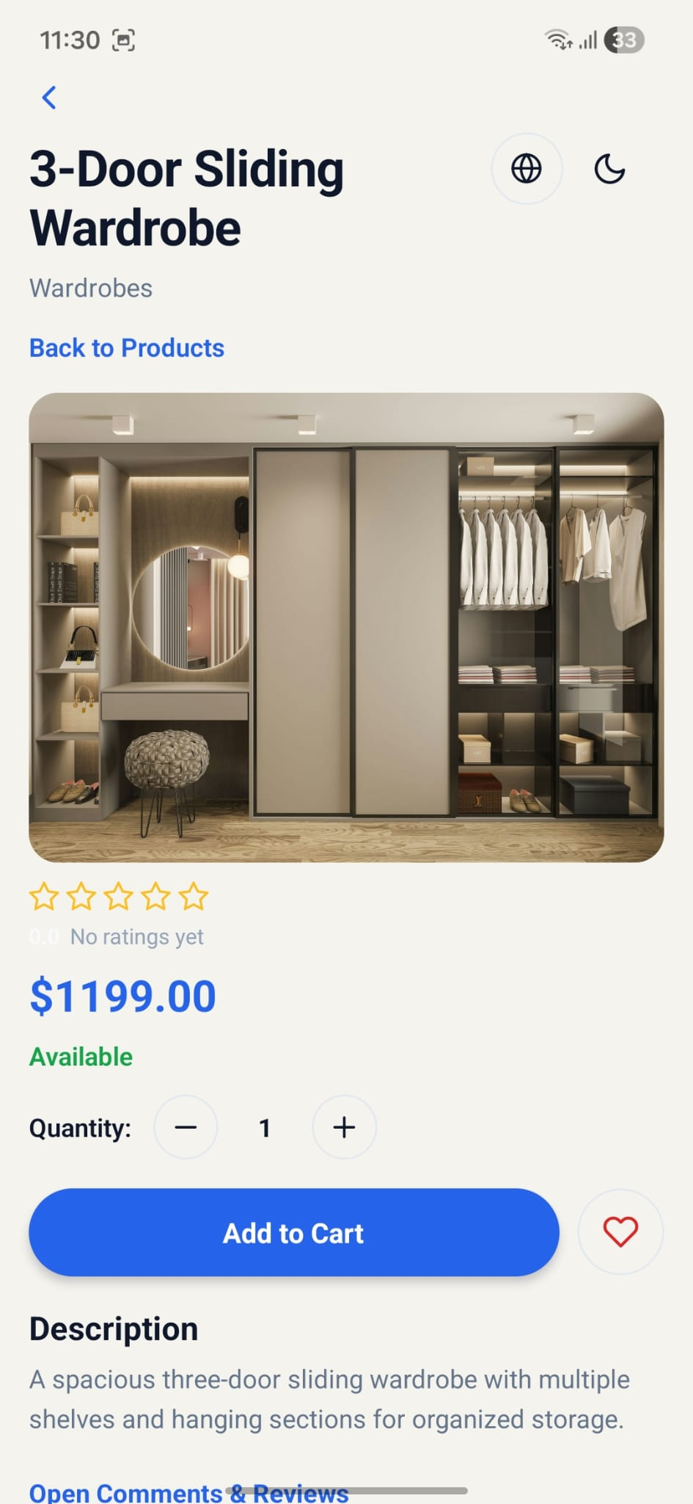
Product Details

Slide 22
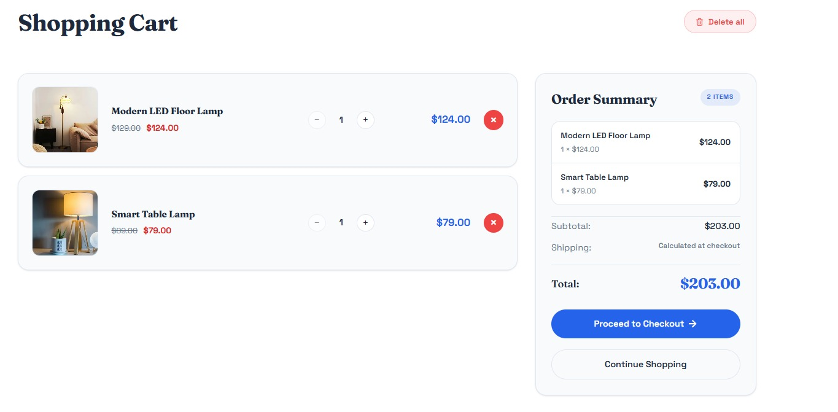
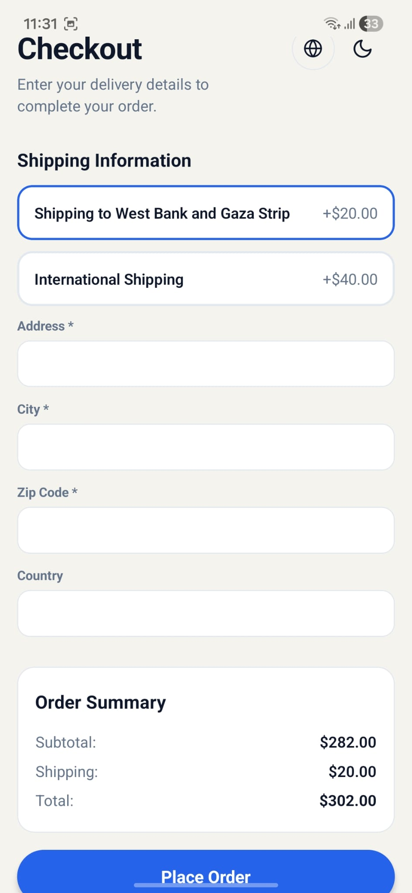
Cart & Checkout

Slide 23
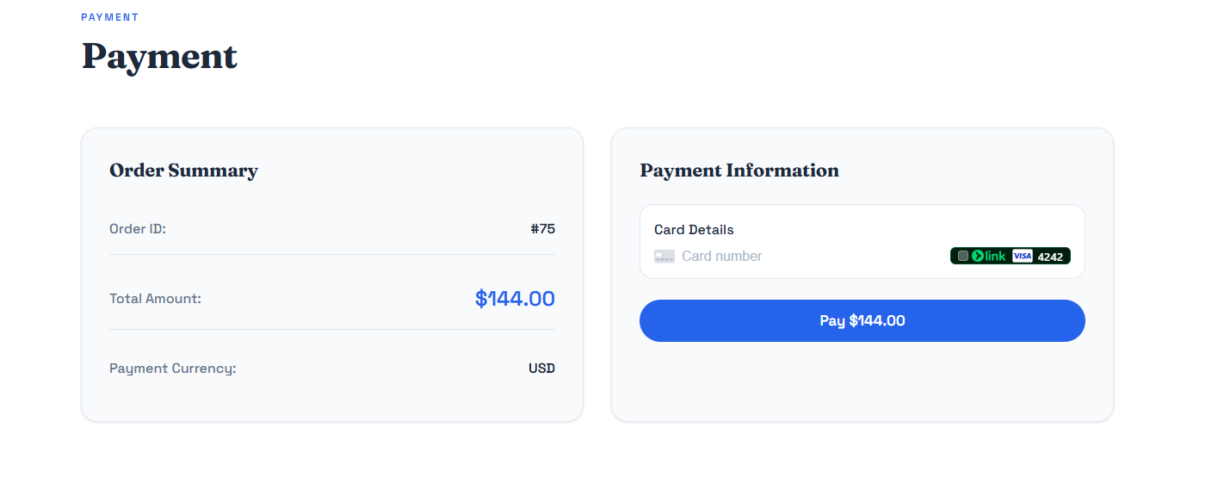
Stripe Payment

Slide 24
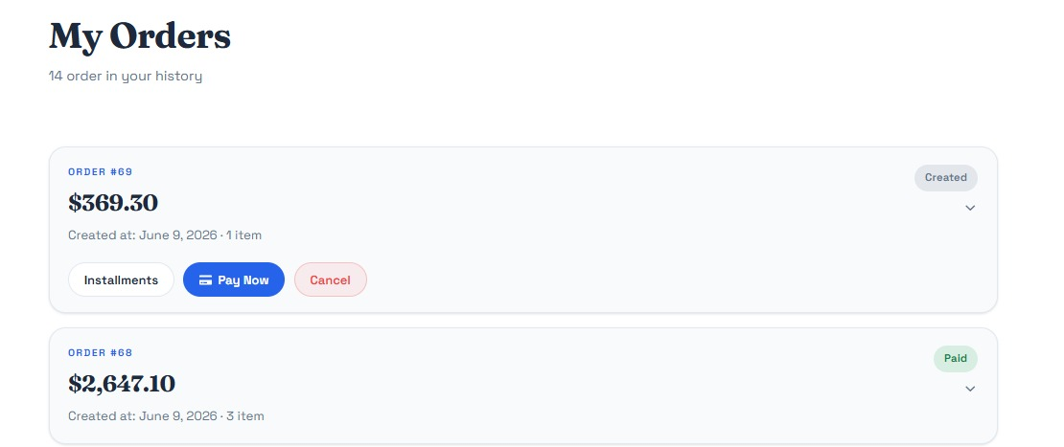
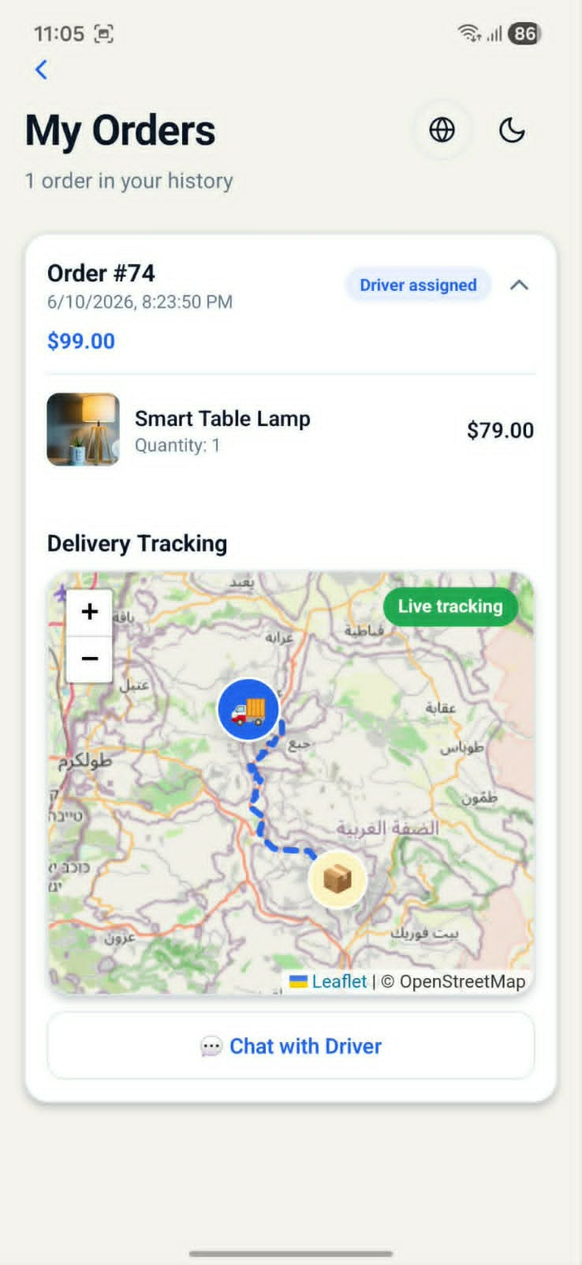
Orders & Delivery Tracking

Slide 25
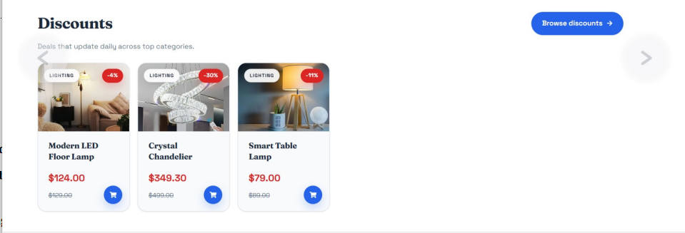
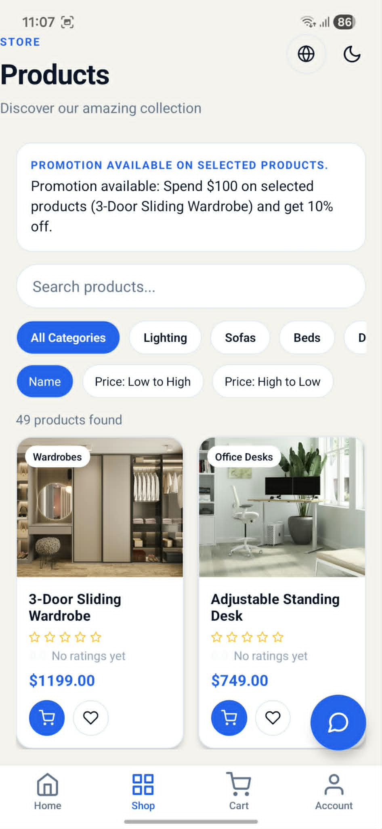
Discounts & Promotions

Slide 26
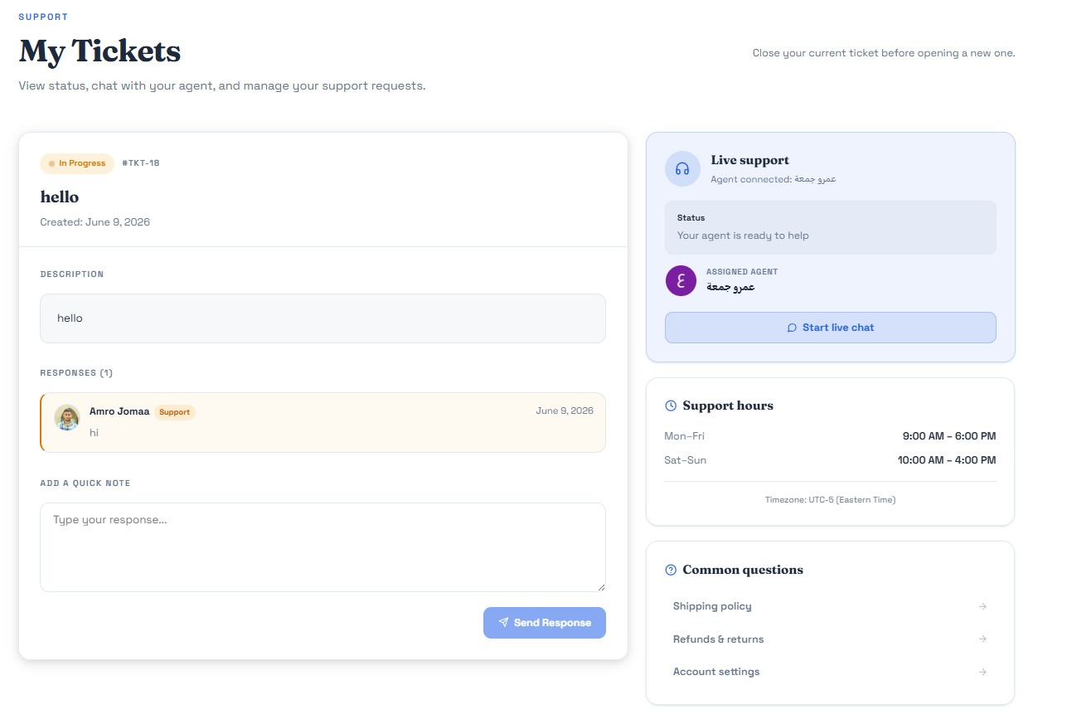
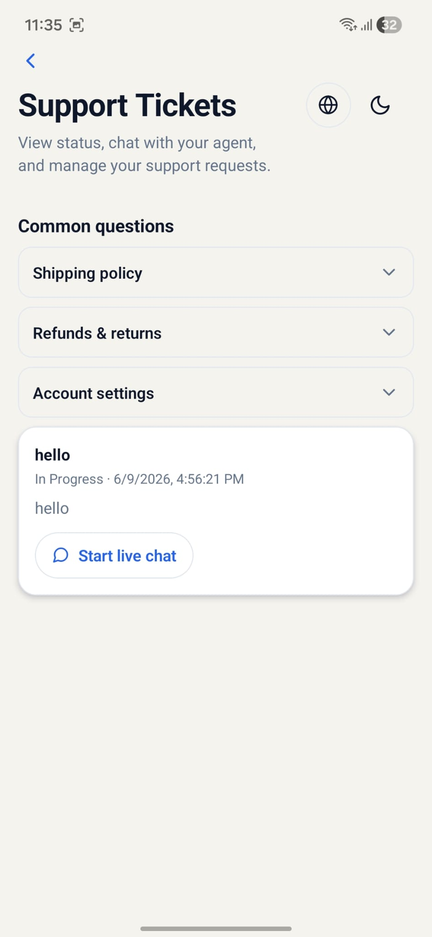
Support Ticket Chat

Slide 27
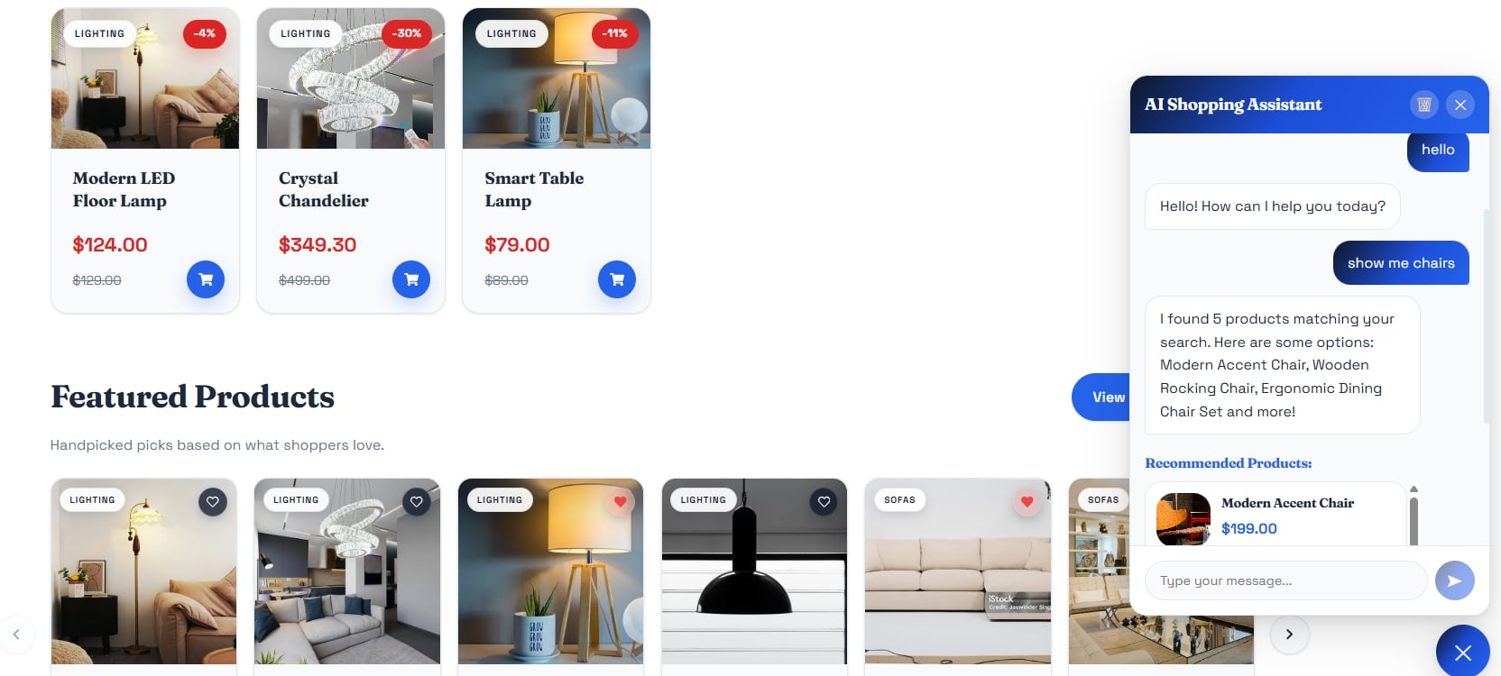
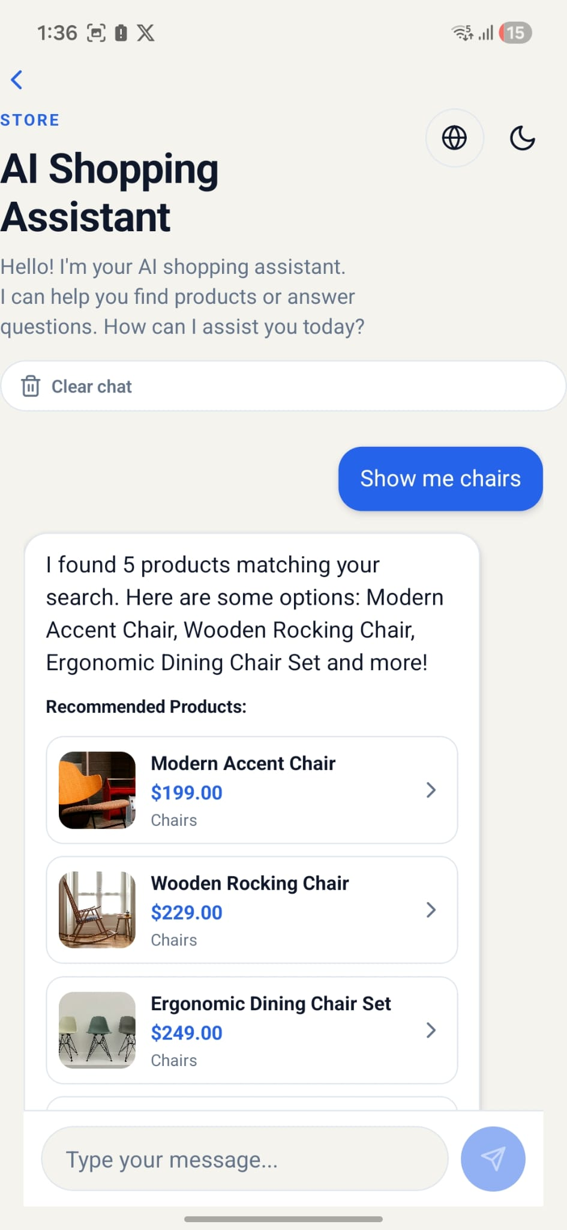
AI Shopping Assistant

Slide 28
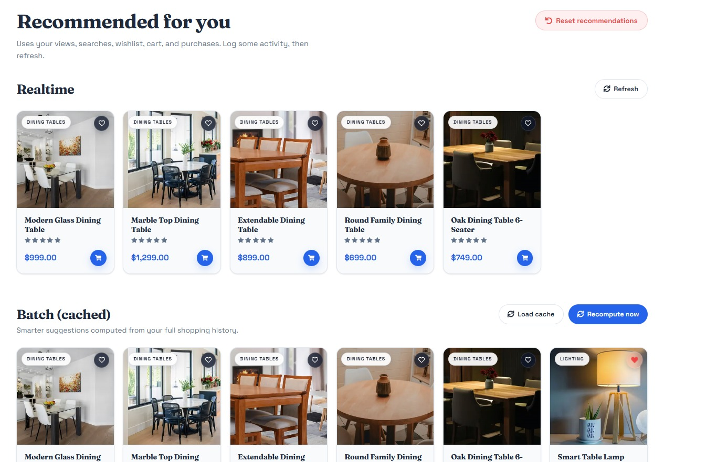
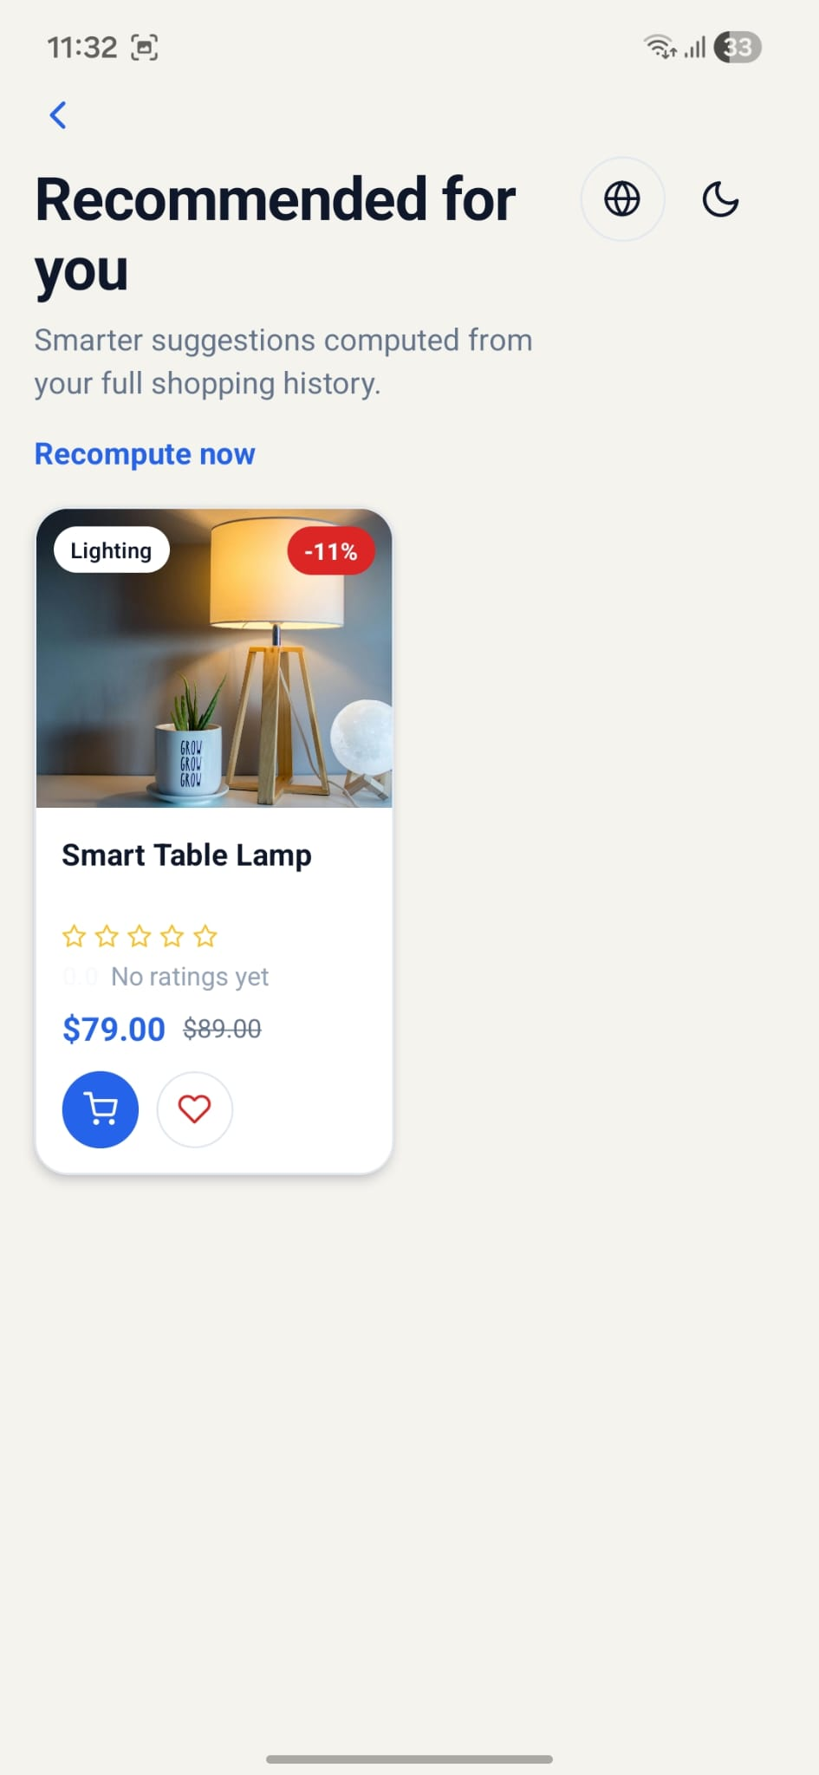
Personalized Recommendations

Slide 29
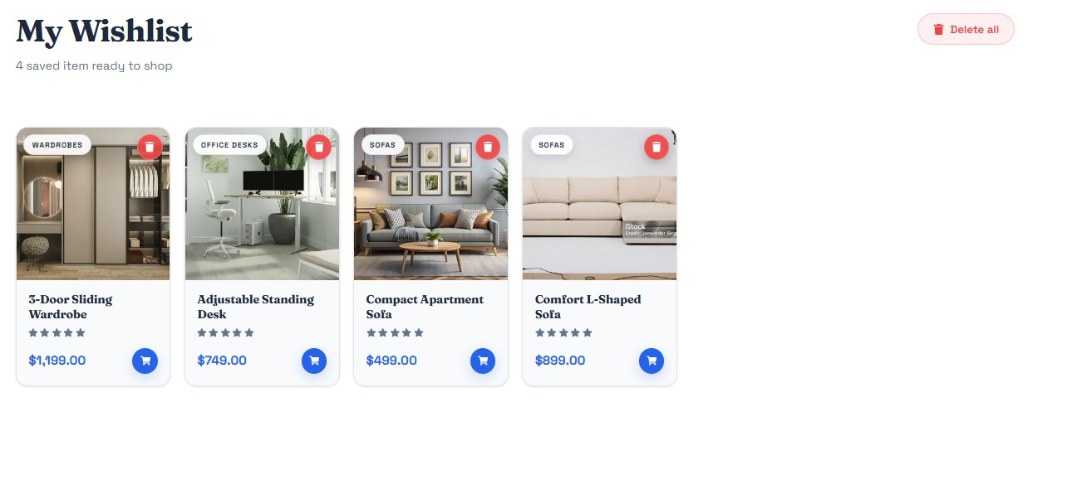
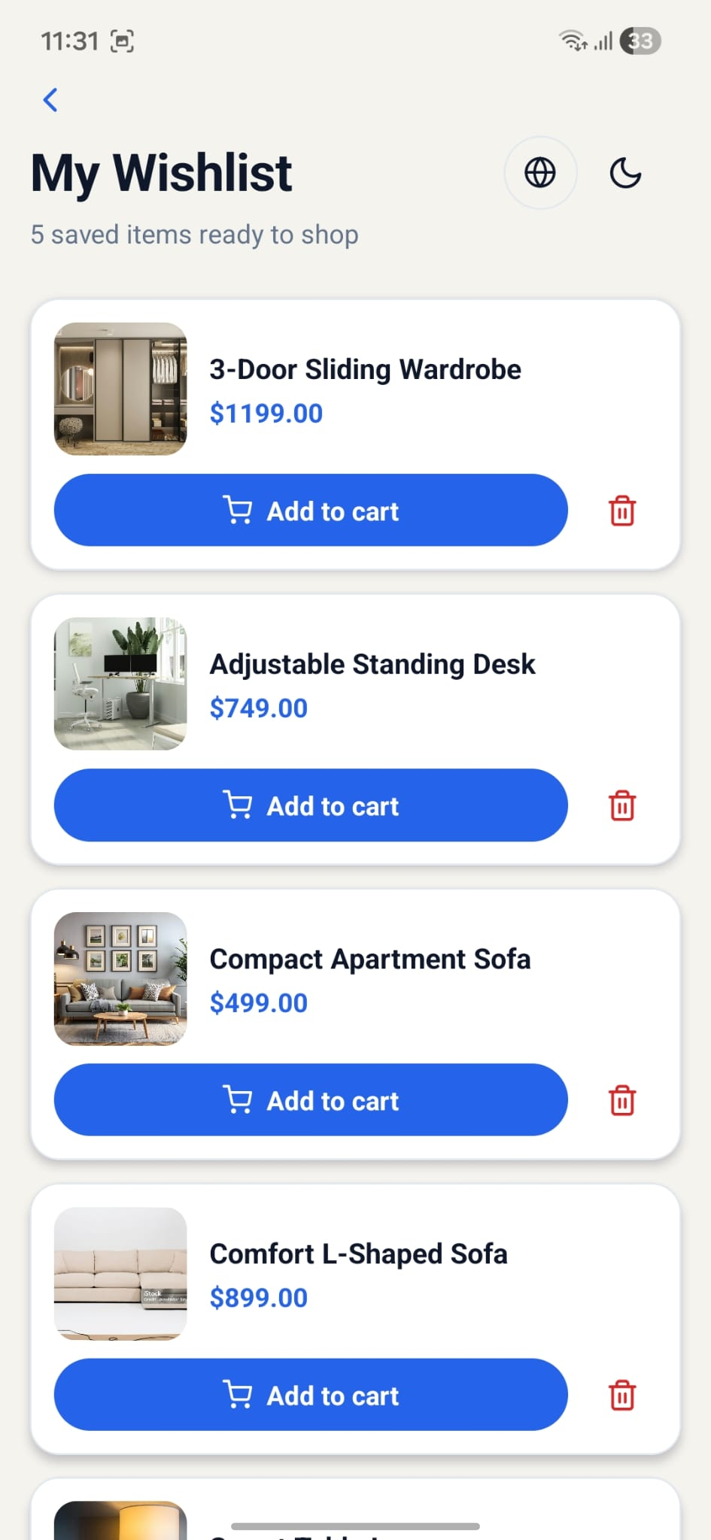
My Wishlist

Slide 30
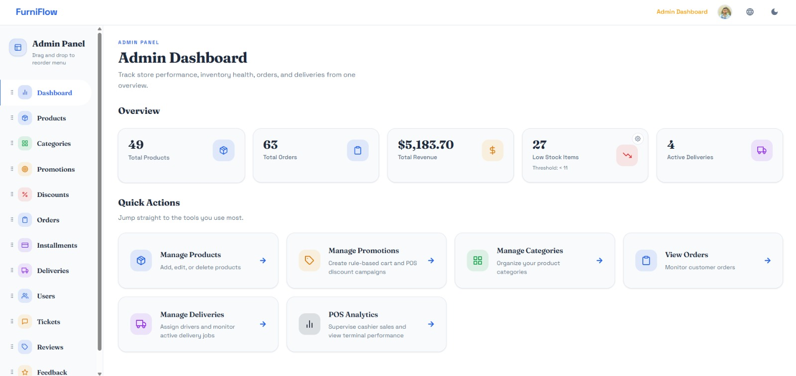
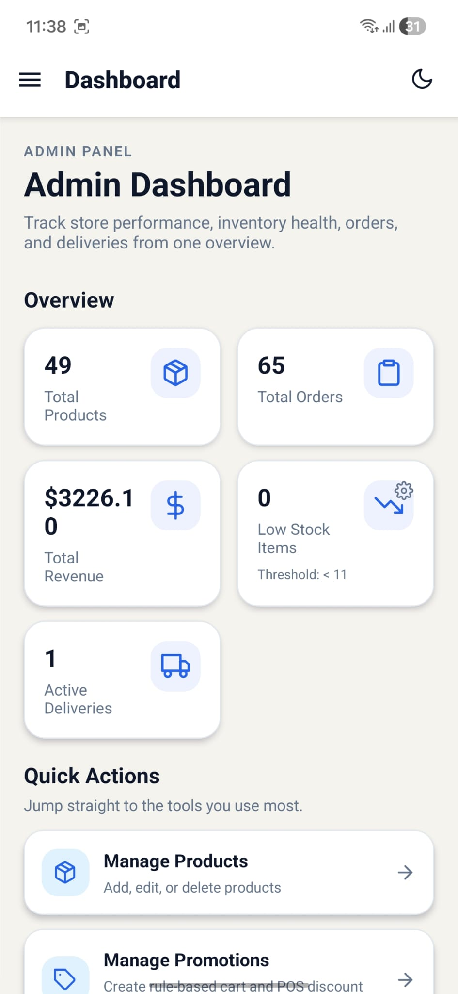
Admin Dashboard

Slide 31
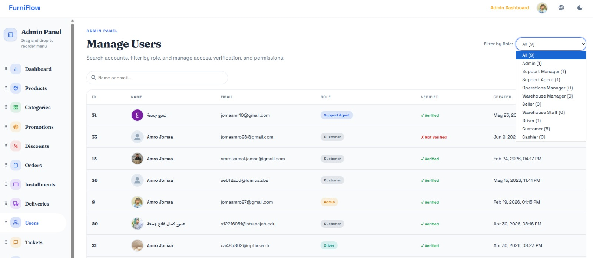
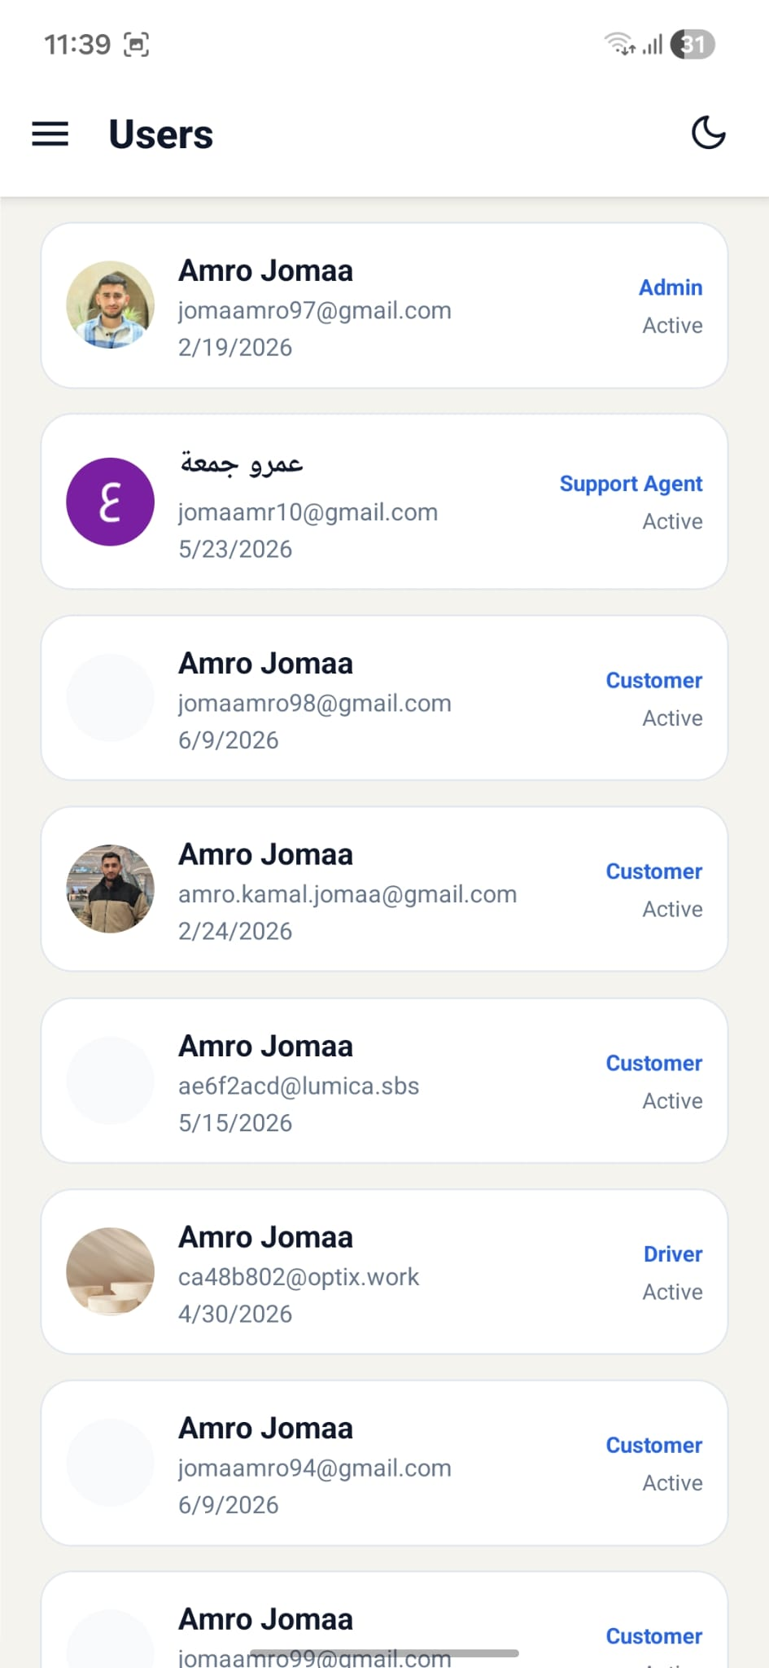
Admin User Management

Slide 32
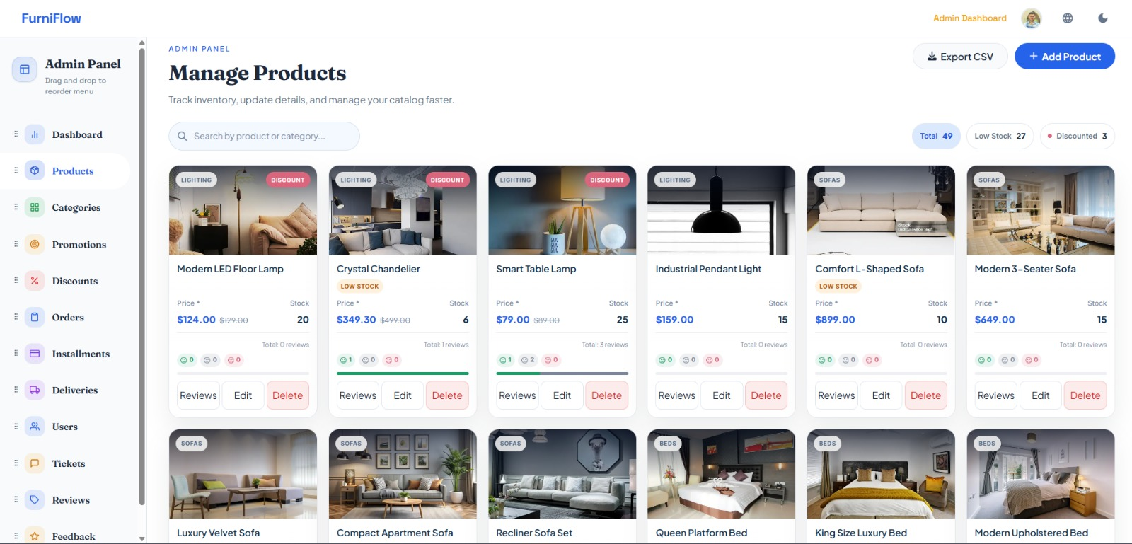
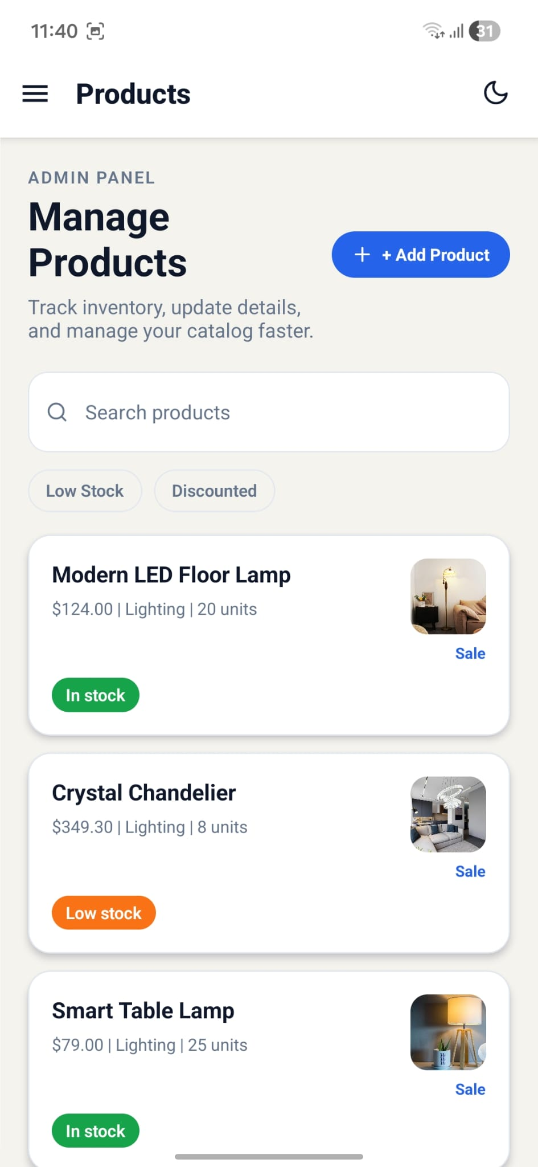
Admin Product Management

Slide 33
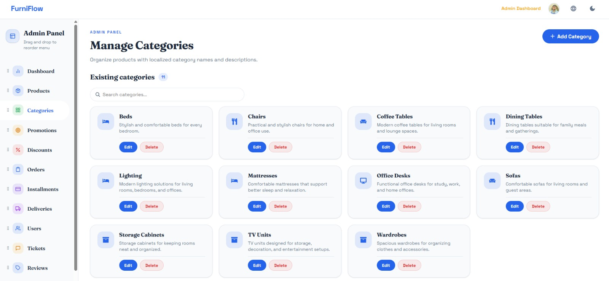
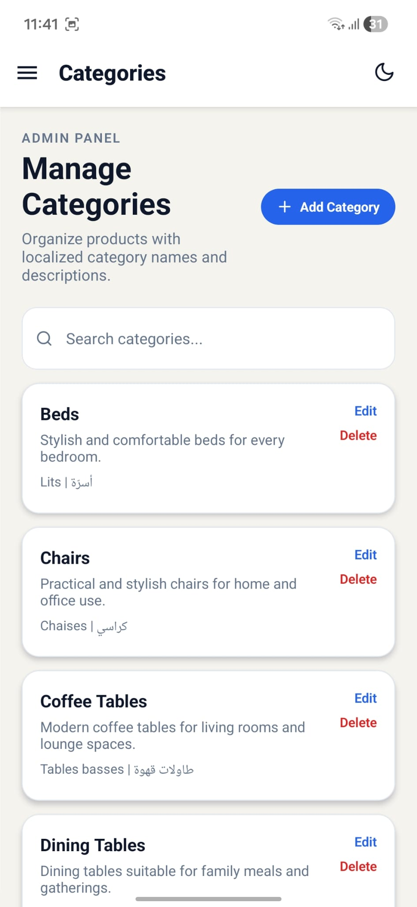
Management Categories

Slide 34
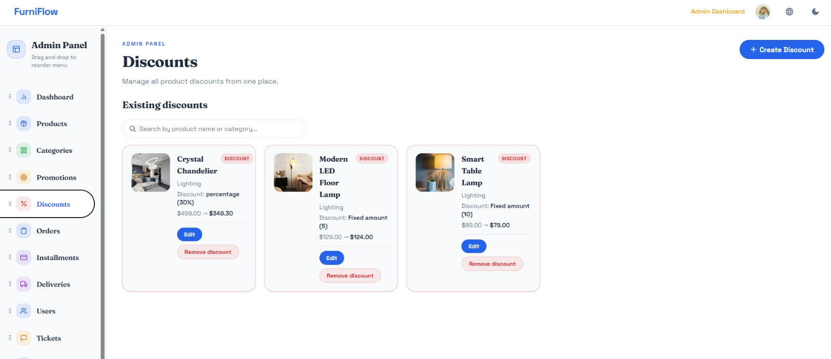
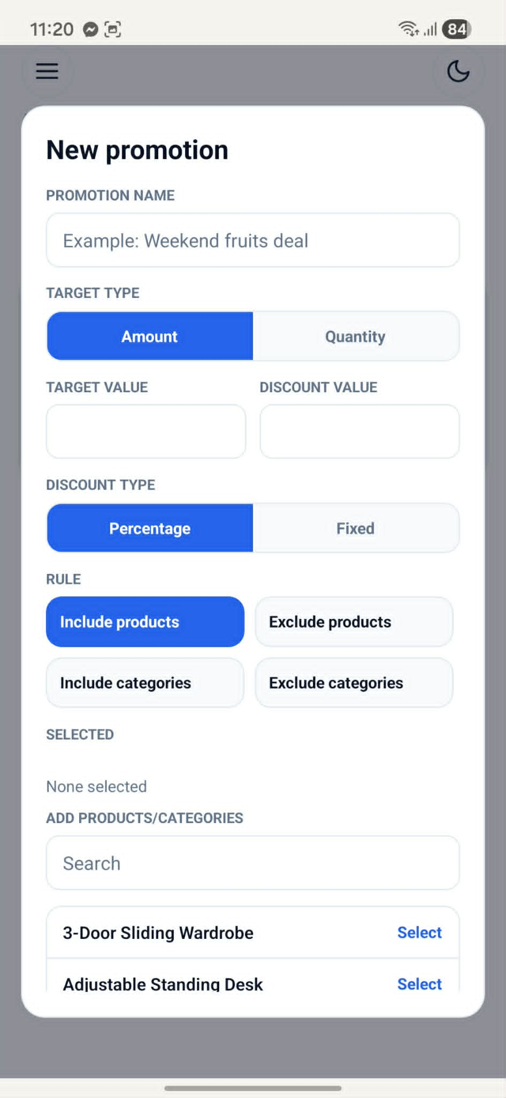
Discount & Promotion

Slide 35
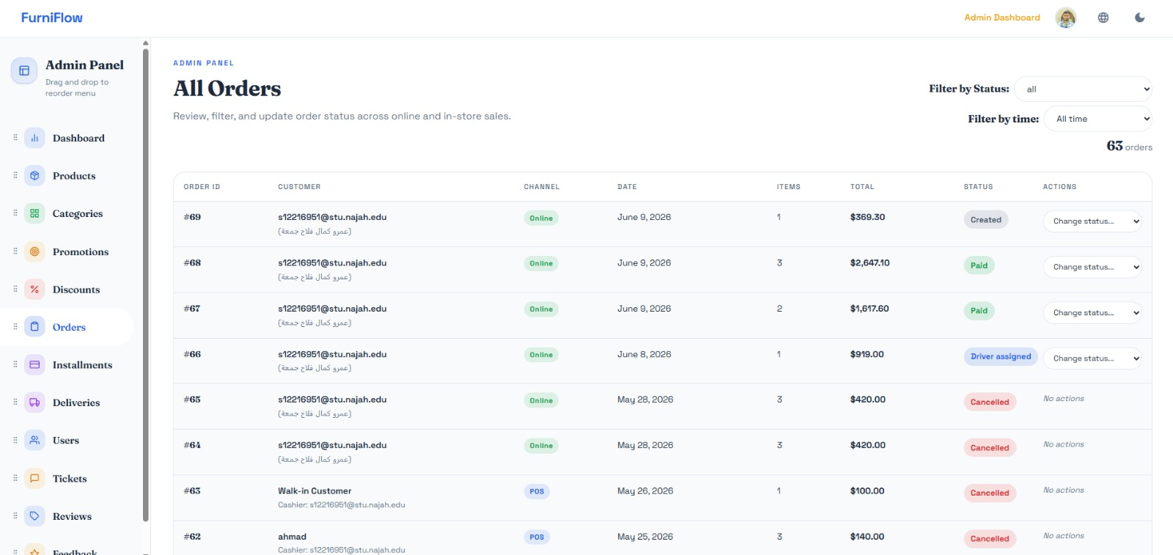
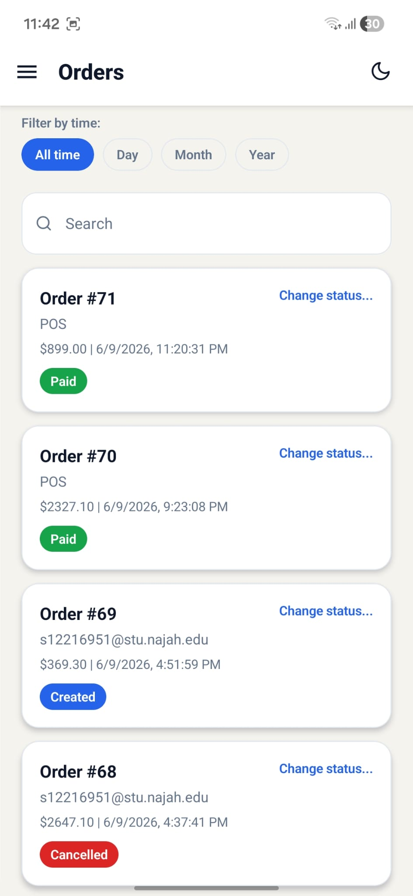
Order Management

Slide 36
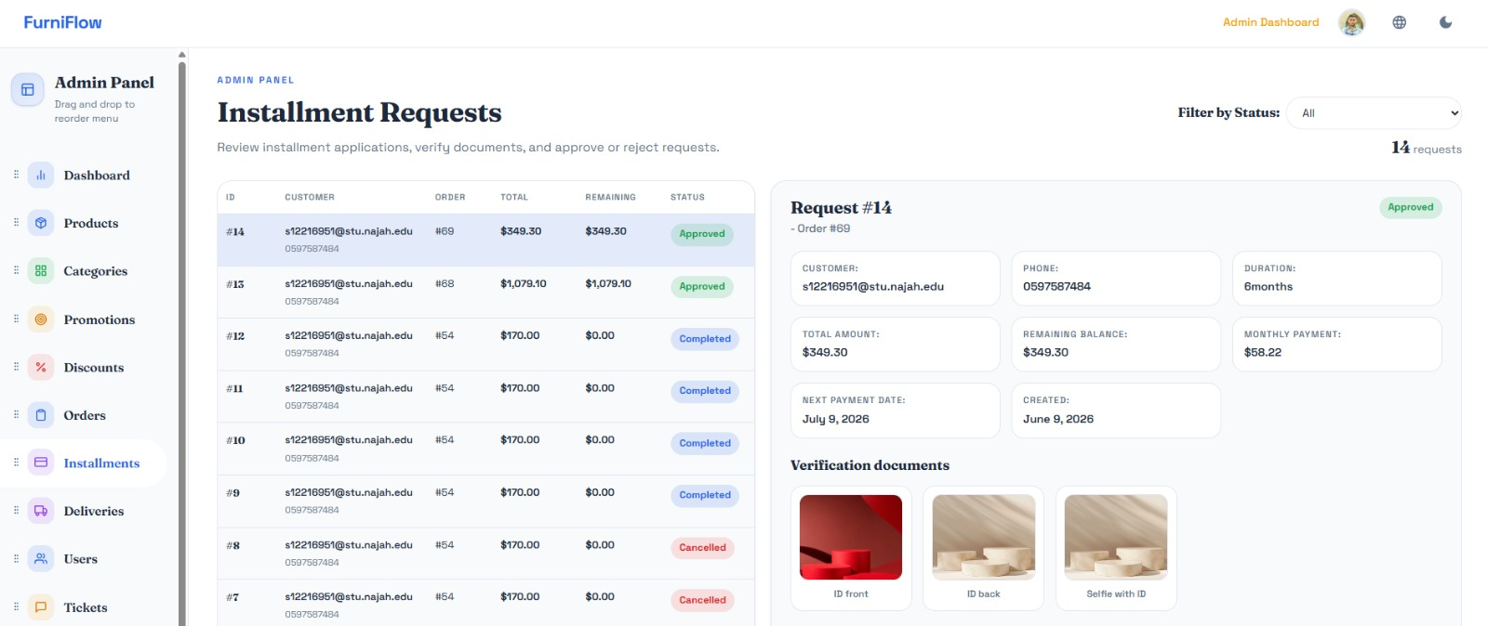
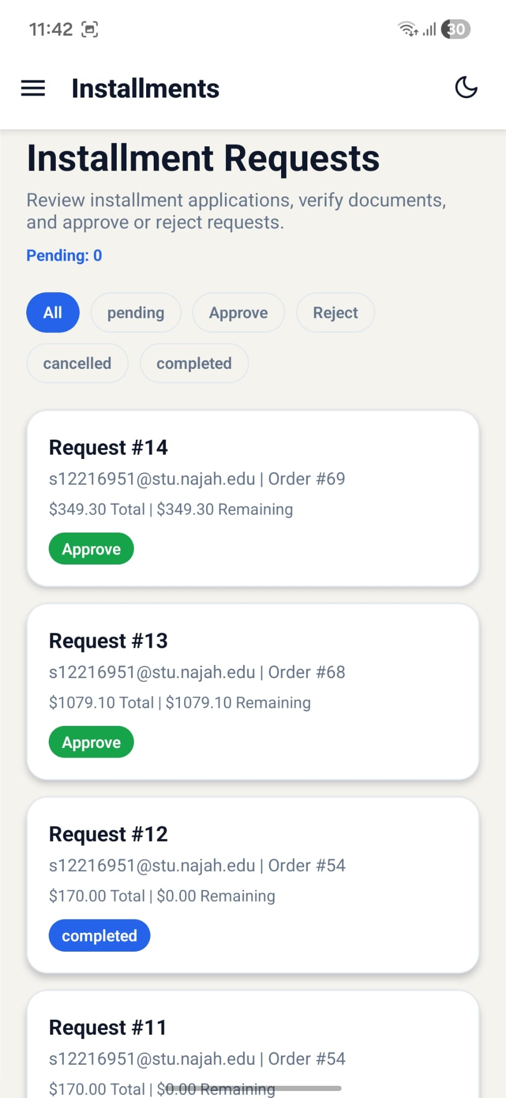
Installment Requests

Slide 37
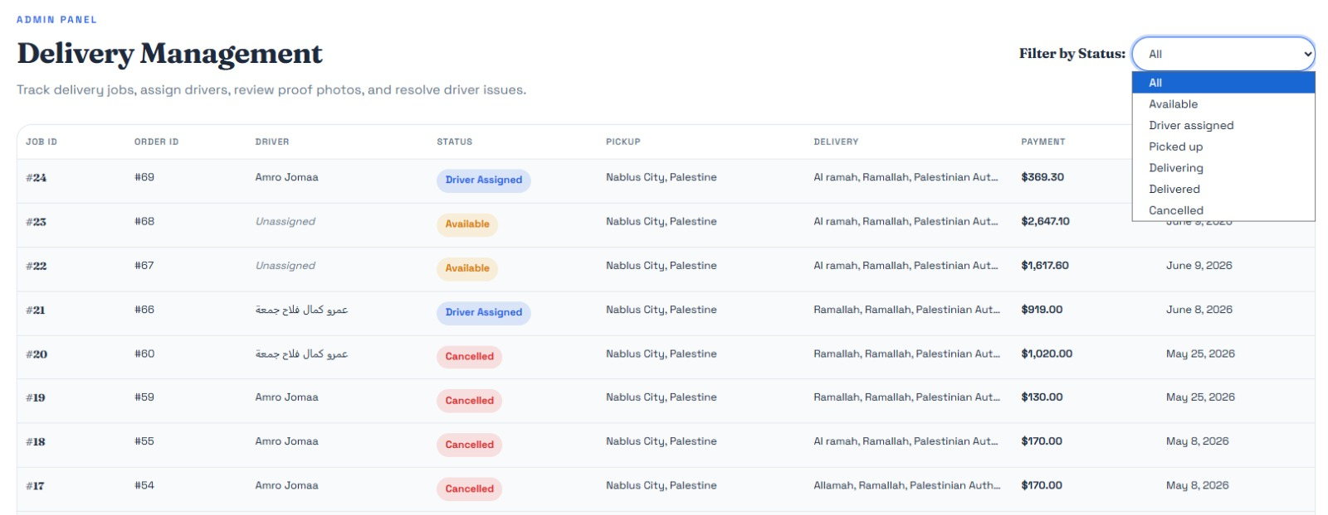
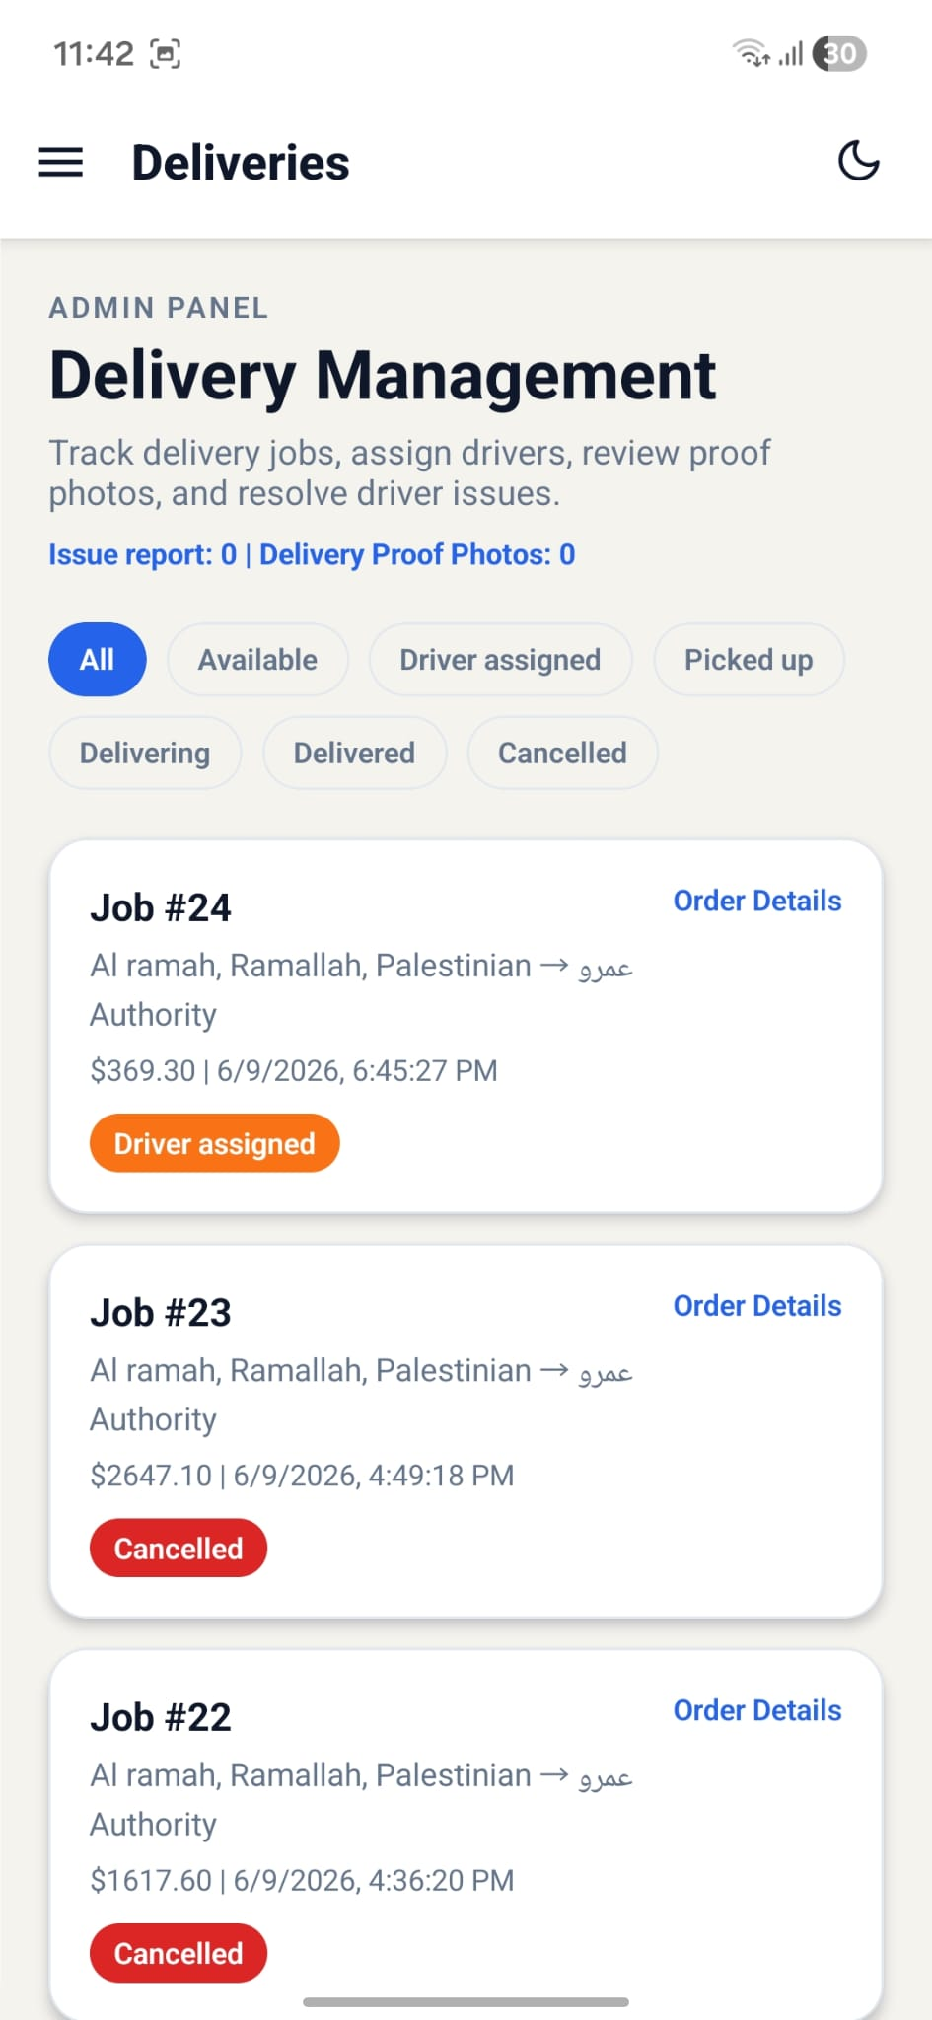
Delivery Management

Slide 38
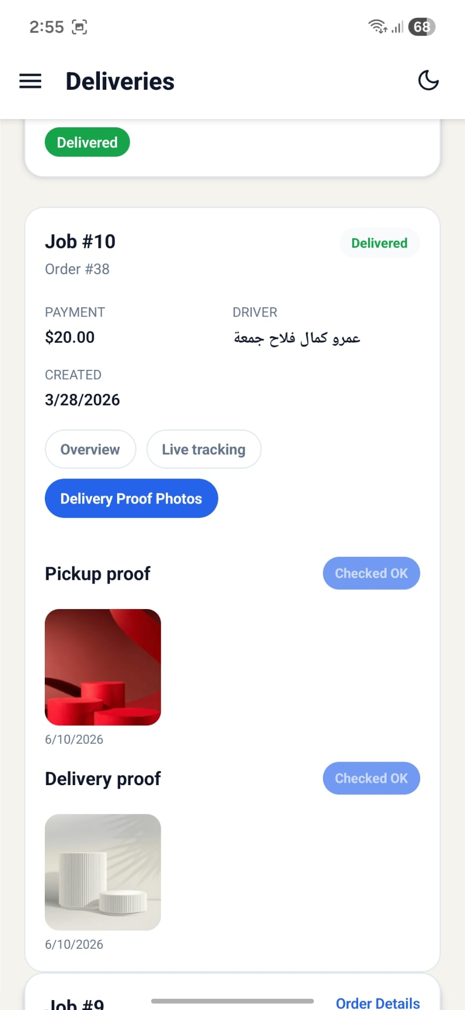
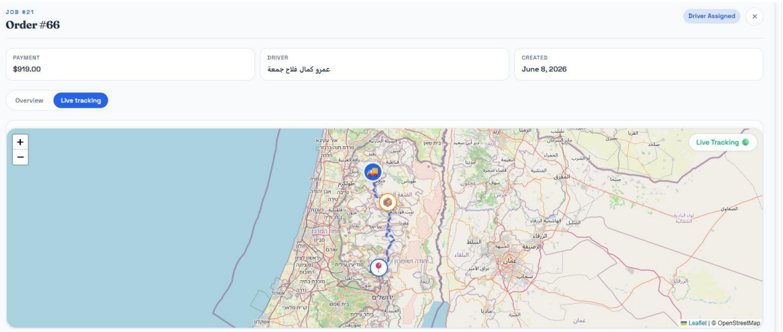
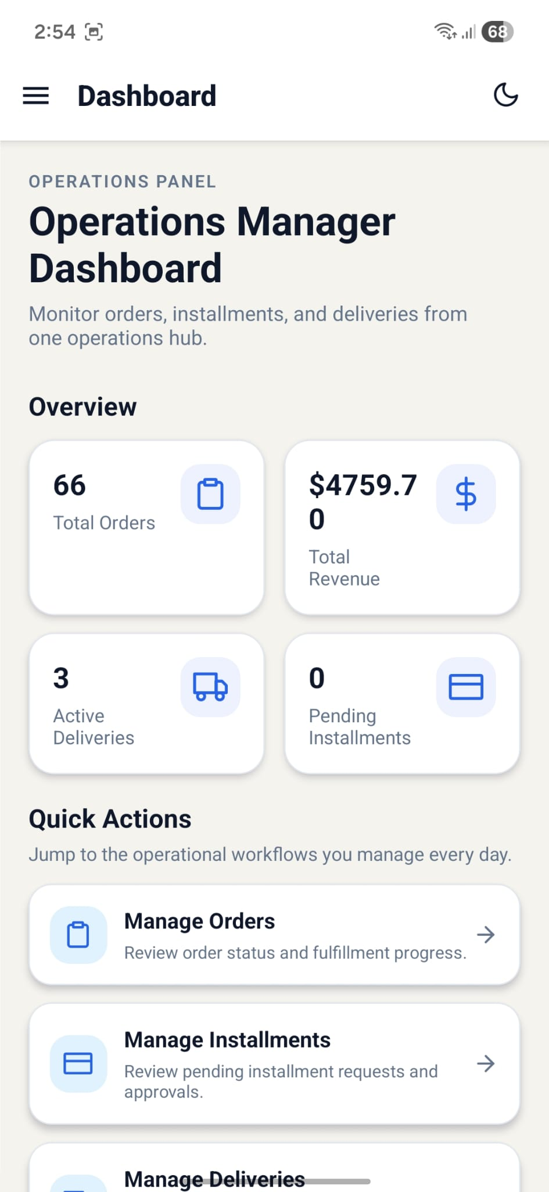
driver tracking & approve proof photos

Slide 39
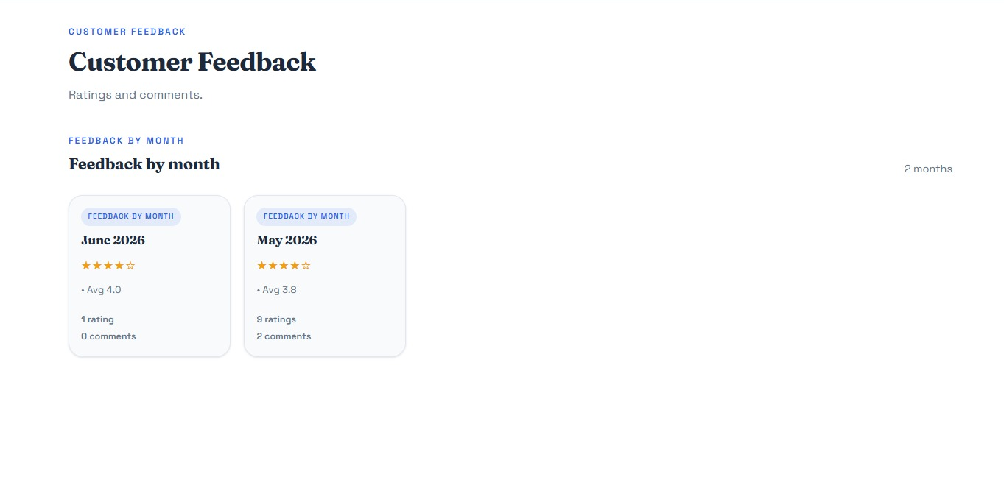
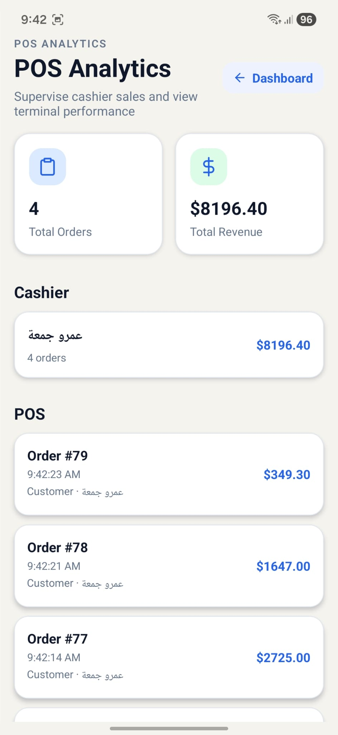
Customer Feedback & POS Analytics

Slide 40
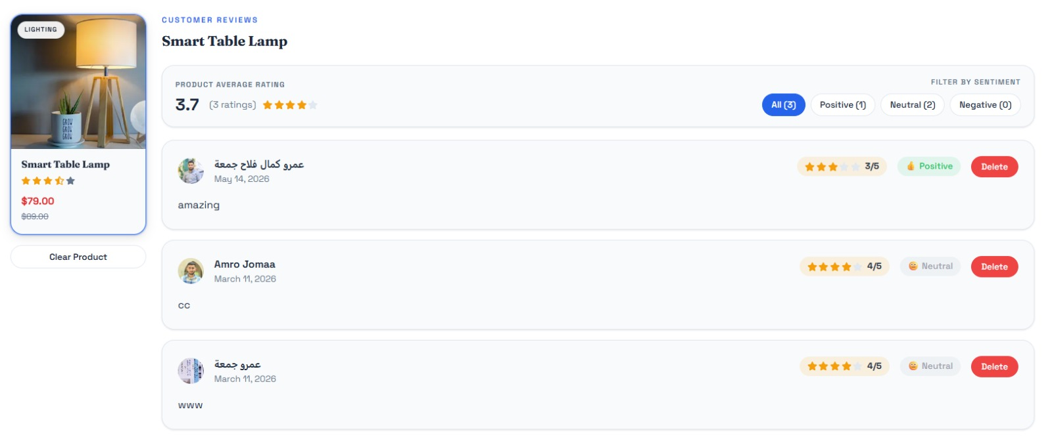
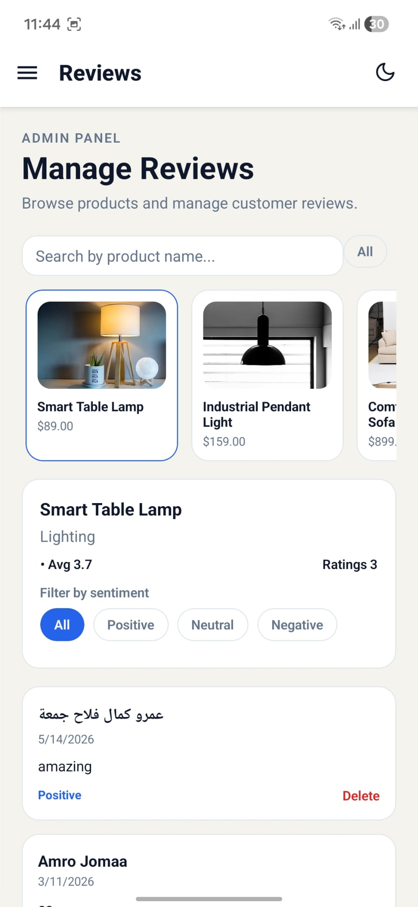
Reviews, Ratings & Sentiment

Slide 41


Seller Dashboard

Slide 42


Seller Product Management

Slide 43


Seller Orders

Slide 44


Warehouse Staff Dashboard

Slide 45


Warehouse Staff order packing

Slide 46


Warehouse Manager Approvals

Slide 47


Warehouse Inventory & Issues

Slide 48


Support Manager

Slide 49


Support Agent Tickets

Slide 50


Cashier POS Terminal

Slide 51


Driver & Available Jobs

Slide 52


Driver Active Delivery

Slide 53

Operations Manager

Slide 54
Operations Manager - tracking & approves

Slide 55
6|Future Development

Slide 56
Suggested Improvement
AI-based demand forecasting to help the store predict which products will sell more.
Use OCR instead of customer enter the information
for the installments
3-3D furniture preview, so customers can see how a product may look in their room before buying.

Slide 57
7|Conclusion

Slide 58

Project Achievements Summary
-FurniFlow successfully delivers a complete web and mobile furniture e-commerce and retail operations platform.
-The system improves efficiency by simplifying order processing, tracking deliveries, and managing customer interactions.
-Smart features such as targeted promotions and customer review sentiment analysis help support better business decisions.
-Improved product discovery through Gemini AI assistance, hybrid recommendations, reviews, ratings, and sentiment analytics. Built with FastAPI, PostgreSQL, React, Expo React Native, Stripe Payment Intents, and role-based JWT security.

Slide 59
Thank You

