Slide 1
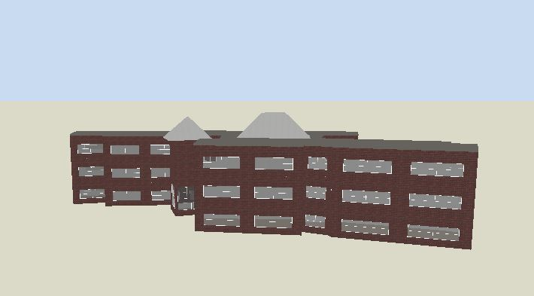
An-Najah National University
Faculty Of Engineering
Department Of Building Engineering
Graduation Project(2)
Redesign Of Faroun Secondary School For Girls
Prepared By:
Hatem G. Hodiri
Majid S. Ghafri
Saeed A. Odeh
Supervisor:
Eng. Fadi Fatayer

Slide 2
Contents
Site Analysis
Architectural Design
Structural Design
Electrical Design
Environmental Design
Mechanical Design
Safety Design
Total Cost

Slide 3
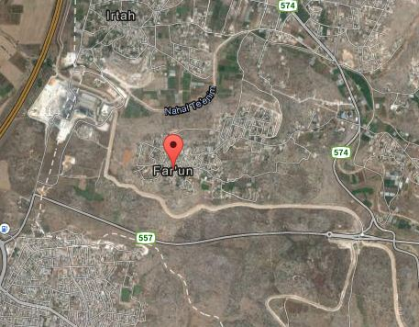
Site Analysis

Slide 4
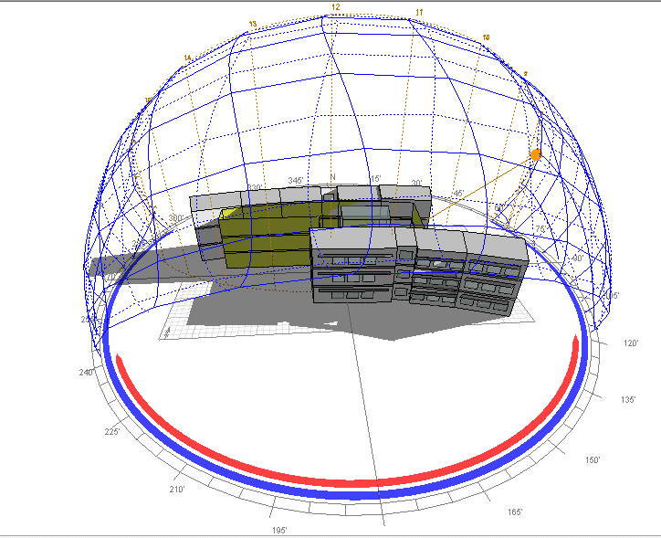
Site Analysis
Shadow

Slide 5
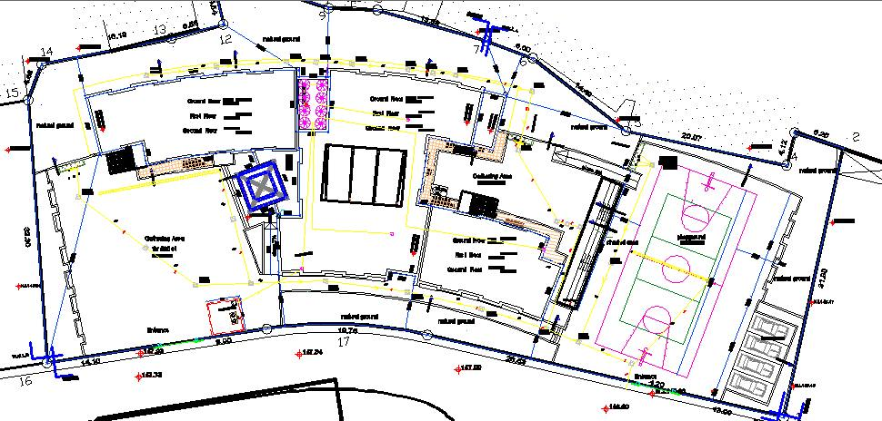
Site Analysis
N
Wind Direction

Slide 6
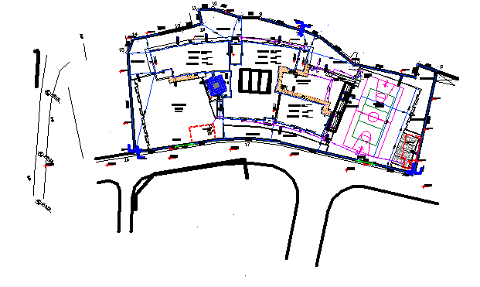
Architectural Design
N
Site Plan

Slide 7
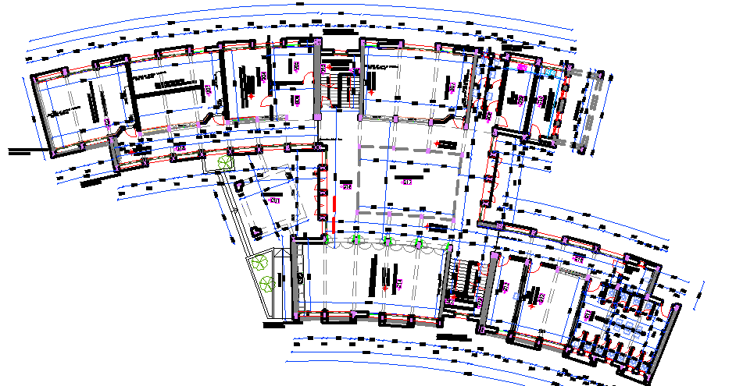
Architectural Design
Ground Floor Plan Before Redesign

Slide 8
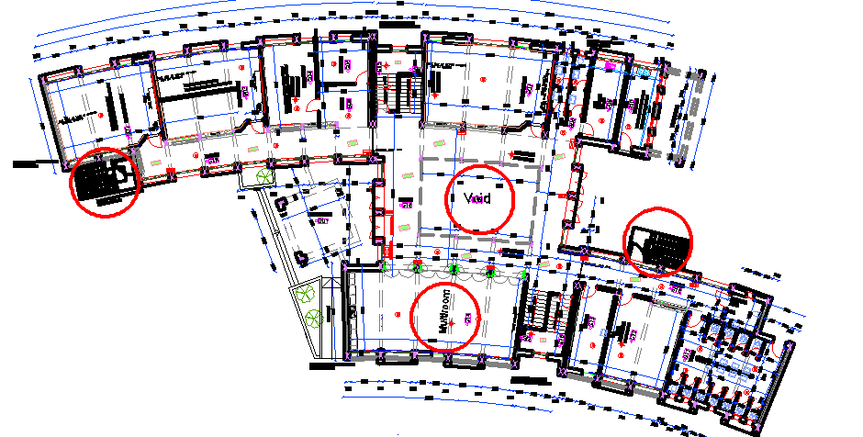
Architectural Design
Ground Floor Plan After Redesign

Slide 9
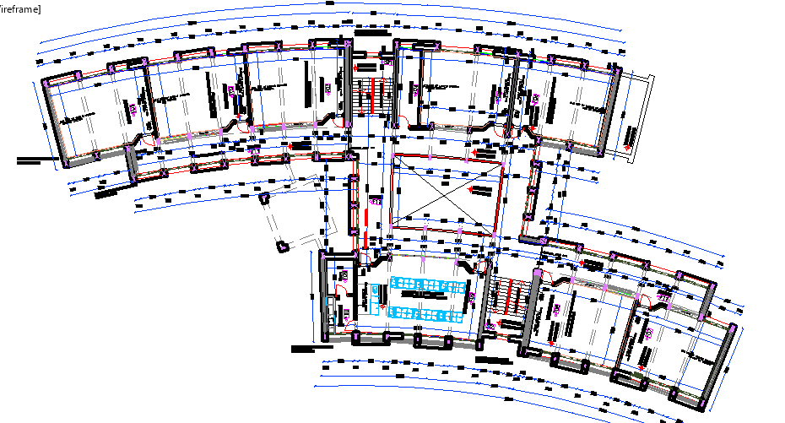
Architectural Design
First Floor Plan Before Redesign

Slide 10
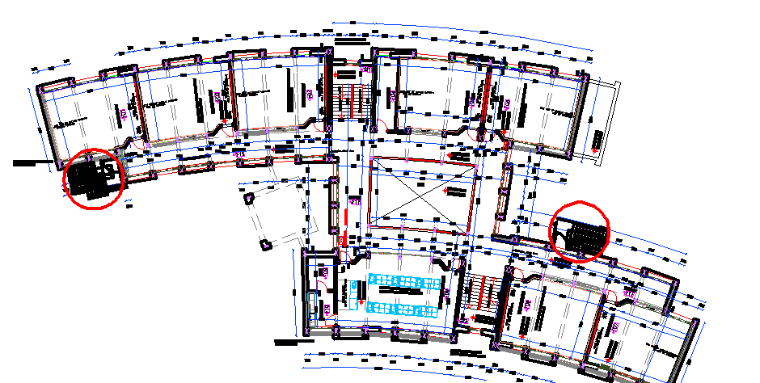
Architectural Design
First Floor Plan After Redesign

Slide 11
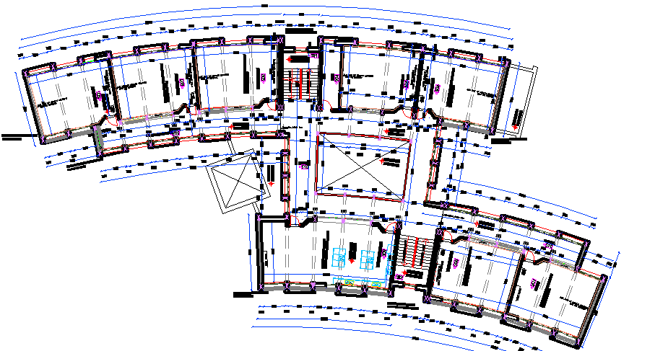
Architectural Design
Second Floor Plan Before Redesign

Slide 12
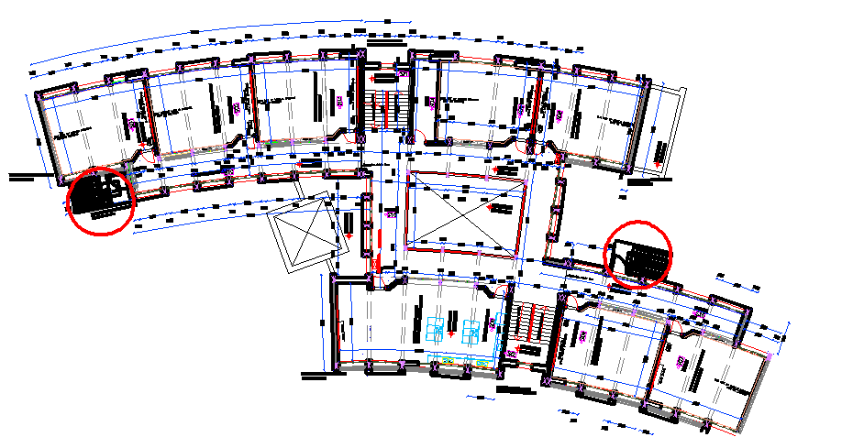
Architectural Design
Second Floor Plan After Redesign

Slide 13
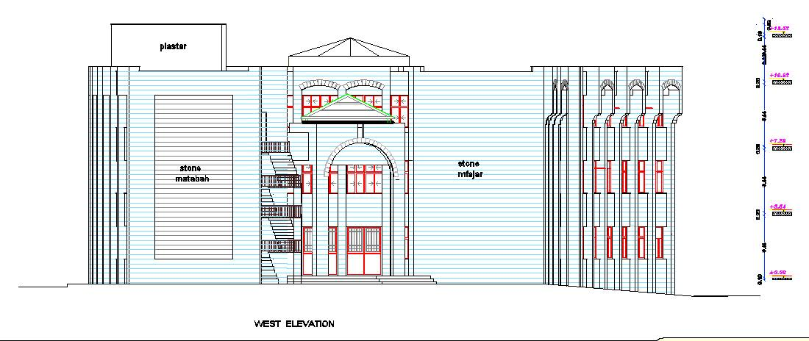
Architectural Design
West Elevation

Slide 14
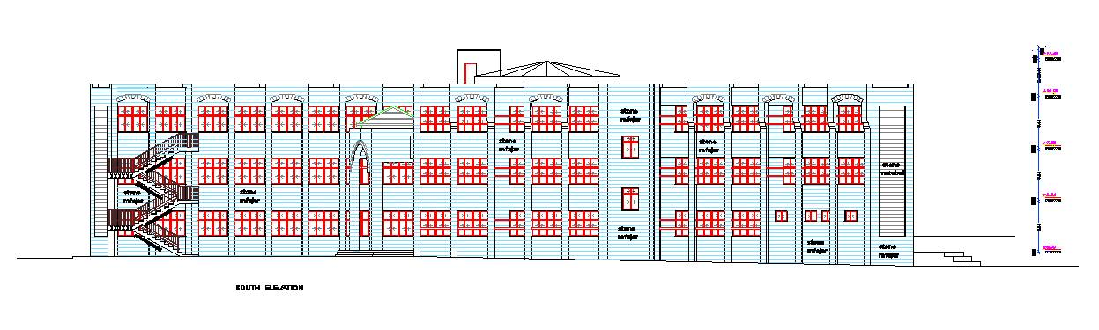
Architectural Design
South Elevation

Slide 15
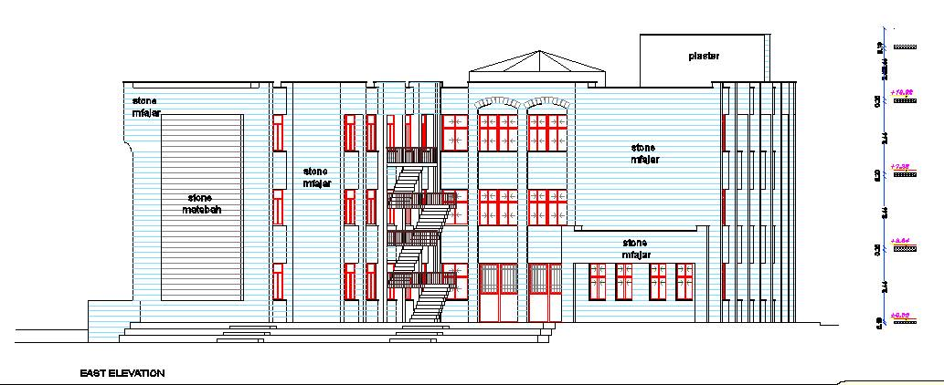
Architectural Design
East Elevation

Slide 16
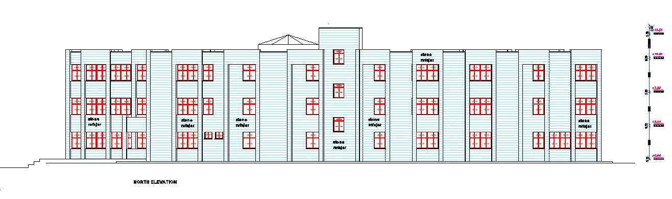
Architectural Design
North Elevation

Slide 17
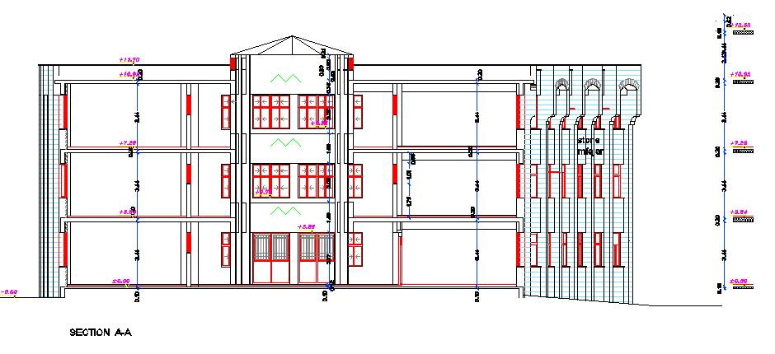
Architectural Design
Section A-A

Slide 18
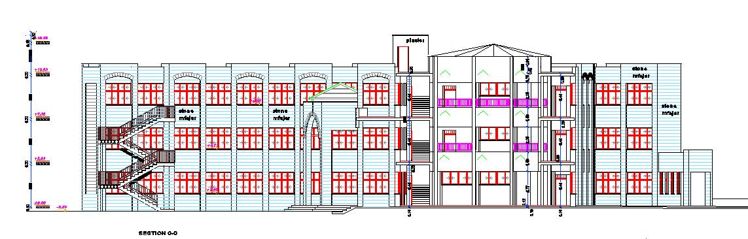
Architectural Design
Section B-B

Slide 19
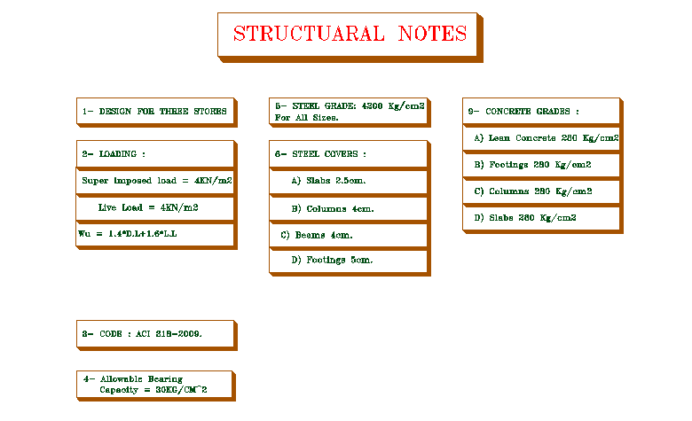
Structural Design

Slide 20
Structural Design
I= 1.25, Ca= 0.18, Cv= 0.25, z=0.15 and g= 9.81 M/S, R=5.5, soil profile Sc
Check Equilibrium:
Total load = 219.16x3x25.93= 17048.14 KN
From SAP = 17643.921 KN/m²
Percentage of error = 17643.921-17048.14/17048.14 = 0.03<0.05 GOOD

Slide 21
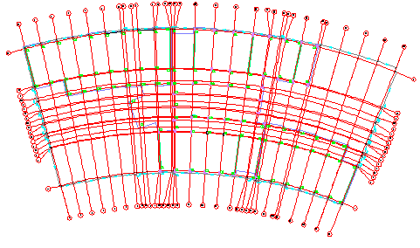
Structural Design
Columns Center Lines

Slide 22
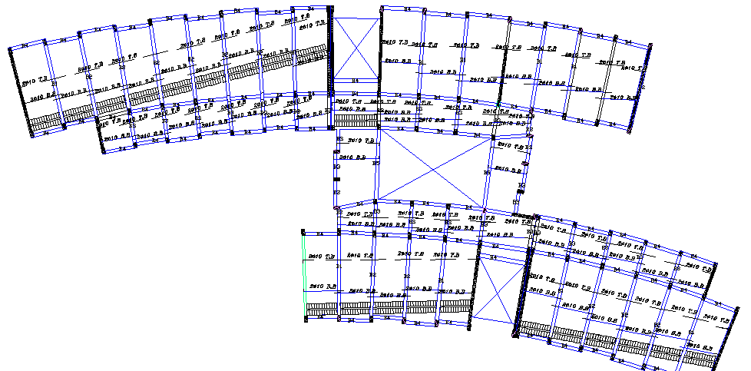
Structural Design
Ground Floor Slab Design

Slide 23
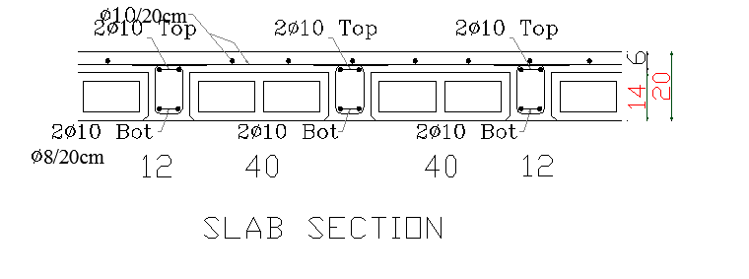
Structural Design
Slab Section

Slide 24
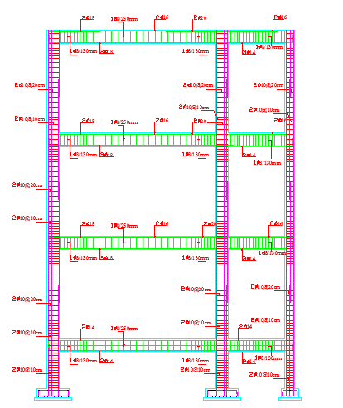
Structural Design
Frame

Slide 25
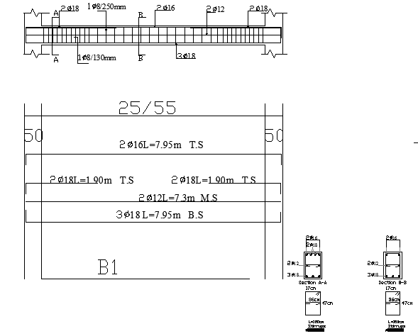
Structural Design
Beam1 Layout (Main Beam )

Slide 26
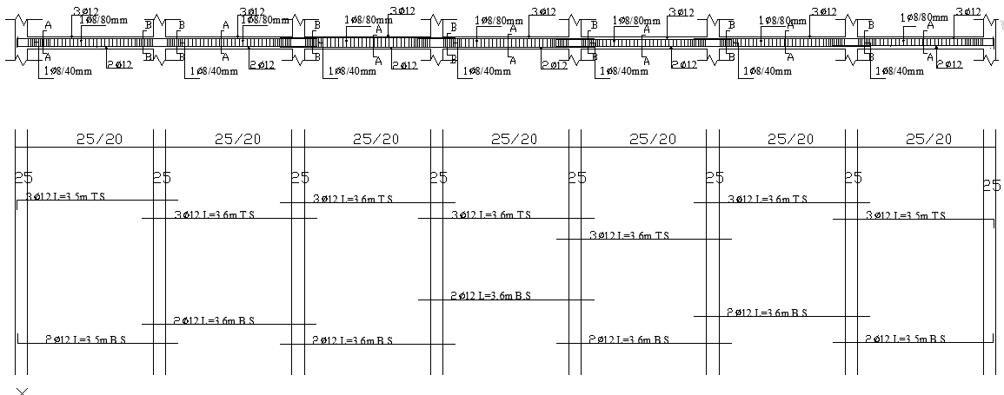
Structural Design
Beam4 Layout (Secondary Beam )

Slide 27
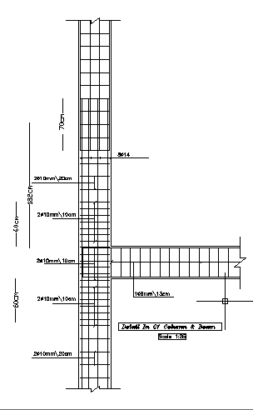
Structural Design
Detail In C1 Column & Beam

Slide 28
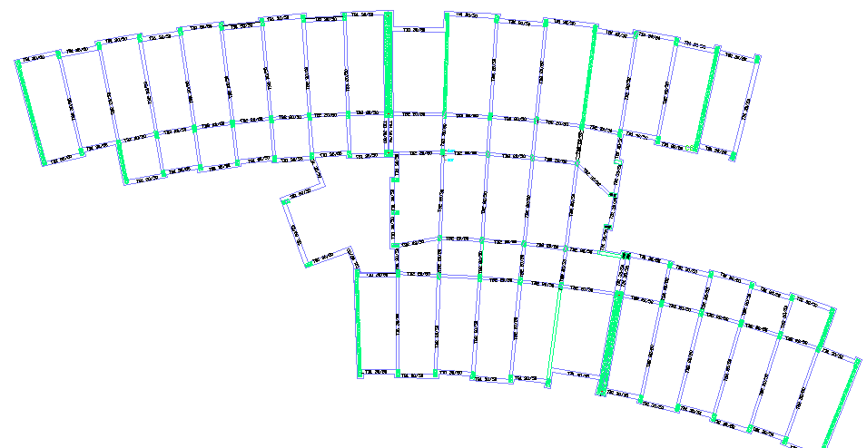
Structural Design
Tie Beam Plan

Slide 29
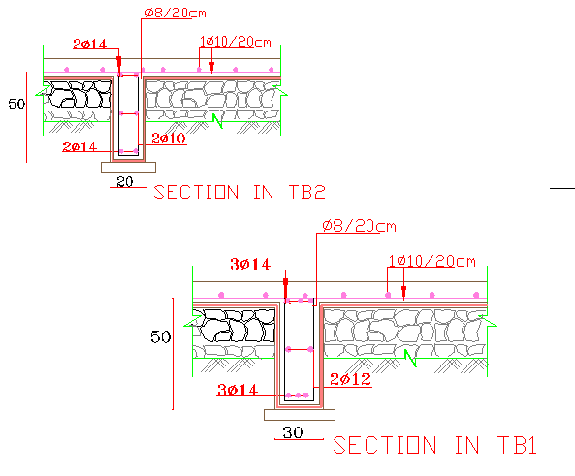
Structural Design
Sections in Tie beams

Slide 30
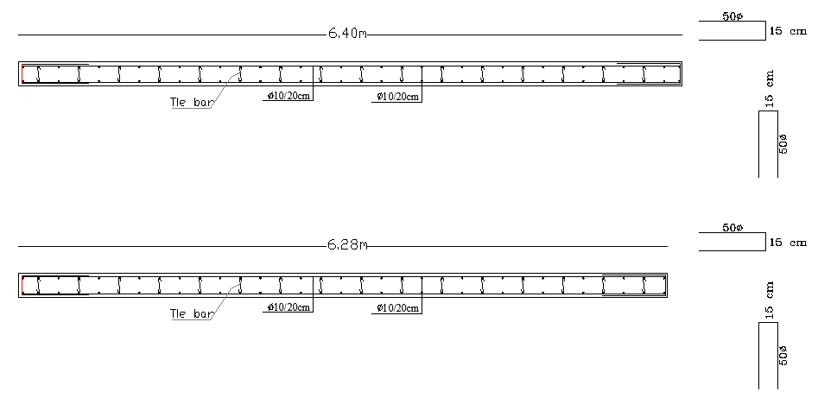
Structural Design
Shear Wall Design

Slide 31
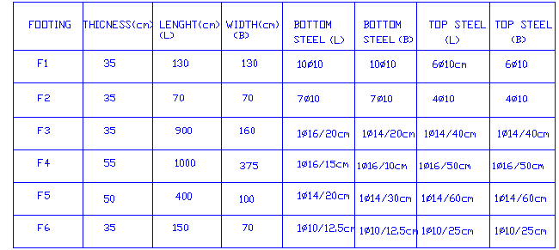
Structural Design
Footing Table

Slide 32
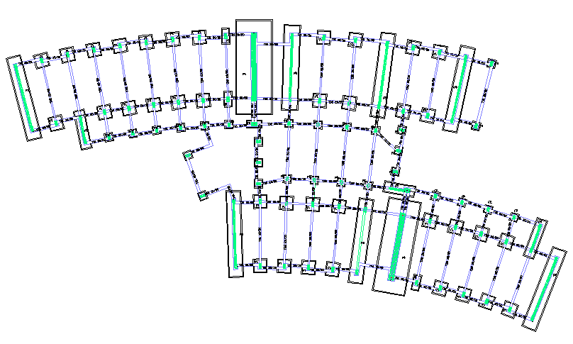
Structural Design
Footing Layout

Slide 33
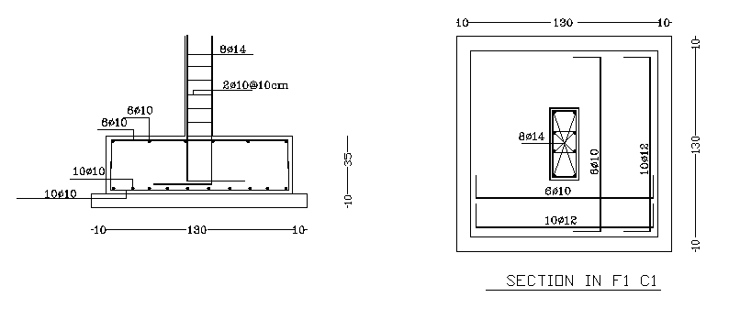
Structural Design
Footing1 layout

Slide 34
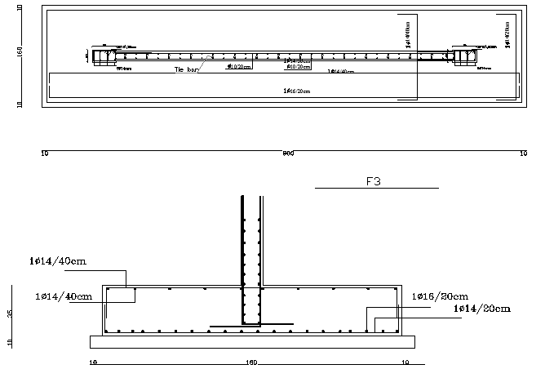
Structural Design
Footing3 Layout

Slide 35
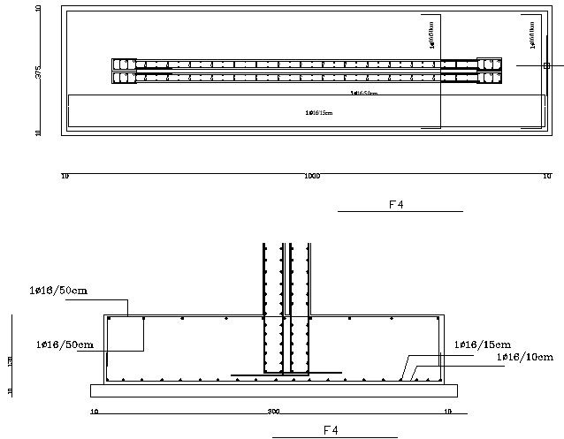
Structural Design
Footing4 Layout

Slide 36
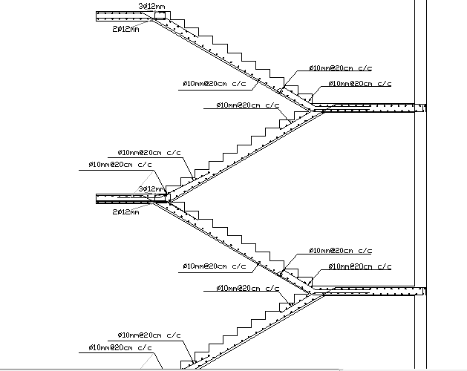
Structural Design
Stair Reinforcement

Slide 37
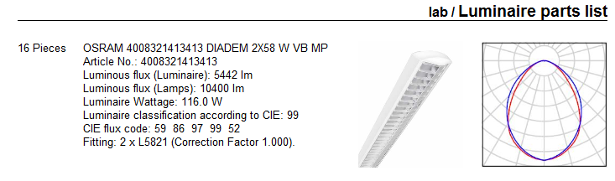
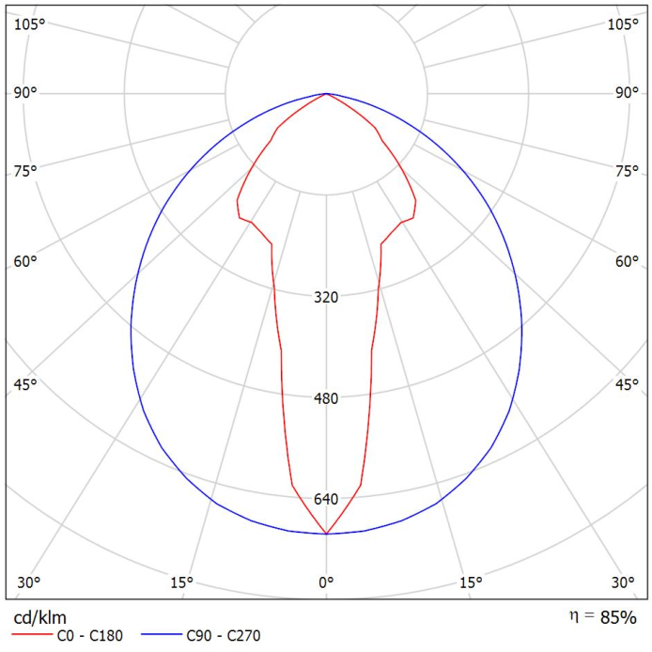
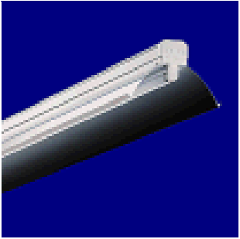
Electrical Design
Lamps Used

Slide 38
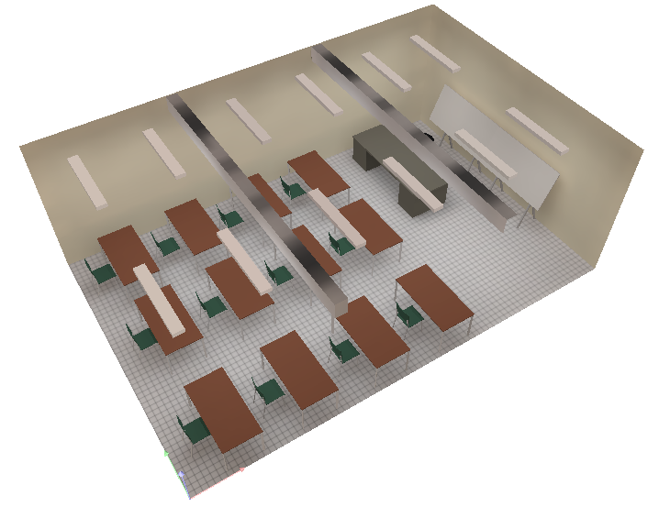
Electrical Design
Dialux Model For Classroom

Slide 39
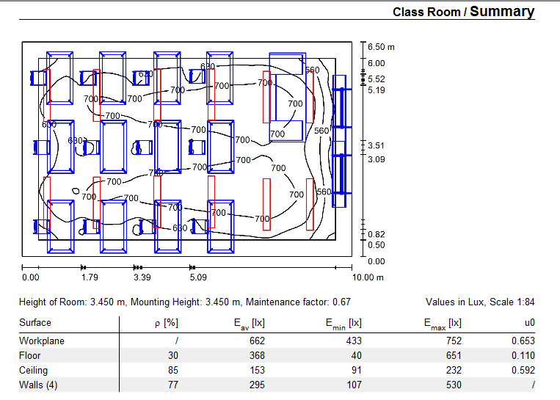
Electrical Design
Uniformity In Classroom

Slide 40
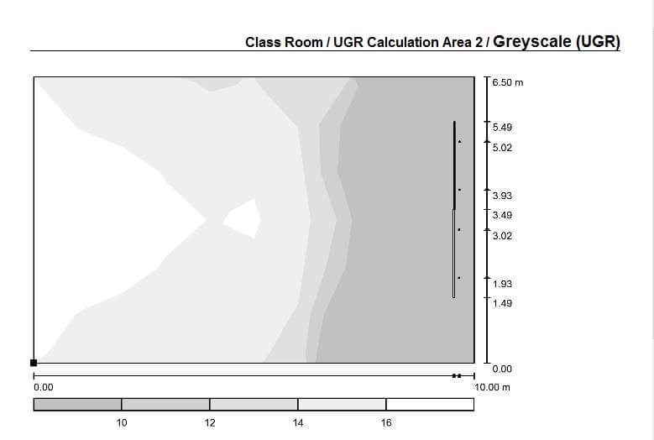
Electrical Design
URG

Slide 41
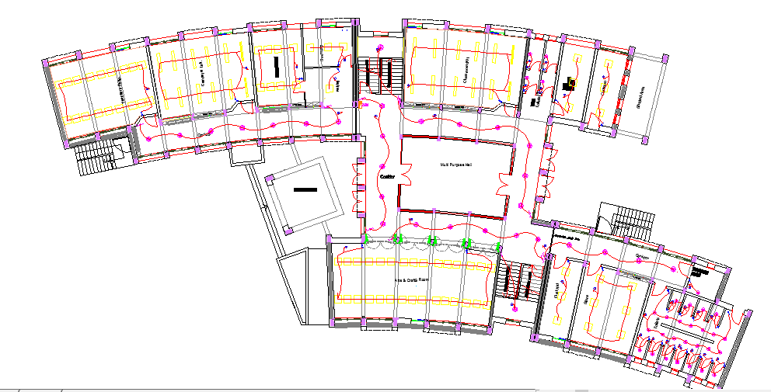
Electrical Design
GF lighting plan

Slide 42
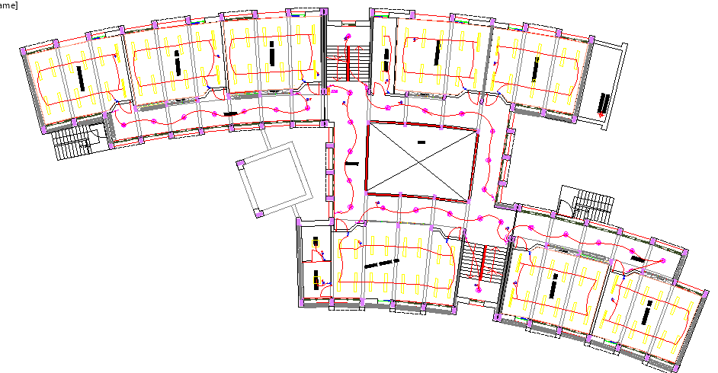
Electrical Design
First Floor lighting Plan

Slide 43
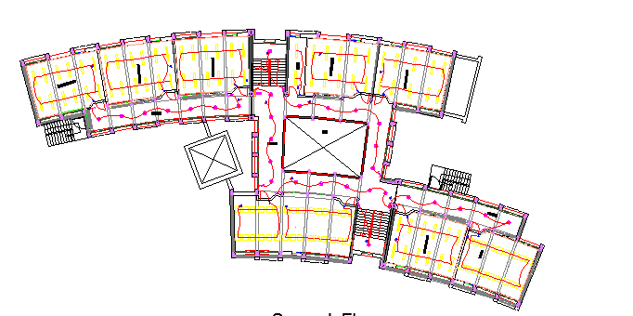
Electrical Design
Second Floor lighting Plan

Slide 44
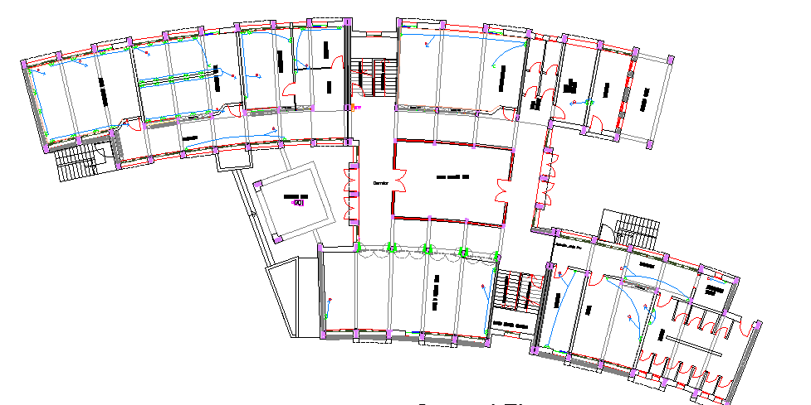
Electrical Design
GF Socket Plan

Slide 45
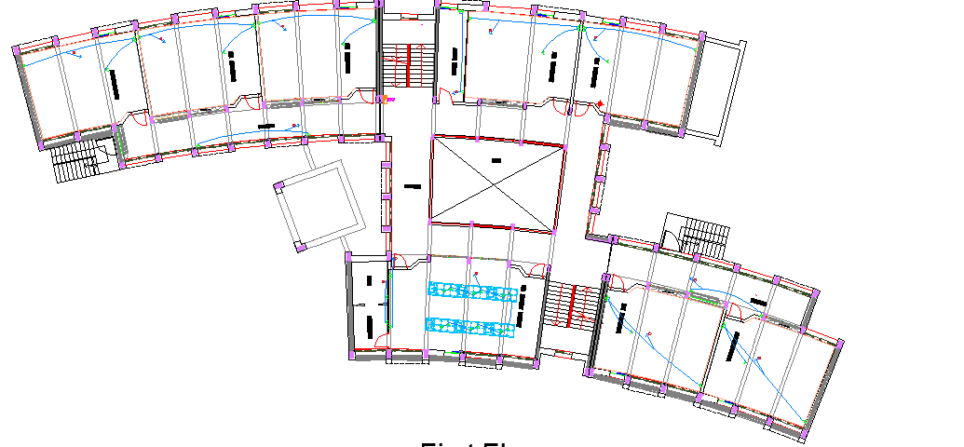
Electrical Design
First Floor Socket Plan

Slide 46
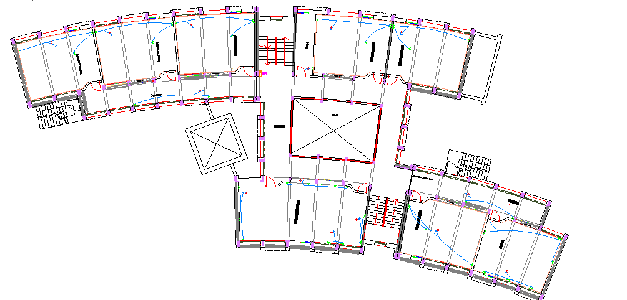
Electrical Design
Second Floor Socket Plan

Slide 47
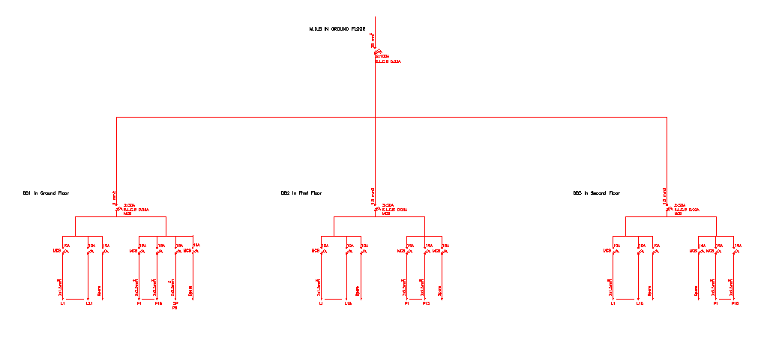
Electrical Design
Circuit Breaker

Slide 48
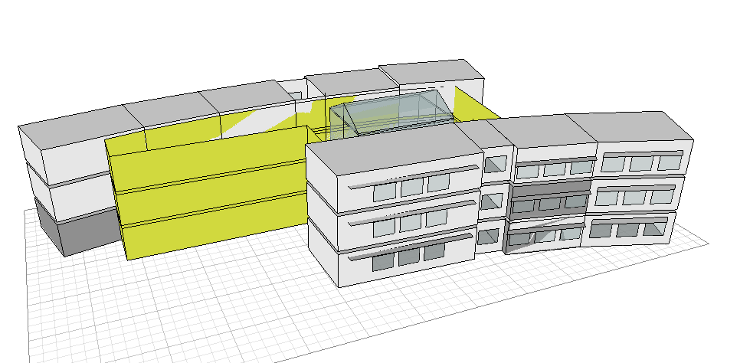
Environmental Design

Slide 49
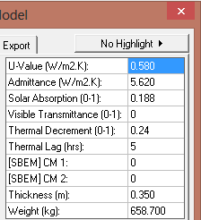
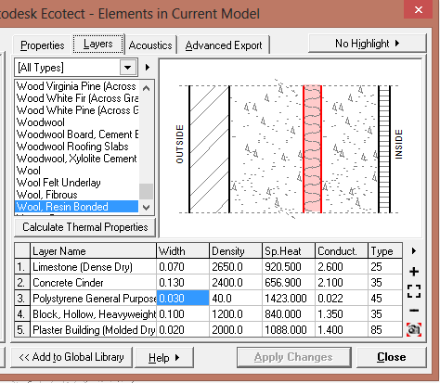
Environmental Design
U- Value For External Walls

Slide 50


Environmental Design
U- Value For The Roof

Slide 51

Environmental Design
Daylight Factor In at the South After Treating

Slide 52

Environmental Design
Daylight factor in the North After Treating

Slide 53


Environmental Design
Total Heating and Cooling Load

Slide 54


Environmental Design
Total Heating Load After Low E-Glass

Slide 55
Environmental Design
No. | Item | Description | Surface (m²) | α | Surface x α
1 | Ceiling | Acoustic Tiles | 47.36 | 0.45 | 21.31
2 | Seats | fabric-upholstered, fully occupied) | 1.40 | 0.93 | 1.30
3 | Desks | Wood: 3/8" plywood panel | 11.00 | 0.10 | 1.10
4 | Flooring | Tiles | 47.36 | 0.02 | 0.95
5 | Windows | (1/4" plate, large pane) | 9.00 | 0.02 | 0.18
6 | Doors | solid wood panels | 2.00 | 0.04 | 0.08
7 | Walls | Concrete block - painted | 86.40 | 0.09 | 7.78
8 | Chalk Board | solid wood panels | 3.00 | 0.04 | 0.12
 | ∑ |  |  | 1.70 | 33
RT60 = 0.16 x V / ∑A.
RT60 = 0.16x162.9/33.29 = 0.78.
From optimum reverberation time curve, the value should be between 0.5s-0.9s for the first range and between 0.6s-0.8s for the second range → RT60 is ok
RT60 Calculations

Slide 56

Environmental Design
For External wall with Windows:
Assume that wall is 300 mm dense weight block
→ STC = 53 dB.
Assume STC for the window = 26 dB.
TL1-TL2= 53-26 = 27 dB.
Area of windows/area of wall = 9/26.57= 34%
From curves → TL1-TLC = 22 →
53-TLC=22 → TLC= 53-22= 31 dB < 50 Not OK
Solution: Use acoustical window
TLC1-TLC2= 51-49 = 2dB
Area of windows/area of wall = 9/26.57= 34%
From curves → TL1-TLC =1 → 53-TLC=1 → TLC= 53-1= 52 dB OK
STC For External Wall

Slide 57
Environmental Design
*STC rating of masonry wall of 100 mm dense hollow block is 38 dB
* IIC check for the slab: one way ribbed slab with thickness = 200 mm ( 60 mm concrete and 140 mm hollow block) so the value of IIC was designed within the range from (60-70) and recommended IIC = 55 dB OK
New STC | Solution | STC Wall | Recommended STC | Next to | Room1
- | - | 38 dB | 38 dB | corridors | Classroom
42 dB | Plastering to both sides | 38 dB | 40 dB | Classroom | Classroom
45 dB | insulation adding + plastering both side | 38 dB | 45 dB | Teacher room | Classroom
STC And IIC

Slide 58

Environmental Design
Time Lag for concrete:-
Thickness = 0.13 m,
density = 2400 Kg/M³
From curve around 5 hours
http://www.new-learn.info/packages/clear/thermal/buildings/building_fabric/properties/time_lag.html

Slide 59
Environmental Design
PMV | PPD | date
-2.42 | 91 | 21-Jan
0.12 | 5.5 | 21-Feb
0.18 | 5.8 | 21-Mar
0.51 | 10.63 | 21-Apr
0.47 | 9.45 | 21-May
-0.19 | 10 | 21-Sep
0.44 | 46 | 21-Oct
0.18 | 9 | 21-Nov
0.46 | 7.8 | 21-Dec
PPD and PMV

Slide 60



Treating Of The Cubic Glass
For Covering: A 10 mm clear twin wall polycarbonate sheet is recommended
For Side Walls: Fabric Acoustic panels is recommended
For The Floor: Acoustical tiles is recommended with NRC = 0.45
The Old Rt60 = 3 Seconds New RT60 = 0.8 Seconds

Slide 61
Mechanical Design
Calculations
Total DFUs | No. of Kitchen Sinks | No. of Lavatories | No. of Water Closets | Floor
71 | 1 | 12 | 13 | GF
8 | 0 | 8 | 0 | First Floor
6 | 2 | 0 | 0 | Second Floor
85 |  |  |  | Total

Slide 62

Mechanical Design
DFU Plan

Slide 63

Mechanical Design
Sewer System on Site Plan

Slide 64

Mechanical Design
Sewer System For Lab.

Slide 65

Mechanical Design
Water Drainage Plan For GF

Slide 66

Mechanical Design
Water Drainage Plan For First Floor

Slide 67

Mechanical Design
Water Drainage Plan For Second Floor

Slide 68

Mechanical Design
Water Supply For GF

Slide 69

Mechanical Design
Water Supply For First Floor

Slide 70

Mechanical Design
Water Supply For Second Floor

Slide 71

Mechanical Design
Water Tanks Plan

Slide 72

Mechanical Design
Water Drainage System

Slide 73





Safety Design
Safety Fixtures

Slide 74

Safety Design
Safety Plan For GF

Slide 75

Safety Design
Safety Plan For First Floor

Slide 76

Safety Design
Safety Plan For Second Floor

Slide 77

Safety Design
Direction to Gathering Area

Slide 78
Total Cost
The Cost of 1 CM of concrete B300 = 300 NIS
The Cost of 1 ton of steel = 2800 NIS
The Cost of M² for finishing = 320 JD
The Total Cost of the Project around 2,025,000 NIS

Slide 79


