Slide 1
An-Najah National University
Faculty of Engineering
Civil Engineering Department
Seismic design for AL-Azizi building
Supervisor : - Eng. Ibrahim Arman
Prepared by: Abedallah Shurabi
Khaldon Dela’
Mohammed Malaysha
Wael Nasasrh

Slide 2
Outline
Abstract
Project description
Slab design
Beam design
Column design
Footing design
Shear wall design
Stairs design

Slide 3
Abstract
Al-Azizi Building represents the most common building in Nablus. A one way ribbed slab structural system will be analyzed and designed for seismic load, then a flat plate structural system analyzed and designed for same purpose, In the end an economic comparison between two designs will be made. As a result, a recommendation will be given for the most economic system.

Slide 4
Project description
Consist of six floors
The area of the base floor is 766m²
The height of the first floor is 6m
The area of the rest floors for each one is 760m²
The height of the rest of floors for each one is 3.4m

Slide 5
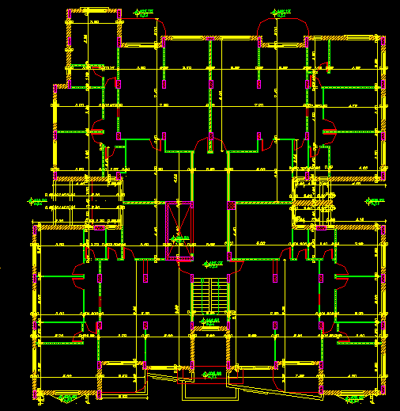

Slide 6
Codes and standards:
ACI 318-08
IBC 2006
ASCE 7-10
SI 413 (Israeli standards)
Notes:
*

Slide 7
Loads affecting the building
1-Gravity loads:
The superimposed dead load is 4.3KN/m²
The live load for basic floor is 2.5 KN/m²
The live load for the balcony is 5KN/m²
The Dead Load Calculated By SAP 2000

Slide 8
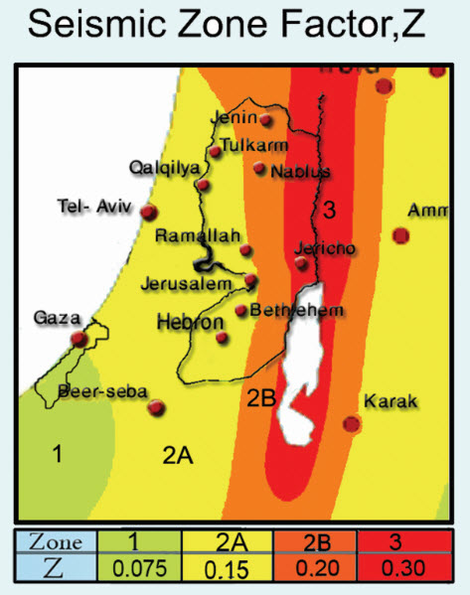
Loads affecting the building
2-Lateral loads:
Seismic map of Palestine

Slide 9
Loads affecting the building
2-Lateral loads:
The seismic zone factor, Z = 0.2
The soil type is soft limestone, soil class C
The importance factor, I = 1
The ductility factor, R = 5(One way ribbed slab)
The ductility factor, R = 3(Flat plate slab)
The system over strength , Omega = 3(both systems)
Deflection Amplification , Cd = 4.5 (One way ribbed slab)
Deflection Amplification , Cd = 2.5 ( Flat Plate slab)

Slide 10
Loads affecting the building
2-Lateral loads:
The spectral acceleration coefficients :
S_{S} = 2.5*Z = 0.5
S₁ = 1.25*Z = 0.25

Slide 11
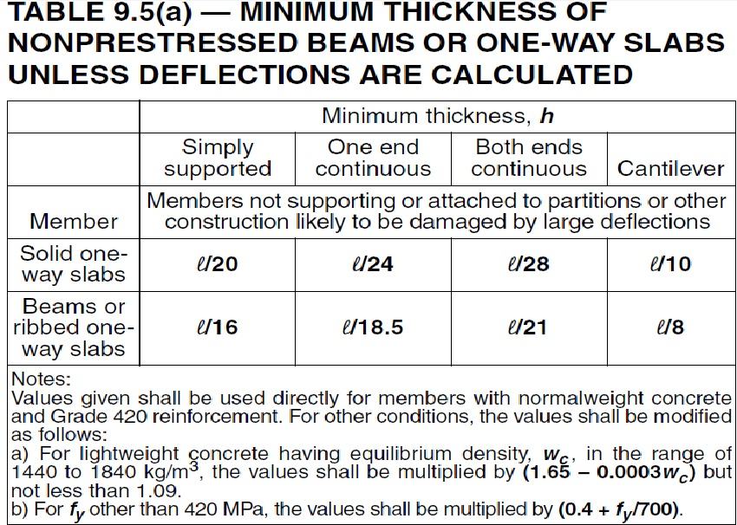
One way ribbed slab
Slab thickness:
Slab thickness =6. 15/18.5=0.33m (assume 0.36m)

Slide 12
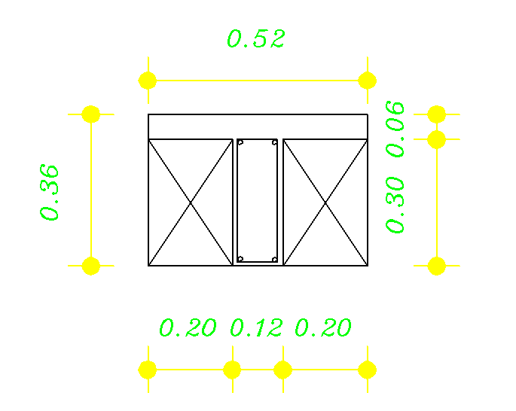
Cross section in rib

Slide 13
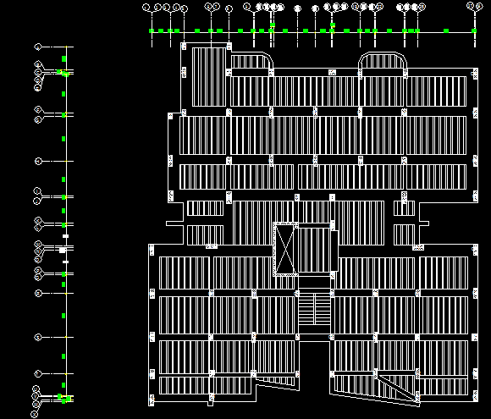
Typical floor framing plan

Slide 14
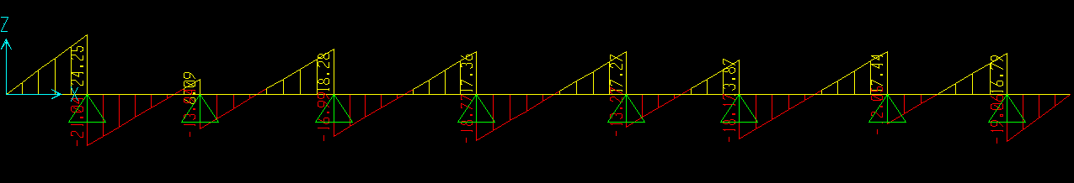

Check shear for slab:
ΦV_{c} = 25 KN
V_{u}= 20.97 KN
V_{c}>V_{u} → ok

Slide 15
Shrinkage steel for slab:
As = 0.0018*b*d
As = 0.0018*1000*60 = 141mm²
Use 3 Ø 8 /m

Slide 16
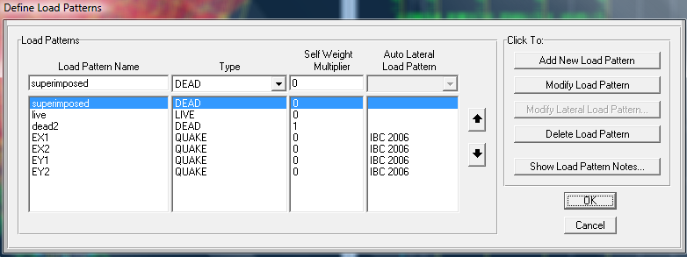
Three Dimensional Analysis and design
Define load patterns
Gravity Load
Seismic Load

Slide 17
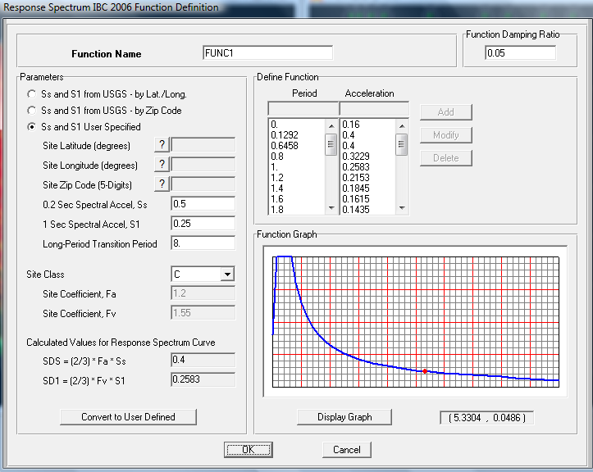
Response spectrum function

Slide 18
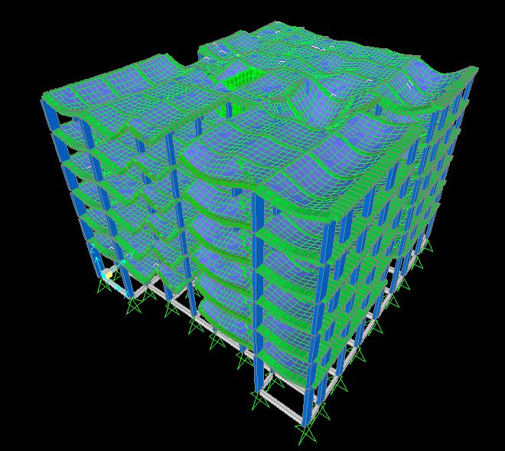
Checks
1) Compatibility Check

Slide 19
2) Equilibrium Check
1.Superimposed Dead Load
By Hand 4.3*4555.8=19589.94 KN
By SAP =18762.089 KN
% of Error =4.41% < 5% ... OK

Slide 20
2) Equilibrium Check
2. Live Load
By Hand
Basic floor = 2.5*4155.12=10387.8KN
Exterior balconies =5*400.68=2003.4KN
By SAP = 11909.947 KN
%error = 4%<5% OK

Slide 21
2) Equilibrium Check
3. Dead load
By Hand=56742. 58KN
By SAP =54455.45KN
% error=4.2% < 5% ok

Slide 22
3)Seismic check
Base shear
1) V = Cs W = 4822.84KN (By Hand)
V = 4823.29 (By SAP)
We have Error = 0.0093% < 5% → OK
2) Time period
T=Ct*hn^{x} =0. 04666*23^{0.9}=0.7843 Sec

Slide 23
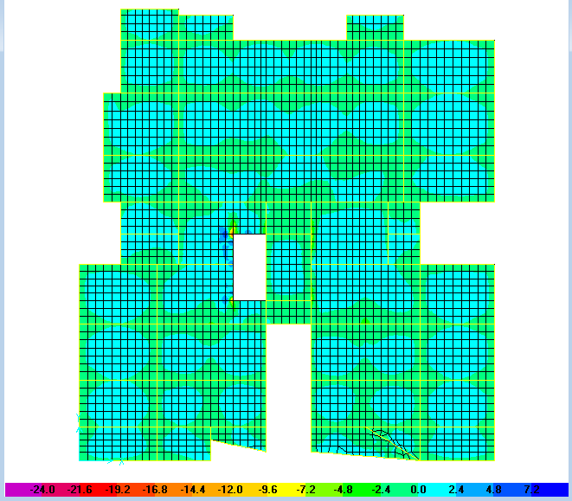
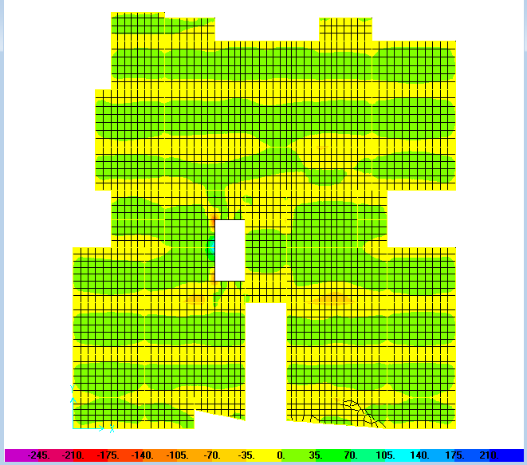
Slab Analysis:
Moment diagrams for slab
Bending moment for first slab in X-direction
Bending moment for first slab in Y-direction

Slide 24
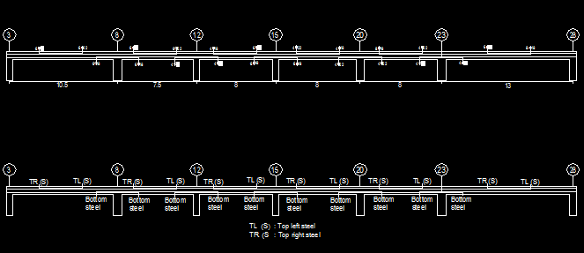
Beam details

Slide 25
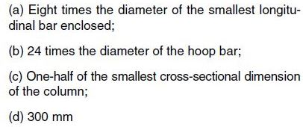
Column Data
The project consists 64 columns with different dimensions and directions
1% ≤ steel ratio ≤ 8% for economic consideration
Lateral reinforcement for columns
Spacing So shall not exceed the smallest of :

Slide 26
Column Reinforcement
Column | Section(cm) | Longitudinal reinforcement | Lateral reinforcement At the middle At the end
C1 | 30*50 | 8 Φ16 | 1 Φ10/16 | 1 Φ10/12
C1` | 30*50 | 10 Φ20 | 1 Φ10/16 | 1 Φ10/12
C2 | 30*90 | 14 Φ16 | 2 Φ10/16 | 2 Φ10/12
C3 | 40*60 | 12 Φ16 | 2 Φ10/16 | 2 Φ10/12
C4 | 60*40 | 12 Φ16 | 2 Φ10/16 | 2 Φ10/12
C5 | 40*80 | 16 Φ16 | 2 Φ10/16 | 2 Φ10/12
C6 | 40*100 | 20 Φ16 | 2 Φ10/16 | 2 Φ10/12
C7 | 100*40 | 20 Φ16 | 2 Φ10/16 | 2 Φ10/12
C8 | 30*70 | 12 Φ16 | 2 Φ10/16 | 2 Φ10/12

Slide 27
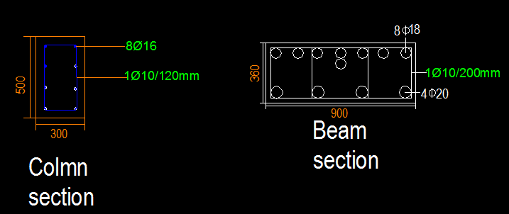

Slide 28
Footing analysis and design
Type of footing:
First the expected area of footing calculated as follows Σ Pservice / qall.= 110030.5 / 250 = 440.122 m2 The ratio of area calculated to the plan area = (440.122 / 750) 100 % = 58.69 % > 50 %
Based on this result a mat foundation selected.

Slide 29
The depth of footing “h “
We assume d= 700 mm and h = 800 mm for mat foundation
Thickness checks:
Wide beam shear check
ɸ Vc = 0.75 * 280.5 * 1000 * 700 / 6 * 1000 = 463 KN
From SAP Vu = 432 KN < 463 KN → OK

Slide 30
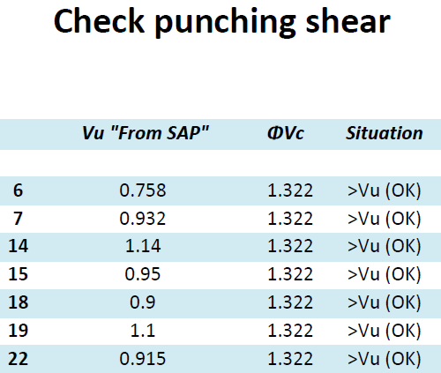
2) Punching shear check
ɸ Vc = 0.75 * 280.5 / 3 = 1.322 MPa
This value compared with stress for column as shown in Table 1, from the table all the
results are ok so the punching is ok.

Slide 31
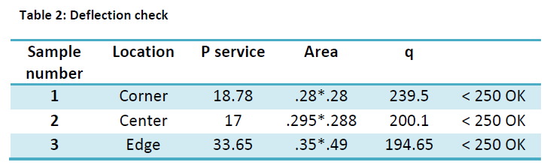
Check q (Bearing Capacity)
qall = 250 KN/ m2, seismic service load used to check because it is the critical case,
Table 2 shows the results of a sample reading for the check.

Slide 32
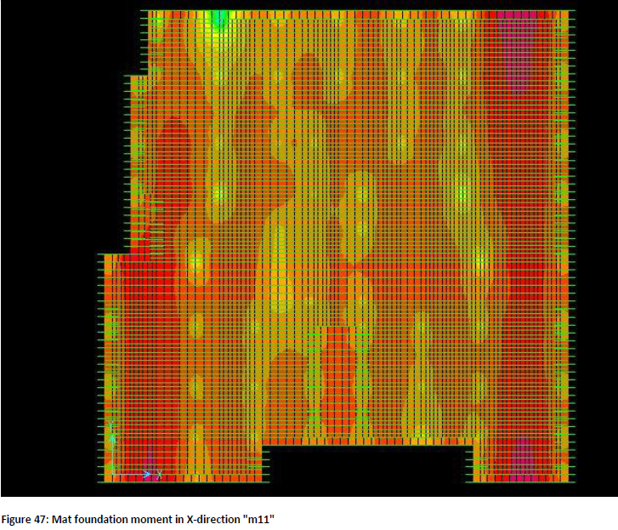
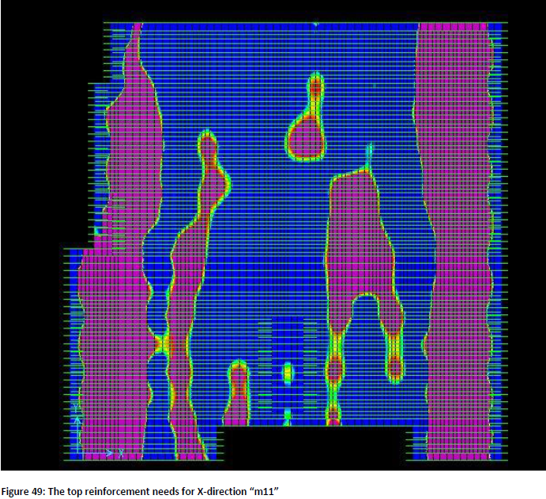
Mat Foundation Design

Slide 33
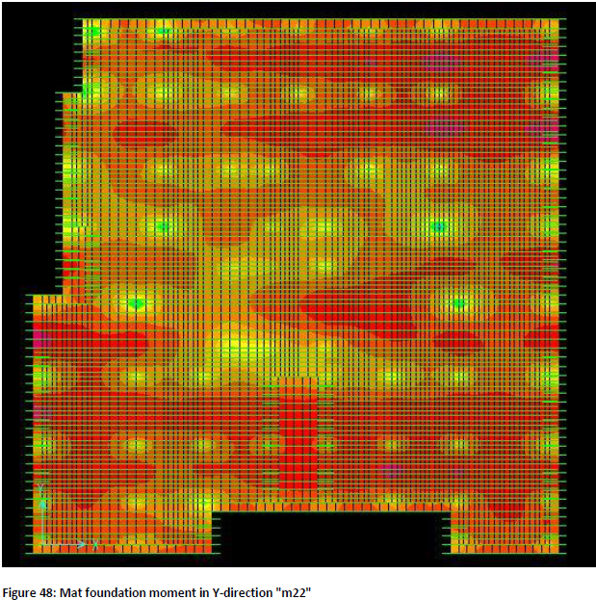
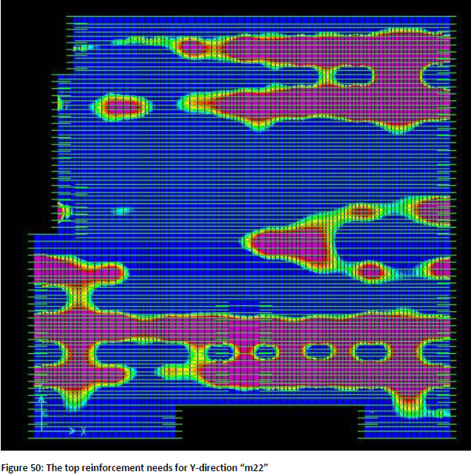

Slide 34
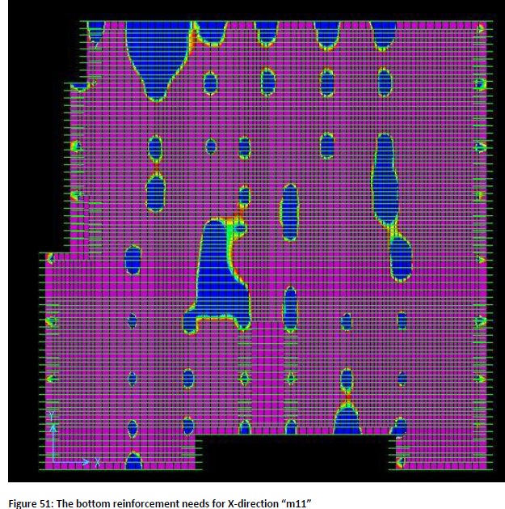
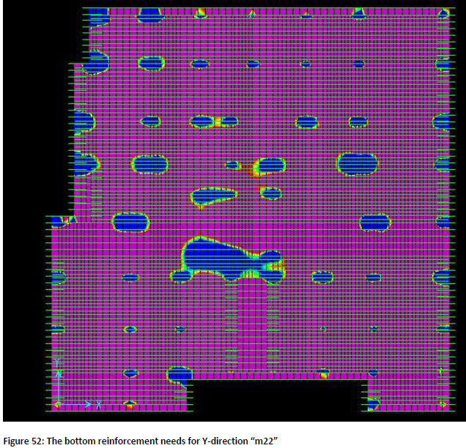

Slide 35
Check slab thickness
From the architectural plan the maximum span length L = 6.15m
Hmin1 = (6.15-0.2-0.15) /33 = 0.176 m
Assume slab thickness h = 0.2 m and d = 0.16 m
Wu slab = 1.2* (5 + 4.3) + 1.6 (2.5) = 15.16 KN/m2
Wu balcony = 1.2 (5 + 4.3) + 1.6 (5) = 19.16 KN/m2

Slide 36
Check slab thickness
- Check for wide beam shear
ΦV_{C} =98 KN
V_{u slab} =41.54 KN < 98 KN→ OK
V_{u balcony} = 52.5 KN < 98 KN → OK
Check punching shear
Vc= 0.33 f_{c}^{0.5} = 1.616 MPa
Vu= 1152.62/1000 KN/m2 = 1.15 Mpa
Vn = Vu / ɸ = 1.15/0.75 = 1.53 < 1.616 OK
So there is no need for reinforcement for punching shear.

Slide 37
Equilibrium check
1.Superimposed Dead Load
Hand calculation = 4.3 * 4555.8 = 19589.94 KN
By SAP = 18762.08 KN
% of difference = 4.41 % < 5 % →OK

Slide 38
Equilibrium check
2. Live load
By Hand Basic floor = 2.5*4155.12=10387.8KN
Exterior balconies =5*400.68=2003.4KN
Total = 12391.2 KN
By SAP = 11909.94 KN
% of difference =4% < 5 % →OK

Slide 39
Equilibrium check
3. Dead load
By hand= 39745.83 KN
By SAP = 41639.16 KN
% of difference =4.54% < 5% →OK

Slide 40
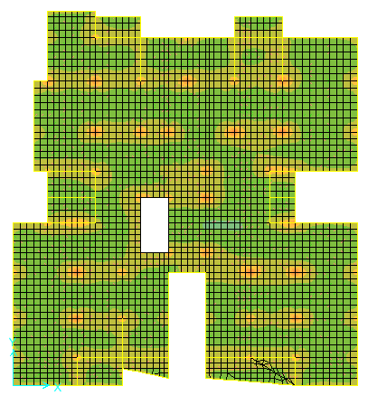
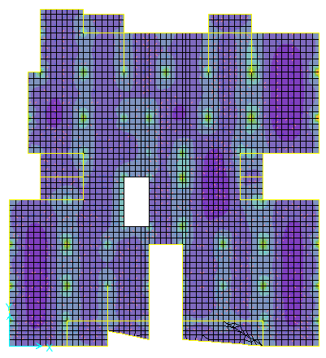
Bending moment for first floor slab in X-direction m11 Bending moment for first floor slab in Y-direction, m22

Slide 41
Beam reinforcement
Beam | Dimensions(mm) | Bottom steel | Top steel | Top steel | Shear reinforcement | Shear reinforcement
 |  |  | Left | Right | Middle | end
A | 250*750 | 6ɸ14 | 5ɸ14 | 5ɸ14 | 1ɸ10/100mm | 1ɸ10/100mm
B | 250*750 | 6ɸ14 | 10ɸ14 | 5ɸ14 | 1ɸ10/100mm | 1ɸ10/100mm
C | 250*750 | 7ɸ14 | 5ɸ14 | 8ɸ14 | 1ɸ10/100mm | 1ɸ10/100mm
D | 250*750 | 7ɸ14 | 7ɸ14 | 6ɸ14 | 1ɸ10/100mm | 1ɸ10/100mm
E | 400*350 | 4ɸ14 | 4ɸ14 | 5ɸ14 | 1ɸ10/100mm | 1ɸ10/100mm

Slide 42
Column reinforcement
Column | Section(cm) | Longitudinal reinforcement | Lateral reinforcement
C1 | 30*40 | 4 Φ20 | 1 Φ10/300
C2 | 30*60 | 6 Φ20 | 2 Φ10/300
C3 | 30*70 | 8 Φ20 | 2 Φ10/300
C4 | 30*80 | 8 Φ20 | 2 Φ10/300
C5 | 30*90 | 10 Φ20 | 2 Φ10/300
C6 | 40*90 | 12 Φ20 | 2 Φ10/300
C7 | 40*110 | 14 Φ20 | 2 Φ10/300
C8 | 110*40 | 14 Φ20 | 2 Φ10/300

Slide 43
Footing analysis and design
Type of footing:
First the expected area of footing calculated as follows Σ Pservice / qall.= 106811.3/ 250 = 427.25 m2 The ratio of area calculated to the plan area = (427.25 / 750) 100 % = 57 % % > 50 %
Based on this result a mat foundation selected.

Slide 44
The depth of footing “h “
We assume d= 600 mm and h = 700 mm for mat foundation
Thickness checks:
Wide beam shear check
ɸ Vc = 0.75 * 280.5 * 1000 * 600 / 6 * 1000 = 397 KN
From SAP Vu = 370.42 KN < 397 KN → OK

Slide 45
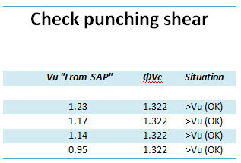
Punching shear check
ɸ Vc = 0.75 * 280.5 / 3 = 1.322 MPa
This value compared with stress for column as shown in Table 1, from the table all the
results are ok so the punching is ok.

Slide 46
Check q (Bearing Capacity)
qall = 250 KN/ m2, seismic service load used to check because it is the critical case,
Table 2 shows the results of a sample reading for the check.
Sample number | Location | P service | Area | Q
1 | Corner | 15 | .0625 | 240 | < 250 OK
2 | Center | 50 | .25 | 232 | < 250 OK
3 | Edge | 29 | .125 | 200 | < 250 OK

Slide 47
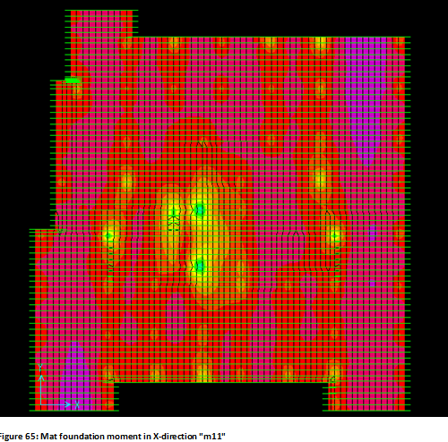
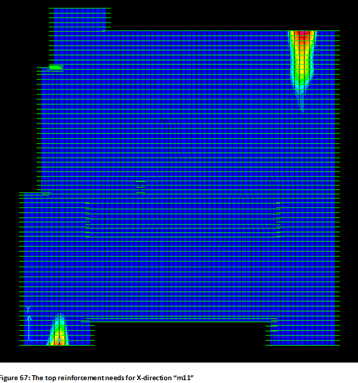
Mat Foundation Design

Slide 48
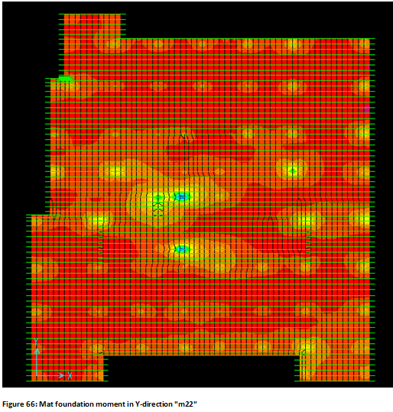
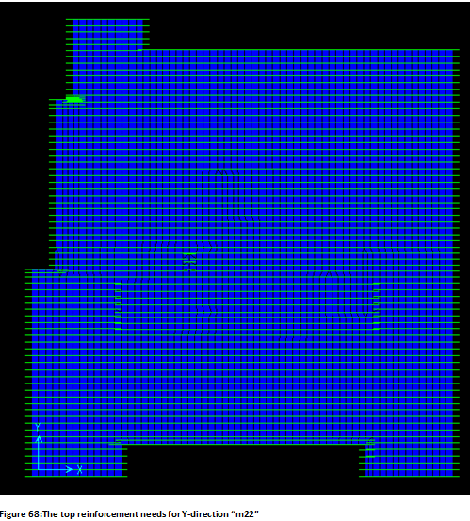

Slide 49
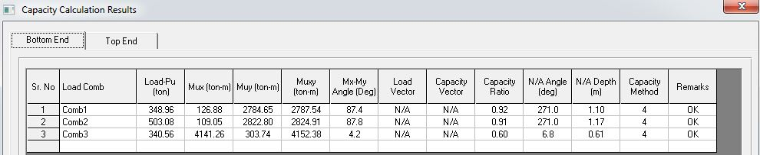
Shear wall design
CSI column program used to design the shear wall; the loads used for design are taken from SAP.
We assume Longitudinal reinforcement 1 Φ28/35 cm

Slide 50
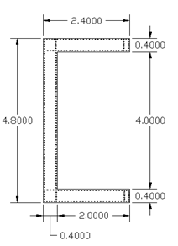
Shear wall transverse reinforcement
Transverse reinforcement in x-direction(2ɸ12/10 cm)
Transverse reinforcement in y-direction(2ɸ12/10 cm)

Slide 51
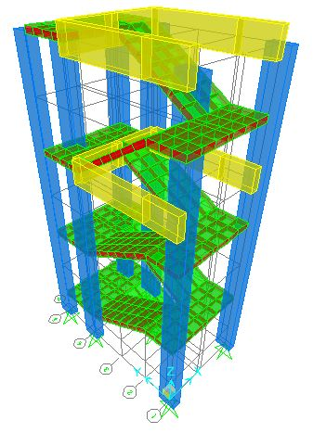
Stairs design
Stairs details
Concrete unit weight = 25KN/m³
fc = 28Mpa
Fy=420Mpa
Live load = 5 KN/m²
Superimposed dead load = 3 KN/m²

Slide 52
h_{min} = (1.1+2.7)/20 = 0.2m
Rise = 0.16 m and run = 0.3 m
Loading (Flight) W_{u} = 20.8*1.45 = 30.16 KN/m
Loading (Landing) W_{u} = 17.6*1.55= 27.28 KN/m

Slide 53
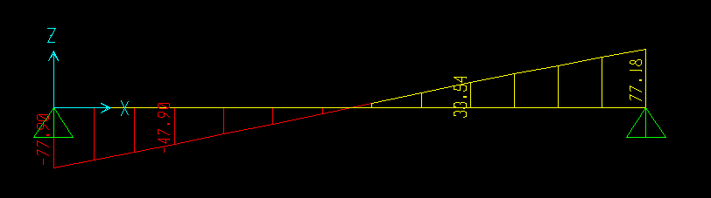
Check For Shear
V_{u} = 77.904 KN
ɸV_{c} = ((0.75/6)24^{0.5}(1450*160)/1000) = 142 KN> 77.904 KN→OK
Notes:
The thickness of the stair is adequate to bear beam shear without the need to shear reinforcement.

Slide 54
M_{u} = 106.54 KN.m
ρ = 0.006899 >ρ_{min} = 0.00333 →OK
A_{s} = 0.006899 *1450*160 = 1600.56 mm² (8Φ16)
For shrinkage reinforcement = 0.0018*1000*200 = 500 mm² (1Φ10/15cm)

Slide 55
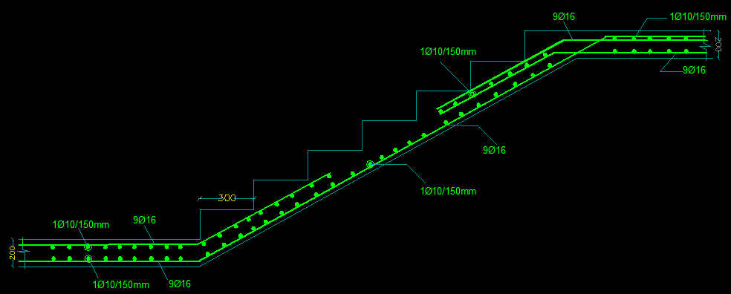
Stairs details

Slide 56
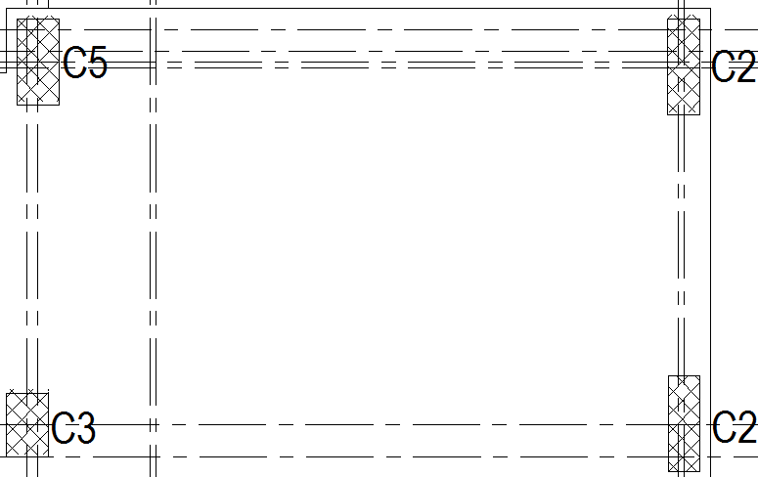
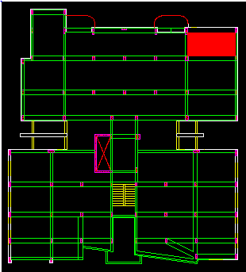
Comparison between two systems

Slide 57
Comparison between two systems
Comparison items | One way ribbed system | Flat plate system
Slab
1-Thickness | 36cm | 20cm
2- Own weight | 6KN/m²(per rib) | 5KN/m²
3-Concrete volume | 1.4 cubic meter | 4.12 cubic meter
4-Concrete weight for meter square | 1.7KN/m² | 5KN/m²
5-Steel weight | 156.5kg | 300.5kg
6-Reinforcement | T2ɸ12/B2ɸ12(Per rib) | T4ɸ12/B4ɸ12(In x and y directions)
Beams
1-Dimensions(L,W,D) | (6.2X.7X.36),(6.2x.9x.36) | (6.2x.25x.75),(6.2x.25x.75)
 | (4.2x.9x.36),(4.2x.4x.36)m | (4.2x.25x.75)m
2-Concrete volume | 5.56 cubic meter | 3.11 cubic meter
3-Steel weight | 515.42kg | 211.17kg
Columns
1-Dimensions(L,W,D) | (3.4x.3x.9),(3.4x.4x.8) | (3.4x.3x.4),(3.4x.3x.7)
 | (3.4x.4x.6)m | (3.4x.3x.5),(3.4x.3x.55)m
2-Concrete volume | 3.74 cubic meter | 2.19 cubic meter
3-Steel weight | 321.14kg | 205.7kg

Slide 58
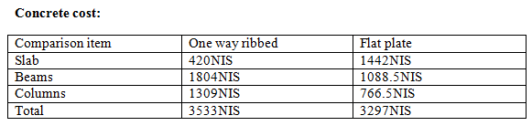
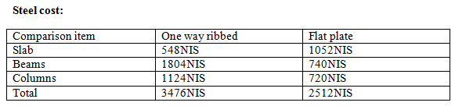
Comparison between two systems

Slide 59
Thank you

