Slide 1

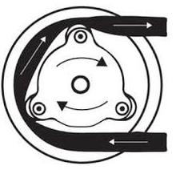
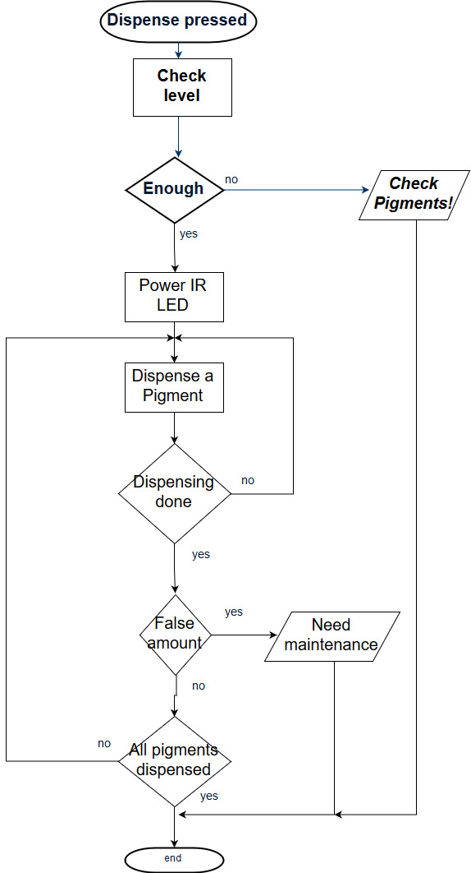
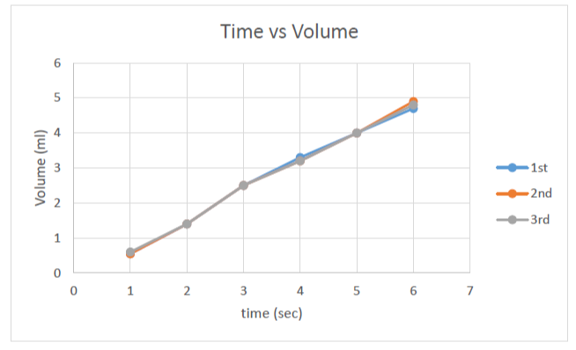
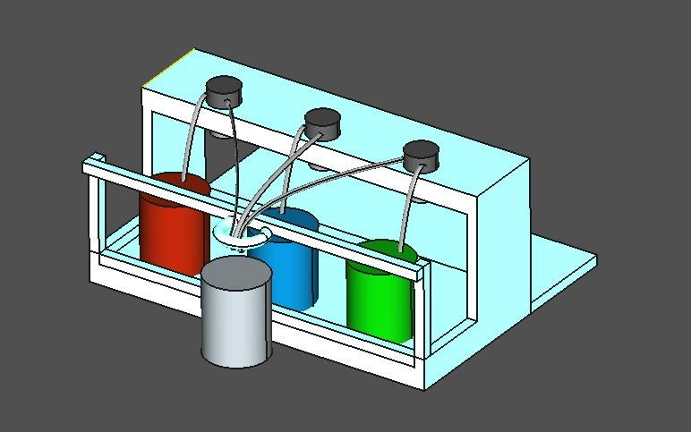
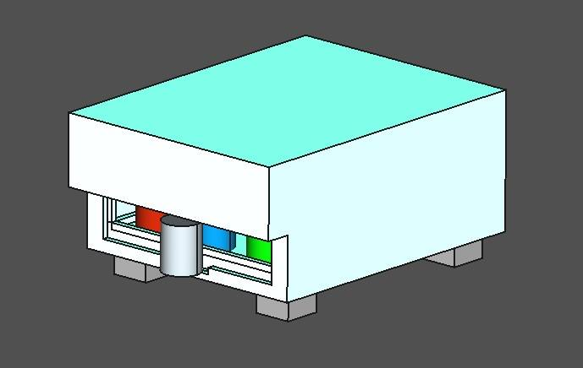
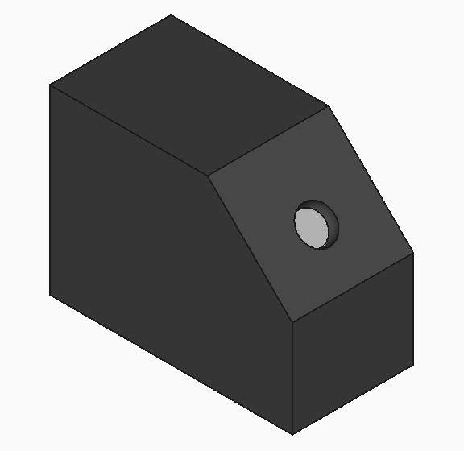
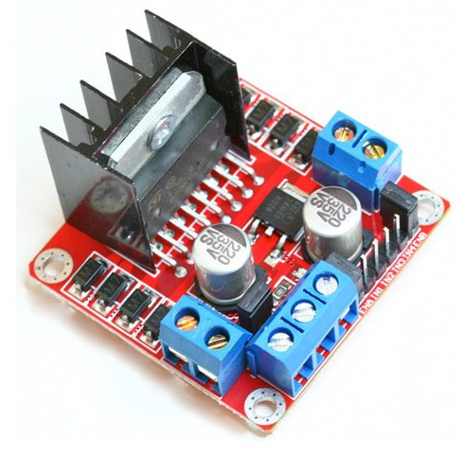
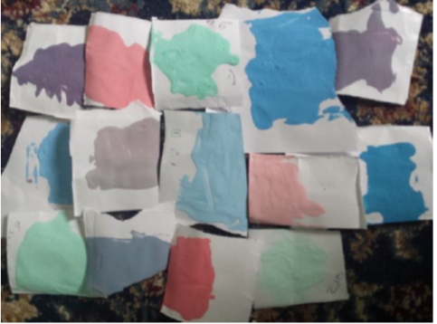
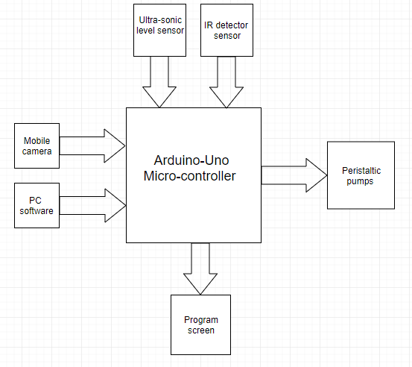
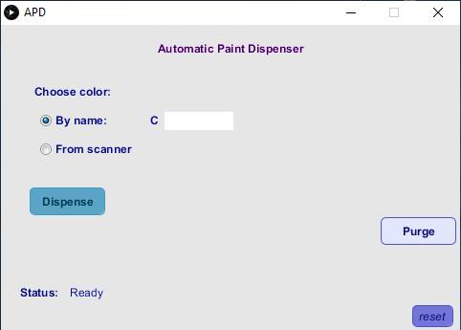
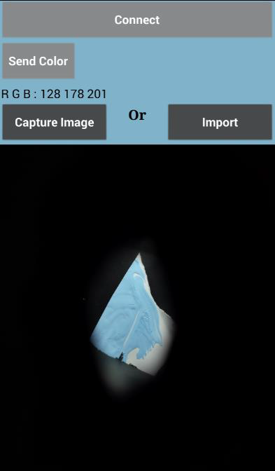

Automatic Paint Tinting Machine
An-Najah National university
By : Abdelrahman Sawalha , Abdallah N'irat , Mazin Adely , Mlaz Antar
Introduction
Dispensing Technique
Algorithm
A colored paint, is made by adding a small amount of pigments to a large amount of a base paint (ex: the conventional white paint). This Tinting process has been automated over time to achieve satisfying, accurate, and repeatable results. Today’s machines are very reliable, however, prices are very high (ex-factory prices start from 4700$). We’ve designed a prototype for a machine that can tint Interior wall base paint with commercial tints. Objectives, to make a machine that is:
- Cheaper.
- More reliable.
- With color matching scanner + mixer.
We used a Peristaltic pump connected with 12v DC motor because it is:
Accurate.
Easy to clean and maintain.
Reliable.
Perfectly work for dispensing.
Has high repeatability.
Pump characteristic:
Curve below shows the time working Vs. volume dispensed
The pooled standard deviation = 4.8% which indicates to its high repeatability.
After the user press the Dispense button in the GUI, the Arduino goes with the flowchart.
When the user uses the scanner, the RGB values may not be exactly as the ones defined in the catalogue. The error can be bypassed by finding the defined RGB values which are closest to the obtained, by finding the shortest Euclidean distance:
$$\sqrt{{(R−R_{i})}^{2}+ {(G−G_{i})}^{2}+ {(B−B_{i})}^{2}}$$
Where:
R: Is the red value obtained.
𝑅𝑖: Is one of the red value of the defined samples.
So the Arduino code does a linear search to find the shortest distance (closest color).
Project Overview
The machine has three canisters, each canister contains a pigment, and the canister has its own pump, the pump is a peristaltic pump head connected with a DC motor.
Catalogue fabricating
we’ve chosen 15 common colors to be the machine catalogue .
Color is specified by a worker, using a computer software, or a mobile application available for Android operating system. the mobile application is for color matching using the camera. then the computer software will control the pump to dispense the required amounts.
Catalog was made by :
1- Dispensing one pigment or combination of the three pigments on the base paint.
2- Shaking the mixture
3- Adding little amount of the mixture to a white card paper, and try to distribute it homogenously.
4- Place the paper in the scanning box, and obtain the RGB vales.
5- Tabulate the RGB values with name and the pigments amounts used.
6- Repeating until achieving 15 colors.
The mobile application must take a picture of the sample under certain illuminance, so we made a closed box to isolate the ambient light, and provided a lamp to achieve a constant illumination. The mobile phone will send the RGB values by Bluetooth to the computer software through the controller.
Motor Driver
To drive the pump motor we used ‘L298N H-bridge’ . Main specifications are:
Power Supply: DC 5 V - 35 V
Peak current: 2 A per motor
We supplied the driver with 19 volts DC, and by applying a PWM signal using MC, and with 2 volts drop in the driver, the motor receives 12 volts.
An ultrasonic sensor was added to the canisters to check the level of the pigments.
An IR LED with IR photodiode were added to form a feedback to check if the theoretical pigments dispensing time equals the actual.
Arduino UNO was chosen to control the machine.
A mixer is fabricated separately using a Universal motor with 30 volts supply.
Discussion
Controller
The peristaltic pump is the best-suited, available dispensing method. It is cheap and reliable. Even it has a disadvantage of the need to change the tube periodically.
The mobile as scanner is very helpful, very cheap and easy to use technique, but it has not enough reliability. In addition, if the user have a sample that is not defined earlier in the catalogue, the algorithm cannot provide its pigments ratios, because it’s very complicated to find the nonlinear relation between the pigments and the paint colors.
Arduino UNO was chosen for controlling the machine because of its great advantages:
Inexpensive.
Reliable.
Simple, clear programming environment, called Arduino IDE.
Open source
The job of Arduino is controlling the machine, by:
Controlling the motors of the pumps.
Connecting with the graphical user interface (GUI) or PC software.
Receiving data from the mobile application by using a Bluetooth module.
Powering and interfacing with the level sensor, which is the ultrasonic sensor.
Powering and interfacing with the IR LED and the IR photodiode.
Doing the calculations and checking as needed.
User Interface
Comparison with the available machines
To use the machine, the user can enter the chosen color code to the pc program, or he can use a mobile phone application that we developed for color matching.
In terms of accuracy, the available machine has more accuracy because of the pump technologies used, however, if we could use a stepper motor instead of a DC motor, the accuracy will be very similar.
Most machine needs periodical cleaning, because the pigments dries in the tubes and the purge process is wasteful since they have to dispense the pigments with no usage. But here, the pigments travel in the reverse direction, which is considered a big advantage.
This machine has a level sensor for canister, which we did not see any machine. And there is no machine contains Amount Verification
feedback. The IR feedback technique is not a full feedback for the amounts dispensed but it is a good indicator that everything happened, as it should.
PC Interface
The User simply chooses a color from the catalogue shown earlier, and enter its code in the program. Then the user can give the order of dispensing.
Program interface clarify machine status as shown.
Feedback System
Feedback contains two parts:
Economical outlook
1- Pigment level
The prototype cost was 217 ILS (56$) :
Used for checking the level of pigments if it is enough for dispensing.
Achieved by placing an ultrasonic module ‘HC-SR04’.
Its Working principle is that the module sends sound waves, after this wave reflects back ,the sensor gives a pulse for the MC, and the MC calculates the time between the transmission and receiving to calculate the distance.
Object | Cost | Object | Cost
3 Peristaltic Pumps | 90 ILS | Body design | 30ILS
3 canisters 100 ml | 3ILS | Arduino-Uno | 45LIS
2 H-bridges | 30LIS | IR detectors | 4ILS
Black box | 15ILS
Mobile Interface
The user must locate the sample in the black box, then, using the android app, he captures an image for the sample , the app will provide the RGB values of the sample, then the user may press send to send the RGB to the micro-controller.
We have estimated a complete machine cost, with stepper motors included instead of DC motors, with their drivers and accessories, and considering 12 bigger canisters and more electronics, all may cost 1500$ and is totally cheaper than imported machines (4700$).
2- Dispensed Amount Verification
When the user opens the app he should connect the app with microcontroller using Bluetooth, for that a Bluetooth module (HC-05) is connected with the microcontroller.
IR LED with IR receiver (Photodiode) are used to detect the pigment while it falling down from the tube to the base paint.
The time of detection of pigments should equal the working time of the motor which depends on the desired amount of pigments. The three tubes of the three canisters are aligned in line horizontally; the IR LED is fixed littlie lower at beginning of the line, and the receiver at the end of the line.
Conclusion
A reliable and cheap automatic paint tinting machine can be fabricated, with a GUI and a mobile application for color matching, In addition to a mixer to mix the mixture. But consider that we used commercial pigments. It can be compete with machines in the markets, but a limitation should be considered, is making a database of at least 1500 color with different base paints.

