Slide 1
Survivors Discovery Robot
By:
Hadeel Safa
Am
al Salawdeh
Supervisor:
Dr. Hanal Abu Zant

Slide 2
OUTLINE
What is Survivors Discovery Robot
Overview
Motivation
Components
Methodology
Constrains
Demo

Slide 3
What is Survivors Discovery robot?
Survivors robot is a vehicle designed to walk on rough area , and search for people who are still alive in destroyed areas or dangerous region

Slide 4
Overview
We take the project idea from Dr.manar ,the main point was how to design a car that can jump and walk through rough area .
The second point is what to do when the robot reach the specific area
The second part consist of two method:
Detect people using IR temperature
Detect people using image processing

Slide 5
Motivation
Recently, there have been many accidents, earthquakes and explosions, and the result of these accidents may be victims in large numbers.
It is safer to send robot to search for people who are still alive instead of you .
Safe time

Slide 6
Components

Slide 7
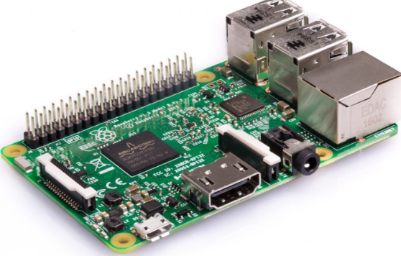
Raspberrypi 3.3 modle B

Slide 8
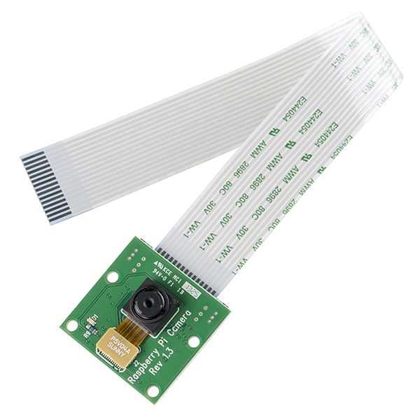
Raspberry Pi Camera Module

Slide 9
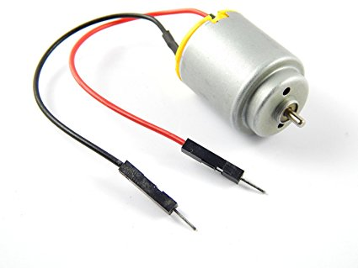
Dc motor

Slide 10
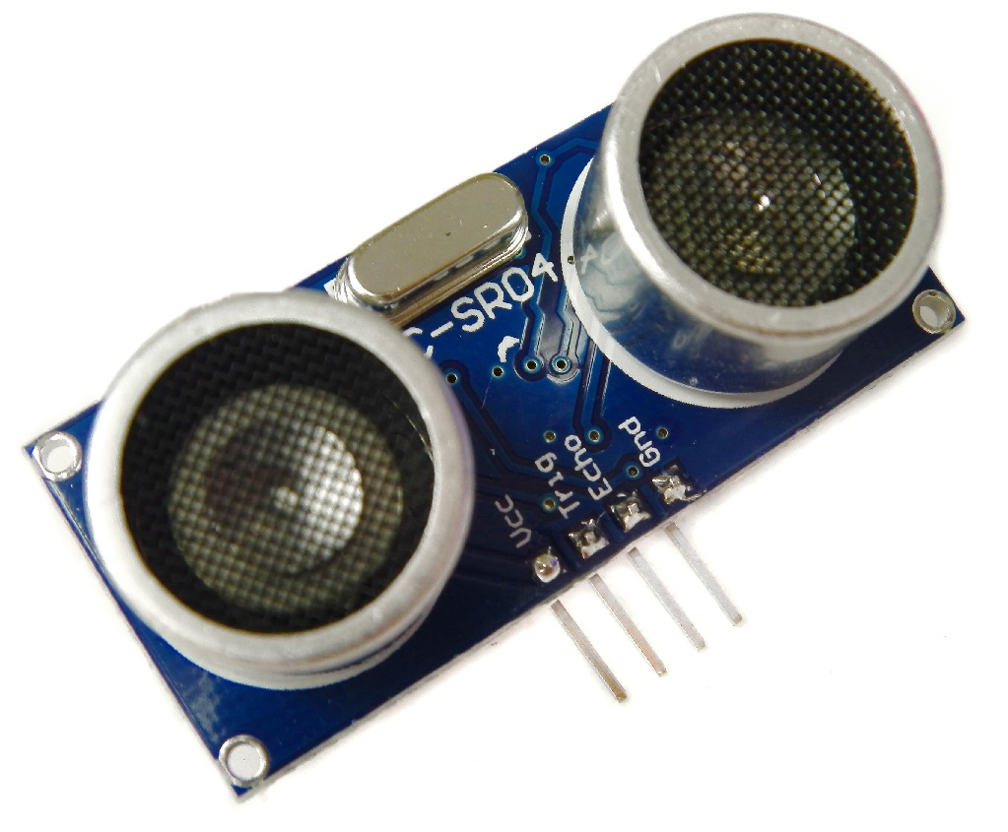
Ultrasonic Sensor

Slide 11
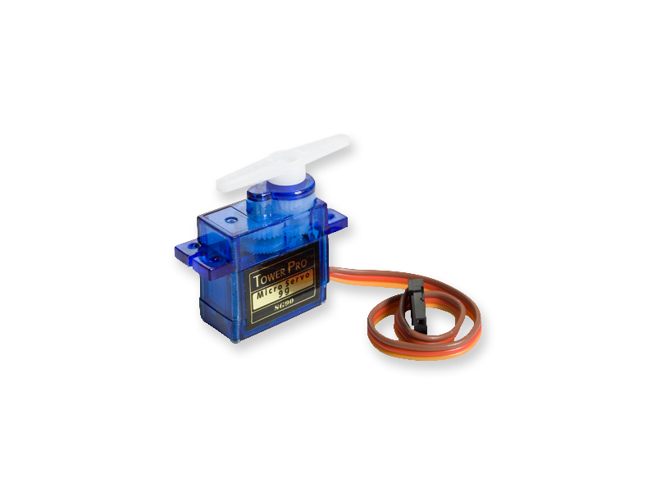
Servo motor

Slide 12
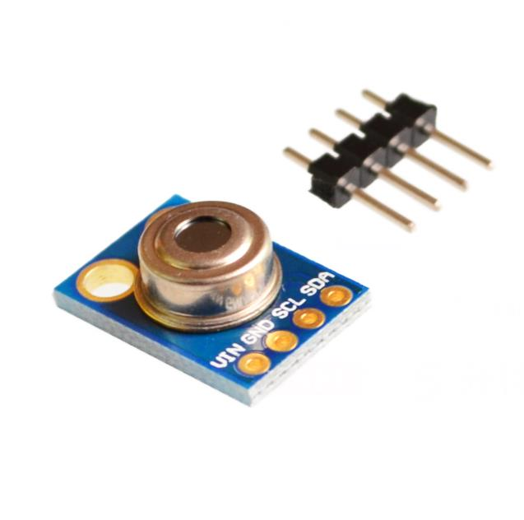
GY-906 Infrared Temperature Sensor

Slide 13
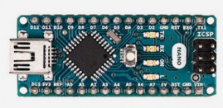
Arduino Nano:

Slide 14
Methodology
Project main parts:
Movement of the Dc motors and detecting obstacles using ultrasonic range detectors
Video live Streaming ,record video , take picture by Raspberry Pi Camera
Detect survived people using Gy-906 sensor
Detect survived people using image processing

Slide 15
Car Movement
Car Arms
The car wheels are designed from specially designed rubber so make it easy to walk on the rough area So that each wheel is fixed on the end of the arm, the arm can wrap 360 and at the middle of it we connect dc motor which is also connected to gears with different sizes ,so when the dc motor operate the gears turns and so the wheels

Slide 16
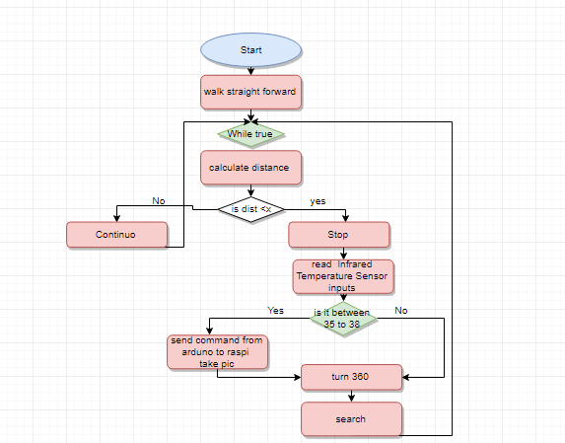

Slide 17
Video live Streaming
it become necessary to stream live video so we can see where is the car located. In addition to recording video and taking picture.

Slide 18
Servo with Camera
The camera turn 180 degree when the car flip over , So that this is controlled by connecting the camera to a servomotor which wraps at certain angles, so the camera will still take the video on the right direction

Slide 19
Detect survived people using Gy-906 sensor
if the sensor measure a temperature in the range (35 to 38 C), it send the data to Arduino and then the Arduino send it serially to the Raspberry Pi
To take picture .

Slide 20
Bluetooth
Automatic system: it find the route without user control.
User control: according to smart phones Bluetooth, Blue Term program was used in a manner to deal with our automated robot car from outside by smart phones.

Slide 21
Image processing
We use image processing to detect faces for more accuracy ,on normal way the camera is recording video when it detect a face it surround it with a square and take apic then save it

Slide 22
Constraints
with Raspberry Pi need a separate screen , keyboard and mouse so the working hours on the project was most of the time inside the university Labs.
the accuracy of the sensors that we used in the project was bad and the alternatives need a long time to arrive.
Project sensors took time until it was available.

Slide 23
Future Work
Improve the image processing part of the project
Improve the car movement

Slide 24
Demo

