Slide 1
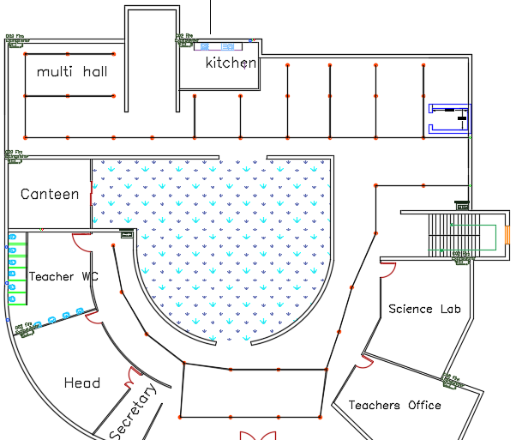

Design for school building
An-Najah National University
Faculty of Engineering & Information Technology
Department of Building Engineering
Prepared By:
Hani shkarnah
Supervisor: Eng. Monther dweikat

Slide 2
Contents:
Site analysis
Architectural Design
Environmental Design
Structural system Design
Electro-Mechanical system Design
Quantity Survey and Cost

Slide 3
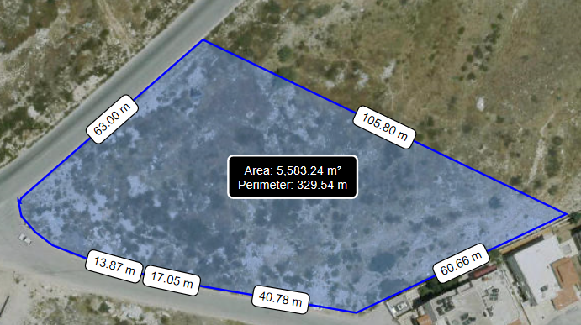
Architectural design
Site analysis
The site is located in maajeen east of Nablus, about 660 m above sea level and 2 kilometers away from city center. Site has a total area of 5583 m2.

Slide 4
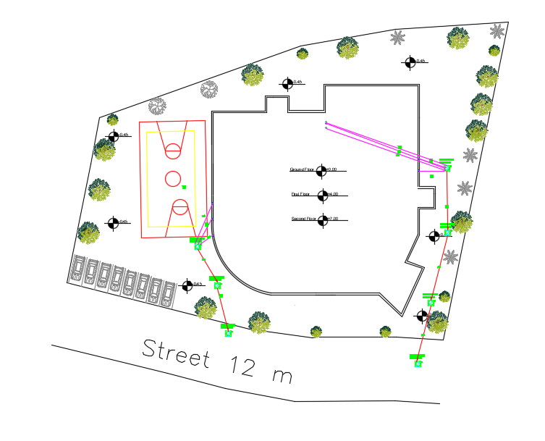
Site analysis

Slide 5
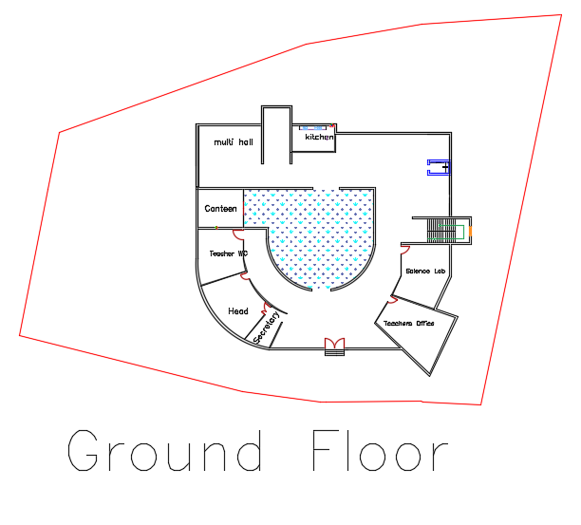
Ground Floor

Slide 6
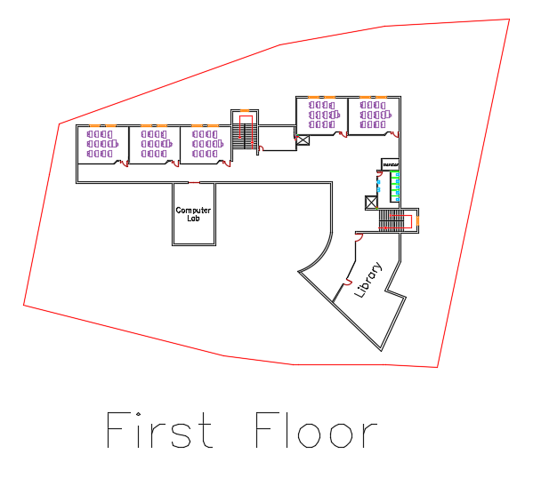
First Floor

Slide 7
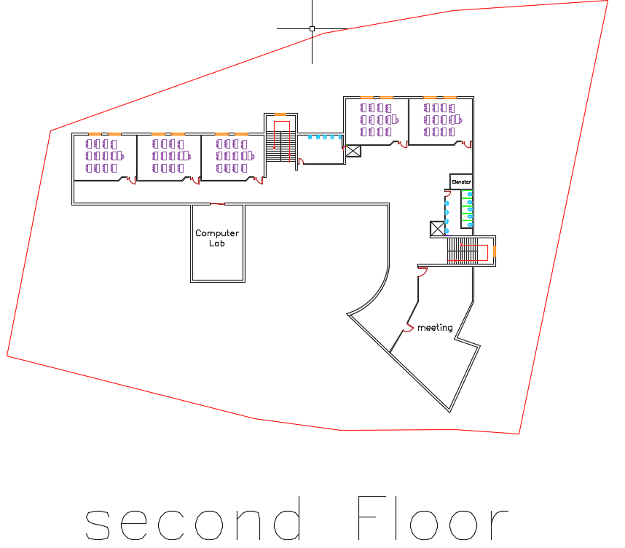
Second Floor

Slide 8
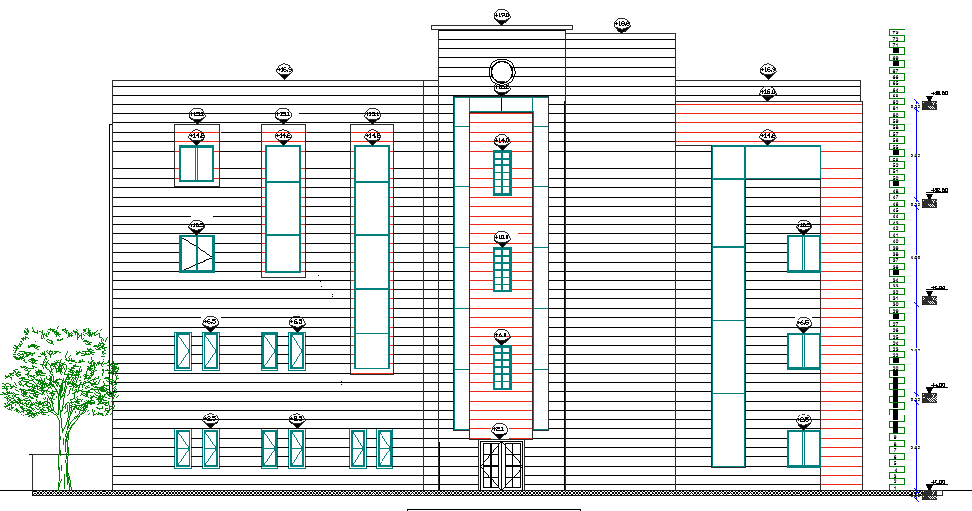
Southern Elevation

Slide 9
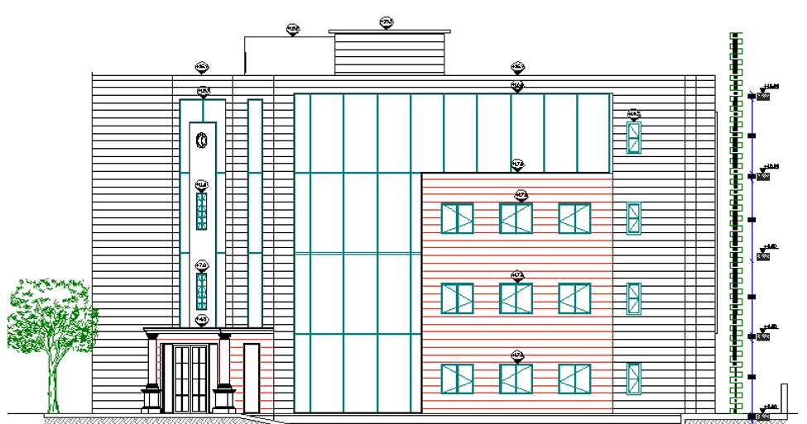
Northern Elevation

Slide 10
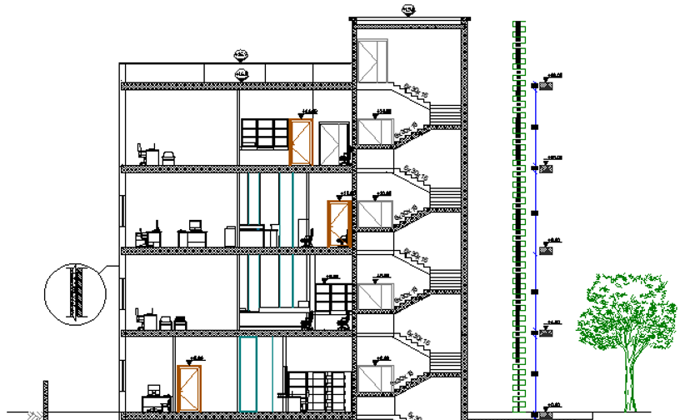
Section A-A

Slide 11
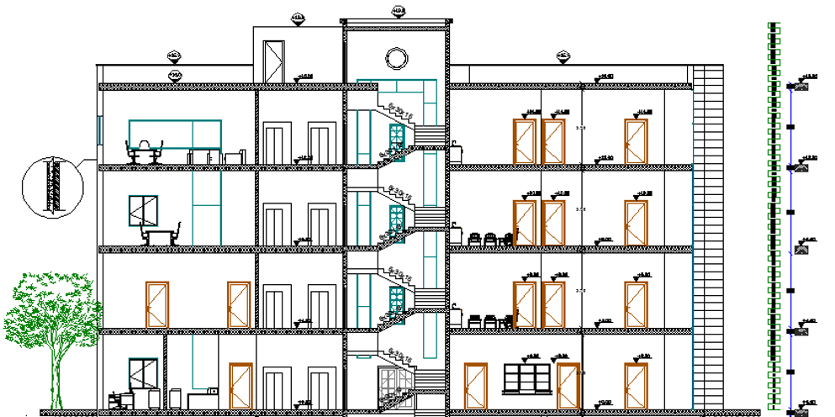
Section B-B

Slide 12
Environmental Design
New U value for building envelope
Component | U-value (w/m²-k)
External Wall | 0.492
Partition Wall | 2.585
Floor | 0.487
Roof | 0.498
Windows (Double glass, low e, 6 mm) | 1.493

Slide 13
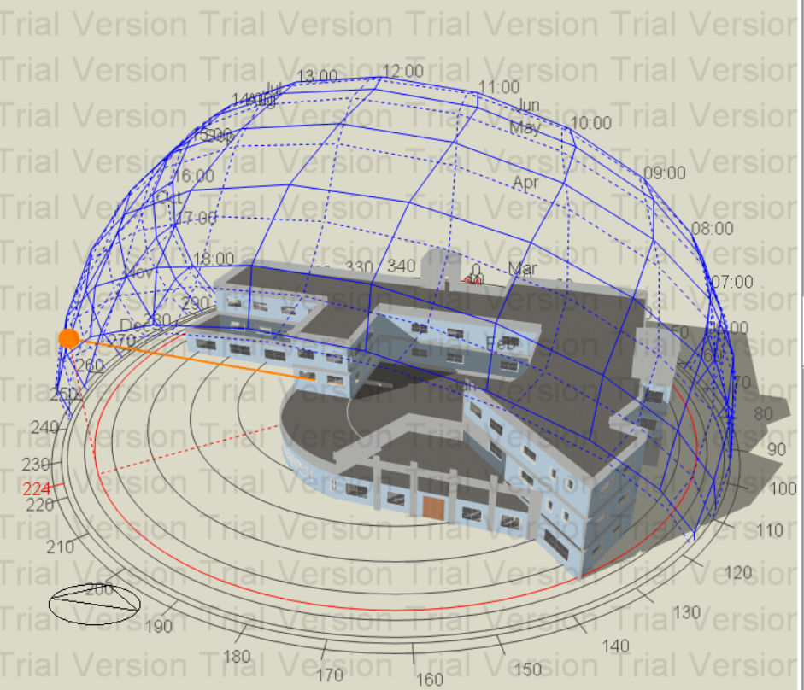
Shading
Design Builder program ( 3D Model )

Slide 14
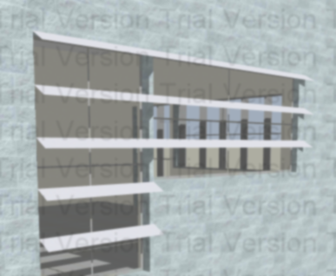
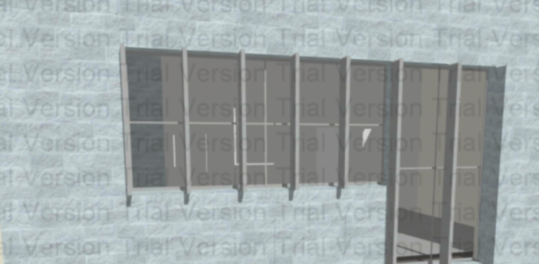
Shading
Southern windows (horizontal Louvers)
Eastern windows (vertical shutters)

Slide 15
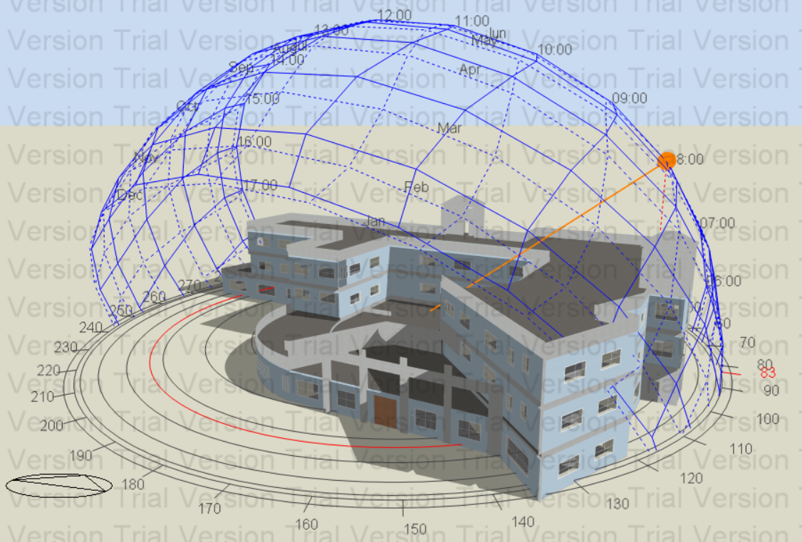
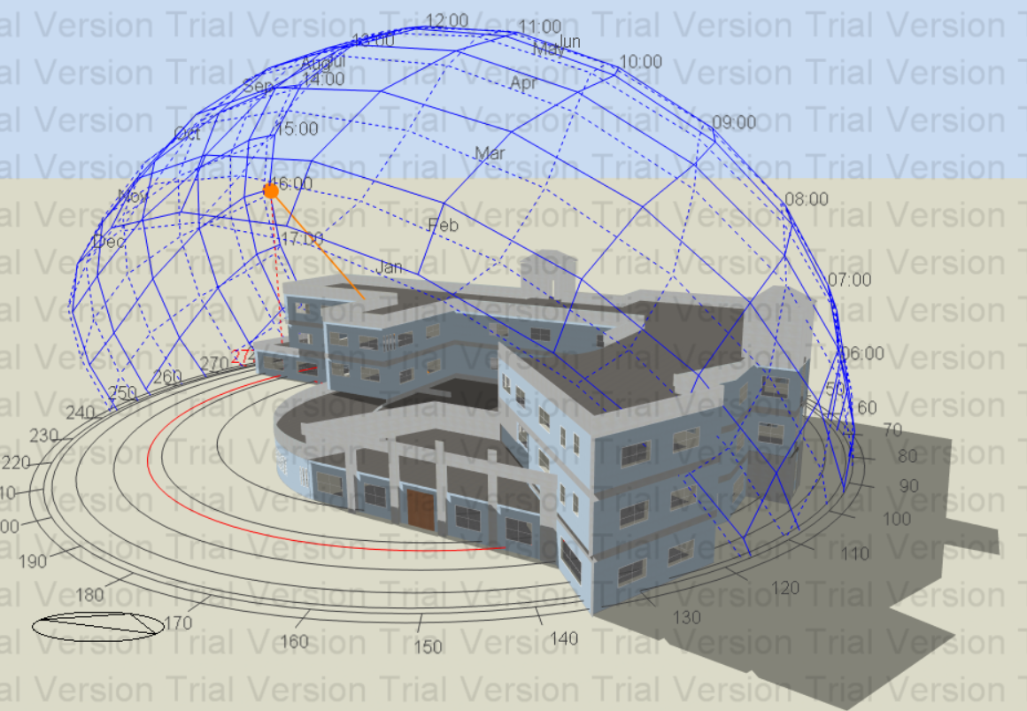
Shading
Summer day (sun path 21/6 at 8:00 am )
Summer day (sun path 21/6 at 2:00 pm )

Slide 16
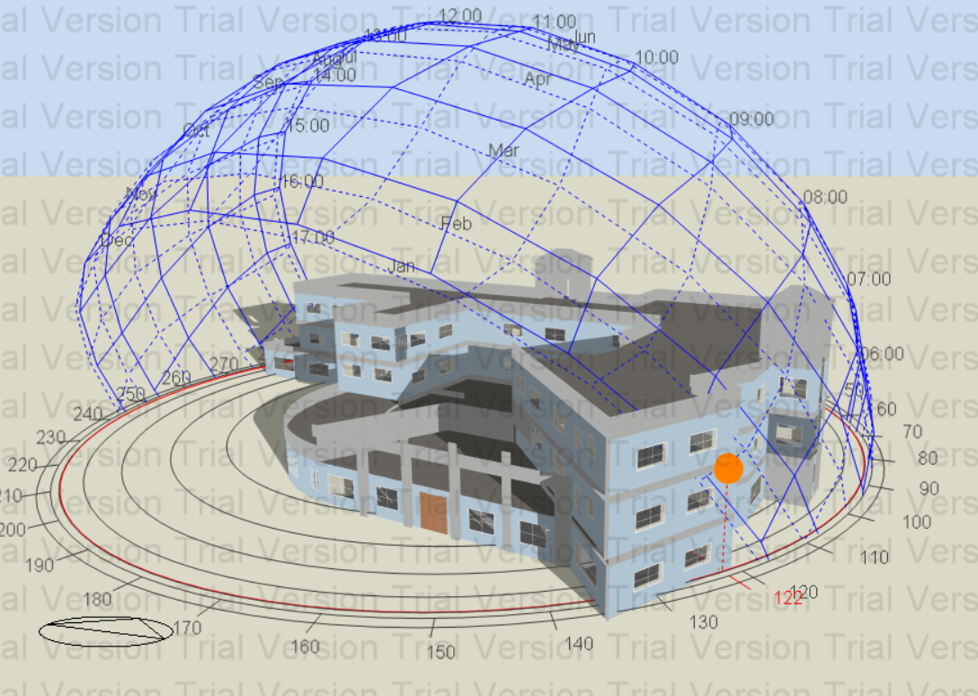
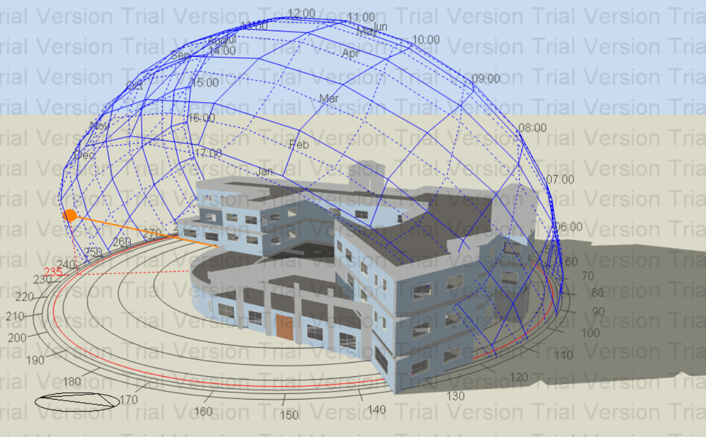
Shading
Winter day (sun path 21/1 at 8:00 am )
Winter day (sun path 21/1 at 2:00 pm )

Slide 17
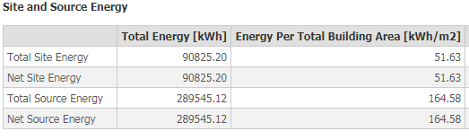
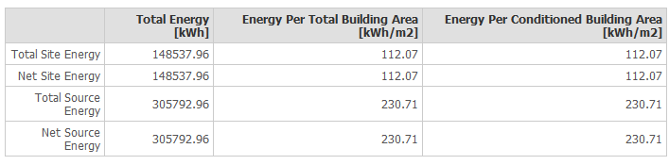
Thermal Design
Heating and cooling load
Cooling load 77.4 kw
Heating load 41.9 kw
Site and Source Energy
Old total site energy
New total site energy

Slide 18
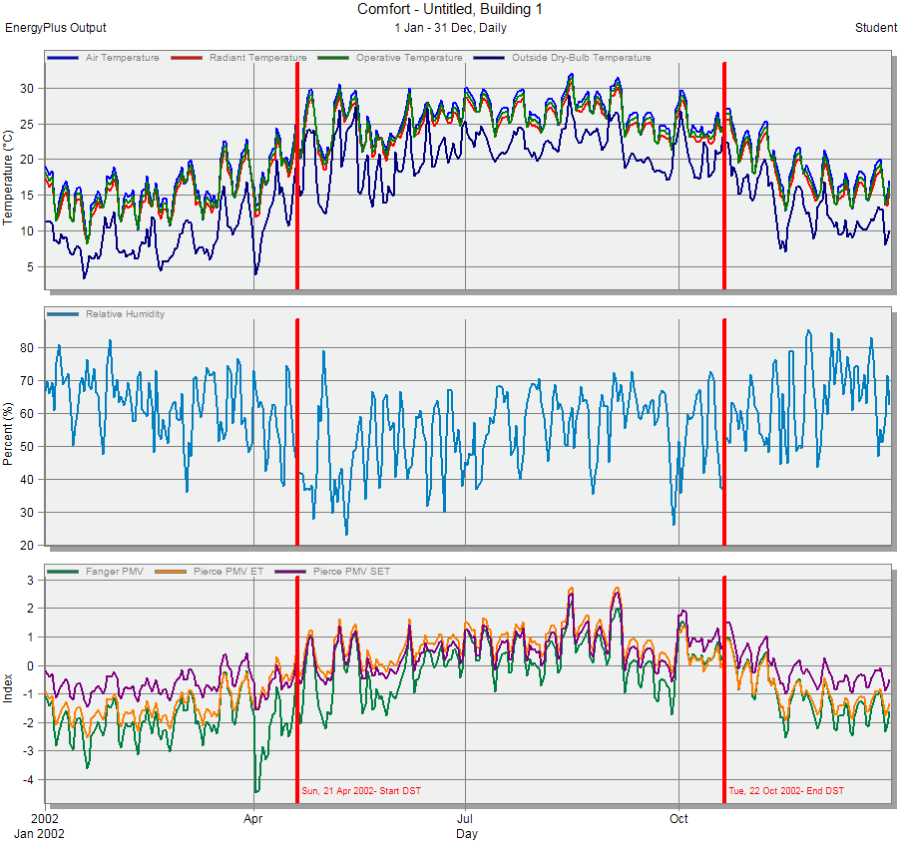
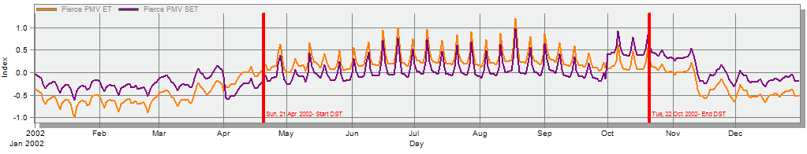
Comfort PMV-Set
Old PMV graph
New PMV graph

Slide 19
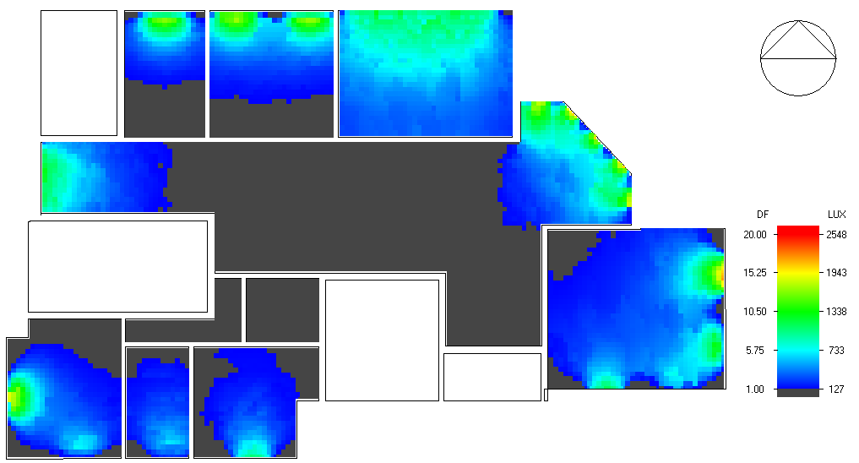
daylight analysis
D.F% | Space
3.64 | Meeting hall
5.23 | Reception
5.61 | Medical committee

Slide 20
Acoustics Design

Slide 21
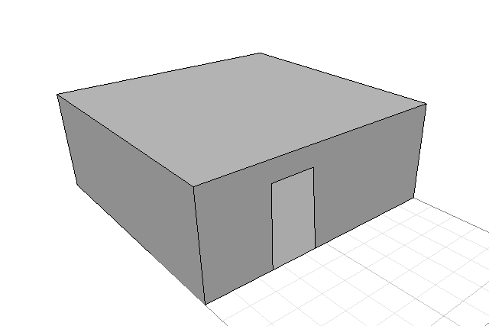
RT60 (Reverberation Time)
Multi purpose

Slide 22
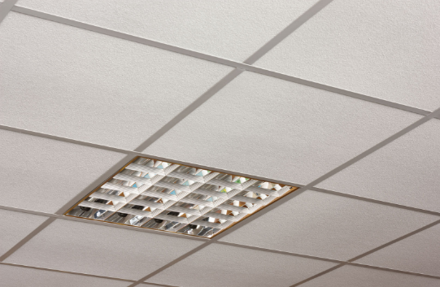
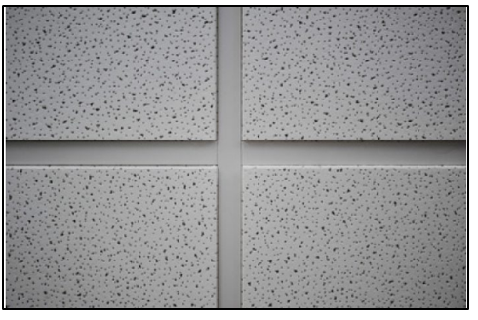
RT60 (Reverberation Time)
Element | Finish material | Absorption coefficient(α) at each frequency
 |  | 63_{HZ} | 125 _{HZ} | 250 _{HZ} | 500 _{HZ} | 1000 _{HZ} | 2000 _{HZ} | 4000 _{HZ} | 8000 _{HZ} | 16000_{HZ}
Ceiling | Acoustical Tile | 0.7 | 0.66 | 0.72 | 0.92 | 0.88 | 0.75 | 0.75 | 0.75 | 0.75

Slide 23
RT60 (Reverberation Time)
Old RT60 Values for Clinic Room
New RT60 Values for Clinic Room
At 50 % occupancy
FREQ. | RT₆₀
63Hz: | 1.1
125Hz: | 0.98
250Hz: | 0.91
500Hz: | 0.96
1kHz: | 0.57
2kHz: | 0.33
4kHz: | 0.17
8kHz: | 0.09
16kHz: | 0.1
At 50 % occupancy
FREQ. | RT (60)
63Hz: | 0.51
125Hz: | 0.52
250Hz: | 0.49
500Hz: | 0.45
1kHz: | 0.44
2kHz: | 0.44
4kHz: | 0.36
8kHz: | 0.23
16kHz: | 0.23
Recommended
Clinic room
(0.4-0.6)

Slide 24
RT60 (Reverberation Time)
Old RT60 Values for Manager Room
New RT60 Values for Manager Room
At 50 % occupancy
FREQ. | RT(60)
63Hz: | 0.98
125Hz: | 1.14
250Hz: | 1.16
500Hz: | 1.19
1kHz: | 1.16
2kHz: | 0.72
4kHz: | 0.43
8kHz: | 0.23
16kHz: | 0.26
At 50 % occupancy
FREQ. | RT (60)
63Hz: | 0.63
125Hz: | 0.66
250Hz: | 0.69
500Hz: | 0.72
1kHz: | 0.75
2kHz: | 0.81
4kHz: | 0.72
8kHz: | 0.5
16kHz: | 0.5
Manager office
room
(0.7-1.3)

Slide 25
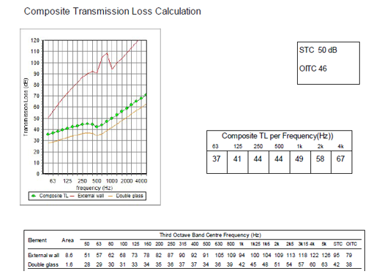
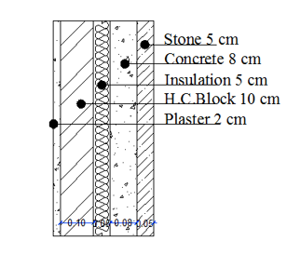
STC and IIC
TL = 50 dB
For External Wall of Clinic Room
External Wall

Slide 26
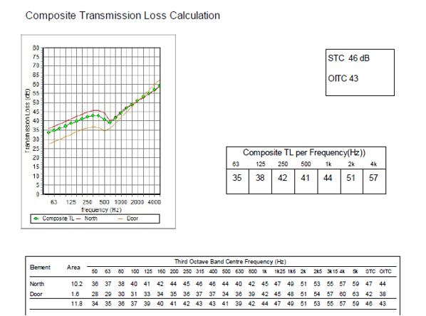
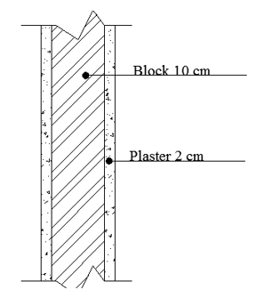
STC and IIC
Recommended Value 45 dB
TL = 46 dB
For Manger room adjacent to secretary office
Internal Wall

Slide 27
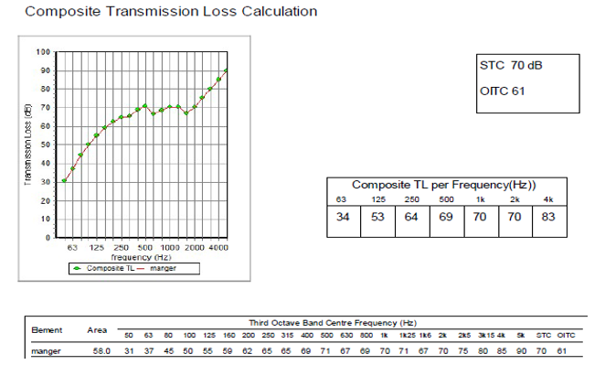
IIC For Ceiling
IIC = 70 dB

Slide 28
Structural Design

Slide 29
Codes and Loads
Structural design
Concrete:
The required compressive strength after 28 days fʹc
f^{ʹ}c=280kg/cm² (28 MPa) (B350) for slab and beams
Modulus of elasticity (E= 2.48*10⁴MPa)
Reinforced Concrete unit weight = 25 (KN/m3).
Reinforcing Steel:
The yield strength of steel is equal to 4200 Kg/cm² (420 MPa).
The modulus of elasticity is 2.04*10⁵MPa
Codes
UBC-97 for Earthquake design
ACI 318-14 for RC structure design

Slide 30
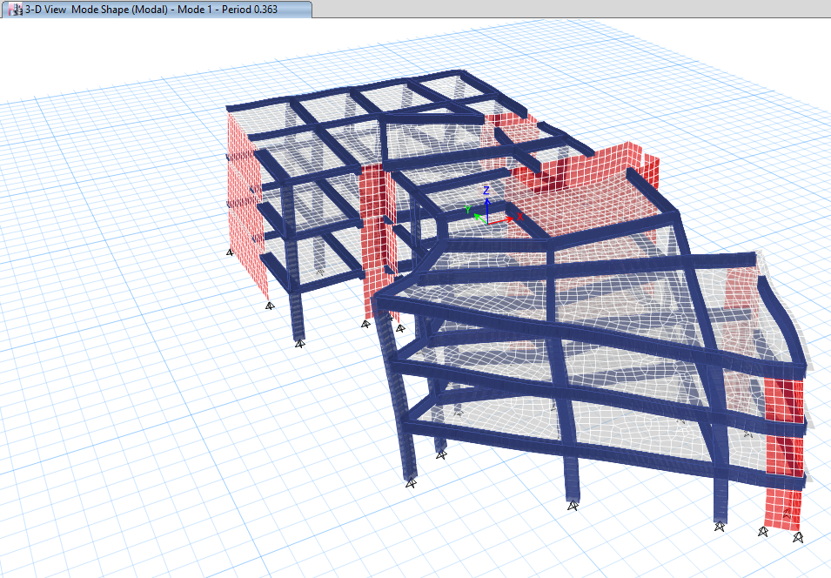
Model Checks
Structural design
Compatibility Check
This check was done for three models, while the period was reasonable and all the structural elements are compatible and moving together, the Figures below show the major periods for the three models:
Sample block 1 :-

Slide 31
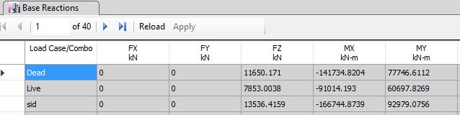
Model Checks
Structural design
Equilibrium Check
Equilibrium check is done to ensure that all input date including loads and assignments are correct. The allowed percent of error is 5 %.
The figures below show the Base reactions (Dead, Live and superimposed) which will be checked manually with an acceptable error up to 5 % for Block 1, 2 and 3.

Slide 32
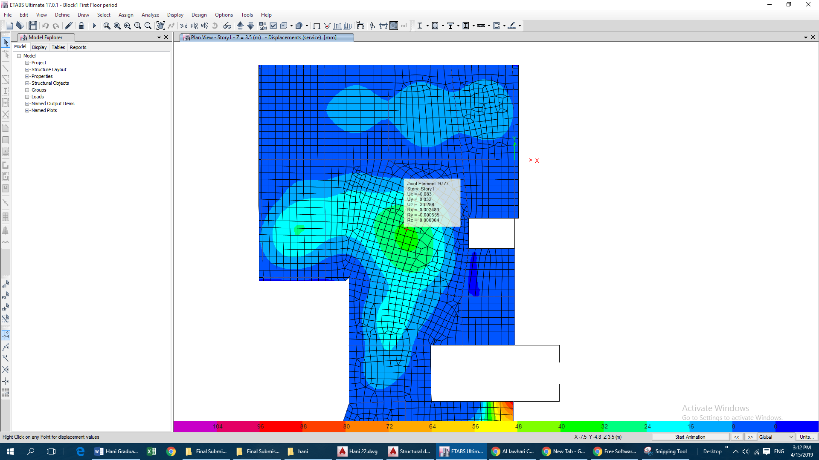
Model Checks
Structural design
Deflection Check
According to ACI-318, the maximum allowed deflection Shall not exceed the length of the slab divided by 240.
For Block One:
Length of the slab = 8.4 m, The maximum allowable deflection = 35 mm,
From Etabs the maximum deflection is 33 mm < 35 mm so deflection check is ok.

Slide 33
Model Checks
Structural design
Period Check
Check period:
According to UBC code the period (T) of the building shall not exceed a value of 40 percent of T obtained from method A in Seismic Zone 2.
T (from A method) = Ct (hn) ^{3/4} where:
hn is the height of structure in meters = 10.5 m, Ct is a constant = 0.0488
For Block 1:
By modeling, the structure has a period T =0.36 seconds.
Then T (from A method) = 0.28 seconds.
The period shall be less than 1.4 * T (from method A) = 1.4*0.28 = 0.4 seconds.
T of the building = 0.36 which is less than 0.4 seconds, So, the period is Ok.

Slide 34
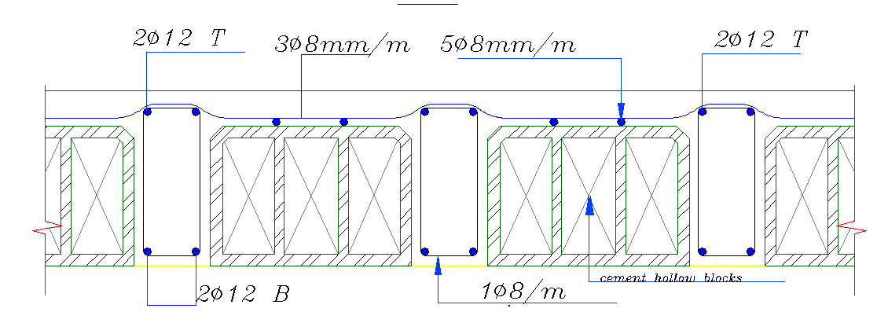
Slab Reinforcement
Structural design

Slide 35
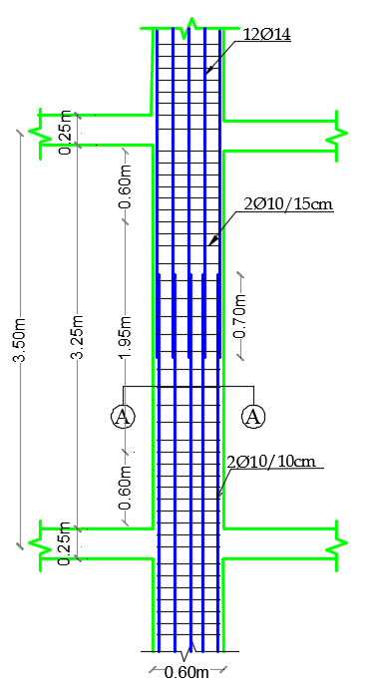
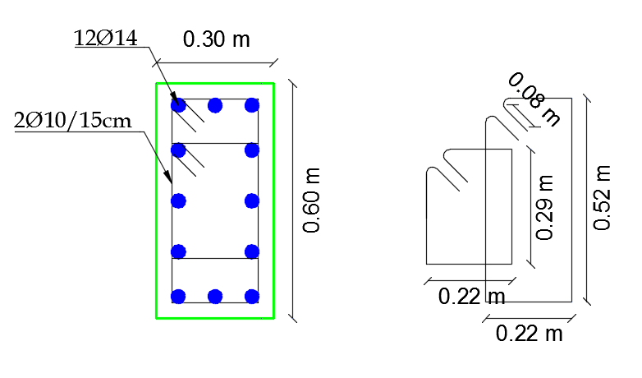
Structural design
Columns Reinforcement

Slide 36
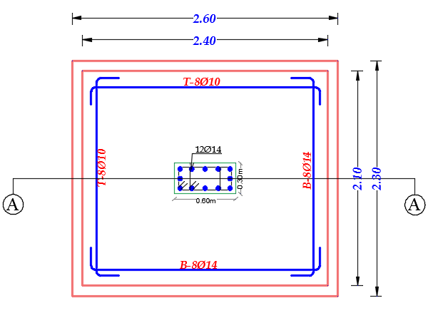
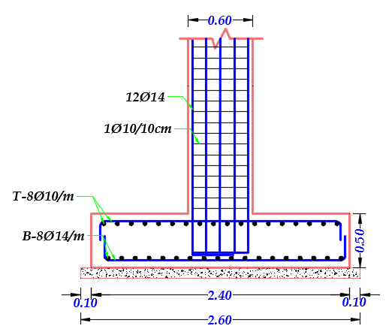
Footing Reinforcement
Structural design
Sample Calculations of Footing (1):
P service = 1693 kN
P ultimate = 2252 kN
Footing Dimensions:
Area Footing = P service / q_{all}
Area of footing = 1693/ 350 = 4.8 m²
The length of footing = 2.4, the width of footing = 2.1
Assume thickness of footing is h= 500 mm so d = 500 – 70 = 430 mm

Slide 37
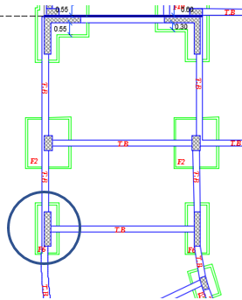
Design of Wall Footings
The selected footing for design in shown in the figure below:
Sample calculations for wall footing (F6)
P service = 243 kN , P ultimate = 314 kN,
P service kN/m = 151 , P ultimate kN/m = 196
Length of wall = 1.6 m
Area of footing = 151 /350 =0.43 m2
Width of footing= 0.43 m² / 2.2 = 0.19 m So try width of 0.9m.

Slide 38
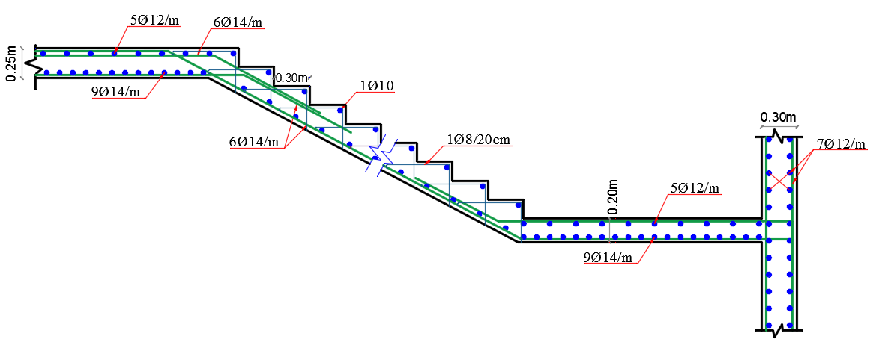
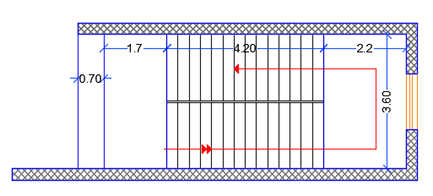
Structural design
Stairs Reinforcement

Slide 39
Electrical Design

Slide 40
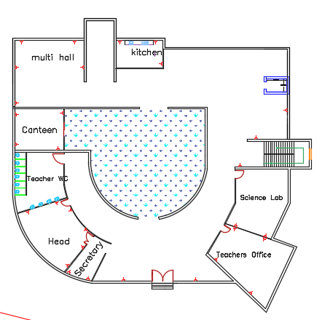
Ground Floor socket plan

Slide 41
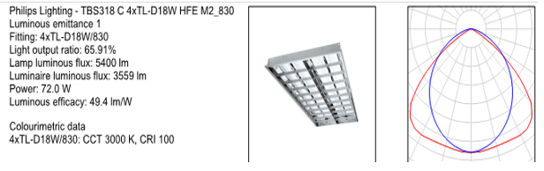
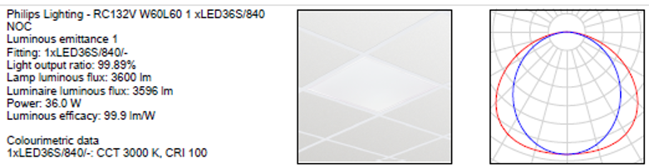
Luminaires Layout
Old Main Luminaire
50 lm/w
100 lm/w
New Main Luminaire

Slide 42
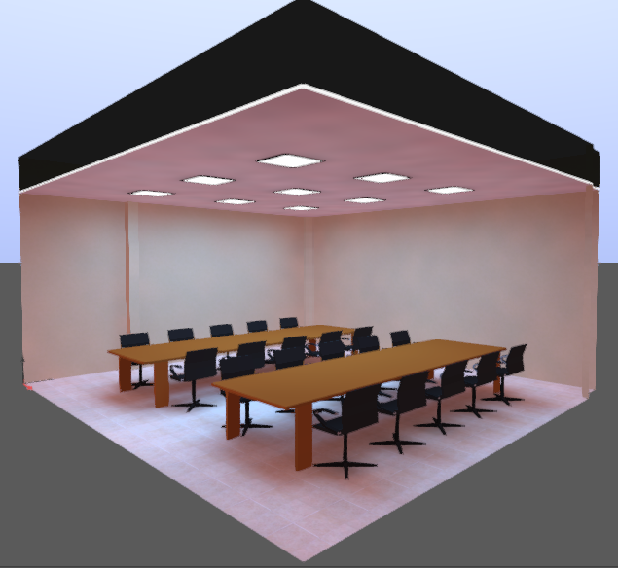
3D Rendering View for Selected Rooms
Teacher room

Slide 43
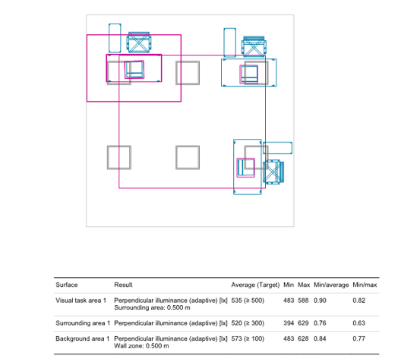
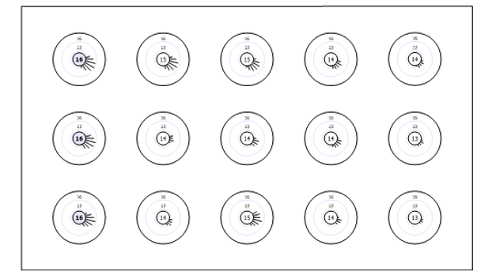
Teacher room
Required illuminance
500 lux
Required uniformity
(>0.60)
Average Illuminance
535 Lux
UGR = 17.7

Slide 44
Mechanical Design

Slide 45
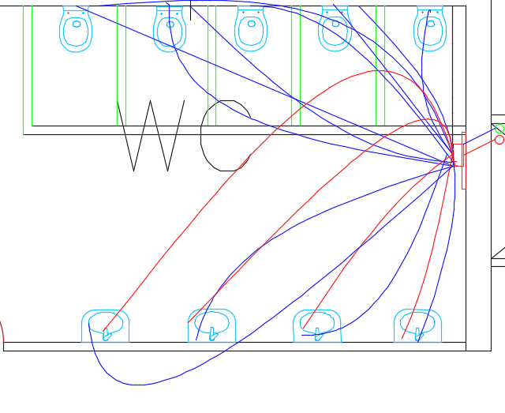
Water Supply System

Slide 46
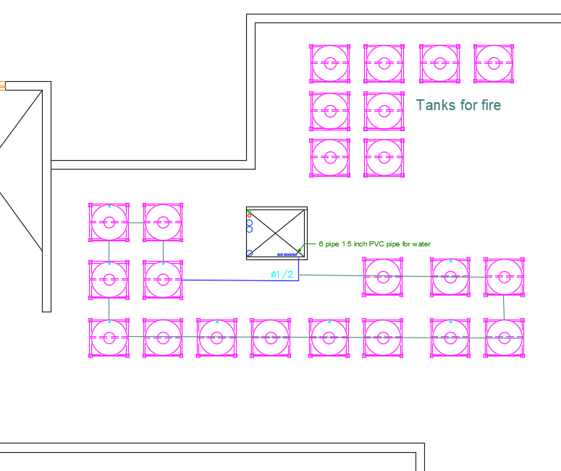
Water Supply System

Slide 47
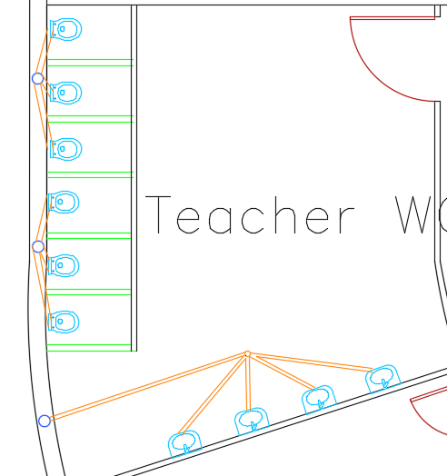

Drainage system

Slide 48

Rain Water Drainage

Slide 49
Firefighting and Safety Design

Slide 50


Emergency Fire Protection System

Slide 51
Emergency Fire Protection System

Slide 52
Quantity Surveying and Cost Estimation

Slide 53
Cost Estimation
Directorate of Health | Total Direct Cost (Nis)
Structure work | 2,297,256
Mechanical Work | 240,500
Finishing Work | 1,158,506
Electrical Work | 294,801
Total direct project cost | 3,991,063
Unit Direct Cost = 3991063/2235 = 1786 Nis /m²
Unit Direct Cost = 352 JD /m²

Slide 54
Thank You

