Slide 1

Assessment of top and middle managers in Palestinian insurance companies awareness of TQM aspects and their effect on organizational performance indicators
Prepared by: Supervisor:
Abdulfattah Faris Dr. Yahya Saleh
Anan Jamos
Huthaifa Arafat

Slide 2
Outlines
Introduction
Objectives
Research questions
Hypotheses and conceptual model
Questionnaire
Population and sample size
Data analysis
Statistical differences in awareness
Correlation and regression
Conclusions and recommendations

Slide 3
Introduction
The aim of this research is to explore the main factors affecting TQM awareness and implementation in Palestinian insurance companies, examining the relationship between TQM awareness and organizational performance and to submit a comprehensive framework for TQM awareness for the development of Palestinian insurance companies.

Slide 4
Objectives
Assessing the level of awareness of TQM implementation as perceived by top and middle management of Palestinian insurance companies.
Investigating the awareness of the impact of TQM implantation on organizational performance indicators.
Identifying the main obstacles to implementing TQM.
Assessing the impact of demographic variables on awareness of top and middle managers in TQM principles.

Slide 5
Research questions
What is the level of awareness of top and middle management to the concept, importance, implementation techniques and implementation obstacles of TQM in the insurance sector.
To what level does the difference in demographic characteristics affect the extent to which top and middle management understand the concept, importance, application and constraints of TQM in the insurance sector
What is the impact of top and middle management awareness of TQM on the organizational performance

Slide 6
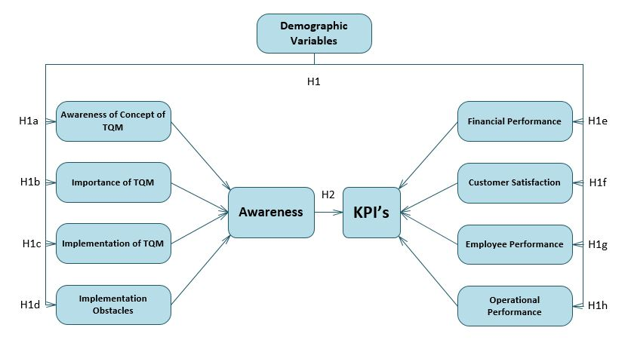
Hypotheses and conceptual model

Slide 7
Questionnaire
The questionnaire consists of 54 questions divided into six main sections:
The first section collects demographic data.
The second section measures the extent to which the top and middle management are aware of the concept of TQM.
The third section measures the extent to which the top and middle management are aware of the importance of TQM.

Slide 8
Questionnaire
The fourth section measures the role of top and middle management in the implementation of TQM in the insurance sector.
The fifth section discusses factors that obstruct the application of TQM.
The sixth section measures the impact of management awareness of TQM aspects on organizational performance.

Slide 9
Population and sample size
The study population consists of the all branch managers and heads of departments (Middle management) and all top management members.
456 middle managers.
90 top management members.
The total population is 546 member.
The approximated sample size is 102.

Slide 10
Data analysis
In data analysis, we used several statistical analysis methods including
kruskal wallis to study the statistical differences between the demographic variables and TQM awareness level and the effect of TQM awareness on organizational performance indicators.
Regression to obtain the relation between Awareness aspects of TQM and the level of awareness of TQM, study the relation between TQM awareness level and the effect of TQM on organizational performance.
Correlation test to study the level of correlation between TQM awareness level and their effect on organizational performance.

Slide 11
Statistical differences in awareness aspects
According to gender
Awareness aspects | Gender
 | P-Value
Concept of TQM | 0.816
Importance of TQM | 0.223
Implementation of TQM | 0.533
Implementation obstacles | 0.287
KPIs | 0.039
Note that difference is significant at the 0.05 level

Slide 12
Statistical differences in awareness aspects
According to age
Awareness aspects | Age
 | P-Value
Concept of TQM | 0.077
Importance of TQM | 0.672
Implementation of TQM | 0.186
Implementation obstacles | 0.386
KPIs | 0.064
Note that difference is significant at the 0.05 level

Slide 13
Statistical differences in awareness aspects
According to education level
Awareness aspects | Education level
 | P-Value
Concept of TQM | 0.124
Importance of TQM | 0.138
Implementation of TQM | 0.749
Implementation obstacles | 0.826
KPIs | 0.002
Note that difference is significant at the 0.05 level

Slide 14
Statistical differences in awareness aspects
According to management level
Awareness aspects | Management level
 | P-Value
Concept of TQM | 0.002
Importance of TQM | 0.001
Implementation of TQM | 0.006
Implementation obstacles | 0.104
KPIs | 0.000
Note that difference is significant at the 0.05 level

Slide 15
Statistical differences in awareness aspects
According to experience
Awareness aspects | Experience
 | P-Value
Concept of TQM | 0.001
Importance of TQM | 0.078
Implementation of TQM | 0.403
Implementation obstacles | 0.648
KPIs | 0.002
Note that difference is significant at the 0.05 level

Slide 16
Statistical differences in awareness aspects
According to salary
Awareness aspects | Salary
 | P-Value
Concept of TQM | 0.014
Importance of TQM | 0.002
Implementation of TQM | 0.029
Implementation obstacles | 0.588
KPIs | 0.001
Note that difference is significant at the 0.05 level

Slide 17
Statistical differences in organizational performance indicators
According to gender
Organizational performance indicators | Gender
 | P-Value
Financial performance | 0.021
Employee performance | 0.205
Operational performance | 0.056
Customer satisfaction | 0.825
Note that difference is significant at the 0.05 level

Slide 18
Statistical differences in organizational performance indicators
According to age
Organizational performance indicators | Age
 | P-Value
Financial performance | 0.017
Employee performance | 0.091
Operational performance | 0.088
Customer satisfaction | 0.007
Note that difference is significant at the 0.05 level

Slide 19
Statistical differences in organizational performance indicators
According to education level
Organizational performance indicators | Education level
 | P-Value
Financial performance | 0.092
Employee performance | 0.103
Operational performance | 0.174
Customer satisfaction | 0.022
Note that difference is significant at the 0.05 level

Slide 20
Statistical differences in organizational performance indicators
according to management level
Organizational performance indicators | Management level
 | P-Value
Financial performance | 0.001
Employee performance | 0.000
Operational performance | 0.000
Customer satisfaction | 0.023
Note that difference is significant at the 0.05 level

Slide 21
Statistical differences in organizational performance indicators
According to experience
Organizational performance indicators | Experience
 | P-Value
Financial performance | 0.068
Employee performance | 0.009
Operational performance | 0.003
Customer satisfaction | 0.001
Note that difference is significant at the 0.05 level

Slide 22
Statistical differences in organizational performance indicators
According to salary
Organizational performance indicators | Salary
 | P-Value
Financial performance | 0.005
Employee performance | 0.002
Operational performance | 0.038
Customer satisfaction | 0.011
Note that difference is significant at the 0.05 level

Slide 23
Correlation
Independent variable | Dependent variable
 | Awareness of TQM principles
 | Pearson corr.(r) | P-value | Type of correlation
Financial performance | 0.773 | 0.000 | Positive
Operational performance | 0.824 | 0.000 | Positive
Employee performance | 0.799 | 0.000 | Positive
Customer satisfaction | 0.480 | 0.000 | Positive

Slide 24
Correlation
Factor | Financial performance | Operational performance | Employee Performance | Customer satisfaction
Concept | 0.636 0.000 | 0.713 0.000 | 0.725 0.000 | 0.545 0.000
Importance | 0.721 0.000 | 0.792 0.000 | 0.714 0.000 | 0.398 0.000
Implementation | 0.592 0.000 | 0.667 0.000 | 0.707 0.000 | 0.400 0.000
Obstacles | 0.652 0.000 | 0.627 0.000 | 0.582 0.000 | 0.300 0.002

Slide 25
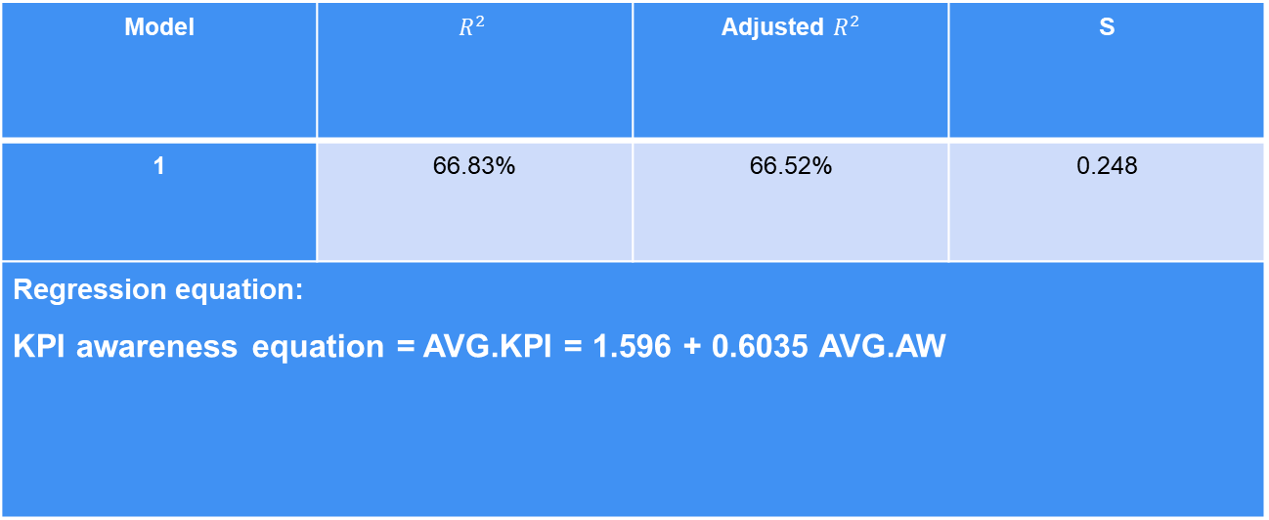
Regression
Regression of company’s KPIs depending on the awareness of TQM concept
Model | $$R^{2}$$ | Adjusted $R^{2}$ | S
1 | 66.83% | 66.52% | 0.248
Regression equation: KPI awareness equation = AVG.KPI = 1.596 + 0.6035 AVG.AW

Slide 26
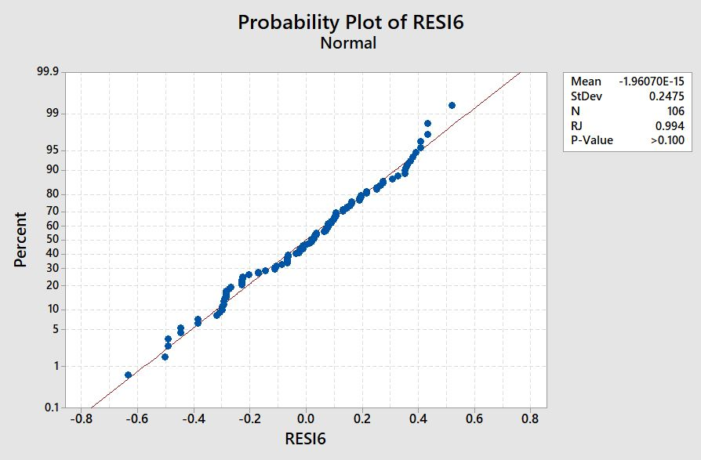
Regression

Slide 27
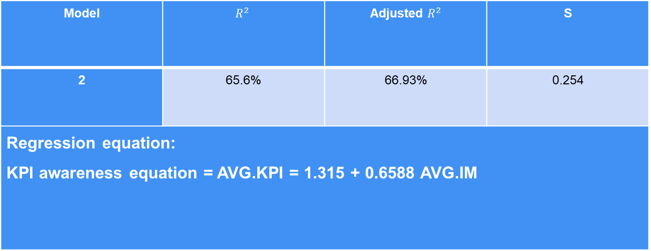
Regression
Regression of company’s KPIs depending on the awareness of TQM importance
Model | $$R^{2}$$ | Adjusted $R^{2}$ | S
2 | 65.6% | 66.93% | 0.254
Regression equation: KPI awareness equation = AVG.KPI = 1.315 + 0.6588 AVG.IM

Slide 28
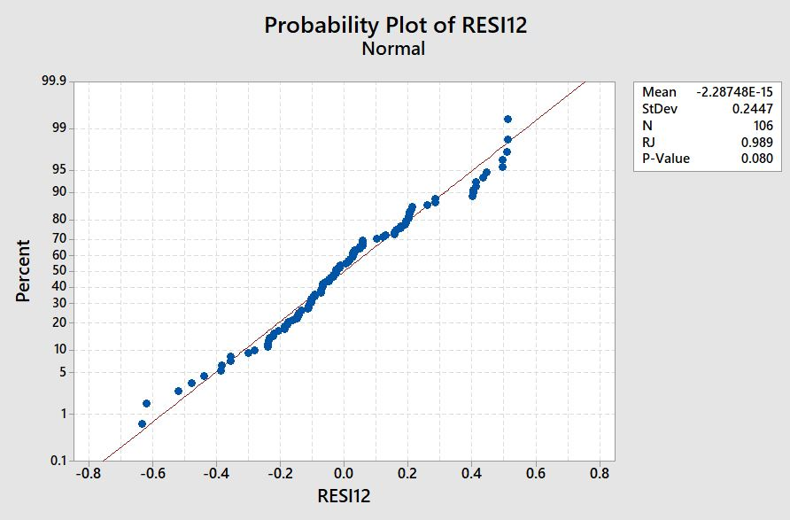
Regression

Slide 29
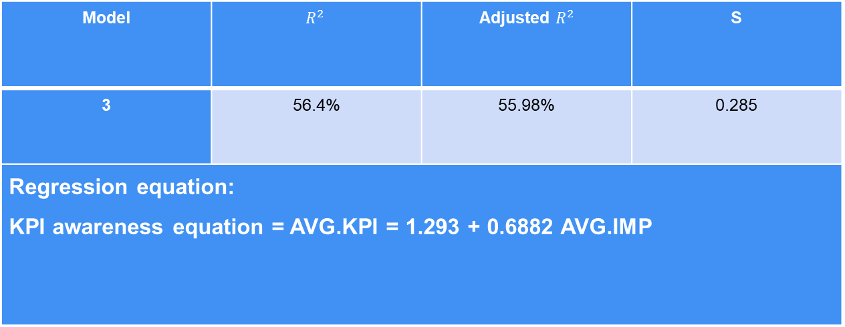
Regression
Regression of company’s KPIs depending on the awareness of TQM implementation
Model | $$R^{2}$$ | Adjusted $R^{2}$ | S
3 | 56.4% | 55.98% | 0.285
Regression equation: KPI awareness equation = AVG.KPI = 1.293 + 0.6882 AVG.IMP

Slide 30
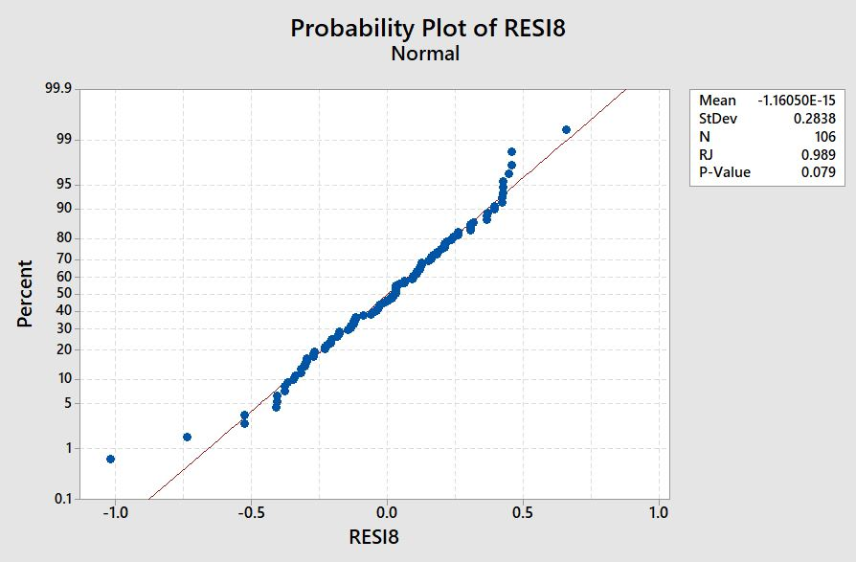
Regression

Slide 31
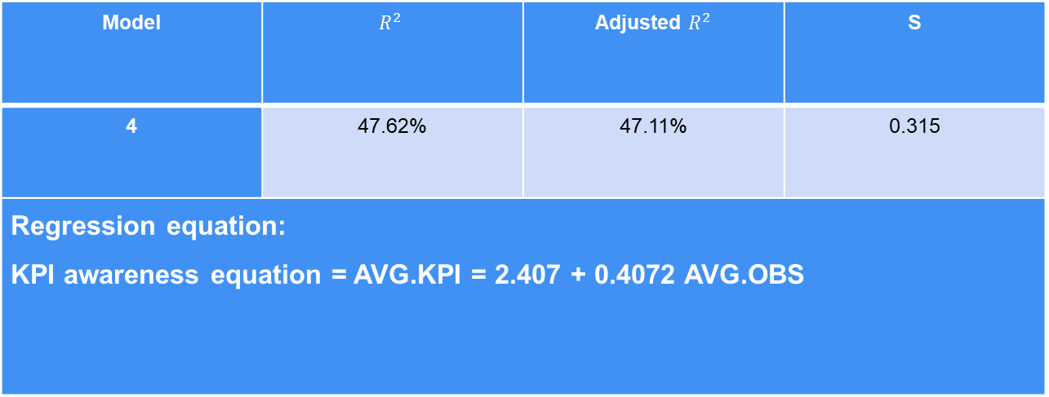
Regression
Regression of company’s KPIs depending on the awareness of TQM implementation obstacles
Model | $$R^{2}$$ | Adjusted $R^{2}$ | S
4 | 47.62% | 47.11% | 0.315
Regression equation: KPI awareness equation = AVG.KPI = 2.407 + 0.4072 AVG.OBS

Slide 32
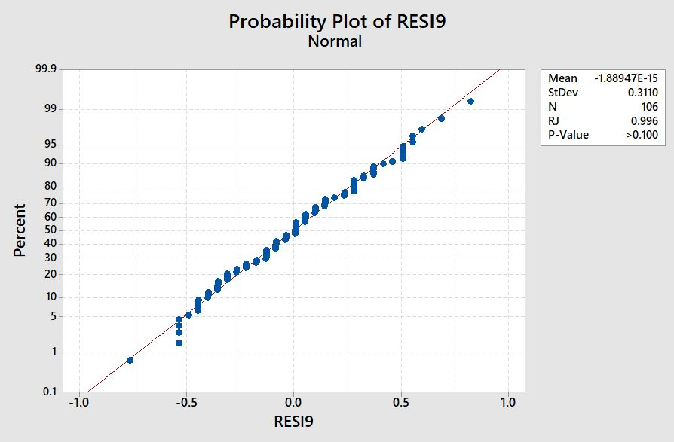
Regression

Slide 33
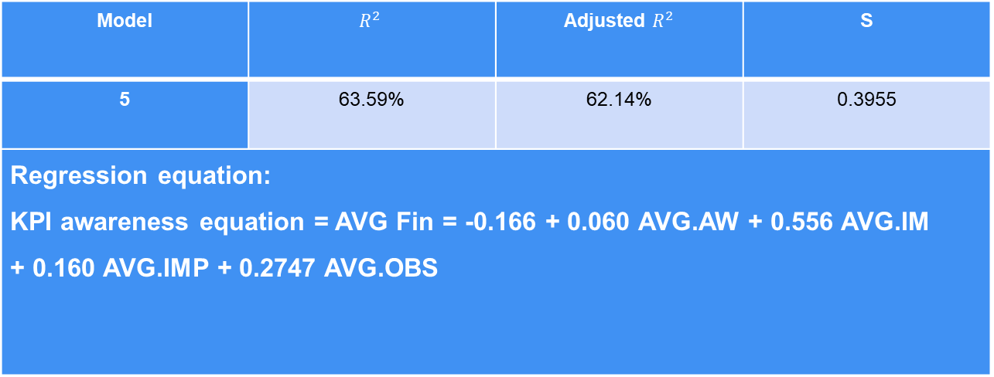
Regression
Regression of financial performance depending on the awareness of TQM
Model | $$R^{2}$$ | Adjusted $R^{2}$ | S
5 | 63.59% | 62.14% | 0.3955
Regression equation: KPI awareness equation = AVG Fin = -0.166 + 0.060 AVG.AW + 0.556 AVG.IM + 0.160 AVG.IMP + 0.2747 AVG.OBS

Slide 34
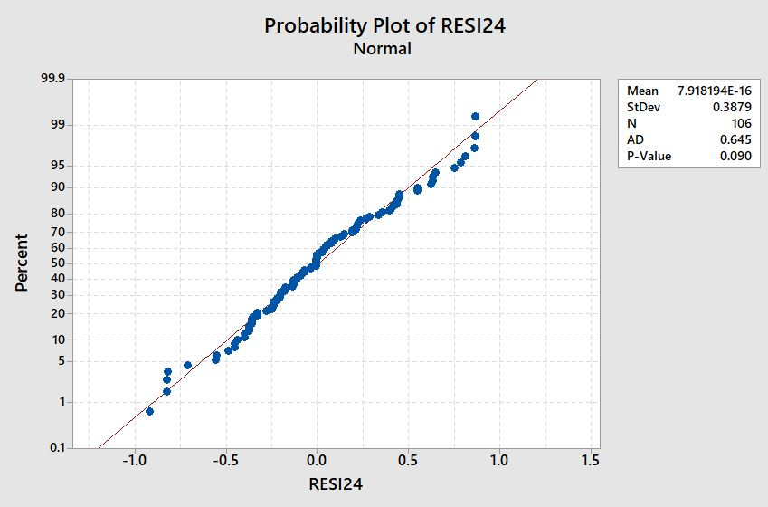
Regression

Slide 35
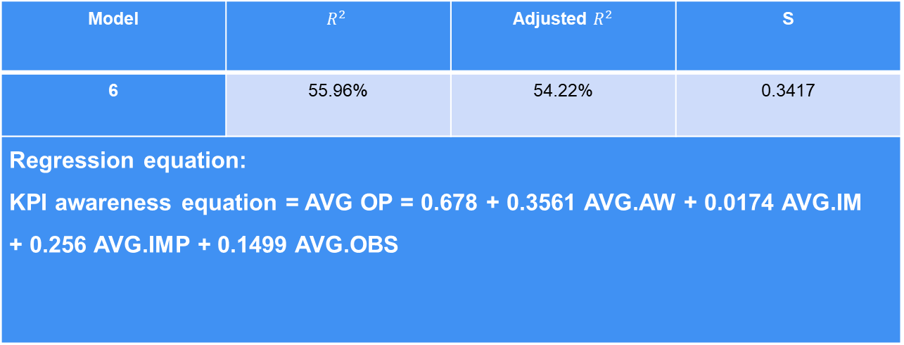
Regression
Regression of operational performance depending on the awareness of TQM
Model | $$R^{2}$$ | Adjusted $R^{2}$ | S
6 | 55.96% | 54.22% | 0.3417
Regression equation: KPI awareness equation = AVG OP = 0.678 + 0.3561 AVG.AW + 0.0174 AVG.IM + 0.256 AVG.IMP + 0.1499 AVG.OBS

Slide 36

Regression

Slide 37
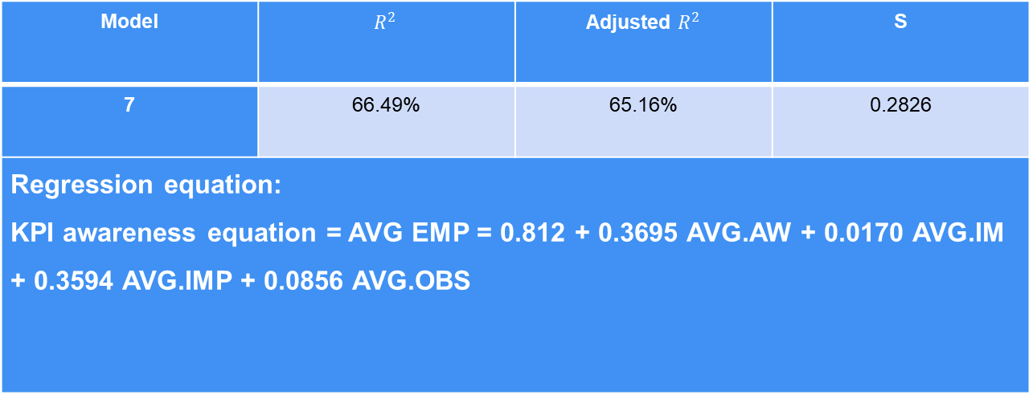
Regression
Regression of employee performance depending on the awareness of TQM
Model | $$R^{2}$$ | Adjusted $R^{2}$ | S
7 | 66.49% | 65.16% | 0.2826
Regression equation: KPI awareness equation = AVG EMP = 0.812 + 0.3695 AVG.AW + 0.0170 AVG.IM + 0.3594 AVG.IMP + 0.0856 AVG.OBS

Slide 38
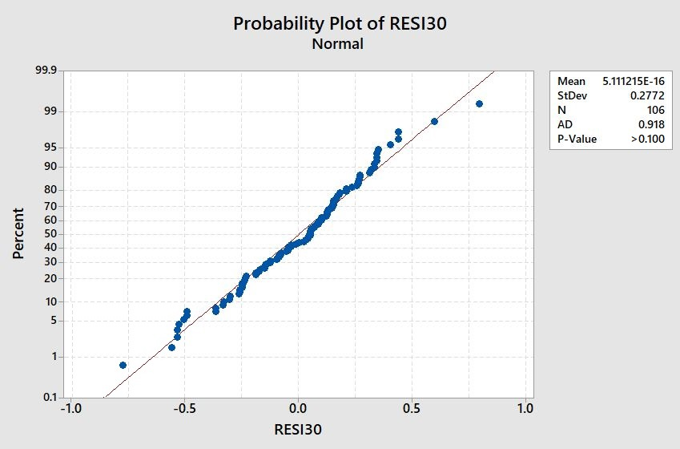
Regression

Slide 39

Regression
Regression of customer satisfaction depending on the awareness of TQM
Model | $$R^{2}$$ | Adjusted $R^{2}$ | S
8 | 30.07% | 27.30% | 0.3523
Regression equation: KPI awareness equation = AVG CUST = 2.683 + 0.3507 AVG.AW + 0.049 AVG.IM + 0.074 AVG.IMP - 0.0519 AVG.OBS

Slide 40
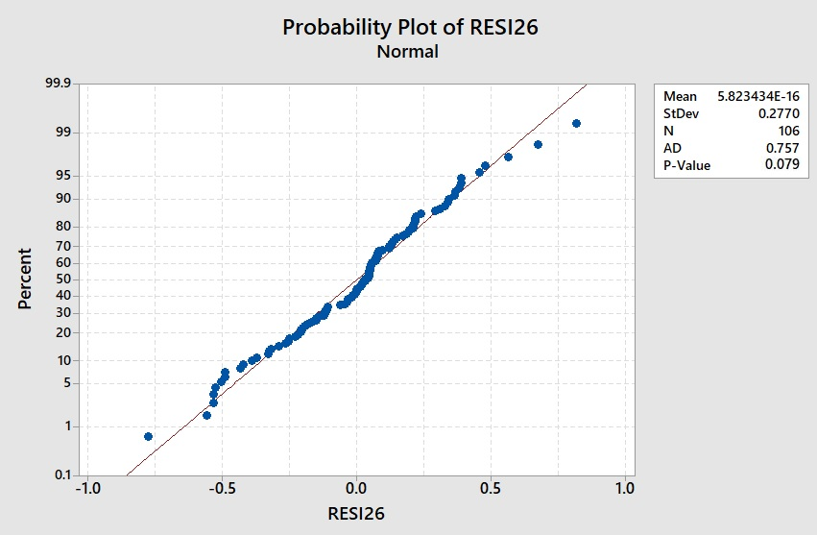
Regression

Slide 41
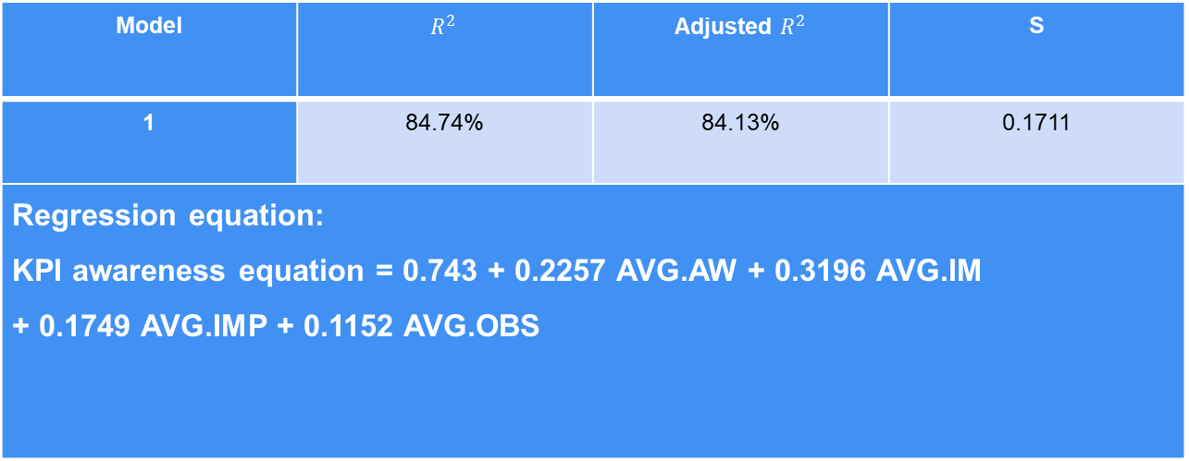
Regression
Regression of the awareness of the effect of all of the TQM factors on the company’s KPIs
Model | $$R^{2}$$ | Adjusted $R^{2}$ | S
1 | 84.74% | 84.13% | 0.1711
Regression equation: KPI awareness equation = 0.743 + 0.2257 AVG.AW + 0.3196 AVG.IM + 0.1749 AVG.IMP + 0.1152 AVG.OBS

Slide 42

Regression

Slide 43
Conclusions
Top and middle managers in Palestinian insurance companies showed good knowledge in TQM aspects and its impact on organizational performance.
Managers with high educational, Managerial and experience level showed better knowledge in TQM in general, while factors like age has no statistical difference in the Awareness of TQM.
Top managers showed lack of trust in the potential advantages of TQM due to the weak partnership between competitors
Awareness of obstacles against implementing TQM proved to be significant and widespread among top and middle managers.

Slide 44
Conclusions
Financial and administrative resources spent on the implementation and development of TQM are insufficient.
According to the correlation matrix, the relation between awareness of importance and operational performance scored the highest score, which conforms to the results obtained in 3 and 4.
The second highest score was between awareness of concept and employee performance.
The third highest score was between awareness of importance and financial performance.

Slide 45
Recommendations
Managers must set a clear vision regarding the use of TQM and develop appropriate strategies to do so.
Management must provide the necessary infrastructure for advanced applications of TQM.
Management devote more financial resources for the development of TQM.
Increase employee awareness, familiarize all issues and obstacles related to TQM implementation, and removing uncertainty.

Slide 46
Thank you

