Slide 1

Faculty of Engineering and Information Technology
MIS department
Graduation project
Lojayn Accessories e-Marketing
Supervised by :
Dr.Ahmad Shraideh
Group Members
Raghad Alzeer
Hanaa Abuhijleh
Tala Shawahneh

Slide 2

Introduction
Lojayn Accessories
  located in Barta'ah
  Activity
    High-quality hijabs, bags , perfumes, and accessories.
  It provides a delivery service to all Palestinian cities.

Slide 3
The project objective
  Develop an e-marketing plan.
  Improve the store's presence in social media and online.
  Expand in new places where our target group is located.

Slide 4

Action plan
  Analysis
  Enhancement
  Extending

Slide 5

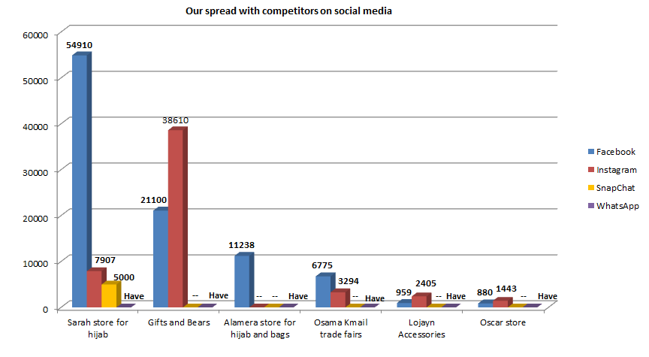

Analysis
Our Competitors
  Different posts types
  Engagement

Slide 6

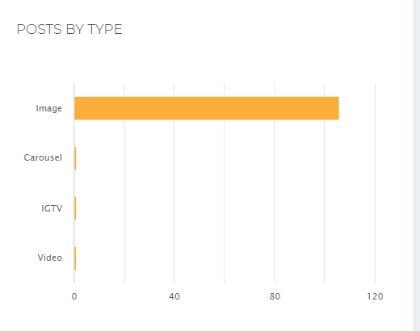
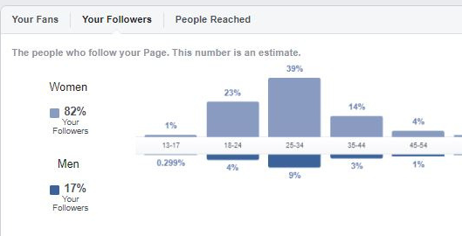



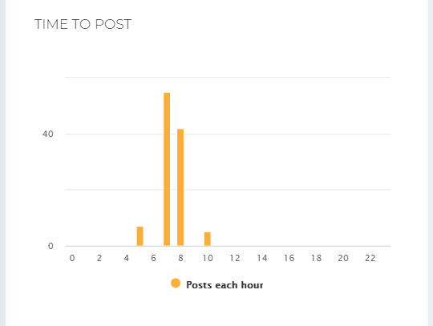

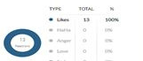
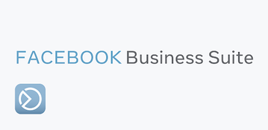
Analysis
Limited presence on social media
- Number of followers = 960

Slide 7

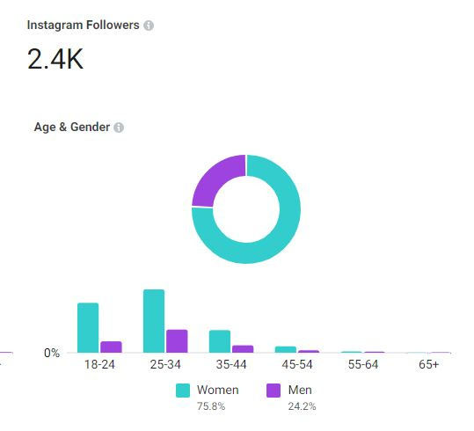
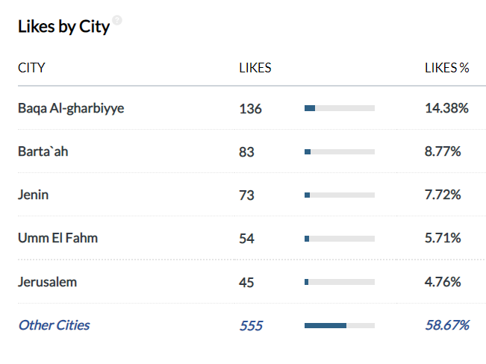
Analysis
Limited presence on social media
Total number of followers: 2406

Slide 8

Solutions:
  Facebook and Instagram development.
  Content Enhancement .
  Extended on social media presence.

Slide 9
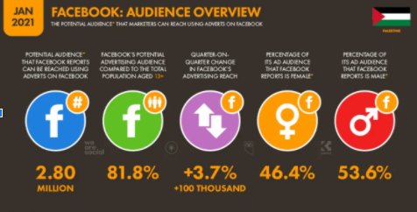
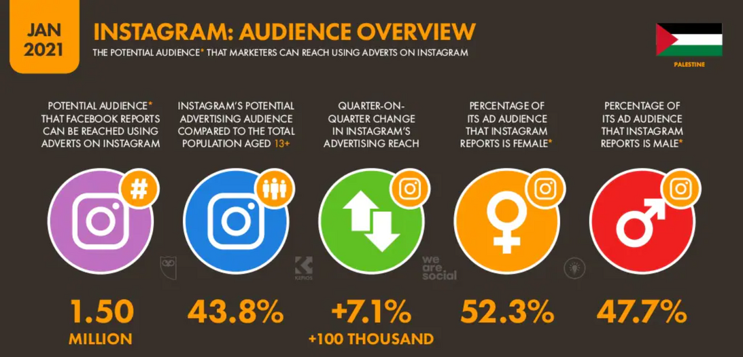
Facebook & Instagram development
We are social , IPOKE

Slide 10
Facebook and Instagram development
  Paid Advertisments.
  Communicating with influencers.
  Invite friends.

Slide 11
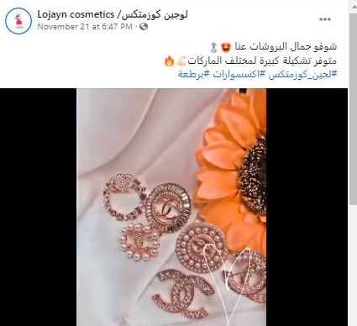
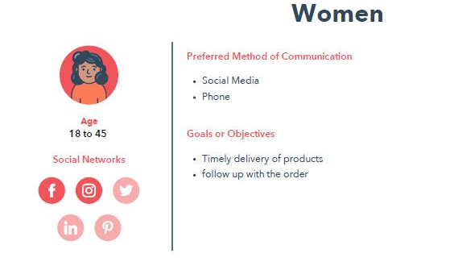


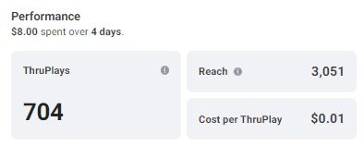
Facebook and Instagram development
  Paid Advertisments

Slide 12

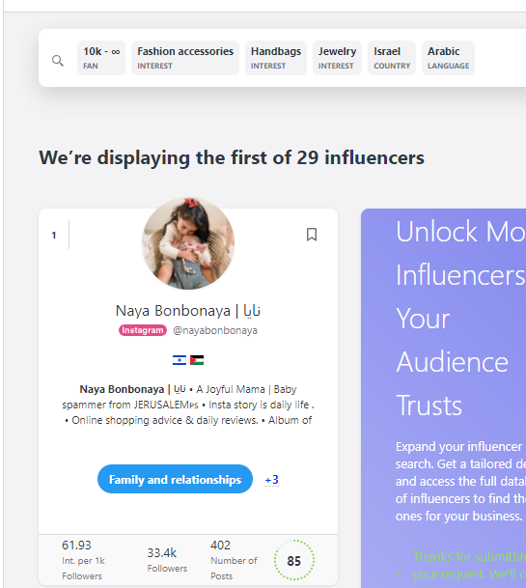

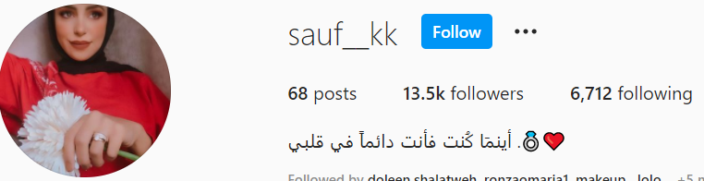
Facebook and Instagram development
  Influencers
  Invite friends

Slide 13


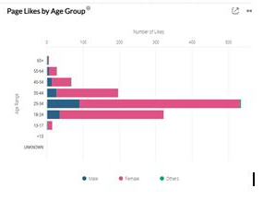

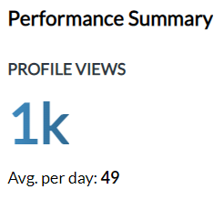
Results

Slide 14
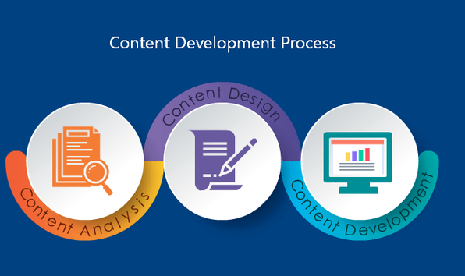
Content Enhancment.
  Schedule posts
  Advertisements & hashtag
  Design
  Educational Content
  Customer Tracking

Slide 15
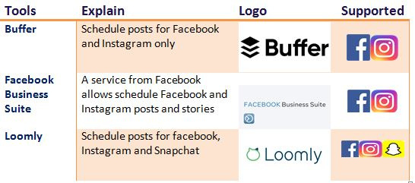
Content Enhancement
  Schedule posts
  Description

Slide 16

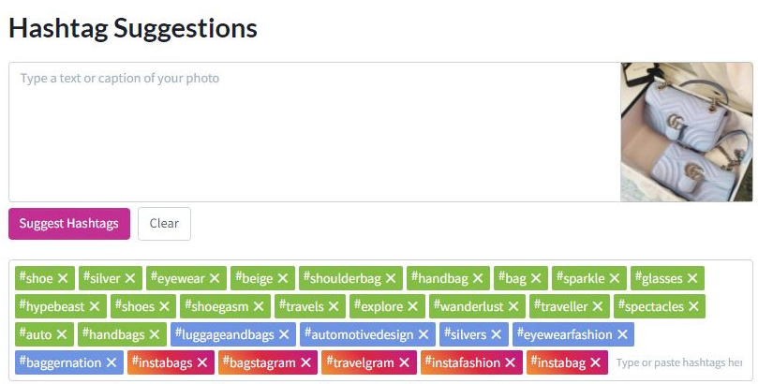
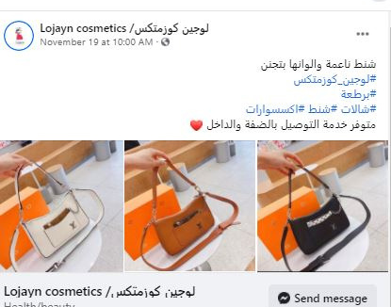
Content Enhancement
  Advertisements & hashtag

Slide 17
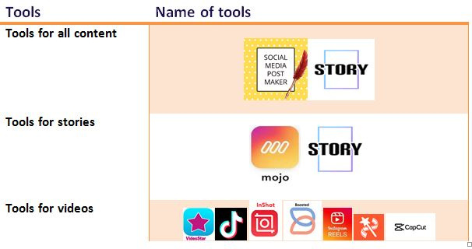
Content Enhancement
  Design

Slide 18


Content Enhancement
  Educational Content

Slide 19
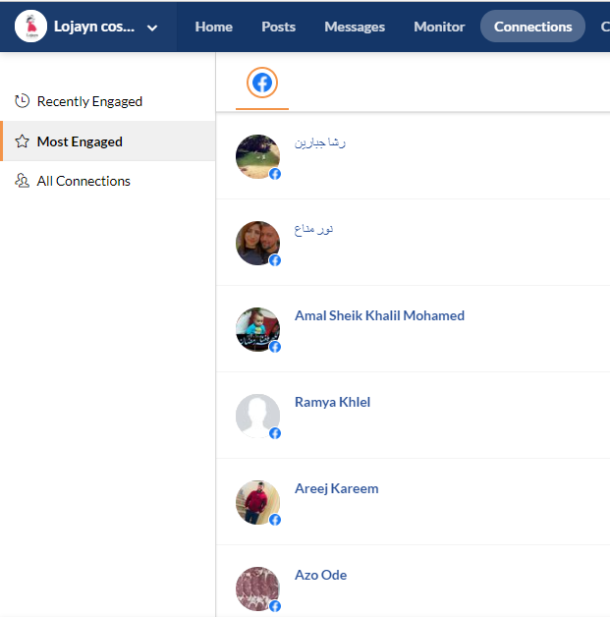
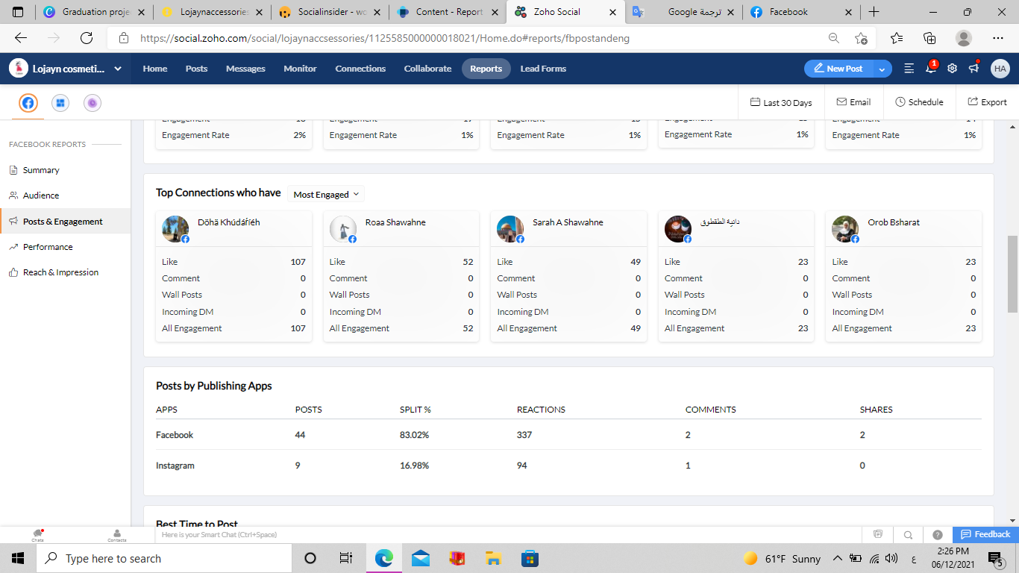
Content Enhancement
  Customer Tracking

Slide 20
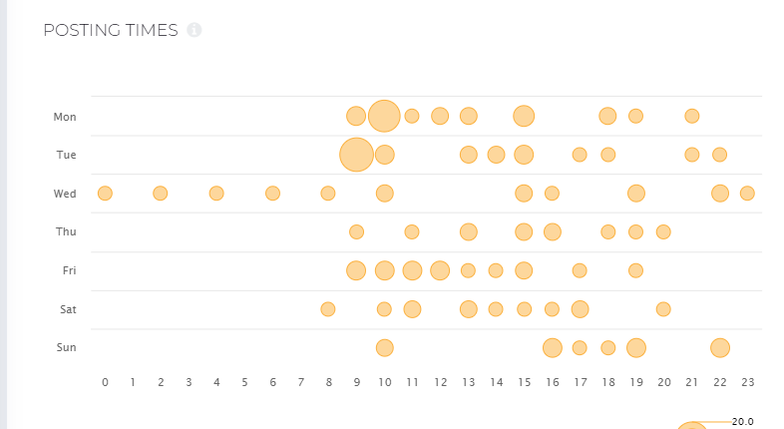
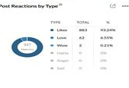
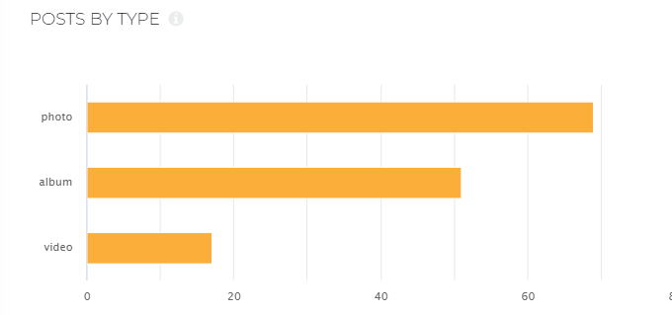
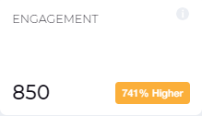
Results

Slide 21

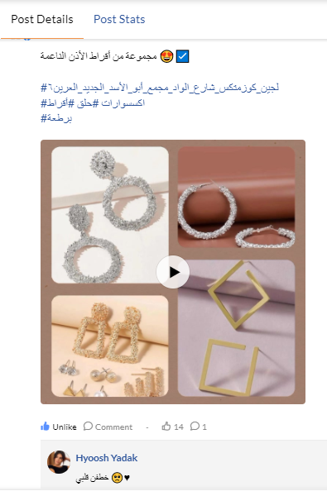
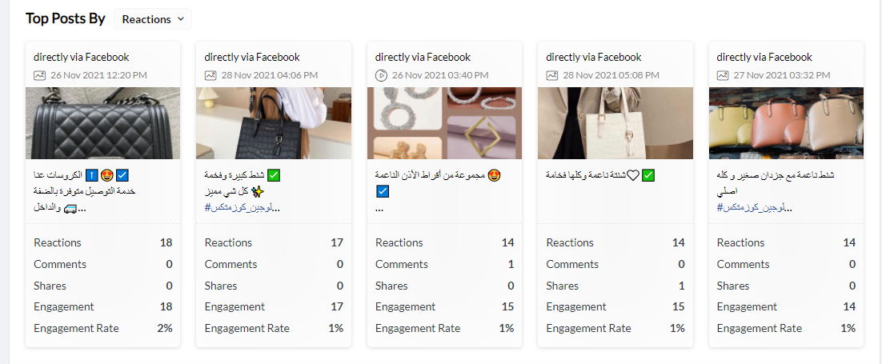
Results
Most interactive posts
Content Design
And use the hashtag

Slide 22
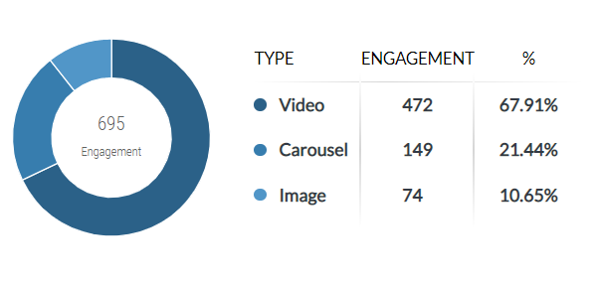
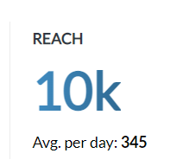
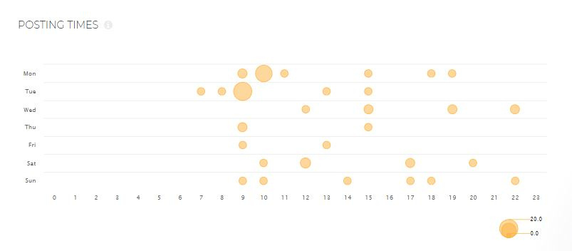
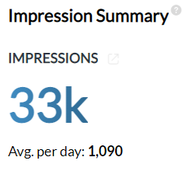
Results

Slide 23

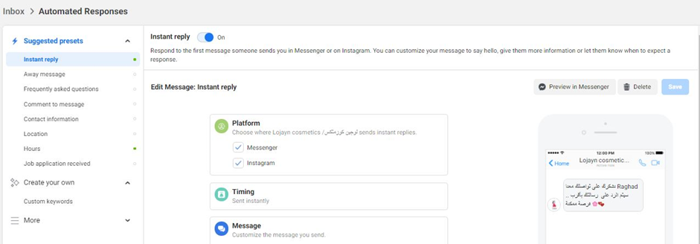
Enhancment
  Auto Reply to messages

Slide 24




Extending on social media.

Slide 25

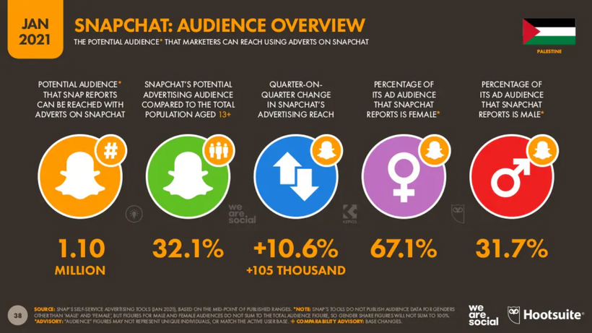
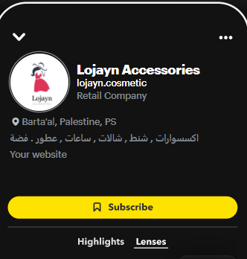

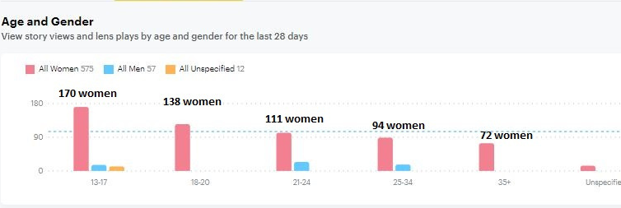
Extending on social media.
snapchat account
  Subscribers : 331
  Stories views: 696

Slide 26


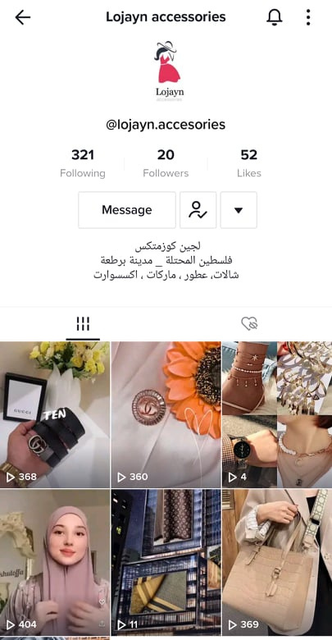
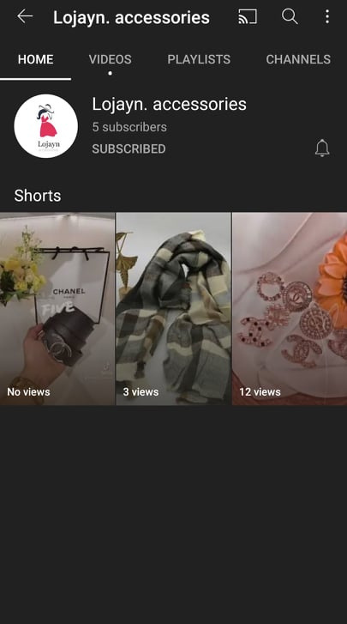
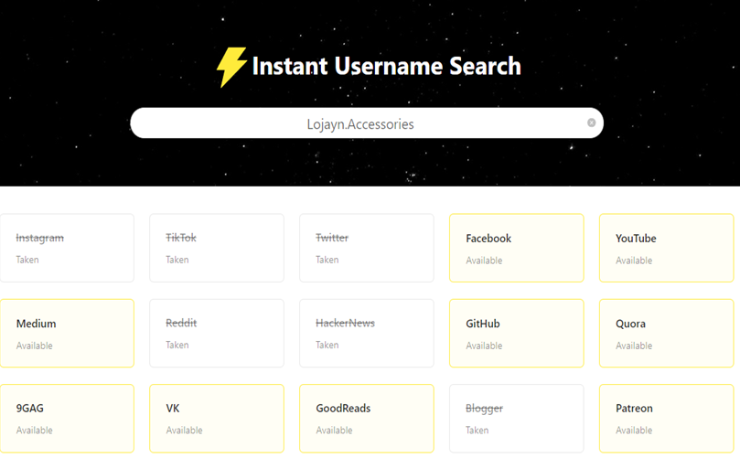
Extending on social media.

Slide 27
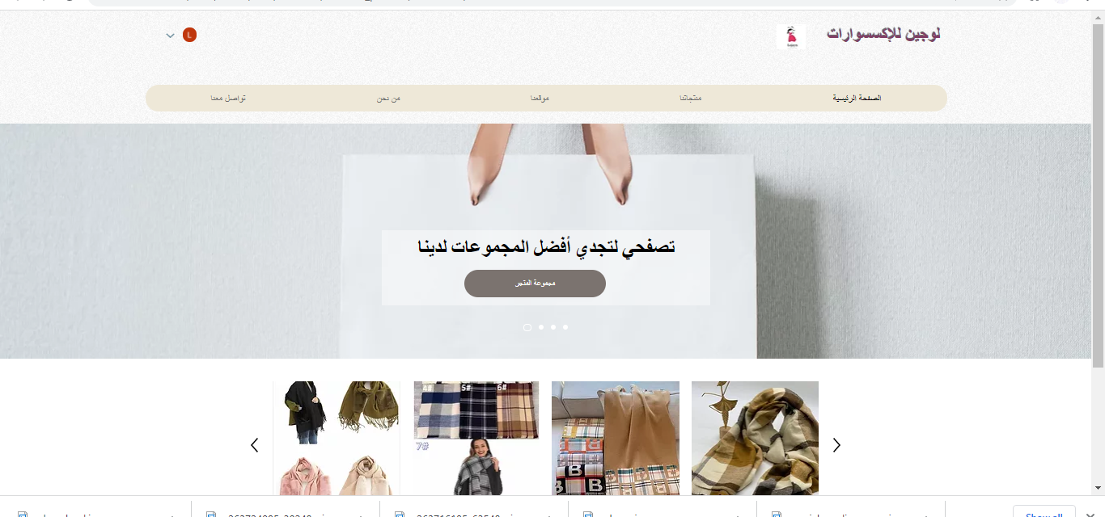
Create a website.
The site aims to display products to customers

Slide 28

Future plan
  Activate YouTube and Tiktok.
  Activate SEO.
  Expand our website to sell products.

Slide 29

Thank You

