Slide 1
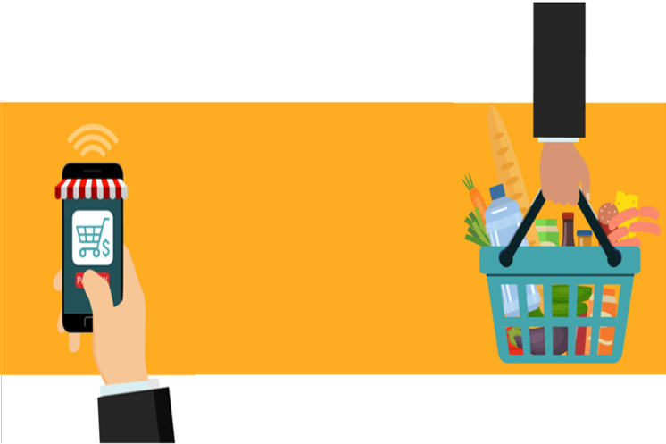
Development of a New Concept of an Online Supermarket
Graduation Project (IΙ)
Prepared by:
Amjad Ashour
Doaa Issam
Haya Ayaseh
Ro’a Sayed
Sara Mlitat
Supervised by:
Dr. Muawiya Tahseen Ramadan

Slide 2

Outline
Introduction
Demand Forecasting
Facility Layout
Process discerption
Sustainability
Future Work
Conclusion

Slide 3
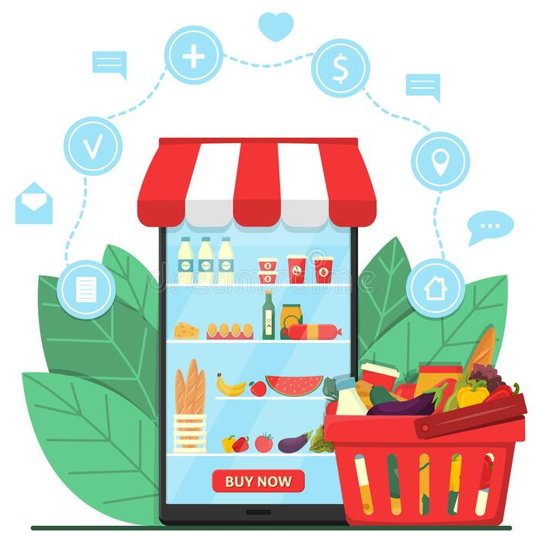
Introduction
This project is a planning to establish a new business model in order to develop a new concept of online supermarkets in Palestine-Nablus.
The stages of the emergence of supermarkets and the system they follow with its development were discussed.
An analysis and study of the market was conducted through a questionnaire.

Slide 4

Demand Forecasting

Slide 5
Methodology
Demand Forecasting
1. Conducting a questionnaire aimed at forecasting the volume of weekly demand, by knowing:
Number of family members (size)
2. Using a questionnaire that was conducted previously, to find out through it:
Their gender
Average weekly purchase order value
Age group
Current Position
Monthly Salary
Tendencies to buy daily groceries through an online application

Slide 6
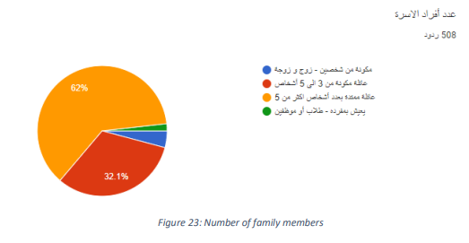
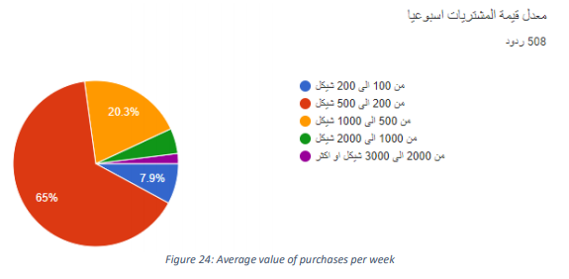
Results and discussion
Demand Forecasting
The required sample size is 383 out of 82,335 families in Nablus, more than 500 responses have been received
Figure 1: Number of family members
Figure 2: Average value of purchases per week

Slide 7
Calculation
Demand Forecasting
A relationship was found between the volume of weekly demand and the number of family members:
𝐓𝐨𝐭𝐚𝐥 𝐝𝐞𝐦𝐚𝐧𝐝 𝐟𝐨𝐫 𝐞𝐚𝐜𝐡 𝐜𝐚𝐭𝐞𝐠𝐨𝐫𝐲
= ∑𝐓𝐨𝐭𝐚𝐥 𝐧𝐮𝐦𝐛𝐞𝐫 𝐨𝐟 𝐚𝐥𝐥 𝐟𝐚𝐦𝐢𝐥𝐢𝐞𝐬 𝐜𝐚𝐭𝐞𝐠𝐨𝐫𝐢𝐞𝐬 × 𝑨𝒗𝒈 𝒅𝒆𝒎𝒂𝒏d
Table 1: Relation between family’s members and weekly demand
Categories of families / Categories of weekly demand | 1 person | two persons | From 3 to 5 people | From 5 or more | Total number of all family’s categories | Total demand for each category | Average weekly demand
100 to 200 Nis | 8 | 9 | 16 | 7 | 40 | 6,000
200-500 Nis | 1 | 9 | 120 | 200 | 330 | 115,500
500-1000 Nis | 0 | 1 | 20 | 83 | 104 | 78,000
1000-2000 Nis | 0 | 1 | 7 | 17 | 25 | 37,500
2000-3000 Nis or more | 0 | 0 | 1 | 8 | 9 | 22,500
 |  |  |  |  |  | 259,500 | 51,900

Slide 8
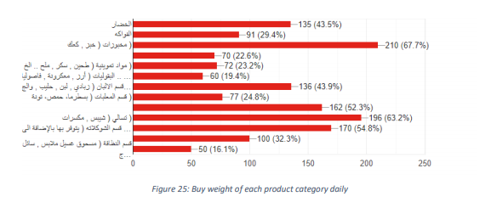
Demand Forecasting
Calculation
Calculates demand weight:
Table 2: Demand Weight for Each Category
 | Categories | Weight | Demand weights
1. | Vegetables | 8.81 | 4577.55
2. | Fruits | 5.96 | 3093.79
3. | Baked goods | 13.72 | 7120.68
4. | Meat section | 4.58 | 2377.02
5. | Food cupboard | 4.7 | 2439.3
6. | Legumes | 3.93 | 2039.67
7. | Dairy section | 8.9 | 4619.1
8. | Canning section | 5.02 | 2605.38
9. | Cold drinks | 10.6 | 5501.4
10. | Snacks and treats | 12.8 | 6643.2
11. | Chocolates and Nuts | 11.11 | 5766.09
12. | Hot drink products | 6.54 | 3394.26
13. | Household | 3.26 | 1691.94
Total |  | 100% | 51,869.39
Figure 3: Buy weight of each product category daily

Slide 9
Trend online shopping Palestine
Demand Forecasting
Factors increasing the trend of online shopping in Palestine
Restrictions created by COVID-19
Extensive use of mobile phones
Extensive use of the internet and social media
The scope of product delivery is wide
Figure 4: Trend online shopping Palestine

Slide 10

Facility Layout

Slide 11
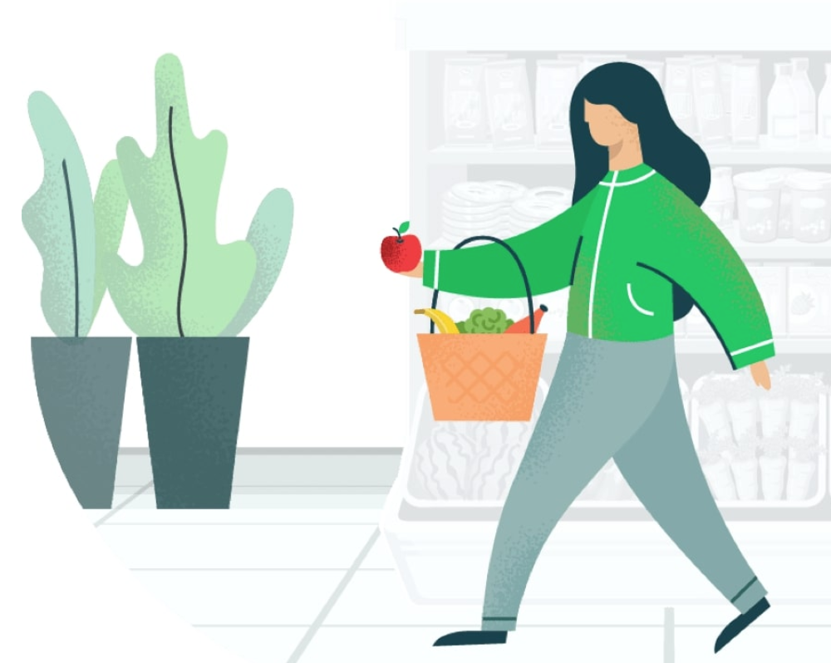
Facility Layout
Traditional supermarket
Important that the location of the store is close so that there is easy access to it and the transfer of goods to and from the supermarket. store’s capacity depends on the number of workers or employees to serve to meet customers' demand.
All the factors that were mentioned entail many costs and may be a hindrance in the capital ratio at the beginning of any project, and here it is considered a strong point in the online supermarket.

Slide 12

Facility Layout
Warehouse
The considered a strong point in the online supermarket, as it is not necessary to open the supermarket in an active location since the store will be online customers will not enter it.
For our project the facility layout will be only for the warehouse, as it will be a fully automatic system, where the human factor will be involved in a very small percentage ranging between (10-20) % only.
This warehouse will reduce the number of employees required to work in the place, as their work will be limited to arranging goods, packing shelves and packing orders.
The location of the warehouse will be in the city of Nablus, where it will be an entire floor of the building, and we will adopt the selection of basement floors to reduce the cost.

Slide 13

Facility Layout
Main benefits of automated warehouses
Main benefits of automated warehouses
More efficiency and accuracy
Safety and conservation
Easy access to products
Ensure the continuous supply of products
Space increases
More sustainable
Figure 5: Main benefits of automated warehouse

Slide 14
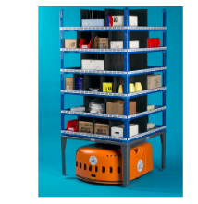
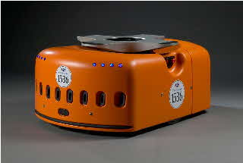
Facility Layout
Robotic Mobile Fulfillment Systems
A modern kind of robotized parts-to-picker material handling device that is specifically designed for e-commerce warehouses.
The system consists of two main parts, the robots and the capsules.
Figure 6: The essential elements of an RMFS

Slide 15
Facility Layout
Robotic Mobile Fulfillment Systems
Is made up of shelves (called pods) on which items are placed, as well as robots that can travel underneath and hold them, which robots move pods between workstations and the storage room.
In an RMFS, each pair of storage and retrieval trips represents one robot cycle. The robot does not set down or leave the rack for one loop until it is returned to a storage position.
The cost of this system is less expensive than the automated systems used in warehouses, and it has high operational efficiency compared to other systems, the robot system works with an operating capacity that lasts 23 hours a day and only needs less than an hour for shipment.

Slide 16
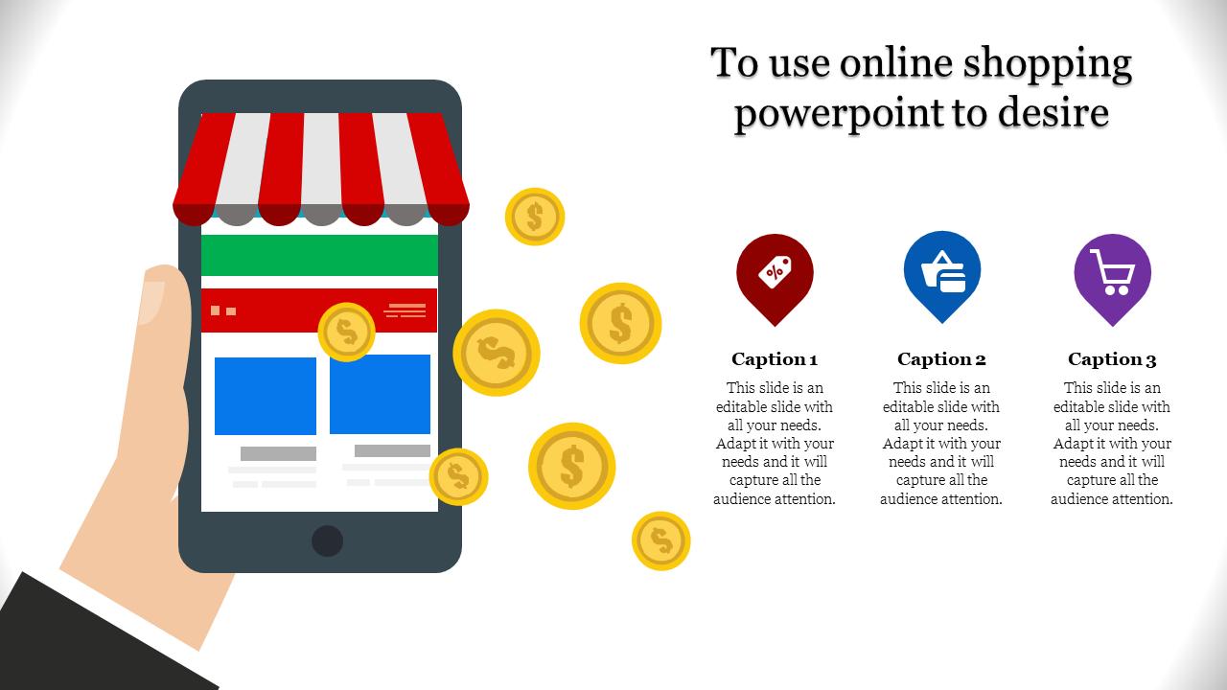
Facility Layout
Advantages of using Robotic Mobile Fulfillment Systems
Increased stocking and order picking productivity and rates.
Order accuracy, order delivery times, and order turnaround time have all improved.
Accuracy and security of inventory
Flexibility and Scalability
Electricity Savings
Reduced Training Time
No downtime and built-in redundancy

Slide 17

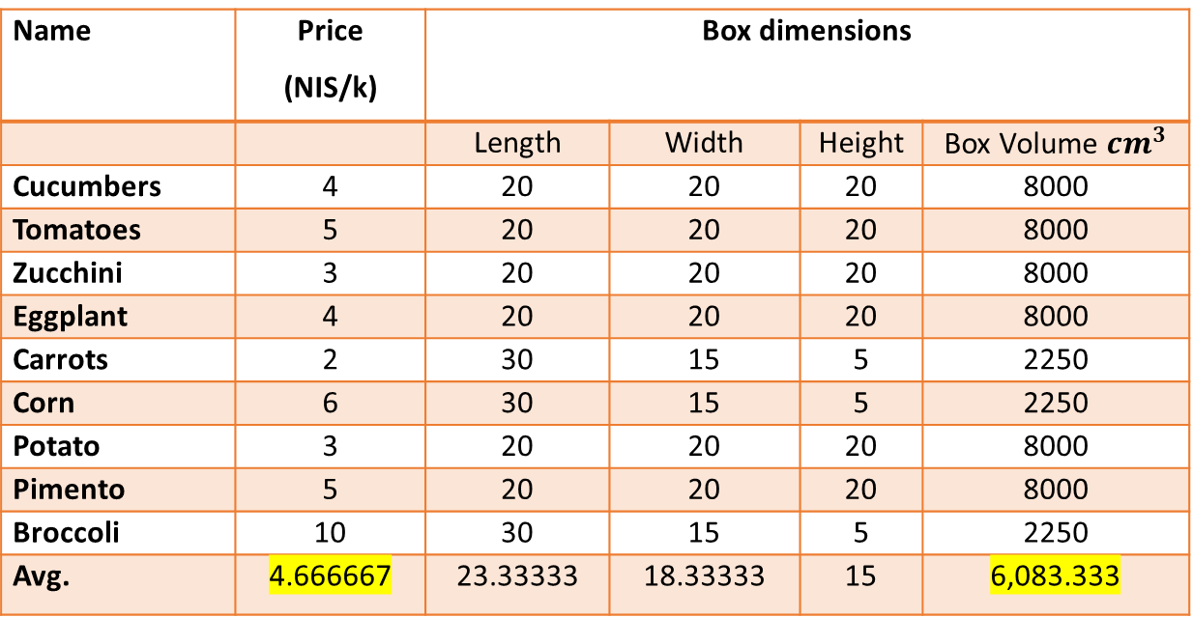
Facility Layout
Warehouse Area needed
Vegetable section
Table 3: Vegetable section example
Name | Price (NIS/k) | Box dimensions
 |  | Length | Width | Height | Box Volume ${cm}^{3}$
Cucumbers | 4 | 20 | 20 | 20 | 8000
Tomatoes | 5 | 20 | 20 | 20 | 8000
Zucchini | 3 | 20 | 20 | 20 | 8000
Eggplant | 4 | 20 | 20 | 20 | 8000
Carrots | 2 | 30 | 15 | 5 | 2250
Corn | 6 | 30 | 15 | 5 | 2250
Potato | 3 | 20 | 20 | 20 | 8000
Pimento | 5 | 20 | 20 | 20 | 8000
Broccoli | 10 | 30 | 15 | 5 | 2250
Avg. | 4.666667 | 23.33333 | 18.33333 | 15 | 6,083.333

Slide 18
Facility Layout
Warehouse Area needed
Calculations:
The dimensions of the shelf:
Length= 80 cm
Width= 40 cm
Height= 50 cm
The volume of the shelf= 160,000 cm³
Shelf capacity of vegetables =Volume of the shelf/Av. Volume of the vegetables boxes
  =160000/6083.333 = 26
No. of Boxes of vegetables = Weight of demand on vegetables/ Av. Of prices of vegetables
  = 4577.55/4.666667= 981 box
No. of shelves of the vegetables= No. of boxes/ shelf capacity
  = 981/26= 37.73 shelf
The need for the vegetable section of the capsules=No of shelves/6(no. of shelves in the one capsule)
  =37.73/6= 6 capsules for vegetable section
The required area for vegetable capsules= 4.5m(capsule area) *6
  = 27 m² of the warehouse area

Slide 19
Facility Layout
Warehouse Area needed
Table 4: Numbers of capsules and area needed
Sections | # Capsules | Area needed (m²)
Vegetables | 6 | 27
Fruits | 3 | 13.5
Baked goods | 19 | 85.5
Meat section | 1 | 4.5
Food cupboard | 1 | 4.5
Legumes | 1 | 4.5
Dairy section | 1 | 4.5
Canning section | 1 | 4.5
Cold drinks | 3 | 14
Snacks and treats | 19 | 85.5
Chocolates and Nuts | 3 | 13.5
Hot drink products | 1 | 4.5
Household | 1 | 4.5
Total | 60 | 270.5

Slide 20

Facility Layout
Total Area needed
The total area required for the capsules is approximately 270 square meters
The area was calculated at 310 square meters consisted the:
  Picking work station
  Control center
  Replenishment station
  Isolation area
  Charging station
The total area of the warehouse would be 580 square meters.

Slide 21
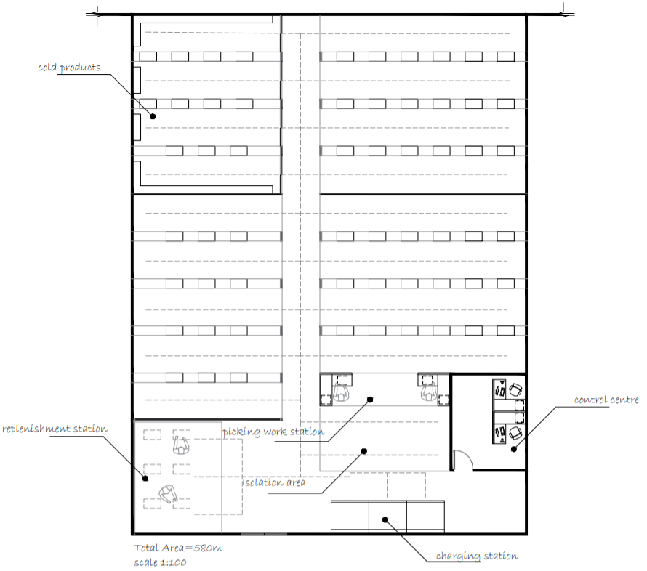
Facility Layout
Supermarket warehouse layout 2D
Cold Products
Control center
Replenishment station
Charging station
Total area= 580 m
Scale 1:100

Slide 22
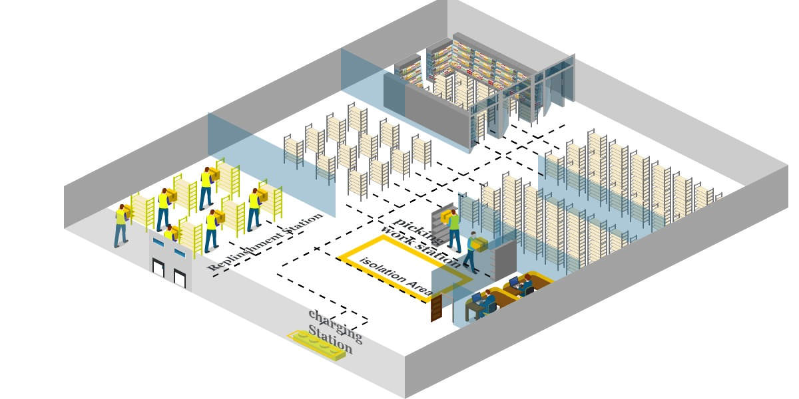
Facility Layout
Supermarket Warehouse layout 3D

Slide 23
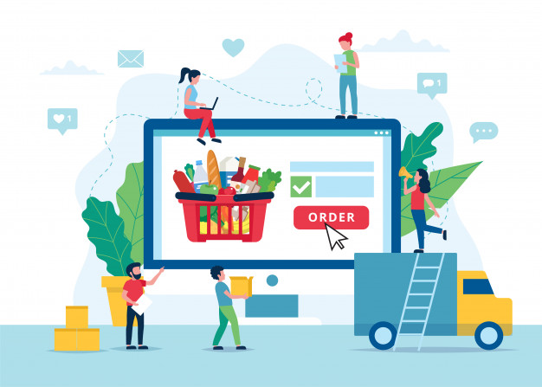
Process Description

Slide 24
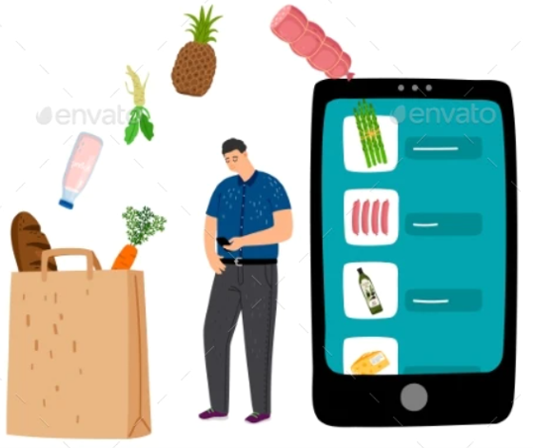
Ordering method
Process description
The customer orders the products from our supermarket through an mobile application.
The products are categorized into sections.
The employee enters the barcodes of the products into the automated system.
The robot in the warehouse reads the barcode of each product.
Then moves to the product sections upon request, and fills the capsule with the required products .

Slide 25
Storage and retrieval processes
Process description
The waypoint scheme, which is mapped out as a map, is used by robots to find their journeys through the warehouse.
Workers at replenishment stations replenish the product in the pods.
The capsules will wait for their turn in the isolation area next to each workstation.
The robot does not set down or leave the rack for one loop until it is returned to a storage position.

Slide 26
Sorting, Categorizing, and storage of inbounded goods Process
Process description
Most of the goods are already packed upon arrival at the supermarket, and some products that need to be packed.
Beams are placed on the shelves, arranged in aisles and sections depending on the type of item
Some items, such as fresh produce, are stored in boxes. Those requiring an intact cold chain are in temperature-controlled display cases.
Place more than one similar variety in the same capsule, to increase efficiency and use time to fill the customer's order faster.
High Demand products are placed on shelves close by picking workstation.

Slide 27
Department of cold products
Process description
The temperature needed to maintain depends on the storage time required and the type of product.
Cold products
Fruits and vegetables
Meat and fish products
Cold drinks
Dairy products
Figure 7: Cold product section

Slide 28
Optimization and prioritizing
Process description
Software is used to create prioritizing and optimization for the target site and the time available to deliver the orders.
The software based on the optimizing system and sorting according to sites of customers ,then optimization of routing according to time division.
The time division is either urgent or normal.
Areas of Nablus
Western Area
Eastern Area
Southern Area
Northern Area
Figure 8: Areas of Nablus

Slide 29

Delivery
Process description
Companies follow their own delivery system or that prefer to contract with external delivery companies.
Internal Delivery: it gives you complete control over how you operate and manage the delivery service.
Outsourcing: save money on fixed costs by eliminating the need to pay delivery workers’ salaries and insurance premiums.

Slide 30
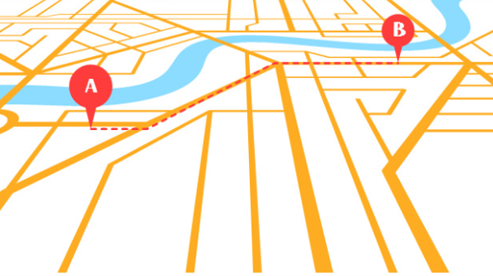
Delivery
Process description
Delivery method in our online supermarket
Have a small car and two transport vehicles in order to meet small and urgent requests.
There will be an external source to deliver large orders that need more time and effort to transport them, such as contracting with a delivery company to ensure that orders arrive correctly.

Slide 31
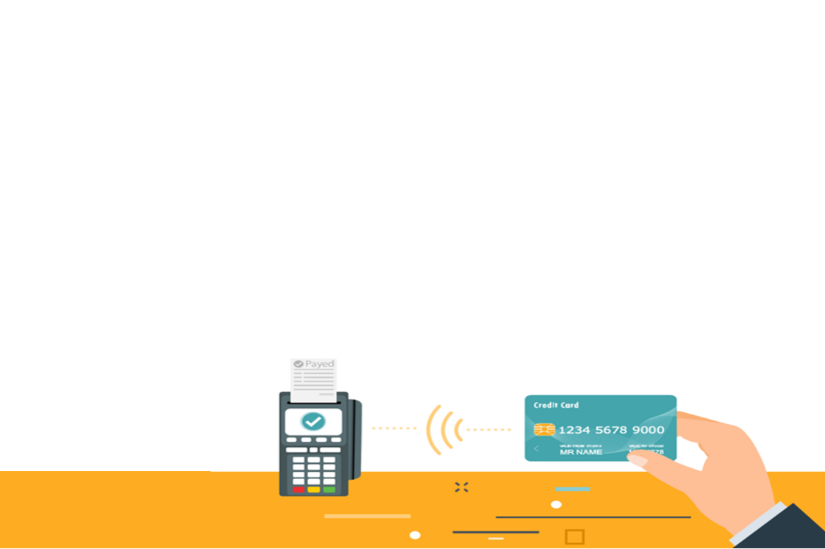
Payment Method
Process description
Pay when receiving
  1. Pay cash on delivery
  2. Pay with credit card upon receipt
Pay on request
  3. Prepaid via (PayPal)
  4. Prepaid via (Jawwal Pay)

Slide 32
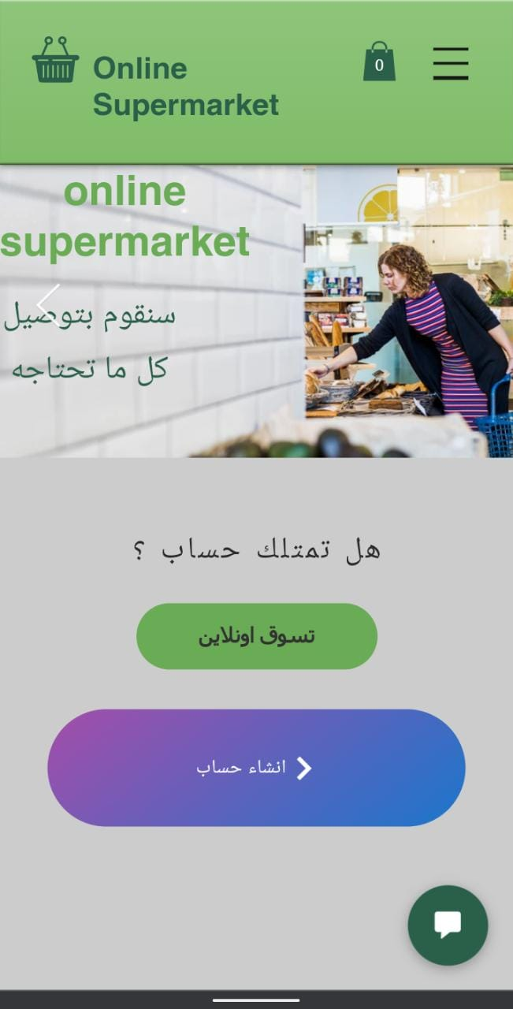
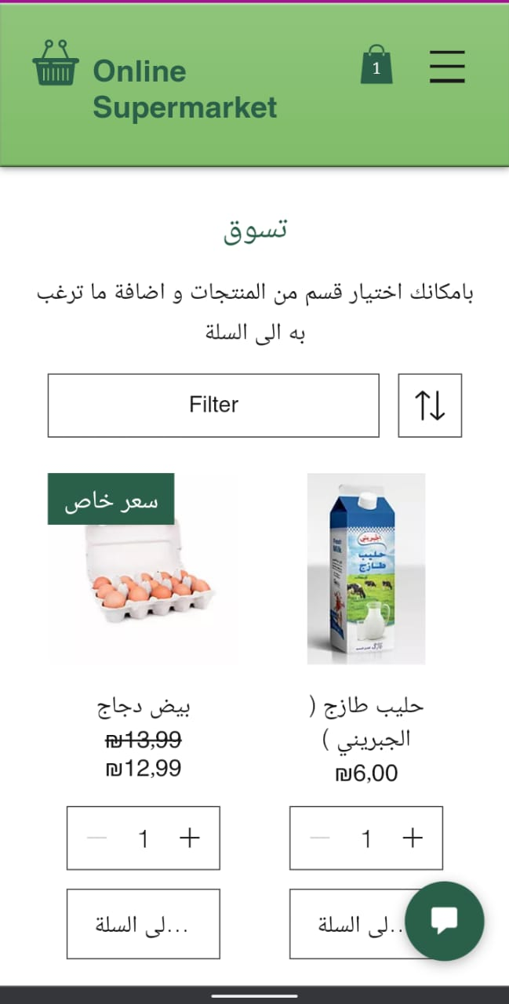
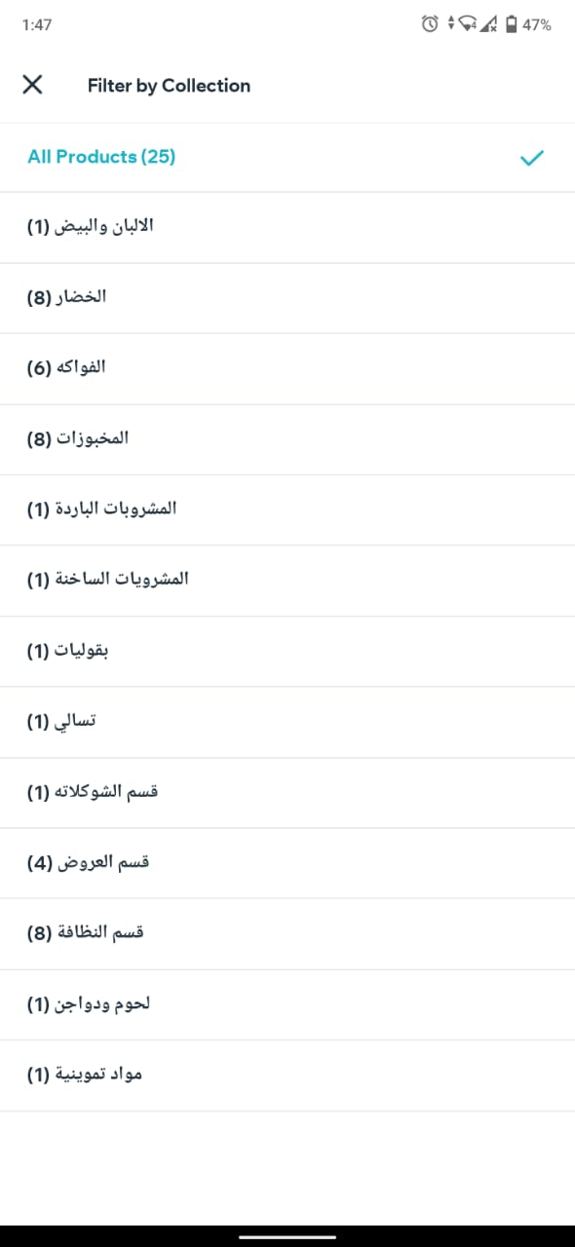
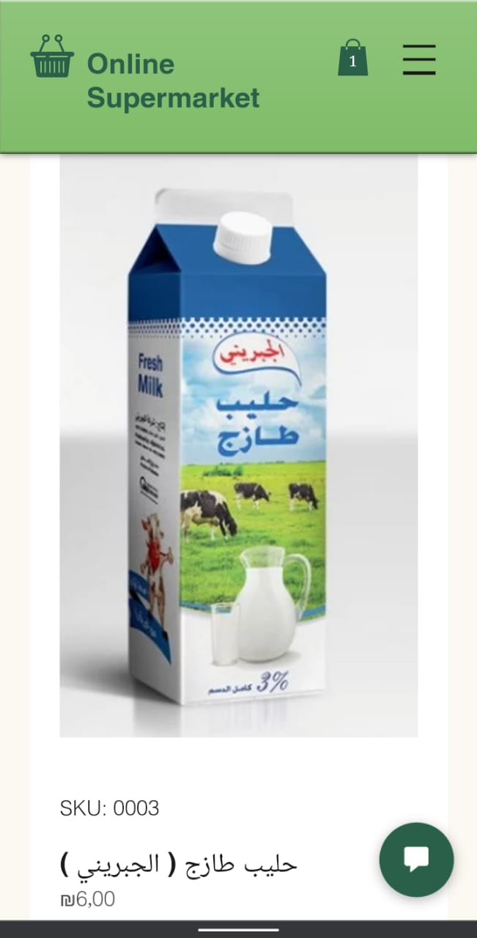
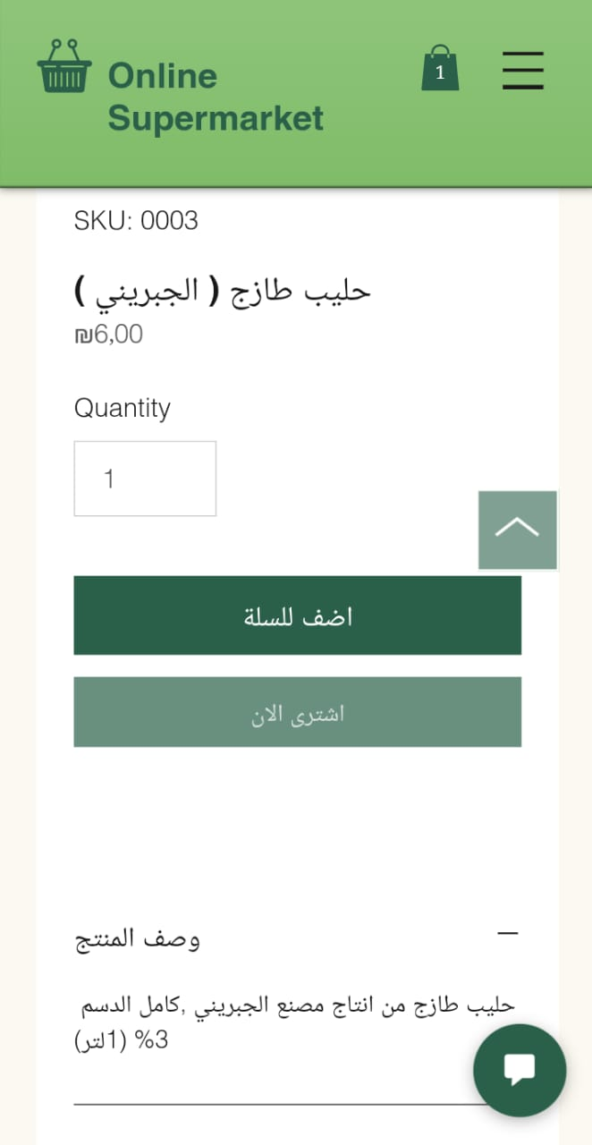
Application interface design
Process description
1
2
3
4
5
Figure 9: Interface design

Slide 33

Sustainability

Slide 34

Sustainability
The sustainability of the project is an important factor that must be taken into consideration to maintain the project’s survival and success.
In order to ensure the continuity and success of the project and to ensure that the consumer receives the best service and the highest quality of products, several factors must be taken into account.

Slide 35
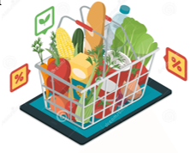
Maintain a High Level of Supply Chain Visibility
Sustainability
In a perfect supply chain everyone involved will be able to view the product's trajectory from the source to arrival at its destination.
Seeing the product path helps monitor the problems that may occur during its path, identify the shortages that may occur and track the problems that may occur with the quality of the product.

Slide 36
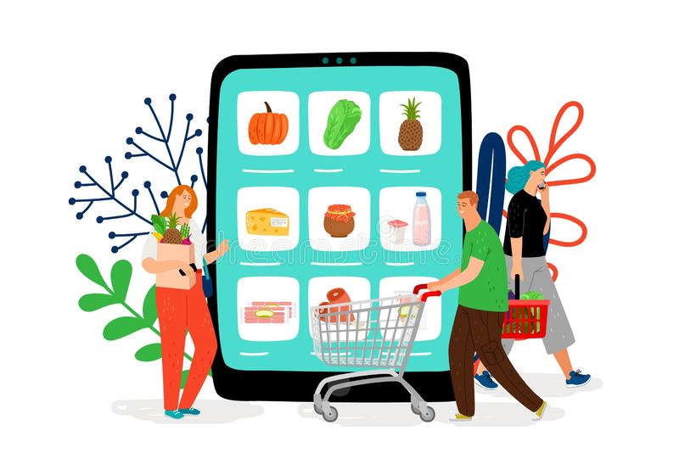
Retail product availability and competition
Sustainability
In the supermarket industry, product availability is an important measure of quality , maintaining optimal product availability is an important dimension of store quality in the retail sector.
Repeated inventory depletion and limited product variety is the number one cause of dissatisfaction among supermarket shoppers.

Slide 37
MIAC model
Sustainability
The MIAC model illustrates how three main components(intention, adoption, repurchase) are linked to five critical variables (consumer characteristics, environmental influences, product/service characteristics, medium characteristics, merchant and intermediary characteristics).
Understanding the factors that affect intention, adoption and repurchase are important for researchers and practitioners alike.

Slide 38

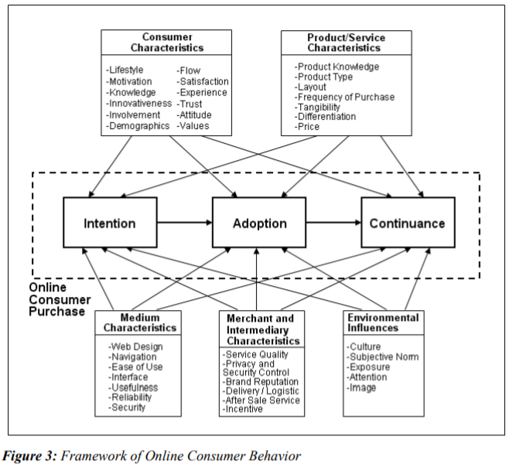
MIAC model
Sustainability
Figure 10: Framework of online consumer behavior

Slide 39

Satisfaction
Sustainability
If the performance provided meets expectations customer's expectations, confirmation is formed and consumers are satisfied. And When the customer is satisfied, he will return to the online supermarket to make another order.

Slide 40

Branding and marketing effort
Sustainability
The whole point of marketing is to sell your products or services, and a strong brand will enable your marketing team to do precisely that.
Social media provides an important factor for good project marketing, you can target ages, gender, interests and much more to really focus in on that target prospect.

Slide 41
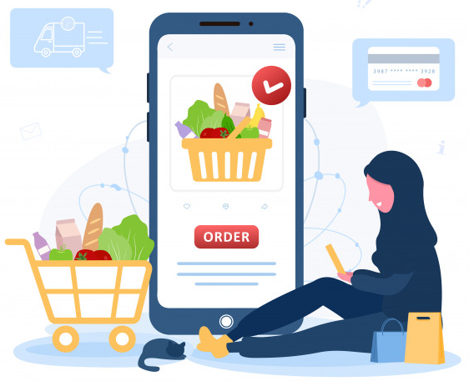
Platform
Sustainability
In our supermarket project, we will apply the platform principle, which is a contract between the electronic supermarket and other companies , whereby the supermarket sells goods through their application in exchange for a certain profit rate that is agreed upon between the two parties.

Slide 42
Application Quality
Sustainability
Good application quality helps customers to complete the purchase process smoothly, so some factors related to the quality of the application must be taken care of:
  Easy to use
  Focusing on user privacy and security
  Quick response to commands

Slide 43

Customer service
Sustainability
Order tracking system: Notifications are sent to the customer when the order is prepared, and the application allows tracking the delivery path from the moment it leaves to the moment it reaches the customer.
Rating the purchase process: Giving the customer the right to provide an evaluation of the completed purchase.
After sales service: Communication with the customer is done through the complaints or problems department, through the feedback received by the customer during his evaluation of the purchase process.

Slide 44
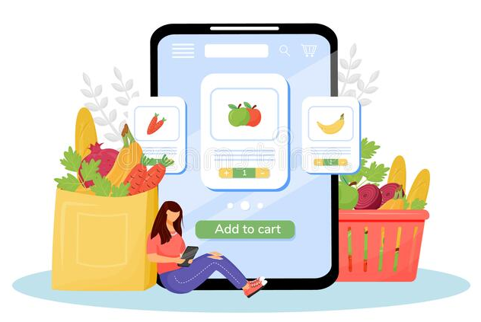
Future Work
Open 24 hours
Prioritizing and optimization software
Notices for offers
Product review

Slide 45
Conclusion
A supermarket will be established that contains the daily needs of the consumer and the internal system will be automated where the products are arranged on capsules that have their own code and are moved by a robot belonging to the system.
Depending on the capsule capacity, the required number of capsules was determined, which is 60 capsules and occupies an area of ​​270 and 2 robots.
Using the AutoCAD program, a plan for the warehouse, including work and movement places, was made, thus the total area became 580. An online application will be approved for the shopping and ordering process to be completed.

Slide 46

Thank You For Attention

