Slide 1
Grid Connected PV System for Nablus Specialist Hospital in Nablus.
Prepared by : Farah Abu Aisheh
Supervisor : Tamer Khtib

Slide 2
Abstract :
It's important to find new sources of energy like renewable energy to produce electricity, especially in Palestine because of the lake of other sources .
Solar radiation in Palestine is good , So using solar systems will produce electricity that will be enough to meet the needs.

Slide 3
Introduction:
Energy situation in Palestine:
is highly different compared to other countries in the Middle East due to non-availability of natural resource, financial crunch and unstable political condition.
Heavily dependent on Israel for meeting its energy requirements , about 92% of electrical energy from the Israeli Electric Corporation.
.

Slide 4
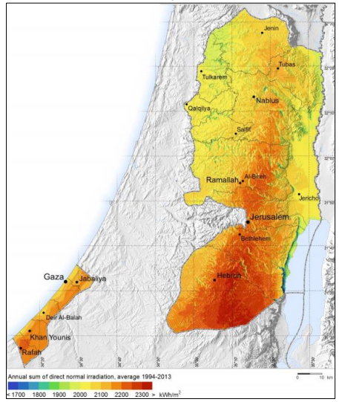
Solar Radiation In Palestine :
Palestine is located between Mediterranean Sea and The Jordan River , It has highly variable climate conditions modified locally by altitude.
Palestine is divided geographically into five regions with different climate conditions.

Slide 5
Grid Connected PV System :
Is an electricity generating solar PV power system that is connected to the utility grid.
It consists of solar panels, one or several inverters, a power conditioning unit and grid connection equipment. It can used for residential or commercial.

Slide 6
Methodology:
Data alanlysis
Conclusions
& Recommendations
Site selection
Data collection
Feasibility Study by RetScreen
Design the system
Design the system by Pvsyst

Slide 7
Site Selection :
The site selected according to the hospital location and to available area which it was the roof of hospital .
the available area for modules equal 155 m² and its enough for 45 modules with it’s components .

Slide 8
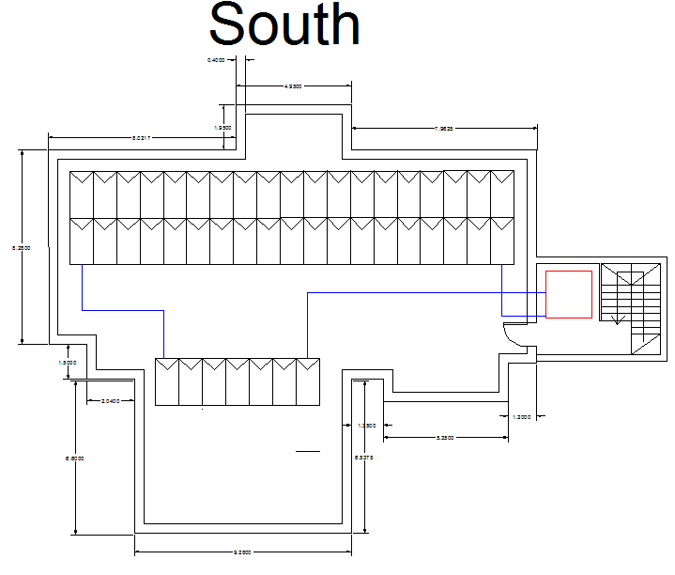
Layout :

Slide 9
Data Collection :
A group of data required to implement Pv system for Palestine region, specially the daily solar radiation .
The data in this project have been collected from PV Companies , Palestinian Energy Authority , RETSCREEN and Pvsyst program.

Slide 10
System sizing :
PV modules | 45
Inverter | 1
SPDT | 5
Electrodes | 3
Wires | 115m
Circuit Breakers | 4

Slide 11
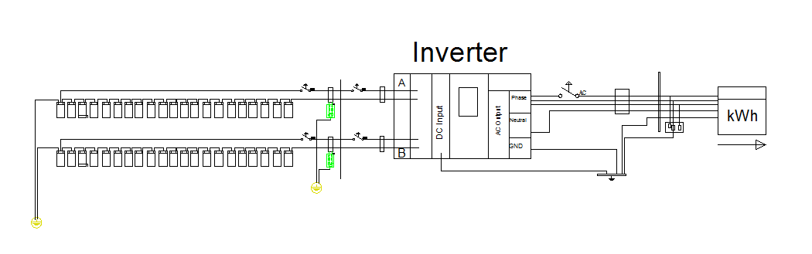
The electrical diagram :

Slide 12
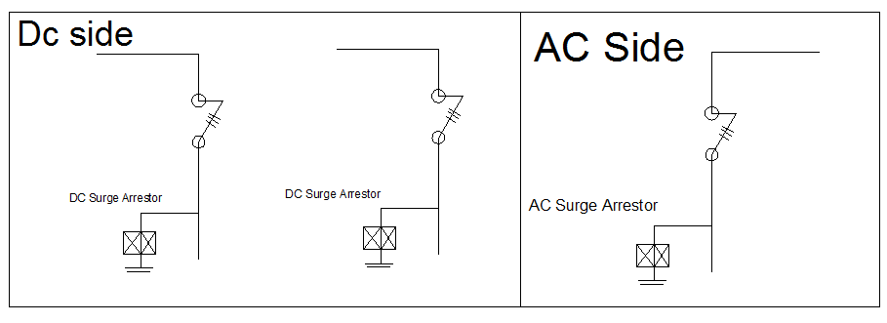
SPDT diagram :

Slide 13
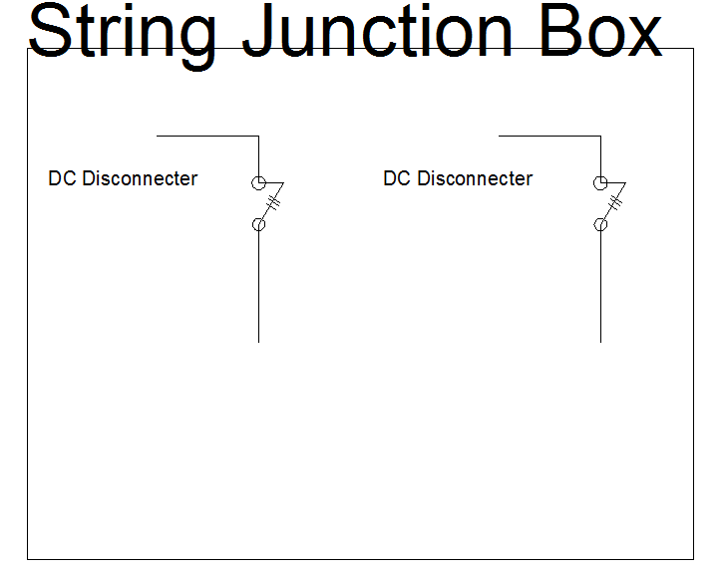

Slide 14
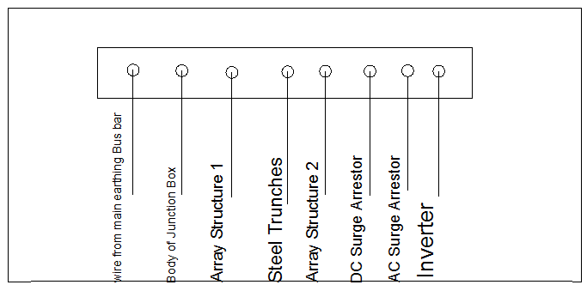
Busbar diagram :

Slide 15
BOQ :
Devices | Price/Device | # of Devices | Total Price
PV Modules (320) | 180$ | 45 | 8100$
Inverter (15kva) | 3000$ | 1 | 3000$
Circuit Breakers (DC) | 30$ | 4 | 120$
Circuit Breakers (AC) | 30$ | 1 | 30$
Wires (DC/4mm) | 4.5 ILS/m | 100m | 450$
Wires (AC/2.5mm) | 120 ILS/100m | 15m | 18 ILS
Electrodes (D=2cm) | 300 ILS | 3 | 900 ILS
Steel Structure | 100$/Kw | 15 | 1500$

Slide 16
Devices | Price/Device | # of devices | Total Price
Stones | 300 ILS | 45 | 13500 ILS
SPDT (DC) | 350 ILS | 4 | 1400 ILS
SPDT (AC) | 480 ILS | 1 | 480 ILS
Surge Arrestor | 400 ILS | 3 | 1200 ILS
Bus Bar | 15$ | 1 | 15$
Bidirectional Meter | 100$ | 1 | 100$
Protection Box | 50 ILS | 2 | 100 ILS
Trunches | 2.5 ILS/m | 100m | 250 ILS

Slide 17
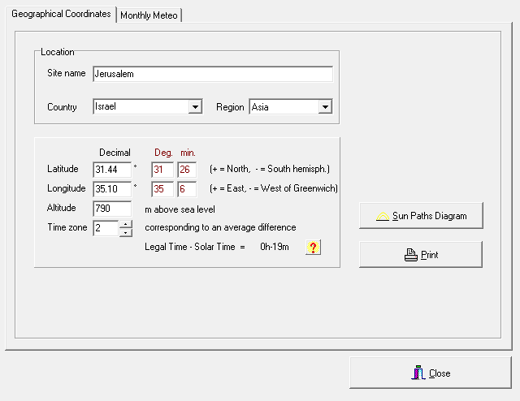
Designed the system by Pvsyst :

Slide 18
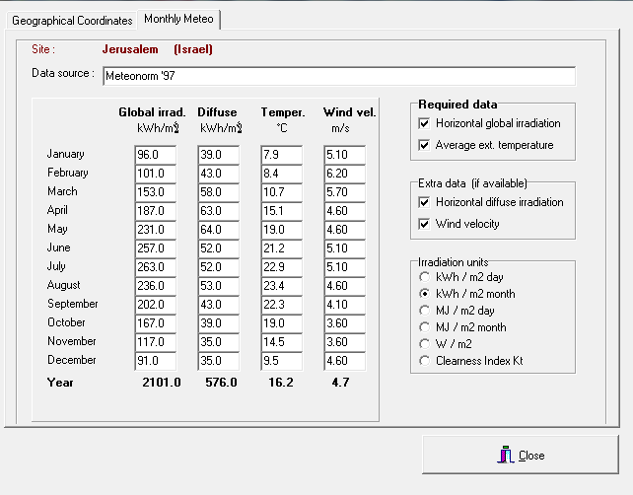

Slide 19
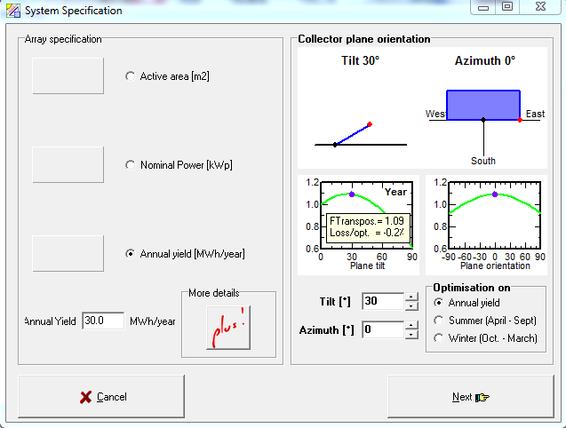

Slide 20
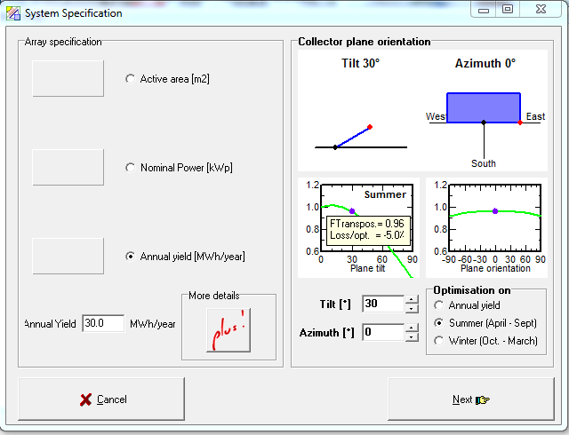

Slide 21
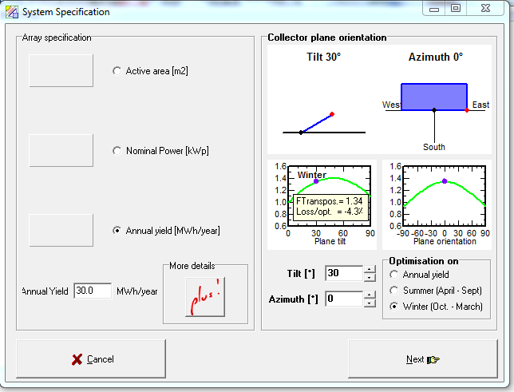

Slide 22
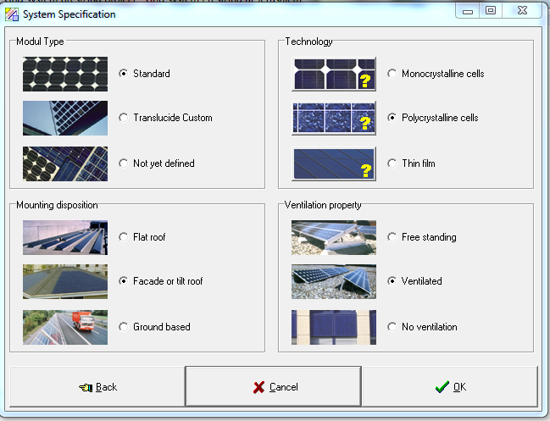

Slide 23
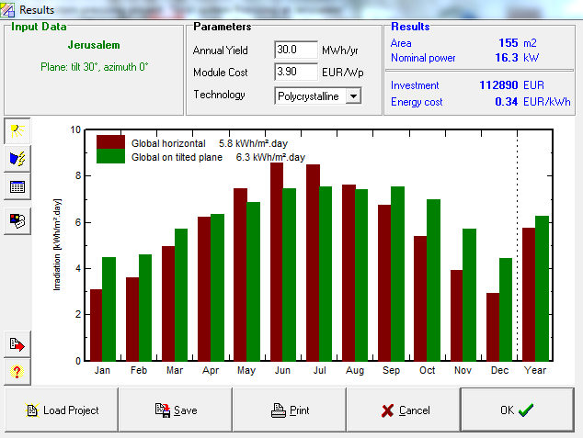
The results from Pvsyst:

Slide 24
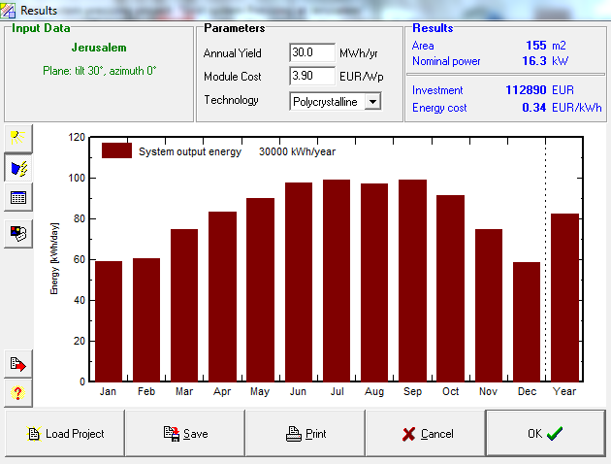

Slide 25
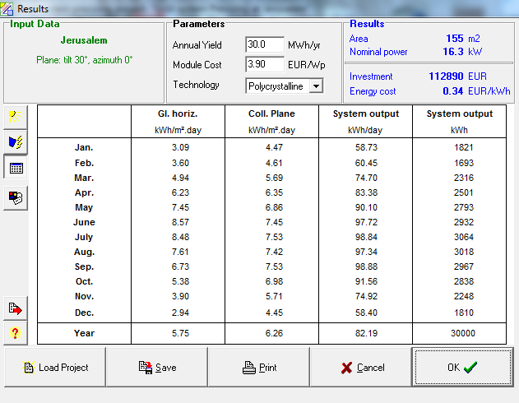

Slide 26
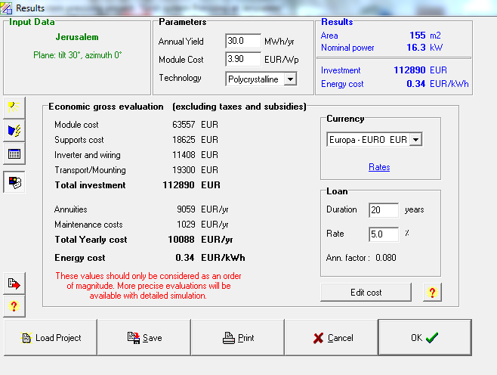

Slide 27
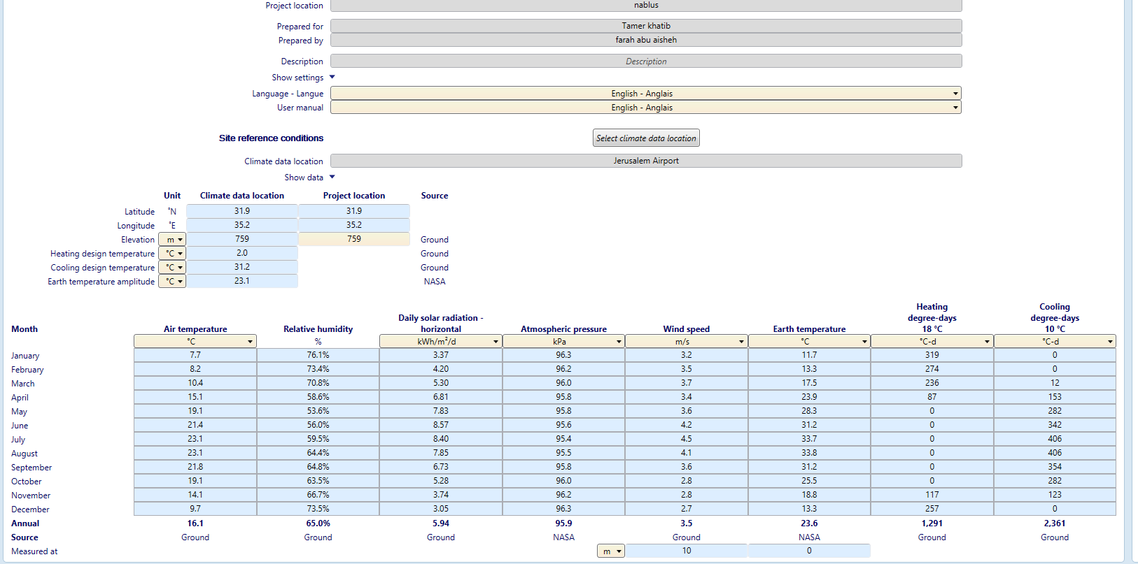
RetScreen Program :

Slide 28
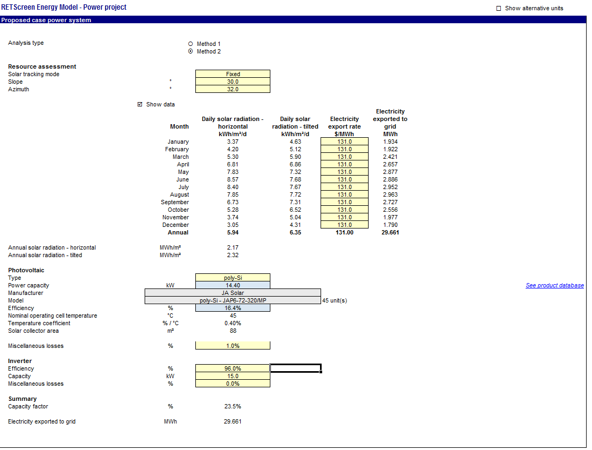

Slide 29
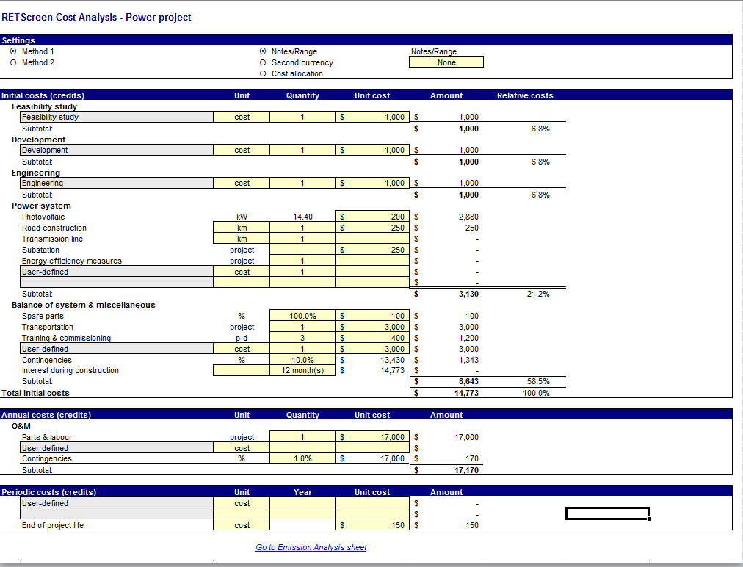

Slide 30
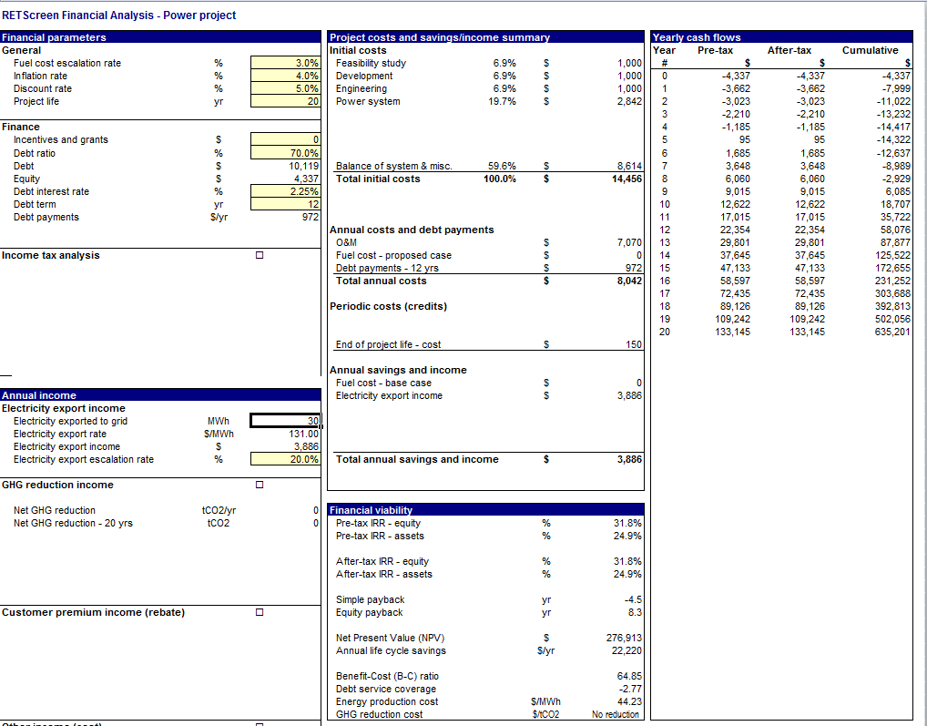

Slide 31
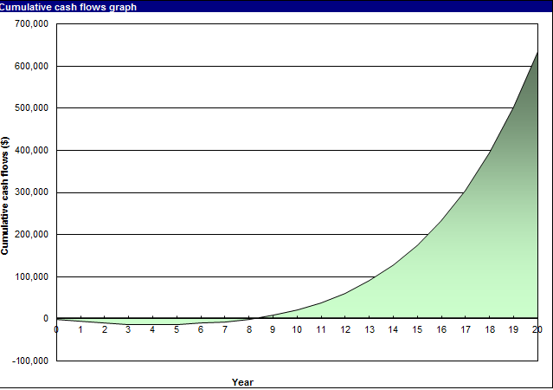
Cash Flow :

Slide 32
Conclusion:
A grid Connected PV system for Nablus Specialist Hospital in Nablus is designed with 45 modules, which produce 14.4kW . The total Initial cost = 14,456$, the total annual costs = 8,042$, the total annual saving and income = 3,886$. In this report system designed by using calculations and two programs which are RETscreen and PVSYST, The obtained results from PVSYST similar to calculation’s result, it show that the available area in hospital can produce 16kW and also it give an indicate to design the system, and RETscreen used to make a feasibility study and it show that the project will gain profits after 8 years.

Slide 33
Thanks for listening

