Slide 1
Multi Carrier CDMA system
Prepared by:
Hanaa Namrouti
Noor Khanfar
Supervised by: Dr.Yousef Dama

Slide 2
Outlines
Scope of the project
MIMO concept overview
OFDM-CDMA concept overview
Results
Conclusions
Recommindations

Slide 3
Scope of the project :
Our project aims to enhance the bit rate by implement a combination of (MIMO- OFDM – CDMA) Models at the same telecommunication system through Matlab simulations.

Slide 4
What is MIMO ?
MIMO is effectively a radio antenna technology as it uses multiple antennas at the transmitter and receiver to enable a variety of signal paths to carry the data, choosing separate paths for each antenna to enable multiple signal paths to be used.

Slide 5
Standard Radio Transmitter Receiver
Mobile station
Base station

Slide 6
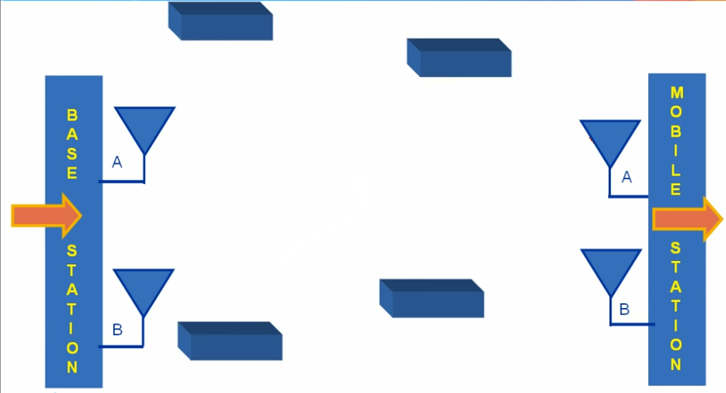
What does MIMO do?

Slide 7
What is OFDM ?
OFDM is a frequency-division multiplexing (FDM) scheme used as a digital multi-carrier modulation method. A large number of closely spaced orthogonal sub-carrier signals are used to carry data on several parallel data streams or channels.

Slide 8
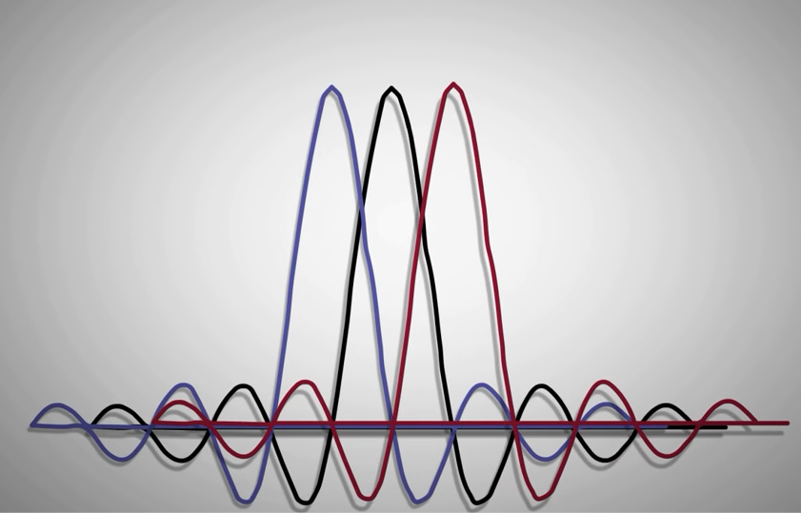
Subcarriers are overlapping in frequency domain
Orthogonal Subcarrier
Amplitude

Slide 9
Orthogonal frequency division multiplexing (OFDM)
Single carrier
OFDM
Level
Frequency
Frequency
Serial symbols
Wide frequency
Short symbol time
S6 | S5 | S4 | S 3 | S2 | S1
S1
S2
S3
S4
S5
S6
Time
Time
parallel symbols
narrow frequency
long symbol time

Slide 10
Space Time Coding
MIMO technologies can be divided into two main categories: diversity and spatial-multiplexing .
Space time coding is a Type of The diversity of MIMO Antenna and its employed to improve the reliability of data transmission in wireless communication system,
(STC) technique is called Alamouti's block code.

Slide 11
MC- CDMA
(MC-CDMA) is a multiple access scheme used in (MIMO- OFDM )combination telecommunication systems, allowing the system to support multiple users at the same time, its development aimed at improved performance over multipath links.

Slide 12
<
Results

Slide 13
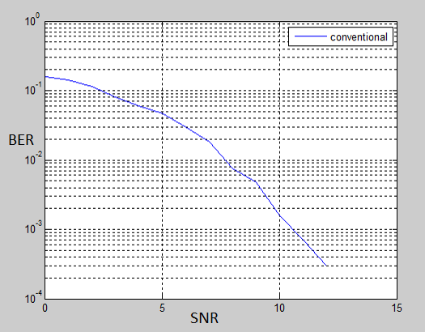
SISO system ( result from GP1)

Slide 14
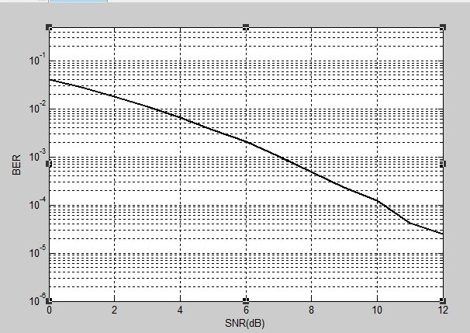
BER vs SNR for MIMO(STC) system

Slide 15
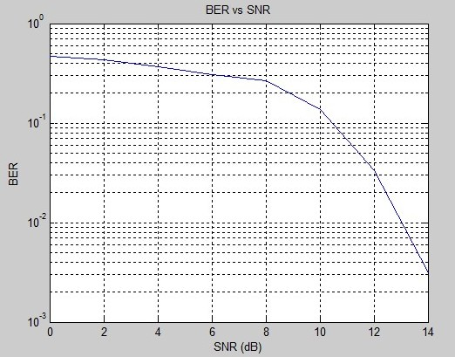
(BER VS SNR )for OFDM System

Slide 16
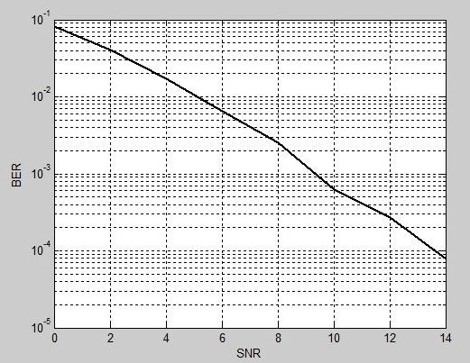
(BER vs SNR) for the combination of MIMO and OFDM System.

Slide 17
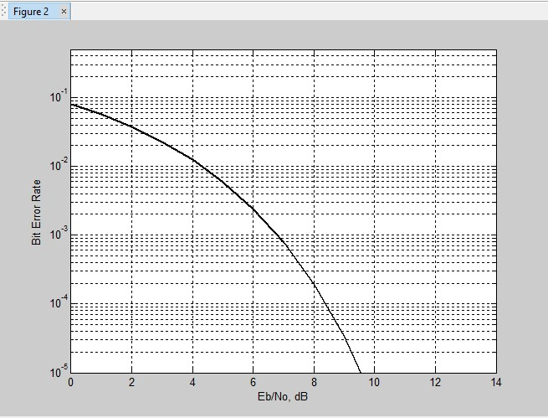
(BER vs SNR) for the combination of MIMO and OFDM System.

Slide 18
Conclusion
Our simulations behaves as expected according to theory.
We noticed the difference between the SISO system in Project 1 and the MIMO system ,as the efficiency of the MIMO system was higher than in SISO and we noted this preference through BER VS SNR simulation .
(MC – CDMA ) is The best system can be configured because it’s affects time, frequency, space and code to gives us the best BER and best performance for the whole system.
We learned also a lot while creating and testing our simulator. Through trial and error, we learned the importance of MIMO and OFDM and CDMA and a combination of all of them.

Slide 19
Recommendation :
As for the future work, our Method can be tested using real data from JAWWAL Company.
This could improve our simulation.

Slide 20

>

