Slide 1
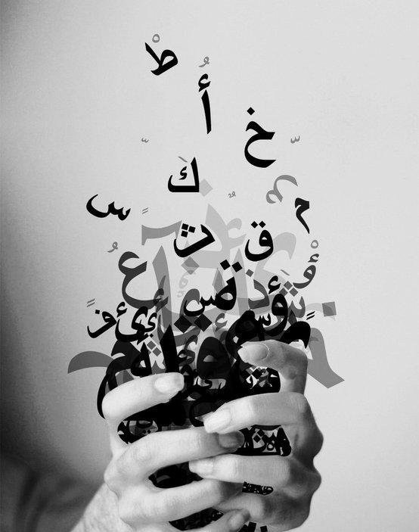
ARSL
Israa Khalifeh
Fatima Daraghmeh

Slide 2
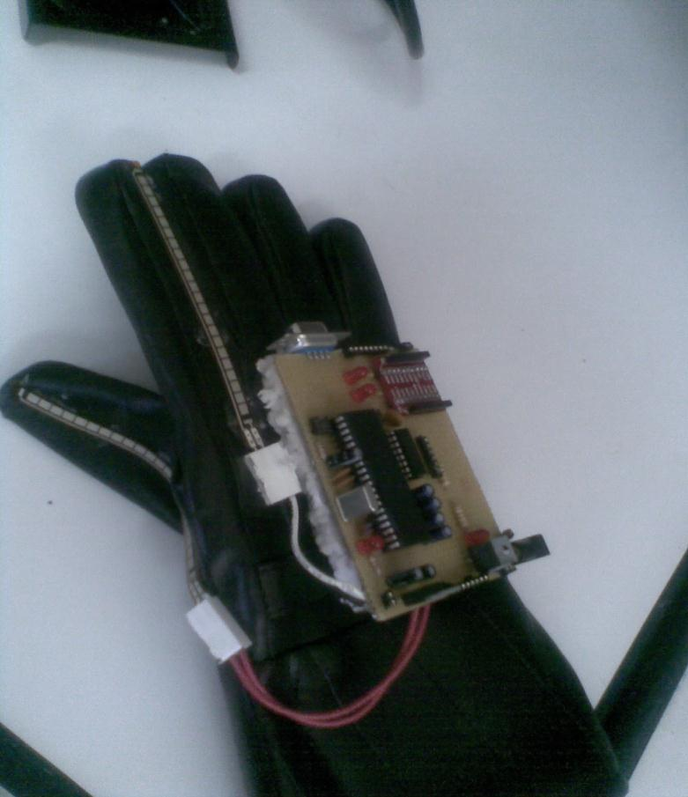
ARSL
Arabic sign language translator.

Slide 3
Why ARSL?
Help vocally disabled people to speak freely.
Easy way of communication with non-mute people.

Slide 4
What is ARSL?
Arabic Sign Language Translator.
Electronic gloves that translate (with the help of a desktop application) the arabic sign language into arabic spoken language (letters,words,etc).

Slide 5
Our ARSL
Detects the sign using the e-glove.
Sends data via wireless to the pc.
The pc desktop application recognizes the corresponding letter.

Slide 6
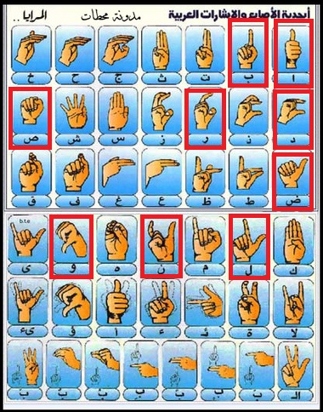

Slide 7
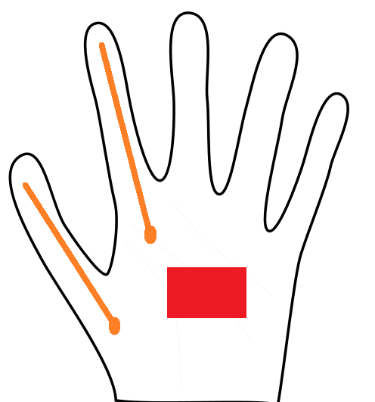

Slide 8
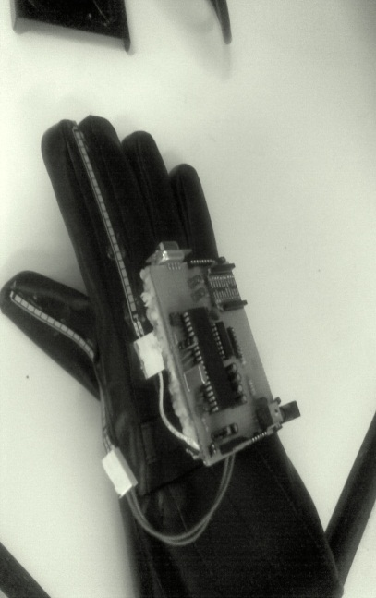
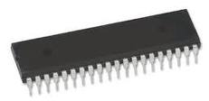
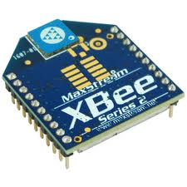

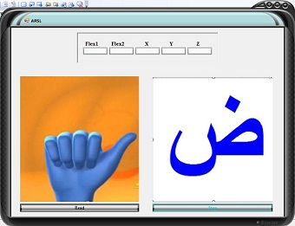
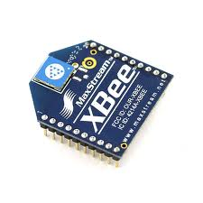

Slide 9
Basic Components
Hardware :
  Gesture input module.
  Gesture preprocessing module.
  Data transmission module.
Software:
  Gesture recognition module.

Slide 10
Hardware
  Gesture input module:

Slide 11

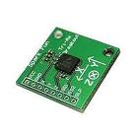
Gesture input module:
Flex sensor (2) :
  Measures the bending
  of the finger.
Accelerometer:
  tri-ax : x,y,z.
  Measure the orientation of the palm.

Slide 12
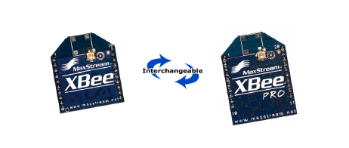
  Gesture preprocessing module.
  -PIC18F4620
  Data transmission module.
  2- Xbee RF Modules .

Slide 13
Software
Microcontroller :
  PICC .
Desktop App.:
  Visual c# 2008.
  Decision trees.
  K-NN (K-Nearest Neighbor).
  Two modules:
    Training module (decision tree).
    Testing module (KNN).

Slide 14
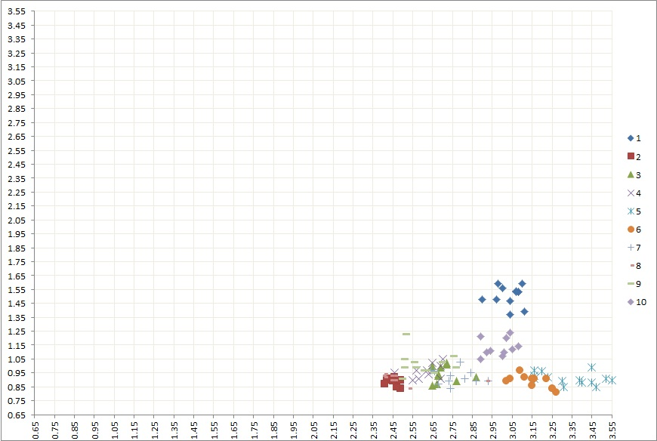
Classification (Training module)

Slide 15
Decision Tree & KNN
(1,2,3,4,5,6,7,8,9,10)
AD
(1)
(10)
(2,8)
(5,6)
(4,9,3,7)

Slide 16
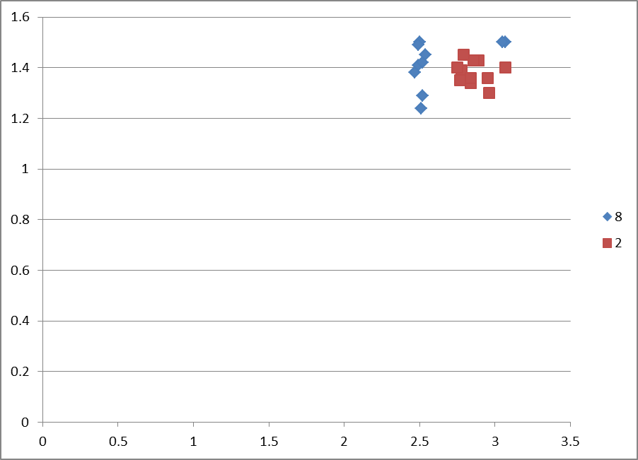
Classification-2

Slide 17
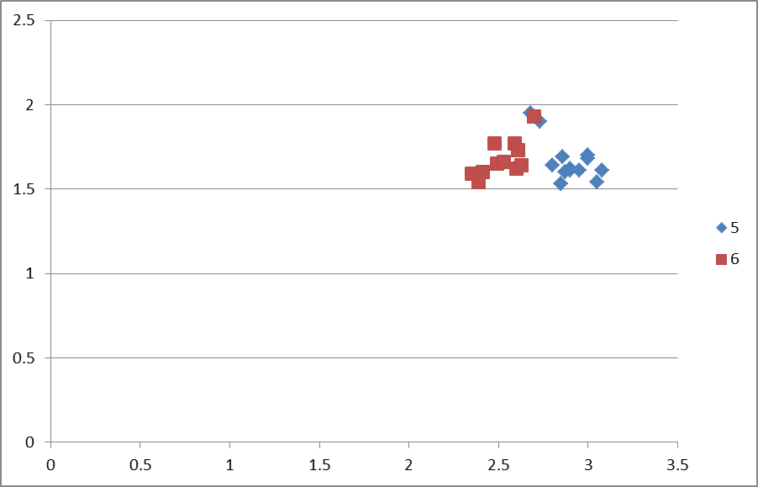
Classification-3

Slide 18
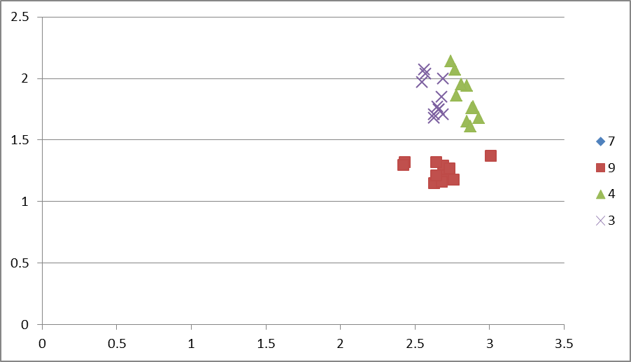
Classification-4

Slide 19
Decision Tree & KNN

Slide 20
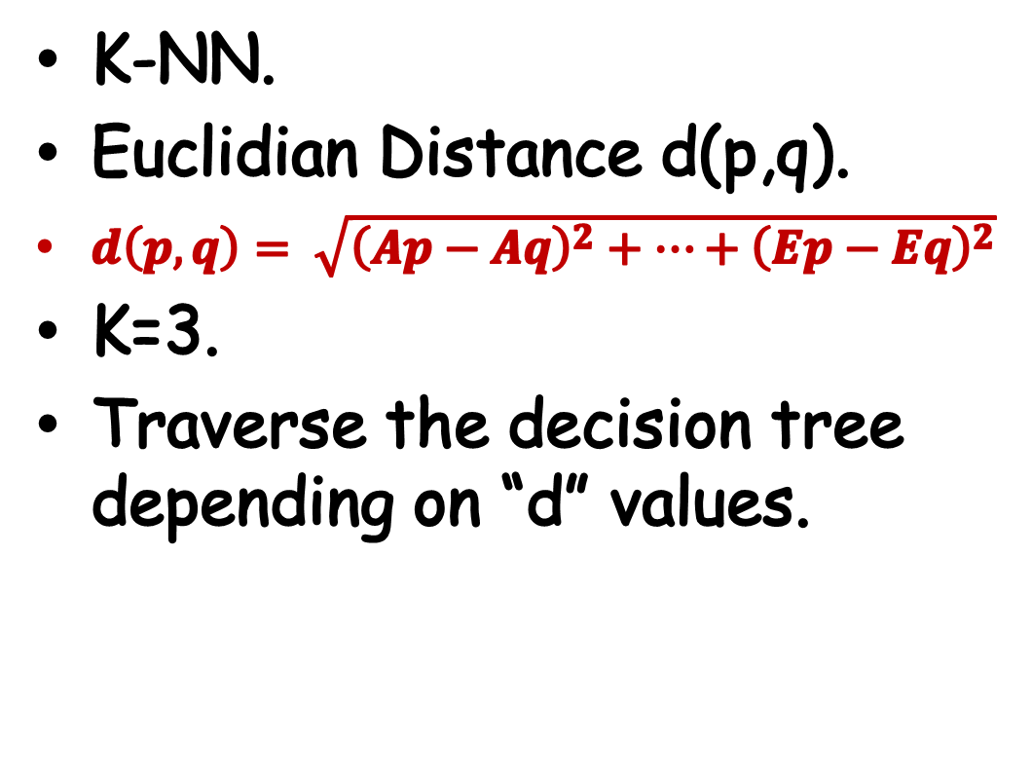
Testing module
K-NN.
Euclidian Distance d(p,q).
$d\left(p,q\right)= \sqrt{{\left(Ap−Aq\right)}^{2}+…+{\left(Ep−Eq\right)}^{2}}$
K=3.
Traverse the decision tree depending on “d” values.

Slide 21
Conclusion
Tested on 160 samples :
  110 training.
  50 testing.
  2 outliers.
  2 mistakes out of 50 => 90% correctness .

Slide 22
Problems
Poor quality of IC’s:
  Flex sensors .
  Accelerometers.
Sending data via xbee.
Difficulties in software implementation.

Slide 23
To be done ….
28 Arabic alphabets.
Most common words and phrases.
Arabic text to speech.

Slide 24
Thanks for your
attention

