Slide 1


Smart ready-mix concrete plant
Prepared by: Ameer Salam
Mosab Bani jaber
Supervisor: Dr. Samer Mayaleh

Slide 2
Introduction
The concrete industry is important globally, especially in Palestine, where it is vital for infrastructure and reconstruction projects, contributing to the economy and creating job opportunities.
The following graph shows the percentages of factories in each region in Palestine.

Slide 3
Introduction
The feature | Wet concrete plant | Dry concrete plant
Mixing method | Mix all ingredients together | Mix the dry ingredients first, then add the water
The quality | Higher quality | Lower quality
The cost | Higher cost | lower price or cheaper
Flexibility | Less flexible | More flexible
Applications | Applications that require high quality Such as bridges and tunnels | Applications that do not require high quality such as sidewalks and roads
There are two types of concrete factories in Palestine:
Dry mix concrete plant
Wet mix concrete plant

Slide 4
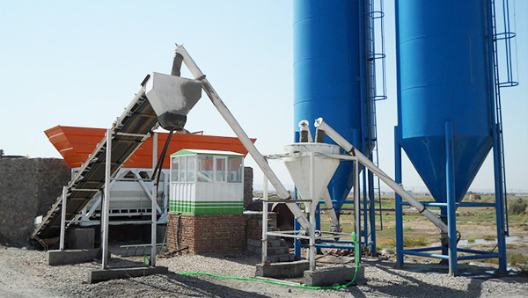

Slide 5
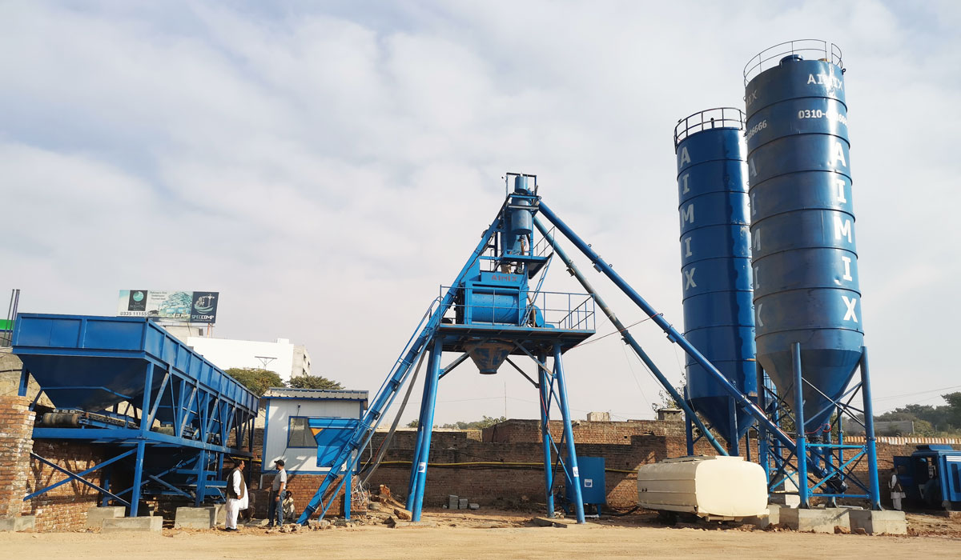

Slide 6

Challenges encountered by ready-mixed concrete factories in Palestine:
  Inadequate control programs:

Slide 7




2. Error in weight measurement.

Slide 8


3. Human errors

Slide 9
4. Weather-related problems
Rainfall can harm concrete quality, especially during curing. Excess rainwater dilutes the mix, weakening the final product.
High humidity can slow down the curing process of concrete. Curing is essential for the development of strength and durability,

Slide 10
Objectives
Enhance efficiency by streamlining processes
improving accuracy
reducing costs
ensuring consistent quality
increasing safety
enabling remote monitoring and control

Slide 11
Methodology
A control system was created that simulates the real system of a concrete plant without using additional units, such as load modules and analog modules, due to their high cost.
This method is used to test the system, inspect it, and experiment with its features.

Slide 12

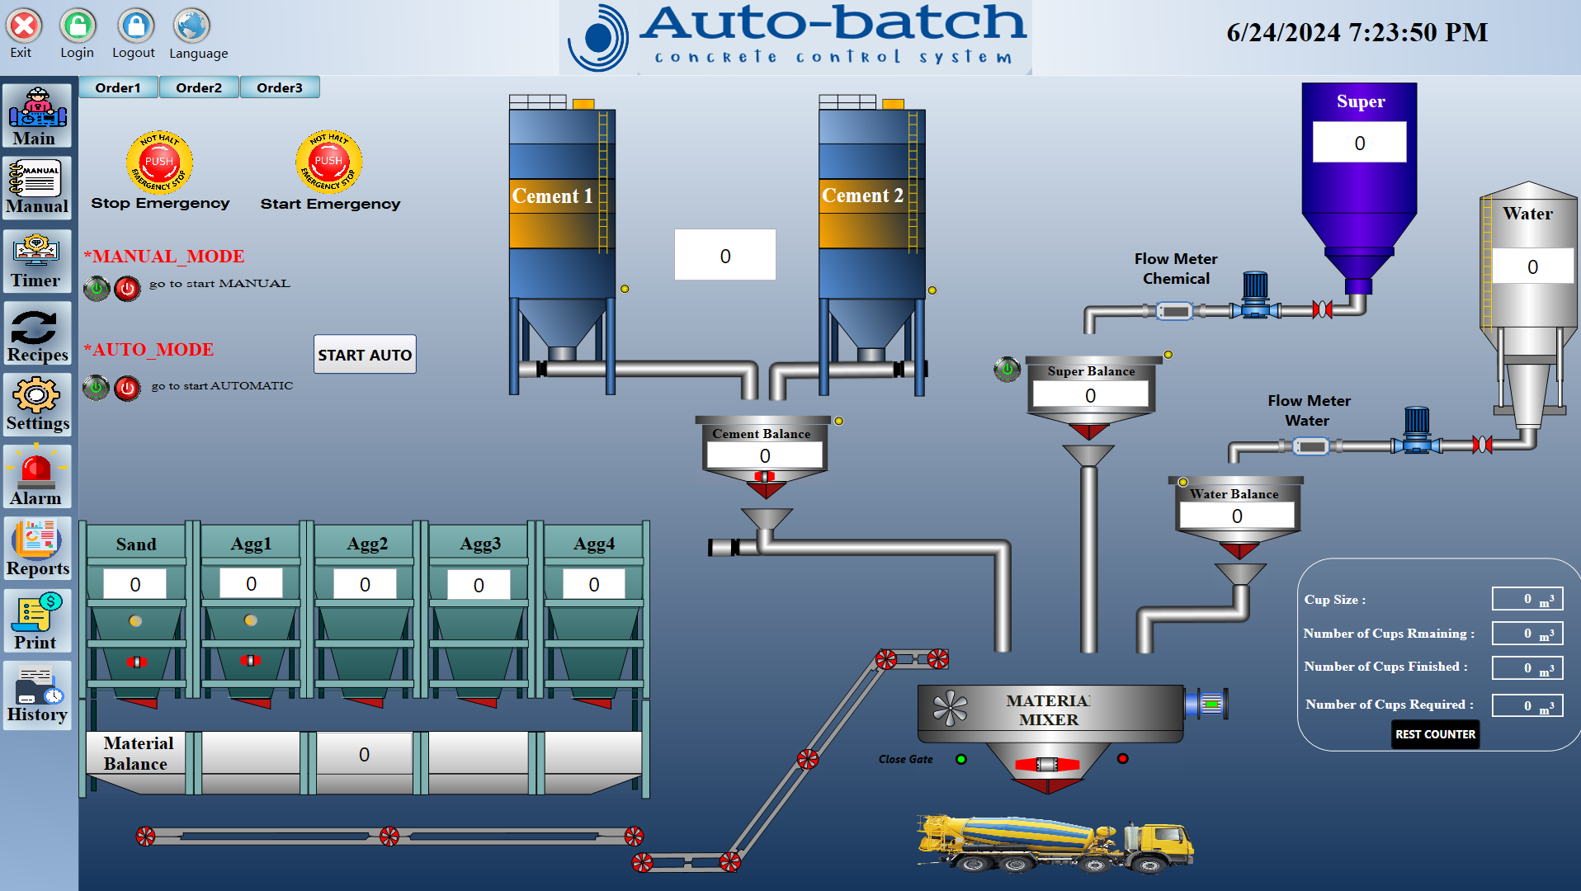
Interface design for Control and Monitoring (SCADA)
The factory control interface was created using DIA View software.

Slide 13
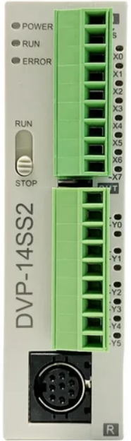
Chosen PLC
DVP-14 SS2
Economic and Compact PLC. Max. 480 I/O points:
Adopts 32-bit CPU
Program capacity: 8k steps/Data register: 5k words
Higher execution speed compared to the \ competition: LD: 0.35μς, ΜΟΥ: 3.4με
Built-in RS-232 and RS-485 ports (Master/Slave)
Supports standard MODBUS ASCII/RTU protocol and PLC Link function

Slide 14
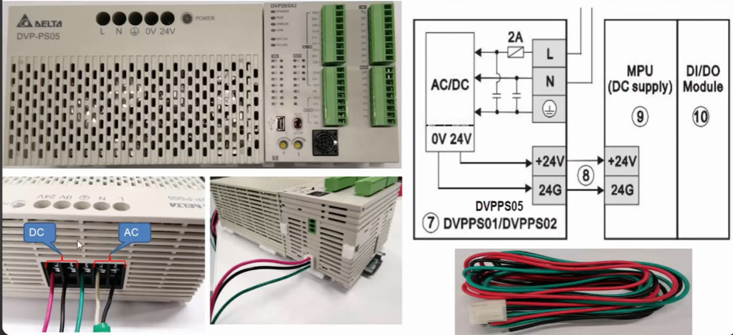

Slide 15
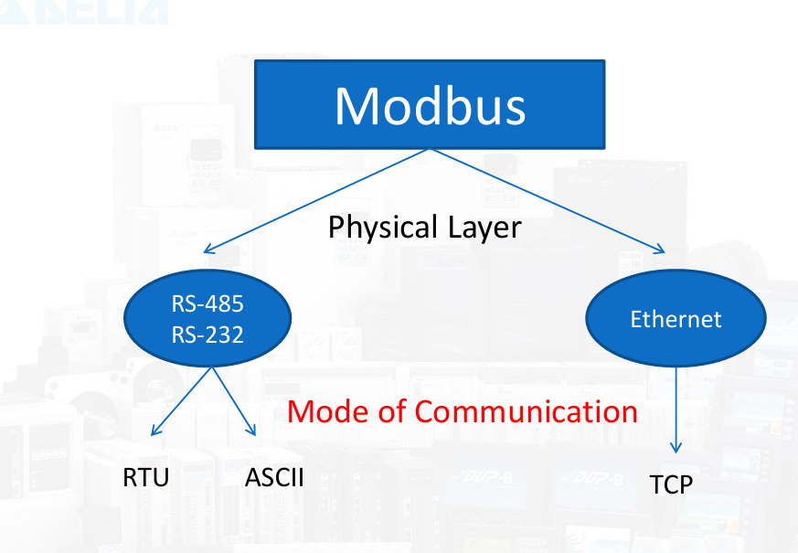
Serial Communications

Slide 16
The difference between RS-485 and RS-232 :
The feature | RS-485 | RS-232
Definition | Multi-point communication standard | Single-ended communication standard
Wiring | Differential (twisted pair) | Single-ended
Maximum Cable Length | Up to 1200 meters | up to 20 meters
Maximum Data Rate | Up to 50 Mbps (for short distances) | Up to 20 Kbps (for short distances)
Noise Immunity | High | Low
Voltage Levels | (±1.5 to ±6)V | (±5 to ±15)V
Number of Devices | Up to 32 Master and 32 Slave | Typically one transmitter and one receiver

Slide 17
The difference between RTU and ASCII:
The feature | RTU | ASCII
Data format | Binary | Text-based (human-readable)
Transmission Speed | Faster | Slower
Error Rate | More | less
Applications | Industrial automation, harsh environments | development

Slide 18



RS-232

Slide 19
Future work
Future work includes:
Developing the SCADA program and programming the PLC for the ready-mixed concrete control system.
Utilizing load cell units and adding an analog unit to network sensors like Moisture Sensors and RFID Sensors.
Employing the latest AI and machine learning technologies to optimize the control system efficiency.
Designing a user-friendly SCADA interface for easy operation and monitoring, with multiple communication options for different clients
Enhancements will focus on:
Real-time data acquisition and analysis for predictive maintenance and reduced downtime.
Integration with cloud services for remote monitoring and control worldwide.
Supporting mobile device compatibility for operational flexibility.

Slide 20

MERCI !
Its NOT the End, Its just the beginning of a GREAT Journey…

