Slide 1

ERP System with Power BI Analytics to Measure Performance
PREPARED BY
ADAM FATTOUH
OSAID BARAHMEH

Slide 2


Company Overview

Slide 3


Problem Statement
Non-standardized inventory.
Lack of real-time visibility.
Decisions not based on data.
Lack of operational automation.

Slide 4

Primary Objective
Building a unified ERP system for managing sales, inventory, and purchasing.
Providing real-time visibility into inventory across branches.
Automating processes and reducing manual errors.
Supporting management with analytical dashboards.
Enabling data-driven decision-making.

Slide 5
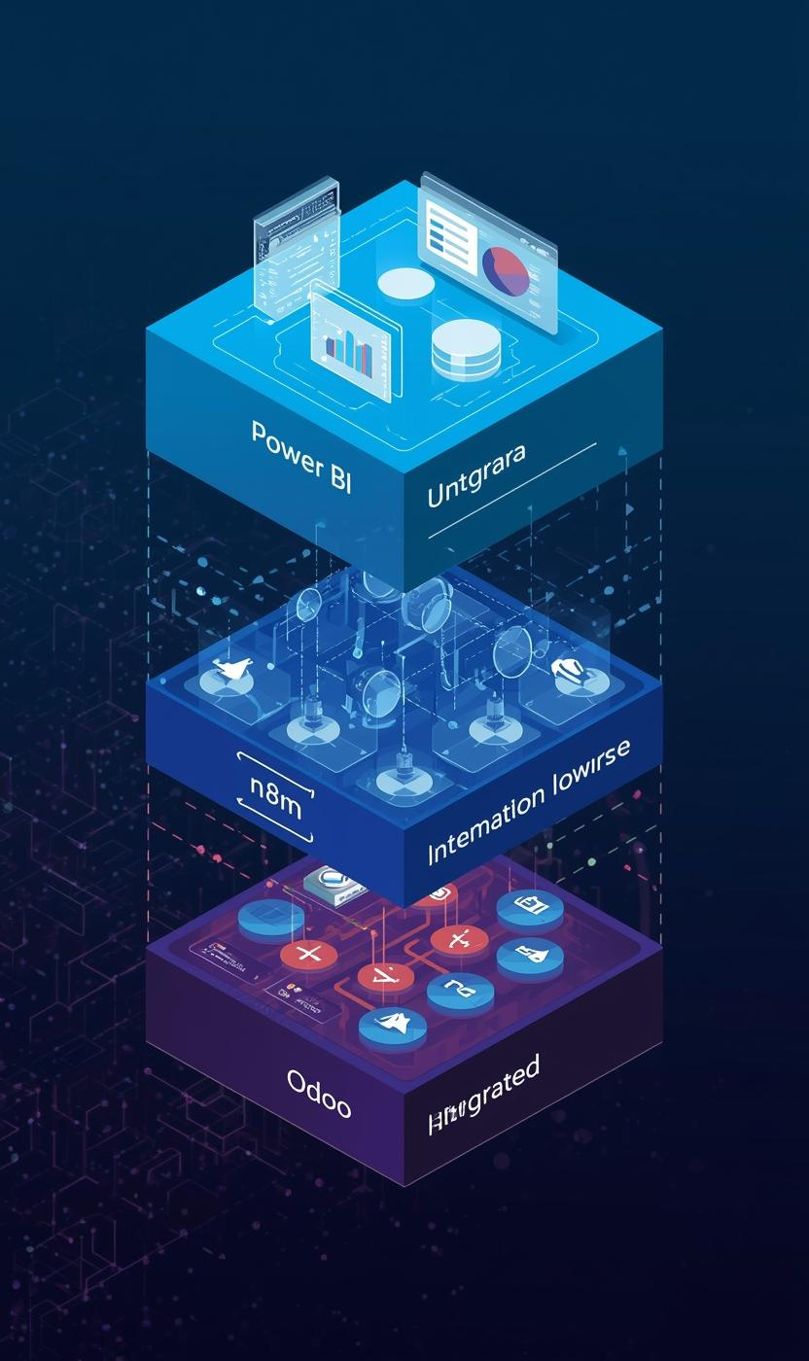
System Architecture
  01
Operational Layer – ERP (Odoo)
  02
Automation & Integration Layer – n8n
.
  03
Analytics & BI Layer – Power BI

Slide 6
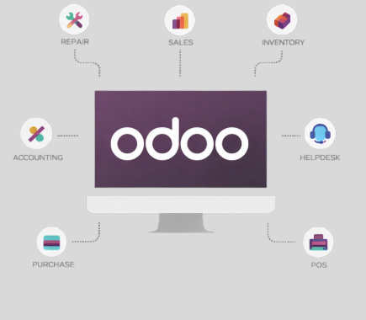
ERP System With ODOO

Slide 7
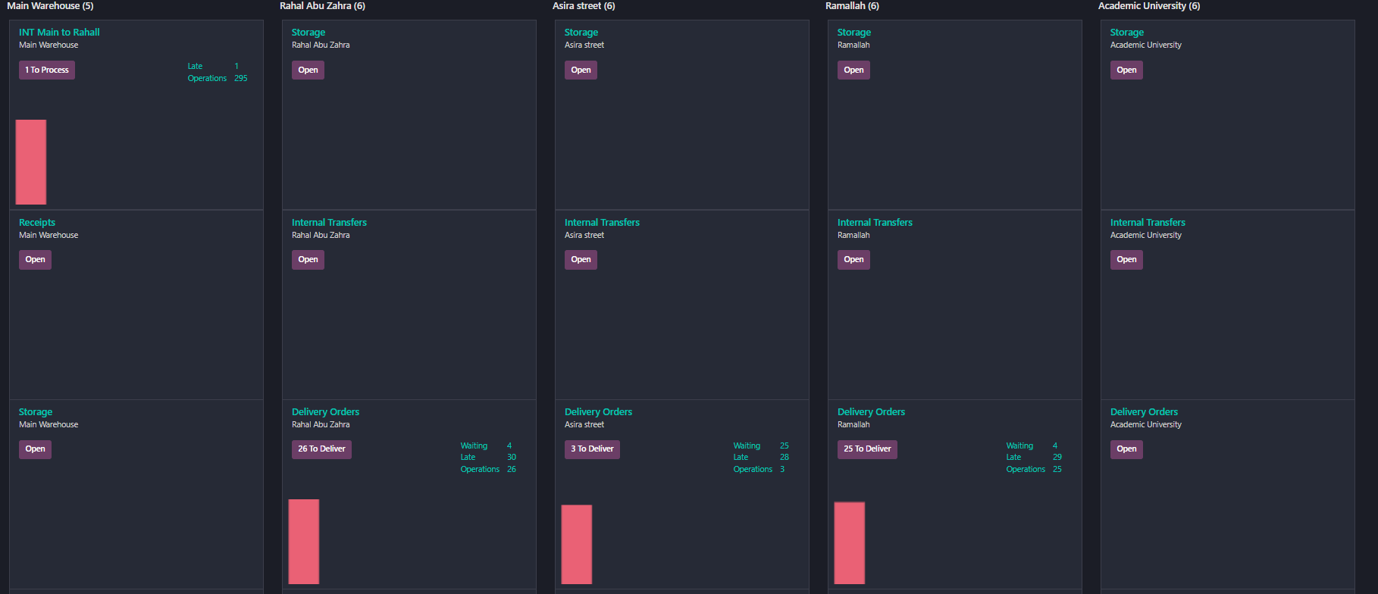
Inventory Overview

Slide 8
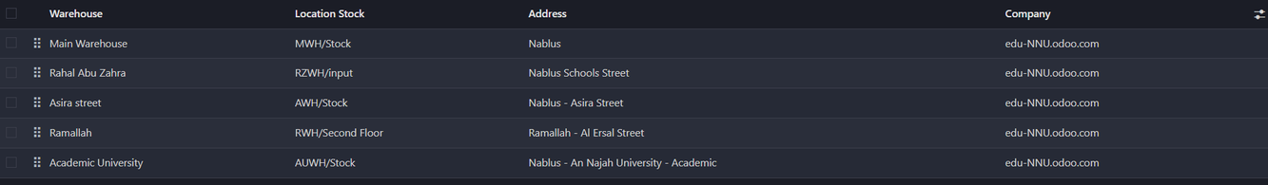
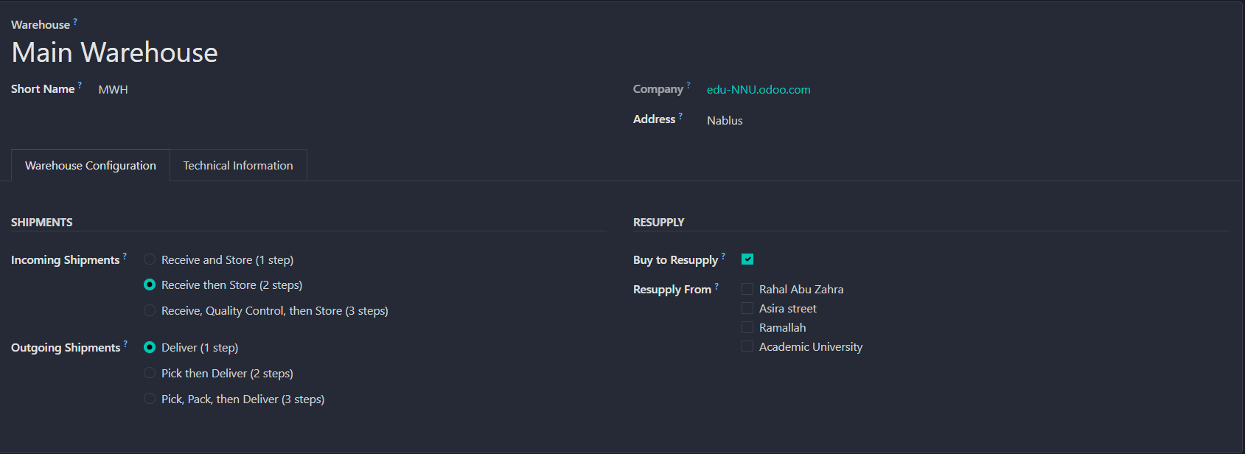
Warehouses

Slide 9
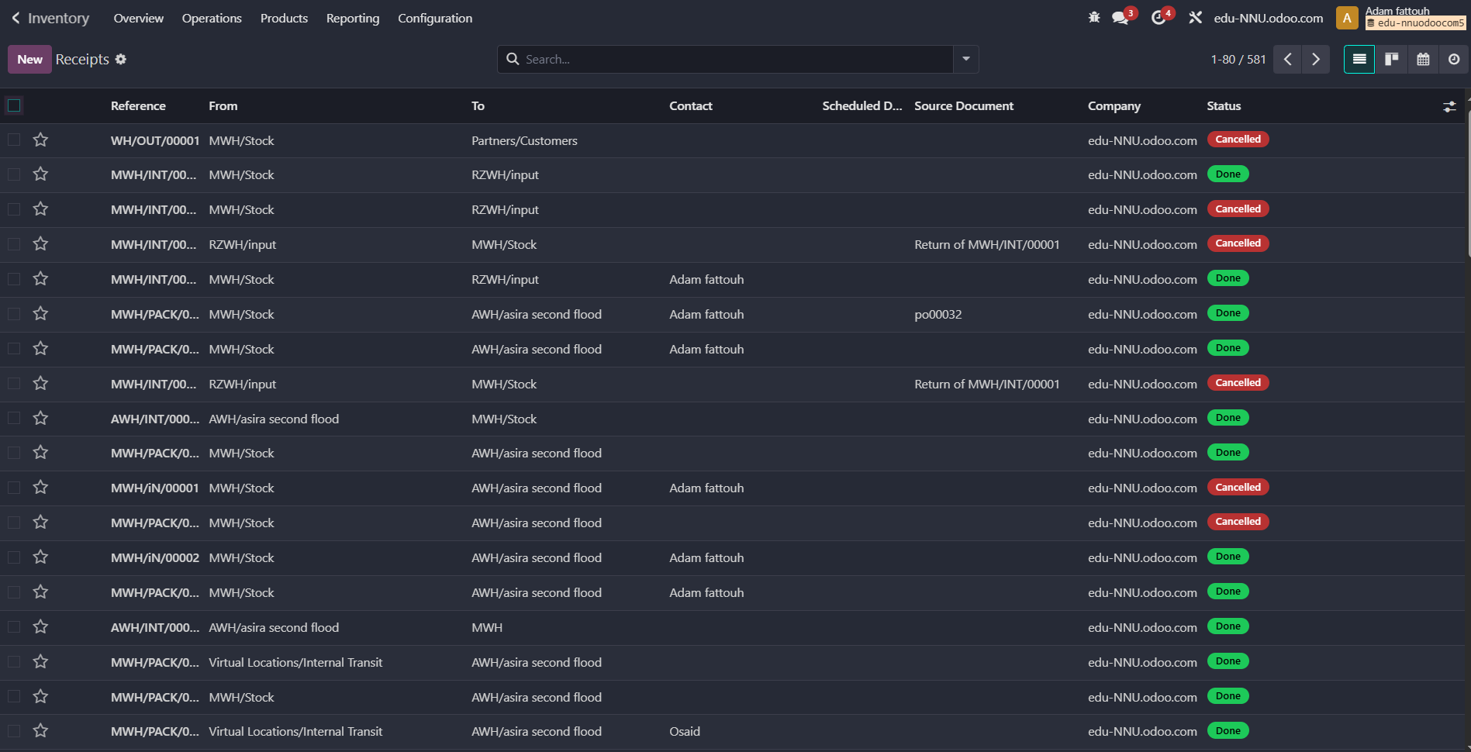
Inventory Operation

Slide 10
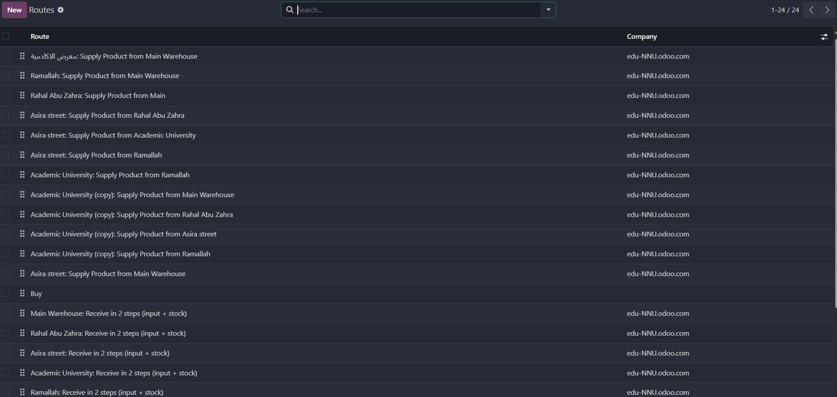
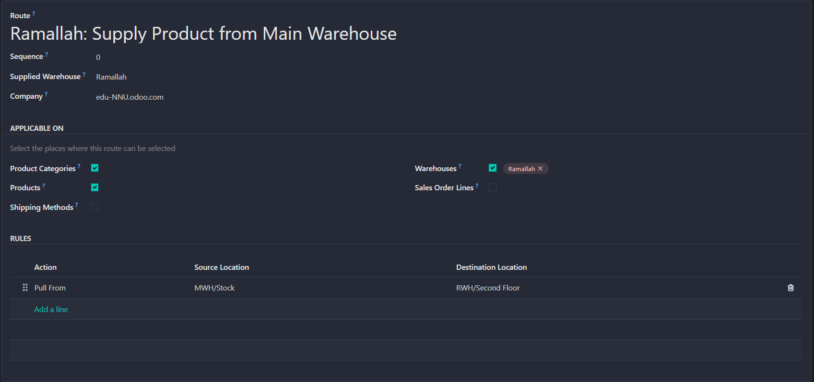
Inventory Rules

Slide 11
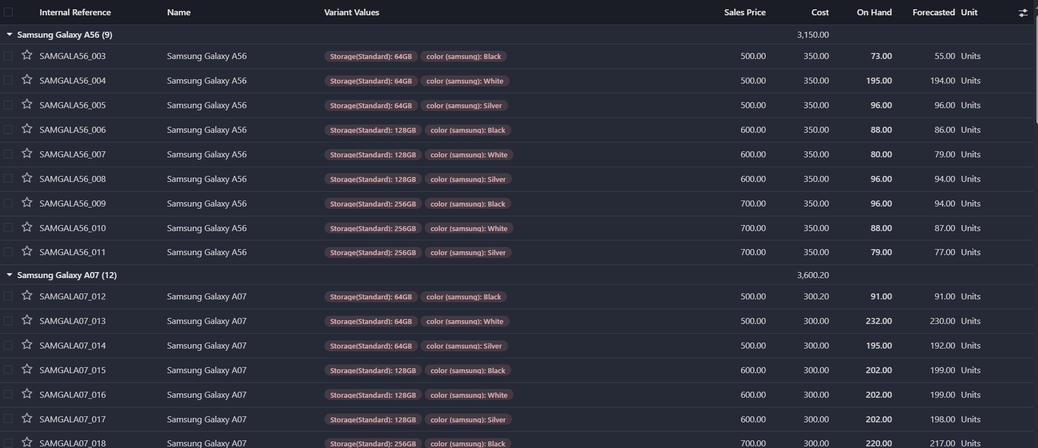
Product Variants

Slide 12
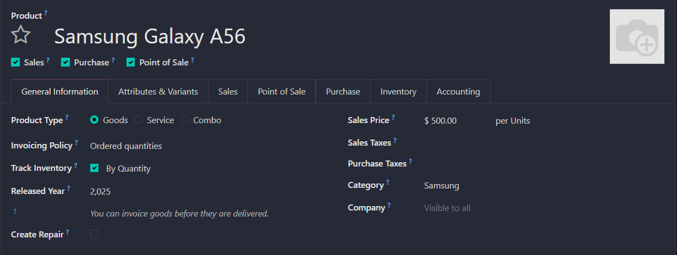
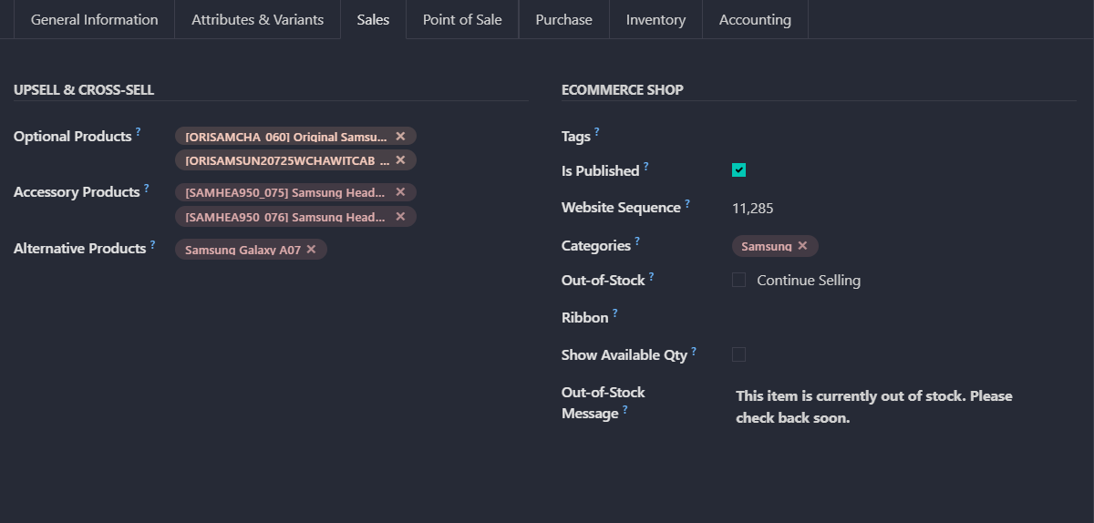
Product Overview

Slide 13
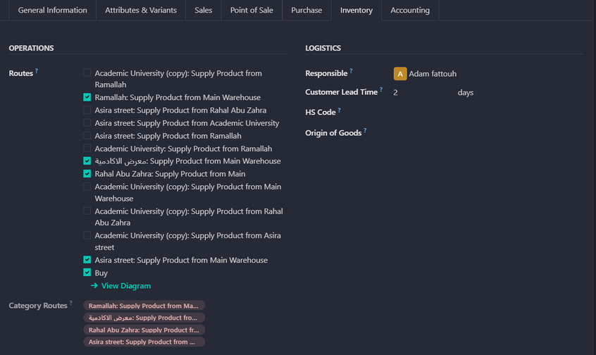
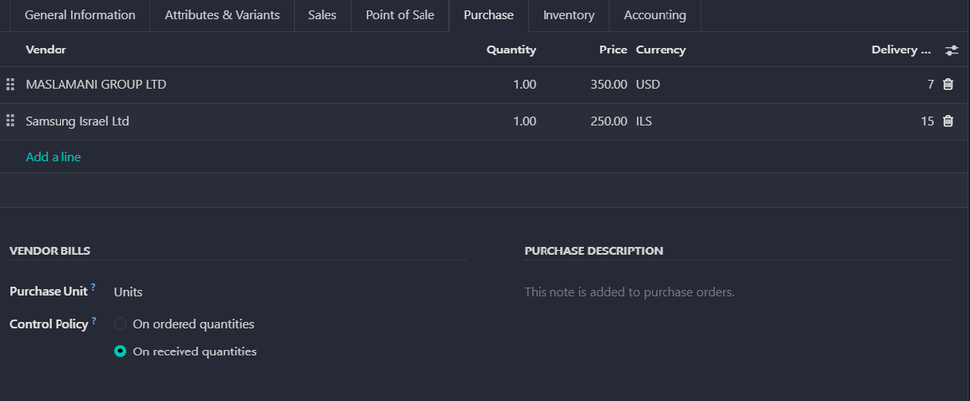
Product Overview

Slide 14
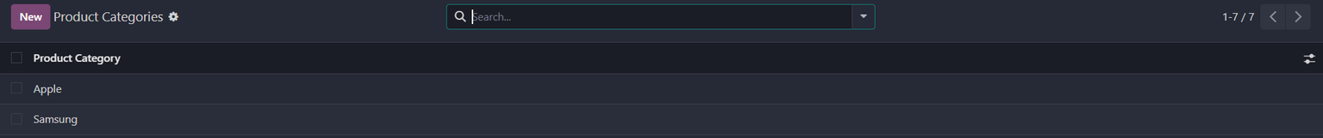
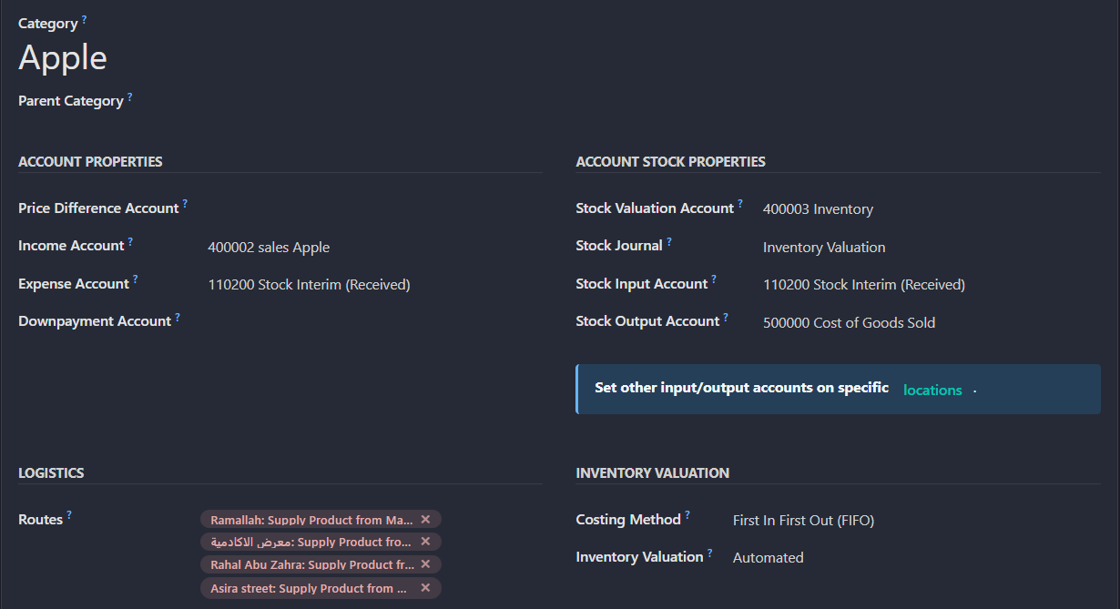
Product Category

Slide 15
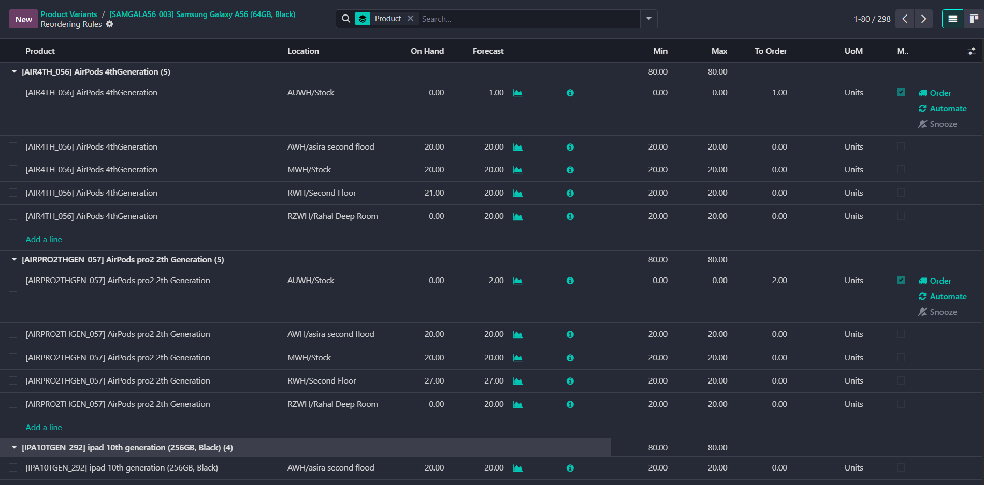
Product Reordring Rules & Repleshmint

Slide 16
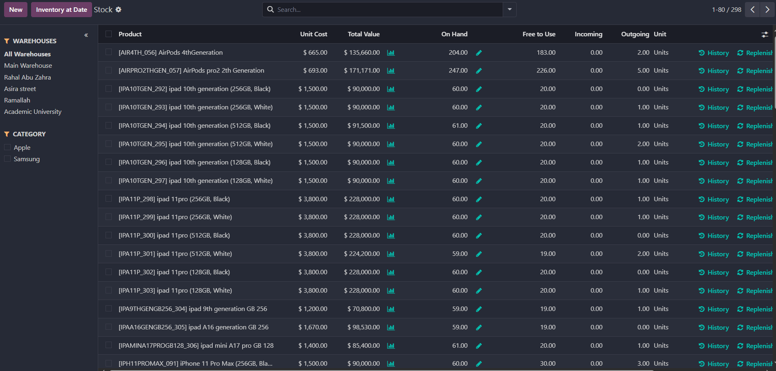
Stock

Slide 17
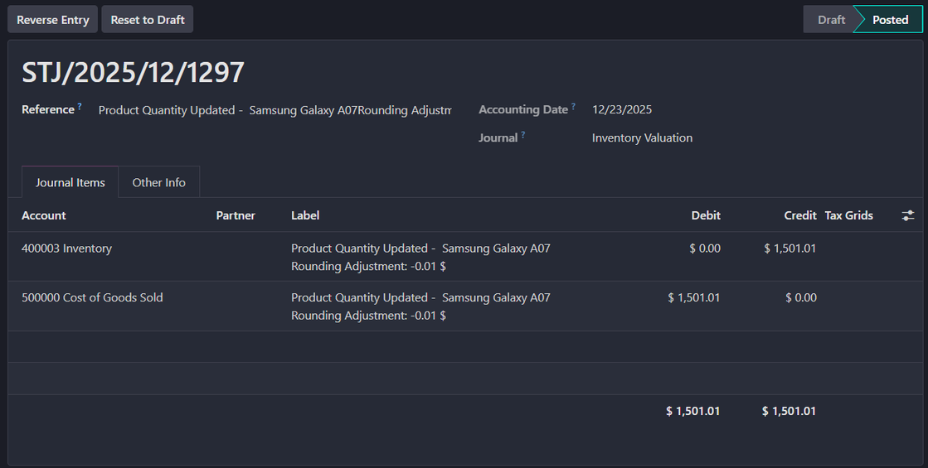
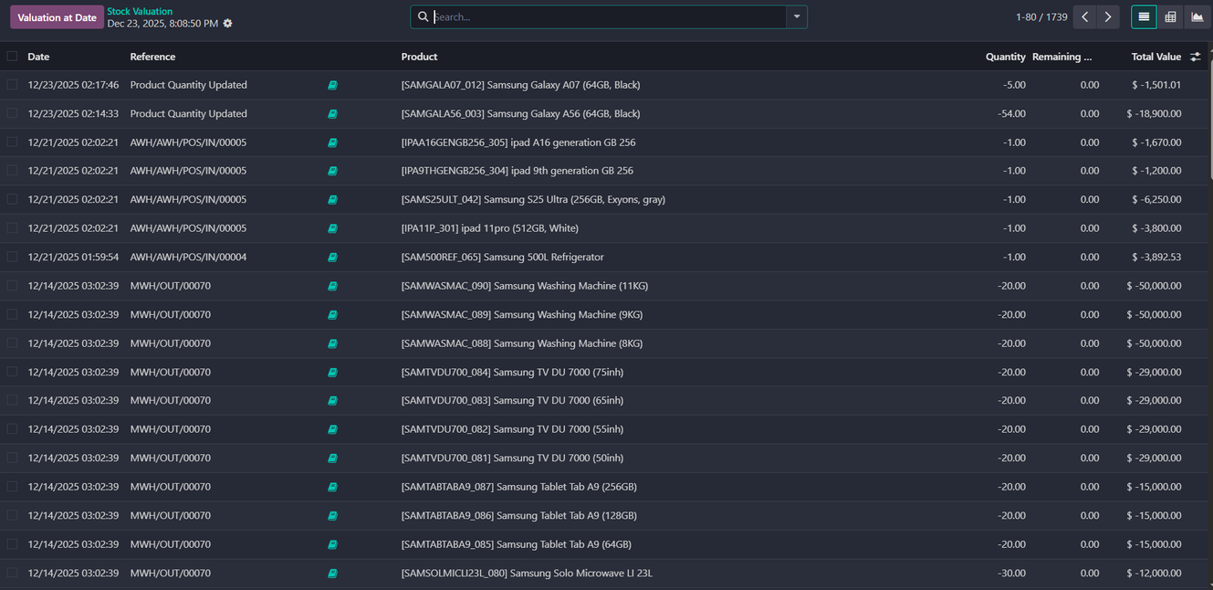
Inventory valuation

Slide 18
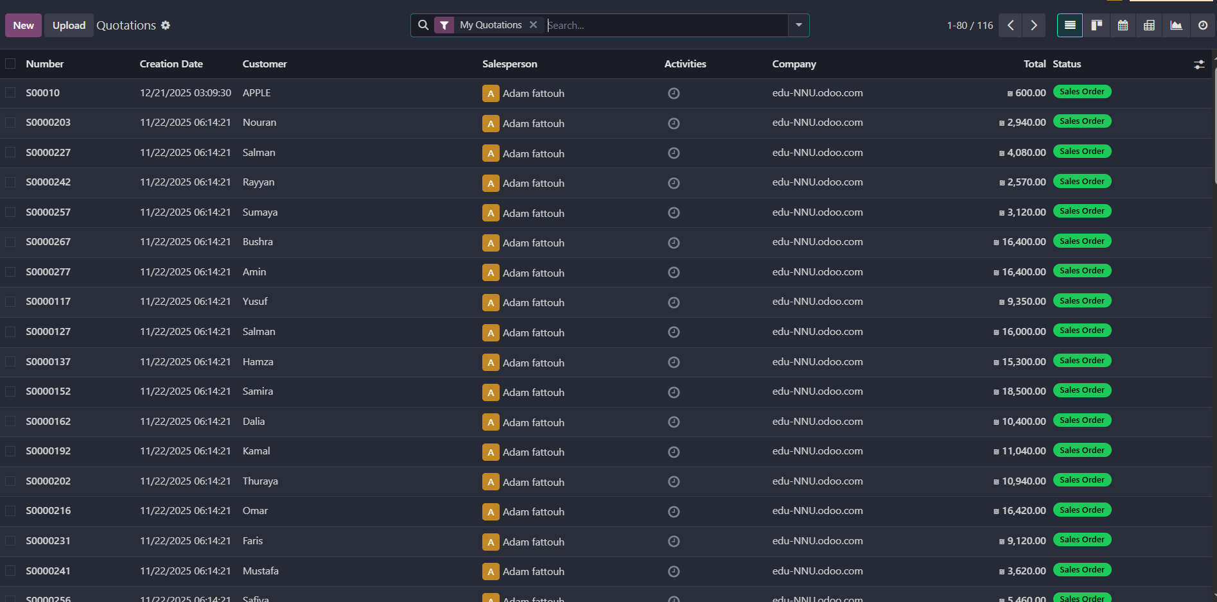
Sales Quotations

Slide 19
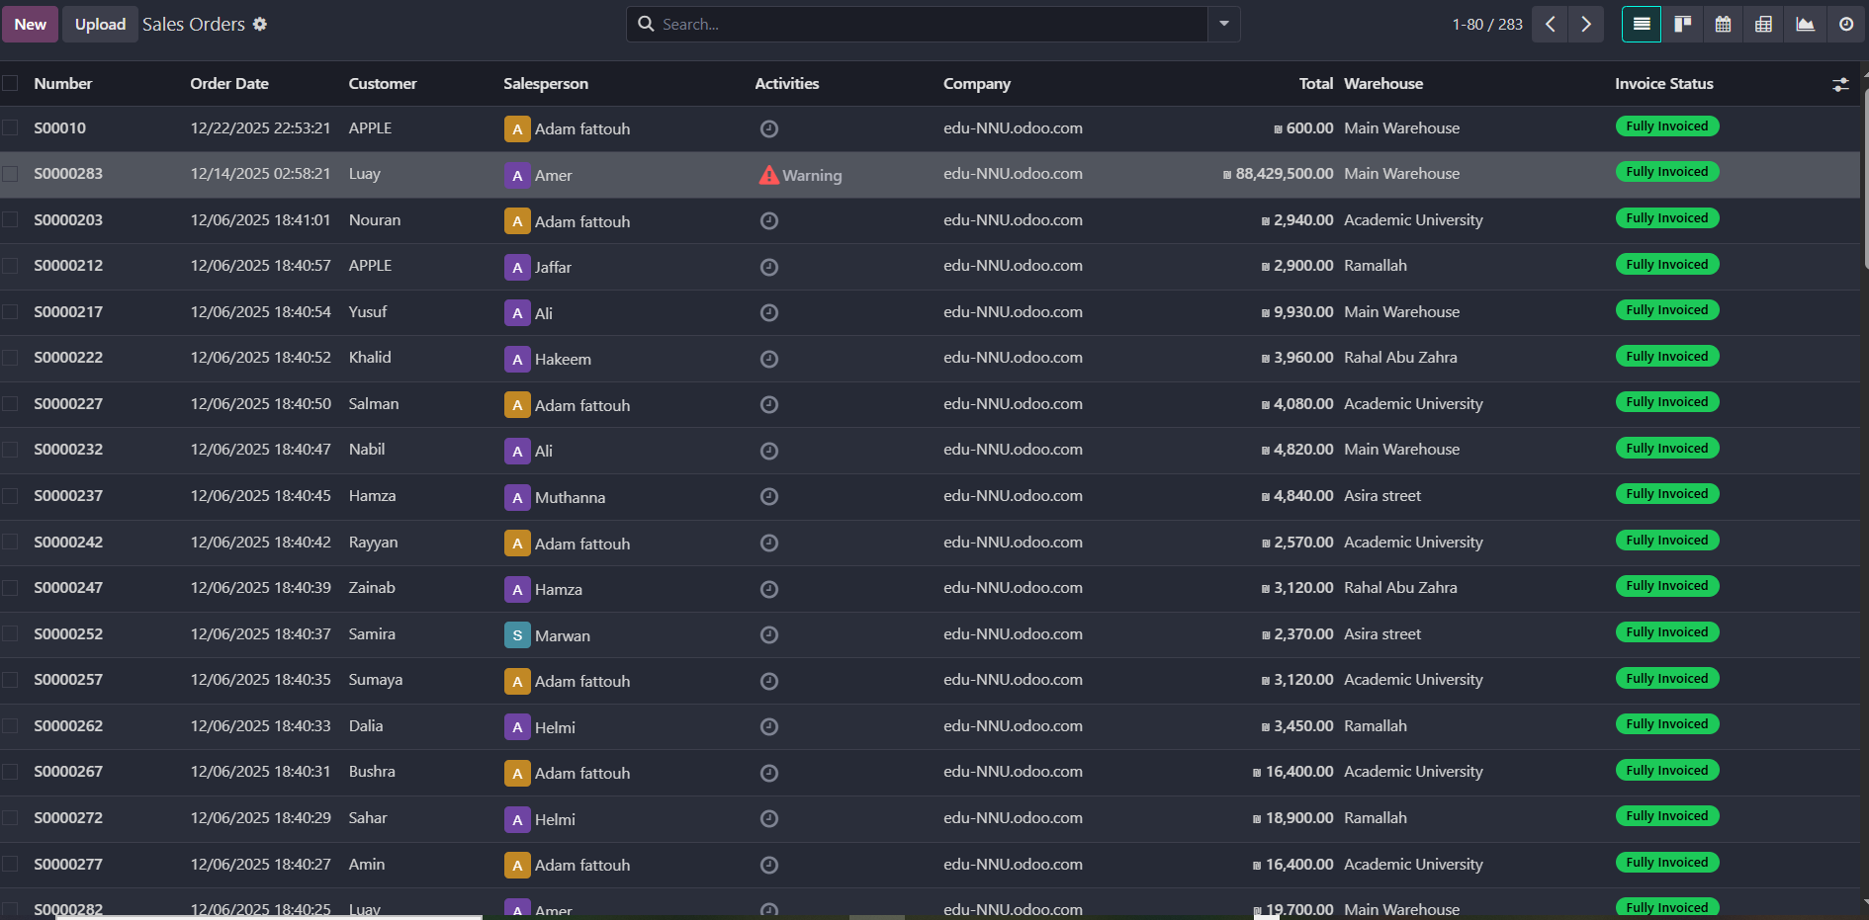
Sales Order

Slide 20
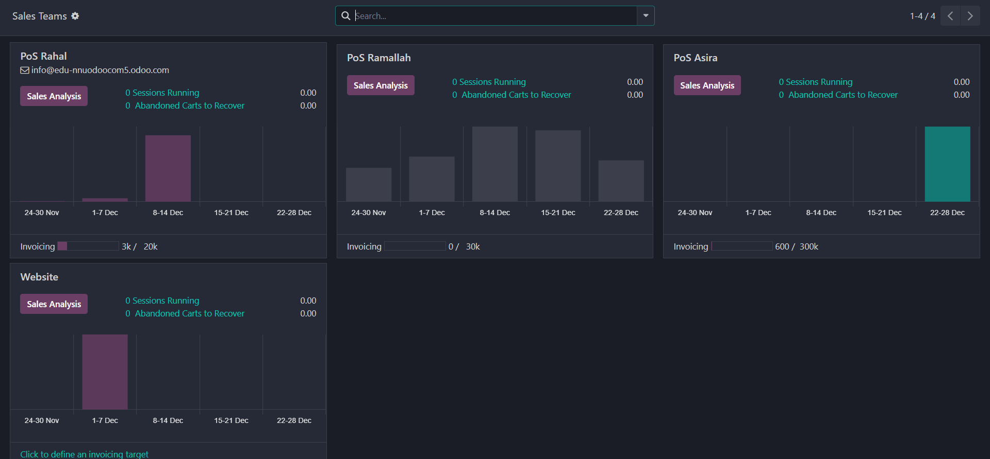
Sales Team

Slide 21
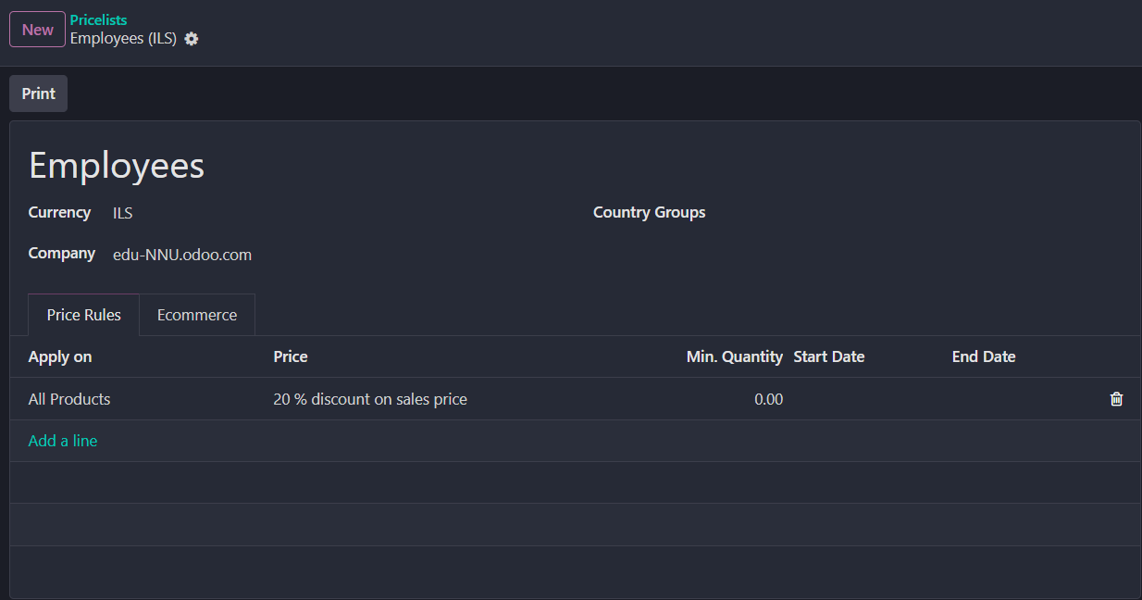
Pricelist

Slide 22
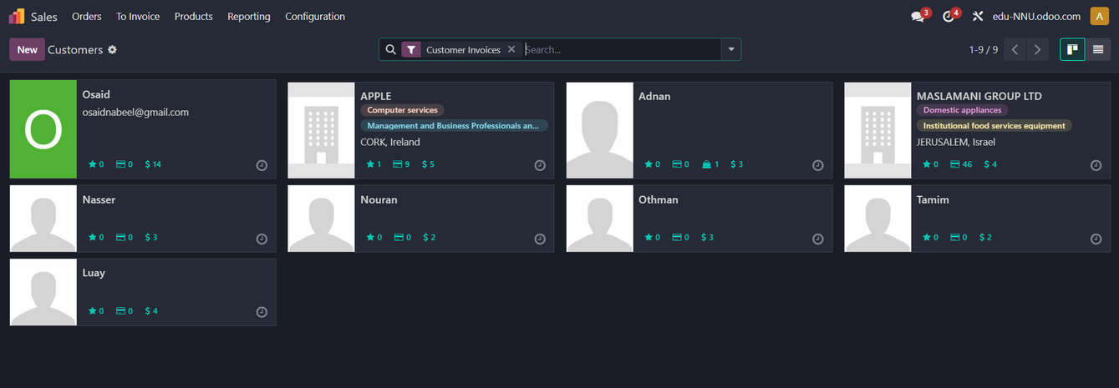
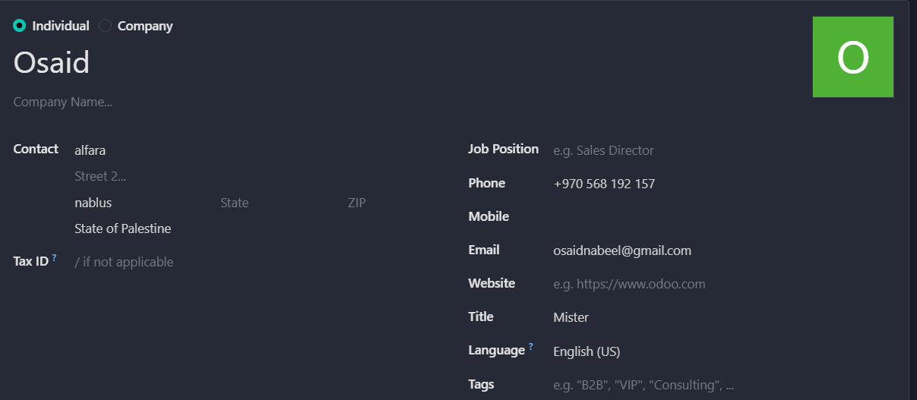
Customers

Slide 23
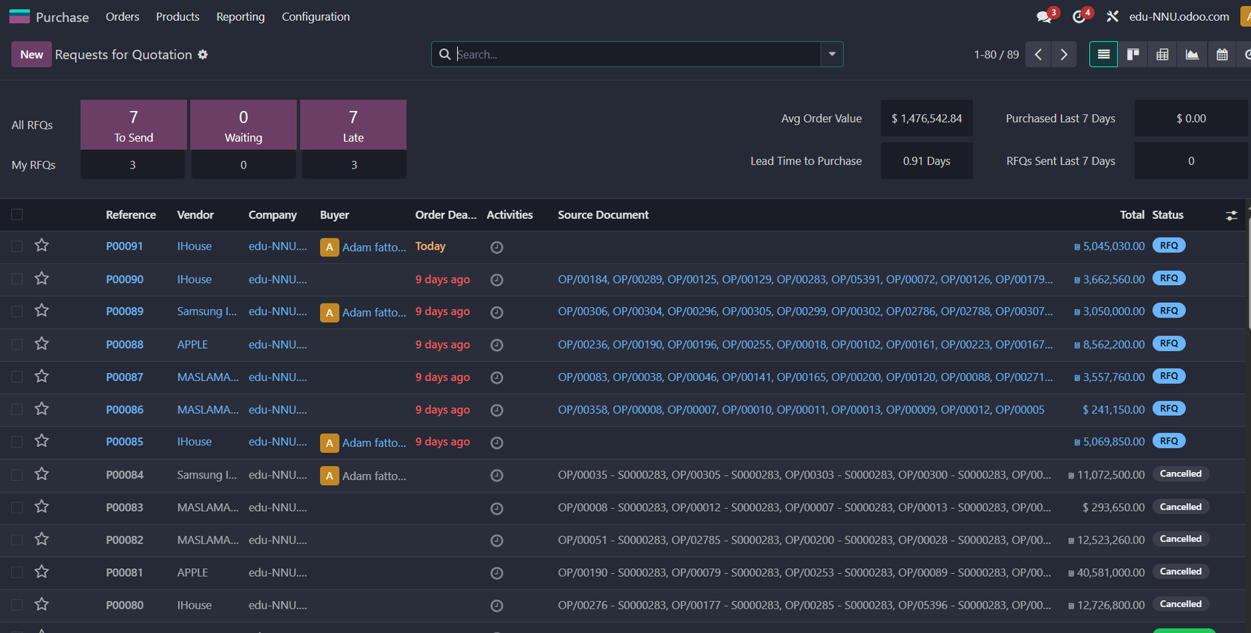
Requestsfor Quotation

Slide 24
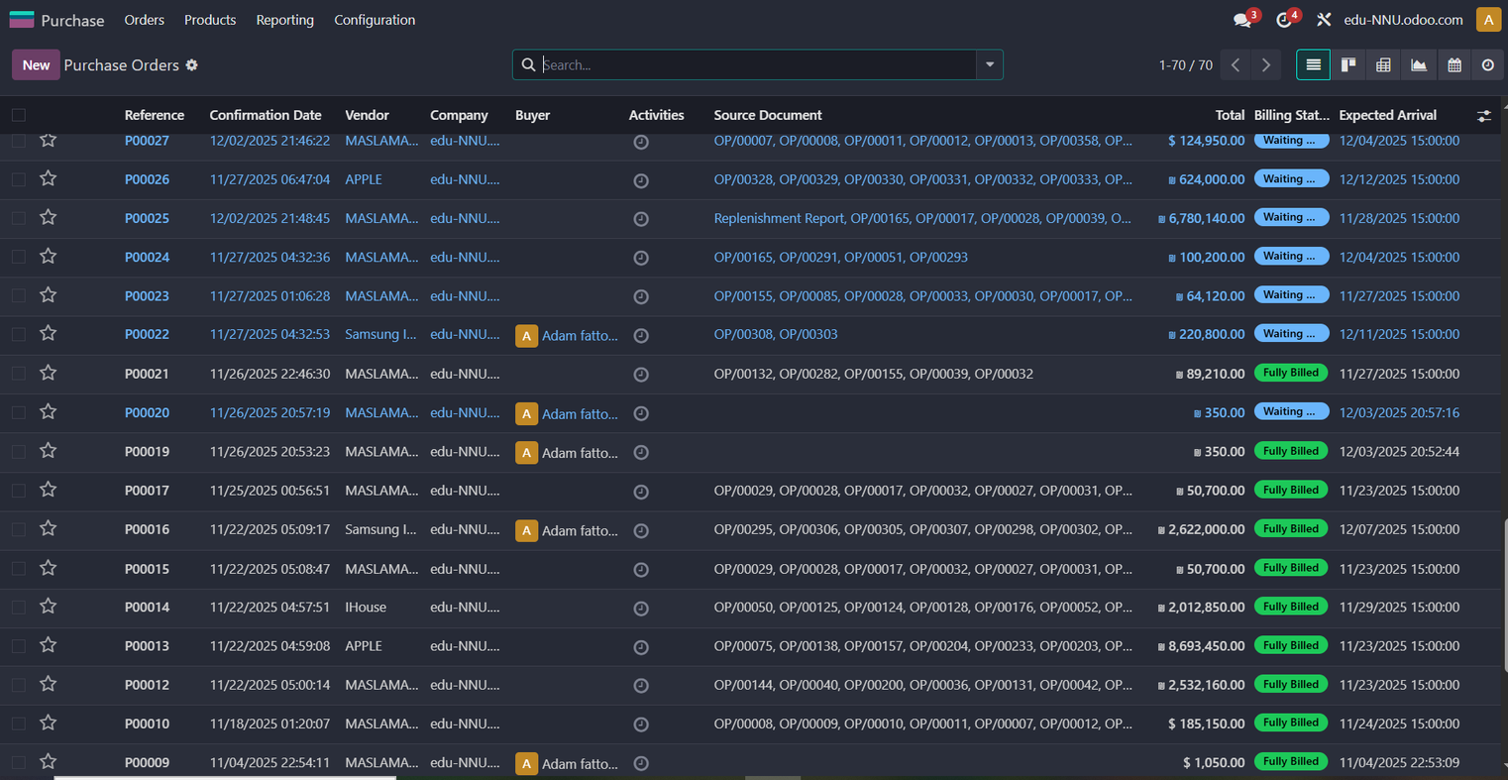
Purchase Order

Slide 25
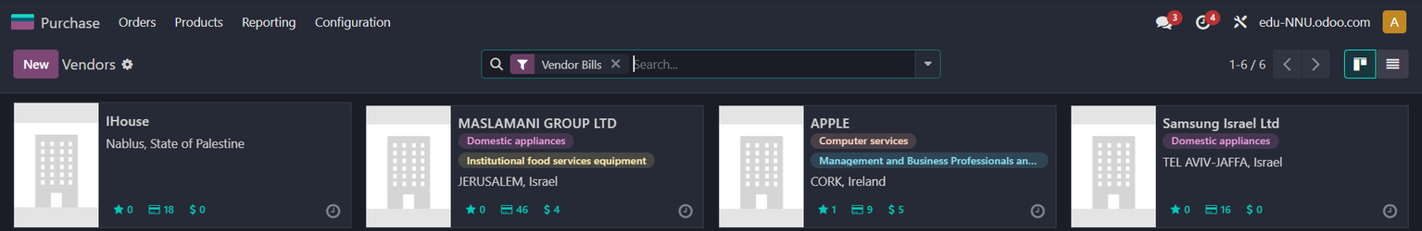
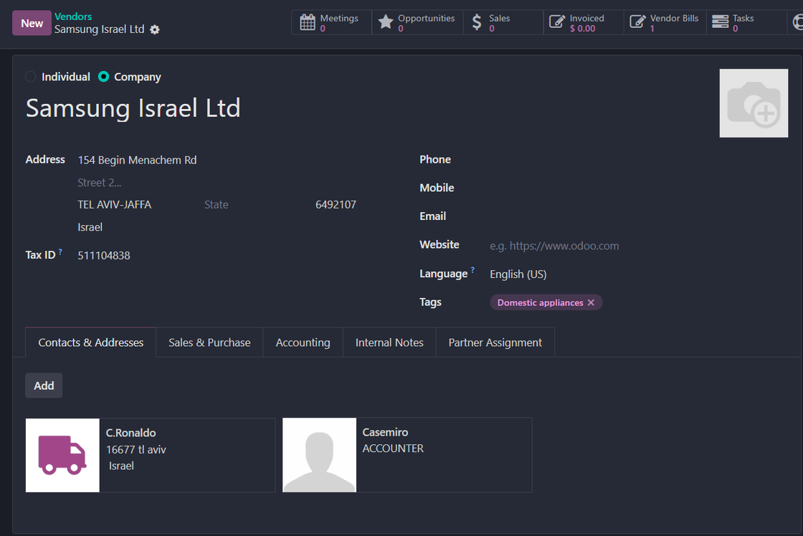
Vendors

Slide 26
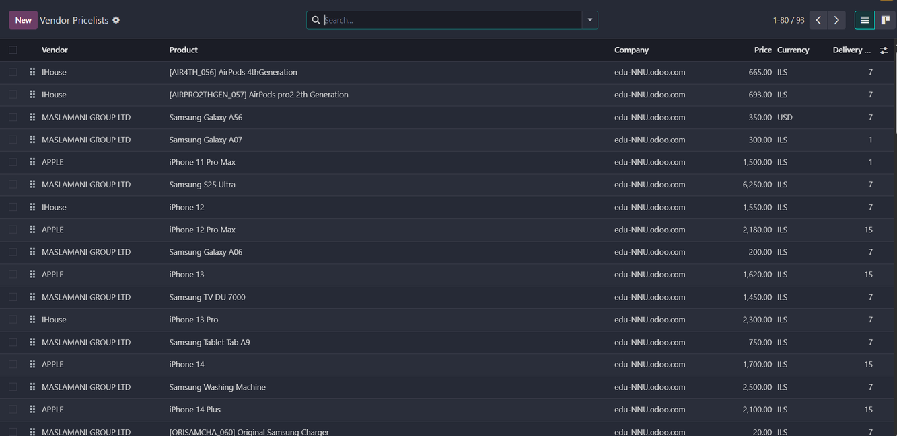
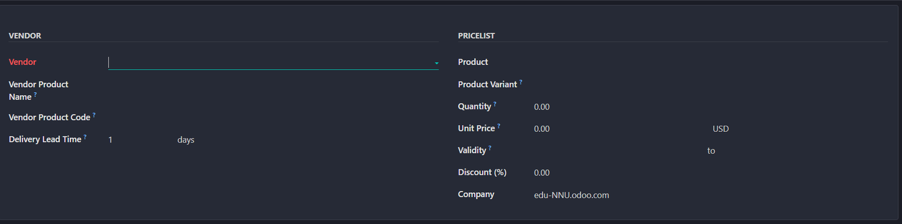
Vendors Pricelists

Slide 27
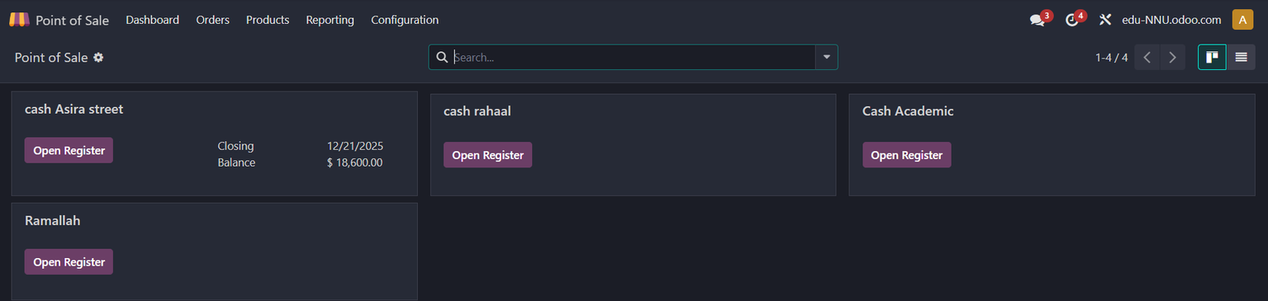
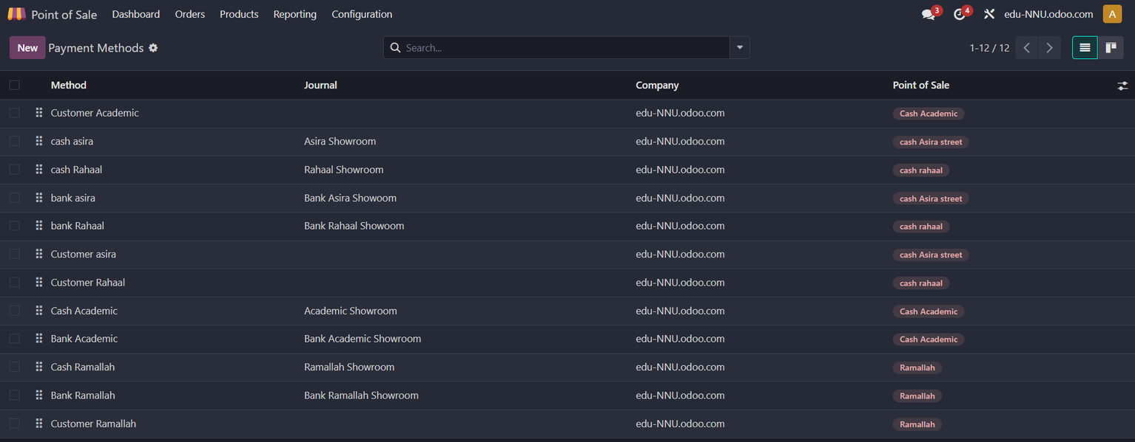
Point Of Sales

Slide 28
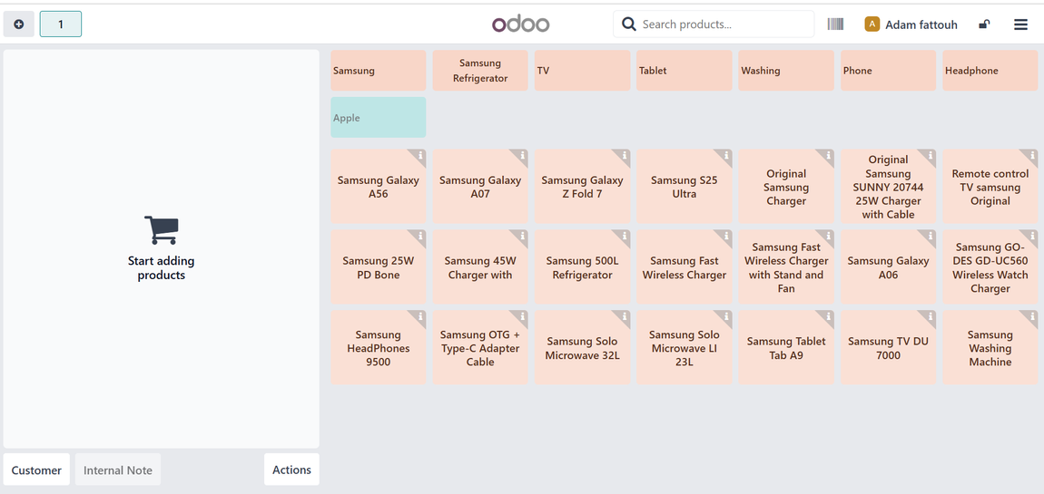
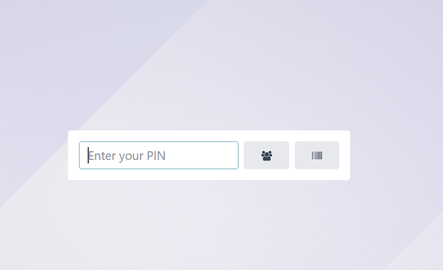
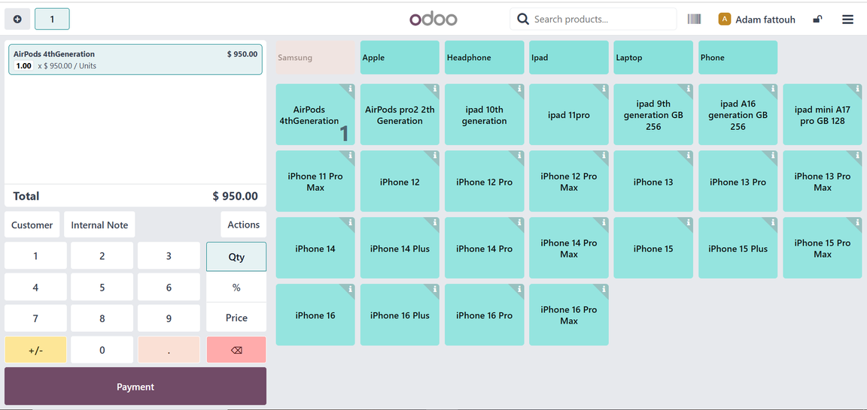
Point Of Sales

Slide 29
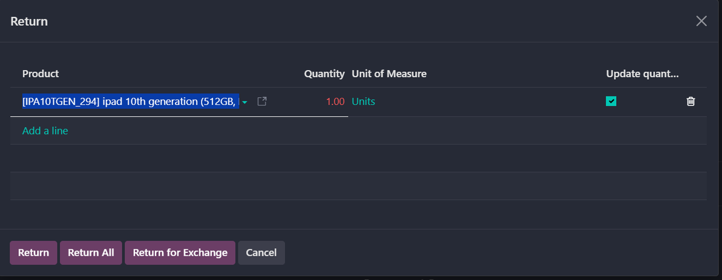
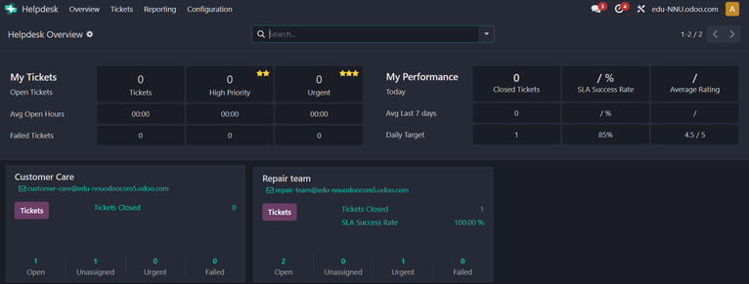
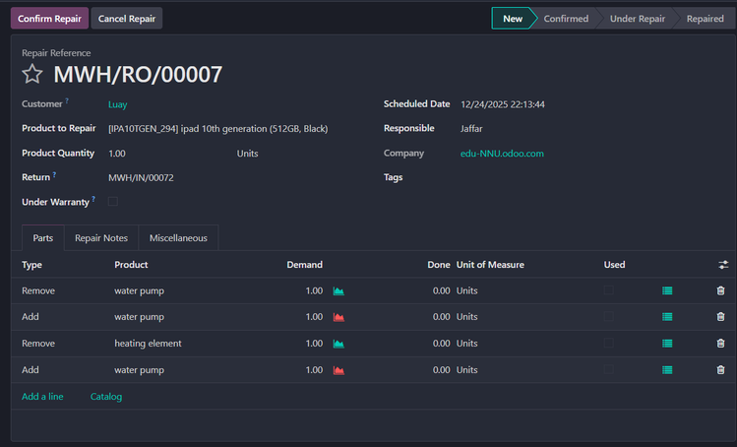
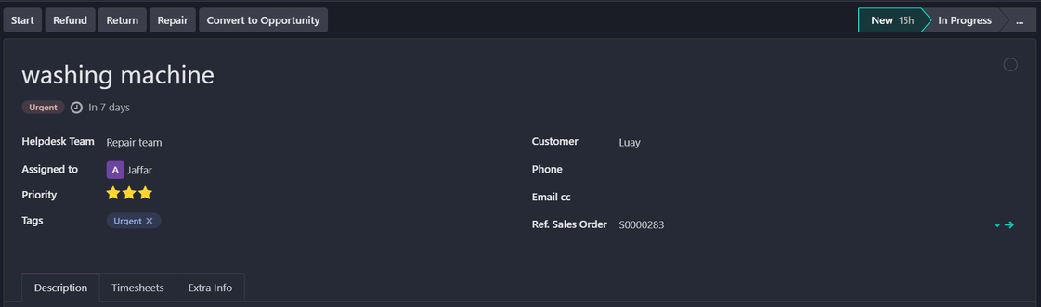

Help Desk & Repair

Slide 30

Automation & Integration – n8n &
Odoo Automation
Automating data flow between systems.
Real-time updates of operational information.
Reducing human error and reliance on manual processes.
Running intelligent, event-driven processes.

Slide 31
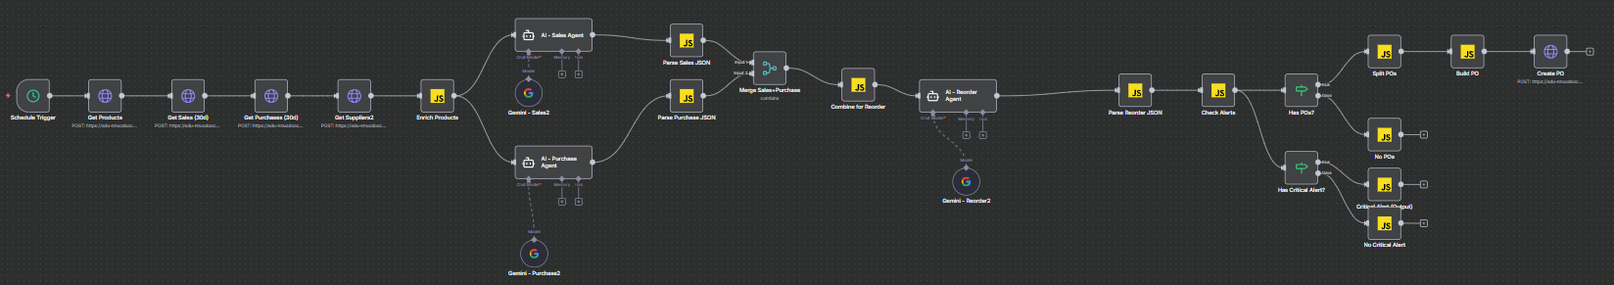
AI-Based Automated Sales, Inventory & Purchase Workflow

Slide 32
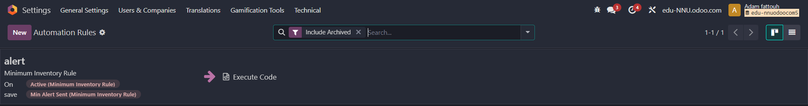
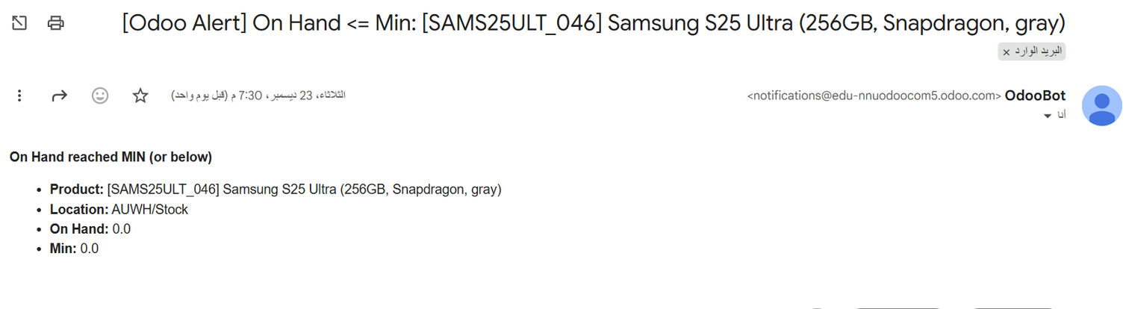
Odoo Stock Shortage Alert

Slide 33

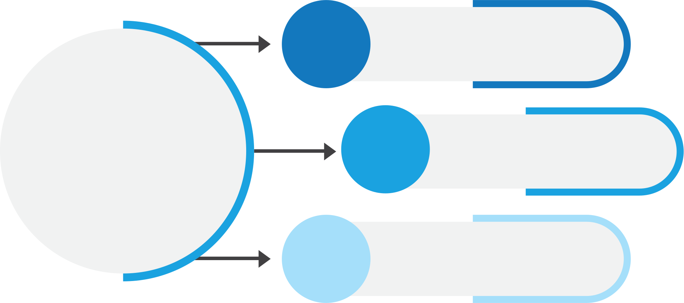
Business Intelligence – Power BI
we adopted the Business Intelligence Life Cycle methodology
ETL
BI
Data Modeling
Dashboards

Slide 34
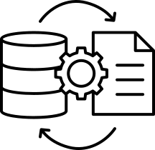


ETL
Extract
Manually extracting sales and inventory data from the Odoo ERP system.
Transfer
Cleaning the data using Power Query within Power BI Using DAX.
Load
Loading clean data into Power BI to be ready for building Star Schema models.

Slide 35

Data Modeling
We used the Star Schema model, built within Power BI.
We built two separate models: one for sales and the other for inventory.
creating Fact Tables and linking them to Dimension.

Slide 36
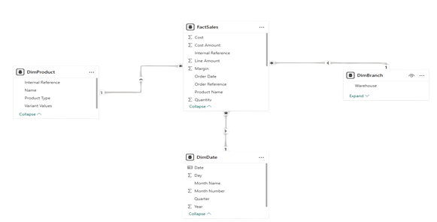
Sales Star Schema

Slide 37
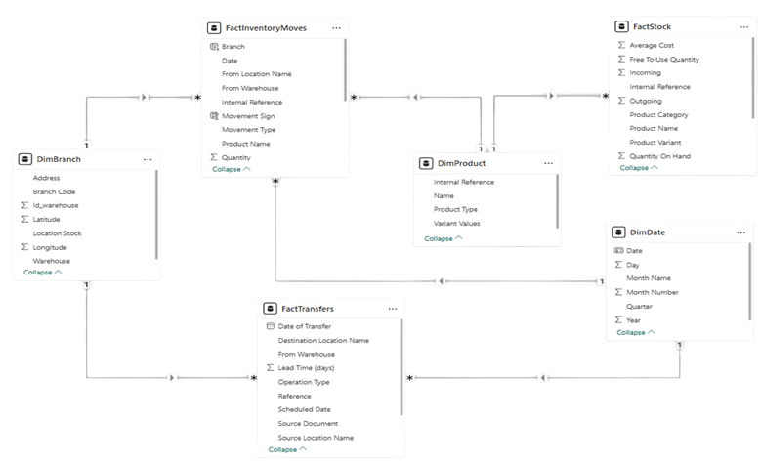
Inventory Star Schema

Slide 38
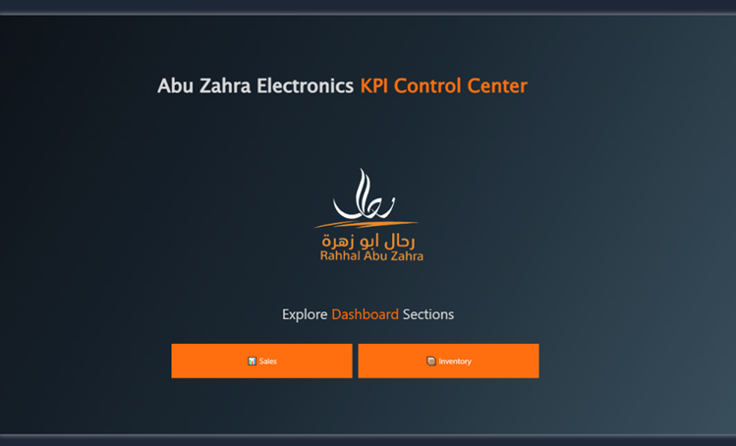
Dashborads

Slide 39
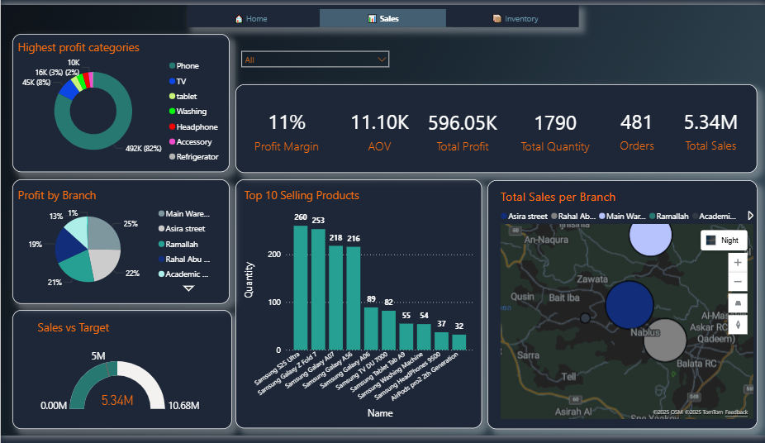
Sales Dashborad

Slide 40
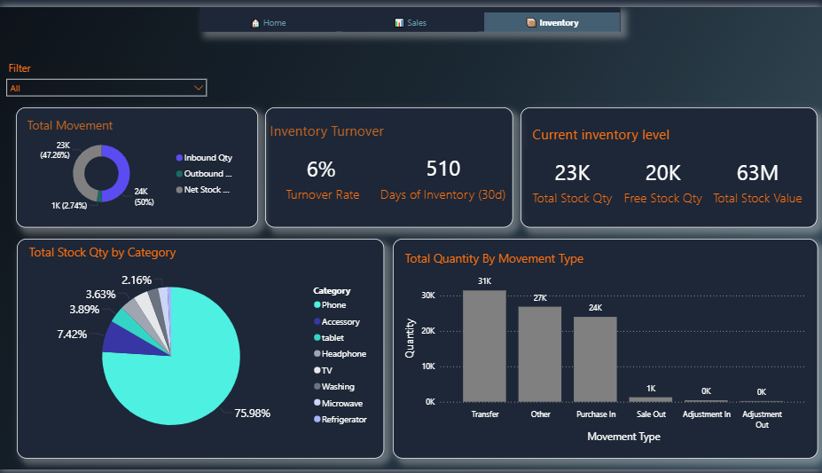
invnetory Dashborad

Slide 41

Testing
Using real data from Abu Zahra Company relating to products and inventory.
Implementing operational scenarios within the Odoo system.
n8n testing to ensure that sales and inventory data are automated and updated automatically.

Slide 42

Evaluation
The dashboard displayed analytical results reflecting actual changes in sales and inventory.
The results contributed to evaluating the system's accuracy and efficiency in supporting decision-making.

Slide 43




Future improvements
Integrating the system with an e-commerce platform
Adding a specialized dashboard
Utilizing predictive analytics and artificial intelligence
Enhancing the alert system

Slide 44

Thank you for listening

