Slide 1
CELL PHONE BASED DTMF CONTROLLED GARAGE DOOR OPENING SYSTEM.
Prepared By:
Fatima Dmaidi.
Majd Darweesh.
Noor Salman.
SUPERVISOR:
Dr.Kamel Subhi.

Slide 2
OUTLINES :
Introduction.
Overview.
Design.
Flow chart of the project.
DTMF.
Arduino.
H-Bridge.
DC Motor (PM Motor) .
Results.
Future work.

Slide 3
OUTLINES :
Introduction.
Overview.
Design.
Flow chart of the project.
DTMF.
Arduino.
H-Bridge.
DC Motor (PM Motor) .
Results.
Future work.

Slide 4
Introduction :
The main objective of this project is to unlock a garage door by a mobile phone using a unique number entered through the keypad of the phone after entering the password given to the user .
This project is based on the concept of DTMF (dual tone multi - frequency).

Slide 5
OUTLINES :
Introduction.
Overview.
Design.
Flow chart of the project.
DTMF.
Arduino.
H-Bridge.
DC Motor (PM Motor) .
Results.
Future work.

Slide 6
Overview:
Our system consists of DTMF decoder, Arduino, Gate driver, H-bridge, DC motor (PM motor) to achieve our goal.

Slide 7
OUTLINES :
Introduction.
Overview.
Design.
Flow chart of the project.
DTMF.
Arduino.
H-Bridge.
DC Motor (PM Motor) .
Results.
Future work.

Slide 8
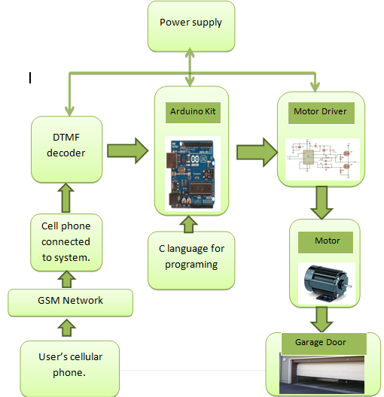
Design :

Slide 9
OUTLINES :
Introduction.
Overview.
Design.
Flow chart of the project.
DTMF.
Arduino.
H-Bridge.
DC Motor (PM Motor) .
Results.
Future work.

Slide 10
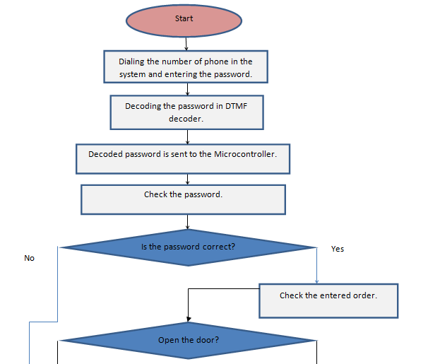
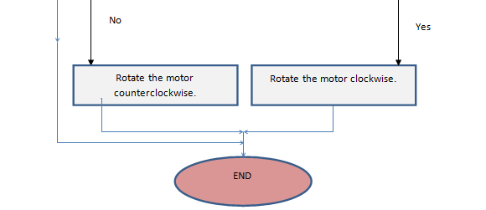

Slide 11
OUTLINES :
Introduction.
Overview.
Design.
Flow chart of the project.
DTMF.
Arduino.
H-Bridge.
DC Motor (PM Motor) .
Results.
Future work.

Slide 12
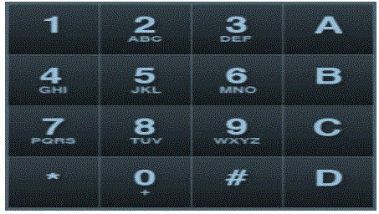
DTMF :
DTMF is a common communication term for touch tone phones.
16 button keypad.

Slide 13
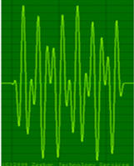
DTMF :
The frequencies generated on pressing different keys are shown in the table:
DTMF frequency | 1209 Hz | 1336 Hz | 1447 Hz
697 Hz | 1 | 2 | 3
770 Hz | 4 | 5 | 6
852 Hz | 7 | 8 | 9
941 Hz | * | 0 | #

Slide 14
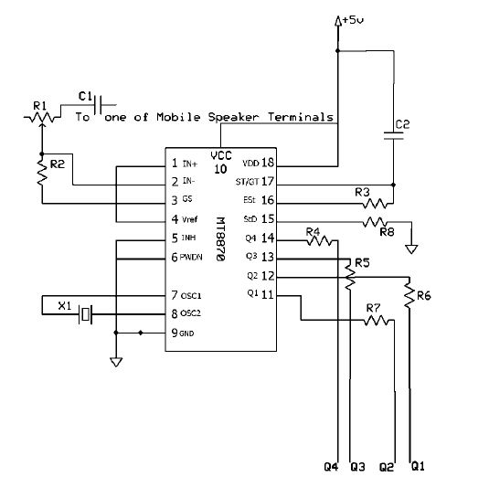
DTMF Decoder:
This DTMF decoder circuit identifies the dial tone from the telephone line and decodes the key pressed on the remote telephone.

Slide 15
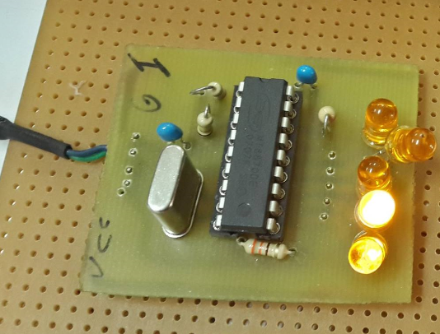
DTMF decoder:

Slide 16
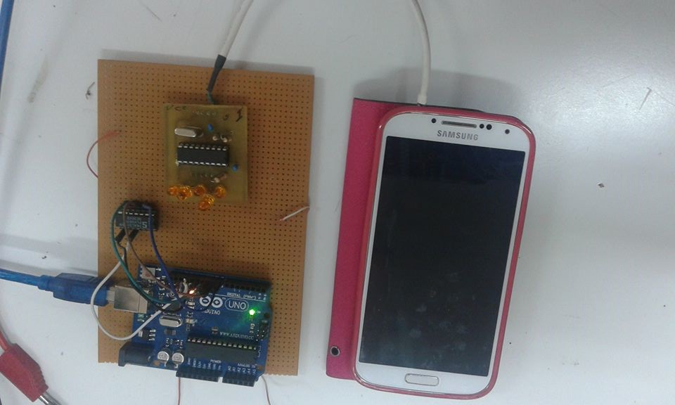
DTMF decoder connected to the cellular phone:

Slide 17
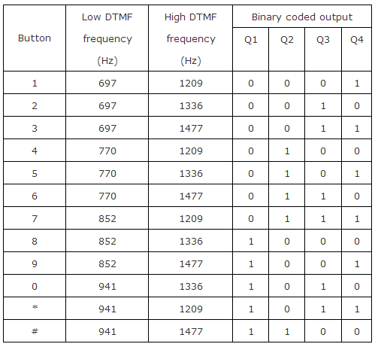
Output of DTMF decoder:

Slide 18
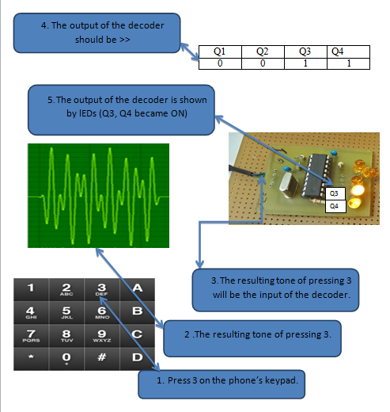

Slide 19
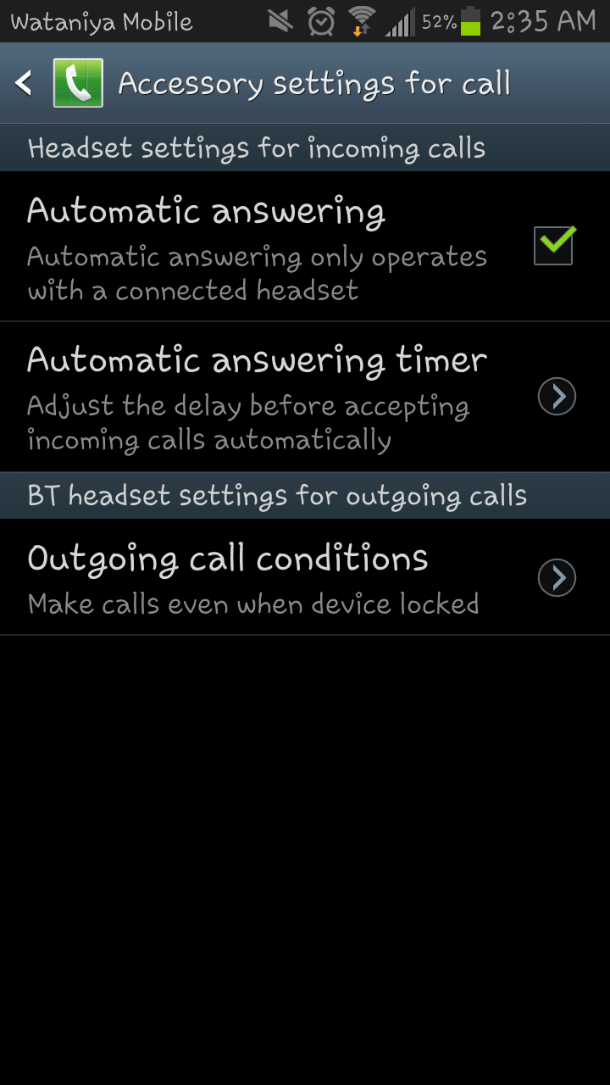

Settings of the phone connected with the system:
1. A SIM card must be inserted in the phone.
2. Automatic answering mode must be selected.

Slide 20
OUTLINES :
Introduction.
Overview.
Design.
Flow chart of the project.
DTMF.
Arduino.
H-Bridge.
DC Motor (PM Motor) .
Results.
Future work.

Slide 21
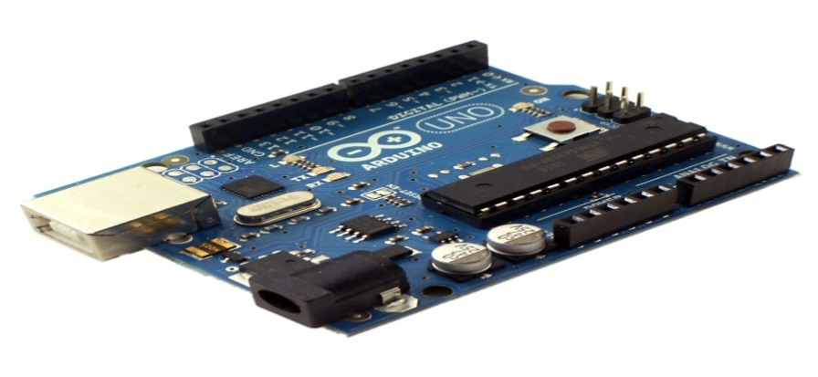
Arduino:
We used Arduino Uno in our project .
The Arduino Uno is a microcontroller board based on the ATmega328. It has 14 digital input/output pins (of which 6 can be used as PWM outputs).

Slide 22
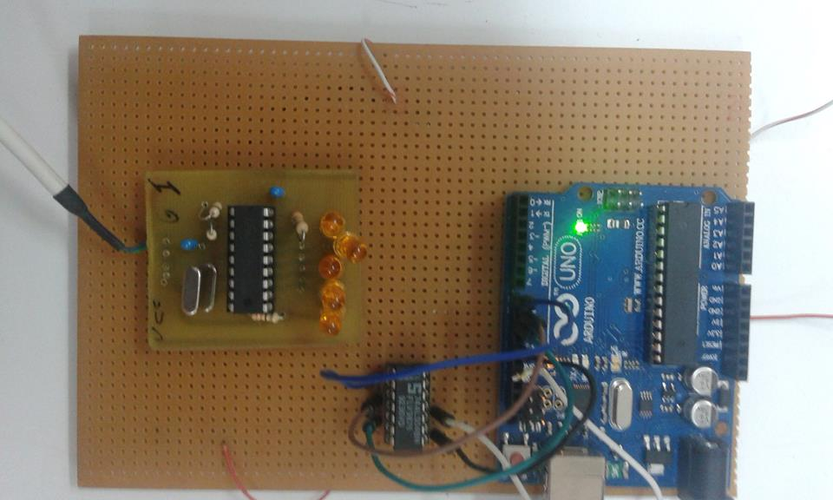

Slide 23
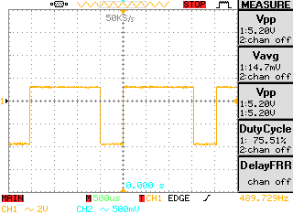
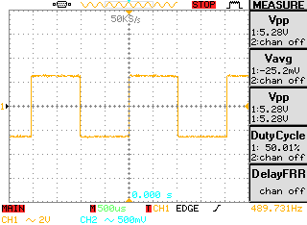
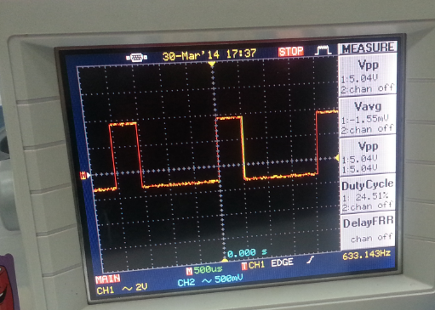
Output of the Arduino :
1
3
2
Notes:
Using arduino we can generate signal waveform with the desired duty cycle.

Slide 24
OUTLINES :
Introduction.
Overview.
Design.
Flow chart of the project.
DTMF.
Arduino.
H-Bridge.
DC Motor (PM Motor) .
Results.
Future work.

Slide 25
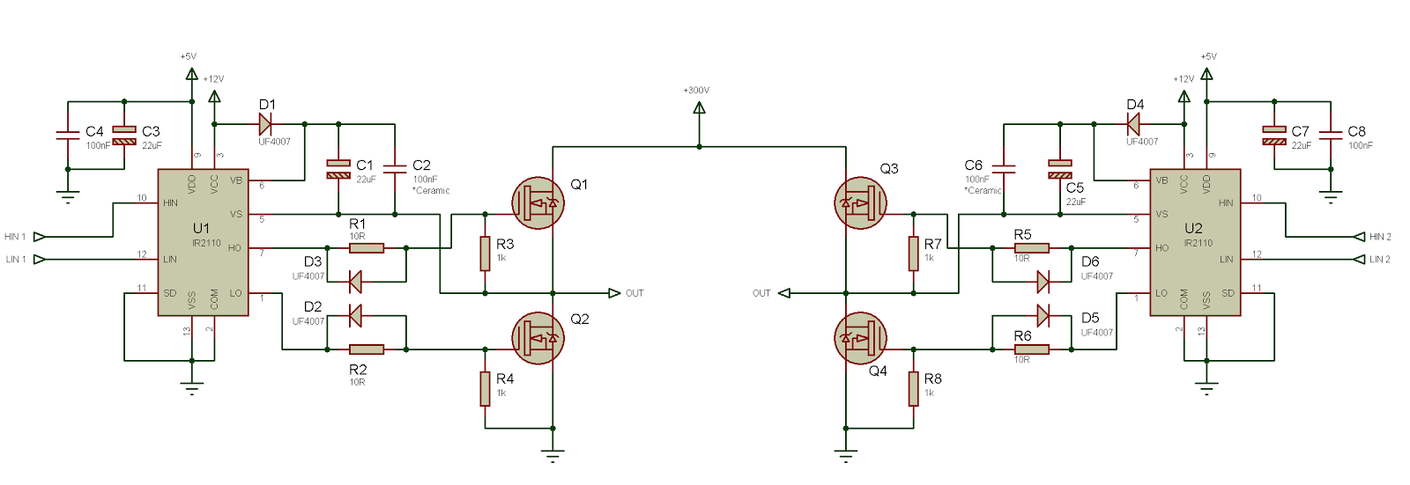
H-bridge and gate drive:

Slide 26
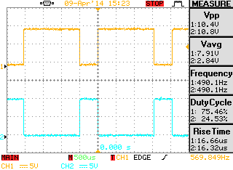
Pulses from Arduino
Output of ir2110

Slide 28
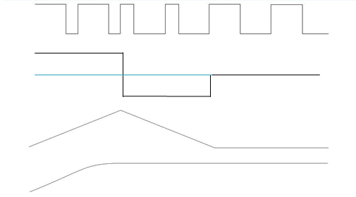
Vavg
0
Speed
Vavg=(0.75*Vdc-0.25*Vdc )/T
distance

Slide 29
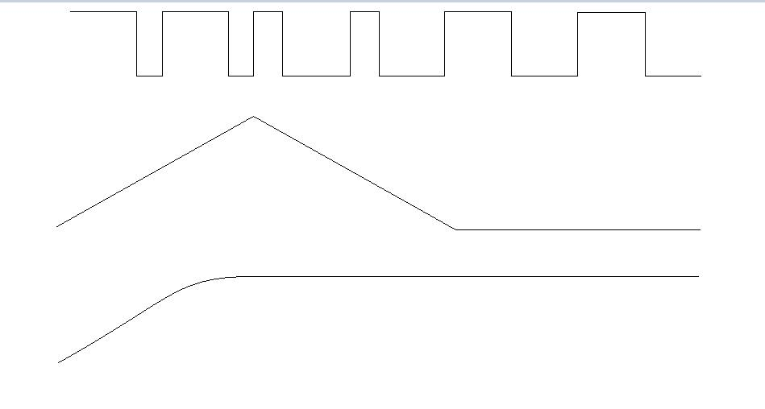
Vavg=(0.75*Vdc-0.25*Vdc )/T

Slide 30

vvv

Slide 31
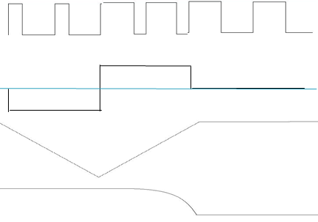
Vavg
0
Speed
Distance
Vavg=(0.25*Vdc-0.*Vdc )/T

Slide 32
VEDIO

Slide 33
OUTLINES :
Introduction.
Overview.
Design.
Flow chart of the project.
DTMF.
Arduino.
H-Bridge.
DC motor (PM motor).
Results.
Future work.

Slide 34
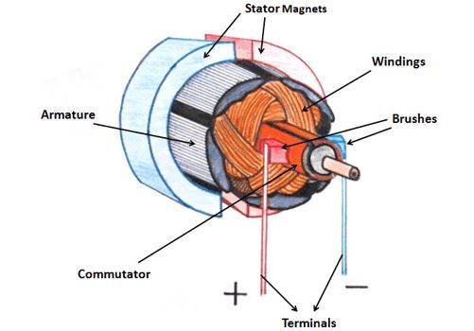
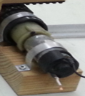
DC Motor (PM motor ) :
Notes:
هون حنحكي عن مواصفات الموتور الي استخدمناه

Slide 35
OUTLINES :
Introduction.
Overview.
Design.
Flow chart of the project.
DTMF.
Arduino.
H-Bridge.
DC motor (PM motor).
Results.
Future work.

Slide 36
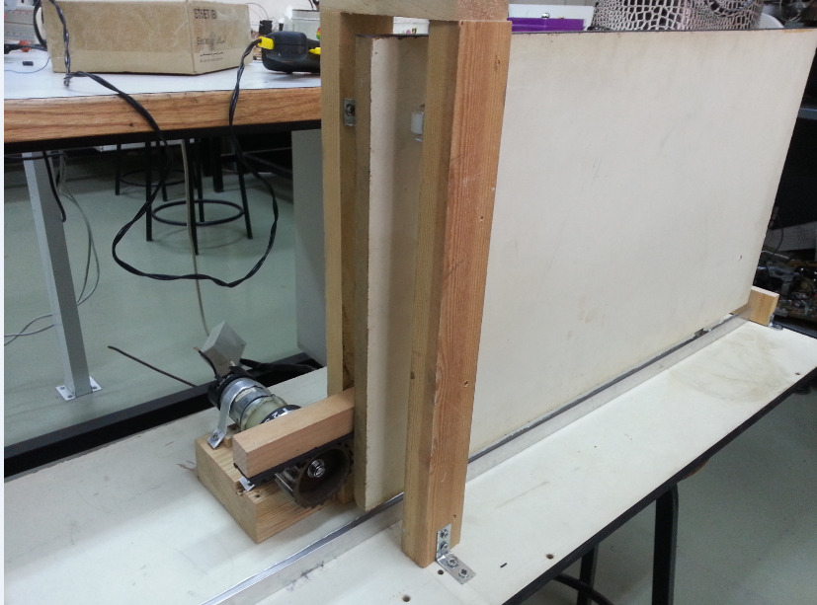
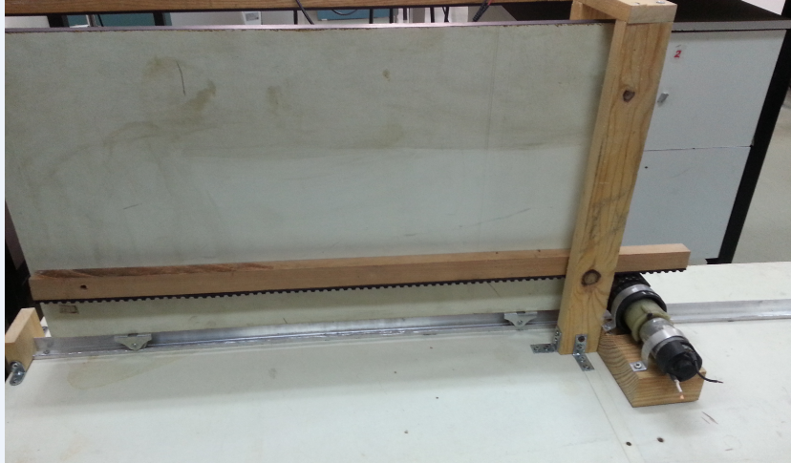
Door design:
Notes:
هون حنحكي انه احنا صممنا باب يمكننا من انه نجرب السيستم الي بنيناه حاولنا نوجد مسافة مناسبة للحركة للباب وصمننا السيستم وزمن البلسات بناء على هاي المسافة وممكن نحكي شوية تفاصيل عن تتصميمه

Slide 37
Simulation and real implementation:

Slide 38
Opening the door :

Slide 39
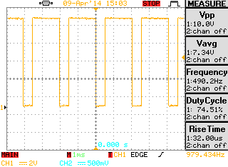
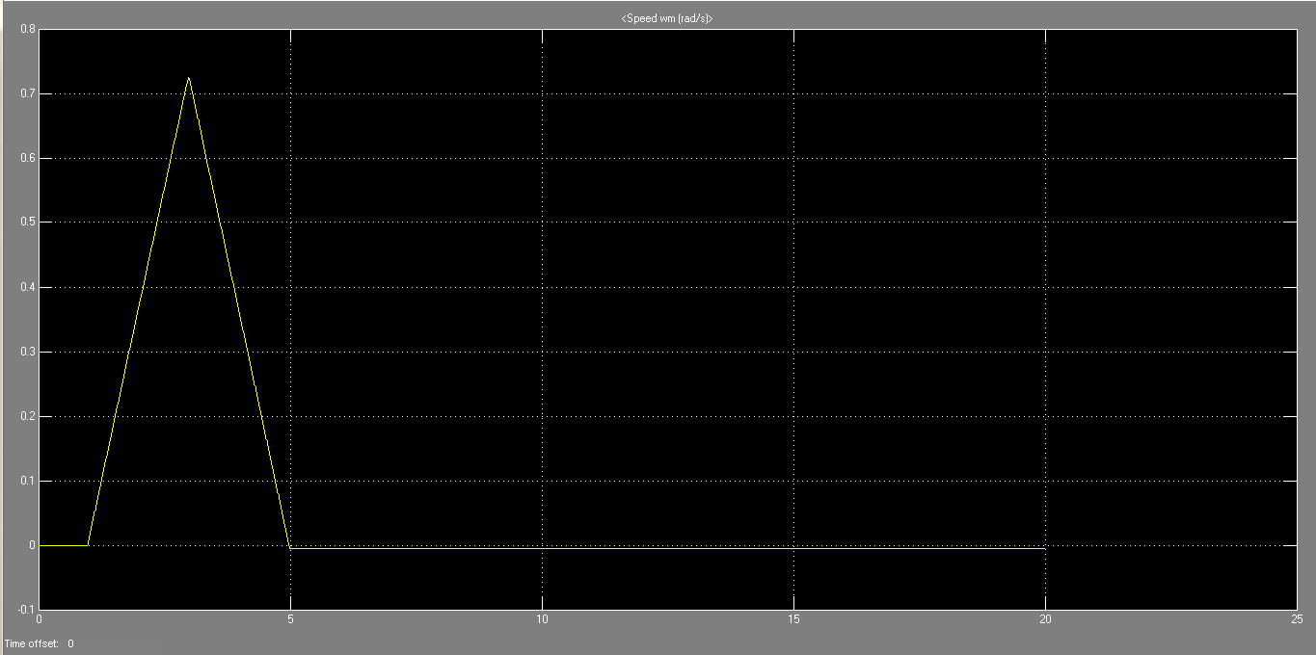
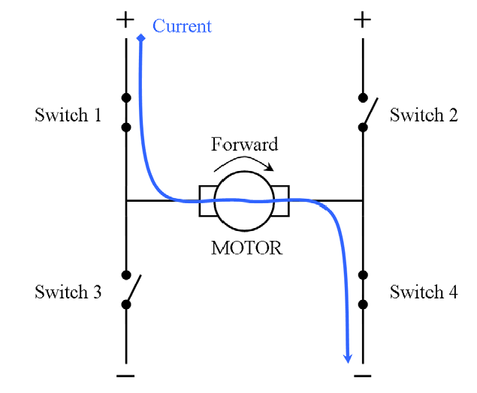
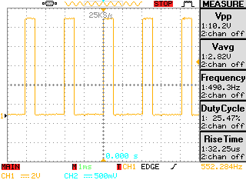
1
Speed variation curve
Notes:
هون حنحكي كيف انه قدرنا نطبق هاد الكيرف بشكل عملي من خلال البلسات الي طلعناهم من الاوردوينو .. وحنحكي كل جزء كيف نتج معنا وحنكمل حكي بالسلايد الي بعدها

Slide 40
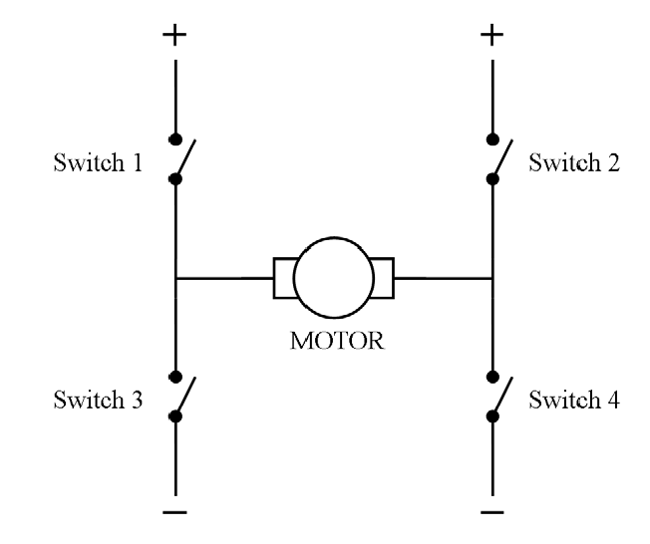
2

Slide 41
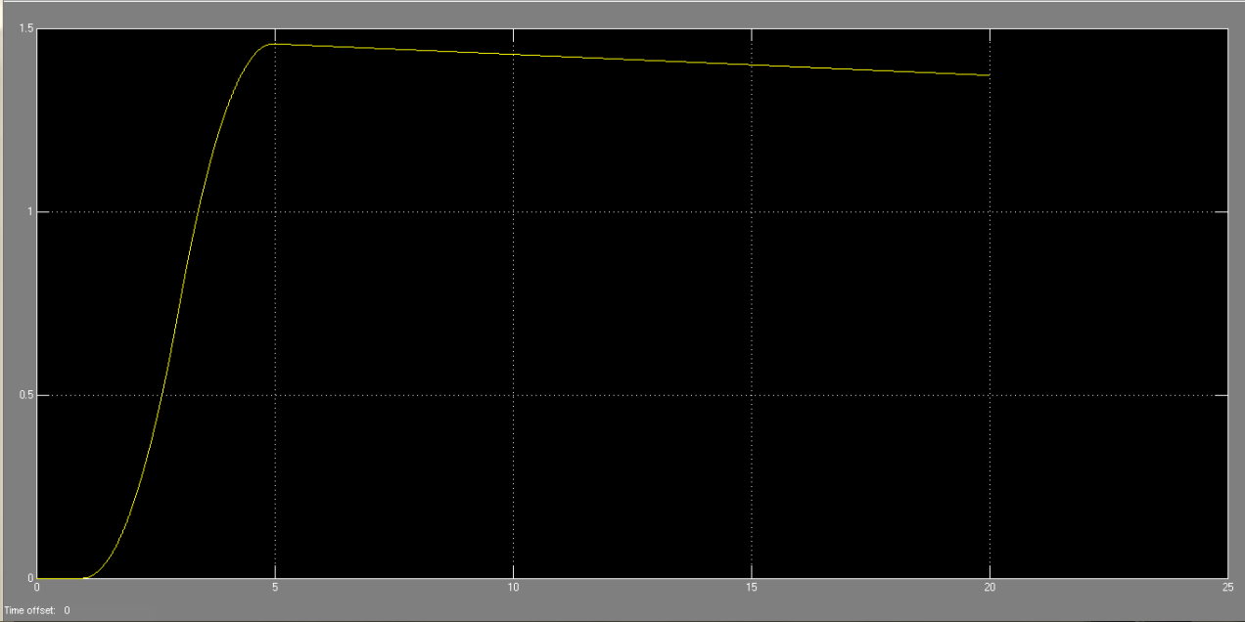
Distance curve in simulation:
Notes:
هون بدنا نشرح انه كيف قدرنا نحقق هاد الكيرف بشكل عملي من خلال انه اتحكمنا بالتسارع وخلينا الموتور يتباطئ والباب يوقف بالاخر.. وازا بنعرف المسافة الي بفتحها الباب الي صممناه بكون احسن مشان نحكي بالزبط اكم المسافة الي اشتغلنا عليها .

Slide 42
Closing the door

Slide 43
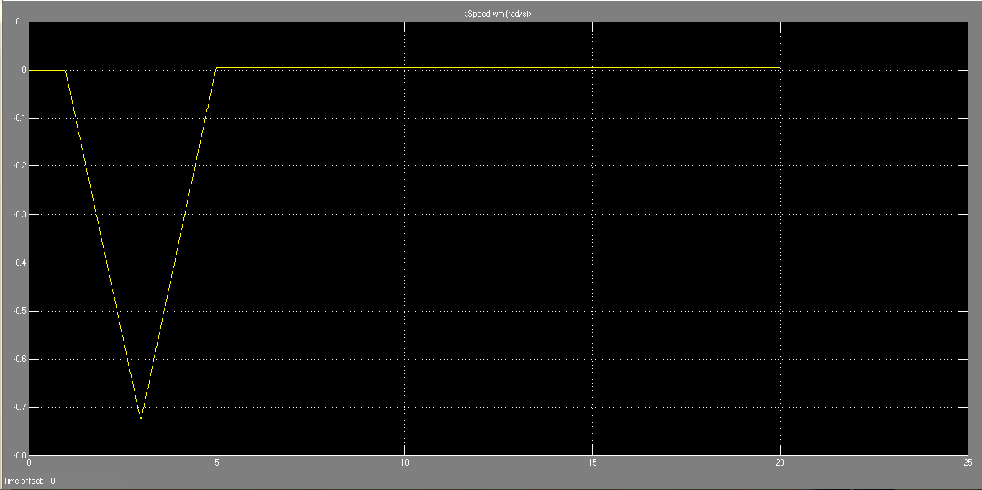
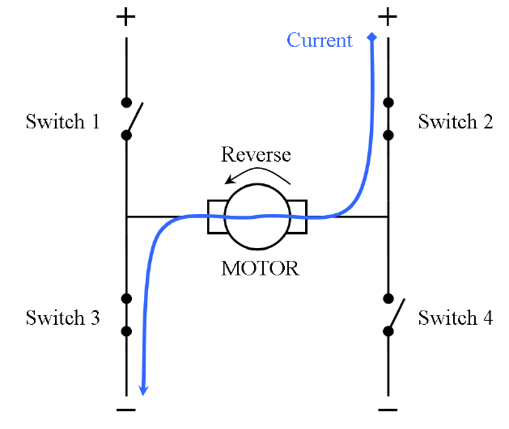
1
1
Speed variation curve
Notes:
هون حنحكي كيف انه قدرنا نطبق هاد الكيرف بشكل عملي من خلال البلسات الي طلعناهم من الاوردوينو .. وحنحكي كل جزء كيف نتج معنا وحنكمل حكي بالسلايد الي بعدها

Slide 44
ا
2

Slide 45
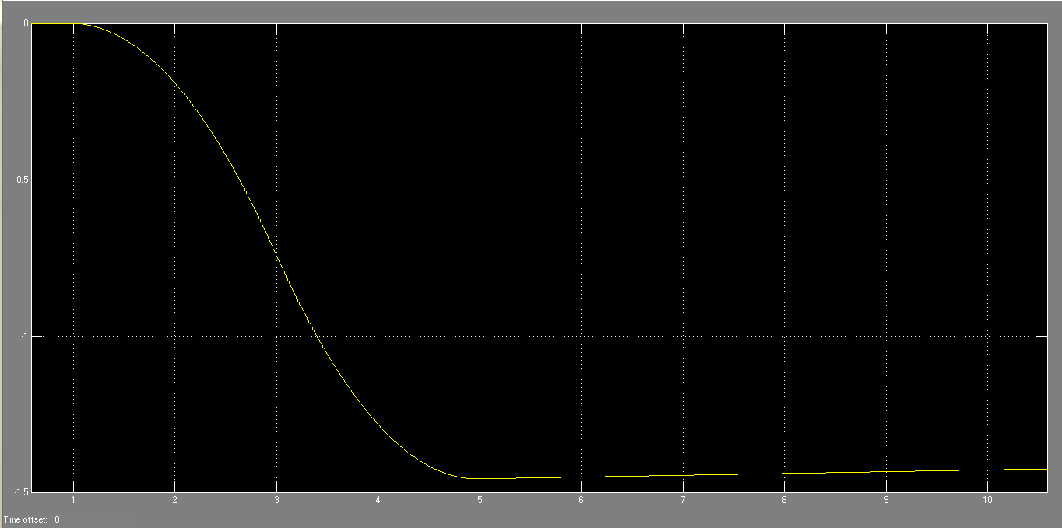
Distance variation, closing:

Slide 46
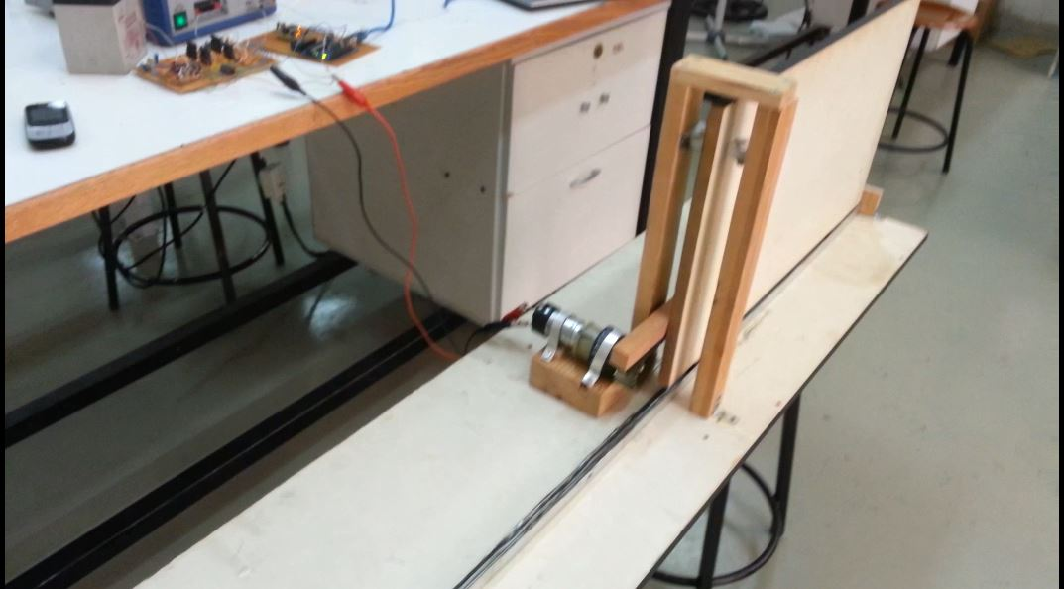
Motor connected to the door:
.

Slide 47
VEDIO

Slide 48
Conclusion

Slide 49
Future work
Notes:
On the other hand we have a future work plan to improve our system, first by using a sensor to check the status of the door before applying the user’s order, and then by making the system send a message to the user to confirm the success of the process, this will require the use of a GSM module that will take instructions from the microcontroller to send messages to the user mobile, another thing we plan to do is to give the user the option to control the system either by entering the password then the controlling number or by sending a message to the system to give the required order.

