Slide 1
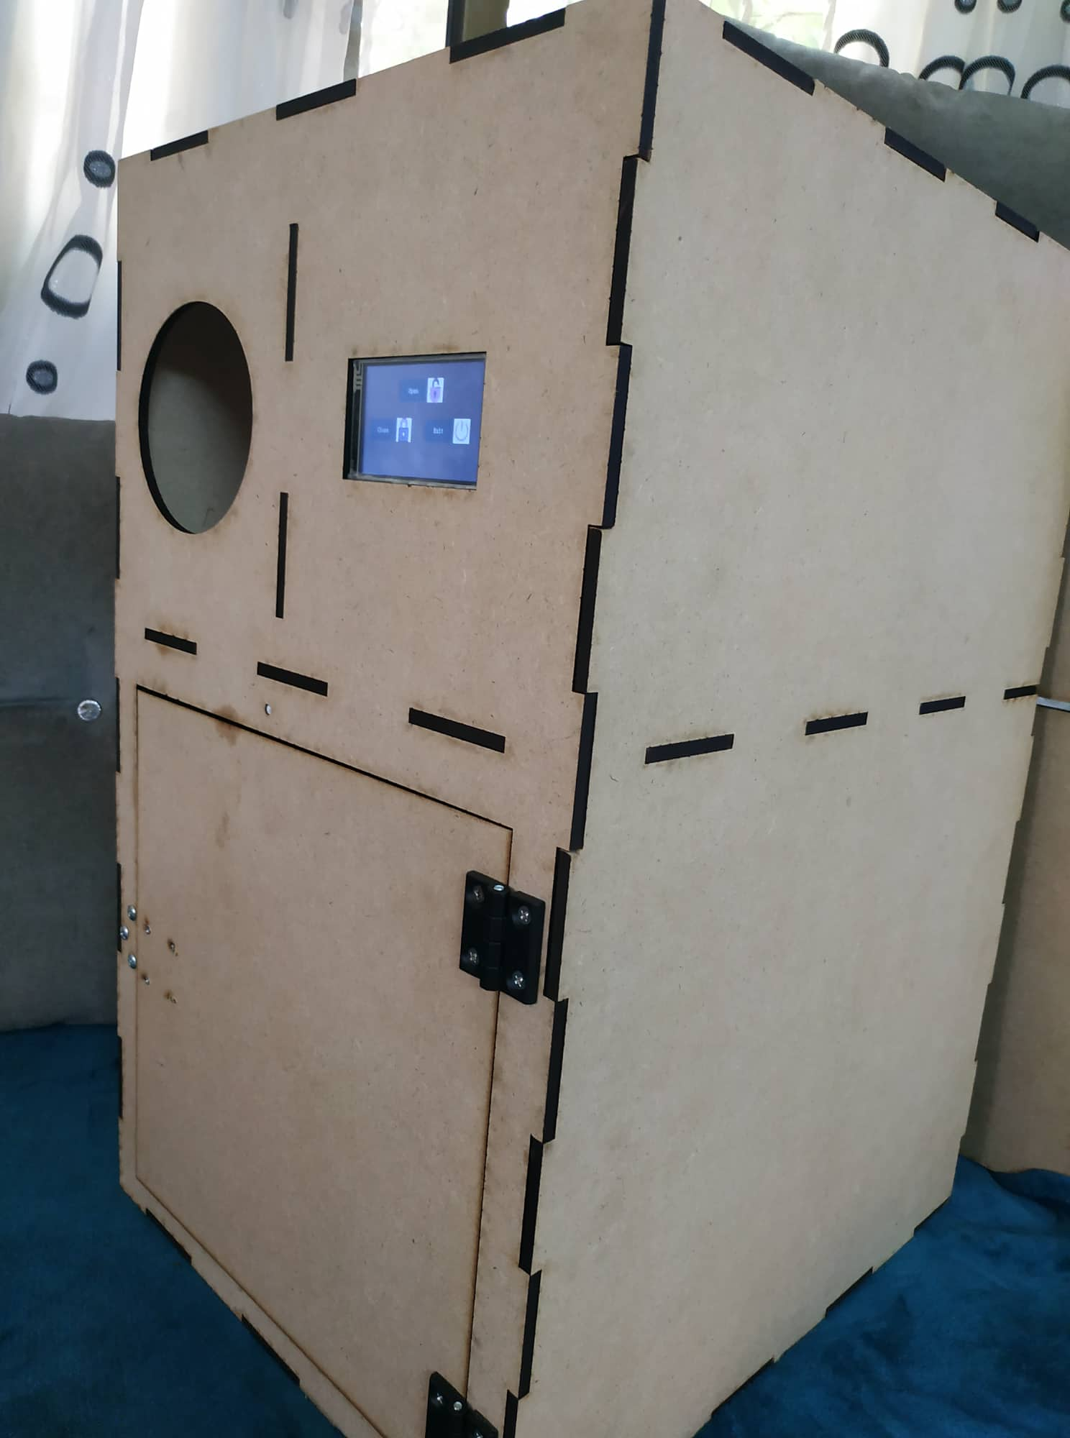
Plastic Bottles Recycling Machine
Under the supervision of
Dr.Sofyan Samara
Students:
Thara’Shehadeh
&&
Roa’a Sawalmeh

Slide 2
Outline
1- Introduction
5- Future Work
2- Constraints
4- Results and Analysis
3- Equipment's

Slide 3
Introduction
Pollution often occurs as a result of throwing plastic bottles on the ground or throwing them in the garbage, Where it is difficult to separate it from the rest of the waste.
Because when plastic is mixed with glass, metal and other waste, it becomes difficult to separate and recycle it because it requires extra time and effort.
Therefore, we made a special machine for plastic bottles, which is easy to recycle and use again and encourage people to throw them in the designated place.

Slide 4
Our project
In our project, we built a model of a plastic bottles recycling machine.
We initially programmed the scanner so that we could distinguish plastic bottles from others
and then after making sure that the bottle complied with the instructions, all information about it appears on the screen
and when he presses the finish button, the QR Code appears and then photograph it And buy from anywhere we support .

Slide 5
Constraints
Scanning The Barcode
Solenoid Electric Lock
mechanical parts
Nextion Display
A6 GSM Module

Slide 6
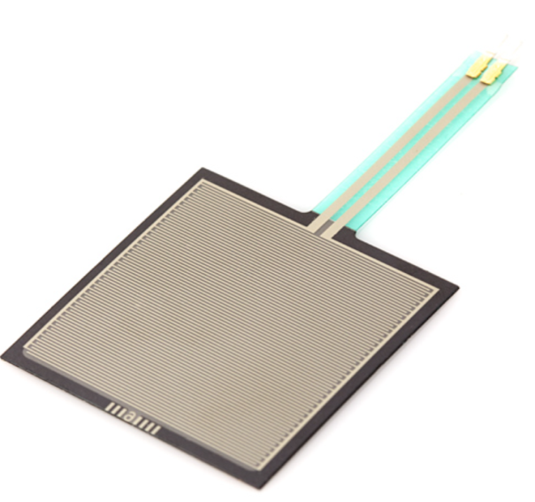
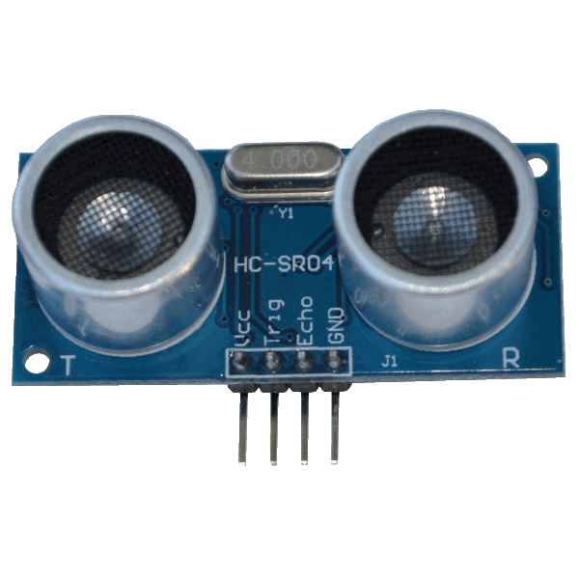
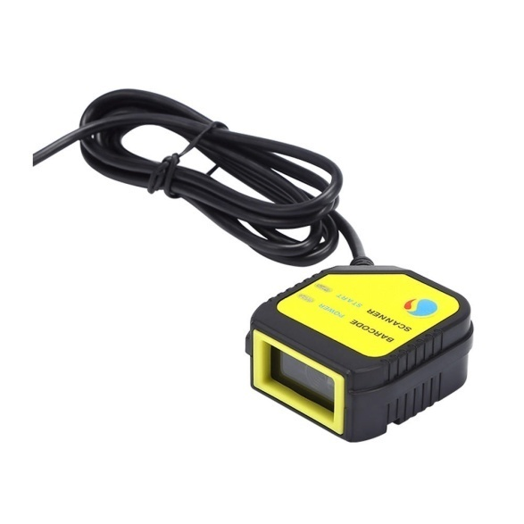
Equipments
Force Sensitive Resistor
Ultrasonic Sensor Module
Barcode And QR Scanner

Slide 7
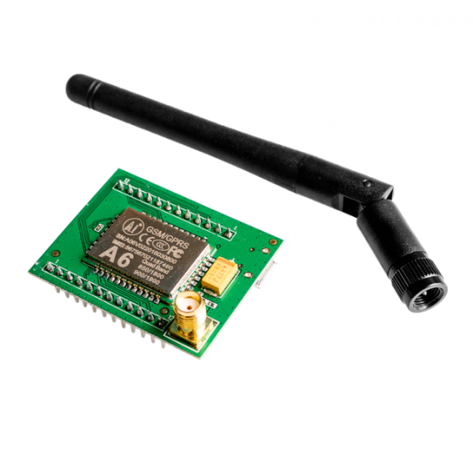
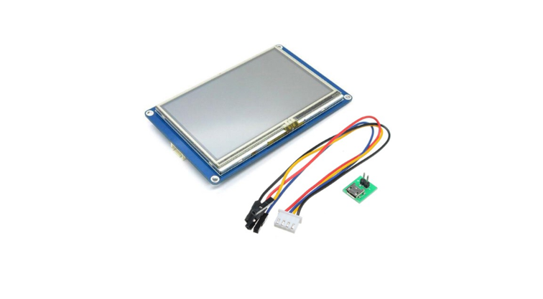
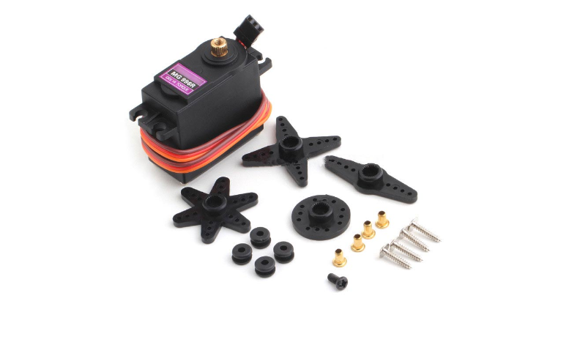
Equipments
A6 GSM Module
Nextion Display Module
Servo Tower Pro

Slide 8
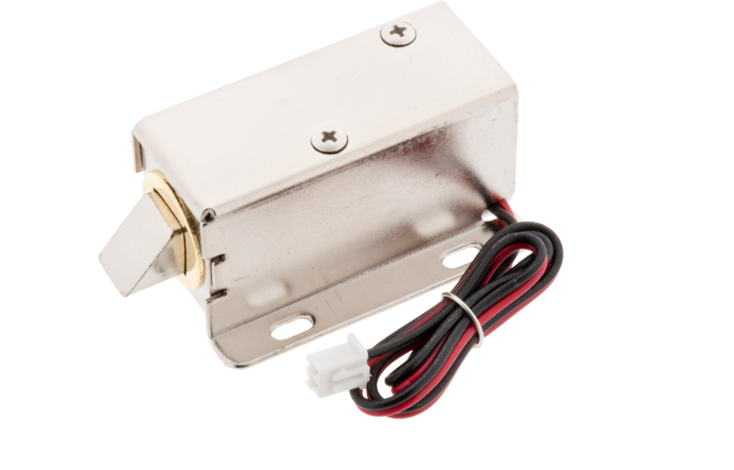
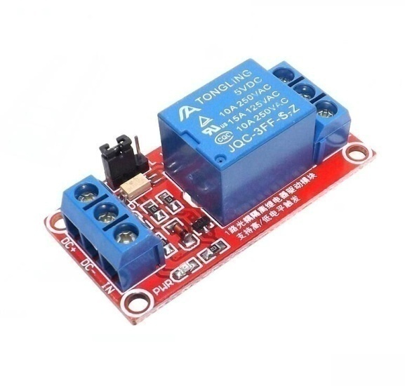
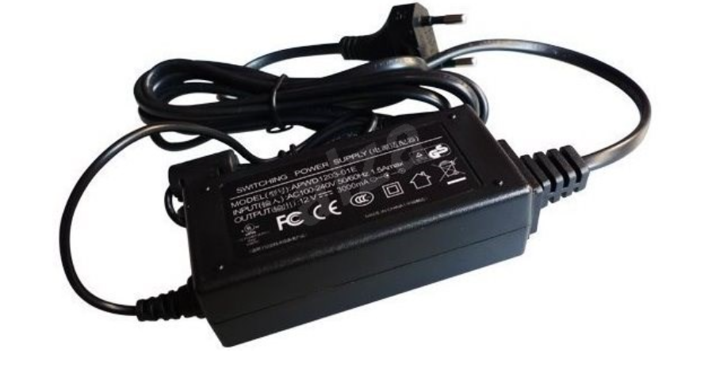
Equipments
Solenoid Electric Lock
5V Channel Relay Module
12V Power Supply

Slide 9
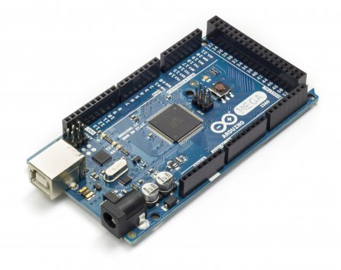
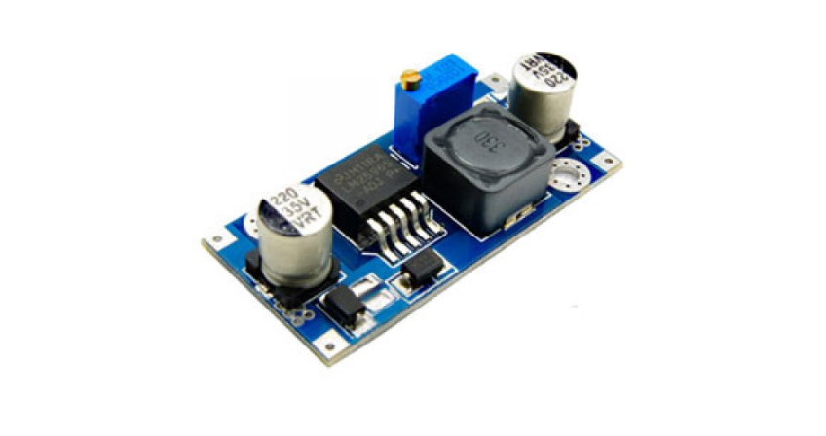
Equipments
Adriano Mega
LM2596

Slide 10
Results and Analysis
.
We compiled the source code for each step and made sure that everything is working fine before moving on to the next step which helps us a lot in identifying the source of errors.
In the final stage our project met the requirements related to it such as the barcode scanner was read correctly, the barcode was read where the special information about the plastic bottles appeared on the touch screen, in addition to the total number of bottles.
Verify the correctness of the information that was read through the ultrasound piece so that the plastic bottle is inserted into the box and when it is full, a message is sent to the owner of the box that it is full, in order to empty it.
.
Results and Analysis

Slide 11
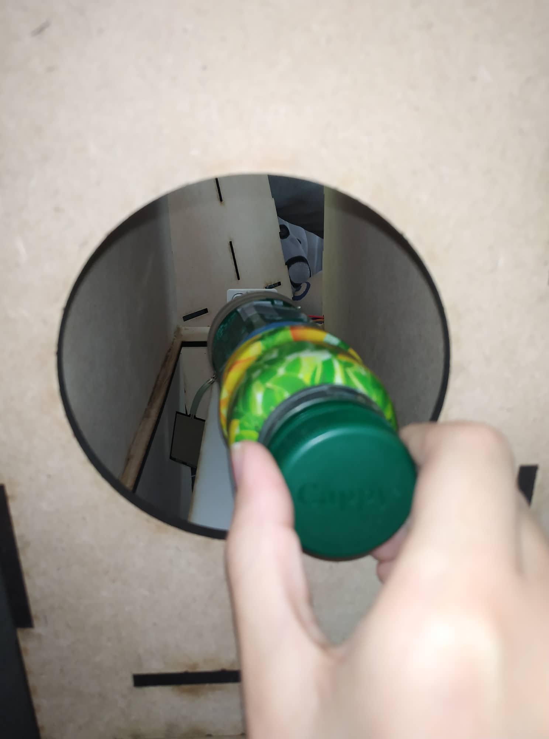
Step 1:
After the user presses
the start button on the touch screen, he inserts the plastic bottle into
the slot to scan it.

Slide 12
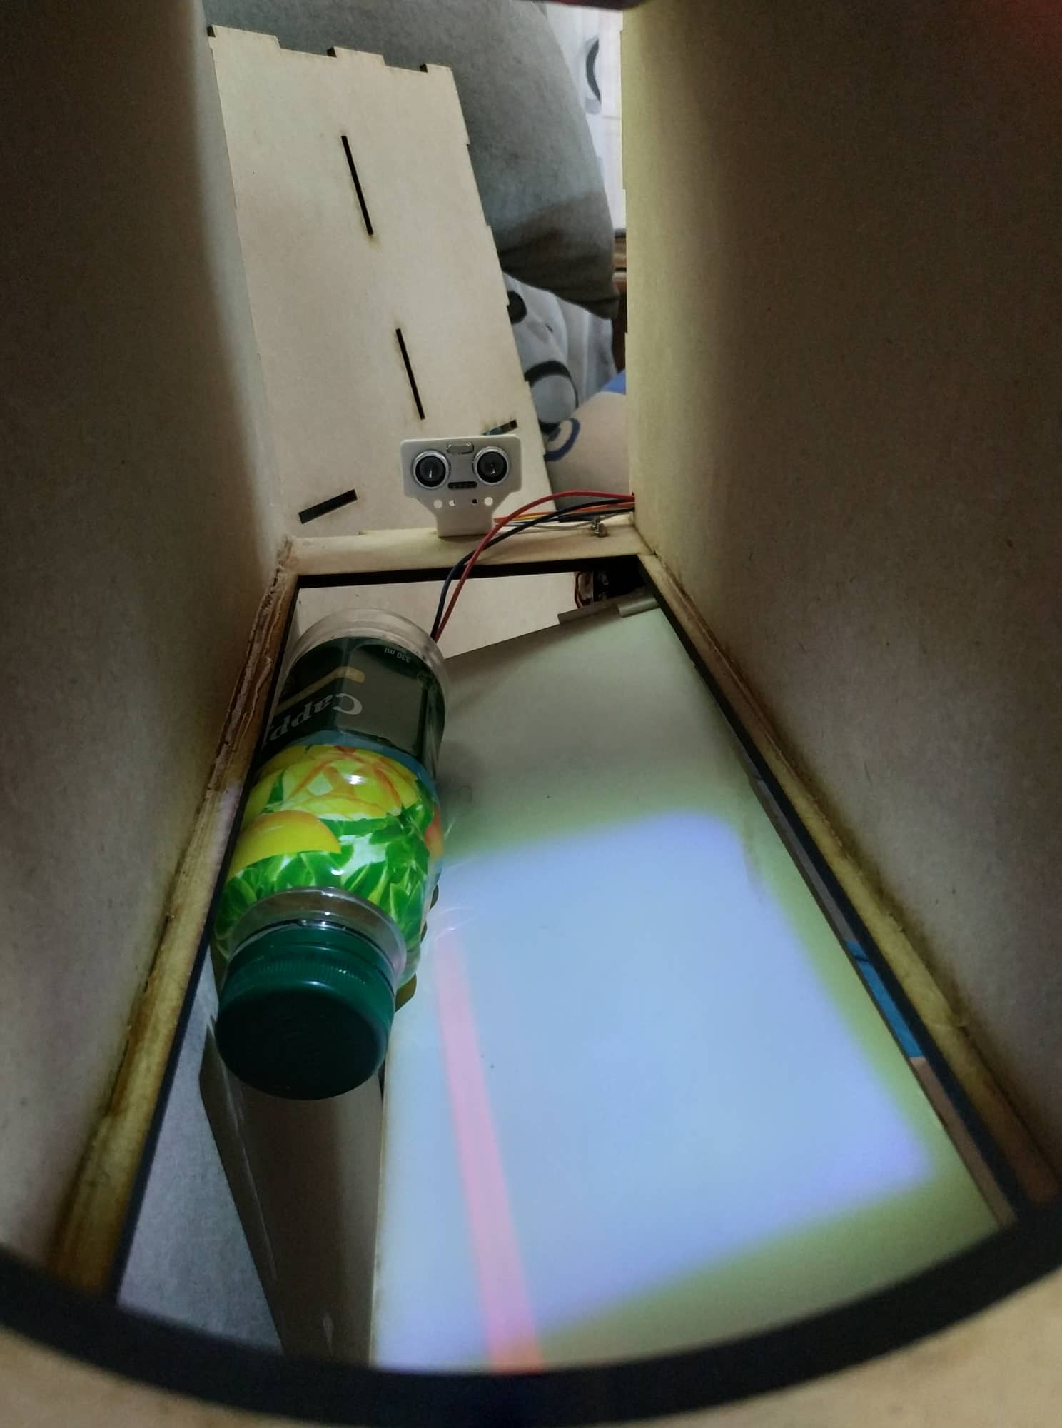
Step 2:
After scanning it,
it is placed in front of the ultrasonic and above the Force Sensitive to make sure that it is still there and has not been pulled out and that it is empty of fluids.

Slide 13
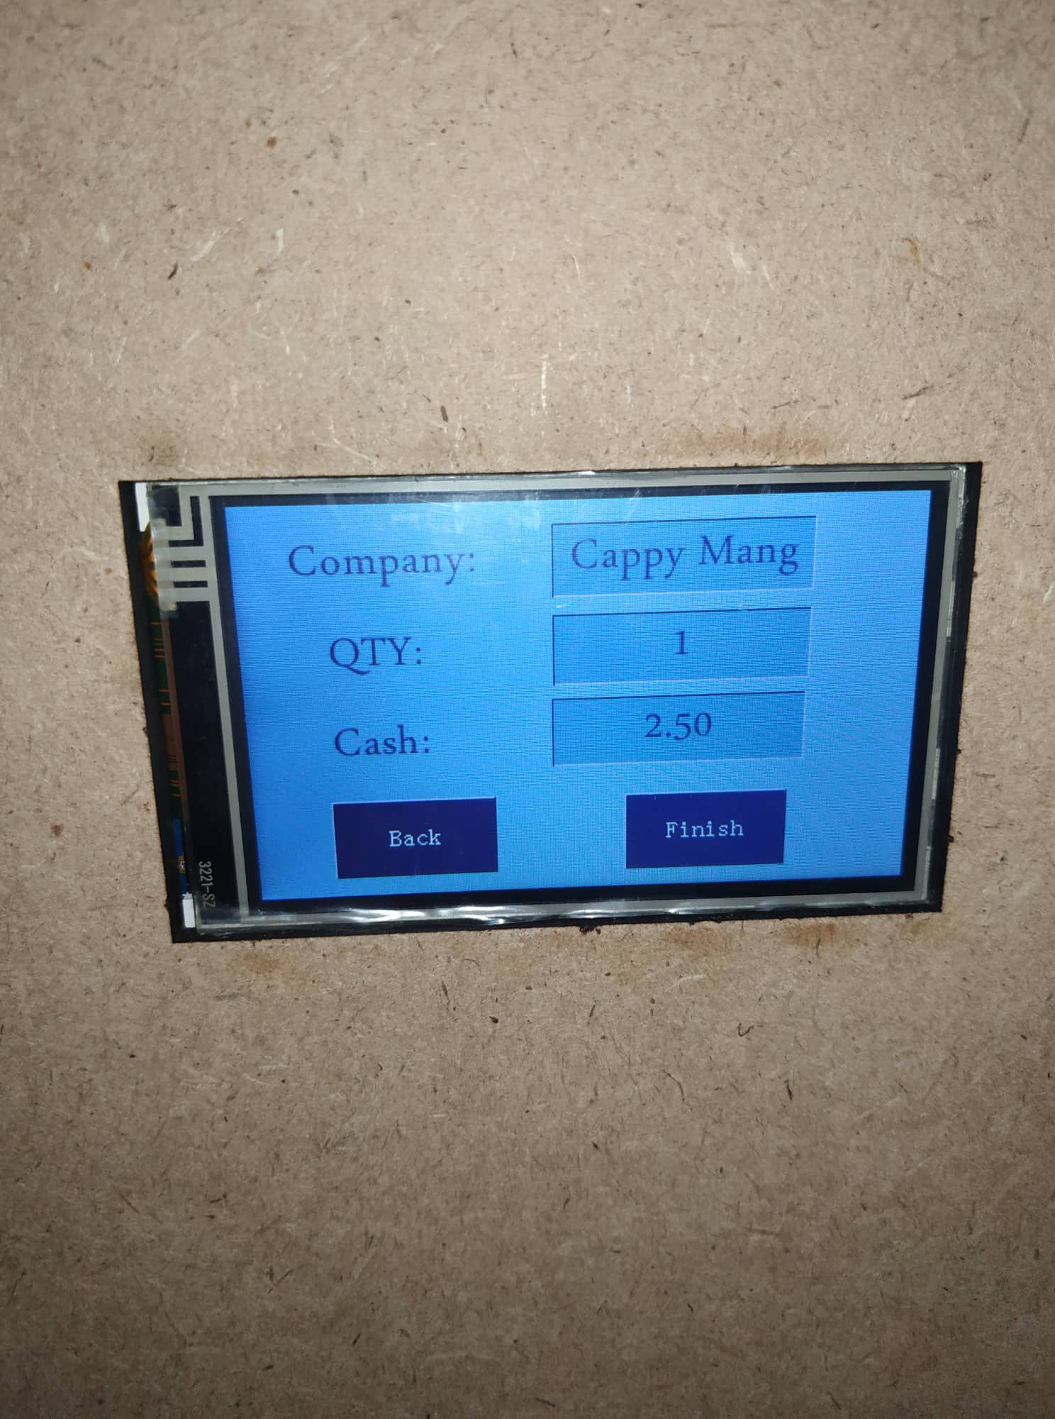
Step 3:
After that, all information about the bottle, such as the name and price, will appear on the screen.

Slide 14
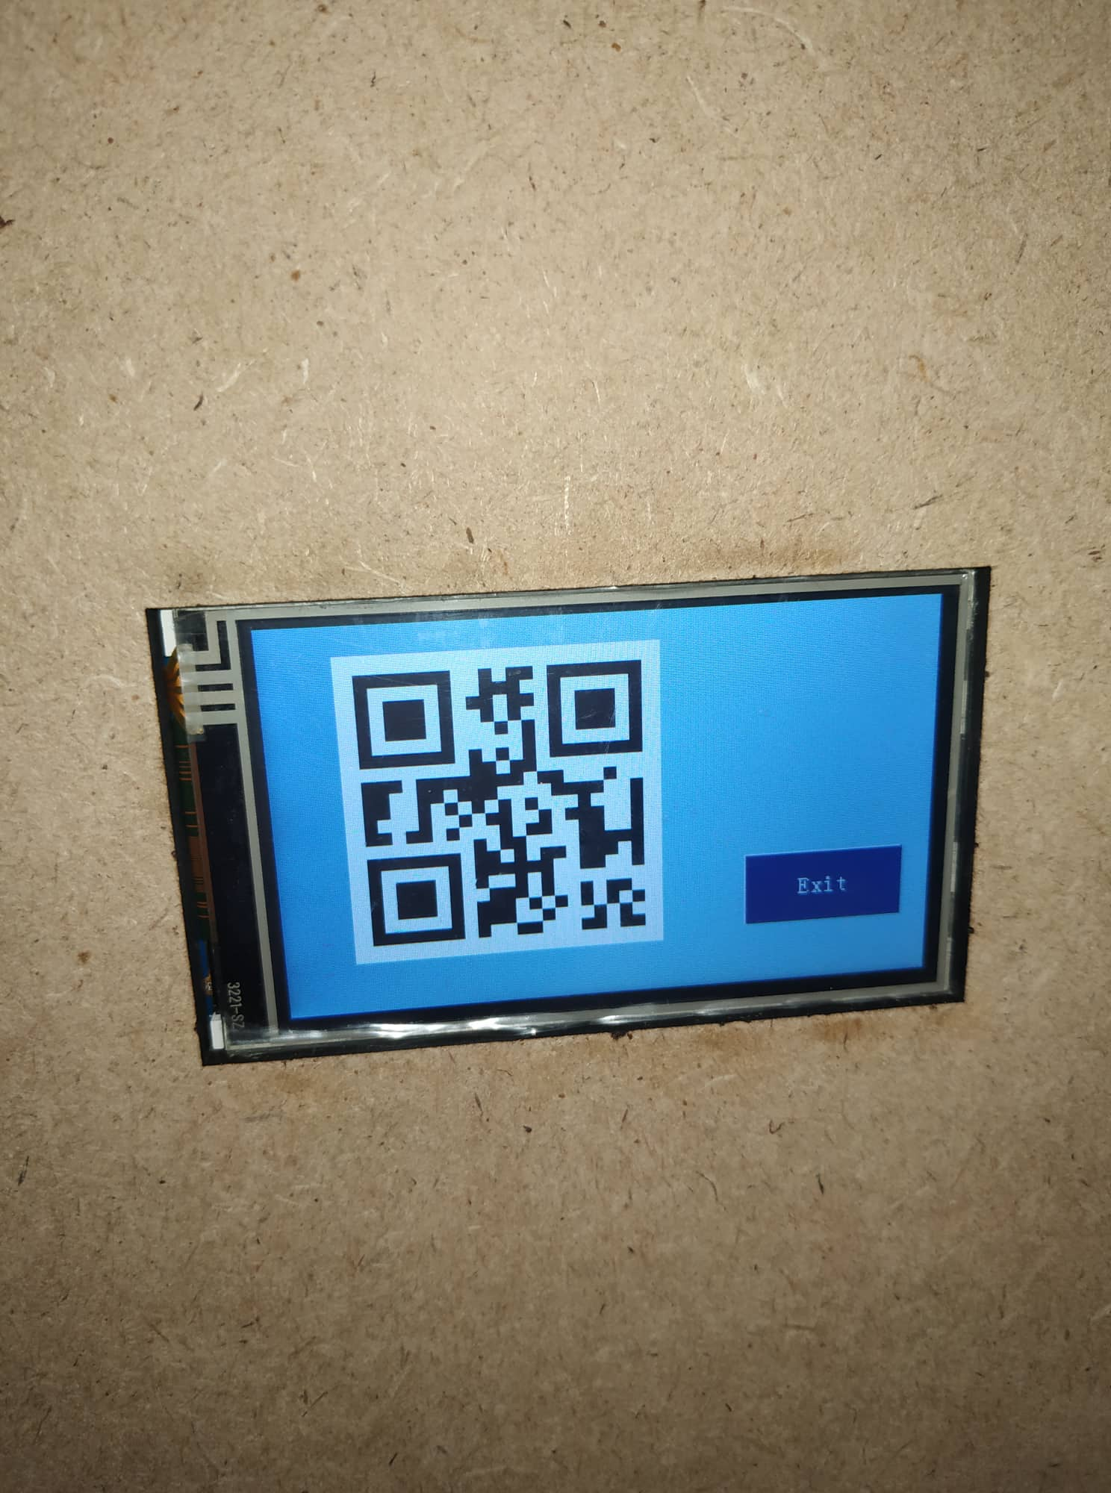
Step 4:
When the user finishes entering all the plastic bottles he has, he presses the finish button, where a QR Code appears on the screen containing all the information and the price for the bottles, he photographs it to buy with its value from anywhere we support it.

Slide 15
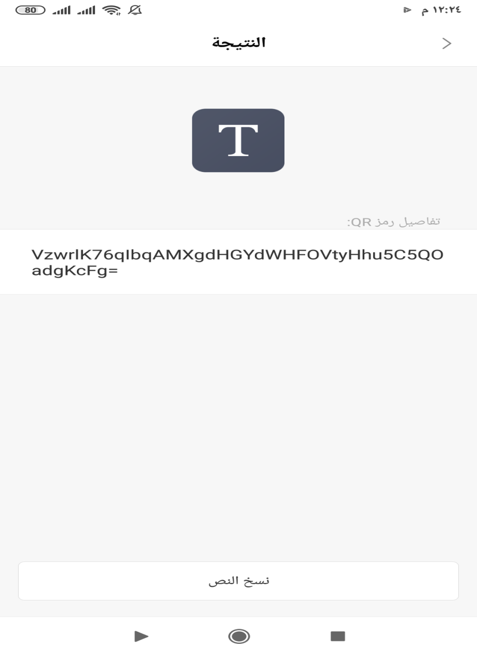

Step5:
After the user takes picture of the QR Code, he goes to any place we support, and the owner of the place scans the QR Code and shows him all the information in order to sell it as much as the bottles that have been placed

Slide 16
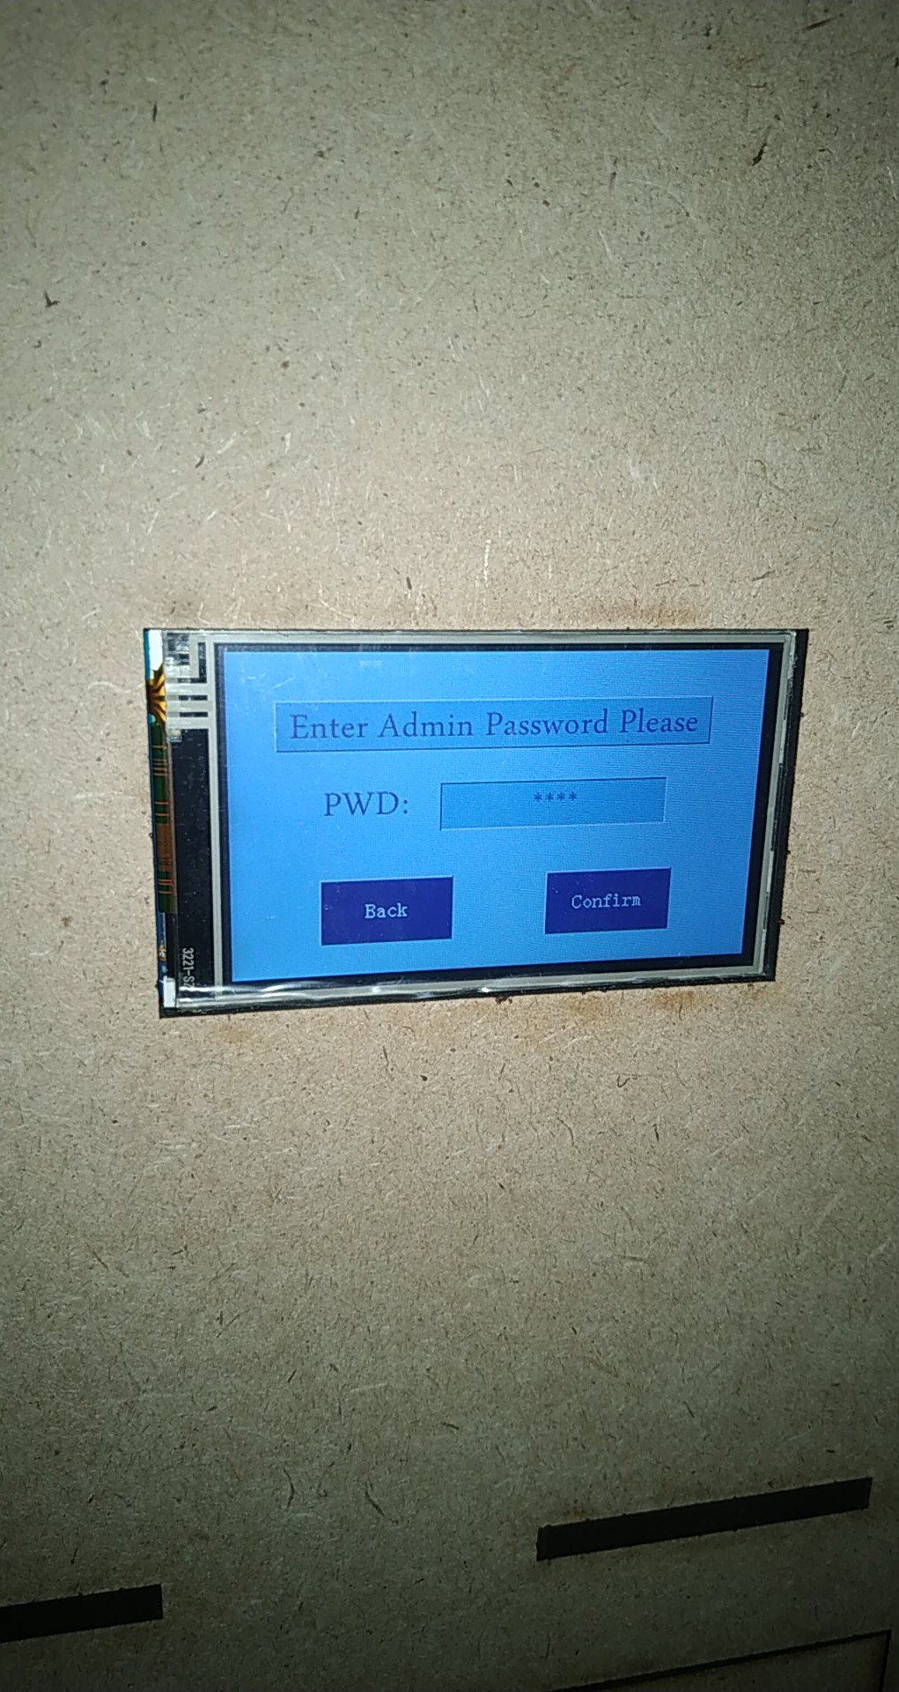
Step 6:
After the box is filled with the required amount of plastic bottles, a page appears for the owner of the box to enter the password and empty it

Slide 17
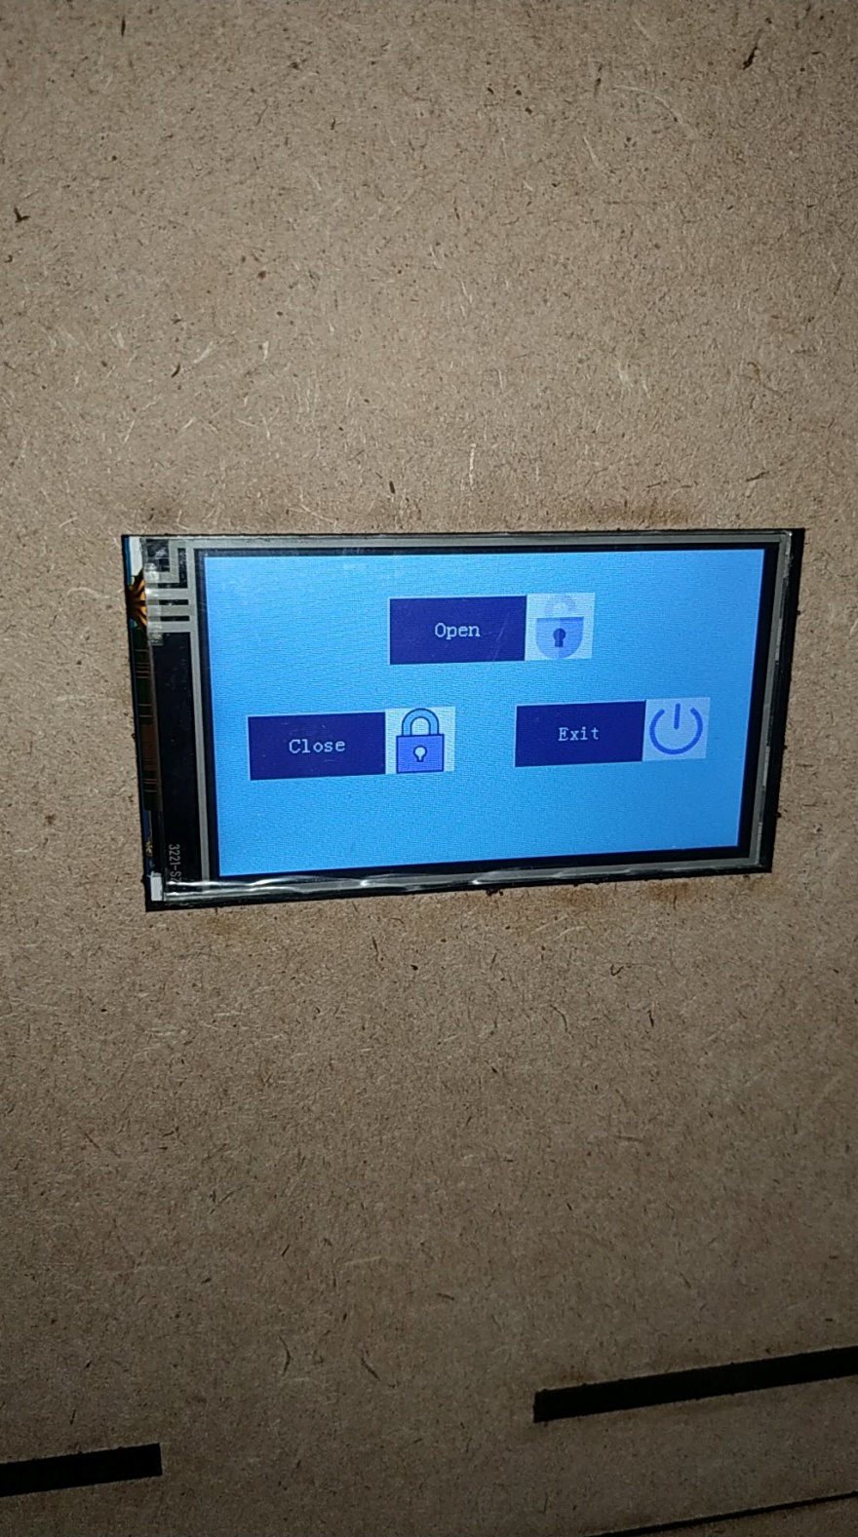
Step 7:
After the owner of the box presses the Confirm, 3 buttons appear to open and close the box and return to the first page

Slide 18
Future Work
We can develop the project on a larger scale of plastic bottles, so that we add places for glass and metal in the machine.
1
To solve the problem of how to insert the plastic bottle instead of moving it by hand to read the barcode correctly, it is being developed by placing it directly inside the slot and reading it correctly.
2
We can develop the project by making several options to get in return for the plastic bottles that have been placed. The option to donate the amount to any organization that needs support or the option to get a coupon or charge a credit to a mobile card by entering the number and then the units are transferred.
3

Slide 19

Thank you

