Slide 1



Slide 2


Blind Guidance system (BGS)
An-Najah National University
Flykit team

Slide 3
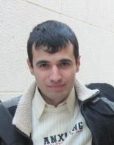
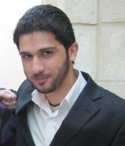
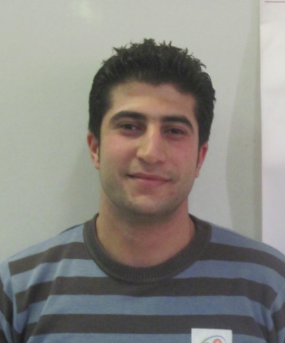
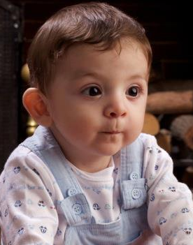
Team Members:
Abdel Azeem Bukhari
Computer Engineer
Core Software Design
Alaa Alhudhud
Computer Engineer
Hardware Design
Akram Dweikat
Computer Engineer
Business Plan and Model, Software Design, Website
Zaina Malhis
Computer Science
Windows Phone, Metro Application, Website
Supervised by:
Dr.Ashraf Armosh
Computer Engineer

Slide 4
What Is the most important human sense?!!

Slide 5


Slide 6
Problem!!!
Some of the problems faced by blind people
Can’t walk easily on their own
Suffer from obstacles
Difficult to reach a certain place:
    Difficult to recognize current location and remaining distance to the target.
    Difficult to figure out directions and routes which direction to go.

Slide 7

Statistics
According to WHO, Oct. 2011:
World Widely
More than 280 Million People Worldwide
Palestine
About 90000 People In Palestine.
are visually impaired;
Almost 40 million of them are blind.
Nablus : Official:401 , Real : over 800.
15 Blind at An-Najah University.
8 Visually Impaired.

Slide 8
Current Solutions …

Slide 9
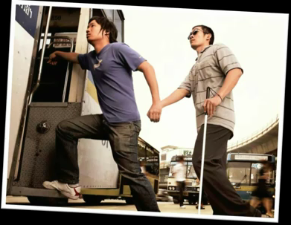
Require permanent Human Help…
Dependence on a Person to lead…
But a person is not always there..

Slide 10
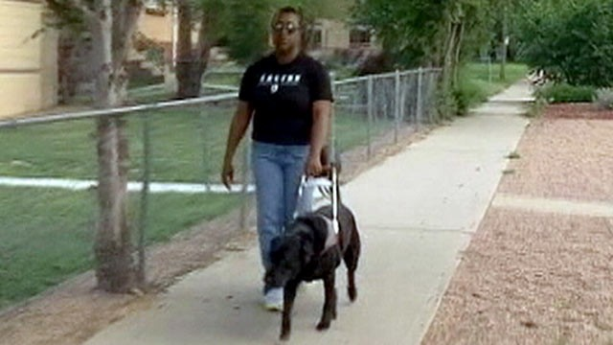
Animal Help...
Dog to lead…
But an animal is not always there,
Or cannot be admitted everywhere..

Slide 11
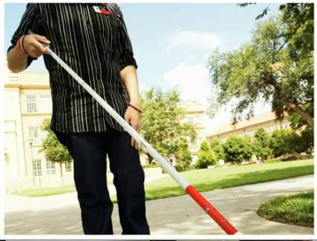
Ultrasonic stick to help the blind
Current designs are very limited…

Slide 12
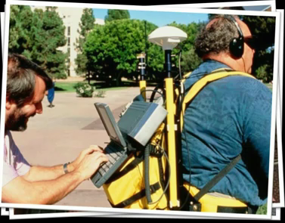
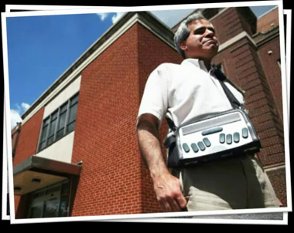
Other devices to the help
Heavy, Hard to carry around, Expensive and in many cases not practical…

Slide 13
So..
How can we help ?

Slide 14
What we really Need?? The Dream Device
Simple and Comfortable to use.
Applicable.
Cheap.
Can be used anywhere, anytime.
Light-weight.
Easy to interact with.
Can avoid obstacles.
Can take the blind anywhere he want, easily, safely and fast.
Can REALLY help. ☺
Our Solution?

Slide 15
Our Solution

Slide 16
What is BGS ?!
Blind Guidance System (BGS) :
a system for helping the blind to reach their destinations easily utilizing live voice feedback and a moving mechanical stick with wheels to ensure avoiding obstacles in the way.
The main goal is to make this system act as the eyes for a blind person.

Slide 17
It’s Demo Time!!

Slide 18
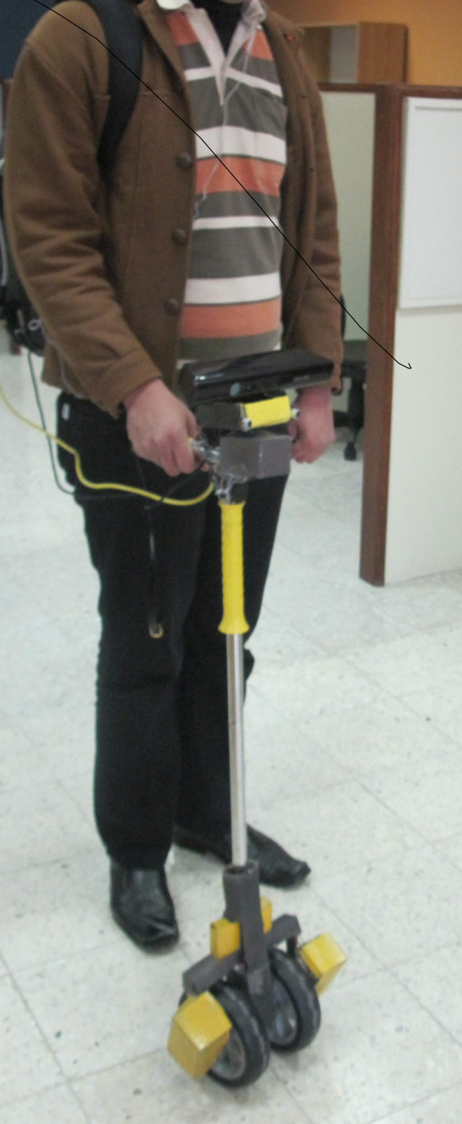
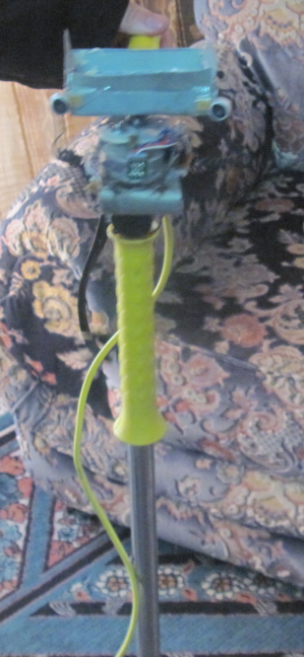
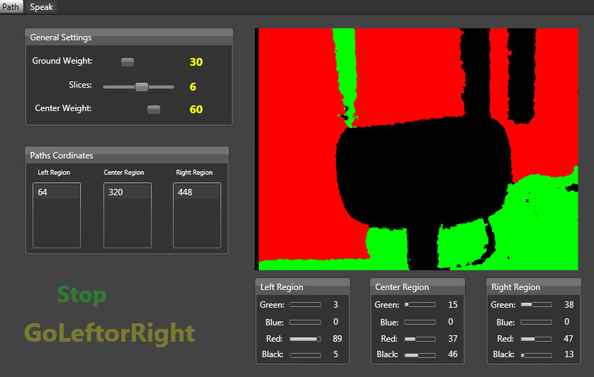
It’s Demo Time!!

Slide 19
It’s Demo Time!!
Video

Slide 20
BGS Features..
Navigation and Mapping.
Shortest Path Detection.
Avoiding obstacles
Voice Feed-back.
Vibrations Feed-back
Voice Commands Support
Recognize Ladders, Stairs.
Gear Navigation - Back Up .
180 Degree Scan.

Slide 21
Features… (Cont.)
Informs the User of his current location.
Supports Automatic Navigation - the user can ask the system to get to a specific place.
Emergency help Request (button or voice-command)
Indoor and Outdoor support.
High-Precision – Very accurate wheels control

Slide 22
Features… (Cont.)
.
Recognize Ladders, Stairs.
Gear Navigation - Back Up .
180 Degree Scan.

Slide 23
Face Recognition & Learning

Slide 24
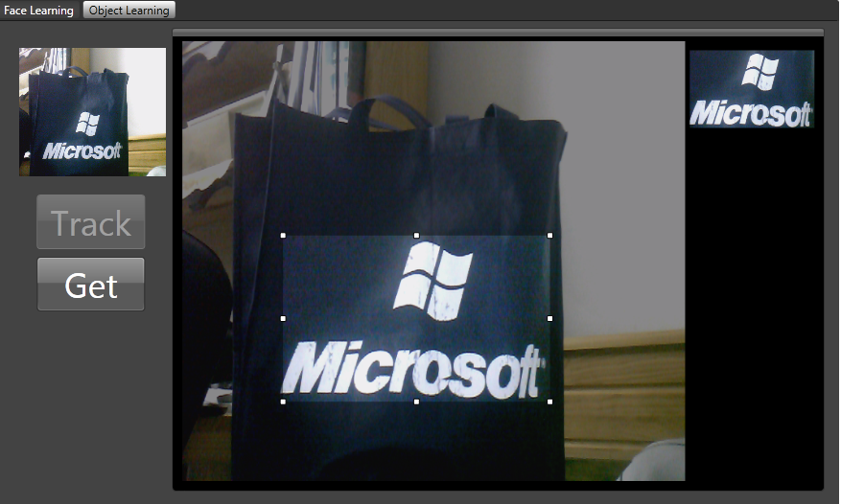
Object Learning

Slide 25
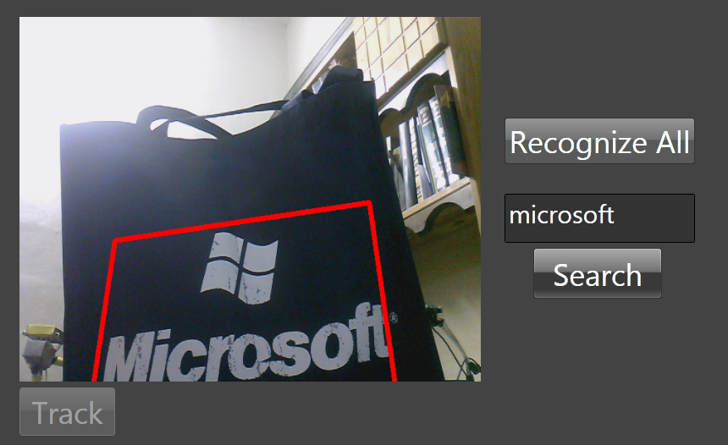
Object Recognition

Slide 26

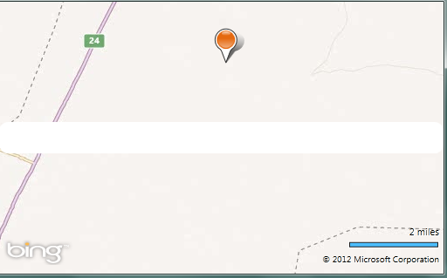

MAPS

Slide 27
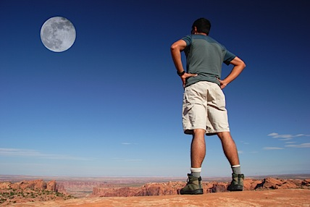
Challenges..
The most challenging issue was knowing the current location in indoor environments.
Using Kinect to build 3D depth map in order to determined the safe regions to navigate into.
Building strong and accurate hardware that can help blind to get to any tagged place.

Slide 28
Challenges..Cont.
Kinect Sight Range:..8-4m ,new ver.: .4-4 m
Kinect sight angle, Solved Revolving Motor.
Kinect and Sun light, Solved with special Algorithm we designed.
Kinect and Glass, Solved using Ultrasonic Sensors.

Slide 29
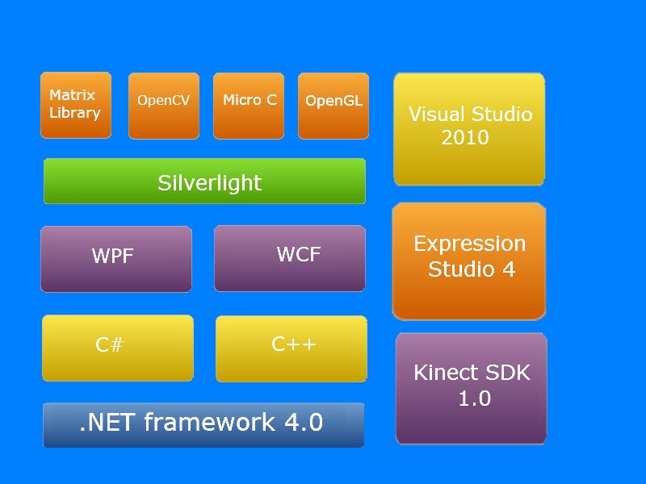
Technologies Used

Slide 30
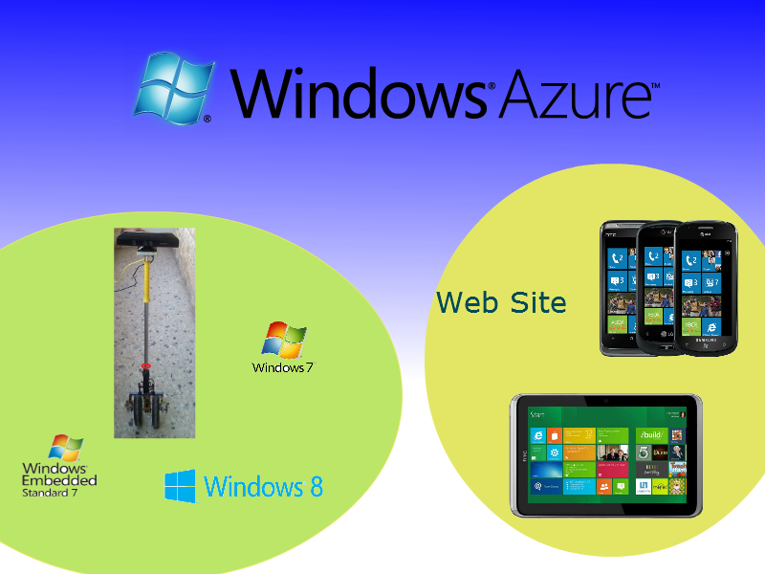

Slide 31
Technical Resources
DreamSpark.
MSDN.
Channel9.

Slide 32
Business Plan & Business Model
Packaging
Individuals
Multi packages to suit individuals needs.
Companies and Organizations
Special Package programed for locations and office at the company to lead the blind visitors to tagged places.
Better than:
Brill sign-language tags at offices
spatial paths, will decrease the costs of construction and design and will be more flexible for modifications at building to accommodate locations changings.

Slide 33
Business Plan & Business Model… Continued
 | Package 1 | Package 2 | Package 3 | Package 4
Description | Indoor System | Outdoor System | Outdoor System | Indoor/Outdoor System
Mechanical stick | Yes | Yes | No | Yes
Website Account | Yes | Yes | Yes | Yes
Kinect | Yes | Yes | Yes | Yes
Vibrations | No | No | No | Yes
GPS | No | Yes | Yes | Yes
Price | 199.9$ | 249.9$ | 199.9$ | 299.9$
Add-ins
Embedded System Version | 150.0$
Vibrations | 40.0$
Windows Phone 7 Application | 20.0$
Metro Style Application | 20.0$

Slide 34
Business Plan & Business Model… Continued
Website
Social Media
Live Demos
Sales and Marketing:
How to Market it?

Slide 35
Business Plan & Business Model… Continued
WHO
NGOs
Hospitals
Support Networks.

Slide 36
Business Plan & Business Model… Continued
Local
Regional
World Wide
How to Sell it?

Slide 37
Feed Back
Dr. Abd ElFattah Arafat

Slide 38
Future Work
BGS in EDUCATION.
Publish Separate Hardware..

Slide 39

Q & A Time….

Slide 40

Thanks for listening .. ☺
Be What’s Next;

